Slide 1
QCD and the Quark Gluon Plasma
part 2: hard physics
Marco van Leeuwen,
Nikhef and Utrecht University
GRK 2149 retreat, 19-22 September 2016

Slide 2
Heavy ion collisions
Heavy-ion collisions produce ‘quasi-thermal’ QCD matter
Dominated by soft partons p ~ T ~ 100-300 MeV
‘Bulk observables’
Study hadrons produced by the QGP
Typically p_{T} < 1-2 GeV
‘Hard probes’
Hard-scatterings produce ‘quasi-free’ partons
⇒ Probe medium through energy loss
p_{T} > 5 GeV
Two basic approaches to learn about the QGP
Bulk observables
Hard probes

Slide 3
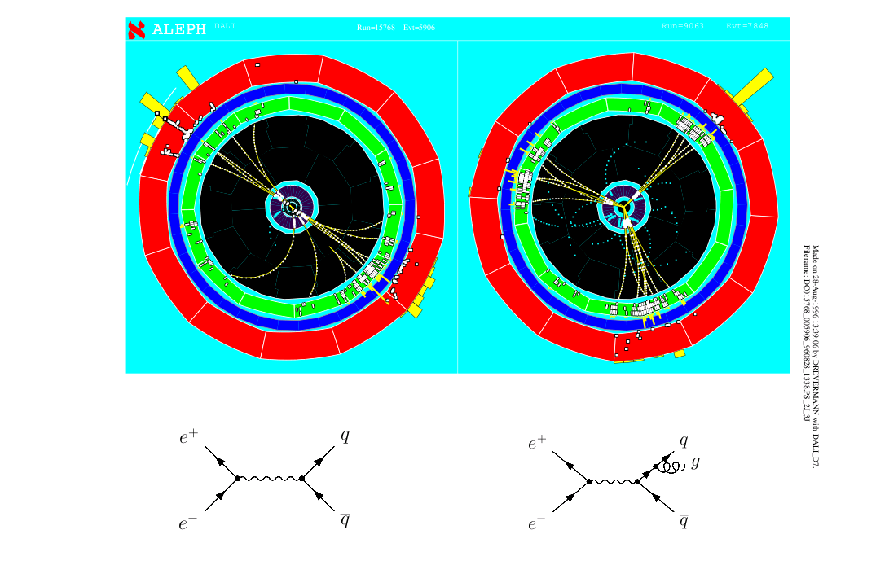
Seeing quarks and gluons
In high-energy collisions, observe traces of quarks, gluons (‘jets’)

Slide 4
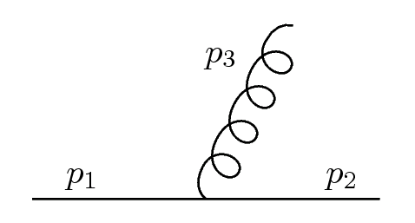
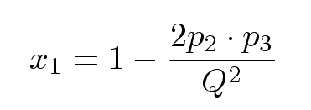
Singularities in pQCD
(massless case)
Soft divergence
Collinear divergence
Closely related to hadronisation effects

Slide 5
Hard processes in QCD
Factorization
Cross section calculation can be split into
Hard part: perturbative matrix element
Soft part: parton density (PDF), fragmentation (FF)
parton density
matrix element
FF
Hard process: scale Q >> Λ_{QCD}
Hard scattering High-p_{T} parton(photon) Q ~ p_{T}
Heavy flavour production m >> Λ_{QCD}
QM interference between hard and soft suppressed (by Q²/Λ² ‘Higher Twist’)
Soft parts, PDF, FF are universal: independent of hard process
This is likely to break down in a QGP, but still a good starting point

Slide 6
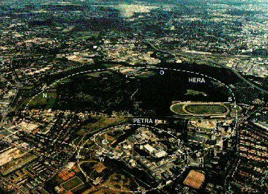
The HERA Collider
The first and only ep collider in the world
Hera at DESY near Hamburg
e± p
27.5 GeV 920 GeV
H1
Zeus
√s = 318 GeV
Equivalent to fixed target experiment with 50 TeV e±

Slide 7
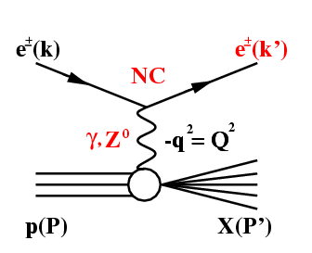
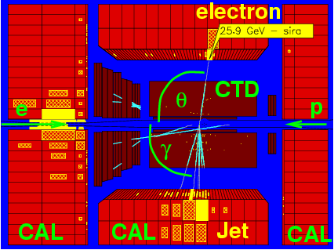
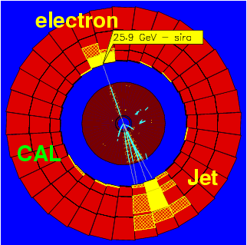
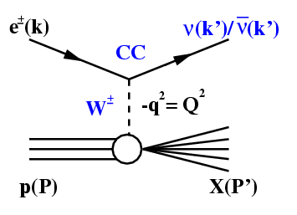
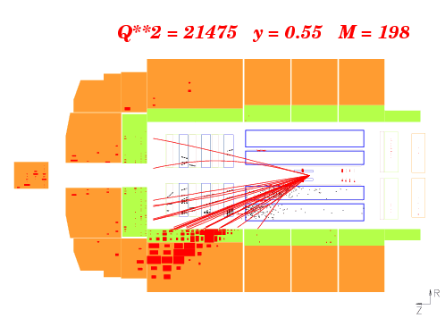
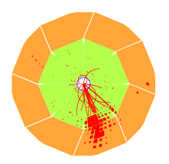
Example DIS events
NC:
CC:
DIS: Measured electron/jet momentum fixes kinematics: x, Q²

Slide 8
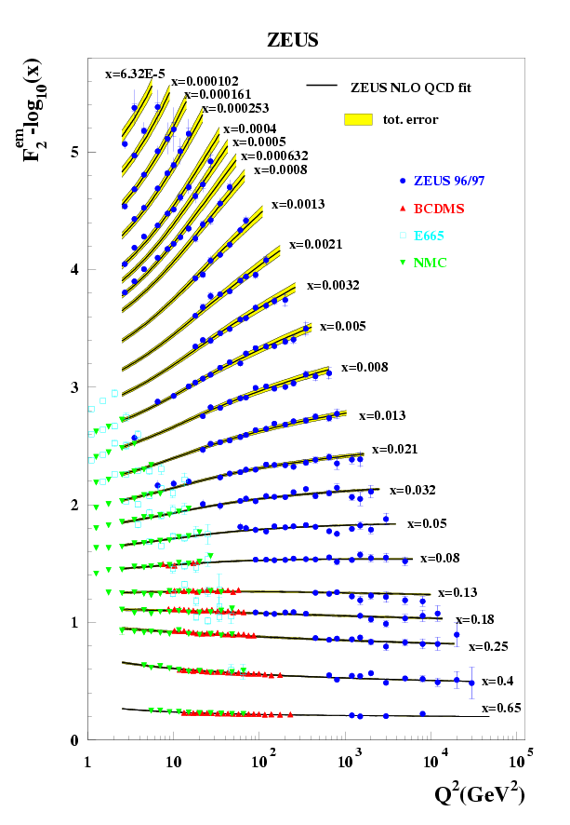
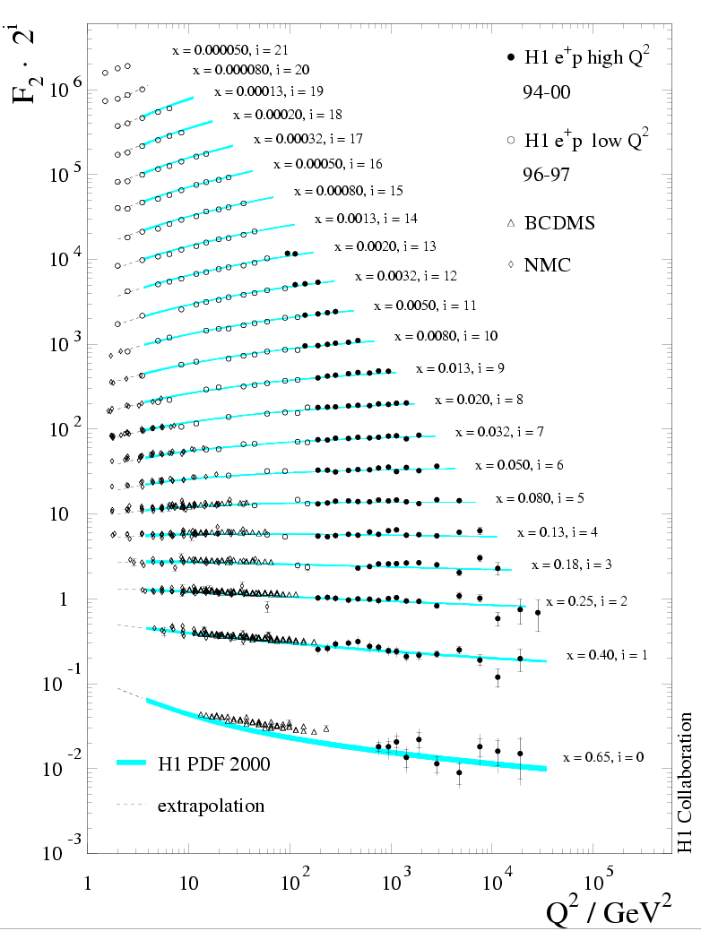
Proton structure F₂
Q²: virtuality of the γ
x = Q² / 2 p q
‘momentum fraction of the struck quark’
F₂: essentially a cross section/scattering probability

Slide 9
Factorisation in DIS
Integral over x is DGLAP evolution with splitting kernel P_{qq}

Slide 10
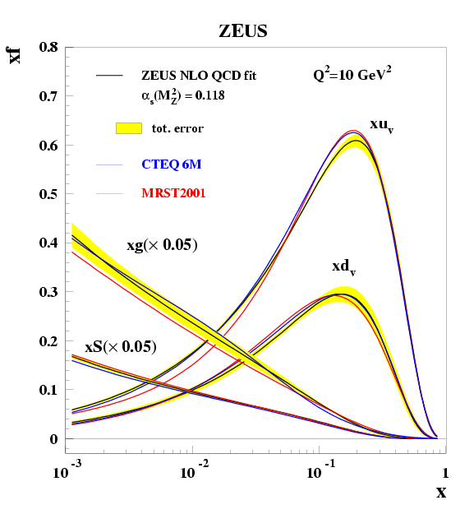
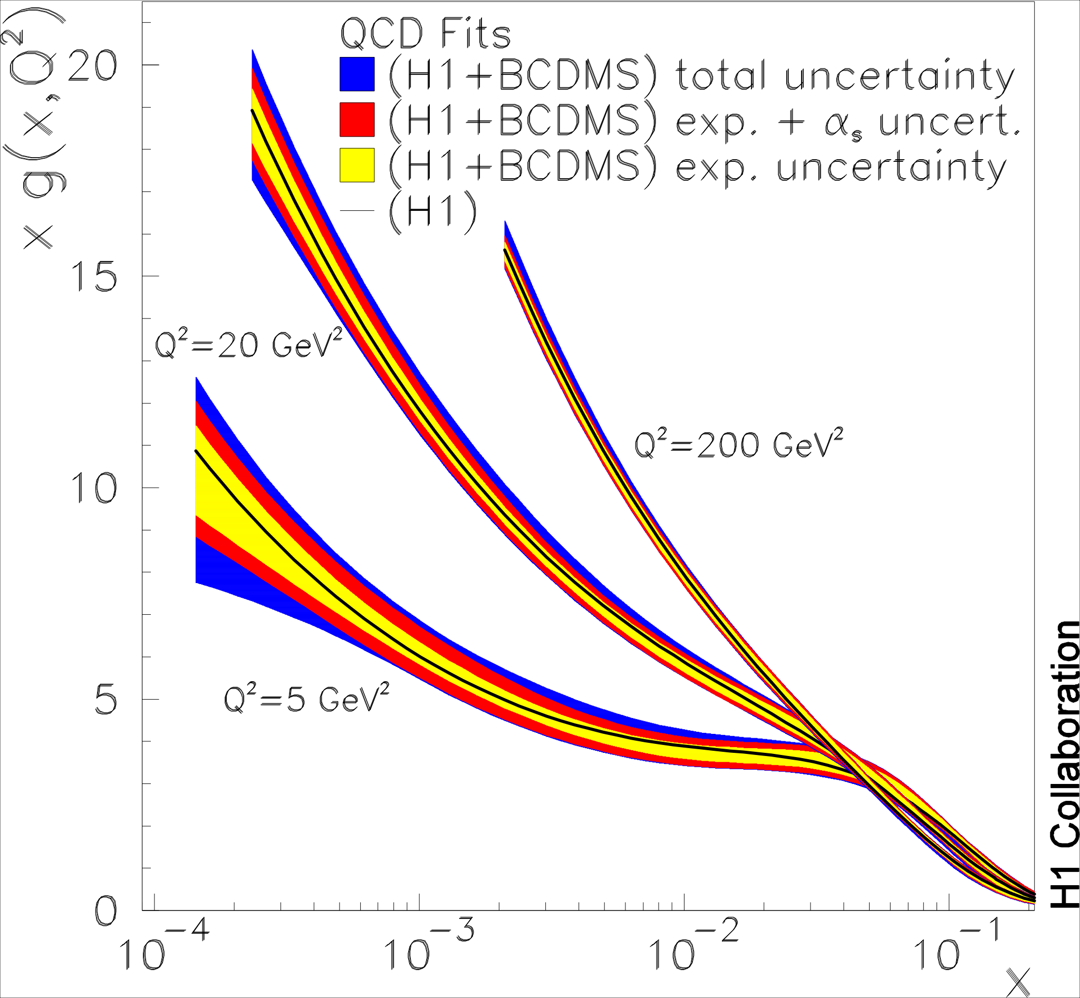
Parton density functions
Low Q²: valence structure
Q² evolution (gluons)
Gluon content of proton rises quickly with Q²
Soft gluons
Valence quarks (p = uud)
x ~ 1/3

Slide 11
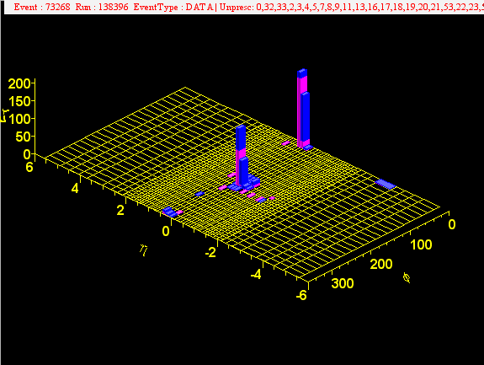
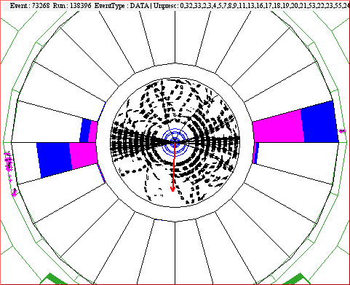
p+p → dijet at Tevatron
Tevatron: p + p at √s = 1.9 TeV
Jets produced with several 100 GeV

Slide 12
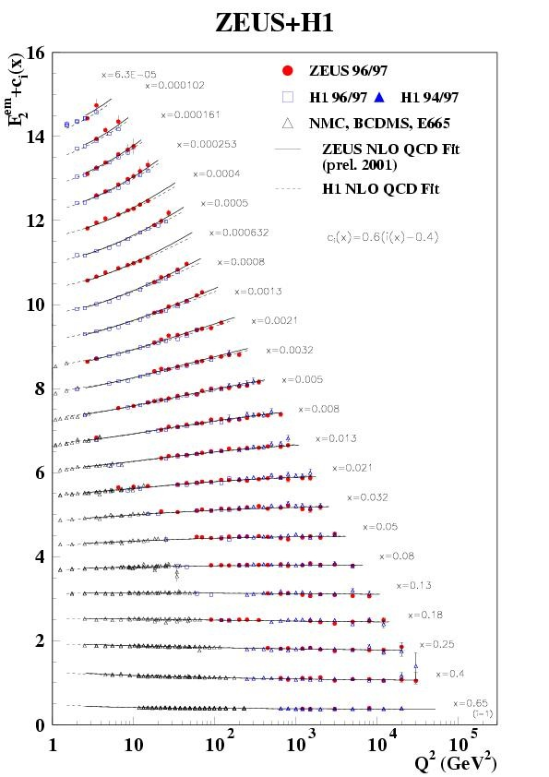
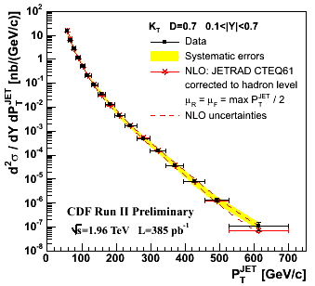
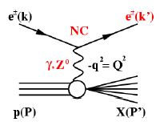
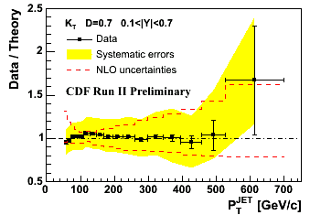
Testing QCD at high energy
small x
x = partonic momentum fraction
Dominant ‘theory’ uncertainty: PDFs
large x
CDF, PRD75, 092006
DIS to measure PDFs
parton density
matrix element
Theory matches data over many orders of magnitude
Universality: PDFs from DIS used to calculate jet-production in pp

Slide 13
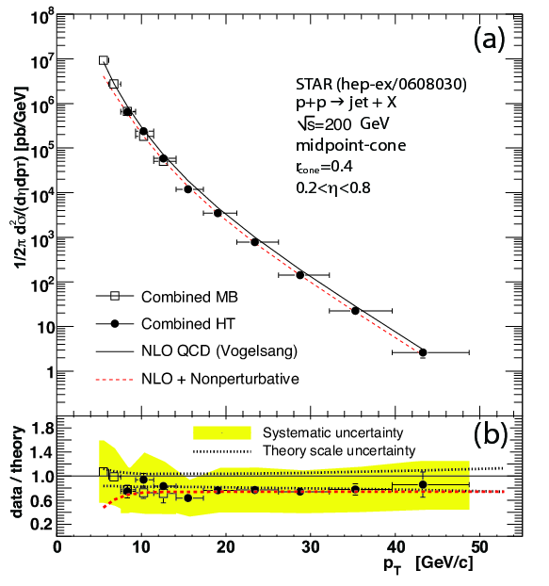
Testing QCD at RHIC with jets
RHIC: p+p at √s = 200 GeV
(p+p at 500 GeV also available)
STAR, hep-ex/0608030
Jets also measured at RHIC
NLO pQCD also works at RHIC
However: significant uncertainties in energy scale, both ‘theory’ and experiment

Slide 14
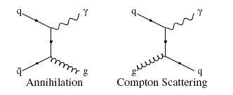
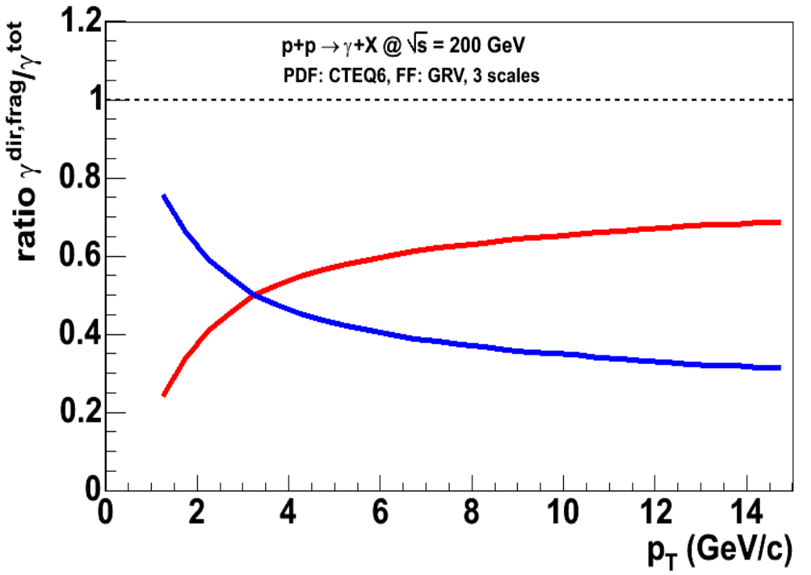
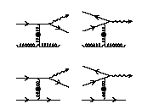
Direct photon basics
LO: γ does not fragment, direct measure of partonic kinematics
Small Rate: Yield ∝ αα_{s}
direct
Gordon and Vogelsang, PRD48, 3136
NLO: quarks radiate photons
fragment
Direct and fragmentation contribution same order of magnitude
‘fragmentation photons’

Slide 15
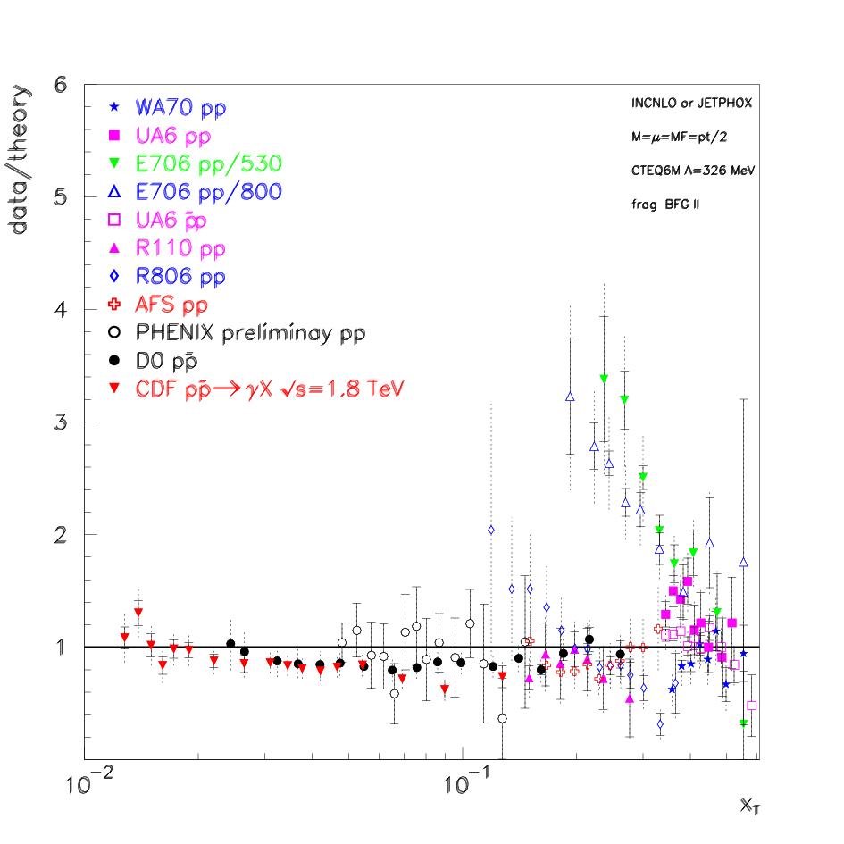
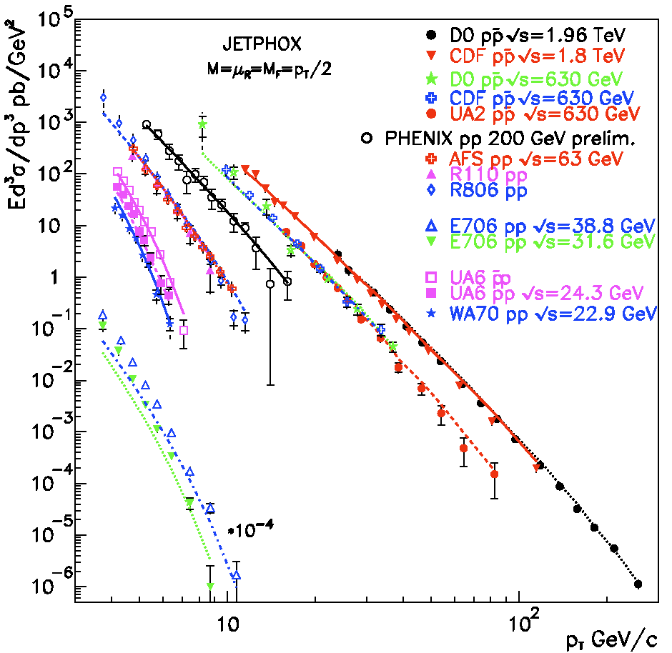
Direct photons: comparison to theory
P. Aurenche et al, PRD73:094007
Good agreement theory-experiment From low energy (√s=20 GeV at CERN) to highest energies (1.96 TeV TevaTron)
Exception: E706, fixed target FNAL deviates from trend: exp problem?

Slide 16
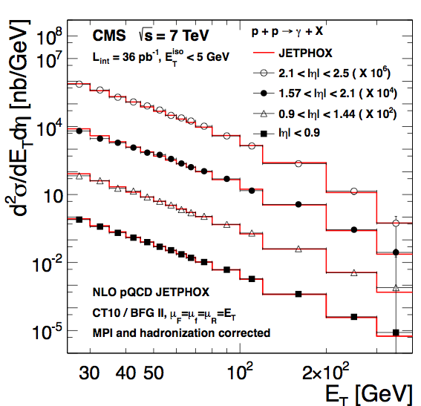
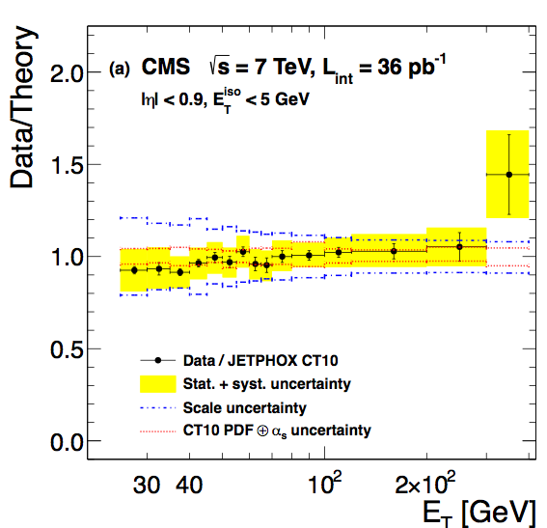
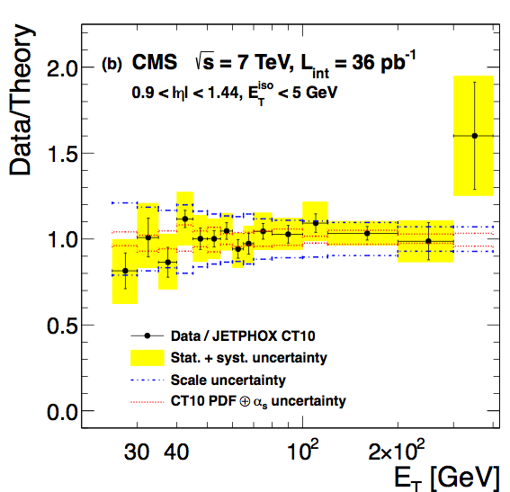
Direct photons LHC
(Isolated prompt photons)
CMS, arXiv:1108.2044
Good agreement data-theory also in p+p at LHC

Slide 17
Towards hadron production: Fragmentation Functions

Slide 18
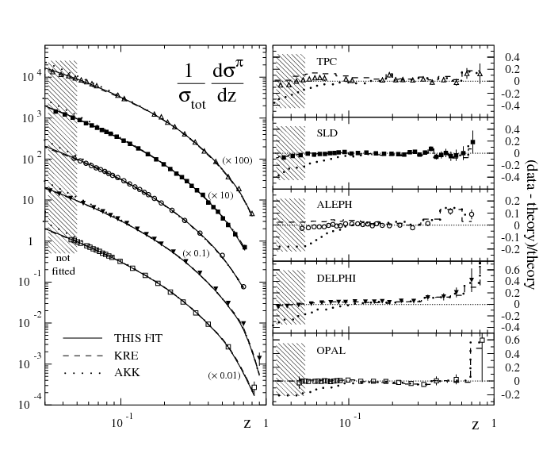
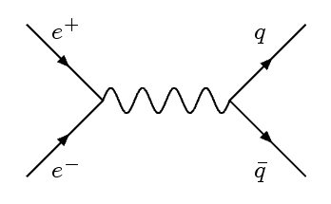
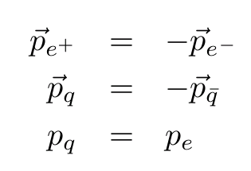
e⁺e⁻ → qq → jets
Direct measurement of fragmentation functions

Slide 19
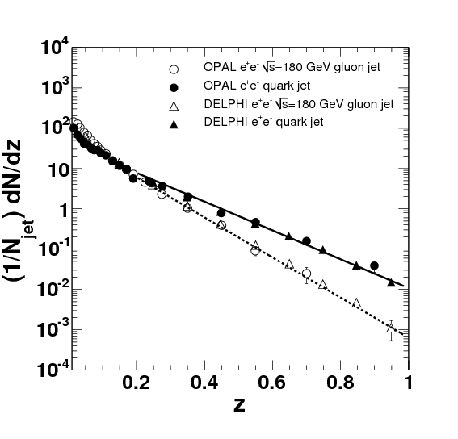
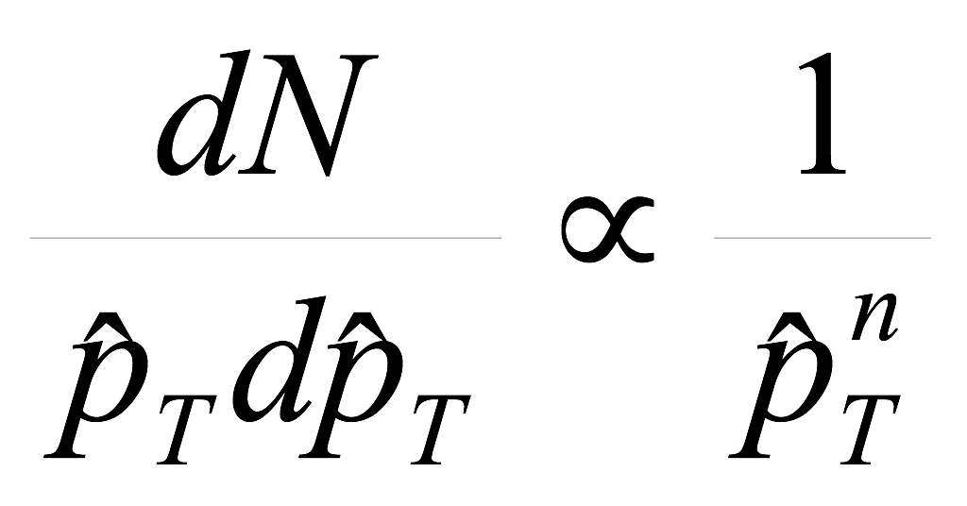
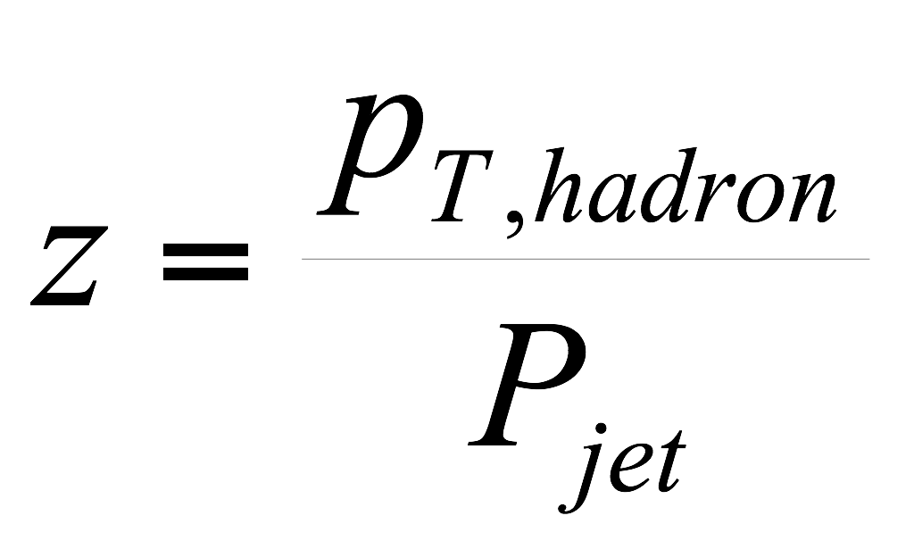
pQCD illustrated
Jet spectrum ~ parton spectrum
Fragmentation
CDF, PRD75, 092006

Slide 20
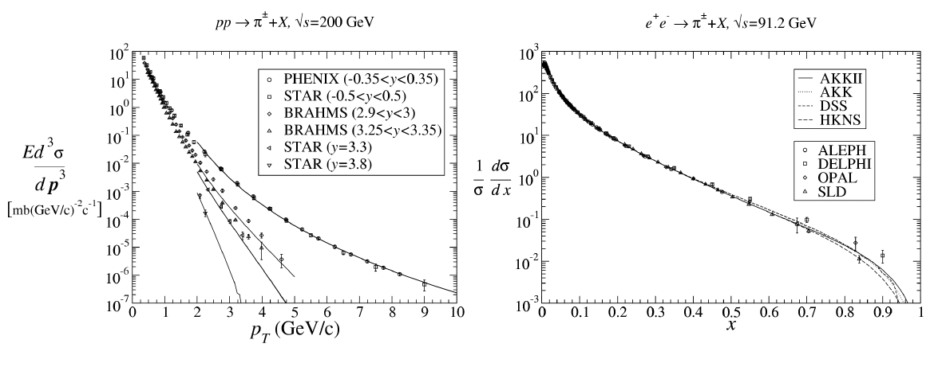
Note: difference p+p, e⁺+e⁻
p+p: steeply falling jet spectrum
Hadron spectrum convolution of jet spectrum with fragmentation
e⁺ + e⁻ QCD events: jets have p=1/2 √s
Directly measure frag function

Slide 21
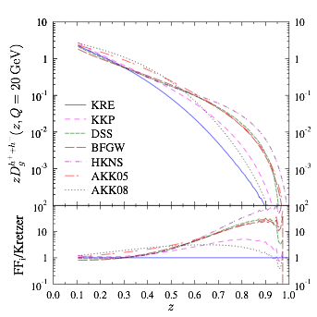
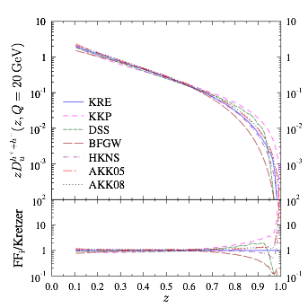
Fragmentation function fits
Gluon fragmentation
quark (u) fragmentation
d’Enterria et al, arXiv:1311.1415
Fragmentation function fits based on e⁺e⁻ have large uncertainty in gluon fragmentation
Some groups use hadron production to further constrain FFs

Slide 22
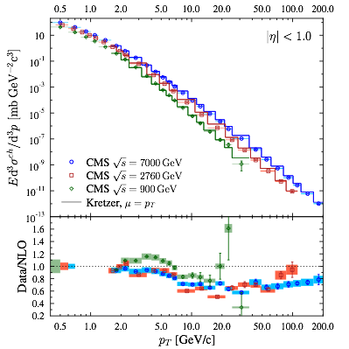
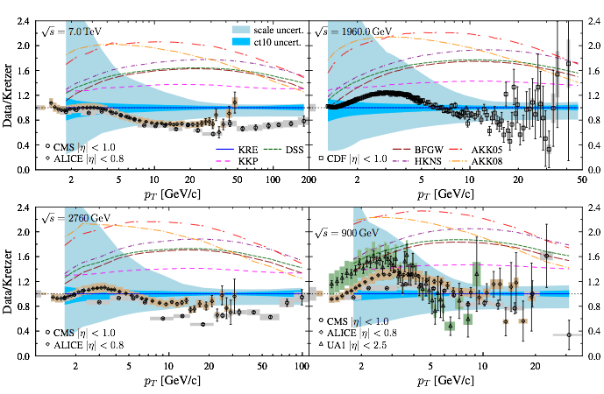
Adding the LHC data in the game
Kretzer fragmentation
Ratios data/theory with uncertainties
d’Enterria et al, arXiv:1311.1415
Factor ~2 spread of results due to FF parameterisations
Mostly due to uncertainty in gluons: next step: use data to constrain gluon FF
Also note: large scale uncertainties at pT < 5 GeV

Slide 23
Part II: Nuclear Modification Factor R_{AA}

Slide 24
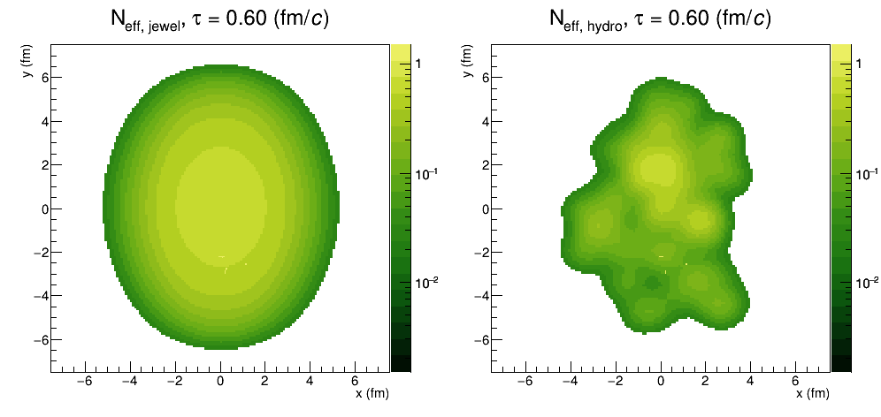
Higher pT: probes of the QGP
R Bertens, JEWEL simulation
Hard probes
Hard-scatterings produce quasi-free partons
⇒ Probe medium through energy loss
Expected to be dominant for pT > 5 GeV or so

Slide 25
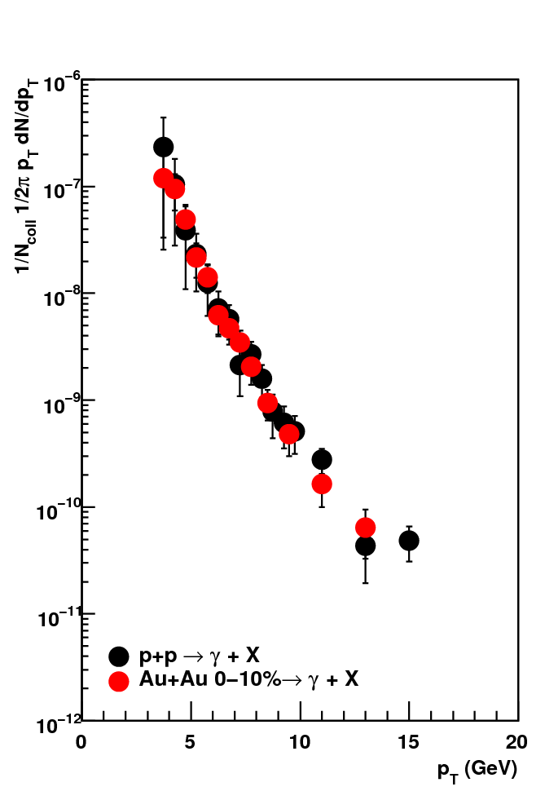
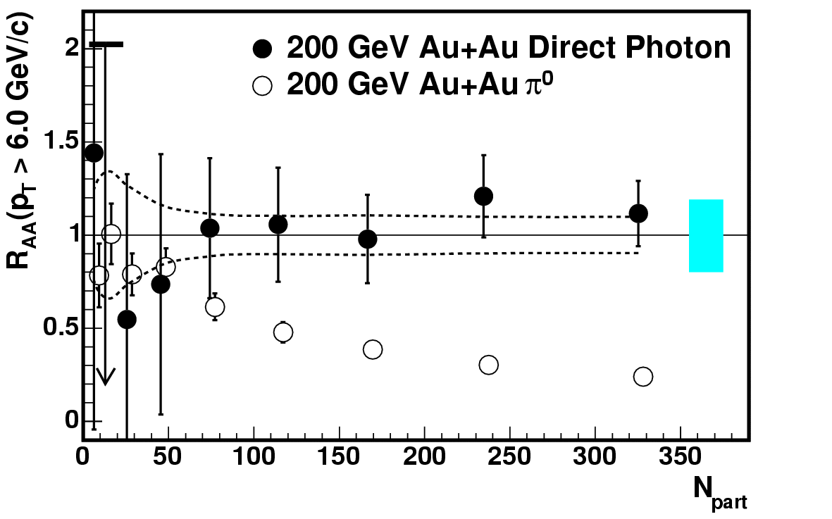
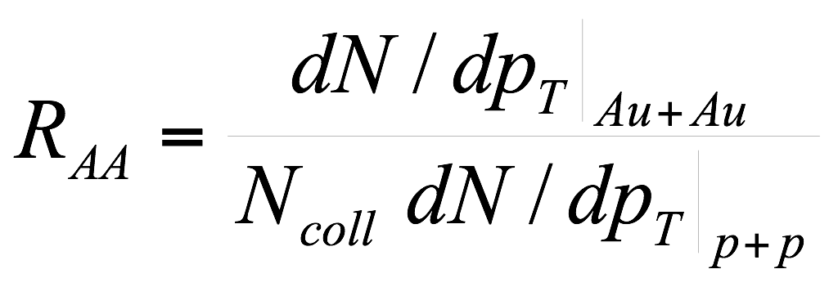
Testing volume (N_{coll}) scaling in Au+Au
Direct γ spectra
PHENIX, PRL 94, 232301
PHENIX
Centrality
Scaled by N_{coll}
Direct γ in A+A scales with N_{coll}
A+A initial state is incoherent superposition of p+p for hard probes

Slide 26
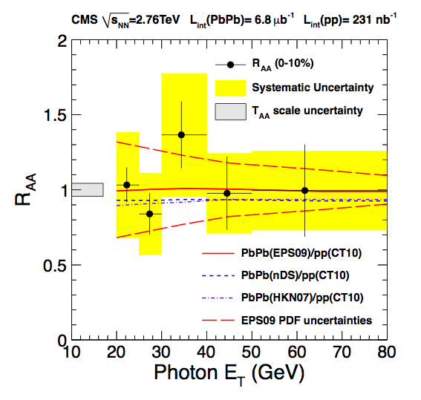
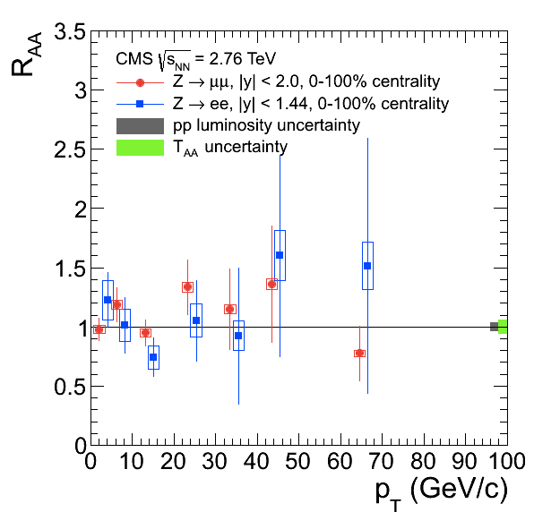
Non-interacting probes at LHC
CMS, arXiv:1201.3093
CMS, arXiv:1410.4825
Ncoll scaling also confirmed at LHC with 𝛾 and even Z (W)

Slide 27
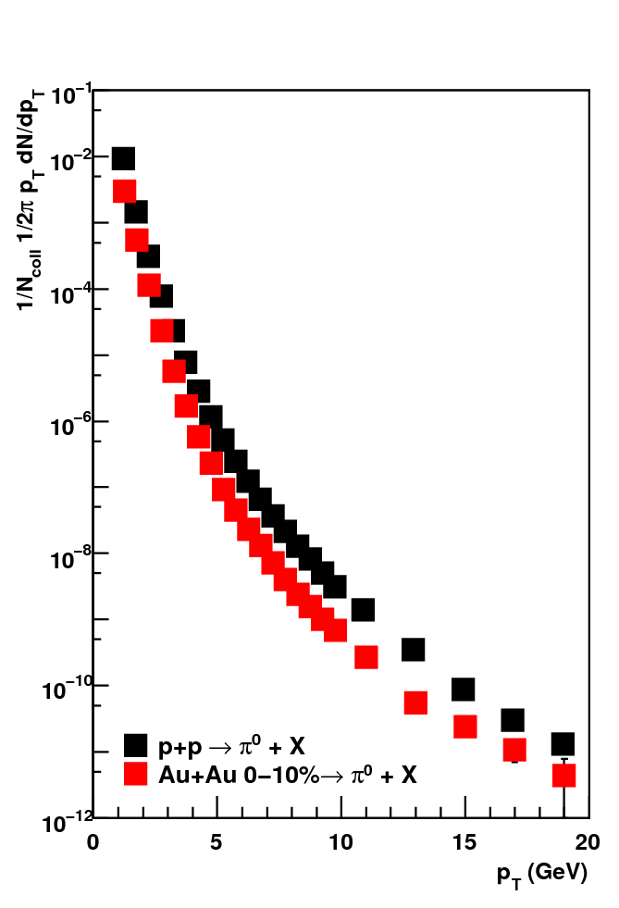
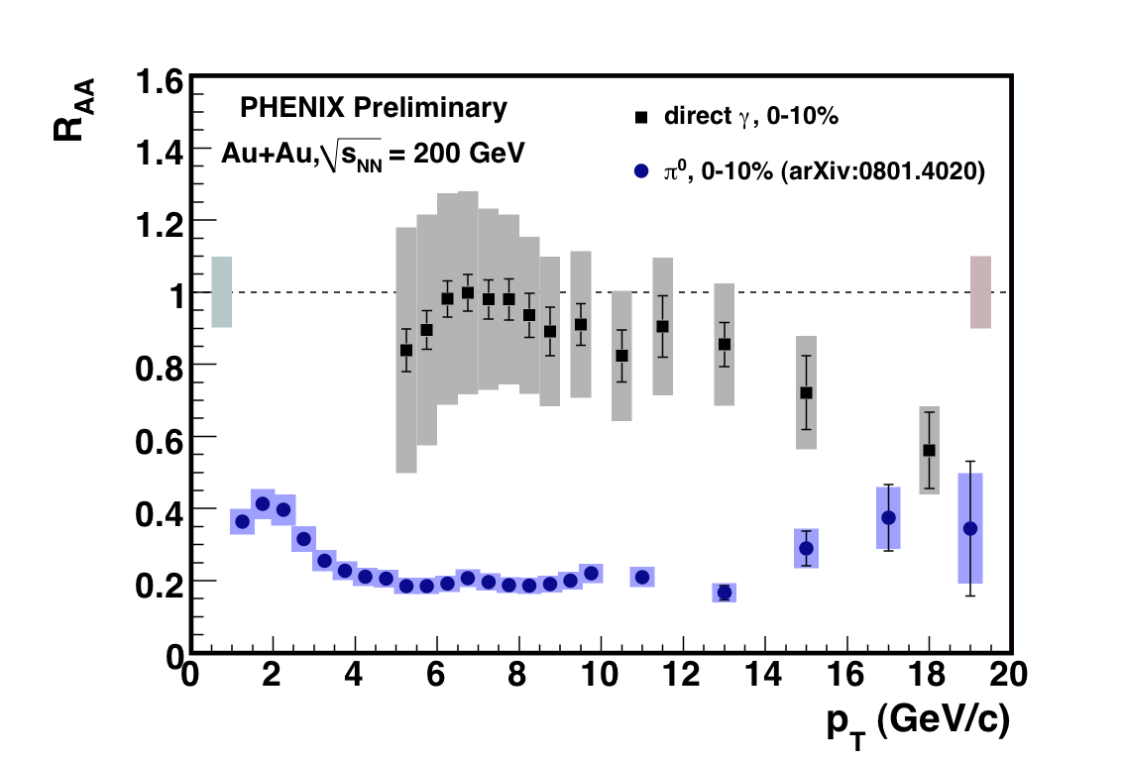
π⁰ R_{AA} – high-p_{T} suppression
γ: R_{AA} = 1
π⁰: R_{AA} ≈ 0.2
γ: no interactions
R_{AA} = 1
R_{AA} < 1
Hard partons lose energy in the hot matter
Hadrons: energy loss

Slide 28
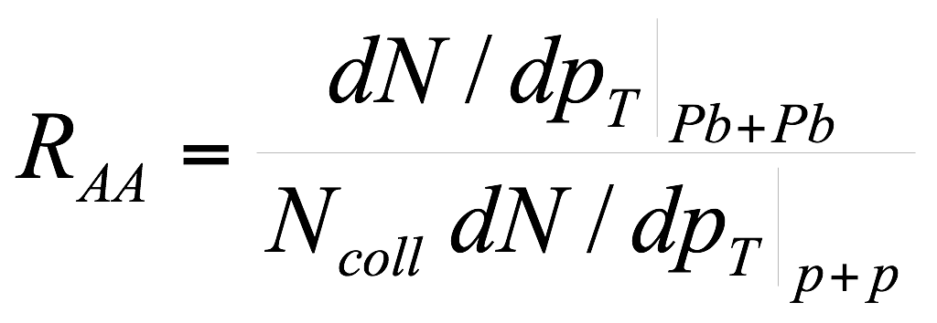
Nuclear modification factor R_{AA}
1/N_{bin} d²N/d²p_{T}
‘Absorption’
‘Energy loss’
p+p
Downward shift
Shift spectrum to left
A+A
p_{T}
Measured R_{AA} is a ratio of yields at a given p_{T}
The physical mechanism is energy loss; shift of yield to lower p_{T}

Slide 29
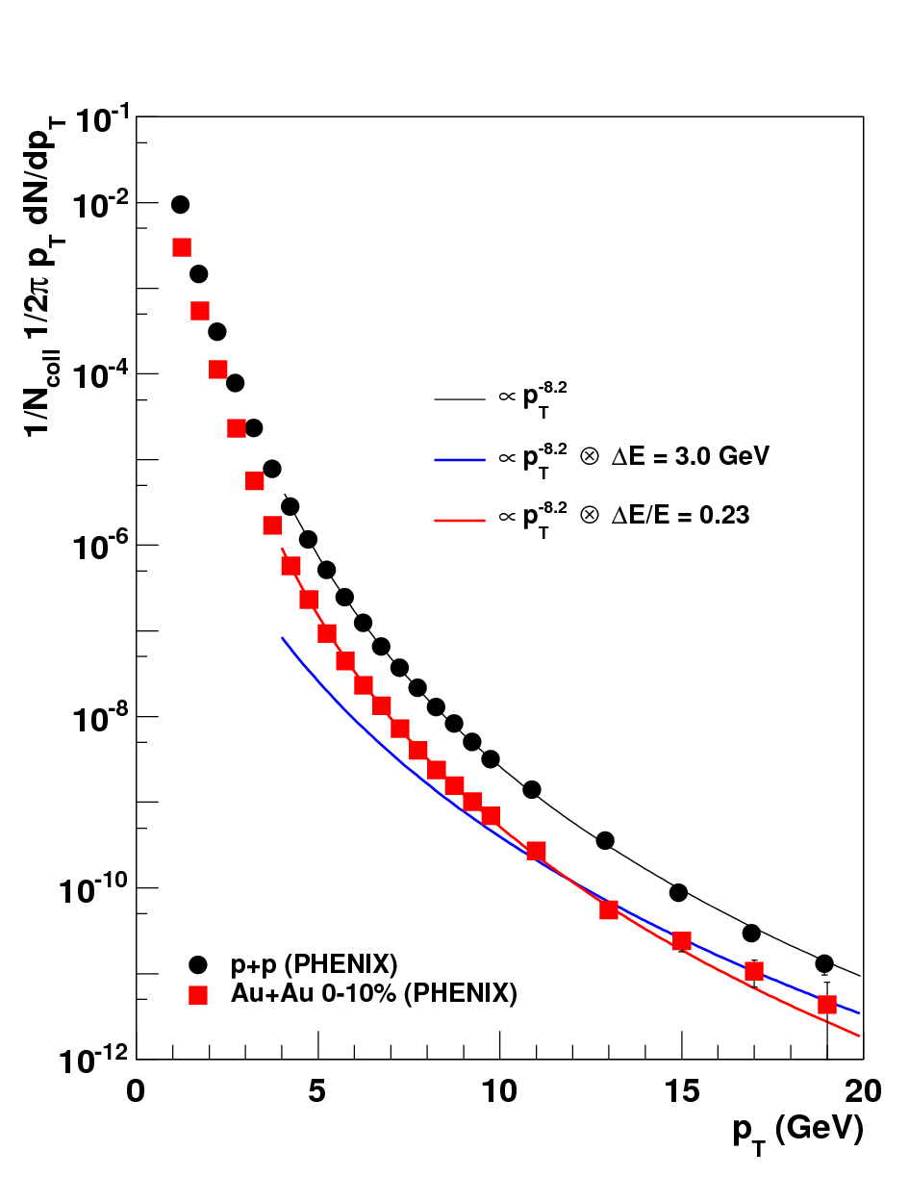
Getting a sense for the numbers – RHIC
π⁰ spectra
Nuclear modification factor
PHENIX, PRD 76, 051106, arXiv:0801.4020
Oversimplified calculation:
Fit pp with power law
Apply energy shift or relative E loss
Not even a model !
Ball-park numbers: ΔE/E ≈ 0.2, or ΔE ≈ 3 GeV for central collisions at RHIC

Slide 30
From RHIC to LHC
RHIC: 200 GeV
LHC: 2.76 TeV
per nucleon pair
Energy ~24 x higher
LHC: spectrum less steep, larger p_{T} reach
RHIC: n ~ 8.2
LHC: n ~ 6.4
Fractional energy loss:
R_{AA} depends on n, steeper spectra, smaller R_{AA}

Slide 31
From RHIC to LHC
RHIC
LHC
RHIC: n ~ 8.2
LHC: n ~ 6.4
Same suppression at RHIC and LHC requires larger loss at LHC
Remember: still ‘getting a sense for the numbers’; this is not a model!

Slide 32
Towards a more complete picture
Energy loss not single-valued, but a distribution
Geometry: density profile; path length distribution
Energy loss is partonic, not hadronic
Full modelling: medium modified shower
Simple ansatz for leading hadrons: energy loss followed by fragmentation
Quark/gluon differences

Slide 33
A simplified approach
Energy loss distribution
Parton spectrum
Fragmentation (function)
known
pQCDxPDF
extract
`known’ from e⁺e⁻
This is where the information about the medium is
P(ΔE) combines geometry with the intrinsic process – Unavoidable for many observables
Notes:
This is the simplest ansatz – most calculation to date use it (except some MCs)
Jet, γ-jet measurements ‘fix’ E, removing one of the convolutions

Slide 34
Geometry
Density profile
Density along parton path
Profile at τ ~ τ_{form} known
Longitudinal expansion dilutes medium
⇒ Important effect
Space-time evolution is taken into account in modelling

Slide 35
Medium-induced radiation
Landau-Pomeranchuk-Migdal effect
Formation time important
Zapp, QM09
radiated
gluon
propagating
parton
L_{c} = τ_{f,max}
Radiation sees length ~τ_{f} at once
If λ < τ_{f}, multiple scatterings
add coherently
Energy loss depends on density:
and nature of scattering centers
(scattering cross section)
Transport coefficient

Slide 36
RHIC and LHC
RHIC
RHIC
Burke et al, JET Collaboration, arXiv:1312.5003
LHC
LHC
Systematic comparison of energy loss models with data
Medium modelled by Hydro (2+1D, 3+1D)
pT dependence matches reasonably well

Slide 37
RHIC and LHC
CUJET 2.0
HT-BW
Burke et al, JET Collaboration, arXiv:1312.5003
CUJET: 𝛼s is medium parameter
Lower at LHC
HT: transport coeff is parameter
Higher at LHC

Slide 38
Summary of transport coefficient study
RHIC:
(T=370 MeV)
LHC:
Burke et al, JET Collaboration, arXiv:1312.5003
(T=470 MeV)
Arnold and Xiao, arXiv:0810.1026
values from different models consistent (NB: ASW/multiple-soft scattering omitted)
HTL expectation:
Sizeable uncertainties from 𝛼S, treatment of logs etc expected
Values found are in the right ballpark compared (p)QCD estimate
Magnitude of parton energy loss is understood

Slide 39
Heavy flavour RAA; mass dependence
ALICE, JHEP11, 205
Compare
beauty: non-prompt J/Ψ
charm: D-mesons
Larger suppression for charm than for beauty
Agrees with expected
‘dead-cone effect’
energy loss reduced when v < c
Indicates radiative energy loss: induced gluon bremmsstrahlung

Slide 40
Nuclear modification factor RAA at 5 TeV
New run 2 result:
RAA for 5 TeV Pb+Pb collisions
CMS-PAS-HIN-15-015
Values similar to 2.76 TeV
expected: medium density similar
(multiplicity increase 20%)
Increase vs pT indicates ΔE/E decreases with E
Expect in high energy limit E >> ΔE

Slide 41
Jets at LHC
ALICE
Transverse energy map of 1 event
ϕ
η
Clear peaks: jets of fragments from high-energy quarks and gluons
And a lot of uncorrelated ‘soft’ background

Slide 42
Jets: reconstructing the partons
Goal: measure energy loss distributions
Longitudinal (fragmentation function)
Transverse (jet profiles)
Jet radius R
Simple expectation:
Limiting behaviour: for large enough R, expect R_{AA} = 1
RAA should increase with jet cone radius (integrate more of the energy)

Slide 43
Comparing hadrons and jets
Suppression of hadron (leading fragment) and jet yield similar
Lost energy is transported to large angles (R > 0.3)

Slide 44
Increasing R to recover the energy
Ratio of spectra with different R
ATLAS, arXiv:1208.1867
ATLAS, arXiv:1208.1967
Larger jet cone: ‘catch’ more radiation → Jet broadening
However, R = 0.5 still has R_{AA} < 1
– Hard to see/measure the radiated energy

Slide 45
Changes in fragmentation
Transverse fragment distributions
Longitudinal fragment distributions
0-10%
PAS CMS-HIN-12-013
CMS, arXiv:1310.0878
Enhancement at large R, low pT
No/very little modification at small R, large pT
Is this expected/understood?

Slide 46
So where does the lost energy go?
Jet RAA is not close to 1
RAA ~ 0.4 - 0.6 for R < 0.5
5-10 GeV energy transported outside of cone
Large energy loss ⟹ Out-of cone radiation
II) Particle distributions in jets show only modest change
~ 10 % at large momentum, small R
larger effects at small pT, large R
Small/modification of in-cone energy flow
Seems qualitatively in contradiction
But many loopholes: event-to-event variations, steep spectra, etc
Let’s test this in a model: JEWEL

Slide 47
RAA vs R in JEWEL
JEWEL: MC event generator with parton energy loss
Zapp, Wiedemann, Krauss
Slow increase of RAA with R, qualitative agreement with observations

Slide 48
In- and out-of-cone radiation in a model (JEWEL)
Ratio PbPb/pp
Cumulative profiles
Small r, high pt:
20% increase (100% relative)
‘hidden’ in large bin?
Intermediate r: 10%, relative 30% effects
much larger than effect data
NB: recent studies by Zapp and Eyalavalli with newer version of JEWEL show smaller effects

Slide 49
Soft-collinear Effective Theory
Y-T Chien, I Vitev, JHEP 1412, 061 and 1605, 023
Radial profile Pb+Pb
Radial profile pp
CMS, arXiv:1310.0878
Need resummation to properly describe radial profile
R-dependence of RAA
Radial profile well described by SCET
ATLAS, arXiv:1208.1967
R dependence too strong?
Predictions for 𝛾-jet available

Slide 50
Summary: Hard Probes
Hard processes: factorisation
Hard and soft processes do no interfere
Provides ‘calibrated source’ to probe hot matter
Suppression of high-pT particle production: parton energy loss
Magnitude of effect understood
‘Dead cone effect’ points to gluon bremmsstrahlung as mechanism
Next step: understand momentum, angular distribution of radiated energy

Slide 51
Thank you for your attention

Slide 52
Jet shapes: radial moment
pT-weighted jet width
Talk D Caffari
Radial moment smaller in Pb+Pb
than pp (PYTHIA)
JEWEL model shows similar trend
Jets in medium narrower than in vacuum

Slide 53
Splitting fraction
SoftDrop grooming, momentum fraction of the first splitting: sensitive to splitting function
Larkoski et al, PRD 91, 111501
Talk M. Verweij
CMS-PAS-HIN-16-006
Comparison to JEWEL MC generator:
good (qualitative) agreement
SoftDrop β = 0, zcut = 0.1
ΔR12 > 0.1
⟨zg⟩ lower in Pb+Pb: softer fragmentation

Slide 54
Nuclear modification: Pb+Pb
ALICE, PLB720, 52
CMS, EPJC, 72, 1945
ATLAS, arXiv:1504.04337
Charged particle pT spectra
Nuclear modification factor
Low pT: soft production,
Npart scaling
Energy loss
Ncoll: number of binary nucleon-nucleon collisions
R_{AA} < 1
Pb+Pb: clear suppression (RAA < 1): parton energy loss

Slide 55
Comparison to pQCD expectation
JET paper:
Burke et al, arXiv:1312.5003
HTL expectation:
Arnold and Xiao, arXiv:0810.1026
Constant depends on 𝛼s (took 𝛼s = 0.3) and jet E (via ln)
plus uncertainties due to assumptions, low momentum cut-off etc
Values found are in reasonable agreement with pQCD estimate

Slide 56
MC vs analytical approaches
Analytical approaches:
Energy loss of leading parting + fragmentation in vacuum
- radiated gluons are not tracked
Monte Carlo parton shower:
All partons tracked (except ‘soft’ medium partons)
High-energy
parton
(from hard scattering)
Hadrons
Implement medium-enhanced splitting everywhere in shower
JEWEL, MARTINI, PYQUEN, q-PYTHIA, YAJeM
large Q²
μ_{F}
Q ~ m_{H} ~ Λ_{QCD}

Slide 57
In-medium showers: energy loss MC
How is does the medium modify parton fragmentation?
Energy-loss: reduced energy of leading hadron – enhancement of yield at low p_{T}?
Broadening of shower?
Path-length dependence
Quark-gluon differences
Final stage of fragmentation outside medium?
2) What does this tell us about the medium ?
Density
Nature of scattering centers? (elastic vs radiative; mass of scatt. centers)
Time-evolution?
High-energy
parton
(from hard scattering)
Hadrons
Red items: QGP physics interest

Slide 58
Four formalisms
Multiple gluon emission
Hard Thermal Loops (AMY)
Dynamical (HTL) medium
Single gluon spectrum: BDMPS-Z like path integral
No vacuum radiation
Multiple soft scattering (BDMPS-Z, ASW-MS)
Static scattering centers
Gaussian approximation for momentum kicks
Full LPM interference and vacuum radiation
Opacity expansion ((D)GLV, ASW-SH)
Static scattering centers, Yukawa potential
Expansion in opacity L/λ (N=1, interference between two centers default)
Interference with vacuum radiation
Higher Twist (Guo, Wang, Majumder)
Medium characterised by higher twist matrix elements
Radiation kernel similar to GLV
Vacuum radiation in DGLAP evolution
Fokker-Planck rate equations
Poisson ansatz
(independent emission)
DGLAP
evolution
See also: arXiv:1106.1106

Slide 59
Large angle radiation
Emitted gluon distribution
Opacity expansion
Gluon perp momentum k⊥ (GeV)
k_{T} < k
Gluon momentum k (GeV)
Calculated gluon spectrum extends to large k⊥ at small k
Outside kinematic limits
GLV, ASW, HT cut this off ‘by hand’

Slide 60
Effect of large angle radiation
Single-gluon spectrum
Opacity expansion formalisms
Expand in powers of
Blue: k_{Tmax} = xE
Red: k_{Tmax} = 2x(1-x)E
Horowitz and Cole, PRC81, 024909
Different definitions of x:
ASW:
GLV:
Different large angle cut-offs:
k_{T} < ω = x_{E} E
k_{T} < ω = 2 x₊ E
Factor ~2 uncertainty
from large-angle cut-off

Slide 61
Energy loss distributions
Radiated gluon distribution
Energy loss probability distribution
Multiple gluon emission:
Poisson Ansatz
Main theory uncertainty:
Large angle radiation
Broad distribution
Significant contributions at ΔE=0, ΔE=E

Slide 62
L-dependence; regions of validity?
Emission rate vs τ (=L)
Caron-Huot, Gale, arXiv:1006.2379
GLV N=1
Too much radiation at large L
(no interference between scatt centers)
E = 16 GeV
k = 3 GeV
T = 200 MeV
Full =
numerical solution of Zakharov path integral
= ‘best we know’
AMY, small L,
no L², boundary effect
H.O = ASW/BDMPS like (harmonic oscillator)
Too little radiation at small L
(ignores ‘hard tail’ of scatt potential)

Slide 63
Testing our intuition
Use two MC event generators to generate ‘reasonable expectations’
for relations between RAA and intra-jet distributions
JEWEL
Interaction model: elastic scatterings+radiation
Includes momentum exchange with medium
Radiation model is MC-implementation of LPM interference/formation time effects
Shown to match multiple soft scattering analytical calculations in the appropriate limits
Geometry: Glauber density profile + longitudinal expansion
q-PYTHIA
Medium-modified splittings, BDMPS-inspired
No momentum exchange with medium
Geometry: Glauber density profile (AliFastGlauber)
Zapp, Wiedemann, Krauss
Cunqueiro, Armesto, Salgado, Apollinario

Slide 64
Situation at RHIC, ca 2008
3 main calculations; comparison with same medium density profile
Bass et al, PRC79, 024901
ASW:
HT:
AMY:
PHENIX, arXiv:1208.2254
Large density:
AMY: T ~ 400 MeV
Transverse kick: qL ~ 10-20 GeV
Large uncertainty in absolute medium density

Slide 65
What’s up with the large angle radiation?
Jet energy profile
~25% in first bin:
r < 0.02
10% of energy
r > 0.13
5% of energy
r > 0.2
Redistribution of energy should be continuous
Would expect O(100%) effect at r > 0.15 or so
and O(30%) effects at r = 0

Slide 66
Experimental challenge: π⁰ → γγ
Below p_{T} = 5 GeV: decays dominant at RHIC

Slide 67
Heavy quark fragmentation
Light quarks
Heavy quarks
Heavy quark fragmentation: leading heavy meson carries large momentum fraction
Less gluon radiation than for light quarks, due to ‘dead cone’

Slide 68
Dead cone effect
Radiated wave front cannot out-run source quark
Heavy quark: β < 1
Result: minimum angle for radiation
⇒ Mass regulates collinear divergence

Slide 69
Heavy Quark Fragmentation II
From: M Cacciari
Significant non-perturbative effects seen even in heavy quark fragmentation

Slide 70
Fragmentation and parton showers
MC event generators
implement ‘parton showers’
Longitudinal and transverse dynamics
High-energy
parton
(from hard scattering)
Hadrons
large Q²
μ_{F}
Q ~ m_{H} ~ Λ_{QCD}
Analytical calculations: Fragmentation Function D(z, μ) z=p_{h}/E_{jet}
Only longitudinal dynamics

