Slide 1


QCD and the Quark Gluon Plasma
part 1: soft physics
Marco van Leeuwen,
Nikhef and Utrecht University
GRK 2149 retreat, 19-22 September 2016

Slide 2
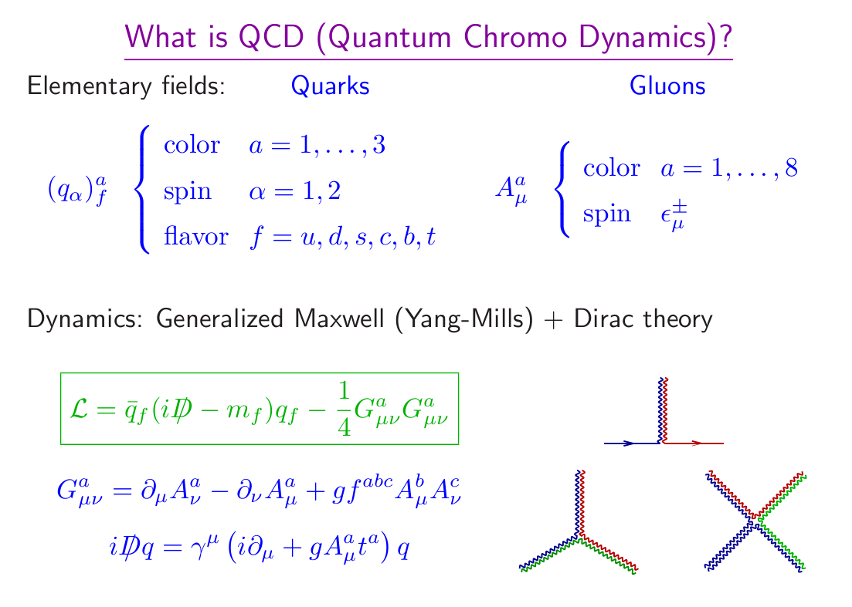
What is QCD?
From: T. Schaefer, QM08 student talk

Slide 3
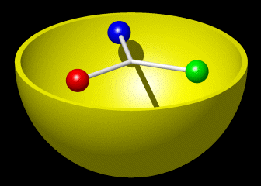
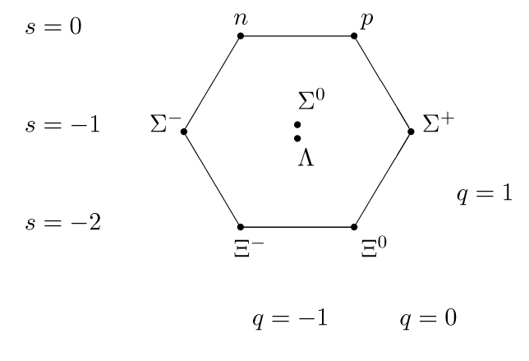
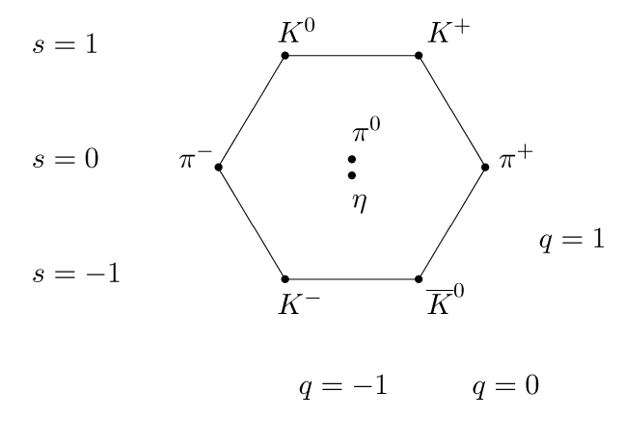
QCD and hadrons
Quarks and gluons are the fundamental particles of QCD
(feature in the Lagrangian)
However, in nature, we observe hadrons:
Color-neutral combinations of quarks, anti-quarks
Baryon multiplet
Meson multiplet
S
strangeness
I₃ (u,d content)
I₃ (u,d content)
Baryons: 3 quarks
Mesons: quark-anti-quark

Slide 4
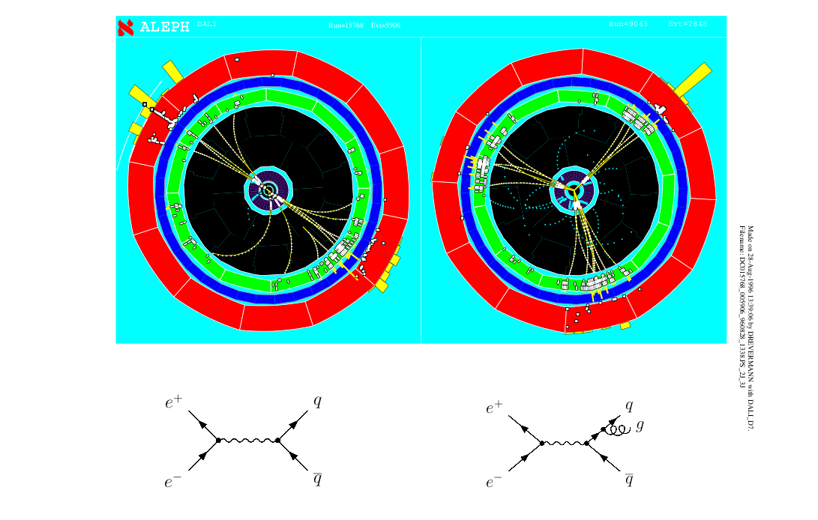
Seeing quarks and gluons
In high-energy collisions, observe traces of quarks, gluons (‘jets’)

Slide 5
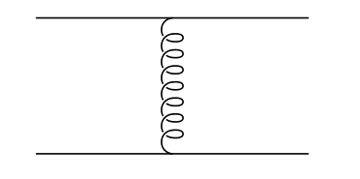

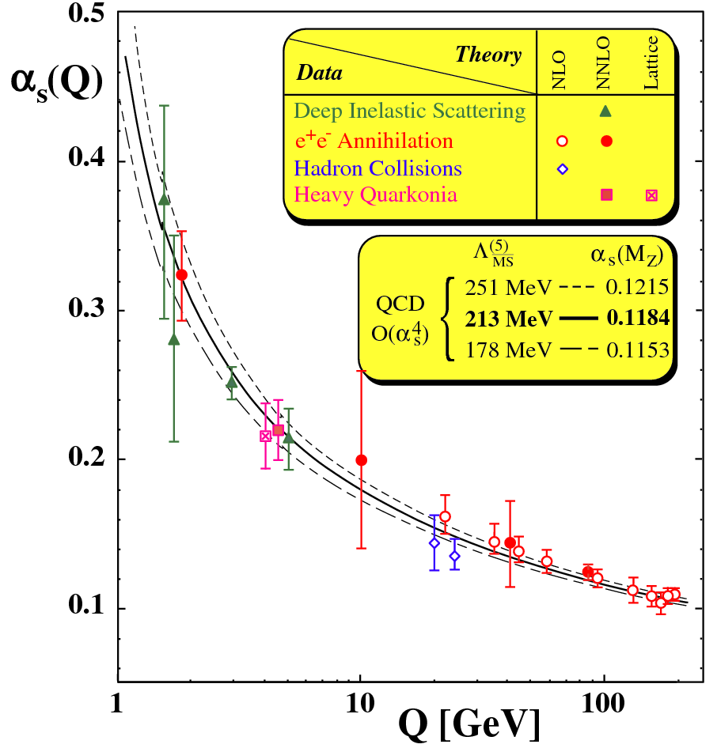

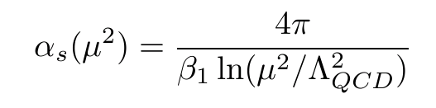
How does it fit together?
S. Bethke, J Phys G 26, R27
Running coupling:
α_{s} decreases with Q²
Pole at μ = Λ
Λ_{QCD} ~ 200 MeV ~ 1 fm⁻¹
Hadronic scale

Slide 6
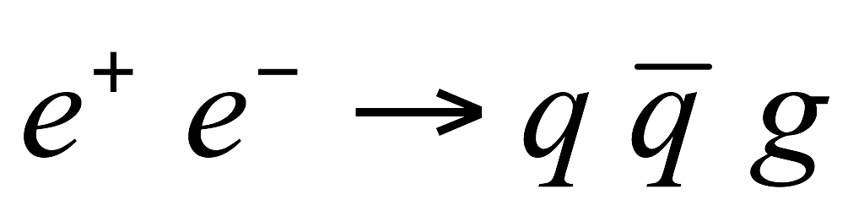
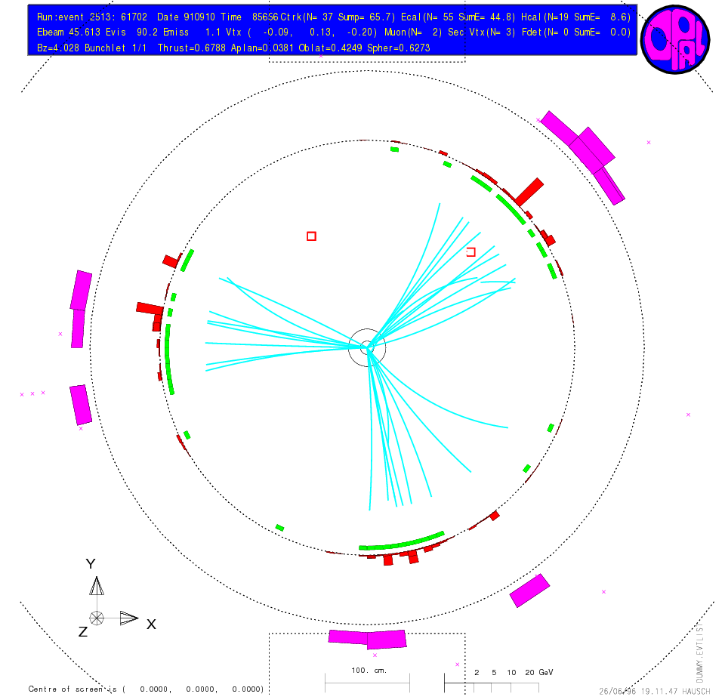
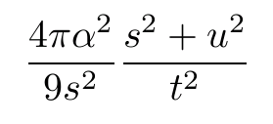
Asymptotic freedom and pQCD
At large Q², hard processes: calculate ‘free parton scattering’
At high energies, quarks and gluons are manifest
+ more subprocesses
But need to add hadronisation (+initial state PDFs)

Slide 7
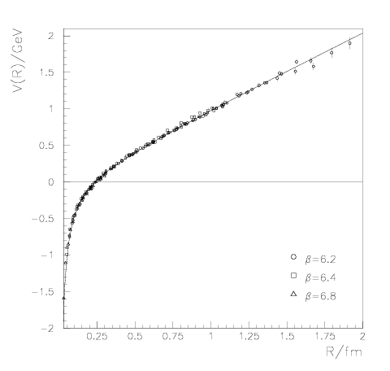
Low Q²: confinement
α large, perturbative techniques not suitable
Bali, hep-lat/9311009
Lattice QCD: solve equations of motion (of the fields) on a space-time lattice by MC
Lattice QCD potential
String breaks, generate qq pair to reduce field energy

Slide 8
Regimes of QCD
Asymptotic freedom
Dilute, hard scattering
Deconfined matter
Bulk matter, hot
Bound states
Hadrons/hadronic matter
Heavy ion physics
Baryon-dense matter (neutron stars)
Bulk matter, cold

Slide 9
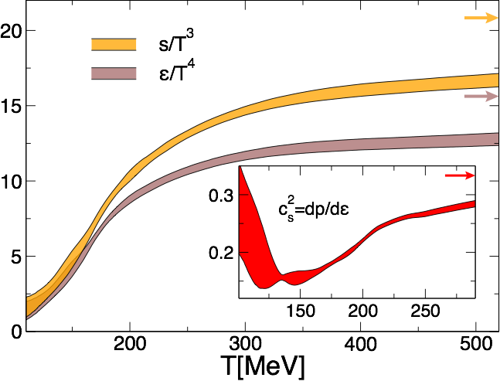
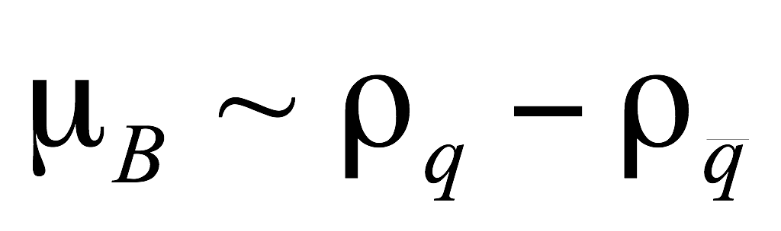
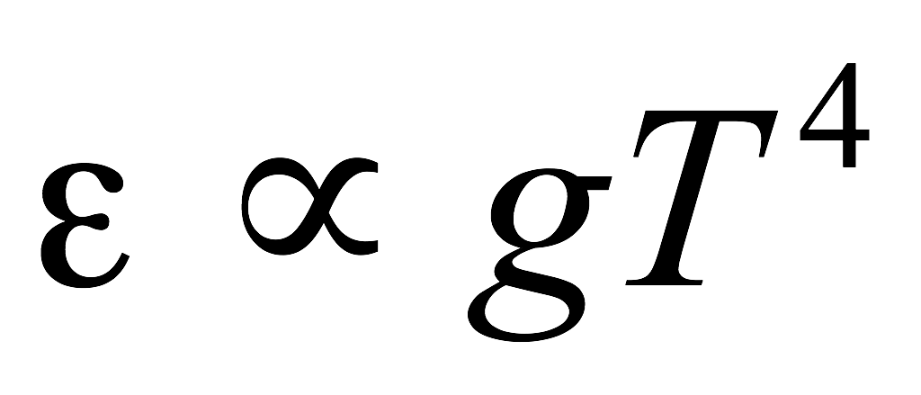
Introduction: Heavy Ion Physics
Phase diagram
Equation of state
Energy density vs temperature
Quark Gluon Plasma
(Quasi-)free quarks and gluons
Temperature
Critical
Point
Borsanyi et al, PLB 730, 99
Early universe
Confined hadronic matter
Elementary collisions
(accelerator physics)
High-density phases?
Neutron stars
Nuclear matter
Tc ≈ 150 MeV
Study the properties of many-body QCD systems
Properties of equilibrium matter: equation of state, transport coefficient
Dynamics: hadronisation, interactions of partons with the medium

Slide 10
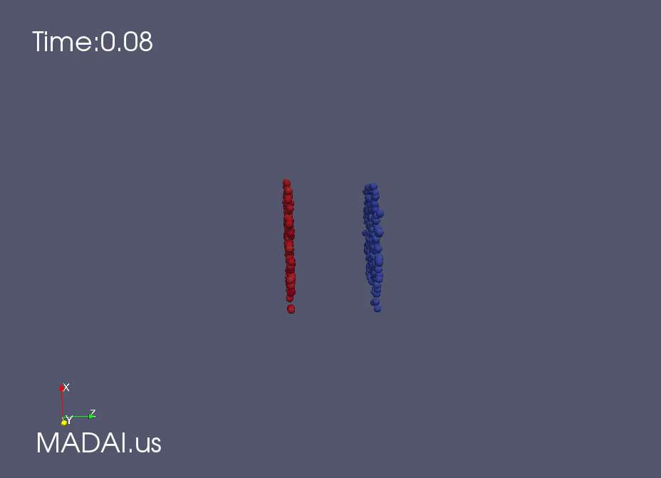
Soft probes: anisotropic flow
MADAI
Initial state (spatial) anisotropy ⇒ Pressure gradients ⇒ anisotropic flow: momentum space anisotropy

Slide 11
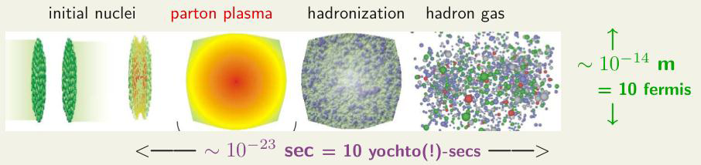
Time evolution in a heavy ion collision
Quark Gluon Plasma/Liquid
(near) thermal equilibrium
Pre-equilibrium
Freeze-out (post-equilibrium)
Expectation: main difference between heavy ion collisions and pp, p+Pb volume + density ⇒ rescattering during evolution ⇒ approach to thermal equilibrium

Slide 12
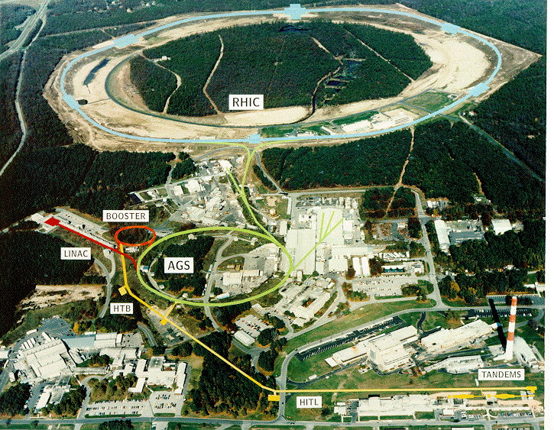
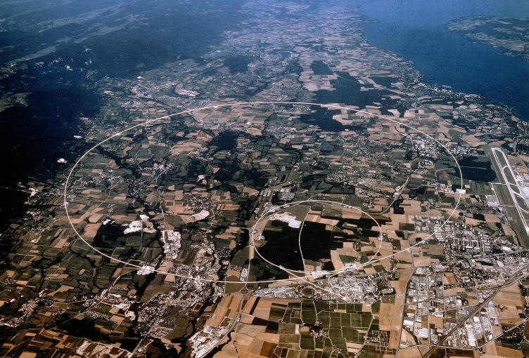

Intro: RHIC and LHC
RHIC, Brookhaven
LHC, Geneva
Au+Au √s_{NN}= 200 GeV
Run 2: Pb+Pb √s_{NN}= 5020 GeV
First run: 2000
First run: 2009/2010
STAR, PHENIX,
(PHOBOS, BRAHMS)
ALICE, ATLAS, CMS, LHCb

Slide 13
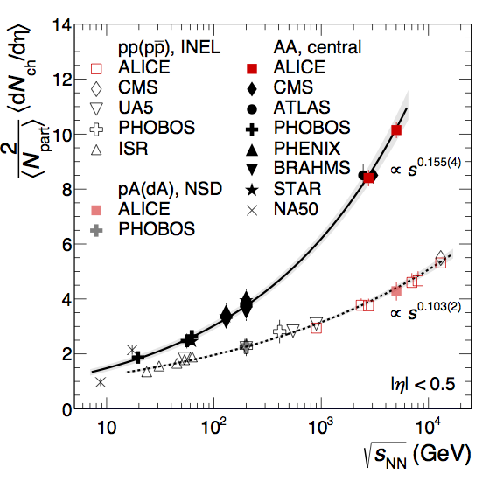
Multiplicity dNch/dη in pp, Pb+Pb
PLB 753, 319
First results from Run-2: multiplicity at new energies
Trend continues to rise faster for AA than pp: conversion of energy to particles in AA is more efficient (larger ‘stopping’)

Slide 14
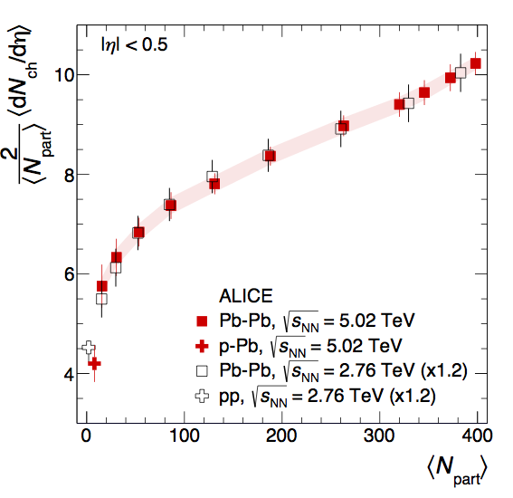
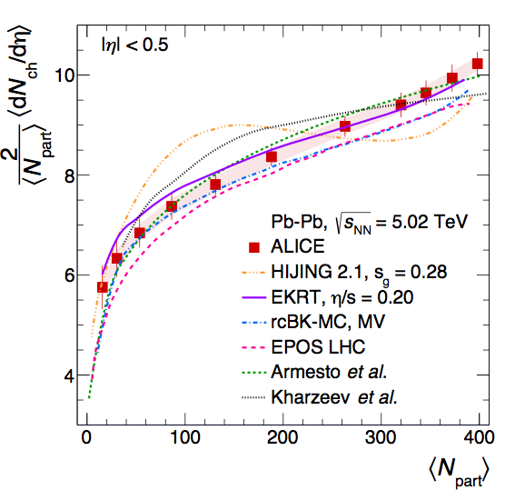
Multiplicity vs centrality PbPb
arXiv:1509.07299
Centrality dependence
very similar at 5.02 and 2.76 TeV
(overall factor 1.2)
Model comparisons:
Soft physics models agree
Hijing: some deviations
Driven by geometry
No change in contribution hard vs soft processes

Slide 15
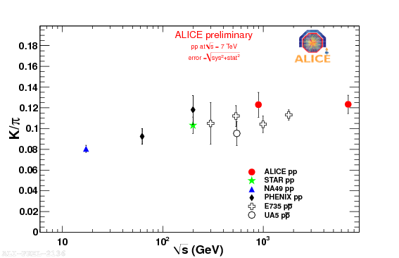
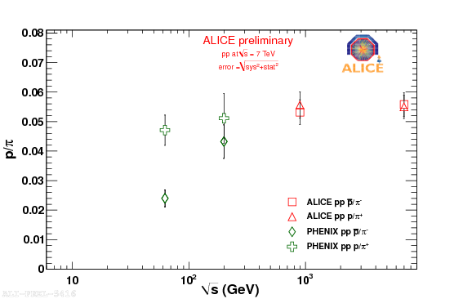
A simple question? – Particle ratios
K/π ratio
(mid-rapidity density)
p/π ratio
(mid-rapidity density)
K/π ≈ 0.1 in pp
– Approx independent of √s
p/π ≈ 0.05 in pp
– Approx independent of √s
At low √s: p > pbar
Baryon number conservation
Finite baryon density at midrapity

Slide 16
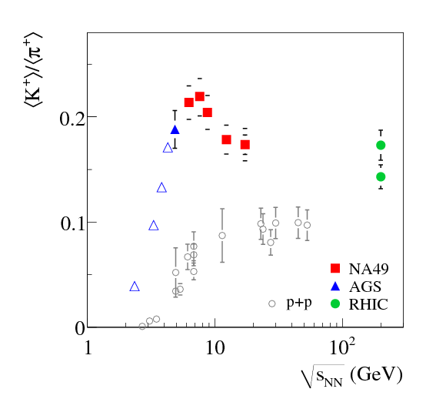
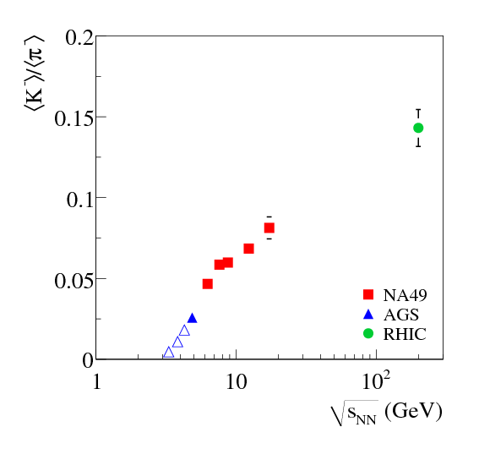
Particle ratios in PbPb (SPS)
NA49,PRC66, 054902
K/π larger in PbPb than pp
K⁻ yield < K⁺ because of baryons
Λ, K⁻ have s, K⁺ anti-s
Strangeness enhancement (usually refers to baryons Λ, Ξ, Ω)

Slide 17
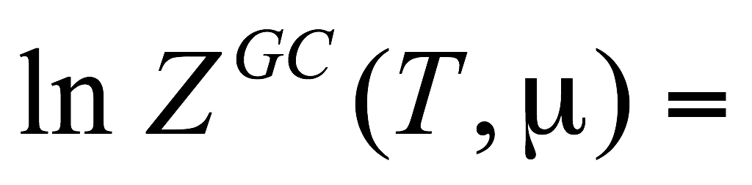
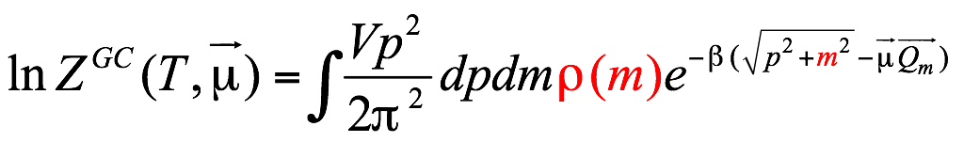
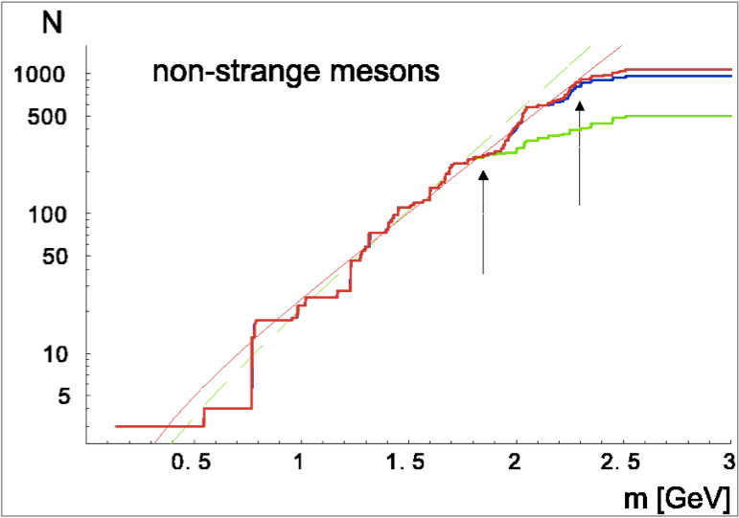
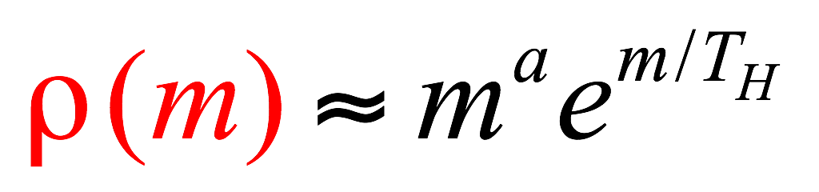
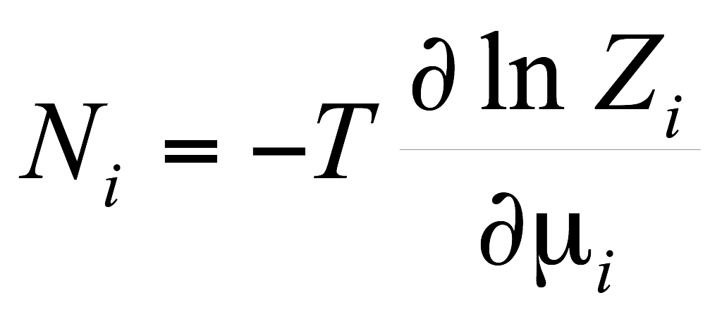

Hadron Gas Model
Meson mass spectrum
R. Hagedorn, Nuovo Cim.Suppl.3:147-186,1965;
Broniowski, et.al. 2004
Result: adding more energy creates heavier resonances, at ~ constant T_{H}≈170 MeV
Full QCD: at higher T (T_{c} ≈ 170 MeV), quarks and gluons become the relevant degrees of freedom
Resonance mass spectrum characterizes QCD interactions
(Hagedorn)

Slide 18
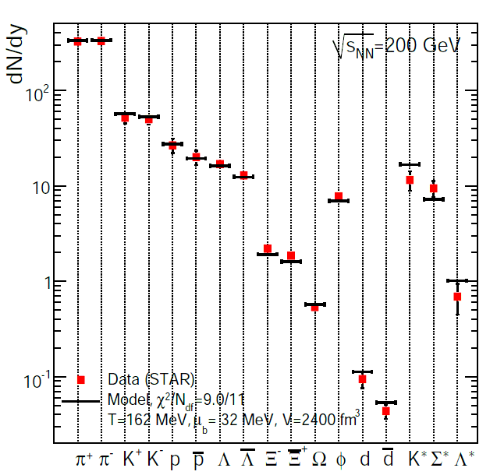
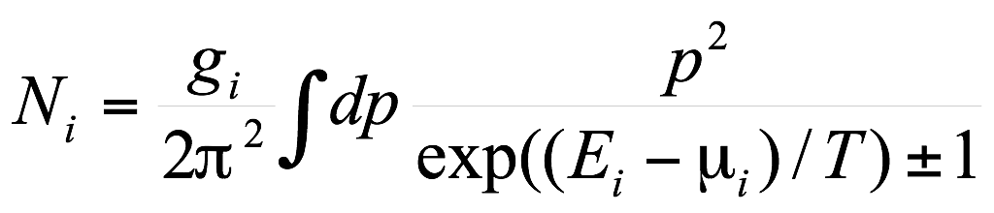
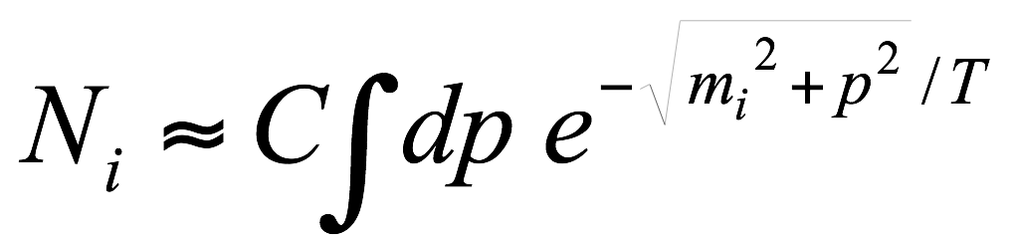
Hadron Gas Model vs data
Braun-Munzinger et al
Yields set by: T, V, conserved charges
Good description for PbPb
– Hadron abundances determined by thermal equilibrium?

Slide 19
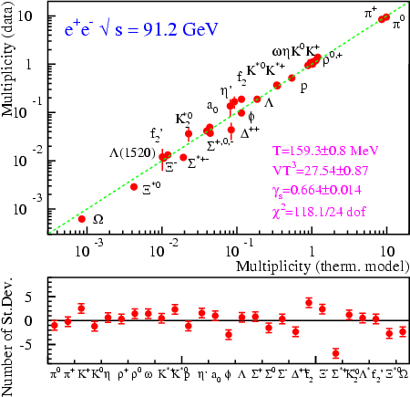
Hadron Gas for e⁺e⁻
F. Becattini
HGM also describes e⁺e⁻ (and pp) results
Canonical ensemble: exact strangeness conservation suppresses strangeness production
Tentative conclusion:
Phase space dominant; Hadron yields not sensitive to dynamics (‘matrix elements’) beyond mass spectrum

Slide 20
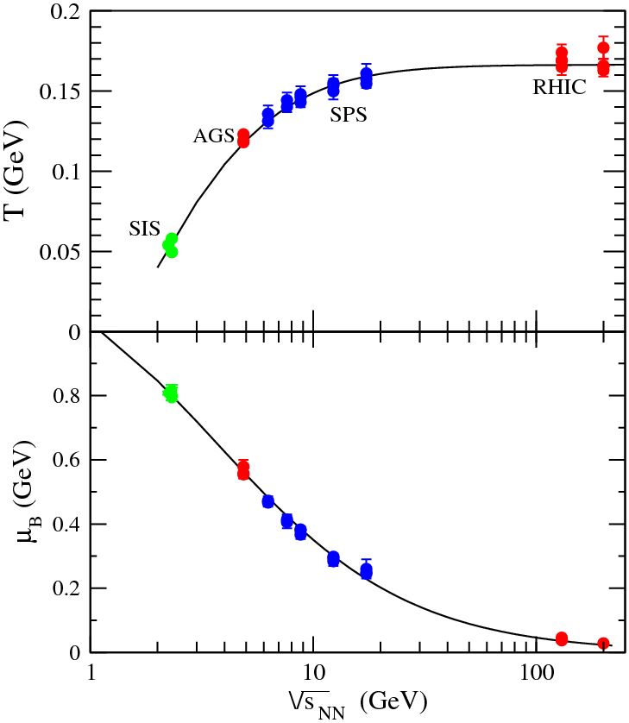
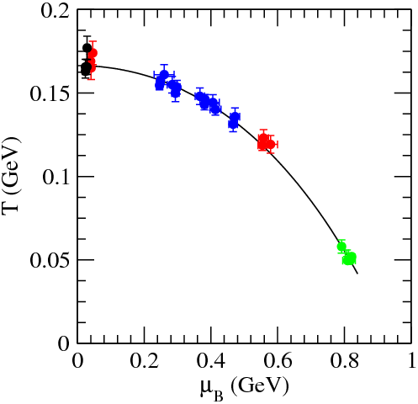
HGM vs energy: freeze-out curve
Hadron Gas Model parameters
Freeze-out curve
Shows T, μ_{B} of the system at hadronisation
J. Cleymans et hep-ph/0511094

Slide 21
Dynamical effects: flow

Slide 22
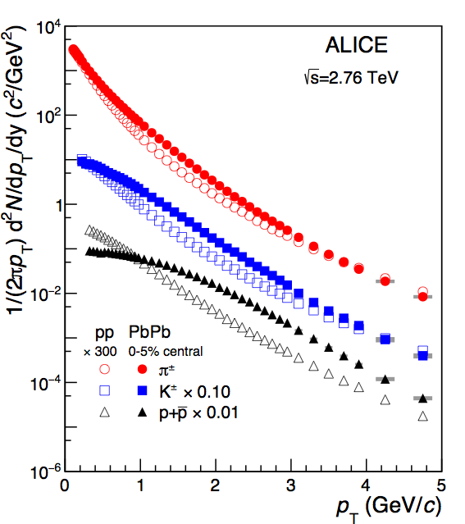
Radial and elliptic flow
ALICE, PLB 736, 196
Spectra change from pp to Pb+Pb:
Increase in mean pT
Larger effect for larger mass
First indication of collective behaviour Pressure leads to radial flow
Same Lorentz boost (β) gives larger momentum for heavier particles
(m_{p} > m_{K} > m_{π})

Slide 23
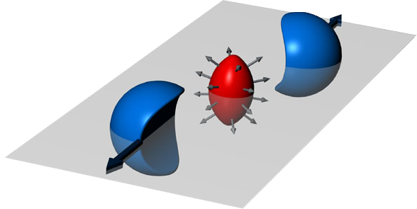
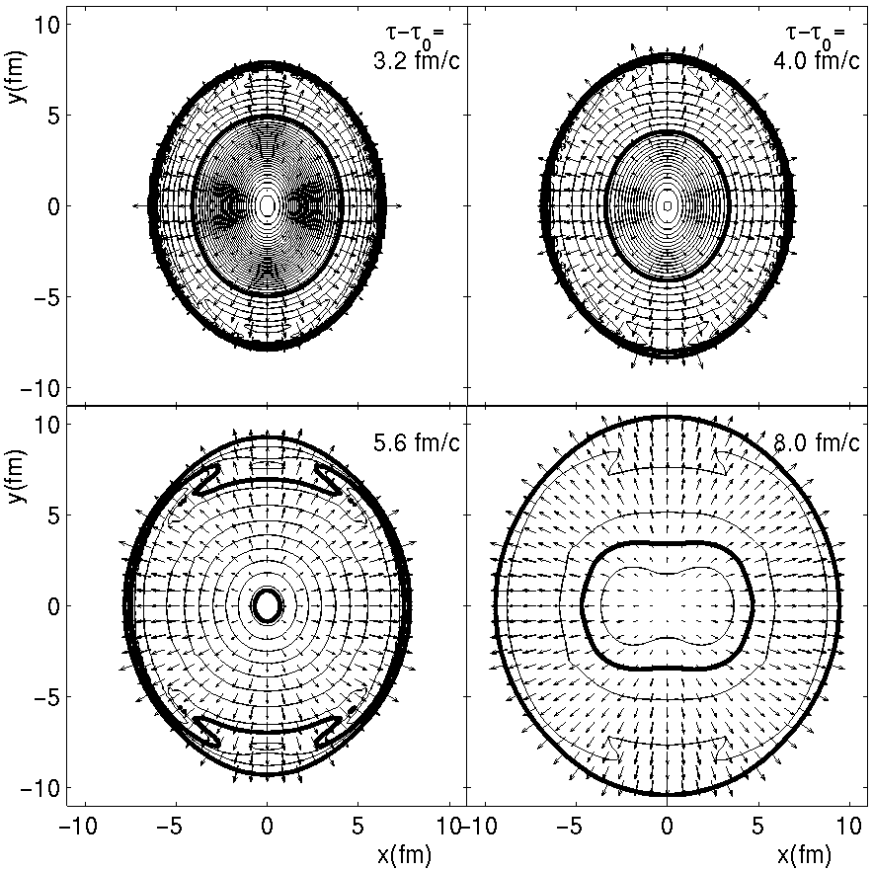
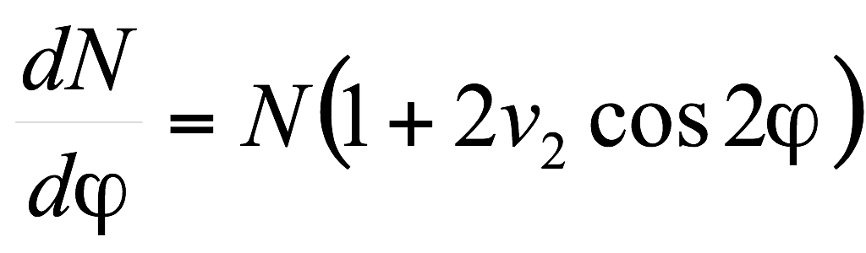
Elliptic flow
Hydrodynamical calculation
Reaction plane
Elliptic flow:
Yield modulation in-out reaction plane
ϕ
reaction
plane
Anisotropy reduces during evolution v₂ more sensitive to early times
b

Slide 24
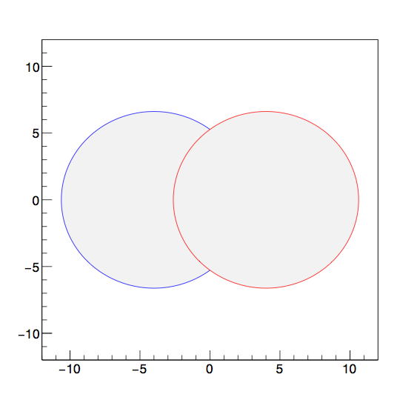
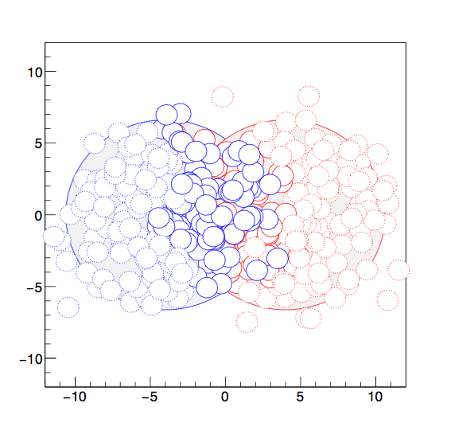
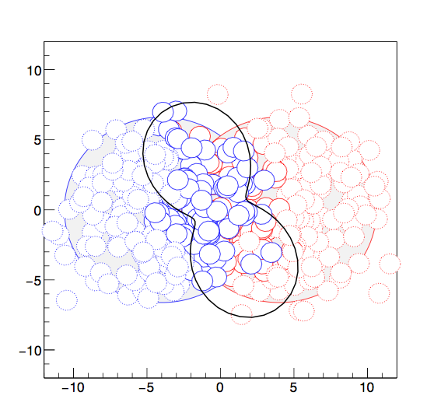
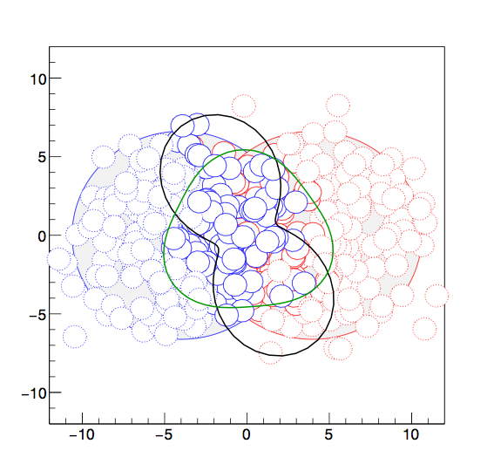
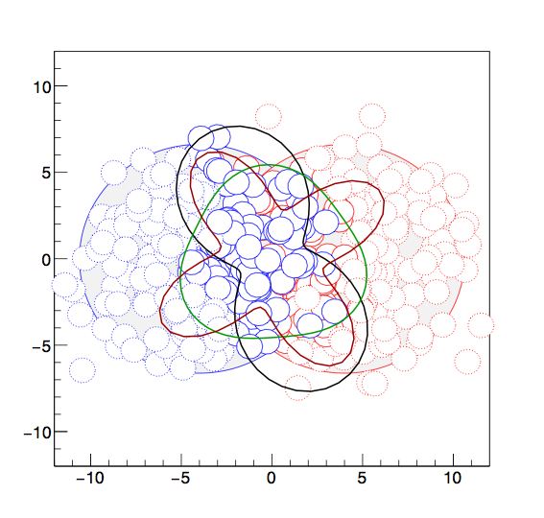
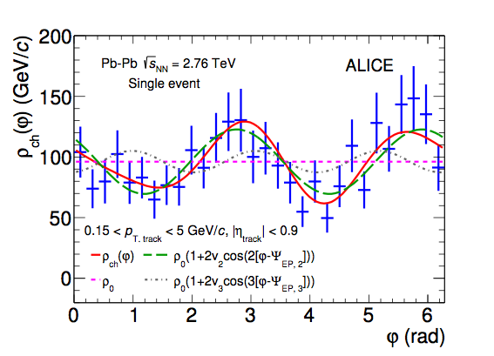
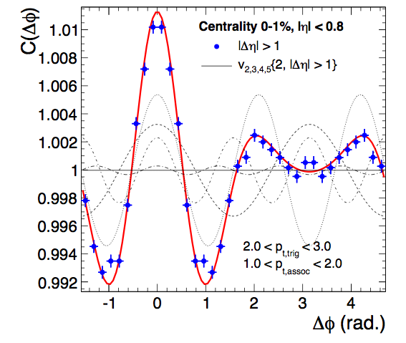
Azimuthal anisotropy: initial and final states
MC event: location of nucleons
Azimuthal distribution single event
ALICE, PLB 753, 511
Sum over many events
ALICE PRL. 107, 032301
Characterise shape by angular moments:
Initial state spatial anisotropies εn are transferred into final state momentum anisotropies vn by pressure gradients, flow of the Quark Gluon Plasma

Slide 25
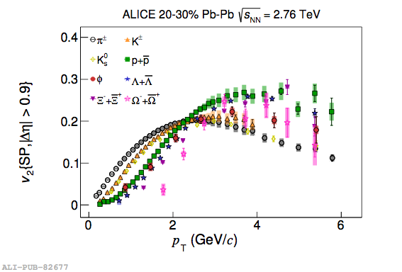
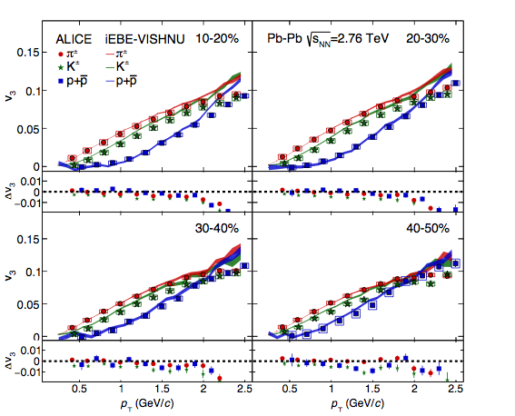

Anisotropic flow results
v3
JHEP106, 190
arXiv:1606.06057
v4
Mass-dependence of v₂ measures flow velocity
Tests hydrodynamical description, freeze-out models

Slide 26



Higher harmonics and viscosity
Schenke and Jeon, Phys.Rev.Lett.106:042301
In general: initial state may be ‘lumpy’
(not a smooth ellipse)
η/s = 0
η/s = 0.16
How much of this is visible in the final state, depends on shear viscosity η

Slide 27

Global fit: input
J. E. Bernhard et al, arXiv: 1605.03954
Input: yields, mean pT and harmonic flow vs pT

Slide 28

Global fit of initial state+hydrodynamics
J. E. Bernhard et al, arXiv: 1605.03954
εn : initial spatial anisotropies from initial state model
vn : observed final state momentum anisotropy
Response: modeled by hydrodynamic evolution
Total 9 parameters:
3 initial state ⟹ εn
4 QGP ⟹ response
2 model parameters

Slide 29


A global fit to anisotropic flow: main results
J. E. Bernhard et al, arXiv: 1605.03954
viscosity of the QGP
εn : initial spatial anisotropies from initial state model
vn : observed final state momentum anisotropy
Response: modeled by hydrodynamic evolution
Total 9 parameters:
3 initial state ⟹ εn
4 QGP ⟹ response
2 model parameters
Fit constrains initial state geometry and transport properties at the same time
Viscosity close to lower bound
Multiplicity production model

Slide 30







Viscosity
Viscous liquid dissipate energy
For a dilute gas:
Liquid
gas
η increases with T
Liquid, densely packed, so:
Viscosity minimal at liquid-gas transition
E_{vac}: activation energy for jumps of vacancies
η decreases with T
QGP viscosity lower than any atomic matter

Slide 31
Hints of collective effects in p+p, p+Pb

Slide 32


Strangeness production in pp, p+Pb
pT spectra in multiplicity-selected pp collisions
particle yields in multiplicity bins
ALICE, arXiv:1606.07424, arXiv:1307.6796, arXiv:1512.07227
Fraction of strange hadrons increases with multiplicity
Large effect for multi-strange Ξ and Ω
Mean pT increases with multiplicity
Similar enhancement in PbPb has been interpreted as thermalisation; global equilibration of the strangeness yield. Are they related?

Slide 33


Mean pT overview pp
QM15 talk, L Bianchi
Mean pT in pp collisions also increases with multiplicity and particle mass
Multiple (initial state) interactions
or proto-flow?
Or are they the same?
Logarithmic fit ‘to guide the eye’:

Slide 34

Mean pT overview pp, p+Pb, Pb+Pb
QM15 talk, A Ortiz
Increasing mean pT trend continues in p+Pb
Raises question: is there flow, collective behaviour in pp, p+Pb?
And how is it generated?

Slide 35


2-particle correlations
trigger
Near side
associated
PLB 708, 249
Intermediate pT
High pT
Pb+Pb
Near-side peak: jets (+decays): larger at high pT
Flow v2, v3: long range correlation (early times+ long expansion)
Near side long range correlation: flow (v2, v3)
Most prominent at lower pT
Away-side: recoil jet also gives a long-range correlation (η1 ≠ η2)

Slide 36



pp and Pb+Pb
Central Pb+Pb
p+p low multiplicity
p+p high multiplicity
CMS, arXiv:1201.3158
Ntrk < 35
Ntrk > 110
1 < pT < 3 GeV
CMS, PLB 718, 795
Near-side long range correlation: indicates early time origin
Seen in high-multiplicity pp and p+Pb events

Slide 37



Two-particle correlations
ATLAS-CONF-2016-026
High-multiplicity p+p
High-multiplicity p+Pb
2 < |Δη| < 5
Clear change in shape from low multiplicity to high multiplicity: no near-side peak in low multiplicity events
Away-side also affected: well described by dipole term (cos (2 Δ𝜑))
Smooth evolution from pp to p+Pb: effect stronger in p+Pb

Slide 38


More on p+Pb
Multiplicity vs η
1.0 < pT < 2.0 GeV/c
2.0 < |Δη| < 4.9
LHCb, arXiv:1512.00439
LHCb Pb+p
LHCb
p+Pb
Near-side ridge identical for forward and backward trigger particles
p+Pb is an asymmetric system

Slide 39

v2 from di-hadron correlations in p+Pb
PLB 726,164
Similar ‘mass ordering’ observed for v2 from two-particle correlations in p+Pb
Is this also pressure-driven?

Slide 40

Multi-particle correlations: testing collectivity
pp
p+Pb
Pb+Pb
CMS-HIN-16-010, arXiv:1606.06198
Multi-particle methods suppress few-particle (non-flow) correlations
Flow-like effect is indeed a multi-particle effect

Slide 41


Changing the projectile
B Schenke
v2 and v3 from ³He+Au
Sizable v3 contribution seen with ³He
RHIC has collided a variety of small nuclei with Au to explore geometric effects
³He gives explicit triangular contribution in initial state
Effect is driven by initial spatial configuration

Slide 42



Flow in small systems: comparisons to hydro
Many aspects of the observed ridge have a natural explanation in hydrodynamics:
Long range correlation
2- and 3-fold symmetries
Dependence on initial geometry
Particle mass dependence
Kozlov et al, Nucl. Phys. A931 (2014)
Why would the system behave as a fluid?
Is there enough time, volume to thermalise?
Hydrodynamisation (isotropisation) of a dense gluon system?
Partonic/hadronic rescattering?
How many scatterings/what density is needed to approximate fluid behaviour?
Many recent developments; active discussion on interpretation
Romatschke, EPJC75, 305
2016 p+Pb run to shed more light on this

Slide 43


Spectra at intermediate p_{T}
Schukraft et al, arXiv:1202.3233
Low-intermediate p_{T} (1-6 GeV): Large baryon/meson ratio
Radial flow and/or hadronisation through parton recombination

Slide 44

Hadronisation by recombination
‘Shower-thermal’ recombination
Fries, Muller et al
Hwa, Yang et al
fragmenting parton:
p_{h} = z p, z<1
Baryon p_{T}=3p_{T,parton}
Meson p_{T}=2p_{T,parton}
recombining partons:
p₁+p₂=p_{h}
Hot matter
Hard parton
(Hwa, Yang)
Recombination of thermal (‘bulk’) partons produces baryons at larger p_{T}
Expect large baryon/meson ratio
associated with high-p_{T} trigger
Meson p_{T}=2p_{T,parton}
Baryon p_{T}=3p_{T,parton}
Hot matter

Slide 45

Di-hadrons: p/π in jets
associated
Δϕ
trigger
5 < p_{T}^{trig} < 10 GeV
Jet peak
Background/Bulk region
(v₂, v₃ peak here)
Use TOF+dE/dx to identify particles

Slide 46


p/π bulk vs jets
p/π ratio in Bulk region agrees with inclusive
M. Veldhoen, HP
p/π ratio in jet* agrees with Pythia
*after background subtraction
No effect of shower-thermal recombination and/or modified color flow observed

Slide 47
Summary so far
Heavy ion collisions: study properties of QCD matter
Soft particle production: thermodynamical description of system: yields, spectra, flow
Quark Gluon Plasma has a very small viscosity ⇔ strong interactions
New observables may better constrain temperature dependence, bulk viscosity
Signs of collective effects also seen in pp, p+Pb collisions
Raises questions about microscopic mechanism; (no) limits to thermal description?

Slide 48
Thank you for your attention!

Slide 49

Hadron Gas Model
Yields set by: T, V, conserved charges

Slide 50
Heavy ion collisions
Heavy-ion collisions produce ‘quasi-thermal’ QCD matter
Dominated by soft partons p ~ T ~ 100-300 MeV
‘Bulk observables’
Study hadrons produced by the QGP
Typically p_{T} < 1-2 GeV
Physical model/picture: hydrodynamical flow, thermodynamics
‘Hard probes’
Hard-scatterings produce ‘quasi-free’ partons
⇒ Probe medium through energy loss
p_{T} > 5 GeV
Physical model/picture: hard scattering+parton energy loss
Two basic approaches to learn about the QGP
Bulk observables
Hard probes

Slide 51
Intro: collision systems
Canonical thinking
‘Recent’ developments
pp
Observation:
Flow-like long range correlations
Hard scattering +
‘Underlying event’
p
p
Suggested mechanisms:
Multi-parton interactions
Color reconnection
p+Pb
Pb
Observation:
Flow-like long range correlations
p
pp-like plus Cold Nuclear Matter effects
Multi-parton interactions
Color reconnection
Color Glass Condensate
Pb+Pb
Pb
Bulk dynamics described by hydrodynamics
+ Hard Probes
Pb
Physical picture holds
But some features also seen in high-multiplicity p+Pb and pp?

Slide 52
PbPb ridge at LHC
CMS, PbPb √s = 2.76 TeV
1.0 < pT,assoc < 1.5 GeV
3.0 < pT,trig < 3.5 GeV
CMS, arXiv:1201.3158
Away-side jet peak (ridge)
Broad structure on away side
Near-side jet peak
Δφ,Δη
‘near side ridge’
Very long range correlation: Δη ~ 4

Slide 53


How does flow enter in Δ𝝋 distributions?
Azimuthal distribution, single event
Pair distribution
Event plane angle changes from event to event Ψ2 and Ψ3 mostly independent
Pair distribution peaks around Δ𝝋 = 0, π, 2π for v2
Δ𝝋 = 0, 2/3 π, 4/3 π for v3

Slide 54

Side note: folding the 𝝋1-𝝋2 plane
Folded pair distribution
Pair distribution
Pair distribution peaks around Δ𝝋 = 0, π for v2
Δ𝝋 = 0, 2/3 π, 4/3 π for v3
Folding: Δ𝝋 = π, -π are equivalent
Same data, more compact presentation

Slide 55






More examples
𝝋
Δ𝝋

Slide 56
General QCD references
Particle Data Group topical reviews http://pdg.lbl.gov/2004/reviews/contents_sports.html
QCD and jets: CTEQ web page and summer school lectures http://www.phys.psu.edu/~cteq/
Handbook of Perturbative QCD, Rev. Mod. Phys. 67, 157–248 (1995) http://www.phys.psu.edu/~cteq/handbook/v1.1/handbook.ps.gz
Gauge Theories in Particle Physics (Vol II: QCD), I.J.R. Aitchison, A.J.G. Hey
QCD and Collider Physics, R. K. Ellis, W. J. Sterling, D.R. Webber, Cambridge University Press (1996)
An Introduction to Quantum Field Theory, M. Peskin and D. Schroeder, Addison Wesley (1995)
Introduction to High Energy Physics, D. E. Perkins, Cambridge University Press, Fourth Edition (2000)

Slide 57
Heavy Ion references
RHIC overviews: P. Jacobs and X. N. Wang, Prog. Part. Nucl. Phys. 54, 443 (2005) B. Mueller and J. Nagle, Ann. Rev. Nucl. Part. Sci. 56, 93 (2006)
Jet quenching reviews: M. Spousta, arXiv:1305.6400
J. Caselderrey-Solana and C. Salgado, arXiv:0712.3443 U. Wiedemann, arXiv:0908.2306 A. Majumder and M. v. L. arXiv:1002.2206 Accardi, Arleo et al, arXiv:0907.3534
RHIC experimental white papers BRAHMS: nucl-ex/0410020 PHENIX: nucl-ex/0410003 PHOBOS: nucl-ex/0410022 STAR: nucl-ex/0501009

Slide 58



Di-hadron correlations and flow at low pT
Low pT <~ 3 GeV: di-hadron correlations dominated by flow
ALICE, PRL 107, 032301
Important contributions from v3, v4
Alver and Roland, PRC81, 054905
Also NB: v1 can mimick jet (near or away-side)

Slide 59


2-particle correlations in p+Pb
Pb+Pb
ALICE, PLB 719, 29
Peripheral p+Pb
Central p+Pb
Near-side long range correlation in central p+Pb
Must be early-time; looks like elliptic flow

Slide 60



Extracting the double-ridge/flow
Central - Peripheral = Double ridge
ALICE, arXiv:1212.2001
Hypothesis: associated jet yields (recoil) are the same in central and peripheral p+Pb
Use peripheral to subtract jet contribution from central

Slide 61

Intro: LHC and ALICE
LHC, Geneva
ALICE: general purpose detector
2010-2013: Run 1
pp @ 7, 8 TeV
p+Pb @ 5.02 TeV
Pb+Pb @ 2.76 TeV
Focus on
Tracking in high-multiplicity events
Particle identification
Forward muon detector for quarkonia
Run 2 started 2015
pp @ 13 TeV
Pb+Pb @ 5.02 TeV
p+Pb @ 8 TeV in 2016 or 2018

Slide 62


Change of color flow may also affect hydrochemistry
Sapeta, Wiedemann, arXiv:0707.3494
(also: Milhano, Caselderrey-Solana)

