Slide 1


Slide 2







Quite a few physicists I know from Münster now work in a bank or consulting firm
5 in 2000/2001
Merger 01.08.2016
And indeed, there is something to
do in a bank for a physicist ....
…

Slide 3


What do physicists do in finance?
Portfolio manager
  How to make people rich (or how to make
  other people believe you can make them rich)?
  How to select an appropriate risk-return profile?
Product designer (quant)
  How to price derivatives (e.g. options for risk protection) ?
  How to create risk (leverage, „ financial weapons of mass destruction“*)?
Risk controller
  How to model and price risk?
  How to make sure that banks can bear their own risks?
  How to communicate the limitations of models?
bank regulation:
1996 market risk, 1999 credit risk
*Warren Buffet

Slide 4
What do physicists do in finance?
Portfolio manager
  How to make people rich (or how to make
  other people believe you can make them rich)?
  How to select an appropriate risk-return profile?
Product designer (quant)
  How to price derivatives (e.g. options for risk protection) ?
  How to create risk (leverage, „ financial weapons of mass destruction“)?
Risk controller
  How to model and price risk?
  How to make sure that banks can bear their own risks?
  How to communicate the limitations of models?

Slide 5

Efficient markets
Efficient market hypothesis: assets prices fully reflect all available information.
Therefore it is impossible to „beat the market“ (e.g. by looking for specific patterns in stock quotes using chart analysis)
See for example Malkiels* blindfolded monkey selecting stocks (and being at least as successful as many professional portfolio managers)
Non efficient markets:
insider information, front running, high-frequency trading.
Creating efficient markets using
mechanism design by game theory,
* B.G. Malkiel , “A Random Walk Down Wall Street” , 1973

Slide 6

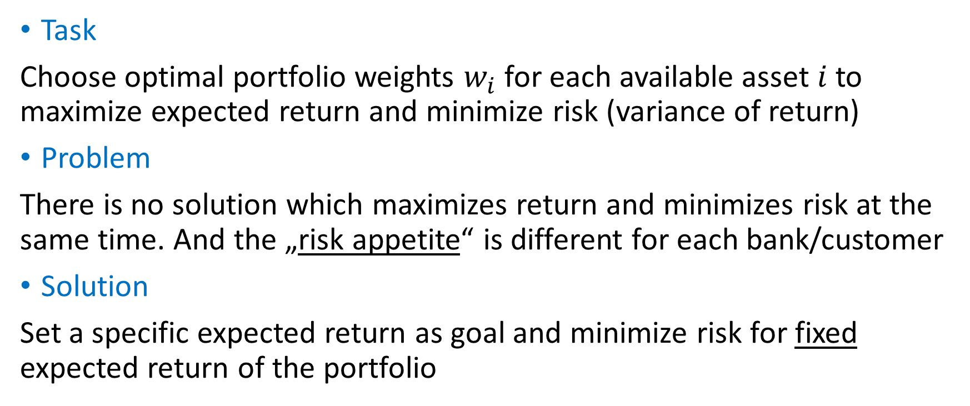
Balancing risk and return
Portfolio Optimization (Markowitz )
NP 1990
Task
Choose optimal portfolio weights $w_{i}$ for each available asset $i$ to maximize expected return and minimize risk (variance of return)
Problem
There is no solution which maximizes return and minimizes risk at the same time. And the „risk appetite“ is different for each bank/customer
Solution
Set a specific expected return as goal and minimize risk for fixed expected return of the portfolio
1952

Slide 7
Portfolio optimization
Risk minimization under constraints
Covariance matrix of all assets returns
(to be measured empirically)
Risk of portfolio return
using variance as risk measure
Lagrange parameters to fix constraints
on initial wealth and expected return
$R\left(w\right)=\frac{1}{2}w^{T}Cw−λw1−νwr⟶$ minimize w.r.t. w
Vector of portfolio weights
of single assets (to be optimized)
Vector of expected return of single assets
(to be measured empirically)

Slide 8
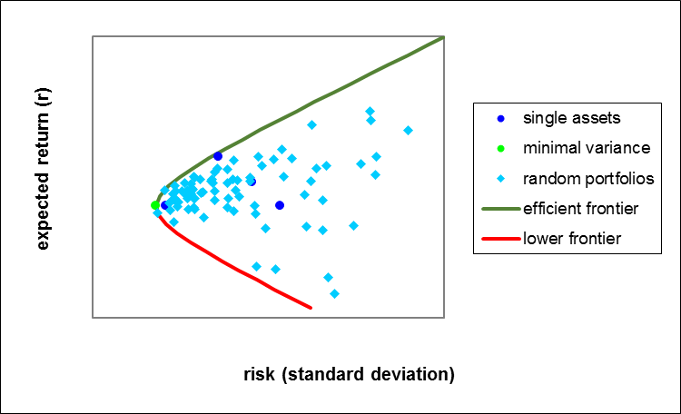
Result: Efficient portfolios
Note: The optimal portfolios are better than any single asset (diversification)

Slide 9
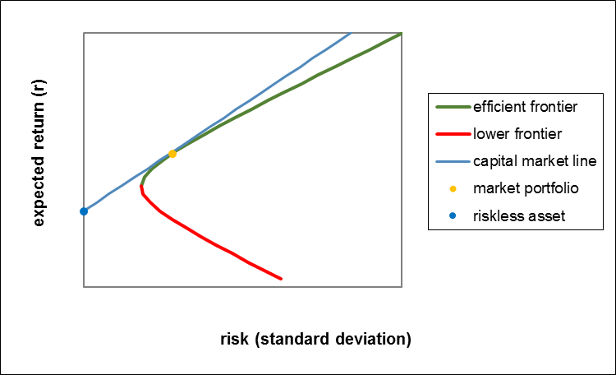
Capital market line mixture with riskless asset (e.g. government bond?)
One can easily show,
that the combinations
of a risky portfolio with
an riskless asset lie on a
straight line.
The efficient frontier with
a riskless asset is also
called capital market line.
tangency point
Tobin separation: Experts (Banks, Funds) provide the risky (tangency) market portfolio,
customer selects her portfolio on the capital market line according to her risk appetite (risk bearing capacity)

Slide 10
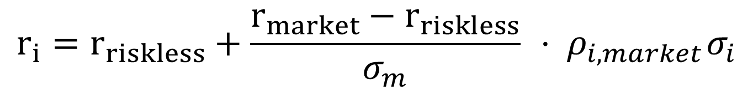
Capital asset pricing model
Risk-return relation for a single asset
$$r_{i}=r_{riskless}+\frac{r_{market}−r_{riskless}}{σ_{m}}{ ⋅ ρ}_{i,market}σ_{i}$$
market price per risk unit
systematic risk
Note: You get paid only for risk correlated with the market („systematic risk“)
because the uncorrelated risk („idiosyncratic risk“) can be diversified away.
… and systematic risk depends on all assets in the market portfolio
Nice theory, but in this strict form not empirically verified!

Slide 11
Some practical problems to be solved by a portfolio manager
You need to estimate the expected return and the covariance matrix which is typically a huge object, so random fluctuations result in very unstable and non-optimal portfolios („fitting the noise“)
fluctuations can be analyzed using random matrix theory
estimates must be stabilized, e.g. by shrinkage methods or bootstrapping
more realistic constraints for short selling lead to spin glas like problems
prediction problem: estimating from past data may not be representative for the future
variance is not a good risk measure, especially for non-symmetric distributions (value at risk, coherent risk measure expected shortfall)

Slide 12
What do physicists do in finance?
Portfolio manager
  How to make people rich (or how to make
  other people believe you can make them rich)?
  How to select an appropriate risk-return profile?
Product designer (quant)
  How to price derivatives (e.g. options for risk protection) ?
  How to create risk (leverage, „ financial weapons of mass destruction“)?
Risk controller
  How to model and price risk?
  How to make sure that banks can bear their own risks?
  How to communicate the limitations of models?

Slide 13

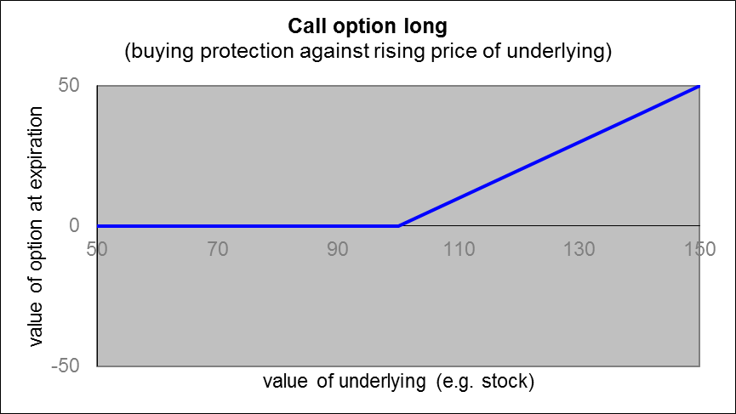
Option pricing (Black, Scholes, Merton )
NP 1997
1973
Definition: A call option is the right (not obligation) to buy an underlying (e.g. a stock)
at expiration time at a fixed price (the strike price)
Analogously a put option
offers protection against
falling prices of the underlying
option is worthless (but
premium has to be paid)
value of option is rising
with price of underlying
strike price
at K = 100
The price of an option is derived from the underlying, so it is an example of a „derivative contract“,
… but what is the fair price of an option before expiration? What do we need to know about the underlying?

Slide 14
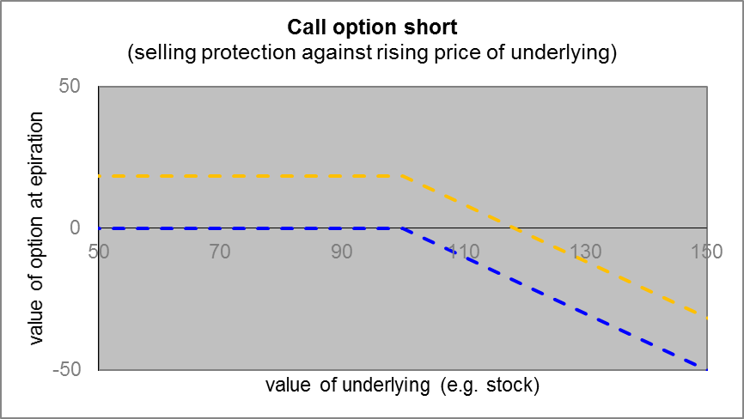
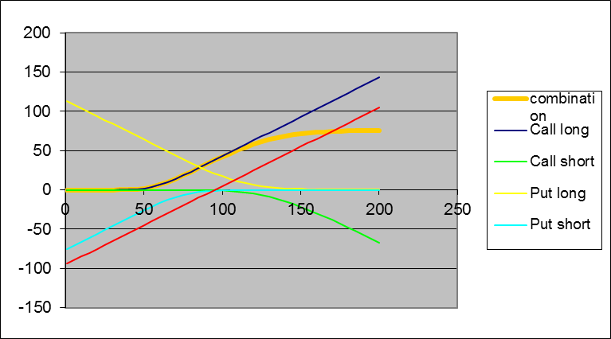

Option pricing (short position, selling protection)
no loss on option
(but premium is received)
loss on option is rising
with price of underlying
premium
(to be calculated)
options can be arbitrarily combined
strike price
at K = 100
High leverage of possible gains or losses with respect to premium:
you can lose the complete premium and even more !

Slide 15
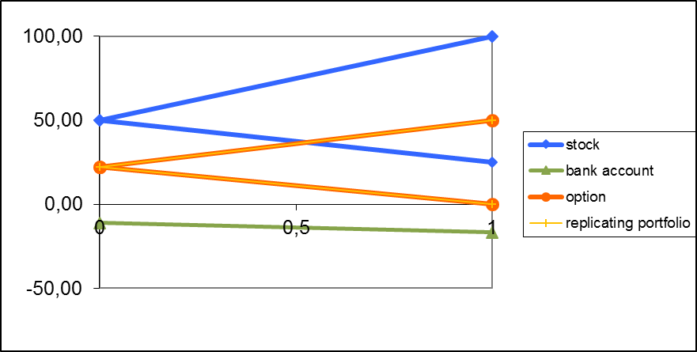
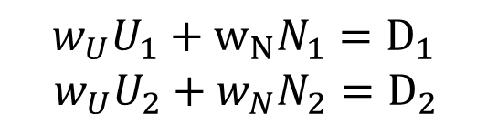

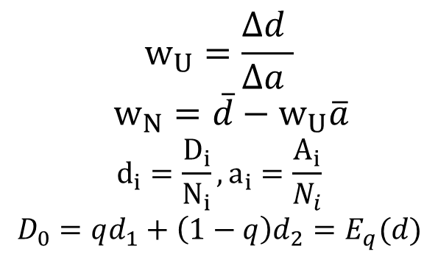
Replication of a derivative (e.g. call option) through a portfolio consisting of a certain amount of the underlying (e.g. stock) and of a numeraire (e.g. money on a bank account) in a simple binomial model of the stock prize
solve for the two future states
$$w_{U}U_{1}+w_{N}N_{1}=D_{1}$$
${ w}_{U}U_{2}+w_{N}N_{2}=D_{2}$
Up
solution: replicating portfolio
Down
$$w_{U}=\frac{Δd }{Δa }$$
$$w_{N}=\overline{d}−w_{U}\overline{a}$$
$$d_{i}=\frac{D_{i}}{N_{i}},a_{i}=\frac{A_{i}}{N_{i}}$$
$$D_{0}=qd_{1}+\left(1−q\right)d_{2}=E_{q}(d)$$
time 0
time 1
with risk neutral probability
… must be equal-valued today
(„no arbitrage principle“)
Two portfolios being equal -valued
in all possible future states …
$$q=\frac{a_{0}−a_{2}}{Δa}$$

Slide 16
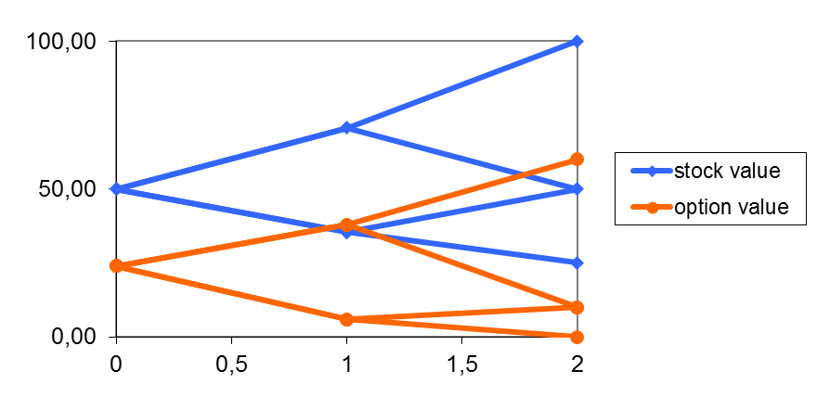
… iterating the model and taking the limit
Iterating the binomial model
define a limit to a log-normal distribution (Gaussian process)
to get the celebrated Black-Scholes-Merton equation.
No free lunch: continuous rebalancing (hedging) required
Analogously:
Solving stochastic (Ito) differential equations
or partial differential equations.
See for example the probably most read paper
in quantitative finance:
John C. Cox, Stephen Ross, Mark Rubinstein:
Option Pricing: A Simplified Approach.
In: Journal of Financial Economics. Nr. 7, 1979, S. 229–263.

Slide 17
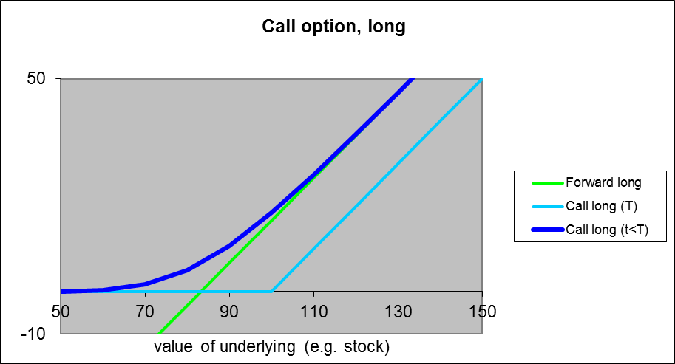
Black-Scholes-Merton equation
Interest rate effect:
You have to wait until expiration
to get the value of the option
Volatility effect:
You don‘t yet know the
value of the underlying
at expiration
interest rate
effect
volatility effect
strike price
at K = 100
Note: It is often somewhat easier to price a derivative given the price of the underlying than it is to predict the price of the underlying. Use information in prices as much as possible and do not try to make unnessesary predictions yourself.

Slide 18
Stages in the life of the theory of option pricing
Before the rise of the theory:
Prices have not been very consistent with the theory
Heyday:
Markets adapt to theory (e.g. allowing short selling), prices are relatively consistent with theory, deviations (e.g. non constant volatilities) are traded away
After the first big crisis (Scholes, Merton with LTCM in 1998):
Option prices deviate from classical theory,
the market trades deviations from theory („implied volatilities“)
Option price theory was very successful and had a lot of influence on the markets
See, for example, D. MacKenzie, F. Muniesa, L. Siu, „DoEconomists Make Markets?“, 2007

Slide 19
Some practical problems
stock prices are not log-normally distributed (but have „longer tails“)
volatility is not constant
there exist some very complex derivatives (path-dependent options, credit derivatives, similar securitizations,…) which are difficult to price
There are not enough instruments for replication (non complete markets)
interest rate is stochastic
transaction costs exists
short selling is restricted
there is counterparty (credit) risk
. …

Slide 20
What do Physicists do in Finance?
Portfolio manager
  How to make people rich (or how to make
  other people believe you can make them rich)?
  How to select an appropriate risk-return profile?
Product designer (quant)
  How to price options (price for protection against risks) ?
  How to create risk (leverage, „ financial weapons of mass destruction“)?
Risk controller
  How to model and price risk?
  How to make sure that banks can bear their own risks?
  How to communicate the limitations of models?

Slide 21
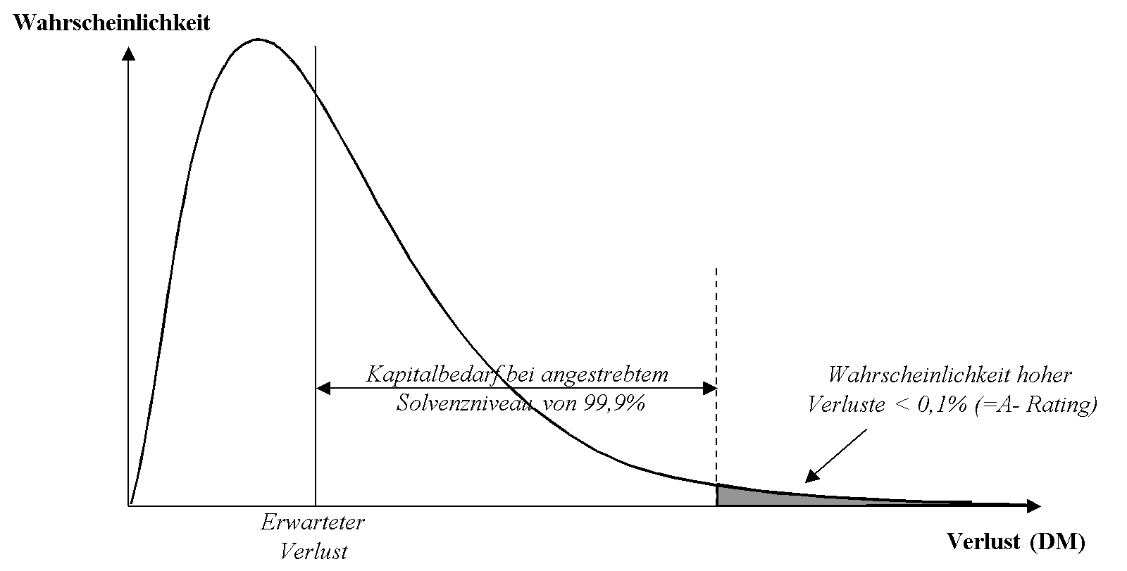
Loss distribution, „value at risk“ and equity capital
loss distribution (market and credit risk)
to be estimated by risk controlling
„value at risk“
(necessary risk capital)
expected loss
„unexpected loss“

Slide 22
Example: Credit risk
Definition of default according to CRR:
Collecting data
‘REGULATION (EU) No 575/2013 OF THE EUROPEAN PARLIAMENT AND OF THE COUNCIL of 26 June 2013
on prudential requirements for credit institutions and investment firms and amending Regulation
(EU) No 648/2012
Article 178
Default of an obligor
1. A default shall be considered to have occurred with regard
to a particular obligor when either or both of the following
have taken place:
(a) the institution considers that the obligor is unlikely to pay
its credit obligations to the institution, the parent undertaking
or any of its subsidiaries in full, without recourse by
the institution to actions such as realising security;
…
collect training data, consisting of
A. default data of customers and
B. risk drivers of customers (e.g. financial ratios from balance sheet)

Slide 23
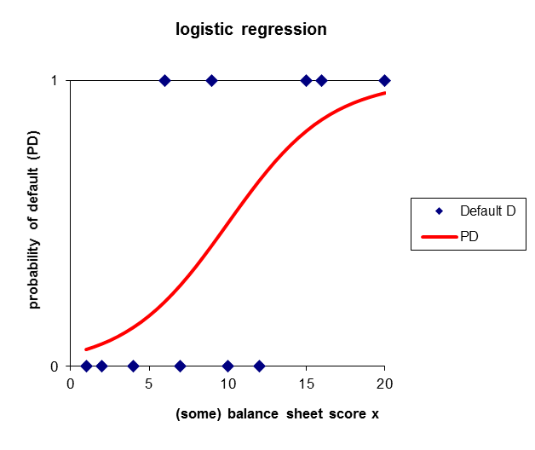

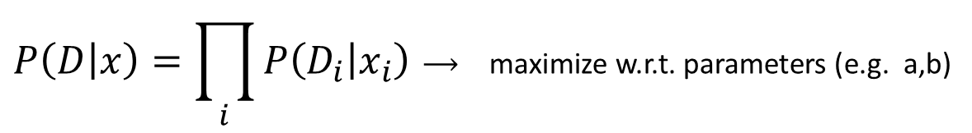
Select a model: logistic regression
$$P\left(D_{i}=1 | x_{i}\right)=f(x_{i};a,b,…)$$
$$=\frac{1}{1+e^{−a−bx_{i}}}$$
$$=\frac{e^{a+bx_{i}}}{1+e^{a+bx_{i}}}$$
$$=\frac{e^{−E(x_{i})}}{Z}$$
energy or error
and
partition sum
(cf. Ising model)
Fix parameters a,b by
maximizing the (log)likelihood
$$P\left(D | x\right)=\prod_{i}{P\left(D_{i} | x_{i}\right)}⟶ \text{maximiz}\text{e} \text{w}\text{.}\text{r}\text{.}\text{t}\text{. }\text{parameters}\text{ (}\text{e}\text{.}\text{g}\text{. }\text{a}\text{,}\text{b}\text{)}$$

Slide 24
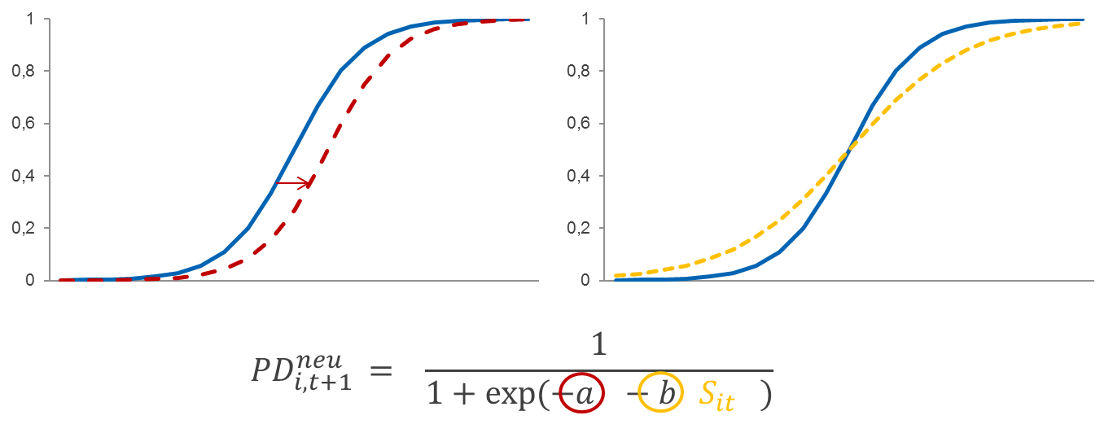
Estimation of probability of default (PD)
!
2. Define model space
and its parameters
3. Define target function
(or equivalent loss function)
collect training data, consisting of A. default data of customers and
B. risk drivers of customers (e.g. financial ratios from balance sheet)

Slide 25
Interlude: Some basics of prediction
Now let‘s fit a model to the data points to predict future outcomes

Slide 26
Fitting a simple mean

Slide 27
Fitting more and more flexible models
Is a linear regression better than taking just the mean?
It is at least more flexible and the likelihood must be larger, or at least equal.

Slide 28
Fitting more and more flexible models
We can even do better!
Note: Having a flexible enough model, data points can be fit arbitrarily well!
But is a flexible model a good predictor?

Slide 29
Prediction with flexible models
Slight change of
single data point
… no, too flexible models are not good predictors!

Slide 30
Cross-validation
1. Divide available data in (e.g. 10) groups
1
2
3
4
5
6
7
8
9
10
2. Use each group once to estimate the prediction error, use others for training
Training
1.
Test
Training
2.
Test
.
.
.
.
.
.
Cross-validation (or bootstrapping)
can be used for (low dimensional)
model selection, for higher
dimensional problems
regularization or Bayesian
methods have to be used.
Training
10.
Test

Slide 31
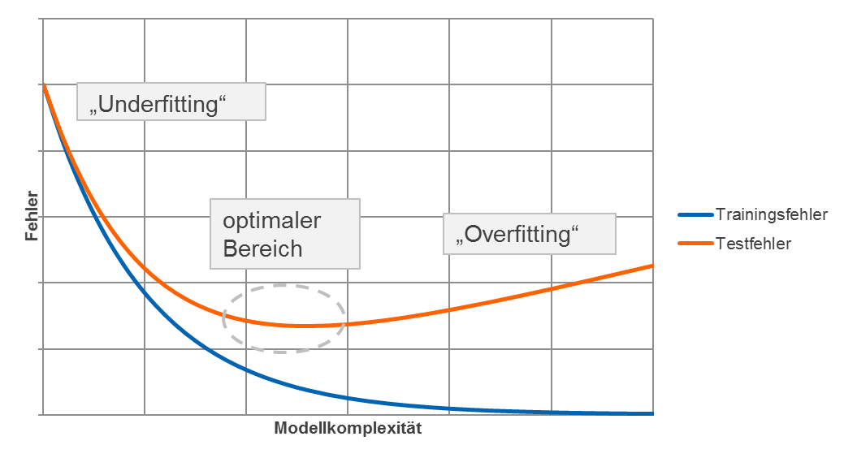
Overfitting

Slide 32
A stresstesting example
Kalib. ext. Rating
mit/ohne Makrov.
Bedingte PD-Modelle
bzw. quadr. Zeitabh.
länderspezifische
Modelle
Nur Mittelwert
Variablen:
S1 = aktueller Score
M0 = aktuelles M
M1 = zukünftiges M
Y = Jahr
F(LG) = 3 Länderguppen als Faktor
F(L) = jedes Land als Faktor
Trainingsfehler:
Deviance= -2 Loglikelihood
Approximativer Testfehler:
AIC = Akaike Informationskriterium
Komplexität:
df = Modellfreiheitsgrade
Modelle: Binomial GLM mit Logit-Link
Analoges GAM-Modell mit Splines S(S1), S(M1)
bzw. mit Tensorsplines TE(S1,M1)

Slide 33
Reducing risk by diversification in a portfolio?
Having estimated the credit risk for a single customer,
we have to analyze the risk in a credit portfolio.
And this is very difficult, because we have to deal
with correlations or even more general dependencies.
The problem is, that uncorrelated risk
can be diversified away,
but not correlated risks.
Example:
Correlation is introduced by
a macroeconomic risk driver
(e.g. gross domestic product)
which influences the PDs
of all customers.
good macroeconomic conditions
bad macroeconomic conditions

Slide 34


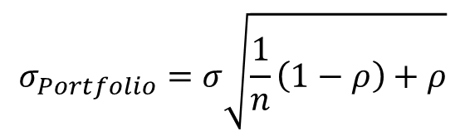
It‘s all about correlation
Stand. dev. for homogeneous portfolio
$$σ_{Portfolio}=σ\sqrt{\frac{1}{n}\left(1−ρ\right)+ρ}$$
P
asymptotically vanishing risk
with increasing number of credits
$$σ_{Portfolio}=σ\sqrt{\frac{1}{n}}→0$$
independent
credits
V
good
$$σ_{Portfolio}→σ\sqrt{ρ}$$
no asymptotically vanishing risk
with increasing numer of credits!
P
bad
dependent
credits
loss
this asymptotically remaining risk is potentially
dangerous and in the focus of the regulators

Slide 35
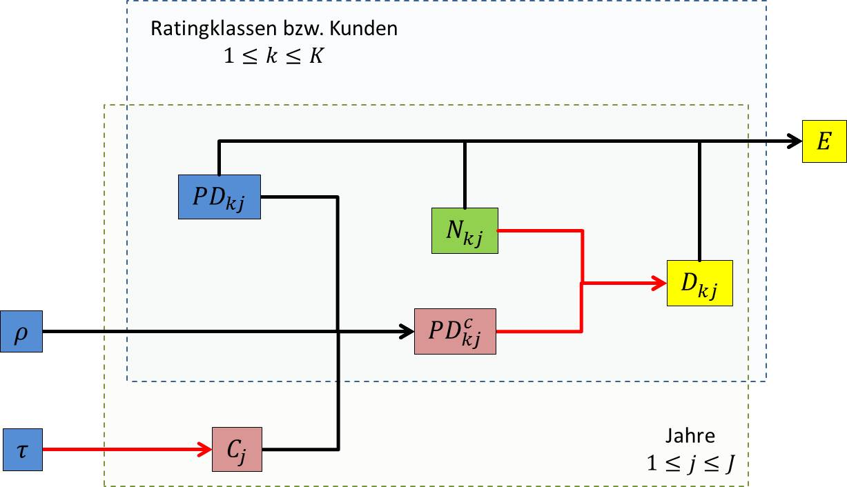
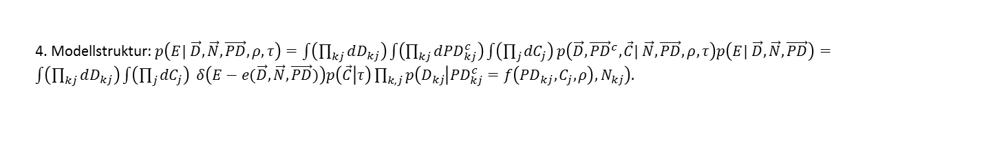
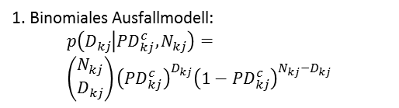
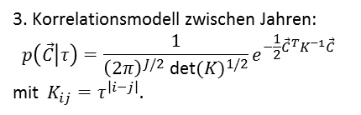
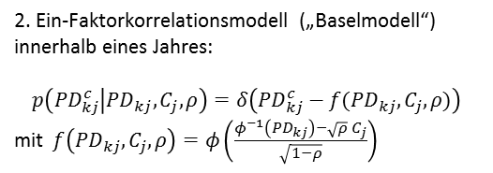
A correlation model for credit risk
1. Binomiales Ausfallmodell:
$$p\left(D_{kj} | {PD}_{kj}^{c},N_{kj}\right)= \\ \left(\begin{matrix}N_{kj} \\ D_{kj}\end{matrix}\right){\left({PD}_{kj}^{c}\right)}^{D_{kj}}{\left(1−{PD}_{kj}^{c}\right)}^{{N_{kj}−D}_{kj}}$$
2. Ein-Faktorkorrelationsmodell („Baselmodell“)
innerhalb eines Jahres:
$$p\left({PD}_{kj}^{c} | {PD}_{kj},C_{j},ρ\right)=δ\left({PD}_{kj}^{c}−f({PD}_{kj},C_{j},ρ)\right)$$
mit $f\left({PD}_{kj},C_{j},ρ\right)=φ\left(\frac{φ^{−1}\left({PD}_{kj}\right)−\sqrt{ρ}{ C}_{j}}{\sqrt{1−ρ}}\right)$
3. Korrelationsmodell zwischen Jahren:
$$p\left(\vec{C} | τ\right)=\frac{1}{{\left(2π\right)}^{J/2}{ \text{det}⁡(K)}^{1/2}}e^{−\frac{1}{2}{{\vec{C}}^{T}K}^{−1}\vec{C}}$$
mit $K_{ij}=τ^{\left|i−j\right|}.$
4. Modellstruktur: $p\left(E| \vec{D},\vec{N},\vec{PD},ρ,τ\right)=\int{\left(\prod_{kj}{dD_{kj}}\right)}\int{\left(\prod_{kj}{d{PD}_{kj}^{c}}\right)}\int{\left(\prod_{j}{{dC}_{j}}\right)}p\left(\vec{D},{\vec{PD}}^{c},\vec{C}| \vec{N},\vec{PD},ρ,τ\right)p\left(E| \vec{D},\vec{N},\vec{PD}\right)=\int{\left(\prod_{kj}{dD_{kj}}\right)}\int{\left(\prod_{j}{{dC}_{j}}\right)} δ\left(E−e(\vec{D},\vec{N},\vec{PD})\right)p\left(\vec{C} | τ\right)\prod_{k,j}{p\left(D_{kj} | {PD}_{kj}^{c}=f\left({PD}_{kj},C_{j},ρ\right),N_{kj}\right).}$

Slide 36
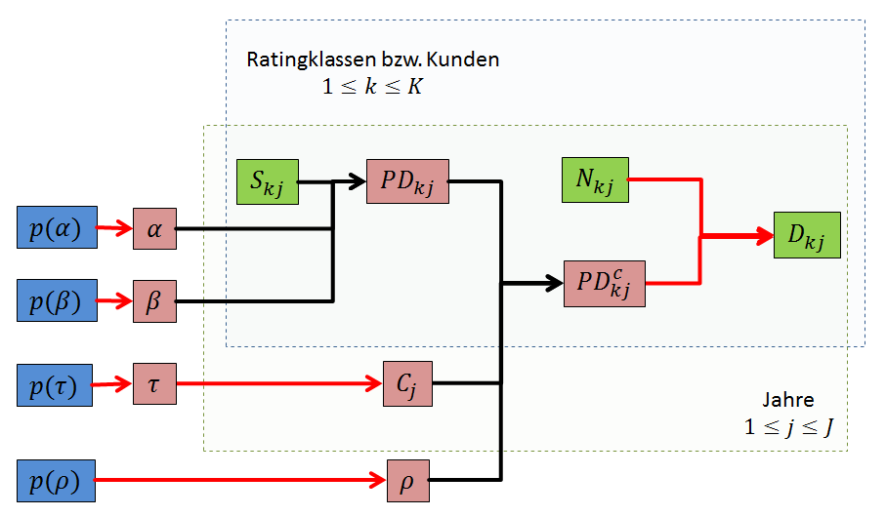
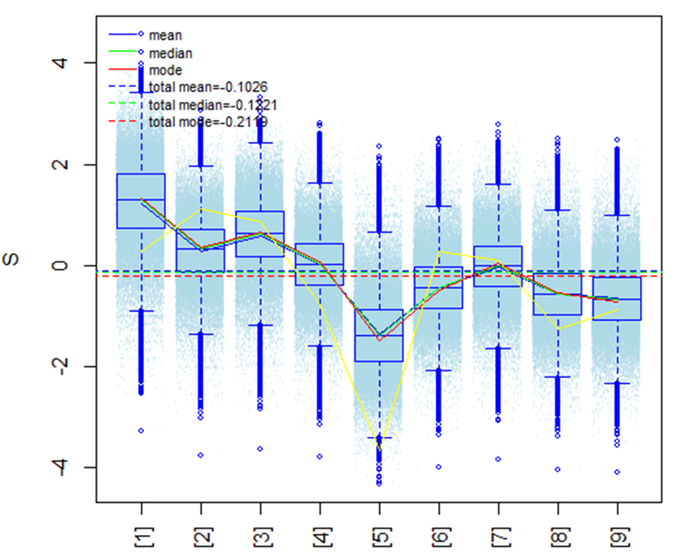
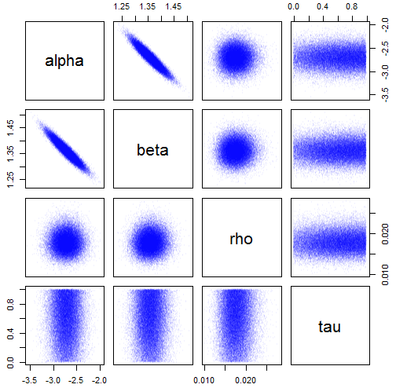
  Example: estimation of implicit
  macroeconomic conditions by Bayesian Monte Carlo
(2/2)
Modell alpha, beta, (PDmax), rho, tau
Implizite „Konjunktur“ im Ob. Mittelstand
Parameterabhängigkeiten
Die Kalibrierungsparameter
passen gut zur Kalibrierung!
Die Kalibrierungs-
parameter sind
unabhängig von
der Korrelation!
Bei kleiner Asset-
korrelation (rho)
ist die zeitliche
Abhängigkeit (tau)
kaum bestimmt
und noch stark
von der uniformen
Prior-Verteilung
abhängig.
Die implizite Konjunktur passt relativ gut zur
tatsächlichen Konjunktur (BIP,gelb, s z.B. 2009).
Die Asset-korrelation
ist sehr klein!

Slide 37
… and finally
Why are physicists welcomed at banks?
  Because they know mathematics
  because they know that models are only models
  because they know how to work with computers, and especially
  because they know how to do numerics (Monte Carlo methods, numerical solution of pde‘s,…)
What do physicists have to learn?
  Getting used to large, structured databases (normalization, SQL)
  applied statistics
  and a bit of economics, bank regulation, reading a balance sheet …

Slide 38



…and last but not least, physicists know how to use knot theorie to tie a tie …
Kontakt: joerg.lemm@dzbank.de

