Slide 1


Hadron collider phenomenology
Anna Kulesza
Research Training Group 2149 Retreat, Telgte, 24-26.11.2015

Slide 2
Current members
AK
PhD students
  Christoph Borschensky
  (till March 2016)
  Oleh Fedkevych
  Daniel Schwartländer
Master students
  Raphael Heger
  Cesar Tejera Centeno
Bachelor students
  NN

Slide 3
Current members
Past members
AK
PhD students
  Christoph Borschensky
  (till March 2016)
  Oleh Fedkevych
  Daniel Schwartländer
Master students
  Raphael Heger
  Cesar Tejera Centeno
Bachelor students
  NN
PhD students
  Vincent Theeuwes (2012-2015)
  ➔ SUNY Buffalo, USA
Master students
  Patrick Hammers (2014)
  ➔ Univ. of Southampton, UK
Bachelor students
  Saskia Schmiemann (2013)
  ➔ WWU Münster
  Kevin Max (2014)
  ➔ Univ. of Heildelberg
  Simon May (2015)
  ➔ WWU / Univ. of Lund

Slide 4
Current members
Past members
AK
PhD students
  Christoph Borschensky
  (till March 2016)
  Oleh Fedkevych
  Daniel Schwartländer
Master students
  Raphael Heger
  Cesar Tejera Centeno
Bachelor students
  NN
PhD students
  Vincent Theeuwes (2012-2015)
  ➔ SUNY Buffalo, USA
Master students
  Patrick Hammers (2014)
  ➔ Univ. of Southampton, UK
Bachelor students
  Saskia Schmiemann (2013)
  ➔ WWU Münster
  Kevin Max (2014)
  ➔ Univ. of Heildelberg
  Simon May (2015)
  ➔ WWU / Univ. of Lund
RTG members/
associated members

Slide 5
Hadron collider phenomenology
Precision predictions for signal and background
processes at the LHC
SUSY
Higgs
EW gauge bosons
Multiple interactions
  Higher-order corrections in perturbation theory
    EW
    QCD (in particular, resummation)

Slide 6
SUSY production at the LHC
MSSM:
minimal content of SUSY particles + R-parity
NLO SUSY-QCD
Hadron colliders: coloured sparticles most copiously produced
  High rates for pair-production of squarks and gluinos
Key discovery processes in SUSY searches

Slide 7
Towards higher orders in SUSY-QCD
Large masses of SUSY particles ⇒ production close to threshold
General structure of the NLO correction in the threshold limit
Large corrections in the limit of threshold production
At higher orders and structures
Both types of corrections can be resummed to all orders
Soft/collinear gluon emission
Coulomb gluons
for coloured final states

Slide 8
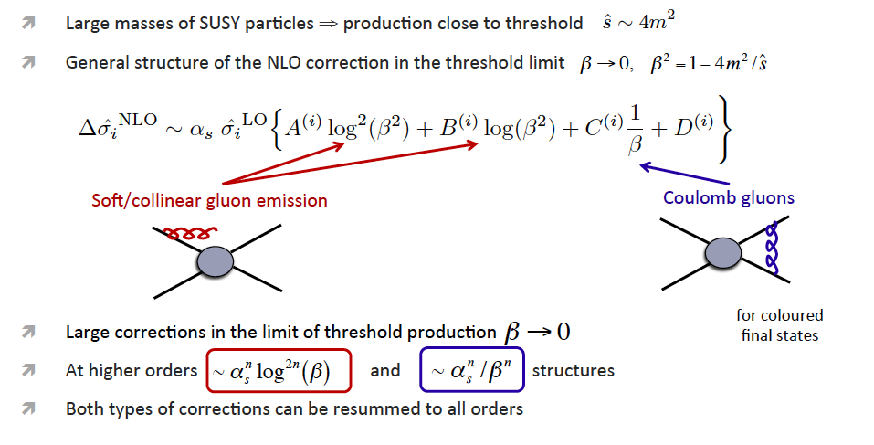
Towards higher orders in SUSY-QCD

Slide 9
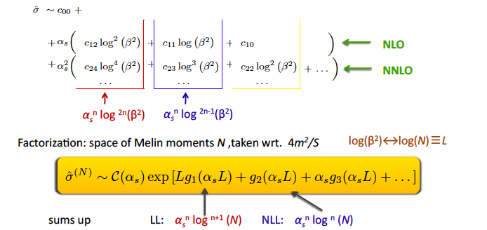
Soft gluon resummation
Systematic reorganization of perturbative series

Slide 10
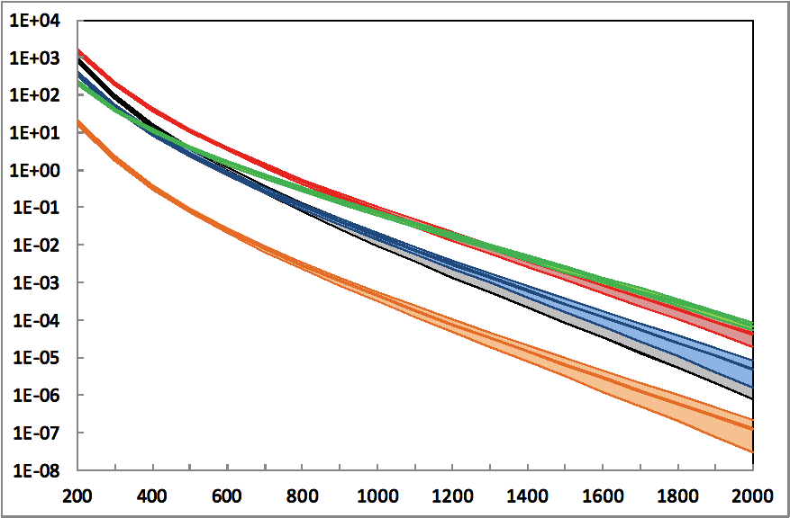
Resummation for squarks and gluinos
full theory error:
scale variation, pdf and α_{s} uncertainty
Numerical tool: NLL-fast
@7, 8, 13 , 33 and 100 TeV
AK and L. Motyka, Phys. Rev. Lett. 102, 111802 (2009); AK and L. Motyka, Phys. Rev. D 80 (2009) 095004; W. Beenakker, S. Brensing, M. Krämer, AK, E. Laenen and I. Niessen, JHEP 12 (2009) 041; W. Beenakker, S. Brensing, M. Krämer, AK, E. Laenen and I. Niessen, JHEP 08 (2010) 098; W. Beenakker, S. Brensing, M. Krämer, AK, E. Laenen, L.Motyka and I. Niessen, IJMP A26 (2011) 2637; Krämer, AK, van der Leeuw, Mangano, Padhi, Plehn, Portell’12; Borschensky, Krämer, AK, Mangano, Padhi, Plehn, Portell’14; Beenakker, Borschensky, Krämer, AK, Laenen, Marzani, Rojo’15

Slide 11
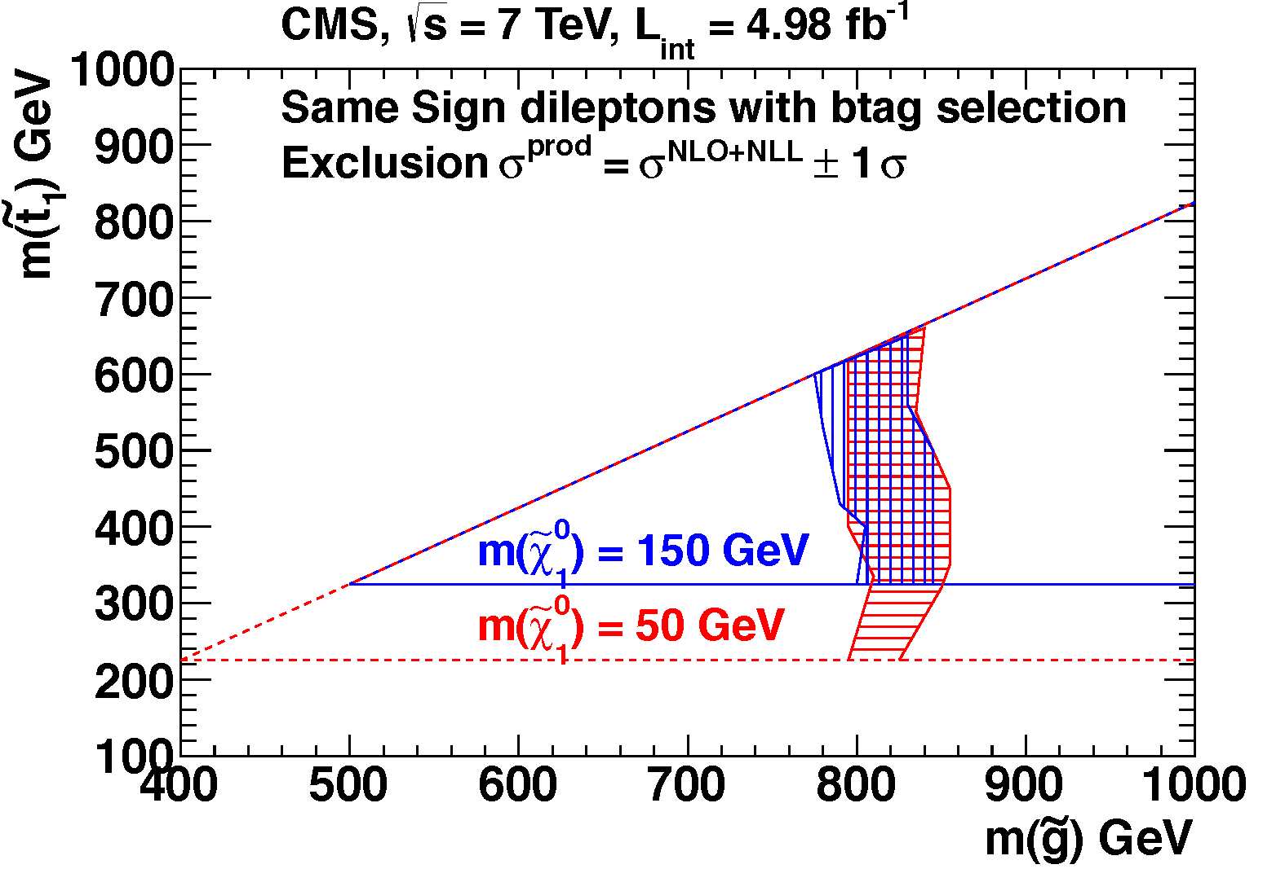
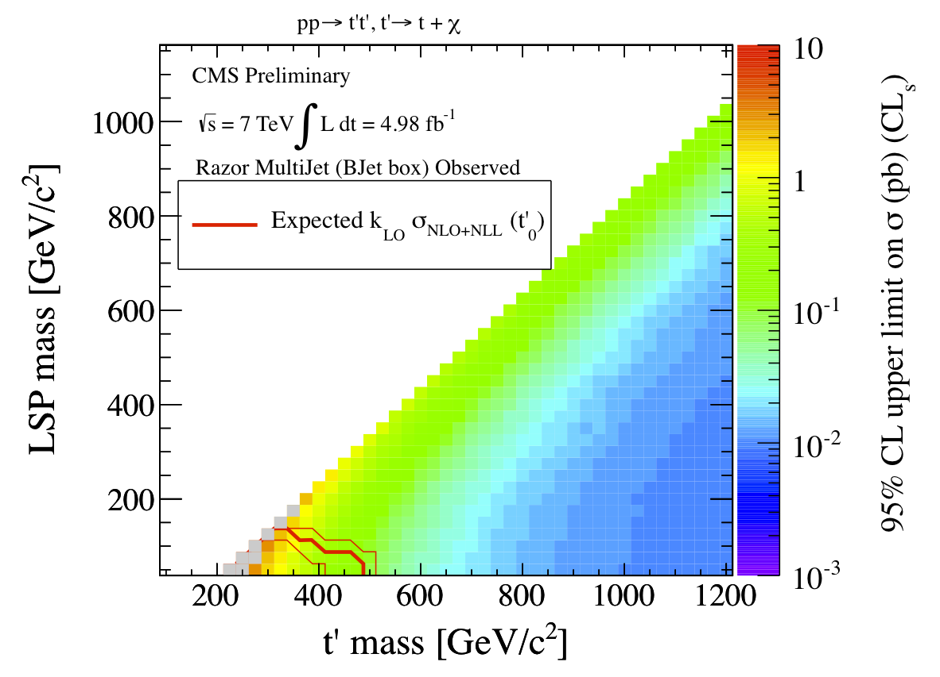
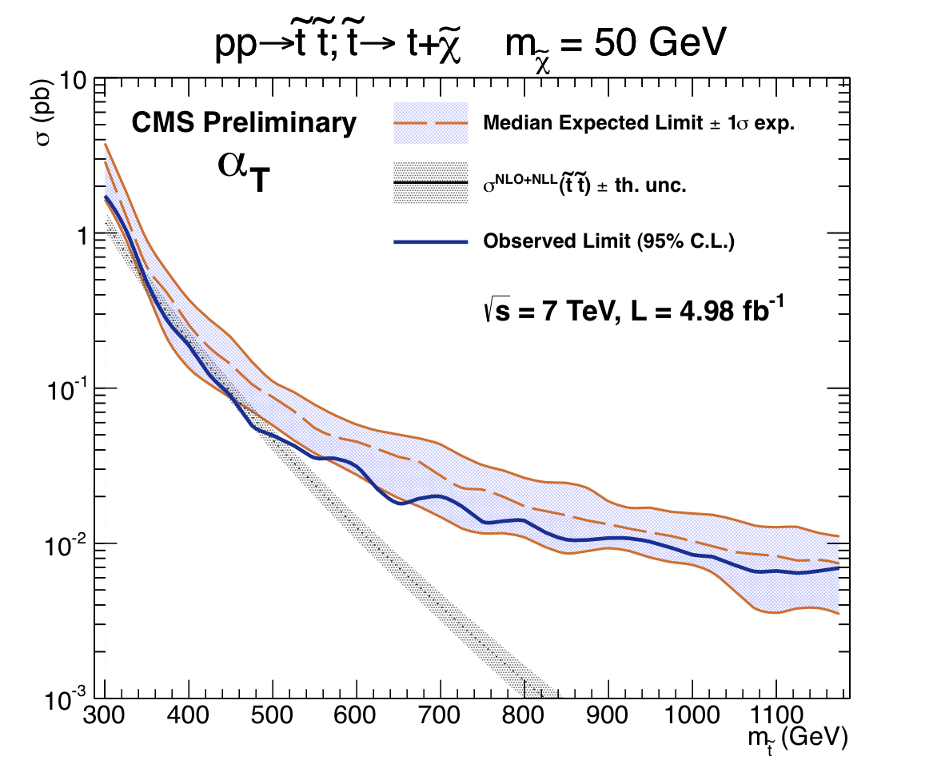
NLL-Fast in action

Slide 12
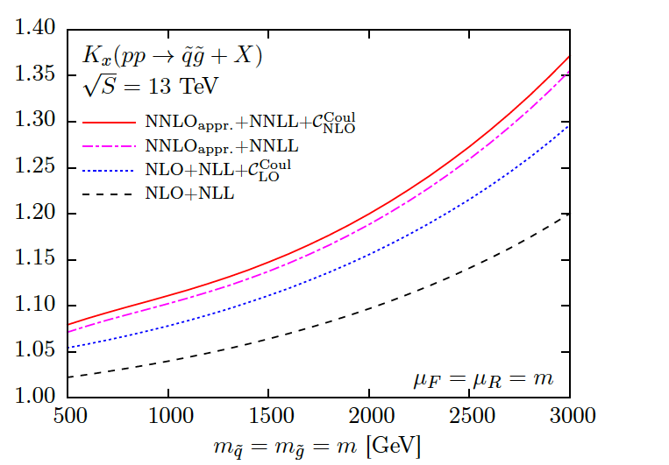
NNLL predictions for SUSY production at LHC Run 2
NNLO_{approx.}+NNLL for the four processes of squark and gluino production⟶ soft gluon resummation, O(α_{s}²) Coulomb and O(α_{s}) hard-matching coefficients [Beenakker, Janssen, Krämer, AK, Laenen, Lepoeter, Niessen, Thewes, Van Daal’13] [Beenakker, Borschensky, Krämer, AK, Laenen, Thewes, Theeuwes’14]
Significant increase of the total cross section for all four processes of squark and gluino production
Reduction of the theoretical error due to scale dependence for almost all processes
NNLL resummation for total cross sections in direct QCD (Mellin space) now also includes Coulomb resummation: public numerical code soon!
[Beenakker, Borschensky, Krämer, AK, Laenen, in preparation]
[Beenakker, Borschensky, Heger, Krämer, AK, Laenen, in preparation]

Slide 13
A word on Higgs
Resummation methods can be also applied to total and differential cross sections for various process of Higgs boson production
  gluon-gluon fusion [AK, Stirling’03][AK, Laenen, Vogelsang’03]
  Higgs Strahlung [Harlander, AK, Theeuwes, Zirke’14]
So far, resummation techniques developed only for 2→1 and 2→2 processes
Final states with more than 2 particles very important at the LHC, e.g.
As the NNLO calculations for 2→3 not yet achievable, resummation can provide information on the impact of higher order corrections
Requires new theoretical developments!

Slide 14
A word on Higgs
Resummation methods can be also applied to total and differential cross sections for various process of Higgs boson production
  gluon-gluon fusion [AK, Stirling’03][AK, Laenen, Vogelsang’03]
  Higgs Strahlung [Harlander, AK, Theeuwes, Zirke’14]
So far, resummation techniques developed only for 2→1 and 2→2 processes
Final states with more than 2 particles very important at the LHC, e.g.
As the NNLO calculations for 2→3 not yet achievable, resummation can provide information on the impact of higher order corrections
Requires new theoretical developments!
[AK, Motyka, Stebel, Theeuwes’15]
Only NLL +NLO predictions for the total cross section so far
Formalism for calculations of differential distributions has to be developed
Formalism applicable to other processes

Slide 15
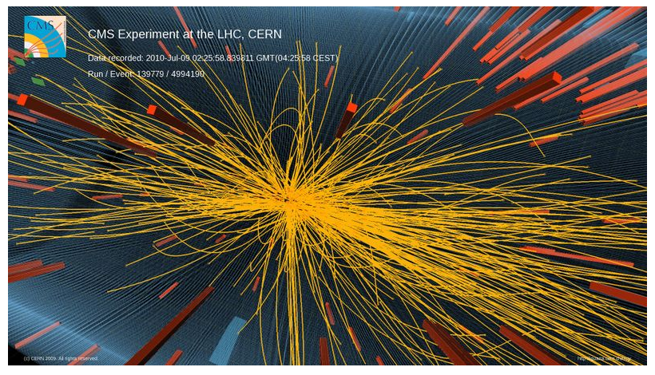
What are multiple interactions ?
LHC reality: high multiplicities

Slide 16
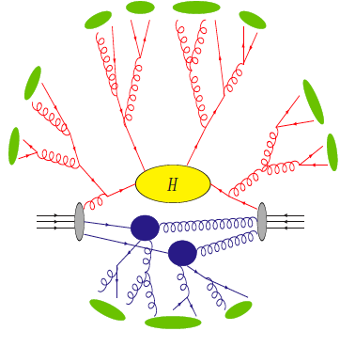
What are multiple interactions ?
Hadronization
Radiation
Hard event
Multiple parton interactions
(picture by Z. Nagy)

Slide 17
Multiple parton scattering
Flux of incoming partons grows with collision energy
⇒ increased probability of having more than one parton-pair scattering
Multiplicity
p_{T}
Soft
Hard
Contribution to Underlying Event
Double Parton Scattering (DPS)
modeled by Monte Carlo codes

Slide 18
MPIs at the LHC
MPIs provide information on matter distribution in hadrons and the correlations between partons
Irreducible background to measurements at the LHC (jets and missing E_{T} !!!)
Theoretical tool: DPS ➔need to find a good exp. testing ground for theory
  Many processes investigated: same–sign W pairs, double Drell-Yan, ..
  One example: double J/psi production
[ Gaunt, Kom, AK, Stirling’10][Kom, AK, Stirling’11]

Slide 19
MPIs at the LHC
MPIs provide information on matter distribution in hadrons and the correlations between partons
Irreducible background to measurements at the LHC (jets and missing E_{T} !!!)
Theoretical tool: DPS ➔need to find a good exp. testing ground for theory
  Many processes investigated: same–sign W pairs, double Drell-Yan, ..
  One example: double J/psi production
[ Gaunt, Kom, AK, Stirling’10][Kom, AK, Stirling’11]
[Kom, AK, Stirling, PRL 107 (2011) 082002]

Slide 20
MPIs at the LHC
MPIs provide information on matter distribution in hadrons and the correlations between partons
Irreducible background to measurements at the LHC (jets and missing E_{T} !!!)
Theoretical tool: DPS ➔need to find a good exp. testing ground for theory
  Many processes investigated: same–sign W pairs, double Drell-Yan, ..
  One example: double J/psi production
[ Gaunt, Kom, AK, Stirling’10][Kom, AK, Stirling’11]
Proposed measurements performed by LHCb, CMS and ATLAS
Updated theory predictions to appear soon
Predictions obtained assuming factorization between longitudinal and transverse components of double PDFs
RTG project: use additional information from pA collisions to disentagle these correlations (ALICE)
[Kom, AK, Stirling, PRL 107 (2011) 082002]

Slide 21
Hadron collider phenomenology
Precision predictions for signal and background
SUSY
Higgs
EW gauge bosons
Multiple interactions
  Higher-order corrections in perturbation theory
    EW
    QCD (in particular, resummation)

