Slide 1
Gender Equality Measures in RTG 2149
Best practice examples from WWU & Physics
Cornelia Denz, Sybille Niemeier
GRK 2149 Annual Retreat 2015
November 24th and 25th 2015

Slide 2
> Requirements from DFG – the Gender equality viewpoint
  German Rector’s conference 2006
    > Insufficient participation by women compromises efficiency and excellence in academia. The innovative potential of science and research can be fully leveraged only if outstanding talents, regardless of gender, work in large numbers in science and academia and do not drift off into other occupational areas even as they approach their peak performance. Men and women must be given equal opportunity to participate in all levels of scientific inquiry.
  German research society 2009
    > A successful strategy for gender equality delivers significant added value. Gender equality enhances research quality because it enlarges the talent pool, promotes a diversity of research perspectives, and eliminates blind spots regarding the significance of gender in research contents and methods. Thus the inclusion of relevant gender and diversity aspects is a key ingredient of high-quality research.
    > Programs, Measures, and support in RTGs, SFBs, …

Slide 3
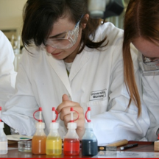
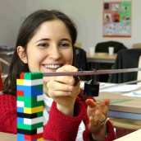
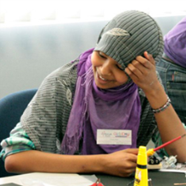
> Contents
• DFG and WWU
Gender equality standards
• Examples of measures at faculty of physics
From fostering interest to mentoring and coaching
• Example TRR61
Activities in a large DFG project
Notes:
Die WWU unterscheidet in ihrer Gleichstellungspolitik zwischen Gender Mainstreaming auf Organisationsebene und klassischer Gleichstellungspolitik zur Herstellung von Chancengleichheit auf personeller Ebene. Im Sinne des Gender Mainstreaming-Ansatzes ist die Genderperspektive durchgängig in alle Strukturen und Prozesse der Universität integriert. Die konkrete Durchsetzung der Gleichstellung von Frauen und Männern findet entlang definierter Kriterien und Ziele auf allen Entscheidungsebenen und in allen Statusgruppen Berücksichtigung (vgl. u.a. das Genderkonzept der WWU und die Frauenförderpläne der Fachbereiche). Sichtbarer Unterrepräsentanz wird durch gezielte Fördermaßnahmen begegnet.
Die Selbstverpflichtung der WWU zu Gender Equality ist im Leitbild der WWU transparent festgeschrieben. Auch im Rahmen des 2009 abgeschlossenen universitätsinternen Strategieentwicklungsprozesses hat das Rektorat Gender Mainstreaming und gezielte Frauenförderpolitik als wichtige Kriterien für die Hochschulentwicklung anerkannt.

Slide 4
> WWU activities – one of DFG’s best
  The principles of WWU gender strategy
    > Gender equality in Mission and Central Goals (“Leitbild”) of WWU
    > Gender mainstreaming = Gender perspective in all structures and processes
    > and gender equality = equal number, participation and opportunities
  Examples for activities
    > Career support (cascade principle to
    foster women’s participation)
    Individual coaching, programs
    Erstklassig!, Frauen managen Hochschule
    > Equality program: funding for projects,
    faculties with females underrepresented
    > Service Family and Child Care Support:
    KiTa Zauberschloss, placements in KiTa
    > Dual Career support
Notes:
Die WWU unterscheidet in ihrer Gleichstellungspolitik zwischen Gender Mainstreaming auf Organisationsebene und klassischer Gleichstellungspolitik zur Herstellung von Chancengleichheit auf personeller Ebene. Im Sinne des Gender Mainstreaming-Ansatzes ist die Genderperspektive durchgängig in alle Strukturen und Prozesse der Universität integriert. Die konkrete Durchsetzung der Gleichstellung von Frauen und Männern findet entlang definierter Kriterien und Ziele auf allen Entscheidungsebenen und in allen Statusgruppen Berücksichtigung (vgl. u.a. das Genderkonzept der WWU und die Frauenförderpläne der Fachbereiche). Sichtbarer Unterrepräsentanz wird durch gezielte Fördermaßnahmen begegnet.
Die Selbstverpflichtung der WWU zu Gender Equality ist im Leitbild der WWU transparent festgeschrieben. Auch im Rahmen des 2009 abgeschlossenen universitätsinternen Strategieentwicklungsprozesses hat das Rektorat Gender Mainstreaming und gezielte Frauenförderpolitik als wichtige Kriterien für die Hochschulentwicklung anerkannt.

Slide 5

> Faculty of Physics – Gender equality structure and programs
  • Gender equality structures
  > Gender equality commission: 2 Professors, 2 WiMi, 2 Students, 2 MTVs
  > Gender officer (Cornelia Denz)
  > Gender support office / school office (Sybille Niemeier)
  > Gender strategy (developed by faculty, with multitude of measures)
  • Gender equality strategy
  > Measures taken according to “Frauenförderplan”
  + Increase number of females (cascade model)
  + Support of students and career support: mentoring programs
  + Foster networking: gender equality meetings and events
  + Show examples: female physicists café (colloquium)
  + Increase interest of females in physics: Girl’s Day, Activities of pupil’s lab MEXlab,
  Long-term projects for Girls:
  Light up your Life, Girls Go 4 Green, Nano 4 your Life

Slide 6
> Examples for Activities for RTGs, SFBs, … in the frame of DFG gender
  • Evaluations: Situation of females in large consortia and projects
  > Experience: EU Evaluations, Evaluation “Photonics 4 Life”, Evaluation TRR61
  > Main outcomes (similar): females tend to leave, career options important, ….

Slide 7

> Examples for Activities for RTGs, SFBs, … in the frame of DFG gender
  • Setting rules and measures
  > Setting a mission for RTG similar to WWU, FB 11
  > Find out details: statistics and evaluation (survey!)
  > Defining a yearly program: with different
  elements for different target group
It‘s a must !!!
  • Defining individual females support programme
  > Examples for work-life balance: Child care, Lab aid, ---
  > Examples for career fostering: Conference support, stay abroad support, …
  > Examples for research support: Own lab money, ...
  !!! Obey DFG rules and existing WWU measures:
  not all nice ideas are gender equality or
  gender mainstreaming support !!!

Slide 8

> Examples for Activities for RTGs, SFBs, … in the frame of DFG gender
  • What DFG loves to see realized …
  • Meetings and Networking: Learning from examples
  > Yearly events for women in the field (e.g. SFB 858)
  > Example speakers at colloquia, retreats, …
  • Mentoring RTG female scientists
  > Setting a program together with WWU programs
  > Pillars of program (e.g. TRR61):
  + Workshops with experts on soft skills
  + Individual mentoring by female experts
  (outside RTG)
  + Mentoring at home by female experts
  (supervisor PhD)

Slide 9
  > Promotion of Female first-year Students in Physics and Chemistry
• Project “Nano4YourLife“ > Duration of 1 – 1½ years
• Participants from grammar schools and first-year students
> Overall concept: Learning experimentally (“Hands on”),
by examples (Women only tutors, mainly from TRR61),
getting extraordinary insights (No help, but VIP treatment)
> Foster interest, sustain interest, reduce breakup, recruite RTG youngsters
• Project pillars
> Explorative workshops (two per cycle) with experiments for all participants
> Lab or business workshops ( approx. 3-4 a year) in small groups
> Web community with journal about TRR61 research, a chat etc.
• First cycle: 57 participants > 44 grammar school students > 11 students
• Participation: partner schools, TRR61 labs, Research Institutions, Companies
• Opening on May, 16th 2014 with approx. 100 guests
• Explorative workshops • Lab workshops

Slide 10
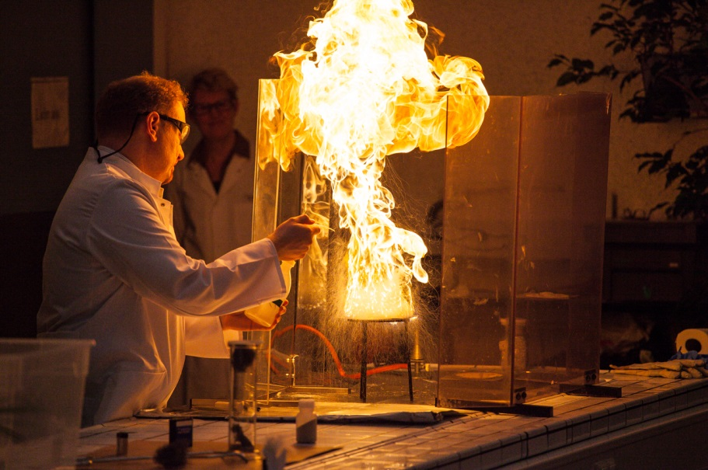
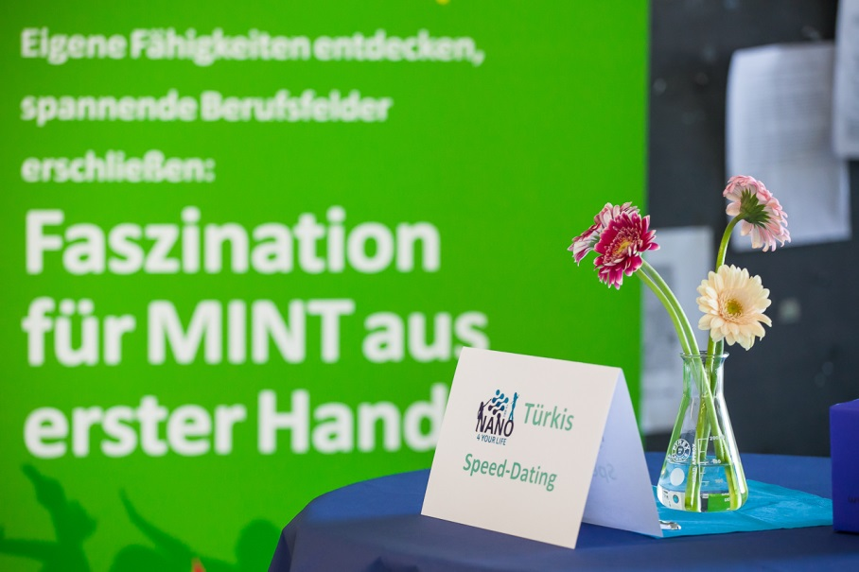
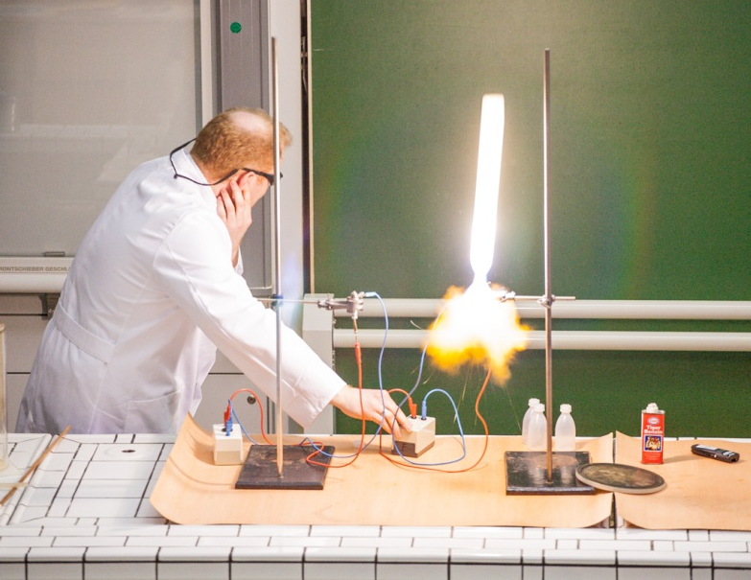
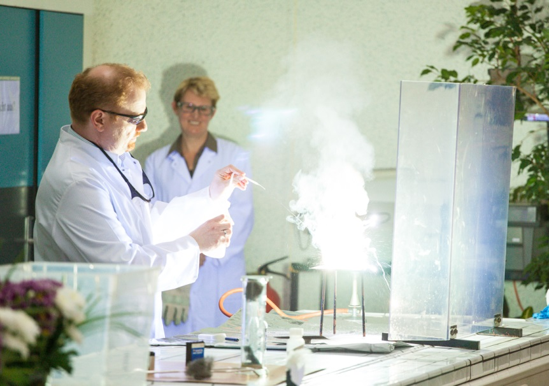
> Opening

Slide 11
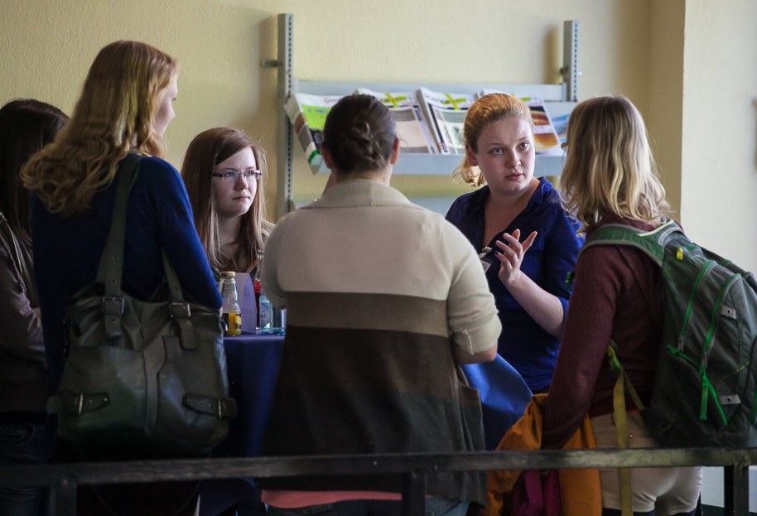
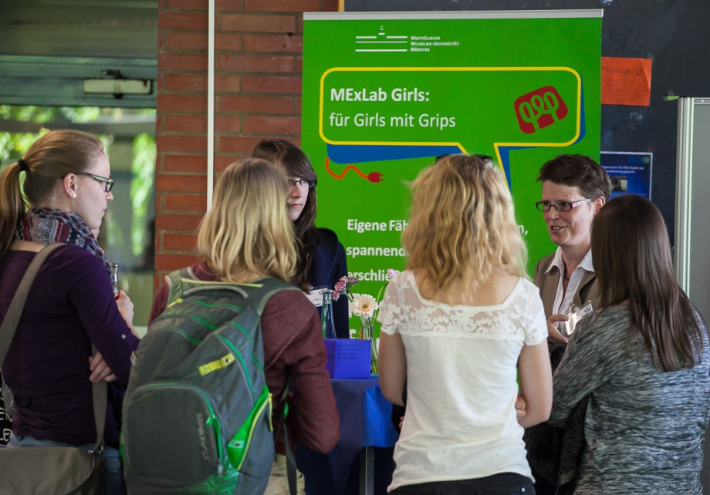
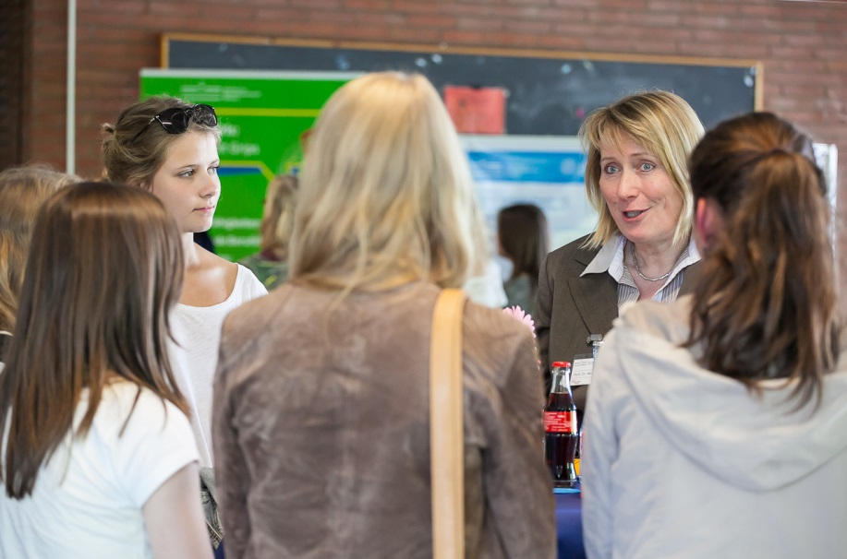
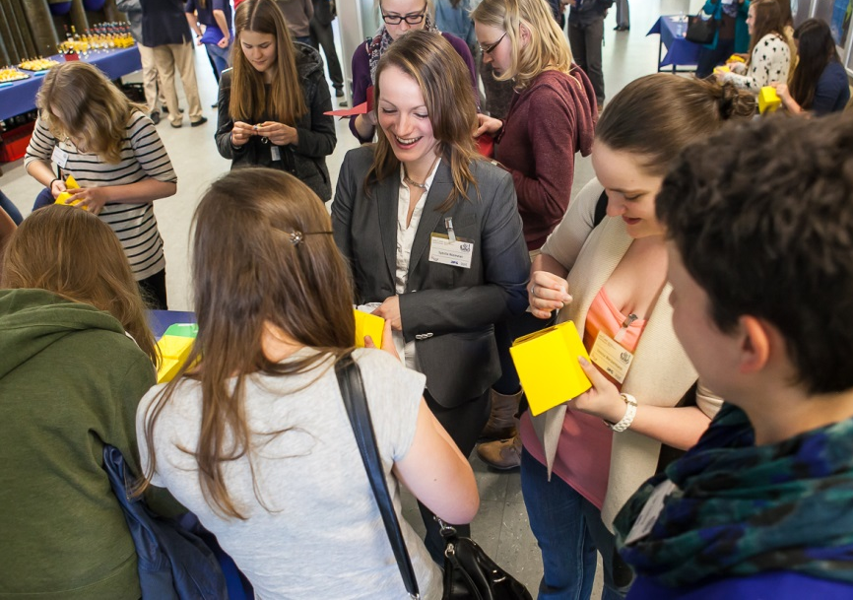
> Opening

Slide 12
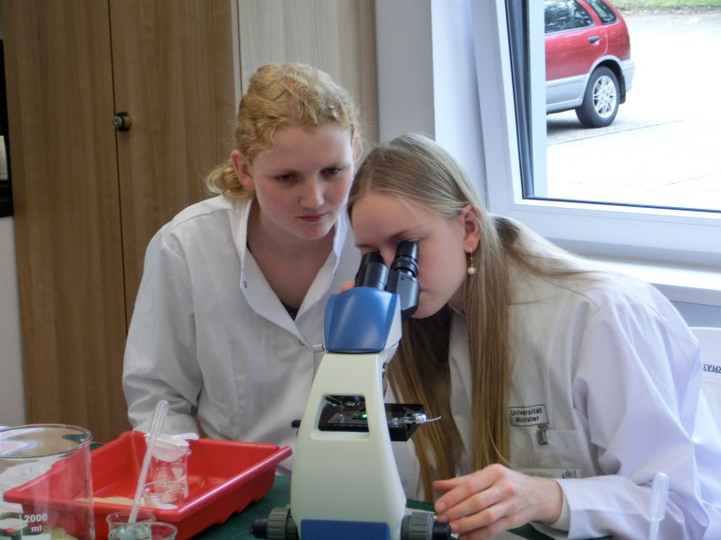
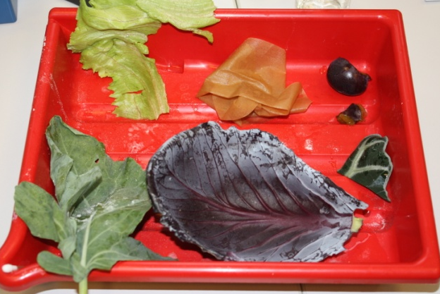
> EinBlick in die Nanowissenschaften: nanostructured surfaces - the Lotus effect
• Participants gathered information
about surface
  > Material
  > Structure
  > Impurity
  > thought experiment solved
• Nanostructured surface material as
origin of the lotus effect was shown
• Projects A6 (C. Denz, N. Doltsinis,
Z. Wang) and B1 (L. Chi, D. Zhang)
were addressed pointing out the
ongoing research on nanostructured
material

Slide 13
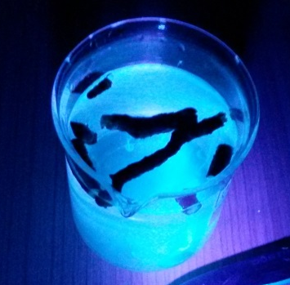
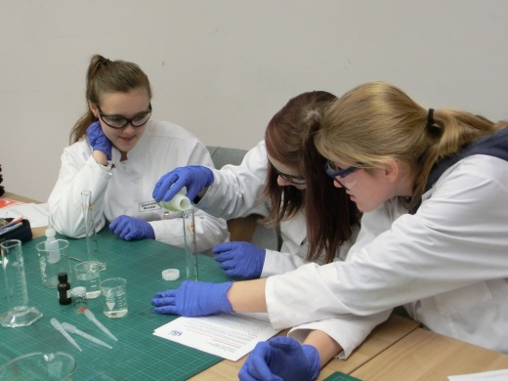
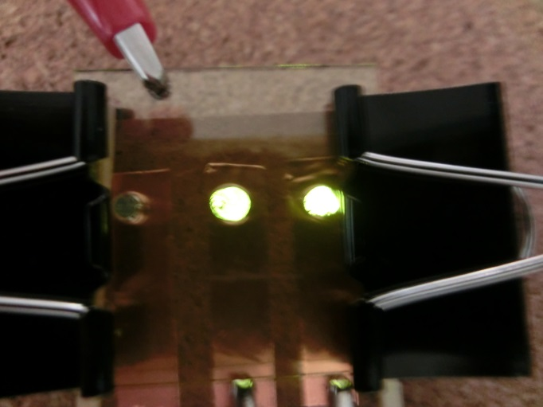
> OLEDs - Leuchten lernen von der Natur nanolayers – OLEDs
• Participants experimented with
fluorescence and phosphorescence in
nature, art and different science:
  > Phosphorescence of painting colour
  > Fluorescence of horse chestnut
  > chemiluminescence of luminol
• Build OLEDs with electro-luminescent
superyellow layer using spin coaters
• Project B13 (C. Strassert, D. Wegner)
is addressed pointing out research on
multifunctional nanolayers for OLEDs

Slide 14
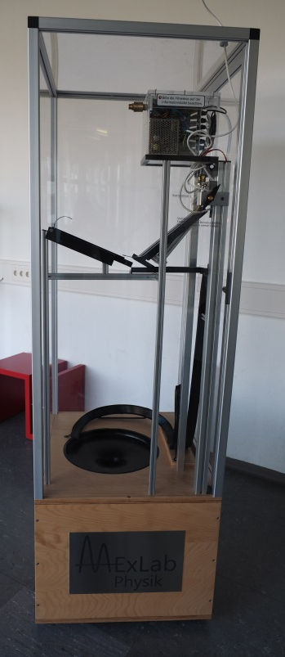
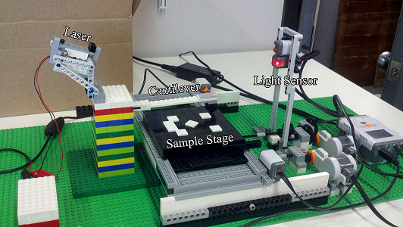
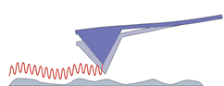
> Further projects in the frame of DFG projects
Theses at the boarder between field and didactics
• Bachelor thesis on an interactive exhibit presenting
the lotus effect
• Bachelor thesis on an fully functional LEGO AFM model
• Master thesis on an exhibit explaining the dynamic
mode of an AFM
Participants
• Chinese female students
• Female PhD students of TRR61
> Examples for young students
(CP for teaching load !)

Slide 15
  > Summary: Concept of Gender Measures in a RTG
• Follow DFG rules > Set up a strategy
• Find out more > Know your group of females, know deficits in gender equality
• Plan measures
> Individual support per call and application (1/4 year)
> Mentoring and Coaching (take over concept of WWU “Erstklassig”)
> Give Examples by female speakers, leaders, …
• Plan project activities
> Foster interest by workshops and lab activities for pupils
> Sustain interest (including freshman and undergraduate females)
> Recruit new students to the field attracting teacher students, …
>> Support by WWU, Gender office and MExLab

