Slide 1
Theory and phenomenology of particle physics
AG Klasen

Slide 2
Group members
Postdoc:
Dr. Karol Kovarik
Ph.D. students:
S. Esch
F. König
D. Lamprea
M. Rothering
P. Steppeler
Master students:
J. Dreier
S. Schmiemann
M. Vargas
Bachelor students:
S. Hellmann
D. Schache
O. Smith

Slide 3
Former group members
Master students => PhD students:
O. Fedkevych => AG Kulesza
F. Herrmann => AG Wessels / AG Klein-Bösing
D. Schwartländer => AG Kulesza

Slide 4
Research interests
Perturbative QCD:
PDFs
(N)NLO
NLO+PS
NLO+N(N)LL
Beyond the Standard Model:
SUSY
GUTs
Minimal models
Colliders:
HERA: H1/ZEUS
RHIC: PHENIX
LHC: ALICE/ATLAS/CMS
Dark Matter:
Planck
XENON100/1T
IceCube

Slide 5
Collaborations
(N)NLO, diffraction, nuclear PDFs:
Prof. em. Dr. Gustav Kramer (Univ. Hamburg)
Dr. Vadim Guzey (Petersburg Nuclear Physics Institute)
NLO+N(N)LL:
Pr. Benjamin Fuks (Univ. Paris 6)
NLO+PS:
Dr. Tomas Jezo (Univ. Milano Bicocca)
DM@NLO:
Dr. Benjamin Herrmann (Univ. Savoie Mont Blanc)

Slide 6
Determination of α_{s} from jets in DIS and photoproduction

Slide 7
Thermal photon interpretation of ALICE low-p_{T} data?

Slide 8
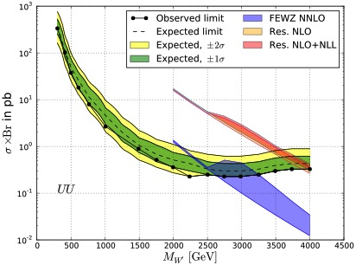
NLO+NLL mass limits on W´ and Z´ bosons

Slide 9
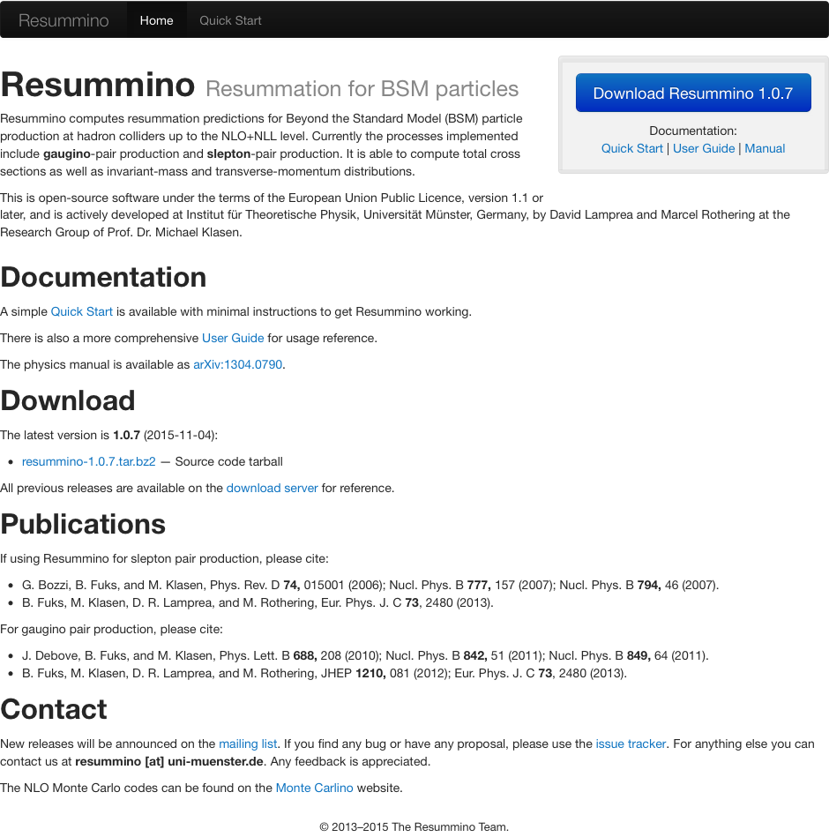
Resummino

Slide 10
Trilepton („golden“) SUSY searches with ATLAS/CMS

