Slide 1

















Decision-theoretic
Models and Inference
$$Υ$$
$$U$$
$${Interference\left(X\right)}^{\left(τ\right)}$$
$${Util}^{\left(τ\right)}$$
$$g_{4}^{\left(τ\right)}$$
$${Restrict\left(X\right)}^{\left(τ\right)}$$
$$g_{U_{IE}}^{\left(τ\right)}$$
$${U\left(X\right)}^{\left(τ\right)}$$
Statistical Relational Artificial Intelligence
(StaRAI)
$$Ξ^{\left(τ\right)}$$
$${Epid}^{\left(τ−1\right)}$$
$$g_{1}^{\left(τ\right)}$$
$${Epid}^{\left(τ\right)}$$
$$g_{E}^{\left(τ−1,τ\right)}$$
$${Travel\left(X\right)}^{\left(τ\right)}$$
$${Treat\left(X,M\right)}^{\left(τ\right)}$$
$$g_{2}^{\left(τ\right)}$$
$$g_{3}^{\left(τ\right)}$$
$${Sick\left(X\right)}^{\left(τ−1\right)}$$
$${Sick\left(X\right)}^{\left(τ\right)}$$
Tanya Braun

Slide 2
Contents
Introduction
  Notions of AI, agents, StaRAI
Modelling Formalisms
  Logic
  Probabilistic Graphical Models (PGMs)
  Probabilistic Relational Models (PRMs)
  Syntax, semantics, inference tasks
Inference
  Logical Inference
  Probabilistic Inference
    Exact Inference
    Approximate Inference
  Inference algorithms
Learning
  Relation learning in logic
  Parameter / structure learning for PGMs
  From PGMs to PRMs, PRM learning
Sequential Models and Inference
  Syntax, semantics, inference tasks, algorithms
Decision-theoretic Models and Inference
  Preferences, utility
  Syntax, semantics, inference task, algorithm

Slide 3

Contents in this Lecture Related to Utility-based Agents
Further topics
  Modelling formalisms
  Inference (in episodic models)
  Learning (of episodic models)
  Sequential models and inference
  Decision-theoretic models and inference
Agent
Environment
Sensors
State
What the world
is like now
How the world evolves
What my actions do
What it will be like
if I do action $A$
Utility
How happy I will be
in such a state
What action I
should do now
Actuators

Slide 4
Setting
Agent can perform actions in an environment
  Episodic, i.e., not sequential, environment
    Next episode does not depend on the previous episode
  Or sequential environment
  Non-deterministic environment
    Outcomes of actions not unique
    Associated with probabilities
    ➝ probabilistic model
  Partially observable
    Latent, i.e., not observable, random variables
Agent has preferences over states / action outcomes
  Encoded in utility or utility function ➝ Utility theory
“Decision theory
= Utility theory + Probability theory”
  Model the world with a probabilistic model
  Model preferences with a utility (function)
  Find action that leads to the maximum expected utility, also called decision making

Slide 5
Outline: 6. Decision-theoretic Models and Inference
Utility Theory
  Preferences, maximum expected utility (MEU) principle
  Utility function, multi-attribute utility theory
Static Decision Making
  Modelling, semantics, inference tasks
  Inference algorithm: LVE for MEU as an example
Sequential Decision Making
  Modelling, semantics, sequential MEU problem
  Inference algorithm: LDJT for MEU as an example
  Acting

Slide 6
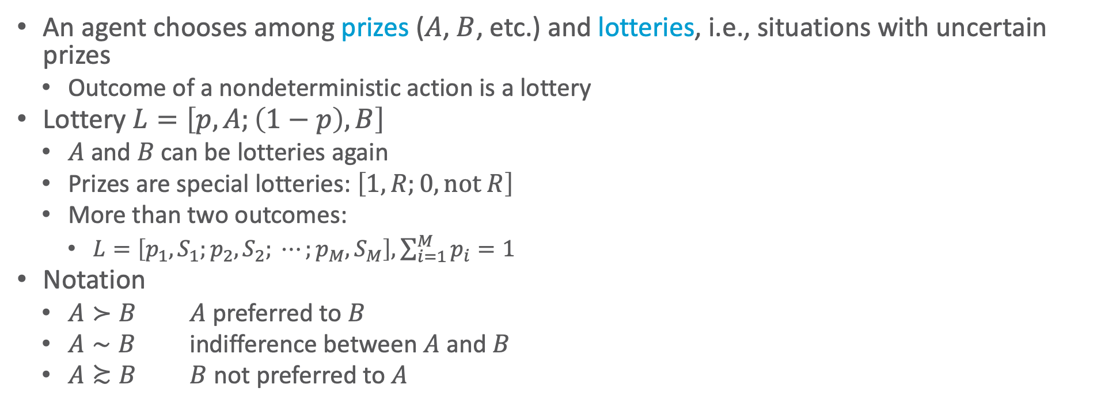
Preferences
An agent chooses among prizes ($A$, $B$, etc.) and lotteries, i.e., situations with uncertain prizes
  Outcome of a nondeterministic action is a lottery
Lottery $L=\left[p,A;\left(1−p\right), B\right]$
  $A$ and $B$ can be lotteries again
  Prizes are special lotteries: $\left[1,R;0, \text{not} R\right]$
  More than two outcomes:
    $L=\left[p_{1},S_{1};p_{2}, S_{2}; ⋯;p_{M}, S_{M}\right], \sum_{i=1}^{M}{p_{i}}=1$
Notation
  $A≻B$ $A$ preferred to $B$
  $A∼B$ indifference between $A$ and $B$
  $A≿B$ $B$ not preferred to $A$
Notes:
Think of the set of outcomes for each action as a lottery—think of each action as a ticket

Slide 7
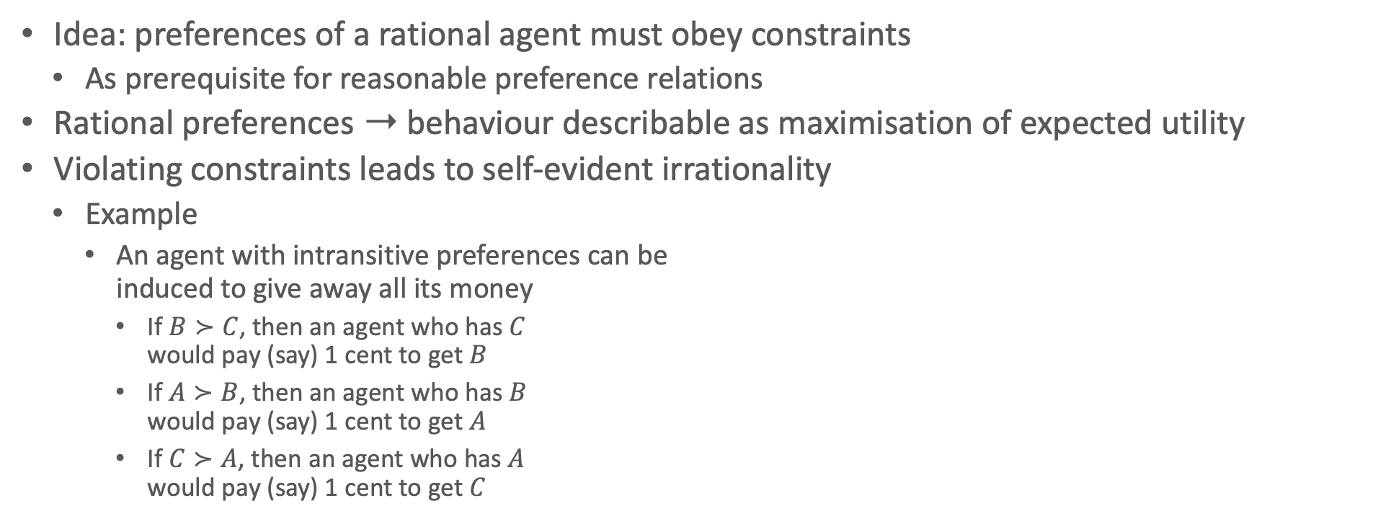
Rational Preferences
Idea: preferences of a rational agent must obey constraints
  As prerequisite for reasonable preference relations
Rational preferences ➝ behaviour describable as maximisation of expected utility
Violating constraints leads to self-evident irrationality
  Example
    An agent with intransitive preferences can be
    induced to give away all its money
      If $B≻C$, then an agent who has $C$
      would pay (say) 1 cent to get $B$
      If $A≻B$, then an agent who has $B$
      would pay (say) 1 cent to get $A$
      If $C≻A$, then an agent who has $A$
      would pay (say) 1 cent to get $C$
B
A
C
1ct
1ct
1ct

Slide 8


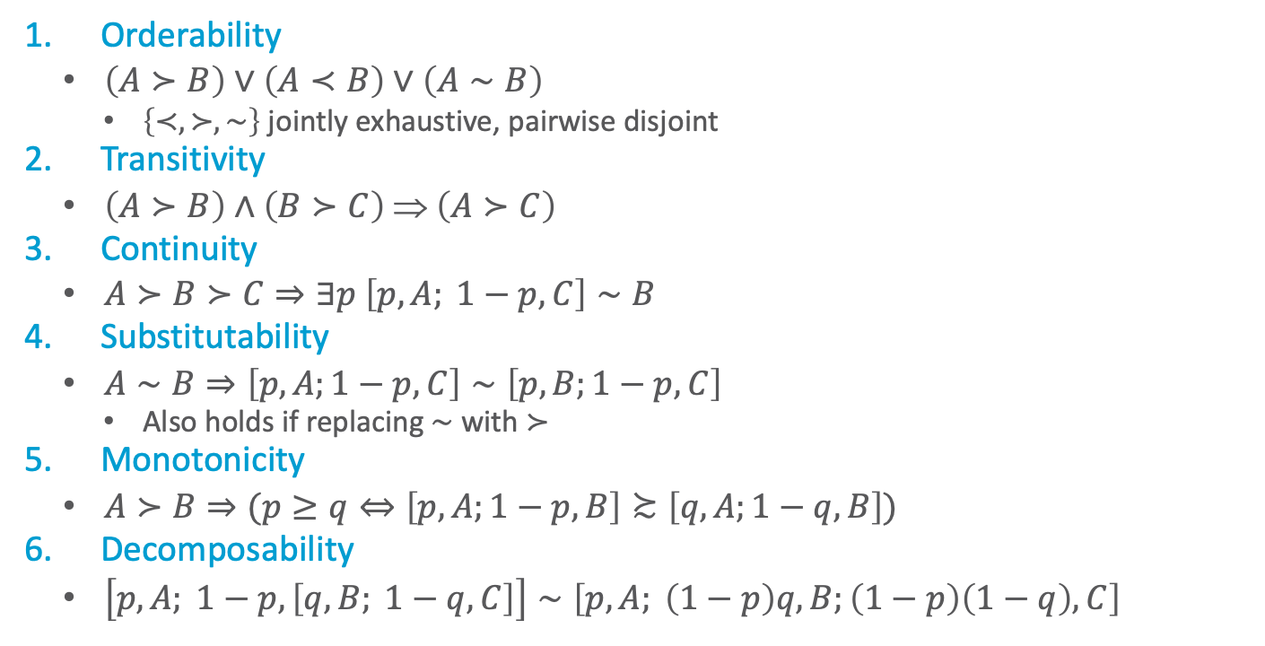










Axioms of Utility Theory
Orderability
  $\left(A≻B\right)∨\left(A≺B\right)∨\left(A∼B\right)$
    $\left\{≺,≻, \sim \right\}$ jointly exhaustive, pairwise disjoint
Transitivity
  $\left(A≻B\right)∧\left(B≻C\right) ⇒ \left(A≻C\right)$
Continuity
  $A≻B≻C⇒∃p \left[p,A; 1−p,C\right]∼B$
Substitutability
  $A∼B⇒\left[p,A;1−p,C\right]∼\left[p,B;1−p,C\right]$
    Also holds if replacing $∼$ with $≻$
Monotonicity
  $A≻B⇒(p≥q⇔\left[p,A;1−p,B\right]≿\left[q,A;1−q,B\right])$
Decomposability
  $\left[p,A; 1−p, \left[q,B; 1−q, C\right]\right]∼\left[p,A; \left(1−p\right)q, B;\left(1−p\right)\left(1−q\right), C\right]$
Decomposability:
There is no fun in gambling.
Equivalent lotteries:
$$p$$
$$A$$
$$q$$
$$B$$
$$1−p$$
$$1−q$$
$$C$$
$$p$$
$$A$$
$$B$$
$$\left(1−p\right)q$$
$$\left(1−p\right)\left(1−q\right)$$
$$C$$
Notes:
Orderability: Agent has to decide (refusing to bet is like refusing to allow time to pass)
Transitivity: example did not follow this axiom
Continuity: Agent will be indifferent between getting $B$ for sure and the lottery that yields $A$ with probability $p$ and $C$ with probability $1−p$
Substitutability: If agent is indifferent between A und B, then it is indifferent between the two if they are part of a more complex lottery
Monotonicity: A preferred over B, then lottery with higher probability for A preferred
Decomposability: Compound lotteries can be reduced to simpler ones using laws of probability (deep models equivalent to broad models); We can account for the enjoyment of gambling by encoding gambling events into the state description; for example, “Have $10 and gambled” could be preferred to “Have $10 and didn’t gamble.”

Slide 9
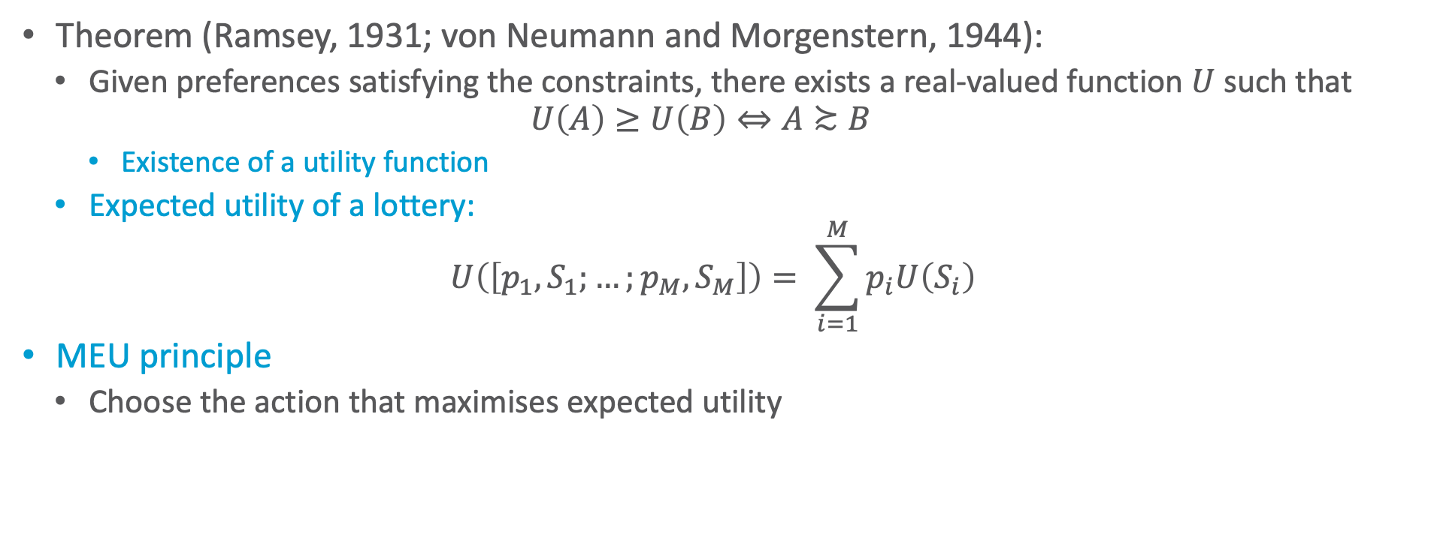
And Then There Was Utility
Theorem (Ramsey, 1931; von Neumann and Morgenstern, 1944):
  Given preferences satisfying the constraints, there exists a real-valued function $U$ such that
  $$U\left(A\right)≥U\left(B\right)⇔A≿B$$
    Existence of a utility function
  Expected utility of a lottery:
  $$U\left(\left[p_{1}, S_{1};…;p_{M},S_{M}\right]\right)= \sum_{i=1}^{M}{p_{i}U\left(S_{i}\right)}$$
MEU principle
  Choose the action that maximises expected utility

Slide 10
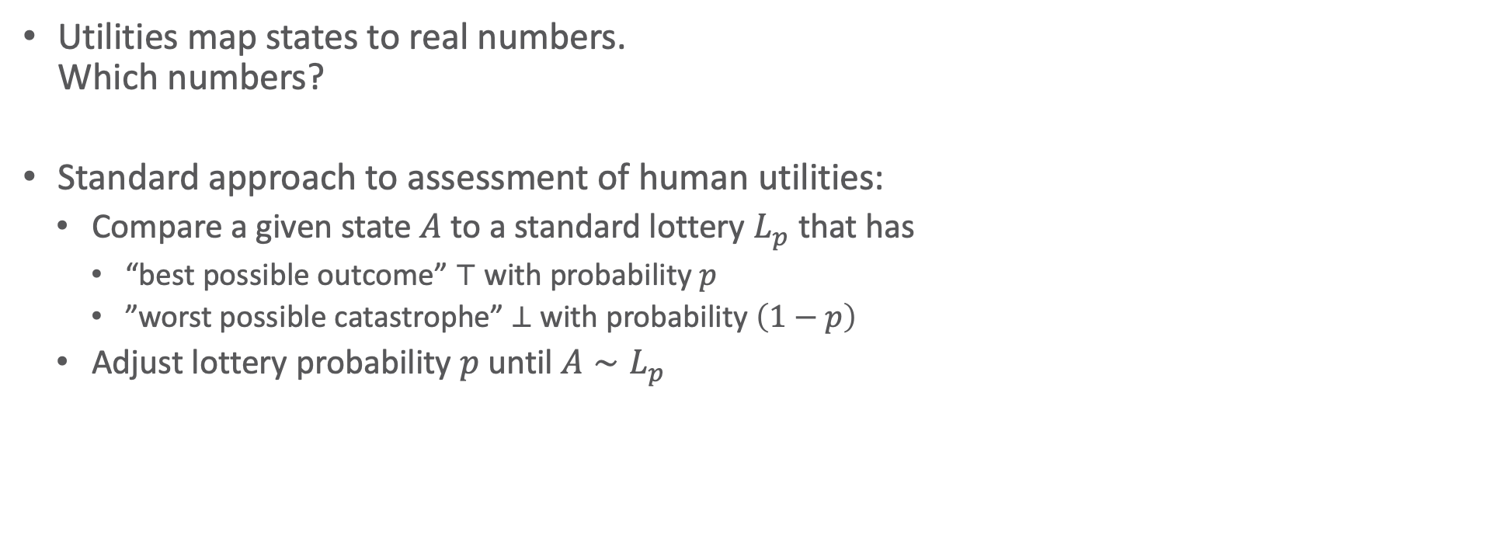



Utilities
Utilities map states to real numbers.
Which numbers?
Standard approach to assessment of human utilities:
  Compare a given state $A$ to a standard lottery $L_{p}$ that has
    “best possible outcome” $⊤$ with probability $p$
    ”worst possible catastrophe” $⊥$ with probability $\left(1−p\right)$
  Adjust lottery probability $p$ until $A∼L_{p}$
$$0.999999$$
continue as before
pay-$30-and-continue-as-before
$$∼L$$
$$0.000001$$
instant death

Slide 11
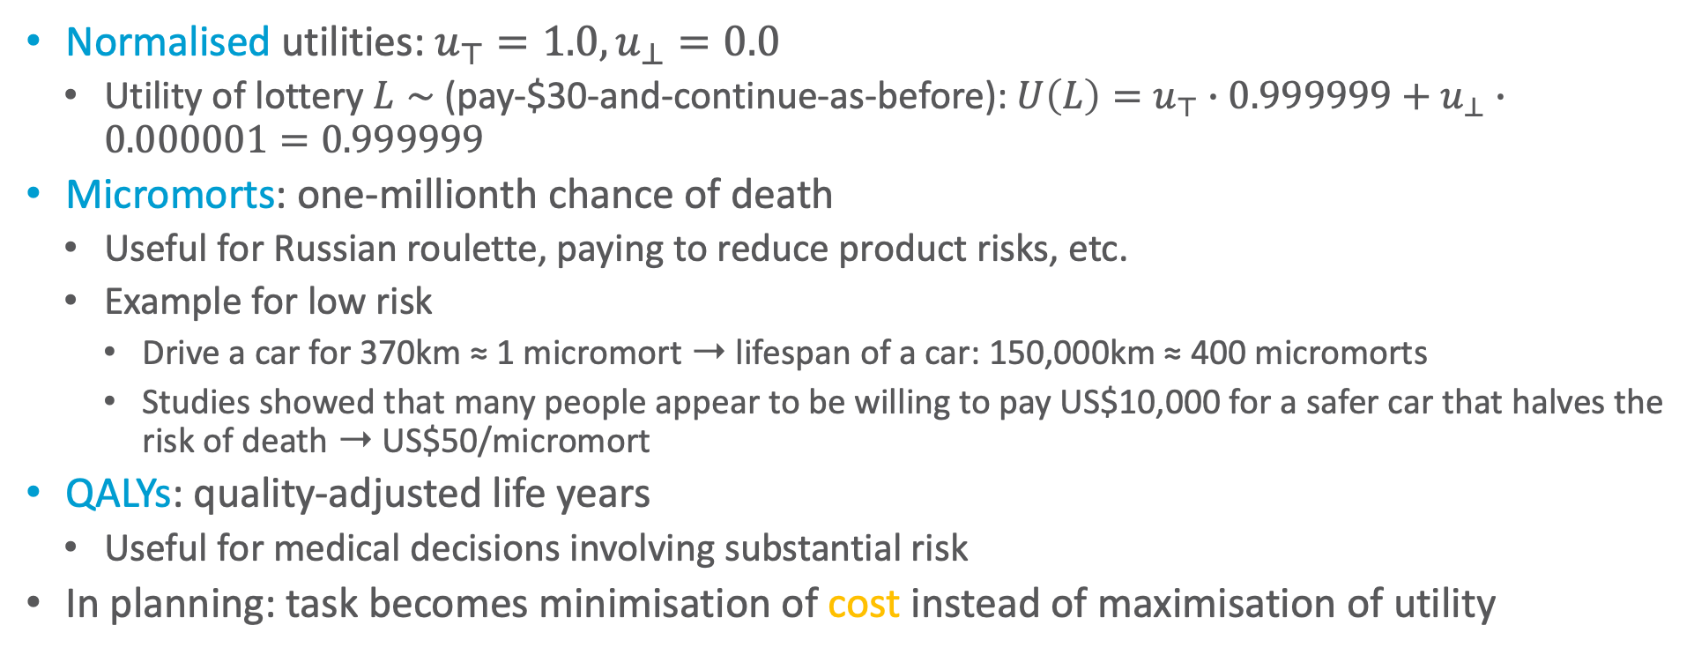
Utility Scales
Normalised utilities: $u_{⊤}=1.0,u_{⊥}=0.0$
  Utility of lottery $L∼$ (pay-$30-and-continue-as-before): $U\left(L\right)=u_{⊤}∙0.999999+u_{⊥}∙0.000001=0.999999$
Micromorts: one-millionth chance of death
  Useful for Russian roulette, paying to reduce product risks, etc.
  Example for low risk
    Drive a car for 370km ≈ 1 micromort ➝ lifespan of a car: 150,000km ≈ 400 micromorts
    Studies showed that many people appear to be willing to pay US$10,000 for a safer car that halves the risk of death ➝ US$50/micromort
QALYs: quality-adjusted life years
  Useful for medical decisions involving substantial risk
In planning: task becomes minimisation of cost instead of maximisation of utility

Slide 12
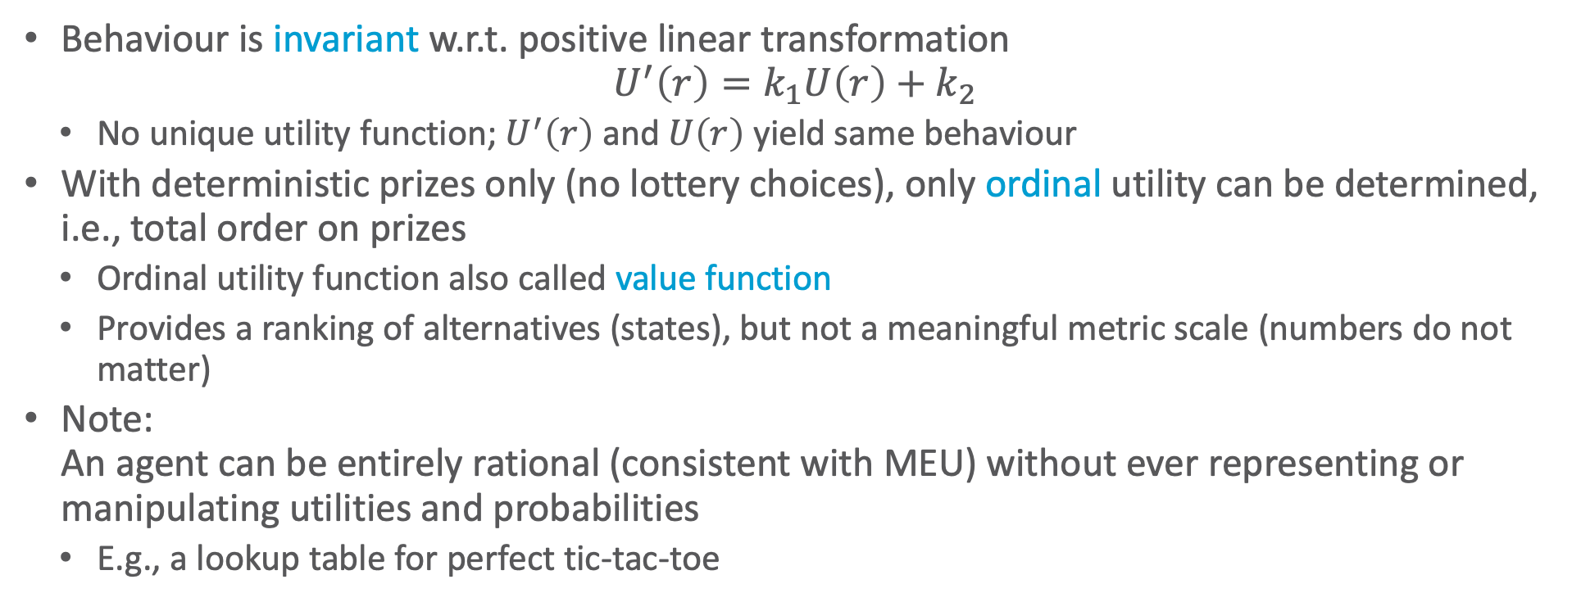
Utility Scales
Behaviour is invariant w.r.t. positive linear transformation
$$U^{′}\left(r\right)=k_{1}U\left(r\right)+k_{2}$$
  No unique utility function; $U^{′}\left(r\right)$ and $U\left(r\right)$ yield same behaviour
With deterministic prizes only (no lottery choices), only ordinal utility can be determined, i.e., total order on prizes
  Ordinal utility function also called value function
  Provides a ranking of alternatives (states), but not a meaningful metric scale (numbers do not matter)
Note:
An agent can be entirely rational (consistent with MEU) without ever representing or manipulating utilities and probabilities
  E.g., a lookup table for perfect tic-tac-toe

Slide 13
Multi-attribute Utility Theory
A given state may have multiple utilities
  ...because of multiple evaluation criteria
  ...because of multiple agents (interested parties) with different utility functions
There are:
  Cases in which decisions can be made without combining the attribute values into a single utility value
    Strict dominance
    Not this lecture
  Cases in which the utilities of attribute combinations can be specified very concisely
    This lecture!
Notes:
Siting a new airport requires consideration of
disruption caused by construction;
the cost of land;
the distance from centers of population;
the noise of flight operations;
safety issues arising from local topography and weather conditions

Slide 14
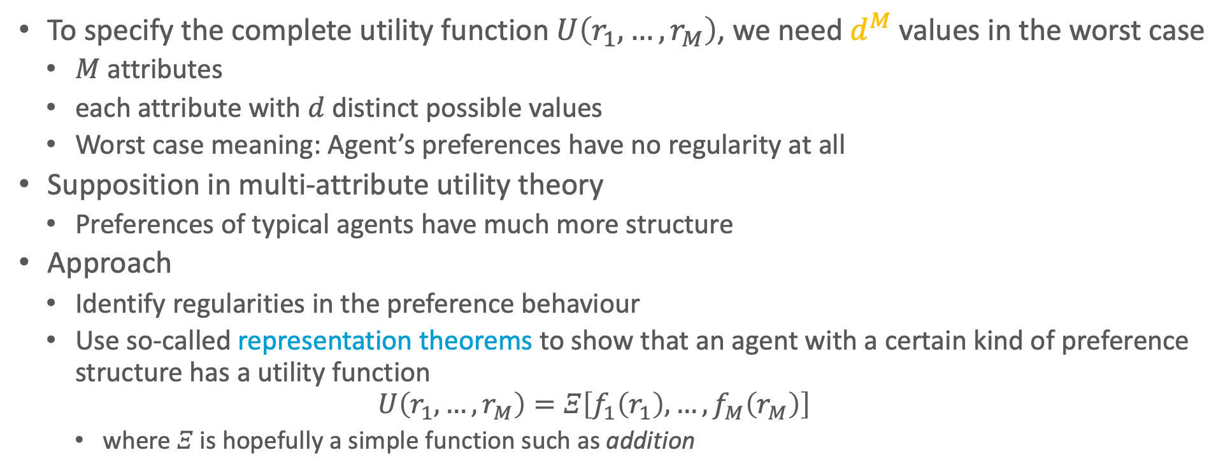
Preference Structure
To specify the complete utility function $U\left(r_{1},…,r_{M}\right)$, we need $d^{M}$ values in the worst case
  $M$ attributes
  each attribute with $d$ distinct possible values
  Worst case meaning: Agent’s preferences have no regularity at all
Supposition in multi-attribute utility theory
  Preferences of typical agents have much more structure
Approach
  Identify regularities in the preference behaviour
  Use so-called representation theorems to show that an agent with a certain kind of preference structure has a utility function
  $$U\left(r_{1},…,r_{M}\right)=Ξ\left[f_{1}\left(r_{1}\right),…,f_{M}\left(r_{M}\right)\right]$$
    where $Ξ$ is hopefully a simple function such as addition
Notes:
Similar to Bayesian networks that decompose the joint probability of several random variables

Slide 15
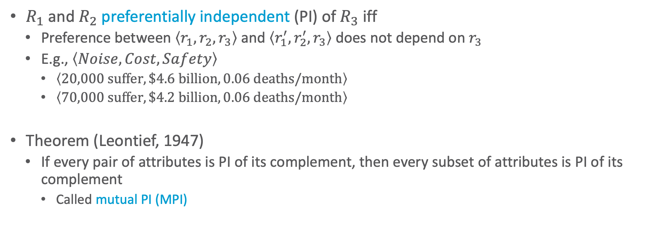
Preference Independence
$R_{1}$ and $R_{2}$ preferentially independent (PI) of $R_{3}$ iff
  Preference between $\left\langle r_{1},r_{2},r_{3}\right\rangle$ and $\left\langle r_{1}^{′},r_{2}^{′},r_{3}\right\rangle$ does not depend on $r_{3}$
  E.g., $\left\langle Noise, Cost, Safety\right\rangle$
    $\left\langle 20,000 suffer, \$4.6 billion, 0.06 deaths/month\right\rangle$
    $\left\langle 70,000 suffer, \$4.2 billion, 0.06 deaths/month\right\rangle$
Theorem (Leontief, 1947)
  If every pair of attributes is PI of its complement, then every subset of attributes is PI of its complement
    Called mutual PI (MPI)
Notes:
MPI, where it doesn’t hold: Suppose you are at a medieval market, considering the purchase of some hunting dogs, some chickens, and some wicker cages for the chickens. The hunting dogs are very valuable, but if you don’t have enough cages for the chickens, the dogs will eat the chickens; hence, the trade-off between dogs and chickens depends strongly on the number of cages, and MPI is violated.
The existence of these kinds of interactions among various attributes makes it much harder to assess the overall value function.

Slide 16
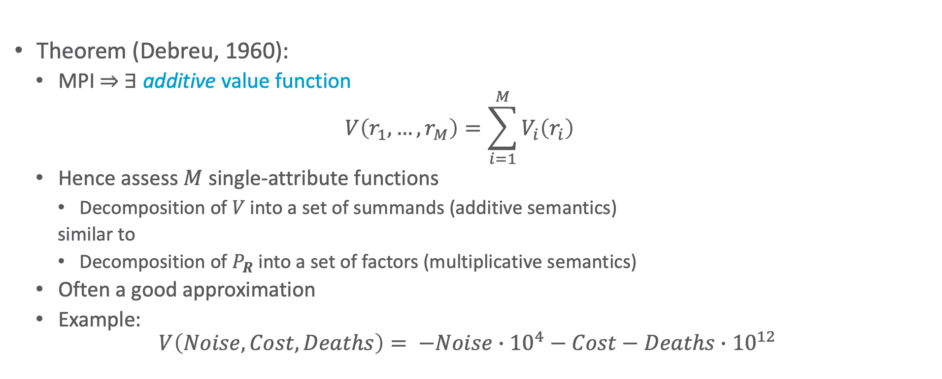
Preference Independence
Theorem (Debreu, 1960):
  MPI ⇒ ∃ additive value function
  $$V\left(r_{1},…, r_{M}\right)=\sum_{i=1}^{M}{V_{i}\left(r_{i}\right)}$$
  Hence assess $M$ single-attribute functions
    Decomposition of $V$ into a set of summands (additive semantics)
    similar to
    Decomposition of $P_{R}$ into a set of factors (multiplicative semantics)
  Often a good approximation
  Example:
  $$V\left(Noise, Cost,Deaths\right)= −Noise∙{10}^{4}−Cost−Deaths∙{10}^{12}$$

Slide 17
Interim Summary
Preferences
  Preferences of a rational agent must obey constraints
Utilities
  Rational preferences = describable as maximisation of expected utility
  Utility axioms
  MEU principle
Multi-attribute utility theory
  Preference structure
  (Mutual) preferential independence

Slide 18
Outline: 6. Decision-theoretic Models and Inference
Utility Theory
  Preferences, maximum expected utility (MEU) principle
  Utility function, multi-attribute utility theory
Static Decision Making
  Modelling, semantics, inference tasks
  Inference algorithm: LVE for MEU as an example
Sequential Decision Making
  Modelling, semantics, sequential MEU problem
  Inference algorithm: LDJT for MEU as an example
  Acting

Slide 19
Decision Networks/Models
Extend a PGM to handle actions and utilities
  Decision variables
  Utility variables
Also called influence diagrams
Given a decision model, use an inference method of one’s choosing to find actions that lead to the highest expected utility
Also allows to perform so-called
Value of Information calculations
  Is it worth it to spend resources on getting more information (in the form of evidence)?
Ronald A. Howard: Information Value Theory. In: IEEE Transactions on Systems Science and Cybernetics, 1966.
Ronald A. Howard, James E. Matheson: Influence Diagrams. In: Readings on the Principles and Applications of Decision Analysis, 1984.

Slide 20



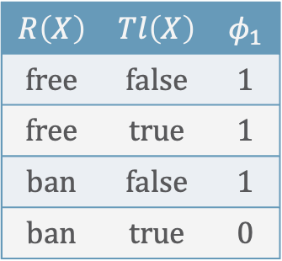



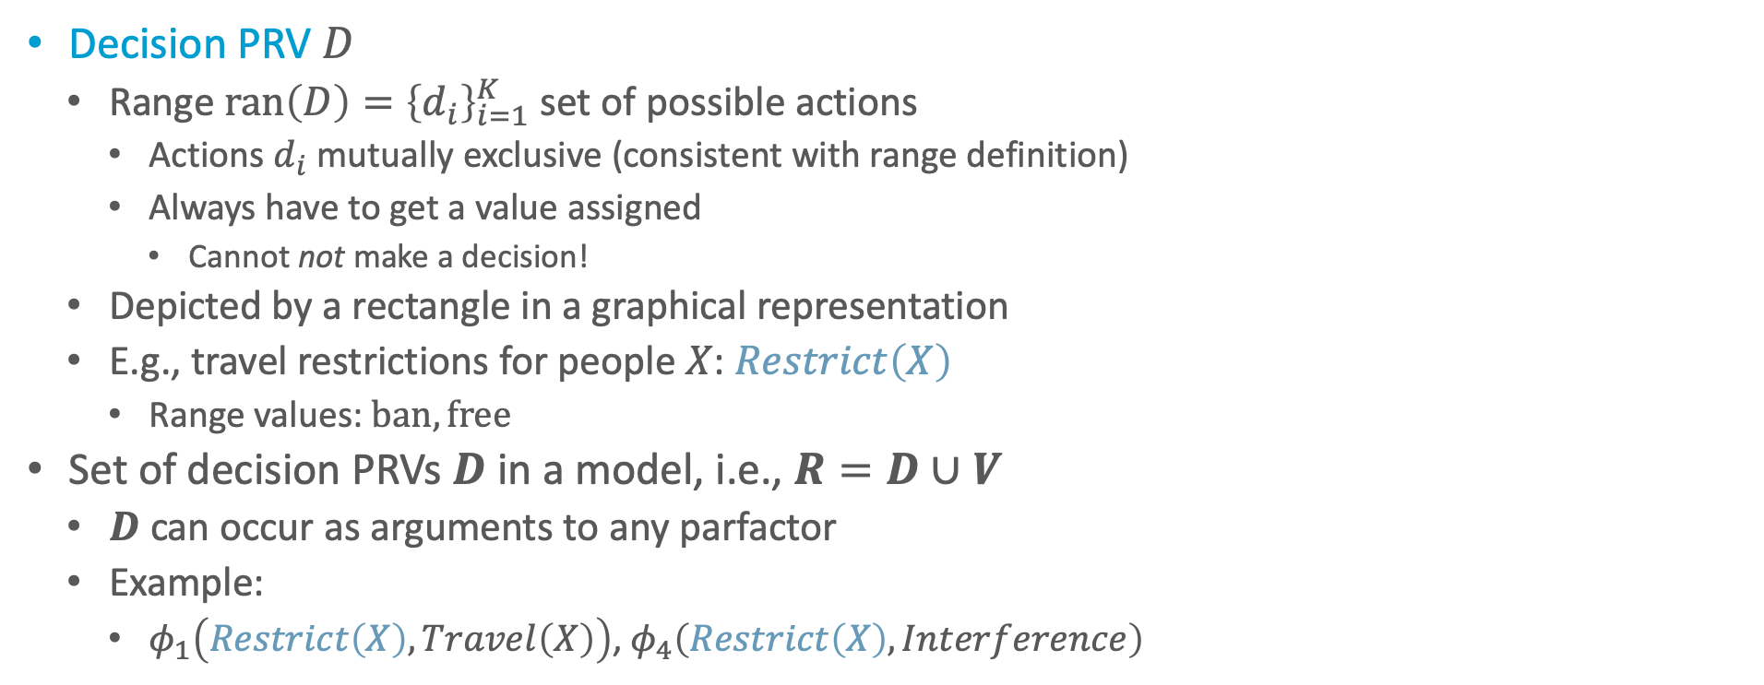







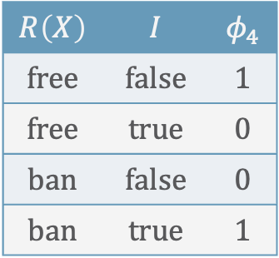
Decision PRVs
$$R\left(X\right)$$ | $$I$$ | $$φ_{4}$$
$$free$$ | $$false$$ | $$1$$
$$free$$ | $$true$$ | $$0$$
$$ban$$ | $$false$$ | $$0$$
$$ban$$ | $$true$$ | $$1$$
$$R\left(X\right)$$ | $$Tl\left(X\right)$$ | $$φ_{1}$$
$$free$$ | $$false$$ | $$1$$
$$free$$ | $$true$$ | $$1$$
$$ban$$ | $$false$$ | $$1$$
$$ban$$ | $$true$$ | $$0$$
Decision PRV $D$
  Range $ran\left(D\right)={\left\{d_{i}\right\}}_{i=1}^{K}$ set of possible actions
    Actions $d_{i}$ mutually exclusive (consistent with range definition)
    Always have to get a value assigned
      Cannot not make a decision!
  Depicted by a rectangle in a graphical representation
  E.g., travel restrictions for people $X$: $Restrict\left(X\right)$
    Range values: $ban,free$
Set of decision PRVs $D$ in a model, i.e., $R=D∪V$
  $D$ can occur as arguments to any parfactor
  Example:
    $φ_{1}\left(Restrict\left(X\right),Travel\left(X\right)\right)$, $φ_{4}\left(Restrict\left(X\right),Interference\right)$
$$Interference$$
$$g_{4}$$
$$Restrict\left(X\right)$$
$$Util$$
$$g_{U}$$
$$Epid$$
$$g_{1}$$
$$g_{0}$$
$$Travel\left(X\right)$$
$$Treat\left(X,M\right)$$
$$g_{2}$$
$$g_{3}$$
$$Sick\left(X\right)$$

Slide 21
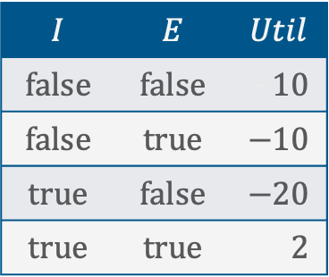
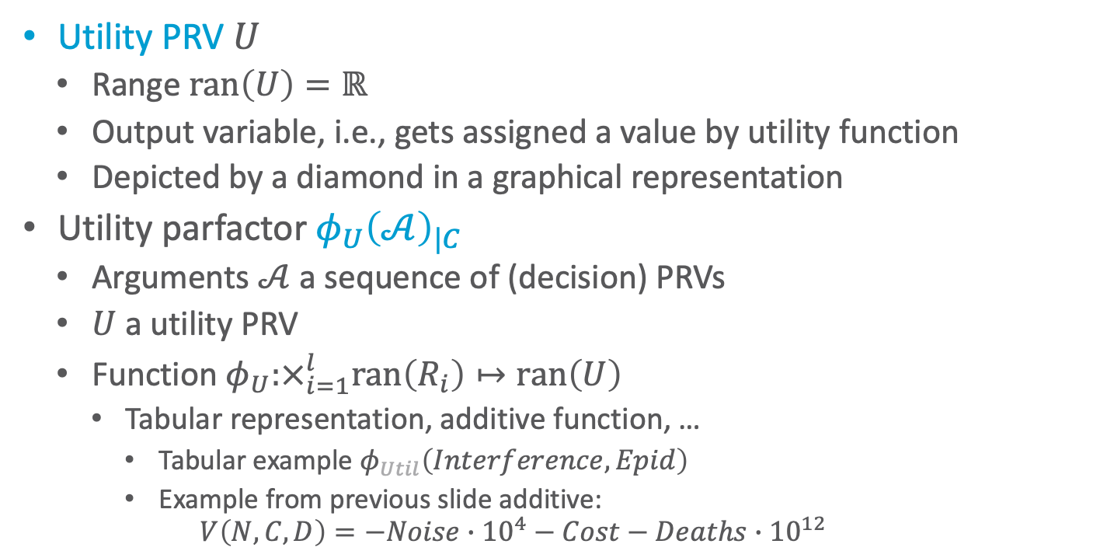
Utility PRVs & Utility Parfactors
$$I$$ | $$E$$ | $$Util$$
$$false$$ | $$false$$ | $$−10$$
$$false$$ | $$true$$ | $$−10$$
$$true$$ | $$false$$ | $$−20$$
$$true$$ | $$true$$ | $$−02$$
Utility PRV $U$
  Range $ran\left(U\right)=ℝ$
  Output variable, i.e., gets assigned a value by utility function
  Depicted by a diamond in a graphical representation
Utility parfactor ${φ_{U}\left(𝒜\right)}_{|C}$
  Arguments $𝒜$ a sequence of (decision) PRVs
  $U$ a utility PRV
  Function $φ_{U}:×_{i=1}^{l}ran\left(R_{i}\right)↦ran\left(U\right)$
    Tabular representation, additive function, …
      Tabular example $φ_{Util}\left(Interference,Epid\right)$
      Example from previous slide additive:
      $V\left(N,C,D\right)=−Noise∙{10}^{4}−Cost−Deaths∙{10}^{12}$
$$Interference$$
$$g_{4}$$
$$Restrict\left(X\right)$$
$$Util$$
$$g_{U}$$
$$Epid$$
$$g_{1}$$
$$g_{0}$$
$$Travel\left(X\right)$$
$$Treat\left(X,M\right)$$
$$g_{2}$$
$$g_{3}$$
$$Sick\left(X\right)$$

Slide 22
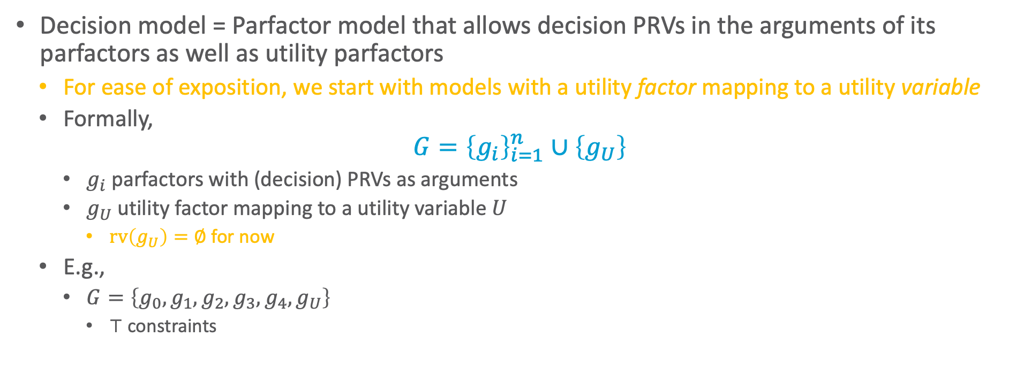
Parfactor-based Decision Model
Decision model = Parfactor model that allows decision PRVs in the arguments of its parfactors as well as utility parfactors
  For ease of exposition, we start with models with a utility factor mapping to a utility variable
  Formally,
$$G={\left\{g_{i}\right\}}_{i=1}^{n}∪\left\{g_{U}\right\}$$
    $g_{i}$ parfactors with (decision) PRVs as arguments
    $g_{U}$ utility factor mapping to a utility variable $U$
      $rv\left(g_{U}\right)=∅$ for now
  E.g.,
    $G=\left\{g_{0},g_{1},g_{2},g_{3},g_{4},g_{U}\right\}$
      $⊤$ constraints
$$Interference$$
$$g_{4}$$
$$Restrict\left(X\right)$$
$$Util$$
$$g_{U}$$
$$Epid$$
$$g_{1}$$
$$g_{0}$$
$$Travel\left(X\right)$$
$$Treat\left(X,M\right)$$
$$g_{2}$$
$$g_{3}$$
$$Sick\left(X\right)$$

Slide 23

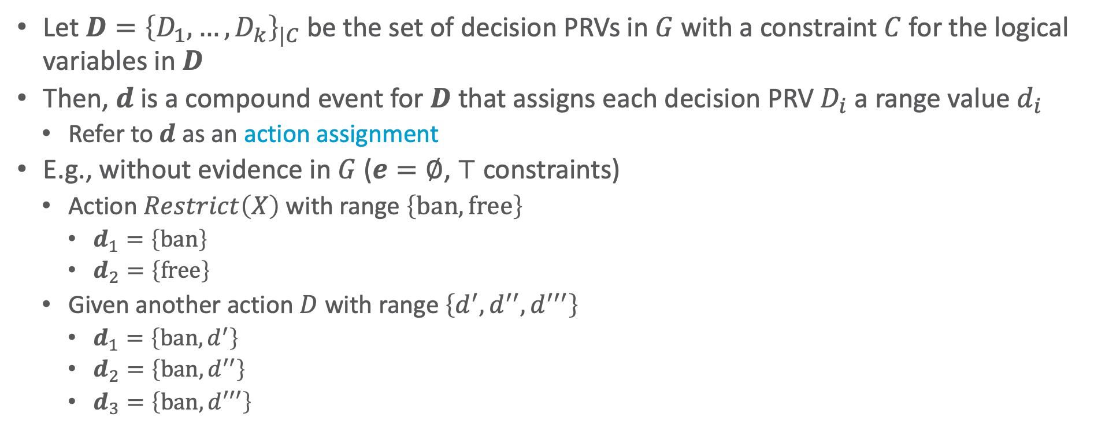
Decision Model: Action Assignments
Let $D={\left\{D_{1},…, D_{k}\right\}}_{|C}$ be the set of decision PRVs in $G$ with a constraint $C$ for the logical variables in $D$
Then, $d$ is a compound event for $D$ that assigns each decision PRV $D_{i}$ a range value $d_{i}$
  Refer to $d$ as an action assignment
E.g., without evidence in $G$ ($e=∅$, $⊤$ constraints)
  Action $Restrict\left(X\right)$ with range $\left\{ban, free\right\}$
    $d_{1}=\left\{ban\right\}$
    $d_{2}=\left\{free\right\}$
  Given another action $D$ with range $\left\{d^{′}, d^{′′},d^{′′′}\right\}$
    $d_{1}=\left\{ban,d^{′}\right\}$
    $d_{2}=\left\{ban,d^{′′}\right\}$
    $d_{3}=\left\{ban,d^{′′′}\right\}$
$$Interference$$
$$g_{4}$$
$$Restrict\left(X\right)$$
$$Util$$
$$g_{U}$$
$$Epid$$
$$g_{1}$$
$$g_{0}$$
    $d_{4}=\left\{free,d^{′}\right\}$
    $d_{5}=\left\{free,d^{′′}\right\}$
    $d_{6}=\left\{free,d^{′′′}\right\}$
$$Travel\left(X\right)$$
$$Treat\left(X,M\right)$$
$$g_{2}$$
$$g_{3}$$
$$Sick\left(X\right)$$

Slide 24
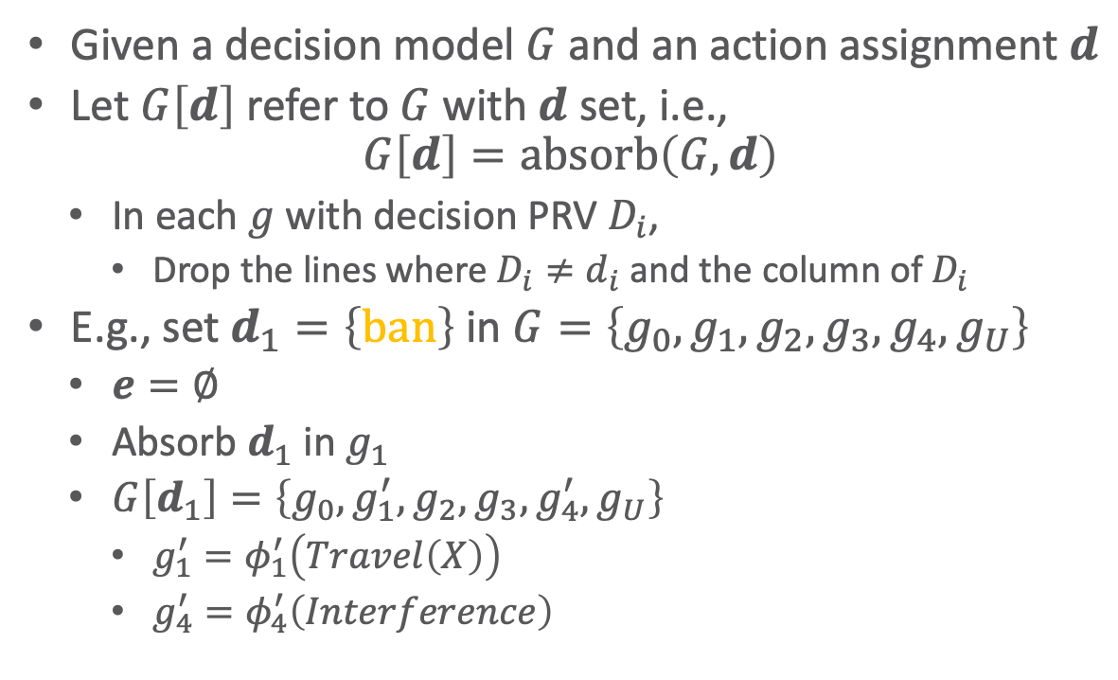
Decision Model: Setting Decisions
$$R\left(X\right)$$ | $$I$$ | $$φ_{4}$$
$$free$$ | $$false$$ | $$1$$
$$free$$ | $$true$$ | $$0$$
$$ban$$ | $$false$$ | $$0$$
$$ban$$ | $$true$$ | $$1$$
$$R\left(X\right)$$ | $$Tl\left(X\right)$$ | $$φ_{1}$$
$$free$$ | $$false$$ | $$1$$
$$free$$ | $$true$$ | $$1$$
$$ban$$ | $$false$$ | $$1$$
$$ban$$ | $$true$$ | $$0$$
Given a decision model $G$ and an action assignment $d$
Let $G\left[d\right]$ refer to $G$ with $d$ set, i.e.,
$G\left[d\right]=\text{absorb}\left(G,d\right)$
  In each $g$ with decision PRV $D_{i}$,
    Drop the lines where $D_{i}≠d_{i}$ and the column of $D_{i}$
E.g., set $d_{1}=\left\{ban\right\}$ in $G=\left\{g_{0},g_{1},g_{2},g_{3},g_{4},g_{U}\right\}$
  $e=∅$
  Absorb $d_{1}$ in $g_{1}$
  $G\left[d_{1}\right]=\left\{g_{0},g_{1}^{′},g_{2},g_{3},g_{4}^{′},g_{U}\right\}$
    $g_{1}^{′}=φ_{1}^{′}\left(Travel\left(X\right)\right)$
    $g_{4}^{′}=φ_{4}^{′}\left(Interference\right)$
$$Interference$$
$$g_{4}$$
$$Restrict\left(X\right)$$
$$Util$$
$$g_{U}$$
$$Epid$$
$$g_{1}$$
$$g_{0}$$
$$Travel\left(X\right)$$
$$Treat\left(X,M\right)$$
$$g_{2}$$
$$g_{3}$$
$$Sick\left(X\right)$$

Slide 25
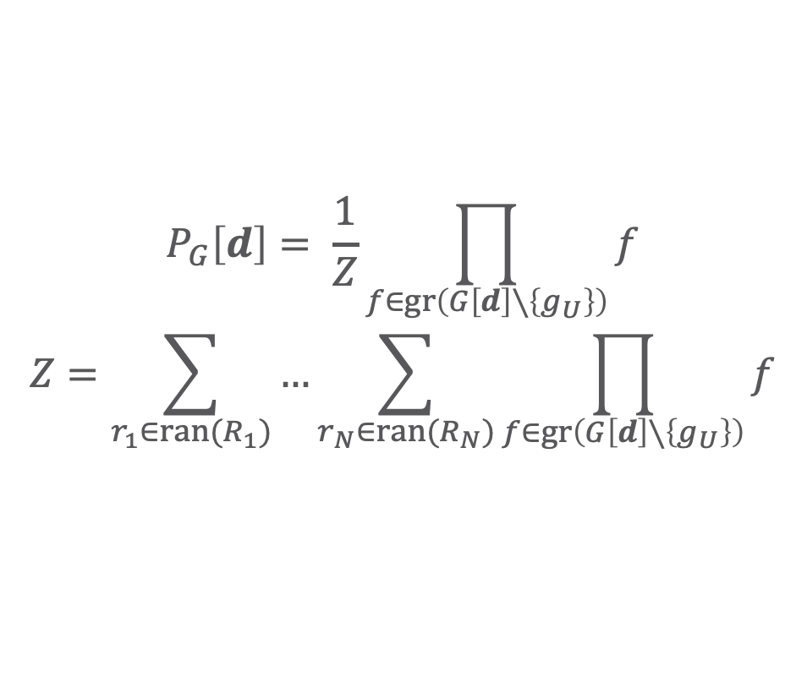
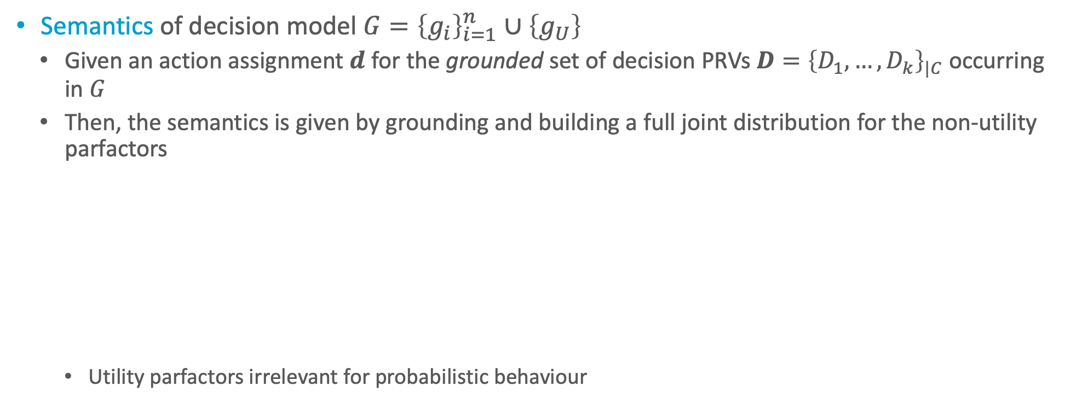
Decision Model: Semantics
Semantics of decision model $G={\left\{g_{i}\right\}}_{i=1}^{n}∪\left\{g_{U}\right\}$
  Given an action assignment $d$ for the grounded set of decision PRVs $D={\left\{D_{1},…, D_{k}\right\}}_{|C}$ occurring in $G$
  Then, the semantics is given by grounding and building a full joint distribution for the non-utility parfactors
    Utility parfactors irrelevant for probabilistic behaviour
  $$P_{G}\left[d\right]= \frac{1}{Z}\prod_{f∈gr\left(G\left[d\right]∖\left\{g_{U}\right\}\right)}{f}$$
  $$Z=\sum_{r_{1}∈ran(R_{1})}{…\sum_{r_{N}∈ran(R_{N})}{\prod_{f∈gr\left(G\left[d\right]∖\left\{g_{U}\right\}\right)}{f}}}$$
Semantics multiplicative with an inner product and outer sum: Multiply parfactors, then sum out PRVs.
➝ Sum-product algorithms

Slide 26


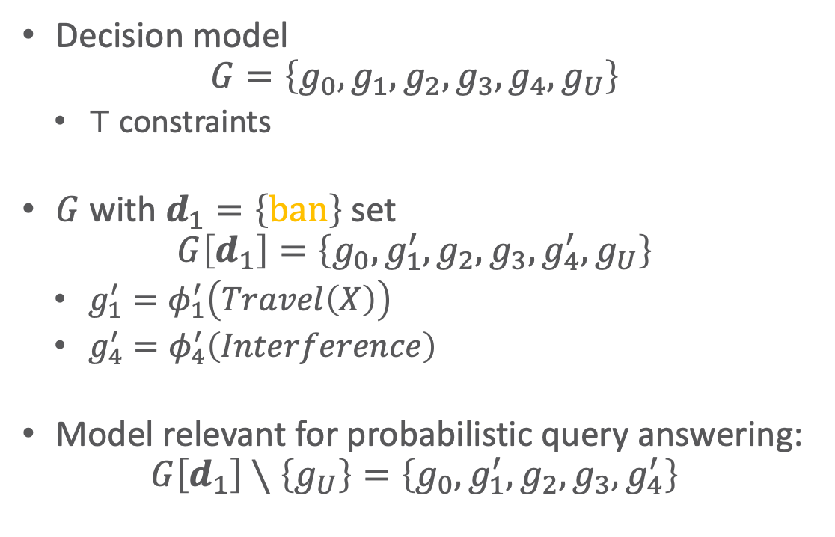






























Decision Model: Example
$$Interference$$
$$g_{4}$$
$$Restrict\left(X\right)$$
$$Util$$
$$g_{U}$$
$$Epid$$
$$g_{1}$$
$$g_{0}$$
Decision model
$$G=\left\{g_{0},g_{1},g_{2},g_{3},g_{4},g_{U}\right\}$$
  $⊤$ constraints
$G$ with $d_{1}=\left\{ban\right\}$ set
$$G\left[d_{1}\right]=\left\{g_{0},g_{1}^{′},g_{2},g_{3},g_{4}^{′},g_{U}\right\}$$
  $g_{1}^{′}=φ_{1}^{′}\left(Travel\left(X\right)\right)$
  $g_{4}^{′}=φ_{4}^{′}\left(Interference\right)$
Model relevant for probabilistic query answering:
$$G\left[d_{1}\right]∖\left\{g_{U}\right\}=\left\{g_{0},g_{1}^{′},g_{2},g_{3},g_{4}^{′}\right\}$$
$$Travel\left(X\right)$$
$$Treat\left(X,M\right)$$
$$g_{2}$$
$$g_{3}$$
$$Sick\left(X\right)$$
$$Interference$$
$$g_{4}^{′}$$
$$Util$$
$$g_{U}$$
$$Epid$$
$$g_{1}^{′}$$
$$g_{0}$$
$$Travel\left(X\right)$$
$$Treat\left(X,M\right)$$
$$g_{2}$$
$$g_{3}$$
$$Sick\left(X\right)$$
$$Interference$$
$$g_{4}^{′}$$
$$Epid$$
$$g_{1}^{′}$$
$$g_{0}$$
$$Travel\left(X\right)$$
$$Treat\left(X,M\right)$$
$$g_{2}$$
$$g_{3}$$
$$Sick\left(X\right)$$

Slide 27
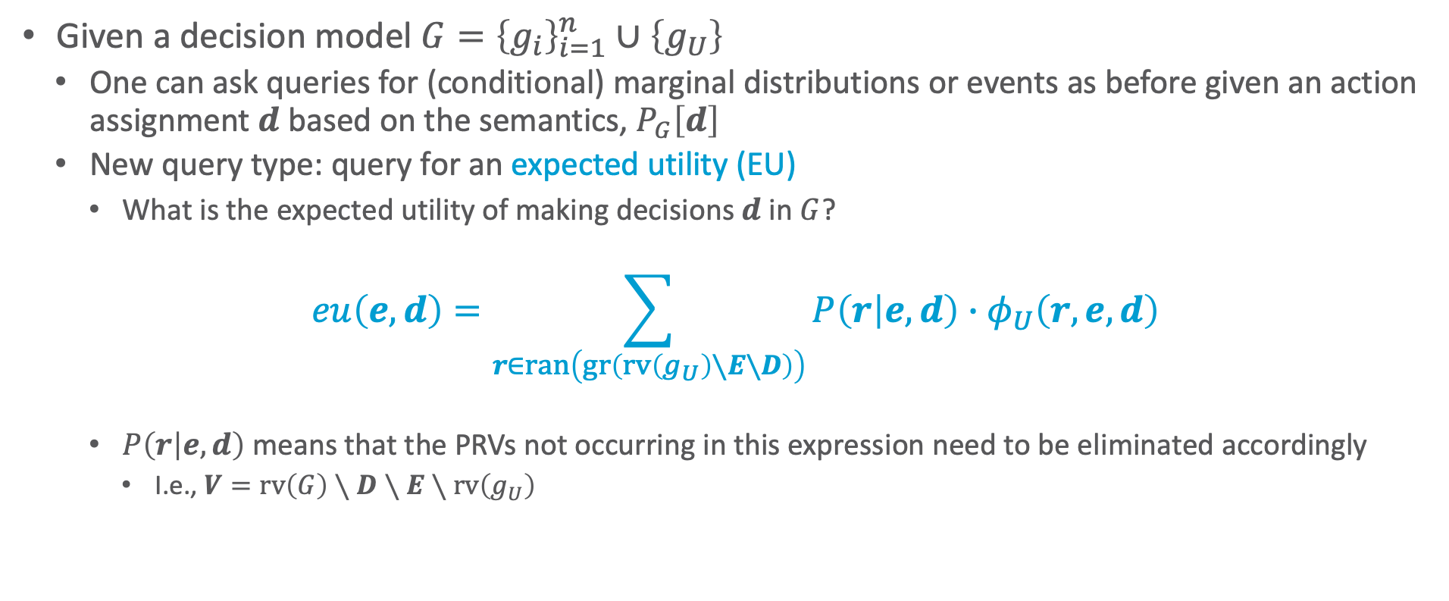
Expected Utility Queries
Given a decision model $G={\left\{g_{i}\right\}}_{i=1}^{n}∪\left\{g_{U}\right\}$
  One can ask queries for (conditional) marginal distributions or events as before given an action assignment $d$ based on the semantics, $P_{G}\left[d\right]$
  New query type: query for an expected utility (EU)
    What is the expected utility of making decisions $d$ in $G$?
$$eu\left(e,d\right)=\sum_{r∈ran\left(gr\left(rv\left(g_{U}\right)∖E∖D\right)\right)}{P\left(r | e,d\right)∙φ_{U}\left(r,e,d\right)}$$
    $P\left(r | e,d\right)$ means that the PRVs not occurring in this expression need to be eliminated accordingly
      I.e., $V=rv\left(G\right)∖D∖E∖rv\left(g_{U}\right)$

Slide 28


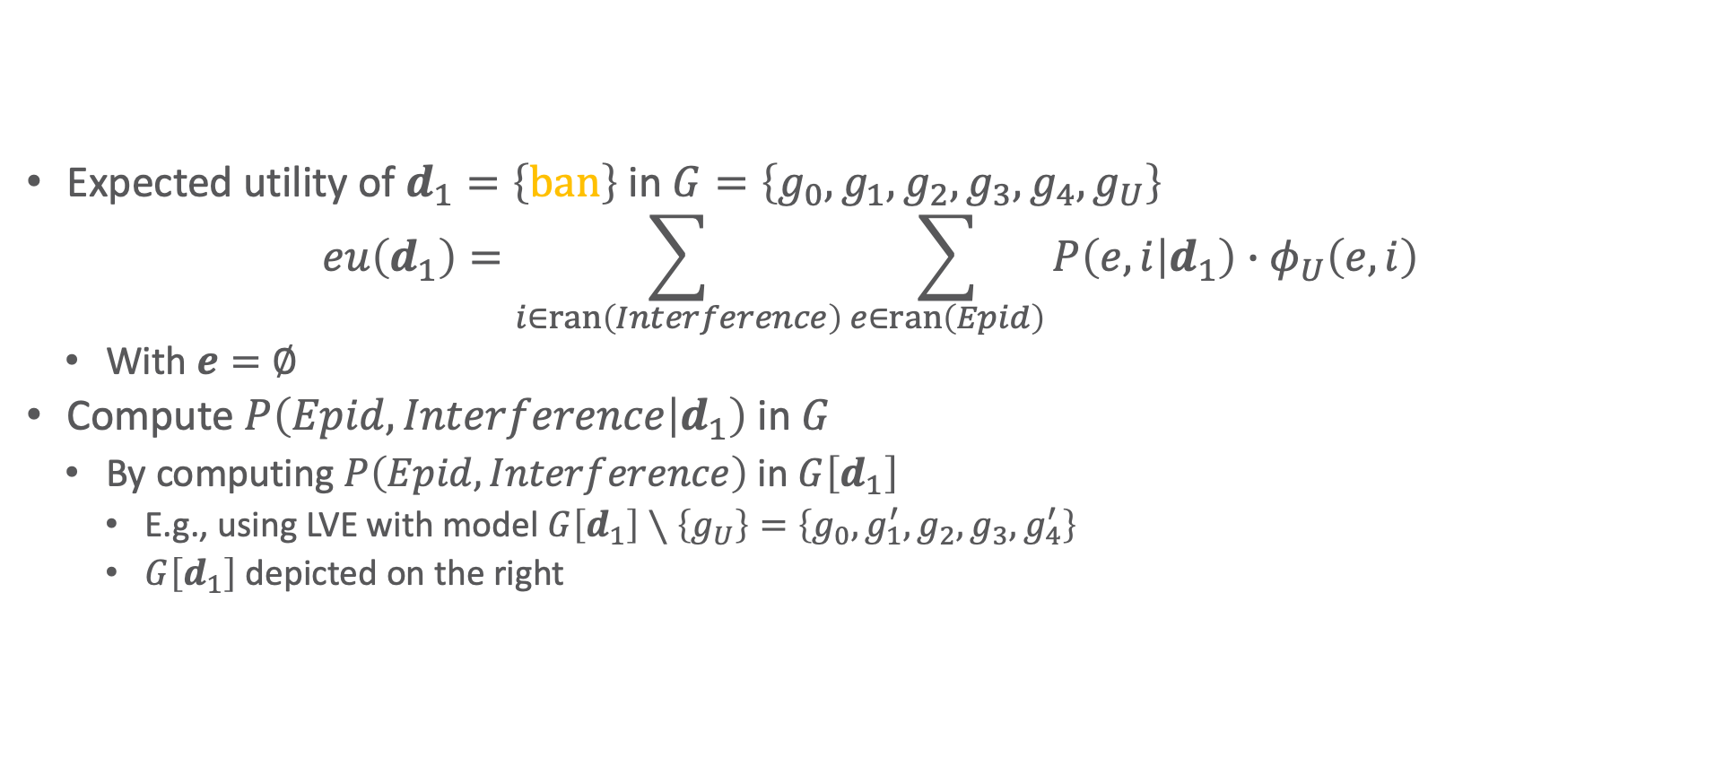








EU Query: Example
Expected utility of $d_{1}=\left\{ban\right\}$ in $G=\left\{g_{0},g_{1},g_{2},g_{3},g_{4},g_{U}\right\}$
$$eu\left(d_{1}\right)=\sum_{i∈ran\left(Interference\right)}{\sum_{e∈ran\left(Epid\right)}{P\left(e, i | d_{1}\right)∙φ_{U}\left(e, i\right)}}$$
  With $e=∅$
Compute $P\left(Epid,Interference | d_{1}\right)$ in $G$
  By computing $P\left(Epid,Interference\right)$ in $G\left[d_{1}\right]$
    E.g., using LVE with model $G\left[d_{1}\right]∖\left\{g_{U}\right\}=\left\{g_{0},g_{1}^{′},g_{2},g_{3},g_{4}^{′}\right\}$
    $G\left[d_{1}\right]$ depicted on the right
$$Interference$$
$$g_{4}^{′}$$
$$Util$$
$$g_{U}$$
$$Epid$$
$$g_{1}^{′}$$
$$g_{0}$$
$$Travel\left(X\right)$$
$$Treat\left(X,M\right)$$
$$g_{2}$$
$$g_{3}$$
$$Sick\left(X\right)$$

Slide 29

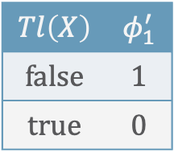
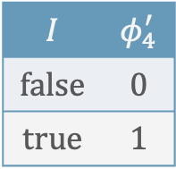
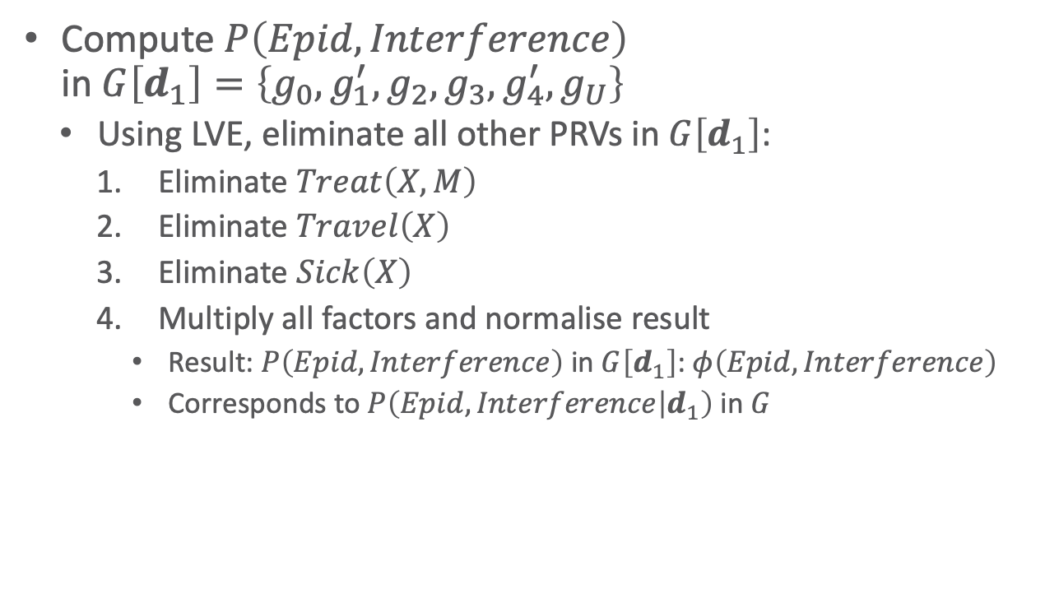
EU Query: Example
Compute $P\left(Epid, Interference\right)$
in $G\left[d_{1}\right]=\left\{g_{0},g_{1}^{′},g_{2},g_{3},g_{4}^{′},g_{U}\right\}$
  Using LVE, eliminate all other PRVs in $G\left[d_{1}\right]$:
    Eliminate $Treat\left(X,M\right)$
    Eliminate $Travel\left(X\right)$
    Eliminate $Sick\left(X\right)$
    Multiply all factors and normalise result
      Result: $P\left(Epid,Interference\right)$ in $G\left[d_{1}\right]$: $φ\left(Epid, Interference\right)$
      Corresponds to $P\left(Epid,Interference | d_{1}\right)$ in $G$
Parfactors $g_{1}^{′}$ and $g_{4}^{′}$ would look differently, had we set $d_{2}=\left\{free\right\}$.
$$I$$ | $$φ_{4}^{′}$$
$$false$$ | $$0$$
$$true$$ | $$1$$
$$Tl\left(X\right)$$ | $$φ_{1}^{′}$$
$$false$$ | $$1$$
$$true$$ | $$0$$
$$Interference$$
$$g_{4}^{′}$$
$$Util$$
$$g_{U}$$
$$Epid$$
$$g_{1}^{′}$$
$$g_{0}$$
$$Travel\left(X\right)$$
$$Treat\left(X,M\right)$$
$$g_{2}$$
$$g_{3}$$
$$Sick\left(X\right)$$

Slide 30
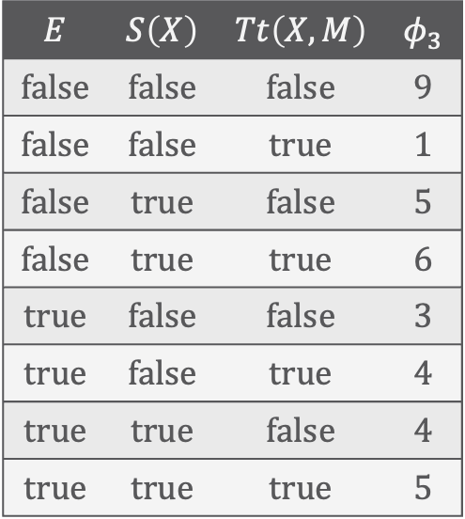
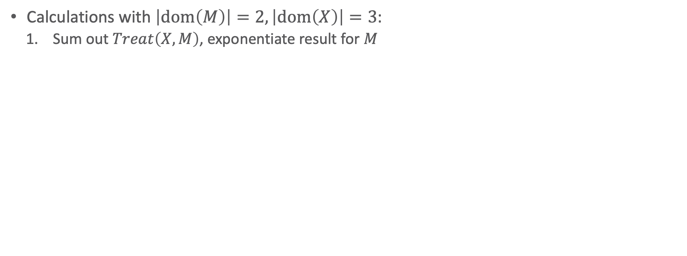
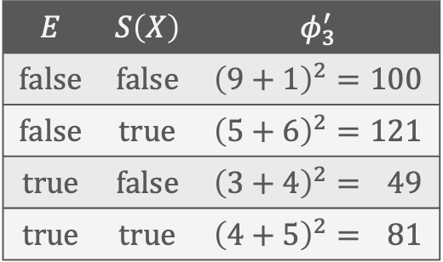
EU Query: Example
Calculations with $\left|dom\left(M\right)\right|=2,\left|dom\left(X\right)\right|=3$:
  Sum out $Treat\left(X,M\right)$, exponentiate result for $M$
$$E$$ | $$S\left(X\right)$$ | $$Tt\left(X,M\right)$$ | $$φ_{3}$$
$$false$$ | $$false$$ | $$false$$ | $$9$$
$$false$$ | $$false$$ | $$true$$ | $$1$$
$$false$$ | $$true$$ | $$false$$ | $$5$$
$$false$$ | $$true$$ | $$true$$ | $$6$$
$$true$$ | $$false$$ | $$false$$ | $$3$$
$$true$$ | $$false$$ | $$true$$ | $$4$$
$$true$$ | $$true$$ | $$false$$ | $$4$$
$$true$$ | $$true$$ | $$true$$ | $$5$$
$$E$$ | $$S\left(X\right)$$ | $$φ_{3}^{′}$$
$$false$$ | $$false$$ | $${\left(9+1\right)}^{2}=100$$
$$false$$ | $$true$$ | $${\left(5+6\right)}^{2}=121$$
$$true$$ | $$false$$ | $${\left(3+4\right)}^{2}=049$$
$$true$$ | $$true$$ | $${\left(4+5\right)}^{2}=081$$
$$Interference$$
$$g_{4}^{′}$$
$$Util$$
$$g_{U}$$
$$Epid$$
$$g_{1}^{′}$$
$$g_{0}$$
$$Travel\left(X\right)$$
$$Treat\left(X,M\right)$$
$$g_{2}$$
$$g_{3}$$
$$Sick\left(X\right)$$

Slide 31
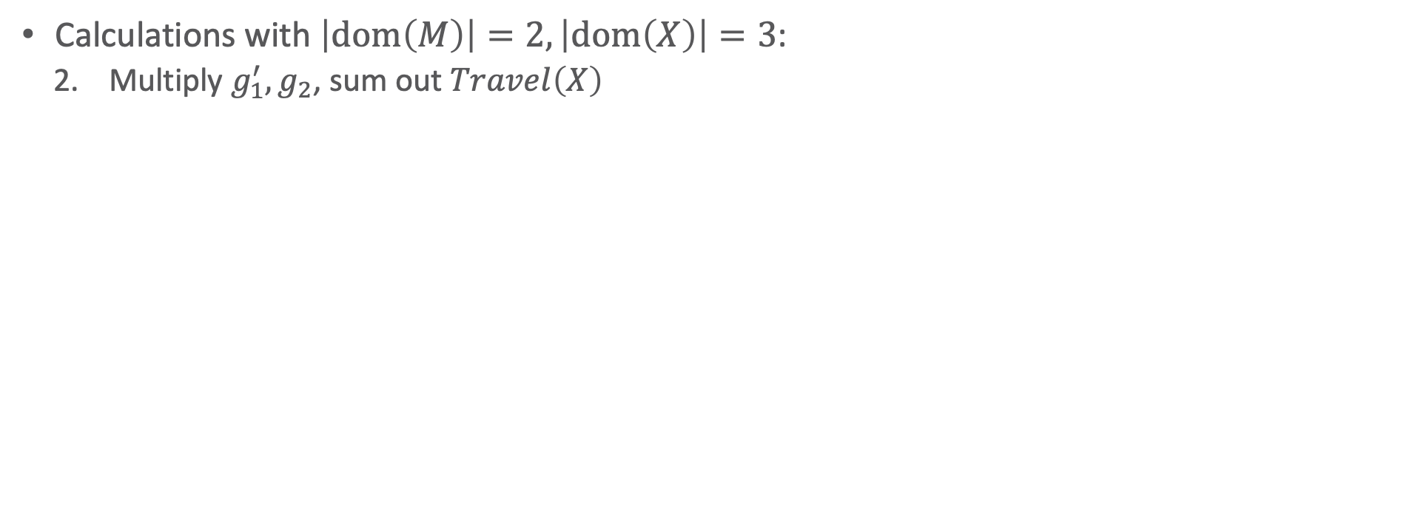
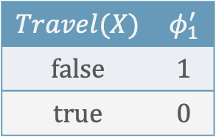
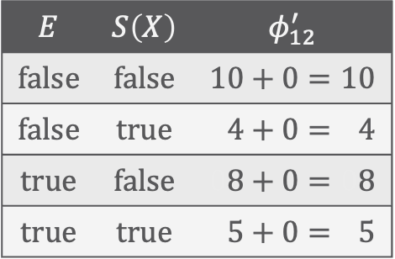

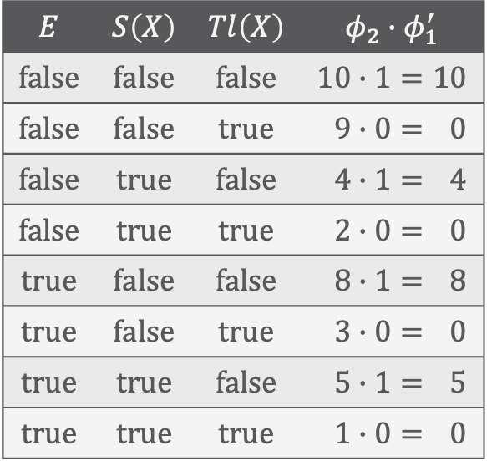
EU Query: Example
Calculations with $\left|dom\left(M\right)\right|=2,\left|dom\left(X\right)\right|=3$:
  Multiply $g_{1}^{′},g_{2}$, sum out $Travel\left(X\right)$
$$E$$ | $$S\left(X\right)$$ | $$Tl\left(X\right)$$ | $$φ_{2}∙φ_{1}^{′}$$
$$false$$ | $$false$$ | $$false$$ | $$10∙1=10$$
$$false$$ | $$false$$ | $$true$$ | $$09∙0=00$$
$$false$$ | $$true$$ | $$false$$ | $$04∙1=04$$
$$false$$ | $$true$$ | $$true$$ | $$02∙0=00$$
$$true$$ | $$false$$ | $$false$$ | $$08∙1=08$$
$$true$$ | $$false$$ | $$true$$ | $$03∙0=00$$
$$true$$ | $$true$$ | $$false$$ | $$05∙1=05$$
$$true$$ | $$true$$ | $$true$$ | $$01∙0=00$$
$$E$$ | $$S\left(X\right)$$ | $$φ_{12}^{′}$$
$$false$$ | $$false$$ | $$10+0=10$$
$$false$$ | $$true$$ | $$04+0=04$$
$$true$$ | $$false$$ | $$08+0=08$$
$$true$$ | $$true$$ | $$05+0=05$$
$$Interference$$
$$g_{4}^{′}$$
$$Util$$
$$g_{U}$$
$$Travel(X)$$ | $$φ_{1}^{′}$$
$$false$$ | $$1$$
$$true$$ | $$0$$
$$Epid$$
$$g_{1}^{′}$$
$$g_{0}$$
$$Travel\left(X\right)$$
$$g_{2}$$
$$g_{3}^{′}$$
$$Sick\left(X\right)$$

Slide 32

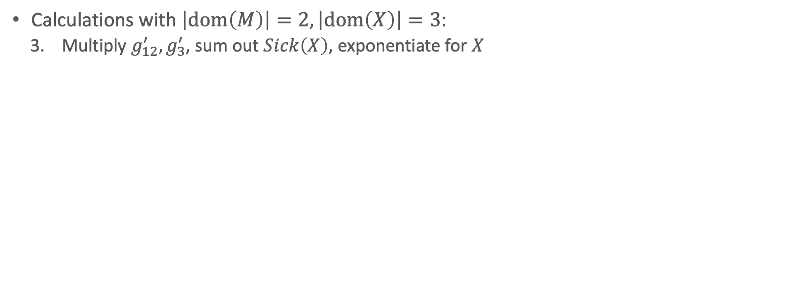
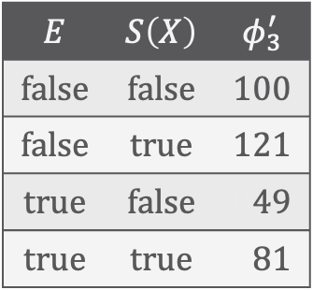
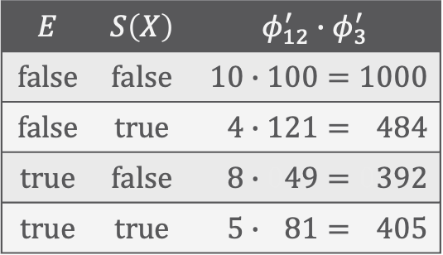
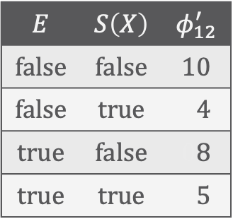
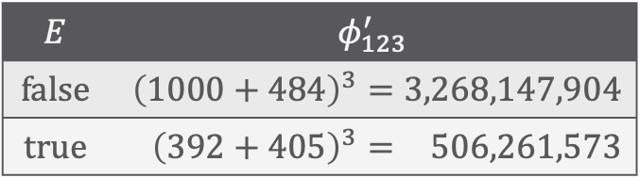
EU Query: Example
Calculations with $\left|dom\left(M\right)\right|=2,\left|dom\left(X\right)\right|=3$:
  Multiply $g_{12}^{′},g_{3}^{′}$, sum out $Sick\left(X\right)$, exponentiate for $X$
$$E$$ | $$S\left(X\right)$$ | $$φ_{12}^{′}$$
$$false$$ | $$false$$ | $$10$$
$$false$$ | $$true$$ | $$04$$
$$true$$ | $$false$$ | $$08$$
$$true$$ | $$true$$ | $$05$$
$$E$$ | $$S\left(X\right)$$ | $$φ_{3}^{′}$$
$$false$$ | $$false$$ | $$100$$
$$false$$ | $$true$$ | $$121$$
$$true$$ | $$false$$ | $$049$$
$$true$$ | $$true$$ | $$081$$
$$E$$ | $$S\left(X\right)$$ | $$φ_{12}^{′}∙φ_{3}^{′}$$
$$false$$ | $$false$$ | $$10∙100=1000$$
$$false$$ | $$true$$ | $$4∙121=0484$$
$$true$$ | $$false$$ | $$8∙049=0392$$
$$true$$ | $$true$$ | $$5∙081=0405$$
$$Interference$$
$$g_{4}^{′}$$
$$Util$$
$$g_{U}$$
$$E$$ | $$φ_{123}^{′}$$
$$false$$ | $${\left(1000+484\right)}^{3}=3,268,147,904$$
$$true$$ | $${\left(392+405\right)}^{3}=0,506,261,573$$
$$Epid$$
$$g_{0}$$
$$g_{12}^{′}$$
$$g_{3}^{′}$$
$$Sick\left(X\right)$$

Slide 33

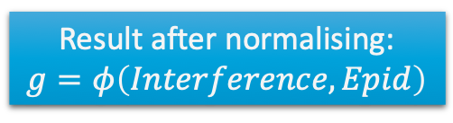

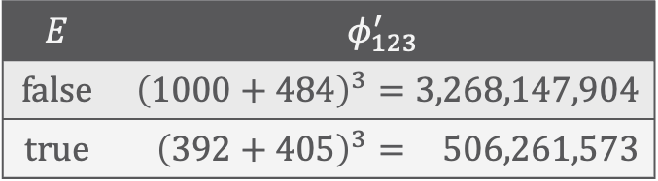
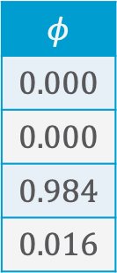


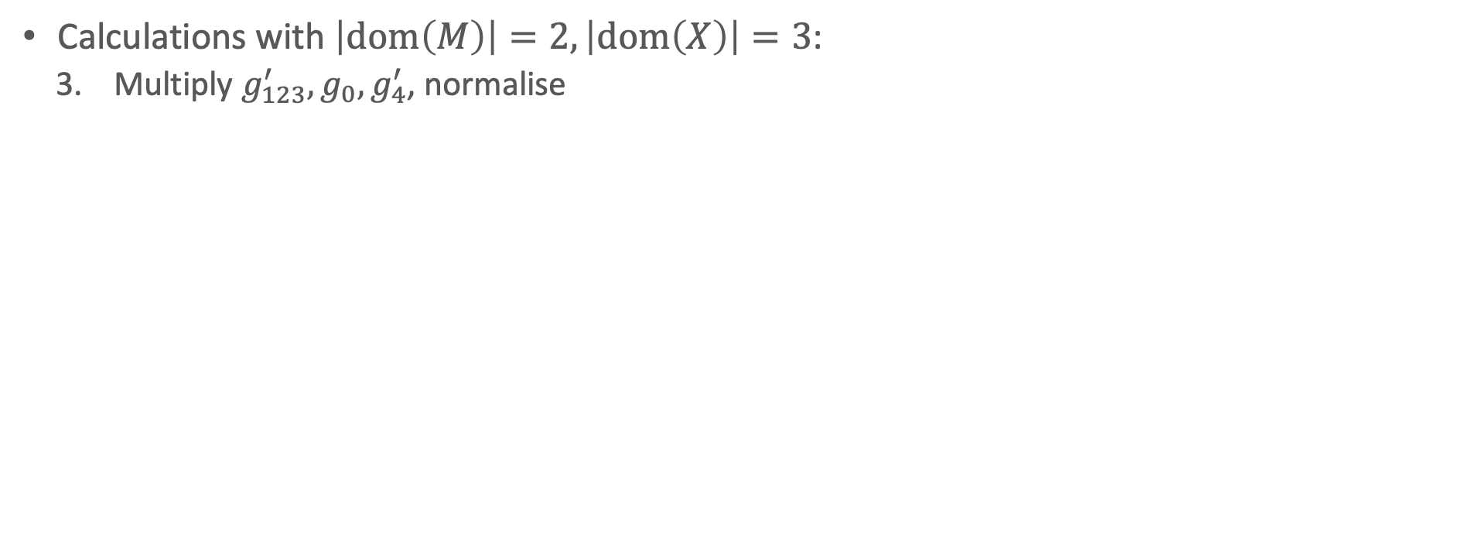
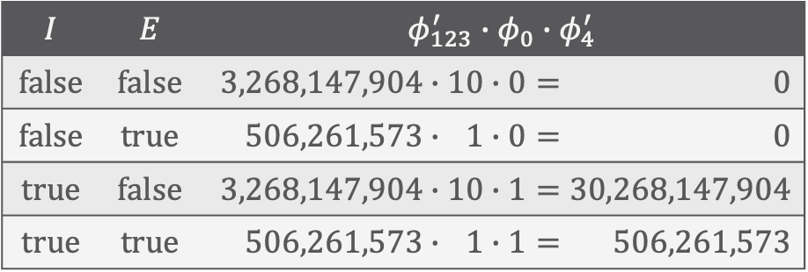
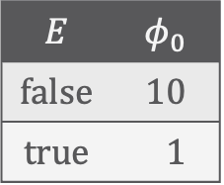
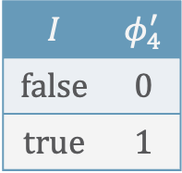

EU Query: Example
Calculations with $\left|dom\left(M\right)\right|=2,\left|dom\left(X\right)\right|=3$:
  Multiply $g_{123}^{′},g_{0},g_{4}^{′}$, normalise
Result after normalising:
$$g=φ\left(Interference,Epid\right)$$
$$E$$ | $$φ_{123}^{′}$$
$$false$$ | $${\left(1000+484\right)}^{3}=3,268,147,904$$
$$true$$ | $${\left(392+405\right)}^{3}=0,506,261,573$$
$$E$$ | $$φ_{0}$$
$$false$$ | $$10$$
$$true$$ | $$01$$
$$I$$ | $$φ_{4}^{′}$$
$$false$$ | $$0$$
$$true$$ | $$1$$
$$Interference$$
$$Util$$
$$g$$
$$Epid$$
$$g_{U}$$
$$I$$ | $$E$$ | $$φ_{123}^{′}∙φ_{0}∙φ_{4}^{′}$$
$$false$$ | $$false$$ | $$3,268,147,904∙10∙0=30,268,147,900$$
$$false$$ | $$true$$ | $$0,506,261,573∙01∙0=30,268,147,900$$
$$true$$ | $$false$$ | $$3,268,147,904∙10∙1=30,268,147,904$$
$$true$$ | $$true$$ | $$0,506,261,573∙01∙1=00,506,261,573$$
$$φ$$
$$0.000$$
$$0.000$$
$$0.984$$
$$0.016$$
$$Interference$$
$$g_{4}^{′}$$
$$Util$$
$$g_{U}$$
$$Epid$$
$$g_{0}$$
$$g_{123}^{′}$$

Slide 34


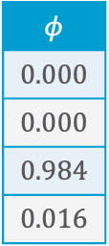
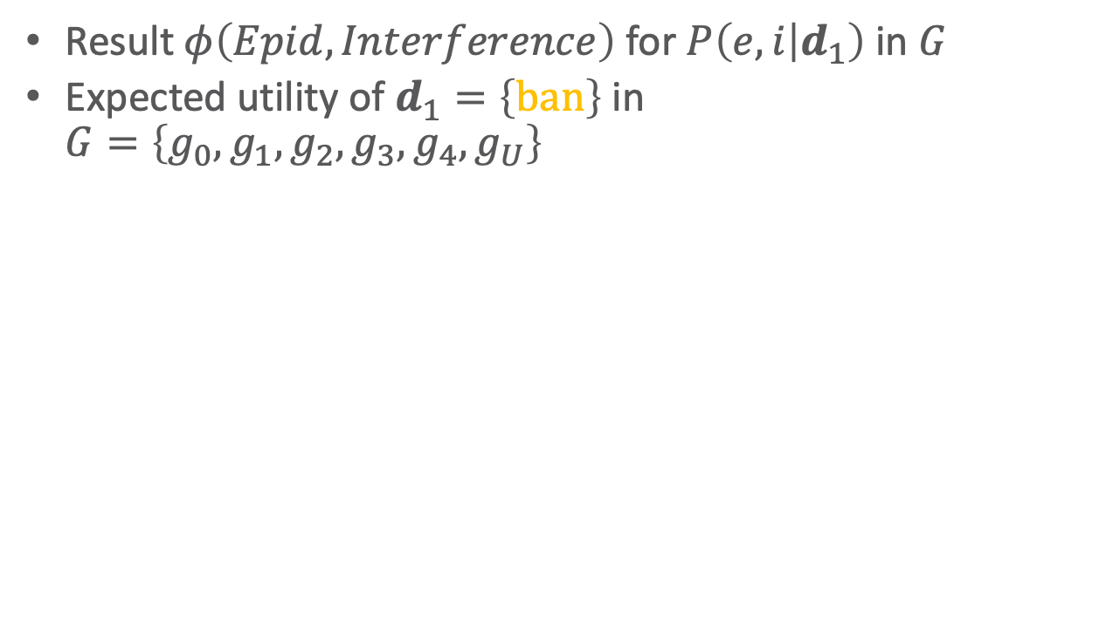

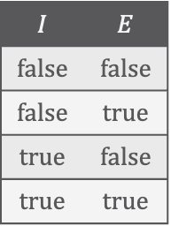
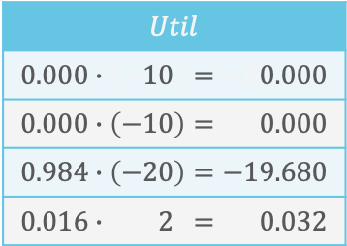


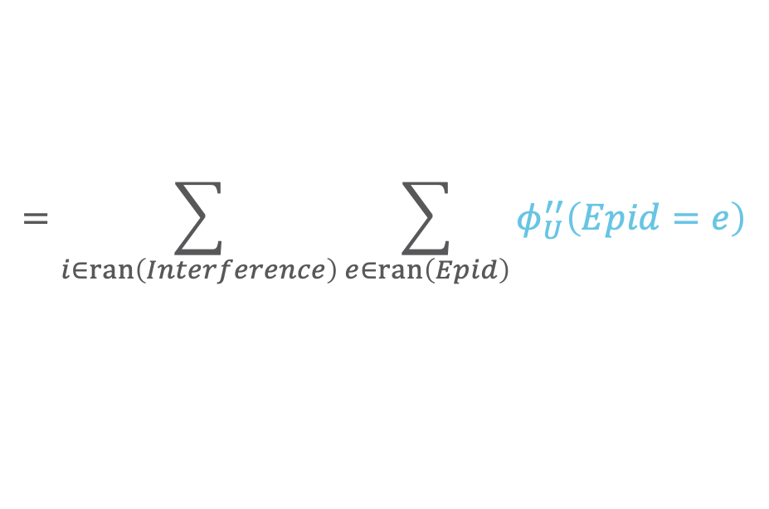











EU Query: Example
$$Interference$$
$$Util$$
$$g$$
$$Epid$$
$$g_{U}$$
$$I$$ | $$E$$
$$false$$ | $$false$$
$$false$$ | $$true$$
$$true$$ | $$false$$
$$true$$ | $$true$$
$$φ$$
$$0.000$$
$$0.000$$
$$0.984$$
$$0.016$$
$$Util$$
$$−10$$
$$−10$$
$$−20$$
$$−02$$
Result $φ\left(Epid, Interference\right)$ for $P\left(e, i | d_{1}\right)$ in $G$
Expected utility of $d_{1}=\left\{ban\right\}$ in
$G=\left\{g_{0},g_{1},g_{2},g_{3},g_{4},g_{U}\right\}$
  $$eu\left(d_{1}\right)=\sum_{i∈ran\left(Interference\right)}{\sum_{e∈ran\left(Epid\right)}{P\left(e, i | d_{1}\right)∙φ_{U}\left(e, i\right)}}$$
$$Interference$$
$$Util$$
$$Epid$$
$$g_{U}^{′′}$$
$$I$$ | $$E$$
$$false$$ | $$false$$
$$false$$ | $$true$$
$$true$$ | $$false$$
$$true$$ | $$true$$
$$Util$$
$$0.000∙\left(−10\right)=−00.000$$
$$0.000∙\left(−10\right)=−00.000$$
$$0.984∙\left(−20\right)=−19.680$$
$$0.016∙\left(−02\right)=−00.032$$
  $$=\sum_{i∈ran\left(Interference\right)}{\sum_{e∈ran\left(Epid\right)}{φ\left(e,i\right)∙φ_{U}^{′}\left(e,i\right)}}$$
  $$=\sum_{i∈ran\left(Interference\right)}{\sum_{e∈ran\left(Epid\right)}{φ_{U}^{′′}\left(Epid=e\right)}}$$
$$Util$$
$$g_{U}^{′′′}$$
$$.$$ | $$Util$$
$$.$$ | $$0+0−19.680+0.032=−19.360$$
  $$=φ_{U}^{′′′}\left(.\right)$$
Notes:
d=free
00: 181,085,703,760 ➝
01: 1,076,890,625
10: 0
11: 0

Slide 35

Answering EU-Queries (with LVE)
Given a decision model $G={\left\{g_{i}\right\}}_{i=1}^{n}∪\left\{g_{U}\right\}$, evidence $e$,
and an action assignment $d$ (*)
  Absorb $e$ and $d$ in $G$
  Calculate the posterior, $P\left(R | e,d\right)$, of the Markov blanket of the utility node
    I.e., $R=rv\left(g_{U}\right)∖rv\left(d\right)∖rv\left(e\right)$ (remaining PRVs in $g_{U}$ after previous step)
    Using LVE: With $R$ as the query terms, eliminate all non-query terms in $G$, i.e., call $\text{LVE}\left(G∖\left\{g_{U}\right\},R,∅\right)$
      Evidence already absorbed, decisions made ➝ $e=∅$ in the call
  Calculate the expected utility by summing over the range values of $R$:
  $$eu\left(e,d\right)=\sum_{r∈ran\left(R\right)}{P\left(r | e,d\right)∙φ_{U}\left(r\right)}$$
    Using LVE: Eliminate remaining PRVs in $G$
      Result: parfactor mapping empty argument to a single value ($U$)
(*) We need to talk about evidence and action assignments later.

Slide 36



MEU Problem
Given a decision model $G$ and evidence $e$, maximum Expected Utility (MEU) problem:
  Find the action assignment that yields the highest expected utility in $G$
  Formally,
  For an exact solution, $\operatorname{meu}\left(G|e\right)$ requires an algorithm to go through all $d∈ran\left(D\right)$
    Size of $ran\left(D\right)$ exponential in $\left|gr\left(D\right)\right|$
$$\operatorname{meu}\left(G|e\right)=\left(d^{∗},eu\left(e,d^{∗}\right)\right)$$
$$d^{∗}=\underset{d∈ran\left(D\right)}{arg max}{eu\left(e,d\right)}$$
Additive semantics with inner sum and outer max: Sum up utilities, then pick maximum
➝ Max-sum algorithms
Alternative specification
$$\operatorname{meu}\left(G|e\right)=\left(\underset{d∈ran\left(D\right)}{arg max}{eu\left(e,d\right)},\max_{d∈ran\left(D\right)}{eu\left(e,d\right)}\right)$$

Slide 37

MEU Problem: Example
Problem instance with $G=\left\{g_{0},g_{1},g_{2},g_{3},g_{U}\right\}$, $e=∅$:
$$\operatorname{meu}\left(G\right)=\left(d^{∗},eu\left(d^{∗}\right)\right) d^{∗}=\underset{d∈\left\{d_{1},d_{2}\right\}}{arg max}{eu\left(d\right)}$$
  $d_{1}=\left\{ban\right\}, d_{2}=\left\{free\right\}$
  Expected utility of $d_{1}=\left\{ban\right\}$: $eu\left(d_{1}\right)=−19.36$
  Expected utility of $d_{2}=\left\{free\right\}$: $eu\left(d_{2}\right)=−19.88$
Solution
  $d^{∗}=\underset{d∈\left\{d_{1},d_{2}\right\}}{argmax}{eu\left(d\right)}=d_{2}$
  $\operatorname{meu}\left(G\right)=\left(d_{2},9.88\right)$
  Decision that leads to maximum EU:
  No travel restrictions
$$Interference$$
$$g_{4}$$
$$Restrict\left(X\right)$$
$$Util$$
$$g_{U}$$
$$Epid$$
$$g_{1}$$
$$g_{0}$$
$$Travel\left(X\right)$$
$$Treat\left(X,M\right)$$
$$g_{2}$$
$$g_{3}$$
$$Sick\left(X\right)$$

Slide 38


Lifted MEU
$$\operatorname{meu}\left(G|e\right)=\left(d^{∗},eu\left(e,d^{∗}\right)\right)$$
$$d^{∗}=\underset{d∈ran\left(D\right)}{arg max}{eu\left(e,d\right)}$$
In terms of semantics, $d∈ran\left(D\right)$ means
  Grounding $D$ and going through all possible combinations of assignments to $gr\left(D\right)$
But: grounding is bad!
  Combinatorial explosion: number of action assignments to test exponential in size of $gr\left(D\right)$
  Grounds any parfactor in G containing a logvar of $D$
Also: Grounding to full extent often unnecessary
  Within groups of indistinguishable constants, the same decision will lead to its maximum influence in the MEU solution
    Only need to test each assignment for complete group
Thus: Test out all possible combinations of assignments w.r.t. the groups occurring in $G$
  No longer exponential in the size of $gr\left(D\right)$!

Slide 39

Lifted MEU: Groups
$$\operatorname{meu}\left(G|e\right)=\left(d^{∗},eu\left(e,d^{∗}\right)\right)$$
$$d^{∗}=\underset{d∈ran\left(D\right)}{arg max}{eu\left(e,d\right)}$$
In parameterised models without evidence
(or evidence for complete domains), $d∈ran\left(D\right)$ means
  Going through all possible combinations of assignments to $D$
    One group per logical variable
In models with evidence affecting parfactors
containing decision PRVs, $d∈ran\left(D\right)$ means
  Going through all possible combinations of
  assignments for each group of constants after
  evidence handling
    Specifically, after shattering
Effect: size exponential in number of groups
$$Interference$$
$$g_{4}$$
$$Restrict\left(X\right)$$
$$Util$$
$$g_{U}$$
$$Epid$$
$$g_{1}$$
$$g_{0}$$
$$Travel\left(X\right)$$
$$Treat\left(X,M\right)$$
$$g_{2}$$
$$g_{3}$$
(*) Now is later.
$$Sick\left(X\right)$$

Slide 40

Lifted MEU: Groups – Example
$$\operatorname{meu}\left(G|e\right)=\left(d^{∗},eu\left(e,d^{∗}\right)\right)$$
$$d^{∗}=\underset{d∈ran\left(D\right)}{arg max}{eu\left(e,d\right)}$$
Decision model $G=\left\{g_{0},g_{1},g_{2},g_{3},g_{4},g_{U}\right\}$
  Decision PRV $Restrict\left(X\right)$ with range $\left\{ban, free\right\}$
  Evidence $e=\left\{Sick\left(X^{′}\right)=true\right\},dom\left(X^{′}\right)=\left\{x_{1},…, x_{10}\right\}$
  Overlap in domain of $X,X^{′}$ ➝ Shattering duplicates $g_{1},g_{2},g_{3},g_{4}$
    For $dom\left(X^{′}\right)=\left\{x_{1},…, x_{10}\right\}$, $dom\left(X^{′′}\right)=\left\{x_{10},…, x_{n}\right\}$
    Alternative: Duplicate + restrict constraints
Action assignments
    $R≜Restrict, b≜ban, f≜free$
  $d_{1}=\left\{R\left(X′′\right)=b,R\left(X^{′}\right)=b\right\}$
  $d_{2}=\left\{R\left(X′′\right)=b, R\left(X^{′}\right)=f\right\}$
  $d_{3}=\left\{R\left(X′′\right)=f,R\left(X^{′}\right)=b\right\}$
  $d_{4}=\left\{R\left(X′′\right)=f,R\left(X^{′}\right)=f\right\}$
$$Interference$$
$$g_{4}$$
$$Restrict\left(X\right)$$
$$Util$$
$$g_{U}$$
$$Epid$$
$$g_{1}$$
$$g_{0}$$
$$Travel\left(X\right)$$
$$Treat\left(X,M\right)$$
$$g_{2}$$
$$g_{3}$$
$$Sick\left(X\right)$$

Slide 41

Answering EU-Queries for MEU
Given a decision model $G={\left\{g_{i}\right\}}_{i=1}^{n}∪\left\{g_{U}\right\}$, evidence $e$, and an action assignment $d$ for groups in $G$ after shattering
  Calculate the posterior, $P\left(R | e,d\right)$, of the Markov blanket of the utility node
    I.e., $R=rv\left(g_{U}\right)∖rv\left(a\right)∖rv\left(E\right)$ (remaining PRVs in $g_{u}$’s after previous step)
    Using LVE: With $R$ as the query terms and $e,d$ as evidence, eliminate all non-query terms in $G$, i.e., call
    $$\text{LVE}\left(G∖\left\{g_{U}\right\},R,e∪d\right)$$
  Calculate the expected utility by summing over the range values of $R$:
  $$eu\left(e,d\right)=\sum_{r∈ran\left(R\right)}{P\left(r | e,d\right)∙φ_{U}\left(r\right)}$$
    Using LVE: Eliminate remaining PRVs in $\left\{g\right\}∪\left\{g_{U}\right\}, g=\text{LVE}\left(G∖\left\{g_{U}\right\},R,e∪d\right)$, i.e., call
    $$\text{LVE}\left(\left\{g\right\}∪\left\{g_{U}\right\},R,e∪d\right)$$
      $e,d$ not yet handled in $g_{U}$; alternatively: absorb $e,d$ at beginning in $G$
      Result: parfactor mapping empty argument to a single value ($U$)

Slide 42

LVE for MEU Problems
function $\text{MEU}\text{−}\text{LVE}\left(G={\left\{g_{i}\right\}}_{i=1}^{n}∪\left\{g_{U}\right\},e\right)$
Absorb $e$ in $G$
$d^{∗}←∅$
${eu}_{max}←−∞$
for each action assignment $d$ in $G$ do
$g←\text{LVE}\left(G∖\left\{g_{U}\right\},rv\left(g_{U}\right),d\right)$ ▹$g$ normalised
$eu←\text{LVE}\left(\left\{g_{U},g\right\},∅,d\right)$
if $eu>{eu}_{max}$ then
$d^{∗}←d$
${eu}_{max}←eu$
return $d^{∗}$
Modify to save all assignments that lie within $ε$-margin
LVE-MEU

Slide 43

Structure in Multi-attribute Settings
So far: Set of attributes without structure
  Single utility functions mapping to one utility
    Example: $φ_{U}\left(Interference, Epid\right)$
Cases with structure:
  Set of (distinguishable) attributes with structure
    Set of utility functions, mapping to interim utilities,
    combined into one overall utility
  Set of indistinguishable attributes
    Utility parfactor mapping to an interim utility PRV, which is combined into one utility
  Sets of distinguishable and indistinguishable attributes
    Set of utility parfactors and utility factors, combined into one utility
  Considering structure requires a combination function $Ξ$
$$Interference$$
$$g_{4}$$
$$Restrict\left(X\right)$$
$$Util$$
$$g_{U}$$
$$Epid$$
$$g_{1}$$
$$g_{0}$$
$$Travel\left(X\right)$$
$$Treat\left(X,M\right)$$
$$g_{2}$$
$$g_{3}$$
$$Sick\left(X\right)$$

Slide 44
























1. Set of Attributes with Structure: Example
$$Enforce.bus$$
$$g_{5}$$
$$Interference$$
Example:
  $φ_{U_{IE}}\left(Interference, Epid\right)$
  utility factor over $Interference, Epid$
  $φ_{U_{Eb}}\left(Enforce.bus\right)$
  utility factor over $Enforce.bus$
    (Effort it takes to enforce travel restriction on busses)
  $Ξ$ a combination function, combining $U_{1},U_{2}$ into $Util$
    Could rewrite model using $Ξ$ into a model containing only
    one utility factor $g_{U}$ (shown above)
      $φ_{U}\left(Interference, Epid,Enforce.bus\right)$
      $=Ξ\left[φ_{U_{IE}}\left(Interference, Epid\right),φ_{U_{Eb}}\left(Enforce.bus\right)\right]$
$$g_{4}$$
$$Restrict\left(X\right)$$
$$g_{U}$$
$$Epid$$
$$Util$$
$$g_{1}$$
$$g_{0}$$
$$Travel\left(X\right)$$
$$Treat\left(X,M\right)$$
$$g_{2}$$
$$g_{3}$$
$$Sick\left(X\right)$$
$$Enforce.bus$$
$$g_{5}$$
$$g_{U_{Eb}}$$
$$Interference$$
$$U_{Eb}$$
$$g_{4}$$
$$Restrict\left(X\right)$$
$$U_{IE}$$
$$g_{U_{IE}}$$
$$Ξ$$
$$Epid$$
$$Util$$
$$g_{1}$$
$$g_{0}$$
$$Travel\left(X\right)$$
$$Treat\left(X,M\right)$$
$$g_{2}$$
$$g_{3}$$
$$Sick\left(X\right)$$

Slide 45

1. Set of Attributes with Structure
Set of attributes that show MPI ➝ Utility function ”factorises” into sets of functions over attributes, combined with a combination function $Ξ$, i.e.,
  $$U\left(r_{1},…,r_{M}\right)=Ξ\left[φ_{1}\left(r_{1}\right),…,φ_{M}\left(r_{M}\right)\right]$$
  I.e., each $φ_{i}\left(r_{i}\right)$ maps to its own interim utility, $U_{i}$, combined into an overall utility $U$ through $Ξ$
  More general: Each $f_{i}$ has a set of random variables $r_{i}$ as input with $r=\left\{r_{1},…,r_{M}\right\}=\bigcup_{i=1}^{m}{r_{i}}$
Extended syntax: Decision model
  $$G={\left\{g_{i}\right\}}_{i=1}^{n}∪{\left\{g_{u}\right\}}_{u=1}^{m}∪\left\{Ξ\right\}$$
    Refer to submodel of potential parfactors by $G_{P}$ and to submodel of utility factors by $G_{U}$
  $g_{i}=φ_{i}{\left(𝒜_{i}\right)}_{|C_{i}}$ parfactors with (decision) PRVs as arguments
  $g_{u}=φ_{U_{u}}\left(ℛ_{u}\right)$ utility factors, each mapping to a utility variable $U_{u}$
  $Ξ$ a combination function, combining all $U_{u}$ into one $U$, i.e.,
    $$φ_{U}\left(r_{1},…,r_{M}\right)=Ξ\left[φ_{U_{1}}\left(π_{ℛ_{1}}\left(r_{1},…,r_{M}\right)\right),…,φ_{U_{m}}\left(π_{ℛ_{m}}\left(r_{1},…,r_{M}\right)\right)\right]$$

Slide 46

1. Set of Attributes with Structure: EU Query & MEU Problem
Given a decision model $G=G_{P}∪G_{U}∪\left\{Ξ\right\}={\left\{g_{i}\right\}}_{i=1}^{n}∪{\left\{g_{u}\right\}}_{u=1}^{m}∪\left\{Ξ\right\}$
  Query for an expected utility (EU): change in sum over $rv\left(G_{U}\right)$ instead of $rv\left(g_{U}\right)$
    $$eu\left(e,d\right)=\sum_{v∈ran\left(rv\left(G_{U}\right)∖E∖D\right)}{P\left(v | e,d\right)∙Ξ\left[φ_{U_{1}}\left(π_{ℛ_{1}}\left(v,e,d\right)\right),…,φ_{U_{m}}\left(π_{ℛ_{m}}\left(v,e,d\right)\right)\right]}$$
    If $Ξ$ addition, then
      $$eu\left(e,d\right)=\sum_{v∈ran\left(gr\left(rv\left(G_{U}\right)∖E∖D\right)\right)}{P\left(v | e,d\right)∙\sum_{g_{u}∈G_{U}}{φ_{U_{u}}\left(π_{ℛ_{u}}\left(v,e,d\right)\right)}}$$
      Works like multiply, i.e., like a join, but with summing of utilities
      instead of multiplying of potentials
  MEU problem: no changes
    $$\operatorname{meu}\left(G|e\right)=\left(d^{∗},eu\left(e,d^{∗}\right)\right)$$
  $$d^{∗}=\underset{d∈ran\left(D\right)}{argmax}{eu\left(e,d\right)}$$
$$Enforce.bus$$
$$g_{5}$$
$$g_{U_{Eb}}$$
$$Interference$$
$$U_{Eb}$$
$$g_{4}$$
$$Restrict\left(X\right)$$
$$U_{IE}$$
$$g_{U_{IE}}$$
$$Ξ$$
$$Epid$$
$$Util$$
$$g_{1}$$
$$g_{0}$$
$$Travel\left(X\right)$$
$$Treat\left(X,M\right)$$
$$g_{2}$$
$$g_{3}$$
$$Sick\left(X\right)$$

Slide 47





1. Set of Attributes with Structure: Additive Join
$$I$$ | $$E$$ | $$U_{IE}$$
$$false$$ | $$false$$ | $$−10$$
$$false$$ | $$true$$ | $$−10$$
$$true$$ | $$false$$ | $$−20$$
$$true$$ | $$true$$ | $$−02$$
$$Eb$$ | $$U_{Eb}$$
$$false$$ | $$−00$$
$$true$$ | $$−10$$
Operator:
  Example
$$I$$ | $$E$$ | $$Eb$$ | $$U_{IE}$$
$$false$$ | $$false$$ | $$false$$ | $$−10+00=−10$$
$$false$$ | $$false$$ | $$true$$ | $$−10−10=−00$$
$$false$$ | $$true$$ | $$false$$ | $$−10+00=−10$$
$$false$$ | $$true$$ | $$true$$ | $$−10−10=−20$$
$$true$$ | $$false$$ | $$false$$ | $$−20+00=−20$$
$$true$$ | $$false$$ | $$true$$ | $$−20−10=−30$$
$$true$$ | $$true$$ | $$false$$ | $$−02+00=−02$$
$$true$$ | $$true$$ | $$true$$ | $$−02−10=−08$$
$$Enforce.bus$$
$$g_{5}$$
$$g_{U_{Eb}}$$
$$Interference$$
$$U_{Eb}$$
$$g_{4}$$
$$Restrict\left(X\right)$$
$$U_{IE}$$
$φ_{U}\left(Interference, Epid,Enforce.bus\right)$
$=Ξ\left[φ_{U_{IE}}\left(Interference, Epid\right),φ_{U_{Eb}}\left(Enforce.bus\right)\right]$
$=φ_{U_{IE}}\left(Interference, Epid\right)+φ_{U_{Eb}}\left(Enforce.bus\right)$
$=add\left(g_{U_{IE}},g_{U_{Eb}}\right)$
$$g_{U_{IE}}$$
$$Ξ$$
$$Epid$$
$$Util$$
$$g_{1}$$
$$g_{0}$$
$$Travel\left(X\right)$$
$$Treat\left(X,M\right)$$
$$g_{2}$$
$$g_{3}$$
$$Sick\left(X\right)$$

Slide 48



1. Set of Attributes with Structure: MEU-LVE
Splitting a single utility function into set of utility factors has upside of needing to learn / specify fewer entries BUT:
Complexity still exponential in $M$ as combined into $g$
Implement add operator
  LVE with add operator referred to as LVE^{add}
Changes in MEU-LVE
  Input: decision model $G=G_{P}∪G_{U}={\left\{g_{i}\right\}}_{i=1}^{n}∪{\left\{g_{u}\right\}}_{u=1}^{m}$
  In for-loop:
    If $Ξ$ not addition, need to implement (change $L{\text{VE}}^{ADD}$ call)
    Combines $G_{U}$ into one $g_{U}$ before multiplying with $g$ and
    summing out the remaining variables
$g←\text{L}\text{VE}\left(M∖G_{U},rv\left(G_{U}\right),d\right)$ ▹$g$ normalised
$eu←L{\text{VE}}^{ADD}\left(G_{U}∪\left\{g\right\},∅,d\right)$
$$Enforce.bus$$
$$g_{5}$$
$$g_{U_{Eb}}$$
$$Interference$$
$$U_{Eb}$$
$$g_{4}$$
$$Restrict\left(X\right)$$
$$U_{IE}$$
$$g_{U_{IE}}$$
$$Ξ$$
$$Epid$$
$$Util$$
$$g_{1}$$
$$g_{0}$$
$$Travel\left(X\right)$$
$$Treat\left(X,M\right)$$
$$g_{2}$$
$$g_{3}$$
$$Sick\left(X\right)$$

Slide 49


1. Set of Attributes with Structure: Simplification
Assume (conditional) independence between the different $rv\left(f_{u}\right)$ given $e,d$, i.e., $P\left(v | e,d\right)=\prod_{u^{′}=1}^{m}{P\left(r_{u^{′}} | e,d\right)}$
    $$eu\left(e,d\right)=\sum_{v∈ran\left(V\right)}{P\left(v | e,d\right)∙}Ξ\left[φ_{U_{1}}\left(r_{1}\right),…,φ_{U_{m}}\left(r_{m}\right)\right] \\ =\sum_{v∈ran\left(V\right)}{P\left(v | e,d\right)∙\sum_{u=1}^{m}{φ_{u}\left(r_{u}\right)}} \\ =\sum_{u=1}^{m}{\sum_{r_{u}∈ran\left(rv\left(g_{u}\right)\right)}{P\left(r_{u} | e,d\right)∙φ_{u}\left(r_{u}\right)}}$$
Only yields correct result under stochastic independence
Idea similar to Boyen-Koller algorithm
Preferential and stochastic independence do not follow from each other!
$$Enforce.bus$$
$$g_{5}$$
$$g_{U_{Eb}}$$
$$Interference$$
$$U_{Eb}$$
$$g_{4}$$
$$Restrict\left(X\right)$$
$$U_{IE}$$
$$g_{U_{IE}}$$
$$Ξ$$
Query on $rv\left(f_{u}\right)$ for each utility factor
➝ Use multi-query algorithm like LJT
$$Epid$$
$$Util$$
$$g_{1}$$
$$g_{0}$$
$$Travel\left(X\right)$$
$$Treat\left(X,M\right)$$
$$g_{2}$$
$$g_{3}$$
$$Sick\left(X\right)$$

Slide 50


Derivation
$$eu\left(e,d\right)=\sum_{v∈ran\left(V\right)}{P\left(v | e,d\right)∙\sum_{u=1}^{m}{φ_{u}\left(r_{u}\right)}}=\sum_{v∈ran\left(V\right)}{\sum_{u=1}^{m}{P\left(v | e,d\right)∙φ_{u}\left(r_{u}\right)}}=\sum_{u=1}^{m}{\sum_{v∈ran\left(V\right)}{P\left(v | e,d\right)∙φ_{u}\left(r_{u}\right)}} \\ =\sum_{u=1}^{m}{\sum_{v∈ran\left(V\right)}{\prod_{u^{′}=1}^{m}{P\left(r_{u^{′}} | e,d\right)}∙φ_{u}\left(r_{u}\right)}} \\ =\sum_{u=1}^{m}{\sum_{r_{1}∈ran\left(R_{1}\right)}{… \sum_{r_{m}∈ran\left(R_{m}\right)}{P\left(r_{1} | e,d\right)∙…∙P\left(r_{m} | e,d\right)∙φ_{u}\left(r_{u}\right)}}} \\ =\sum_{u=1}^{m}{\sum_{r_{1}∈ran\left(R_{1}\right)}{P\left(r_{1} | e,d\right)∙…∙\sum_{r_{m}∈ran\left(R_{m}\right)}{P\left(r_{m} | e,d\right)∙φ_{u}\left(r_{u}\right)}}} \\ =\sum_{u=1}^{m}{\sum_{r_{u}∈ran\left(R_{u}\right)}{P\left(r_{u} | e,d\right)∙φ_{u}\left(r_{u}\right)∙\sum_{u^{′}=1,u^{′}≠u}^{m}{P\left(r_{u^{′}} | e,d\right)}}} \\ =\sum_{u=1}^{m}{\sum_{r_{u}∈ran\left(R_{u}\right)}{P\left(r_{u} | e,d\right)∙φ_{u}\left(r_{u}\right)}}$$
$$=1$$
(probability distributions
➝ sums to $1$)

Slide 51





1. Set of Attributes with Structure: Simplification – Example
Example: $d_{1}=\left\{ban\right\}$
  $P\left(E,I,Eb | d\right)=P\left(E | d\right)∙P\left(I | d\right)∙P\left(Eb | d\right)$
  $$eu\left(d_{1}\right) \\ =\sum_{eb∈ran\left(Eb\right)}{\sum_{i∈ran\left(I\right)}{\sum_{e∈ran\left(E\right)}{P\left(eb,i,e | d\right)∙\sum_{u=1}^{2}{φ_{u}\left(r_{u}\right)}}}} \\ =\sum_{eb∈ran\left(Eb\right)}{\sum_{i∈ran\left(I\right)}{\sum_{e∈ran\left(E\right)}{P\left(eb | d\right)∙P\left(i | d\right)∙P\left(e | d\right)∙}}}\sum_{u=1}^{2}{φ_{u}\left(r_{u}\right)} \\ =\sum_{eb∈ran\left(Eb\right)}{P\left(eb | d\right)∙φ_{Eb}\left(eb\right)} \\ +\sum_{i∈ran\left(I\right)}{P\left(i | d\right)∙\sum_{e∈ran\left(E\right)}{P\left(e | d\right)∙φ_{IE}\left(i,e\right)}}$$
If adding $Epid$ as an input to $g_{U_{Eb}}$,
$$P\left(E,I,Eb | d\right)≠P\left(E,Eb | d\right)∙P\left(E,I | d\right)$$
$$Enforce.bus$$
$$g_{5}^{′}$$
$$g_{U_{Eb}}$$
$$Interference$$
$$U_{Eb}$$
$$g_{4}^{′}$$
$$U_{IE}$$
$$g_{U_{IE}}$$
$$Ξ$$
$$Epid$$
$$Util$$
$$g_{1}^{′}$$
$$g_{0}$$
$$Travel\left(X\right)$$
$$Treat\left(X,M\right)$$
$$g_{2}$$
$$g_{3}$$
$$Sick\left(X\right)$$

Slide 52

Structure in Multi-attribute Settings
So far: Set of attributes without structure
  Single utility functions mapping to one utility
    Example: $φ_{U}\left(Interference, Epid\right)$
Cases with structure:
  Set of (distinguishable) attributes with structure
    Set of utility functions, mapping to interim utilities,
    combined into one overall utility
  Set of indistinguishable attributes
    Utility parfactor mapping to an interim utility PRV, which is combined into one utility
  Sets of distinguishable and indistinguishable attributes
    Set of utility parfactors and utility factors, combined into one utility
  Considering structure requires a combination function $Ξ$
$$Interference$$
$$g_{4}$$
$$Restrict\left(X\right)$$
$$Util$$
$$g_{U}$$
$$Epid$$
$$g_{1}$$
$$g_{0}$$
$$Travel\left(X\right)$$
$$Treat\left(X,M\right)$$
$$g_{2}$$
$$g_{3}$$
$$Sick\left(X\right)$$

Slide 53






2. Set of Indistinguishable Attributes
Indistinguishable attributes $R_{1},…,R_{M}$ that show MPI ➝ Utility function ”factorises” into a set of indistinguishable functions $f_{i}$ over indistinguishable attributes
  Utility function:
  $$U\left(r_{1},…,r_{M}\right)=Ξ\left[φ_{1}\left(r_{1}\right),…,φ_{M}\left(r_{M}\right)\right]=Ξ\left[φ_{u}\left(r_{1}\right),…,φ_{u}\left(r_{M}\right)\right]$$
    All $φ_{i}$ are $φ_{u}$, mapping to an interim utility variable $U_{i}$
    If $Ξ$ addition, then $U\left(r_{1},…,r_{M}\right)=M∙φ_{u}\left(r_{u}\right)$
  Precondition: For the $f_{i}$ to be indistinguishable,
  the $R_{i}$ need to be indistinguishable
    Encode indistinguishable attributes
    as PRV $R\left(L\right)$, $\left|dom\left(L\right)\right|=M$
    Then, encode interim utilities $U_{i}$ as utility PRV $U\left(L\right)$
    Logical variables of utility PRV always follow
    logical variables in PRVs of utility function
$$Enforce.bus$$
$$g_{5}$$
$$g_{U_{Eb}}$$
$$Enforce.train$$
$$U_{Eb}$$
$$g_{5}$$
$$Restrict.bus\left(X\right)$$
$$Restrict.train\left(X\right)$$
$$U_{Et}$$
$$g_{U_{Et}}$$
$$Ξ$$
$$Epid$$
$$Util$$
$$g_{1}$$
$$g_{1}$$
$$g_{0}$$
$$Travel\left(X\right)$$
$$Treat\left(X,M\right)$$
$$g_{2}$$
$$g_{3}$$
$$Sick\left(X\right)$$

Slide 54








2. Set of Indistinguishable Attributes
$$Enforce\left(R\right)$$
$$U\left(R\right)$$
$$g_{5}$$
$$g_{U_{EE}}$$
Extended syntax: Decision model
  $$G={\left\{g_{i}\right\}}_{i=1}^{n}∪\left\{g_{U}\right\}∪\left\{Ξ\right\}$$
  $g_{i}=φ_{i}{\left(𝒜_{i}\right)}_{|C_{i}}$ parfactors with (decision) PRVs as arguments
  $g_{U}=φ_{U\left(ℒ\right)}\left(𝒜\right)$ a utility parfactor and $U\left(ℒ\right)$ a utility PRV
    $ℒ=lv\left(𝒜\right)$ holds
    $gr\left(g_{U}\right)=\left\{f_{1},…,f_{m}\right\}$, all $f_{i}$ with utility function $φ_{U}$
  $Ξ$ a combination function, combining $U\left(ℒ\right)$
  into one $U$ in lifted way (for liftability)
    Addition yields a multiplication
      Compare multiplication leading to an
      exponentiation in multiplicative semantics
$$Restrict\left(X,R\right)$$
$$Ξ$$
$$Epid$$
$$Util$$
$$g_{1}$$
$$g_{0}$$
$$Travel\left(X\right)$$
$$Treat\left(X,M\right)$$
$$g_{2}$$
$$g_{3}$$
$$Sick\left(X\right)$$
$$Enforce.bus$$
$$g_{5}$$
$$g_{U_{Eb}}$$
$$Enforce.train$$
$$U_{Eb}$$
$$g_{5}$$
$$Restrict.bus\left(X\right)$$
$$Restrict.train\left(X\right)$$
$$U_{Et}$$
$$g_{U_{Et}}$$
$$Ξ$$
$$Epid$$
$$Util$$
$$g_{1}$$
$$g_{1}$$
$$g_{0}$$
$$Travel\left(X\right)$$
$$Treat\left(X,M\right)$$
$$g_{2}$$
$$g_{3}$$
As of now, logical variables in utility model possible!
$$Sick\left(X\right)$$

Slide 55

2. Set of Indistinguishable Attributes: Example
$$Enforce\left(R\right)$$
$$U\left(R\right)$$
$$g_{5}$$
$$g_{U_{EE}}$$
Example:
  Assume that effort for enforcing travel restrictions on busses and trains is identical
  Ground:
    Utility factor $φ_{U_{Eb}}\left(Epid,Enforce.bus\right)$
    Utility factor $φ_{U_{Et}}\left(Epid,Enforce.train\right)$
  Lifted:
    Utility parfactor $φ_{U\left(R\right)}\left(Epid,Enforce\left(R\right)\right)$
      ⊤ constraint with $dom\left(R\right)=\left\{train, bus\right\}$
  Combination function: addition
    Lifted: multiplication with $\left|dom\left(R\right)\right|$
$$Restrict\left(X,R\right)$$
$$Ξ$$
$$Epid$$
$$Util$$
$$g_{1}$$
$$g_{0}$$
$$Travel\left(X\right)$$
$$Treat\left(X,M\right)$$
$$g_{2}$$
$$g_{3}$$
$$Sick\left(X\right)$$
$$Enforce.bus$$
$$g_{5}$$
$$g_{U_{Eb}}$$
$$Enforce.train$$
$$U_{Eb}$$
$$g_{5}$$
$$Restrict.bus\left(X\right)$$
$$Restrict.train\left(X\right)$$
$$U_{Et}$$
$$g_{U_{Et}}$$
$$Ξ$$
$$Epid$$
$$Util$$
$$g_{1}$$
$$g_{1}$$
$$g_{0}$$
$$Travel\left(X\right)$$
$$Treat\left(X,M\right)$$
$$g_{2}$$
$$g_{3}$$
$$Sick\left(X\right)$$

Slide 56







2. Set of Indistinguishable Attributes: EU Query & MEU Problem
Given a decision model $G=G_{P}∪G_{U}∪\left\{Ξ\right\}={\left\{g_{i}\right\}}_{i=1}^{n}∪\left\{g_{U}\right\}∪\left\{Ξ\right\}$
  Query for an expected utility (EU): sum over $gr\left(rv\left(g_{U}\right)\right)$
    $$eu\left(e,d\right)=\sum_{v∈ran\left(gr\left(rv\left(G_{U}\right)∖E∖D\right)\right)}{P\left(v | e,d\right)∙Ξ\left[φ_{U_{1}}\left(π_{ℛ_{1}}\left(v,e,d\right)\right),…,φ_{U_{m}}\left(π_{ℛ_{m}}\left(v,e,d\right)\right)\right]}$$
  MEU problem: no changes
    $$\operatorname{meu}\left(G|e\right)=\left(d^{∗},eu\left(e,d^{∗}\right)\right)$$
  $$d^{∗}=\underset{d∈ran\left(D\right)}{argmax}{eu\left(e,d\right)}$$
But: Given semantics, EU query calculation not lifted!
➝ Can we avoid grounding?
$$Enforce\left(R\right)$$
$$U\left(R\right)$$
$$g_{5}$$
$$g_{U_{EE}}$$
$$Restrict\left(X,R\right)$$
$$Ξ$$
$$Epid$$
$$Util$$
$$g_{1}$$
$$g_{0}$$
$$Travel\left(X\right)$$
$$Treat\left(X,M\right)$$
$$g_{2}$$
$$g_{3}$$
$$Sick\left(X\right)$$

Slide 57

2. Set of Indistinguishable Attributes: Liftability
Given a decision model $G=G_{P}∪G_{U}∪\left\{Ξ\right\}={\left\{g_{i}\right\}}_{i=1}^{n}∪\left\{g_{U}\right\}∪\left\{Ξ\right\}$
  Query for an expected utility (EU): sum over $gr\left(rv\left(g_{U}\right)\right)$
    $$eu\left(e,d\right)=\sum_{v∈ran\left(gr\left(rv\left(G_{U}\right)∖E∖D\right)\right)}{P\left(v | e,d\right)∙Ξ\left[φ_{U_{1}}\left(π_{ℛ_{1}}\left(v,e,d\right)\right),…,φ_{U_{m}}\left(π_{ℛ_{m}}\left(v,e,d\right)\right)\right]}$$
Changes in calculations for $eu\left(e,d\right)$ with $rv\left(G_{U}\right)$ now containing logical variables
  $P\left(v | e,d\right)$ a parameterised query with $V=rv\left(G_{U}\right)$
  If query liftable, then $V$ as CRVs in answer ➝ liftable
  But: logical variables in $g_{U}$ not counted
  If $Ξ$ addition: additive count-conversion for utility parfactors
  Sum then over range of CRVs (include $Mul\left(h\right)$!)
  Lifted calculations: Sum polynomial in domain sizes
$$Enforce\left(R\right)$$
$$U\left(R\right)$$
$$g_{5}$$
$$g_{U_{EE}}$$
$$Restrict\left(X,R\right)$$
$$Ξ$$
$$Epid$$
$$Util$$
$$g_{1}$$
$$g_{0}$$
$$Travel\left(X\right)$$
$$Treat\left(X,M\right)$$
$$g_{2}$$
$$g_{3}$$
$$Sick\left(X\right)$$

Slide 58


2. Set of Indistinguishable Attributes: Additive Count-Conversion
Operator:
Compare multiplicate count-conversion:
$$φ^{′}\left(…,a_{i−1},{h,a}_{i+1},…\right)=\prod_{a_{i}∈ran\left(A_{i}\right)}{φ{\left(…, a_{i−1},a_{i},a_{i+1},…\right)}^{h\left(a_{i}\right)}}$$
$$Enforce\left(R\right)$$
$$U\left(R\right)$$
$$g_{5}$$
$$g_{U_{EE}}$$
$$Restrict\left(X,R\right)$$
$$Ξ$$
$$Epid$$
$$Util$$
$$g_{1}$$
$$g_{0}$$
$$Travel\left(X\right)$$
$$Treat\left(X,M\right)$$
$$g_{2}$$
$$g_{3}$$
$$Sick\left(X\right)$$

Slide 59















$$E$$ | $$E\left(R\right)$$ | $$φ$$
$$false$$ | $$false$$ | $$10$$
$$false$$ | $$true$$ | $$4$$
$$true$$ | $$false$$ | $$8$$
$$true$$ | $$true$$ | $$5$$
$$E$$ | $$E\left(R\right)$$ | $$φ_{U\left(R\right)}$$
$$false$$ | $$false$$ | $$5$$
$$false$$ | $$true$$ | $$0$$
$$true$$ | $$false$$ | $$−5$$
$$true$$ | $$true$$ | $$−10$$
$$Enforce\left(R\right)$$
$$U\left(R\right)$$
$$g_{5}$$
$$g_{U_{EE}}$$
$$Restrict\left(X,R\right)$$
$$Ξ$$
$$Epid$$
$$Util$$
$$g_{1}$$
$$g_{0}$$
$$Travel\left(X\right)$$
$$Treat\left(X,M\right)$$
$$g_{2}$$
$$g_{3}$$
$$Sick\left(X\right)$$
$$E$$ | $$\#_{R}\left[E\left(R\right)\right]$$ | $$φ^{\#}$$ | $$φ^{n}$$
$$false$$ | $$\left[0,2\right]$$ | $$4^{0}∙{10}^{2}=100$$ | $$0.263$$
$$false$$ | $$\left[1,1\right]$$ | $$4^{1}∙{10}^{1}=040$$ | $$0.105$$
$$false$$ | $$\left[2,0\right]$$ | $$4^{2}∙{10}^{0}=016$$ | $$0.042$$
$$true$$ | $$\left[0,2\right]$$ | $$5^{0}∙08^{2}=064$$ | $$0.168$$
$$true$$ | $$\left[1,1\right]$$ | $$5^{1}∙08^{1}=040$$ | $$0.105$$
$$true$$ | $$\left[2,0\right]$$ | $$5^{2}∙08^{0}=040$$ | $$0.105$$
$$E$$ | $$\#_{R}\left[E\left(R\right)\right]$$ | $$φ_{\#_{R}\left[U\left(R\right)\right]}^{′}$$
$$false$$ | $$\left[0,2\right]$$ | $$0∙0+2∙5=10$$
$$false$$ | $$\left[1,1\right]$$ | $$1∙0+1∙5=05$$
$$false$$ | $$\left[2,0\right]$$ | $$2∙0+0∙5= 0$$
$$true$$ | $$\left[0,2\right]$$ | $$0∙−10+2∙−5=−10$$
$$true$$ | $$\left[1,1\right]$$ | $$1∙−10+1∙−5=−15$$
$$true$$ | $$\left[2,0\right]$$ | $$2∙−10+0∙−5=−20$$
$$φ^{\#}∙φ_{\#_{R}\left[U\left(R\right)\right]}^{′}$$
$$0.263∙10=2.630$$
$$0.105∙05=0.525$$
$$0.042∙00=0.000$$
$$0.168∙−10=−1.680$$
$$0.105∙−15=−1.575$$
$$0.105∙−20=−2.100$$
$$eu=1∙2.630+2∙0.525+1∙0+1∙−1.68+2∙−1.575+1∙−2.1=−3.25$$
Sum of $φ^{\#}$ potentials $=1∙100+2∙40+1∙16+1∙64+2∙40+1∙40=380$

Slide 60



2. Set of Indistinguishable Attributes: Simplification
Assume all groundings are independent
  $∀R\left(x\right),R\left(y\right)∈gr\left(rv\left(g_{U}\right)\right) :\left(R\left(x\right)⊥R\left(y\right) | e,d\right)$
Then,
    $$eu\left(e,d\right)=\sum_{u=1}^{m}{\sum_{a_{u}∈ran\left(rv\left(g_{U}\right)\right)}{P\left(a_{u} | e,d\right)∙φ_{u}\left(a_{u}\right)}} \\ =m∙\sum_{a_{u}∈ran\left(rv\left(g_{U}\right)\right)}{P\left(a_{u} | e,d\right)∙φ_{u}\left(a_{u}\right)}$$
  $P\left(a_{u} | e,d\right)$ a representative query, i.e., a query over $A_{u}=rv\left(g_{U}\right)$ with a representative grounding $x$ of its logical variables $X=lv\left(A_{u}\right)$
  $m=\left|gr\left(g_{U}\right)\right|$
  Lifted calculation:
  Sum independent of domain sizes $m$
  Multiplication with domain size in $O\left(\log{m}\right)$
Here, groundings are not independent because of $Epid$; without $Epid$, the groundings would be independent (of each other and anything else in the model)
$$Enforce\left(R\right)$$
$$U\left(R\right)$$
$$g_{5}$$
$$g_{U_{EE}}$$
$$Restrict\left(X,R\right)$$
$$Ξ$$
$$Epid$$
$$Util$$
$$g_{1}$$
$$g_{0}$$
$$Travel\left(X\right)$$
$$Treat\left(X,M\right)$$
$$g_{2}$$
$$g_{3}$$
$$Sick\left(X\right)$$
We will see an example later.

Slide 61



2. Set of Indistinguishable Attributes: MEU-LVE
If parameterised query liftable, then:
Complexity polynomial in $M$
Implement add-count-convert operator
  LVE with add operator and
  add-count-convert operator referred to as LVE^{addCC}
Changes in MEU-LVE
  Input: decision model $G=G_{P}∪G_{U}={\left\{g_{i}\right\}}_{i=1}^{n}∪\left\{g_{U}\right\}$
  In for-loop:
    If $Ξ$ not addition, need to implement (change $L{\text{VE}}^{addCC}$ call)
    Count-converts the PRVs in $g_{U}$ before multiplying with $g$ and
    summing out the remaining variables
      If PRVs in $g_{U}$ not count-convertible ➝ Ground logical variable and
      join partially grounded utility parfactors using add operator
$g←\text{L}\text{VE}\left(G∖G_{U},rv\left(G_{U}\right),d\right)$ ▹$g$ normalised
$eu←L{\text{VE}}^{addCC}\left(G_{U}∪\left\{g\right\},∅,d\right)$
$$Enforce\left(R\right)$$
$$U\left(R\right)$$
$$g_{5}$$
$$g_{U_{EE}}$$
$$Restrict\left(X,R\right)$$
$$Ξ$$
$$Epid$$
$$Util$$
$$g_{1}$$
$$g_{0}$$
$$Travel\left(X\right)$$
$$Treat\left(X,M\right)$$
$$g_{2}$$
$$g_{3}$$
$$Sick\left(X\right)$$

Slide 62

2. Set of Indistinguishable Attributes: Logical Variables in Utility PRVs
Definition says $ℒ=lv\left(𝒜\right)$ holds for a utility parfactor $φ_{U\left(ℒ\right)}\left(𝒜\right)$ a utility parfactor and $U\left(ℒ\right)$ a utility PRV
What about $ℒ⊂lv\left(𝒜\right)$?
  Given grounding semantics, not valid as combination not defined
  Example: $φ_{Util}\left(Restrict\left(X\right),Epid\right)$
    Groundings: $φ_{Util}\left(Restrict\left(alice\right),Epid\right),φ_{Util}\left(Restrict\left(eve\right),Epid\right),φ_{Util}\left(Restrict\left(bob\right),Epid\right)$
What about $ℒ⊃lv\left(𝒜\right)$?
  Given grounding semantics, valid as only more utility factors occur
  Example: $φ_{U\left(R,C\right)}\left(Enforce\left(R\right),Epid\right)$, $\left|dom\left(C\right)\right|=3$
    Groundings: $φ_{U\left(b,c_{1}\right)}\left(Enforce\left(b\right),Epid\right),φ_{U\left(b,c_{2}\right)}\left(Enforce\left(b\right),Epid\right)$, $φ_{U\left(b,c_{3}\right)}\left(Enforce\left(b\right),Epid\right)$, $φ_{U\left(t,c_{1}\right)}\left(Enforce\left(t\right),Epid\right),φ_{U\left(t,c_{2}\right)}\left(Enforce\left(t\right),Epid\right)$, $φ_{U\left(t,c_{3}\right)}\left(Enforce\left(t\right),Epid\right)$,
Notes:
Blackboard examples

Slide 63


2. Set of Indistinguishable Attributes: Eliminating Logical Variables
Grounding a utility parfactor with additional logical variables in its utility PRV leads to copies of utility factors over the same inputs that can be combined based on $Ξ$
  Eliminate beforehand as a first step to simplify a model
Operator for eliminating additional logical variables in a utility PRV of a utility parfactor
$$Enforce\left(R\right)$$
$$U\left(R\right)$$
$$g_{5}$$
$$g_{U_{EE}}$$
$$Restrict\left(X,R\right)$$
$$Ξ$$
$$Epid$$
$$Util$$
$$g_{1}$$
$$g_{0}$$
$$Travel\left(X\right)$$
$$Treat\left(X,M\right)$$
$$g_{2}$$
$$g_{3}$$
$$Sick\left(X\right)$$

Slide 64



2. Set of Indistinguishable Attributes: Eliminating Logical Variables
Example: $φ_{U\left(R,C\right)}\left(Enforce\left(R\right),Epid\right)$, $\left|dom\left(C\right)\right|=3$
  New utility parfactor: $φ_{U\left(R\right)}\left(Enforce\left(R\right),Epid\right)$
    For all $en∈ran\left(Enforce\left(R\right)\right), ep∈ran\left(Epid\right)$:
    $$φ_{U\left(R\right)}\left(en, ep\right)=3⋅φ_{U\left(R,C\right)}\left(en,ep\right)$$
  Ground comparison:
    For all $en∈ran\left(Enforce\left(b\right)\right), ep∈ran\left(Epid\right)$:
    $$φ_{U\left(b,c_{1}\right)}\left(en, ep\right)+φ_{U\left(b,c_{2}\right)}\left(en, ep\right)+φ_{U\left(b,c_{3}\right)}\left(en, ep\right) \\ =3⋅φ_{U\left(R,C\right)}\left(en, ep\right)$$
    For all $en∈ran\left(Enforce\left(t\right)\right), ep∈ran\left(Epid\right)$:
    $$φ_{U\left(t,c_{1}\right)}\left(en, ep\right)+φ_{U\left(t,c_{2}\right)}\left(en, ep\right)+φ_{U\left(t,c_{3}\right)}\left(en, ep\right) \\ =3⋅φ_{U\left(R,C\right)}\left(en, ep\right)$$
$$Enforce\left(R\right)$$
$$U\left(R,C\right)$$
$$g_{5}$$
$$g_{U_{EE}}$$
$$Restrict\left(X,R\right)$$
$$Ξ$$
$$Epid$$
$$Util$$
$$g_{1}$$
$$g_{0}$$
$$Travel\left(X\right)$$
$$Treat\left(X,M\right)$$
$$g_{2}$$
$$g_{3}$$
Combine into:
$$φ_{U\left(R\right)}\left(Enforce\left(R\right),Epid\right)$$
$$Sick\left(X\right)$$
$$Enforce\left(R\right)$$
$$U\left(R\right)$$
$$g_{5}$$
$$g_{U_{EE}}$$
$$Restrict\left(X,R\right)$$
$$Ξ$$
$$Epid$$
$$Util$$
$$g_{1}$$
$$g_{0}$$
$$Travel\left(X\right)$$
$$Treat\left(X,M\right)$$
$$g_{2}$$
$$g_{3}$$
$$Sick\left(X\right)$$

Slide 65

Structure in Multi-attribute Settings
So far: Set of attributes without structure
  Single utility functions mapping to one utility
    Example: $φ_{U}\left(Interference, Epid\right)$
Cases with structure:
  Set of (distinguishable) attributes with structure
    Set of utility functions, mapping to interim utilities,
    combined into one overall utility
  Set of indistinguishable attributes
    Utility parfactor mapping to an interim utility PRV, which is combined into one utility
  Sets of distinguishable and indistinguishable attributes
    Set of utility parfactors and utility factors, combined into one utility
  Considering structure requires a combination function $Ξ$
$$Interference$$
$$g_{4}$$
$$Restrict\left(X\right)$$
$$Util$$
$$g_{U}$$
$$Epid$$
$$g_{1}$$
$$g_{0}$$
$$Travel\left(X\right)$$
$$Treat\left(X,M\right)$$
$$g_{2}$$
$$g_{3}$$
$$Sick\left(X\right)$$

Slide 66

3. Sets of Distinguishable & Indistinguishable Attributes
Full expressiveness in terms of syntax: Allows for a set of utility parfactors as utility model
Full decision model:
  Syntax
  $$G={\left\{g_{i}\right\}}_{i=1}^{n}∪{\left\{g_{u}\right\}}_{u=1}^{m}∪\left\{Ξ\right\}$$
    $g_{i}=φ_{i}{\left(𝒜_{i}\right)}_{|C_{i}}$ parfactor with (decision) PRVs as arguments
    $g_{u}={φ_{U_{u}\left(ℒ_{u}\right)}\left(𝒜_{u}\right)}_{|C_{u}}$ utility parfactor, mapping to a utility PRV $U_{u}\left(ℒ_{u}\right)$ with $ℒ_{u}=lv\left(𝒜_{u}\right)$
    $Ξ$ a combination function, combining all $U_{u}\left(ℒ_{u}\right)$ into one $U$
  Semantics: grounding semantics
    Given an action assignment $d$, full joint $P_{G_{P}}\left[d\right]$ over grounding, multiplying, and normalising
    EU queries sum over $gr\left(rv\left(G_{U}\right)\right)$ ➝ Liftable parameterised query or simplification for liftability
    MEU problem: With $D$ the decision PRVs in $G$
    $$\operatorname{meu}\left(G|e\right)=\left(d^{∗},eu\left(e,d^{∗}\right)\right) d^{∗}=\underset{d∈ran\left(D\right)}{argmax}{eu\left(e,d\right)}$$

Slide 67













3. Sets of Distinguishable & Indistinguishable Attributes: Example
Decision model $G=G_{P}∪G_{U}∪\left\{Ξ\right\}$
  $G_{P}={\left\{g_{i}\right\}}_{i=0}^{5}$
    $g_{0}=φ_{0}\left(Epid\right)$
    $g_{1}=φ_{1}\left(Restrict\left(X,R\right),Travel\left(X\right)\right)$
    $g_{2}=φ_{2}\left(Epid,Sick\left(X\right),Travel\left(X\right)\right)$
    $g_{3}=φ_{3}\left(Epid,Sick\left(X\right),Treat\left(X,M\right)\right)$
    $g_{4}=φ_{4}\left(Restrict\left(X,R\right),Enforce\left(R\right)\right)$
    $g_{5}=φ_{5}\left(Restrict\left(X,R\right),Interf.\left(X\right)\right)$
  $G_{U}={\left\{g_{u}\right\}}_{u=0}^{5}$
    $g_{U_{EE}}=φ_{U\left(R\right)}\left(Enforce\left(R\right)\right)$
    $g_{U_{IE}}=φ_{U\left(X\right)}\left(Interference\left(X\right),Epid\right)$
  $Ξ$ addition with additive operators for LVE
In EU query
  Independences given $Restrict\left(X,R\right)$
    Between utility parfactor PRVs $✓$
    Between groundings of $Enforce\left(R\right)$ $✓$
$$Enforce\left(R\right)$$
$$g_{5}$$
$$g_{U_{EE}}$$
$$Interference\left(X\right)$$
$$U\left(R\right)$$
$$g_{4}$$
$$Restrict\left(X,R\right)$$
$$U\left(X\right)$$
$$g_{U_{IE}}$$
$$Ξ$$
$$Epid$$
$$Util$$
$$g_{1}$$
$$g_{0}$$
$$Travel\left(X\right)$$
$$Treat\left(X,M\right)$$
$$g_{2}$$
$$g_{3}$$
$$Sick\left(X\right)$$

Slide 68

MEU Problems: Alternative Solution Approach
Solving an MEU problem in decision model $G$ with $Ξ\left(v\right)$ as short form for utility model:
    $$\operatorname{meu}\left(G|e\right)=\left(d^{∗},eu\left(e,d^{∗}\right)\right),d^{∗}=\underset{d∈ran\left(D\right)}{argmax}{eu\left(e,d\right)}=\underset{d∈ran\left(D\right)}{argmax}{\sum_{v∈ran\left(gr\left(rv\left(G_{U}\right)∖E∖D\right)\right)}{P\left(v | e,d\right)∙Ξ\left(v\right)}}$$
So far: for each $d$, set $d$, eliminate all PRVs not in $G_{U}$, eliminate remaining PRVs
  Advantage: Reduced model by setting $d$ (possible independences)
  Disadvantage: possibly large $P\left(v | e,d\right)$ has to be computed
Alternative: Compute a maximum-a-posteriori (MAP) assignment for the decision PRVs
  Eliminate all non-decision PRVs in $G_{P}$ by summing out, eliminate the decision PRVs by maxing out (replace sum operation by max-out operation)
    Max-out: for each remaining world, pick the assignment with maximum value and store
  Advantage: Does not require computing $P\left(v | e,d\right)$, easier to exploit factorisation
  Disadvantage: Only a ranking (no true expected utility), no further independences through $d$

Slide 69
Some References
MEU in parfactor-based decision models
  Warning: not as detailed as in these slides
Markov logic decision networks (MLDNs)
  MLN + parameterised decisions + utility weights
    Probability + utility weights per first-order formula
  Use weighted model counting to solve MEU problem
Decision-theoretic Probabilistic Prolog (DTProbLog)
  Utilities of DTProbLog programs combined into EU over theory defined by programs
  Version using an early version of LVE, mashing early parfactor graphs and MLNs:
  Udi Apsel and Ronan I. Brafman. Extended Lifted Inference with Joint Formulas. In: UAI-11 Proceedings of the 27th Conference on Uncertainty in Artificial Intelligence, 2011.
  MEU-LVE: Marcel Gehrke, Tanya Braun, Ralf Möller, Alexander Waschkau, Christoph Strumann, and Jost Steinhäuser. Towards Lifted Maximum Expected Utility. In: Proceedings of the First Joint Workshop on Artificial Intelligence in Health in Conjunction with the 27th IJCAI, the 23rd ECAI, the 17th AAMAS, and the 35th ICML, 2018.
  Marcel Gehrke, Tanya Braun, Ralf Möller, Alexander Waschkau, Christoph Strumann, and Jost Steinhäuser. Lifted Maximum Expected Utility. In: Artificial Intelligence in Health, 2019.
  MLDNs: Aniruddh Nath and Pedro Domingos. A Language for Relational Decision Theory. In: Proceedings of the International Workshop on Statistical Relational Learning, 2009.
  MLDNs + WMC: Udi Apsel and Ronan I. Brafman. Lifted MEU by Weighted Model Counting. In: AAAI-12 Proceedings of the 26th AAAI Conference on Artificial Intelligence, 2012.
  DTProbLog: Guy Van den Broeck, Ingo Thon, Martijn van Otterlo, and Luc De Raedt. DTProbLog: A Decision-Theoretic Probabilistic Prolog. In: AAAI-10 Proceedings of the 24th AAAI Conference on Artificial Intelligence, 2010.

Slide 70
Interim Summary
Decision models
  Probabilistic graphical model extended with decision and utility variables
Parfactor-based version
  Decision PRVs, utility PRVs, utility parfactors, combination function
  Collective decisions for groups of indistinguishable constants
EU queries, MEU problem
  Find set of actions (decisions) that lead to maximum expect utility
  MEU-LVE using calls to LVE and LVE operators to answer EU queries
    Combination function addition ➝ additive join + count-conversion

Slide 71
Outline: 6. Decision-theoretic Models and Inference
Utility Theory
  Preferences, maximum expected utility (MEU) principle
  Utility function, multi-attribute utility theory
Static Decision Making
  Modelling, semantics, inference tasks
  Inference algorithm: LVE for MEU as an example
Sequential Decision Making
  Modelling, semantics, sequential MEU problem
  Inference algorithm: LDJT for MEU as an example
  Acting

Slide 72
Decision Making over Time
So far:
Calculate the expected utility of a decision and its effect on the (current) state
With time
Decisions need to be made at each time step
Each time step yields a utility
Decisions/actions have an effect not only on the current state/utility but also on the future and therefore, future decisions
Need to consider a temporal sequence of decisions and project its effect into the future
Requires calculating the expected utility over a sequence

Slide 73


















Sequential Parfactor-based Model
Sequential parfactor-based model $\left(G^{0},G^{→}\right)$ with
  $G^{0}={\left\{g_{i}^{\left(0\right)}\right\}}_{i=1}^{n_{0}},g_{i}^{\left(0\right)}=φ_{i}^{\left(0\right)}\left(A_{1}^{\left(0\right)},…,A_{k_{i}}^{\left(0\right)}\right)$
  $G^{→}$ a 2-slice model, i.e., $G^{→}={\left\{g_{i}^{\left(τ\right)}\right\}}_{i=1}^{n}∪{\left\{g_{j}^{\left(τ−1,τ\right)}\right\}}_{j=1}^{m}$
  Example: $G^{0}=\left\{g_{2}^{\left(0\right)},g_{3}^{\left(0\right)}\right\}∪\left\{g_{0}^{\left(0\right)}\right\}$, $G^{→}=\left\{g_{2}^{\left(τ\right)},g_{3}^{\left(τ\right)}\right\}∪\left\{g_{E}^{\left(τ−1,τ\right)}\right\}$
    No assumptions about observability
  Semantics: Unroll model $M$ for $T$ steps, ground, build full joint.
    $$M^{\left(0:T\right)}=M^{0}∪\bigcup_{t=1}^{T}{M^{→|τ=t}}$$
    $$P_{M}^{T}=\frac{1}{Z}\prod_{ζ∈gr\left(M^{\left(0 :T\right)}\right)}{ζ}$$
$$g_{0}^{\left(0\right)}$$
$$g_{E}^{\left(τ−1,τ\right)}$$
$${Epid}^{\left(0\right)}$$
$${Epid}^{\left(τ−1\right)}$$
$${Epid}^{\left(τ\right)}$$
$${Travel\left(X\right)}^{\left(0\right)}$$
$${Treat\left(X,M\right)}^{\left(0\right)}$$
$${Travel\left(X\right)}^{\left(τ\right)}$$
$${Treat\left(X,M\right)}^{\left(τ\right)}$$
$$g_{2}^{\left(0\right)}$$
$$g_{3}^{\left(0\right)}$$
$$g_{2}^{\left(τ\right)}$$
$$g_{3}^{\left(τ\right)}$$
$${Sick\left(X\right)}^{\left(0\right)}$$
$${Sick\left(X\right)}^{\left(τ−1\right)}$$
$${Sick\left(X\right)}^{\left(τ\right)}$$

Slide 74







Query Answering Problem & Query Types
Inference Tasks
Inference Algorithm: LDJT
Formally, query on a dynamic model $M$ over template random variables $R$:
$$P\left(S^{\left(π\right)} | e^{\left(0 :t\right)}\right)$$
    where $t$ the current step, $S⊆R$ query terms, $E⊆R$ evidence terms, and usually $S∩E=∅$
  Filtering: $π=t$
  Prediction: $π>t$
  Hindsight: $π<t$
Two FO jtrees $\left(J^{0},J^{→}\right)$ with interfaces for separation between past and present
LJT as a subroutine for query answering
Forward/backward messages to move in time
Rest of $M^{\left(t\right)}$
$$α^{\left(t\right)}$$
Rest of $M^{\left(t+1\right)}$
$$I^{\left(t\right)}∪R^{′}$$
$$I^{\left(t\right)}∪R^{′′}$$

Slide 75






























Decision Making over Time
Basis: a sequential model $\left(G^{0},G^{→}\right)$
  Describe behaviour over time using interslice parfactors
  Within a slice, describe intra-slice (episodic) behaviour
Extend intra-slice parts with decision + utility PRVs
  Intra-slice behaviour described using a decision model
  Inter-slice behaviour allows for predicting effect of decision on next step
$${Interference\left(X\right)}^{\left(τ−1\right)}$$
$${Util}^{\left(τ−1\right)}$$
$${Interference\left(X\right)}^{\left(τ\right)}$$
$${Util}^{\left(τ\right)}$$
$$g_{4}^{\left(τ−1\right)}$$
$$g_{4}^{\left(τ\right)}$$
$${Restrict\left(X\right)}^{\left(τ−1\right)}$$
$$g_{U_{IE}}^{\left(τ−1\right)}$$
$${U\left(X\right)}^{\left(τ−1\right)}$$
$${Restrict\left(X\right)}^{\left(τ\right)}$$
$$g_{U_{IE}}^{\left(τ\right)}$$
$${U\left(X\right)}^{\left(τ\right)}$$
$$Ξ^{\left(τ−1\right)}$$
$$Ξ^{\left(τ\right)}$$
$$g_{1}^{\left(τ−1\right)}$$
$${Epid}^{\left(τ−1\right)}$$
$$g_{1}^{\left(τ\right)}$$
$${Epid}^{\left(τ\right)}$$
$$g_{E}^{\left(τ−1,τ\right)}$$
$${Travel\left(X\right)}^{\left(τ−1\right)}$$
$${Treat\left(X,M\right)}^{\left(τ−1\right)}$$
$${Travel\left(X\right)}^{\left(τ\right)}$$
$${Treat\left(X,M\right)}^{\left(τ\right)}$$
$$g_{2}^{\left(τ−1\right)}$$
$$g_{3}^{\left(τ−1\right)}$$
$$g_{2}^{\left(τ\right)}$$
$$g_{3}^{\left(τ\right)}$$
$${Sick\left(X\right)}^{\left(τ−1\right)}$$
$${Sick\left(X\right)}^{\left(τ\right)}$$

Slide 76




A First Version of a Sequential Decision Model
$G=\left(G^{0},G^{→}\right)$ is a sequential model where $G^{0},G^{→}$ are decision models, i.e.,
  $G^{0}$ is a decision model describing the intra-time slice behaviour for $t=0$
  $$G^{0}={\left\{g_{i}^{\left(0\right)}\right\}}_{i=1}^{n_{0}}∪{\left\{g_{u}^{\left(0\right)}\right\}}_{u=1}^{m_{0}}∪\left\{Ξ^{\left(0\right)}\right\}$$
  $G^{→}$ is a decision model describing the intra- and inter-slice behaviour for $t>0$
  $$G^{→}={\left\{g_{i}^{\left(τ\right)}\right\}}_{i=1}^{n}∪{\left\{g_{u}^{\left(τ\right)}\right\}}_{u=1}^{m}∪{\left\{g_{j}^{\left(τ−1,τ\right)}\right\}}_{j=1}^{k}∪\left\{Ξ^{\left(τ\right)}\right\}$$
  with
    $g_{i}^{\left(t\right)},g_{j}^{\left(τ−1,τ\right)}$ (potential) parfactors
    $g_{u}^{\left(t\right)}$ utility parfactors
    $Ξ^{\left(t\right)}$ a combination function
    $t∈\left\{0,τ\right\}$
$${Interference\left(X\right)}^{\left(τ\right)}$$
$${Util}^{\left(τ\right)}$$
$$g_{4}^{\left(τ\right)}$$
$${Restrict\left(X\right)}^{\left(τ\right)}$$
$$g_{U_{IE}}^{\left(τ\right)}$$
$${U\left(X\right)}^{\left(τ\right)}$$
$$Ξ^{\left(τ\right)}$$
$${Epid}^{\left(τ−1\right)}$$
$$g_{1}^{\left(τ\right)}$$
$${Epid}^{\left(τ\right)}$$
$$g_{E}^{\left(τ−1,τ\right)}$$
$${Travel\left(X\right)}^{\left(τ\right)}$$
$${Treat\left(X,M\right)}^{\left(τ\right)}$$
$$g_{2}^{\left(τ\right)}$$
$$g_{3}^{\left(τ\right)}$$
$${Sick\left(X\right)}^{\left(τ−1\right)}$$
$${Sick\left(X\right)}^{\left(τ\right)}$$

Slide 77
Assumptions about Actions
Assumptions in terms of time / sequential behaviour…
  Discrete steps
  Markov-1
  Stationary process
… lead to assumptions/ constraints on decisions
  Actions can be carried out from one step to the next (no duration)
  Effect/outcome of actions immediately captured in the next step
  Actions do not affect the stationary process

Slide 78

Actions over Time
Given a set of decision PRVs
  $D^{\left(τ\right)}=\left\{D_{1}^{\left(τ\right)},…,D_{n}^{\left(τ\right)}\right\}$
Sequential sequence of decisions = sequential action assignment
  Compound event for a sequence of steps from $t_{1}$ to $t_{2}$, written as $d^{\left(t_{1} :t_{2}\right)}$, i.e.,
  $$d^{\left(t_{1} :t_{2}\right)}=\left(d^{\left(t_{1}\right)},d^{\left(t_{1}+1\right)},…,d^{\left(t_{2}−1\right)},d^{\left(t_{2}\right)}\right)$$
    $d^{\left(t_{i}\right)}=\left\{D_{1}^{\left(t_{i}\right)}=d_{1}^{\left(t_{i}\right)},…,D_{n}^{\left(t_{i}\right)}=d_{n}^{\left(t_{i}\right)}\right\},t_{i}∈\left\{t_{1},…,t_{2}\right\}$
Decision making over time usually involves calculating the best sequence starting at current step $t$, making decisions for $κ$ steps, given evidence up until $t$ and previous decisions
  I.e., finding the best $d^{\left(t :t+κ\right)}$ given $e^{\left(1 :t\right)}$ and $d^{\left(1 :t−1\right)}$
So far, we used utilities to determine “the best”. How can we use them with time?

Slide 79

Utilities over Time
One has to iterate over sequential action assignments and pick the one that yields the maximum expected utility
  Each individual slice has a utility (or reward) ➝ Multi-attribute utility theory
  All individual utilities need to be combined into one utility of the complete sequence using a sequential combination function $Υ$
  $$U\left(r^{\left(0\right)},r^{\left(1\right)},r^{\left(2\right)},…\right)=Υ\left[U\left(r^{\left(0\right)}\right),U\left(r^{\left(1\right)}\right),U\left(r^{\left(2\right)}\right),…\right]$$
  Assumption: Preference of one sequence over the other does not depend on time
  ➝ Preferences are stationary
    Formally, if two state sequences $\left(r^{\left(0\right)},r^{\left(1\right)},r^{\left(2\right)},…\right)$ and $\left(s^{\left(0\right)},s^{\left(1\right)},s^{\left(2\right)},…\right)$ have the same starting state ($r^{\left(0\right)}=s^{\left(0\right)}$), then the two sequences $\left(r^{\left(1\right)},r^{\left(2\right)},…\right)$ and $\left(s^{\left(1\right)},s^{\left(2\right)},…\right)$ should be preference-ordered in the same way as $\left(r^{\left(0\right)},r^{\left(1\right)},r^{\left(2\right)},…\right)$ and $\left(s^{\left(0\right)},s^{\left(1\right)},s^{\left(2\right)},…\right)$
    ➝ Preference independence between the different slices
    ➝ Use additive combination function ($Υ$)

Slide 80

Sequential Combination Functions
General sequential combination function $Υ$
  $$U\left(r^{\left(0\right)},r^{\left(1\right)},r^{\left(2\right)},…\right)=Υ\left[U\left(r^{\left(0\right)}\right),U\left(r^{\left(1\right)}\right),U\left(r^{\left(2\right)}\right),…\right]$$
Additive
  Sum over individual utilities
  $$U\left(r^{\left(0\right)},r^{\left(1\right)},r^{\left(2\right)},…\right)=U\left(r^{\left(0\right)}\right)+U\left(r^{\left(1\right)}\right)+U\left(r^{\left(2\right)}\right)+…$$
Discounted
  Using a discount factor $γ∈\left[0,1\right]$
    Reward now may be more important than one in $t$ steps
    If $γ=1$: additive
  Utility of a sequence = sum over discounted individual utilities
  $$U\left(r^{\left(0\right)},r^{\left(1\right)},r^{\left(2\right)},…\right)=γ^{0}∙U\left(r^{\left(0\right)}\right)+γ^{1}∙U\left(r^{\left(1\right)}\right)+γ^{2}∙U\left(r^{\left(2\right)}\right)+…=\sum_{t=0}{γ^{t}U\left(r^{\left(t\right)}\right)}$$

Slide 81



Sequential Decision Model
Sequential decision model $G=\left(G^{0},G^{→},Υ\right)$ is given by
  Decision model $G^{0}$ describing the intra-time slice behaviour for $t=0$ (as before)
  Decision model $G^{→}$ describing the intra- and inter-slice behaviour for $t>0$ (as before)
  Sequential combination function $Υ$ such as (discounted) addition
Semantics given by unrolling $G$
for $T$ steps to form an episodic
decision model as defined before
  Ground to get a propositional model
$$Υ$$
$$U$$
$${Interference\left(X\right)}^{\left(τ\right)}$$
$${Util}^{\left(τ\right)}$$
$$g_{4}^{\left(τ\right)}$$
$${Restrict\left(X\right)}^{\left(τ\right)}$$
$$g_{U_{IE}}^{\left(τ\right)}$$
$${U\left(X\right)}^{\left(τ\right)}$$
$$Ξ^{\left(τ\right)}$$
$${Epid}^{\left(τ−1\right)}$$
$$g_{1}^{\left(τ\right)}$$
$${Epid}^{\left(τ\right)}$$
$$g_{E}^{\left(τ−1,τ\right)}$$
$${Travel\left(X\right)}^{\left(τ\right)}$$
$${Treat\left(X,M\right)}^{\left(τ\right)}$$
$$g_{2}^{\left(τ\right)}$$
$$g_{3}^{\left(τ\right)}$$
$${Sick\left(X\right)}^{\left(τ−1\right)}$$
$${Sick\left(X\right)}^{\left(τ\right)}$$

Slide 82

Sequential EU Query
Sequential EU query at a current step $t$ with a horizon $κ$ in a sequential decision model $G$
  $$eu\left(e^{\left(1 :t\right)},d^{\left(1 :t−1\right)},d^{\left(t :t+κ\right)}\right)=\sum_{v^{\left(t :t+κ\right)}∈ran\left(rv\left(G_{U}^{\left(t :t+κ\right)}\right)\right)}{P\left(v^{\left(t :t+κ\right)} | e^{\left(1 :t\right)},d^{\left(1 :t−1\right)},d^{\left(t :t+κ\right)}\right)\sum_{k=0}^{κ}{γ^{k}Ξ^{\left(t+k\right)}\left(G_{U}^{\left(t+k\right)}\right)}}$$
  Additive/discounted combination ($Υ$)
  In terms of semantics, unroll $G$ for
  $t+κ$ steps and answer an “episodic”
  EU query over “future” decisions
  $d^{\left(t :t+κ\right)}$ given observations $e^{\left(1 :t\right)}$ and
  “past” decisions $d^{\left(1 :t−1\right)}$ as evidence
    Observation: $G_{U}^{\left(1 :t−1\right)}$ irrelevant at $t$
$$Υ$$
$$U$$
$${Interference\left(X\right)}^{\left(τ\right)}$$
$${Util}^{\left(τ\right)}$$
$$g_{4}^{\left(τ\right)}$$
$${Restrict\left(X\right)}^{\left(τ\right)}$$
$$g_{U_{IE}}^{\left(τ\right)}$$
$${U\left(X\right)}^{\left(τ\right)}$$
$$Ξ^{\left(τ\right)}$$
$${Epid}^{\left(τ−1\right)}$$
$$g_{1}^{\left(τ\right)}$$
$${Epid}^{\left(τ\right)}$$
$$g_{E}^{\left(τ−1,τ\right)}$$
$${Travel\left(X\right)}^{\left(τ\right)}$$
$${Treat\left(X,M\right)}^{\left(τ\right)}$$
$$g_{2}^{\left(τ\right)}$$
$$g_{3}^{\left(τ\right)}$$
$${Sick\left(X\right)}^{\left(τ−1\right)}$$
$${Sick\left(X\right)}^{\left(τ\right)}$$

Slide 83




























EU Query over Time: Exact
  $$eu\left(e^{\left(1 :t\right)},d^{\left(1 :t−1\right)},d^{\left(t :t+κ\right)}\right)=\sum_{v^{\left(t :t+κ\right)}∈ran\left(rv\left(G_{U}^{\left(t :t+κ\right)}\right)\right)}{P\left(v^{\left(t :t+κ\right)} | e^{\left(1 :t\right)},d^{\left(1 :t−1\right)},d^{\left(t :t+κ\right)}\right)\sum_{k=0}^{κ}{γ^{k}Ξ^{\left(t+k\right)}\left(G_{U}^{\left(t+k\right)}\right)}}$$
Problem with answering an EU query exactly: Query terms from all slices $t :t+κ$ involved
  Unlikely that query terms are independent
  Even assuming current model $G^{\left(t\right)}$ independent from the past with $e^{\left(1 :t−1\right)},d^{\left(1 :t−1\right)}$ set, still need to unroll model for $κ$ steps
$$U$$
$$Υ$$
$${Util}^{\left(t\right)}$$
$${Util}^{\left(t+1\right)}$$
$${Util}^{\left(t+2\right)}$$
$${Util}^{\left(t+κ\right)}$$
$$Ξ^{\left(t\right)}$$
$$Ξ^{\left(t+1\right)}$$
$$Ξ^{\left(t+2\right)}$$
$$Ξ^{\left(t+κ\right)}$$
$${U\left(X\right)}^{\left(t\right)}$$
$${U\left(X\right)}^{\left(t+1\right)}$$
$${U\left(X\right)}^{\left(t+2\right)}$$
…
$${U\left(X\right)}^{\left(t+κ\right)}$$
$$g_{U}^{\left(t\right)}$$
$$g_{U}^{\left(t+1\right)}$$
$$g_{U}^{\left(t+2\right)}$$
$$g_{U}^{\left(t+κ\right)}$$
$${I\left(X\right)}^{\left(t\right)}$$
$${I\left(X\right)}^{\left(t+1\right)}$$
$${I\left(X\right)}^{\left(t+2\right)}$$
$${I\left(X\right)}^{\left(t+κ\right)}$$
$${Epid}^{\left(t\right)}$$
$${Epid}^{\left(t+1\right)}$$
$${Epid}^{\left(t+2\right)}$$
$${Epid}^{\left(t+κ\right)}$$
Realistically not computable!
Rest of $G$

Slide 84

EU Query over Time: Approximate
In episodic model, assume independence between PRVs of utility parfactors given $e,d$ to factorise query
  Set of smaller queries instead of one large
  Exact answer if independences hold
Does that help with sequential models?
– Yes and no.
  Assuming independence allows for factorising query into queries for each slice
  BUT: Query answer will be approximate as independence between slices not reasonable in a sequential model just given $e^{\left(1 :t\right)},d^{\left(1 :t−1\right)}$
    Otherwise, a set of episodic models suffice

Slide 85



EU Query over Time: Approximate
$eu\left(e^{\left(1 :t\right)},d^{\left(1 :t−1\right)},d^{\left(t :t+κ\right)}\right)$when assuming the inter-slice independence:
$$eu\left(e^{\left(1 :t\right)},d^{\left(1 :t−1\right)},d^{\left(t :t+κ\right)}\right) \\ =\sum_{v^{\left(t :t+κ\right)}∈ran\left(rv\left(G_{U}^{\left(t :t+κ\right)}\right)\right)}{P\left(v^{\left(t :t+κ\right)} | e^{\left(1 :t\right)},d^{\left(1 :t−1\right)},d^{\left(t :t+κ\right)}\right)\sum_{k=0}^{κ}{γ^{k}∙Ξ^{\left(t+k\right)}\left[φ_{U_{1}}^{\left(t+k\right)}\left(r_{1}^{\left(t+k\right)}\right),…,φ_{U_{m}}^{\left(t+k\right)}\left(r_{m}^{\left(t+k\right)}\right)\right]}} \\ =\sum_{v^{\left(t :t+κ\right)}∈ran\left(rv\left(G_{U}^{\left(t :t+κ\right)}\right)\right)}{\prod_{k^{′}=0}^{κ}{P\left(v^{\left(t+k^{′}\right)} | e^{\left(1 :t\right)},d^{\left(1 :t−1\right)},d^{\left(t :t+k^{′}\right)}\right)}\sum_{k=0}^{κ}{γ^{k}∙Ξ^{\left(t+k\right)}\left[φ_{U_{1}}^{\left(t+k\right)}\left(r_{1}^{\left(t+k\right)}\right),…,φ_{U_{m}}^{\left(t+k\right)}\left(r_{m}^{\left(t+k\right)}\right)\right]}} \\ =\sum_{k=0}^{κ}{γ^{k}\sum_{v^{\left(t+k\right)}∈ran\left(rv\left(G_{U}^{\left(t+k\right)}\right)\right)}{P\left(v^{\left(t+k\right)} | e^{\left(1 :t\right)},d^{\left(1 :t−1\right)},d^{\left(t :t+k\right)}\right)∙Ξ\left[φ_{U_{1}}^{\left(t+k\right)}\left(r_{1}^{\left(t+k\right)}\right),…,φ_{U_{m}}^{\left(t+k\right)}\left(r_{m}^{\left(t+k\right)}\right)\right]}} \\ =\sum_{k=0}^{κ}{γ^{k}∙eu\left(e^{\left(1 :t\right)},d^{\left(1 :t+k−1\right)},d^{\left(t+k\right)}\right)}$$
$$r_{u}^{\left(t+k\right)}=π_{R_{u}}\left(v^{\left(t :t+κ\right)}\right)$$
One EU query per step

Slide 86



EU Query over Time: Approximate
Assuming independence between intra-slice utility parfactors
  $$eu\left(e^{\left(1 :t\right)},d^{\left(1 :t−1\right)},d^{\left(t :t+κ\right)}\right)$$
Solving a sequential EU query reduces to solving individual EU queries per step
  $$eu\left(e^{\left(1 :t\right)},d^{\left(1 :t−1\right)},d^{\left(t :t+κ\right)}\right)=\sum_{k=0}^{κ}{γ^{k}∙eu\left(e^{\left(1 :t\right)},d^{\left(1 :t+k−1\right)},d^{\left(t+k\right)}\right)}$$
  Solve individual EU queries based on intra-slice assumptions
    E.g., assuming additive combination function or independence between intra-slice utility parfactors
$$eu\left(e^{\left(1 :t\right)},d^{\left(1 :t−1\right)},d^{\left(t :t+κ\right)}\right) \\ =\sum_{k=0}^{κ}{γ^{k}\sum_{v^{\left(t+k\right)}∈ran\left(rv\left(G_{U}^{\left(t+k\right)}\right)\right)}{P\left(v^{\left(t+k\right)} | e^{\left(1 :t\right)},d^{\left(1 :t−1\right)},d^{\left(t :t+κ\right)}\right)\sum_{u=1}^{m}{φ_{u}^{\left(t+k\right)}\left(r_{u}^{\left(t+k\right)}\right)}}} \\ =\sum_{k=0}^{κ}{γ^{k}\sum_{u=1}^{m}{\sum_{r_{u}^{\left(t+k\right)}∈ran\left(rv\left(g_{u}^{\left(t+k\right)}\right)\right)}{φ_{u}^{\left(t+k\right)}\left(r_{u}^{\left(t+k\right)}\right)P\left(r_{u}^{\left(t+k\right)} | e^{\left(1 :t\right)},d^{\left(1 :t−1\right)},d^{\left(t :t+κ\right)}\right)}}}$$

Slide 87

Sequential MEU Problem
Given a sequential decision model $G$, evidence $e^{\left(0 :t\right)}$, previous decisions $d^{\left(0 :t−1\right)}$, and a horizon (integer) $κ$
Sequential MEU problem
  Find the sequential action assignment that yields the highest expected utility in $G$
  Formally,
  $$MEU\left(e^{\left(0 :t\right)},d^{\left(0 :t−1\right)},κ\right)=\left(d^{∗},eu\left(e^{\left(0 :t\right)},d^{\left(0 :t−1\right)},d^{∗}\right)\right)$$
  $$d^{∗}=\underset{d^{\left(t :t+κ\right)}∈ran\left(D^{\left(t :t+k\right)}\right)}{arg max}{eu\left(e^{\left(0 :t\right)},d^{\left(0 :t−1\right)},d^{\left(t :t+κ\right)}\right)}$$
    Size of $ran\left(D^{\left(t:t+κ\right)}\right)$ exponential in number of groups (as with episodic decision making) and $κ$

Slide 88


Solving a Sequential MEU Problem: MEU-LDJT
Given a sequential decision model $G$, evidence $e^{\left(0 :t\right)}$, previous decisions $d^{\left(0 :t−1\right)}$, a horizon (integer) $κ$, and incoming filtering, prediction, hindsight queries $Q$
Procedure:
  Construct FO jtrees $J^{0},J^{→}$
  For $t=0,…,$
    Instantiate $J^{\left(t\right)}$, add $α^{\left(t−1\right)}$, enter $e^{\left(t\right)}$,
    pass messages, answer $Q$
    MEU loop: For each possible sequential action assignment $d^{\left(t :t+κ\right)}$
      $eu←$ Calculate EU query, exactly or approximately
      if $eu>{eu}^{∗}$, then store $d^{\left(t :t+κ\right)}$ in $d^{∗}$, setting ${eu}^{∗}←eu$
      Output $d^{∗}$ or act out $d^{∗}$: Set $d^{\left(t\right)}$ (and send $d^{\left(t\right)}$ to an execution platform)
    Calculate $α^{\left(t\right)}$
Calculates MEU problem anew in each step; adapt such that $d^{∗}$ is acted out for $κ$ steps, or until following $d^{∗}$ no longer appears safe
Store $d^{∗}$ and, instead of going into the MEU loop, set the next $d^{\left(t\right)}$ from $d^{∗}$

Slide 89

Solving a Sequential MEU Problem: MEU-LDJT
Calculating a sequential EU query for $d^{\left(t :t+κ\right)}$ in a sequential FO jtree
  Exact:
    Unroll FO jtree for $κ$ steps, set $d^{\left(t :t+κ\right)}$, compute probability query over $rv\left(G_{U}^{\left(t :t+κ\right)}\right)$, calculate expected utility
  Approximate:
    Overall expected utility $U←0$
    For $k=0, …,κ$
      Instantiate FO jtree $J^{\left(t+k\right)}$, add $α^{\left(t+k−1\right)}$ (if not already done)
      Set $d^{\left(t+k\right)}$, pass (or update) messages, compute probability query over $rv\left(G_{U}^{\left(t+k\right)}\right)$, calculate expected utility for $t+k$ (set of EU queries if assuming intra-slice independence), add result to $U$
      Calculate $α^{\left(t+k\right)}$

Slide 90


Sequential MEU Problem: Example
 | $$d^{\left(2\right)}$$ | $$d^{\left(3\right)}$$ | $$d^{\left(4\right)}$$
$$d_{1}^{\left(2 :4\right)}$$ | $$ban$$ | $$ban$$ | $$ban$$
$$d_{2}^{\left(2 :4\right)}$$ | $$ban$$ | $$ban$$ | $$free$$
$$d_{3}^{\left(2 :4\right)}$$ | $$ban$$ | $$free$$ | $$ban$$
$$d_{4}^{\left(2 :4\right)}$$ | $$ban$$ | $$free$$ | $$free$$
$$d_{5}^{\left(2 :4\right)}$$ | $$free$$ | $$ban$$ | $$ban$$
$$d_{6}^{\left(2 :4\right)}$$ | $$free$$ | $$ban$$ | $$free$$
$$d_{7}^{\left(2 :4\right)}$$ | $$free$$ | $$free$$ | $$ban$$
$$d_{8}^{\left(2 :4\right)}$$ | $$free$$ | $$free$$ | $$free$$
Given no evidence, current time step $t=2$, and $κ=2$
  $$d^{∗}=\underset{i∈\left\{1,…,8\right\}}{arg max}{eu\left(d_{i}^{\left(2 :4\right)}\right)}$$
  Test eight sequential action assignments
    For each $d_{i}^{\left(2 :4\right)}$
      Set $d_{i}^{\left(2 :4\right)}$ in unrolled FO jtree $J^{\left(2 :4\right)}$
      and answer EU query $eu\left(d_{i}^{\left(2 :4\right)}\right)$ or
      Set $d_{i}^{\left(2 :4\right)}$ incrementally in $J^{\left(t+k\right)}$
      and add up EU queries $eu\left(d_{i}^{\left(t+k\right)}\right)$
  Output argmax $d_{i}^{\left(2 :4\right)}$
    Or act out $d_{i}^{\left(2\right)}$
$$Υ$$
$$U$$
$${Interference\left(X\right)}^{\left(τ\right)}$$
$${Util}^{\left(τ\right)}$$
$$g_{4}^{\left(τ\right)}$$
$${Restrict\left(X\right)}^{\left(τ\right)}$$
$$g_{U_{IE}}^{\left(τ\right)}$$
$${U\left(X\right)}^{\left(τ\right)}$$
$$Ξ^{\left(τ\right)}$$
$${Epid}^{\left(τ−1\right)}$$
$$g_{1}^{\left(τ\right)}$$
$${Epid}^{\left(τ\right)}$$
$$g_{E}^{\left(τ−1,τ\right)}$$
$${Travel\left(X\right)}^{\left(τ\right)}$$
$${Treat\left(X,M\right)}^{\left(τ\right)}$$
$$g_{2}^{\left(τ\right)}$$
$$g_{3}^{\left(τ\right)}$$
$${Sick\left(X\right)}^{\left(τ−1\right)}$$
$${Sick\left(X\right)}^{\left(τ\right)}$$

Slide 91

Acting
After computing a sequential action assignment, assignment is acted out, including:
  Actuators get commands to carry out the action behind a current assignment,
  Internal state is updated: Decision PRVs are set, (messages are passed,) and then time moves on
Agent can then continue to act according to the sequential assignment or recalculate as new evidence comes in
  Recalculate once every $k≤κ$ steps
Next three slides adapted from material provided by Dana Nau, http://www.laas.fr/planning

Slide 92

Using Decision Making in Acting
Receding horizon:
  Call $meu$, obtain a sequential action assignment $π$, perform 1st action, call $meu$ again …
    $meu$ refers to an implementation solving an MEU problem
  Like game-tree search (chess, checkers, etc.)
Useful when unpredictable things are likely to happen
  Re-plans immediately
Potential problem:
  May pause repeatedly while
  waiting for $meu$ to return
Run-MEU(G,𝜅)
while e ← new evidence do
absorb e in G
𝜋 ← meu(G,𝜅)
d ← pop-first(𝜋)
perform d
update G with d
Planning stage
Acting stage
Notes:
Abstraction of observed state (may omit parts that are irrelevant or include hypothesised values of state variables that the actor cannot currently observe)
Useful, for example, in unpredictable or dynamic environments in which some of the states are likely to be different from what the planner predicted.

Slide 93

Using Decision Making in Acting
Lazy look-ahead:
  Call $\text{meu}$, execute the sequential action assignment as far as possible, do not call $\text{meu}$ again unless necessary
  $\text{Simulate}$ tests whether the assignment will execute correctly
    Lower-level refinement, physics-based simulation, prediction accuracy < some threshold
Potential problems
  May might miss opportunities to
  replace $π$ with a better assignment
  Without Simulate, may not detect
  problems until it is too late
Run-Lazy-MEU(G,𝜅)
while e ← new evidence do
absorb e in G
𝜋 ← meu(G,𝜅)
while 𝜋 ≠ () and
Simulate(G,𝜋) ≠ failure do
d ← pop-first(𝜋)
perform d
update G with d
Planning stage
Acting stage
Notes:
Useful in environments where it is computationally expensive to call Lookahead and the actions in π are likely to produce the predicted outcomes.
Sometimes it can be difficult to predict that replanning is needed without actually doing the replanning to find out.

Slide 94

Using Decision Making in Acting
May detect opportunities earlier than Run-Lazy-MEU
  But may miss some that Run-MEU would find
Without $\text{Simulate}$, may fail to detect problems until it is too late
  Not as bad at this as Run-Lazy-MEU
Run-Concurrent-MEU(G,𝜅)
𝜋 ← ⟨⟩
// thread 1 + 2 run concurrently
thread 1:
while e ← new evidence do
absorb e in G
𝜋 ← meu(G,𝜅)
thread 2:
while e ← new evidence do
absorb e in G
if 𝜋 ≠ () and
Simulate(G,𝜋) ≠ failure then
d ← pop-first(𝜋)
perform d
update G with d

Slide 95
Offline vs. Online Decision Making
Online decision making: Depends on how far one looks into the future
  Can extend the look-ahead further and further, propagating future effects back to present to see if the current best decision still holds
  Extending the look-ahead to infinity, one will eventually reach a fix point: offline decision making
Offline decision making
  Solving a partially observable Markov decision process (POMDP) – Ch. 17 in Russell/Norvig’s AIMA3
    Basically find the steady state in terms of actions that leads to the maximum expected utility
      Look-up table, fast during acting, huge overhead beforehand
      Reacting to extreme situations/evidence no possible
    In basic form, no longer factorised model but a transition function over complete state space
  Part of the lecture: Automated Planning and Acting (next winter term)

Slide 96
Interim Summary
Sequential decision models as a combination of
  Sequential models for temporal / sequential aspect
  Decision models for decision making
Sequential expected utilities
  Additive or discounted utilities
  Exact solution virtually impossible to compute
  Approximation by summing over EU query result for each step
Inference based on LDJT
  Proceed in time to answer EU queries part of a sequential EU query
Acting
  Immediate look-ahead, lazy run until failed simulation or sequence acted out, both concurrently

Slide 97
Contents in this Lecture Related to Utility-based Agents
Further topics
  (Episodic) PRMs
  Lifted inference (in episodic PRMs)
  Lifted learning (of episodic PRMs)
  Lifted sequential PRMs and inference
  Lifted decision making
  Continuous space and lifting
Agent
Environment
Sensors
State
What the world
is like now
How the world evolves
What my actions do
What it will be like
if I do action $A$
Sequential Decision Models
Uncertainty modelled by probabilities
Relational aspect using logical variables
Temporal aspect by time indexing
Decisions and effects by actions & utilities in a sequential model
How happy I will be
in such a state
Utility
What action I
should do now
Actuators

Slide 98
Outline: 6. Decision-theoretic Models and Inference
Utility Theory
  Preferences, maximum expected utility (MEU) principle
  Utility function, multi-attribute utility theory
Static Decision Making
  Modelling, semantics, inference tasks
  Inference algorithm: LVE for MEU as an example
Sequential Decision Making
  Modelling, semantics, sequential MEU problem
  Inference algorithm: LDJT for MEU as an example
  Acting
  The End

