Slide 1
















Sequential
Models and Inference
$$g_{0}^{\left(0\right)}$$
$${Epid}^{\left(0\right)}$$
$${Travel\left(X\right)}^{\left(0\right)}$$
$${Treat\left(X,M\right)}^{\left(0\right)}$$
$$g_{2}^{\left(0\right)}$$
$$g_{3}^{\left(0\right)}$$
$${Sick\left(X\right)}^{\left(0\right)}$$
Statistical Relational Artificial Intelligence
(StaRAI)
$${Epid}^{\left(τ−1\right)}$$
$$g_{E}^{\left(τ−1,τ\right)}$$
$${Epid}^{\left(τ\right)}$$
$${Travel\left(X\right)}^{\left(τ\right)}$$
$${Treat\left(X,M\right)}^{\left(τ\right)}$$
$$g_{2}^{\left(τ\right)}$$
$$g_{3}^{\left(τ\right)}$$
$${Sick\left(X\right)}^{\left(τ−1\right)}$$
$${Sick\left(X\right)}^{\left(τ\right)}$$
Tanya Braun

Slide 2
Contents
Introduction
  Notions of AI, agents, StaRAI
Modelling Formalisms
  Logic
  Probabilistic Graphical Models (PGMs)
  Probabilistic Relational Models (PRMs)
  Syntax, semantics, inference tasks
Inference
  Exact Inference
    (Weighted) Model Counting
    Variable Elimination
    Lifted Inference
  Approximate Inference
  Inference algorithms
Learning
  Relation learning in logic
  Parameter / structure learning for PGMs
  From PGMs to PRMs, PRM learning
Sequential Models and Inference
  Syntax, semantics, inference tasks, algorithms
Decision-theoretic Models and Inference
  Preferences, utility
  Syntax, semantics, inference task, algorithm

Slide 3
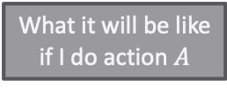
Contents in this Lecture Related to Utility-based Agents
Further topics
  Modelling formalisms
  Inference (in episodic models)
  Learning (of episodic models)
  Sequential models and inference
  Decision-theoretic models and inference
Agent
Environment
Sensors
State
What the world
is like now
How the world evolves
What my actions do
What it will be like
if I do action $A$
Utility
How happy I will be
in such a state
What action I
should do now
Actuators

Slide 4
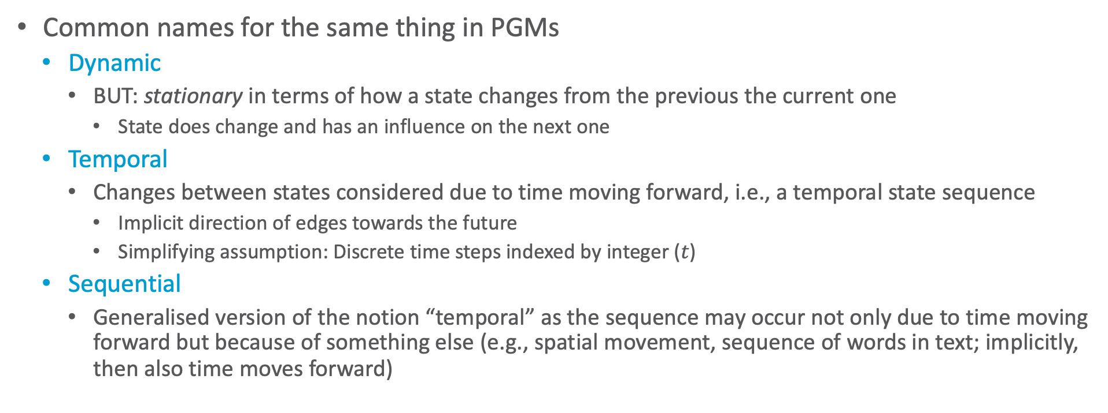
A Note on Naming Conventions
Common names for the same thing in PGMs
  Dynamic
    BUT: stationary in terms of how a state changes from the previous the current one
      State does change and has an influence on the next one
  Temporal
    Changes between states considered due to time moving forward, i.e., a temporal state sequence
      Implicit direction of edges towards the future
      Simplifying assumption: Discrete time steps indexed by integer ($t$)
  Sequential
    Generalised version of the notion “temporal” as the sequence may occur not only due to time moving forward but because of something else (e.g., spatial movement, sequence of words in text; implicitly, then also time moves forward)

Slide 5
Outline: 5. Sequential Models and Inference
Modelling of Sequences
  Templates, modelling
  Semantics, inference tasks
Dynamic Inference
  Interfaces, lifted dynamic junction tree algorithm (LDJT)
  Theoretical analysis: complexity
  Keeping inference polynomial: Temporal approximate merging (TAMe)

Slide 6
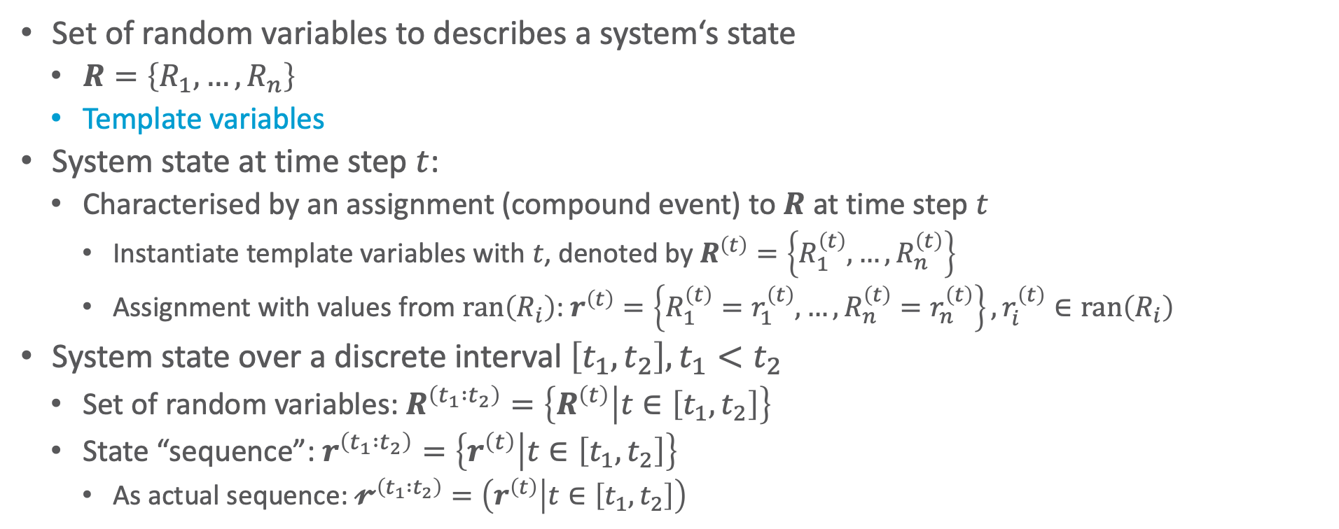
System State over Time
Set of random variables to describes a system‘s state
  $R=\left\{R_{1},…,R_{n}\right\}$
  Template variables
System state at time step $t$:
  Characterised by an assignment (compound event) to $R$ at time step $t$
    Instantiate template variables with $t$, denoted by $R^{\left(t\right)}=\left\{R_{1}^{\left(t\right)},…,R_{n}^{\left(t\right)}\right\}$
    Assignment with values from $ran\left(R_{i}\right)$: $r^{\left(t\right)}=\left\{R_{1}^{\left(t\right)}=r_{1}^{\left(t\right)},…,R_{n}^{\left(t\right)}=r_{n}^{\left(t\right)}\right\}, r_{i}^{\left(t\right)}∈ran\left(R_{i}\right)$
System state over a discrete interval $\left[t_{1},t_{2}\right],t_{1}<t_{2}$
  Set of random variables: $R^{\left(t_{1} :t_{2}\right)}=\left\{R^{\left(t\right)} | t∈\left[t_{1},t_{2}\right]\right\}$
  State “sequence”: $r^{\left(t_{1} :t_{2}\right)}=\left\{r^{\left(t\right)} | t∈\left[t_{1},t_{2}\right]\right\}$
    As actual sequence: $𝓻^{\left(t_{1} :t_{2}\right)}=\left(r^{\left(t\right)} | t∈\left[t_{1},t_{2}\right]\right)$

Slide 7
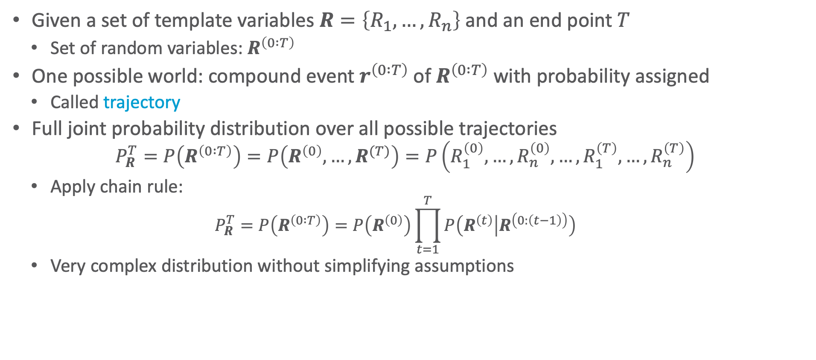
System State over Time
Given a set of template variables $R=\left\{R_{1},…,R_{n}\right\}$ and an end point $T$
  Set of random variables: $R^{\left(0 :T\right)}$
One possible world: compound event $r^{\left(0 :T\right)}$ of $R^{\left(0 :T\right)}$ with probability assigned
  Called trajectory
Full joint probability distribution over all possible trajectories
  $$P_{R}^{T}=P\left(R^{\left(0 :T\right)}\right)=P\left(R^{\left(0\right)},…,R^{(T)}\right)=P\left(R_{1}^{\left(0\right)},…,R_{n}^{\left(0\right)},…,R_{1}^{\left(T\right)},…,R_{n}^{\left(T\right)}\right)$$
  Apply chain rule:
    $$P_{R}^{T}=P\left(R^{\left(0 :T\right)}\right)=P\left(R^{\left(0\right)}\right)\prod_{t=1}^{T}{P\left(R^{\left(t\right)} | R^{\left(0:\left(t−1\right)\right)}\right)}$$
  Very complex distribution without simplifying assumptions

Slide 8


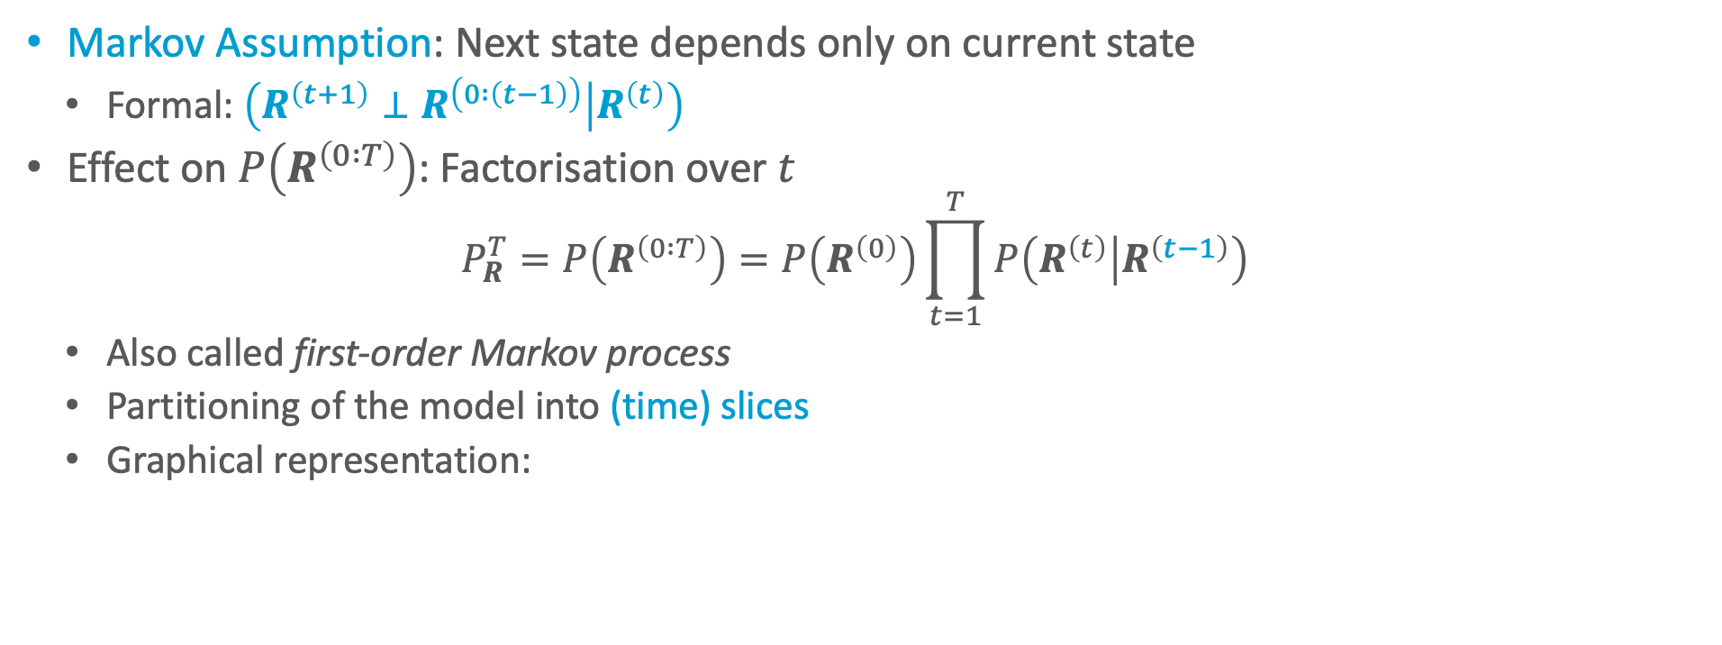



Simplifying Assumption 1: Markov Assumption
Markov Assumption: Next state depends only on current state
  Formal: $\left(R^{\left(t+1\right)}⊥R^{\left(0 :\left(t−1\right)\right)} | R^{\left(t\right)}\right)$
Effect on $P\left(R^{\left(0 :T\right)}\right)$: Factorisation over $t$
  $$P_{R}^{T}=P\left(R^{\left(0 :T\right)}\right)=P\left(R^{\left(0\right)}\right)\prod_{t=1}^{T}{P\left(R^{\left(t\right)} | R^{\left(t−1\right)}\right)}$$
  Also called first-order Markov process
  Partitioning of the model into (time) slices
  Graphical representation:
$$R^{\left(t−2\right)}$$
$$R^{\left(t−1\right)}$$
$$R^{\left(t\right)}$$
$$R^{\left(t+1\right)}$$
$$R^{\left(t+2\right)}$$

Slide 9


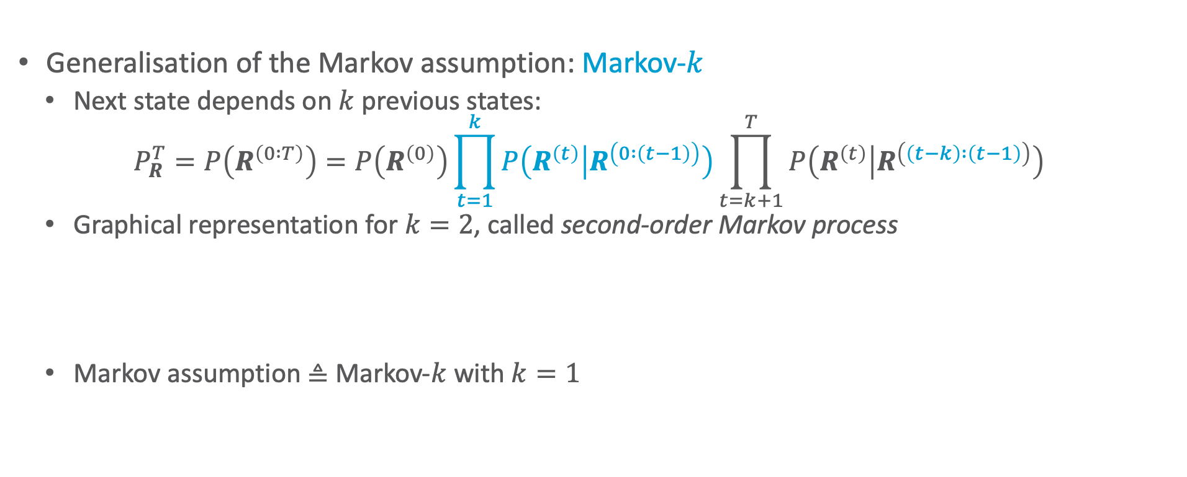



Simplifying Assumption 1: Markov Assumption
Generalisation of the Markov assumption: Markov-$k$
  Next state depends on $k$ previous states:
  $$P_{R}^{T}=P\left(R^{\left(0 :T\right)}\right)=P\left(R^{\left(0\right)}\right)\prod_{t=1}^{k}{P\left(R^{\left(t\right)} | R^{\left(0 :\left(t−1\right)\right)}\right)}\prod_{t=k+1}^{T}{P\left(R^{\left(t\right)} | R^{\left(\left(t−k\right) :\left(t−1\right)\right)}\right)}$$
  Graphical representation for $k=2$, called second-order Markov process
  Markov assumption ≜ Markov-$k$ with $k=1$
$$R^{\left(t−2\right)}$$
$$R^{\left(t−1\right)}$$
$$R^{\left(t\right)}$$
$$R^{\left(t+1\right)}$$
$$R^{\left(t+2\right)}$$
$$R^{\left(t−2\right)}$$
$$R^{\left(t−1\right)}$$
$$R^{\left(t\right)}$$
$$R^{\left(t+1\right)}$$
$$R^{\left(t+2\right)}$$

Slide 10
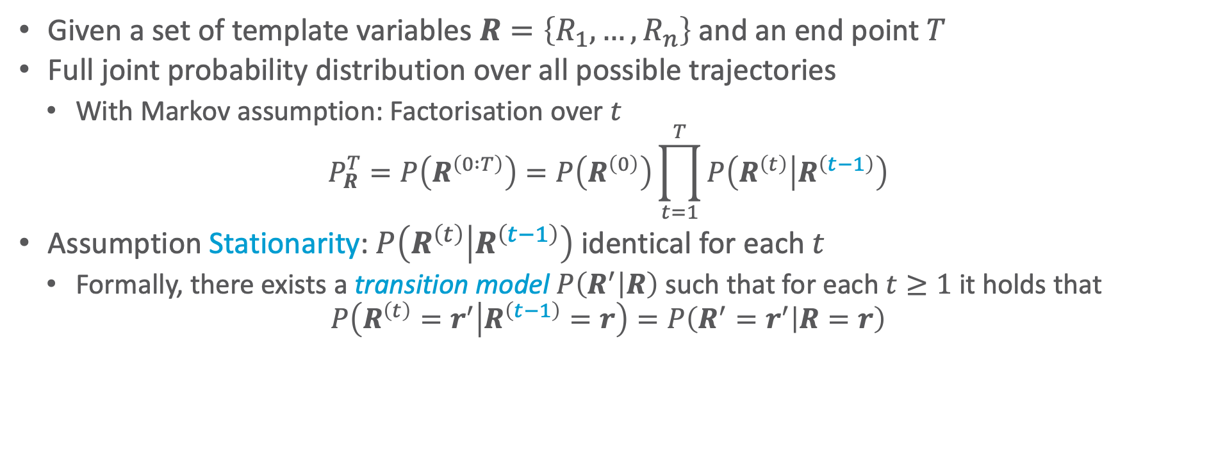
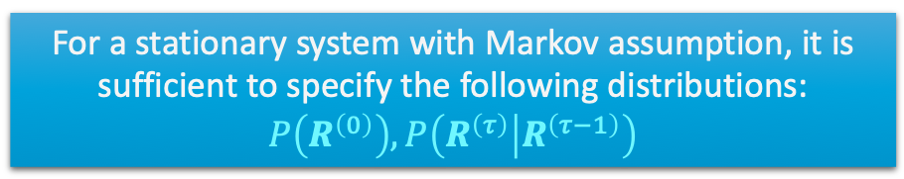
Simplifying Assumption 2: Stationary System
Given a set of template variables $R=\left\{R_{1},…,R_{n}\right\}$ and an end point $T$
Full joint probability distribution over all possible trajectories
  With Markov assumption: Factorisation over $t$
  $$P_{R}^{T}=P\left(R^{\left(0 :T\right)}\right)=P\left(R^{\left(0\right)}\right)\prod_{t=1}^{T}{P\left(R^{\left(t\right)} | R^{\left(t−1\right)}\right)}$$
Assumption Stationarity: $P\left(R^{\left(t\right)} | R^{\left(t−1\right)}\right)$ identical for each $t$
  Formally, there exists a transition model $P\left(R^{′} | R\right)$ such that for each $t≥1$ it holds that
  $$P\left(R^{\left(t\right)}=r^{′} | R^{\left(t−1\right)}=r\right)=P\left(R^{′}=r^{′} | R=r\right)$$
For a stationary system with Markov assumption, it is sufficient to specify the following distributions: $P\left(R^{\left(0\right)}\right),P\left(R^{\left(τ\right)} | R^{\left(τ−1\right)}\right)$
What is a problem with that?
Notes:
Kombinatorische Explosion

Slide 11


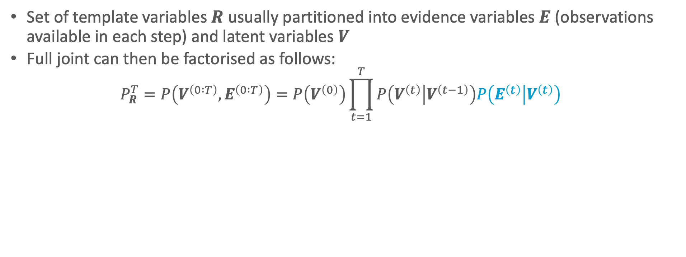








Observable and Latent Variables
Set of template variables $R$ usually partitioned into evidence variables $E$ (observations available in each step) and latent variables $V$
Full joint can then be factorised as follows:
  $$P_{R}^{T}=P\left(V^{\left(0 :T\right)},E^{\left(0 :T\right)}\right)=P\left(V^{\left(0\right)}\right)\prod_{t=1}^{T}{P\left(V^{\left(t\right)} | V^{\left(t−1\right)}\right)P\left(E^{\left(t\right)} | V^{\left(t\right)}\right)}$$
What (conditional) independences hold?
Transition model
Sensor model
$$V^{\left(t−2\right)}$$
$$V^{\left(t−1\right)}$$
$$V^{\left(t\right)}$$
$$V^{\left(t+1\right)}$$
$$V^{\left(t+2\right)}$$
$$E^{\left(t−2\right)}$$
$$E^{\left(t−1\right)}$$
$$E^{\left(t\right)}$$
$$E^{\left(t+1\right)}$$
$$E^{\left(t+2\right)}$$
Notes:
S Separator zwischen den Zeitscheiben
Evidenzen der unterschiedlichen Zeitschritte unabhängig voneinander gegeben S

Slide 12


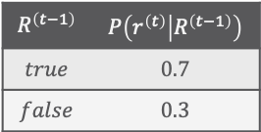
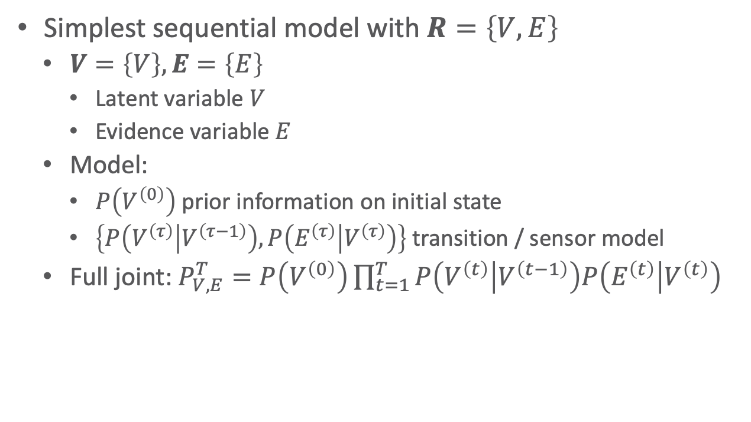


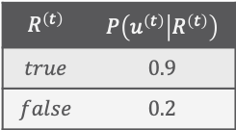










Hidden Markov Modell (HMM)
Simplest sequential model with $R=\left\{V,E\right\}$
  $V=\left\{V\right\},E=\left\{E\right\}$
    Latent variable $V$
    Evidence variable $E$
  Model:
    $P\left(V^{\left(0\right)}\right)$ prior information on initial state
    $\left\{P\left(V^{\left(τ\right)} | V^{\left(τ−1\right)}\right),P\left(E^{\left(τ\right)} | V^{\left(τ\right)}\right)\right\}$ transition / sensor model
  Full joint: $P_{V,E}^{T}=P\left(V^{\left(0\right)}\right)\prod_{t=1}^{T}{P\left(V^{\left(t\right)} | V^{\left(t−1\right)}\right)P\left(E^{\left(t\right)} | V^{\left(t\right)}\right)}$
HMM can be found in various application scenarios such as
Signal processing
Bio informatics
Text understanding
$${Rain}^{\left(0\right)}$$
$$P\left(r^{\left(0\right)}\right)$$
$$0.5$$
$$R^{\left(t−1\right)}$$ | $$P\left(r^{\left(t\right)} | R^{\left(t−1\right)}\right)$$
$$true$$ | $$0.7$$
$$false$$ | $$0.3$$
$${Rain}^{\left(t\right)}$$
$$V^{\left(t−2\right)}$$
$$V^{\left(t−1\right)}$$
$$V^{\left(t\right)}$$
$$V^{\left(t+1\right)}$$
$$V^{\left(t+2\right)}$$
$${Umbrella}^{\left(t\right)}$$
$$R^{\left(t\right)}$$ | $$P\left(u^{\left(t\right)} | R^{\left(t\right)}\right)$$
$$true$$ | $$0.9$$
$$false$$ | $$0.2$$
$$E^{\left(t−2\right)}$$
$$E^{\left(t−1\right)}$$
$$E^{\left(t\right)}$$
$$E^{\left(t+1\right)}$$
$$E^{\left(t+2\right)}$$
Notes:
DBN von vorheriger Folie: V als Konglomerat aus Weather, Velocity, Location, Failure, 2^4 abstrakte Domänenwerte, die für 0000 bis 1111 stehen, E = Obs

Slide 13





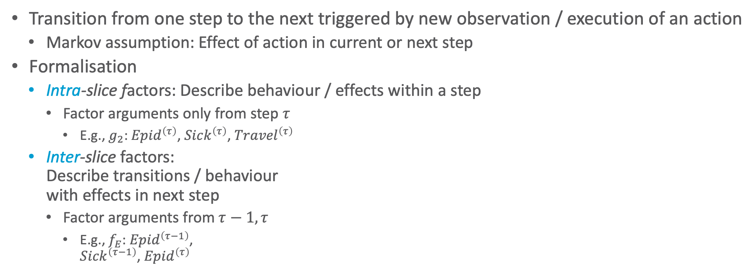








General Factorisation in Sequential Models
Transition from one step to the next triggered by new observation / execution of an action
  Markov assumption: Effect of action in current or next step
Formalisation
  Intra-slice factors: Describe behaviour / effects within a step
    Factor arguments only from step $τ$
      E.g., $g_{2}$: ${Epid}^{\left(τ\right)}$, ${Sick}^{\left(τ\right)}$, ${Travel}^{\left(τ\right)}$
  Inter-slice factors:
  Describe transitions / behaviour
  with effects in next step
    Factor arguments from $τ−1,τ$
      E.g., $f_{E}$: ${Epid}^{\left(τ−1\right)}$,
      ${Sick}^{\left(τ−1\right)}$, ${Epid}^{\left(τ\right)}$
$$f_{E}^{\left(τ−1,τ\right)}$$
$${Epid}^{\left(τ−1\right)}$$
$${Epid}^{\left(τ\right)}$$
$${Travel}^{\left(τ−1\right)}$$
$${Treat}^{\left(τ−1\right)}$$
$${Travel}^{\left(τ\right)}$$
$${Treat}^{\left(τ\right)}$$
$$f_{2}^{\left(τ−1\right)}$$
$$f_{3}^{\left(τ−1\right)}$$
$$f_{2}^{\left(τ\right)}$$
$$f_{3}^{\left(τ\right)}$$
$${Sick}^{\left(τ−1\right)}$$
$${Sick}^{\left(τ\right)}$$

Slide 14
















Lifting the Factorisation
Assume regularities / symmetries among factors due to relational setup
Use logical variables to encode symmetries compactly
$$f_{E}^{\left(τ−1,τ\right)}$$
$${Epid}^{\left(τ−1\right)}$$
$${Epid}^{\left(τ\right)}$$
$${Travel}^{\left(τ−1\right)}$$
$${Treat}^{\left(τ−1\right)}$$
$${Travel}^{\left(τ\right)}$$
$${Treat}^{\left(τ\right)}$$
$$f_{2}^{\left(τ−1\right)}$$
$$f_{3}^{\left(τ−1\right)}$$
$$f_{2}^{\left(τ\right)}$$
$$f_{3}^{\left(τ\right)}$$
$${Sick}^{\left(τ−1\right)}$$
$${Sick}^{\left(τ\right)}$$
What information is depicted redundantly?
$$g_{E}^{\left(τ−1,τ\right)}$$
$${Epid}^{\left(τ−1\right)}$$
$${Epid}^{\left(τ\right)}$$
$${Travel\left(X\right)}^{\left(τ−1\right)}$$
$${Treat\left(X,M\right)}^{\left(τ−1\right)}$$
$${Travel\left(X\right)}^{\left(τ\right)}$$
$${Treat\left(X,M\right)}^{\left(τ\right)}$$
$$g_{2}^{\left(τ−1\right)}$$
$$g_{3}^{\left(τ−1\right)}$$
$$g_{2}^{\left(τ\right)}$$
$$g_{3}^{\left(τ\right)}$$
$${Sick\left(X\right)}^{\left(τ−1\right)}$$
$${Sick\left(X\right)}^{\left(τ\right)}$$

Slide 15


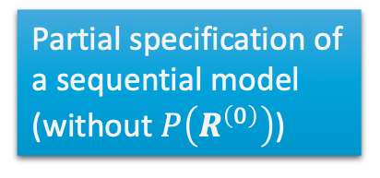
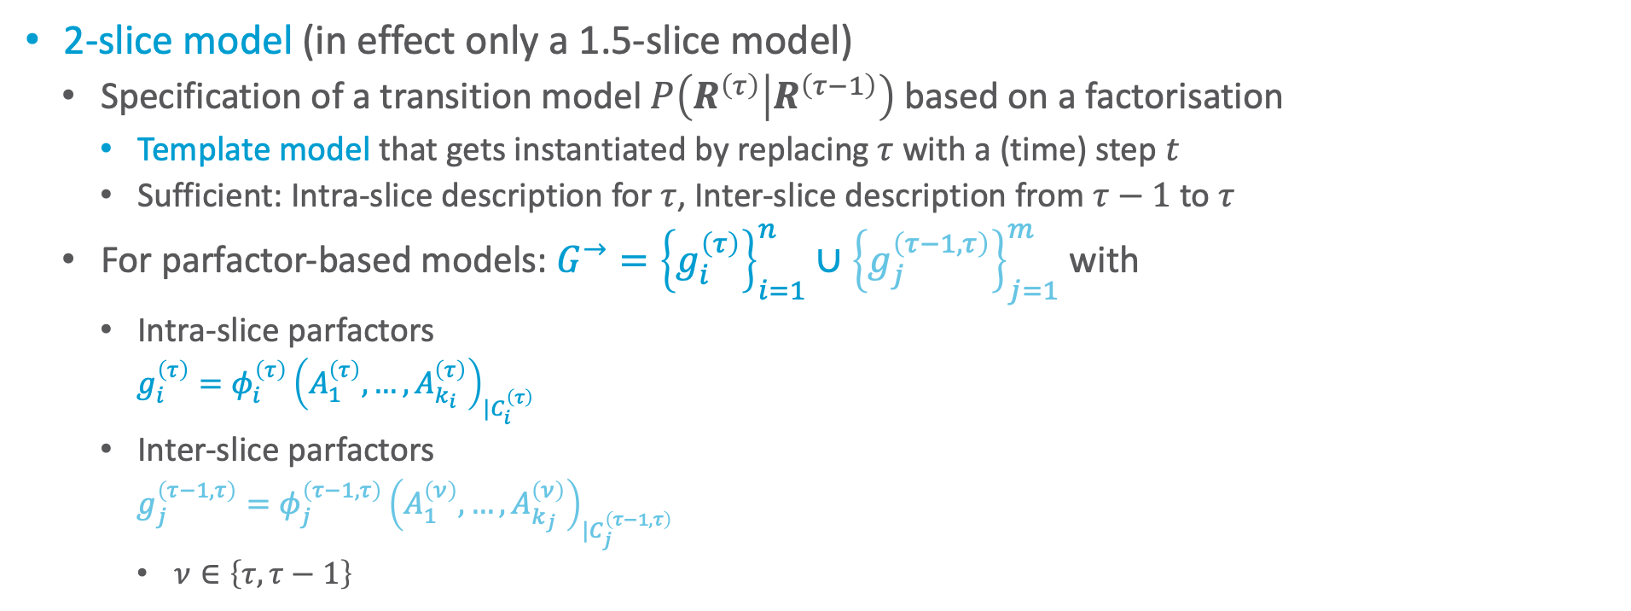
2-slice Model & 1.5-slice Model
2-slice model (in effect only a 1.5-slice model)
  Specification of a transition model $P\left(R^{\left(τ\right)} | R^{\left(τ−1\right)}\right)$ based on a factorisation
    Template model that gets instantiated by replacing $τ$ with a (time) step $t$
    Sufficient: Intra-slice description for $τ$, Inter-slice description from $τ−1$ to $τ$
  For parfactor-based models: $G^{→}={\left\{g_{i}^{\left(τ\right)}\right\}}_{i=1}^{n}∪{\left\{g_{j}^{\left(τ−1,τ\right)}\right\}}_{j=1}^{m}$ with
    Intra-slice parfactors
      $g_{i}^{\left(τ\right)}={φ_{i}^{\left(τ\right)}\left(A_{1}^{\left(τ\right)},…,A_{k_{i}}^{\left(τ\right)}\right)}_{|C_{i}^{\left(τ\right)}}$
    Inter-slice parfactors
      $g_{j}^{\left(τ−1,τ\right)}={φ_{j}^{\left(τ−1,τ\right)}\left(A_{1}^{\left(ν\right)},…,A_{k_{j}}^{\left(ν\right)}\right)}_{|C_{j}^{\left(τ−1,τ\right)}}$
      $ν∈\left\{τ,τ−1\right\}$
Partial specification of a sequential model (without $P\left(R^{\left(0\right)}\right)$)
$$g_{E}^{\left(τ−1,τ\right)}$$
$${Epid}^{\left(τ−1\right)}$$
$${Epid}^{\left(τ\right)}$$
$${Travel\left(X\right)}^{\left(τ\right)}$$
$${Treat\left(X,M\right)}^{\left(τ\right)}$$
$$g_{2}^{\left(τ\right)}$$
$$g_{3}^{\left(τ\right)}$$
$${Sick\left(X\right)}^{\left(τ−1\right)}$$
$${Sick\left(X\right)}^{\left(τ\right)}$$

Slide 16
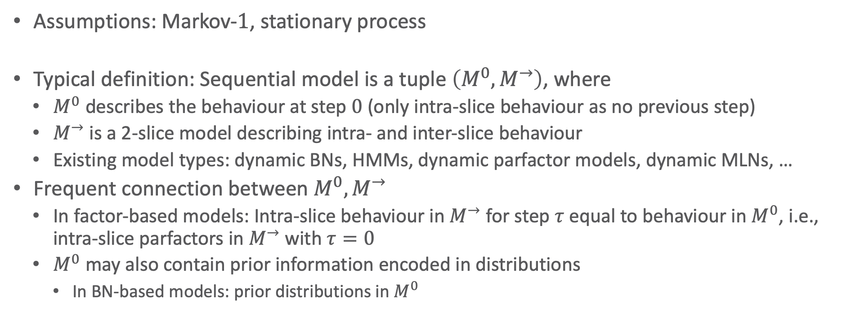
Sequential Models
Assumptions: Markov-$1$, stationary process
Typical definition: Sequential model is a tuple $\left(M^{0},M^{→}\right)$, where
  $M^{0}$ describes the behaviour at step $0$ (only intra-slice behaviour as no previous step)
  $M^{→}$ is a 2-slice model describing intra- and inter-slice behaviour
  Existing model types: dynamic BNs, HMMs, dynamic parfactor models, dynamic MLNs, …
Frequent connection between $M^{0},M^{→}$
  In factor-based models: Intra-slice behaviour in $M^{→}$ for step $τ$ equal to behaviour in $M^{0}$, i.e., intra-slice parfactors in $M^{→}$ with $τ=0$
  $M^{0}$ may also contain prior information encoded in distributions
    In BN-based models: prior distributions in $M^{0}$

Slide 17


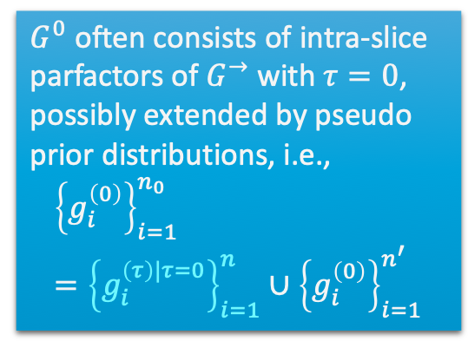

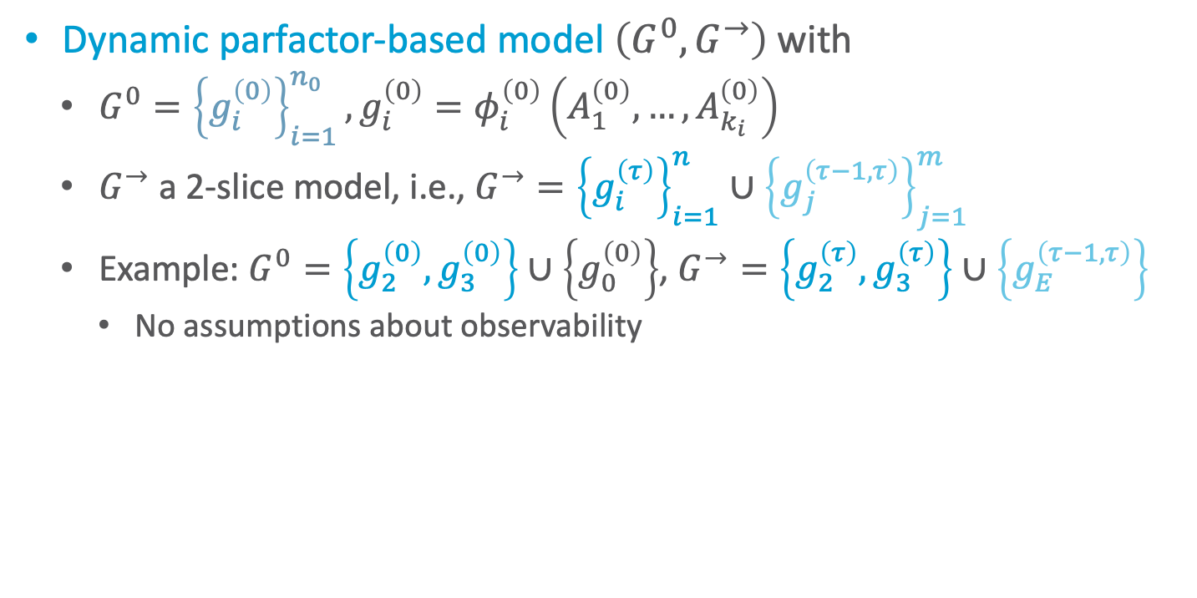




Dynamic Parfactor-based Model
Dynamic parfactor-based model $\left(G^{0},G^{→}\right)$ with
  $G^{0}={\left\{g_{i}^{\left(0\right)}\right\}}_{i=1}^{n_{0}},g_{i}^{\left(0\right)}=φ_{i}^{\left(0\right)}\left(A_{1}^{\left(0\right)},…,A_{k_{i}}^{\left(0\right)}\right)$
  $G^{→}$ a 2-slice model, i.e., $G^{→}={\left\{g_{i}^{\left(τ\right)}\right\}}_{i=1}^{n}∪{\left\{g_{j}^{\left(τ−1,τ\right)}\right\}}_{j=1}^{m}$
  Example: $G^{0}=\left\{g_{2}^{\left(0\right)},g_{3}^{\left(0\right)}\right\}∪\left\{g_{0}^{\left(0\right)}\right\}$, $G^{→}=\left\{g_{2}^{\left(τ\right)},g_{3}^{\left(τ\right)}\right\}∪\left\{g_{E}^{\left(τ−1,τ\right)}\right\}$
    No assumptions about observability
  $G^{0}$ often consists of intra-slice parfactors of $G^{→}$ with $τ=0$, possibly extended by pseudo prior distributions, i.e.,
  $${\left\{g_{i}^{\left(0\right)}\right\}}_{i=1}^{n_{0}}={\left\{g_{i}^{\left(τ\right)|τ=0}\right\}}_{i=1}^{n}∪{\left\{g_{i}^{\left(0\right)}\right\}}_{i=1}^{n^{′}}$$
$$g_{0}^{\left(0\right)}$$
$$g_{E}^{\left(τ−1,τ\right)}$$
$${Epid}^{\left(0\right)}$$
$${Epid}^{\left(τ−1\right)}$$
$${Epid}^{\left(τ\right)}$$
$${Travel\left(X\right)}^{\left(0\right)}$$
$${Treat\left(X,M\right)}^{\left(0\right)}$$
$${Travel\left(X\right)}^{\left(τ\right)}$$
$${Treat\left(X,M\right)}^{\left(τ\right)}$$
$$g_{2}^{\left(0\right)}$$
$$g_{3}^{\left(0\right)}$$
$$g_{2}^{\left(τ\right)}$$
$$g_{3}^{\left(τ\right)}$$
$${Sick\left(X\right)}^{\left(0\right)}$$
$${Sick\left(X\right)}^{\left(τ−1\right)}$$
$${Sick\left(X\right)}^{\left(τ\right)}$$

Slide 18
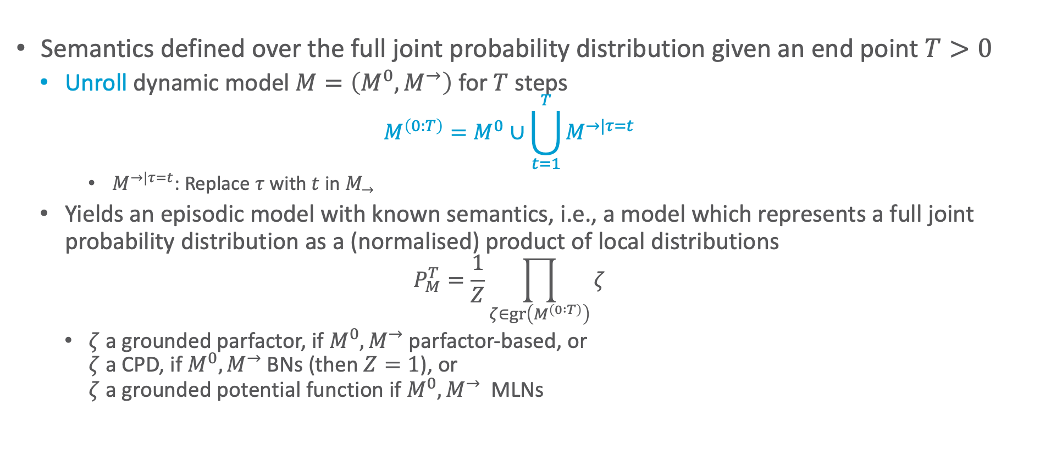
Semantics
Semantics defined over the full joint probability distribution given an end point $T>0$
  Unroll dynamic model $M=\left(M^{0},M^{→}\right)$ for $T$ steps
    $$M^{\left(0:T\right)}=M^{0}∪\bigcup_{t=1}^{T}{M^{→|τ=t}}$$
      $M^{→|τ=t}$: Replace $τ$ with $t$ in $M_{→}$
  Yields an episodic model with known semantics, i.e., a model which represents a full joint probability distribution as a (normalised) product of local distributions
    $$P_{M}^{T}=\frac{1}{Z}\prod_{ζ∈gr\left(M^{\left(0 :T\right)}\right)}{ζ}$$
    $ζ$ a grounded parfactor, if $M^{0},M^{→}$ parfactor-based, or
    $ζ$ a CPD, if $M^{0},M^{→}$ BNs (then $Z=1$), or
    $ζ$ a grounded potential function if $M^{0},M^{→}$ MLNs

Slide 19
























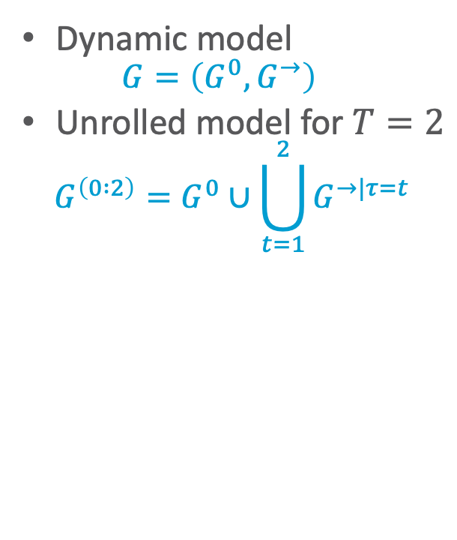






Semantics: Example – Unrolling
Dynamic model
  $$G=\left(G^{0},G^{→}\right)$$
Unrolled model for $T=2$
  $$G^{\left(0 :2\right)}=G^{0}∪\bigcup_{t=1}^{2}{G^{→|τ=t}}$$
$$\left\{g_{E}^{\left(0,1\right)}\right\}$$
$$\left\{g_{E}^{\left(1,2\right)}\right\}$$
$$G=\left\{g_{0}^{\left(0\right)},g_{2}^{\left(0\right)},g_{3}^{\left(0\right)}\right\} ∪$$
$$∪\left\{g_{2}^{\left(1\right)},g_{3}^{\left(1\right)}\right\} ∪$$
$$∪\left\{g_{2}^{\left(2\right)},g_{3}^{\left(2\right)}\right\}$$
$$g_{0}^{\left(0\right)}$$
$${Epid}^{\left(0\right)}$$
$$g_{E}^{\left(0,1\right)}$$
$${Epid}^{\left(1\right)}$$
$$g_{E}^{\left(1,2\right)}$$
$${Epid}^{\left(2\right)}$$
$${Travel\left(X\right)}^{\left(0\right)}$$
$${Treat\left(X,M\right)}^{\left(0\right)}$$
$${Travel\left(X\right)}^{\left(1\right)}$$
$${Treat\left(X,M\right)}^{\left(1\right)}$$
$${Travel\left(X\right)}^{\left(2\right)}$$
$${Treat\left(X,M\right)}^{\left(2\right)}$$
$$g_{2}^{\left(0\right)}$$
$$g_{3}^{\left(0\right)}$$
$$g_{2}^{\left(1\right)}$$
$$g_{3}^{\left(1\right)}$$
$$g_{2}^{\left(2\right)}$$
$$g_{3}^{\left(2\right)}$$
$${Sick\left(X\right)}^{\left(0\right)}$$
$${Sick\left(X\right)}^{\left(1\right)}$$
$${Sick\left(X\right)}^{\left(2\right)}$$
$$t=0$$
$$t=1$$
$$t=2$$
$$g_{0}^{\left(0\right)}$$
$$g_{E}^{\left(τ−1,τ\right)}$$
$${Epid}^{\left(0\right)}$$
$${Epid}^{\left(τ−1\right)}$$
$${Epid}^{\left(τ\right)}$$
$${Travel\left(X\right)}^{\left(0\right)}$$
$${Treat\left(X,M\right)}^{\left(0\right)}$$
$${Travel\left(X\right)}^{\left(τ\right)}$$
$${Treat\left(X,M\right)}^{\left(τ\right)}$$
$$g_{2}^{\left(0\right)}$$
$$g_{3}^{\left(0\right)}$$
$$g_{2}^{\left(τ\right)}$$
$$g_{3}^{\left(τ\right)}$$
$${Sick\left(X\right)}^{\left(0\right)}$$
$${Sick\left(X\right)}^{\left(τ−1\right)}$$
$${Sick\left(X\right)}^{\left(τ\right)}$$

Slide 20

































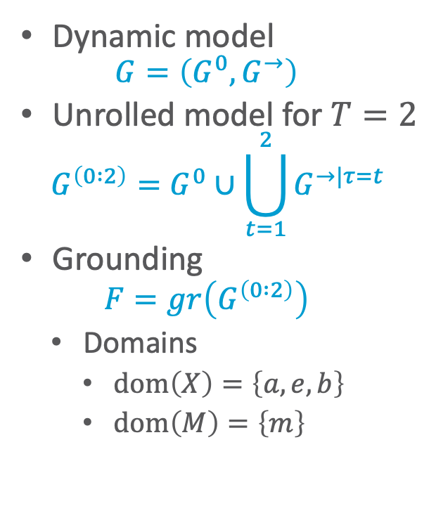






































Semantics: Example – Grounding
$$t=0$$
$$t=1$$
$$t=2$$
Dynamic model
  $$G=\left(G^{0},G^{→}\right)$$
Unrolled model for $T=2$
  $$G^{\left(0 :2\right)}=G^{0}∪\bigcup_{t=1}^{2}{G^{→|τ=t}}$$
Grounding
  $$F=gr\left(G^{\left(0 :2\right)}\right)$$
  Domains
    $dom\left(X\right)=\left\{a,e,b\right\}$
    $dom\left(M\right)=\left\{m\right\}$
$$g_{0}^{\left(0\right)}$$
$${Epid}^{\left(0\right)}$$
$$g_{E}^{\left(0,1\right)}$$
$${Epid}^{\left(1\right)}$$
$$g_{E}^{\left(1,2\right)}$$
$${Epid}^{\left(2\right)}$$
$${Travel\left(X\right)}^{\left(0\right)}$$
$${Treat\left(X,M\right)}^{\left(0\right)}$$
$${Travel\left(X\right)}^{\left(1\right)}$$
$${Treat\left(X,M\right)}^{\left(1\right)}$$
$${Travel\left(X\right)}^{\left(2\right)}$$
$${Treat\left(X,M\right)}^{\left(2\right)}$$
$$g_{2}^{\left(0\right)}$$
$$g_{3}^{\left(0\right)}$$
$$g_{2}^{\left(1\right)}$$
$$g_{3}^{\left(1\right)}$$
$$g_{2}^{\left(2\right)}$$
$$g_{3}^{\left(2\right)}$$
$${Sick\left(X\right)}^{\left(0\right)}$$
$${Sick\left(X\right)}^{\left(1\right)}$$
$${Sick\left(X\right)}^{\left(2\right)}$$
$$g_{0}^{\left(0\right)}$$
$${Epid}^{\left(0\right)}$$
$$g_{E}^{\left(0,1\right)}$$
$${Epid}^{\left(1\right)}$$
$$g_{E}^{\left(1,2\right)}$$
$${Epid}^{\left(2\right)}$$
$${Travel\left(a\right)}^{\left(0\right)}$$
$${Treat\left(a,m\right)}^{\left(0\right)}$$
$${Travel\left(a\right)}^{\left(1\right)}$$
$${Treat\left(a,m\right)}^{\left(1\right)}$$
$${Travel\left(a\right)}^{\left(2\right)}$$
$${Treat\left(a,m\right)}^{\left(2\right)}$$
$$g_{2}^{\left(0\right)}$$
$$g_{3}^{\left(0\right)}$$
$$g_{E}^{\left(0,1\right)}$$
$$g_{2}^{\left(1\right)}$$
$$g_{3}^{\left(1\right)}$$
$$g_{E}^{\left(0,1\right)}$$
$$g_{2}^{\left(2\right)}$$
$$g_{3}^{\left(2\right)}$$
$${Sick\left(a\right)}^{\left(0\right)}$$
$${Sick\left(a\right)}^{\left(1\right)}$$
$${Sick\left(a\right)}^{\left(2\right)}$$
$${Travel\left(e\right)}^{\left(0\right)}$$
$${Treat\left(e,m\right)}^{\left(0\right)}$$
$${Travel\left(e\right)}^{\left(1\right)}$$
$${Treat\left(e,m\right)}^{\left(1\right)}$$
$${Travel\left(e\right)}^{\left(2\right)}$$
$${Treat\left(e,m\right)}^{\left(2\right)}$$
$$g_{2}^{\left(0\right)}$$
$$g_{3}^{\left(0\right)}$$
$$g_{2}^{\left(1\right)}$$
$$g_{3}^{\left(1\right)}$$
$$g_{2}^{\left(2\right)}$$
$$g_{3}^{\left(2\right)}$$
$${Sick\left(e\right)}^{\left(0\right)}$$
$$g_{E}^{\left(0,1\right)}$$
$${Sick\left(e\right)}^{\left(1\right)}$$
$$g_{E}^{\left(0,1\right)}$$
$${Sick\left(e\right)}^{\left(2\right)}$$
$${Travel\left(b\right)}^{\left(0\right)}$$
$${Treat\left(b,m\right)}^{\left(0\right)}$$
$${Travel\left(b\right)}^{\left(1\right)}$$
$${Treat\left(b,m\right)}^{\left(1\right)}$$
$${Travel\left(b\right)}^{\left(2\right)}$$
$${Treat\left(b,m\right)}^{\left(2\right)}$$
$$g_{2}^{\left(0\right)}$$
$$g_{3}^{\left(0\right)}$$
$$g_{2}^{\left(1\right)}$$
$$g_{3}^{\left(1\right)}$$
$$g_{2}^{\left(2\right)}$$
$$g_{3}^{\left(2\right)}$$
$${Sick\left(b\right)}^{\left(0\right)}$$
$${Sick\left(b\right)}^{\left(1\right)}$$
$${Sick\left(b\right)}^{\left(2\right)}$$

Slide 21
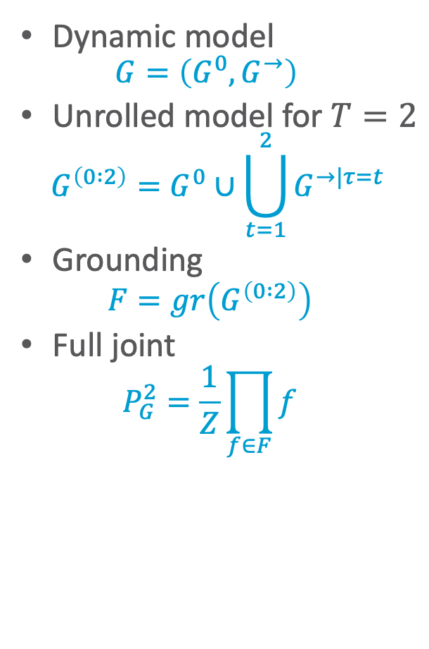
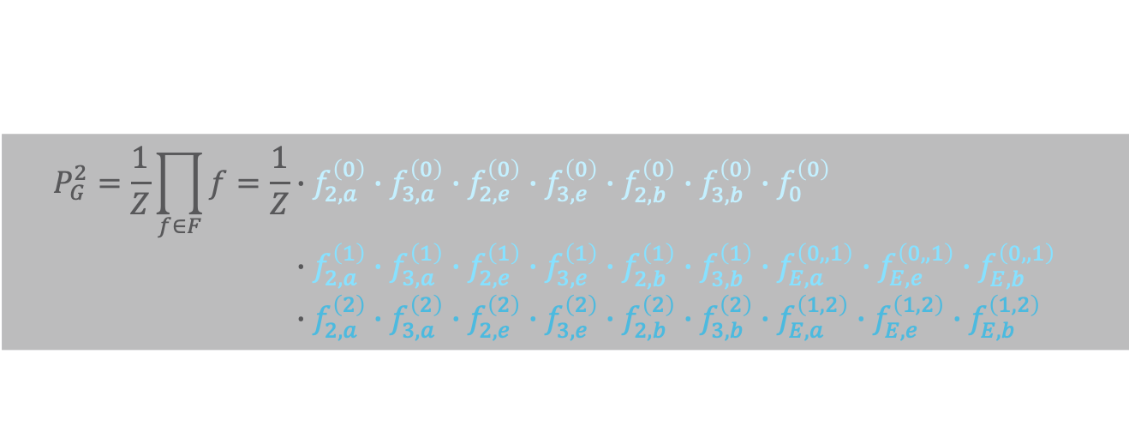
Semantics: Example – Full Joint
$$P_{G}^{2}=\frac{1}{Z}\prod_{f∈F}{f}=\frac{1}{Z}∙f_{2,a}^{\left(0\right)}∙f_{3,a}^{\left(0\right)}∙f_{2,e}^{\left(0\right)}∙f_{3,e}^{\left(0\right)}∙f_{2,b}^{\left(0\right)}∙f_{3,b}^{\left(0\right)}∙f_{0}^{\left(0\right)} \\ ∙f_{2,a}^{\left(1\right)}∙f_{3,a}^{\left(1\right)}∙f_{2,e}^{\left(1\right)}∙f_{3,e}^{\left(1\right)}∙f_{2,b}^{\left(1\right)}∙f_{3,b}^{\left(1\right)}∙f_{E,a}^{\left(0,,1\right)}∙f_{E,e}^{\left(0,,1\right)}∙f_{E,b}^{\left(0,,1\right)} \\ ∙f_{2,a}^{\left(2\right)}∙f_{3,a}^{\left(2\right)}∙f_{2,e}^{\left(2\right)}∙f_{3,e}^{\left(2\right)}∙f_{2,b}^{\left(2\right)}∙f_{3,b}^{\left(2\right)}∙f_{E,a}^{\left(1,2\right)}∙f_{E,e}^{\left(1,2\right)}∙f_{E,b}^{\left(1,2\right)}$$
Dynamic model
  $$G=\left(G^{0},G^{→}\right)$$
Unrolled model for $T=2$
  $$G^{\left(0 :2\right)}=G^{0}∪\bigcup_{t=1}^{2}{G^{→|τ=t}}$$
Grounding
  $$F=gr\left(G^{\left(0 :2\right)}\right)$$
Full joint
  $$P_{G}^{2}=\frac{1}{Z}\prod_{f∈F}{f}$$
$$g_{0}^{\left(0\right)}$$
$${Epid}^{\left(0\right)}$$
$$g_{E}^{\left(0,1\right)}$$
$${Epid}^{\left(1\right)}$$
$$g_{E}^{\left(1,2\right)}$$
$${Epid}^{\left(2\right)}$$
$${Travel\left(a\right)}^{\left(0\right)}$$
$${Treat\left(a,m\right)}^{\left(0\right)}$$
$${Travel\left(a\right)}^{\left(1\right)}$$
$${Treat\left(a,m\right)}^{\left(1\right)}$$
$${Travel\left(a\right)}^{\left(2\right)}$$
$${Treat\left(a,m\right)}^{\left(2\right)}$$
$$g_{2}^{\left(0\right)}$$
$$g_{3}^{\left(0\right)}$$
$$g_{E}^{\left(0,1\right)}$$
$$g_{2}^{\left(1\right)}$$
$$g_{3}^{\left(1\right)}$$
$$g_{E}^{\left(0,1\right)}$$
$$g_{2}^{\left(2\right)}$$
$$g_{3}^{\left(2\right)}$$
$${Sick\left(a\right)}^{\left(0\right)}$$
$${Sick\left(a\right)}^{\left(1\right)}$$
$${Sick\left(a\right)}^{\left(2\right)}$$
$${Travel\left(e\right)}^{\left(0\right)}$$
$${Treat\left(e,m\right)}^{\left(0\right)}$$
$${Travel\left(e\right)}^{\left(1\right)}$$
$${Treat\left(e,m\right)}^{\left(1\right)}$$
$${Travel\left(e\right)}^{\left(2\right)}$$
$${Treat\left(e,m\right)}^{\left(2\right)}$$
$$g_{2}^{\left(0\right)}$$
$$g_{3}^{\left(0\right)}$$
$$g_{2}^{\left(1\right)}$$
$$g_{3}^{\left(1\right)}$$
$$g_{2}^{\left(2\right)}$$
$$g_{3}^{\left(2\right)}$$
$${Sick\left(e\right)}^{\left(0\right)}$$
$$g_{E}^{\left(0,1\right)}$$
$${Sick\left(e\right)}^{\left(1\right)}$$
$$g_{E}^{\left(0,1\right)}$$
$${Sick\left(e\right)}^{\left(2\right)}$$
$${Travel\left(b\right)}^{\left(0\right)}$$
$${Treat\left(b,m\right)}^{\left(0\right)}$$
$${Travel\left(b\right)}^{\left(1\right)}$$
$${Treat\left(b,m\right)}^{\left(1\right)}$$
$${Travel\left(b\right)}^{\left(2\right)}$$
$${Treat\left(b,m\right)}^{\left(2\right)}$$
$$g_{2}^{\left(0\right)}$$
$$g_{3}^{\left(0\right)}$$
$$g_{2}^{\left(1\right)}$$
$$g_{3}^{\left(1\right)}$$
$$g_{2}^{\left(2\right)}$$
$$g_{3}^{\left(2\right)}$$
$${Sick\left(b\right)}^{\left(0\right)}$$
$${Sick\left(b\right)}^{\left(1\right)}$$
$${Sick\left(b\right)}^{\left(2\right)}$$

Slide 22



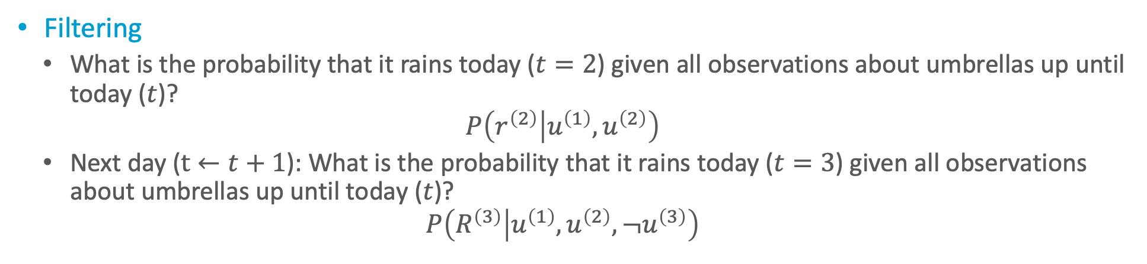






Query Answering Problem & Query Types
Filtering
  What is the probability that it rains today ($t=2$) given all observations about umbrellas up until today ($t$)?
  $$P\left(r^{\left(2\right)} | u^{\left(1\right)},u^{\left(2\right)}\right)$$
  Next day ($t←t+1$): What is the probability that it rains today ($t=3$) given all observations about umbrellas up until today ($t$)?
  $$P\left(R^{\left(3\right)} | u^{\left(1\right)},u^{\left(2\right)},¬u^{\left(3\right)}\right)$$
today
⇩
today
⇩
$$R^{\left(0\right)}$$
$$R^{\left(1\right)}$$
$$R^{\left(2\right)}$$
$$R^{\left(3\right)}$$
$${Rain}^{\left(t\right)}$$
$$u^{\left(1\right)}$$
$$u^{\left(2\right)}$$
$${¬u}^{\left(3\right)}$$
$${Umbrella}^{\left(t\right)}$$

Slide 23

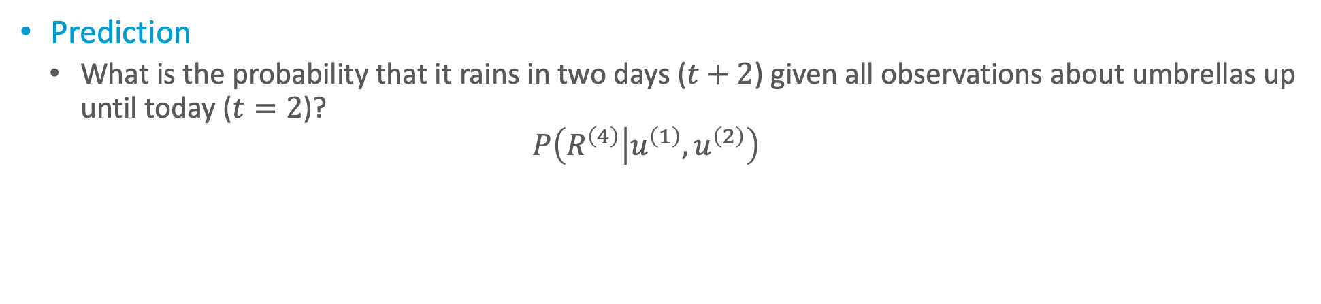



Query Answering Problem & Query Types
Prediction
  What is the probability that it rains in two days ($t+2$) given all observations about umbrellas up until today ($t=2$)?
  $$P\left(R^{\left(4\right)} | u^{\left(1\right)},u^{\left(2\right)}\right)$$
today
⇩
in two days
⇩
$$R^{\left(0\right)}$$
$$R^{\left(1\right)}$$
$$R^{\left(2\right)}$$
$$R^{\left(3\right)}$$
$$R^{\left(4\right)}$$
$${Rain}^{\left(t\right)}$$
$$u^{\left(1\right)}$$
$$u^{\left(2\right)}$$
$$U^{\left(3\right)}$$
$$U^{\left(4\right)}$$
$${Umbrella}^{\left(t\right)}$$

Slide 24
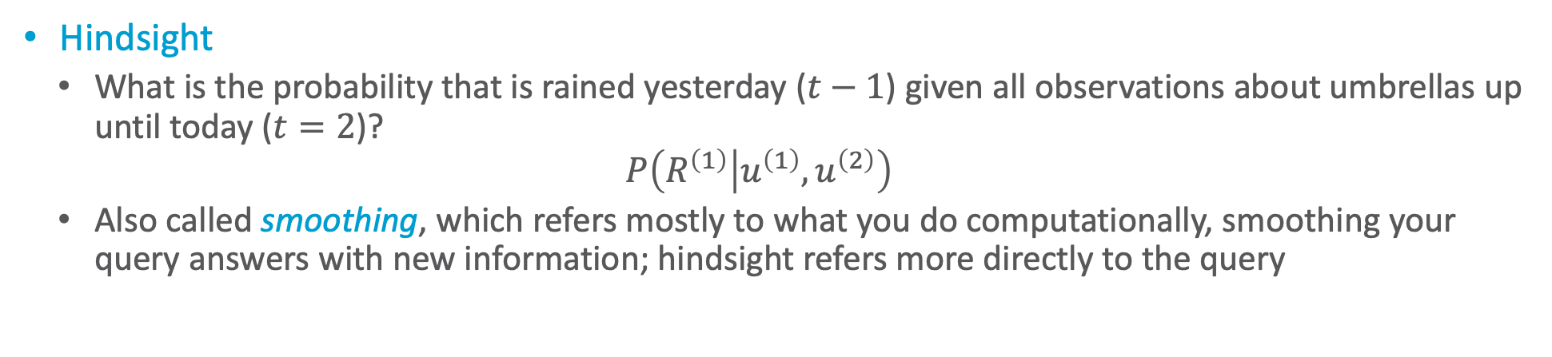
Query Answering Problem & Query Types
Hindsight
  What is the probability that is rained yesterday ($t−1$) given all observations about umbrellas up until today ($t=2$)?
  $$P\left(R^{\left(1\right)} | u^{\left(1\right)},u^{\left(2\right)}\right)$$
  Also called smoothing, which refers mostly to what you do computationally, smoothing your query answers with new information; hindsight refers more directly to the query
yesterday
⇩
today
⇩
$$R^{\left(0\right)}$$
$$R^{\left(1\right)}$$
$$R^{\left(2\right)}$$
$${Rain}^{\left(t\right)}$$
$$u^{\left(1\right)}$$
$$u^{\left(2\right)}$$
$${Umbrella}^{\left(t\right)}$$

Slide 25

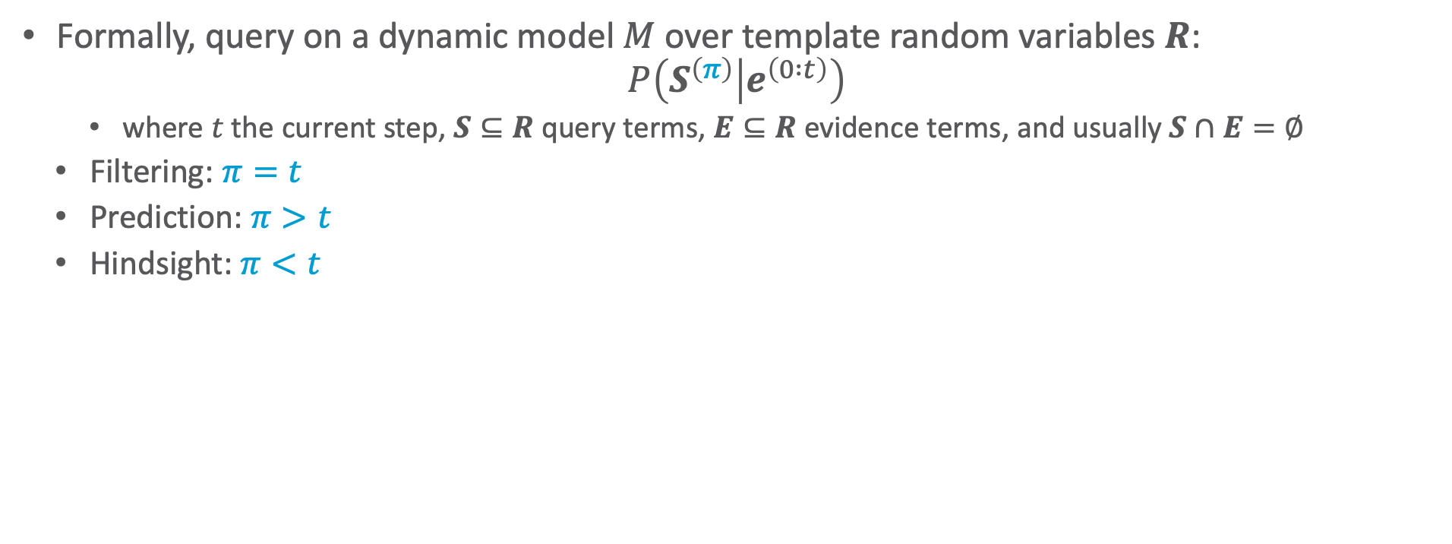

Query Answering Problem & Query Types
Formally, query on a dynamic model $M$ over template random variables $R$:
$$P\left(S^{\left(π\right)} | e^{\left(0 :t\right)}\right)$$
    where $t$ the current step, $S⊆R$ query terms, $E⊆R$ evidence terms, and usually $S∩E=∅$
  Filtering: $π=t$
  Prediction: $π>t$
  Hindsight: $π<t$
yesterday
⇩
today
⇩
in two days
⇩
$$R^{\left(0\right)}$$
$$R^{\left(1\right)}$$
$$R^{\left(2\right)}$$
$$R^{\left(3\right)}$$
$$R^{\left(4\right)}$$
$${Rain}^{\left(t\right)}$$
$$u^{\left(1\right)}$$
$$u^{\left(2\right)}$$
$$U^{\left(3\right)}$$
$$U^{\left(4\right)}$$
$${Umbrella}^{\left(t\right)}$$

Slide 26
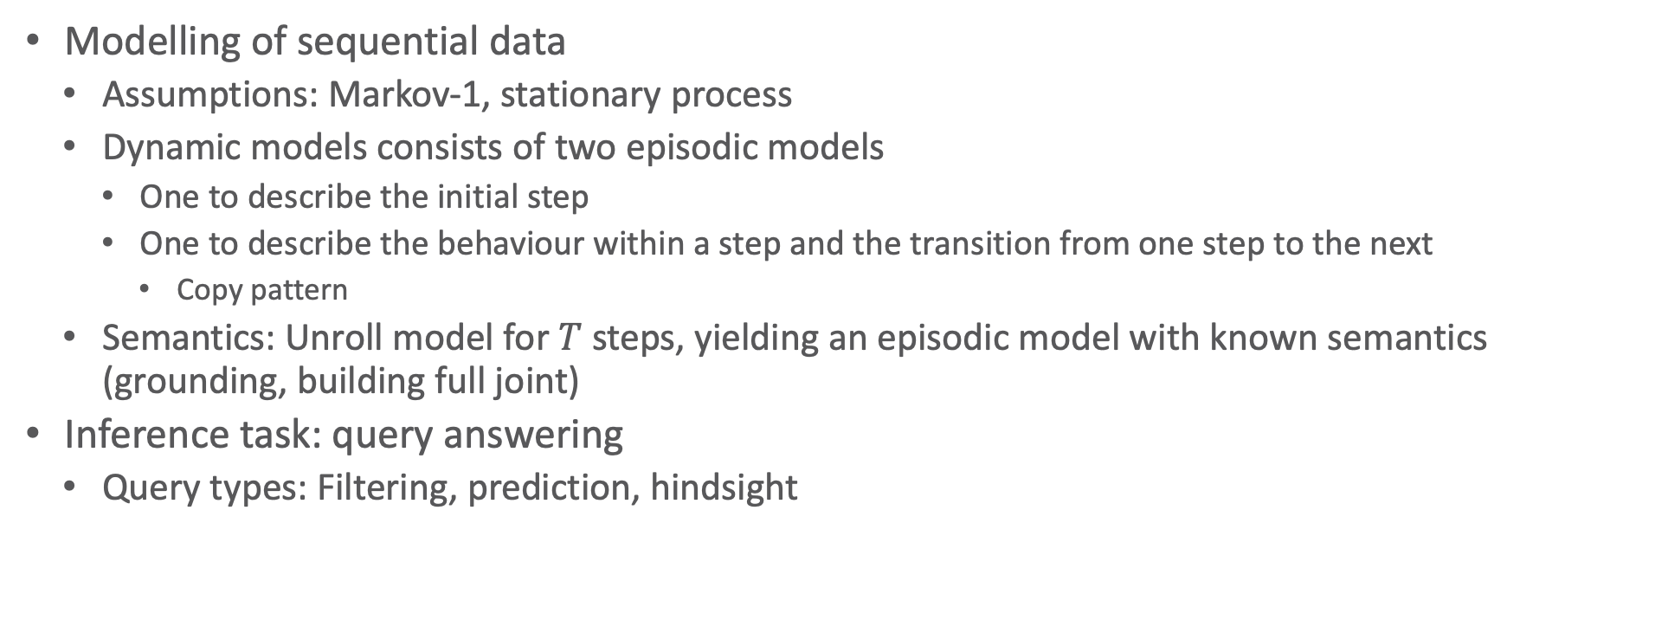
Interim Summary
Modelling of sequential data
  Assumptions: Markov-1, stationary process
  Dynamic models consists of two episodic models
    One to describe the initial step
    One to describe the behaviour within a step and the transition from one step to the next
      Copy pattern
  Semantics: Unroll model for $T$ steps, yielding an episodic model with known semantics (grounding, building full joint)
Inference task: query answering
  Query types: Filtering, prediction, hindsight

Slide 27
Outline: 6. Lifted Sequential Models & Inference
Modelling of Sequences
  Templates, modelling
  Semantics, inference tasks
Dynamic Inference
  Interfaces, lifted dynamic junction tree algorithm (LDJT)
  Theoretical analysis: complexity
  Keeping inference polynomial: Temporal approximate merging (TAMe)

Slide 28

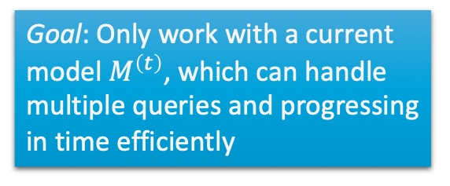




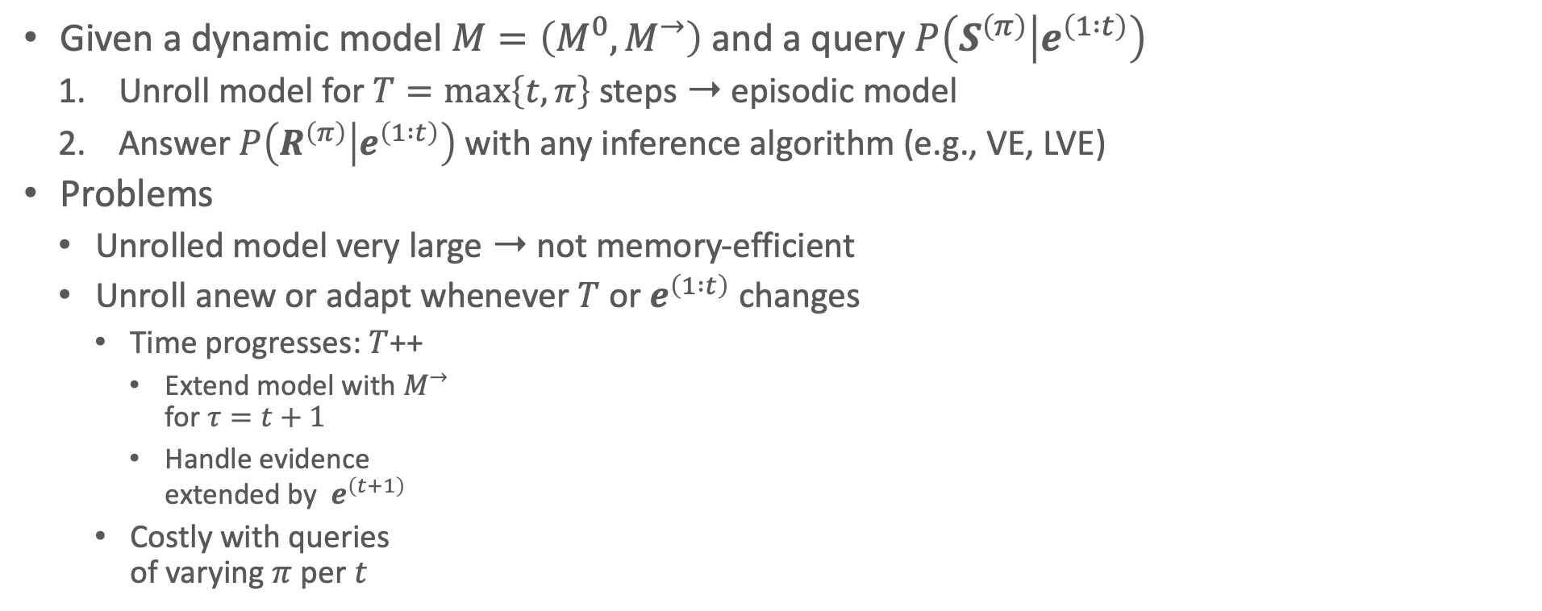











Naïve Inference Using Unrolling
Given a dynamic model $M=\left(M^{0},M^{→}\right)$ and a query $P\left(S^{\left(π\right)} | e^{\left(1 :t\right)}\right)$
  Unroll model for $T=\max\left\{t,π\right\}$ steps ➝ episodic model
  Answer $P\left(R^{\left(π\right)} | e^{\left(1 :t\right)}\right)$with any inference algorithm (e.g., VE, LVE)
Problems
  Unrolled model very large ➝ not memory-efficient
  Unroll anew or adapt whenever $T$ or $e^{\left(1 :t\right)}$ changes
    Time progresses: $T$++
      Extend model with $M^{→}$
      for $τ=t+1$
      Handle evidence
      extended by $e^{\left(t+1\right)}$
    Costly with queries
    of varying $π$ per $t$
Goal: Only work with a current model $M^{\left(t\right)}$, which can handle multiple queries and progressing in time efficiently
$$\left\{g_{E}^{\left(0,1\right)}\right\}$$
$$\left\{g_{E}^{\left(1,2\right)}\right\}$$
$$G=\left\{g_{0}^{\left(0\right)},g_{2}^{\left(0\right)},g_{3}^{\left(0\right)}\right\} ∪$$
$$∪\left\{g_{2}^{\left(1\right)},g_{3}^{\left(1\right)}\right\} ∪$$
$$∪\left\{g_{2}^{\left(2\right)},g_{3}^{\left(2\right)}\right\}$$
$$g_{0}^{\left(0\right)}$$
$${Epid}^{\left(0\right)}$$
$$g_{E}^{\left(0,1\right)}$$
$${Epid}^{\left(1\right)}$$
$$g_{E}^{\left(1,2\right)}$$
$${Epid}^{\left(2\right)}$$
$${Travel\left(X\right)}^{\left(0\right)}$$
$${Treat\left(X,M\right)}^{\left(0\right)}$$
$${Travel\left(X\right)}^{\left(1\right)}$$
$${Treat\left(X,M\right)}^{\left(1\right)}$$
$${Travel\left(X\right)}^{\left(2\right)}$$
$${Treat\left(X,M\right)}^{\left(2\right)}$$
$$g_{2}^{\left(0\right)}$$
$$g_{3}^{\left(0\right)}$$
$$g_{2}^{\left(1\right)}$$
$$g_{3}^{\left(1\right)}$$
$$g_{2}^{\left(2\right)}$$
$$g_{3}^{\left(2\right)}$$
$${Sick\left(X\right)}^{\left(0\right)}$$
$${Sick\left(X\right)}^{\left(1\right)}$$
$${Sick\left(X\right)}^{\left(2\right)}$$

Slide 29






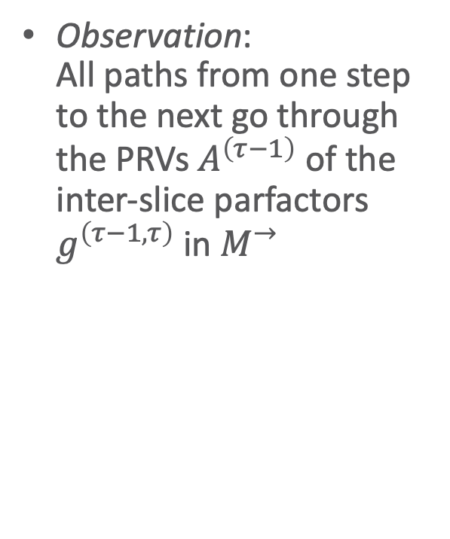


Independences in Dynamic Models
Observation:
All paths from one step to the next go through the PRVs $A^{\left(τ−1\right)}$ of the inter-slice parfactors $g^{\left(τ−1,τ\right)}$ in $M^{→}$
$$\left\{g_{E}^{\left(0,1\right)}\right\}$$
$$\left\{g_{E}^{\left(1,2\right)}\right\}$$
$$G=\left\{g_{0}^{\left(0\right)},g_{2}^{\left(0\right)},g_{3}^{\left(0\right)}\right\} ∪$$
$$∪\left\{g_{2}^{\left(1\right)},g_{3}^{\left(1\right)}\right\} ∪$$
$$∪\left\{g_{2}^{\left(2\right)},g_{3}^{\left(2\right)}\right\}$$
$$g_{0}^{\left(0\right)}$$
$${Epid}^{\left(0\right)}$$
$$g_{E}^{\left(0,1\right)}$$
$${Epid}^{\left(1\right)}$$
$$g_{E}^{\left(1,2\right)}$$
$${Epid}^{\left(2\right)}$$
$${Travel\left(X\right)}^{\left(0\right)}$$
$${Treat\left(X,M\right)}^{\left(0\right)}$$
$${Travel\left(X\right)}^{\left(1\right)}$$
$${Treat\left(X,M\right)}^{\left(1\right)}$$
$${Travel\left(X\right)}^{\left(2\right)}$$
$${Treat\left(X,M\right)}^{\left(2\right)}$$
$$g_{2}^{\left(0\right)}$$
$$g_{3}^{\left(0\right)}$$
$$g_{2}^{\left(1\right)}$$
$$g_{3}^{\left(1\right)}$$
$$g_{2}^{\left(2\right)}$$
$$g_{3}^{\left(2\right)}$$
$${Sick\left(X\right)}^{\left(0\right)}$$
$${Sick\left(X\right)}^{\left(1\right)}$$
$${Sick\left(X\right)}^{\left(2\right)}$$
$$t=0$$
$$t=1$$
$$t=2$$
$$g_{0}^{\left(0\right)}$$
$$g_{E}^{\left(τ−1,τ\right)}$$
$${Epid}^{\left(0\right)}$$
$${Epid}^{\left(τ−1\right)}$$
$${Epid}^{\left(τ\right)}$$
$${Travel\left(X\right)}^{\left(0\right)}$$
$${Treat\left(X,M\right)}^{\left(0\right)}$$
$${Travel\left(X\right)}^{\left(τ\right)}$$
$${Treat\left(X,M\right)}^{\left(τ\right)}$$
$$g_{2}^{\left(0\right)}$$
$$g_{3}^{\left(0\right)}$$
$$g_{2}^{\left(τ\right)}$$
$$g_{3}^{\left(τ\right)}$$
$${Sick\left(X\right)}^{\left(0\right)}$$
$${Sick\left(X\right)}^{\left(τ−1\right)}$$
$${Sick\left(X\right)}^{\left(τ\right)}$$

Slide 30
Independences in Dynamic Models
Fact: Conditioning on these PRVs makes a current step independent of the previous steps
  Collect information on these PRVs as a message before progressing in time
$$\left\{g_{E}^{\left(0,1\right)}\right\}$$
$$\left\{g_{E}^{\left(1,2\right)}\right\}$$
$$G=\left\{g_{0}^{\left(0\right)},g_{2}^{\left(0\right)},g_{3}^{\left(0\right)}\right\} ∪$$
$$∪\left\{g_{2}^{\left(1\right)},g_{3}^{\left(1\right)}\right\} ∪$$
$$∪\left\{g_{2}^{\left(2\right)},g_{3}^{\left(2\right)}\right\}$$
$$g_{0}^{\left(0\right)}$$
$${Epid}^{\left(0\right)}$$
$$g_{E}^{\left(0,1\right)}$$
$${Epid}^{\left(1\right)}$$
$$g_{E}^{\left(1,2\right)}$$
$${Epid}^{\left(2\right)}$$
$${Travel\left(X\right)}^{\left(0\right)}$$
$${Treat\left(X,M\right)}^{\left(0\right)}$$
$${Travel\left(X\right)}^{\left(1\right)}$$
$${Treat\left(X,M\right)}^{\left(1\right)}$$
$${Travel\left(X\right)}^{\left(2\right)}$$
$${Treat\left(X,M\right)}^{\left(2\right)}$$
$$g_{2}^{\left(0\right)}$$
$$g_{3}^{\left(0\right)}$$
$$g_{2}^{\left(1\right)}$$
$$g_{3}^{\left(1\right)}$$
$$g_{2}^{\left(2\right)}$$
$$g_{3}^{\left(2\right)}$$
$${Sick\left(X\right)}^{\left(0\right)}$$
$${Sick\left(X\right)}^{\left(1\right)}$$
$${Sick\left(X\right)}^{\left(2\right)}$$
$$t=0$$
$$t=1$$
$$t=2$$
$$g_{0}^{\left(0\right)}$$
$$g_{E}^{\left(τ−1,τ\right)}$$
$${Epid}^{\left(0\right)}$$
$${Epid}^{\left(τ−1\right)}$$
$${Epid}^{\left(τ\right)}$$
$${Travel\left(X\right)}^{\left(0\right)}$$
$${Treat\left(X,M\right)}^{\left(0\right)}$$
$${Travel\left(X\right)}^{\left(τ\right)}$$
$${Treat\left(X,M\right)}^{\left(τ\right)}$$
$$g_{2}^{\left(0\right)}$$
$$g_{3}^{\left(0\right)}$$
$$g_{2}^{\left(τ\right)}$$
$$g_{3}^{\left(τ\right)}$$
$${Sick\left(X\right)}^{\left(0\right)}$$
$${Sick\left(X\right)}^{\left(τ−1\right)}$$
$${Sick\left(X\right)}^{\left(τ\right)}$$

Slide 31


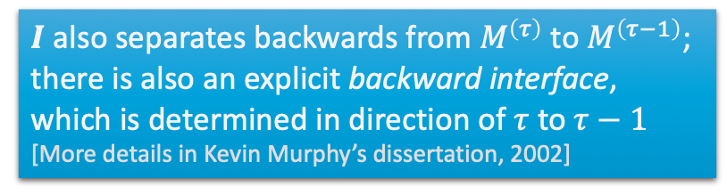




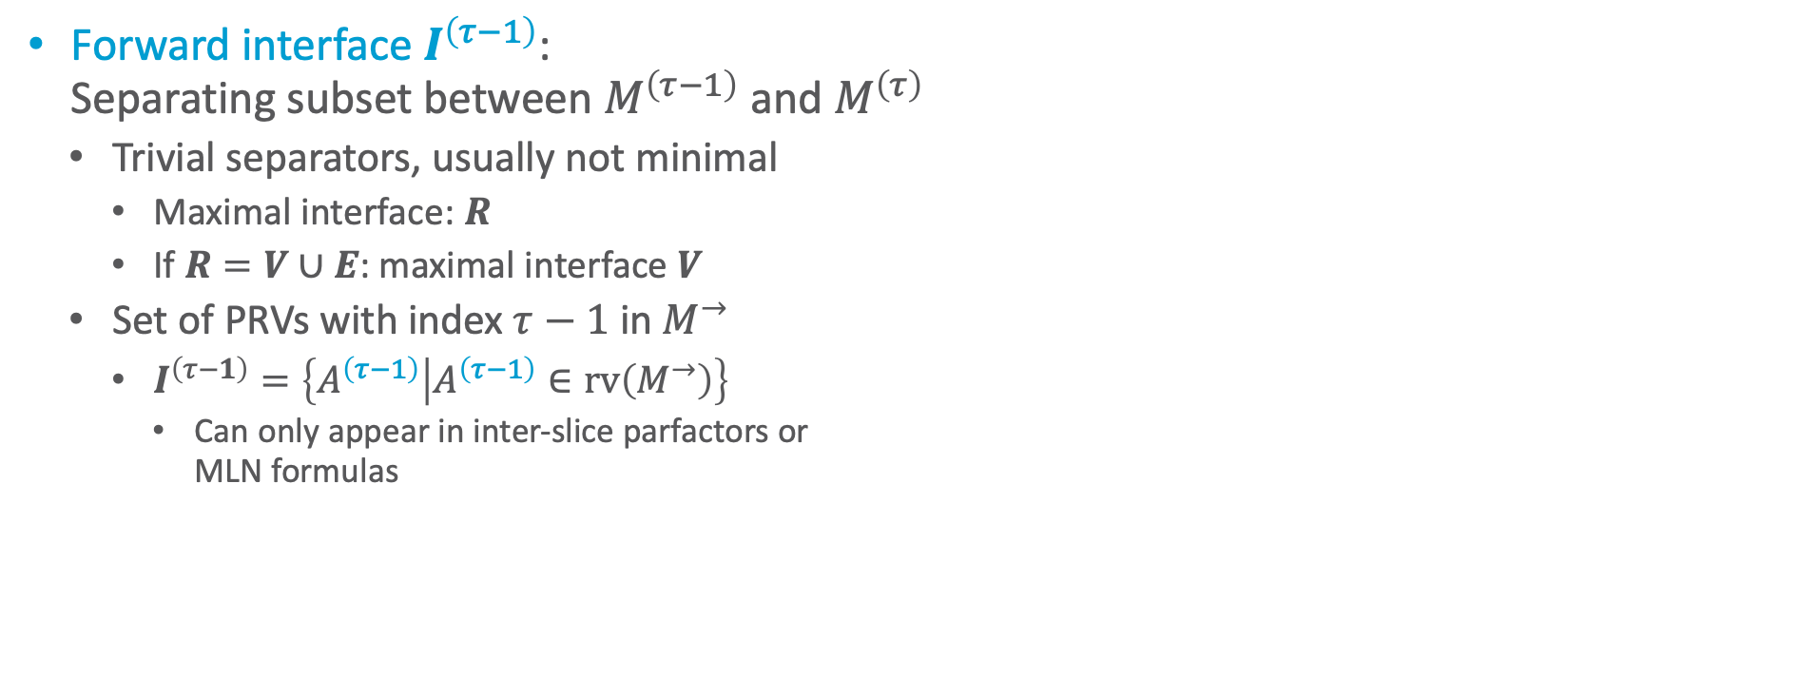











Interfaces
$$R^{\left(t−1\right)}$$
$$R^{\left(t\right)}$$
$$V^{\left(t−1\right)}$$
$$V^{\left(t\right)}$$
Forward interface $I^{\left(τ−1\right)}$:
Separating subset between $M^{\left(τ−1\right)}$ and $M^{\left(τ\right)}$
  Trivial separators, usually not minimal
    Maximal interface: $R$
    If $R=V∪E$: maximal interface $V$
  Set of PRVs with index $τ−1$ in $M^{→}$
    $I^{\left(τ−1\right)}=\left\{A^{\left(τ−1\right)} | A^{\left(τ−1\right)}∈rv\left(M^{→}\right)\right\}$
      Can only appear in inter-slice parfactors or
      MLN formulas
$$E^{\left(t−1\right)}$$
$$E^{\left(t\right)}$$
$${Epid}^{\left(τ−1\right)}$$
$$f_{E}$$
$${Epid}^{\left(τ\right)}$$
$${Travel}^{\left(τ\right)}$$
$${Treat}^{\left(τ\right)}$$
$$f_{2}^{\left(τ\right)}$$
$$f_{3}^{\left(τ\right)}$$
$${Sick}^{\left(τ−1\right)}$$
$${Sick}^{\left(τ\right)}$$
$${Epid}^{\left(τ−1\right)}$$
$$g_{E}^{\left(τ−1,τ\right)}$$
$${Epid}^{\left(τ\right)}$$
$I$ also separates backwards from $M^{\left(τ\right)}$ to $M^{\left(τ−1\right)}$; there is also an explicit backward interface, which is determined in direction of $τ$ to $τ−1$
[More details in Kevin Murphy’s dissertation, 2002]
$${Travel\left(X\right)}^{\left(τ\right)}$$
$${Treat\left(X,M\right)}^{\left(τ\right)}$$
$$g_{2}^{\left(τ\right)}$$
$$g_{3}^{\left(τ\right)}$$
$${Sick\left(X\right)}^{\left(τ−1\right)}$$
$${Sick\left(X\right)}^{\left(τ\right)}$$

Slide 32


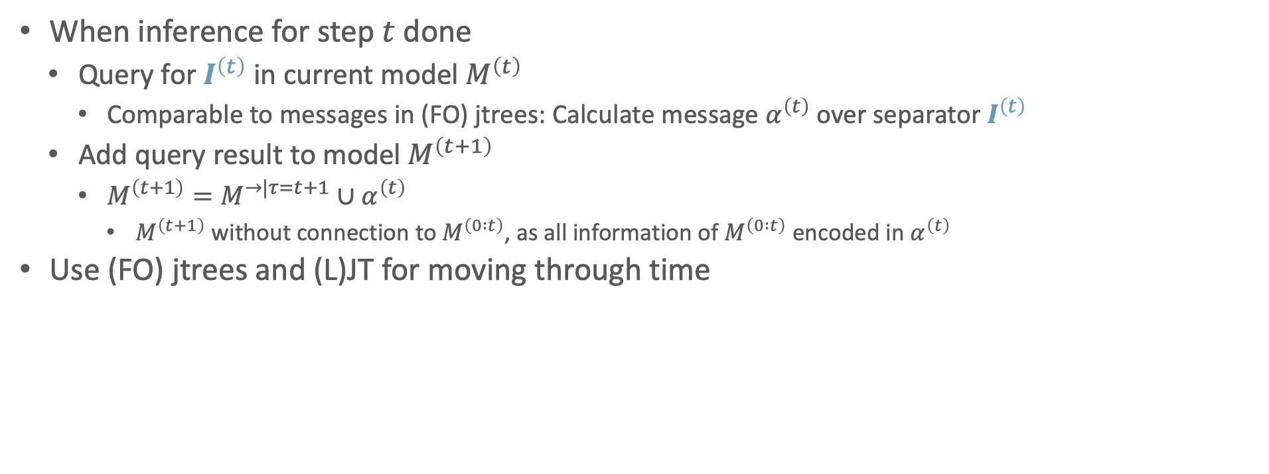




















Interfaces To Move Through Time
When inference for step $t$ done
  Query for $I^{\left(t\right)}$ in current model $M^{\left(t\right)}$
    Comparable to messages in (FO) jtrees: Calculate message $α^{\left(t\right)}$ over separator $I^{\left(t\right)}$
  Add query result to model $M^{\left(t+1\right)}$
    $M^{\left(t+1\right)}=M^{→|τ=t+1}∪α^{\left(t\right)}$
      $M^{\left(t+1\right)}$ without connection to $M^{\left(0 :t\right)}$, as all information of $M^{\left(0 :t\right)}$ encoded in $α^{\left(t\right)}$
Use (FO) jtrees and (L)JT for moving through time
$$g_{0}^{\left(0\right)}$$
$${Epid}^{\left(0\right)}$$
$${Epid}^{\left(0\right)}$$
$$g_{E}^{\left(0,1\right)}$$
$${Epid}^{\left(1\right)}$$
$${Epid}^{\left(1\right)}$$
$$g_{E}^{\left(1,2\right)}$$
$${Epid}^{\left(2\right)}$$
$${Travel\left(X\right)}^{\left(0\right)}$$
$${Treat\left(X,M\right)}^{\left(0\right)}$$
$$α^{\left(0\right)}$$
$${Travel\left(X\right)}^{\left(1\right)}$$
$${Treat\left(X,M\right)}^{\left(1\right)}$$
$$α^{\left(1\right)}$$
$${Travel\left(X\right)}^{\left(2\right)}$$
$${Treat\left(X,M\right)}^{\left(2\right)}$$
$$g_{2}^{\left(0\right)}$$
$$g_{3}^{\left(0\right)}$$
$$g_{2}^{\left(1\right)}$$
$$g_{3}^{\left(1\right)}$$
$$g_{2}^{\left(2\right)}$$
$$g_{3}^{\left(2\right)}$$
$${Sick\left(X\right)}^{\left(0\right)}$$
$${Sick\left(X\right)}^{\left(0\right)}$$
$${Sick\left(X\right)}^{\left(1\right)}$$
$${Sick\left(X\right)}^{\left(1\right)}$$
$${Sick\left(X\right)}^{\left(2\right)}$$

Slide 33

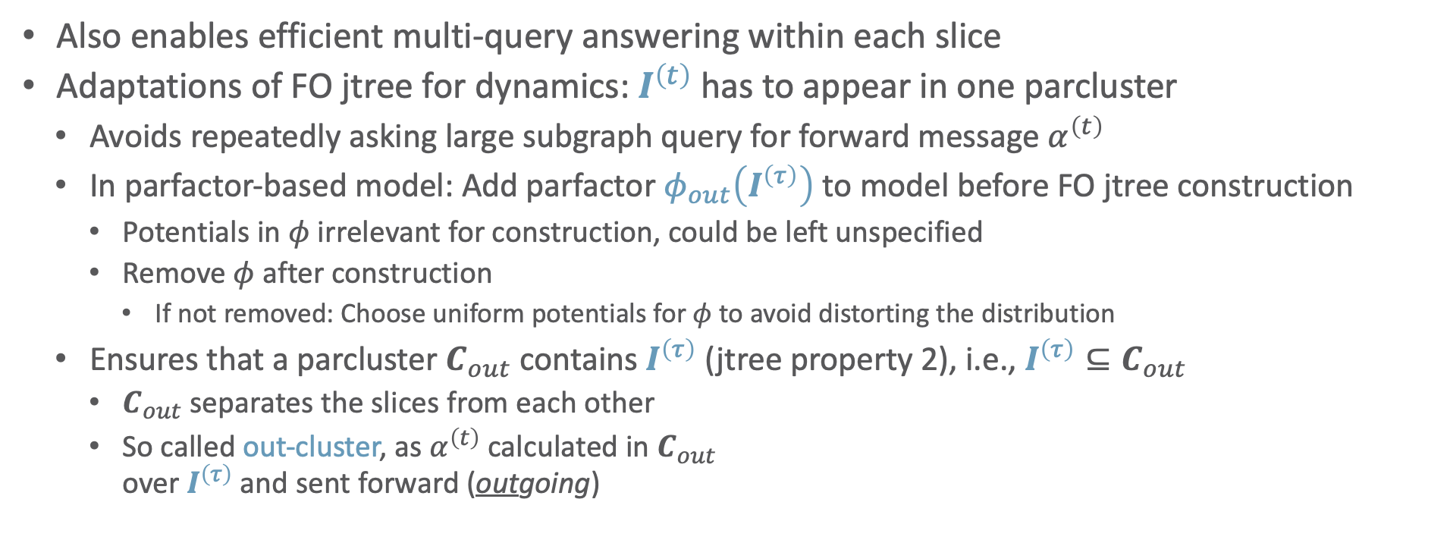



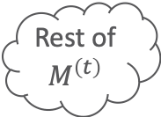

FO Jtrees and LJT To Move Through Time
Also enables efficient multi-query answering within each slice
Adaptations of FO jtree for dynamics: $I^{\left(t\right)}$ has to appear in one parcluster
  Avoids repeatedly asking large subgraph query for forward message $α^{\left(t\right)}$
  In parfactor-based model: Add parfactor $φ_{out}\left(I^{\left(τ\right)}\right)$ to model before FO jtree construction
    Potentials in $φ$ irrelevant for construction, could be left unspecified
    Remove $φ$ after construction
      If not removed: Choose uniform potentials for $φ$ to avoid distorting the distribution
  Ensures that a parcluster $C_{out}$ contains $I^{\left(τ\right)}$ (jtree property 2), i.e., $I^{\left(τ\right)}⊆C_{out}$
    $C_{out}$ separates the slices from each other
    So called out-cluster, as $α^{\left(t\right)}$ calculated in $C_{out}$
    over $I^{\left(τ\right)}$ and sent forward (outgoing)
Rest of $M^{\left(t\right)}$
$$R^{′}=C_{out}^{\left(t\right)}∖I^{\left(t\right)}$$
$$α^{\left(t\right)}$$
$$I^{\left(t\right)}∪R^{′}$$
$$M^{\left(t+1\right)}$$
$$C_{out}^{\left(t\right)}$$

Slide 34


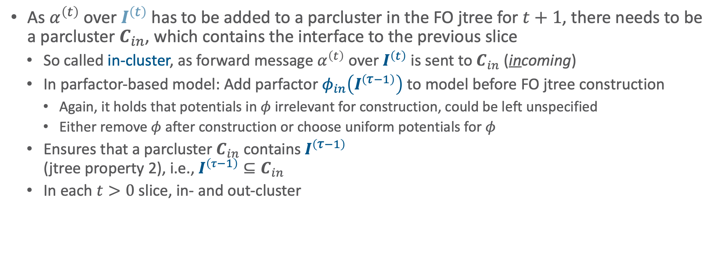




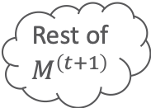




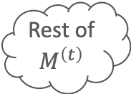
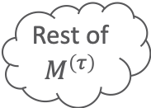

FO Jtrees and LJT To Move Through Time
As $α^{\left(t\right)}$ over $I^{\left(t\right)}$ has to be added to a parcluster in the FO jtree for $t+1$, there needs to be a parcluster $C_{in}$, which contains the interface to the previous slice
  So called in-cluster, as forward message $α^{\left(t\right)}$ over $I^{\left(t\right)}$ is sent to $C_{in}$ (incoming)
  In parfactor-based model: Add parfactor $φ_{in}\left(I^{\left(τ−1\right)}\right)$ to model before FO jtree construction
    Again, it holds that potentials in $φ$ irrelevant for construction, could be left unspecified
    Either remove $φ$ after construction or choose uniform potentials for $φ$
  Ensures that a parcluster $C_{in}$ contains $I^{\left(τ−1\right)}$
  (jtree property 2), i.e., $I^{\left(τ−1\right)}⊆C_{in}$
  In each $t>0$ slice, in- and out-cluster
$$α^{\left(τ−1\right)}$$
Rest of $M^{\left(τ\right)}$
$$α^{\left(τ\right)}$$
$$I^{\left(τ−1\right)}∪R^{′′}$$
$$I^{\left(τ\right)}∪R^{′}$$
$$C_{in}^{\left(τ\right)}$$
$$C_{out}^{\left(τ\right)}$$
Rest of $M^{\left(t\right)}$
$$α^{\left(t\right)}$$
Rest of $M^{\left(t+1\right)}$
$$I^{\left(t\right)}∪R^{′}$$
$$I^{\left(t\right)}∪R^{′′}$$
$$C_{out}^{\left(t\right)}$$
$$C_{in}^{\left(t+1\right)}$$

Slide 35
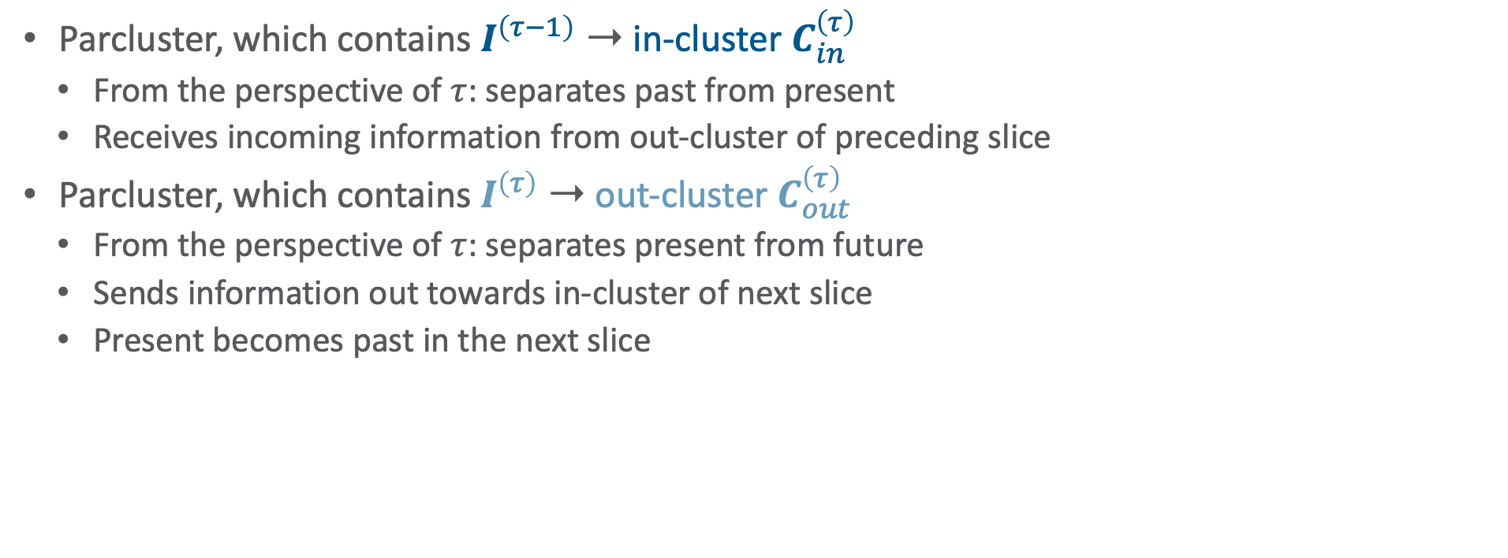


In-cluster & Out-cluster: Comparison
Parcluster, which contains $I^{\left(τ−1\right)}$ ➝ in-cluster $C_{in}^{\left(τ\right)}$
  From the perspective of $τ$: separates past from present
  Receives incoming information from out-cluster of preceding slice
Parcluster, which contains $I^{\left(τ\right)}$ ➝ out-cluster $C_{out}^{\left(τ\right)}$
  From the perspective of $τ$: separates present from future
  Sends information out towards in-cluster of next slice
  Present becomes past in the next slice
$$α^{\left(τ−1\right)}$$
Rest of $M^{\left(τ\right)}$
$$α^{\left(τ\right)}$$
$$I^{\left(τ−1\right)}∪R^{′′}$$
$$I^{\left(τ\right)}∪R^{′}$$
$$C_{in}^{\left(τ\right)}$$
$$C_{out}^{\left(τ\right)}$$

Slide 36
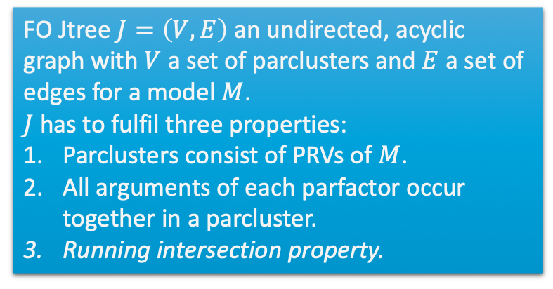
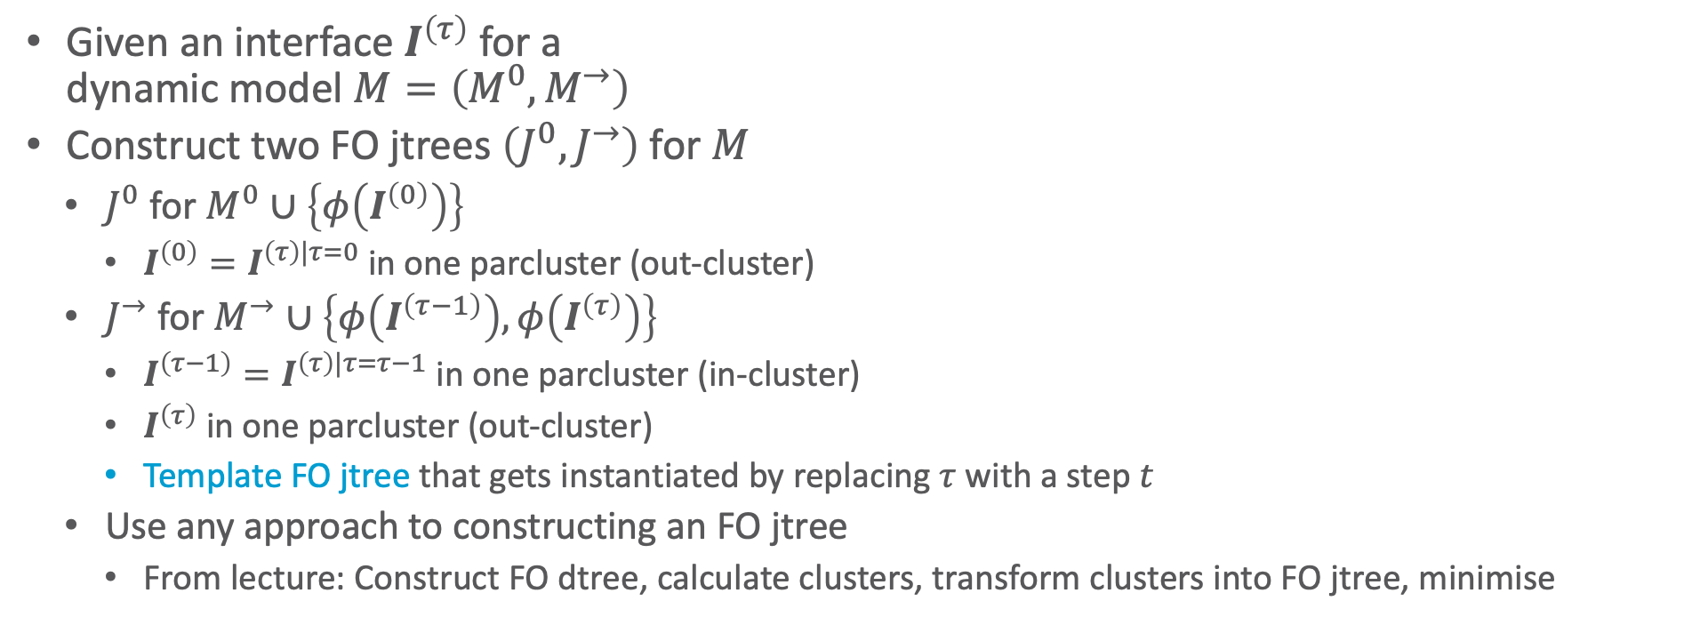
Dynamic FO Jtrees
Given an interface $I^{\left(τ\right)}$ for a
dynamic model $M=\left(M^{0},M^{→}\right)$
Construct two FO jtrees $\left(J^{0},J^{→}\right)$ for $M$
  $J^{0}$ for $M^{0}∪\left\{φ\left(I^{\left(0\right)}\right)\right\}$
    $I^{\left(0\right)}=I^{\left(τ\right)|τ=0}$ in one parcluster (out-cluster)
  $J^{→}$ for $M^{→}∪\left\{φ\left(I^{\left(τ−1\right)}\right),φ\left(I^{\left(τ\right)}\right)\right\}$
    $I^{\left(τ−1\right)}=I^{\left(τ\right)|τ=τ−1}$ in one parcluster (in-cluster)
    $I^{\left(τ\right)}$ in one parcluster (out-cluster)
    Template FO jtree that gets instantiated by replacing $τ$ with a step $t$
  Use any approach to constructing an FO jtree
    From lecture: Construct FO dtree, calculate clusters, transform clusters into FO jtree, minimise
FO Jtree $J=\left(V,E\right)$ an undirected, acyclic graph with $V$ a set of parclusters and $E$ a set of edges for a model $M$.
$J$ has to fulfil three properties:
Parclusters consist of PRVs of $M$.
All arguments of each parfactor occur together in a parcluster.
Running intersection property.

Slide 37

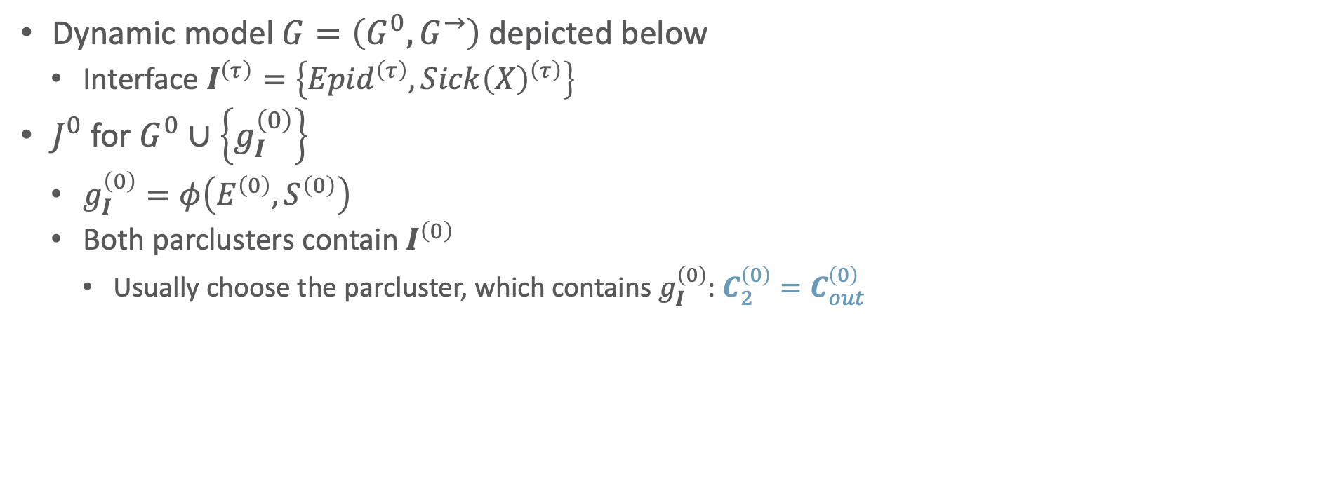








Dynamic FO Jtrees: Example
$${Epid}^{\left(0\right)}{Sick\left(X\right)}^{\left(0\right)}$$
$${Travel}^{\left(0\right)}$$
Dynamic model $G=\left(G^{0},G^{→}\right)$ depicted below
  Interface $I^{\left(τ\right)}=\left\{{Epid}^{\left(τ\right)},{Sick\left(X\right)}^{\left(τ\right)}\right\}$
$J^{0}$ for $G^{0}∪\left\{g_{I}^{\left(0\right)}\right\}$
  $g_{I}^{\left(0\right)}=φ\left(E^{\left(0\right)},S^{\left(0\right)}\right)$
  Both parclusters contain $I^{\left(0\right)}$
    Usually choose the parcluster, which contains $g_{I}^{\left(0\right)}$: $C_{2}^{\left(0\right)}=C_{out}^{\left(0\right)}$
$$C_{out}^{\left(0\right)}$$
$$C_{2}^{\left(0\right)}$$
$$g_{2}^{\left(0\right)}$$
, $g_{I}^{\left(0\right)}$
Remove
$${Epid}^{\left(0\right)}{Sick\left(X\right)}^{\left(0\right)}$$
$${Treat\left(X,M\right)}^{\left(0\right)}$$
$$C_{3}^{\left(0\right)}$$
$$g_{0}^{\left(0\right)},g_{3}^{\left(0\right)}$$
$$g_{0}^{\left(0\right)}$$
$${Epid}^{\left(0\right)}$$
$${Epid}^{\left(τ−1\right)}$$
$$g_{E}^{\left(τ−1,τ\right)}$$
$${Epid}^{\left(τ\right)}$$
$${Travel\left(X\right)}^{\left(0\right)}$$
$${Treat\left(X,M\right)}^{\left(0\right)}$$
$${Travel\left(X\right)}^{\left(τ\right)}$$
$${Treat\left(X,M\right)}^{\left(τ\right)}$$
$$g_{2}^{\left(0\right)}$$
$$g_{3}^{\left(0\right)}$$
$$g_{I}^{\left(0\right)}$$
$$g_{2}^{\left(τ\right)}$$
$$g_{3}^{\left(τ\right)}$$
$${Sick\left(X\right)}^{\left(0\right)}$$
$${Sick\left(X\right)}^{\left(τ−1\right)}$$
$${Sick\left(X\right)}^{\left(τ\right)}$$
$g_{I}^{\left(0\right)}$ not necessary here as $I^{\left(0\right)}$ already contained in parfactors

Slide 38

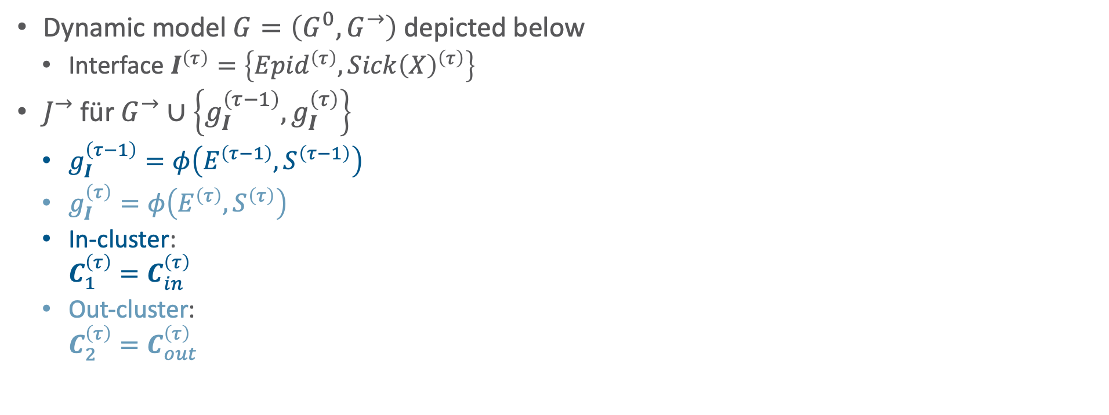















Dynamic FO Jtrees: Example
$${Epid}^{\left(τ−1\right)}{Epid}^{\left(τ\right)}$$
$${Sick\left(X\right)}^{\left(τ−1\right)}$$
${Epid}^{\left(τ\right)}{Sick\left(X\right)}^{\left(τ\right)}$
${Travel\left(X\right)}^{\left(τ\right)}$
Dynamic model $G=\left(G^{0},G^{→}\right)$ depicted below
  Interface $I^{\left(τ\right)}=\left\{{Epid}^{\left(τ\right)},{Sick\left(X\right)}^{\left(τ\right)}\right\}$
$J^{→}$ für $G^{→}∪\left\{g_{I}^{\left(τ−1\right)},g_{I}^{\left(τ\right)}\right\}$
  $g_{I}^{\left(τ−1\right)}=φ\left(E^{\left(τ−1\right)},S^{\left(τ−1\right)}\right)$
  $g_{I}^{\left(τ\right)}=φ\left(E^{\left(τ\right)},S^{\left(τ\right)}\right)$
  In-cluster:
  $C_{1}^{\left(τ\right)}=C_{in}^{\left(τ\right)}$
  Out-cluster:
  $C_{2}^{\left(τ\right)}=C_{out}^{\left(τ\right)}$
$$C_{out}^{\left(τ\right)}$$
$$C_{in}^{\left(τ\right)}$$
$$C_{2}^{\left(τ\right)}$$
$$C_{1}^{\left(τ\right)}$$
$$g_{E}^{\left(τ−1,τ\right)}$$
, $g_{I}^{\left(τ−1\right)}$
$$g_{2}^{\left(τ\right)}$$
, $g_{I}^{\left(τ\right)}$
Remove
$${Epid}^{\left(τ\right)}{Sick\left(X\right)}^{\left(τ\right)}$$
$${Treat\left(X,M\right)}^{\left(τ\right)}$$
$$C_{3}^{\left(τ\right)}$$
$$g_{0}^{\left(τ\right)},g_{3}^{\left(τ\right)}$$
$$g_{0}^{\left(0\right)}$$
$${Epid}^{\left(0\right)}$$
$${Epid}^{\left(τ−1\right)}$$
$$g_{E}^{\left(τ−1,τ\right)}$$
$${Epid}^{\left(τ\right)}$$
$${Travel\left(X\right)}^{\left(0\right)}$$
$${Treat\left(X,M\right)}^{\left(0\right)}$$
$$g_{I}^{\left(τ−1\right)}$$
$${Travel\left(X\right)}^{\left(τ\right)}$$
$${Treat\left(X,M\right)}^{\left(τ\right)}$$
$$g_{2}^{\left(0\right)}$$
$$g_{3}^{\left(0\right)}$$
$$g_{2}^{\left(τ\right)}$$
$$g_{3}^{\left(τ\right)}$$
$$g_{I}^{\left(τ\right)}$$
$${Sick\left(X\right)}^{\left(0\right)}$$
$${Sick\left(X\right)}^{\left(τ−1\right)}$$
$${Sick\left(X\right)}^{\left(τ\right)}$$
$g_{I}^{\left(τ\right)},g_{I}^{\left(τ−1\right)}$ not necessary here as $I^{\left(τ\right)},I^{\left(τ−1\right)}$ already contained in parfactors

Slide 39
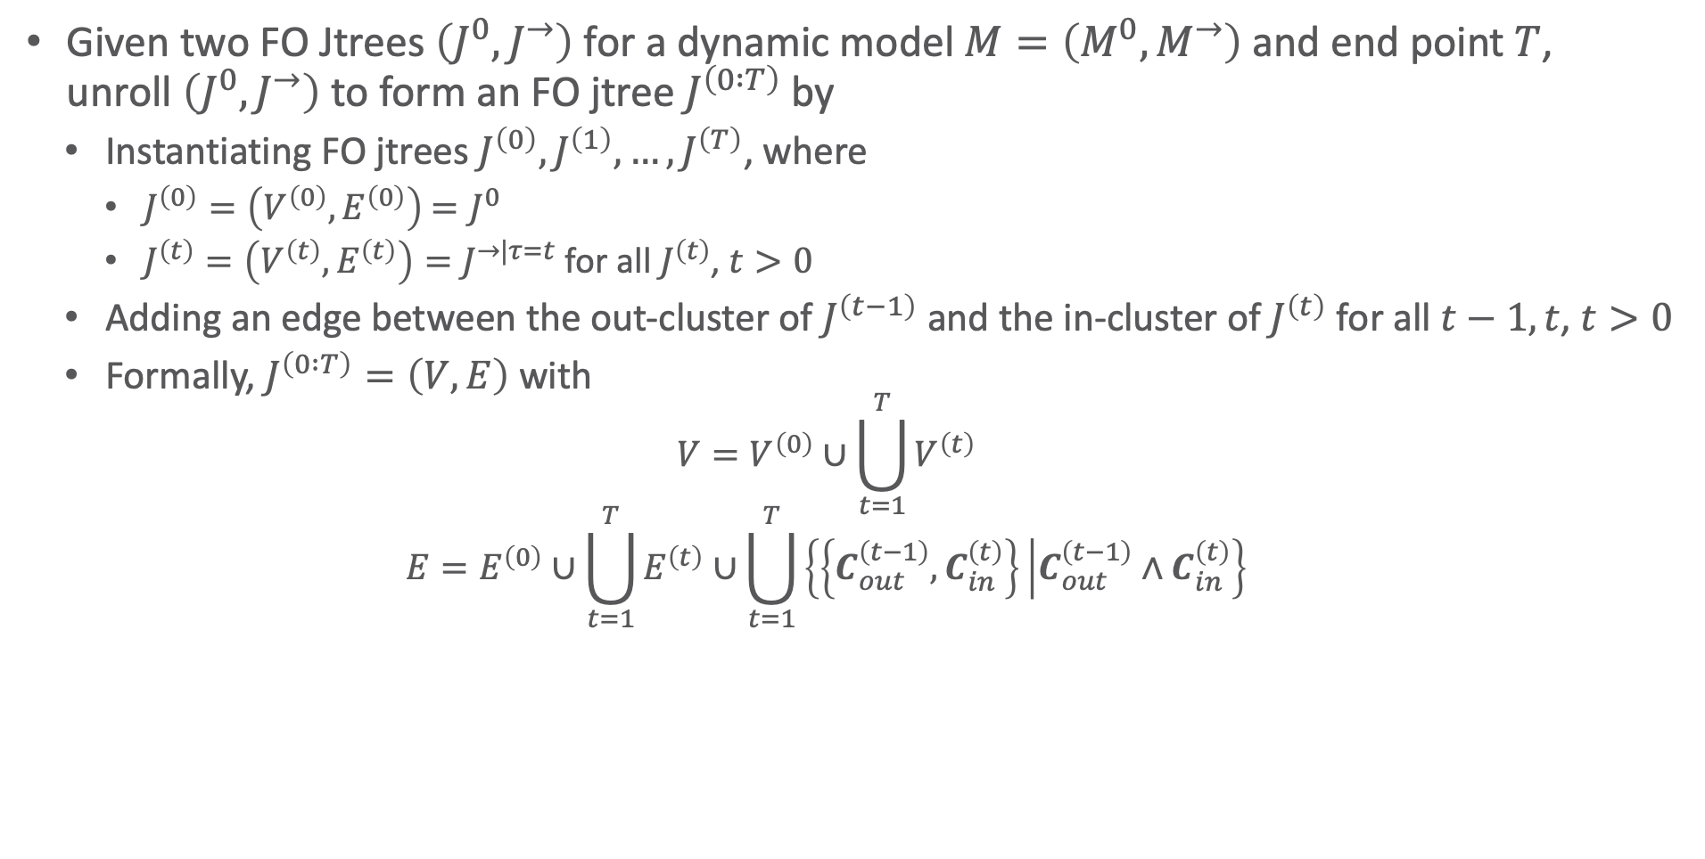
Dynamic FO Jtrees: Unrolling
Given two FO Jtrees $\left(J^{0},J^{→}\right)$ for a dynamic model $M=\left(M^{0},M^{→}\right)$ and end point $T$,
unroll $\left(J^{0},J^{→}\right)$ to form an FO jtree $J^{\left(0 :T\right)}$ by
  Instantiating FO jtrees $J^{\left(0\right)},J^{\left(1\right)},…,J^{\left(T\right)}$, where
    $J^{\left(0\right)}=\left(V^{\left(0\right)},E^{\left(0\right)}\right)$ $=J^{0}$
    $J^{\left(t\right)}=\left(V^{\left(t\right)},E^{\left(t\right)}\right)=J^{→|τ=t}$ for all $J^{\left(t\right)}$, $t>0$
  Adding an edge between the out-cluster of $J^{\left(t−1\right)}$ and the in-cluster of $J^{\left(t\right)}$ for all $t−1,t$, $t>0$
  Formally, $J^{\left(0 :T\right)}=\left(V,E\right)$ with
    $$V=V^{\left(0\right)}∪\bigcup_{t=1}^{T}{V^{\left(t\right)}}$$
    $$E=E^{\left(0\right)}∪\bigcup_{t=1}^{T}{E^{\left(t\right)}}∪\bigcup_{t=1}^{T}{\left\{\left\{C_{out}^{\left(t−1\right)},C_{in}^{\left(t\right)}\right\} | C_{out}^{\left(t−1\right)}∧C_{in}^{\left(t\right)}\right\}}$$

Slide 40










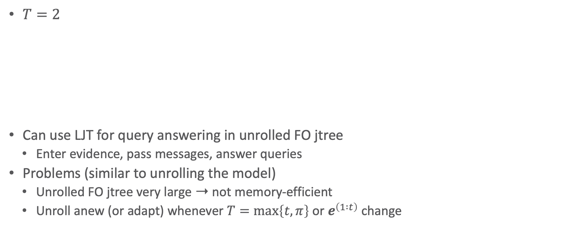














Dynamic FO Jtrees: Unrolling – Example
$T=2$
Can use LJT for query answering in unrolled FO jtree
  Enter evidence, pass messages, answer queries
Problems (similar to unrolling the model)
  Unrolled FO jtree very large ➝ not memory-efficient
  Unroll anew (or adapt) whenever $T=\max\left\{t,π\right\}$ or $e^{\left(1 :t\right)}$ change
$${Epid}^{\left(0\right)}{Sick\left(X\right)}^{\left(0\right)}$$
$${Travel}^{\left(0\right)}$$
$${Epid}^{\left(0\right)}{Epid}^{\left(1\right)}$$
$${Sick\left(X\right)}^{\left(0\right)}$$
${Epid}^{\left(1\right)}{Sick\left(X\right)}^{\left(1\right)}$
${Travel\left(X\right)}^{\left(1\right)}$
$${Epid}^{\left(1\right)}{Epid}^{\left(2\right)}$$
$${Sick\left(X\right)}^{\left(1\right)}$$
${Epid}^{\left(2\right)}{Sick\left(X\right)}^{\left(2\right)}$
${Travel\left(X\right)}^{\left(2\right)}$
$$C_{out}^{\left(0\right)}$$
$$C_{in}^{\left(1\right)}$$
$$C_{out}^{\left(1\right)}$$
$$C_{in}^{\left(2\right)}$$
$$C_{out}^{\left(2\right)}$$
$$g_{2}^{\left(0\right)}$$
$$g_{E}^{\left(0,1\right)}$$
$$g_{2}^{\left(1\right)}$$
$$g_{E}^{\left(1,2\right)}$$
$$g_{2}^{\left(2\right)}$$
$${Epid}^{\left(0\right)}{Sick\left(X\right)}^{\left(0\right)}$$
$${Treat\left(X,M\right)}^{\left(0\right)}$$
$${Epid}^{\left(1\right)}{Sick\left(X\right)}^{\left(1\right)}$$
$${Treat\left(X,M\right)}^{\left(1\right)}$$
$${Epid}^{\left(2\right)}{Sick\left(X\right)}^{\left(2\right)}$$
$${Treat\left(X,M\right)}^{\left(2\right)}$$
$$C_{3}^{\left(0\right)}$$
$$C_{3}^{\left(1\right)}$$
$$C_{3}^{\left(2\right)}$$
$$g_{0}^{\left(0\right)},g_{3}^{\left(0\right)}$$
$$g_{0}^{\left(1\right)},g_{3}^{\left(1\right)}$$
$$g_{0}^{\left(2\right)},g_{3}^{\left(2\right)}$$

Slide 41
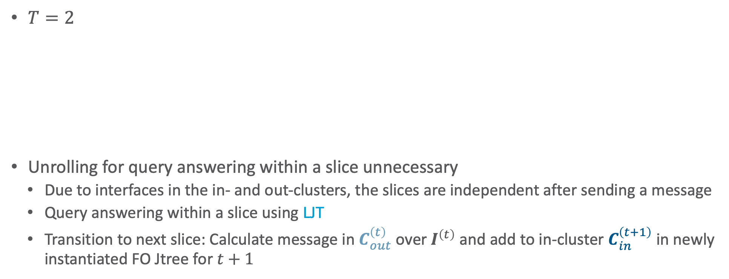
Dynamic FO Jtrees: Unrolling – Example
$T=2$
Unrolling for query answering within a slice unnecessary
  Due to interfaces in the in- and out-clusters, the slices are independent after sending a message
  Query answering within a slice using LJT
  Transition to next slice: Calculate message in $C_{out}^{\left(t\right)}$ over $I^{\left(t\right)}$ and add to in-cluster $C_{in}^{\left(t+1\right)}$ in newly instantiated FO Jtree for $t+1$
$${Epid}^{\left(0\right)}{Sick\left(X\right)}^{\left(0\right)}$$
$${Travel}^{\left(0\right)}$$
$${Epid}^{\left(0\right)}{Epid}^{\left(1\right)}$$
$${Sick\left(X\right)}^{\left(0\right)}$$
${Epid}^{\left(1\right)}{Sick\left(X\right)}^{\left(1\right)}$
${Travel\left(X\right)}^{\left(1\right)}$
$${Epid}^{\left(1\right)}{Epid}^{\left(2\right)}$$
$${Sick\left(X\right)}^{\left(1\right)}$$
${Epid}^{\left(2\right)}{Sick\left(X\right)}^{\left(2\right)}$
${Travel\left(X\right)}^{\left(2\right)}$
$$C_{out}^{\left(0\right)}$$
$$C_{in}^{\left(1\right)}$$
$$C_{out}^{\left(1\right)}$$
$$C_{in}^{\left(2\right)}$$
$$C_{out}^{\left(2\right)}$$
$$g_{2}^{\left(0\right)}$$
$$g_{E}^{\left(0,1\right)}$$
$$g_{2}^{\left(1\right)}$$
$$g_{E}^{\left(1,2\right)}$$
$$g_{2}^{\left(2\right)}$$
$${Epid}^{\left(0\right)}{Sick\left(X\right)}^{\left(0\right)}$$
$${Treat\left(X,M\right)}^{\left(0\right)}$$
$${Epid}^{\left(1\right)}{Sick\left(X\right)}^{\left(1\right)}$$
$${Treat\left(X,M\right)}^{\left(1\right)}$$
$${Epid}^{\left(2\right)}{Sick\left(X\right)}^{\left(2\right)}$$
$${Treat\left(X,M\right)}^{\left(2\right)}$$
$$C_{3}^{\left(0\right)}$$
$$C_{3}^{\left(1\right)}$$
$$C_{3}^{\left(2\right)}$$
$$g_{0}^{\left(0\right)},g_{3}^{\left(0\right)}$$
$$g_{0}^{\left(1\right)},g_{3}^{\left(1\right)}$$
$$g_{0}^{\left(2\right)},g_{3}^{\left(2\right)}$$

Slide 42
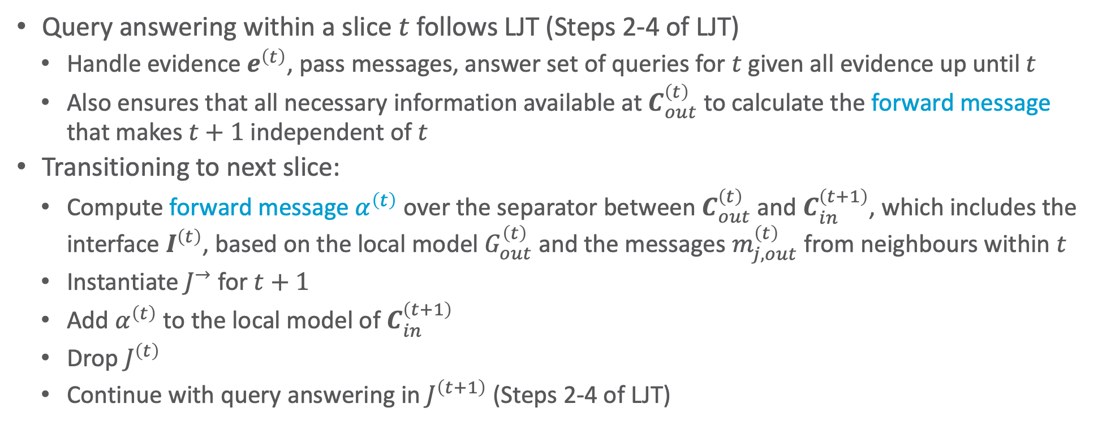
Progressing in Time
Query answering within a slice $t$ follows LJT (Steps 2-4 of LJT)
  Handle evidence $e^{\left(t\right)}$, pass messages, answer set of queries for $t$ given all evidence up until $t$
  Also ensures that all necessary information available at $C_{out}^{\left(t\right)}$ to calculate the forward message that makes $t+1$ independent of $t$
Transitioning to next slice:
  Compute forward message $α^{\left(t\right)}$ over the separator between $C_{out}^{\left(t\right)}$ and $C_{in}^{\left(t+1\right)}$, which includes the interface $I^{\left(t\right)}$, based on the local model $G_{out}^{\left(t\right)}$ and the messages $m_{j,out}^{\left(t\right)}$ from neighbours within $t$
  Instantiate $J^{→}$ for $t+1$
  Add $α^{\left(t\right)}$ to the local model of $C_{in}^{\left(t+1\right)}$
  Drop $J^{\left(t\right)}$
  Continue with query answering in $J^{\left(t+1\right)}$ (Steps 2-4 of LJT)

Slide 43
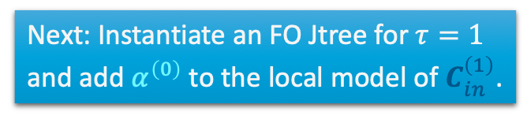

















Progressing in Time: Example
$t=0$
  Current FO jtree
  Enter evidence $e^{\left(0\right)}=\left\{{sick\left(alice\right)}^{\left(0\right)}\right\}$
  Send intra-slice messages: $m_{3,out}^{\left(0\right)}$, $m_{out,3}^{\left(0\right)}$
  Answer queries $P\left(R_{i}^{\left(0\right)} | e^{\left(0\right)}\right)$
Inter-slice message: $α^{\left(0\right)}$
  Eliminate all non-separator PRVs, here ${Travel\left(X\right)}^{\left(0\right)}$, from the local model $G_{out}^{\left(0\right)}=\left\{g_{2}^{\left(0\right)},g_{2,a}^{\left(0\right)}\right\}$ and $m_{3,out}^{\left(0\right)}$
  Send result as message $α^{\left(0\right)}$ to $C_{in}^{\left(1\right)}$
$α^{\left(0\right)}$ contains all information from $G^{\left(0\right)}$ including $e^{\left(0\right)}$, which makes slice $0$ and $1$ independent.
Next: Instantiate an FO Jtree for $τ=1$ and add $α^{\left(0\right)}$ to the local model of $C_{in}^{\left(1\right)}$.
$${Epid}^{\left(0\right)}$$
$${Sick\left(X\right)}^{\left(0\right)}$$
$${Epid}^{\left(0\right)}{Sick\left(X\right)}^{\left(0\right)}$$
$${Travel}^{\left(0\right)}$$
$${Epid}^{\left(0\right)}{Epid}^{\left(1\right)}$$
$${Sick\left(X\right)}^{\left(0\right)}$$
$$C_{out}^{\left(0\right)}$$
$$C_{in}^{\left(1\right)}$$
$$g_{2}^{\left(0\right)}$$
$$m_{3,out}^{\left(0\right)}$$
$$α^{\left(0\right)}$$
$$g_{E}^{\left(0,1\right)}$$
$$g_{2,a}^{\left(0\right)}$$
$${Epid}^{\left(0\right)}{Sick\left(X\right)}^{\left(0\right)}$$
$${Treat\left(X,M\right)}^{\left(0\right)}$$
$$C_{3}^{\left(0\right)}$$
$$g_{0}^{\left(0\right)},g_{3}^{\left(0\right)}$$
$$g_{3.a}^{\left(0\right)}$$
$$m_{out,3}^{\left(0\right)}$$

Slide 44

























Progressing in Time: Example
The information in $α^{\left(0\right)}$ is distributed during the intra-slice message passing and therefore also included in $α^{\left(1\right)}$. $α^{\left(1\right)}$ now contains all information from $G^{\left(0 :1\right)}$ including $e^{\left(0 :1\right)}$, which makes slice $1$ and $2$ independent.
$t=1$
  Current FO jtree with $α^{\left(0\right)}$
  Enter evidence $e^{\left(1\right)}=\left\{{sick\left(alice\right)}^{\left(1\right)}\right\}$
  Send intra-slice messages:
  $m_{3,out}^{\left(1\right)}$, $m_{out,3}^{\left(1\right)}$, $m_{in,out}^{\left(1\right)}$, $m_{out,in}^{\left(1\right)}$
  Answer queries $P\left(R_{i}^{\left(1\right)} | e^{\left(0:1\right)}\right)$
Inter-slice message: $α^{\left(1\right)}$
  Eliminate ${Travel\left(X\right)}^{\left(1\right)}$ from
  $G_{out}^{\left(1\right)}=\left\{g_{2}^{\left(1\right)},g_{2,a}^{\left(1\right)}\right\}$, $m_{in,out}^{\left(1\right)}$, and $m_{3,out}^{\left(1\right)}$
  Send result as message $α^{\left(1\right)}$ to $C_{in}^{\left(2\right)}$
Next: Instantiate an FO Jtree for $τ=2$ and add $α^{\left(1\right)}$ to the local model of $C_{in}^{\left(2\right)}$.
$${Epid}^{\left(1\right)}$$
$${Sick\left(X\right)}^{\left(1\right)}$$
$${Epid}^{\left(0\right)}{Epid}^{\left(1\right)}$$
$${Sick\left(X\right)}^{\left(0\right)}$$
${Epid}^{\left(1\right)}{Sick\left(X\right)}^{\left(1\right)}$
${Travel\left(X\right)}^{\left(1\right)}$
$${Epid}^{\left(1\right)}{Epid}^{\left(2\right)}$$
$${Sick\left(X\right)}^{\left(1\right)}$$
$$C_{in}^{\left(1\right)}$$
$$C_{out}^{\left(1\right)}$$
$$C_{in}^{\left(2\right)}$$
$$g_{E}^{\left(0,1\right)}$$
$$α^{\left(0\right)}$$
$$g_{2}^{\left(1\right)}$$
$$m_{3,out}^{\left(1\right)}$$
$$g_{E}^{\left(1,2\right)}$$
$$g_{E,a}^{\left(0,1\right)}$$
$$m_{out,in}^{\left(1\right)}$$
$$g_{2,a}^{\left(1\right)}$$
$$α^{\left(1\right)}$$
$$m_{in,out}^{\left(1\right)}$$
$${Epid}^{\left(1\right)}{Sick\left(X\right)}^{\left(1\right)}$$
$${Treat\left(X,M\right)}^{\left(1\right)}$$
$$C_{3}^{\left(1\right)}$$
$$g_{0}^{\left(1\right)},g_{3}^{\left(1\right)}$$
$$g_{3,a}^{\left(1\right)}$$
$$m_{out,3}^{\left(1\right)}$$

Slide 45





















Filtering Queries
Queries one can answer in this way: Filtering queries
  $P\left(R^{\left(t\right)} | e^{\left(0 :t\right)}\right)$
  Queries for random variables / grounded instances of PRVs / parameterised queries of the current slice $t$ given all evidence $e^{\left(0 :t\right)}$ up until $t$
  Advantages
    Only a current FO jtree necessary
    One additional message ($α^{\left(t\right)}$) to progress in time
What about prediction and hindsight queries?
  $P\left(R^{\left(π\right)} | e^{\left(0 :t\right)}\right)$, $π≠t$
Any ideas?
$${Epid}^{\left(1\right)}$$
$${Sick\left(X\right)}^{\left(1\right)}$$
$${Epid}^{\left(0\right)}{Epid}^{\left(1\right)}$$
$${Sick\left(X\right)}^{\left(0\right)}$$
${Epid}^{\left(1\right)}{Sick\left(X\right)}^{\left(1\right)}$
${Travel\left(X\right)}^{\left(1\right)}$
$$α^{\left(1\right)}$$
$$C_{in}^{\left(1\right)}$$
$$C_{out}^{\left(1\right)}$$
$$g_{E}^{\left(0,1\right)}$$
$$α^{\left(0\right)}$$
$$g_{2}^{\left(1\right)}$$
$$m_{3,out}^{\left(1\right)}$$
$$g_{E}^{\left(0,1\right)}$$
$$m_{out,in}^{\left(1\right)}$$
$$g_{2,a}^{\left(1\right)}$$
$$m_{in,out}^{\left(1\right)}$$
$${Epid}^{\left(1\right)}{Sick\left(X\right)}^{\left(1\right)}$$
$${Treat\left(X,M\right)}^{\left(1\right)}$$
$$C_{3}^{\left(1\right)}$$
$$g_{0}^{\left(1\right)},g_{3}^{\left(1\right)}$$
$$m_{out,3}^{\left(1\right)}$$
$$g_{3,a}^{\left(1\right)}$$

Slide 46

Prediction Queries
Queries for upcoming instances of PRVs / random variables: $P\left(R^{\left(π\right)} | e^{\left(0 :t\right)}\right),π>t$
  Look into the future: Move forward in time until $π$ without seeing evidence, i.e.,
    Filtering $P\left(R^{\left(π\right)} | e^{\left(0 :π\right)}\right)$ with empty evidence between $t+1$ and $π$ in $e^{\left(0 :π\right)}$: $e^{\left(\left(t+1\right) :π\right)}={\left\{∅^{\left(t^{′}\right)}\right\}}_{t^{′}=t+1}^{π}$
Query answering for prediction
  Move forward until $t=π$
    One pass from periphery to out-cluster as centre sufficient
  Answer query with query term $R^{\left(π\right)}$
    If only one query
      Find parcluster $C_{i}^{π}$, which contains $R^{\left(π\right)}$; do one message pass from periphery to $C_{i}^{π}$ as centre; answer in $C_{i}^{π}$
    Otherwise:
      Do a complete message pass; answer queries
Saves half the messages

Slide 47















Prediction Queries: Example
$P\left({Epid}^{\left(3\right)} | e^{\left(0 :1\right)}\right)$, $3>1$
  No Evidence for slices $2$ and $3$: $e^{\left(2 :3\right)}={\left\{∅^{\left(t^{′}\right)}\right\}}_{t^{′}=2}^{3}$
  Progress in time until $t=3$, then answer query for ${Epid}^{\left(3\right)}$
  $t=2$, current FO Jtree with $α^{\left(1\right)}$ in local model of $C_{in}^{\left(2\right)}$
    No Evidence to enter: $∅^{\left(2\right)}$
    Send intra-slice messages towards $C_{out}^{\left(2\right)}$
    (collect all information at out-cluster)
    Compute inter-slice message $α^{\left(2\right)}$
$${Epid}^{\left(2\right)}$$
$${Sick\left(X\right)}^{\left(2\right)}$$
$${Epid}^{\left(1\right)}{Epid}^{\left(2\right)}$$
$${Sick\left(X\right)}^{\left(1\right)}$$
${Epid}^{\left(2\right)}{Sick\left(X\right)}^{\left(2\right)}$
${Travel\left(X\right)}^{\left(2\right)}$
$$α^{\left(2\right)}$$
$$C_{in}^{\left(2\right)}$$
$$C_{out}^{\left(2\right)}$$
$$g_{E}^{\left(1,2\right)}$$
$$α^{\left(1\right)}$$
$$g_{2}^{\left(2\right)}$$
$$m_{3,out}^{\left(2\right)}$$
$$m_{in,out}^{\left(2\right)}$$
$${Epid}^{\left(2\right)}{Sick\left(X\right)}^{\left(2\right)}$$
$${Treat\left(X,M\right)}^{\left(2\right)}$$
$$C_{3}^{\left(2\right)}$$
$$g_{0}^{\left(2\right)},g_{3}^{\left(2\right)}$$

Slide 48













Prediction Queries: Example
$P\left({Epid}^{\left(3\right)} | e^{\left(0 :1\right)}\right)$, $3>1$
  No Evidence for slices $2$ and $3$: $e^{\left(2 :3\right)}={\left\{∅^{\left(t^{′}\right)}\right\}}_{t^{′}=2}^{3}$
  Progress in time until $t=3$, then answer query for ${Epid}^{\left(3\right)}$
  $t=3$, current FO Jtree with $α^{\left(2\right)}$ in local model of $C_{in}^{\left(3\right)}$
    No Evidence to enter: $∅^{\left(3\right)}$
    If ${Epid}^{\left(3\right)}$ only query
      Send intra-slice messages towards $C_{out}^{\left(3\right)}$ (or $C_{3}^{\left(3\right)}$)
      Answer query in $C_{out}^{\left(3\right)}$ (or $C_{3}^{\left(3\right)}$)
    Otherwise:
      Send all messages ($m_{out,3}^{\left(3\right)}$, $m_{out,in }^{\left(3\right)}$ as well)
$${Epid}^{\left(2\right)}{Epid}^{\left(3\right)}$$
$${Sick\left(X\right)}^{\left(2\right)}$$
${Epid}^{\left(3\right)}{Sick\left(X\right)}^{\left(3\right)}$
${Travel\left(X\right)}^{\left(3\right)}$
$$C_{in}^{\left(3\right)}$$
$$C_{out}^{\left(3\right)}$$
$$g_{E}^{\left(2,3\right)}$$
$$α^{\left(2\right)}$$
$$g_{2}^{\left(3\right)}$$
$$m_{3,out}^{\left(3\right)}$$
$$m_{in,out}^{\left(3\right)}$$
$${Epid}^{\left(3\right)}{Sick\left(X\right)}^{\left(3\right)}$$
$${Treat\left(X,M\right)}^{\left(3\right)}$$
$$C_{3}^{\left(3\right)}$$
$$g_{0}^{\left(3\right)},g_{3}^{\left(3\right)}$$

Slide 49

Hindsight Queries: Going Back Again
Query for previous instances of PRVs / random variables: $P\left(R^{\left(π\right)} | e^{\left(0 :t\right)}\right),π<t$
  Looking back with the knowledge from now ($t$) regarding evidence, i.e.,
    Move backwards from the current slice $t$ and bring the information, which has been accumulated between $π$ and $t$, to $π$; then answer a filtering query in $π$
Query answering for hindsight
  Move backwards until $t=π$
    Calculate a backward message $β^{\left(t\right)}$ from $C_{in}^{\left(t\right)}$ to $C_{out}^{\left(t−1\right)}$ starting at $t$ until $π$
      One pass from periphery to the in-cluster as centre is sufficient
  Answer query with query term $R^{\left(π\right)}$ in $J^{π}$ with $α^{\left(π−1\right)}$ in in-cluster, $β^{\left(π+1\right)}$ in out-cluster
    Again: If only one query, one message pass from periphery to $C_{i}^{π}$, $R^{\left(π\right)}∈C_{i}^{π}$, as centre; answer in $C_{i}^{π}$
    Otherwise: complete message pass; answer queries

Slide 50





Hindsight Queries: Backward Message $β^{\left(t\right)}$
Idea: Make slice independent from future (forward message backwards)
From the perspective of slice $π$ somewhere in the sequence from $0$ to $t$
  Forward message $α^{\left(π−1\right)}$ contains all information from $M^{\left(0 :\left(π−1\right)\right)}$ including $e^{\left(0 :\left(π−1\right)\right)}$
    Makes $π−1$ independent of $π$
  Backward message $β^{\left(π+1\right)}$ contains all information from $M^{\left(\left(π+1\right) :t\right)}$ including $e^{\left(\left(π+1\right) :t\right)}$
    Makes $π$ independent of $π+1$
Send from $C_{in}^{\left(t\right)}$ to $C_{out}^{\left(t−1\right)}$,
until $t=π$
$${Epid}^{\left(1\right)}$$
$${Sick\left(X\right)}^{\left(1\right)}$$
$${Epid}^{\left(2\right)}$$
$${Sick\left(X\right)}^{\left(2\right)}$$
$$α^{\left(1\right)}$$
$${Epid}^{\left(1\right)}{Epid}^{\left(2\right)}$$
$${Sick\left(X\right)}^{\left(1\right)}$$
${Epid}^{\left(2\right)}{Sick\left(X\right)}^{\left(2\right)}$
${Travel\left(X\right)}^{\left(2\right)}$
$$β^{\left(3\right)}$$
$$C_{in}^{\left(2\right)}$$
$$C_{out}^{\left(2\right)}$$
$$g_{E}^{\left(1,2\right)}$$
$$g_{2}^{\left(2\right)}$$
$${Epid}^{\left(2\right)}{Sick\left(X\right)}^{\left(2\right)}$$
$${Treat\left(X,M\right)}^{\left(2\right)}$$
$$C_{3}^{\left(2\right)}$$
$$g_{0}^{\left(2\right)},g_{3}^{\left(2\right)}$$

Slide 51























Hindsight Queries: Backward Message $β^{\left(t\right)}$
Calculation
  Eliminate all non-separator PRVs between $C_{in}^{\left(t\right)}$ and $C_{out}^{\left(t−1\right)}$ from the local model $G_{in}^{\left(t\right)}$ and messages $m_{j,in}^{\left(t\right)}$ from neighbours in $t$
    Do not take into account forward message $α^{\left(t−1\right)}$ for backward message, as $α^{\left(t−1\right)}$ came from $C_{out}^{\left(t−1\right)}$
      Information in $α^{\left(t−1\right)}$ already present at slice $t−1$
Example:
  Current slice $t=3$ with
  evidence $e^{\left(3\right)}=\left\{sick{\left(alice\right)}^{\left(3\right)}\right\}$
  Calculate $β^{\left(3\right)}$ by eliminating
  ${Epid}^{\left(3\right)}$ from $g_{E}^{\left(2,3\right)},g_{E,a}^{\left(2,3\right)}$, $m_{out,in}^{\left(3\right)}$
    Without $α^{\left(2\right)}$
$${Epid}^{\left(2\right)}$$
$${Sick\left(X\right)}^{\left(2\right)}$$
${Epid}^{\left(2\right)}{Sick\left(X\right)}^{\left(2\right)}$
${Travel\left(X\right)}^{\left(2\right)}$
$${Epid}^{\left(2\right)}{Epid}^{\left(3\right)}$$
$${Sick\left(X\right)}^{\left(2\right)}$$
${Epid}^{\left(3\right)}{Sick\left(X\right)}^{\left(3\right)}$
${Travel\left(X\right)}^{\left(3\right)}$
$$C_{out}^{\left(2\right)}$$
$$C_{in}^{\left(3\right)}$$
$$C_{out}^{\left(3\right)}$$
$$g_{2}^{\left(2\right)}$$
$$g_{E}^{\left(2,3\right)}$$
$$α^{\left(2\right)}$$
$$g_{2}^{\left(3\right)}$$
$$m_{3,out}^{\left(3\right)}$$
$$β^{\left(3\right)}$$
$$g_{E,a}^{\left(2,3\right)}$$
$$m_{out,in}^{\left(3\right)}$$
$$g_{2,a}^{\left(3\right)}$$
$$m_{in,out}^{\left(3\right)}$$
$${Epid}^{\left(3\right)}{Sick\left(X\right)}^{\left(3\right)}$$
$${Treat\left(X,M\right)}^{\left(3\right)}$$
$$C_{3}^{\left(3\right)}$$
$$g_{0}^{\left(3\right)},g_{3}^{\left(3\right)}$$
$$g_{3,a}^{\left(3\right)}$$
$$m_{out,3}^{\left(3\right)}$$

Slide 52



Hindsight Queries: Example
$P\left({Epid}^{\left(1\right)} | e^{\left(0 :3\right)}\right)$, $1<3$
  Move backwards until $t=1$, then answer query with query term ${Epid}^{\left(1\right)}$
  $t=3$, current FO jtree with $α^{\left(2\right)}$ in the local model if $C_{in}^{\left(3\right)}$
    Calculate backward message $β^{\left(3\right)}$
    Instantiate FO jtree for $t=2$, add $β^{\left(3\right)}$
    to local model of $C_{out}^{\left(2\right)}$
$${Epid}^{\left(2\right)}$$
$${Sick\left(X\right)}^{\left(2\right)}$$
$$β^{\left(3\right)}$$
$${Epid}^{\left(2\right)}{Epid}^{\left(3\right)}$$
$${Sick\left(X\right)}^{\left(2\right)}$$
${Epid}^{\left(3\right)}{Sick\left(X\right)}^{\left(3\right)}$
${Travel\left(X\right)}^{\left(3\right)}$
$$C_{in}^{\left(3\right)}$$
$$C_{out}^{\left(3\right)}$$
$$g_{E}^{\left(2,3\right)}$$
$$α^{\left(2\right)}$$
$$g_{2}^{\left(3\right)}$$
$$m_{3,out}^{\left(3\right)}$$
$$g_{E,a}^{\left(2,3\right)}$$
$$m_{out,in}^{\left(3\right)}$$
$$g_{2,a}^{\left(3\right)}$$
$$m_{in,out}^{\left(3\right)}$$
$${Epid}^{\left(3\right)}{Sick\left(X\right)}^{\left(3\right)}$$
$${Treat\left(X,M\right)}^{\left(3\right)}$$
$$C_{3}^{\left(3\right)}$$
$$g_{0}^{\left(3\right)},g_{3}^{\left(3\right)}$$
$$g_{3,a}^{\left(3\right)}$$
$$m_{out,3}^{\left(3\right)}$$

Slide 53


















Hindsight Queries: Example
$P\left({Epid}^{\left(1\right)} | e^{\left(0 :3\right)}\right)$, $1<3$
  Move backwards until $t=1$, then answer query with query term ${Epid}^{\left(1\right)}$
  $t=2$, current FO jtree with $β^{\left(3\right)}$ in local model of $C_{out}^{\left(2\right)}$
    Enter evidence $e^{\left(2\right)}=\left\{sick{\left(alice\right)}^{\left(2\right) }\right\}$
    Send messages towards $C_{in}^{\left(2\right)}$
    Calculate backward message $β^{\left(2\right)}$
    Instantiate FO jtree for $t=1$,
    add $β^{\left(2\right)}$ to local model of $C_{out}^{\left(2\right)}$
$${Epid}^{\left(1\right)}$$
$${Sick\left(X\right)}^{\left(1\right)}$$
$$β^{\left(2\right)}$$
$${Epid}^{\left(1\right)}{Epid}^{\left(2\right)}$$
$${Sick\left(X\right)}^{\left(1\right)}$$
${Epid}^{\left(2\right)}{Sick\left(X\right)}^{\left(2\right)}$
${Travel\left(X\right)}^{\left(2\right)}$
$$C_{in}^{\left(2\right)}$$
$$C_{out}^{\left(2\right)}$$
$$g_{E}^{\left(1,2\right)}$$
$$g_{2}^{\left(2\right)}$$
$$β^{\left(3\right)}$$
$$g_{E,a}^{\left(1,2\right)}$$
$$m_{out,in}^{\left(2\right)}$$
$$g_{2,a}^{\left(2\right)}$$
$$m_{3,out}^{\left(2\right)}$$
$${Epid}^{\left(2\right)}{Sick\left(X\right)}^{\left(2\right)}$$
$${Treat\left(X,M\right)}^{\left(2\right)}$$
$$C_{3}^{\left(2\right)}$$
$$g_{0}^{\left(2\right)},g_{3}^{\left(2\right)}$$
$$g_{3,a}^{\left(2\right)}$$

Slide 54

















Hindsight Queries: Example
$P\left({Epid}^{\left(1\right)} | e^{\left(0 :3\right)}\right)$, $1<3$
  Move backwards until $t=1$, then answer query with query term ${Epid}^{\left(1\right)}$
  $t=1$, current FO jtree with $β^{\left(2\right)}$ in local model of $C_{out}^{\left(1\right)}$, $α^{\left(0\right)}$ in local model of $C_{in}^{\left(1\right)}$
    Enter evidence $e^{\left(1\right)}=\left\{sick{\left(alice\right)}^{\left(1\right)}\right\}$
    If ${Epid}^{\left(1\right)}$ only query
      Send intra-slice messages towards $C_{in}^{\left(1\right)}$
      (or one of the other two)
      Answer query in $C_{in}^{\left(1\right)}$
    Otherwise: Send all messages
$${Epid}^{\left(0\right)}{Epid}^{\left(1\right)}$$
$${Sick\left(X\right)}^{\left(0\right)}$$
${Epid}^{\left(1\right)}{Sick\left(X\right)}^{\left(1\right)}$
${Travel\left(X\right)}^{\left(1\right)}$
$$C_{in}^{\left(1\right)}$$
$$C_{out}^{\left(1\right)}$$
$$g_{E}^{\left(1,2\right)}$$
$$α^{\left(1\right)}$$
$$g_{2}^{\left(1\right)}$$
$$β^{\left(2\right)}$$
$$g_{E.a}^{\left(1,2\right)}$$
$$m_{out,in}^{\left(1\right)}$$
$$g_{2,a}^{\left(1\right)}$$
$$m_{3,out}^{\left(1\right)}$$
To support hindsight queries for arbitrary slices $π$, we have to store all forward messages, as $α^{\left(π−1\right)}$ is needed for query answering in $π$, next to all evidence $e^{\left(0 :t\right)}$.
$${Epid}^{\left(1\right)}{Sick\left(X\right)}^{\left(1\right)}$$
$${Treat\left(X,M\right)}^{\left(1\right)}$$
$$C_{3}^{\left(1\right)}$$
$$g_{0}^{\left(1\right)},g_{3}^{\left(1\right)}$$
$$g_{3,a}^{\left(1\right)}$$

Slide 55

Sequential Query Answering
Forward-Backward Algorithm for answering filtering, prediction, hindsight queries
Given: Set of queries $Q^{\left(0 :T_{q}\right)}={\left\{{\left\{Q_{i}^{\left(π_{i}\right)}\right\}}_{i=1}^{m_{t}}\right\}}_{t=0}^{T_{q}}$
  With increasing evidence $e^{\left(0 :t\right)},t∈\left\{0,…, T_{e}\right\}$
  Also possible to consider in online setting: one query and one evidence stream over increasing $t$
  Go through $Q^{\left(0 :T_{q}\right)}$ with increasing $t$ and through the queries ${\left\{Q_{i}^{\left(π_{i}\right)}\right\}}_{i=1}^{m_{t}}$ given evidence $e^{\left(0 :t\right)}$ based on type and slice $π_{i}$; answer in the following order in each $t$:
    Filtering queries $Q_{i}^{\left(π_{i}\right)},π_{i}=t$
    Prediction queries $Q_{i}^{\left(π_{i}\right)}$, ordered by increasing $π_{i}$ ($π_{i}>t$)
    Hindsight queries $Q_{i}^{\left(π_{i}\right)}$, ordered by decreasing $π_{i}$ ($π_{i}<t$)
    Order of 2. and 3. can be exchanged

Slide 56

Sequential Query Answering: Answering Queries
Given the current slice $t$, query terms ${\left\{Q_{i}^{\left(π_{i}\right)}\right\}}_{i=1}^{m_{t}}$, and a completed message pass in $t$
  For all $Q_{i}^{\left(π_{i}\right)}$ with $t=π_{i}$, answer $Q_{i}^{\left(π_{i}\right)}$ in $J^{\left(t\right)}$
  Keep $J^{\left(t\right)}$ and move through time with $t^{′}$, initialised with $t^{′}←t$
  For all $Q_{i}^{\left(π_{i}\right)}$ with $t<π_{i}$, move forward without evidence until $t^{′}=\max_{i}{π_{i}}$:
    Instantiate FO jtree $J^{\left(t^{′}\right)}$ and calculate necessary messages
    Whenever $t^{′}=π_{i}$, answer $Q_{i}^{\left(π_{i}\right)}$
  For all $Q_{i}^{\left(π_{i}\right)}$ with $t>π_{i}$, move backward until $t^{′}=\min_{i}{π_{i}}$
    Instantiate FO jtree $J^{\left(t^{′}\right)}$, enter evidence $e^{\left(t^{′}\right)}$, and calculate necessary messages
    Whenever $t^{′}=π_{i}$, answer $Q_{i}^{\left(π_{i}\right)}$
Which messages need to be calculated?

Slide 57

Lifted Dynamic Junction Tree Algorithm (LDJT)
procedure $\text{LDJT}$($\left(M^{0},M^{→}\right),Q^{\left(0 :T_{q}\right)},e^{\left(0 :T_{e}\right)}$)
Construct FO jtrees $\left(J^{0},J^{→}\right)$ for $M^{0},M^{→}$
for $t$ in $0…T_{q}$ do
Instantiate $J^{\left(t\right)}$ and drop $J^{\left(t−1\right)}$ ▹ $J^{0}$ if $t=0$; $J^{→}$ otherwise
Add $α^{\left(t−1\right)}$ to Incluster von $J^{\left(t\right)}$ hinzu ▹if $t>0$
Enter evidence $e^{\left(t\right)}$ in $J^{\left(t\right)}$
Send messages in $J^{\left(t\right)}$
Answer queries $Q^{\left(t\right)}$ ▹Proceed as described on previous slide
Calculate $α^{\left(t\right)}$
In online setting, two streams of incoming queries $Q^{\left(t\right)}$ and evidence $e^{\left(t\right)}$
  Instead of inputs $Q^{\left(0 :T_{q}\right)},e^{\left(0 :T_{e}\right)}$
LDJT

Slide 58

Approaches to Moving Backwards
Store forward messages for arbitrary hindsight queries
  Forward message of in-cluster needed for hindsight query in that slice
Moving backwards means calculating messages anew in each passing slice
  Slice $t$ backwards without queries
    Calculate one pass with $n−1$ messages, $n$ number of parclusters in $J_{t}$
  Slice $t$ backwards with queries
    Calculate complete message pass
    with $2\left(n−1\right)$ messages
  Advantage
    Only one FO jtree in memory at a time
What if LDJT keeps the old FO jtrees in memory?
  Instantiate on-demand (so far) vs. keep instantiations
$${Epid}^{\left(1\right)}$$
$${Sick\left(X\right)}^{\left(1\right)}$$
$$β^{\left(2\right)}$$
$${Epid}^{\left(1\right)}{Epid}^{\left(2\right)}$$
$${Sick\left(X\right)}^{\left(1\right)}$$
${Epid}^{\left(2\right)}{Sick\left(X\right)}^{\left(2\right)}$
${Travel\left(X\right)}^{\left(2\right)}$
$$C_{in}^{\left(2\right)}$$
$$C_{out}^{\left(2\right)}$$
$$g_{E}^{\left(1,2\right)}$$
$$g_{2}^{\left(2\right)}$$
$$β^{\left(3\right)}$$
$$g_{E,a}^{\left(1,2\right)}$$
$$m_{out,in}^{\left(2\right)}$$
$$g_{2,a}^{\left(2\right)}$$
$$m_{3,out}^{\left(2\right)}$$
$${Epid}^{\left(2\right)}{Sick\left(X\right)}^{\left(2\right)}$$
$${Treat\left(X,M\right)}^{\left(2\right)}$$
$$C_{3}^{\left(2\right)}$$
$$g_{0}^{\left(2\right)},g_{3}^{\left(2\right)}$$
$$g_{3,a}^{\left(2\right)}$$
Notes:
Was müssen wir dann beim Rückwärtsgehen noch nachberechnen?

Slide 59

Approaches to Moving Backwards: Keeping Instantiations
What does LDJT pay in memory?
  Local models, intra-slice messages for each slice
What runtime can LDJT save?
  Entering evidence not necessary, as evidence already entered during moving forward
  Adaptive message passing possible: Only update messages that change due to $β_{t+1}$
    Slice $t$ backwards without queries
      $β_{t+1}$ new information arriving at out-cluster, has to be passed to in-cluster
      Calculate messages on path between out-cluster and in-cluster ➝ up to $n−1$ messages, $n$ number of parclusters in $J_{t}$ (Worst Case: all parclusters in sequence with in- and out-cluster at the ends)
    Slice $t$ backwards with queries
      $β_{t+1}$ new information arriving at out-cluster, has to be passed to all other parclusters
      Calculate one message pass from out-cluster outward to periphery with $n−1$ messages

Slide 60


































































Approaches to Moving Backwards: Example – Messages to Calculate
Hindsight query
$$P\left({Treat}^{\left(1\right)} | e^{\left(0 :3\right)}\right)$$
In $t=2$ (without query)
  Keep instantiations: $m_{out,in}^{\left(2\right)}$ (on path)
  Instantiate on-demand: $m_{3,out}^{\left(2\right)},m_{out,in}^{\left(2\right)}$ (towards $C_{2}^{in}$)
In $t=1$ (with query)
  Keep instantiations: $m_{out,3}^{\left(1\right)}$ (outwards to $C_{3}^{\left(1\right)}$) + $m_{out,in}^{\left(1\right)}$ (for arbitrary queries)
  Instantiate on-demand: $m_{in,out}^{\left(1\right)},m_{out,3}^{\left(1\right)}$ (to $C_{3}^{\left(1\right)}$) + $m_{out,in}^{\left(1\right)},m_{3,out}^{\left(1\right)}$ (for arbitrary queries)
$${Epid}^{\left(0\right)}{Sick\left(X\right)}^{\left(0\right)}$$
$${Travel}^{\left(0\right)}$$
$${Epid}^{\left(0\right)}{Epid}^{\left(1\right)}$$
$${Sick\left(X\right)}^{\left(0\right)}$$
${Epid}^{\left(1\right)}{Sick\left(X\right)}^{\left(1\right)}$
${Travel\left(X\right)}^{\left(1\right)}$
$${Epid}^{\left(1\right)}{Epid}^{\left(2\right)}$$
$${Sick\left(X\right)}^{\left(1\right)}$$
${Epid}^{\left(2\right)}{Sick\left(X\right)}^{\left(2\right)}$
${Travel\left(X\right)}^{\left(2\right)}$
$${Epid}^{\left(2\right)}{Epid}^{\left(3\right)}$$
$${Sick\left(X\right)}^{\left(2\right)}$$
${Epid}^{\left(3\right)}{Sick\left(X\right)}^{\left(3\right)}$
${Travel\left(X\right)}^{\left(3\right)}$
$$C_{in}^{\left(0\right)}$$
$$C_{in}^{\left(1\right)}$$
$$C_{out}^{\left(1\right)}$$
$$C_{in}^{\left(2\right)}$$
$$C_{out}^{\left(2\right)}$$
$$C_{in}^{\left(3\right)}$$
$$C_{out}^{\left(3\right)}$$
$$g_{2}^{\left(0\right)}$$
$$m_{3,out}^{\left(0\right)}$$
$$g_{E}^{\left(0,1\right)}$$
$$α^{\left(0\right)}$$
$$g_{2}^{\left(1\right)}$$
$$m_{3,out}^{\left(1\right)}$$
$$β^{\left(2\right)}$$
$$g_{E}^{\left(1,2\right)}$$
$$α^{\left(1\right)}$$
$$g_{2}^{\left(2\right)}$$
$$m_{3,out}^{\left(2\right)}$$
$$β^{\left(3\right)}$$
$$g_{E}^{\left(2,3\right)}$$
$$α^{\left(2\right)}$$
$$g_{2}^{\left(3\right)}$$
$$m_{3,out}^{\left(3\right)}$$
$$g_{E,a}^{\left(0,1\right)}$$
$$m_{out,in}^{\left(1\right)}$$
$$g_{2,a}^{\left(1\right)}$$
$$m_{in,out}^{\left(1\right)}$$
$$g_{E,a}^{\left(1,2\right)}$$
$$m_{out,in}^{\left(2\right)}$$
$$g_{2,a}^{\left(2\right)}$$
$$m_{in,out}^{\left(2\right)}$$
$$g_{E,a}^{\left(2,3\right)}$$
$$m_{out,in}^{\left(3\right)}$$
$$g_{2,a}^{\left(3\right)}$$
$$m_{in,out}^{\left(3\right)}$$
$$m_{3}^{1,out}$$
$$m_{3}^{in,out}$$
$${Epid}^{\left(0\right)}{Sick\left(X\right)}^{\left(0\right)}$$
$${Treat\left(X,M\right)}^{\left(0\right)}$$
$${Epid}^{\left(1\right)}{Sick\left(X\right)}^{\left(1\right)}$$
$${Treat\left(X,M\right)}^{\left(1\right)}$$
$${Epid}^{\left(2\right)}{Sick\left(X\right)}^{\left(2\right)}$$
$${Treat\left(X,M\right)}^{\left(2\right)}$$
$${Epid}^{\left(3\right)}{Sick\left(X\right)}^{\left(3\right)}$$
$${Treat\left(X,M\right)}^{\left(3\right)}$$
$$C_{3}^{\left(0\right)}$$
$$C_{3}^{\left(1\right)}$$
$$C_{3}^{\left(2\right)}$$
$$C_{3}^{\left(3\right)}$$
$$g_{0}^{\left(0\right)},g_{3}^{\left(0\right)}$$
$$m_{out,3}^{\left(0\right)}$$
$$g_{3,a}^{\left(1\right)}$$
$$g_{0}^{\left(1\right)},g_{3}^{\left(1\right)}$$
$$m_{out,3}^{\left(1\right)}$$
$$g_{3,a}^{\left(2\right)}$$
$$g_{0}^{\left(2\right)},g_{3}^{\left(2\right)}$$
$$m_{out,3}^{\left(2\right)}$$
$$g_{0}^{\left(3\right)},g_{3}^{\left(3\right)}$$
$$g_{3,a}^{\left(3\right)}$$
$$m_{out,3}^{\left(3\right)}$$
$$m_{3}^{out,1}$$
Unrolled FO jtree in memory

Slide 61


Approaches to Moving Backwards
 | Keep instantiations | Instantiate on-demand
Slices without queries | $$≤n−1$$ | $$n−1$$
Slices with arbitrary queries | $$n−1$$ | $$2(n−1)$$
Additional memory for hindsight compared to filtering/prediction | Local models, intra-slice messages, $α^{\left(t\right)}$ messages | $α^{\left(t\right)}$ messages
Keeping all instantiations in memory usually not feasible
  Additionally, goal was to build a memory-efficient algorithm that does not keep the whole model from the first slice onward in memory
Trade off runtime vs. memory
  Keep last $k$ instantiations and instantiate on-demand for queries with larger lag
    Analyse data (queries) to find out typical lag

Slide 62

Queries over Multiple Slices
So far, assumed that query terms of a single query refer to the same slice $π$
What about query terms from different slices?
  Example: $P\left({Treat}^{\left(1\right)},{Travel}^{\left(2\right)} | e^{\left(0 :3\right)}\right)$ with $t=3$ ➝ $min=1,max=2$ in query
Query answering (one of many possibilities):
  Unroll FO jtree for those slices covered by query: $J^{\left(min :max\right)}$
    $min=$ minimum slice in query, $max=$ maximum slice in query
    $α^{\left(min−1\right)}$ in in-cluster of $J^{\left(min\right)}$; if $max<t$, $β^{\left(max+1\right)}$ in out-cluster of $J^{\left(max\right)}$
  Enter evidence $e^{\left(min :max\right)}$
  Find subgraph covering the query terms
  Send messages in $J^{\left(min :max\right)}$ from periphery towards border of subgraph
  Answer query on submodel of local models of $J^{\left(min :max\right)}$ and messages at the border

Slide 63



Algorithm-induced Groundings
Like LJT, LDJT may induce groundings during message passing
  Intra-slice: use LJT-fusion to avoid
    Merge parclusters if a separator
    PRV induces groundings

Slide 64

Algorithm-induced Groundings
Inter-slice?
  Check if calculation of $α_{t}$ leads to groundings using the same conditions as LJT-fusion
    If so, extend incluster with PRV that causes groundings
      Do not merge but keep separate to keep up sequential/temporal separation between $t$ and $t+1$
  But: still may lead to outcluster of $t$ or incluster of $t+1$ being a subset of the other (separation removed) that cannot be avoided if wanting to avoid groundings
Trade off between lifting and handling temporal aspects due to restrictions on elimination orders
Marcel Gehrke, Tanya Braun, and Ralf Möller. Preventing Unnecessary Groundings in the Lifted Dynamic Junction Tree Algorithm. In: Proceedings of the AI 2018: Advances in Artificial Intelligence, 2018.
Marcel Gehrke, Tanya Braun, Ralf Möller: Towards Preventing Unnecessary Groundings in the Lifted Dynamic Junction Tree Algorithm. In: Proceedings of KI 2018: Advances in Artificial Intelligence, 2018.

Slide 65
Complexity Analysis
& Runtimes
Lifted Dynamic Junction Tree Algorithm (LDJT)

Slide 66

Complexity
LJT complexity for message passing and query answering
$$O_{MP}=O\left(n_{J}∙\log_{2}\left(n\right)∙r^{w_{g}}∙n^{r_{\#}w_{\#}}\right) \\ O_{QA}= O\left(\log_{2}\left(n\right)∙r^{w_{g}}∙n^{r_{\#}w_{\#}}\right)$$
  $n_{T},n_{J}$ number of nodes in FO dtree/jtree
  $n$ largest domain size
  $r$ largest range size, $r_{\#}$ largest range size of a PRV in a CRV
  $w_{g}$ largest ground width
  $w_{\#}$ largest counting width
LDJT: Moving forward in time
  Uses message passing within each time step ➝ $O_{MP}$
  Uses LJT query answering for inter-slice message ➝ $O_{QA}$
Lifted calculations
Largest parfactor size
What are the worst-case and best-case scenarios in terms of queries?

Slide 67


Complexity
Given a maximum number $T$ occurring over all $M$ queries ($M=\sum_{t=0}^{T}{m_{t}}$, $m=\frac{1}{T}\sum_{t=0}^{T}{m_{t}}$)
  Moving forward: $T∙\left(O_{MP}+O_{QA}\right)$
  Best worst case at a time step $t∈\left\{0,…,T\right\}$
    Filtering query for $t$, each with $O_{QA}$
  Overall,
$$=T∙\left(O_{MP}+O_{QA}\right)+M∙O_{QA}=\left(T∙n_{J}+T+M\right)∙O\left(\log_{2}\left(n\right)∙r^{w_{g}}∙n^{r_{\#}w_{\#}}\right) \\ =O\left(\left(T∙n_{J}+M\right)∙\log_{2}\left(n\right)∙r^{w_{g}}∙n^{r_{\#}w_{\#}}\right)=O\left(\left(T∙n_{J}+T∙m\right)∙\log_{2}\left(n\right)∙r^{w_{g}}∙n^{r_{\#}w_{\#}}\right)$$
Compare LJT complexity
$$O\left(\left(n_{J}+m\right)∙\log_{2}\left(n\right)∙r^{w_{g}}∙n^{r_{\#}w_{\#}}\right)$$

Slide 68

Complexity
  Worst worst case at a time step $t∈\left\{0,…,T\right\}$
    Hindsight query for $t=0$
      Backward message pass to $t=0$: $t∙\left(O_{MP}+O_{QA}\right)$
    Prediction query for $t=T$
      Forward message pass to $t=T$: $\left(T−t\right)∙\left(O_{MP}+O_{QA}\right)$
    Together, a hindsight and a prediction query yield a complexity of
    $$=t∙\left(O_{MP}+O_{QA}\right)+\left(T−t\right)∙\left(O_{MP}+O_{QA}\right) \\ =T∙\left(O_{MP}+O_{QA}\right)$$
    For $m$ queries per step, we have
    $$T∙\left(O_{MP}+O_{QA}\right)+m∙O_{QA}$$
  For $T$ steps, we have
  $$=T∙T∙\left(O_{MP}+O_{QA}\right)+T∙m∙O_{QA}=T^{2}∙\left(O_{MP}+O_{QA}\right)+M∙O_{QA}$$

Slide 69


Complexity
  Worst worst case at a time step $t∈\left\{0,…,T\right\}$
  Moving forward: $T∙\left(O_{MP}+O_{QA}\right)$
  Query answering complexity: $T^{2}∙\left(O_{MP}+O_{QA}\right)+M∙O_{QA}$
  Overall,
$$=T∙\left(O_{MP}+O_{QA}\right)+T^{2}∙\left(O_{MP}+O_{QA}\right)+M∙O_{QA} \\ =\left(T∙n_{J}+T+T^{2}∙n_{J}+T^{2}+M\right)∙O_{QA} \\ =O\left(\left(\left(T^{2}+T\right)∙n_{J}+M\right)∙\log_{2}\left(n\right)∙r^{w_{g}}∙n^{r_{\#}w_{\#}}\right)=O\left(\left(\left(T^{2}+T\right)∙n_{J}+T∙m\right)∙\log_{2}\left(n\right)∙r^{w_{g}}∙n^{r_{\#}w_{\#}}\right)$$
Compare filtering complexity
$$O\left(\left(T∙n_{J}+T∙m\right)∙\log_{2}\left(n\right)∙r^{w_{g}}∙n^{r_{\#}w_{\#}}\right)$$

Slide 70

















Comparison to Ground Inference
Earnings of LVE vs. VE
  $n_{gr\left(T\right)}≫n_{T}$ (with large domains)
  $w≫\left(w_{g}+w_{\#}\right)$ (with count conversions)
    Without count conversions, $w=w_{g}$, $w_{\#}=0$
In sequential case,
  Earnings because of lifting the interface
    Even without count conversions, $w≫w_{g}$
  Example: Grounding with
    $dom\left(X\right)=\left\{a,e,b\right\}$
    $dom\left(M\right)=\left\{m\right\}$
$${Epid}^{\left(1\right)}$$
$$g_{E}^{\left(1,2\right)}$$
$${Epid}^{\left(2\right)}$$
$${Travel\left(X\right)}^{\left(1\right)}$$
$${Treat\left(X,M\right)}^{\left(1\right)}$$
$${Travel\left(X\right)}^{\left(2\right)}$$
$${Treat\left(X,M\right)}^{\left(2\right)}$$
$$g_{2}^{\left(1\right)}$$
$$g_{3}^{\left(1\right)}$$
$$g_{2}^{\left(2\right)}$$
$$g_{3}^{\left(2\right)}$$
$${Sick\left(X\right)}^{\left(1\right)}$$
$${Sick\left(X\right)}^{\left(2\right)}$$
$${Epid}^{\left(1\right)}$$
$$g_{E}^{\left(1,2\right)}$$
$${Epid}^{\left(2\right)}$$
$${Travel\left(a\right)}^{\left(1\right)}$$
$${Treat\left(a,m\right)}^{\left(1\right)}$$
$${Travel\left(a\right)}^{\left(2\right)}$$
$${Treat\left(a,m\right)}^{\left(2\right)}$$
$$g_{2}^{\left(1\right)}$$
$$g_{3}^{\left(1\right)}$$
$$g_{E}^{\left(0,1\right)}$$
$$g_{2}^{\left(2\right)}$$
$$g_{3}^{\left(2\right)}$$
$${Sick\left(a\right)}^{\left(1\right)}$$
$${Sick\left(a\right)}^{\left(2\right)}$$
$${Travel\left(e\right)}^{\left(1\right)}$$
$${Treat\left(e,m\right)}^{\left(1\right)}$$
$${Travel\left(e\right)}^{\left(2\right)}$$
$${Treat\left(e,m\right)}^{\left(2\right)}$$
$$g_{2}^{\left(1\right)}$$
$$g_{3}^{\left(1\right)}$$
$$g_{2}^{\left(2\right)}$$
$$g_{3}^{\left(2\right)}$$
$${Sick\left(e\right)}^{\left(1\right)}$$
$$g_{E}^{\left(0,1\right)}$$
$${Sick\left(e\right)}^{\left(2\right)}$$
$${Travel\left(b\right)}^{\left(1\right)}$$
$${Treat\left(b,m\right)}^{\left(1\right)}$$
$${Travel\left(b\right)}^{\left(2\right)}$$
$${Treat\left(b,m\right)}^{\left(2\right)}$$
$$g_{2}^{\left(1\right)}$$
$$g_{3}^{\left(1\right)}$$
$$g_{2}^{\left(2\right)}$$
$$g_{3}^{\left(2\right)}$$
$${Sick\left(b\right)}^{\left(1\right)}$$
$${Sick\left(b\right)}^{\left(2\right)}$$

Slide 71





Runtimes
    LJT FOJT performs similar to LDJT as they perform the same calculations only LJT FOJT has to keep the unrolled model in memory.
Algorithms for comparison
  LDJT as presented here
  DJT: propositional interface algorithm
  LJT FOJT: unrolling the FO jtree
  LJT Model: unrolling the model
X-axis: maximum number of steps $T$
Y-axis: runtime in seconds
Figs. 1 + 2: Filtering queries
Fig. 3: Hindsight queries
  Prediction runtimes look similar
Fig. 4: Preventing groundings
n = 10
Fig. 1
Fig. 3
Fig. 2
Fig. 4
Implementation available at: https://www.ifis.uni-luebeck.de/index.php?id=483

Slide 72


A Note on Approximations
Boyen-Koller algorithm
  Assume independences in interface
    Partition of interface required as input
      E.g., $\left\{\left\{A,C\right\},\left\{B\right\}\right\}$ in an interface $\left\{A,B,C\right\}$
  Query no longer over complete interface but as a product over independent parts
    Inter-slice message: Union of the results of queries of the individual parts of the partition
    E.g., call LVE with the local model at $C_{τ}^{out}$and a query for $\left\{A,C\right\}$ and a query for $\left\{B\right\}$:
    $$α_{τ}=\left\{\text{LVE}\text{−}\text{MSG}\left(G_{τ}^{out},\left\{A,C\right\}\right),\text{LVE}\text{−}\text{MSG}\left(G_{τ}^{out},\left\{B\right\}\right)\right\}$$
  Exact algorithm if independences actually hold, otherwise approximate
Xavier Boyen and Daphne Koller: Tractable Inference for Complex Stochastic Processes. In: UAI-98 Proceedings of the Fourteenth Conference on Uncertainty in Artificial Intelligence, 1998.

Slide 73
A Note on Approximations
Factored-frontier algorithm (Murphy, 2002)
  Remember:
    Probability propagation on polytree BNs: Send messages directly between the nodes
    Probability propagation in general graphs called (loopy) belief propagation (BP):
    Send messages directly between the nodes
      Similar to the colour passing scheme but sending actual messages instead of just colours
      Exact if polytree, otherwise approximate
      Lifted BP: Compress a graph (using colour passing) and send lifted messages on compressed graph
  Core idea: Use BP over time
  Lifted version for dynamic MLNs using lifted BP
  [Ahmadi et al, 2013]
Kevin P. Murphy: Dynamic Bayesian Networks: Representation, Inference and Learning. PhD thesis, University of California, Berkeley, 2002.
Babak Ahmadi, Kristian Kersting, Martin Mladenov, and Sriraam Natarajan. Exploiting Symmetries for Scaling Loopy Belief Propagation and Relational Training. In Machine Learning. 92(1):91-132, 2013.

Slide 74
Interim Summary
Interfaces to separate past from present and present from future
  Inter-slice messages
    Forward message to propagate all information up to current slice to next slice
    Backward message to propagate all information down to current slice to previous slice
LDJT algorithm
  LJT algorithm for intra-slice inference
  Inter-slice messages to move in time
  Algorithm-induced groundings possible but not necessarily preventable while keeping sequential separation up
  Reduced complexity in terms of lifted interface

Slide 75

Temporal
Approximate
Merging (TAMe)
The problem of keeping inference polynomial

Slide 76
The Problem with Evidence
Evidence can ground a model over time
Non-symmetric evidence
  Observe evidence for some instances in one time step
  Observe evidence for a subset of these instances in another time step
  Splits a logical variable slowly over time
Vanilla junction trees for each time step
  Without any splits
Forward message carries over splits, leading to slowly grounding a model over time
Marcel Gehrke, Tanya Braun, and Ralf Möller. Lifted Taming Reasoning in Temporal Probabilistic Relational Models Explanation. In ECAI-20 Proceedings of the 24th European Conference on Artificial Intelligence, 2020.

Slide 77
















Evidence over Time
Slight variation of example
  Replace ${Epid}^{\left(t\right)}$ with some ${R\left(X\right)}^{\left(t\right)}$
Evidence: ${Tl\left(x_{1}\right)}^{\left(3\right)}=true$
  Split $g_{2}^{\left(3\right)}$ into
    $g_{2,x_{1}}^{\left(3\right)}$ for $x_{1}$ and
    $g_{2,X_{1}}^{\left(3\right)}$ for $X≠x_{1}$
$α_{3}$ consists of
  $m_{in,out}^{\left(3\right)}$
  $m_{1,out}^{\left(3\right)}$
  $g_{2,x_{1}}^{\left(3\right)}$ and $g_{2,X_{1}}^{\left(3\right)}$ with ${Tl\left(X\right)}^{\left(3\right)}$ eliminated
$${R\left(X\right)}^{\left(2\right)}{S\left(X\right)}^{\left(2\right)} \\ {R\left(X\right)}^{\left(3\right)}$$
$${R\left(X\right)}^{\left(3\right)}{S\left(X\right)}^{\left(3\right)} \\ {Tl\left(X\right)}^{\left(3\right)}$$
$${R\left(X\right)}^{\left(3\right)}{S\left(X\right)}^{\left(3\right)} \\ {R\left(X\right)}^{\left(4\right)}$$
$$C_{in}^{\left(3\right)}$$
$$C_{out}^{\left(3\right)}$$
$$α^{\left(3\right)}$$
$$C_{in}^{\left(4\right)}$$
$α^{\left(2\right)}g_{E}^{\left(2,3\right)}$ $m_{out,in}^{\left(3\right)}$
$$g_{2}^{\left(3\right)}$$
$$m_{in,out}^{\left(3\right)}$$
$$g_{E}^{\left(3,4\right)}$$
$$m_{1,out}^{\left(3\right)}$$
$${R\left(X\right)}^{\left(3\right)}{S\left(X\right)}^{\left(3\right)} \\ {Tt\left(X,M\right)}^{\left(3\right)}$$
$$C_{1}^{\left(3\right)}$$
$$g_{3}^{\left(3\right)}m_{out,1}^{\left(3\right)}$$

Slide 78
















Evidence over Time
Next step $t=4$
Evidence: $Tl{\left(x_{2}\right)}^{\left(4\right)}=true$
  Split $g_{2}^{\left(4\right)}$ into
    $g_{2,x_{2}}^{\left(4\right)}$ for $x_{2}$ and
    $g_{2,X_{2}}^{\left(4\right)}$ for $X≠x_{2}$
$α^{\left(3\right)}$ contains
  $g_{2,x_{1}}^{\left(3\right)}$ and $g_{2,X_{1}}^{\left(3\right)}$ with ${Tl\left(X\right)}^{\left(3\right)}$ eliminated
  In $m_{in,out}^{\left(4\right)}$, $X$ is split w.r.t. $x_{1}$
In $α^{\left(4\right)}$, $X$ is split w.r.t. $x_{1}$ and $x_{2}$
$${R\left(X\right)}^{\left(3\right)}{S\left(X\right)}^{\left(3\right)} \\ {R\left(X\right)}^{\left(4\right)}$$
$${R\left(X\right)}^{\left(4\right)}{S\left(X\right)}^{\left(4\right)} \\ {Tl\left(X\right)}^{\left(4\right)}$$
$${R\left(X\right)}^{\left(4\right)}{S\left(X\right)}^{\left(4\right)} \\ {R\left(X\right)}^{\left(5\right)}$$
$$C_{in}^{\left(4\right)}$$
$$C_{out}^{\left(3\right)}$$
$$α^{\left(4\right)}$$
$$C_{in}^{\left(5\right)}$$
$α^{\left(3\right)}g_{E}^{\left(3,4\right)}$ $m_{out,in}^{\left(4\right)}$
$$g_{2}^{\left(4\right)}$$
$$m_{in,out}^{\left(4\right)}$$
$$g_{E}^{\left(4,5\right)}$$
$$m_{1,out}^{\left(4\right)}$$
$${R\left(X\right)}^{\left(4\right)}{S\left(X\right)}^{\left(4\right)} \\ {Tt\left(X,M\right)}^{\left(4\right)}$$
$$C_{1}^{\left(4\right)}$$
$X$ is slowly grounded
$$g_{3}^{\left(4\right)}m_{out,1}^{\left(4\right)}$$

Slide 79
Undoing Splits
Need to undo splits to
keep reasoning polynomial w.r.t. domain sizes
Where can splits be undone efficiently?
How to undo splits?
Is it reasonable to undo splits?
  Effect of slight differences in evidence?
  Impact of evidence vs. temporal behaviour of model?

Slide 80
1. Where Can Splits Be Undone Efficiently?
Evidence causes splits in a logical variable
in the same way in all factors in a model
LDJT always instantiates a vanilla junction tree
Forward message carries over splits
$${R\left(X\right)}^{\left(2\right)}{S\left(X\right)}^{\left(2\right)} \\ {R\left(X\right)}^{\left(3\right)}$$
$${R\left(X\right)}^{\left(3\right)}{S\left(X\right)}^{\left(3\right)} \\ {Tl\left(X\right)}^{\left(3\right)}$$
$${R\left(X\right)}^{\left(3\right)}{S\left(X\right)}^{\left(3\right)} \\ {R\left(X\right)}^{\left(4\right)}$$
$$C_{in}^{\left(3\right)}$$
$$C_{out}^{\left(3\right)}$$
$$α^{\left(3\right)}$$
$$C_{in}^{\left(4\right)}$$
$α^{\left(2\right)}g_{E}^{\left(2,3\right)}$ $m_{out,in}^{\left(3\right)}$
$$g_{2}^{\left(3\right)}$$
$$m_{in,out}^{\left(3\right)}$$
$$g_{E}^{\left(3,4\right)}$$
$$m_{1,out}^{\left(3\right)}$$
$${R\left(X\right)}^{\left(3\right)}{S\left(X\right)}^{\left(3\right)} \\ {Tt\left(X,M\right)}^{\left(3\right)}$$
$$C_{1}^{\left(3\right)}$$
$$g_{3}^{\left(3\right)}m_{out,1}^{\left(3\right)}$$

Slide 81
2. How to Undo Splits?
The colour passing algorithm can efficiently identify exact symmetries
But
  Evidence causes differences in distributions
Need to find approximate symmetries to undo splits caused by evidence
Need a way to merge factors

Slide 82



Comparing Parfactors: Approaches
Comparing all marginals is expensive
Comparing the joint distribution over the complete interface is expensive
Comparing marginals of a subset of PRVs can determine non-similar factors similar
  E.g.,
    $dom\left(X\right)=\left\{x_{1}\right\}$
    $P\left(S\left(x_{1}\right)=true\right)$: $\frac{2}{3}$ $\frac{2}{3}$
    $P\left(R\left(x_{1}\right)=true\right)$: $\frac{5}{12}$ $\frac{1}{2}$
$$R\left(X\right)$$ | $$S\left(X\right)$$ | $$g$$
$$false$$ | $$false$$ | $$0$$
$$false$$ | $$true$$ | $$7$$
$$true$$ | $$false$$ | $$4$$
$$true$$ | $$true$$ | $$1$$
$$R\left(X\right)$$ | $$S\left(X\right)$$ | $$g$$
$$false$$ | $$false$$ | $$2$$
$$false$$ | $$true$$ | $$4$$
$$true$$ | $$false$$ | $$2$$
$$true$$ | $$true$$ | $$4$$

Slide 83



Comparing Parfactors
Potentials determine distributions
Similar ratios in potentials lead to similar marginals and similar factors
  E.g.,
    $dom\left(X\right)=\left\{x_{1}\right\}$
    $P\left(S\left(x_{1}\right)=true\right)$: $\frac{4}{10}$ $\frac{4}{10}$
    $P\left(R\left(x_{1}\right)=true\right)$: $\frac{3}{10}$ $\frac{3}{10}$
    $P\left(S\left(x_{1}\right)=true,R\left(x_{1}\right)=true\right)$: $\frac{1}{10}$ $\frac{0.9}{10}$
$$R\left(X\right)$$ | $$S\left(X\right)$$ | $$g$$
$$false$$ | $$false$$ | $$4$$
$$false$$ | $$true$$ | $$3$$
$$true$$ | $$false$$ | $$2$$
$$true$$ | $$true$$ | $$1$$
$$R\left(X\right)$$ | $$S\left(X\right)$$ | $$g$$
$$false$$ | $$false$$ | $$3.9$$
$$false$$ | $$true$$ | $$3.1$$
$$true$$ | $$false$$ | $$2.1$$
$$true$$ | $$true$$ | $$0.9$$

Slide 84

Identifying Similar Groups
Groups are equal if they have the same full joint distribution
Full joint distribution computationally hard to get
Use parfactors as vector
If vectors of two groups point in same direction,
they have a similar full joint distribution

Slide 85



Find Approximate Symmetries
Cosine similarity for similarity of vectors
$$\cos\left(θ\right)=\frac{\sum_{i=1}^{n}{A_{i}{⋅B}_{i}}}{\sqrt{\sum_{i=1}^{n}{A_{i}^{2}}}⋅\sqrt{\sum_{i=1}^{n}{B_{i}^{2}}}}$$
E.g.,
  $\cos\left(θ\right)=\frac{0⋅2+7⋅4+4⋅2+1⋅4}{\sqrt{0+49+16+1}⋅\sqrt{4+16+4+16}}\sim 0.7785$
$$Tl\left(X\right)$$ | $$S\left(X\right)$$ | $$g$$
$$false$$ | $$false$$ | $$0$$
$$false$$ | $$true$$ | $$7$$
$$true$$ | $$false$$ | $$4$$
$$true$$ | $$true$$ | $$1$$
$$Tl\left(X\right)$$ | $$S\left(X\right)$$ | $$g$$
$$false$$ | $$false$$ | $$2$$
$$false$$ | $$true$$ | $$4$$
$$true$$ | $$false$$ | $$2$$
$$true$$ | $$true$$ | $$4$$

Slide 86



Find Approximate Symmetries
Cosine similarity for similarity of vectors
$$\cos\left(θ\right)=\frac{\sum_{i=1}^{n}{A_{i}{⋅B}_{i}}}{\sqrt{\sum_{i=1}^{n}{A_{i}^{2}}}⋅\sqrt{\sum_{i=1}^{n}{B_{i}^{2}}}}$$
E.g.,
  $\cos\left(θ\right)=\frac{4⋅3.9+3⋅3.1+2⋅2.1+1⋅0.9}{\sqrt{16+9+4+1}⋅\sqrt{15.21+9.61+4.41+0.81}}\sim 0.9993$
$$Tl\left(X\right)$$ | $$S\left(X\right)$$ | $$g$$
$$false$$ | $$false$$ | $$4$$
$$false$$ | $$true$$ | $$3$$
$$true$$ | $$false$$ | $$2$$
$$true$$ | $$true$$ | $$1$$
$$Tl\left(X\right)$$ | $$S\left(X\right)$$ | $$g$$
$$false$$ | $$false$$ | $$3.9$$
$$false$$ | $$true$$ | $$3.1$$
$$true$$ | $$false$$ | $$2.1$$
$$true$$ | $$true$$ | $$0.9$$

Slide 87



Find Approximate Symmetries
Cosine similarity for similarity of vectors
$$\cos\left(θ\right)=\frac{\sum_{i=1}^{n}{A_{i}{⋅B}_{i}}}{\sqrt{\sum_{i=1}^{n}{A_{i}^{2}}}⋅\sqrt{\sum_{i=1}^{n}{B_{i}^{2}}}}$$
E.g.,
  $\cos\left(θ\right)=\frac{4⋅8+3⋅6+2⋅4+1⋅3}{\sqrt{16+9+4+1}⋅\sqrt{64+36+16+4}}=1$
$$Tl\left(X\right)$$ | $$S\left(X\right)$$ | $$g$$
$$false$$ | $$false$$ | $$4$$
$$false$$ | $$true$$ | $$3$$
$$true$$ | $$false$$ | $$2$$
$$true$$ | $$true$$ | $$1$$
$$Tl\left(X\right)$$ | $$S\left(X\right)$$ | $$g$$
$$false$$ | $$false$$ | $$8$$
$$false$$ | $$true$$ | $$6$$
$$true$$ | $$false$$ | $$4$$
$$true$$ | $$true$$ | $$2$$
Use $1−cos\left(θ\right)$ as distance function in clustering algorithm

Slide 88
Cluster Groups
Density-based clustering as unknown number of clusters
  E.g., DBSCAN
Cosine similarity as distance function
Use ANOVA for testing fitness of clustering
  Hypothesis testing
  Do the cluster means sufficiently distinguish the clusters?

Slide 89

Merge Groups
Merge groups of cluster by calculating mean of cluster while accounting for groundings
Replace old groups with merged group in forward message

Slide 90









Merging Parfactors
Merge similar parfactors, accounting for groundings
$$\left|dom\left(X\right)\right|=4$$
$$\left|dom\left(X^{′}\right)\right|=4$$
$$\left|dom\left(X^{′′}\right)\right|=2$$
$$\left|dom\left(X\right)\right|=10$$
$$Tl\left(X\right)$$ | $$S\left(X\right)$$ | $$g$$
$$false$$ | $$false$$ | $$4$$
$$false$$ | $$true$$ | $$3$$
$$true$$ | $$false$$ | $$2$$
$$true$$ | $$true$$ | $$1$$
$$Tl\left(X^{′}\right)$$ | $$S\left(X^{′}\right)$$ | $$g$$
$$false$$ | $$false$$ | $$7.9$$
$$false$$ | $$true$$ | $$6$$
$$true$$ | $$false$$ | $$3.9$$
$$true$$ | $$true$$ | $$2.1$$
$$Tl\left(X^{′′}\right)$$ | $$S\left(X^{′′}\right)$$ | $$g$$
$$false$$ | $$false$$ | $$15.7$$
$$false$$ | $$true$$ | $$12.2$$
$$true$$ | $$false$$ | $$8.1$$
$$true$$ | $$true$$ | $$3.8$$
$$➝$$
$$Tl\left(X\right)$$ | $$S\left(X\right)$$ | $$g$$
$$false$$ | $$false$$ | $$\frac{\left(4⋅4+7.9⋅4+15.7⋅2\right)}{10}\text{=7.9}$$
$$false$$ | $$true$$ | $$\frac{\left(3⋅4+6⋅4+12.2⋅2\right)}{10}=6.04$$
$$true$$ | $$false$$ | $$\frac{\left(2⋅4+3.9⋅4+8.1⋅2\right)}{10}=3.98$$
$$true$$ | $$true$$ | $$\frac{\left(1⋅4+2.1⋅4+3.8⋅2\right)}{10}=2$$

Slide 91



Runtimes and Error
DBSCAN for Clustering (neighbourhood: $ε$, $n=2$)
ANOVA for checking fitness of clusters ($α=0.005$)
Right: Runtimes in seconds
  I denotes how often TAMe is run (every I’th run)
  $ε$ parameter for DBSCAN
Below: prediction error of LDJT with TAMe
compared to LDJT without TAMe
$$π$$ | Max | Min | Average
0 | 0.0001537746121 | 0.0000000001720 | 0.0000191206488
2 | 0.0000000851654 | 0.0000000000001 | 0.0000000111949
4 | 0.0000000000478 | 0 | 0.0000000000068

Slide 92
Is It Reasonable to Undo Splits?
Approximate forward message
For each time step, sequential behaviour is multiplied onto the forward message
Indefinitely bounded error due to sequential behaviour
Without any new evidence, the model would become fully lifted again!
$${R\left(X\right)}^{\left(2\right)}{S\left(X\right)}^{\left(2\right)} \\ {R\left(X\right)}^{\left(3\right)}$$
$${R\left(X\right)}^{\left(3\right)}{S\left(X\right)}^{\left(3\right)} \\ {Tl\left(X\right)}^{\left(3\right)}$$
$${R\left(X\right)}^{\left(3\right)}{S\left(X\right)}^{\left(3\right)} \\ {R\left(X\right)}^{\left(4\right)}$$
$$C_{in}^{\left(3\right)}$$
$$C_{out}^{\left(3\right)}$$
$$α^{\left(3\right)}$$
$$C_{in}^{\left(4\right)}$$
$α^{\left(2\right)}g_{E}^{\left(2,3\right)}$ $m_{out,in}^{\left(3\right)}$
$$g_{2}^{\left(3\right)}$$
$$m_{in,out}^{\left(3\right)}$$
$$g_{E}^{\left(3,4\right)}$$
$$m_{1,out}^{\left(3\right)}$$
$${R\left(X\right)}^{\left(3\right)}{S\left(X\right)}^{\left(3\right)} \\ {Tt\left(X,M\right)}^{\left(3\right)}$$
$$C_{1}^{\left(3\right)}$$
$$g_{3}^{\left(3\right)}m_{out,1}^{\left(3\right)}$$

Slide 93
Interim Summary
Need to undo splits to
keep reasoning polynomial w.r.t. domain sizes
Where can splits be undone efficiently?
  Undo splits in a forward message
How to undo splits?
  Find approximate symmetries
  Merge based on groundings
Is it reasonable to undo splits?
  Yes, due to the temporal model behaviour (indefinitely bounded error)
    Achieve fully lifted model again without new evidence

Slide 94

Outlook
Changing domains over time / sequences
  Towards open-world assumption
Non-stationarity
  Outside forces change the distributions
  Maybe use ideas from reinforcement learning
Markov-$k$
  Influence might be further in the future than just the next step
  ➝ Something that will be even more apparent during next topic, decision making,
  where actions might only have an effect after $c$ steps

Slide 95
Outline: 5. Sequential Models and Inference
Modelling of Sequences
  Templates, modelling
  Semantics, inference tasks
Dynamic Inference
  Interfaces, lifted dynamic junction tree algorithm (LDJT)
  Theoretical analysis: complexity
  Keeping inference polynomial: Temporal approximate merging (TAMe)
➝ Next: Decision-theoretic Models and Inference

