Slide 1
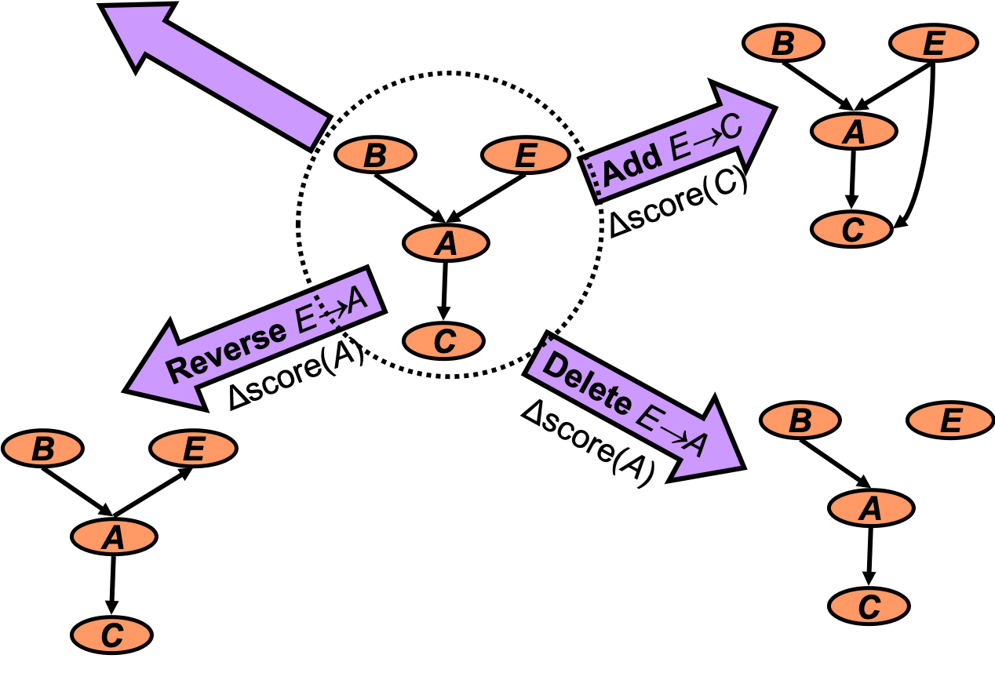
Learning
Statistical Relational Artificial Intelligence
(StaRAI)
Tanya Braun

Slide 2
Contents
Introduction
  Notions of AI, agents, StaRAI
Modelling Formalisms
  Logic
  Probabilistic Graphical Models (PGMs)
  Probabilistic Relational Models (PRMs)
  Syntax, semantics, inference tasks
Inference
  Exact Inference
    (Weighted) Model Counting
    Variable Elimination
    Lifted Inference
  Approximate Inference
  Inference algorithms
Learning
  Relation learning in logic
  Parameter / structure learning for PGMs
  From PGMs to PRMs, PRM learning
Sequential Models and Inference
  Syntax, semantics, inference tasks, algorithms
Decision-theoretic Models and Inference
  Preferences, utility
  Syntax, semantics, inference task, algorithm

Slide 3
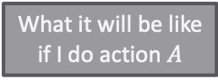
Contents in this Lecture Related to Utility-based Agents
Further topics
  Modelling formalisms
  Inference (in episodic models)
  Learning (of episodic models)
  Sequential models and inference
  Decision-theoretic models and inference
Agent
Environment
Sensors
State
What the world
is like now
How the world evolves
What my actions do
What it will be like
if I do action $A$
Utility
How happy I will be
in such a state
What action I
should do now
Actuators

Slide 4
Contents in this Lecture Related to Utility-based Agents
Further topics
  (Episodic) PRMs
  Lifted inference (in episodic PRMs)
  Lifted learning (of episodic PRMs)
  Lifted sequential PRMs and inference
  Lifted decision making
  Continuous space and lifting
Agent
Environment
Sensors
State
What the world
is like now
How the world evolves
What my actions do
What it will be like
if I do action $A$
Utility
How happy I will be
in such a state
What action I
should do now
Actuators

Slide 5
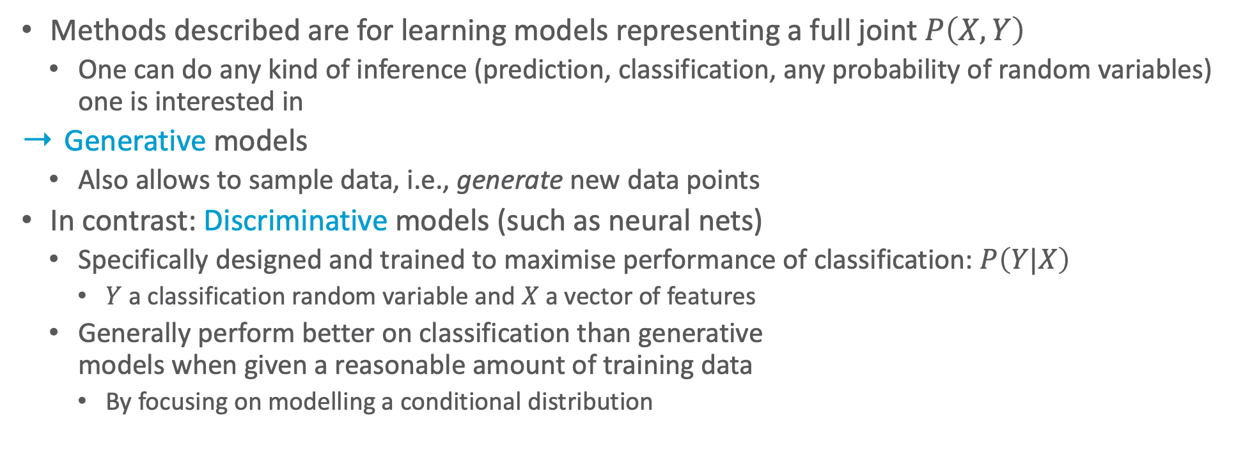
Generative & Discriminative Models
Methods described are for learning models representing a full joint $P\left(X,Y\right)$
  One can do any kind of inference (prediction, classification, any probability of random variables) one is interested in
Generative models
  Also allows to sample data, i.e., generate new data points
In contrast: Discriminative models (such as neural nets)
  Specifically designed and trained to maximise performance of classification: $P\left(Y|X\right)$
    $Y$ a classification random variable and $X$ a vector of features
  Generally perform better on classification than generative
  models when given a reasonable amount of training data
    By focusing on modelling a conditional distribution
In both cases: Models are an abstraction/generalisation of data, which cannot represent the data with 100% accuracy. Only the data can do that.

Slide 6
Outline: 4. Learning
Relation Learning in Logic
  First-order inductive learning, first-order logical decision trees
Learning of PGMs
  Parameter and structure learning
Lifting PGMs to PRMs
  Colour passing
PRM Learning
  Relational dependency network learning
  Changing domains

Slide 7
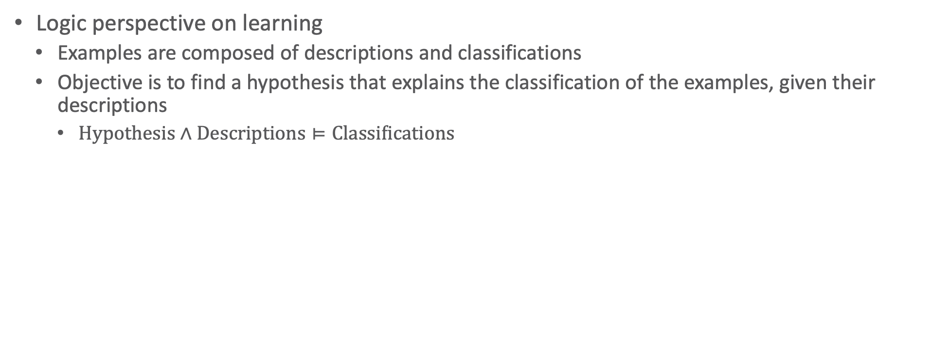
Relation Learning in Logic
Logic perspective on learning
  Examples are composed of descriptions and classifications
  Objective is to find a hypothesis that explains the classification of the examples, given their descriptions
    $\text{Hypothesis}∧\text{Descriptions}⊨\text{Classifications}$

Slide 8
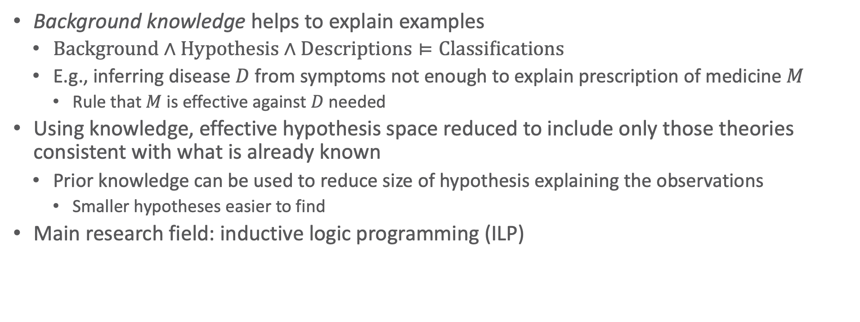
Knowledge-based Inductive Learning
Background knowledge helps to explain examples
  $\text{Background}∧\text{Hypothesis}∧\text{Descriptions}⊨\text{Classifications}$
  E.g., inferring disease $D$ from symptoms not enough to explain prescription of medicine $M$
    Rule that $M$ is effective against $D$ needed
Using knowledge, effective hypothesis space reduced to include only those theories consistent with what is already known
  Prior knowledge can be used to reduce size of hypothesis explaining the observations
    Smaller hypotheses easier to find
Main research field: inductive logic programming (ILP)

Slide 9
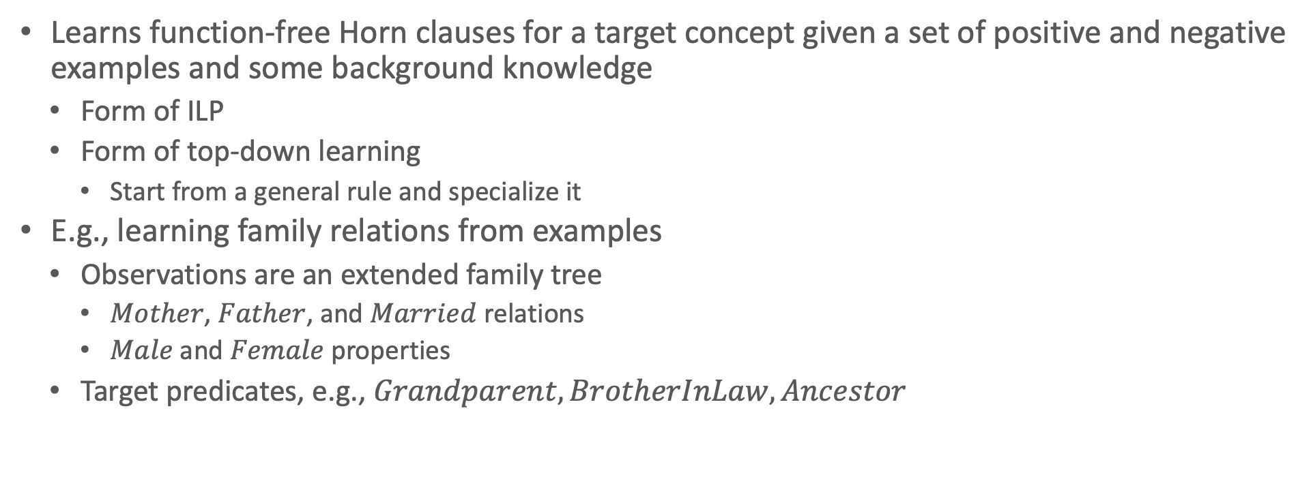
First-order Inductive Learning (FOIL)
Learns function-free Horn clauses for a target concept given a set of positive and negative examples and some background knowledge
  Form of ILP
  Form of top-down learning
    Start from a general rule and specialize it
E.g., learning family relations from examples
  Observations are an extended family tree
    $Mother$, $Father$, and $Married$ relations
    $Male$ and $Female$ properties
  Target predicates, e.g., $Grandparent, BrotherInLaw, Ancestor$
John Ross Quinlan: Learning Logical Definitions from Relations. In Machine Learning, 1990.

Slide 10
A Not-so-recent Example
George |><| Mum
Spencer |><| Kydd
Elizabeth |><| Philip
Margaret
Diana |><| Charles
Anne |><| Mark
Andrew |><| Sarah
Edward
William
Harry
Peter
Zara
Beatrice
Eugenie

Slide 11
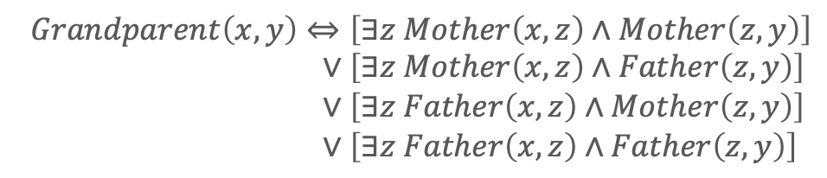
Example: $Grandparent$
$$\text{Background}∧\text{Hypothesis}∧\text{Descriptions}⊨\text{Classifications}$$
Descriptions
include facts like
Sentences in Classifications depend on the target concept being learned
  In the example: 12 positive, 388 negative
Goal: find a set of sentences for Hypothesis such that the entailment constraint is satisfied
  E.g., without background knowledge, hypothesis is:
  $$Father\left(Philip, Charles\right), Mother\left(Mum, Margaret\right)$$
  $$Married\left(Diana, Charles\right), Male\left(Philip\right),Female\left(Beatrice\right)$$
  $$Grandparent\left(Mum, Charles\right),¬Grandparent\left(Mum, Harry\right)$$
$$Grandparent\left(x,y\right)⇔\left[∃z Mother\left(x,z\right)∧Mother\left(z,y\right)\right] \\ ∨\left[∃z Mother\left(x,z\right)∧Father\left(z,y\right)\right] \\ ∨\left[∃z Father\left(x,z\right)∧Mother\left(z,y\right)\right] \\ ∨\left[∃z Father\left(x,z\right)∧Father\left(z,y\right)\right]$$

Slide 12
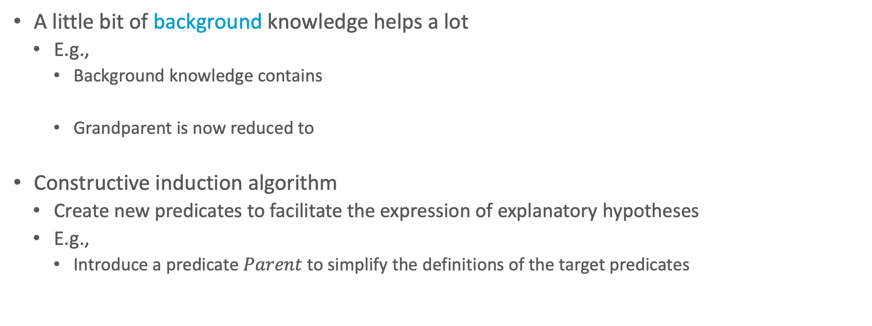
Background Knowledge
$$\text{Background}∧\text{Hypothesis}∧\text{Descriptions}⊨\text{Classifications}$$
A little bit of background knowledge helps a lot
  E.g.,
    Background knowledge contains
    Grandparent is now reduced to
Constructive induction algorithm
  Create new predicates to facilitate the expression of explanatory hypotheses
  E.g.,
    Introduce a predicate $Parent$ to simplify the definitions of the target predicates
$$Parent\left(x,y\right)⇔\left[Mother\left(x,y\right)∨Father\left(x,y\right)\right]$$
$$Grandparent\left(x,y\right)⇔\left[∃z Parent\left(x,z\right)∧Parent\left(z,y\right)\right]$$

Slide 13
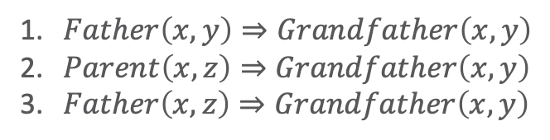
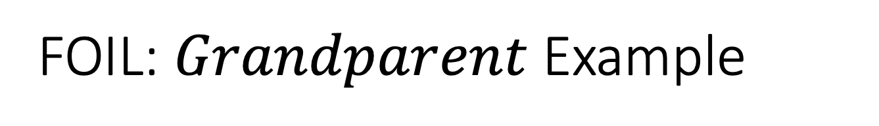

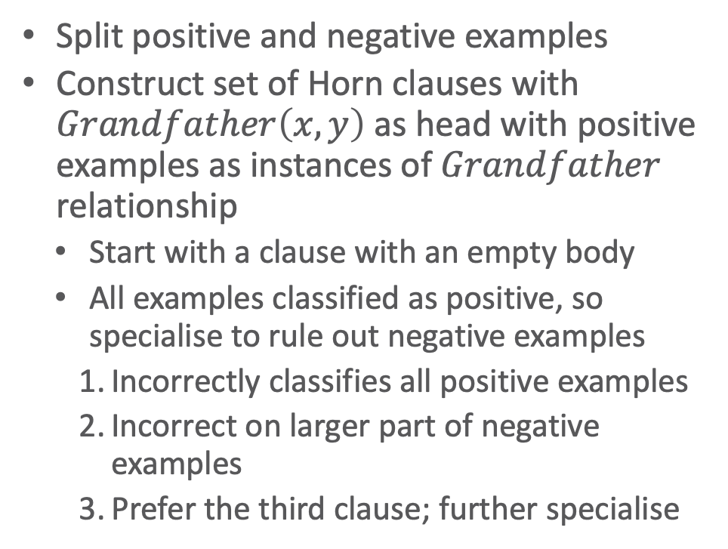
FOIL: $Grandparent$ Example
Split positive and negative examples
Construct set of Horn clauses with $Grandfather\left(x,y\right)$ as head with positive examples as instances of $Grandfather$ relationship
  Start with a clause with an empty body
  All examples classified as positive, so specialise to rule out negative examples
  Incorrectly classifies all positive examples
  Incorrect on larger part of negative examples
  Prefer the third clause; further specialise
Positive:
Negative:
Start:
3 potential additions:
Further specialisation:
<$George$,$Anne$>, <$Philip$,$Peter$>, <$Spencer$,$Harry$>, …
<$George$,$Elizabeth$>, <$Harry$,$Zara$>, <$Charles$,$Philip$>, …
$$______⇒Grandfather\left(x,y\right)$$
    $Father\left(x,y\right)⇒Grandfather\left(x,y\right)$
    $Parent\left(x,z\right)⇒Grandfather\left(x,y\right)$
    $Father\left(x,z\right)⇒Grandfather\left(x,y\right)$
      $$Father\left(x,z\right)∧Parent\left(z,y\right)⇒Grandfather\left(x,y\right)$$
Notes:
<George, Anne> makes Father(x,y) false, which implies Grandfather (x,y) is false but <George, Anne> is a positive example of grandfather relation (holds for all positive examples; some negative examples are incorrectly classified as correct as well)
Positive examples all still in the run as being a grandfather implies that one was a parent but still incorrect on larger part of negative examples as also grandmothers and only parents with grandchildren fulfil the rule
Positive examples all still in the run as being a grandfather implies that one was a father, excludes grandmothers

Slide 14
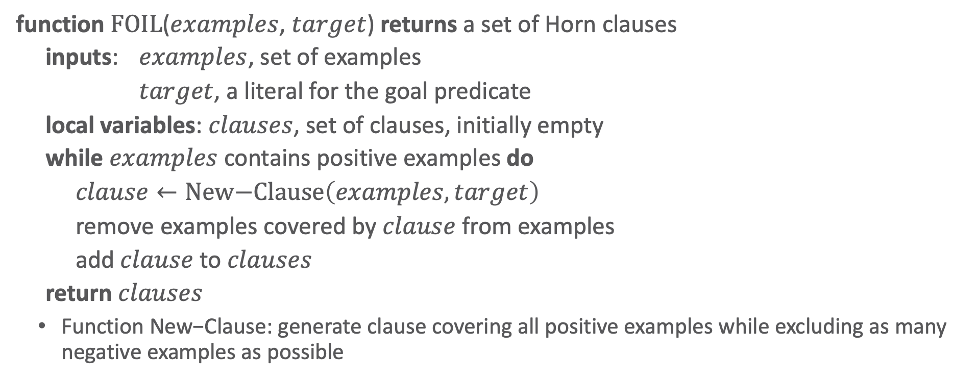
FOIL: Algorithm
function $\text{FOIL}$($examples$, $target$) returns a set of Horn clauses
inputs: $examples$, set of examples
$target$, a literal for the goal predicate
local variables: $clauses$, set of clauses, initially empty
while $examples$ contains positive examples do
$clause←\text{New}\text{−}\text{Clause}\left(examples,target\right)$
remove examples covered by $clause$ from examples
add $clause$ to $clauses$
return $clauses$
  Function $\text{New}\text{−}\text{Clause}$: generate clause covering all positive examples while excluding as many negative examples as possible
FOIL

Slide 15
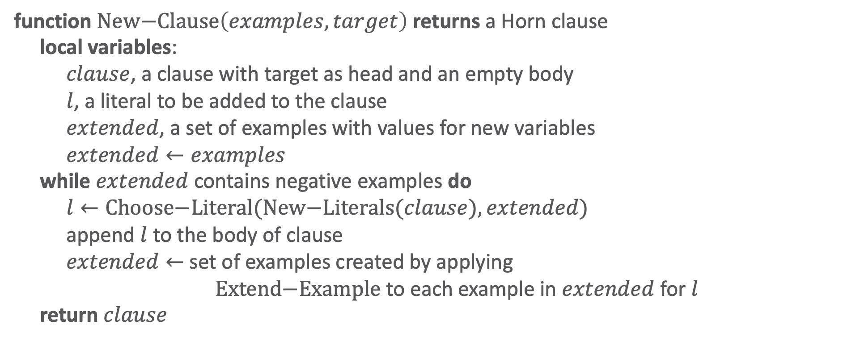
FOIL: New Clause
function $\text{New}\text{−}\text{Clause}\left(examples, target\right)$ returns a Horn clause
local variables:
$clause$, a clause with target as head and an empty body
$l$, a literal to be added to the clause
$extended$, a set of examples with values for new variables
$extended←examples$
while $extended$ contains negative examples do
$l←\text{Choose}\text{−}\text{Literal}(\text{New}\text{−}\text{Literals}(clause), extended)$
append $l$ to the body of clause
$extended←$ set of examples created by applying
$\text{Extend}\text{−}\text{Example}$ to each example in $extended$ for $l$
return $clause$
FOIL: new clause

Slide 16
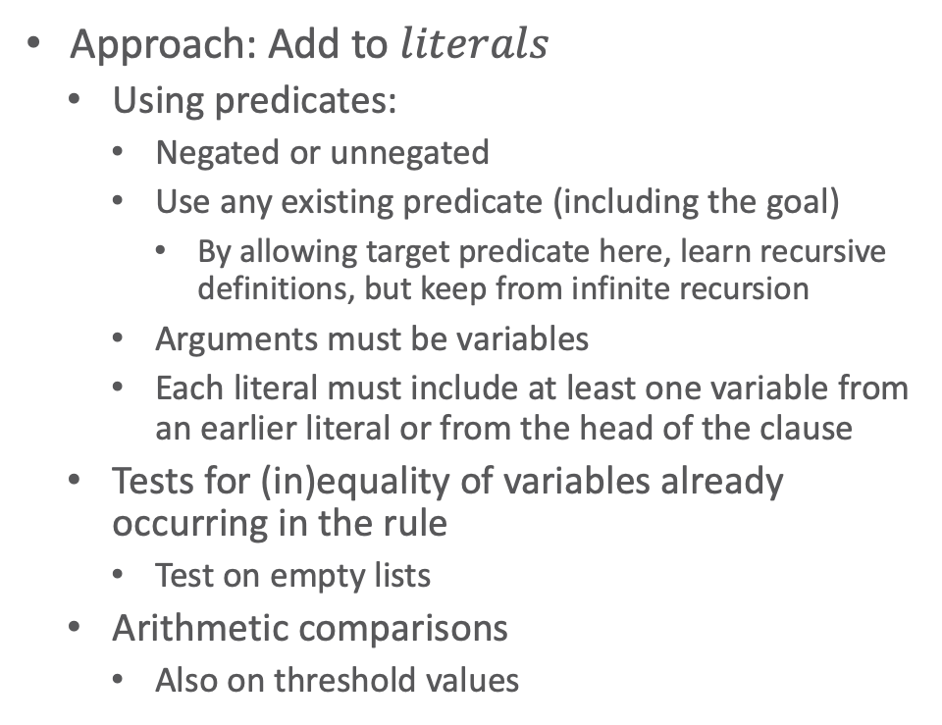
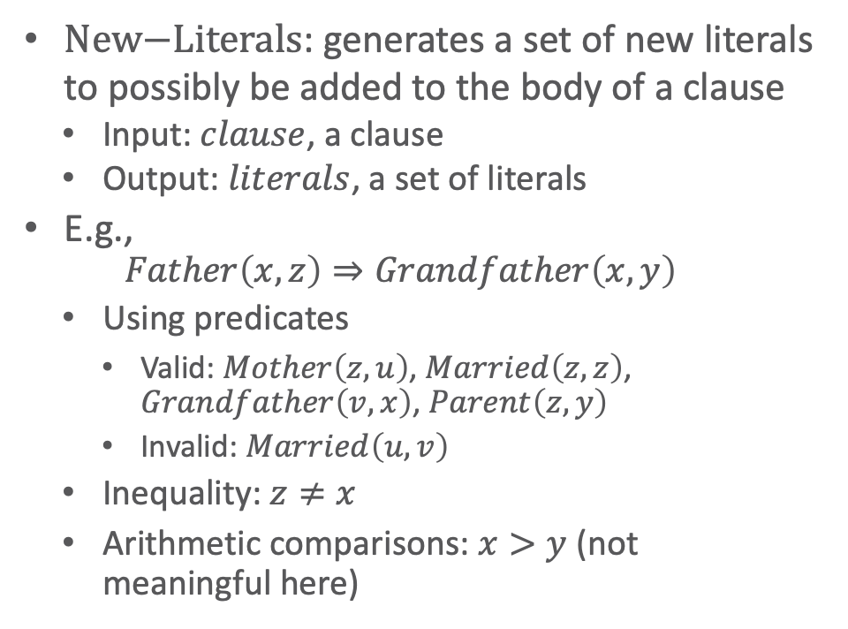
FOIL: New Literals
$\text{New}\text{−}\text{Literals}$: generates a set of new literals to possibly be added to the body of a clause
  Input: $clause$, a clause
  Output: $literals$, a set of literals
E.g.,
  $$Father\left(x,z\right)⇒Grandfather\left(x,y\right)$$
  Using predicates
    Valid: $Mother\left(z,u\right)$, $Married\left(z,z\right)$, $Grandfather\left(v,x\right)$, $Parent\left(z,y\right)$
    Invalid: $Married\left(u,v\right)$
  Inequality: $z≠x$
  Arithmetic comparisons: $x>y$ (not meaningful here)
Approach: Add to $literals$
  Using predicates:
    Negated or unnegated
    Use any existing predicate (including the goal)
      By allowing target predicate here, learn recursive definitions, but keep from infinite recursion
    Arguments must be variables
    Each literal must include at least one variable from an earlier literal or from the head of the clause
  Tests for (in)equality of variables already occurring in the rule
    Test on empty lists
  Arithmetic comparisons
    Also on threshold values

Slide 17
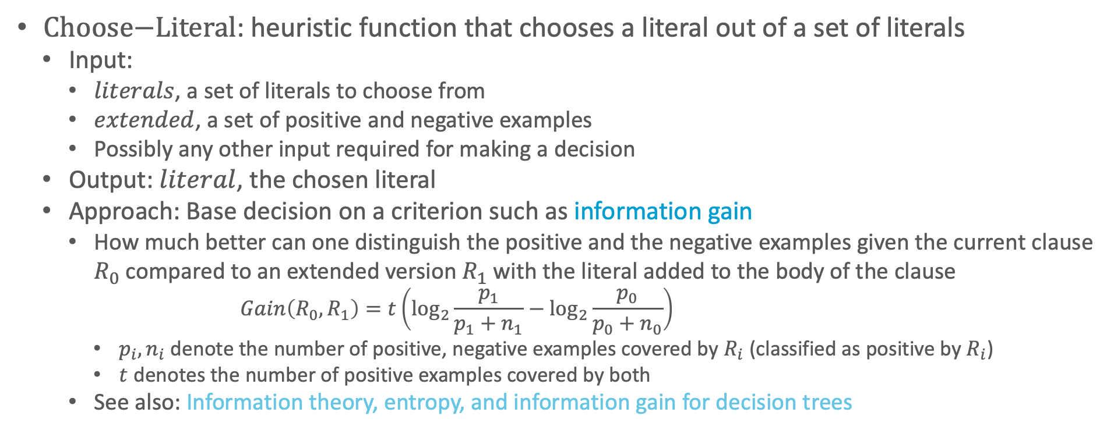
FOIL: Choose Literal
$\text{Choose}\text{−}\text{Literal}$: heuristic function that chooses a literal out of a set of literals
  Input:
    $literals$, a set of literals to choose from
    $extended$, a set of positive and negative examples
    Possibly any other input required for making a decision
  Output: $literal$, the chosen literal
  Approach: Base decision on a criterion such as information gain
    How much better can one distinguish the positive and the negative examples given the current clause $R_{0}$ compared to an extended version $R_{1}$ with the literal added to the body of the clause
      $$Gain\left(R_{0},R_{1}\right)=t\left(\log_{2}{\frac{p_{1}}{p_{1}+n_{1}}}−\log_{2}{\frac{p_{0}}{p_{0}+n_{0}}}\right)$$
      $p_{i},n_{i}$ denote the number of positive, negative examples covered by $R_{i}$ (classified as positive by $R_{i}$)
      $t$ denotes the number of positive examples covered by both
    See also: Information theory, entropy, and information gain for decision trees

Slide 18
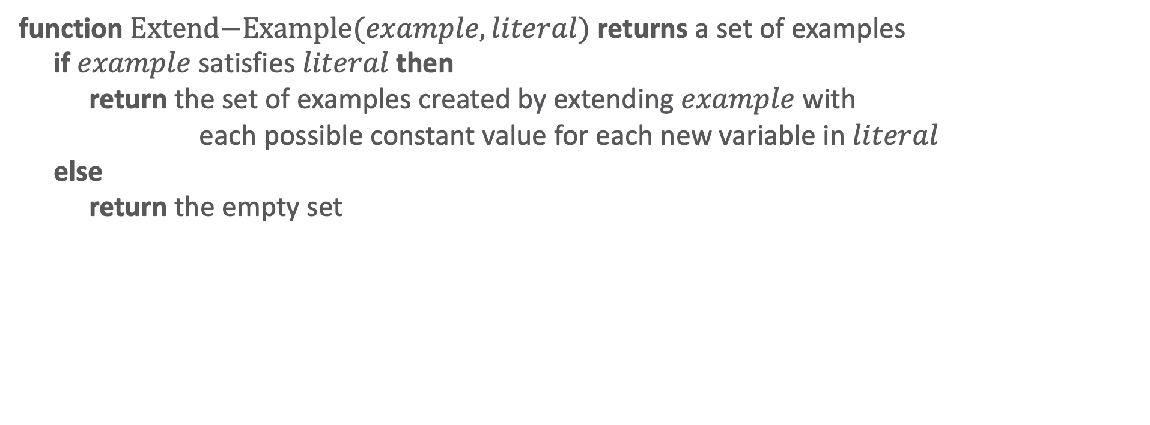
FOIL: Extend Example
function $\text{Extend}\text{−}\text{Example}(example, literal)$ returns a set of examples
if $example$ satisfies $literal$ then
return the set of examples created by extending $example$ with
each possible constant value for each new variable in $literal$
else
return the empty set
FOIL: extend example

Slide 19
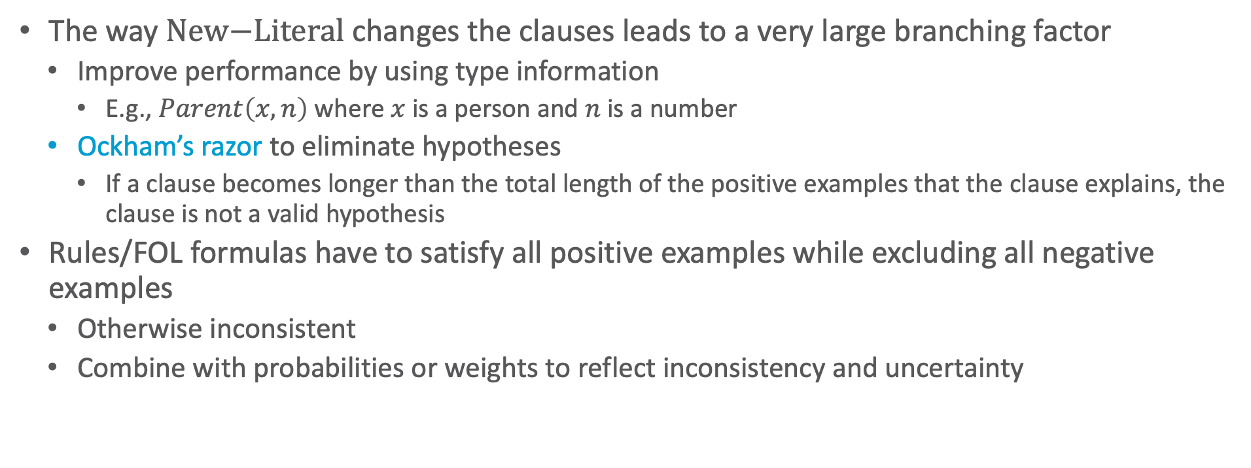
FOIL: Optimisations
The way $\text{New}\text{−}\text{Literal}$ changes the clauses leads to a very large branching factor
  Improve performance by using type information
    E.g., $Parent\left(x,n\right)$ where $x$ is a person and $n$ is a number
  Ockham’s razor to eliminate hypotheses
    If a clause becomes longer than the total length of the positive examples that the clause explains, the clause is not a valid hypothesis
Rules/FOL formulas have to satisfy all positive examples while excluding all negative examples
  Otherwise inconsistent
  Combine with probabilities or weights to reflect inconsistency and uncertainty

Slide 20


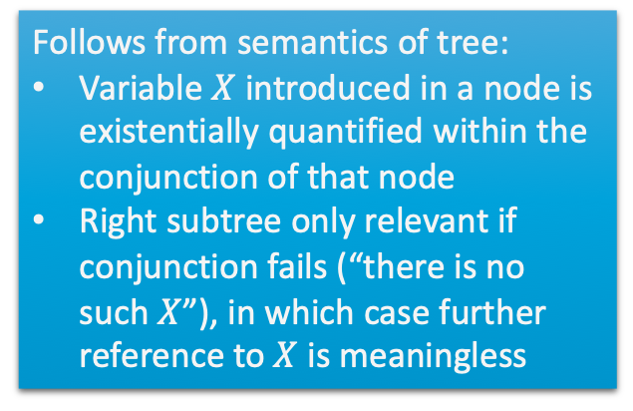


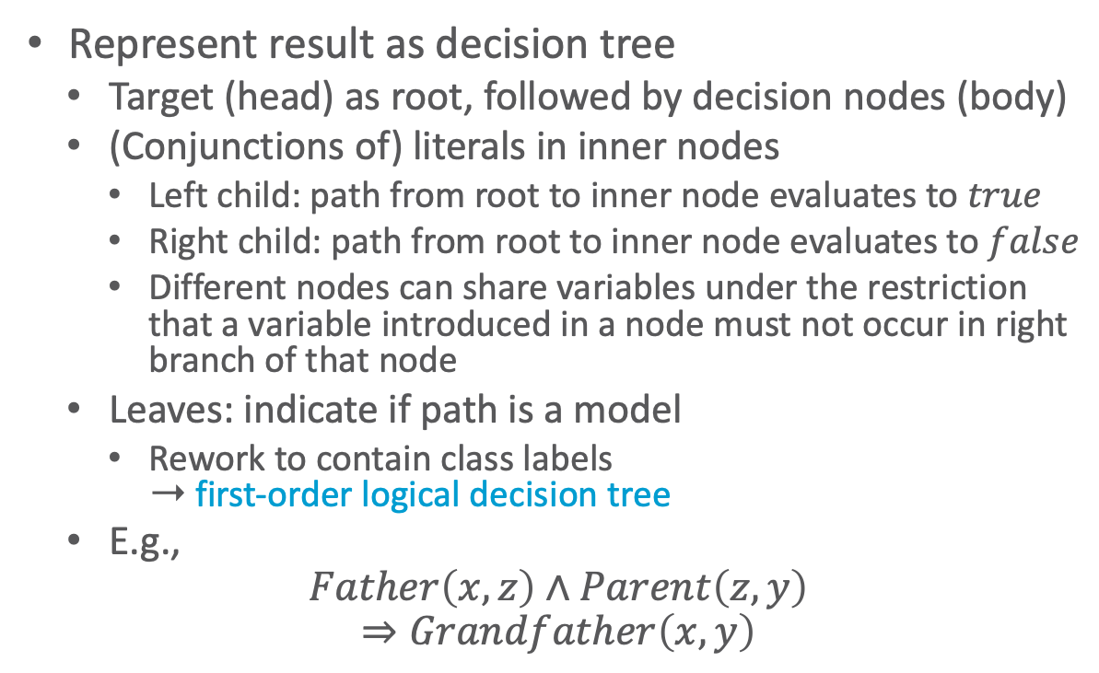






Decision Tree Representation
Follows from semantics of tree:
Variable $X$ introduced in a node is existentially quantified within the conjunction of that node
Right subtree only relevant if conjunction fails (“there is no such $X$”), in which case further reference to $X$ is meaningless
Represent result as decision tree
  Target (head) as root, followed by decision nodes (body)
  (Conjunctions of) literals in inner nodes
    Left child: path from root to inner node evaluates to $true$
    Right child: path from root to inner node evaluates to $false$
    Different nodes can share variables under the restriction that a variable introduced in a node must not occur in right branch of that node
  Leaves: indicate if path is a model
    Rework to contain class labels
    ➝ first-order logical decision tree
  E.g.,
  $$Father\left(x,z\right)∧Parent\left(z,y\right)$$
  $$⇒Grandfather\left(x,y\right)$$
$$Grandfather\left(x,y\right)$$
$$Father\left(x,z\right)$$
$$true$$
$$false$$
$$Parent\left(z,y\right)$$
$$false$$
$$true$$
$$false$$
$$true$$
$$false$$
Hendrik Blockeel and Luc De Raedt: Top-down Induction of First-order Logical Decision Trees. In Artificial Intelligence, 1998.

Slide 21
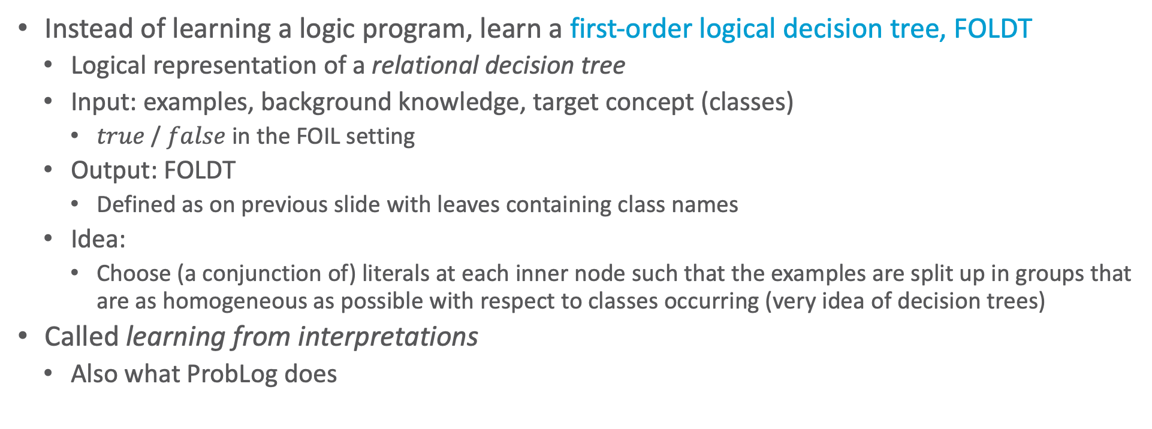
First-order Logical Decision Trees
Instead of learning a logic program, learn a first-order logical decision tree, FOLDT
  Logical representation of a relational decision tree
  Input: examples, background knowledge, target concept (classes)
    $true$ / $false$ in the FOIL setting
  Output: FOLDT
    Defined as on previous slide with leaves containing class names
  Idea:
    Choose (a conjunction of) literals at each inner node such that the examples are split up in groups that are as homogeneous as possible with respect to classes occurring (very idea of decision trees)
Called learning from interpretations
  Also what ProbLog does
Hendrik Blockeel and Luc De Raedt: Top-down Induction of First-order Logical Decision Trees. In Artificial Intelligence, 1998.

Slide 22
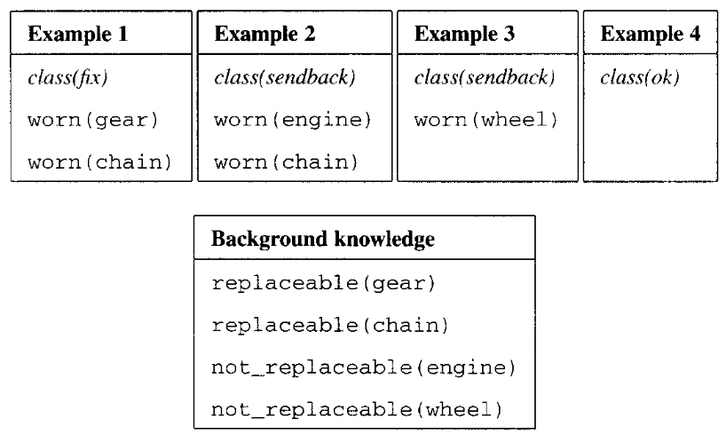
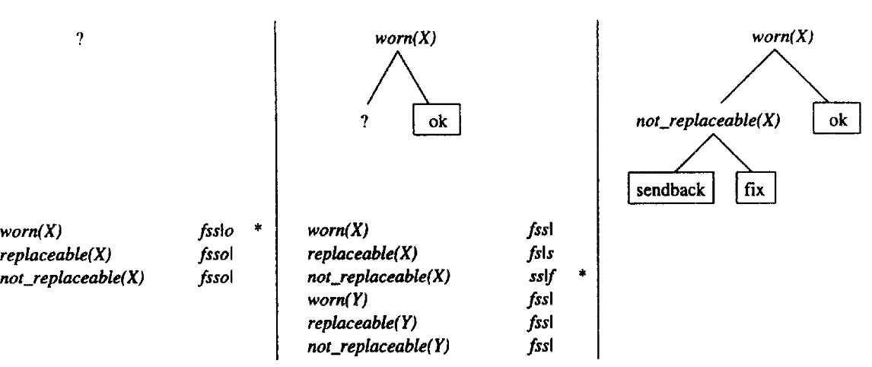


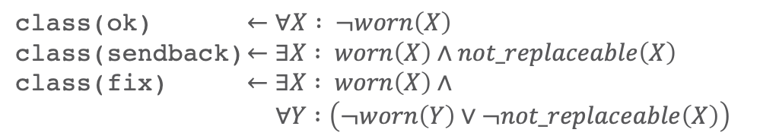


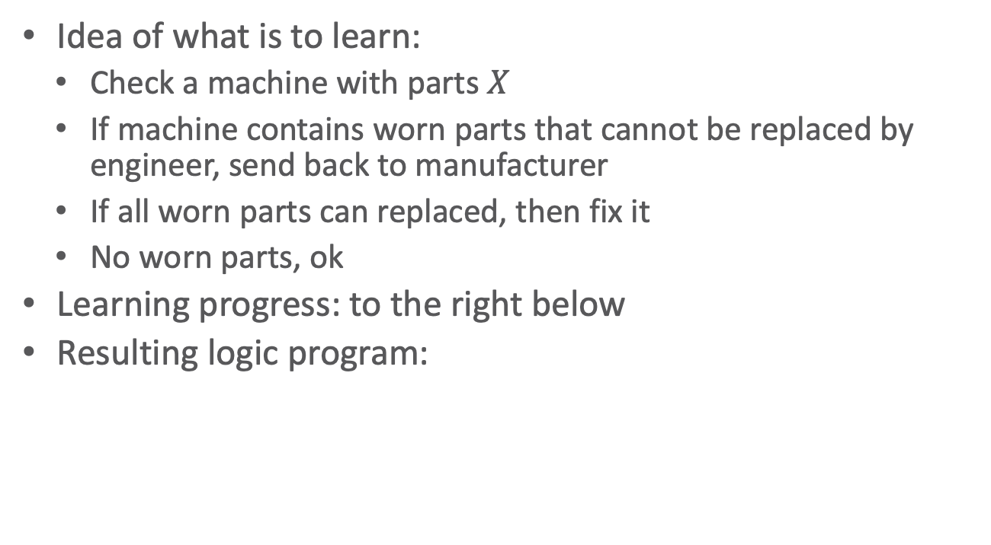


FOLDT: Example
Input examples, background knowledge
Idea of what is to learn:
  Check a machine with parts $X$
  If machine contains worn parts that cannot be replaced by engineer, send back to manufacturer
  If all worn parts can replaced, then fix it
  No worn parts, ok
Learning progress: to the right below
Resulting logic program:
$$true$$
$$false$$
$$true$$
$$false$$
$$true$$
$$false$$
class(ok) $←∀X : ¬worn\left(X\right)$
class(sendback) $←∃X : worn\left(X\right)∧not\text{_}replaceable\left(X\right)$
class(fix) $←∃X : worn\left(X\right)∧$
$∀Y :\left(¬worn\left(Y\right)∨¬not\text{_}replaceable\left(X\right)\right)$
Hendrik Blockeel and Luc De Raedt: Top-down Induction of First-order Logical Decision Trees. In Artificial Intelligence, 1998.

Slide 23
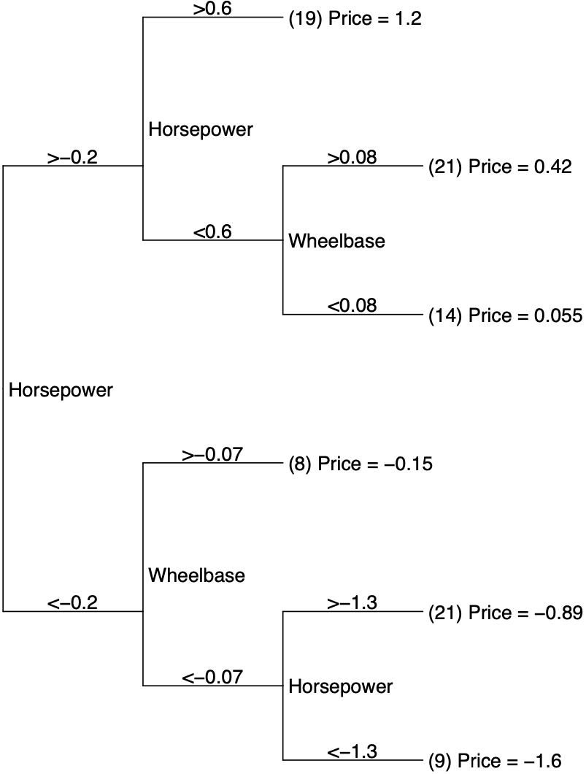
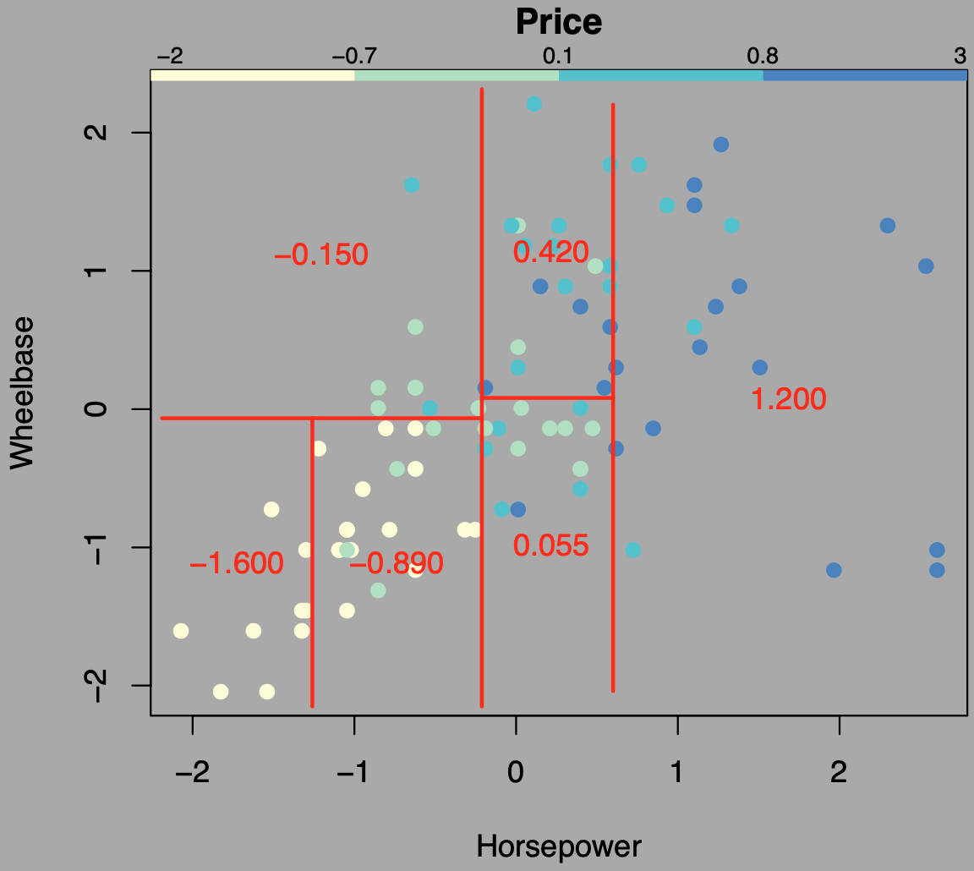
Regression Trees
Regression trees = decision trees with continuous values (regression values) in leaves
  Could base decision on variance
  Depends on application how
  regression values are calculated
  E.g., predict price of cars
    Regression values = average
–0.150
0.420
1.200
–1.600
–0.890
0.055
http://www.stat.cmu.edu/~cshalizi/350-2006/lecture-10.pdf

Slide 24
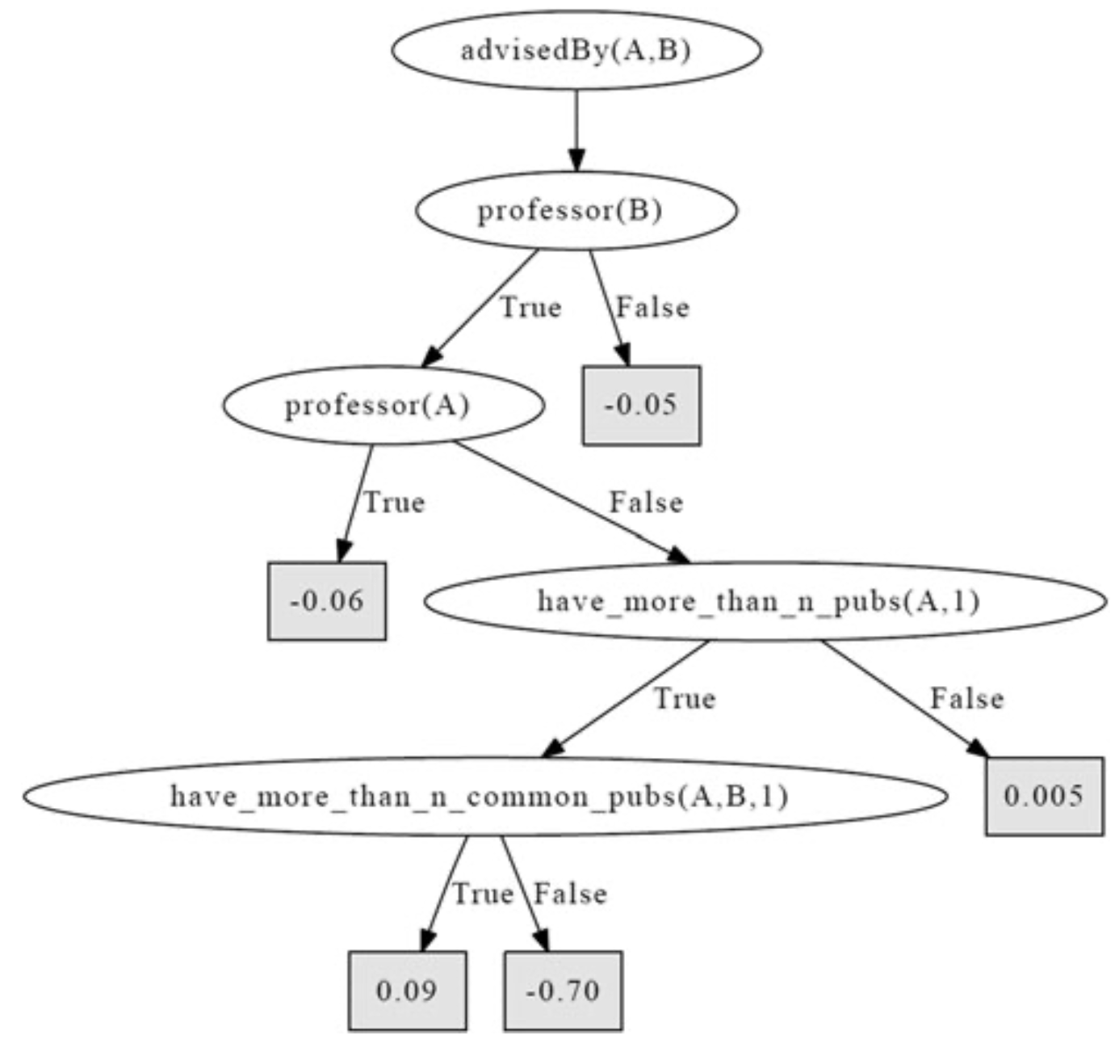
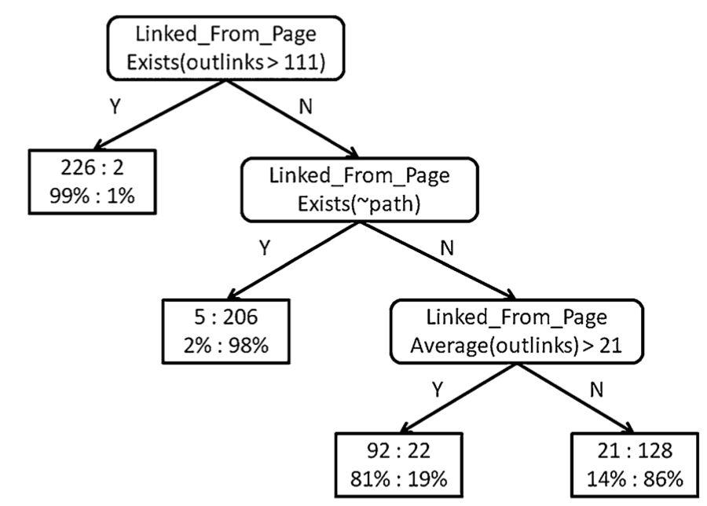
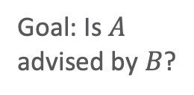
Relational Regression & Probability Trees
Relational regression tree (RRT)
  FOLDT with continuous values in leaves
Relational probability tree (RPT)
  FOLDT with probability distributions in leaves
Goal: Is $A$ advised by $B$?
Goal: Is a web page a student web page?
(WebKB data set)
There are some differences what they allow inner nodes to be
Not important to grasp the general idea
Left figure: Sriraam Natarajan, Tushar Khot, Kristian Kersting, Bernd Gutmann, Jude Shavlik: Gradient-based Boosting for Statistical Relational Learning: The Relational Dependency Network Case. In Machine Learning, 2012.
Right figure: Jennifer Neville, David Jensen, Lisa Friedland, and Michael Hay: Learning Relational Probability Trees. In SIGKDD-03 Proceedings, 2003. // WebKB data set: http://www.cs.cmu.edu/~webkb/

Slide 25
Interim Summary
FOIL
  Learn relations given examples, background knowledge and a target concept
First-order logical decision trees
  Learn relations in tree form given examples, background knowledge and a target concept

Slide 26
Outline: 4. Learning
Relation Learning in Logic
  First-order inductive learning, first-order logical decision trees
Learning of PGMs
  Parameter and structure learning
Lifting PGMs to PRMs
  Colour passing
PRM Learning
  Relational dependency network learning
  Changing domains

Slide 27
Learning PGMs
Learning Setting
Dimensions
So far: query answering task given a model ➝ form of predicting data
New task: Given a set of samples (data), learn a model
  Question: Which model is the “right” one?
    Model which makes data most likely: Reproduce given data with high probability (by sampling)
    Sub-questions: Are all random variables (features) known? Is data available for all?
Parameter estimation
  Find the best parameters (probabilities in CPTs / potentials in factors)
    One set of parameter values called hypothesis
    Easier if data available for all variables
Structure search (on top of parameter est.)
  Find the best structure representation
    Correctly represent (in)dependencies
    Which random variables are connected? Should we introduce new variables?

Slide 28
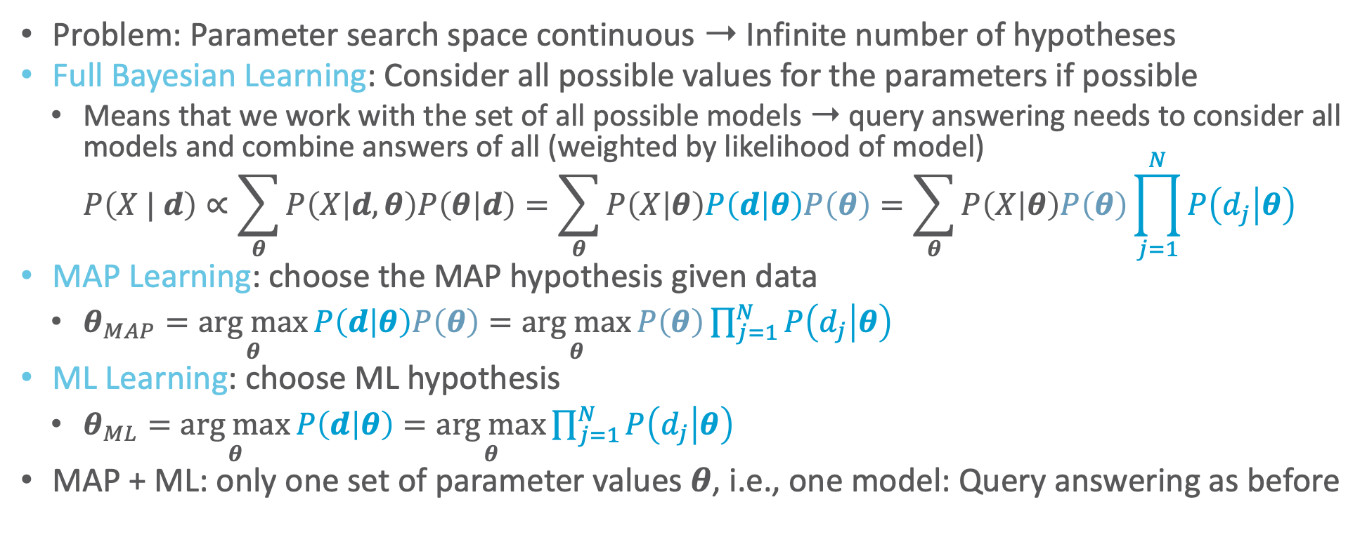
Parameter Estimation: Approaches
Problem: Parameter search space continuous ➝ Infinite number of hypotheses
Full Bayesian Learning: Consider all possible values for the parameters if possible
  Means that we work with the set of all possible models ➝ query answering needs to consider all models and combine answers of all (weighted by likelihood of model)
  $P\left(X | d\right)∝\sum_{θ}{P\left(X | d,θ\right)P\left(θ | d\right)}=\sum_{θ}{P\left(X | θ\right)P\left(d | θ\right)P\left(θ\right)}=\sum_{θ}{P\left(X | θ\right)P\left(θ\right)\prod_{j=1}^{N}{P\left(d_{j} | θ\right)}}$
MAP Learning: choose the MAP hypothesis given data
  $θ_{MAP}=\underset{θ}{arg max}{P\left(d | θ\right)P\left(θ\right)}=\underset{θ}{arg max}{P\left(θ\right)\prod_{j=1}^{N}{P\left(d_{j} | θ\right)}}$
ML Learning: choose ML hypothesis
  $θ_{ML}=\underset{θ}{arg max}{P\left(d | θ\right)}=\underset{θ}{arg max}{\prod_{j=1}^{N}{P\left(d_{j} | θ\right)}}$
MAP + ML: only one set of parameter values $θ$, i.e., one model: Query answering as before
independent and identically distributed (iid) data points

Slide 29
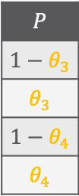
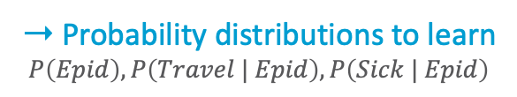
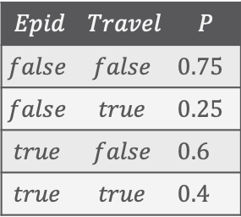
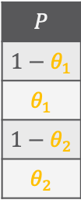

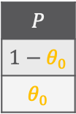

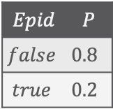

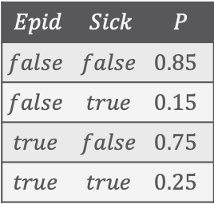
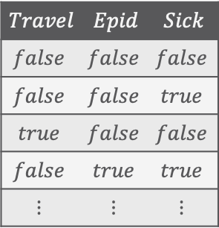
Learning in BNs: Data Science with Complete Data
We begin with the simplest learning problem: Learning parameters in BNs with
  Known structure
  Data contains observations for all variables
    All variables observable, no missing data
Model
Data
➝ Probability distributions to learn
$$P\left(Epid\right),P\left(Travel | Epid\right),P\left(Sick | Epid\right)$$
$$Travel$$ | $$Epid$$ | $$Sick$$
$$false$$ | $$false$$ | $$false$$
$$false$$ | $$false$$ | $$true$$
$$true$$ | $$false$$ | $$false$$
$$false$$ | $$true$$ | $$true$$
$$⋮$$ | $$⋮$$ | $$⋮$$
$$Epid$$ | $$Travel$$ | $$P$$
$$false$$ | $$false$$ | $0.75$
$$false$$ | $$true$$ | $0.25$
$$true$$ | $$false$$ | $0.6$
$$true$$ | $$true$$ | $0.4$
$$P$$
$$1−θ_{1}$$
$$θ_{1}$$
$$1−θ_{2}$$
$$θ_{2}$$
$$Epid$$ | $$Sick$$ | $$P$$
$$false$$ | $$false$$ | $0.85$
$$false$$ | $$true$$ | $0.15$
$$true$$ | $$false$$ | $0.75$
$$true$$ | $$true$$ | $0.25$
$$P$$
$$1−θ_{3}$$
$$θ_{3}$$
$$1−θ_{4}$$
$$θ_{4}$$
$$Epid$$
$$Epid$$ | $$P$$
$$false$$ | $0.8$
$$true$$ | $0.2$
$$P$$
$$1−θ_{0}$$
$$θ_{0}$$
$$Travel$$
$$Sick$$

Slide 30
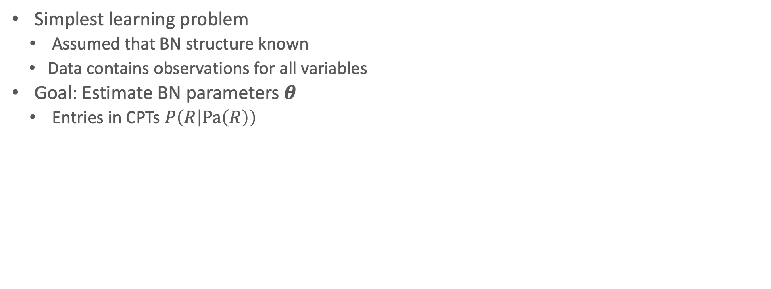
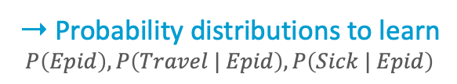
Maximum-Likelihood Parameter Estimation
Simplest learning problem
  Assumed that BN structure known
  Data contains observations for all variables
Goal: Estimate BN parameters $θ$
  Entries in CPTs $P\left(R | Pa\left(R\right)\right)$
Model
Data
➝ Probability distributions to learn
$$P\left(Epid\right),P\left(Travel | Epid\right),P\left(Sick | Epid\right)$$
$$Travel$$ | $$Epid$$ | $$Sick$$
$$false$$ | $$false$$ | $$false$$
$$false$$ | $$false$$ | $$true$$
$$true$$ | $$false$$ | $$false$$
$$false$$ | $$true$$ | $$true$$
$$⋮$$ | $$⋮$$ | $$⋮$$
$$Epid$$ | $$Travel$$ | $$P$$
$$false$$ | $$false$$ | $0.75$
$$false$$ | $$true$$ | $0.25$
$$true$$ | $$false$$ | $0.6$
$$true$$ | $$true$$ | $0.4$
$$P$$
$$1−θ_{1}$$
$$θ_{1}$$
$$1−θ_{2}$$
$$θ_{2}$$
$$Epid$$ | $$Sick$$ | $$P$$
$$false$$ | $$false$$ | $0.85$
$$false$$ | $$true$$ | $0.15$
$$true$$ | $$false$$ | $0.75$
$$true$$ | $$true$$ | $0.25$
$$P$$
$$1−θ_{3}$$
$$θ_{3}$$
$$1−θ_{4}$$
$$θ_{4}$$
$$Epid$$
$$Epid$$ | $$P$$
$$false$$ | $0.8$
$$true$$ | $0.2$
$$P$$
$$1−θ_{0}$$
$$θ_{0}$$
$$Travel$$
$$Sick$$

Slide 31
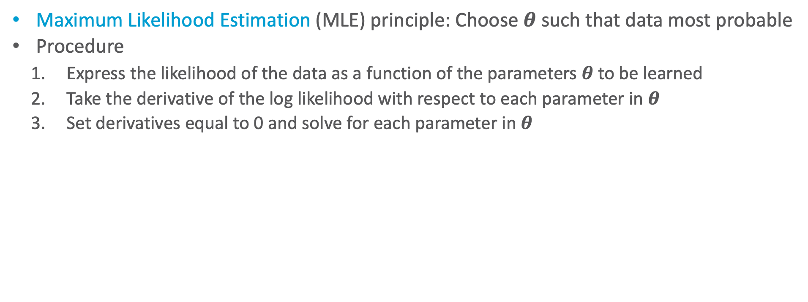
General ML procedure
Maximum Likelihood Estimation (MLE) principle: Choose $θ$ such that data most probable
Procedure
  Express the likelihood of the data as a function of the parameters $θ$ to be learned
  Take the derivative of the log likelihood with respect to each parameter in $θ$
  Set derivatives equal to 0 and solve for each parameter in $θ$
Model
Data
➝ Probability distributions to learn
$$P\left(Epid\right),P\left(Travel | Epid\right),P\left(Sick | Epid\right)$$
$$Travel$$ | $$Epid$$ | $$Sick$$
$$false$$ | $$false$$ | $$false$$
$$false$$ | $$false$$ | $$true$$
$$true$$ | $$false$$ | $$false$$
$$false$$ | $$true$$ | $$true$$
$$⋮$$ | $$⋮$$ | $$⋮$$
$$Epid$$ | $$Travel$$ | $$P$$
$$false$$ | $$false$$ | $0.75$
$$false$$ | $$true$$ | $0.25$
$$true$$ | $$false$$ | $0.6$
$$true$$ | $$true$$ | $0.4$
$$P$$
$$1−θ_{1}$$
$$θ_{1}$$
$$1−θ_{2}$$
$$θ_{2}$$
$$Epid$$ | $$Sick$$ | $$P$$
$$false$$ | $$false$$ | $0.85$
$$false$$ | $$true$$ | $0.15$
$$true$$ | $$false$$ | $0.75$
$$true$$ | $$true$$ | $0.25$
$$P$$
$$1−θ_{3}$$
$$θ_{3}$$
$$1−θ_{4}$$
$$θ_{4}$$
$$Epid$$
$$Epid$$ | $$P$$
$$false$$ | $0.8$
$$true$$ | $0.2$
$$P$$
$$1−θ_{0}$$
$$θ_{0}$$
$$Travel$$
$$Sick$$

Slide 32
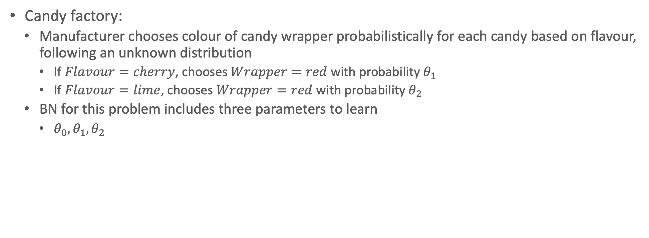
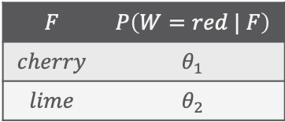
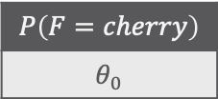


An Even Smaller Example
Candy factory:
  Manufacturer chooses colour of candy wrapper probabilistically for each candy based on flavour, following an unknown distribution
    If $Flavour=cherry$, chooses $Wrapper=red$ with probability $θ_{1}$
    If $Flavour=lime$, chooses $Wrapper=red$ with probability $θ_{2}$
  BN for this problem includes three parameters to learn
    $θ_{0},θ_{1},θ_{2}$
$$P\left(F=cherry\right)$$
$$θ_{0}$$
$$Flavour$$
$$Wrapper$$
$$F$$ | $$P\left(W=red | F\right)$$
$$cherry$$ | $$θ_{1}$$
$$lime$$ | $$θ_{2}$$

Slide 33
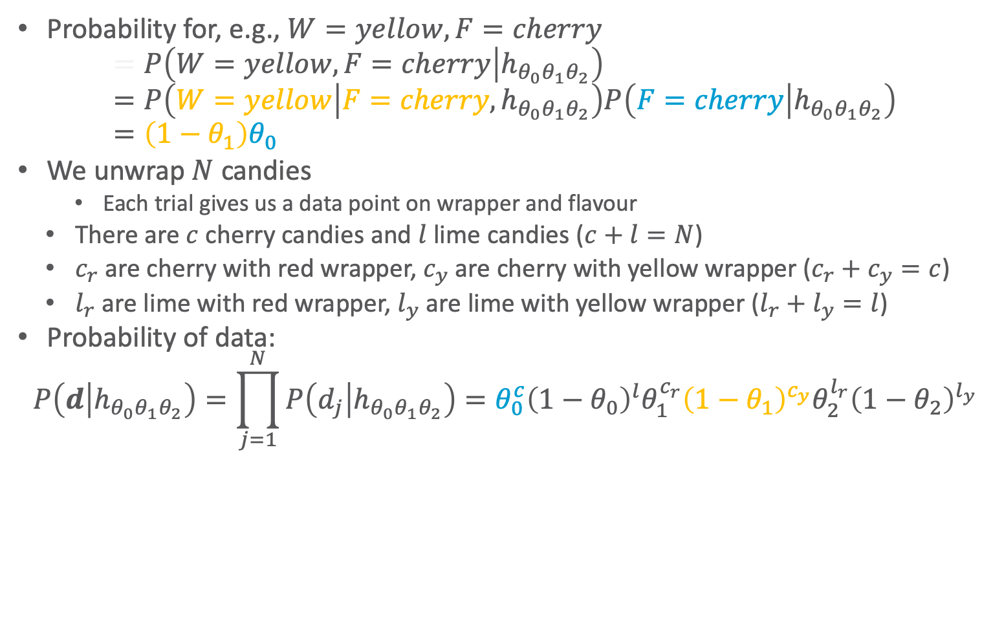

An Even Smaller Example
Probability for, e.g., $W=yellow,F=cherry$
$$=P\left(W=yellow,F=cherry | h_{θ_{0}θ_{1}θ_{2}}\right) \\ =P\left(W=yellow | F=cherry,h_{θ_{0}θ_{1}θ_{2}}\right)P\left(F=cherry | h_{θ_{0}θ_{1}θ_{2}}\right) \\ =\left(1−θ_{1}\right)θ_{0}$$
We unwrap $N$ candies
    Each trial gives us a data point on wrapper and flavour
  There are $c$ cherry candies and $l$ lime candies ($c+l=N$)
  $c_{r}$ are cherry with red wrapper, $c_{y}$ are cherry with yellow wrapper ($c_{r}+c_{y}=c$)
  $l_{r}$ are lime with red wrapper, $l_{y}$ are lime with yellow wrapper ($l_{r}+l_{y}=l$)
Probability of data:
$$P\left(d | h_{θ_{0}θ_{1}θ_{2}}\right)=\prod_{j=1}^{N}{P\left(d_{j} | h_{θ_{0}θ_{1}θ_{2}}\right)}=θ_{0}^{c}{\left(1−θ_{0}\right)}^{l}θ_{1}^{c_{r}}{\left(1−θ_{1}\right)}^{c_{y}}θ_{2}^{l_{r}}{\left(1−θ_{2}\right)}^{l_{y}}$$
$$P\left(F=cherry\right)$$
$$θ_{0}$$
$$Flavour$$
$$Wrapper$$
$$F$$ | $$P\left(W=red | F\right)$$
$$cherry$$ | $$θ_{1}$$
$$lime$$ | $$θ_{2}$$

Slide 34
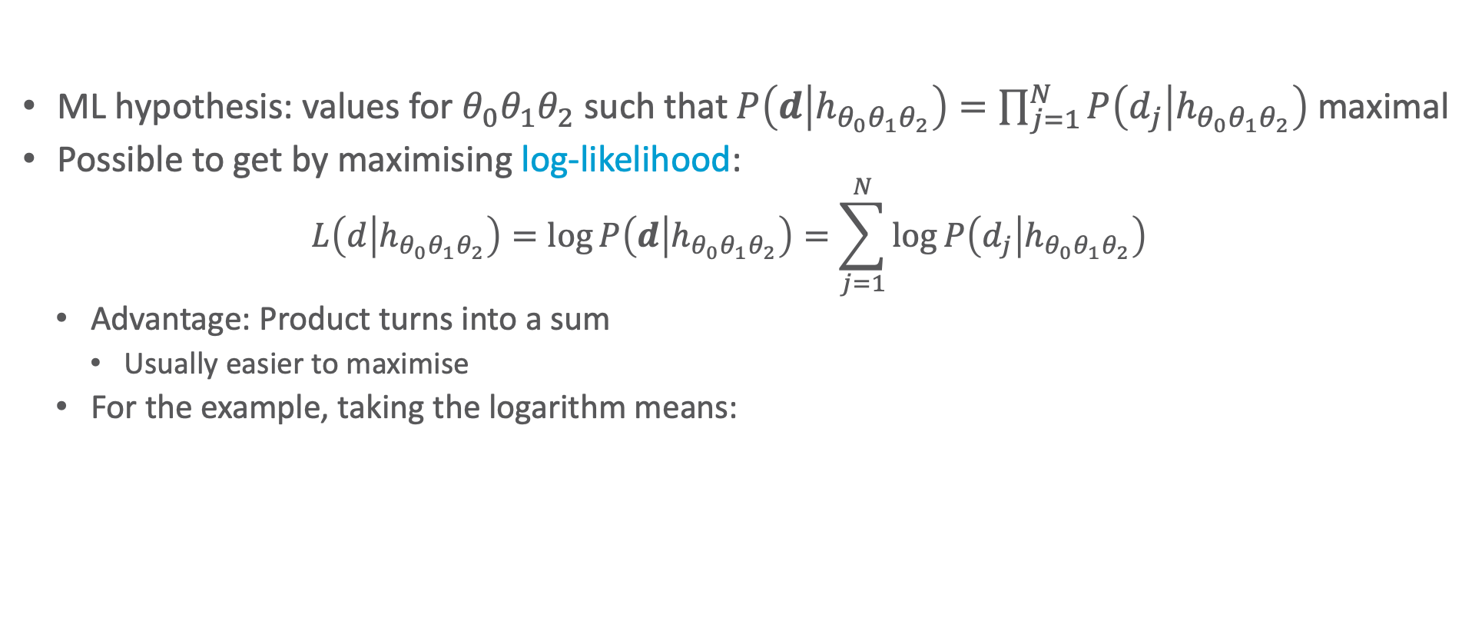
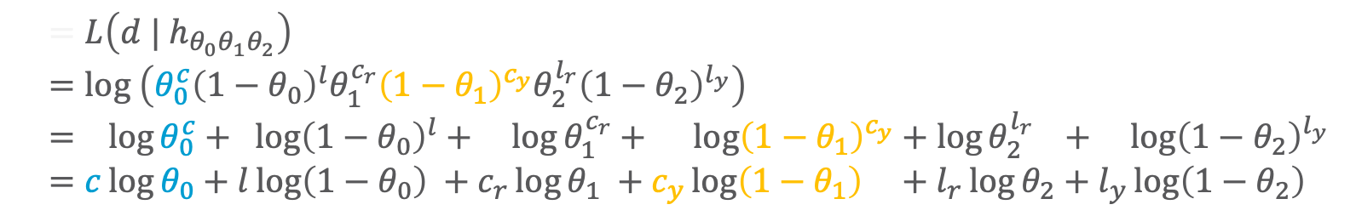
An Even Smaller Example
ML hypothesis: values for $θ_{0}θ_{1}θ_{2}$ such that $P\left(d | h_{θ_{0}θ_{1}θ_{2}}\right)=\prod_{j=1}^{N}{P\left(d_{j} | h_{θ_{0}θ_{1}θ_{2}}\right)}$ maximal
Possible to get by maximising log-likelihood:
  $$L\left(d | h_{θ_{0}θ_{1}θ_{2}}\right)=\log{P\left(d | h_{θ_{0}θ_{1}θ_{2}}\right)}=\sum_{j=1}^{N}{\log{P\left(d_{j} | h_{θ_{0}θ_{1}θ_{2}}\right)}}$$
  Advantage: Product turns into a sum
    Usually easier to maximise
  For the example, taking the logarithm means:
$$P\left(F=cherry\right)$$
$$θ_{0}$$
$$Flavour$$
  $$=L\left(d | h_{θ_{0}θ_{1}θ_{2}}\right) \\ =log \left(θ_{0}^{c}{\left(1−θ_{0}\right)}^{l}θ_{1}^{c_{r}}{\left(1−θ_{1}\right)}^{c_{y}}θ_{2}^{l_{r}}{\left(1−θ_{2}\right)}^{l_{y}}\right) \\ = \log{θ_{0}^{c}}+ \log{{\left(1−θ_{0}\right)}^{l}}+ \log{θ_{1}^{c_{r}}}+ \log{{\left(1−θ_{1}\right)}^{c_{y}}}+\log{θ_{2}^{l_{r}}} + \log{{\left(1−θ_{2}\right)}^{l_{y}}} \\ =c\log{θ_{0}}+l\log\left(1−θ_{0}\right) +c_{r}\log{θ_{1}} +c_{y}\log\left(1−θ_{1}\right) +l_{r}\log{θ_{2}}+l_{y}\log\left(1−θ_{2}\right)$$
$$Wrapper$$
$$F$$ | $$P\left(W=red | F\right)$$
$$cherry$$ | $$θ_{1}$$
$$lime$$ | $$θ_{2}$$

Slide 35
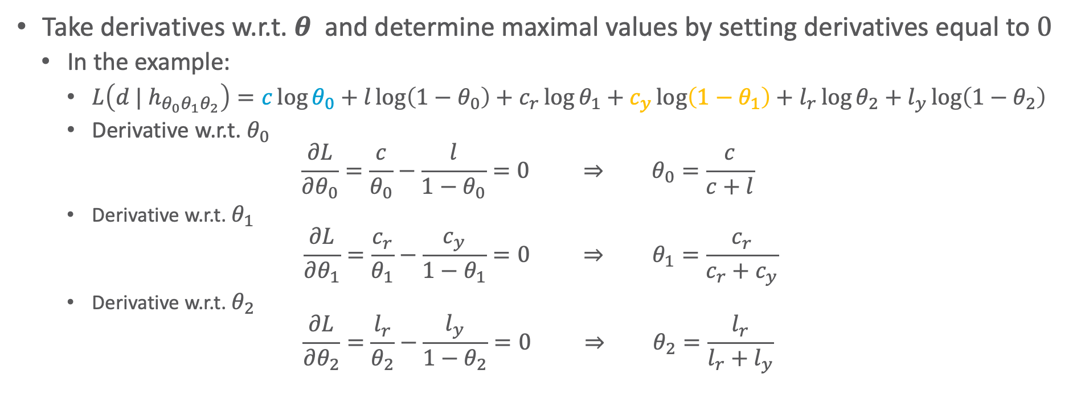
An Even Smaller Example
Take derivatives w.r.t. $θ$ and determine maximal values by setting derivatives equal to $0$
  In the example:
    $L\left(d | h_{θ_{0}θ_{1}θ_{2}}\right)=c\log{θ_{0}}+l\log\left(1−θ_{0}\right)+c_{r}\log{θ_{1}}+c_{y}\log\left(1−θ_{1}\right)+l_{r}\log{θ_{2}}+l_{y}\log\left(1−θ_{2}\right)$
    Derivative w.r.t. $θ_{0}$
    $$\frac{∂L}{∂θ_{0}}=\frac{c}{θ_{0}}−\frac{l}{1−θ_{0}}=0 ⇒ θ_{0}=\frac{c}{c+l}$$
    Derivative w.r.t. $θ_{1}$
    $$\frac{∂L}{∂θ_{1}}=\frac{c_{r}}{θ_{1}}−\frac{c_{y}}{1−θ_{1}}=0 ⇒ θ_{1}=\frac{c_{r}}{c_{r}+c_{y}}$$
    Derivative w.r.t. $θ_{2}$
    $$\frac{∂L}{∂θ_{2}}=\frac{l_{r}}{θ_{2}}−\frac{l_{y}}{1−θ_{2}}=0 ⇒ θ_{2}=\frac{l_{r}}{l_{r}+l_{y}}$$
$$P\left(F=cherry\right)$$
$$θ_{0}$$
$$Flavour$$
$$Wrapper$$
$$F$$ | $$P\left(W=red | F\right)$$
$$cherry$$ | $$θ_{1}$$
$$lime$$ | $$θ_{2}$$

Slide 36
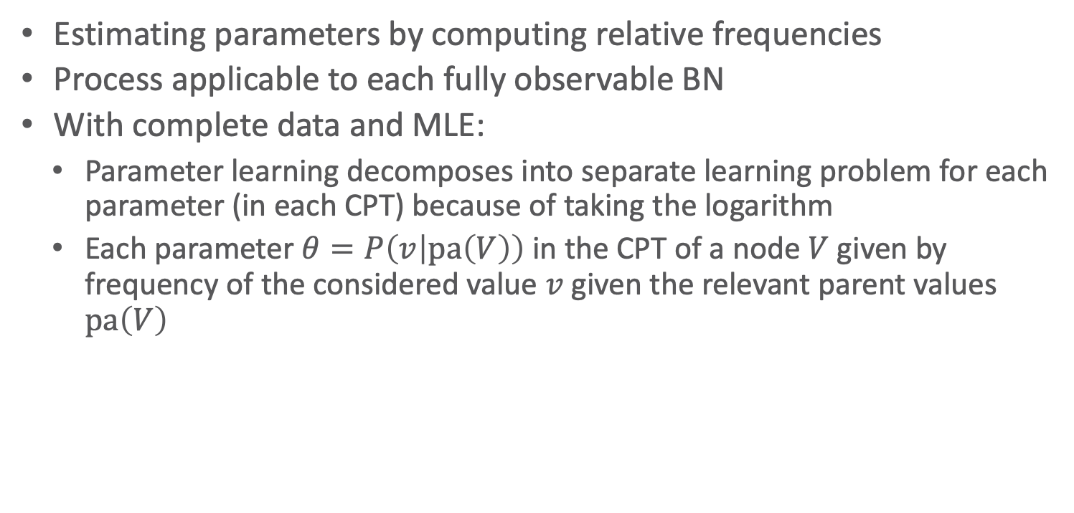
Maximum-Likelihood Parameter Estimation
Estimating parameters by computing relative frequencies
Process applicable to each fully observable BN
With complete data and MLE:
  Parameter learning decomposes into separate learning problem for each parameter (in each CPT) because of taking the logarithm
  Each parameter $θ=P\left(v | pa\left(V\right)\right)$ in the CPT of a node $V$ given by frequency of the considered value $v$ given the relevant parent values $pa\left(V\right)$
$$P\left(F=cherry\right)$$
$$θ_{0}$$
$$Flavour$$
$$Wrapper$$
$$F$$ | $$P\left(W=red | F\right)$$
$$cherry$$ | $$θ_{1}$$
$$lime$$ | $$θ_{2}$$

Slide 37

Maximum-Likelihood Parameter Estimation: General Procedure
Lot of mathematical effort to detect the obvious
Sketches a general procedure for estimating parameters ML-style:
  Tasks: Maximise $P\left(d | θ\right)$, i.e., $h_{ML}=\underset{θ}{arg max}{P\left(d | θ\right)}=\underset{θ}{arg max}{\prod_{j=1}^{N}{P\left(d_{j} | θ\right)}}$
  Procedure
    Describe probabilities of data as a function of the parameters to be learning ($P\left(d | θ\right)$)
    Differentiate the log-likelihood ($\log{P\left(d | θ\right)}$) w.r.t. each parameter
    Solve derivatives set equal to zero for each parameter
    Afterwards, determine the necessary relative frequencies (i.e., counting)
Note: Sampling can be interpreted as ML parameter estimations
  Learning of the queried distribution using samples by determining relative frequencies

Slide 38










Application: Naïve Bayes Classifier
Classification:
  Set of features $X_{1},…,X_{n}$
  Determine class label $C=c$
  based on feature values $x_{1},…,x_{n}$
  Assumption: conditional independence of features given $C$
Advantage: Relatively few parameters (entries in the CPTs) to learn
  $2n+1$ parameters for Boolean variables (general: $r\left(r−1\right)n+r−1$)
    $r=\left|Val\left(C\right)\right|$, $r−1$ entries in $P\left(C\right)$, $r\left(r−1\right)$ entries in $P\left(X_{i}|C\right)$ (for each $c$, learn $\left(r−1\right)$ entries)
Form of supervised learning; i.e., labelled data available for learning):
  Set of feature values with corresponding class label $D=$ ${\left\{\left(x_{1}^{j},…,x_{n}^{j},c^{j}\right)\right\}}_{j=1}^{N}$
  Count relative frequencies of each $c$ in $D$ for $P\left(C\right)$ and of each $x_{i},c$ in $D$ for $P\left(X_{i} | C\right)$
$$C$$
$$P\left(C\right)$$
$$X_{1}$$
$$X_{2}$$
$$…$$
$$X_{n}$$
$$P\left(X_{1}|C\right)$$
$$P\left(X_{2}|C\right)$$
$$P\left(X_{n}|C\right)$$

Slide 39






Parameter Learning with Hidden (Latent) Variables
So far we have assumed that we can collect data on all variables in the network
Next difficult problem
  Hidden variables in model
    No observations available
  Approach using relative frequencies not directly applicable as we cannot count observations for these variables
    Example: missing all counts involving $H$
$$A$$ | $$B$$ | $$C$$
$$true$$ | $$false$$ | $$true$$
$$false$$ | $$true$$ | $$true$$
$$true$$ | $$true$$ | $$false$$
$$⋮$$
$$A$$
$$H$$
$$B$$
$$C$$

Slide 40








Quick Fix
2
2
2
Get rid of or avoid hidden variables
May work in simple networks
Example
  Each variable has $3$ values ($low, moderate, high$)
  Numbers next to the nodes represent how many parameters need to be specified for the CPTs of that node
    $78$ parameters overall
$$Smoking$$
$$Diet$$
$$Exercise$$
54
$$HeartDisease$$
6
6
6
$${Symptom}_{1}$$
$${Sympton}_{2}$$
$${Symptom}_{3}$$

Slide 41






Quick Fix Does Not Help!
2
2
2
Without hidden node, edges need to directly represent indirect dependencies
In the example:
  Symptoms no longer conditionally independent given their parents
  Many more edges ➝ many more parameters to learn: 708 overall
  Need much more data to learn these parameters properly
$$Smoking$$
$$Diet$$
$$Exercise$$
54
$$HeartDisease$$
6
6
6
$${Symptom}_{1}$$
$${Sympton}_{2}$$
$${Symptom}_{3}$$
2
2
2
$$Smoking$$
$$Diet$$
$$Exercise$$
54
162
486
$${Symptom}_{1}$$
$${Sympton}_{2}$$
$${Symptom}_{3}$$

Slide 42
Expectation-Maximisation (EM)
If we keep the hidden variables and want to learn parameters from data, we have a form of unsupervised learning
  Data do not include infromation on the true nature of each data point
Expectation-Maximisation (EM)
  General algorithm for learning model parameters from incomplete data
  Here, how it works on learning parameters for BNs with discrete variables

Slide 43

EM: General Idea
If we had data for all the variables in the network, we could learn the parameters by using ML methods
  Compute relative frequencies as discussed before
If we had the parameters in the network, we could estimate the posterior probability of any event, including the hidden variables
  $P\left(H | A,B,C\right)$
  Could estimate parameters involving $H$
$$A$$ | $$B$$ | $$C$$
$$true$$ | $$false$$ | $$true$$
$$false$$ | $$true$$ | $$true$$
$$true$$ | $$true$$ | $$false$$
$$⋮$$
$$A$$
$$H$$
$$B$$
$$C$$
Dempster, A.P., Laird. N.M., Rubin, D.B.: Maximum-Likelihood from Incomplete Data via the EM Algorithm. In: Journal of the Royal Statistical Society, 1977
Notes:
Posterior-Wahrscheinlichkeiten

Slide 44
EM: General Idea
Algorithm starts from “invented” (e.g., randomly generated) information to solve the learning problem
  Invented parameters (virtually noted down in the CPTs)
It then refines this initial guess by cycling through two basic steps
  Expectation (E):
  Update the data with predictions generated via the current model (expected counts)
  Maximisation (M):
  Given the updated data, update the model parameters using MLE
    Same step as when learning parameters for fully observable networks

Slide 45









EM: Naïve Bayes Models as Application
Data
Consider the following data
  $N$ samples with Boolean attributes $X_{1},…, X_{4}$
  ... which we want to label with possible values of a class $C,Val\left(C\right)=\left\{1,2,3\right\}$
Naïve Bayes classifier with hidden variable $C$
$$X_{1}$$ | $$X_{2}$$ | $$X_{3}$$ | $$X_{4}$$
$$true$$ | $$false$$ | $$true$$ | $$true$$
$$false$$ | $$true$$ | $$true$$ | $$false$$
$$true$$ | $$false$$ | $$true$$ | $$true$$
$$⋮$$
Model
➝ probability distributions to learn
$$P\left(C\right)$$
$$P\left(X_{1} | C\right)$$
$$P\left(X_{2} | C\right)$$
$$P\left(X_{3} | C\right)$$
$$P\left(X_{4} | C\right)$$
$$X_{1}$$ | $$X_{2}$$ | $$X_{3}$$ | $$X_{4}$$ | Count
$$false$$ | $$false$$ | $$false$$ | $$false$$ | $$19$$
$$false$$ | $$false$$ | $$false$$ | $$true$$ | $$7$$
$$false$$ | $$false$$ | $$true$$ | $$false$$ | $$13$$
$$⋮$$
?
?
?
?
?
$$C$$
$$X_{1}$$
$$X_{3}$$
$$X_{2}$$
$$X_{4}$$

Slide 46
EM: Initialisation
Algorithm starts from “invented” (e.g., randomly generated) information to solve the learning problem
  Invented parameters (virtually noted down in the CPTs)
Model
➝ probability distributions to learn
$$P\left(C\right)$$
$$P\left(X_{1} | C\right)$$
$$P\left(X_{2} | C\right)$$
$$P\left(X_{3} | C\right)$$
$$P\left(X_{4} | C\right)$$
?
?
?
?
?
$$C$$
Define
random
parameters
$$X_{1}$$
$$X_{3}$$
$$X_{2}$$
$$X_{4}$$

Slide 47



EM: Expectation Step (Augment Data: Compute Expected Counts)
What would we need to learn parameters using MLE?
  $P\left(C=k\right)=\frac{\#(datapoints with C=k)}{\#(all datapoints)}$ for each $k=1,2,3$
  $P\left(X_{i}=x | C=k\right)=\frac{\#(datapoints with X_{i}=x and C=k)}{\#(datapoints with C=k)}$ for each $x∈ran\left(X_{i}\right),i=1,…,4$, $k=1,2,3$
  But, so far, we only have: $N=\#\left(all datapoints\right)$
  ➝ Approximate all other necessary counts with expected counts, derived from the model with „invented“ parameters
Model
Data
➝ probability distributions to learn
$$P\left(C\right)$$
$$P\left(X_{1} | C\right)$$
$$P\left(X_{2} | C\right)$$
$$P\left(X_{3} | C\right)$$
$$P\left(X_{4} | C\right)$$
$$X_{1}$$ | $$X_{2}$$ | $$X_{3}$$ | $$X_{4}$$ | Zähler
$$false$$ | $$false$$ | $$false$$ | $$false$$ | $$19$$
$$false$$ | $$false$$ | $$false$$ | $$true$$ | $$7$$
$$false$$ | $$false$$ | $$true$$ | $$false$$ | $$13$$
$$⋮$$
?
?
?
?
?
$$C$$
$$X_{1}$$
$$X_{3}$$
$$X_{2}$$
$$X_{4}$$

Slide 48


EM: Expectation Step (Augment Data: Compute Expected Counts)
Expected count $\hat{N}\left(C=k\right)$ is the sum, over all $N$ samples, of the probability that each sample is in category $k$
$$\hat{N}\left(C=k\right)=\sum_{j=1}^{N}{P\left(C=k | x_{1}^{j},x_{2}^{j},x_{3}^{j},x_{4}^{j}\right)}$$
Estimation then is:
$$P\left(C=k\right)=\frac{exp\#\left(Datenpunkte mit C=k\right)}{\#\left(alle Datenpunkte\right)}=\frac{\hat{N}\left(C=k\right)}{N}$$
How do we get the necessary probabilities for $\hat{N}$?
  In Naïve Bayes model easy to compute:
  $$P\left(C=k | x_{1}^{j},x_{2}^{j},x_{3}^{j},x_{4}^{j}\right)=\frac{P\left(C=k, x_{1}^{j},x_{2}^{j},x_{3}^{j},x_{4}^{j}\right)}{P\left(x_{1}^{j},x_{2}^{j},x_{3}^{j},x_{4}^{j}\right)}=\frac{P\left(x_{1}^{j} | C=k\right)…P\left(x_{4}^{j} | C=k\right)P\left(C=k\right)}{P\left(x_{1}^{j},x_{2}^{j},x_{3}^{j},x_{4}^{j}\right)}$$
Feature values of $j$‘th sample
Use invented parameters
Also calculate using invented parameters

Slide 49

EM: Expectation Step (Augment Data: Compute Expected Counts)
Similarly, we obtain expected counts of samples with feature values $X_{i}=x$ and category $k$
  $$\hat{N}\left(X_{i}=x,C=k\right)=\sum_{j=1}^{N}{P\left(C=k | x_{i}^{j}=x,x_{i^{′}}^{j},x_{i^{′′}}^{j},x_{i^{′′′}}^{j}\right)}$$
  $i,i^{′},i^{′′},i^{′′′}∈\left\{1,2,3,4\right\},i≠i^{′}≠i^{′′}≠i^{′′′}$
  Example:
  $$\hat{N}\left(X_{1}=true,C=1\right)=\sum_{e_{j}=\left(x_{1},x_{2},x_{3},x_{4}\right),x_{1}=true}{P\left(C=1 | x_{1}^{j}=true,x_{2}^{j},x_{3}^{j}, x_{4}^{j}\right)}$$
Estimate $P\left(X_{i} | C\right)$
  $$P\left(X_{i}=x | C=k\right)=\frac{exp\#(datapoints with X_{i}=x, C=k)}{exp\#(datapoints with C=k)}=\frac{\hat{N}\left(X_{i}=x,C=k\right)}{\hat{N}\left(C=k\right)}$$
    for ach $x∈ran\left(X_{i}\right),i=1,…,4$, $k=1,2,3$
Also computed using invented parameters

Slide 50
EM: General Idea
Algorithm starts from “invented” (e.g., randomly generated) information to solve the learning problem
  Invented parameters (virtually noted down in the CPTs)
It then refines this initial guess by cycling through two basic steps
  Expectation (E):
  Update the data with predictions generated via the current model (expected counts)
  Maximisation (M):
  Given the updated data, update the model parameters using MLE
    Same step as when learning parameters for fully observable networks

Slide 51

EM: Maximisation Step (Refining Parameters)
Now, we can refine paramteters by applying ML using the expected counts
$$P\left(C=k\right)=\frac{\hat{N}\left(C=k\right)}{N}$$
$$P\left(X_{i}=x | C=k\right)=\frac{\hat{N}\left(X_{i}=x,C=k\right)}{\hat{N}\left(C=k\right)}$$
    for each $x∈ran\left(X_{i}\right),i=1,…,4$, $k=1,2,3$

Slide 52


EM Cycle
Now, the E step can be repeated
  Calculate new expected counts given the just updated parameters
Then, the M step can be repeated
  Update parameters given the just newly computed expected counts
expected counts (augmented data)
Probabilities
$$X_{1}$$ | $$X_{2}$$ | $$X_{3}$$ | $$X_{4}$$ | $$C$$ | Zähler
$$⋮$$ | $$⋮$$ | $$⋮$$ | $$⋮$$ | $$⋮$$ | $$⋮$$
$$true$$ | $$false$$ | $$true$$ | $$true$$ | $$1$$ | $$0.4$$
$$true$$ | $$false$$ | $$true$$ | $$true$$ | $$2$$ | $$0.1$$
$$true$$ | $$false$$ | $$true$$ | $$true$$ | $$3$$ | $$0.5$$
$$⋮$$ | $$⋮$$ | $$⋮$$ | $$⋮$$ | $$⋮$$ | $$⋮$$
M step
$$P\left(C\right)$$
$$P\left(X_{1} | C\right)$$
$$P\left(X_{2} | C\right)$$
$$P\left(X_{3} | C\right)$$
$$P\left(X_{4} | C\right)$$
E step

Slide 53









Example: Candy Factory Again
Two bags of candy (1 and 2) have been mixed together
Candies described by three features
  $Flavour$
  $Wrapper$
  $Hole$ (whether they have a hole in the middle)
  Features depend probabilistically on the bag they originally came from
For each candy, we want to predict, which was its original bag, from its features:
Naïve Bayes classifier
$$Bag$$
$$P\left(B=1\right)$$
$$θ$$
$$Flavour$$
$$Wrapper$$
$$Hole$$
$$B$$ | $$P\left(cherry | B\right)$$
$$1$$ | $$θ_{F1}$$
$$2$$ | $$θ_{F2}$$
$$B$$ | $$P\left(red | B\right)$$
$$1$$ | $$θ_{W1}$$
$$2$$ | $$θ_{W2}$$
$$B$$ | $$P\left(yes | B\right)$$
$$1$$ | $$θ_{H1}$$
$$2$$ | $$θ_{H2}$$

Slide 54


Data
Assume the true parameters are
  $θ=0.5$
  $θ_{F1}=θ_{W1}=θ_{H1}=0.8$
  $θ_{F2}=θ_{W2}=θ_{H2}=0.3$
Assume that following counts have been sampled from $P\left(B,F,W,H\right)$, $N=1000$
We want to re-learn the true parameters using EM
$$Bag$$
$$P\left(B=1\right)$$
$$θ$$
Data | $$W=red$$ |  | $$W=yellow$$
 | $$H=yes$$ | $$H=no$$ | $$H=yes$$ | $$H=no$$
$$F=cherry$$ | $$273$$ | $$93$$ | $$104$$ | $$90$$
$$F=lime$$ | $$79$$ | $$100$$ | $$94$$ | $$167$$
$$Flavour$$
$$Wrapper$$
$$Hole$$
$$B$$ | $$P\left(cherry | B\right)$$
$$1$$ | $$θ_{F1}$$
$$2$$ | $$θ_{F2}$$
$$B$$ | $$P\left(red | B\right)$$
$$1$$ | $$θ_{W1}$$
$$2$$ | $$θ_{W2}$$
$$B$$ | $$P\left(yes | B\right)$$
$$1$$ | $$θ_{H1}$$
$$2$$ | $$θ_{H2}$$

Slide 55


EM: Initialisation
Assign arbitrary initial parameters
    Usually done randomly; here we select numbers convenient for computation
  $θ^{(0)} =0.6$
  $θ_{F1}^{(0)}=θ_{W1}^{\left(0\right)}=θ_{H1}^{\left(0\right)}=0.6$
  $θ_{F2}^{(0)}=θ_{W2}^{\left(0\right)}=θ_{H2}^{\left(0\right)}=0.4$
Work through one cycle of EM to compute $θ^{(1)}$
  We will also look at $θ_{F1}^{(1)}$ afterwards
  Conceptionally, one would first perform the E step for all and then the M step for all
Data | $$W=red$$ |  | $$W=yellow$$
 | $$H=yes$$ | $$H=no$$ | $$H=yes$$ | $$H=no$$
$$F=cherry$$ | $$273$$ | $$93$$ | $$104$$ | $$90$$
$$F=lime$$ | $$79$$ | $$100$$ | $$94$$ | $$167$$
$$Bag$$
$$P\left(B=1\right)$$
$$θ$$
$$Flavour$$
$$Wrapper$$
$$Hole$$
$$B$$ | $$P\left(cherry | B\right)$$
$$1$$ | $$θ_{F1}$$
$$2$$ | $$θ_{F2}$$
$$B$$ | $$P\left(red | B\right)$$
$$1$$ | $$θ_{W1}$$
$$2$$ | $$θ_{W2}$$
$$B$$ | $$P\left(yes | B\right)$$
$$1$$ | $$θ_{H1}$$
$$2$$ | $$θ_{H2}$$

Slide 56










E Step
$$P\left(B\right)$$
$$B$$
$$F$$
$$W$$
$$H$$
First, we compute the expected count of candies from Bag $1$:
  Sum of the probabilities that each of the $N$ data points comes from Bag $1$
  Let $f_{j},w_{j},h_{j}$ be the values of the corresponding attributes for the $j$‘th datapoint
$$P\left(F | B\right)$$
$$P\left(W | B\right)$$
$$P\left(H | B\right)$$
$$\hat{N}\left(Bag=1\right)=\sum_{j=1}^{N}{P\left(Bag=1 | f_{j}, w_{j}, h_{j}\right)} \\ =\sum_{j=1}^{N}{\frac{P\left(f_{j},w_{j}, h_{j} | Bag=1\right)P\left(Bag=1\right)}{P\left(f_{j},w_{j},h_{j}\right)}} \\ =\sum_{j=1}^{N}{\frac{P\left(f_{j} | Bag=1\right)P\left(w_{j} | Bag=1\right)P\left(h_{j} | Bag=1\right)P\left(Bag=1\right)}{\sum_{k=1}^{2}{P\left(f_{j} | Bag=k\right)P\left(w_{j} | Bag=k\right)P\left(h_{j} | Bag=k\right)P\left(Bag=k\right)}}}$$

Slide 57


E Step
  $$θ^{\left(0\right)} =0.6$$
  $$θ_{F1}^{\left(0\right)}=θ_{W1}^{\left(0\right)}=θ_{H1}^{\left(0\right)}=0.6$$
  $$θ_{F2}^{\left(0\right)}=θ_{W2}^{\left(0\right)}=θ_{H2}^{\left(0\right)}=0.4$$
$$\hat{N}\left(Bag=1\right)=\sum_{j=1}^{N}{\frac{P\left(f_{j} | Bag=1\right)P\left(w_{j} | Bag=1\right)P\left(h_{j} | Bag=1\right)P\left(Bag=1\right)}{\sum_{k=1}^{2}{P\left(f_{j} | Bag=k\right)P\left(w_{j} | Bag=k\right)P\left(h_{j} | Bag=k\right)P\left(Bag=k\right)}}}$$
Summation can be broken down into the $8$ candy groups in the data table
  For instance, the sum over the $273$ cherry candies with read wrapper and hole (first entry in the data table) gives
    $$273\frac{θ_{F1}^{(0)}θ_{W1}^{(0)}θ_{H1}^{(0)}θ^{(0)}}{θ_{F1}^{(0)}θ_{W1}^{(0)}θ_{H1}^{(0)}θ^{(0)}+θ_{F1}^{\left(0\right)}θ_{W1}^{\left(0\right)}θ_{H1}^{\left(0\right)}\left(1−θ^{\left(0\right)}\right)}$$
    $$=273\frac{{0.6}^{4}}{{0.6}^{4}+{0.4}^{4}}=273\frac{0.1296}{0.1552}=227.97$$
Data | $$W=red$$ |  | $$W=yellow$$
 | $$H=yes$$ | $$H=no$$ | $$H=yes$$ | $$H=no$$
$$F=cherry$$ | $$273$$ | $$93$$ | $$104$$ | $$90$$
$$F=lime$$ | $$79$$ | $$100$$ | $$94$$ | $$167$$
$$Bag$$
$$P\left(B=1\right)$$
$$θ$$
$$Flavour$$
$$Wrapper$$
$$Hole$$
$$B$$ | $$P\left(cherry | B\right)$$
$$1$$ | $$θ_{F1}$$
$$2$$ | $$θ_{F2}$$
$$B$$ | $$P\left(red | B\right)$$
$$1$$ | $$θ_{W1}$$
$$2$$ | $$θ_{W2}$$
$$B$$ | $$P\left(yes | B\right)$$
$$1$$ | $$θ_{H1}$$
$$2$$ | $$θ_{H2}$$

Slide 58

M Step
  $$θ^{\left(0\right)} =0.6$$
  $$θ_{F1}^{\left(0\right)}=θ_{W1}^{\left(0\right)}=θ_{H1}^{\left(0\right)}=0.6$$
  $$θ_{F2}^{\left(0\right)}=θ_{W2}^{\left(0\right)}=θ_{H2}^{\left(0\right)}=0.4$$
If we do compute the sums over the other $7$ candy groups, we get
$$\hat{N}\left(Bag=1\right)=612.4$$
At this point, we can perform the M step to refine $θ$ by taking the expected frequency of the data points that come from Bag $1$
  Expected count of Bag $1$ divided by $N$
$$θ^{\left(1\right)}=\frac{\hat{N}\left(Bag=1\right)}{N}=\frac{612.4}{1000}=0.6124$$
Data | $$W=red$$ |  | $$W=yellow$$
 | $$H=yes$$ | $$H=no$$ | $$H=yes$$ | $$H=no$$
$$F=cherry$$ | $$273$$ | $$93$$ | $$104$$ | $$90$$
$$F=lime$$ | $$79$$ | $$100$$ | $$94$$ | $$167$$
$$Bag$$
$$P\left(B=1\right)$$
$$θ$$
$$Flavour$$
$$Wrapper$$
$$Hole$$
$$B$$ | $$P\left(cherry | B\right)$$
$$1$$ | $$θ_{F1}$$
$$2$$ | $$θ_{F2}$$
$$B$$ | $$P\left(red | B\right)$$
$$1$$ | $$θ_{W1}$$
$$2$$ | $$θ_{W2}$$
$$B$$ | $$P\left(yes | B\right)$$
$$1$$ | $$θ_{H1}$$
$$2$$ | $$θ_{H2}$$

Slide 59




Another Parameter: $θ_{F1}$
  $$θ^{\left(0\right)} =0.6$$
  $$θ_{F1}^{\left(0\right)}=θ_{W1}^{\left(0\right)}=θ_{H1}^{\left(0\right)}=0.6$$
  $$θ_{F2}^{\left(0\right)}=θ_{W2}^{\left(0\right)}=θ_{H2}^{\left(0\right)}=0.4$$
E step: Compute expected count of cherry candies from Bag $1$ given $θ^{\left(0\right)}$
  Same as before:
M step: Refine $θ_{F1}$ by computing relative frequencies
Data | $$W=red$$ |  | $$W=yellow$$
 | $$H=yes$$ | $$H=no$$ | $$H=yes$$ | $$H=no$$
$$F=cherry$$ | $$273$$ | $$93$$ | $$104$$ | $$90$$
$$F=lime$$ | $$79$$ | $$100$$ | $$94$$ | $$167$$
$$\hat{N}\left(B=1, F=cherry\right)=\sum_{j :F=cherry}{P\left(B=1 | cherry_{j}, w_{j}, h_{j}\right)}$$
$$\hat{N}\left(Bag=1, F=cherry\right)=\sum_{j=1}^{N}{\frac{P\left({cherry}_{j} | Bag=1\right)P\left(w_{j} | Bag=1\right)P\left(h_{j} | Bag=1\right)P\left(Bag=1\right)}{\sum_{k=1}^{2}{P\left({cherry}_{j} | Bag=k\right)P\left(w_{j} | Bag=k\right)P\left(h_{j} | Bag=k\right)P\left(Bag=k\right)}}}$$
$$P\left(B=1\right)$$
$$θ$$
$$Bag$$
$$Flavour$$
$$Wrapper$$
$$Hole$$
$$B$$ | $$P\left(cherry | B\right)$$
$$1$$ | $$θ_{F1}$$
$$2$$ | $$θ_{F2}$$
$$B$$ | $$P\left(red | B\right)$$
$$1$$ | $$θ_{W1}$$
$$2$$ | $$θ_{W2}$$
$$B$$ | $$P\left(yes | B\right)$$
$$1$$ | $$θ_{H1}$$
$$2$$ | $$θ_{H2}$$
$$θ_{F1}^{\left(1\right)}=\frac{\hat{N}\left(B=1, F=cherry\right)}{\hat{N}\left(B=1\right)}$$

Slide 60

Learning Result
  $$θ^{\left(0\right)} =0.6$$
  $$θ_{F1}^{\left(0\right)}=θ_{W1}^{\left(0\right)}=θ_{H1}^{\left(0\right)}=0.6$$
  $$θ_{F2}^{\left(0\right)}=θ_{W2}^{\left(0\right)}=θ_{H2}^{\left(0\right)}=0.4$$
After a full cycle through all parameters:
  $θ^{\left(1\right)}=0.6124$
  $θ_{F1}^{\left(1\right)}=0.6684, θ_{W1}^{\left(1\right)}=0.6483, θ_{H1}^{\left(1\right)}=0.658$
  $θ_{F2}^{\left(1\right)}=0.3887,θ_{W2}^{\left(1\right)}=0.3817,θ_{H2}^{\left(1\right)}=0.3827$
For any set of parameters, compute log likelihood as we did before
Data | $$W=red$$ |  | $$W=yellow$$
 | $$H=yes$$ | $$H=no$$ | $$H=yes$$ | $$H=no$$
$$F=cherry$$ | $$273$$ | $$93$$ | $$104$$ | $$90$$
$$F=lime$$ | $$79$$ | $$100$$ | $$94$$ | $$167$$
$$Bag$$
$$P\left(B=1\right)$$
$$θ$$
$$Flavour$$
$$Wrapper$$
$$Hole$$
$$B$$ | $$P\left(cherry | B\right)$$
$$1$$ | $$θ_{F1}$$
$$2$$ | $$θ_{F2}$$
$$B$$ | $$P\left(red | B\right)$$
$$1$$ | $$θ_{W1}$$
$$2$$ | $$θ_{W2}$$
$$B$$ | $$P\left(yes | B\right)$$
$$1$$ | $$θ_{H1}$$
$$2$$ | $$θ_{H2}$$

Slide 61




Learning Result
Log likelihood of parameters:
  $$P\left(d | h_{θ^{\left(t\right)}θ_{F1}^{\left(t\right)}θ_{W1}^{\left(t\right)}θ_{H1}^{\left(t\right)}θ_{F2}^{\left(t\right)}θ_{W2}^{\left(t\right)}θ_{H2}^{\left(t\right)}}\right)=\prod_{j=1}^{N}{P\left(d_{j} | h_{θ^{\left(t\right)}θ_{F1}^{\left(t\right)}θ_{W1}^{\left(t\right)}θ_{H1}^{\left(t\right)}θ_{F2}^{\left(t\right)}θ_{W2}^{\left(t\right)}θ_{H2}^{\left(t\right)}}\right)}$$
  $$⇒\log{P\left(d,h_{θ}\right)=\sum_{j=1}^{N}{\log{P\left(d_{j} | h_{θ^{\left(t\right)}θ_{F1}^{\left(t\right)}θ_{W1}^{\left(t\right)}θ_{H1}^{\left(t\right)}θ_{F2}^{\left(t\right)}θ_{W2}^{\left(t\right)}θ_{H2}^{\left(t\right)}}\right)}}}$$
  One can show that this value increases with each EM cycle (convergence)
    Example candy factory: Log likelihood $L=\log{P\left(d,h_{θ}\right)}$ increases with each iteration [figure right]
  EM with ML can get stuck in local maxima
    Possible fix: start with different initial values, use MAP learning
$L$ in iterated model (over $θ^{\left(t\right)}θ_{F1}^{\left(t\right)}θ_{W1}^{\left(t\right)}θ_{H1}^{\left(t\right)}θ_{F2}^{\left(t\right)}θ_{W2}^{\left(t\right)}θ_{H2}^{\left(t\right)}$)
$L$ in true model (over $θθ_{F1}θ_{W1}θ_{H1}θ_{F2}θ_{W2}θ_{H2}$)

Slide 62

EM: Discussion
For more complex BNs, the algorithm is basically the same
  In general, compute CPD entries for each random variable $R_{i}$ given its parent values $pa\left(R_{i}\right)$
  $$θ_{ijk}=P\left(R_{i}=r_{ij} | Pa\left(R_{i}\right)={pa}_{k}\right)$$
  $$θ_{ijk}=\frac{\hat{N}\left(R_{i}=r_{ij},Pa\left(R_{i}\right)={pa}_{k}\right)}{\hat{N}\left(Pa\left(R_{i}\right)={pa}_{k}\right)}$$
  Expected counts computed by summing over samples, after having computed all necessary $P\left(R_{i}=r_{ij},Pa\left(R_{i}\right)={pa}_{ik}\right)$ using any BN inference algorithm (e.g., VE, JT, sampling-based)
Inference can be intractable
  Fix: Use sampling algorithms for E step

Slide 63

Undirected Models
BNs have the advantage of a normalisation constant of $Z=1$
  Parameter estimation reduces to estimating parameters of local CPTs
  Undirected models do not have this advantage
  $$P_{F}= \frac{1}{Z}\prod_{i=1}^{n}{φ_{i}\left(R_{1},…, R_{k}\right)}$$
  $$Z=\sum_{r_{1}∈ran(R_{1})}{\sum_{r_{n}∈ran(R_{n})}{\prod_{i=1}^{k}{φ_{i}\left(r_{1},…, r_{k}\right)}}}$$
    $Z$ combines all variables in model in one function

Slide 64

ML Procedure for Undirected Models
Given a model $F={\left\{f_{i}\right\}}_{i=1}^{n}$ with $l$ random variables $R∈rv\left(F\right)$ with range values $r∈ran\left(R\right)$
  Let $W=×_{i=1}^{l}ran\left(R_{i}\right)$ denote the set of possible worlds
    With $r=\left(r_{1},…,r_{l}\right)$ referring to a single world (compound event for $rv\left(F\right)$)
    Let $r_{α}$ denote the projection of $r$ onto the random variables of some entity $α$
      E.g., $r_{f}=π_{rv\left(f\right)}\left(r\right)$: project $r$ onto the random variables in $f$
  Let $φ_{f}$ refer to the potential function of $f$
Given a data set $D$ with $k$ compound events for $rv\left(F\right)$ (i.e., complete data)
  Let $\#\left(r\right)$ denote how often $r$ has been observed in $D$
  Could write $D$ as multi-set, i.e., $D={\left\{{\left(r,\#\left(r\right)\right)}_{i}\right\}}_{i=1}^{m}$

Slide 65

ML Procedure for Undirected Models
Express the likelihood $P\left(D|θ\right)$ of the data $D$ as a function of the parameters $θ$ to be learned
  $θ$ refers to the potentials in the factors of $F$
$$P\left(D|θ\right)=\prod_{r∈W}{P{\left(r|θ\right)}^{\#\left(r\right)}}$$
  In this formulation, $P\left(D|θ\right)$ can become zero if an $r∈W$ has not been observed
    E.g., initialise all counts to $1$ to circumvent problem
and take the logarithm
$$\log{P\left(D|θ\right)}=\log{\prod_{r∈W}{P{\left(r|θ\right)}^{\#\left(r\right)}}}$$

Slide 66








ML Procedure for
Undirected Models
$$\log{P\left(D|θ\right)}=\log{\prod_{r∈W}{P{\left(r|θ\right)}^{\#\left(r\right)}}}$$
$φ_{f}\left(r_{f}\right)$refers to parameter $∈θ$
$$=\sum_{r∈W}{\#\left(r\right)\log{P\left(r|θ\right)}}=\sum_{r∈W}{\#\left(r\right)\log\left(\frac{1}{Z}\prod_{f∈F}{φ_{f}\left(r_{f}\right)}\right)}$$
$$=\sum_{r∈W}{\#\left(r\right)\left(\log\left(\frac{1}{Z}\right)+\log{\prod_{f∈F}{φ_{f}\left(r_{f}\right)}}\right)}$$
$$=\sum_{r∈W}{\#\left(r\right)\left(−\log\left(Z\right)+\sum_{f∈F}{\log{φ_{f}\left(r_{f}\right)}}\right)}$$
$$=\left(\sum_{r∈W}{\#\left(r\right)\sum_{f∈F}{\log{φ_{f}\left(r_{f}\right)}}}\right)−\sum_{r∈W}{\#\left(r\right)\log\left(Z\right)}$$
$$=\left(\sum_{r∈W}{\#\left(r\right)\sum_{f∈F}{\log{φ_{f}\left(r_{f}\right)}}}\right)−k\log\left(Z\right)$$
$$=\left(\sum_{f∈F}{\sum_{r_{f}∈ran\left(rv\left(f\right)\right)}{\#\left(r_{f}\right)\log{φ_{f}\left(r_{f}\right)}}}\right)−k\log\left(Z\right)$$

Slide 67







ML Procedure for Undirected Models
Take the derivative of the log likelihood with respect to each parameter, i.e., $φ_{f}\left(r_{f}\right)$
  Derivation of $l_{1}$
$$\log{P\left(D|θ\right)}=\left(\sum_{f∈F}{\sum_{r_{f}∈ran\left(rv\left(f\right)\right)}{\#\left(r_{f}\right)\log{φ_{f}\left(r_{f}\right)}}}\right)−k\log\left(Z\right)$$
$$l_{1}$$
$$l_{2}$$
$$\frac{∂l_{1}}{∂φ_{f}\left(r_{f}\right)}=\#\left(r_{f}\right)∙\frac{1}{φ_{f}\left(r_{f}\right)}$$
Derivation of $log$:
$$\frac{∂\log{f\left(x\right)}}{∂x}=\frac{1}{f\left(x\right)}∙\frac{∂f\left(x\right)}{∂x}$$
E.g., if $f\left(x\right)=x$:
$$\frac{∂\log{x}}{∂x}=\frac{1}{x}∙\frac{∂x}{∂x}=\frac{1}{x}∙1=\frac{1}{x}$$
constant w.r.t. $φ_{f}\left(r_{f}\right)$

Slide 68







ML Procedure for Undirected Models
  Derivation of $l_{2}=k\log\left(Z\right)$
$$\frac{∂l_{2}}{∂φ_{f}\left(r_{f}\right)}=k∙\frac{1}{Z}∙\frac{∂Z}{∂φ_{f}\left(r_{f}\right)}=k∙\frac{1}{Z}∙\frac{∂}{∂φ_{f}\left(r_{f}\right)}∙\sum_{s∈W}{\prod_{e∈F}{φ_{e}\left(s_{e}\right)}}$$
$$=k∙\frac{1}{Z}∙\sum_{s∈W}{δ\left(r_{f},s_{f}\right)\frac{∂}{∂φ_{f}\left(r_{f}\right)}∙\prod_{e∈F}{φ_{e}\left(s_{e}\right)}}$$
Only those summands that contain $φ_{f}\left(r_{f}\right)$ remain; derivation of the others returns $0$; use indicator function to denote this:
$$δ\left(r,s\right)=\left\{\begin{aligned}\begin{matrix}1 & \text{if} r=s\end{matrix} \\ \begin{matrix}0 & \text{otherwise}\end{matrix}\end{aligned}\right.$$
One of the $e$’s is $f$, i.e., $φ_{f}\left(r_{f}\right)=φ_{e}\left(s_{e}\right)$ for one $e$; the rest is constant w.r.t. $φ_{f}\left(r_{f}\right)$
$$=\frac{∂}{∂φ_{f}\left(r_{f}\right)}∙φ_{f}\left(s_{f}\right)∙\prod_{\begin{aligned}e∈F \\ e≠f\end{aligned}}{φ_{e}\left(s_{e}\right)}=\prod_{\begin{aligned}e∈F \\ e≠f\end{aligned}}{φ_{e}\left(s_{e}\right)}$$
$$=\frac{φ_{f}\left(r_{f}\right)}{φ_{f}\left(r_{f}\right)}∙\prod_{\begin{aligned}e∈F \\ e≠f\end{aligned}}{φ_{e}\left(s_{e}\right)}=\frac{1}{φ_{f}\left(r_{f}\right)}∙\prod_{\begin{aligned}e∈F\end{aligned}}{φ_{e}\left(s_{e}\right)}$$

Slide 69





ML Procedure for Undirected Models
  Derivation of $l_{2}$
$$\frac{∂l_{2}}{∂φ_{f}\left(r_{f}\right)}=k∙\frac{1}{Z}∙\sum_{s∈W}{δ\left(r_{f},s_{f}\right)\frac{1}{φ_{f}\left(r_{f}\right)}∙\prod_{\begin{aligned}e∈F\end{aligned}}{φ_{e}\left(s_{e}\right)}}$$
$$=k∙\frac{1}{φ_{f}\left(r_{f}\right)}∙\sum_{s∈W}{δ\left(r_{f},s_{f}\right)∙\frac{1}{Z}∙\prod_{\begin{aligned}e∈F\end{aligned}}{φ_{e}\left(s_{e}\right)}}$$
$$=k∙\frac{1}{φ_{f}\left(r_{f}\right)}∙\sum_{s∈W}{δ\left(r_{f},s_{f}\right)∙P\left(s\right)}$$
$$=k∙\frac{1}{φ_{f}\left(r_{f}\right)}∙P\left(r_{f}\right)$$

Slide 70




ML Procedure for Undirected Models
Take the derivative of the log likelihood with respect to each parameter, i.e., $φ_{f}\left(r_{f}\right)$
  Derivative for each parameter $φ_{f}\left(r_{f}\right)$
$$\log{P\left(D|θ\right)}=\left(\sum_{f∈F}{\sum_{r_{f}∈ran\left(rv\left(f\right)\right)}{\#\left(r_{f}\right)\log{φ_{f}\left(r_{f}\right)}}}\right)−k\log\left(Z\right)$$
$$l_{1}$$
$$l_{2}$$
$$\frac{∂l_{1}}{∂φ_{f}\left(r_{f}\right)}=\frac{\#\left(r_{f}\right)}{φ_{f}\left(r_{f}\right)}$$
$$\frac{∂l_{2}}{∂φ_{f}\left(r_{f}\right)}=k∙\frac{P\left(r_{f}\right)}{φ_{f}\left(r_{f}\right)}$$
$$\frac{∂\log{P\left(D|θ\right)}}{∂φ_{f}\left(r_{f}\right)}=\frac{\#\left(r_{f}\right)}{φ_{f}\left(r_{f}\right)}−k∙\frac{P\left(r_{f}\right)}{φ_{f}\left(r_{f}\right)}$$

Slide 71






ML Procedure for Undirected Models
Find the parameter value that makes the derivative equal to 0
  States that the ML estimates should be in such a way that the model marginals $P\left(r_{f}\right)$ are equal to the normalised empirical counts:
    $$P^{\#}\left(r_{f}\right)≝\frac{\#\left(r_{f}\right)}{k}=P\left(r_{f}\right)$$
  Does not state how to get the estimates
$$\frac{∂\log{P\left(D|θ\right)}}{∂φ_{f}\left(r_{f}\right)}=\frac{\#\left(r_{f}\right)}{φ_{f}\left(r_{f}\right)}−k∙\frac{P\left(r_{f}\right)}{φ_{f}\left(r_{f}\right)}=0$$
$$→ \frac{\#\left(r_{f}\right)}{φ_{f}\left(r_{f}\right)}=k∙\frac{P\left(r_{f}\right)}{φ_{f}\left(r_{f}\right)}$$
$$\#\left(r_{f}\right)=k∙P\left(r_{f}\right)$$
$$\frac{\#\left(r_{f}\right)}{k}=P\left(r_{f}\right)$$
$$!$$

Slide 72










Factors over Maximal Cliques
$$Epid$$
Markov net with potential functions over its maximal cliques
  Clique: set of nodes where every node is directly connected with every other node
    In factor graphs: Directly connected = appear in same factor
  Maximal clique
    There is no node in the graph that you could add to the clique with the clique remaining a clique
  Equivalent factor models
Corresponding jtree with one factor per cluster assigned as local model
$$Travel\text{.}eve$$
$$Sick\text{.}eve$$
Markov network (MN)
$$Epid$$
$$Travel\text{.}eve$$
$$Sick\text{.}eve$$
Factor graph (FG)
$$Travel.eve \\ Epid$$
$$Sick\left(eve\right) \\ Epid$$
$$C_{1}$$
$$C_{2}$$
$$f_{1}$$
$$f_{2}$$
Junction tree

Slide 73

Factors over Maximal Cliques
Factor model $F={\left\{f_{i}\right\}}_{i=1}^{n}$ with a junction tree $\left(V,E\right)$ where each $C_{i}$ has one factor $f_{i}$ assigned
  Like in Hugin
Full joint represented:
  $$P_{F}=\frac{1}{Z}\prod_{f∈F}{f}=\frac{1}{Z}\prod_{C_{i}∈V}{f_{i}}=\frac{\prod_{C_{i}∈V}{P\left(C_{i}\right)}}{\prod_{\left\{i,j\right\}∈E}{P\left(S_{ij}\right)}}$$
  For a world $r$,
  $$P\left(r\right)=\frac{\prod_{C_{i}∈V}{P\left(r_{i}\right)}}{\prod_{\left\{i,j\right\}∈E}{P\left(r_{ij}\right)}}=\frac{\prod_{f∈F}{P\left(r_{f}\right)}}{\prod_{\left\{i,j\right\}∈E}{P\left(r_{ij}\right)}}$$

Slide 74



Factors over Maximal Cliques
  $$P\left(r\right)=\frac{\prod_{C_{i}∈V}{P\left(r_{i}\right)}}{\prod_{\left\{i,j\right\}∈E}{P\left(r_{ij}\right)}}=\frac{\prod_{f∈F}{P\left(r_{f}\right)}}{\prod_{\left\{i,j\right\}∈E}{P\left(r_{ij}\right)}}$$
Set factors to be the normalised empirical counts $P^{\#}\left(r_{f}\right)$ and, for each separator, pick one neighbour and divide the factor by the normalised empirical count of the separator $P^{\#}\left(r_{ij}\right)$, i.e.,
  For each $f∈F$,
    Set $φ_{f}\left(r_{f}\right)←P^{\#}\left(r_{f}\right)$
  For each $\left\{i,j\right\}∈E$, i.e., separator $S_{ij}$,
    Choose $h∈\left\{i,j\right\}$ at random
    Set $φ_{h}\left(r_{h}\right)←\frac{φ_{h}\left(r_{h}\right)}{P^{\#}\left(r_{ij}\right)}$
Enforces $Z=1$ as we have now probability distributions in the factors
  $$P^{\#}\left(r_{f}\right)≝\frac{\#\left(r_{f}\right)}{k}=P\left(r_{f}\right)$$
$$!$$
LearnMaxCliques

Slide 75







Learning with General Factors
If factors over non-maximal cliques, closed form solution not possible; fixed-point iteration:
  Update rule
  $φ_{f}^{(t+1)}\left(r_{f}\right)←φ_{f}^{t}\left(r_{f}\right)\frac{P^{\#}\left(r_{f}\right)}{P^{t}\left(r_{f}\right)}$
    $φ_{f}^{t}\left(r_{f}\right)$ current potentials
    $P^{\#}\left(r_{f}\right)$ fixed
    $P^{t}\left(r_{f}\right)$ query to compute
    on current $φ_{f}^{t}\left(r_{f}\right)$
$$\frac{∂\log{P\left(D|θ\right)}}{∂φ_{f}\left(r_{f}\right)}=\frac{\#\left(r_{f}\right)}{φ_{f}\left(r_{f}\right)}−k∙\frac{P\left(r_{f}\right)}{φ_{f}\left(r_{f}\right)}=0$$
$$→ \frac{\#\left(r_{f}\right)}{φ_{f}\left(r_{f}\right)}=k∙\frac{P\left(r_{f}\right)}{φ_{f}\left(r_{f}\right)}$$
$$\frac{\#\left(r_{f}\right)}{k∙φ_{f}\left(r_{f}\right)}=\frac{P\left(r_{f}\right)}{φ_{f}\left(r_{f}\right)}$$
$$\frac{P^{\#}\left(r_{f}\right)}{φ_{f}\left(r_{f}\right)}=\frac{P\left(r_{f}\right)}{φ_{f}\left(r_{f}\right)}$$
$$\frac{φ_{f}\left(r_{f}\right)}{P^{\#}\left(r_{f}\right)}=\frac{φ_{f}\left(r_{f}\right)}{P\left(r_{f}\right)}$$
$$φ_{f}\left(r_{f}\right)=φ_{f}\left(r_{f}\right)\frac{P^{\#}\left(r_{f}\right)}{P\left(r_{f}\right)}$$

Slide 76

Iterative proportional fitting (IPF)
Initialise all factors with $t=0$ uniformly, e.g., all potentials $1$
for $t=1,2, …$ do
  if convergence criterion does not hold then
    for all $r_{f}∈ran\left(rv\left(f\right)\right),f∈F$ do
      $φ_{f}^{(t+1)}\left(r_{f}\right)←φ_{f}^{t}\left(r_{f}\right)\frac{P^{\#}\left(r_{f}\right)}{P^{t}\left(r_{f}\right)}$
  else break
Convergence criterion, e.g., given error threshold $ε$
  $∀f∈F :φ_{f}^{\left(t+1\right)}\left(r_{f}\right)−φ_{f}^{t}\left(r_{f}\right)<ε$
Many $P^{t}\left(r_{f}\right)$ queries to compute over all factors!
  Efficient execution using a junction tree (jtree)
    Jtree construction independent of parameters
IPF
Radim Jiroušek: Solution of the Marginal Problem and Decomposable Distributions. In: Kybernetika 27, 1991.
Radim Jiroušek and Stanislav Přeučil: On the Effective Implementation of the Iterative Proportional Fitting Procedure. In: Computational Statistics & Data Analysis 19, 1995.

Slide 77



IPF with Jtrees
Construct a jtree
Initialise all factors and messages uniformly for $t=0$
Pick a random cluster $C_{i}$ as the current cluster
for $t=1,2, …$ do
  if convergence criterion does not hold then
    for all $r_{f}∈ran\left(rv\left(f\right)\right),f∈F_{i}^{t}$ do
      $φ_{f}^{(t+1)}\left(r_{f}\right)←φ_{f}^{t}\left(r_{f}\right)\frac{P^{\#}\left(r_{f}\right)}{P^{t}\left(r_{f}\right)}$
  else break
  Choose a neighbour $C_{j}$ as new current cluster at random
  Compute and send message $m_{ij}^{t}$ to $C_{j}$
Compute $P^{t}\left(r_{f}\right)$ using current $m_{ji}^{t}$ and $F_{i}^{t}$
Organise in a reasonable way over all local factors and assignments
No ordering prescribed; implicitly required that all $C_{i}$ visited enough
E.g., start at a leaf, traverse the clusters by depth first search
IPF-JT
Yee Whye Teh and Max Welling: On Improving the Efficiency of the Iterative Proportional Fitting Procedure. In: AISTATS-03 Proceedings of the Ninth International Workshop on Artificial Intelligence and Statistics, 2003.

Slide 78




Properties of IPF Updates
Reduces to one update per factor if factors are over maximal cliques
Coordinate ascent algorithm
  Coordinates = parameters $θ$ in clusters
  At each step, the update increases the log-likelihood of the data $\log{P\left(D|θ\right)}$and it will converge to a global maximum
Maximising the log-likelihood is equivalent to minimising the KL divergence (cross entropy)
  $$\max{\log{P\left(D|θ\right)}}⇔\min{KL\left(P^{\#}\left(r\right)∥P\left(r|θ\right)\right)} \\ KL\left(P^{\#}\left(r\right)∥P\left(r|θ\right)\right)=\sum_{r}{P^{\#}\left(r\right)\log{\frac{P^{\#}\left(r\right)}{P\left(r|θ\right)}}}$$
Max-entropy principle for parameterisation: dual perspective to MLE
$$P^{\#}\left(r\right)$$
$$P\left(r|θ\right)$$
$$KL\left(P^{\#}\left(r\right)∥P\left(r|θ\right)\right)$$

Slide 79

IPF with Incomplete Data
Problem with incomplete data:
  Update rule
  $$φ_{f}^{(t+1)}\left(r_{f}\right)←φ_{f}^{t}\left(r_{f}\right)\frac{P^{\#}\left(r_{f}\right)}{P^{t}\left(r_{f}\right)}$$
  Hidden variables do not have $P^{\#}\left(r_{f}\right)$
EM-IPF: IPF procedure merged with EM scheme
  E step: Calculate expected counts for hidden variables
  M step: Update parameters $φ_{f}^{\left(t+1\right)}\left(r_{f}\right)$
  Could also use jtree for efficiency

Slide 80



Structure Learning
Unknown network structure
Given training set $D$
Find model that best matches $D$, includes:
  Model selection
  Parameter estimation
Approaches sketched here are general frameworks that apply to structure learning in all sorts of PGMs
B
E
Inducer
$$\left[\begin{matrix}e_{1} & b_{1} & a_{1} & c_{1} \\ ∙ & ∙ & ∙ & ∙ \\ ∙ & ∙ & ∙ & ∙ \\ e_{N} & b_{N} & a_{N} & c_{N}\end{matrix}\right]$$
A
C
Data $d$
Some of the following slides from an AI course “Graphical models”
by Burgard/De Raedt/Kersting/Nebel

Slide 81
Model selection
Goal: Select the best network structure
Input: Training data, scoring function
Output: A network that maximises the score
Perform heuristic search for model candidates
Perform EM for parameters
  If complete data
  ➝ all variables known
  ➝ MLE instead of EM
Score each model
Pick model with highest score

Slide 82





Local Search in Practice
$$G_{1}$$
$$G_{2}$$
$$G_{3}$$
Perform EM for each candidate graph
Computationally expensive
  Parameter optimisation via EM – non-trivial
  Need to perform EM for all candidate structures
  Spend time even on poor candidates
  Data might be incomplete
Parameterraum
Parametrische Optimierung (EM)
Lokales Maximum
$$G_{4}$$
$$G_{n}$$

Slide 83
Structure Learning: Incomplete Data
There might be hidden variables
  No data available for the hidden variables
  Search space becomes that much larger
Idea:
  Use current model to help evaluate new structures
Outline:
  Perform search in (Structure, Parameters) space
  At each iteration, use current model for finding either:
    Better scoring parameters: “parametric” EM step
    or
    Better scoring structure: “structural” EM step

Slide 84

EM
S X D C B
<? 0 1 0 1>
<1 1 ? 0 1>
<0 0 0 ? ?>
<? ? 0 ? 1>
………
Data
EM-Algorithm:
Iterate
until convergence
E
Inference:
$$P\left(S | X=0,D=1,C=0,B=1\right)$$
B
A
Expectation
Parameter
Maximisation
Current model
Expected
counts
S X D C B
1 0 1 0 1
1 1 1 0 1
0 0 0 0 0
1 0 0 0 1
………..

Slide 85
Structural EM
S X D C B
<? 0 1 0 1>
<1 1 ? 0 1>
<0 0 0 ? ?>
<? ? 0 ? 1>
………
Data
SEM-Algorithm:
Iterate
until convergence
E
B
E
A
Inference:
$$P\left(S | X=0,D=1,C=0,B=1\right)$$
B
A
Expectation
Parameter
Maximisation
Current model
Expected
counts
S X D C B
1 0 1 0 1
1 1 1 0 1
0 0 0 0 0
1 0 0 0 1
………..
Structure
Maximisation
E
B
E
E
A
A
A
B
B

Slide 86


Bits and Pieces
Can use approximate inference to compute queries asked during learning
Can use alternative objectives such as
  Pseudo-likelihood
  Contrastive divergence
Different approach to structure learning with fully observable data:
Independence tests
  Start with a fully connected graph, learn $P_{R}$ MLE-style
  Find which random variables are independent of each other,
  delete edges accordingly
  Alternative: hypothesis tests to not learn $P_{R}$ first
  but find independences for a factorisation; then,
  learn parameters MLE-style
See Ch. 20, in “Probabilistic Graphical Models” by Koller & Friedman (2009) for more details on learning

Slide 87

Interim Summary
Known structure, fully observable:
only need to do parameter estimation
  MLE: relative frequencies in BNs; in undirected models: need to handle $Z≠1$, when computing relative frequencies
Known structure, hidden variables:
use expectation maximisation (EM) to estimate parameters
  Cycle through computing expected counts
Unknown structure, fully observable:
do heuristic search through structure space, then parameter estimation
Unknown structure, hidden variables:
structural EM

Slide 88
Outline: 4. Learning
Relation Learning in Logic
  First-order inductive learning, first-order logical decision trees
Learning of PGMs
  Parameter and structure learning
Lifting PGMs to PRMs
  Colour passing
PRM Learning
  Relational dependency network learning
  Changing domains

Slide 89




Compression
Goal
$$Nat\left(D\right)$$
$$Acc\left(I\right)$$
$$g_{1}$$
Input
$$Epid$$
$$g_{0}$$
$$Acc\text{.}chem$$
$$Travel\left(X\right)$$
$$Treat\left(X,M\right)$$
$$g_{2}$$
$$g_{3}$$
$$Acc\text{.}nucl$$
$$Sick\left(X\right)$$
$$f_{1}$$
$$Nat\text{.}flood$$
$$f_{1}$$
$$f_{1}$$
$$Nat\text{.}fire$$
$$f_{1}$$
$$f_{2}$$
$$Epid$$
$$f_{0}$$
$$f_{2}$$
$$f_{3}$$
$$f_{3}$$
$$Treat\text{.}alice\text{.}m_{1}$$
$$Treat\text{.}bob\text{.}m_{1}$$
$$Travel\text{.}alice$$
$$f_{2}$$
$$f_{3}$$
$$f_{3}$$
$$Travel.bob$$
$$f_{3}$$
$$Treat\text{.}eve\text{.}m_{1}$$
$$f_{3}$$
$$Sick\text{.}alice$$
$$Sick\text{.}bob$$
$$Sick\text{.}eve$$
$$Treat\text{.}alice\text{.}m_{2}$$
$$Travel\text{.}eve$$
$$Treat\text{.}eve\text{.}m_{2}$$
$$Treat\text{.}bob\text{.}m_{2}$$

Slide 90
From Propositional Models to Lifted Models
Having learned a propositional model, lift the model to a first-order representation
  Identify symmetries in model
    Subgraph isomorphisms
    Exchangeabl function specifications
Colour passing algorithm
  Based on Weisfeiler-Leman subgraph isomorphism test,
  extended to include information on factors
  Follows the idea of (loopy) belief propagation
    Compress graph whenever nodes would send identical messages
      Make symbolic message passes, sending colours instead of computed messages
      Less computational effort
    Use compressed graph for probabilistic inference

Slide 91

Compression: Pass the Colours Around
Colour nodes according to the evidence you have
  No evidence, say red
  State “one”, say brown
  State “two”, say orange
  ...
Colour factors distinctively according to their equivalences
  For instance, assuming f₁ and f₂ to be identical and B appears at the second position within both, say blue

Slide 92

















Compression
Initialisation: Colour nodes and factors
  1 colour for the
  nodes: ●
  4 colours for the
  factors: ■ ■ ■ □
$$Acc\text{.}chem$$
$$Acc\text{.}nucl$$
$$f_{1}$$
$$Nat\text{.}flood$$
$$f_{1}$$
$$f_{1}$$
$$Nat\text{.}fire$$
$$f_{1}$$
$$f_{2}$$
$$Epid$$
$$f_{0}$$
$$f_{2}$$
$$f_{3}$$
$$f_{3}$$
$$Treat\text{.}alice\text{.}m_{1}$$
$$Treat\text{.}bob\text{.}m_{1}$$
$$Travel\text{.}alice$$
$$f_{2}$$
$$f_{3}$$
$$f_{3}$$
$$Travel.bob$$
$$f_{3}$$
$$Treat\text{.}eve\text{.}m_{1}$$
$$f_{3}$$
$$Sick\text{.}alice$$
$$Sick\text{.}bob$$
$$Sick\text{.}eve$$
$$Treat\text{.}alice\text{.}m_{2}$$
$$Travel\text{.}eve$$
$$Treat\text{.}eve\text{.}m_{2}$$
$$Treat\text{.}bob\text{.}m_{2}$$

Slide 93
Compression
Factors collecting colours from nodes
$$Acc\text{.}chem$$
$$Acc\text{.}nucl$$
$$f_{1}$$
$$Nat\text{.}flood$$
$$f_{1}$$
$$f_{1}$$
$$Nat\text{.}fire$$
$$f_{1}$$
$$f_{2}$$
$$Epid$$
$$f_{0}$$
$$f_{2}$$
$$f_{3}$$
$$f_{3}$$
$$Treat\text{.}alice\text{.}m_{1}$$
$$Treat\text{.}bob\text{.}m_{1}$$
$$Travel\text{.}alice$$
$$f_{2}$$
$$f_{3}$$
$$f_{3}$$
$$Travel.bob$$
$$f_{3}$$
$$Treat\text{.}eve\text{.}m_{1}$$
$$f_{3}$$
$$Sick\text{.}alice$$
$$Sick\text{.}bob$$
$$Sick\text{.}eve$$
$$Treat\text{.}alice\text{.}m_{2}$$
$$Travel\text{.}eve$$
$$Treat\text{.}eve\text{.}m_{2}$$
$$Treat\text{.}bob\text{.}m_{2}$$

Slide 94
Compression
Factors signing their own colours to the collected ones
$$Acc\text{.}chem$$
$$Acc\text{.}nucl$$
$$f_{1}$$
$$Nat\text{.}flood$$
$$f_{1}$$
$$f_{1}$$
$$Nat\text{.}fire$$
$$f_{1}$$
$$f_{2}$$
$$Epid$$
$$f_{0}$$
$$f_{2}$$
$$f_{3}$$
$$f_{3}$$
$$Treat\text{.}alice\text{.}m_{1}$$
$$Treat\text{.}bob\text{.}m_{1}$$
$$Travel\text{.}alice$$
$$f_{2}$$
$$f_{3}$$
$$f_{3}$$
$$Travel.bob$$
$$f_{3}$$
$$Treat\text{.}eve\text{.}m_{1}$$
$$f_{3}$$
$$Sick\text{.}alice$$
$$Sick\text{.}bob$$
$$Sick\text{.}eve$$
$$Treat\text{.}alice\text{.}m_{2}$$
$$Travel\text{.}eve$$
$$Treat\text{.}eve\text{.}m_{2}$$
$$Treat\text{.}bob\text{.}m_{2}$$

Slide 95













Compression
Nodes collecting colours from factors
$$Acc\text{.}chem$$
$$Acc\text{.}nucl$$
$$f_{1}$$
$$Nat\text{.}flood$$
$$f_{1}$$
$$f_{1}$$
$$Nat\text{.}fire$$
$$f_{1}$$
$$f_{2}$$
$$Epid$$
$$f_{0}$$
$$f_{2}$$
$$f_{3}$$
$$f_{3}$$
$$Treat\text{.}alice\text{.}m_{1}$$
$$Treat\text{.}bob\text{.}m_{1}$$
$$Travel\text{.}alice$$
$$f_{2}$$
$$f_{3}$$
$$f_{3}$$
$$Travel.bob$$
$$f_{3}$$
$$Treat\text{.}eve\text{.}m_{1}$$
$$f_{3}$$
$$Sick\text{.}alice$$
$$Sick\text{.}bob$$
$$Sick\text{.}eve$$
$$Treat\text{.}alice\text{.}m_{2}$$
$$Travel\text{.}eve$$
$$Treat\text{.}eve\text{.}m_{2}$$
$$Treat\text{.}bob\text{.}m_{2}$$

Slide 96
















Compression
Recolour nodes based on collected signatures
  5 colours for the
  nodes: ● ● ● ● ●
  Factors as before
$$Acc\text{.}chem$$
$$Acc\text{.}nucl$$
$$f_{1}$$
$$Nat\text{.}flood$$
$$f_{1}$$
$$f_{1}$$
$$Nat\text{.}fire$$
$$f_{1}$$
$$f_{2}$$
$$Epid$$
$$f_{0}$$
$$f_{2}$$
$$f_{3}$$
$$f_{3}$$
$$Treat\text{.}alice\text{.}m_{1}$$
$$Treat\text{.}bob\text{.}m_{1}$$
$$Travel\text{.}alice$$
$$f_{2}$$
$$f_{3}$$
$$f_{3}$$
$$Travel.bob$$
$$f_{3}$$
$$Treat\text{.}eve\text{.}m_{1}$$
$$f_{3}$$
$$Sick\text{.}alice$$
$$Sick\text{.}bob$$
$$Sick\text{.}eve$$
$$Treat\text{.}alice\text{.}m_{2}$$
$$Travel\text{.}eve$$
$$Treat\text{.}eve\text{.}m_{2}$$
$$Treat\text{.}bob\text{.}m_{2}$$

Slide 97
Compression
If no new colour created, stop. Otherwise, pass colours again.
  Before: ●
  After: ● ● ● ● ●
  New colours
  ➝ Go to Step 1
$$Acc\text{.}chem$$
$$Acc\text{.}nucl$$
$$f_{1}$$
$$Nat\text{.}flood$$
$$f_{1}$$
$$f_{1}$$
$$Nat\text{.}fire$$
$$f_{1}$$
$$f_{2}$$
$$Epid$$
$$f_{0}$$
$$f_{2}$$
$$f_{3}$$
$$f_{3}$$
$$Treat\text{.}alice\text{.}m_{1}$$
$$Treat\text{.}bob\text{.}m_{1}$$
$$Travel\text{.}alice$$
$$f_{2}$$
$$f_{3}$$
$$f_{3}$$
$$Travel.bob$$
$$f_{3}$$
$$Treat\text{.}eve\text{.}m_{1}$$
$$f_{3}$$
$$Sick\text{.}alice$$
$$Sick\text{.}bob$$
$$Sick\text{.}eve$$
$$Treat\text{.}alice\text{.}m_{2}$$
$$Travel\text{.}eve$$
$$Treat\text{.}eve\text{.}m_{2}$$
$$Treat\text{.}bob\text{.}m_{2}$$

Slide 98
Compression
Factors collecting colours from nodes
$$Acc\text{.}chem$$
$$Acc\text{.}nucl$$
$$f_{1}$$
$$Nat\text{.}flood$$
$$f_{1}$$
$$f_{1}$$
$$Nat\text{.}fire$$
$$f_{1}$$
$$f_{2}$$
$$Epid$$
$$f_{0}$$
$$f_{2}$$
$$f_{3}$$
$$f_{3}$$
$$Treat\text{.}alice\text{.}m_{1}$$
$$Treat\text{.}bob\text{.}m_{1}$$
$$Travel\text{.}alice$$
$$f_{2}$$
$$f_{3}$$
$$f_{3}$$
$$Travel.bob$$
$$f_{3}$$
$$Treat\text{.}eve\text{.}m_{1}$$
$$f_{3}$$
$$Sick\text{.}alice$$
$$Sick\text{.}bob$$
$$Sick\text{.}eve$$
$$Treat\text{.}alice\text{.}m_{2}$$
$$Travel\text{.}eve$$
$$Treat\text{.}eve\text{.}m_{2}$$
$$Treat\text{.}bob\text{.}m_{2}$$

Slide 99
Compression
Factors signing their own colours to the collected ones
$$Acc\text{.}chem$$
$$Acc\text{.}nucl$$
$$f_{1}$$
$$Nat\text{.}flood$$
$$f_{1}$$
$$f_{1}$$
$$Nat\text{.}fire$$
$$f_{1}$$
$$f_{2}$$
$$Epid$$
$$f_{0}$$
$$f_{2}$$
$$f_{3}$$
$$f_{3}$$
$$Treat\text{.}alice\text{.}m_{1}$$
$$Treat\text{.}bob\text{.}m_{1}$$
$$Travel\text{.}alice$$
$$f_{2}$$
$$f_{3}$$
$$f_{3}$$
$$Travel.bob$$
$$f_{3}$$
$$Treat\text{.}eve\text{.}m_{1}$$
$$f_{3}$$
$$Sick\text{.}alice$$
$$Sick\text{.}bob$$
$$Sick\text{.}eve$$
$$Treat\text{.}alice\text{.}m_{2}$$
$$Travel\text{.}eve$$
$$Treat\text{.}eve\text{.}m_{2}$$
$$Treat\text{.}bob\text{.}m_{2}$$

Slide 100
Compression
Nodes collecting colours from factors
$$Acc\text{.}chem$$
$$Acc\text{.}nucl$$
$$f_{1}$$
$$Nat\text{.}flood$$
$$f_{1}$$
$$f_{1}$$
$$Nat\text{.}fire$$
$$f_{1}$$
$$f_{2}$$
$$Epid$$
$$f_{0}$$
$$f_{2}$$
$$f_{3}$$
$$f_{3}$$
$$Treat\text{.}alice\text{.}m_{1}$$
$$Treat\text{.}bob\text{.}m_{1}$$
$$Travel\text{.}alice$$
$$f_{2}$$
$$f_{3}$$
$$f_{3}$$
$$Travel.bob$$
$$f_{3}$$
$$Treat\text{.}eve\text{.}m_{1}$$
$$f_{3}$$
$$Sick\text{.}alice$$
$$Sick\text{.}bob$$
$$Sick\text{.}eve$$
$$Treat\text{.}alice\text{.}m_{2}$$
$$Travel\text{.}eve$$
$$Treat\text{.}eve\text{.}m_{2}$$
$$Treat\text{.}bob\text{.}m_{2}$$

Slide 101
Compression
Recolour nodes based on collected signatures
  5 colours for the
  nodes: ● ● ● ● ●
  Factors as before
$$Acc\text{.}chem$$
$$Acc\text{.}nucl$$
$$f_{1}$$
$$Nat\text{.}flood$$
$$f_{1}$$
$$f_{1}$$
$$Nat\text{.}fire$$
$$f_{1}$$
$$f_{2}$$
$$Epid$$
$$f_{0}$$
$$f_{2}$$
$$f_{3}$$
$$f_{3}$$
$$Treat\text{.}alice\text{.}m_{1}$$
$$Treat\text{.}bob\text{.}m_{1}$$
$$Travel\text{.}alice$$
$$f_{2}$$
$$f_{3}$$
$$f_{3}$$
$$Travel.bob$$
$$f_{3}$$
$$Treat\text{.}eve\text{.}m_{1}$$
$$f_{3}$$
$$Sick\text{.}alice$$
$$Sick\text{.}bob$$
$$Sick\text{.}eve$$
$$Treat\text{.}alice\text{.}m_{2}$$
$$Travel\text{.}eve$$
$$Treat\text{.}eve\text{.}m_{2}$$
$$Treat\text{.}bob\text{.}m_{2}$$

Slide 102
Compression
If no new colour created, stop. Otherwise, pass colours again.
  Before: ● ● ● ● ●
  After: ● ● ● ● ●
No new colour!
$$Acc\text{.}chem$$
$$Acc\text{.}nucl$$
$$f_{1}$$
$$Nat\text{.}flood$$
$$f_{1}$$
$$f_{1}$$
$$Nat\text{.}fire$$
$$f_{1}$$
$$f_{2}$$
$$Epid$$
$$f_{0}$$
$$f_{2}$$
$$f_{3}$$
$$f_{3}$$
$$Treat\text{.}alice\text{.}m_{1}$$
$$Treat\text{.}bob\text{.}m_{1}$$
$$Travel\text{.}alice$$
$$f_{2}$$
$$f_{3}$$
$$f_{3}$$
$$Travel.bob$$
$$f_{3}$$
$$Treat\text{.}eve\text{.}m_{1}$$
$$f_{3}$$
$$Sick\text{.}alice$$
$$Sick\text{.}bob$$
$$Sick\text{.}eve$$
$$Treat\text{.}alice\text{.}m_{2}$$
$$Travel\text{.}eve$$
$$Treat\text{.}eve\text{.}m_{2}$$
$$Treat\text{.}bob\text{.}m_{2}$$

Slide 103






Compression
$$Nat\left(D\right)$$
$$Acc\left(I\right)$$
$$g_{1}$$
Compressed graph*
    Colour passing algorithm in its initial version does not introduce logical variables
$$Epid$$
$$g_{0}$$
$$Acc\text{.}chem$$
$$Travel\left(X\right)$$
$$Treat\left(X,M\right)$$
$$g_{2}$$
$$g_{3}$$
$$Acc\text{.}nucl$$
$$Sick\left(X\right)$$
$$f_{1}$$
$$Nat\text{.}flood$$
$$f_{1}$$
$$f_{1}$$
$$Nat\text{.}fire$$
$$f_{1}$$
$$f_{2}$$
$$Epid$$
$$f_{0}$$
$$f_{2}$$
$$f_{3}$$
$$f_{3}$$
$$Treat\text{.}alice\text{.}m_{1}$$
$$Treat\text{.}bob\text{.}m_{1}$$
$$Travel\text{.}alice$$
$$f_{2}$$
$$f_{3}$$
$$f_{3}$$
$$Travel.bob$$
$$f_{3}$$
$$Treat\text{.}eve\text{.}m_{1}$$
$$f_{3}$$
$$Sick\text{.}alice$$
$$Sick\text{.}bob$$
$$Sick\text{.}eve$$
$$Treat\text{.}alice\text{.}m_{2}$$
$$Travel\text{.}eve$$
$$Treat\text{.}eve\text{.}m_{2}$$
$$Treat\text{.}bob\text{.}m_{2}$$

Slide 104
Colour Passing Compression
Algorithm:
  Initialisation: Colour each factor based on equality and each node according to evidence
  Each factor collects the colours of its neighbouring nodes
  Each factor “signs“ its colour signature with its own colour
  Each node collects the signatures of its neighbouring factors
  Nodes are recoloured according to the collected signatures
  If no new colour is created stop, otherwise go back to 1
  Afterwards, build compressed version by combining random variables of same colour using logical variables
Uses exact symmetries in factors
  Same colour if factors considered equivalent (same potentials; arguments in fitting order)
Babak Ahmadi, Kristian Kersting, Martin Mladenov, and Sriraam Natarajan. Exploiting Symmetries for Scaling Loopy Belief Propagation and Relational Training. In Machine Learning. 92(1):91-132, 2013.

Slide 105



Advanced Colour Passing (ACP)
Check
  if permuting inputs allows for aligning factors
  for counting symmetries within a factor
Build a parfactor version
  Three representative cases in the liftable two-variable fragment (see figure right above)
  Can be ambiguous (see figure right below)
(a) Two log. vars.
non-overlapping
(b) Two log. vars.
with overlap
(c) One log. var.
The four exchangeable factors can be represented
using one log. var. with domain size 4 or two with size 2 each
Malte Luttermann, Tanya B, Ralf Möller, and Marcel Gehrke: Colour Passing Revisited: Lifted Model Construction with Commutative Factors”. In Proceedings of the Thirty-Eighth AAAI Conference on Artificial Intelligence (AAAI-2024), 2024.

Slide 106



Approximating Colour Passing
$ε$-ACP: Approximate version allowing potentials to differ by a factor of $\left(1±ε\right)$
  E.g., consider $\left(1.0,2.0\right)$ and $\left(1.1,2.0\right)$ to be equivalent
  Introduces $ε$ as a hyperparameter
  Possible to compute effect on query answers
Malte Luttermann, Jan Speller, Marcel Gehrke, Tanya B, Ralf Möller, and Mattis Hartwig: “Approximate Lifted Model Construction”. In Proceedings of the Thirty-Fourth International Joint Conference on Artificial Intelligence (IJCAI-2025), 2025.

Slide 107


Approximating Colour Passing
h-ACP: Hierarchical version that builds increasingly compact models with increasing $ε$
  Hyperparameter-free construction yielding a hierarchy of models
  Structure preservation: Once grouped at some $ε$,
  factors stay grouped for every larger $ε$
  Larger $ε$ only merges smaller-$ε$ groups
  ➝ nested, interpretable models
Jan Speller, Malte Luttermann, Marcel Gehrke, and Tanya Braun: “Compression versus Accuracy: A Hierarchy of Lifted Models”. In Proceedings of the Twenty-Eighth European Conference on Artificial Intelligence (ECAI-2025), 2025.

Slide 108

Interim Summary
Compress a model (lifted or ground) based on semantics
  Pass colours around until convergence (no new colours)
  Uses exact symmetries in factors
    Same colour if factors considered equivalent
  Ignores syntax
    E.g., names of random variables
“Literal” translation of propositional models into lifted models
  Take the ground model, find the symmetries, combine them into a compact encoding
Advanced colour passing to consider different argument orders, counting symmetries
Approximate versions: $ε$-ACP, h-ACP

Slide 109
Outline: 4. Learning
Relation Learning in Logic
  First-order inductive learning, first-order logical decision trees
Learning of PGMs
  Parameter and structure learning
Lifting PGMs to PRMs
  Colour passing
PRM Learning
  Relational dependency network learning
  Changing domains

Slide 110

Relational Parameter Learning
Assumption: individual instances in training data behave indistinguishably
  Relational representation captures the setting with adequate accuracy
Assuming relational structure is known
  Complete data, e.g., using MLE
    MLNs: decomposes per rule because of $\log{\exp{w}}=w$
    PM: e.g., use IPF
    Can use lifted inference for queries during learning
    Data on groundings mapped to PRVs/predicates
  Incomplete data: EM version
  Could cluster instances into different domains and shatter model to increase accuracy
    Trade-off between compact representation (no clustering) and accuracy (each instance in own cluster)

Slide 111
Structure Learning
Can follow the same idea of structural EM
  Already NP-hard problem in propositional setting
  More complicated because there are not only random variables but also logical variables that can be combined together
Other approaches
  Learning approximate models, e.g.,
    Relational dependency networks (RDNs)
      Using a relational probability tree for local distributions in RDNs
      Boosted learning: Learn a set of distributions to approximate a local distribution (RDN-Boost)

Slide 112
Learn Approximate Models
Relational dependency networks (RDNs)
  Using RPTs for local distributions in RDNs
  Boosted learning: Learn a set of distributions to approximate a local distribution
    Set of RRTs for local distributions in RDNs
  Based on approximate propositional model of dependency networks (DN)
Next slides
  DNs
  RDNs
  Learning RPTs for RDNs
  Boosted learning for RDNs

Slide 113







Dependency Networks
Dependency network
  Like a BN, i.e., a directed graph, but allowing for cycles
    Each node corresponding to random variable $R_{k}$ has a conditional probability distribution (CPD) $P\left(R_{k}|parents\left(R_{k}\right)\right)$ assigned
  Approximate model
    Represent joint distribution as a product of (conditional) marginals
      Does not necessarily result in coherent joint distribution
        If no cycles: exact (and equivalent to BN)
        If discrete random variables and positive local CPDs
        ➝ full joint recoverable [see Heckerman et al. (2000) for proof/details]
      Allows for learning each distribution independently from the rest
    Can work well with large amounts of data
Due to representing conditionals, better suited for classification
$$P_{F}\left(r_{f}\right)=\frac{\prod_{f∈F}{P\left(r_{f}\right)}}{\prod_{\left\{i,j\right\}∈E}{P\left(r_{ij}\right)}}$$
CPDs:
$$P\left(A|D\right) \\ P\left(B|A\right) \\ P\left(C|B,D\right) \\ P\left(D|A\right)$$
$$A$$
$$B$$
$$D$$
$$C$$
David Heckerman, David Maxwell Chickering, Christopher Meek, Robert Rounthwaite, and Carl Kadie: Dependency Networks for Inference, Collaborative Filtering, and Data Visualisation. In Journal of Machine Learning Research, 2000.

Slide 114



Relational Dependency Networks
Relational aspects explicitly modelled in DN
  Relational databases as original motivation and backend for algorithms; logic perspective here
Represent joint distribution as a product of (conditional) marginals over ground atoms
  Inference by grounding and unrolling the model such that we have a BN again and then sampling on the ground BN
    Unrolling the cycles in the model
Each predicate $A_{k}$ associated with a CPD $P\left(A_{k}|parents\left(A_{k}\right)\right)$
  Aggregators such as count, max, average
$$P_{F}\left(r_{f}\right)=\frac{\prod_{f∈F}{P\left(r_{f}\right)}}{\prod_{\left\{i,j\right\}∈E}{P\left(r_{ij}\right)}}$$
Jennifer Neville and David Jensen: Relational Dependency Networks. In Journal of Machine Learning Research, 2007.
Figure: Sriraam Natarajan, Tushar Khot, Kristian Kersting, Bernd Gutmann, Jude Shavlik: Gradient-based Boosting for Statistical Relational Learning: The Relational Dependency Network Case. In Machine Learning, 2012.

Slide 115


Learning RPTs for RDNs
Represent CPD not as a table but as an RPT
Learn RPTs individually for each (target) predicate
  Construct aggregators: $mode$, $count$, $proportion$, $degree$
    Inner nodes: decisions on aggregators
      Actually restricted to aggregated predicates
  Method: Recursive greedy partitioning
    Split on feature that maximises the correlation between feature and class using $χ^{2}$ statistics
    Pre-pruning with
      $p$-value cut-off at $\frac{0.05}{\#attr}$
      Depth cut-off at $7$
    Class distribution in leaves
$χ^{2}$ statistics: Calculate a so-called $p$-value as roughly the normalised sum of squared deviations between observed and theoretical frequencies
Used in hypothesis testing to test, e.g., if observed values follow a theoretical distribution; given $α$, often $α=0.05$, if $p<α$, reject H₀
Jennifer Neville, David Jensen, Lisa Friedland, and Michael Hay: Learning Relational Probability Trees. In SIGKDD-03 Proceedings, 2003.
Notes:
Goal of this RPT is to predict whether a web page is a student web page based on the number of outgoing links.
Numbers at a leaf node report the number and percentage of positive and negative examples reaching that leaf

Slide 116











Boosting Idea
Ensemble of (simple) classifiers ($x$: feature vector, $y$: class labels)
  Each classifier marginally better than random guessing
    Idea: each classifier works well
    enough for a subset of the
    samples but not all of them
  Combine these weak classifiers
  to one strong classifier $h\left(x\right)$
    Weighted sum:
    $h\left(x\right)=\sum_{i}{α_{i}h_{i}\left(x\right)}$
  E.g., AdaBoost with
  decision trees
Training loop:
Train classifier $h_{i}\left(x\right)$ on current training set, add it to ensemble
Find out which samples do not work well in ensemble, prioritise them, e.g., weight them higher ($w_{i+1}$), in the current training set $S^{′}$
$$h\left(x\right)=α_{1}h_{1}\left(x\right)$$
$$+α_{2}h_{2}\left(x\right)$$
$$+…+α_{n}h_{n}\left(x\right)$$
$$S^{′}=\left\{{\left(x,y,w_{1}\right)}_{i}\right\}$$
$$S^{′}=\left\{{\left(x,y,w_{2}\right)}_{i}\right\}$$
$$S^{′}=\left\{{\left(x,y,w_{2}\right)}_{i}\right\}$$
…
Stop when validation
performance plateaus
$$h_{1}\left(x\right)$$
$$h_{2}\left(x\right)$$
$$h_{n}\left(x\right)$$
https://www.cs.princeton.edu/~schapire/papers/explaining-adaboost.pdf

Slide 117

Functional-gradient Ascent
Models given by $\frac{\exp{ψ\left(y;x\right)}}{\sum_{y^{′}}{\exp{ψ\left(y^{′};x\right)}}}$
Method for potential functions of models
  Start with initial potential $ψ_{0}$ and iteratively add gradients $Δ_{i}$
  After $m$ iterations, potential is given by
  $$ψ_{m}=ψ_{0}+Δ_{1}+…+Δ_{m}$$
  $Δ_{m}$ is the functional gradient at iteration $m$ and given by
  $$Δ_{m}=η_{m}∙E_{x,y}\left[\frac{∂}{∂ψ_{m−1}}\log{P\left(y|x;ψ_{m−1}\right)}\right]$$
    $η_{m}$ learning rate
    Basically, each $Δ_{m}$ is a step in the direction of the gradient of the log likelihood function and $η_{m}$ is the parameter that controls the step size
Thomas G. Dietterich, Guohua Hao, and Adam Ashenfelter: Gradient Tree Boosting for Training Conditional Random Fields. In Journal of Machine Learning Research, 2008.

Slide 118

Functional Gradient Tree Boosting
Since full joint unknown, treat data as surrogate
  Instead of computing functional gradient over a potential function, functional gradients are computed for each training sample $y_{i};x_{i}$ (conditioned on potential from previous iteration)
  $$Δ_{m}\left(y_{i};x_{i}\right)=∇_{ψ}\sum_{i}{\log{P\left(y_{i}|x_{i};ψ\right)}{\left.​\right|}_{ψ_{m−1}}}$$
Set of $Δ_{m}\left(y_{i};x_{i}\right)$ over all $i$ form set of training examples
Train a function $h_{m}$ that approximates $Δ_{m}$
Build/fit a regression tree $h_{m}$ to minimise $\sum_{i}{{\left(h_{m}\left(y_{i};x_{i}\right)−Δ_{m}\left(y_{i};x_{i}\right)\right)}^{2}}$
  Fitted function $h_{m}$ not exactly the same as $Δ_{m}$ but will point in same general direction (assuming enough training examples)
  Then, the new potential at stage $m$ is given by: $ψ_{m}=ψ_{m−1}+η_{m}h_{m}$
  After $M$ iterations, there are $M$ regression trees to represent $ψ$
Thomas G. Dietterich, Guohua Hao, and Adam Ashenfelter: Gradient Tree Boosting for Training Conditional Random Fields. In Journal of Machine Learning Research, 2008.

Slide 119

Functional Gradient for RDNs
RDN represented as a set of conditional distributions $P\left(Y | Pa\left(Y\right)\right)$ for all predicates $Y$
Let $P\left(y | Pa\left(y\right)\right)$ for a grounding $y$ of $Y$ be
$$P\left(y | Pa\left(y\right)\right)=\frac{\exp{ψ\left(y;x\right)}}{\sum_{y^{′}}{\exp{ψ\left(y^{′};x\right)}}}$$
  $ψ\left(y;x\right)$denotes potential function of $y$ given all other $x, x≠y$; $y^{′}$ iterates over groundings of $Y$
Probability of example/grounding $y_{i}$ of example $i$
$$P\left(y_{i};x_{i}\right)=\frac{\exp{ψ\left(y_{i};x_{i}\right)}}{\sum_{y^{′}}{\exp{ψ\left(y^{′};x_{i}\right)}}}$$
Logarithm of $P\left(y_{i};x_{i}\right)$
$$\log{P\left(y_{i};x_{i}\right)}=\frac{\log{\exp{ψ\left(y_{i};x_{i}\right)}}}{\log{\sum_{y^{′}}{\exp{ψ\left(y^{′};x_{i}\right)}}}} \\ =ψ\left(y_{i};x_{i}\right)−\log{\sum_{y^{′}}{\exp{ψ\left(y^{′};x_{i}\right)}}}$$
Sriraam Natarajan, Tushar Khot, Kristian Kersting, Bernd Gutmann, Jude Shavlik: Gradient-based Boosting for Statistical Relational Learning: The Relational Dependency Network Case. In Machine Learning, 2012.

Slide 120



Functional Gradient for RDNs
$$\log{P\left(y_{i};x_{i}\right)}=ψ\left(y_{i};x_{i}\right)−\log{\sum_{y^{′}}{\exp{ψ\left(y^{′};x_{i}\right)}}}$$
Functional gradient for $y_{i}$ of example $i$
  Gradient at each example: adjustment required for the probabilities to match the observed value for that example
  Use $y_{i};x_{i}$ and $Δ_{m}\left(y_{i};x_{i}\right)$ for all examples to fit an RRT
$$Δ_{m}\left(y_{i};x_{i}\right)=\frac{∂\log{P\left(y_{i};x_{i}\right)}}{∂ψ\left(y_{i}=1;x_{i}\right)} \\ =I\left(y_{i}=1;x_{i}\right)−\frac{1}{\sum_{y^{′}}{\exp{ψ\left(y^{′};x_{i}\right)}}}\frac{∂}{∂ψ\left(y_{i}=1;x_{i}\right)}\sum_{y^{′}}{\exp{ψ\left(y^{′};x_{i}\right)}} \\ =I\left(y_{i}=1;x_{i}\right)−\frac{\exp{ψ\left(y_{i}=1;x_{i}\right)}}{\sum_{y^{′}}{\exp{ψ\left(y^{′};x_{i}\right)}}}=I\left(y_{i}=1;x_{i}\right)−P\left(y_{i}=1;x_{i}\right)$$
Indicator function that returns $1$ if $a_{i}=1$ and $0$ otherwise
Sriraam Natarajan, Tushar Khot, Kristian Kersting, Bernd Gutmann, Jude Shavlik: Gradient-based Boosting for Statistical Relational Learning: The Relational Dependency Network Case. In Machine Learning, 2012.

Slide 121







RDN-Boost: Overview
For each $ψ\left(A_{k};parents\left(A_{k}\right)\right)∈F$
  I.e., for each predicate $A_{k}$
  Build a set of RRTs, which form $ψ$
    Each RRT estimates the gradient with which to update $ψ$
      Using the gradient of each example of $f$ as training examples
$$P_{F}\left(r_{f}\right)=\frac{\prod_{f∈F}{P\left(r_{f}\right)}}{\prod_{\left\{i,j\right\}∈E}{P\left(r_{ij}\right)}}$$
$$ψ_{0}$$
$$Δ_{1}$$
$$Δ_{m}$$
$$ψ_{m}$$
Left figure: Siwen Yam, Devendra Singh Dhami, and Sriraam Natarajan: The Curious Case of Stacking Boosted Relational Dependency Networks. In 1st I Can’t Believe It’s Not Better Workshop (ICBINB@NeurIPS 2020), 2020.
Right figure: Sriraam Natarajan, Tushar Khot, Kristian Kersting, Bernd Gutmann, Jude Shavlik: Gradient-based Boosting for Statistical Relational Learning: The Relational Dependency Network Case. In Machine Learning, 2012.

Slide 122


RDN-Boost
Function $\text{FitRelRegressTree}$ returns an RRT fitted for $S_{k}$ with a maximum of $L$ leaves and a maximum depth $D$ (cut-off criteria)
procedure $\text{TreeBoostForRDNs}(Data)$
for $1≤k≤K$ do ▹Iterate through $K$ predicates
for $1≤m≤M$ do ▹Iterate through $M$ gradient steps
$S_{k}←\text{GenExamples}\left(k;Data;F_{m−1}^{k}\right)$ ▹Generate examples
$Δ_{m}\left(k\right)←\text{FitRelRegressTree}\left(S_{k};L;D\right)$ ▹Functional gradient
$F_{m}^{k}←F_{m−1}^{k}+Δ_{m}\left(k\right)$ ▹Update model
$P\left(a_{k} | Pa\left(A_{k}\right)\right)∝ψ^{k}$ ▹ $ψ^{k}$ is obtained by grounding $F_{M}^{k}$
function $\text{GenExamples}\left(k, Data, F\right)$
$S←∅$
for $1≤i≤N_{k}$ do ▹Iterative over all examples
Compute $P\left(y_{k}^{i}=1;x_{k}^{i}\right),x_{k}^{i}=parents\left(y_{k}^{i}\right)$ ▹Probability of $y_{k}^{i}$ being true
$Δ\left(y_{k}^{i};x_{k}^{i}\right)←I\left(y_{k}^{i}=1\right)−P\left(y_{k}^{i}=1;x_{k}^{i}\right)$ ▹Compute gradient
$S←S∪\left\{\left(\left(x_{k}^{i},y_{k}^{i}\right),Δ\left(y_{k}^{i};x_{k}^{i}\right)\right)\right\}$ ▹Update regression examples
return $S$
TreeBoostForRDNs
Sriraam Natarajan, Tushar Khot, Kristian Kersting, Bernd Gutmann, Jude Shavlik: Gradient-based Boosting for Statistical Relational Learning: The Relational Dependency Network Case. In Machine Learning, 2012.

Slide 123
Bagging
Ensemble method that reduces variance compared to boosting reducing bias
  Compare: Random forests
    Set of decision trees
    Each tree learned on
      Sampled subset of training instances
      Sampled set of features available for each decision
Combine both: Learn a set of boosted RDN models
  Each run of RDN-Boost uses a sampled subset of the training examples
  Only consider a random 50% of the candidate literals
Increased prediction accuracy + easy parallelisation
  Boosting does decrease variance with a large number of gradient steps, so bagging + boosting only has positive effect if considering small number of gradient steps
Sriraam Natarajan, Tushar Khot, Kristian Kersting, Bernd Gutmann, Jude Shavlik: Gradient-based Boosting for Statistical Relational Learning: The Relational Dependency Network Case. In Machine Learning, 2012.

Slide 124

Interpretability
Set of RRTs not really interpretable
  Combine all RRTs into one tree and produce probabilities in leaves for interpretation by humans
Sriraam Natarajan, Tushar Khot, Kristian Kersting, Bernd Gutmann, Jude Shavlik: Gradient-based Boosting for Statistical Relational Learning: The Relational Dependency Network Case. In Machine Learning, 2012.

Slide 125
Interim Summary
FOIL
  Logic based: Learn relations given examples, background knowledge and a target concept
First-order logical decision trees
  Logic based: Learn relations in tree form given examples, background knowledge and a target concept
Regression/probability trees
  Leaves with continuous values/probability distributions
  Relational versions: predicates in inner nodes
  Represent conditional distributions as trees
  Boosting
    Set of trees to represent distributions
Can construct weighted FOL formulas to build an MLN and then convert it to whatever form one needs (FOKC; LVE/LJT)
Very little work on learning the structure of general PRMs

Slide 126

Changing Domains
What happens after we have learned a model and domains change?

Slide 127
Known Universe
Lifting based on knowing your universe
  Universe = set of domains for logical variables in model
Grounding semantics is only defined given specific domains for logical variables
  Evidence for known constants
  Queries reference known constants
Potentials in parfactors learned with an underlying, specific universe size
  “Make sense” for that size
What if domains change?
  Can we transfer the learned model to the new setting?
  What needs to change? Does something need to change
Notes:
Animation if fitting for break

Slide 128


Changing Domains
Keep semantics as before
  Assume that parfactors accurately describe world
Posterior probabilities change depending on domain sizes
  Example by Poole (2003)
David Poole. First-order Probabilistic Inference. In IJCAI-03 Proc. of the 18th Internat. Joint Conf. on AI, 2003.

Slide 129











… Without Effects
(Conditional) Independence
PRVs, containing logical variables $X$, that are (conditionally) independent from query terms ➝ domains of $X$ have no influence on query results
E.g., given $Epid=e$,
  $dom\left(D\right)$ and $dom\left(I\right)$ do not matter for queries
  regarding $Travel$, $Sick$, and $Treat$
  $dom\left(X\right)$ and $dom\left(M\right)$ do not matter for queries
  regarding $Nat$ and $Man$
Partly invariant under increasing domain sizes
$$Nat\left(D\right)$$
$$Acc\left(I\right)$$
$$g_{1}$$
$$e$$
$$g_{0}$$
$$Travel\left(X\right)$$
$$Treat\left(X,M\right)$$
$$g_{2}$$
$$g_{3}$$
$$Sick\left(X\right)$$

Slide 130




… Without Effects
A simple case of so-called projectivity
  After shattering, query terms are independent of model parts containing logical variables $X$
  ➝ domains of $X$ have no influence on query results
    Depends on model structure
    More by Jaeger and Schulte (2018)
E.g., $P(Sick\left(x_{1}\right))$
  $dom(X)=\{x_{1}, …, x_{n}\}$
  After shattering:
    $dom\left(X\right)=\left\{x_{2},…, x_{n}\right\}$
    Upper part independent from lower part;
    $dom\left(X\right)$ irrelevant
Partly invariant under increasing domain sizes
$$Travel\left(x_{1}\right)$$
$$Treat\left(x_{1},M\right)$$
$$g_{2}$$
$$g_{3}$$
$$Sick\left(x_{1}\right)$$
$$Travel\left(X\right)$$
$$Treat\left(X,M\right)$$
$$g_{2}$$
$$g_{3}$$
$$Sick\left(X\right)$$
Manfred Jaeger and Oliver Schulte. Inference, Learning, and Population Size: Projectivity for SRL Models. In StaRAI-18 Workshop on Statistical Relational Artificial Intelligence, 2018.

Slide 131














Growing Domain Sizes
Let domain size $n$ grow
  With grounding semantics, posteriors change
    Can lead to extreme behaviour in the posteriors
Example: $Epid$ gets more and more neighbours with $n$ rising
$$Epid$$
$$g$$
$$Sick\left(X\right)$$
$$P\left(Epid\right)∝{\left(\sum_{s∈ran\left(Sick\left(X\right)\right)}{g\left(Epid,Sick\left(x\right)=s\right) }\right)}^{n}$$
$$={\left(g^{′}\left(Epid\right)\right)}^{n}=g^{′′}\left(Epid\right)=g^{n}\left(Epid\right)$$
$$Epid$$ | $$g′$$
$$false$$ | $$a$$
$$true$$ | $$b$$
$$Epid$$ | $$g′′$$
$$false$$ | $$a^{n}$$
$$true$$ | $$b^{n}$$
$$Epid$$ | $$g^{n}$$
$$false$$ | $$\frac{a^{n}}{a^{n}+b^{n}}$$
$$true$$ | $$\frac{b^{n}}{a^{n}+b^{n}}$$
$$b>a$$
$$0$$
$$\frac{1}{1+{\left(\frac{b}{a}\right)}^{n}}$$
$$n→∞$$
$$a>b$$
$$1$$
Sigmoid
function
David Poole, David Buchman, Seyed Mehran Kazemi, Kristian Kersting, and Sriraam Natarajan. Population Size Extrapolation in Relational Probabilistic Modeling. In SUM-14 Proceedings of the 8th International Conference on Scalable Uncertainty Management, 2014.
Notes:
cancel $a^{n}$ in $\frac{a^{n}}{a^{n}+b^{n}}$
if b>a: ${\left(\frac{b}{a}\right)}^{n}$ gets larger and larger, which means the denominator gets larger and larger, which means the complete fraction gets smaller and smaller
if a>b: ${\left(\frac{b}{a}\right)}^{n}$ gets smaller and smaller, which means the denominator gets closer to 1, bringing the complete fraction closer to 1

Slide 132

Growing Domain Sizes
How to avoid extreme behaviour?
Adapt values in model dependent on domain size
  Approach for MLNs: Domain-size aware MLNs
    Assume predicates $P_{1},…, P_{m}$ occur in a FOL formula $F$
      Count number of connections $c_{j}$ for each predicate $P_{j}$ given new domains
      Build a connection vector $\left[c_{1},…, c_{m}\right]$
      Choose $\max_{c_{i}}\left[c_{1},…, c_{m}\right]$ as scaling-down factor
        Instead of $max$, other functions possible
        Works best if the values in $\left[c_{1},…, c_{m}\right]$ do not vary that much
    Given an MLN with a set of formulas $F_{i}$ with weights $w_{i}$
      Rescale each $w_{i}$ with scaling-down factor $s_{i}$ computed for $F_{i}$ as $\frac{w_{i}}{s_{i}}$
  Analogous approach possible for parfactors
Happy Mittal, Ayush Bhardwaj, Vibhav Gogate, and Parag Singla. Domain-size Aware Markov Logic Networks. In AISTATS-19 Proceedings of the 22nd International Conference on Artificial Intelligence and Statistics, 2019.

Slide 133
Outline: 4. Learning
Relation Learning in Logic
  First-order inductive learning, first-order logical decision trees
Learning of PGMs
  Parameter and structure learning
Lifting PGMs to PRMs
  Colour passing
PRM Learning
  Relational dependency network learning
  Changing domains
➝ Next: Sequential Models and Inference

