Slide 1


























Inference:
Approximate Probabilistic Inference
tff
ttf
fff
fft
ftf
ftt
tft
ttt
$$v$$
$$0$$
$$0.5$$
$$1$$
$$Cloudy$$
$$Cloudy$$
$$Sprinkler$$
$$Rain$$
$$Sprinkler$$
$$Rain$$
Statistical Relational Artificial Intelligence
(StaRAI)
$$WetGrass$$
$$WetGrass$$
State transition system
$$Cloudy$$
$$Cloudy$$
$$Sprinkler$$
$$Rain$$
$$Sprinkler$$
$$Rain$$
$$WetGrass$$
$$WetGrass$$
$$tt$$
$$0.017$$
A
B
$$ft tf$$
$$0.49$$
$$ff$$
$$0.003$$
Tanya Braun

Slide 2
Contents
Introduction
  Notions of AI, agents, StaRAI
Modelling Formalisms
  Logic
  Probabilistic Graphical Models (PGMs)
  Probabilistic Relational Models (PRMs)
  Syntax, semantics, inference tasks
Inference
  Exact Inference
    (Weighted) Model Counting
    Variable Elimination
    Lifted Inference
  Approximate Inference
  Inference algorithms
Learning
  Relation learning in logic
  Parameter / structure learning for PGMs
  From PGMs to PRMs, PRM learning
Sequential Models and Inference
  Syntax, semantics, inference tasks, algorithms
Decision-theoretic Models and Inference
  Preferences, utility
  Syntax, semantics, inference task, algorithm

Slide 3
Outline: 3. Inference
Exact Inference
  (Weighted) Model Counting
    Model counting
    Weighted model counting, knowledge compilation (KC)
  Variable Elimination and the Like
    Variable elimination (VE)
    Junction tree algorithm (JT)
  Lifted Inference
    First-order KC, Lifted VE, lifted JT
Approximate Inference
  Direct sampling: Rejection sampling, (lifted) importance sampling
  (Lifted) Markov Chain Monte Carlo sampling

Slide 4

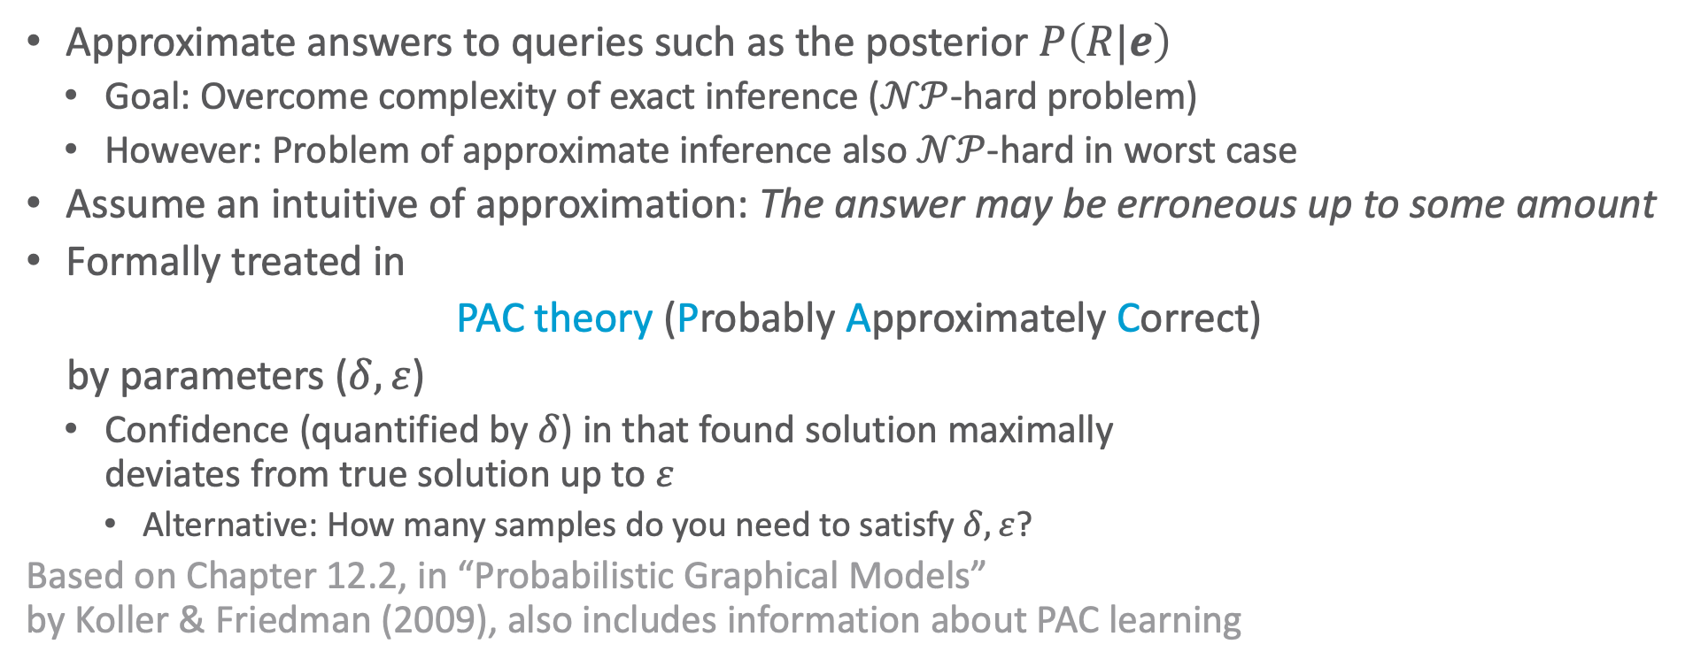
Approximations
Approximate answers to queries such as the posterior $P\left(R|e\right)$
  Goal: Overcome complexity of exact inference ($𝒩𝒫$-hard problem)
  However: Problem of approximate inference also $𝒩𝒫$-hard in worst case
Assume an intuitive of approximation: The answer may be erroneous up to some amount
Formally treated in
PAC theory (Probably Approximately Correct)
by parameters ($δ,ε$)
  Confidence (quantified by $δ$) in that found solution maximally
  deviates from true solution up to $ε$
    Alternative: How many samples do you need to satisfy $δ,ε$?
Based on Chapter 12.2, in “Probabilistic Graphical Models”
by Koller & Friedman (2009), also includes information about PAC learning

Slide 5















Deterministic vs. Stochastic Approximations
Deterministic Approximations
Stochastic Approximations
Yields same result in different runs
  E.g., message passing on cyclic graphs
    Always follows same
    schema, computations
    will be identical in each
    run, meaning result
    will be identical
    Known as loopy
    belief propagation
Can yield different results in different runs
Typically sampling-based
  E.g., depending on different seeds for random numbers
  Should converge towards true result
$$S_{1}$$
$$S_{2}$$
$$π_{S_{1}R}\left(S_{1}\right)$$
$$π_{S_{2}R}\left(S_{2}\right)$$
$$λ_{RS_{1}}\left(S_{1}\right)$$
$$λ_{RS_{2}}\left(S_{2}\right)$$
$$π\left(R\right),λ\left(R\right)$$
$$R$$
$$P\left(R | S_{1},…,S_{p}\right)$$
$$π_{RT_{1}}\left(R\right)$$
$$π_{RT_{2}}\left(R\right)$$
Focus of this lecture
$$λ_{T_{1}R}\left(R\right)$$
$$T_{1}$$
$$λ_{T_{2}R}\left(R\right)$$
$$T_{2}$$

Slide 6
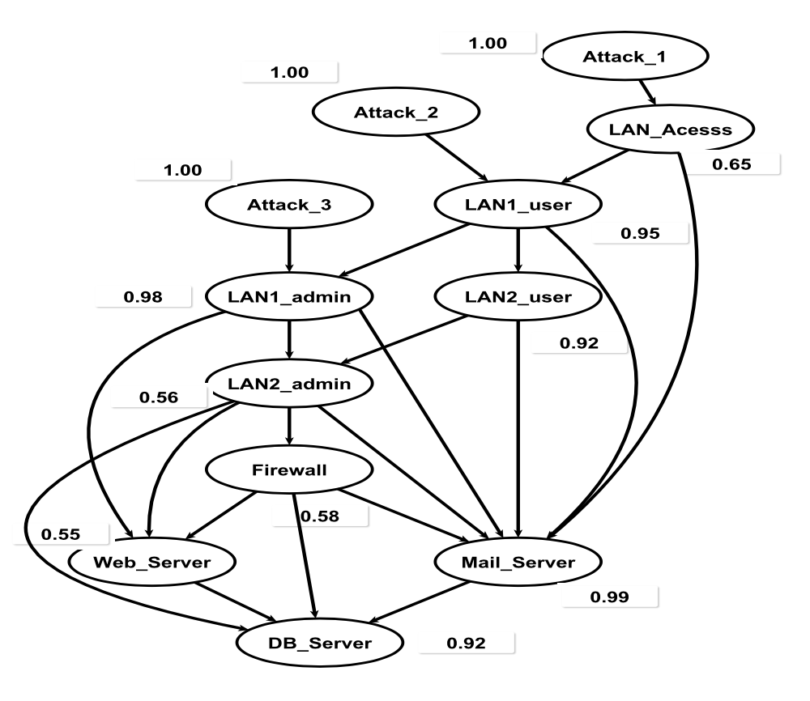
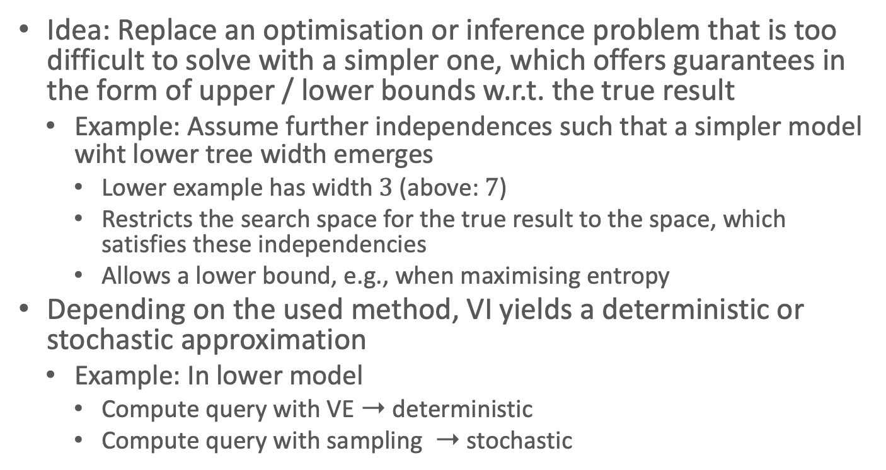
Side Note: Variational Inference (VI)
Idea: Replace an optimisation or inference problem that is too difficult to solve with a simpler one, which offers guarantees in the form of upper / lower bounds w.r.t. the true result
  Example: Assume further independences such that a simpler model wiht lower tree width emerges
    Lower example has width $3$ (above: $7$)
    Restricts the search space for the true result to the space, which satisfies these independencies
    Allows a lower bound, e.g., when maximising entropy
Depending on the used method, VI yields a deterministic or stochastic approximation
  Example: In lower model
    Compute query with VE ➝ deterministic
    Compute query with sampling ➝ stochastic
Notes:
Fast alle Kanten gelöscht, die eine direkte Abhängigkeit dargestellt haben, aber jetzt immer noch durch eine indirekte Abhängigkeit über einen gerichteten Pfad verbunden sind (Nachfahren/Vorfahren)

Slide 7
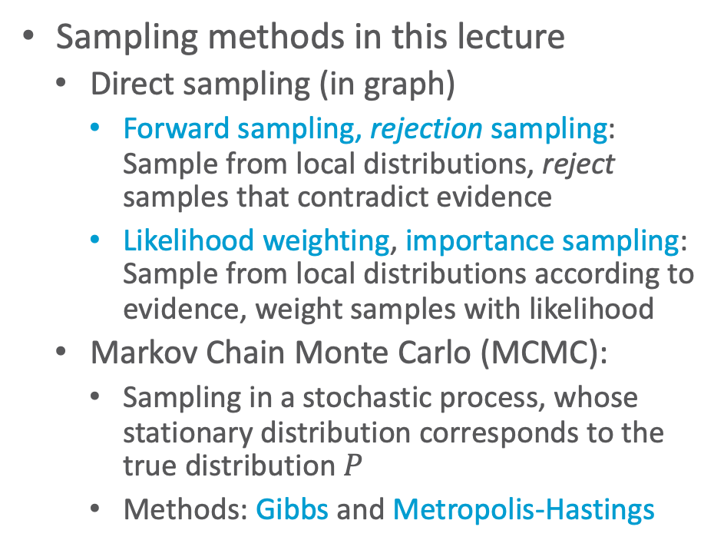
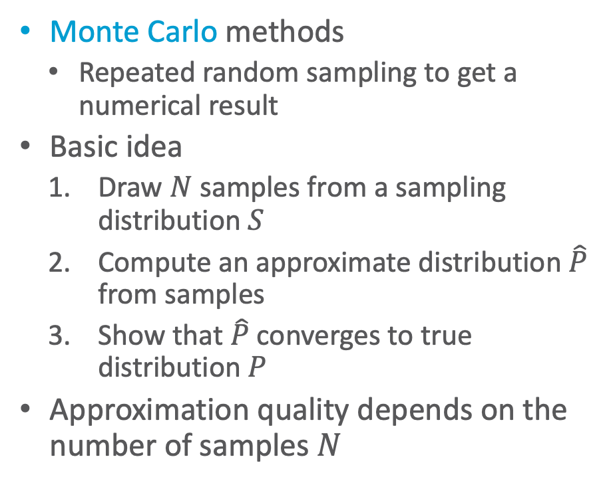
Query Answering Using Stochastic Simulation
Monte Carlo methods
  Repeated random sampling to get a numerical result
Basic idea
  Draw $N$ samples from a sampling distribution $S$
  Compute an approximate distribution $\hat{P}$ from samples
  Show that $\hat{P}$ converges to true distribution $P$
Approximation quality depends on the number of samples $N$
Sampling methods in this lecture
  Direct sampling (in graph)
    Forward sampling, rejection sampling:
    Sample from local distributions, reject samples that contradict evidence
    Likelihood weighting, importance sampling: Sample from local distributions according to evidence, weight samples with likelihood
  Markov Chain Monte Carlo (MCMC):
    Sampling in a stochastic process, whose stationary distribution corresponds to the true distribution $P$
    Methods: Gibbs and Metropolis-Hastings

Slide 8
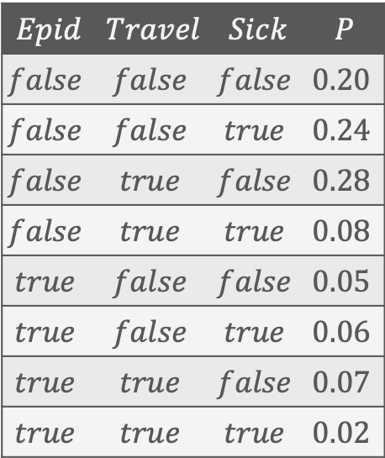
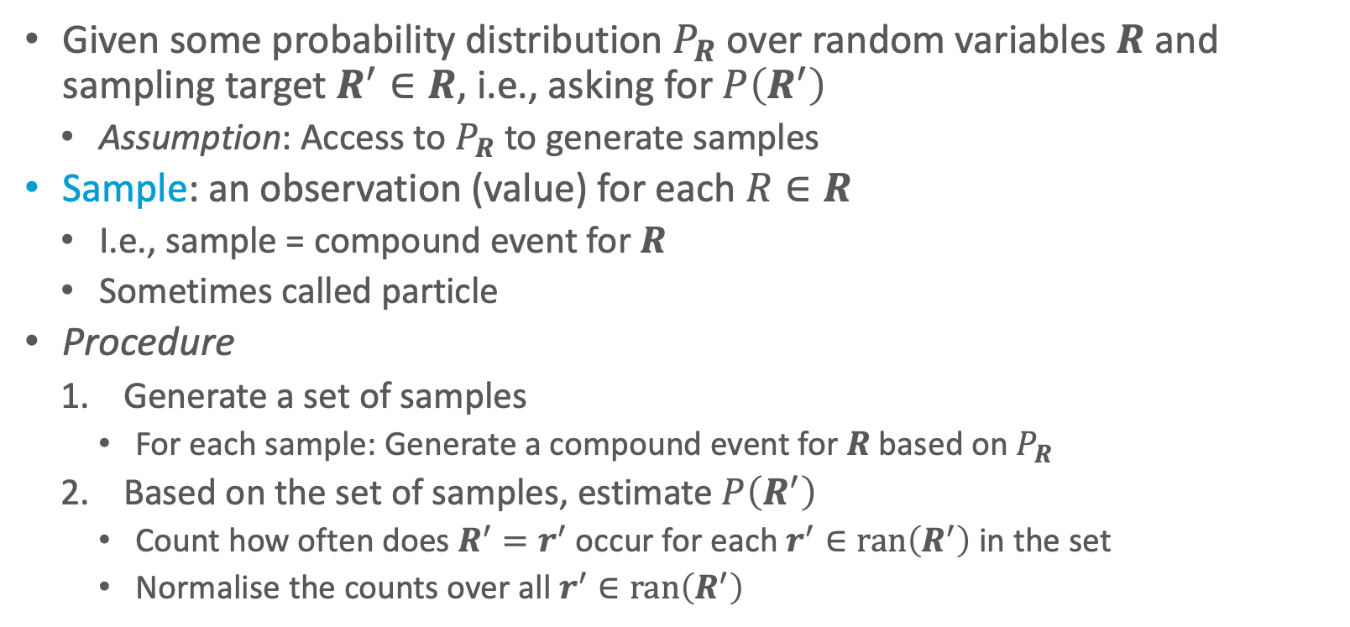
Basic Idea of Sampling from a Probability Distribution
Given some probability distribution $P_{R}$ over random variables $R$ and sampling target $R^{′}∈R$, i.e., asking for $P\left(R^{′}\right)$
  Assumption: Access to $P_{R}$ to generate samples
Sample: an observation (value) for each $R∈R$
  I.e., sample = compound event for $R$
  Sometimes called particle
Procedure
  Generate a set of samples
    For each sample: Generate a compound event for $R$ based on $P_{R}$
  Based on the set of samples, estimate $P\left(R^{′}\right)$
    Count how often does $R^{′}=r^{′}$ occur for each $r^{′}∈ran\left(R^{′}\right)$ in the set
    Normalise the counts over all $r^{′}∈ran\left(R^{′}\right)$
$$Epid$$ | $$Travel$$ | $$Sick$$ | $$P$$
$$false$$ | $$false$$ | $$false$$ | $$0.20$$
$$false$$ | $$false$$ | $$true$$ | $$0.24$$
$$false$$ | $$true$$ | $$false$$ | $$0.28$$
$$false$$ | $$true$$ | $$true$$ | $$0.08$$
$$true$$ | $$false$$ | $$false$$ | $$0.05$$
$$true$$ | $$false$$ | $$true$$ | $$0.06$$
$$true$$ | $$true$$ | $$false$$ | $$0.07$$
$$true$$ | $$true$$ | $$true$$ | $$0.02$$
How do we do that? Can we use a random number generator?

Slide 9
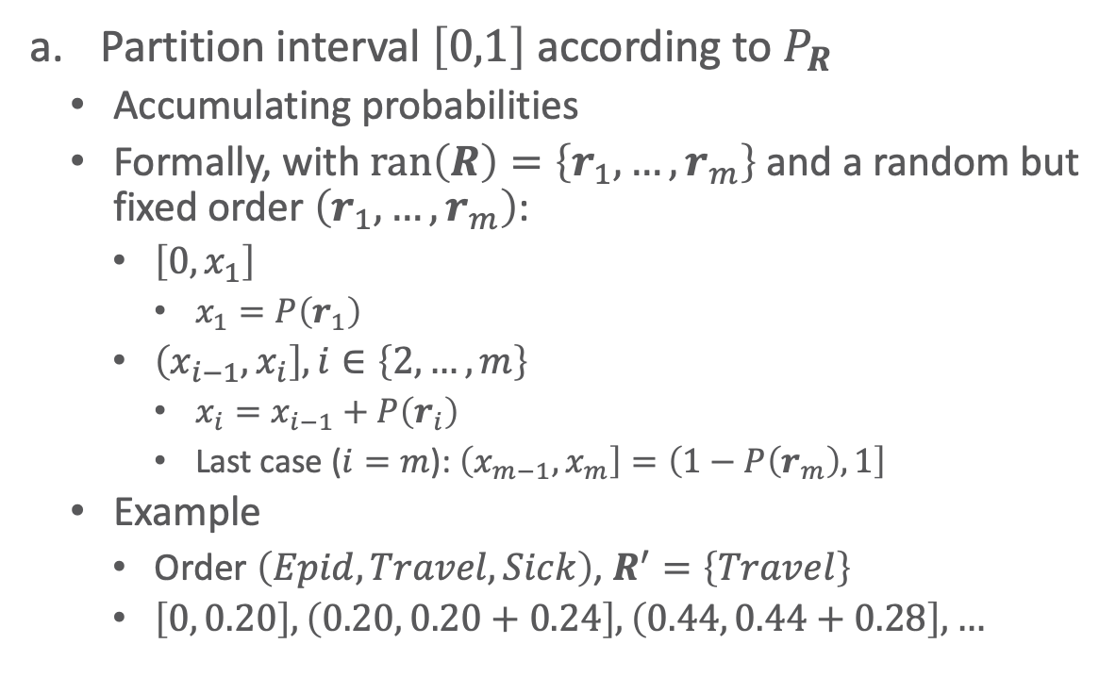



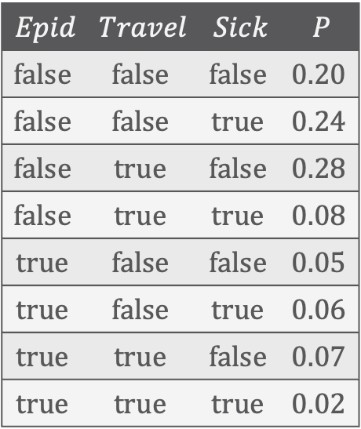
Sampling: 1. Generate Samples
tff
ttf
Partition interval $\left[0,1\right]$ according to $P_{R}$
  Accumulating probabilities
  Formally, with $ran\left(R\right)=\left\{r_{1},…,r_{m}\right\}$ and a random but fixed order $\left(r_{1},…,r_{m}\right)$:
    $\left[0, x_{1}\right]$
      $x_{1}=P\left(r_{1}\right)$
    $\left(x_{i−1}, x_{i}\right],i∈\left\{2,…,m\right\}$
      $x_{i}=x_{i−1}+P\left(r_{i}\right)$
        Last case ($i=m$): $\left(x_{m−1}, x_{m}\right]=\left(1−P\left(r_{m}\right),1\right]$
  Example
    Order $\left(Epid,Travel,Sick\right)$, $R^{′}=\left\{Travel\right\}$
    $\left[0, 0.20\right],\left(0.20, 0.20+0.24\right],\left(0.44, 0.44+0.28\right],…$
fff
fft
ftf
ftt
tft
ttt
$$0$$
$$0.5$$
$$1$$
$$Epid$$ | $$Travel$$ | $$Sick$$ | $$P$$
$$false$$ | $$false$$ | $$false$$ | $$0.20$$
$$false$$ | $$false$$ | $$true$$ | $$0.24$$
$$false$$ | $$true$$ | $$false$$ | $$0.28$$
$$false$$ | $$true$$ | $$true$$ | $$0.08$$
$$true$$ | $$false$$ | $$false$$ | $$0.05$$
$$true$$ | $$false$$ | $$true$$ | $$0.06$$
$$true$$ | $$true$$ | $$false$$ | $$0.07$$
$$true$$ | $$true$$ | $$true$$ | $$0.02$$

Slide 10

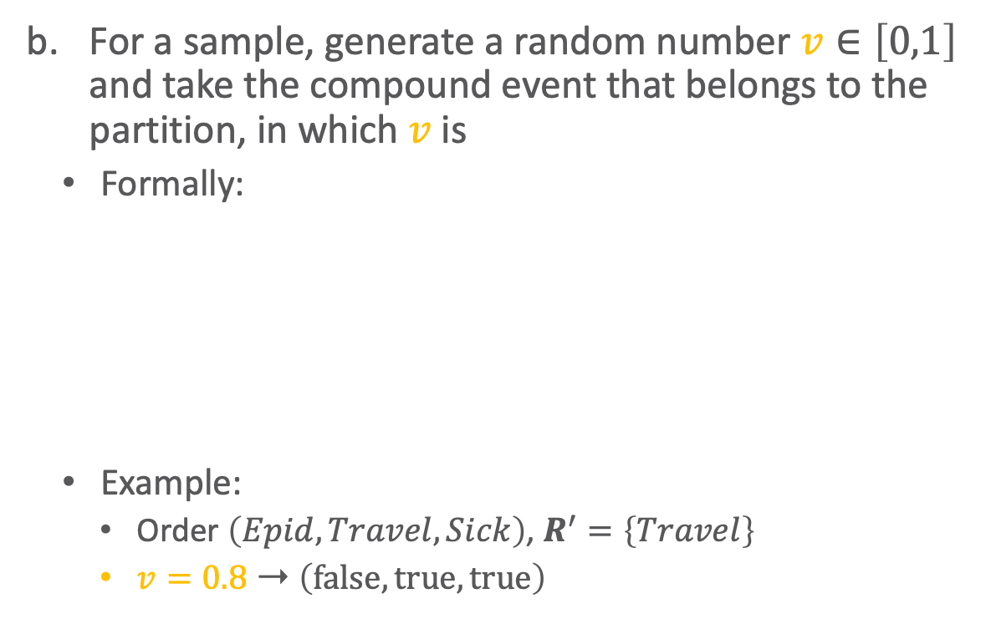


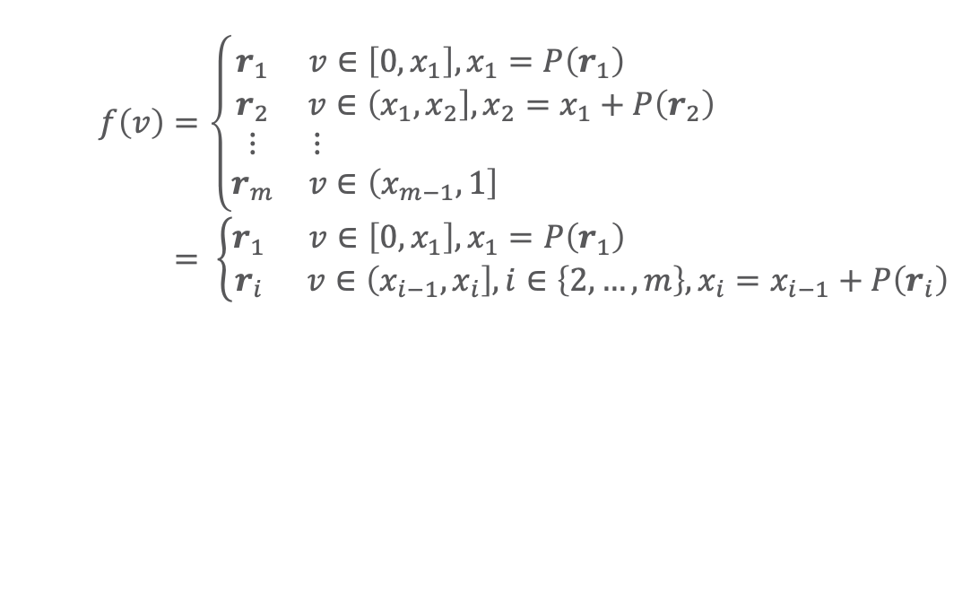

Sampling: 1. Generate Samples
tff
ttf
For a sample, generate a random number $v∈\left[0,1\right]$ and take the compound event that belongs to the partition, in which $v$ is
  Formally:
  Example:
    Order $\left(Epid,Travel,Sick\right)$, $R^{′}=\left\{Travel\right\}$
    $v=0.8$ ➝ $\left(false,true,true\right)$
fff
fft
ftf
ftt
tft
ttt
$$0$$
$$0.5$$
$$v$$
$$1$$
$$Epid$$ | $$Travel$$ | $$Sick$$ | $$P$$
$$false$$ | $$false$$ | $$false$$ | $$0.20$$
$$false$$ | $$false$$ | $$true$$ | $$0.24$$
$$false$$ | $$true$$ | $$false$$ | $$0.28$$
$$false$$ | $$true$$ | $$true$$ | $$0.08$$
$$true$$ | $$false$$ | $$false$$ | $$0.05$$
$$true$$ | $$false$$ | $$true$$ | $$0.06$$
$$true$$ | $$true$$ | $$false$$ | $$0.07$$
$$true$$ | $$true$$ | $$true$$ | $$0.02$$
$$f\left(v\right)=\left\{\begin{matrix}r_{1} & v∈\left[0,x_{1}\right],x_{1}=P\left(r_{1}\right) \\ r_{2} & v∈\left(x_{1}, x_{2}\right], x_{2}=x_{1}+P\left(r_{2}\right) \\ ⋮ & ⋮ \\ r_{m} & v∈\left(x_{m−1}, 1\right] \end{matrix}\right. \\ = \left\{\begin{matrix}r_{1} & v∈\left[0,x_{1}\right],x_{1}=P\left(r_{1}\right) \\ r_{i} & v∈\left(x_{i−1}, x_{i}\right],i∈\left\{2,…,m\right\},x_{i}=x_{i−1}+P\left(r_{i}\right)\end{matrix}\right.$$

Slide 11
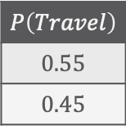
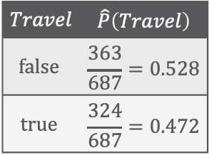
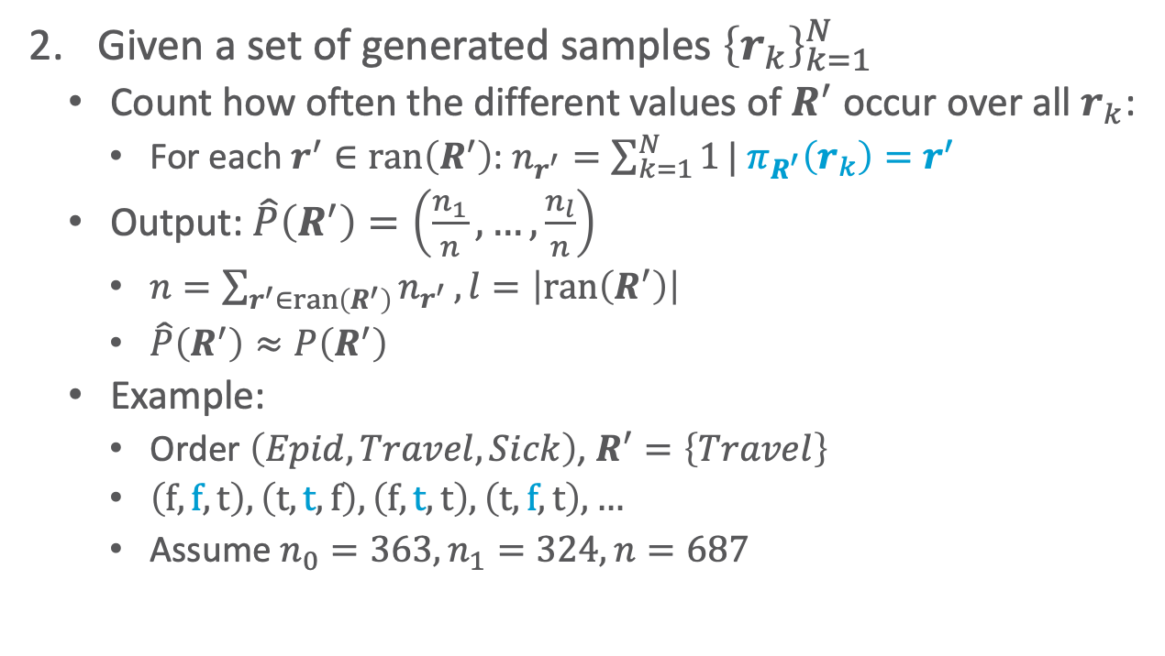
Sampling: 2. Estimate $P\left(R^{′}\right)$ (Count Occurences)
tff
ttf
Given a set of generated samples ${\left\{r_{k}\right\}}_{k=1}^{N}$
  Count how often the different values of $R^{′}$ occur over all $r_{k}$:
    For each $r^{′}∈ran\left(R^{′}\right)$: $n_{r^{′}}=\sum_{k=1}^{N}{1}| π_{R^{′}}\left(r_{k}\right)=r^{′}$
  Output: $\hat{P}\left(R^{′}\right)=\left(\frac{n_{1}}{n},…,\frac{n_{l}}{n}\right)$
    $n=\sum_{r^{′}∈ran\left(R^{′}\right)}{n_{r^{′}}}, l=\left|ran\left(R^{′}\right)\right|$
    $\hat{P}\left(R^{′}\right)≈P\left(R^{′}\right)$
  Example:
    Order $\left(Epid,Travel,Sick\right)$, $R^{′}=\left\{Travel\right\}$
    $\left(f,f,t\right),\left(t,t,f\right),\left(f,t,t\right),\left(t,f,t\right), …$
    Assume $n_{0}=363,n_{1}=324,n=687$
fff
fft
ftf
ftt
tft
ttt
$$0$$
$$0.5$$
$$1$$
$$Epid$$ | $$Travel$$ | $$Sick$$ | $$P$$
$$false$$ | $$false$$ | $$false$$ | $$0.20$$
$$false$$ | $$false$$ | $$true$$ | $$0.24$$
$$false$$ | $$true$$ | $$false$$ | $$0.28$$
$$false$$ | $$true$$ | $$true$$ | $$0.08$$
$$true$$ | $$false$$ | $$false$$ | $$0.05$$
$$true$$ | $$false$$ | $$true$$ | $$0.06$$
$$true$$ | $$true$$ | $$false$$ | $$0.07$$
$$true$$ | $$true$$ | $$true$$ | $$0.02$$
$$Travel$$ | $$\hat{P}\left(Travel\right)$$
$$false$$ | $$\frac{363}{687}=0.528$$
$$true$$ | $$\frac{324}{687}=0.472$$
$$P\left(Travel\right)$$
$$0.55$$
$$0.45$$

Slide 12
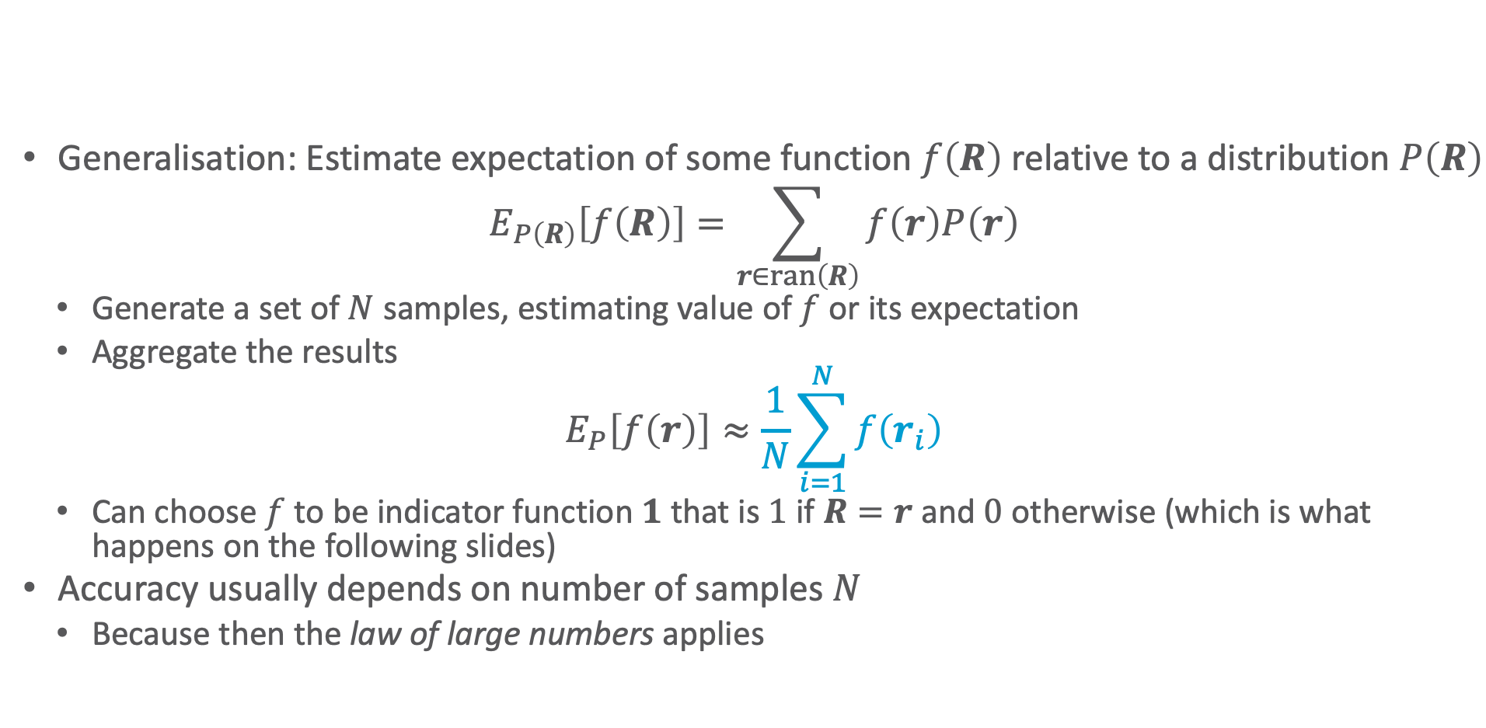
Sampling: Generalisation
Generalisation: Estimate expectation of some function $f\left(R\right)$ relative to a distribution $P\left(R\right)$
$$E_{P\left(R\right)}\left[f\left(R\right)\right]=\sum_{r∈ran\left(R\right)}{f\left(r\right)P\left(r\right)}$$
  Generate a set of $N$ samples, estimating value of $f$ or its expectation
  Aggregate the results
$$E_{P}\left[f\left(r\right)\right]≈\frac{1}{N}\sum_{i=1}^{N}{f\left(r_{i}\right)}$$
  Can choose $f$ to be indicator function $1$ that is $1$ if $R=r$ and $0$ otherwise (which is what happens on the following slides)
Accuracy usually depends on number of samples $N$
  Because then the law of large numbers applies

Slide 13
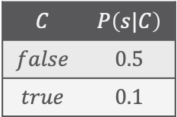




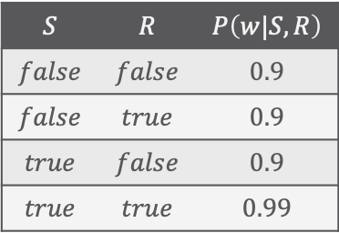

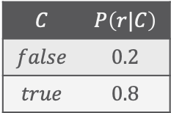
Direct Sampling
$$C$$ | $$P\left(s|C\right)$$
$$false$$ | $$0.5$$
$$true$$ | $$0.1$$
$$C$$ | $$P\left(r|C\right)$$
$$false$$ | $$0.2$$
$$true$$ | $$0.8$$
$$P\left(c\right)=0.5$$
$$Cloudy$$
$$Sprinkler$$
$$Rain$$
$$WetGrass$$
$$S$$ | $$R$$ | $$P\left(w|S,R\right)$$
$$false$$ | $$false$$ | $$0.9$$
$$false$$ | $$true$$ | $$0.9$$
$$true$$ | $$false$$ | $$0.9$$
$$true$$ | $$true$$ | $$0.99$$
Rejection Sampling, Likelihood Weighting, Importance Sampling
Lifted Importance Sampling

Slide 14
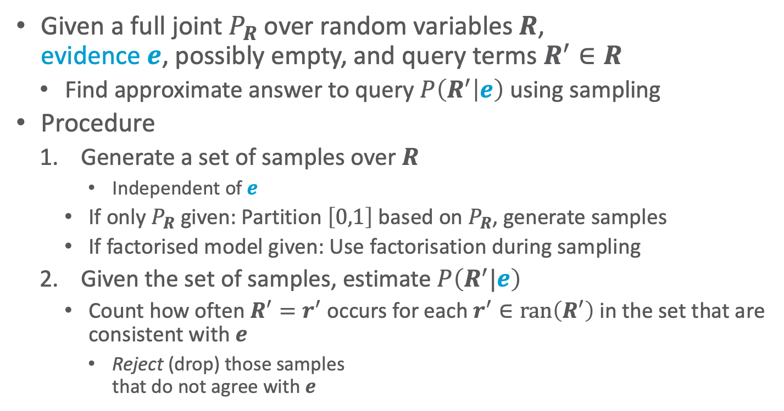
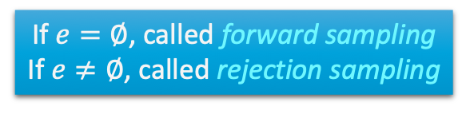
Direct Sampling: Forward & Rejection Sampling
tff
ttf
Given a full joint $P_{R}$ over random variables $R$,
evidence $e$, possibly empty, and query terms $R^{′}∈R$
  Find approximate answer to query $P\left(R^{′} | e\right)$ using sampling
Procedure
  Generate a set of samples over $R$
      Independent of $e$
    If only $P_{R}$ given: Partition $\left[0,1\right]$ based on $P_{R}$, generate samples
    If factorised model given: Use factorisation during sampling
  Given the set of samples, estimate $P\left(R^{′}|e\right)$
    Count how often $R^{′}=r^{′}$ occurs for each $r^{′}∈ran\left(R^{′}\right)$ in the set that are consistent with $e$
      Reject (drop) those samples
      that do not agree with $e$
tft
ttt
fff
fft
ftf
ftt
$$0$$
$$0.5$$
$$1$$
$$Epid$$ | $$Travel$$ | $$Sick$$ | $$P$$
$$false$$ | $$false$$ | $$false$$ | $$0.20$$
$$false$$ | $$false$$ | $$true$$ | $$0.24$$
$$false$$ | $$true$$ | $$false$$ | $$0.28$$
$$false$$ | $$true$$ | $$true$$ | $$0.08$$
$$true$$ | $$false$$ | $$false$$ | $$0.05$$
$$true$$ | $$false$$ | $$true$$ | $$0.06$$
$$true$$ | $$true$$ | $$false$$ | $$0.07$$
$$true$$ | $$true$$ | $$true$$ | $$0.02$$
How do we do that?
How does this work?
If $e=∅$, called forward sampling
If $e≠∅$, called rejection sampling
Notes:
Forward sampling = sampling from an empty network

Slide 15
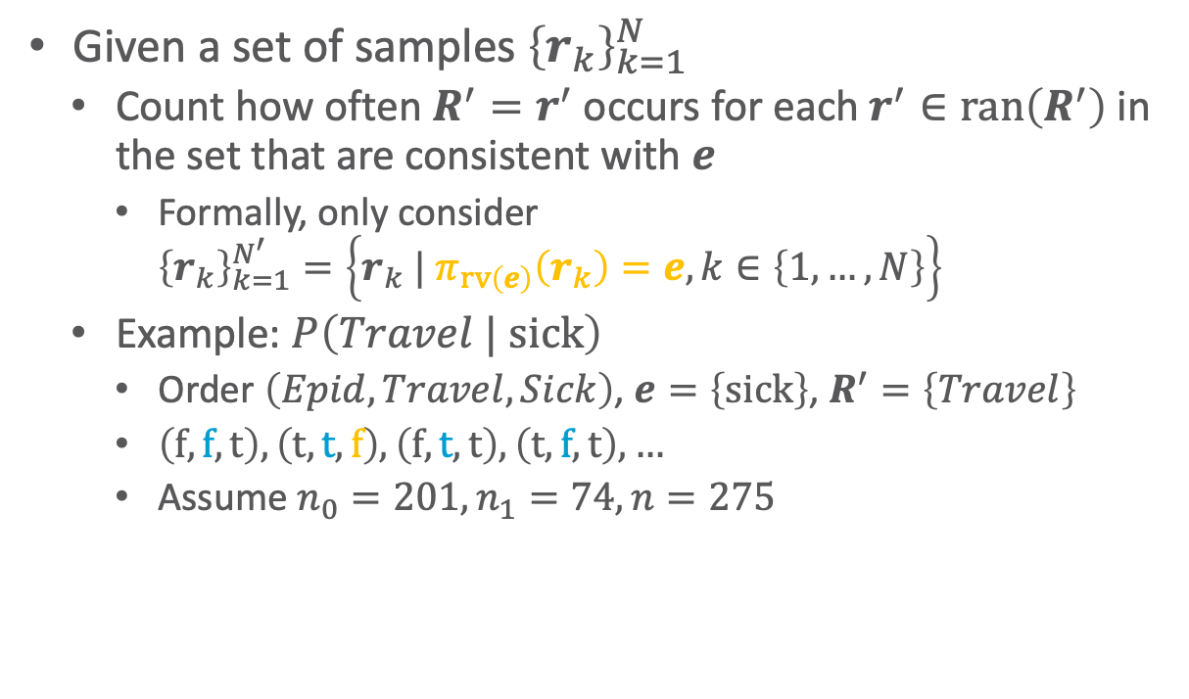
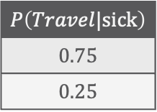
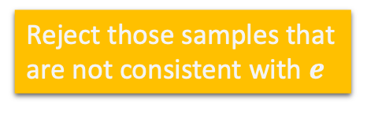
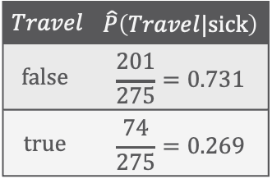
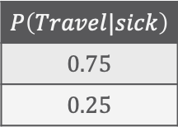
Rejecting Samples
tff
ttf
Given a set of samples ${\left\{r_{k}\right\}}_{k=1}^{N}$
  Count how often $R^{′}=r^{′}$ occurs for each $r^{′}∈ran\left(R^{′}\right)$ in the set that are consistent with $e$
    Formally, only consider
    $${\left\{r_{k}\right\}}_{k=1}^{N^{′}}=\left\{r_{k} | π_{rv\left(e\right)}\left(r_{k}\right)=e,k∈\left\{1,…,N\right\}\right\}$$
  Example: $P\left(Travel | sick\right)$
    Order $\left(Epid,Travel,Sick\right)$, $e=\left\{sick\right\}$, $R^{′}=\left\{Travel\right\}$
    $\left(f,f,t\right),\left(t,t,f\right),\left(f,t,t\right),\left(t,f,t\right), …$
    Assume $n_{0}=201,n_{1}=74,n=275$
fff
fft
ftf
ftt
tft
ttt
$$0$$
$$0.5$$
$$1$$
$$Epid$$ | $$Travel$$ | $$Sick$$ | $$P$$
$$false$$ | $$false$$ | $$false$$ | $$0.20$$
$$false$$ | $$false$$ | $$true$$ | $$0.24$$
$$false$$ | $$true$$ | $$false$$ | $$0.28$$
$$false$$ | $$true$$ | $$true$$ | $$0.08$$
$$true$$ | $$false$$ | $$false$$ | $$0.05$$
$$true$$ | $$false$$ | $$true$$ | $$0.06$$
$$true$$ | $$true$$ | $$false$$ | $$0.07$$
$$true$$ | $$true$$ | $$true$$ | $$0.02$$
Reject those samples that are not consistent with $e$
$$Travel$$ | $$\hat{P}\left(Travel|sick\right)$$
$$false$$ | $$\frac{201}{275}=0.731$$
$$true$$ | $$\frac{74}{275}=0.269$$
$$P\left(Travel|sick\right)$$
$$0.75$$
$$0.25$$
Next part: How can we use a factorised model for this?

Slide 16
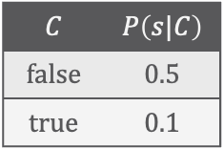
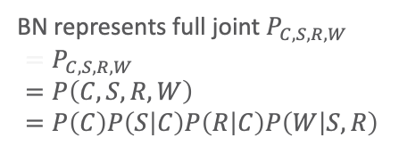
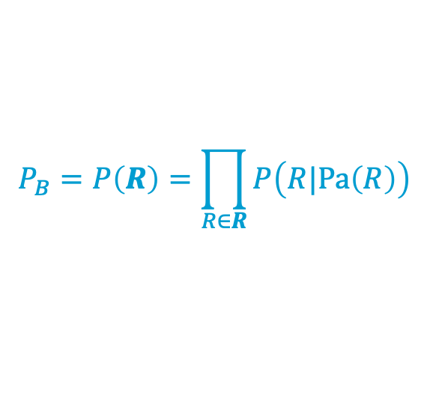
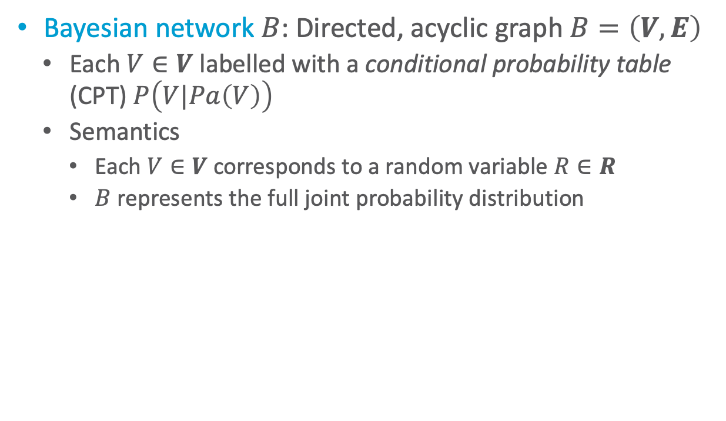

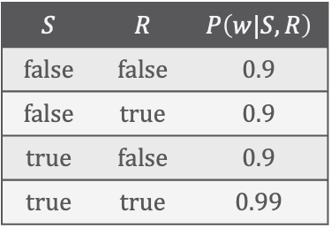
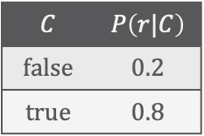
Remember: Bayes Nets (BNs)
BN represents full joint $P_{C,S,R,W}$
$$=P_{C,S,R,W} \\ =P\left(C,S,R,W\right) \\ =P\left(C\right)P\left(S | C\right)P\left(R | C\right)P\left(W | S,R\right)$$
Bayesian network $B$: Directed, acyclic graph $B=\left(V,E\right)$
  Each $V∈V$ labelled with a conditional probability table (CPT) $P\left(V|Pa\left(V\right)\right)$
  Semantics
    Each $V∈V$ corresponds to a random variable $R∈R$
    $B$ represents the full joint probability distribution
$$C$$ | $$P\left(s|C\right)$$
$$false$$ | $$0.5$$
$$true$$ | $$0.1$$
$$C$$ | $$P\left(r|C\right)$$
$$false$$ | $$0.2$$
$$true$$ | $$0.8$$
$$P\left(c\right)=0.5$$
$$Cloudy$$
$$P_{B}=P\left(R\right)=\prod_{R∈R}{P\left(R|Pa\left(R\right)\right)}$$
$$Sprinkler$$
$$Rain$$
$$WetGrass$$
Why BNs?
Given a probability distribution, we can sample from it
In CPTs: Parent values determine which probability distribution holds
If sampling from roots to leaves (along a topological order), we always have parent values for CPTs (enabled by acyclicity)
$$S$$ | $$R$$ | $$P\left(w|S,R\right)$$
$$false$$ | $$false$$ | $$0.9$$
$$false$$ | $$true$$ | $$0.9$$
$$true$$ | $$false$$ | $$0.9$$
$$true$$ | $$true$$ | $$0.99$$

Slide 17
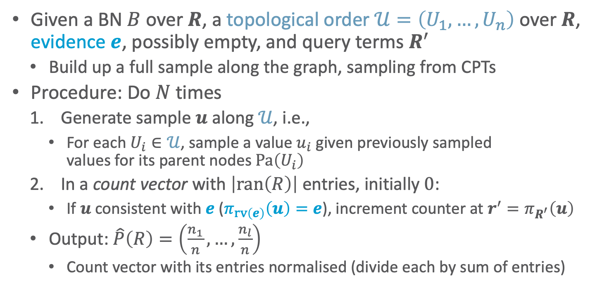
Direct Sampling: Forward + Rejection Sampling in BNs
Given a BN $B$ over $R$, a topological order $𝒰=\left(U_{1},…,U_{n}\right)$ over $R$, evidence $e$, possibly empty, and query terms $R^{′}$
  Build up a full sample along the graph, sampling from CPTs
Procedure: Do $N$ times
  Generate sample $u$ along $𝒰$, i.e.,
    For each $U_{i}∈𝒰$, sample a value $u_{i}$ given previously sampled
    values for its parent nodes $Pa\left(U_{i}\right)$
  In a count vector with $\left|ran\left(R\right)\right|$ entries, initially $0$:
    If $u$ consistent with $e$ ($π_{rv\left(e\right)}\left(u\right)=e$), increment counter at $r^{′}=π_{R^{′}}\left(u\right)$
  Output: $\hat{P}\left(R\right)=\left(\frac{n_{1}}{n},…,\frac{n_{l}}{n}\right)$
    Count vector with its entries normalised (divide each by sum of entries)
$$C$$ | $$P\left(s|C\right)$$
$$false$$ | $$0.5$$
$$true$$ | $$0.1$$
$$C$$ | $$P\left(r|C\right)$$
$$false$$ | $$0.2$$
$$true$$ | $$0.8$$
$$P\left(c\right)=0.5$$
$$Cloudy$$
$$Sprinkler$$
$$Rain$$
$$WetGrass$$
$$S$$ | $$R$$ | $$P\left(w|S,R\right)$$
$$false$$ | $$false$$ | $$0.9$$
$$false$$ | $$true$$ | $$0.9$$
$$true$$ | $$false$$ | $$0.9$$
$$true$$ | $$true$$ | $$0.99$$

Slide 18

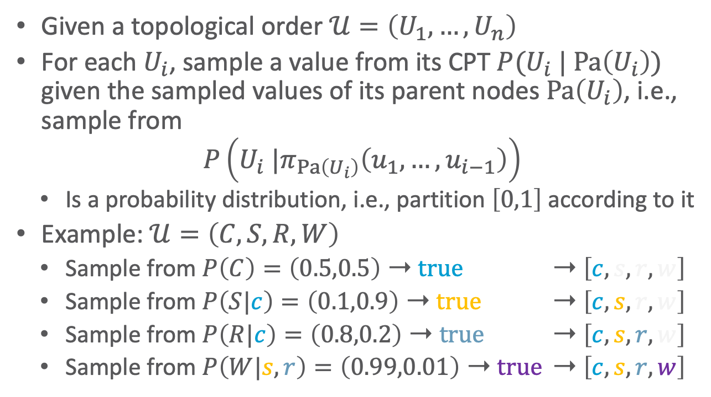



1. Generate Sample
Given a topological order $𝒰=\left(U_{1},…,U_{n}\right)$
For each $U_{i}$, sample a value from its CPT $P(U_{i} | Pa\left(U_{i}\right))$ given the sampled values of its parent nodes $Pa\left(U_{i}\right)$, i.e., sample from
$$P\left(U_{i} |π_{Pa\left(U_{i}\right)}\left(u_{1},…,u_{i−1}\right)\right)$$
  Is a probability distribution, i.e., partition $\left[0,1\right]$ according to it
Example: $𝒰=\left(C,S,R,W\right)$
  Sample from $P\left(C\right)=\left(0.5,0.5\right)$ ➝ $true$ ➝ $\left[c, s, r, w\right]$
  Sample from $P\left(S|c\right)=\left(0.1,0.9\right)$ ➝ $true$ ➝ $\left[c, s, r, w\right]$
  Sample from $P\left(R|c\right)=\left(0.8,0.2\right)$ ➝ $true$ ➝ $\left[c, s, r, w\right]$
  Sample from $P\left(W|s,r\right)=\left(0.99,0.01\right)$ ➝ $true$ ➝ $\left[c, s, r, w\right]$
$$C$$ | $$P\left(s|C\right)$$
$$false$$ | $$0.5$$
$$true$$ | $$0.1$$
$$C$$ | $$P\left(r|C\right)$$
$$false$$ | $$0.2$$
$$true$$ | $$0.8$$
$$P\left(c\right)=0.5$$
$$Cloudy$$
$$Sprinkler$$
$$Rain$$
Sample
true
false
$$WetGrass$$
$$S$$ | $$R$$ | $$P\left(w|S,R\right)$$
$$false$$ | $$false$$ | $$0.9$$
$$false$$ | $$true$$ | $$0.9$$
$$true$$ | $$false$$ | $$0.9$$
$$true$$ | $$true$$ | $$0.99$$

Slide 19
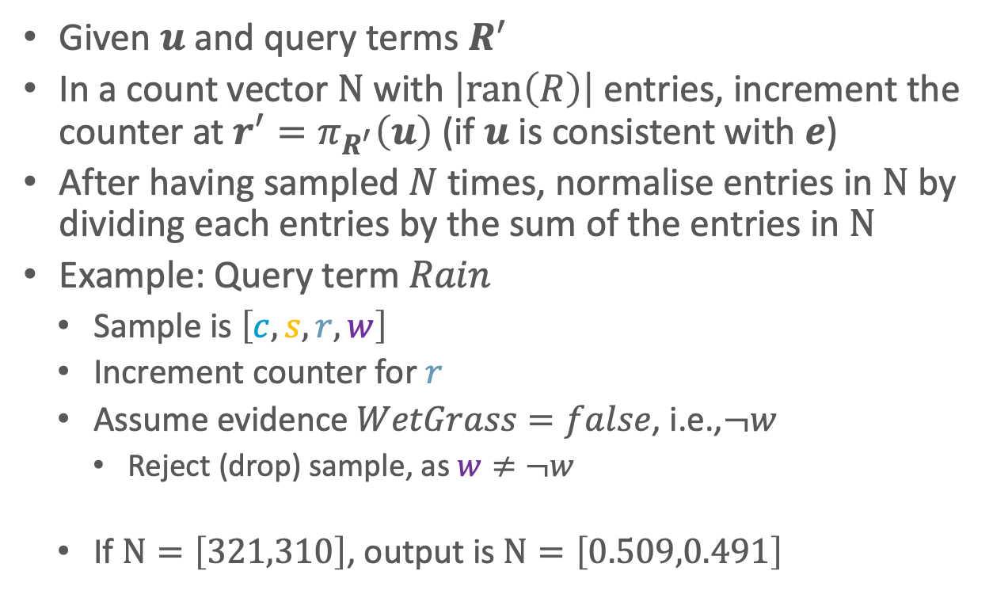
2. Count, and Output
Given $u$ and query terms $R^{′}$
In a count vector $Ν$ with $\left|ran\left(R\right)\right|$ entries, increment the counter at $r^{′}=π_{R^{′}}\left(u\right)$ (if $u$ is consistent with $e$)
After having sampled $N$ times, normalise entries in $Ν$ by dividing each entries by the sum of the entries in $Ν$
Example: Query term $Rain$
  Sample is $\left[c, s, r,w\right]$
  Increment counter for $r$
  Assume evidence $WetGrass=false$, i.e.,$¬w$
    Reject (drop) sample, as $w≠¬w$
  If $Ν=\left[321,310\right]$, output is $Ν=\left[0.509,0.491\right]$
$$C$$ | $$P\left(s|C\right)$$
$$false$$ | $$0.5$$
$$true$$ | $$0.1$$
$$C$$ | $$P\left(r|C\right)$$
$$false$$ | $$0.2$$
$$true$$ | $$0.8$$
$$P\left(c\right)=0.5$$
$$Cloudy$$
$$Sprinkler$$
$$Rain$$
$$WetGrass$$
$$S$$ | $$R$$ | $$P\left(w|S,R\right)$$
$$false$$ | $$false$$ | $$0.9$$
$$false$$ | $$true$$ | $$0.9$$
$$true$$ | $$false$$ | $$0.9$$
$$true$$ | $$true$$ | $$0.99$$
true
false

Slide 20
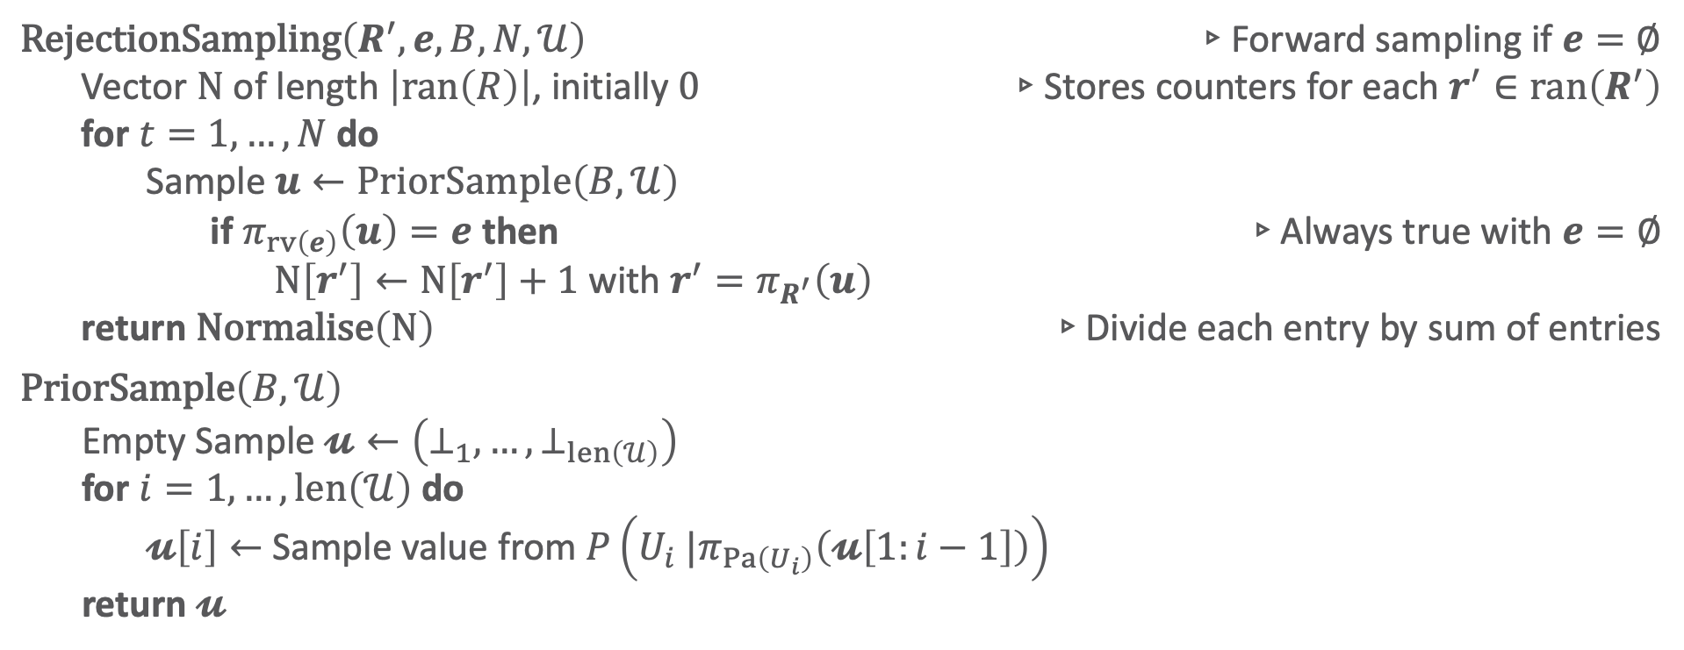
Rejection Sampling
$\text{RejectionSampling}\left(R^{′}, e,B,N,𝒰\right)$ ▹Forward sampling if $e=∅$
  Vector $Ν$ of length $\left|ran\left(R\right)\right|$, initially $0$ ▹Stores counters for each $r^{′}∈ran\left(R^{′}\right)$
  for $t=1,…,N$ do
  Sample $u←PriorSample\left(B,𝒰\right)$
  if $π_{rv\left(e\right)}\left(u\right)=e$ then ▹Always true with $e=∅$
  $Ν\left[r^{′}\right]←Ν\left[r^{′}\right]+1$ with $r^{′}=π_{R^{′}}\left(u\right)$
  return $\text{Normalise}\left(Ν\right)$ ▹Divide each entry by sum of entries
$\text{PriorSample}\left(B,𝒰\right)$
  Empty Sample $𝓾←\left(⊥_{1},…,⊥_{len\left(𝒰\right)}\right)$
  for $i=1,…,len\left(𝒰\right)$ do
  $𝓾\left[i\right]←$ Sample value from $P\left(U_{i} |π_{Pa\left(U_{i}\right)}\left(𝓾\left[1:i−1\right]\right)\right)$
  return $𝓾$
Rejection Sampling
M. Henrion: “Propagating uncertainty in Bayesian networks by probabilistic logic sampling”. In: Uncertainty in AI, 1988.

Slide 21
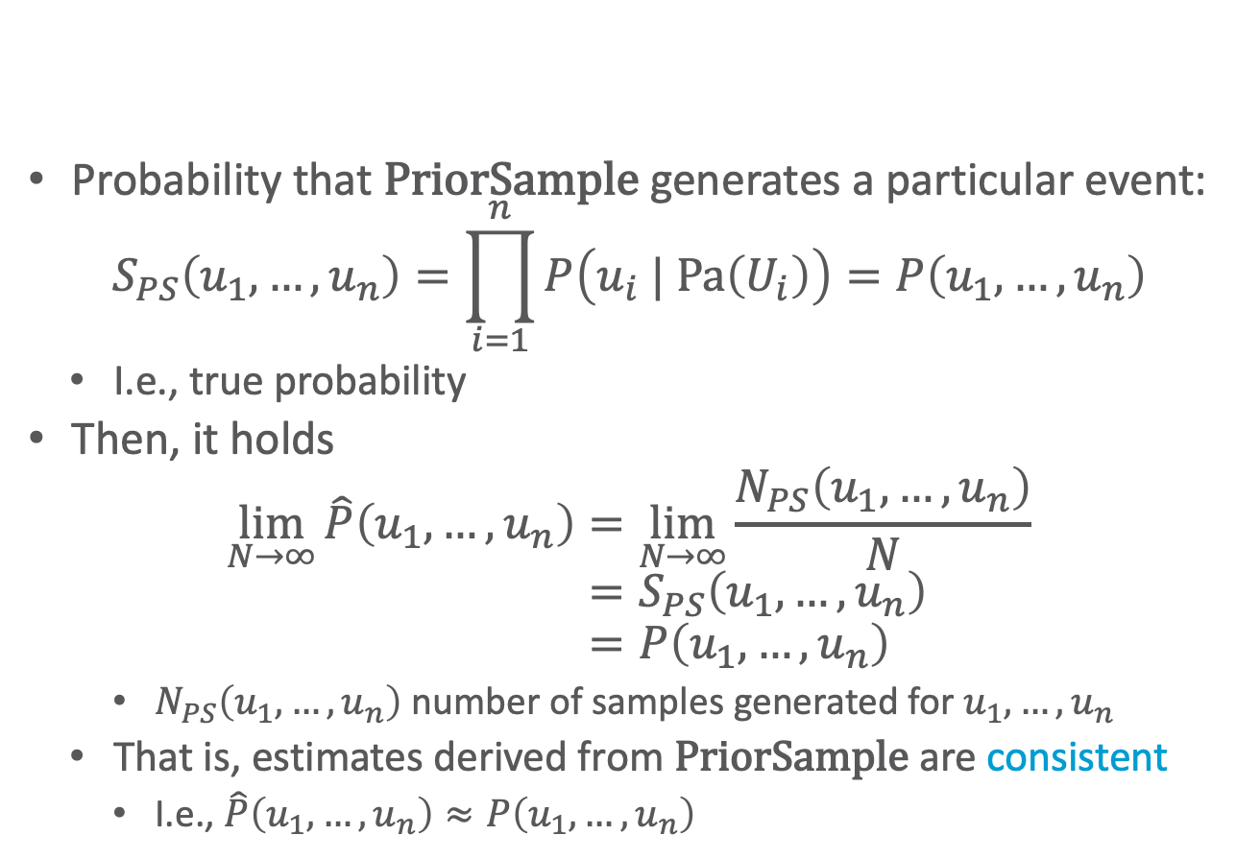
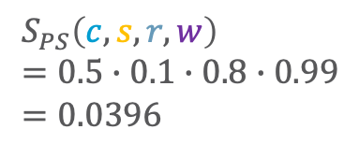
Forward Sampling: Analysis
$$S_{PS}\left(c, s, r,w\right) \\ =0.5∙0.1∙0.8∙0.99 \\ =0.0396$$
Probability that $\text{PriorSample}$ generates a particular event:
$$S_{PS}\left(u_{1},…,u_{n}\right)=\prod_{i=1}^{n}{P\left(u_{i} | Pa\left(U_{i}\right)\right)}=P\left(u_{1},…,u_{n}\right)$$
  I.e., true probability
Then, it holds
$$\lim_{N→∞}{\hat{P}\left(u_{1},…,u_{n}\right)}=\lim_{N→∞}{\frac{N_{PS}\left(u_{1},…,u_{n}\right)}{N}} \\ =S_{PS}\left(u_{1},…,u_{n}\right) \\ =P\left(u_{1},…, u_{n}\right)$$
    $N_{PS}\left(u_{1},…,u_{n}\right)$ number of samples generated for $u_{1},…,u_{n}$
  That is, estimates derived from $\text{PriorSample}$ are consistent
    I.e., $\hat{P}\left(u_{1},…,u_{n}\right)≈P\left(u_{1},…, u_{n}\right)$
$$C$$ | $$P\left(s|C\right)$$
$$false$$ | $$0.5$$
$$true$$ | $$0.1$$
$$C$$ | $$P\left(r|C\right)$$
$$false$$ | $$0.2$$
$$true$$ | $$0.8$$
$$P\left(c\right)=0.5$$
$$Cloudy$$
$$Sprinkler$$
$$Rain$$
$$WetGrass$$
$$S$$ | $$R$$ | $$P\left(w|S,R\right)$$
$$false$$ | $$false$$ | $$0.9$$
$$false$$ | $$true$$ | $$0.9$$
$$true$$ | $$false$$ | $$0.9$$
$$true$$ | $$true$$ | $$0.99$$
Notes:
Note: second probability is 0.9 = 1 – 0.1 = 1 – P(S|C)

Slide 22
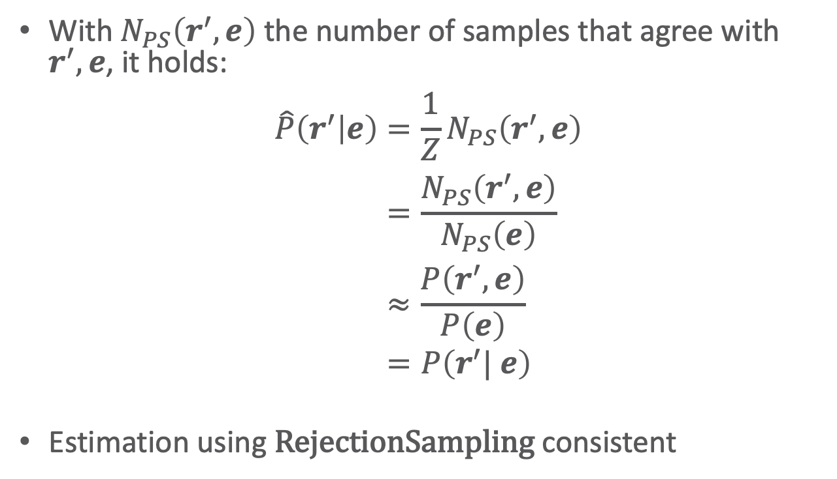
Rejection Sampling: Analysis
With $N_{PS}\left(r^{′},e\right)$ the number of samples that agree with $r^{′},e$, it holds:
$$\hat{P}\left(r^{′} | e\right)=\frac{1}{Z}N_{PS}\left(r^{′},e\right) \\ =\frac{N_{PS}\left(r^{′},e\right)}{N_{PS}\left(e\right)} \\ ≈\frac{P\left(r^{′},e\right)}{P\left(e\right)} \\ =P\left(r^{′}| e\right)$$
Estimation using $\text{Rejection}\text{Sampl}\text{ing}$ consistent
$$C$$ | $$P\left(s|C\right)$$
$$false$$ | $$0.5$$
$$true$$ | $$0.1$$
$$C$$ | $$P\left(r|C\right)$$
$$false$$ | $$0.2$$
$$true$$ | $$0.8$$
$$P\left(c\right)=0.5$$
$$Cloudy$$
$$Sprinkler$$
$$Rain$$
$$WetGrass$$
$$S$$ | $$R$$ | $$P\left(w|S,R\right)$$
$$false$$ | $$false$$ | $$0.9$$
$$false$$ | $$true$$ | $$0.9$$
$$true$$ | $$false$$ | $$0.9$$
$$true$$ | $$true$$ | $$0.99$$
Notes:
Note: second probability is 0.9 = 1 – 0.1 = 1 – P(S|C)

Slide 23
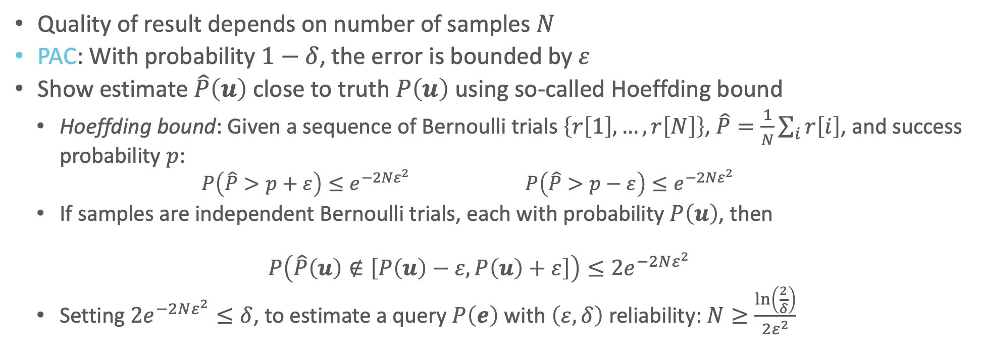
Brief Look into PAC Estimators
Quality of result depends on number of samples $N$
PAC: With probability $1−δ$, the error is bounded by $ε$
Show estimate $\hat{P}\left(u\right)$ close to truth $P\left(u\right)$ using so-called Hoeffding bound
  Hoeffding bound: Given a sequence of Bernoulli trials $\left\{r\left[1\right],…,r\left[N\right]\right\}$, $\hat{P}=\frac{1}{N}\sum_{i}{r\left[i\right]}$, and success probability $p$:
    $$P\left(\hat{P}>p+ε\right)≤e^{−2Nε^{2}} P\left(\hat{P}>p−ε\right)≤e^{−2Nε^{2}}$$
  If samples are independent Bernoulli trials, each with probability $P\left(u\right)$, then
  $$P\left(\hat{P}\left(u\right)∉\left[P\left(u\right)−ε,P\left(u\right)+ε\right]\right)≤2e^{−2Nε^{2}}$$
  Setting $2e^{−2Nε^{2}}≤δ$, to estimate a query $P\left(e\right)$ with $\left(ε,δ\right)$ reliability: $N≥\frac{\ln\left(\frac{2}{δ}\right)}{2ε^{2}}$

Slide 24
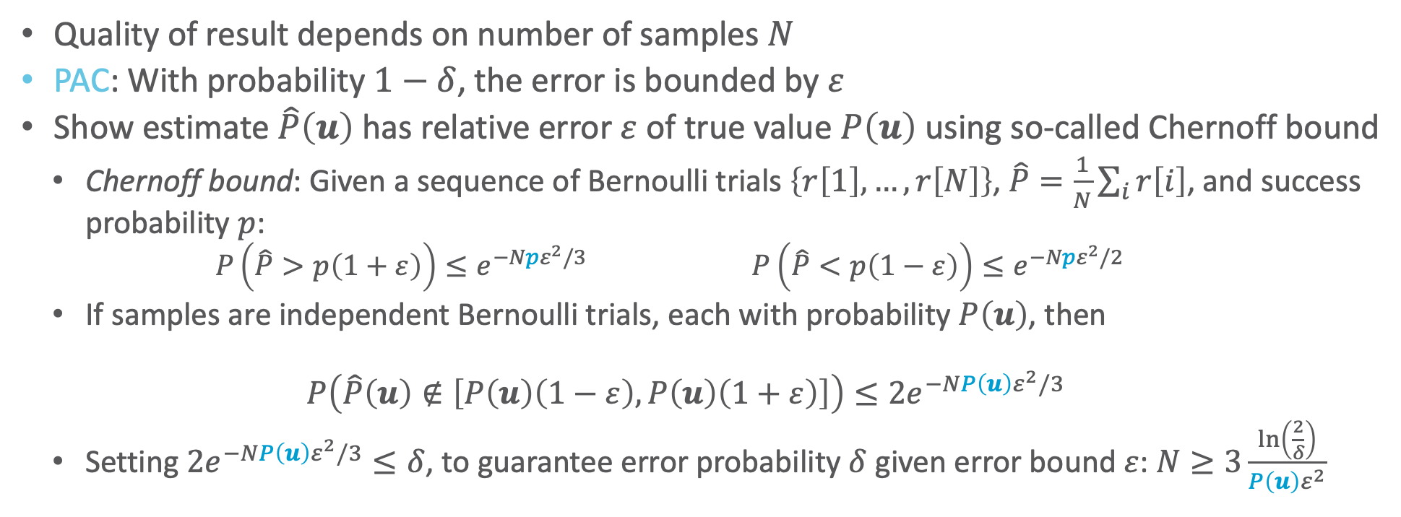
Brief Look into PAC Estimators
What is a problem with sampling like this?
Quality of result depends on number of samples $N$
PAC: With probability $1−δ$, the error is bounded by $ε$
Show estimate $\hat{P}\left(u\right)$ has relative error $ε$ of true value $P\left(u\right)$ using so-called Chernoff bound
  Chernoff bound: Given a sequence of Bernoulli trials $\left\{r\left[1\right],…,r\left[N\right]\right\}$, $\hat{P}=\frac{1}{N}\sum_{i}{r\left[i\right]}$, and success probability $p$:
    $$P\left(\hat{P}>p\left(1+ε\right)\right)≤e^{−Npε^{2}/3} P\left(\hat{P}<p\left(1−ε\right)\right)≤e^{−Npε^{2}/2}$$
  If samples are independent Bernoulli trials, each with probability $P\left(u\right)$, then
  $$P\left(\hat{P}\left(u\right)∉\left[P\left(u\right)\left(1−ε\right),P\left(u\right)\left(1+ε\right)\right]\right)≤2e^{−NP\left(u\right)ε^{2}/3}$$
  Setting $2e^{−NP\left(u\right)ε^{2}/3}≤δ$, to guarantee error probability $δ$ given error bound $ε$: $N≥3\frac{\ln\left(\frac{2}{δ}\right)}{P\left(u\right)ε^{2}}$

Slide 25
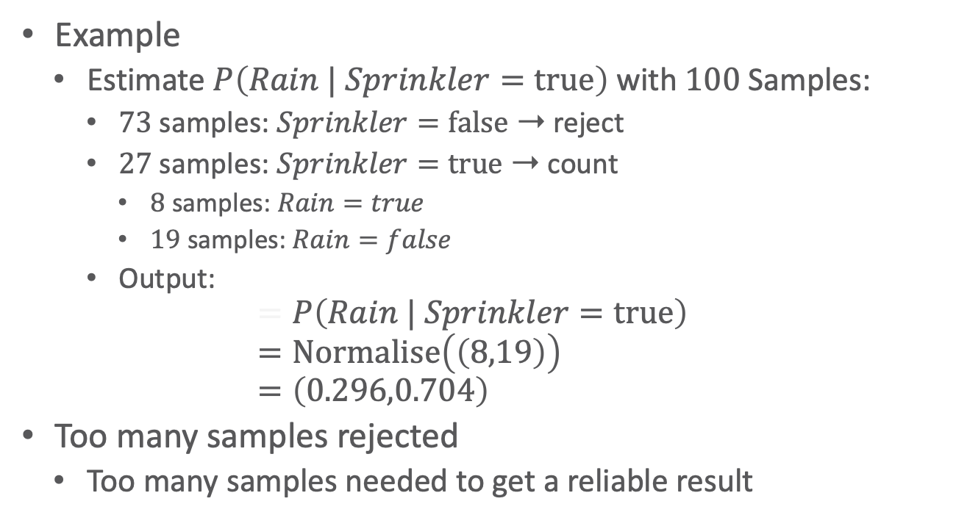
Rejection Sampling: Problem
Example
  Estimate $P\left(Rain | Sprinkler=true\right)$ with $100$ Samples:
    $73$ samples: $Sprinkler=false$ ➝ reject
    $27$ samples: $Sprinkler=true$ ➝ count
      $8$ samples: $Rain=true$
      $19$ samples: $Rain=false$
    Output:
  $$=P\left(Rain | Sprinkler=true\right) \\ =Normalise\left(\left(8,19\right)\right) \\ =\left(0.296,0.704\right)$$
Too many samples rejected
  Too many samples needed to get a reliable result
$$C$$ | $$P\left(s|C\right)$$
$$false$$ | $$0.5$$
$$true$$ | $$0.1$$
$$C$$ | $$P\left(r|C\right)$$
$$false$$ | $$0.2$$
$$true$$ | $$0.8$$
$$P\left(c\right)=0.5$$
$$Cloudy$$
$$Sprinkler$$
$$Rain$$
$$WetGrass$$
$$S$$ | $$R$$ | $$P\left(w|S,R\right)$$
$$false$$ | $$false$$ | $$0.9$$
$$false$$ | $$true$$ | $$0.9$$
$$true$$ | $$false$$ | $$0.9$$
$$true$$ | $$true$$ | $$0.99$$

Slide 26
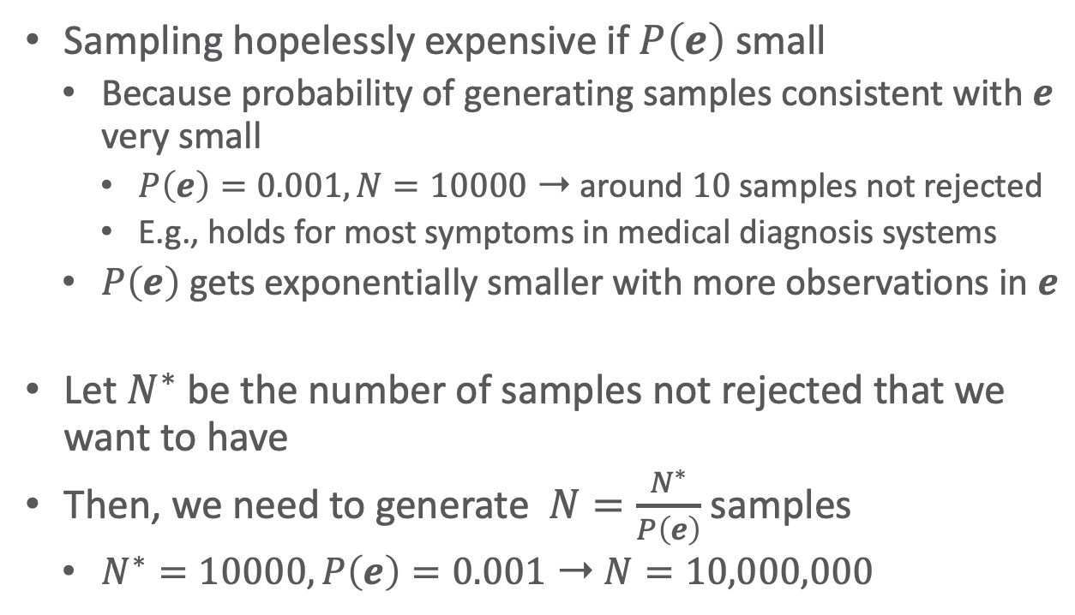
Rejection Sampling: Problem
Sampling hopelessly expensive if $P\left(e\right)$ small
  Because probability of generating samples consistent with $e$ very small
    $P\left(e\right)=0.001,N=10000$ ➝ around $10$ samples not rejected
    E.g., holds for most symptoms in medical diagnosis systems
  $P\left(e\right)$ gets exponentially smaller with more observations in $e$
Let $N^{∗}$ be the number of samples not rejected that we want to have
Then, we need to generate $N=\frac{N^{∗}}{P\left(e\right)}$ samples
  $N^{∗}=10000,P\left(e\right)=0.001$ ➝ $N=10,000,000$
$$C$$ | $$P\left(s|C\right)$$
$$false$$ | $$0.5$$
$$true$$ | $$0.1$$
$$C$$ | $$P\left(r|C\right)$$
$$false$$ | $$0.2$$
$$true$$ | $$0.8$$
$$P\left(c\right)=0.5$$
$$Cloudy$$
$$Sprinkler$$
$$Rain$$
$$WetGrass$$
$$S$$ | $$R$$ | $$P\left(w|S,R\right)$$
$$false$$ | $$false$$ | $$0.9$$
$$false$$ | $$true$$ | $$0.9$$
$$true$$ | $$false$$ | $$0.9$$
$$true$$ | $$true$$ | $$0.99$$

Slide 27
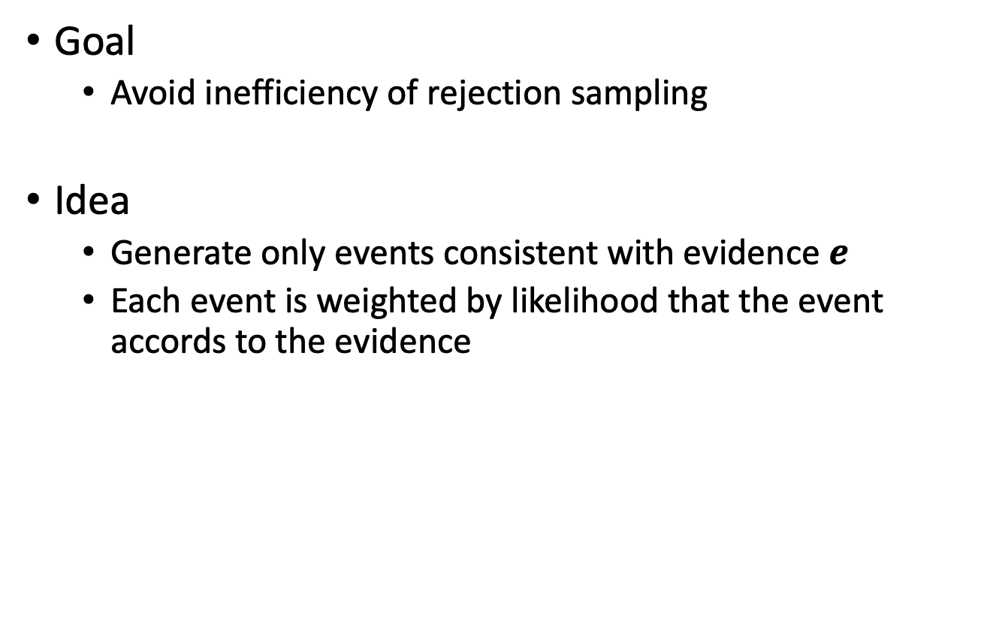
Likelihood Weighting
Goal
  Avoid inefficiency of rejection sampling
Idea
  Generate only events consistent with evidence $e$
  Each event is weighted by likelihood that the event accords to the evidence
R. Fung and K.-C. Chang. Weighing and integrating evidence for stochastic simulation in Bayesian networks. In Uncertainty in AI, 1989.
R. D. Shachter and M. A. Peot. Simulation approaches to general probabilistic inference on belief networks. In Uncertainty in AI, 1989.

Slide 28
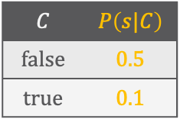
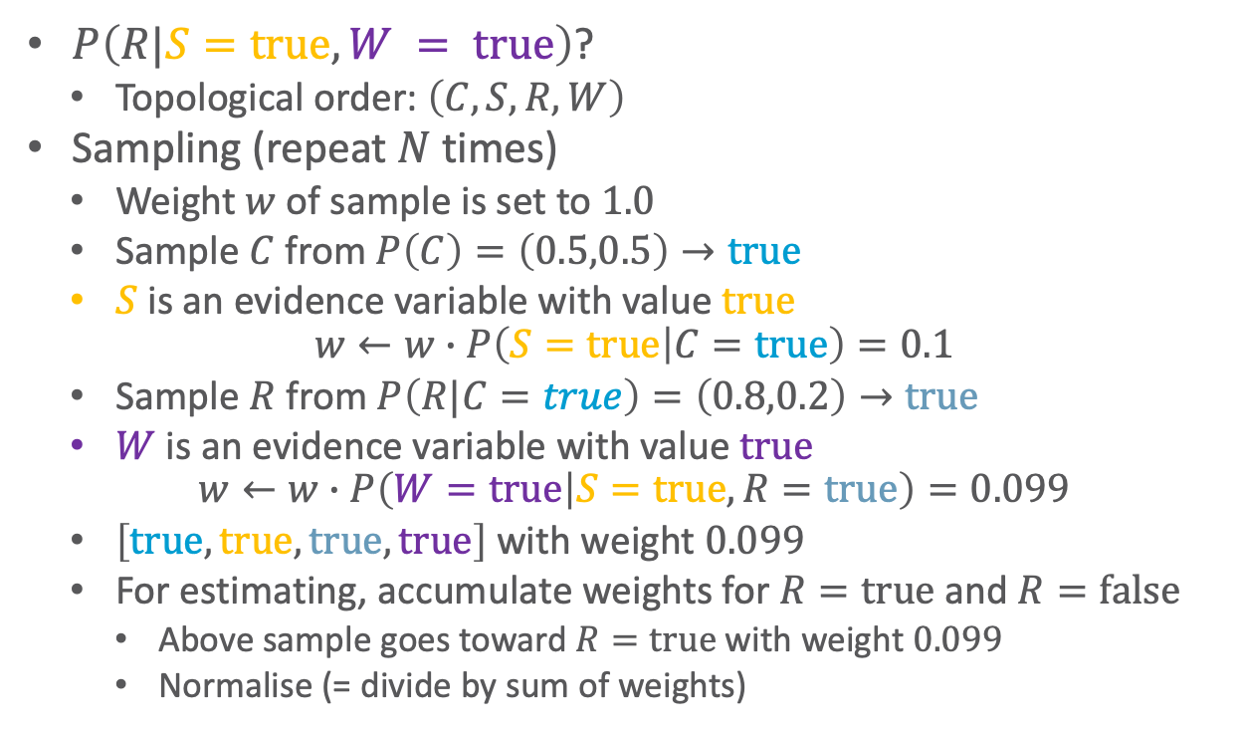


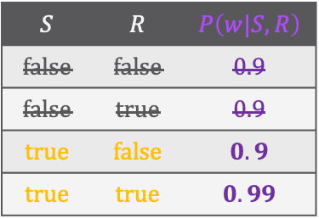
Likelihood Weighting: Example
$P\left(R|S=true,W = true\right)$?
  Topological order: $\left(C, S,R,W\right)$
Sampling (repeat $N$ times)
  Weight $w$ of sample is set to $1.0$
  Sample $C$ from $P\left(C\right)=\left(0.5,0.5\right)→true$
  $S$ is an evidence variable with value $true$
  $$w←w∙P\left(S=true | C=true\right)=0.1$$
  Sample $R$ from $P\left(R|C=true\right)=\left(0.8,0.2\right)→true$
  $W$ is an evidence variable with value $true$
  $$w←w∙P\left(W=true | S=true,R=true\right)=0.099$$
  $\left[true, true, true, true\right]$ with weight $0.099$
  For estimating, accumulate weights for $R=true$ and $R=false$
    Above sample goes toward $R=true$ with weight $0.099$
    Normalise (= divide by sum of weights)
$$C$$ | $$P\left(s|C\right)$$
$$false$$ | $$0.5$$
$$true$$ | $$0.1$$
$$C$$ | $$P\left(r|C\right)$$
$$false$$ | $$0.2$$
$$true$$ | $$0.8$$
$$P\left(c\right)=0.5$$
$$Cloudy$$
$$Sprinkler$$
$$Rain$$
$$WetGrass$$
$$S$$ | $$R$$ | $$P\left(w|S,R\right)$$
$$false$$ | $$false$$ | $$0.9$$
$$false$$ | $$true$$ | $$0.9$$
$$true$$ | $$false$$ | $$0.9$$
$$true$$ | $$true$$ | $$0.99$$
Notes:
Weight is low because it is a cloudy day which makes sprinkler unlikely

Slide 29
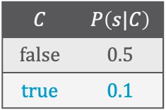
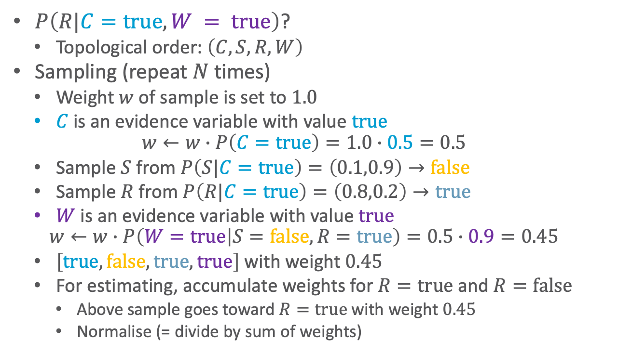

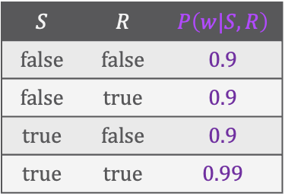

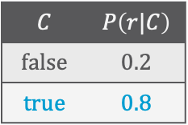
Likelihood Weighting: Example
$P\left(R|C=true,W = true\right)$?
  Topological order: $\left(C, S,R,W\right)$
Sampling (repeat $N$ times)
  Weight $w$ of sample is set to $1.0$
  $C$ is an evidence variable with value $true$
  $$w←w∙P\left(C=true\right)=1.0∙0.5=0.5$$
  Sample $S$ from $P\left(S|C=true\right)=\left(0.1,0.9\right)→false$
  Sample $R$ from $P\left(R|C=true\right)=\left(0.8,0.2\right)→true$
  $W$ is an evidence variable with value $true$
  $$w←w∙P\left(W=true | S=false,R=true\right)=0.5∙0.9=0.45$$
  $\left[true, false, true, true\right]$ with weight $0.45$
  For estimating, accumulate weights for $R=true$ and $R=false$
    Above sample goes toward $R=true$ with weight $0.45$
    Normalise (= divide by sum of weights)
$$C$$ | $$P\left(s|C\right)$$
$$false$$ | $$0.5$$
$$true$$ | $$0.1$$
$$C$$ | $$P\left(r|C\right)$$
$$false$$ | $$0.2$$
$$true$$ | $$0.8$$
$$P\left(c\right)=0.5$$
$$Cloudy$$
$$Sprinkler$$
$$Rain$$
$$WetGrass$$
$$S$$ | $$R$$ | $$P\left(w|S,R\right)$$
$$false$$ | $$false$$ | $$0.9$$
$$false$$ | $$true$$ | $$0.9$$
$$true$$ | $$false$$ | $$0.9$$
$$true$$ | $$true$$ | $$0.99$$

Slide 30

Likelihood Weighting: Algorithm
function $\text{LikelihoodWeighting}\left(R^{′},e, B,N\right)$ returns an estimate of $P\left(R^{′}|e\right)$
local variables:
$W$, a vector of weighted counts over the range values of $R^{′}$, initially $0$
for $j=1$ to $N$ do
$r,w←\text{WeightedSample}\left(B,e\right)$
$W\left[r^{′}\right]←W\left[r^{′}\right]+w$ where $r^{′}$ are the values of $R^{′}$ in $r$
return $\text{Normalise}\left(W\right)$ ▹divide each entry by sum of all entries
function $\text{WeightedSample}\left(B,e\right)$ returns a compound event and a weight
$r←$ an event with $n=\left|rv\left(B\right)\right|$ elements; $w←1$
for $i=1$ to $n$ do ▹follows topological order
if $R_{i}$ has a value $r_{i}$ in $e$ then
$w←w∙P\left(r_{i}|pa\left(R_{i}\right)\right)$; set $r_{i}$ in $r$
else
$r_{i}←$ a random sample from $P\left(R_{i}|pa\left(R_{i}\right)\right)$
return $r,w$
Likelihood Weighting

Slide 31




Likelihood Analysis
What if we cannot sample from $P$?
$$S_{WS}\left(r,e\right)=\prod_{i=1}^{l}{P\left(r_{i}|Pa\left(R_{i}\right)\right)}$$
Sampling probability for $\text{WeightedSample}$
  $i$ goes through $r∖e$
  Takes only evidence in ancestors into consideration
Weight for a given sample $r,e$
  $j$ goes through $e$
Weighted sampling probability is
  $$S_{WS}\left(r,e\right)∙w\left(r,e\right)=\prod_{i=1}^{l}{P\left(r_{i}|pa\left(R_{i}\right)\right)}∙\prod_{j=1}^{k}{P\left(e_{j}|pa\left(E_{j}\right)\right)}=P\left(r,e\right)$$
  Last step by semantics of BN
Hence, likelihood weighting returns consistent estimates
$$w\left(r,e\right)=\prod_{j=1}^{k}{P\left(e_{j}|Pa\left(E_{j}\right)\right)}$$
But performance still degrades with many evidence variables because few samples have nearly all the total weight

Slide 32

Importance Sampling
Remember: Estimates expectation of a function $f\left(r\right)$ relative to some distribution $P\left(R\right)$
$$E_{P\left(R\right)}\left[f\left(R\right)\right]=\sum_{r∈ℛ\left(R\right)}{f\left(r\right)P\left(r\right)}$$
  $P\left(R\right)$typically called target distribution
  Estimate this expectation by generating samples $r_{i}$ from $P$ and then estimating
  $$E_{P}\left[f\left(r\right)\right]≈\frac{1}{N}\sum_{i=1}^{N}{f\left(r_{i}\right)}$$
    What we have done so far
If generating samples from $P$ is hard, use a (simpler) proposal distribution $Q$ instead
Herman Kahn. Random Sampling (Monte Carlo) Techniques in Neutron Attenuation Problems. Nucleonics, 1950.

Slide 33


Using a Proposal Distribution
Condition: Proposal distribution $Q$ dominates $P$
  I.e., $Q\left(r\right)>0$ whenever $P\left(r\right)>0$
    $Q$ may not ignore any states that have non-zero probability with $P$
    Specifically, support of $Q$ has to include support of $P$
      Support for a distribution $S$ are all points $r$ s. t. $S\left(r\right)>0$
  In general, $Q$ can be arbitrary but computational performance highly depends on how similar $Q$ to $P$ is
    E.g., want probabilities close to zero in $Q\left(r\right)$
    only if $f\left(r\right)P\left(r\right)$ also very small
Generate samples from $Q$ instead of $P$
  Cannot average $f$-values of samples generated
  Adjust estimator to compensate for incorrect sampling distribution
$$E_{P\left(R\right)}\left[f\left(R\right)\right]=\sum_{r∈ℛ\left(R\right)}{f\left(r\right)P\left(r\right)}$$

Slide 34



Unnormalised Importance Sampling
How to adjust:
$$E_{P\left(R\right)}\left[f\left(R\right)\right] =\sum_{r∈ran\left(R\right)}{f\left(r\right)P\left(r\right)} \\ =\sum_{r∈ran\left(R\right)}{Q\left(r\right)f\left(r\right)\frac{P\left(r\right)}{Q\left(r\right)}} \\ =E_{Q\left(R\right)}\left[f\left(R\right)\frac{P\left(R\right)}{Q\left(R\right)}\right]$$
  Adjustment: $\frac{P\left(R\right)}{Q\left(R\right)}$
Generate a set of samples from $Q$ and then estimate
$$E_{P}\left[f\left(r\right)\right]≈\frac{1}{N}\sum_{i=1}^{N}{f\left(r_{i}\right)\frac{P\left(r_{i}\right)}{Q\left(r_{i}\right)}}=\frac{1}{N}\sum_{i=1}^{N}{f\left(r_{i}\right)w\left(r_{i}\right)}$$
Assumes that $P$ is known
$$w\left(r_{i}\right)≝\frac{P\left(r_{i}\right)}{Q\left(r_{i}\right)}$$

Slide 35


When $P$ is known: Example
Interpret likelihood weighting as importance sampling
  Model without evidence set is $P$, model with evidence is $Q$
  Samples are weighted according to probabilities in CPTs
    Probability of a sample $v_{i}$ in model $B$ conformant with evidence $e$, i.e., $P$:
    $$P\left(v_{i}|e\right)=\frac{P\left(v_{i},e\right)}{P\left(e\right)}=\frac{\prod_{r_{j}∈\left(v_{i}∪e\right)}{P\left(r_{j}|pa\left(R_{j}\right)\right)}}{P\left(e\right)}$$
    Probability of a sample $v_{i}$ sampled in model $B$ with evidence set, i.e., $Q$:
    $$Q\left(v_{i}\right)=\prod_{r_{j}∈v_{i}}{P\left(r_{j}|pa\left(R_{j}\right)\right)}$$
    Weight
      $$w\left(v_{i}\right)=\frac{P\left(v_{i}|e\right)}{Q\left(v_{i}\right)}=\frac{\prod_{r_{j}∈\left(v_{i}∪e\right)}{P\left(r_{j}|pa\left(R_{j}\right)\right)}}{P\left(e\right)\prod_{r_{j}∈v_{i}}{P\left(r_{j}|pa\left(R_{j}\right)\right)}}=\frac{\prod_{r_{j}∈e}{P\left(r_{j}|pa\left(R_{j}\right)\right)}}{P\left(e\right)}$$
    $P\left(e\right)$ identical for all samples ➝ okay to ignore, i.e.,
    $$w\left(v_{i}\right)=\prod_{r_{j}∈e}{P\left(r_{j}|pa\left(R_{j}\right)\right)}$$

Slide 36





When $P$ is not known
Most common reason for sampling from $Q$:
$P$ only known up to normalising constant $Z$
  Access to a function $\tilde{P}$ that is not a normalised distribution but $\tilde{P}\left(R\right)=P\left(R\right)∙Z$
Normalised Importance Sampling
  Define $w\left(r_{i}\right)$ using $\tilde{P}$: $w\left(r_{i}\right)≝\frac{\tilde{P}\left(r_{i}\right)}{Q\left(r_{i}\right)}$
  Estimation no longer works (no probability distribution)
$$w\left(r_{i}\right)≝\frac{P\left(r_{i}\right)}{Q\left(r_{i}\right)}$$
$$E_{P\left(R\right)}\left[f\left(R\right)\right] ≠\sum_{r∈ran\left(R\right)}{f\left(r\right)\tilde{P}\left(r\right)} \\ =\sum_{r∈ran\left(R\right)}{Q\left(r\right)f\left(r\right)\frac{\tilde{P}\left(r\right)}{Q\left(r\right)}} \\ ≠E_{Q\left(R\right)}\left[f\left(R\right)\frac{\tilde{P}\left(r\right)}{Q\left(R\right)}\right]$$
$$E_{P}\left[f\left(r\right)\right]≈\frac{1}{N}\sum_{i=1}^{N}{f\left(r_{i}\right)\frac{\tilde{P}\left(r_{i}\right)}{Q\left(r_{i}\right)}}$$

Slide 37

Normalised Importance Sampling
Trick: Consider $w\left(R\right)$ as a random variable with expected value $Z$
  $$E_{Q\left(R\right)}\left[w\left(R\right)\right]=\sum_{r∈ran\left(R\right)}{Q\left(r\right)w\left(r\right)}=\sum_{r∈ran\left(R\right)}{Q\left(r\right)\frac{\tilde{P}\left(r\right)}{Q\left(r\right)}}=\sum_{r∈ran\left(R\right)}{\tilde{P}\left(r\right)}=Z$$
Given $E_{Q\left(R\right)}\left[w\left(R\right)\right]=Z$
  $$E_{P\left(R\right)}\left[f\left(R\right)\right] =\sum_{r∈ran\left(R\right)}{f\left(r\right)P\left(r\right)}=\frac{1}{Z}\sum_{r∈ran\left(R\right)}{Q\left(r\right)f\left(r\right)\frac{\tilde{P}\left(r\right)}{Q\left(r\right)}} \\ =\frac{1}{Z}E_{Q\left(R\right)}\left[f\left(R\right)w\left(R\right)\right]=\frac{E_{Q\left(R\right)}\left[f\left(R\right)w\left(R\right)\right]}{E_{Q\left(R\right)}\left[w\left(R\right)\right]}$$
Use estimator for numerator and denominator
  $$E_{P}\left[f\left(r\right)\right]≈\frac{\sum_{i=1}^{N}{f\left(r_{i}\right)w\left(r_{i}\right)}}{\sum_{i=1}^{N}{w\left(r_{i}\right)}}$$

Slide 38



Sampling in Undirected Models
Assuming we have a proposal distribution $Q\left(R\right)$ for a factor-based model $F$, which allows for easy sampling, we can generate samples $r_{i}$ and weight them accordingly:
  $$w\left(r_{i}\right)=\frac{\tilde{P}\left(r_{i}\right)}{Q\left(r_{i}\right)}$$
  $\tilde{P}\left(r_{i}\right)=\prod_{f}{φ_{f}\left(π_{rv\left(f\right)}\left(r_{i}\right)\right)}$, i.e., product of potentials that $r_{i}$ maps to in each $f$
If we do this for all samples, we estimate $Z$ (or $P\left(e\right)$):
If are interested in $P\left(r^{′}|e\right)$:
$$E_{P\left(R\right)}\left[w\left(R\right)\right]≈\sum_{r∈ran\left(R\right)}{\frac{\tilde{P}\left(r_{i}\right)}{Q\left(r_{i}\right)}}=Z$$
$$E_{P}\left[f\left(r^{′}\right)\right]≈\frac{\sum_{i=1}^{N}{f\left(r^{′}\right)\frac{\tilde{P}\left(r^{′}\right)}{Q\left(r^{′}\right)}}}{\sum_{i=1}^{N}{\frac{\tilde{P}\left(r_{i}\right)}{Q\left(r_{i}\right)}}}$$

Slide 39


Where To Get $Q$ From? – An Idea
Given a factor-based model $F$
Turn $F$ into a model $F^{′}$ s. t. factors are over maximal cliques
  In jtree: Multiply all factors in each local model $G_{i}$ of cluster $C_{i}$ into a single factor $f_{i}=φ_{i}\left(C_{i}\right)$
Turn $F^{′}$ into a “sort-of” BN $F^{BN}$ by
  Choose one cluster as root and direct all edges away from that cluster ➝ “directed jtree”
  Normalise such that
    Root cluster: marginal over all random variables (potentials sum to $1$)
    All other clusters: conditional on separator random variables of “parent” in directed jtree
    Enforces a factorisation into (conditional) probability distributions with $Z=1$
    Fixes a form of topological ordering over random variables in $F$
      Root cluster random variables first, followed by random variables as they are visited in the directed jtree
Sample from $Q=F^{BN}$, e.g., using likelihood weighting
Notes:
1: compare Hugin factor

Slide 40















Example
Model $F$ with jtree $J$
Model $F^{′}$, max. cliques: $f_{2}^{′}=f_{2}∙f_{0}$
Choose one as root, e.g., $C_{1}=\left\{\text{AB}\right\}$
Normalise
  $C_{1}$ such that $f_{1}$ is a marginal distribution $f_{1}^{BN}$
  $C_{2}$ such that $f_{2}^{′}$ is a distribution $f_{2}^{BN}$conditional on B
$$f_{0}$$
$$f_{1}$$
$$f_{2}$$
B
A
B
C
AB
BC
$$f_{1}$$
$$f_{0},f_{2}$$
$$f_{1}$$
$$f_{2}^{′}$$
B
A
B
C
AB
BC
$$f_{1}$$
$$f_{2}^{′}$$
AB
B
BC
$$f_{1}$$
$$f_{2}^{′}$$
A | B | $$f_{1}$$
$$false$$ | $$false$$ | $$1$$
$$false$$ | $$true$$ | $$2$$
$$true$$ | $$false$$ | $$3$$
$$true$$ | $$true$$ | $$4$$
A | B | $$f_{1}^{BN}$$
$$false$$ | $$false$$ | $$0.1$$
$$false$$ | $$true$$ | $$0.2$$
$$true$$ | $$false$$ | $$0.3$$
$$true$$ | $$true$$ | $$0.4$$
B | C | $$f_{2}^{′}$$
$$false$$ | $$false$$ | $$6$$
$$false$$ | $$true$$ | $$4$$
$$true$$ | $$false$$ | $$4$$
$$true$$ | $$true$$ | $$1$$
B | C | $$f_{2}^{BN}$$
$$false$$ | $$false$$ | $$0.6$$
$$false$$ | $$true$$ | $$0.4$$
$$true$$ | $$false$$ | $$0.8$$
$$true$$ | $$true$$ | $$0.2$$

Slide 41















Example
$$f_{0}$$
tt
t
$$f_{1}$$
$$f_{2}$$
B
A
B
C
AB
BC
Ordering of AB, C
Sample values for AB from $f_{1}^{BN}$
  Since it is a distribution
    Generate a random number $v$ between $0$ and $1$ and take values for AB where $v$ lies in the corresponding interval
    E.g., $v=0.8$ ➝ tt
  Map to separator random variables
  ➝ B = t
$$f_{1}$$
$$f_{2}^{′}$$
B | $$f_{0}$$
$$false$$ | $$2$$
$$true$$ | $$1$$
A | B | $$f_{1}$$
$$false$$ | $$false$$ | $$1$$
$$false$$ | $$true$$ | $$2$$
$$true$$ | $$false$$ | $$3$$
$$true$$ | $$true$$ | $$4$$
A | B | $$f_{2}$$
$$false$$ | $$false$$ | $$3$$
$$false$$ | $$true$$ | $$2$$
$$true$$ | $$false$$ | $$4$$
$$true$$ | $$true$$ | $$1$$
ff
ft
tf
tt
A | B | $$f_{1}^{BN}$$
$$false$$ | $$false$$ | $$0.1$$
$$false$$ | $$true$$ | $$0.2$$
$$true$$ | $$false$$ | $$0.3$$
$$true$$ | $$true$$ | $$0.4$$
B | C | $$f_{2}^{BN}$$
$$false$$ | $$false$$ | $$0.6$$
$$false$$ | $$true$$ | $$0.4$$
$$true$$ | $$false$$ | $$0.8$$
$$true$$ | $$true$$ | $$0.2$$
$$0$$
$$0.5$$
$$v$$
$$1$$

Slide 42






Example
$$f_{0}$$
tt
t
tf
$$f_{1}$$
$$f_{2}$$
B
A
B
C
AB
BC
Ordering of AB, C
Sample values for BC\B conditioned on B = t from $f_{2}^{BN}$
  With B = t, it is a distribution
    E.g., $v=0.35$ ➝ 0
Sample: $\left[t,t,f\right]$
  $Q$ weight: $Q\left(\left[t,t,f\right]\right)=0.4∙0.8$
  $\tilde{P}$ weight: $\tilde{P}\left(\left[t,t,f\right]\right)=1∙4∙4$
  $w\left(\left[t,t,f\right]\right)=\frac{16}{0.32}=50$
$$f_{1}$$
$$f_{2}^{′}$$
B | $$f_{0}$$
$$false$$ | $$2$$
$$true$$ | $$1$$
A | B | $$f_{1}$$
$$false$$ | $$false$$ | $$1$$
$$false$$ | $$true$$ | $$2$$
$$true$$ | $$false$$ | $$3$$
$$true$$ | $$true$$ | $$4$$
A | B | $$f_{2}$$
$$false$$ | $$false$$ | $$3$$
$$false$$ | $$true$$ | $$2$$
$$true$$ | $$false$$ | $$4$$
$$true$$ | $$true$$ | $$1$$
f
t
$$0$$
$$v$$
$$0.5$$
$$1$$
A | B | $$f_{1}^{BN}$$
$$false$$ | $$false$$ | $$0.1$$
$$false$$ | $$true$$ | $$0.2$$
$$true$$ | $$false$$ | $$0.3$$
$$true$$ | $$true$$ | $$0.4$$
B | C | $$f_{2}^{BN}$$
$$false$$ | $$false$$ | $$0.6$$
$$false$$ | $$true$$ | $$0.4$$
$$true$$ | $$false$$ | $$0.8$$
$$true$$ | $$true$$ | $$0.2$$

Slide 43


Example
$$f_{0}$$
$$f_{1}$$
$$f_{2}$$
B
A
B
C
AB
BC
Ordering of AB, C
Set of $N$samples $r_{i}$ with weights $w\left(r_{i}\right)$
  E.g., sample $\left[t,t,f\right]$
    $w\left(\left[t,t,f\right]\right)=50$
Assume query for $P\left(C=true\right)$
Estimate
$$P\left(C\right)≈\frac{\sum_{i=1}^{N}{1\left(r_{i},C=true\right)w\left(r_{i}\right)}}{\sum_{i=1}^{N}{w\left(r_{i}\right)}}$$
  $$1\left(r_{i},C=true\right)=\left\{\begin{matrix}\begin{matrix}1 & π_{C}\left(r_{i}\right)=true\end{matrix} \\ \begin{matrix}0 & otherwise\end{matrix}\end{matrix}\right.$$
$$f_{1}$$
$$f_{2}^{′}$$
B | $$f_{0}$$
$$false$$ | $$2$$
$$true$$ | $$1$$
A | B | $$f_{1}$$
$$false$$ | $$false$$ | $$1$$
$$false$$ | $$true$$ | $$2$$
$$true$$ | $$false$$ | $$3$$
$$true$$ | $$true$$ | $$4$$
A | B | $$f_{2}$$
$$false$$ | $$false$$ | $$3$$
$$false$$ | $$true$$ | $$2$$
$$true$$ | $$false$$ | $$4$$
$$true$$ | $$true$$ | $$1$$
A | B | $$f_{1}^{BN}$$
$$false$$ | $$false$$ | $$0.1$$
$$false$$ | $$true$$ | $$0.2$$
$$true$$ | $$false$$ | $$0.3$$
$$true$$ | $$true$$ | $$0.4$$
B | C | $$f_{2}^{BN}$$
$$false$$ | $$false$$ | $$0.6$$
$$false$$ | $$true$$ | $$0.4$$
$$true$$ | $$false$$ | $$0.8$$
$$true$$ | $$true$$ | $$0.2$$

Slide 44


Lifted Importance Sampling (LIS)
Consider an MLN $Ψ={\left\{\left(w_{i},ψ_{i}\right)\right\}}_{i=1}^{n}$
  Probability of a world $ω$:
  $$P_{Ψ}\left(ω\right)=\frac{1}{Z_{Ψ}}exp\left(\sum_{i=1}^{n}{w_{i}n_{i}\left(ω\right)}\right)$$
  Normalisation:
  $$Z_{Ψ}=\sum_{ω}{exp\left(\sum_{i=1}^{n}{w_{i}n_{i}\left(ω\right)}\right)}$$
MLN in a normal form:
  No constants in any formula
  If any distinct atoms with the same predicate symbol have variables $x,y$ in the same position, then $x,y$ have the same domain
Idea
  Sample a value for one predicate
    Value applies to all instances of predicate under the same evidence (group)
  Use value to estimate quantities defined over the group
Vibhav Gogate, Abhay Jha, and Deepak Venugopal: Advances in Lifted Importance Sampling. In: Proceedings of the Twenty-Sixth AAAI Conference on Artificial Intelligence, 2012.

Slide 45





Problems with Importance Sampling
Requires a reasonably fitting proposal distribution $Q$
  Can be hard to construct/find if we deal with something other than directed models
Cannot estimate distributions well for evidence in leaves
  Independent of whether we deal with directed or undirected models
  Consider two extreme cases in BNs (the easy model type)
    All evidence at roots
      Proposal distribution = posterior distribution
      No weighting necessary (for all, $w=P\left(e\right)$)
    All evidence at leaves
      Proposal distribution = prior distribution
      Correction purely by weights, yielding high variance
      Will only work well if prior similar to posterior distribution;
      otherwise most samples are irrelevant, evidenced by a low weight
$$Cloudy$$
$$Sprinkler$$
$$Rain$$
$$WetGrass$$

Slide 46
Markov Chain
Monte Carlo (MCMC)
Sampling
$$Cloudy$$
$$Cloudy$$
$$Sprinkler$$
$$Rain$$
$$Sprinkler$$
$$Rain$$
$$WetGrass$$
$$WetGrass$$
State transition system
$$Cloudy$$
$$Cloudy$$
$$Sprinkler$$
$$Rain$$
$$Sprinkler$$
$$Rain$$
$$WetGrass$$
$$WetGrass$$
Gibbs Sampling, Metropolis-Hastings Sampling
Lifted Gibbs Sampling, Lifted Metropolis-Hastings Sampling

Slide 47

Markov Chain Monte Carlo (MCMC)
Monte Carlo methods
  Repeated random sampling to get to some numerical result
Let us think of the model as being in a particular current state specifying a value for every variable
MCMC generates each compound event by making a random change to the preceding event
  Next state generated by randomly sampling a value for one non-evidence variable $R_{i}$ conditioned on the current values of the variables in Markov blanket of $R_{i}$
  Simplest form called Gibbs sampling, which the next slides build towards

Slide 48






















MCMC: Example
$$Cloudy$$
Colour coding
$$true$$
$$false$$
Fixed evidence
Given $S=true,W = true$, four states (boxes) in state transition system
  Four possible combinations of range values for remaining $C,R$
  Arrows between states describe possible transitions
    Probabilities from model
    Leads to a (the Markov) chain of states
Procedure:
Wander about for a while, average what you see
$$Sprinkler$$
$$Rain$$
$$WetGrass$$
$$Cloudy$$
$$Cloudy$$
$$Sprinkler$$
$$Rain$$
$$Sprinkler$$
$$Rain$$
$$WetGrass$$
$$WetGrass$$
State transition system
$$Cloudy$$
$$Cloudy$$
$$Sprinkler$$
$$Rain$$
$$Sprinkler$$
$$Rain$$
$$WetGrass$$
$$WetGrass$$

Slide 49













MCMC: Example
$$C$$ | $$P\left(s|C\right)$$
$$false$$ | $$0.5$$
$$true$$ | $$0.1$$
$$C$$ | $$P\left(r|C\right)$$
$$false$$ | $$0.2$$
$$true$$ | $$0.8$$
$$P\left(c\right)=0.5$$
$P\left(R|s,w\right)$?
  Topological order (without evidence variables): $\left(C,R\right)$
  Random choice of next variable to sample also possible
Sampling (repeat $N$ times)
  Random initial state: $\left[c, s,¬r, w\right]$
  Sample $C$ given current values of $MB\left(C\right)=\left\{S,R\right\}$, i.e., from $P\left(C|s,¬r\right)$
    $P\left(C|s,¬r\right)=P\left(C\right)P\left(¬r|C\right)P\left(s|C\right)=\left(0.5∙0.1∙0.2, 0.5∙0.5∙0.8\right)$
    $=\left(0.01,0.2\right)=\left(0.05,0.95\right)$
    Suppose result is $¬c$
      New current state: $\left[¬c, s,¬r, w\right]$
      Update count: $R=false$ ➝ +1
$$Cloudy$$
$$Sprinkler$$
$$Rain$$
$$WetGrass$$
$$S$$ | $$R$$ | $$P\left(w|S,R\right)$$
$$false$$ | $$false$$ | $$0.9$$
$$false$$ | $$true$$ | $$0.9$$
$$true$$ | $$false$$ | $$0.9$$
$$true$$ | $$true$$ | $$0.99$$
true
false
$$Cloudy$$
$$Sprinkler$$
$$Rain$$
$$WetGrass$$

Slide 50













MCMC: Example
$$C$$ | $$P\left(s|C\right)$$
$$false$$ | $$0.5$$
$$true$$ | $$0.1$$
$$C$$ | $$P\left(r|C\right)$$
$$false$$ | $$0.2$$
$$true$$ | $$0.8$$
$$P\left(c\right)=0.5$$
$P\left(R|s,w\right)$?
  Topological order (without evidence variables): $\left(C,R\right)$
  Random choice of next variable to sample also possible
Sampling (repeat $N$ times)
  Current state: $\left[¬c, s,¬r, w\right]$
  Sample $R$ given current values of $MB\left(R\right)=\left\{C,S,W\right\}$, i.e., from $P\left(R|¬c,s,w\right)$
    Suppose result is $r$
      New current state: $\left[¬c, s, r, w\right]$
      Update count: $R=true$ ➝ +1
  Sample $C$from $P\left(C|s,r\right)$ ➝ $\left[¬c, s,r, w\right]$, $R=true$ ➝ +1
  Sample $R$ from $P\left(R|¬c,s,w\right)$➝ $\left[¬c, s,¬r, w\right]$, $R=false$ ➝ +1
$$Cloudy$$
$$Sprinkler$$
$$Rain$$
$$WetGrass$$
$$S$$ | $$R$$ | $$P\left(w|S,R\right)$$
$$false$$ | $$false$$ | $$0.9$$
$$false$$ | $$true$$ | $$0.9$$
$$true$$ | $$false$$ | $$0.9$$
$$true$$ | $$true$$ | $$0.99$$
$$Cloudy$$
$$Sprinkler$$
$$Rain$$
$$WetGrass$$

Slide 51




















MCMC: Example
$$Cloudy$$
$$Sprinkler$$
$$Rain$$
$$WetGrass$$
$P\left(R|s,w\right)$?
  Topological order (without evidence variables): $\left(C,R\right)$
  Random choice of next variable to sample also possible
Random initial state: $\left[c, s,¬r, w\right]$
  Next state: $\left[¬c, s,¬r, w\right]$
  Next state : $\left[¬c, s,¬r, w\right]$
  Next state : $\left[¬c, s,¬r, w\right]$
  Next state : $\left[¬c, s,¬r, w\right]$
Suppose that after $N=80$ iterations, the process has visited $20$ states with $R=true$ and $60$ states with $R=false$; query result:
$\text{Normalise}\left(\left(20,60\right)\right)=\left(0.25,0.75\right)$
$$Cloudy$$
$$Sprinkler$$
$$Rain$$
$$WetGrass$$
$$Cloudy$$
$$Sprinkler$$
$$Rain$$
$$WetGrass$$
$$Cloudy$$
$$Sprinkler$$
$$Rain$$
$$Cloudy$$
$$WetGrass$$
$$Sprinkler$$
$$Rain$$
$$WetGrass$$

Slide 52

Gibbs Sampling
Given a BN $B$, evidence $e$, and query terms $R^{′}$
State = current assignment $r$ to all random variables $R=rv\left(B\right)$
  Initially, $e$ for $rv\left(e\right)$ (fixed) and random values $u$ for all non-evidence random variables $U=rv\left(B\right)∖rv\left(e\right)$
Generate the next state by sampling a value for non-evidence rancom variable $U$ given its Markov blanket $MB\left(U\right)$ with assignments from the current state $r$
  Sample value $u$ for $U$ from $P\left(U | π_{MB\left(U\right)}\left(r\right)\right)$
  Replace value of $U$ in $r$ with $u$
  Increment counter for $r^{′}$ of $R^{′}$ occurring in $r$, i.e., where $r^{′}=π_{R^{′}}\left(r\right)$
  Sample each variable according to some order or randomly, keep evidence fixed

Slide 53

Gibbs Sampling: Algorithm
$\text{Gibbs}\left(R^{′},e, B,N\right)$
  Vector $Ν$ of length $\left|ran\left(R^{′}\right)\right|$, initially $0$ ▹stores counters for all $r^{′}∈ran\left(R^{′}\right)$
Current state $r$ consisting of $e$ and random values $u$ for $rv\left(B\right)∖rv\left(e\right)$
for $i=1…N$ do
for $U∈rv\left(B\right)∖rv\left(e\right)$ do
$u←$ Sample value for $U$ from $P\left(U | π_{MB\left(U\right)}\left(r\right)\right)$
  $r\left[U\right]←u$ ▹Replace value of $U$ in $r$ by $u$
  $Ν\left[r^{′}\right]←Ν\left[r^{′}\right]+1$ with $r^{′}=π_{R^{′}}\left(r\right)$
return $\text{Normalise}\left(Ν\right)$
Gibbs Sampling

Slide 54















Gibbs Sampling and Factor-based Models
$$Travel$$ | $$Epid$$ | $$Sick$$ | $$φ_{2}$$
$$false$$ | $$false$$ | $$false$$ | $$20$$
$$false$$ | $$false$$ | $$true$$ | $$24$$
$$false$$ | $$true$$ | $$false$$ | $$5$$
$$false$$ | $$true$$ | $$true$$ | $$6$$
$$true$$ | $$false$$ | $$false$$ | $$28$$
$$true$$ | $$false$$ | $$true$$ | $$8$$
$$true$$ | $$true$$ | $$false$$ | $$7$$
$$true$$ | $$true$$ | $$true$$ | $$2$$
$$P$$
Sample from $P\left(U | π_{MB\left(U\right)}\left(r\right)\right)$ in model $F$
As $U$ given $MB\left(U\right)$independent of all other random variables in $F$
and values for $MB\left(U\right)$ from current state $r$ available:
Use normalised product $P(U,π_{MB\left(U\right)}\left(r\right))$
of the factors $F_{U}$ between $U$ and $MB\left(U\right)$ with values $π_{MB\left(U\right)}\left(r\right)$
  $F_{U}=\left\{f | f∈F, U∈rv\left(f\right)\right\}$
  $P\left(U,MB\left(U\right)\right)=\frac{1}{Z}\prod_{f∈F_{U}}{f}$
Example: State $\left[e,¬n,¬a, s,¬tl,tt\right]$, query term $Tl$
  Sample new value for, e.g., $Tl$ from $P(Tl | π_{MB\left(Tl\right)}\left(r\right))=P\left(Tl | e,s\right)$
  $F_{Tl}=\left\{f_{2}\right\}$: normalise $φ_{2}\left(Tl,e, s\right)$ ➝ $P\left(Tl , e,s\right)=\left(0.25,0.75\right)$
  Suppose new value for $Tl$: $tl$, new state $\left[e,¬n,¬a, s,tl,tt\right]$, $Tl=true$: +1
$$0.75$$
$$0.25$$
$$NatDis$$
$$Artif$$
$$f_{1}$$
$$Epid$$
$$f_{0}$$
$$Travel$$
$$Treat$$
$$f_{2}$$
$$f_{3}$$
$$Sick$$
$$E≜Epid,N≜NatDis,A≜Artif,S≜Sick,Tr≜Travel,Tt≜Treat$$

Slide 55













Example with Two Factors
Model
Sample new value for $R$ from
$$P\left(R | π_{MB\left(R\right)}\left(r\right)\right)=P\left(R | n_{1},n_{2},n_{3}\right)$$
Normalise $φ\left(R,n_{1}\right)∙φ\left(R,n_{2},n_{3}\right)$
➝ $P\left(R, n_{1},n_{2},n_{3}\right)$
Given $N_{1}=true,N_{2}=true,N_{3}=false$
  $f_{12}=φ\left(R, true\right)∙φ\left(R, true, false\right)=φ\left(R\right)$
  Sample new $R$ value from $f_{12}^{′}=\frac{1}{Z}f_{12}$
(MB values absorbed)
$$R$$
$$N_{1}$$
$$R_{1}$$
$$R$$ | $$N_{1}$$ | $$f_{1}$$
$$f$$ | $$f$$ | $$1$$
$$f$$ | $$t$$ | $$2$$
$$t$$ | $$f$$ | $$3$$
$$t$$ | $$t$$ | $$4$$
$$R$$ | $$N_{2}$$ | $$N_{3}$$ | $$f_{2}$$
$$f$$ | $$f$$ | $$f$$ | $$3$$
$$f$$ | $$f$$ | $$t$$ | $$2$$
$$f$$ | $$t$$ | $$f$$ | $$4$$
$$f$$ | $$t$$ | $$t$$ | $$1$$
$$t$$ | $$f$$ | $$f$$ | $$5$$
$$t$$ | $$f$$ | $$t$$ | $$6$$
$$t$$ | $$t$$ | $$f$$ | $$8$$
$$t$$ | $$t$$ | $$t$$ | $$1$$
$$R$$ | $$f_{1}$$
$$f$$ | $$2$$
$$t$$ | $$4$$
$$R$$ | $$f_{2}$$
$$f$$ | $$4$$
$$t$$ | $$8$$
$$R_{3}$$
$$N_{3}$$
$$N_{2}$$
Product
$$R$$ | $$f_{12}$$
$$f$$ | $$8$$
$$t$$ | $$32$$
Norm.
$$R$$ | $$f_{12}^{′}$$
$$f$$ | $$0.2$$
$$t$$ | $$0.8$$

Slide 56





Some Basics for MCMC
A Markov chain consists of $n$ states, plus an $n×n$ transition matrix $𝒯$
  At each step, we are in exactly one of the states
  For $1≤i,j≤n$, matrix entry $𝒯_{ij}$ tells us the relative frequency of $j$ being the next state, given we are currently in state $i$
    $𝔗_{ij}≜𝔗\left(i→j\right)$
    Probability distribution, i.e.:
  $$\sum_{j=1}^{n}{𝔗_{ij}}=1$$
$$i$$
$$j$$
$$𝔗_{ij}$$
$𝒯_{ii}>0$ ok (self loops)

Slide 57

Some Basics for MCMC
Markov chain has to be ergodic for MCMC to work
Markov chain is ergodic if
  You have a path from any state to any other state (irreducibility)
    No part of the system wanders off
  Returns to states occur at irregular times (aperiodicity)
    Periodicity: Returns to a state are only possible every $c>1$ steps
  For any start state, after a finite transient time $T_{0}$,
  the probability of being in any state at a fixed time $T>T_{0}$ is nonzero (positive recurrence)
    Given a finite state space:
    Positive recurrence follows from irreducibility
Not ergodic (even / odd)

Slide 58
Some Basics for MCMC
Ergodic theory: about dynamical systems that are ergodic
  System must be measure-preserving
    Measure on a set: assign a number to each suitable subset of that set
    Axioms of probability theory correspond to axioms of measure theory (Kolmogorov axioms)
    Some ergodic theorems can be applied to probabilistic setting
Some differences
  In ergodic theory
    irreducible + positive recurrent = ergodic and
    irreducible + positive recurrent + aperiodic = mixing
  Whereas in probability theory
    irreducible + aperiodic + positive recurrent = ergodic
Kolmogorov axioms
Probability of an event is a non-negative real number
Assumption of unit measure: probabilities add up to 1
Assumption of 𝜎-additivity: Probability of a set of disjoint events equals the sum over the individual probabilities (independence)

Slide 59
Some Basics for MCMC
For any finite-state ergodic Markov chain, there is a unique long-term visit rate for each state
  “Steady-state” or stationary distribution
    Stationarity: Transition probabilities between states do not change over time
  Over long time-period, each state visited in proportion to this rate
    It does not matter where we start
Reason why sampling works with a large enough sampling size

Slide 60

Some Basics for MCMC
For any finite-state ergodic Markov chain, there is a unique long-term visit rate for each state
  Well-known application that you might have seen:
  PageRank, original ranking principle of Google
    Rank set of relevant web pages for a query according to the probabilities they have in the steady-state distribution (ranking is query independent)
    Markov chain:
      Web pages = states (i.e., being on one and not the others)
      Arrows from one state/webpage to the next if outgoing link from one to the next
      Transition model $𝔗$: for each state, uniformly distributed over all outgoing links
    Compute steady state distribution $λ$ (as vector): $λ$ has to fulfil $λ^{T}𝔗=λ^{T}$
      Eigenvector corresponding to eigenvalue $1$
Lawrence Page, Sergey Brin, Rajeev Motwani, and Terry Winograd: The PageRank Citation Ranking: Bringing Order to the Web. In Proceedings of the 7th International World Wide Web Conference, 1998.

Slide 61

Stationary Distribution Formally
A Markov chain is regular if there exists some number $k$ such that, for every $r,r^{′}∈ran\left(R\right)$, the probability of getting from $r$ to $r^{′}$ in exactly $k$ steps is $>0$
  For finite state spaces: Condition on regularity equivalent to condition on ergodicity
    Sometimes easier to verify
  In factor-based models:
  If all potentials are strictly positive, then the Gibbs-sampling Markov chain is regular

Slide 62


Stationary Distribution Formally
Markov chain with transition model $𝔗$ is reversible if there exists a unique distribution $λ$ such that, for all $r,r^{′}∈ran\left(R\right)$:
$$λ\left(r\right)𝔗\left(r→r^{′}\right)=λ\left(r^{′}\right)𝔗\left(r^{′}→r\right)$$
  Equation is called detailed balance
    Pick a starting state at random according to $λ$
    Take a random transition from the chosen state according to $𝔗$
  Asserts that, using this process, probability of a transition from $r→r^{′}$ is the same as probability of transition from $r^{′}→r$
If $𝔗$ is regular and satisfies the detailed balance equation relative to $λ$, then $λ$ is the unique stationary distribution of $𝔗$.

Slide 63
Parallelisation
Run Gibbs independently on full copies of the same model
  More samples in the same time
  or
  Same number of samples in less time
Combine individual counters in one
Abbildung: Theo Rekatsinas, https://thodrek.github.io/CS839_fall18/lectures/lecture_14/Lecture_14.pdf

Slide 64


Burn-in & Thinning
Controversial techniques that each try to solve a problem
Problem 1: Samples start at a random state that might be highly unlikely and skew the distribution
  Burn-in/warm-up: Toss the first $N^{′}<N$ samples
  Alternatives
    Start at highly likely state if known
    Start at state that a previous run ended in
Problem 2: As the next state depends on the previous one, the samples are no longer independent (autocorrelation)
  Thinning/subsampling: Only take every $k$’th sample
    Does not really solve problem
A set of random variables following a mean-zero normal distribution; started at $x=10$ and $x=0$
Abbildungen: Charles Geyer: Burn-in Is Unnecessary. http://users.stat.umn.edu/~geyer/mcmc/burn.html
William A. Link and Mitchell J. Eaton: On Thinning of Chains in MCMC. In Methods in Ecology and Evolution, 2011. https://besjournals.onlinelibrary.wiley.com/doi/10.1111/j.2041-210X.2011.00131.x

Slide 65
Other Problems with Gibbs Sampling
Only very local moves over the state space
  One random variable at a time
In models with tightly correlated random variables, such moves can lead from highly likely states to states with very low probability
  With a high probability of moving back to the high-probability state
  Chain is unlikely to move away from such a state
    Chain will mix slowly
Consider chains that allow broader range of moves including larger steps
  Have to construct such a Markov chain with the same/desired stationary distribution

Slide 66

Metropolis-Hastings Algorithm (MH)
Construct a Markov chain that is reversible with a particular stationary distribution $λ$
Does not assume that we can generate next-state samples from a particular target distribution but uses the idea of a proposal distribution
  Compare with importance sampling and its proposal distribution
    Target distribution: next-state sampling distribution at a desired state
    Sample from proposal distribution and correct for error
  But: Do not keep track of importance weights
    Are going to decay exponentially with number of transitions
  Instead: Randomly choose whether to accept a proposed transition with a probability that corrects for the difference between proposal and target distribution
W.K. Hastings: Monte Carlo Sampling Methods Using Markov Chains and Their Applications. In Biometrika, 1970.

Slide 67

Proposal Distribution in MH
Proposal distribution $𝔗^{Q}$ defines a transition model over state space $ran\left(R\right)$
  For each state $r$, $𝔗^{Q}$ defines a distribution over possible successor states in $ran\left(R\right)$, from which one randomly selects a candidate next state $r^{′}$
    Either accept proposal and transition to $r^{′}$
    Or reject proposal and stay at $r$
  For each pair of states $r,r^{′}$, there exists an acceptance probability $𝔄\left(r→r^{′}\right)$
  Actual transition model of Markov chain:
    $$𝔗\left(r→r^{′}\right)=\left\{\begin{matrix}𝔗^{Q}\left(r→r^{′}\right)𝔄\left(r→r^{′}\right) & r≠r^{′} \\ 𝔗^{Q}\left(r→r\right)+\sum_{r^{′}≠r}{𝔗^{Q}\left(r→r^{′}\right)\left(1−𝔄\left(r→r^{′}\right)\right)} & sonst \end{matrix}\right.$$
  Choice of proposal distribution arbitrary as long as it induces a regular chain

Slide 68


Acceptance Probabilities
Given a proposal distribution $𝔗^{Q}$, select acceptance probabilities $𝔄$ to obtain desired stationary distribution $λ$
  Detailed balance equation that has to hold
  $$=λ\left(r\right)𝔗^{Q}\left(r→r^{′}\right)𝔄\left(r→r^{′}\right) \\ =λ\left(r^{′}\right)𝔗^{Q}\left(r^{′}→r\right)𝔄\left(r^{′}→r\right)$$
  Set $𝔄$ to be
  $$𝔄\left(r→r^{′}\right)=\min\left[1,\frac{λ\left(r^{′}\right)𝔗^{Q}\left(r^{′}→r\right)}{λ\left(r\right)𝔗^{Q}\left(r→r^{′}\right)}\right]$$
Let $𝔗^{Q}$ be any proposal distribution. Consider the Markov chain $𝔗$ defined by
$$𝔗\left(r→r^{′}\right)=\left\{\begin{matrix}𝔗^{Q}\left(r→r^{′}\right)𝔄\left(r→r^{′}\right) & r≠r^{′} \\ 𝔗^{Q}\left(r→r\right)+\sum_{r^{′}≠r}{𝔗^{Q}\left(r→r^{′}\right)\left(1−𝔄\left(r→r^{′}\right)\right)} & oth. \end{matrix}\right.$$
with
$$𝔄\left(r→r^{′}\right)=\min\left[1,\frac{λ\left(r^{′}\right)𝔗^{Q}\left(r^{′}→r\right)}{λ\left(r\right)𝔗^{Q}\left(r→r^{′}\right)}\right].$$
If $𝔗$ is regular, then it has the stationary distribution $λ$.

Slide 69


MH: Algorithm
Follows the same procedure as Gibbs sampling except
  Generate a new state $r_{i}$ from proposal distribution $𝔗^{Q}$ instead of target distribution $𝔗$
  Pick or discard $r_{i}$ based on acceptance probability $𝔄$

Slide 70







Lifted MCMC
As far as I know at this point
No direct transformation of MCMC to lifted models
  But: application of the lifting idea to Markov chains
Exchangeable Boolean random variables $S$
  If for every assignment to $S$, i.e., $s∈{\left\{f,t\right\}}^{k}$, and every permutation $𝔤$ on ${\left\{f,t\right\}}^{k}$,
  $$P\left(S=s\right)=P\left(S=s^{𝔤}\right)$$
  Example: Random variables that exhibit counting symmetry
  Find these so-called automorphism groups using colour passing (forward pointer to next topic)
Then, there are $k+1$ orbits each containing random variable assignments
  Here:
  Orbit ≈ equivalence class where elements within
  each class are mapped to the same probability
$$tt$$
$$0.017$$
A
B
$ft$ $tf$
$$0.49$$
$$ff$$
$$0.003$$
Mathias Niepert: Markov Chains on Orbits of Permutation Groups. In UAI-12 Proceedings of the 28th Conference on Uncertainty in Artificial Intelligence, 2012.

Slide 71

Why Do Orbits help?
Example: Two Boolean random variables and a symmetric potential function
  Probabilities of states $ft$ and $tf$ both $0.49$
    States $ft$ and $tf$ part of the same orbit
Assume a standard Gibbs sampler is in state 10
  Probability to transition to $tt$ or $ff$ is only $0.02$ ($0.017+0.003$)
  Cannot transition directly to state $ft$ (two changes)
  Chain is “stuck” in $tf$ until it is able to move to $tt$ or $ff$
With orbital Gibbs sampler, intuitively, while it is “waiting” to move to one of the low probability states, it samples the two high probability states horizontally uniformly at random from the orbit $\left\{ft, tf\right\}$
  Converges faster than standard Gibbs sampler
    Can show analytically
$$tt$$
$$0.017$$
A
B
$ft$ $tf$
$$0.49$$
$$ff$$
$$0.003$$
Mathias Niepert: Markov Chains on Orbits of Permutation Groups. In UAI-12 Proceedings of the 28th Conference on Uncertainty in Artificial Intelligence, 2012.

Slide 72

Orbital Markov Chain
Assume standard Markov chain $M^{′}$ over state space $ran\left(R\right)$ with stationary distribution $λ$
Let $𝔊$be an automorphism group on $\left(ran\left(R\right),λ\right)$
Orbital Markov chain $M$ for $M^{′}$ performs:
  Let $r^{′}$ be the state of $M^{′}$ at time $t$
  Sample $r$, the state of $M$ at time $t$, uniformly at random from the orbit ${r^{′}}^{𝔊}$ of $r^{′}$
If $M^{′}$ is aperiodic/irreducible/reversible, then $M$ also aperiodic/irreducible/reversible
So, we can build a Gibbs sampler that converges to stationary distribution $λ$ at least as fast or faster
$$tt$$
$$0.017$$
A
B
$ft$ $tf$
$$0.49$$
$$ff$$
$$0.003$$
Mathias Niepert: Markov Chains on Orbits of Permutation Groups. In UAI-12 Proceedings of the 28th Conference on Uncertainty in Artificial Intelligence, 2012.

Slide 73

Orbital Gibbs Sampling
Two Markov chains,
  One ordinary $M^{′}$
  One orbital $M$ (based on symmetry groups)
In each sampling iteration
  Run a step of traditional MCMC, chain $M^{′}$
    Select a random variable $R$ uniformly at random
    Sample a value for $R$ based on the current states of $M$
  Sample the state of $M$ uniformly at random from the orbit of the new state of $R$,
  i.e., select an equivalent state uniformly at random
$$tt$$
$$0.017$$
A
B
$ft$ $tf$
$$0.49$$
$$ff$$
$$0.003$$
Mathias Niepert: Markov Chains on Orbits of Permutation Groups. In UAI-12 Proceedings of the 28th Conference on Uncertainty in Artificial Intelligence, 2012.

Slide 74

Lifted MH
Given an orbital Metropolis chain $A$:
  Given symmetry group $G$ (approx. symmetries)
  Orbit $x^{G}$ contains all states approximately symmetric to $x$
  In state $x$
    Select $x^{′}$ uniformly at random from $x^{G}$
    Move from $x$ to $x^{′}$with probability $min\left\{\frac{Pr\left(x\right)}{Pr\left(x^{′}\right)}, 1\right\}$
    Otherwise: stay in $x$ (reject)
    Repeat
and an ordinary (base) Markov chain $B$
With probability $α$ follow $B$
With $\left(1−α\right)$ follow $A$
Account for evidence that may break symmetries, using, e.g., approximate symmetries
➝ forward pointer to learning
Guy Van den Broeck and Mathias Niepert: Lifted Probabilistic Inference for Asymmetric Graphical Models . In AAAI-15 Proceedings of the 29th AAAI Conference on Artificial Intelligence, 2015.

Slide 75
Interim Summary
Approximate inference based on sampling can lead to faster but approximate results
  Goodness of approximation depends on the number of samples generated
Direct sampling
  Rejection sampling
    Sample along graph structure, reject samples inconsistent with evidence
  Importance sampling
    Use proposal distribution for sampling, weight samples to correct the difference between proposal distribution and target distribution
    Use domain knowledge about groups of indistinguishable instances to reduce variance
MCMC sampling
  Build a Markov chain and sample a new state based on the previous state
  Find orbits for faster convergence

Slide 76


When to Choose Approximate or Exact Inference?
Depends on:
  Do you need exact results?
    Can you get them in time / at all?
    Can you get them numerically?
  Can you sample from your model?
    Can you get enough samples?
What if we run both?
  See what finishes first
    Exact inference
    Approximate inference with sufficient
    reliability
  Give yourself a time horizon $T$
Agent
Environment
Sensors
State
What the world
is like now
How the world evolves
What my actions do
What it will be like
if I do action $A$
Utility
How happy I will be
in such a state
What action I
should do now
Actuators
AIMA, Russell/Norvig

Slide 77

Agents: Monte Carlo vs. Las Vegas
Agent has to work with available resources, requires an answer in a given time $T$
Monte Carlo ➝ Approximate inference (sampling)
  The best possible but not necessarily correct result that could be generated in the given time
Las Vegas ➝ Exact inference
  Either get the correct result in the given time or bust!
Combine Monte Carlo & Las Vegas
  While current time $t<T$
    One thread works on exact inference, e.g., eliminate variables with LVE
    One thread works on approximate inference, e.g., generate and count samples
  If exact inference produces a result before $t$ reaches $T$, break and return result
  Otherwise: use result of approximate inference at $T$

Slide 78
Outline: 3. Inference
Exact Inference
  (Weighted) Model Counting
  Variable Elimination and the Like
  Lifted Inference
Approximate Inference
  Direct sampling: Rejection sampling, (lifted) importance sampling
  (Lifted) Markov Chain Monte Carlo sampling
➝ Learning

Slide 79
Appendix
Lifted importance sampling

Slide 80

Lifted Importance Sampling (LIS)
Consider estimating $Z_{Ψ}=\sum_{ω}{exp\left(\sum_{i=1}^{n}{w_{i}n_{i}\left(ω\right)}\right)}$
  Remember $E_{Q\left(R\right)}\left[w\left(R\right)\right]=Z$
Then
$$Z_{Ψ}=\sum_{ω}{exp\left(\sum_{i=1}^{n}{w_{i}n_{i}\left(ω\right)}\right)\frac{Q\left(ω\right)}{Q\left(ω\right)}}=E_{Q\left(R\right)}\left[\frac{exp\left(\sum_{i=1}^{n}{w_{i}n_{i}\left(ω\right)}\right)}{Q\left(ω\right)}\right]$$
Given $N$ sampled worlds $ω^{\left(t\right)}$, sampled independently from $Q$, then
$$Z≈\hat{Z}=\frac{1}{N}\sum_{t=1}^{N}{\frac{exp\left(\sum_{i=1}^{n}{w_{i}n_{i}\left(ω^{\left(t\right)}\right)}\right)}{Q\left(ω^{\left(t\right)}\right)}}$$
LIS uses different lifting rules to handle instances as groups
  Reduce variance for indistinguishable instances
Vibhav Gogate, Abhay Jha, and Deepak Venugopal: Advances in Lifted Importance Sampling. In: Proceedings of the Twenty-Sixth AAAI Conference on Artificial Intelligence, 2012.

Slide 81

LIS: Lifting Rules – Power Rule
Given a normal MLN $Ψ$, a set of logical variables $x$ is called a decomposer if it satisfies the following two conditions
  Every atom in $Ψ$ contains exactly one variable from $x$
  For any predicate symbol $R$, there exists a position s. t. variables from $x$ only appear at that position in atoms of $R$
    Any $x,y∈x$ have the same domain because of normal form
Given a decomposer $x$ and any $x∈x$, rewrite $Z_{Ψ}$ as
$$Z_{Ψ}={\left(Z_{Ψ|x→x}\right)}^{\left|dom\left(x\right)\right|}$$
  $Ψ|x→x$ denoting that all occurrences of $x$ are replaced with the same constant $x∈dom\left(x\right)$ and the resulting MLN is converted into a normal MLN
Compare DPGs in FO dtrees and
set conjunctions in FO dDNNF circuits
Vibhav Gogate, Abhay Jha, and Deepak Venugopal: Advances in Lifted Importance Sampling. In: Proceedings of the Twenty-Sixth AAAI Conference on Artificial Intelligence, 2012.
Notes:
Each grounding contributes the same weight to weight of sample (w)

Slide 82

LIS: Lifting Rules – Generalised Binomial Rule
Compare counting
Given a normal MLN $Ψ$ and a singleton atom $R\left(x\right)$ not involved in self-joins (does not appear more than once in same formula), rewrite $Z_{Ψ}$ as
$$Z_{Ψ}=\sum_{j=0}^{\left|dom\left(x\right)\right|}{\left(\begin{matrix}\left|dom\left(x\right)\right| \\ j\end{matrix}\right)Z_{Ψ|r^{j}}w\left(j\right)2^{p\left(j\right)}}$$
  $Ψ|r^{j}$ denotes that in $Ψ$, truth values are assigned to $R\left(x\right)$ s.t. $j$ instances are set to $true$; specifically
    Ground all $R\left(x\right)$ and assign truth values to the groundings
    Delete all formulas that evaluate to either $true$ or $false$
    Delete all groundings of $R\left(x\right)$
    Convert the resulting MLN into a normal one
  $w\left(j\right)$ is the exponentiated sum of the weights of formulas that evaluate to $true$
  $p\left(j\right)$ is the number of ground atoms that are removed from the MLN as a result of removing formulas
    Don’t-care propositional atoms, which can be set to $true$ or $false$
Can be relaxed by not requiring singleton atoms but then no longer exact
Vibhav Gogate, Abhay Jha, and Deepak Venugopal: Advances in Lifted Importance Sampling. In: Proceedings of the Twenty-Sixth AAAI Conference on Artificial Intelligence, 2012.
Notes:
If we would ground R(x), we would consider (sum over) all different worlds where 0 to |dom(x)| instances are true in all its permutations
Instead: Consider one representative for each case of 0 to |dom(x)| instances being true (avoid permutations ➝ multiply with bin. coeff.) ➝ multiply with weight of true formulas (w) ➝ multiply with 2^p(j) as don’t care atoms not important for true case but represent different formula parts that contribute same weight

Slide 83


LIS: Lifting Rules – Isolated Variable Rule
For predicate symbol $R$ of an MLN $Ψ$, a logical variable $x$ at position $m$ in its arguments is called isolated
  if it is exclusive to $R$ in all formulas containing $R$
Let $x$ denote the set of all isolated variables of $R$ and let $y$ denote the set of remaining variables in $R$
  $dom\left(y\right)$ cartesian product of the domains of $y$; $y_{i}$ denotes the $i$^{th} element
Then, estimate $Z_{Ψ}$ as
  $Ψ|x$ an MLN obtained from $Ψ$ by applying the following steps:
    For $i=1$ to $\left|dom\left(y\right)\right|$, sample number $j_{i}$ from a distribution $Q_{i}\left(j_{i}|j_{1},…,j_{i−1}\right)$ and set $j_{i}$ arbitrarily selected groundings of $R\left(x, y_{i}\right)$ to $true$ and the remaining to $false$,
    Delete all formulas that evaluate to either $true$ or $false$
    Delete all groundings of $R$
    Convert the MLN to a normal one
  $w\left(R\right)$ exponentiated sum of the weights of formulas that evaluate to $true$
  $p\left(R\right)$ number of ground atoms that are removed from $Ψ$as a result of (2)
$$Z_{Ψ}=Z_{Ψ|x}w\left(R\right)2^{p\left(R\right)}\prod_{i=1}^{\left|dom\left(y\right)\right|}{\frac{\left(\begin{matrix}\left|dom\left(x\right)\right| \\ j_{i}\end{matrix}\right)}{Q_{i}\left(j_{i}|j_{1},…,j_{i−1}\right)}}$$
Vibhav Gogate, Abhay Jha, and Deepak Venugopal: Advances in Lifted Importance Sampling. In: Proceedings of the Twenty-Sixth AAAI Conference on Artificial Intelligence, 2012.
Notes:
In contrast to previous with R(x), now we have R(x,y)

Slide 84


LIS: Algorithm ($Z$)
LIS tries to apply the power rule, followed by the generalised binomial rule, followed by the isolated variable rule. If all fail, then LIS grounds an atom and samples for the groundings.
function $\text{LIS}\left(Ψ −in normal form,Q\right)$ returns an estimate of $Z$
if $Ψ$ is empty then
return $\text{1}$
if there exists a decomposer $x$ then
return ${\left(\text{LIS}\left(Ψ|x→x,Q\right)\right)}^{\left|dom\left(x\right)\right|}$
if there exists a singleton atom $R\left(x\right)$ without self-joins then
Use $Q$ to sample an integer $j∈\left\{0,…,\left|dom\left(x\right)\right|\right\}$
return $\frac{LIS\left(Ψ|r^{j},Q\right)w\left(j\right)2^{p\left(j\right)}}{Q\left(j\right)}\left(\begin{matrix}\left|dom\left(x\right)\right| \\ j\end{matrix}\right)$
if there exists isolated variables $x$ in a predicate $R$ then
return $LIS\left(Ψ|x,Q\right)w\left(R\right)2^{p\left(R\right)}\prod_{j=1}^{\left|dom\left(y\right)\right|}{\frac{\left(\begin{matrix}\left|dom\left(x\right)\right| \\ j_{i}\end{matrix}\right)}{Q_{i}\left(j_{i}|j_{1},…,j_{i−1}\right)}}$
Choose an atom $A$ and sample all of its groundings from $Q$
Let $a$ be the sampled assignment
return $\frac{LIS\left(Ψ|a,Q\right)w\left(a\right)2^{p\left(a\right)}}{Q\left(a\right)}$
LIS for $Z$
Vibhav Gogate, Abhay Jha, and Deepak Venugopal: Advances in Lifted Importance Sampling. In: Proceedings of the Twenty-Sixth AAAI Conference on Artificial Intelligence, 2012.

Slide 85



LIS: Constructing $Q$
General ideas used
  4: disjoint parts
    Handle independently
  8: choose an ordering for an atom
    Assume parent-child relationship
Lifting rules used for constructing $Q$
  2: power rule
    Simplifies the MLN
  12: approximate generalised binomial rule
  13: isolated variable rule
$$m$$
Vibhav Gogate, Abhay Jha, and Deepak Venugopal: Advances in Lifted Importance Sampling. In: Proceedings of the Twenty-Sixth AAAI Conference on Artificial Intelligence, 2012. (Algorithm from there)

