Slide 1






















Exact Inference:
Lifted Inference
$$Epid$$
root
$$∅$$
$$∅$$
$$∀x :⊤$$
$$T_{X}$$
$$Acc\left(I\right)$$
$$∀d :⊤$$
$$T_{D}$$
$$Epid$$
$$Epid$$
$$Sick\left(x\right)$$
$$Nat\left(d\right)$$
Statistical Relational Artificial Intelligence
(StaRAI)
$$Epid$$
$$T_{x}$$
$$Acc\left(I\right),Epid$$
$$T_{d}$$
$$Travel\left(x\right)$$
$$∅$$
$$∀m :⊤$$
$$∅$$
$$∀i :⊤$$
$$Sick\left(x\right)$$
$$Epid$$
$$Sick\left(x\right)$$
$$Epid$$
$$T_{M}$$
$$Nat\left(d\right)$$
$$Acc\left(I\right),Epid$$
$$T_{I}$$
$$Treat\left(x,m\right)$$
$$∅$$
$$Sick\left(x\right)$$
$$Epid$$
$$T_{m}$$
$$Nat\left(d\right)$$
$$Acc\left(i\right),Epid$$
$$T_{i}$$
$$g_{2}$$
$$g_{3}$$
$$g_{0}$$
$$g_{1}$$
Tanya Braun

Slide 2
Contents
Introduction
  Notions of AI, agents, StaRAI
Modelling Formalisms
  Logic
  Probabilistic Graphical Models (PGMs)
  Probabilistic Relational Models (PRMs)
  Syntax, semantics, inference tasks
Inference
  Exact Inference
    (Weighted) Model Counting
    Variable Elimination
    Lifted Inference
  Approximate Inference
  Inference algorithms
Learning
  Relation learning in logic
  Parameter / structure learning for PGMs
  From PGMs to PRMs, PRM learning
Sequential Models and Inference
  Syntax, semantics, inference tasks, algorithms
Decision-theoretic Models and Inference
  Preferences, utility
  Syntax, semantics, inference task, algorithm

Slide 3
Outline: 3. Inference
Exact Inference
  (Weighted) Model Counting
    Model counting
    Weighted model counting, knowledge compilation (KC)
  Variable Elimination and the Like
    Variable elimination (VE)
    Junction tree algorithm (JT)
  Lifted Inference
    First-order KC, Lifted VE, lifted JT
Approximate Inference
  Direct sampling: Rejection sampling, (lifted) importance sampling
  (Lifted) Markov Chain Monte Carlo sampling

Slide 4





Inference Tasks
Query Answering Problem (as before)
  Compute an answer to a query $P\left(S|T\right)$ given a model $G$ representing the full joint probability distribution $P_{G}$
    Avoid grounding (parts of) $G$
  E.g.,
    $P\left(Treat(eve,m_{1})\right)$
    $P\left(Travel\left(eve\right),Epid\right)$
    $P\left(Sick(eve)\right|Epid)$
    $P\left(Epid\right|Sick\left(eve\right)=true)$
    $P\left(\#_{E}\left[Epid\left(E\right)\right]\right)$
    $P\left(\#_{E}\left[Epid\left(E\right)\right]=[2,2]\right)$
Model: either parfactor model or MLN
$$10 Presents\left(X, P, C\right)⇒Attends\left(X, C\right)$$
$$3.75 Publishes\left(X, C\right)∧FarAway\left(C\right)⇒Attends\left(X, C\right)$$
$$Nat\left(D\right)$$
$$Acc\left(I\right)$$
$$g_{1}$$
$$Epid$$
$$g_{0}$$
$$Travel\left(X\right)$$
$$Treat\left(X,M\right)$$
$$g_{2}$$
$$g_{3}$$
$$Sick\left(X\right)$$
Notes:
Argmax and sum not commutative

Slide 5
Lifted Variable Elimination
$$Nat\left(D\right)$$
$$Acc\left(I\right)$$
$$g_{1}$$
$$Epid$$
$$g_{0}$$
$$Travel\left(X\right)$$
$$Treat\left(X,M\right)$$
$$g_{2}$$
$$g_{3}$$
$$Sick\left(X\right)$$
Inference algorithm
Complexity analysis, tractability

Slide 6

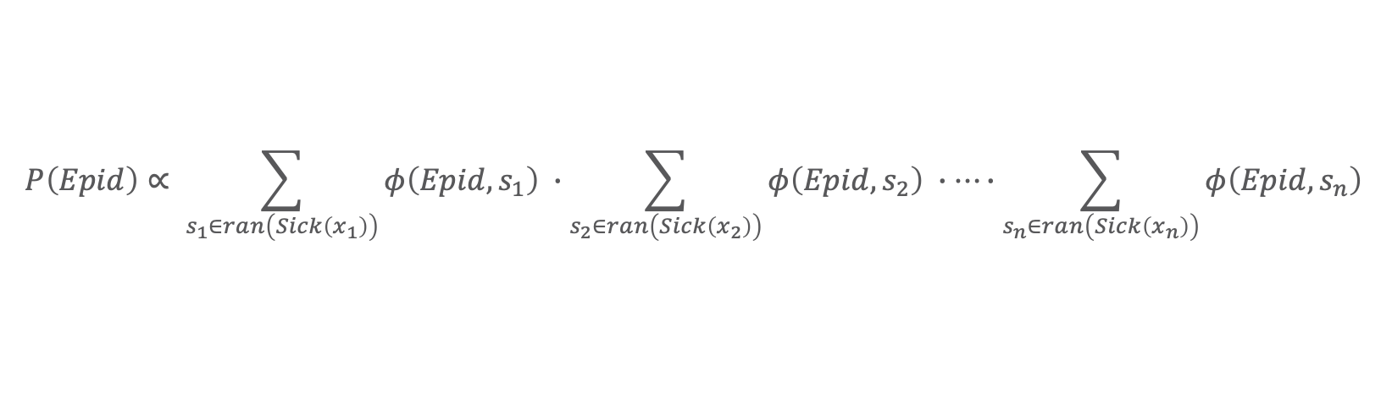











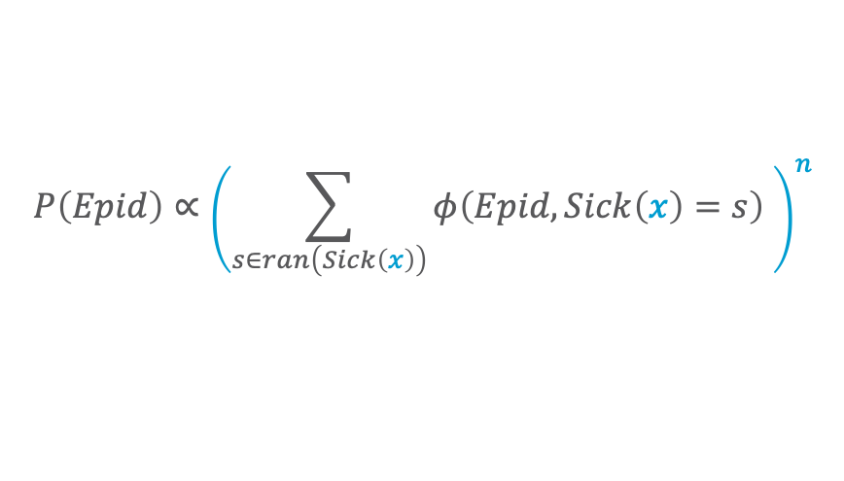



What Happens During Variable Elimination Given Relations?
$$P\left(Epid\right)∝ \sum_{s_{1}∈ran\left(Sick\left(x_{1}\right)\right)}{φ\left(Epid, s_{1}\right) }∙\sum_{s_{2}∈ran\left(Sick\left(x_{2}\right)\right)}{φ\left(Epid, s_{2}\right) }∙…∙\sum_{s_{n}∈ran\left(Sick\left(x_{n}\right)\right)}{φ\left(Epid,s_{n}\right) }$$
$$Epid$$
$$=φ^{′}\left(Epid\right)∙φ^{′}\left(Epid\right)∙…∙φ^{′}\left(Epid\right)$$
$$={\left(φ^{′}\left(Epid\right)\right)}^{n}$$
$n$ times
$$φ$$
$$φ$$
$$φ$$
$$Sick\left(x_{1}\right)$$
$$Sick\left(x_{2}\right)$$
$$…$$
$$Sick\left(x_{n}\right)$$
$$P\left(Epid\right)∝{\left(\sum_{s∈ran\left(Sick\left(x\right)\right)}{φ\left(Epid,Sick\left(x\right)=s\right) }\right)}^{n}$$
$$={\left(φ^{′}\left(Epid\right)\right)}^{n}$$
$$Epid$$
# of $X$ relative to $Epid$
$$φ$$
Representative for $X$ in $φ\left(Epid,Sick\left(X\right)\right)$
$$Sick\left(X\right)$$

Slide 7
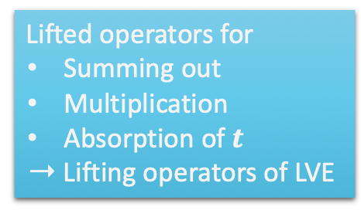

Lifted Variable Elimination (LVE)
Outline:
  Absorb evidence $t$ in each parfactor $g$ covered by $t$, i.e., $rv\left(g\right)∩t≠∅$, in a lifted way,
  Eliminate non-query PRVs $U=R∖rv\left(S,t\right)$ in a lifted way in model $G$
    Factor out parfactors from sums if arguments not covered by sum
    May require manipulation of constraints as at least constants
    appearing in query are distinguishable
  Divide by $P\left(t\right)$ = Normalise $P\left(S,t\right)$
$$P\left(S | t\right)=\frac{1}{P\left(t\right)}\sum_{u∈ran\left(U\right)}{P_{G}\left(S,t,U=u\right)} \\ =\frac{1}{P\left(t\right)}\sum_{u∈ran\left(U\right)}{\prod_{g∈G}{φ_{g}\left(R_{1},…, R_{k}\right)}}$$
Lifted operators for
  Summing out
  Multiplication
  Absorption of $t$
  ➝ Lifting operators of LVE
$$π_{rv\left(f\right)}\left(S,t,U=u\right)$$
Lifting operators to enable the main operators above necessary
Notes:
No probability queries (special case)
No conjunctive queries

Slide 8










LVE in Detail
Example: $P\left(Travel\left(eve\right)\right)$ in $G={\left\{g_{i}\right\}}_{i=0}^{3}$
  Pre-processing:
  Split all parfactors whose constraint contains constants occurring in query terms: $eve$
    If parameterised query $P\left(A_{|C}\right)$: split parfactors based on $C$
Called shattering
$$Travel\left(eve\right)$$
$$Nat\left(D\right)$$
$$Acc\left(I\right)$$
$$g_{1}$$
$$Sick\left(eve\right)$$
$$g_{2}$$
$$Epid$$
$$g_{0}$$
$$Treat\left(eve,M\right)$$
$$g_{3}$$
$$Travel\left(X\right)$$
$$Treat\left(X,M\right)$$
$$g_{2}$$
$$g_{3}$$
So, we need a formal split operation to split of (set of) constants
$$X∈\{alice, bob)$$
$$Sick\left(X\right)$$

Slide 9














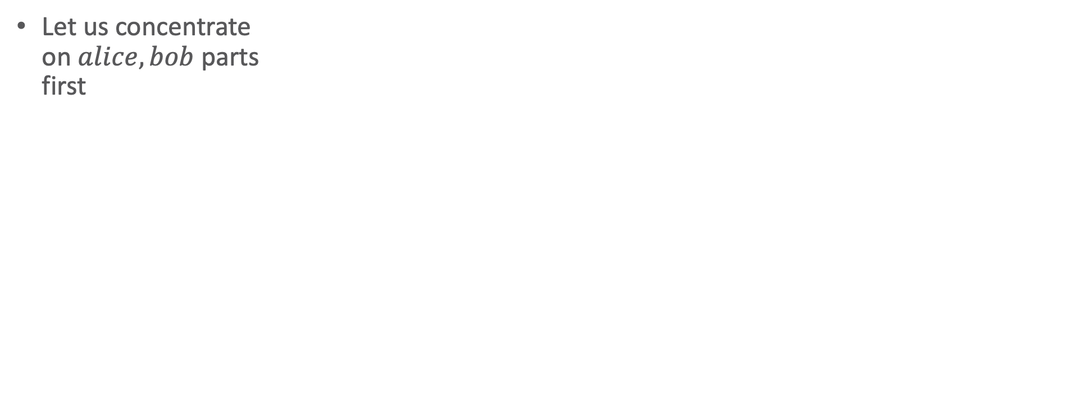



Equivalent Ground
Eliminations
$$Travel\left(eve\right)$$
$$Nat\left(D\right)$$
$$Acc\left(I\right)$$
$$g_{1}$$
$$g_{2}$$
$$Sick\left(eve\right)$$
$$Epid$$
$$g_{0}$$
$$Treat\left(eve,M\right)$$
$$g_{3}$$
Let us concentrate
on $alice,bob$ parts
first
$$Travel\left(X\right)$$
$$Treat\left(X,M\right)$$
$$Acc\text{.}chem$$
$$g_{2}$$
$$g_{3}$$
$$Sick\left(X\right)$$
$$X∈\{alice, bob)$$
$$Acc\text{.}nucl$$
$$f_{1}$$
$$Nat\text{.}flood$$
$$f_{1}$$
$$f_{1}$$
$$Nat\text{.}fire$$
$$f_{1}$$
$$f_{2}$$
$$Epid$$
$$f_{0}$$
$$f_{2}$$
$$f_{3}$$
$$f_{3}$$
$$Treat\text{.}alice\text{.}m_{1}$$
$$Treat\text{.}bob\text{.}m_{1}$$
$$Travel\text{.}alice$$
$$f_{2}$$
$$f_{3}$$
$$f_{3}$$
$$Travel.bob$$
$$f_{3}$$
$$Treat\text{.}eve\text{.}m_{1}$$
$$f_{3}$$
$$Sick\text{.}alice$$
$$Sick\text{.}bob$$
$$Sick\text{.}eve$$
$$Treat\text{.}alice\text{.}m_{2}$$
$$Travel\text{.}eve$$
$$Treat\text{.}eve\text{.}m_{2}$$
$$Treat\text{.}bob\text{.}m_{2}$$

Slide 10





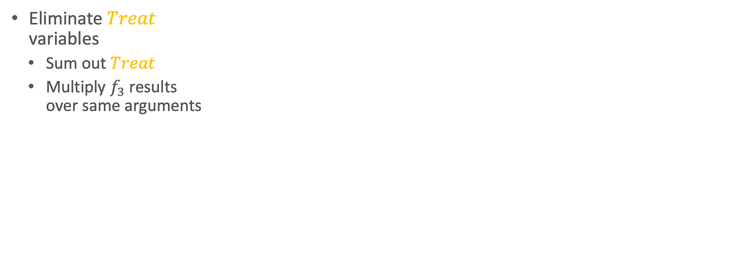




Equivalent Ground
Eliminations
$$Travel\left(eve\right)$$
$$Nat\left(D\right)$$
$$Acc\left(I\right)$$
$$g_{1}$$
$$g_{2}$$
$$Sick\left(eve\right)$$
$$Epid$$
$$g_{0}$$
$$Treat\left(eve,M\right)$$
$$g_{3}$$
Eliminate $Treat$
variables
  Sum out $Treat$
  Multiply $f_{3}$ results
  over same arguments
$$Travel\left(X\right)$$
$$Treat\left(X,M\right)$$
$$Acc\text{.}chem$$
$$g_{2}$$
$$g_{3}$$
$$Sick\left(X\right)$$
$$X∈\{alice, bob)$$
$$Acc\text{.}nucl$$
$$f_{1}$$
$$Nat\text{.}flood$$
$$f_{1}$$
$$f_{1}$$
$$Nat\text{.}fire$$
$$f_{1}$$
$$f_{2}$$
$$Epid$$
$$f_{0}$$
$$f_{2}$$
$$f_{3}^{′}$$
$$f_{3}^{′}$$
$$f_{3}$$
$$f_{3}$$
$$Treat\text{.}alice\text{.}m_{1}$$
$$Treat\text{.}bob\text{.}m_{1}$$
$$Travel\text{.}alice$$
$$f_{2}$$
$$f_{3}$$
$$f_{3}$$
$$Travel.bob$$
$$f_{3}^{′}$$
$$Treat\text{.}eve\text{.}m_{1}$$
$$f_{3}$$
$$f_{3}^{′}$$
$$Sick\text{.}alice$$
$$f_{3}$$
$$Sick\text{.}bob$$
$$Sick\text{.}eve$$
$$Treat\text{.}alice\text{.}m_{2}$$
$$Travel\text{.}eve$$
$$Treat\text{.}eve\text{.}m_{2}$$
$$Treat\text{.}bob\text{.}m_{2}$$

Slide 11






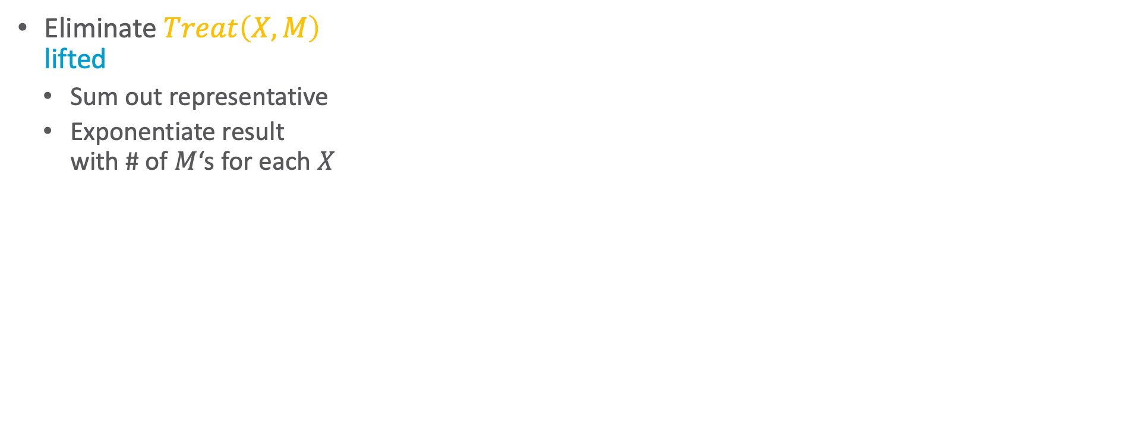

Equivalent Ground
Eliminations
$$Travel\left(eve\right)$$
$$Nat\left(D\right)$$
$$Acc\left(I\right)$$
$$g_{1}$$
$$g_{2}$$
$$Sick\left(eve\right)$$
$$Epid$$
$$g_{0}$$
$$Treat\left(eve,M\right)$$
$$g_{3}$$
Eliminate $Treat\left(X,M\right)$
lifted
  Sum out representative
  Exponentiate result
  with # of $M$‘s for each $X$
$$Travel\left(X\right)$$
$$Treat\left(X,M\right)$$
$$g_{2}$$
$$g_{3}^{′}$$
$$Acc\text{.}chem$$
$$g_{3}$$
$$Sick\left(X\right)$$
$$X∈\{alice, bob)$$
$$Acc\text{.}nucl$$
$$f_{1}$$
$$Nat\text{.}flood$$
$$f_{1}$$
$$f_{1}$$
$$Nat\text{.}fire$$
$$f_{1}$$
$$f_{2}$$
$$Epid$$
$$f_{0}$$
$$f_{2}$$
$$f_{3}^{′′}={\left(f_{3}^{′}\right)}^{2}$$
$$f_{3}^{′′}={\left(f_{3}^{′}\right)}^{2}$$
$$Travel\text{.}alice$$
$$f_{2}$$
$$f_{3}$$
$$f_{3}$$
$$Travel.bob$$
$$Treat\text{.}eve\text{.}m_{1}$$
$$Sick\text{.}alice$$
$$Sick\text{.}bob$$
$$Sick\text{.}eve$$
$$Travel\text{.}eve$$
$$Treat\text{.}eve\text{.}m_{2}$$

Slide 12
Equivalent Ground
Eliminations
$$Travel\left(eve\right)$$
$$Nat\left(D\right)$$
$$Acc\left(I\right)$$
$$g_{1}$$
$$g_{2}$$
$$Sick\left(eve\right)$$
$$Epid$$
$$g_{0}$$
$$Treat\left(eve,M\right)$$
$$g_{3}$$
Preconditions for lifted sum-out operator
PRV contained in only one parfactor (like in VE)
Operation eliminates the same number of instances for each remaining instance
(then all have the same exponent; otherwise: split operation as for shattering)
PRV must contain all logical variables of parfactor
$$Travel\left(X\right)$$
$$Treat\left(X,M\right)$$
$$Acc\text{.}chem$$
$$g_{2}$$
$$g_{3}$$
$$Sick\left(X\right)$$
$$X∈\{alice, bob)$$
$$Acc\text{.}nucl$$
$$f_{1}$$
$$Nat\text{.}flood$$
$$f_{1}$$
$$f_{1}$$
$$Nat\text{.}fire$$
$$f_{1}$$
$$f_{2}$$
$$Epid$$
$$f_{0}$$
$$f_{2}$$
Why?
$$f_{3}$$
$$f_{3}$$
$$Treat\text{.}alice\text{.}m_{1}$$
$$Treat\text{.}bob\text{.}m_{1}$$
$$Travel\text{.}alice$$
$$f_{2}$$
$$f_{3}$$
$$f_{3}$$
$$Travel.bob$$
$$f_{3}$$
$$Treat\text{.}eve\text{.}m_{1}$$
$$f_{3}$$
$$Sick\text{.}alice$$
$$Sick\text{.}bob$$
$$Sick\text{.}eve$$
$$Treat\text{.}alice\text{.}m_{2}$$
$$Travel\text{.}eve$$
$$Treat\text{.}eve\text{.}m_{2}$$
$$Treat\text{.}bob\text{.}m_{2}$$
Notes:
Essentially sums out variables without a proper multiplication before (on chalk board)

Slide 13







Equivalent Ground
Eliminations
$$Travel\left(eve\right)$$
$$Nat\left(D\right)$$
$$Acc\left(I\right)$$
$$g_{1}$$
$$g_{2}$$
$$Sick\left(eve\right)$$
$$Epid$$
$$g_{0}$$
$$Treat\left(eve,M\right)$$
$$g_{3}$$
Eliminate $Travel$
variables
  Sum out $Travel$
Eliminate $Travel\left(X\right)$
lifted
  Sum out representative
$$Travel\left(X\right)$$
$$g_{2}$$
$$Acc\text{.}chem$$
$$g_{2}^{′}$$
$$g_{3}^{′}$$
$$Sick\left(X\right)$$
$$X∈\{alice, bob)$$
$$Acc\text{.}nucl$$
$$f_{1}$$
$$Nat\text{.}flood$$
$$f_{1}$$
$$f_{1}$$
$$Nat\text{.}fire$$
$$f_{1}$$
$$f_{0}$$
$$f_{2}$$
$$f_{2}^{′}$$
$$f_{2}^{′}$$
$$f_{2}$$
$$Epid$$
$$f_{3}^{′′}={\left(f_{3}^{′}\right)}^{2}$$
$$f_{3}^{′′}={\left(f_{3}^{′}\right)}^{2}$$
$$Travel\text{.}alice$$
$$f_{2}$$
$$f_{3}$$
$$f_{3}$$
$$Travel.bob$$
$$Treat\text{.}eve\text{.}m_{1}$$
$$Sick\text{.}alice$$
$$Sick\text{.}bob$$
$$Sick\text{.}eve$$
$$Travel\text{.}eve$$
$$Treat\text{.}eve\text{.}m_{2}$$

Slide 14





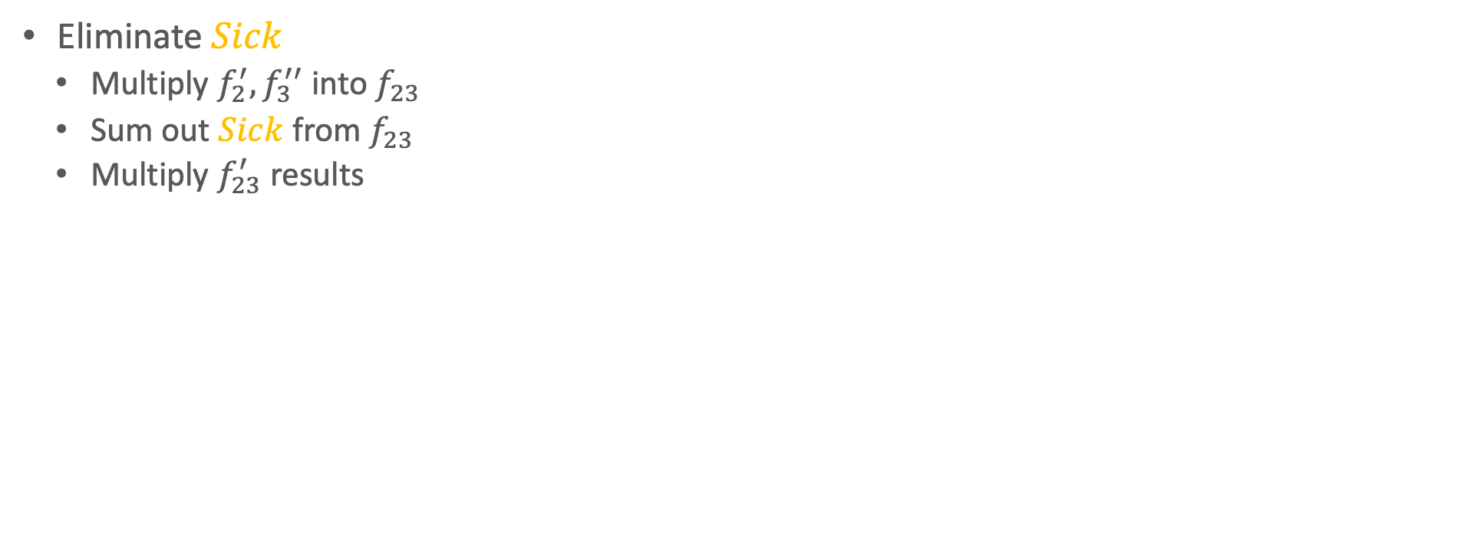

Equivalent Ground
Eliminations
$$Travel\left(eve\right)$$
$$Nat\left(D\right)$$
$$Acc\left(I\right)$$
$$g_{1}$$
$$g_{2}$$
$$Sick\left(eve\right)$$
$$Epid$$
$$g_{0}$$
$$Treat\left(eve,M\right)$$
$$g_{3}$$
Eliminate $Sick$
  Multiply $f_{2}^{′},f_{3}^{′′}$ into $f_{23}$
  Sum out $Sick$ from $f_{23}$
  Multiply $f_{23}^{′}$ results
$$Acc\text{.}chem$$
$$g_{2}^{′}$$
$$g_{3}^{′}$$
$$Sick\left(X\right)$$
$$X∈\{alice, bob)$$
$$Acc\text{.}nucl$$
$$f_{1}$$
$$Nat\text{.}flood$$
$$f_{1}$$
$$f_{1}$$
$$Nat\text{.}fire$$
$$f_{1}$$
$$f_{2}^{′}$$
$$f_{23}^{′′}={\left(f_{23}^{′}\right)}^{2}$$
$$Epid$$
$$f_{0}$$
$$f_{2}^{′}$$
$$f_{23}^{′}$$
$$f_{23}$$
$$f_{3}^{′′}={\left(f_{3}^{′}\right)}^{2}$$
$$f_{23}^{′}$$
$$f_{23}$$
$$f_{3}^{′′}={\left(f_{3}^{′}\right)}^{2}$$
$$f_{2}$$
$$f_{3}$$
$$Treat\text{.}eve\text{.}m_{1}$$
$$f_{3}$$
$$Sick\text{.}alice$$
$$Sick\text{.}bob$$
$$Sick\text{.}eve$$
$$Travel\text{.}eve$$
$$Treat\text{.}eve\text{.}m_{2}$$

Slide 15

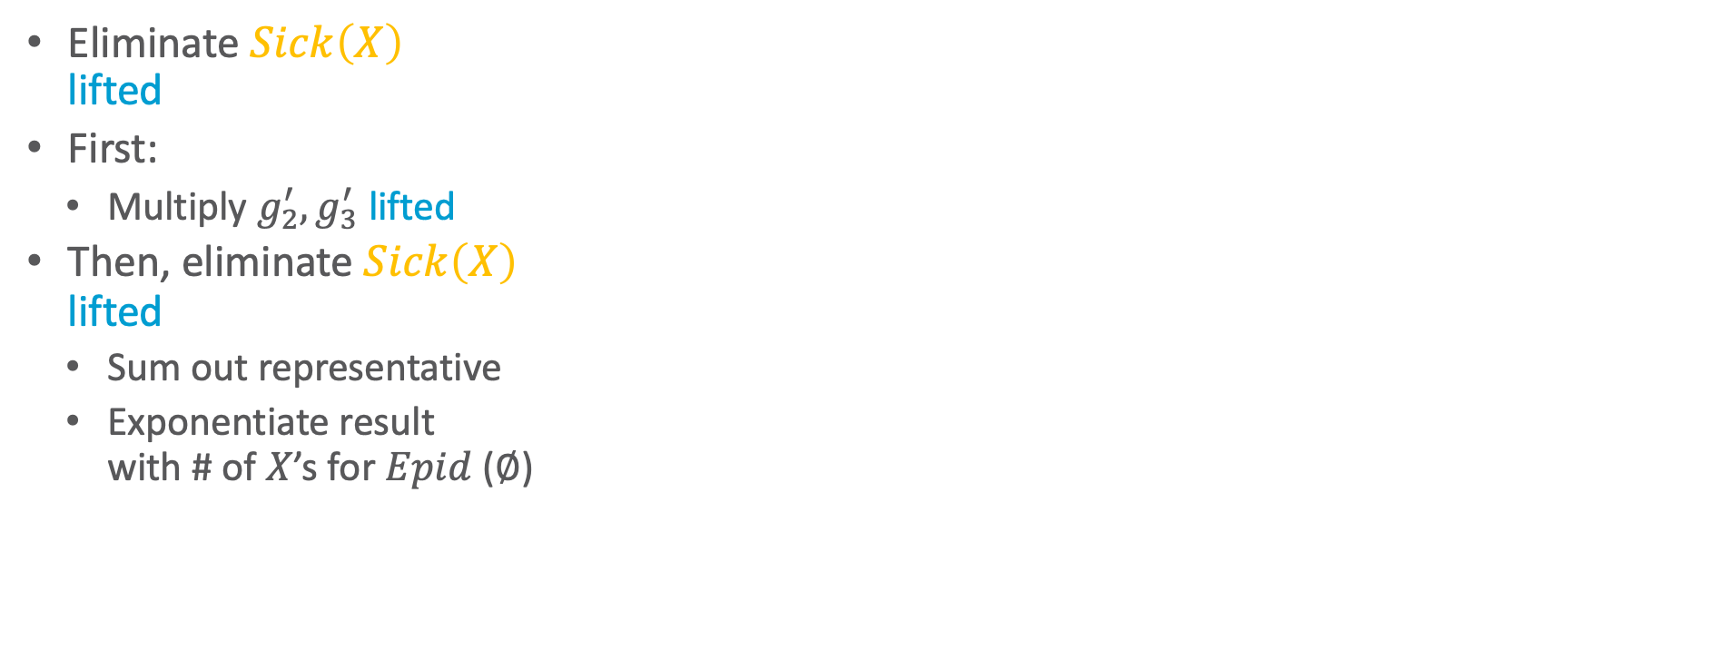
Equivalent Ground
Eliminations
$$Travel\left(eve\right)$$
$$Nat\left(D\right)$$
$$Acc\left(I\right)$$
$$g_{1}$$
$$g_{2}$$
$$Sick\left(eve\right)$$
$$Epid$$
$$g_{0}$$
$$Treat\left(eve,M\right)$$
$$g_{3}$$
Eliminate $Sick\left(X\right)$
lifted
First:
  Multiply $g_{2}^{′},g_{3}^{′}$ lifted
Then, eliminate $Sick\left(X\right)$
lifted
  Sum out representative
  Exponentiate result
  with # of $X$’s for $Epid$ ($∅$)
$$g_{23}^{′}$$
$$g_{2}^{′}$$
$$Acc\text{.}chem$$
$$g_{23}$$
$$g_{3}^{′}$$
$$Sick\left(X\right)$$
$$X∈\{alice, bob)$$
$$Acc\text{.}nucl$$
$$f_{1}$$
$$Nat\text{.}flood$$
$$f_{1}$$
$$f_{1}$$
$$Nat\text{.}fire$$
$$f_{1}$$
Formal lifted multiply operator
Open question: What happens if both parfactors represent different number of groundings?
$$f_{23}^{′′}={\left(f_{23}^{′}\right)}^{2}$$
$$Epid$$
$$f_{0}$$
$$f_{2}$$
$$f_{3}$$
$$Treat\text{.}eve\text{.}m_{1}$$
$$f_{3}$$
$$Sick\text{.}eve$$
$$Travel\text{.}eve$$
$$Treat\text{.}eve\text{.}m_{2}$$

Slide 16







Equivalent Ground
Eliminations
$$Travel\left(eve\right)$$
$$Nat\left(D\right)$$
$$Acc\left(I\right)$$
$$g_{1}$$
$$g_{2}$$
$$Sick\left(eve\right)$$
$$Epid$$
$$g_{0}$$
$$Treat\left(eve,M\right)$$
$$g_{3}$$
Eliminate $Treat.eve$,
$Sick.eve$ variables
  Sum out $Treat.eve$ variables
  Multiply results over
  same arguments
  Multiply $f_{2},f_{3}^{′′}$ for $eve$
  Sum out $Sick.eve$
$$Acc\text{.}chem$$
$$g_{23}^{′}$$
$$Acc\text{.}nucl$$
$$f_{1}$$
$$Nat\text{.}flood$$
$$f_{1}$$
$$f_{1}$$
$$Nat\text{.}fire$$
$$f_{1}$$
$$f_{23}^{′′}={\left(f_{23}^{′}\right)}^{2}$$
$$Epid$$
$$f_{0}$$
$$f_{23}^{eve}$$
$$f_{2}$$
$$f_{3}$$
$$Treat\text{.}eve\text{.}m_{1}$$
$$f_{3}$$
$$Sick\text{.}eve$$
$$Travel\text{.}eve$$
$$Treat\text{.}eve\text{.}m_{2}$$

Slide 17


Equivalent Ground
Eliminations
$$Travel\left(eve\right)$$
$$Nat\left(D\right)$$
$$Acc\left(I\right)$$
$$g_{1}$$
$$g_{23}^{eve}$$
$$g_{2}$$
$$Sick\left(eve\right)$$
$$Epid$$
$$g_{0}$$
$$Treat\left(eve,M\right)$$
$$g_{3}$$
Eliminate
$Treat\left(eve,M\right)$ lifted,
$Sick\left(eve\right)$
  Sum out representative of
  $Treat\left(eve,M\right)$
  Exponentiate with $2$
  Multiply $g_{2},g_{3}^{′}$
  Sum out $Sick\left(eve\right)$
$$Acc\text{.}chem$$
$$g_{23}^{′}$$
$$Acc\text{.}nucl$$
$$f_{1}$$
$$Nat\text{.}flood$$
$$f_{1}$$
$$f_{1}$$
$$Nat\text{.}fire$$
$$f_{1}$$
$$f_{23}^{′′}={\left(f_{23}^{′}\right)}^{2}$$
$$Epid$$
$$f_{0}$$
$$f_{23}^{eve}$$
$$Travel\text{.}eve$$

Slide 18
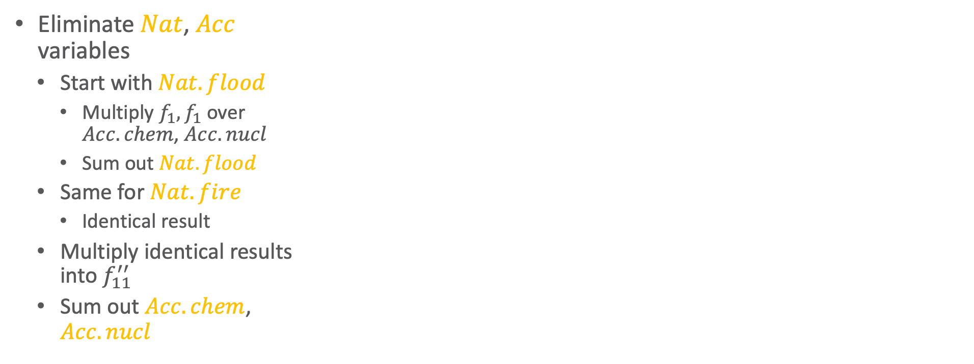




Equivalent Ground
Eliminations
$$Travel\left(eve\right)$$
$$Nat\left(D\right)$$
$$Acc\left(I\right)$$
$$g_{1}$$
$$g_{23}^{eve}$$
$$Epid$$
$$g_{0}$$
Eliminate $Nat$, $Acc$
variables
  Start with $Nat.flood$
    Multiply $f_{1},f_{1}$ over
    $Acc.chem$, $Acc.nucl$
    Sum out $Nat.flood$
  Same for $Nat.fire$
    Identical result
  Multiply identical results
  into $f_{11}^{′′}$
  Sum out $Acc.chem$,
  $Acc.nucl$
$$Acc\text{.}chem$$
$$g_{23}^{′}$$
$$Acc\text{.}nucl$$
$$f_{1}$$
$$Nat\text{.}flood$$
$$f_{1}$$
$$f_{1}$$
$$Nat\text{.}fire$$
$$f_{1}$$
$$f_{11}^{′′′′}$$
$$f_{23}^{′′}={\left(f_{23}^{′}\right)}^{2}$$
$$Epid$$
$$f_{0}$$
$$f_{2}$$
$$Travel\text{.}eve$$

Slide 19
Equivalent Ground
Eliminations
$$Travel\left(eve\right)$$
$$Nat\left(D\right)$$
$$Acc\left(I\right)$$
$$g_{1}$$
$$g_{23}^{eve}$$
$$Epid$$
$$g_{0}$$
Eliminate $Nat\left(D\right)$,
$Acc\left(I\right)$ lifted
  Problem:
  Neither contains all
  logical variables of $g_{1}$
  Solution: Ground $I$?
    Eliminate $Nat\left(D\right)$
    Eliminate $Acc\left(chem\right)$,
    $Acc\left(nucl\right)$
  But: local symmetries,
  encode in histograms
  Better solution: Count $I$!
$$Acc\text{.}chem$$
$$g_{23}^{′}$$
$$Acc\text{.}nucl$$
$$f_{1}$$
$$Nat\text{.}flood$$
$$f_{1}$$
$$f_{1}$$
$$Nat\text{.}fire$$
$$f_{1}$$
Formal ground-logical variable operation
As a last resort operation
Form of split operation, splitting off all constants
$$f_{23}^{′′}={\left(f_{23}^{′}\right)}^{2}$$
$$Epid$$
$$f_{0}$$
$$f_{2}$$
$$Travel\text{.}eve$$

Slide 20
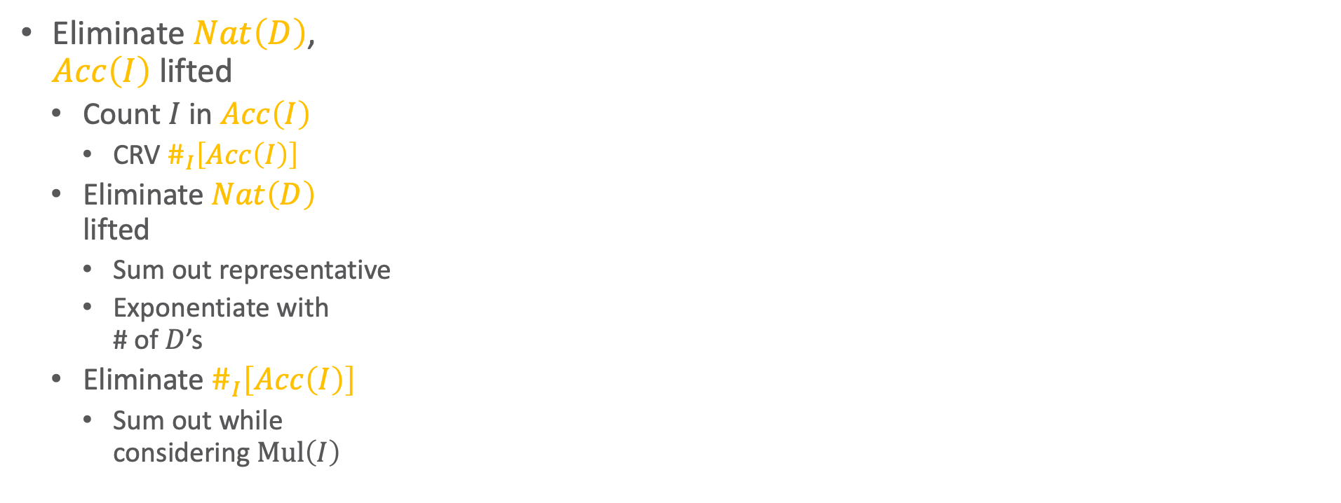
Equivalent Ground
Eliminations
$$Travel\left(eve\right)$$
$$Nat\left(D\right)$$
$$\#_{I}\left[Acc\left(I\right)\right]$$
$$g_{1}$$
$$g_{23}^{eve}$$
$$Epid$$
$$g_{0}$$
Eliminate $Nat\left(D\right)$,
$Acc\left(I\right)$ lifted
  Count $I$ in $Acc\left(I\right)$
    CRV $\#_{I}\left[Acc\left(I\right)\right]$
  Eliminate $Nat\left(D\right)$
  lifted
    Sum out representative
    Exponentiate with
    # of $D$’s
  Eliminate $\#_{I}\left[Acc\left(I\right)\right]$
    Sum out while
    considering $Mul\left(I\right)$
$$Acc\text{.}chem$$
$$g_{23}^{′}$$
$$Acc\text{.}nucl$$
Lifted sum-out operator addendum
Sum-out operation needs to be able to handle CRVs correctly
$$f_{1}$$
$$Nat\text{.}flood$$
$$f_{1}$$
$$f_{1}$$
$$Nat\text{.}fire$$
$$f_{1}$$
Formal count conversion operator
Number of instances of logical variable to count identical for all instances of other logical variables in parfactor
(to have identical histograms)
Logical variable to count appears in only one PRV
$$f_{23}^{′′}={\left(f_{23}^{′}\right)}^{2}$$
$$Epid$$
$$f_{0}$$
$$f_{2}$$
$$Travel\text{.}eve$$

Slide 21
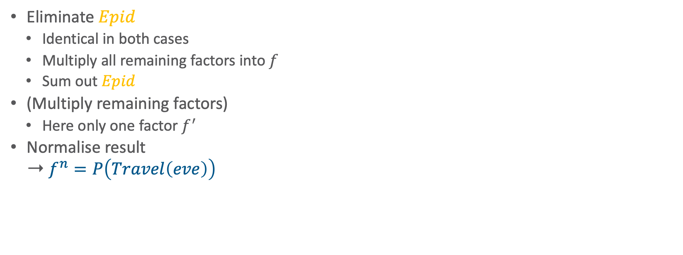




Equivalent Ground
Eliminations
$$Travel\left(eve\right)$$
$$g_{1}^{\#′′}$$
$$f$$
$$g_{23}^{eve}$$
$$f^{′}$$
$$Epid$$
$$g_{0}$$
Eliminate $Epid$
  Identical in both cases
  Multiply all remaining factors into $f$
  Sum out $Epid$
(Multiply remaining factors)
  Here only one factor $f^{′}$
Normalise result
➝ $f^{n}=P\left(Travel\left(eve\right)\right)$
$$g_{23}^{′}$$
$$f_{11}^{′′′′}$$
$$f_{23}^{′′}={\left(f_{23}^{′}\right)}^{2}$$
$$Epid$$
$$f_{0}$$
$$f^{n}$$
$$f$$
$$f_{2}$$
$$f^{′}$$
$$Travel\text{(}eve)$$
$$Travel\text{.}eve$$

Slide 22
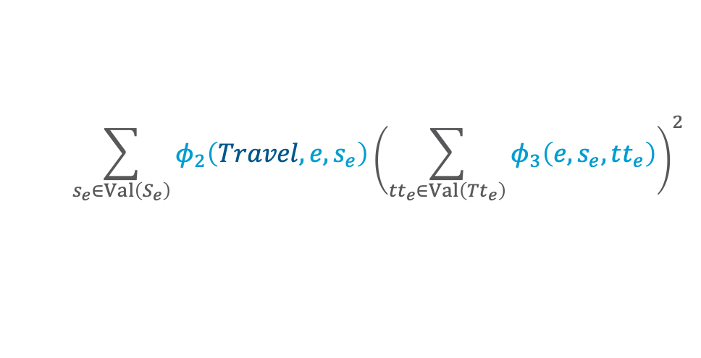
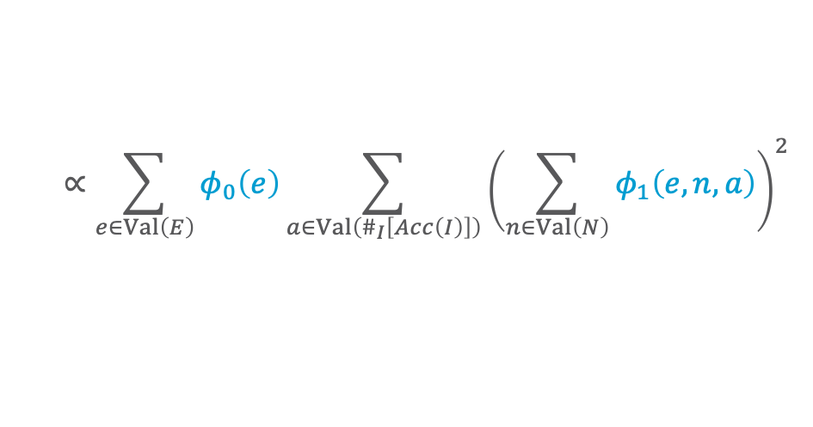
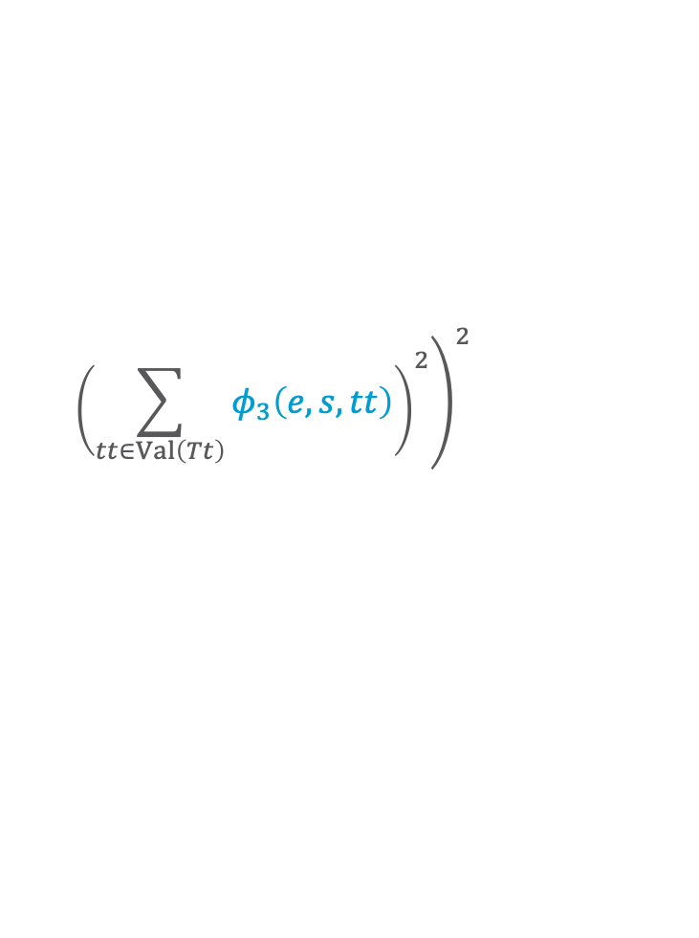
$$Travel\left(eve\right)$$
$$Nat\left(D\right)$$
$$Acc\left(I\right)$$
$$g_{1}$$
$$Sick\left(eve\right)$$
$$g_{2}$$
$$Epid$$
$$g_{0}$$
$$Treat\left(eve,M\right)$$
$$g_{3}$$
$$Travel\left(X\right)$$
$$Treat\left(X,M\right)$$
$$P\left(Travel\left(eve\right)\right)$$
$$g_{2}$$
$$g_{3}$$
$$∝\sum_{e∈Val\left(E\right)}{\sum_{a∈Val\left(\#_{I}\left[Acc\left(I\right)\right]\right)}{\sum_{n∈Val\left(N\right)}{\sum_{s_{e}∈Val\left(S_{e}\right)}{\sum_{{tt}_{e}∈Val\left({Tt}_{e}\right)}{\sum_{s∈Val\left(S\right)}{\sum_{tr∈Val\left(Tr\right)}{\sum_{tt∈Val\left(Tt\right)}{P_{G}}}}}}}}}$$
$$Sick\left(X\right)$$
$$X∈\{alice, bob)$$
$$∝\sum_{e∈Val\left(E\right)}{φ_{0}\left(e\right)\sum_{a∈Val\left(\#_{I}\left[Acc\left(I\right)\right]\right)}{{\left(\sum_{n∈Val\left(N\right)}{φ_{1}\left(e,n,a\right)}\right)}^{2}}}$$
Lifted operators for
  Summing out
  Multiplication
  Absorption of $t$
  ➝ Lifting operators of LVE
$$\sum_{s_{e}∈Val\left(S_{e}\right)}{φ_{2}\left(Travel,e,s_{e}\right){\left(\sum_{{tt}_{e}∈Val\left({Tt}_{e}\right)}{φ_{3}\left(e,s_{e},tt_{e}\right)}\right)}^{2}}$$
$$\left(\sum_{s∈Val\left(S\right)}{\sum_{tr∈Val\left(Tr\right)}{φ_{2}\left(tr,e,s\right)}}\right.$$
Lifting operators to enable the main operators above necessary
$${\left.{\left(\sum_{tt∈Val\left(Tt\right)}{φ_{3}\left(e,s,tt\right)}\right)}^{2}\right)}^{2}$$
$E≜Epid,N≜Nat\left(D\right),A≜Acc\left(I\right),S≜Sick\left(X\right),Tt≜Treat\left(X,M\right),Tr≜Travel\left(X\right);$ subscript $e$ for $eve$

Slide 23
Lifted Operators and
Their Preconditions
$$Travel\left(eve\right)$$
$$Nat\left(D\right)$$
$$Acc\left(I\right)$$
$$g_{1}$$
$$g_{2}$$
$$Sick\left(eve\right)$$
$$Epid$$
$$g_{0}$$
$$Treat\left(eve,M\right)$$
$$g_{3}$$
$$Travel\left(X\right)$$
$$Treat\left(X,M\right)$$
$$g_{2}$$
$$g_{3}$$
Preconditions for lifted sum-out operator
PRV contained in only one parfactor (like in VE)
PRV must contain all logical variables of parfactor
Operation eliminates the same number of instances for each remaining instance
(then all have the same exponent; otherwise: split operation as for shattering)
Formal lifted multiply operator
Open question: What happens if both parfactors represent different number of groundings?
$$X∈\{alice, bob)$$
Formal count conversion operator
Number of instances of logical variable to count identical for all instances of other logical variables in parfactor
(to have identical histograms)
Logical variable to count appears in only one PRV
$$Sick\left(X\right)$$
Lifted sum-out operator addendum
Sum-out operation needs to be able to handle CRVs correctly
Formal ground-logical variable operation
As a last resort operation
Form of split operation, splitting off all constants
So, we need a formal split operation to split of (set of) constants

Slide 24
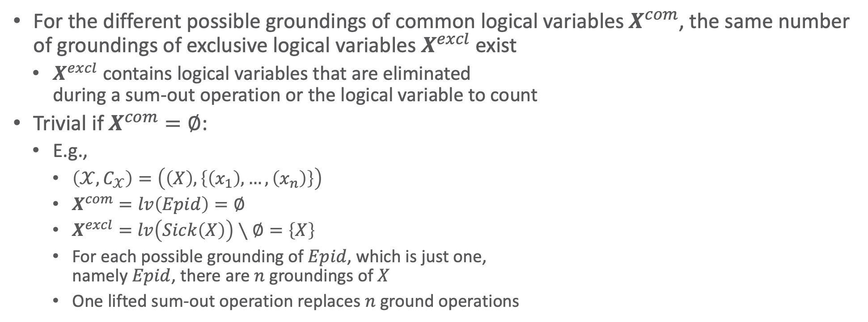
Count Normalisation
For the different possible groundings of common logical variables $X^{com}$, the same number of groundings of exclusive logical variables $X^{excl}$ exist
  $X^{excl}$ contains logical variables that are eliminated
  during a sum-out operation or the logical variable to count
Trivial if $X^{com}=∅$:
  E.g.,
    $\left(𝒳,C_{𝒳}\right)=\left(\left(X\right),\left\{\left(x_{1}\right),…,\left(x_{n}\right)\right\}\right)$
    $X^{com}=lv\left(Epid\right)=∅$
    $X^{excl}=lv\left(Sick\left(X\right)\right)∖∅=\left\{X\right\}$
    For each possible grounding of $Epid$, which is just one,
    namely $Epid$, there are $n$ groundings of $X$
    One lifted sum-out operation replaces $n$ ground operations
$$Epid$$
$$φ$$
$$φ$$
$$φ$$
$$Sick\left(x_{1}\right)$$
$$Sick\left(x_{2}\right)$$
$$…$$
$$Sick\left(x_{n}\right)$$
$$Epid$$
$$φ$$
$$Sick\left(X\right)$$
Notes:
Also used in absorption, multiplication

Slide 25
Lifted Summing Out
Summing out transforms the current model $G$
  Removes a PRV from $rv\left(G\right)$
Effect on logical variables :
  Number of logical variables decreases over the whole LVE run for one query
  Until only propositional random variables and CRVs (counted logical variables are bound) are left
  ➝ Standard variable elimination
Preconditions act as a filter on possible $\text{sum}\text{−}\text{out}$ operations
Preconditions for lifted sum-out operator
PRV contained in only one parfactor (like in VE)
PRV must contain all logical variables of parfactor
Operation eliminates the same number of instances for each remaining instance
(then all have the same exponent; otherwise: split operation as for shattering)
Lifted sum-out operator addendum
Sum-out operation needs to be able to handle CRVs correctly

Slide 26
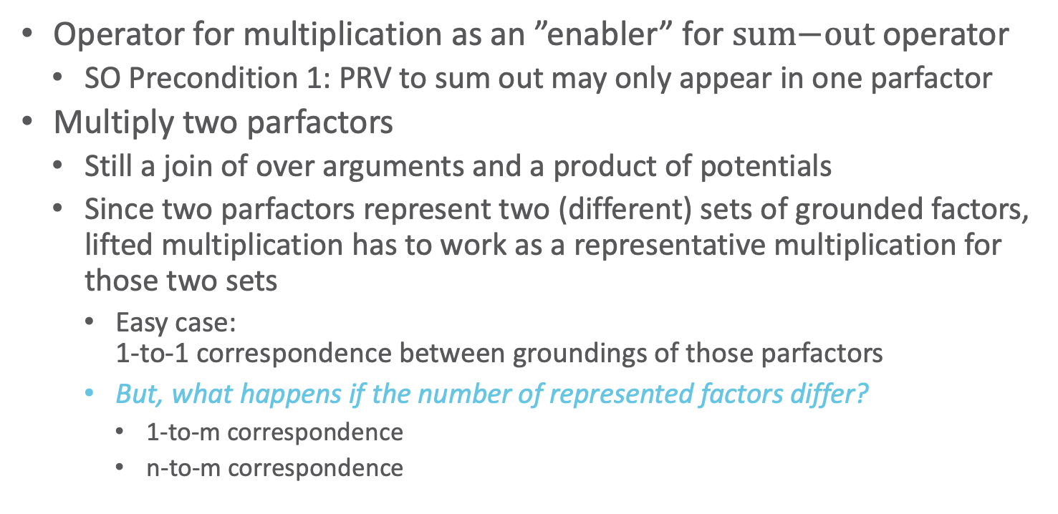
Lifted Multiplication
Operator for multiplication as an ”enabler” for $\text{sum}\text{−}\text{out}$ operator
  SO Precondition 1: PRV to sum out may only appear in one parfactor
Multiply two parfactors
  Still a join of over arguments and a product of potentials
  Since two parfactors represent two (different) sets of grounded factors, lifted multiplication has to work as a representative multiplication for those two sets
    Easy case:
    1-to-1 correspondence between groundings of those parfactors
    But, what happens if the number of represented factors differ?
      1-to-m correspondence
      n-to-m correspondence
Formal lifted multiply operator
Open question: What happens if both parfactors represent different number of groundings?

Slide 27
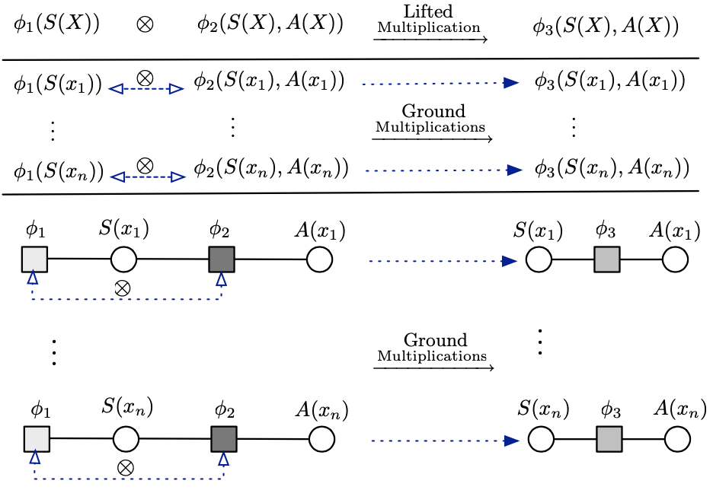



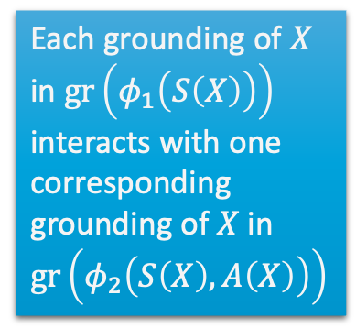
Lifted Multiplication: Trivial Case
1-to-1 correspondence between the ground factors of each parfactor
  E.g., $φ_{1}\left(S\left(X\right)\right)∙φ_{2}\left(S\left(X\right),A\left(X\right)\right)$
$$∙$$
$$∙$$
    Each grounding of $X$ in $gr\left(φ_{1}\left(S\left(X\right)\right)\right)$ interacts with one corresponding grounding of $X$ in $gr\left(φ_{2}\left(S\left(X\right),A\left(X\right)\right)\right)$
$$∙$$
$$∙$$
$$∙$$
Figure taken from: Nima Taghipour, Daan Fierens, Jesse Davis, and Hendrik Blockeel: Lifted Variable Elimination: Decoupling the Operators from the Constraint Language. In: Journal of Artificial Intelligence Research, 2013.

Slide 28
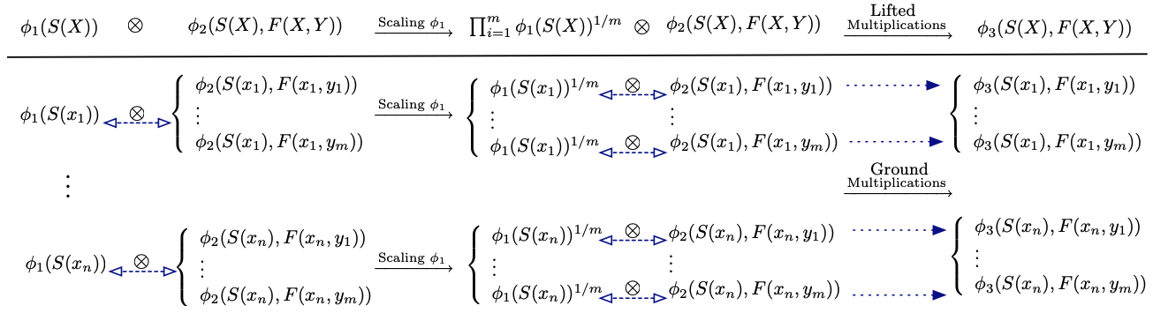





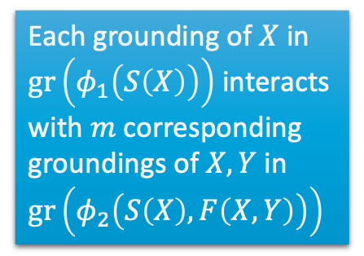

Lifted Multiplication: More General
$1$-to-$m$ correspondence between the ground factors of each parfactor
  Scaling necessary
  E.g., $φ_{1}\left(S\left(X\right)\right)∙φ_{2}\left(S\left(X\right),F\left(X,Y\right)\right)$
Distribute $φ_{1}\left(S\left(X\right)\right)$ into $m$ factors proportionally
$$∙$$
$$∙$$
    Each grounding of $X$ in $gr\left(φ_{1}\left(S\left(X\right)\right)\right)$ interacts with $m$ corresponding groundings of $X,Y$ in $gr\left(φ_{2}\left(S\left(X\right),F\left(X,Y\right)\right)\right)$
$$∙$$
$$∙$$
$$∙$$
$$∙$$
$$∙$$
$$∙$$
Figure taken from: Nima Taghipour, Daan Fierens, Jesse Davis, and Hendrik Blockeel: Lifted Variable Elimination: Decoupling the Operators from the Constraint Language. In: Journal of Artificial Intelligence Research, 2013.

Slide 29
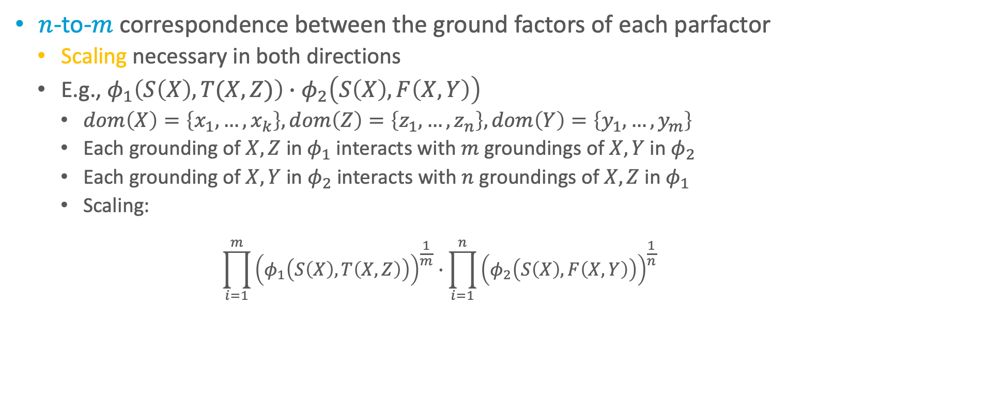
Lifted Multiplication: General Case
$n$-to-$m$ correspondence between the ground factors of each parfactor
  Scaling necessary in both directions
  E.g., $φ_{1}\left(S\left(X\right),T(X,Z)\right)∙φ_{2}\left(S\left(X\right),F\left(X,Y\right)\right)$
    $dom\left(X\right)=\left\{x_{1},…,x_{k}\right\},dom\left(Z\right)=\left\{z_{1},…,z_{n}\right\}, dom\left(Y\right)=\left\{y_{1},…,y_{m}\right\}$
    Each grounding of $X,Z$ in $φ_{1}$ interacts with $m$ groundings of $X,Y$ in $φ_{2}$
    Each grounding of $X,Y$ in $φ_{2}$ interacts with $n$ groundings of $X,Z$ in $φ_{1}$
    Scaling:
      $$\prod_{i=1}^{m}{{\left(φ_{1}\left(S\left(X\right),T\left(X,Z\right)\right)\right)}^{\frac{1}{m}}}∙\prod_{i=1}^{n}{{\left(φ_{2}\left(S\left(X\right),F\left(X,Y\right)\right)\right)}^{\frac{1}{n}} }$$
Distribute $φ_{1}\left(S\left(X\right),T\left(X,Z\right)\right)$ into $m$ factors and $φ_{1}\left(S\left(X\right),F\left(X,Y\right)\right)$ into $n$ factors proportionally

Slide 30
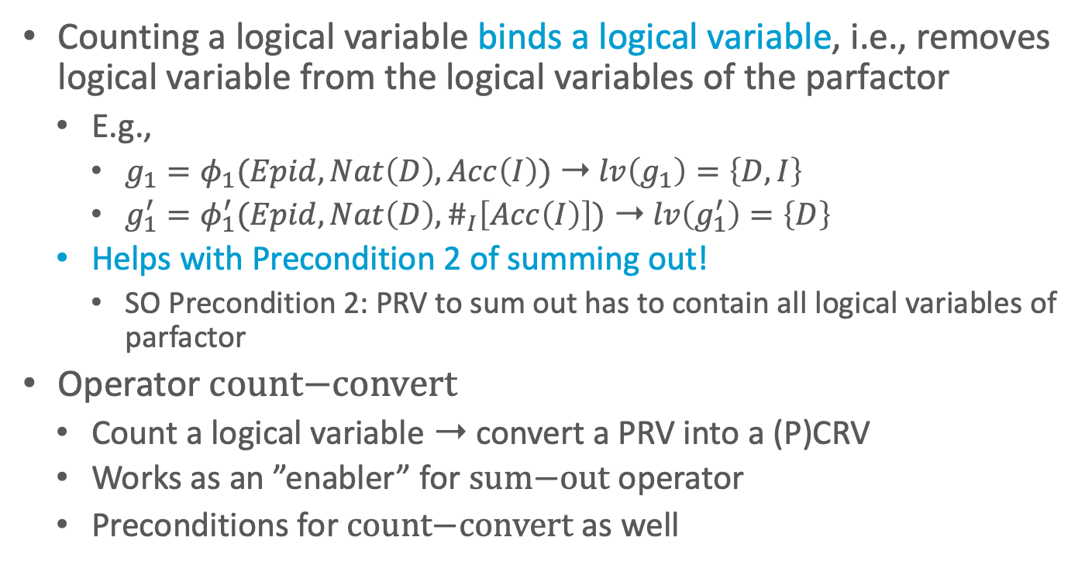
Count Conversion
Counting a logical variable binds a logical variable, i.e., removes logical variable from the logical variables of the parfactor
  E.g.,
    $g_{1}=φ_{1}(Epid,Nat\left(D\right),Acc\left(I\right))$ ➝ $lv\left(g_{1}\right)=\left\{D,I\right\}$
    $g_{1}^{′}=φ_{1}^{′}(Epid,Nat\left(D\right),\#_{I}\left[Acc\left(I\right)\right])$ ➝ $lv\left(g_{1}^{′}\right)=\left\{D\right\}$
  Helps with Precondition 2 of summing out!
    SO Precondition 2: PRV to sum out has to contain all logical variables of parfactor
Operator $\text{count}\text{−}\text{convert}$
  Count a logical variable ➝ convert a PRV into a (P)CRV
  Works as an ”enabler” for $\text{sum}\text{−}\text{out}$ operator
  Preconditions for $\text{count}\text{−}\text{convert}$ as well
Formal count conversion operator
Number of instances of logical variable to count identical for all instances of other logical variables in parfactor
(to have identical histograms)
Logical variable to count appears in only one PRV

Slide 31
Generalised Counting
Count conversion as discussed here, first introduced by Milch et al. (2008)
Generalised counting by Nima Taghipour et al. (2013)
  Count logical variables that appear in more than one PRV
    E.g., $φ\left(Q\left(X\right),R\left(X\right),S\left(Y\right),T\left(Y\right)\right)$
    ➝ $φ\left(\#_{X}\left[Q\left(X\right),R\left(X\right)\right],S\left(Y\right),T\left(Y\right)\right)$
  Merge CRVs with counted logical variables of the same domain
    E.g., $φ{\left(\#_{X}\left[Q\left(X\right),R\left(X\right)\right]\right)}_{C^{X}}$ and $φ{\left(\#_{Y}\left[Q\left(Y\right),R\left(Y\right)\right]\right)}_{|C^{Y}}$ with $gr\left(X_{|C^{X}}\right)=gr\left(Y_{|C^{Y}}\right)$
    ➝ $φ{\left(\#_{X}\left[Q\left(X\right),R\left(X\right)\right]\right)}_{C}$
  Merge-count a PRV and a CRV with an inequality constraint
    E.g., $φ{\left(\#_{X}\left[Q\left(X\right)\right],R\left(Y\right)\right)}_{C}$ with $C$ encoding $X≠Y$
    ➝ $φ{\left(\#_{X}\left[Q\left(X\right),R\left(X\right)\right] \right)}_{C}$
Brian Milch, Luke S. Zettelmoyer, Kristian Kersting, Michael Haimes, and Leslie Pack Kaelbling: Lifted Probabilistic Inference with Counting Formulas. In: AAAI-08 Proceedings of the 23rd AAAI Conference on Artificial Intelligence, 2008.
Nima Taghipour and Jesse Davis: Generalised Counting for Lifted Variable Elimination. In: ILP-13 Proceedings of the International Conference on Inductive Logic Programming, 2013. (or in Nima Taghipour’s PhD thesis)

Slide 32


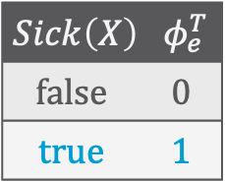


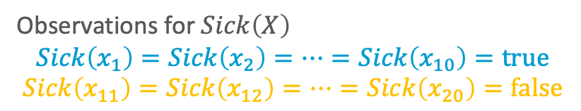

Lifted Absorption
Remember:
Observations for groundings of a PRV can be
  One of the range values
  Not available (N/A)
Compactly encode evidence with PRVs and parfactors
  Within each group:
  instances are indistinguishable again
Absorb evidence for each group at once using the parfactors
  Observations for $Sick\left(X\right)$
    $$Sick\left(x_{1}\right)=Sick\left(x_{2}\right)=…=Sick\left(x_{10}\right)=true$$
    $$Sick\left(x_{11}\right)=Sick\left(x_{12}\right)=…=Sick\left(x_{20}\right)=false$$
$$Sick\left(X\right)$$ | $$φ_{e}^{T}$$
$$false$$ | $$0$$
$$true$$ | $$1$$
$$Sick\left(X\right)$$ | $$φ_{e}^{F}$$
$$false$$ | $$1$$
$$true$$ | $$0$$
$$Nat\left(D\right)$$
$$Acc\left(I\right)$$
$$g_{1}$$
$$Epid$$
$$g_{0}$$
$$Travel\left(X\right)$$
$$Treat\left(X,M\right)$$
$$g_{2}$$
$$g_{3}$$
$$Sick\left(X\right)$$
$$g_{e}^{T}$$
$$g_{e}^{F}$$

Slide 33









Lifted Absorption: Shattering on Evidence
$$Nat\left(D\right)$$
$$Acc\left(I\right)$$
$$g_{1}$$
$$Epid$$
$$g_{0}$$
$$Travel\left(X\right)$$
$$Treat\left(X,M\right)$$
$$g_{2}$$
$$g_{3}$$
As observations are seldom for all constants in a constraint, parfactors have to be split based on the constants that occur in the observations
  Only then: absorb applicable evidence in each parfactor individually
  E.g., given evidence parfactors $g_{e}^{T}$, $g_{e}^{F}$, every parfactor containing $Sick\left(X\right)$has to be split on the constraints: $g_{2},g_{3}$
After shattering, absorb each evidence parfactor $g_{e}$ in each applicable parfactor $g_{i}$
  Possible to interleave shattering and absorption
$$Sick\left(X\right)$$
$$Travel\left(X^{T}\right)$$
$$Treat\left(X^{T},M\right)$$
$$g_{2}$$
$$g_{3}$$
$$Sick\left(X^{T}\right)$$
$$g_{e}^{T}$$
$$Travel\left(X^{F}\right)$$
$$Treat\left(X^{F},M\right)$$
$$g_{2}$$
$$g_{3}$$
$$Nat\left(D\right)$$
$$Sick\left(X^{F}\right)$$
$$Acc\left(I\right)$$
$$g_{1}$$
$$g_{e}^{F}$$
$$Epid$$
$$g_{0}$$
$$Travel\left(X\right)$$
$$Treat\left(X,M\right)$$
$$g_{2}$$
$$g_{3}$$
$$Sick\left(X\right)$$
$$g_{e}^{T}$$
$$g_{e}^{F}$$

Slide 34
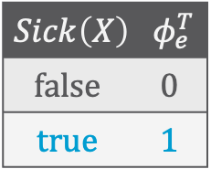
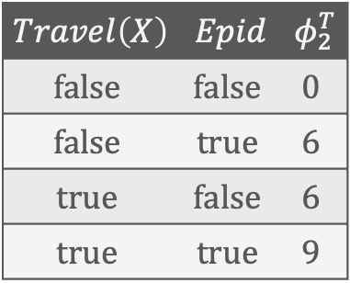
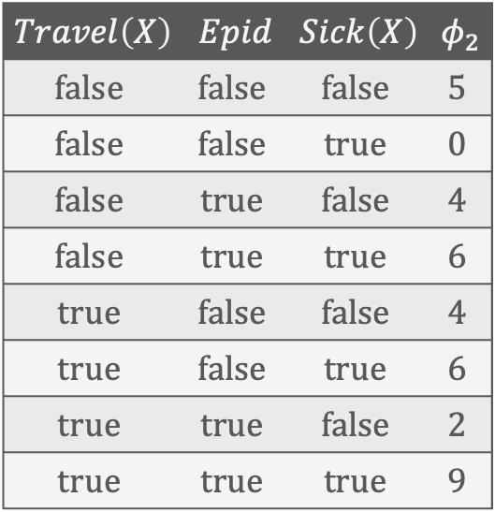
Lifted Absorption: Example
$$Nat\left(D\right)$$
$$Acc\left(I\right)$$
$$g_{1}$$
$$Epid$$
$$g_{0}$$
$$Travel\left(X\right)$$
$$Treat\left(X,M\right)$$
$$g_{2}$$
$$g_{3}$$
Absorb $g_{e}^{T}$ in $g_{2}$:
Same for $g_{e}^{T}$ in $g_{3}$, $g_{e}^{F}$ in $g_{2}$, $g_{e}^{F}$ in $g_{3}$
$$Sick\left(X\right)$$
$$Travel\left(X\right)$$ | $$Epid$$ | $$Sick\left(X\right)$$ | $$φ_{2}$$
$$false$$ | $$false$$ | $$false$$ | $$5$$
$$false$$ | $$false$$ | $$true$$ | $$0$$
$$false$$ | $$true$$ | $$false$$ | $$4$$
$$false$$ | $$true$$ | $$true$$ | $$6$$
$$true$$ | $$false$$ | $$false$$ | $$4$$
$$true$$ | $$false$$ | $$true$$ | $$6$$
$$true$$ | $$true$$ | $$false$$ | $$2$$
$$true$$ | $$true$$ | $$true$$ | $$9$$
$$Sick\left(X\right)$$ | $$φ_{e}^{T}$$
$$false$$ | $$0$$
$$true$$ | $$1$$
$$Travel\left(X^{T}\right)$$
$$Treat\left(X^{T},M\right)$$
$$g_{2}$$
$$g_{3}$$
$$Sick\left(X^{T}\right)$$
$$g_{e}^{T}$$
$$Travel\left(X^{F}\right)$$
$$Treat\left(X^{F},M\right)$$
$$Travel\left(X\right)$$ | $$Epid$$ | $$φ_{2}^{T}$$
$$false$$ | $$false$$ | $$0$$
$$false$$ | $$true$$ | $$6$$
$$true$$ | $$false$$ | $$6$$
$$true$$ | $$true$$ | $$9$$
$$g_{2}$$
$$g_{3}$$
$$Sick\left(X^{F}\right)$$
$$g_{e}^{F}$$

Slide 35

Lifted Absorption: Eliminating a Logical variable
$$Nat\left(D\right)$$
$$Acc\left(I\right)$$
Output: $g^{′}=φ^{′}{\left(𝒜^{′}\right)}_{|C^{′}}$
  $$φ^{′}\left(…,a_{i−1},a_{i+1},…\right)=φ{\left(…,a_{i−1},e,a_{i+1},…\right)}^{r}$$
    with $e=o$ if $A_{i}=R\left(Y\right)$
E.g., $Treat\left(X,M\right)=true ∀\left(x, m\right)∈⊤$
  Parfactor $g_{3}$ contains $Treat\left(X,M\right)$
  Output: $φ^{′}\left(Epid, Sick\left(X\right)\right)$
    Absorbing $Treat\left(X,M\right)=true$ eliminates $M$
    $r=n{\text{count}}_{M|X}\left(C\right)=2$
    Potentials in selected lines have
    to be raised to the power of $2$
$$g_{1}$$
$$Epid$$
$$g_{0}$$
$$Travel\left(X\right)$$
$$g_{2}$$
$$g_{3}^{T}$$
$$Sick\left(X\right)$$
After lifted absorb
$$Nat\left(D\right)$$
$$Acc\left(I\right)$$
$$g_{1}$$
$$Epid$$
$$g_{0}$$
$$Travel\left(X\right)$$
$$Treat\left(X,M\right)$$
$$g_{2}$$
$$g_{3}$$
$$Sick\left(X\right)$$

Slide 36



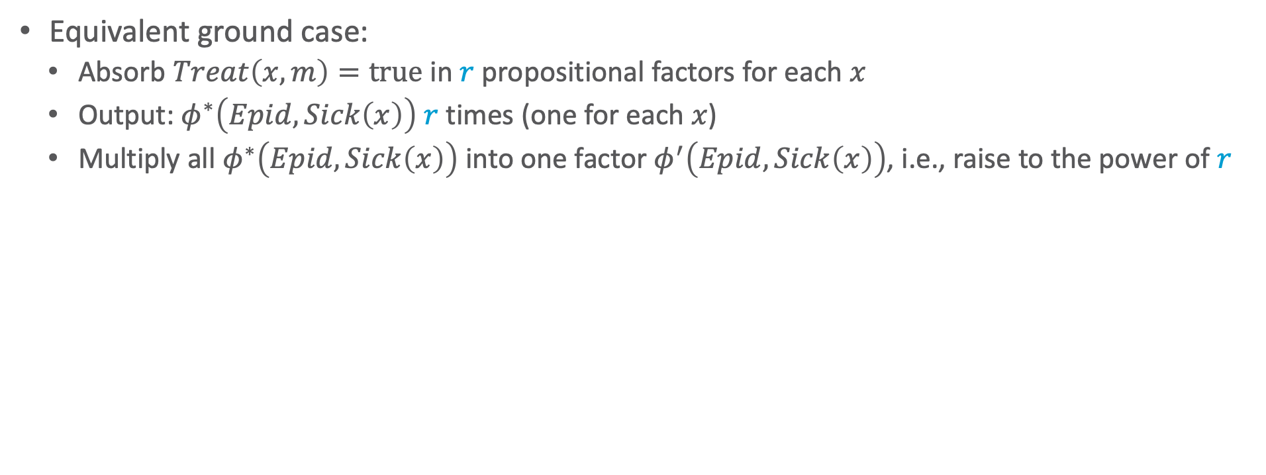






Lifted Absorption: Eliminating a Logical variable
Equivalent ground case:
  Absorb $Treat\left(x,m\right)=true$ in $r$ propositional factors for each $x$
  Output: $φ^{∗}\left(Epid, Sick\left(x\right)\right)$ $r$ times (one for each $x$)
  Multiply all $φ^{∗}\left(Epid, Sick\left(x\right)\right)$ into one factor $φ^{′}\left(Epid, Sick\left(x\right)\right)$, i.e., raise to the power of $r$
$$Epid$$
$$Epid$$
$$Epid$$
$$Treat(x,m_{2})$$
$$φ_{3}$$
$$φ^{∗}$$
$$Treat(x,m_{1})$$
$$φ^{′}$$
$$φ_{3}$$
$$φ^{∗}$$
$$Sick(x)$$
$$Sick(x)$$
$$Sick(x)$$
Initial model
After absorb
After multiply

Slide 37
Types of Shattering
So far considered: Pre-emptive shattering
  Recursively shattering the model on evidence, query terms, and itself before starting with any calculations
    Shattering a model on itself: Ensure that all sets of constants for logical variables occurring in constraints are either identical or disjoint
        Allows for introducing one logical variable for each set of constants and $⊤$ constraints except when an inequality is encoded
        Avoids splitting during LVE and makes PRV comparisons easier
On-demand shattering
  Splitting on constraints only if the application
  of an LVE operator requires it
  In initial example calculation for $P\left(Travel\left(eve\right)\right)$:
  Eliminate $Treat\left(X,M\right)$ before splitting of $Sick\left(eve\right)$
Does not change complexity of the problem
  May be hard to determine when to shatter + extra work for checking
$$Nat\left(D\right)$$
$$Acc\left(I\right)$$
$$g_{1}$$
$$Epid$$
$$g_{0}$$
$$Travel\left(X\right)$$
$$Treat\left(X,M\right)$$
$$g_{2}$$
$$g_{3}$$
$$Sick\left(X\right)$$
Notes:
Example on chalk board

Slide 38
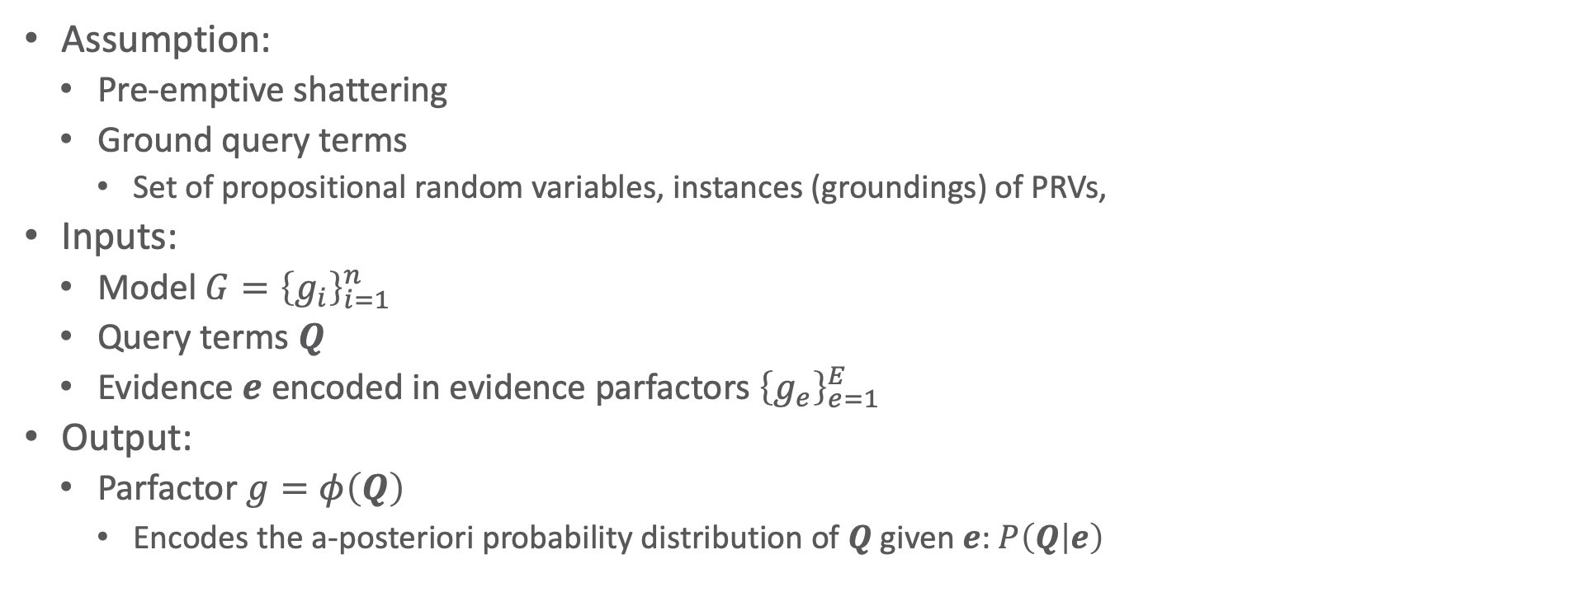
LVE: Algorithm
Assumption:
  Pre-emptive shattering
  Ground query terms
    Set of propositional random variables, instances (groundings) of PRVs,
Inputs:
  Model $G={\left\{g_{i}\right\}}_{i=1}^{n}$
  Query terms $Q$
  Evidence $e$ encoded in evidence parfactors ${\left\{g_{e}\right\}}_{e=1}^{E}$
Output:
  Parfactor $g=φ\left(Q\right)$
    Encodes the a-posteriori probability distribution of $Q$ given $e$: $P\left(Q | e\right)$

Slide 39
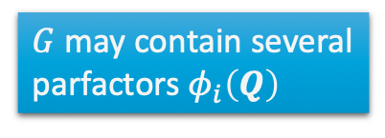
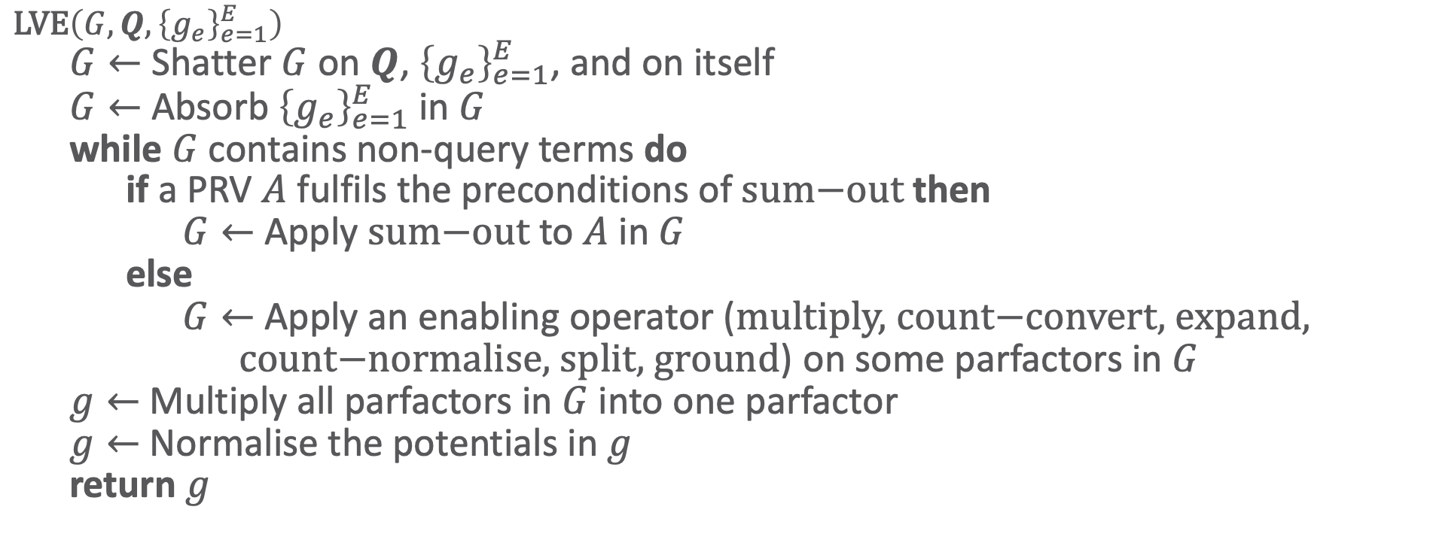
LVE: Algorithm
$\text{LVE}\left(G, Q,{\left\{g_{e}\right\}}_{e=1}^{E}\right)$
  $G←$ Shatter $G$ on $Q$, ${\left\{g_{e}\right\}}_{e=1}^{E}$, and on itself
  $G←$Absorb ${\left\{g_{e}\right\}}_{e=1}^{E}$ in $G$
  while $G$ contains non-query terms do
    if a PRV $A$ fulfils the preconditions of $\text{sum}\text{−}\text{out}$ then
      $G←$Apply $\text{sum}\text{−}\text{out}$ to $A$ in $G$
    else
      $G←$ Apply an enabling operator ($\text{multiply}\text{, }\text{count}\text{−}\text{convert}\text{, }\text{expand}\text{, }$
      $\text{count}\text{−}\text{normalise}\text{, }\text{split}\text{, }\text{ground}$) on some parfactors in $G$
  $g←$Multiply all parfactors in $G$ into one parfactor
  $g←$ Normalise the potentials in $g$
  return $g$
How to choose?
$G$ may contain several
parfactors $φ_{i}\left(Q\right)$

Slide 40
LVE: Heuristics
Important for an implementation
  Cannot search all possible permutations of all possible operator applications
Preconditions of lifted operators already restrict possible elimination order
One possible greedy heuristics (as used in the upcoming implementation):
  Choose sum-out operations over any other operation
    Explicitly written down in algorithm
  Only consider multiplication if the arguments of the two parfactors are the same or ground
    Avoid scaling
  Choose operation that results into the smallest parfactor(s) to be added to $G$
    If same size: choose at random
    May result in sub-optimal application order or unnecessary applications
      E.g., if a grounding is unavoidable, the heuristics may lead to various count conversions being applied before grounding as the result of a count conversion is usually smaller in size than the result of grounding the same logical variable

Slide 41
Interim Summary
LVE lifted operators
  Eliminate PRVs: lifted summing out, lifted absorption
  Enable elimination: lifted multiplication, count conversion, splitting
    Other based on splitting: expand, ground, count-normalise
Shattering = splitting on query terms, evidence, model constraints
  Pre-emptive, on-demand
LVE algorithm
  Heuristics

Slide 42
Formal Analysis
$$Epid$$
root
$$∅$$
$$∅$$
$$∀x :⊤$$
$$T_{X}$$
$$Acc\left(I\right)$$
$$∀d :⊤$$
$$T_{D}$$
$$Epid$$
$$Epid$$
$$Sick\left(x\right)$$
$$T_{x}$$
$$Nat\left(d\right)$$
$$T_{d}$$
$$Epid$$
$$Acc\left(I\right),Epid$$
$$Travel\left(x\right)$$
$$∅$$
$$∀m :⊤$$
$$∅$$
$$∀i :⊤$$
$$Sick\left(x\right)$$
$$Epid$$
$$Sick\left(x\right)$$
$$Epid$$
$$T_{M}$$
$$Nat\left(d\right)$$
$$Acc\left(I\right),Epid$$
$$T_{I}$$
$$Treat\left(x,m\right)$$
$$∅$$
$$Sick\left(x\right)$$
$$Epid$$
$$T_{m}$$
$$Nat\left(d\right)$$
$$Acc\left(i\right),Epid$$
$$T_{i}$$
$$g_{2}$$
$$g_{3}$$
$$g_{0}$$
$$g_{1}$$
Complexity, runtimes
Tractability, completeness

Slide 43
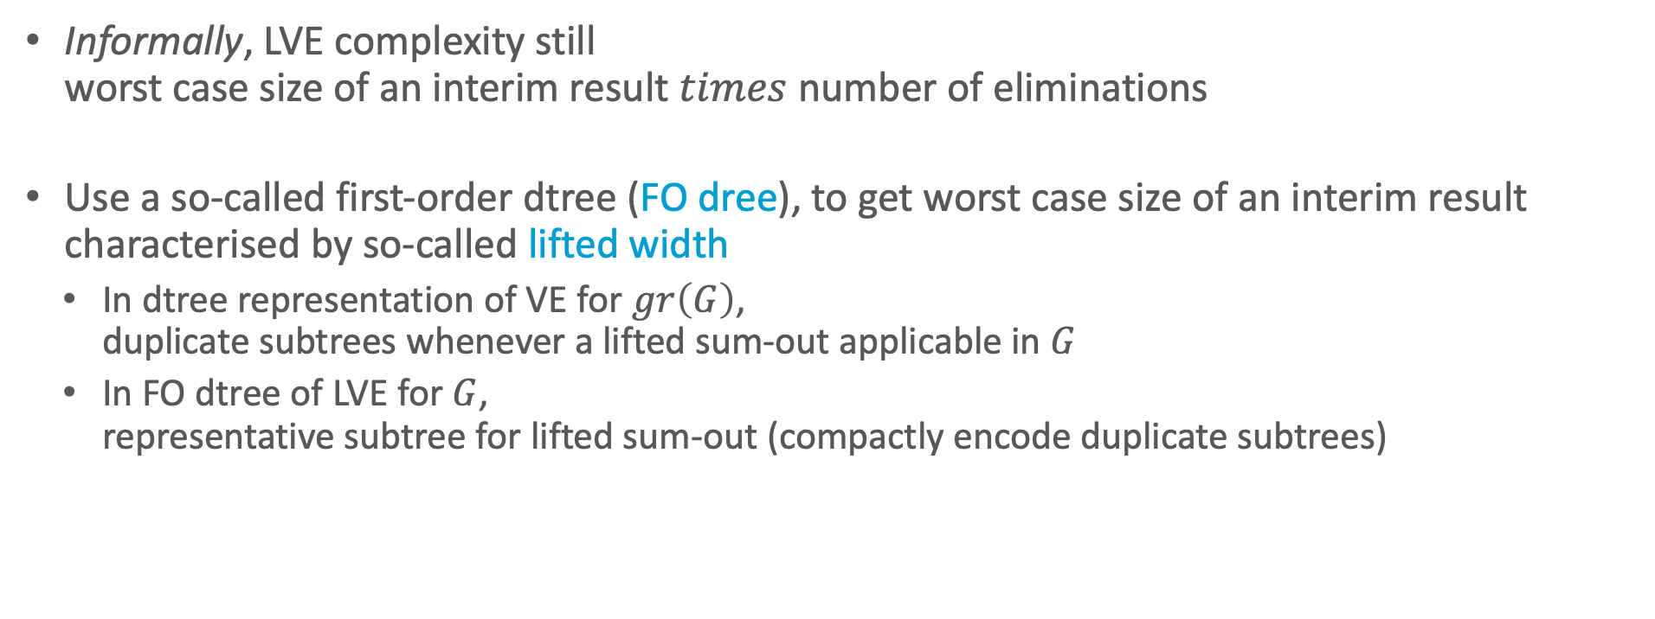
Complexity of Probabilistic Inference in PRMs
Informally, LVE complexity still
worst case size of an interim result $times$ number of eliminations
Use a so-called first-order dtree (FO dree), to get worst case size of an interim result characterised by so-called lifted width
  In dtree representation of VE for $gr\left(G\right)$,
  duplicate subtrees whenever a lifted sum-out applicable in $G$
  In FO dtree of LVE for $G$,
  representative subtree for lifted sum-out (compactly encode duplicate subtrees)

Slide 44

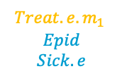
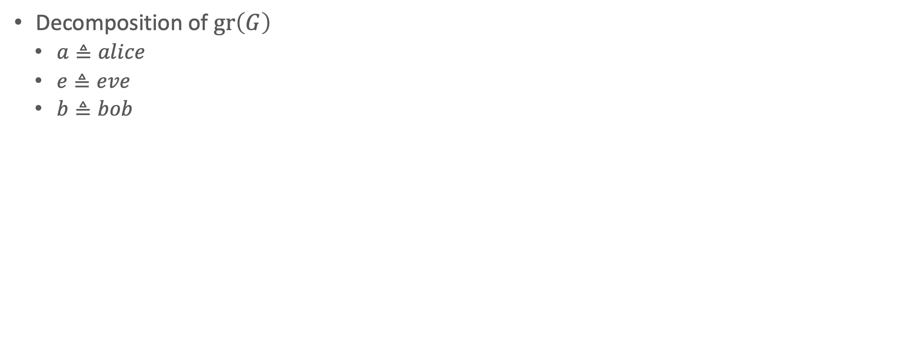






















Dtree with Repeating Structures
Aim for a node that basically says:
$∀x$ in this submodel
Decomposition of $gr\left(G\right)$
  $a≜alice$
  $e≜eve$
  $b≜bob$
Duplicated for $alice, bob$, i.e., for each $x$ that is indistinguishable
Duplicated for each $m_{i}$, i.e., for each $m$ that is indistinguishable
$$Epid$$
$$Sick.a$$
$$Epid$$
$$Sick.e$$
$$Epid$$
$$Sick.b$$
$$Epid$$
$$Acc.chem$$
$$Epid$$
$$Acc.nucl$$
$$Epid$$
$$Acc.chem$$
$$Travel.a$$
$$Epid$$
$$Sick.a$$
$$Treat.a.m_{1}$$
$$Epid$$
$$Sick.a$$
$$Treat.a.m_{2}$$
$$Epid$$
$$Sick.a$$
$$Travel.e$$
$$Epid$$
$$Sick.e$$
$$Treat.e.m_{1}$$
$$Epid$$
$$Sick.e$$
$$Treat.e.m_{2}$$
$$Epid$$
$$Sick.e$$
$$Travel.b$$
$$Epid$$
$$Sick.b$$
$$Treat.b.m_{1}$$
$$Epid$$
$$Sick.b$$
$$Treat.b.m_{2}$$
$$Epid$$
$$Sick.b$$
$$Nat.fire$$
$$Epid$$
$$Acc.chem$$
$$Acc.nucl$$
$$Nat.flood$$
$$Epid$$
$$Acc.chem$$
$$Acc.nucl$$
$$f_{2}$$
$$f_{3}$$
$$f_{3}$$
$$f_{2}$$
$$f_{3}$$
$$f_{3}$$
$$f_{2}$$
$$f_{3}$$
$$f_{3}$$
$$f_{0}$$
$$f_{1}$$
$$f_{1}$$
$$f_{1}$$
$$f_{1}$$

Slide 45
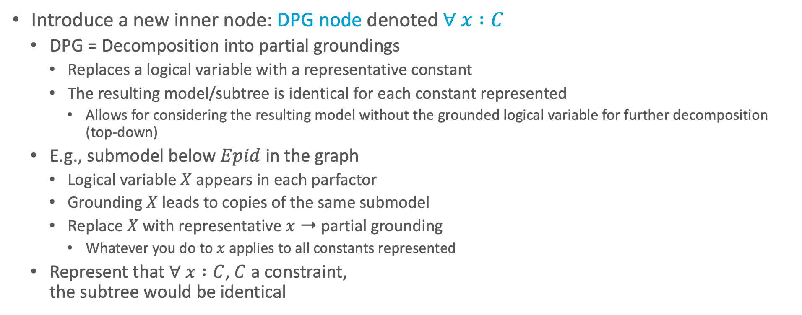
Decomposition into Partial Groundings
Introduce a new inner node: DPG node denoted $∀ x :C$
  DPG = Decomposition into partial groundings
    Replaces a logical variable with a representative constant
    The resulting model/subtree is identical for each constant represented
      Allows for considering the resulting model without the grounded logical variable for further decomposition (top-down)
  E.g., submodel below $Epid$ in the graph
    Logical variable $X$ appears in each parfactor
    Grounding $X$ leads to copies of the same submodel
    Replace $X$ with representative $x$ ➝ partial grounding
      Whatever you do to $x$ applies to all constants represented
  Represent that $∀ x :C$, $C$ a constraint,
  the subtree would be identical
$$Nat\left(D\right)$$
$$Acc\left(I\right)$$
$$g_{1}$$
$$Epid$$
$$g_{0}$$
$$Travel\left(X\right)$$
$$Treat\left(X,M\right)$$
$$g_{2}$$
$$g_{3}$$
$$Sick\left(X\right)$$

Slide 46
FO Dtree Construction
Recursively, starting with $G$ as the current model $G^{′}$ at the root
  Check if there exists logical variable $X$ that allows for a DPG in $G^{′}$
    If so, make current node a DPG node $T_{X}$ for $X$, replace $X$ with representative $x$, i.e., apply $θ=\left\{X→x\right\}$ to $G^{′}$, add child node $T_{x}$with $G^{′}=Gθ$ as current model
      If parent node is a DPG node $T_{X^{′}}$ as well, with current node being $T_{x^{′}}$, add new DPG node $T_{X}$ as child of $T_{x^{′}}$
  Otherwise: Partition $G^{′}$ on logical variables (if exist) or random variables into ${\left\{G_{i}^{′}\right\}}_{i=1}^{n}$
    Add a child node for each $G_{i}^{′}$ with $G_{i}^{′}$ as current model
Until
  All logical variables replaced by representatives
  and
  Only one parfactor per partition
$$Nat\left(D\right)$$
$$Acc\left(I\right)$$
$$g_{1}$$
$$Epid$$
$$g_{0}$$
$$Travel\left(X\right)$$
$$Treat\left(X,M\right)$$
$$g_{2}$$
$$g_{3}$$
$$Sick\left(X\right)$$

Slide 47


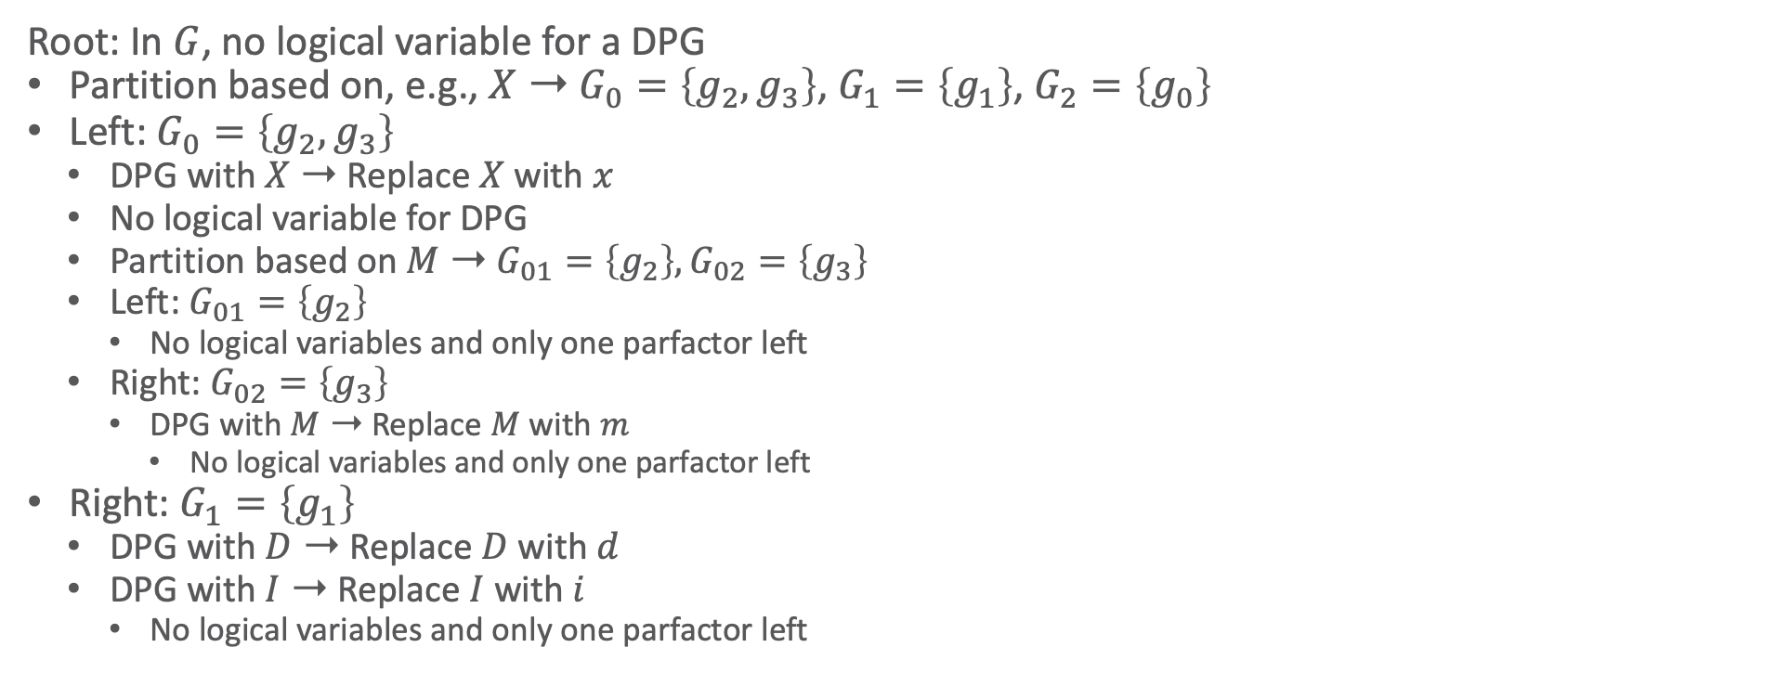














FO Dtree: Example
$$Nat\left(D\right)$$
$$Acc\left(I\right)$$
$$d$$
$$i$$
$$g_{1}$$
$$Epid$$
$$g_{0}$$
$$Travel\left(X\right)$$
$$Treat\left(X,M\right)$$
Root: In $G$, no logical variable for a DPG
Partition based on, e.g., $X$ ➝ $G_{0}=\left\{g_{2},g_{3}\right\}$, $G_{1}=\left\{g_{1}\right\}$, $G_{2}=\left\{g_{0}\right\}$
Left: $G_{0}=\left\{g_{2},g_{3}\right\}$
  DPG with $X$ ➝ Replace $X$ with $x$
  No logical variable for DPG
  Partition based on $M$ ➝ $G_{01}=\left\{g_{2}\right\},G_{02}=\left\{g_{3}\right\}$
  Left: $G_{01}=\left\{g_{2}\right\}$
    No logical variables and only one parfactor left
  Right: $G_{02}=\left\{g_{3}\right\}$
    DPG with $M$ ➝ Replace $M$ with $m$
        No logical variables and only one parfactor left
Right: $G_{1}=\left\{g_{1}\right\}$
  DPG with $D$ ➝ Replace $D$ with $d$
  DPG with $I$ ➝ Replace $I$ with $i$
    No logical variables and only one parfactor left
$$x$$
$$g_{2}$$
$$g_{3}$$
$$x$$
$$m$$
$$Sick\left(X\right)$$
$$x$$
root
$$∀x :⊤$$
$$T_{X}$$
$$∀d :⊤$$
$$T_{D}$$
$$T_{x}$$
$$T_{d}$$
$$∀m :⊤$$
$$T_{M}$$
$$∀i :⊤$$
$$T_{I}$$
$$T_{m}$$
$$T_{i}$$
$$g_{2}$$
$$g_{3}$$
$$g_{0}$$
$$g_{1}$$

Slide 48
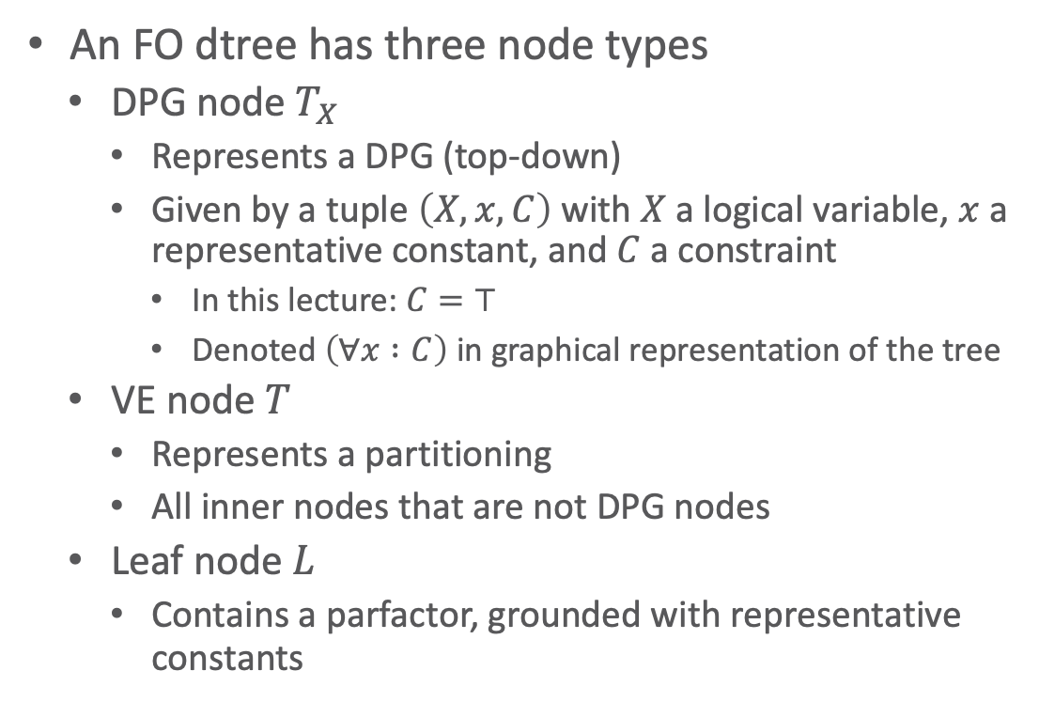
FO Dtree Definition
$$Nat\left(D\right)$$
$$Acc\left(I\right)$$
$$g_{1}$$
$$Epid$$
$$g_{0}$$
An FO dtree has three node types
  DPG node $T_{X}$
    Represents a DPG (top-down)
    Given by a tuple $\left(X,x,C\right)$ with $X$ a logical variable, $x$ a representative constant, and $C$ a constraint
      In this lecture: $C=⊤$
      Denoted $\left(∀x :C\right)$ in graphical representation of the tree
  VE node $T$
    Represents a partitioning
    All inner nodes that are not DPG nodes
  Leaf node $L$
    Contains a parfactor, grounded with representative constants
$$Travel\left(X\right)$$
$$Treat\left(X,M\right)$$
$$g_{2}$$
$$g_{3}$$
$$Sick\left(X\right)$$
root
$$∀x :⊤$$
$$T_{X}$$
$$∀d :⊤$$
$$T_{D}$$
$$T_{x}$$
$$T_{d}$$
$$∀m :⊤$$
$$T_{M}$$
$$∀i :⊤$$
$$T_{I}$$
$$T_{m}$$
$$T_{i}$$
$$g_{2}$$
$$g_{3}$$
$$g_{0}$$
$$g_{1}$$

Slide 49
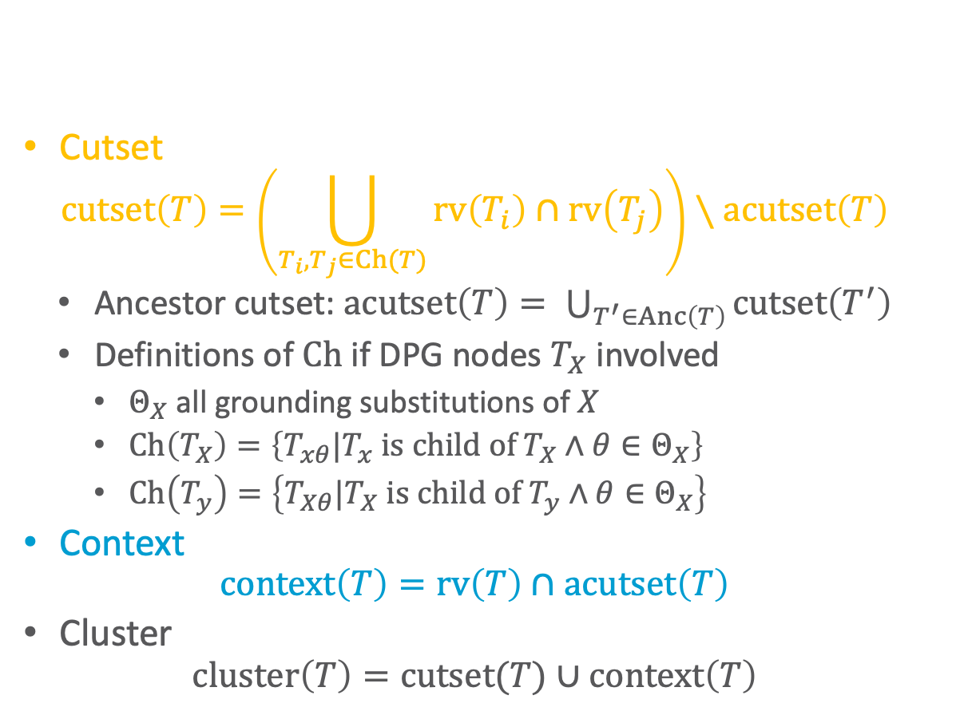


FO Dtree Properties (as before)
$$Nat\left(D\right)$$
$$Acc\left(I\right)$$
$$g_{1}$$
$$Epid$$
$$g_{0}$$
Cutset
  $$cutset\left(T\right)=\left(\bigcup_{T_{i},T_{j}∈Ch(T)}{rv\left(T_{i}\right)∩rv\left(T_{j}\right)}\right)∖acutset\left(T\right)$$
  Ancestor cutset: $acutset\left(T\right)= \bigcup_{T^{′}∈Anc\left(T\right)}{cutset\left(T^{′}\right)}$
  Definitions of $Ch$ if DPG nodes $T_{X}$ involved
    $Θ_{X}$ all grounding substitutions of $X$
    $Ch\left(T_{X}\right)=\left\{T_{xθ}|T_{x} \text{is} \text{child} \text{of} T_{X}∧θ∈Θ_{X}\right\}$
    $Ch\left(T_{y}\right)=\left\{T_{Xθ}|T_{X} \text{is} \text{child} \text{of} T_{y}∧θ∈Θ_{X}\right\}$
Context
  $$context\left(T\right)=rv\left(T\right)∩acutset\left(T\right)$$
Cluster
  $$cluster\left(T\right)=cutset(T)∪context\left(T\right)$$
$$Travel\left(X\right)$$
$$Treat\left(X,M\right)$$
$$g_{2}$$
$$g_{3}$$
$$Sick\left(X\right)$$
$$Epid$$
root
$$∅$$
$$∅$$
$$∀x :⊤$$
$$T_{X}$$
$$Acc\left(I\right)$$
$$∀d :⊤$$
$$T_{D}$$
$$Epid$$
$$Epid$$
$$Sick\left(x\right)$$
$$T_{x}$$
$$Nat\left(d\right)$$
$$T_{d}$$
$$Epid$$
$$Acc\left(I\right),Epid$$
$$Travel\left(x\right)$$
$$∅$$
$$∀m :⊤$$
$$∅$$
$$∀i :⊤$$
$$Sick\left(x\right)$$
$$Epid$$
$$Sick\left(x\right)$$
$$Epid$$
$$T_{M}$$
$$Nat\left(d\right)$$
$$Acc\left(I\right),Epid$$
$$T_{I}$$
$$Treat\left(x,m\right)$$
$$∅$$
$$Sick\left(x\right)$$
$$Epid$$
$$T_{m}$$
$$Nat\left(d\right)$$
$$Acc\left(i\right),Epid$$
$$T_{i}$$
$$g_{2}$$
$$g_{3}$$
$$g_{0}$$
$$g_{1}$$

Slide 50
FO dtree: Bottom-up Interpretation
$$Nat\left(D\right)$$
$$Acc\left(I\right)$$
$$g_{1}$$
$$Epid$$
$$g_{0}$$
$$Travel\left(X\right)$$
$$Treat\left(X,M\right)$$
If only lifted summing out and multiplication involved
  VE node: (Multiplication), elimination
  DPG node: Exponentiation
  Cutset and context interpretation
    Cutset of DPG child VE node:
    PRV summed out in representative summing out
    Cutset of DPG node:
    Exponentiation for logical variable of DPG node
    Context:
    All other PRVs involved at this point in operation
$$g_{2}$$
$$g_{3}$$
$$Sick\left(X\right)$$
$$Epid$$
root
$$∅$$
$$∅$$
$$∀x :⊤$$
$$T_{X}$$
$$Acc\left(I\right)$$
$$∀d :⊤$$
$$T_{D}$$
$$Epid$$
$$Epid$$
$$Sick\left(x\right)$$
$$T_{x}$$
$$Nat\left(d\right)$$
$$T_{d}$$
$$Epid$$
$$Acc\left(I\right),Epid$$
$$Travel\left(x\right)$$
$$∅$$
$$∀m :⊤$$
$$∅$$
$$∀i :⊤$$
$$Sick\left(x\right)$$
$$Epid$$
$$Sick\left(x\right)$$
$$Epid$$
$$T_{M}$$
$$Nat\left(d\right)$$
$$Acc\left(I\right),Epid$$
$$T_{I}$$
$$Treat\left(x,m\right)$$
$$∅$$
$$Sick\left(x\right)$$
$$Epid$$
$$T_{m}$$
$$Nat\left(d\right)$$
$$Acc\left(i\right),Epid$$
$$T_{i}$$
$$g_{2}$$
$$g_{3}$$
$$g_{0}$$
$$g_{1}$$
Notes:
If only lifted summing out and multiplication involved
Cutset interpretation works as before
VE node: cutset holds the PRV eliminated in a representative summing out
DPG node above: cutset empty as no sum-out involved but exponentiation w.r.t. the logical variable of the DPG

Slide 51








FO dtree: Bottom-up Interpretation
$$Nat\left(D\right)$$
$$Acc\left(I\right)$$
$$g_{1}$$
$$Epid$$
$$g_{0}$$
If DPG logical variable occurs in the context of its DPG node:
Count conversion necessary!
  E.g., $Acc\left(I\right)$ in context of DPG node $T_{I}$
  Shows “only” that PRV not directly eliminable
    Occurs when eliminating
    $Nat\left(d\right)$ at $T_{d}$
    No direct interpretation
    in terms of LVE operations
  Rework FO dtree to represent
  calculations in count-converted
  model
    E.g., consider model with
    $\#_{I}\left[Acc\left(I\right)\right]$ instead of $Acc\left(I\right)$
$$Travel\left(X\right)$$
$$Treat\left(X,M\right)$$
$$g_{2}$$
$$g_{3}$$
$$Sick\left(X\right)$$
$$Epid$$
root
$$∅$$
$$∅$$
$$∀x :⊤$$
$$T_{X}$$
$$Acc\left(I\right)$$
$$∀d :⊤$$
$$T_{D}$$
$$Epid$$
$$Epid$$
$$\#_{I}\left[Acc\left(I\right)\right]$$
$$Sick\left(x\right)$$
$$Nat\left(d\right)$$
$$Epid$$
$$Epid$$
$$T_{x}$$
$$Acc\left(I\right),Epid$$
$$T_{d}$$
$$∅$$
$$∀d :⊤$$
$$T_{D}$$
$$Travel\left(x\right)$$
$$∅$$
$$∀m :⊤$$
$$∅$$
$$∀i :⊤$$
$$\#_{I}\left[Acc\left(I\right)\right]$$
$$Epid$$
$$Sick\left(x\right)$$
$$Epid$$
$$Sick\left(x\right)$$
$$Epid$$
$$T_{M}$$
$$Nat\left(d\right)$$
$$Acc\left(I\right),Epid$$
$$T_{I}$$
$$Nat\left(d\right)$$
$$Treat\left(x,m\right)$$
$$∅$$
$$\#_{I}\left[Acc\left(I\right)\right]$$
$$Epid$$
$$T_{d}$$
$$Sick\left(x\right)$$
$$Epid$$
$$T_{m}$$
$$Nat\left(d\right)$$
$$Acc\left(i\right),Epid$$
$$T_{i}$$
$$g_{1}$$
$$g_{2}$$
$$g_{3}$$
$$g_{0}$$
$$g_{1}$$
Notes:
If only lifted summing out and multiplication involved
Cutset interpretation works as before
VE node: cutset holds the PRV eliminated in a representative summing out
DPG node above: cutset empty as no sum-out involved but exponentiation w.r.t. the logical variable of the DPG

Slide 52
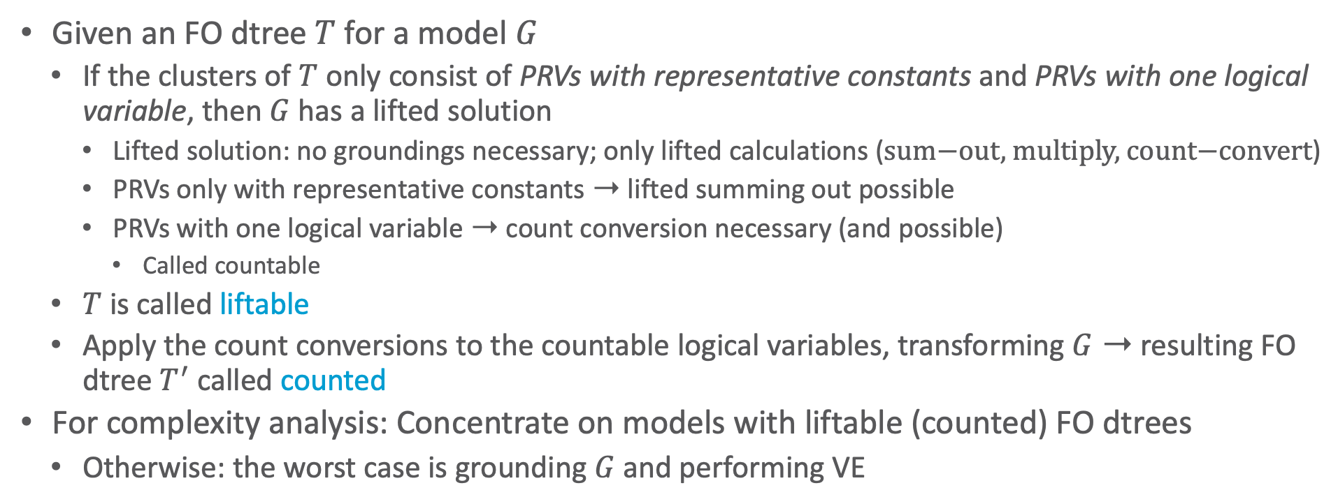
Liftability
Given an FO dtree $T$ for a model $G$
  If the clusters of $T$ only consist of PRVs with representative constants and PRVs with one logical variable, then $G$ has a lifted solution
    Lifted solution: no groundings necessary; only lifted calculations ($\text{sum}\text{−}\text{out}\text{, }\text{multiply}\text{, }\text{count}\text{−}\text{convert}$)
    PRVs only with representative constants ➝ lifted summing out possible
    PRVs with one logical variable ➝ count conversion necessary (and possible)
      Called countable
  $T$ is called liftable
  Apply the count conversions to the countable logical variables, transforming $G$ ➝ resulting FO dtree $T^{′}$ called counted
For complexity analysis: Concentrate on models with liftable (counted) FO dtrees
  Otherwise: the worst case is grounding $G$ and performing VE

Slide 53




































Liftability: Example FO Dtree
$$Nat\left(D\right)$$
$$Acc\left(I\right)$$
$$g_{1}$$
$$Epid$$
$$g_{0}$$
Only PRVs with representative constants or one logical variable in the clusters
➝ liftable
If counting $I$ and reworking the FO dtree
➝ counted, liftable
$$Travel\left(X\right)$$
$$Treat\left(X,M\right)$$
$$g_{2}$$
$$g_{3}$$
$$Sick\left(X\right)$$
$$Epid$$
root
$$Epid$$
root
$$∅$$
$$∅$$
$$∅$$
$$∀x :⊤$$
$$T_{X}$$
$$∅$$
$$∀x :⊤$$
$$T_{X}$$
$$Acc\left(I\right)$$
$$∀d :⊤$$
$$T_{D}$$
$$Epid$$
$$Epid$$
$$Epid$$
$$Sick\left(x\right)$$
$$T_{x}$$
$$\#_{I}\left[Acc\left(i\right)\right]$$
$$Sick\left(x\right)$$
$$T_{x}$$
$$Nat\left(d\right)$$
$$T_{d}$$
$$Epid$$
$$Epid$$
$$Epid$$
$$Acc\left(I\right),Epid$$
$$Travel\left(x\right)$$
$$∅$$
$$∀m :⊤$$
$$∅$$
$$∀d :⊤$$
$$Travel\left(x\right)$$
$$∅$$
$$∀m :⊤$$
$$∅$$
$$∀i :⊤$$
$$Sick\left(x\right)$$
$$Epid$$
$$Sick\left(x\right)$$
$$Epid$$
$$T_{M}$$
$$\#_{I}\left[Acc\left(i\right)\right]$$
$$Epid$$
$$T_{D}$$
$$Sick\left(x\right)$$
$$Epid$$
$$Sick\left(x\right)$$
$$Epid$$
$$T_{M}$$
$$Nat\left(d\right)$$
$$Acc\left(I\right),Epid$$
$$T_{I}$$
$$Treat\left(x,m\right)$$
$$Nat\left(d\right)$$
$$Treat\left(x,m\right)$$
$$∅$$
$$Sick\left(x\right)$$
$$Epid$$
$$T_{m}$$
$$T_{d}$$
$$Sick\left(x\right)$$
$$Epid$$
$$T_{m}$$
$$Nat\left(d\right)$$
$$Acc\left(i\right),Epid$$
$$T_{i}$$
$$\#_{I}\left[Acc\left(i\right)\right]$$
$$Epid$$
$$g_{2}$$
$$g_{3}$$
$$g_{0}$$
$$g_{1}$$
$$g_{2}$$
$$g_{3}$$
$$g_{0}$$
$$g_{1}$$
counted, liftable
liftable

Slide 54


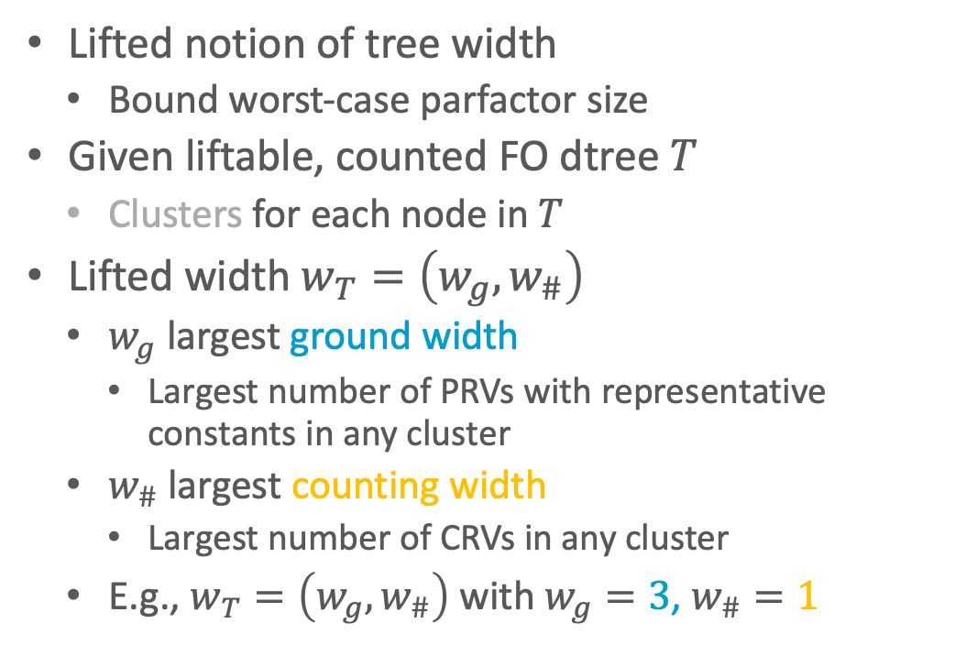






Lifted Width
$$Nat\left(D\right)$$
$$Acc\left(I\right)$$
$$g_{1}$$
$$Epid$$
$$g_{0}$$
Lifted notion of tree width
  Bound worst-case parfactor size
Given liftable, counted FO dtree $T$
  Clusters for each node in $T$
Lifted width $w_{T}=\left(w_{g},w_{\#}\right)$
  $w_{g}$ largest ground width
    Largest number of PRVs with representative constants in any cluster
  $w_{\#}$ largest counting width
    Largest number of CRVs in any cluster
  E.g., $w_{T}=\left(w_{g},w_{\#}\right)$ with $w_{g}=3$, $w_{\#}=1$
$$Travel\left(X\right)$$
$$Treat\left(X,M\right)$$
$$g_{2}$$
$$g_{3}$$
$$Sick\left(X\right)$$
$$Epid$$
root
$$∅$$
$$∅$$
$$∀x :⊤$$
$$T_{X}$$
$$Epid$$
$$Sick\left(x\right)$$
$$T_{x}$$
$$\#_{I}\left[Acc\left(i\right)\right]$$
$$Epid$$
$$Epid$$
$$Travel\left(x\right)$$
$$∅$$
$$∀m :⊤$$
$$∅$$
$$∀d :⊤$$
$$Sick\left(x\right)$$
$$Epid$$
$$Sick\left(x\right)$$
$$Epid$$
$$T_{M}$$
$$\#_{I}\left[Acc\left(i\right)\right]$$
$$Epid$$
$$T_{D}$$
$$Treat\left(x,m\right)$$
$$Nat\left(d\right)$$
$$Sick\left(x\right)$$
$$Epid$$
$$T_{m}$$
$$\#_{I}\left[Acc\left(i\right)\right]$$
$$Epid$$
$$T_{d}$$
$$g_{2}$$
$$g_{3}$$
$$g_{0}$$
$$g_{1}$$

Slide 55
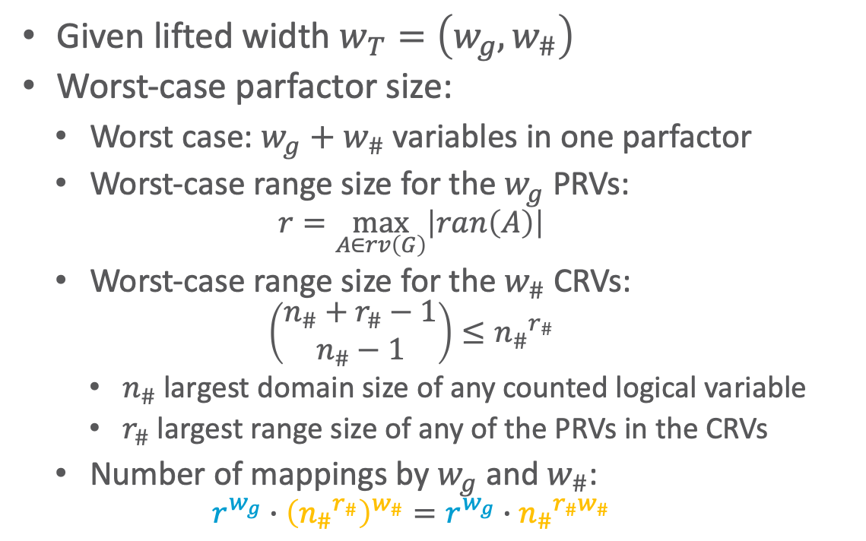
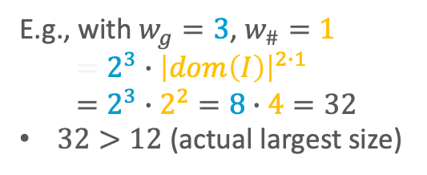
Worst-case Parfactor Size
  E.g., with $w_{g}=3$, $w_{\#}=1$
  $$=2^{3}∙{\left|dom\left(I\right)\right|}^{2∙1} \\ =2^{3}∙2^{2}=8∙4=32$$
  $32>12$ (actual largest size)
$$Nat\left(D\right)$$
$$Acc\left(I\right)$$
$$g_{1}$$
$$Epid$$
$$g_{0}$$
Given lifted width $w_{T}=\left(w_{g},w_{\#}\right)$
Worst-case parfactor size:
  Worst case: $w_{g}+w_{\#}$ variables in one parfactor
  Worst-case range size for the $w_{g}$ PRVs:
    $$r=\max_{A∈rv\left(G\right)}\left|ran\left(A\right)\right|$$
  Worst-case range size for the $w_{\#}$ CRVs:
    $$\left(\begin{aligned}n_{\#}+r_{\#}−1 \\ n_{\#}−1\end{aligned}\right)≤{n_{\#}}^{r_{\#}}$$
    $n_{\#}$ largest domain size of any counted logical variable
    $r_{\#}$ largest range size of any of the PRVs in the CRVs
  Number of mappings by $w_{g}$ and $w_{\#}$:
    $$r^{w_{g}}∙{\left({n_{\#}}^{r_{\#}}\right)}^{w_{\#}}=r^{w_{g}}∙{n_{\#}}^{r_{\#}w_{\#}}$$
$$Travel\left(X\right)$$
$$Treat\left(X,M\right)$$
$$g_{2}$$
$$g_{3}$$
$$Sick\left(X\right)$$
$$Epid$$
root
$$∅$$
$$∅$$
$$∀x :⊤$$
$$T_{X}$$
$$Epid$$
$$Sick\left(x\right)$$
$$T_{x}$$
$$\#_{I}\left[Acc\left(i\right)\right]$$
$$Epid$$
$$Epid$$
$$Travel\left(x\right)$$
$$∅$$
$$∀m :⊤$$
$$∅$$
$$∀d :⊤$$
$$Sick\left(x\right)$$
$$Epid$$
$$Sick\left(x\right)$$
$$Epid$$
$$T_{M}$$
$$\#_{I}\left[Acc\left(i\right)\right]$$
$$Epid$$
$$T_{D}$$
$$Treat\left(x,m\right)$$
$$Nat\left(d\right)$$
$$Sick\left(x\right)$$
$$Epid$$
$$T_{m}$$
$$\#_{I}\left[Acc\left(i\right)\right]$$
$$Epid$$
$$T_{d}$$
$$g_{2}$$
$$g_{3}$$
$$g_{0}$$
$$g_{1}$$

Slide 56
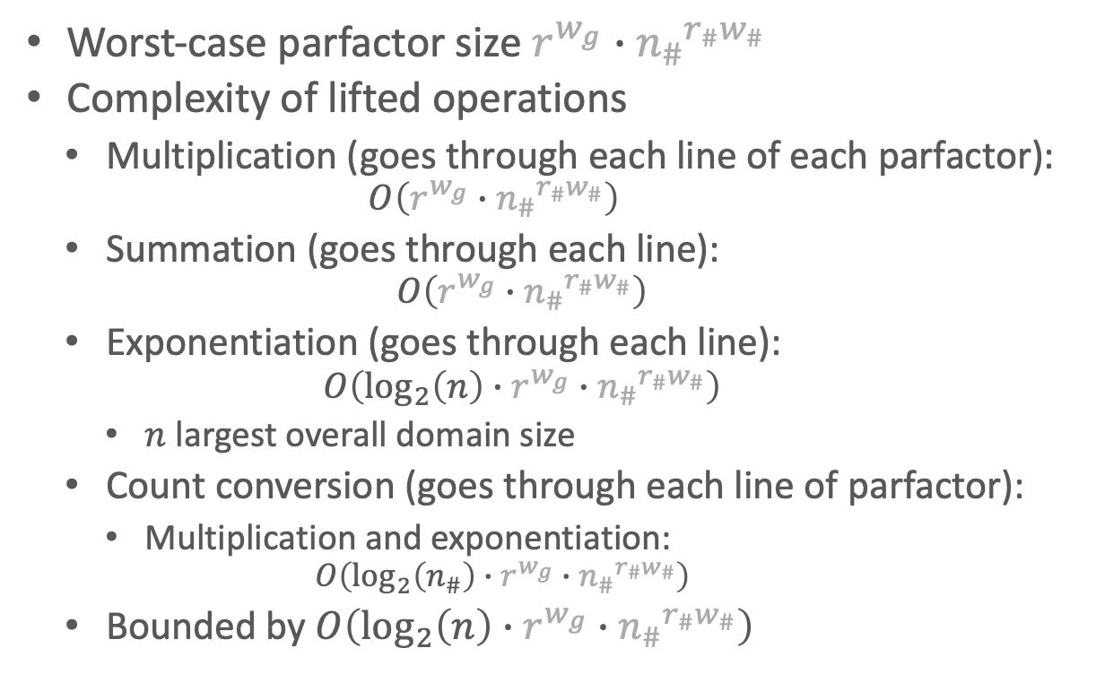
Complexity
  E.g., with $w_{g}=3$, $w_{\#}=1$
  $$r^{w_{g}}∙{n_{\#}}^{r_{\#}w_{\#}}=32$$
  $\log_{2}\left(\left|dom\left(X\right)\right|\right)∙32$
  $\log_{2}\left(\left|dom\left(I\right)\right|\right)∙32$
$$Nat\left(D\right)$$
$$Acc\left(I\right)$$
$$g_{1}$$
$$Epid$$
$$g_{0}$$
Worst-case parfactor size $r^{w_{g}}∙{n_{\#}}^{r_{\#}w_{\#}}$
Complexity of lifted operations
  Multiplication (goes through each line of each parfactor):
    $$O\left(r^{w_{g}}∙{n_{\#}}^{r_{\#}w_{\#}}\right)$$
  Summation (goes through each line):
    $$O\left(r^{w_{g}}∙{n_{\#}}^{r_{\#}w_{\#}}\right)$$
  Exponentiation (goes through each line):
    $$O\left(\log_{2}\left(n\right)∙r^{w_{g}}∙{n_{\#}}^{r_{\#}w_{\#}}\right)$$
    $n$ largest overall domain size
  Count conversion (goes through each line of parfactor):
    Multiplication and exponentiation:
      $$O\left(\log_{2}\left(n_{\#}\right)∙r^{w_{g}}∙{n_{\#}}^{r_{\#}w_{\#}}\right)$$
  Bounded by $O\left(\log_{2}\left(n\right)∙r^{w_{g}}∙{n_{\#}}^{r_{\#}w_{\#}}\right)$
$$Travel\left(X\right)$$
$$Treat\left(X,M\right)$$
$$g_{2}$$
$$g_{3}$$
$$Sick\left(X\right)$$
$$Epid$$
root
$$∅$$
$$∅$$
$$∀x :⊤$$
$$T_{X}$$
$$Epid$$
$$Sick\left(x\right)$$
$$T_{x}$$
$$\#_{I}\left[Acc\left(i\right)\right]$$
$$Epid$$
$$Epid$$
$$Travel\left(x\right)$$
$$∅$$
$$∀m :⊤$$
$$∅$$
$$∀d :⊤$$
$$Sick\left(x\right)$$
$$Epid$$
$$Sick\left(x\right)$$
$$Epid$$
$$T_{M}$$
$$\#_{I}\left[Acc\left(i\right)\right]$$
$$Epid$$
$$T_{D}$$
$$Treat\left(x,m\right)$$
$$Nat\left(d\right)$$
$$Sick\left(x\right)$$
$$Epid$$
$$T_{m}$$
$$\#_{I}\left[Acc\left(i\right)\right]$$
$$Epid$$
$$T_{d}$$
$$g_{2}$$
$$g_{3}$$
$$g_{0}$$
$$g_{1}$$

Slide 57
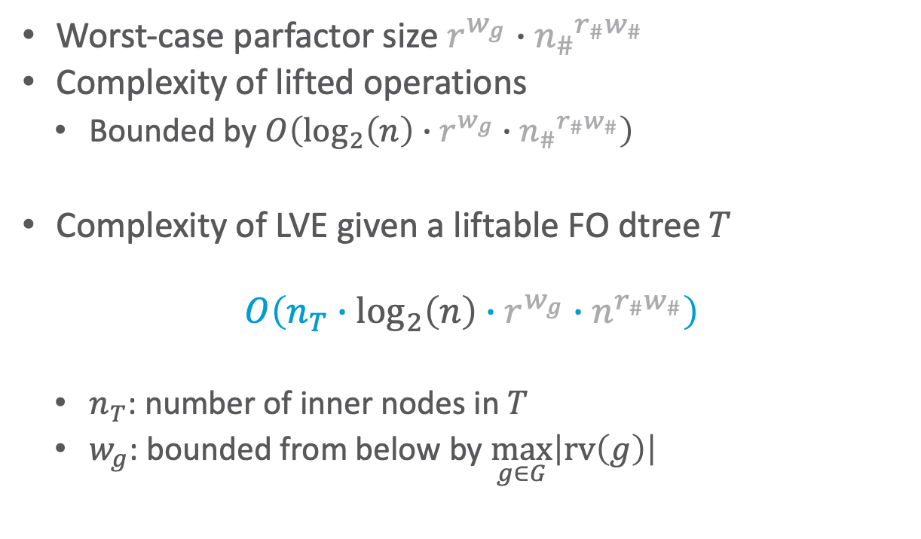
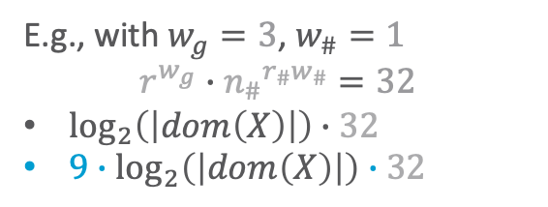
Complexity
  E.g., with $w_{g}=3$, $w_{\#}=1$
  $$r^{w_{g}}∙{n_{\#}}^{r_{\#}w_{\#}}=32$$
  $\log_{2}\left(\left|dom\left(X\right)\right|\right)∙32$
  $9∙\log_{2}\left(\left|dom\left(X\right)\right|\right)∙32$
$$Nat\left(D\right)$$
$$Acc\left(I\right)$$
$$g_{1}$$
$$Epid$$
$$g_{0}$$
Worst-case parfactor size $r^{w_{g}}∙{n_{\#}}^{r_{\#}w_{\#}}$
Complexity of lifted operations
  Bounded by $O\left(\log_{2}\left(n\right)∙r^{w_{g}}∙{n_{\#}}^{r_{\#}w_{\#}}\right)$
Complexity of LVE given a liftable FO dtree $T$
$$O\left(n_{T}∙\log_{2}\left(n\right)∙r^{w_{g}}∙n^{r_{\#}w_{\#}}\right)$$
  $n_{T}$: number of inner nodes in $T$
  $w_{g}$: bounded from below by $\max_{g∈G}\left|rv\left(g\right)\right|$
$$Travel\left(X\right)$$
$$Treat\left(X,M\right)$$
$$g_{2}$$
$$g_{3}$$
$$Sick\left(X\right)$$
$$Epid$$
root
$$∅$$
$$∅$$
$$∀x :⊤$$
$$T_{X}$$
$$Epid$$
$$Sick\left(x\right)$$
$$T_{x}$$
$$\#_{I}\left[Acc\left(i\right)\right]$$
$$Epid$$
$$Epid$$
$$Travel\left(x\right)$$
$$∅$$
$$∀m :⊤$$
$$∅$$
$$∀d :⊤$$
$$Sick\left(x\right)$$
$$Epid$$
$$Sick\left(x\right)$$
$$Epid$$
$$T_{M}$$
$$\#_{I}\left[Acc\left(i\right)\right]$$
$$Epid$$
$$T_{D}$$
$$Treat\left(x,m\right)$$
$$Nat\left(d\right)$$
$$Sick\left(x\right)$$
$$Epid$$
$$T_{m}$$
$$\#_{I}\left[Acc\left(i\right)\right]$$
$$Epid$$
$$T_{d}$$
$$g_{2}$$
$$g_{3}$$
$$g_{0}$$
$$g_{1}$$

Slide 58
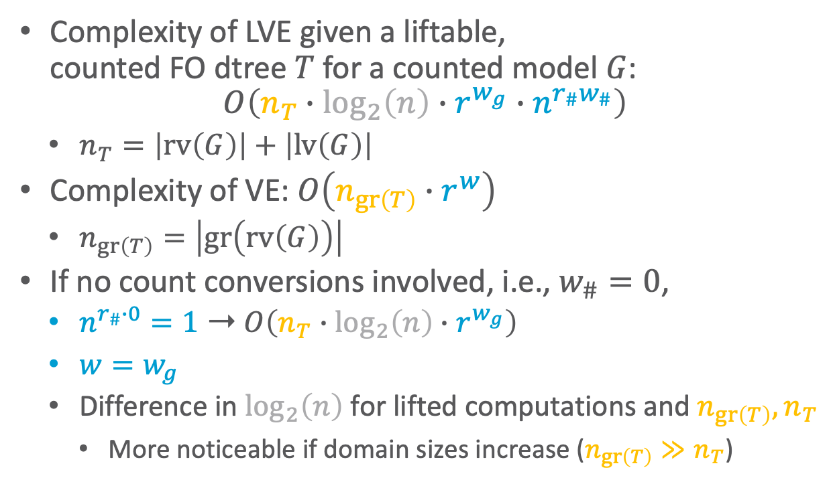
Comparison
$$Nat\left(D\right)$$
$$Acc\left(I\right)$$
$$g_{1}$$
$$Epid$$
$$g_{0}$$
Complexity of LVE given a liftable,
counted FO dtree $T$ for a counted model $G$:
$$O\left(n_{T}∙\log_{2}\left(n\right)∙r^{w_{g}}∙n^{r_{\#}w_{\#}}\right)$$
  $n_{T}=\left|rv\left(G\right)\right|+\left|lv\left(G\right)\right|$
Complexity of VE: $O\left(n_{gr\left(T\right)}∙r^{w}\right)$
  $n_{gr\left(T\right)}=\left|gr\left(rv\left(G\right)\right)\right|$
If no count conversions involved, i.e., $w_{\#}=0$,
  $n^{r_{\#}∙0}=1$ ➝ $O\left(n_{T}∙\log_{2}\left(n\right)∙r^{w_{g}}\right)$
  $w=w_{g}$
  Difference in $\log_{2}\left(n\right)$ for lifted computations and $n_{gr\left(T\right)},n_{T}$
    More noticeable if domain sizes increase ($n_{gr\left(T\right)}≫n_{T}$)
$$Travel\left(X\right)$$
$$Treat\left(X,M\right)$$
$$g_{2}$$
$$g_{3}$$
$$Sick\left(X\right)$$
$$Epid$$
root
$$∅$$
$$∅$$
$$∀x :⊤$$
$$T_{X}$$
$$Epid$$
$$Sick\left(x\right)$$
$$T_{x}$$
$$\#_{I}\left[Acc\left(i\right)\right]$$
$$Epid$$
$$Epid$$
$$Travel\left(x\right)$$
$$∅$$
$$∀m :⊤$$
$$∅$$
$$∀d :⊤$$
$$Sick\left(x\right)$$
$$Epid$$
$$Sick\left(x\right)$$
$$Epid$$
$$T_{M}$$
$$\#_{I}\left[Acc\left(i\right)\right]$$
$$Epid$$
$$T_{D}$$
$$Treat\left(x,m\right)$$
$$Nat\left(d\right)$$
$$Sick\left(x\right)$$
$$Epid$$
$$T_{m}$$
$$\#_{I}\left[Acc\left(i\right)\right]$$
$$Epid$$
$$T_{d}$$
$$g_{2}$$
$$g_{3}$$
$$g_{0}$$
$$g_{1}$$

Slide 59
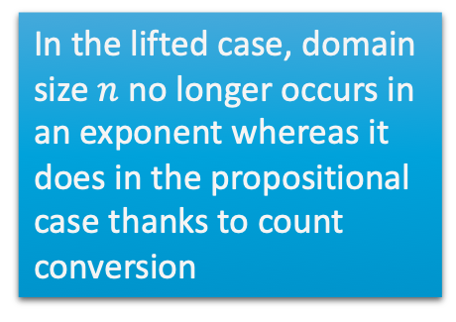
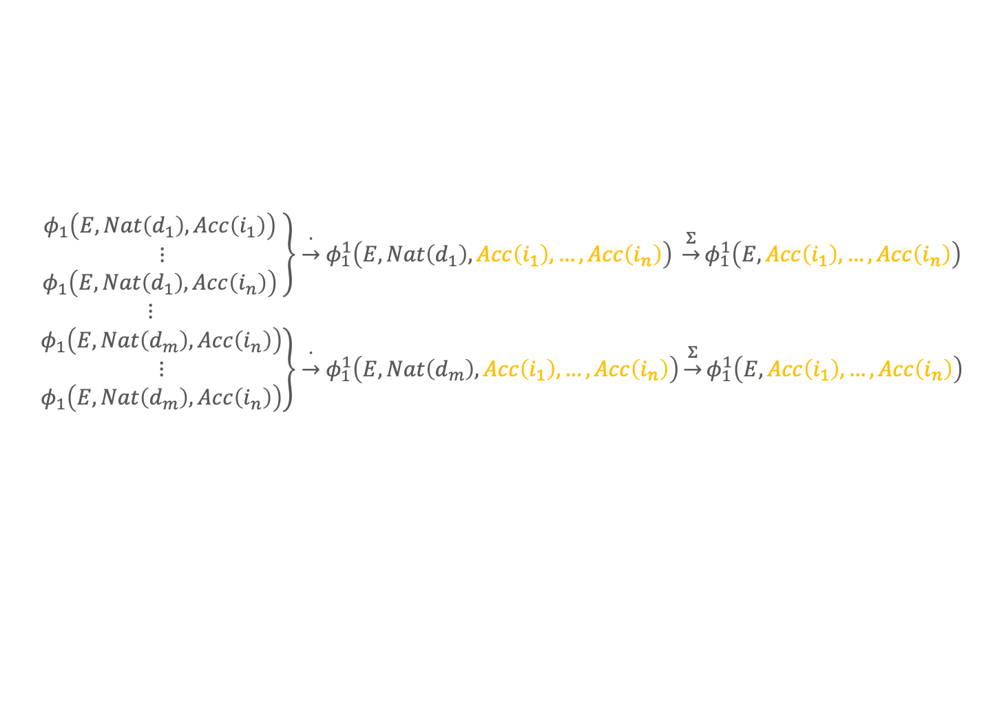
Comparison
$$Nat\left(D\right)$$
$$Acc\left(I\right)$$
$$g_{1}$$
$$Epid$$
$$g_{0}$$
$$Travel\left(X\right)$$
$$Treat\left(X,M\right)$$
If count conversions involved, i.e., $w_{\#}>0$,
  $w≫\left(w_{g}+w_{\#}\right)$
    CRV with counted logical variable of domain size $n$ appears grounded in a factor
    With one count conversion, $O\left(n_{T}∙\log_{2}\left(n\right)∙r^{w_{g}}∙n^{r_{\#}}\right)$ vs. $O\left(n_{gr\left(T\right)}∙r^{n+c}\right)$
      $c$ the number of random variables also occurring in the cluster
      E.g., with $c=2$:
$$g_{2}$$
$$g_{3}$$
$$Sick\left(X\right)$$
      $φ_{1}\left(E, Nat\left(D\right),Acc\left(I\right)\right)$ $\underset{→}{\#} φ_{1}^{\#}\left(E,Nat\left(D\right), \#_{I}\left[Acc\left(I\right)\right] \right) \underset{→}{Σ}φ_{1}\left(E,\#_{I}\left[Acc\left(I\right)\right]\right)$
In the lifted case, domain size $n$ no longer occurs in an exponent whereas it does in the propositional case thanks to count conversion
      $$\left.\begin{aligned}φ_{1}\left(E, Nat\left(d_{1}\right),Acc\left(i_{1}\right)\right) \\ ⋮ \\ φ_{1}\left(E, Nat\left(d_{1}\right),Acc\left(i_{n}\right)\right) \end{aligned}\right\}\underset{→}{∙}φ_{1}^{1}\left(E,Nat\left(d_{1}\right), Acc\left(i_{1}\right),…,Acc\left(i_{n}\right)\right) \underset{→}{Σ}φ_{1}^{1}\left(E,Acc\left(i_{1}\right),…,Acc\left(i_{n}\right)\right)$$
      $⋮$
      $$\left.\begin{aligned}φ_{1}\left(E, Nat\left(d_{m}\right),Acc\left(i_{n}\right)\right) \\ ⋮ \\ φ_{1}\left(E, Nat\left(d_{m}\right),Acc\left(i_{n}\right)\right)\end{aligned}\right\}\underset{→}{∙}φ_{1}^{1}\left(E,Nat\left(d_{m}\right), Acc\left(i_{1}\right),…,Acc\left(i_{n}\right)\right)\underset{→}{Σ}φ_{1}^{1}\left(E,Acc\left(i_{1}\right),…,Acc\left(i_{n}\right)\right)$$
$$E=Epid$$

Slide 60
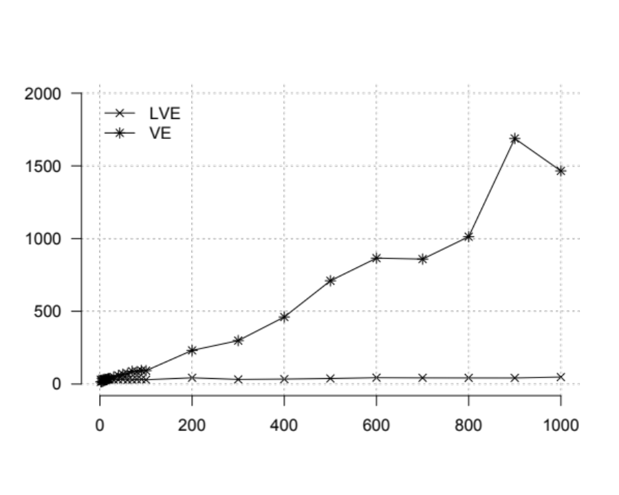
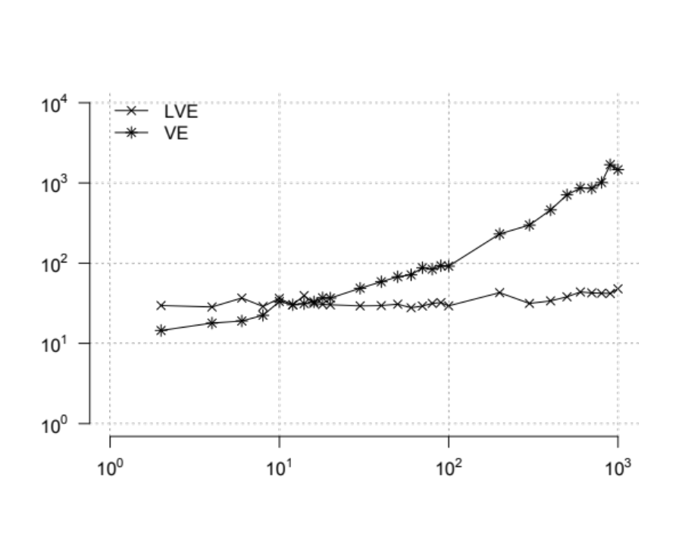









Runtimes: Increasing Domain Sizes
$$Nat\left(D\right)$$
$$Acc\left(I\right)$$
$$g_{1}$$
$$Epid$$
Running example model with all domain sizes 2, except
$\left|dom\left(X\right)\right|∈\{2,4,…, 20, 30,…, 100,200, …,1000\}$
Query: $P\left(Travel\left(x_{1}\right)\right)$
$$g_{0}$$
$$Travel\left(X\right)$$
$$Treat\left(X,M\right)$$
$$g_{2}$$
$$g_{3}$$
$$Sick\left(X\right)$$
  Linear scale
Log scale
Runtimes in milliseconds
Domain size $\left|𝒟\left(X\right)\right|$
Domain size $\left|𝒟\left(X\right)\right|$

Slide 61





Runtimes: Increasing Counted Domain Size
$$Nat\left(D\right)$$
$$Acc\left(I\right)$$
$$g_{1}$$
$$Epid$$
$$g_{0}$$
$$Travel\left(X\right)$$
$$Treat\left(X,M\right)$$
One count conversion, i.e., $w_{\#}=1$,
  $O\left(n_{T}∙\log_{2}\left(n\right)∙r^{w_{g}}∙n^{r_{\#}}\right)$ vs. $O\left(n_{gr\left(T\right)}∙r^{n+c}\right)$
  With domain size of $D$ and $I$ (in $g_{1}$) increasing
$$g_{2}$$
$$g_{3}$$
$$Sick\left(X\right)$$
  Linear scale
Log scale
Runtimes in milliseconds
Domain size $\left|dom\left(D\right)\right|=\left|dom\left(I\right)\right|$
Domain size $\left|dom\left(D\right)\right|=\left|dom\left(I\right)\right|$

Slide 62
Tractability
A query answering problem is tractable
  if it is solved by an efficient algorithm, running in time polynomial in the number of random variables
Assume that the number of random variables is characterised by domain size $n$ and
  In LVE, $n$ does not occur in the exponent: $O\left(n_{T}∙\log_{2}\left(n\right)∙r^{w_{g}}∙n^{r_{\#}w_{\#}}\right)$
  Solving a query answering problem is tractable under liftability
  Runtime still exponential in other terms ($w_{g},w_{\#},r_{\#}$)
More general results by
Mathias Niepert and Guy Van den Broeck. Tractability through Exchangeability: A New Perspective on Efficient Probabilistic Inference. In AAAI-14 Proceedings of the 28th AAAI Conference on Artificial Intelligence, 2014.
  Tractability through Exchangeability

Slide 63


Completeness
Class of models $ℳ$
  Set of all possible models given some model characteristic
An algorithm is complete for a class of models $ℳ$ iff
  No groundings necessary in all models of $ℳ$
    All models allow for a liftable FO dtree
  Then, class called liftable
Existing liftable classes
  $ℳ^{2lv}$:
    Two logical variables per parfactor max
    $$g\left(A\left(X,Y\right),B\left(X,Y\right)\right)$$
    $$g\left(A\left(X,Y\right),C\left(X\right),C(Y)\right), X≠Y$$
    $$g\left(A\left(X,Y\right),D\left(X\right), E(Y)\right)$$
  $ℳ^{1prv}$:
    One logical variable per PRV (arbitrarily many logical variables per parfactor)
    $$g\left(A\left(X\right), B\left(Y\right),C\left(Z\right)\right)$$
  Holds for various lifted algorithms
    E.g., LVE, LJT, FOKC

Slide 64


Completeness
LVE is complete for $ℳ^{1prv}$ with generalised counting
  $ℳ^{1prv}$: One logical variable per PRV
Proof:
  Fact: Only PRVs with one logical variable to eliminate
  Perform count conversion on all logical variables in the model; possible scenarios in each parfactor
    Logical variable is the only one with a particular domain ➝ Standard count conversion applies
    Logical variable occurs in several PRVs without inequality constraints ➝ Generalised Counting 1 applies
    Logical variable occurs in several PRVs with inequality constraints ➝ After count-converting PRVs of Scenario B, Generalised Counting 3 applies
    Afterwards: No uncounted logical variables remain
  Multiply all parfactors into one large parfactor and merge CRVs (Generalised Counting 2)
  Eliminate all merged CRVs (possible since the different CRVs do not overlap after Step 2)
  Eliminate all propositional random variables

Slide 65

Completeness
$$Nat\left(D\right)$$
$$Acc\left(I\right)$$
$$g_{1}$$
$$Epid$$
$$g_{0}$$
$$Travel\left(X\right)$$
$$Treat\left(X,M\right)$$
LVE is complete for $ℳ^{2lv}$
  $ℳ^{2lv}$: Maximum of two logical variables per parfactor
Requires another operator: Group Inversion
  For the case $φ{\left(F\left(X,Y\right),F\left(Y,X\right)\right)}_{|C}$, $C$ encodes $X≠Y$
    Cannot sum out $F\left(X,Y\right)$ independently of $F\left(Y,X\right)$ as they refer to same grounded random variables
    Sums out PRVs $\left\{A_{1},…, A_{k}\right\}$ from $φ{\left(𝒜\right)}_{|C}$ at once where
      $lv\left(A_{1}\right)=…=lv\left(A_{k}\right)=lv(𝒜)$
      $C$ encodes $X_{i}≠X_{j}$for each
      pair of logical variables
      $X_{i},X_{j}$, $dom\left(X_{i}\right)=dom\left(X_{j}\right)$
$$g_{2}$$
$$g_{3}$$
$$Sick\left(X\right)$$
Figure taken from: Nima Taghipour: Lifted Probabilistic Inference by Variable Elimination. PhD Thesis, 2013.
Group Inversion: Nima Taghipour, Daan Fierens, Guy Van den Broeck, Jesse Davis, and Hendrik Blockeel: Completeness Results for Lifted Variable Elimination. In: AISTATS-13 Proceedings of the 16th International Conference on Artificial Intelligence and Statistics, 2013. (or Nima Taghipour’s PhD thesis)

Slide 66

Completeness
$$Nat\left(D\right)$$
$$Acc\left(I\right)$$
$$g_{1}$$
$$Epid$$
$$g_{0}$$
$$Travel\left(X\right)$$
$$Treat\left(X,M\right)$$
LVE is complete for $ℳ^{2lv}$
  $ℳ^{2lv}$: Maximum of two logical variables per parfactor
Proof idea:
  Fact 1: Each parfactor has two logical variables $X,Y$ at most
  Fact 2: Once PRVs with two logical variables are eliminated, model is in $ℳ^{1prv}$
  Multiply all parfactors together that share PRVs with two logical variables
    Preserves the number of logical variables per parfactor, namely, two
  Eliminate each PRV with two logical variables in each parfactor; possible scenarios
    Only PRVs with two logical variables and no inequality constraint ➝ Eliminate using summing out
    PRVs with two logical variables with an inequality constraint ➝ Eliminate using group inversion
    Afterwards: Only PRVs with one logical variable and propositional random variables remain (Fact 2)
  Count logical variables in all parfactors, multiply the parfactors and merge CRVs, eliminate CRVs and propositional random variables (compare proof for completeness of $ℳ^{1prv}$)
$$g_{2}$$
$$g_{3}$$
$$Sick\left(X\right)$$

Slide 67

Completeness
Models with other constellations may be computed without groundings but not all possible models
  E.g., for lifted variable elimination, models with three logical variables
  $$g\left(A\left(X,Y,Z\right), B\left(X,Y\right),C\left(X\right)\right) → liftable$$
  $$g\left(F\left(X,Y\right), F\left(Y,Z\right),K\left(X,Z\right)\right) →not liftable$$
  Not complete for class $ℳ^{3lv}$, i.e., models with three logical variables per parfactor
Completeness results assume a liftable class of queries $𝒬$ and a liftable class of evidence $ℰ$

Slide 68
Interim Summary
(FO) dtrees
  Cutset, context, cluster ➝ (lifted) tree width
  Liftable models
Complexity
  No longer exponential in domain sizes given liftable model ➝ tractability
Completeness
  No groundings for
    Models with two logical variables per parfactor
    Models with one-logical variable PRVs and propositional random variables

Slide 69
Lifting Queries, Junction Trees, Most Probable Assignments
Parameterised queries
Lifted Junction Tree Algorithm (LJT)
Lifted MPE / MAP

Slide 70

What About Parameterised Queries?
Allow logical variables in query terms: $P\left(A_{|C}|T\right)$
  Represents a conjunctive query $P\left(gr\left(A_{|C}\right)|T\right)$
E.g., $P\left(Sick{\left(X\right)}_{|⊤}\right)$ for $P\left(Sick\left(alice\right), Sick\left(eve\right), Sick\left(bob\right)\right)$
$$Nat\left(D\right)$$
$$Acc\left(I\right)$$
$$g_{1}$$
$$Epid$$
$$g_{0}$$
$$Travel\left(X\right)$$
$$Treat\left(X,M\right)$$
$$g_{2}$$
$$g_{3}$$
$$Sick\left(X\right)$$
Tanya B and Ralf Möller: Parameterised Queries and Lifted Query Answering. In: IJCAI-18 Proceedings of the 27th International Joint Conference on Artificial Intelligence, 2018.

Slide 71













Indistinguishable Query Terms
$$Nat\left(D\right)$$
$$Acc\left(I\right)$$
$$g_{1}$$
$$Epid$$
Indistinguishable instances in query:
  $P\left(Sick\left(alice\right), Sick\left(eve\right), Sick\left(bob\right)\right)$
Standard LVE:
  Shattering leads to groundings w.r.t. constants in query
$$g_{0}$$
$$Travel\left(X\right)$$
$$Treat\left(X,M\right)$$
$$g_{2}$$
$$g_{3}$$
$$Sick\left(X\right)$$
$$Nat\left(D\right)$$
$$Acc\left(I\right)$$
$$g_{1}$$
$$f_{2}$$
$$Epid$$
$$f_{2}$$
$$g_{0}$$
$$f_{3}$$
$$f_{3}$$
$$Treat\text{.}alice\text{.}m_{1}$$
$$Treat\text{.}bob\text{.}m_{1}$$
$$Travel\text{.}alice$$
$$f_{2}$$
$$f_{3}$$
$$f_{3}$$
$$Travel.bob$$
$$f_{3}$$
$$Treat\text{.}eve\text{.}m_{1}$$
$$f_{3}$$
$$Sick\text{.}alice$$
$$Sick\text{.}bob$$
$$Sick\text{.}eve$$
$$Treat\text{.}alice\text{.}m_{2}$$
$$Travel\text{.}eve$$
$$Treat\text{.}eve\text{.}m_{2}$$
$$Treat\text{.}bob\text{.}m_{2}$$
Notes:
Eliminate: identical calculations, possibly larger interim results, counting symmetries in result

Slide 72





… And Their Effect
$$Nat\left(D\right)$$
$$Acc\left(I\right)$$
$$g_{1}$$
$$Epid$$
Query: $P\left(Sick\left(alice\right), Sick\left(eve\right), Sick\left(bob\right)\right)$
After shattering, eliminate all non-query terms
  Identical computations in eliminations
  Large intermediate results
  Symmetries in result
    Encode with CRV
$$g_{0}$$
$$Travel\left(X\right)$$
$$Treat\left(X,M\right)$$
$$g_{2}$$
$$g_{3}$$
$$Sick(alice)$$ | $$Sick(eve)$$ | $$Sick(bob)$$ | $$g^{′}$$
$$false$$ | $$false$$ | $$false$$ | $$1$$
$$false$$ | $$false$$ | $$true$$ | $$2$$
$$false$$ | $$true$$ | $$false$$ | $$2$$
$$false$$ | $$true$$ | $$true$$ | $$3$$
$$true$$ | $$false$$ | $$false$$ | $$2$$
$$true$$ | $$false$$ | $$true$$ | $$3$$
$$true$$ | $$true$$ | $$false$$ | $$3$$
$$true$$ | $$true$$ | $$true$$ | $$4$$
$$Sick\left(X\right)$$
$$\#_{X}[Sick\left(X\right)]$$ | $$g$$
$$[0,3]$$ | $$1$$
$$[1,2]$$ | $$2$$
$$[2,1]$$ | $$3$$
$$[3,0]$$ | $$4$$
$$g^{′}$$
$$Sick\text{(}alice)$$
$$Sick\text{(}bob)$$
$$Sick\text{(}eve)$$

Slide 73
LVE for Parameterised Queries
To avoid grounding, take PRV representation of query terms and apply LVE as before
  Shatter model on constraint of query terms ➝ maximum of two groups per parfactor and logical variable
  Eliminate all non-query terms
    If logical variable prevents application of operator ➝ count or ground logical variable from query
  After all non-query terms eliminated, count or ground remaining logical variables to make logical variables explicit
    Otherwise only in representative form but not a joint over all groundings
At the end, the result contains the logical variables counted (or grounded)
  If counting the logical variables of $A_{|C}$ is not possible, then LVE needs to ground them to ensure a distribution over $A_{|C}$

Slide 74

Normalisation
Histogram $h$ may encode multiple assignments ${\left\{a_{i}\right\}}_{i=1}^{Mul\left(h\right)}$
  $Mul\left(h\right)$ assignments have the potential $φ\left(h\right)$
  Incorporate into normalisation (just like we needed to incorporate that into $\text{sum}\text{−}\text{out}$)
To get the probability of one assignment $a$ behind histogram $h$ in parfactor $φ\left(\#_{X}\left[R\left(X\right)\right]\right)$:
  $$p_{a|h}=\frac{φ\left(h\right)}{\sum_{h∈ran\left(\#_{X}\left[R\left(X\right)\right]\right)}{Mul\left(h\right)∙φ\left(h\right)}}$$
  Probability of $Mul\left(h\right)$ assignments
  $p_{h}=Mul\left(h\right)∙p_{a|h}$
  Distribution:
  $$\sum_{h∈ran\left(\#_{X}\left[R\left(X\right)\right]\right)}{p_{h}}=\sum_{h∈ran\left(\#_{X}\left[R\left(X\right)\right]\right)}{Mul\left(h\right)∙p_{a|h}}=1$$
$$\#_{X}[Sick\left(X\right)]$$ | $$g$$
$$[0,3]$$ | $$1$$
$$[1,2]$$ | $$2$$
$$[2,1]$$ | $$3$$
$$[3,0]$$ | $$4$$

Slide 75










Example
$$\#_{X}[Sick\left(X\right)]$$ | $$φ^{′}$$
$$[0,3]$$ | $$1$$
$$[1,2]$$ | $$2$$
$$[2,1]$$ | $$3$$
$$[3,0]$$ | $$4$$
$$g_{1}^{′′}$$
$$Epid$$
$$Epid$$
Query: $P\left(Sick\left(X\right)\right)$
No shattering necessary with $⊤$ constraints
Elimination:
  Eliminate $Treat\left(X,M\right)$
  Eliminate $Travel\left(X\right)$
  Count-convert $Acc\left(I\right)$
  Eliminate $Nat\left(D\right)$
  Eliminate $\#_{I}\left[Acc\left(I\right)\right]$
  Eliminate $Epid$
    Multiply parfactors (fulfil precondition 1)
    Count-convert $X$ (fulfil precondition 2)
    Sum out $Epid$
$$g_{2}^{′}$$
$$g_{3}^{′}$$
$$g_{123}^{\#}$$
$$g^{′}$$
Here, count conversion as part of elimination, but if logical variables remaining after elimination, count conversions afterwards (trivially possible):
$$Sick\left(X\right)$$
$$\#_{X}\left[Sick\left(X\right)\right]$$
$$\#_{X}\left[Sick\left(X\right)\right]$$
$$Nat\left(D\right)$$
$$Acc\left(I\right)$$
$$g_{1}$$
$$Epid$$
$$g_{0}$$
$$Sick\left(X\right)$$
$$\#_{X}\left[Sick\left(X\right)\right]$$
$$Travel\left(X\right)$$
$$Treat\left(X,M\right)$$
$$g_{2}$$
$$g_{3}$$
$$Sick\left(X\right)$$
Notes:
Chalk board

Slide 76







Example
single
assignment
all
assignments
$$\#_{X}[Sick\left(X\right)]$$ | $$φ^{′}$$
$$[0,3]$$ | $$1$$
$$[1,2]$$ | $$2$$
$$[2,1]$$ | $$3$$
$$[3,0]$$ | $$4$$
$$→1/{20}$$
$$→1/{20}$$
$$g^{′}$$
Query: $P\left(Sick\left(X\right)\right)$
Elimination: Finished
Normalisation:
  $$p_{a|h}=\frac{φ\left(h\right)}{\sum_{h∈ran\left(\#_{X}\left[R\left(X\right)\right]\right)}{Mul\left(h\right)∙φ\left(h\right)}}=\frac{φ\left(h\right)}{1∙1+3∙2+3∙3+1∙4}$$
  Probability distribution:
  $$\sum_{h∈ran\left(\#_{X}\left[R\left(X\right)\right]\right)}{{Mul\left(h\right)∙p}_{a|h}}$$
  $$=1∙\frac{1}{20}+3∙\frac{2}{20}+3∙\frac{3}{20}+1∙\frac{4}{20}=\frac{1+6+9+4}{20}=\frac{20}{20}=1$$
$$→2/{20}$$
$$→6/{20}$$
$$\#_{X}\left[Sick\left(X\right)\right]$$
$$→3/{20}$$
$$→9/{20}$$
$$→4/{20}$$
$$→4/{20}$$

Slide 77
Splits Affecting Query Logical Variables
Logical variables $X$ in query terms may be split (or grounded) in result
  If splits of the model affect the query logical variables
Prominent case: evidence; three cases given query PRV ${R\left(X\right)}_{|C}$, evidence PRV ${E\left(Y\right)}_{|C_{e}}$
  Overlap of instances (i.e., $R\left(X\right)=E\left(Y\right)$): $gr\left({R\left(X\right)}_{|C}\right)∩gr\left({E\left(X\right)}_{|C_{e}}\right)≠∅$
    Split $C$ on the overlap with $C_{e}$, i.e., $C/_{X}C_{e}$ ➝ instances of $C_{e}$ will be absorbed
    Result has ${R\left(X\right)}_{|C}$ partitioned into $C/_{X}C_{e}∖C_{e}$ (absorbed instances: probability $1$ of observed value)
  Overlap of constants ($Z$ shared logical variables): $gr\left(π_{Z}\left(X_{|C}\right)\right)∩gr\left(π_{Z}\left(Y_{|C_{e}}\right)\right)≠∅$
    Split $C$ on the overlap with $C_{e}$, i.e., $C/_{Z}C_{e}$
    Answer has ${R\left(X\right)}_{|C}$ partitioned into $C/_{X}C_{e}$ in the result (different evidence applies)
  No overlap (more of a non-case): $gr\left({R\left(X\right)}_{|C}\right)∩gr\left({E\left(Y\right)}_{|C_{e}}\right)=∅∧\text{no} \text{shared} \text{logvars} Z$
    ${R\left(X\right)}_{|C}$ is not partitioned in the result because of evidence (maybe partitioned for other reasons)
Tanya B. Rescued from a Sea of Queries: Exact Inference in Probabilistic Relational Models. PhD Thesis, 2020.
Notes:
Chalk board example

Slide 78

Splits Affecting Query Logical Variables: Examples
Given query $P\left(Sick{\left(X\right)}_{|\left(X,{\left\{x_{i}\right\}}_{i=1}^{20}\right)}\right)$:
  Overlap of instances:
  evidence $φ_{e}{\left(Sick\left(X\right)\right)}_{|\left(X,{\left\{x_{i}\right\}}_{i=1}^{10}\right)}$
      Result: $φ{\left(\#_{X}\left[Sick\left(X\right)\right]\right)}_{|\left(X,{\left\{x_{i}\right\}}_{i=11}^{20}\right)}$
  Overlap of constants:
  evidence $φ_{e}{\left(Travel\left(X\right)\right)}_{|\left(X,{\left\{x_{i}\right\}}_{i=1}^{10}\right)}$
      Result: $φ{\left(\#_{X^{′}}\left[Sick\left(X^{′}\right)\right],\#_{X^{′′}}\left[Sick\left(X^{′′}\right)\right]\right)}_{|\left(\left(X^{′},X^{′′}\right),{\left\{x_{i}\right\}}_{i=1}^{10}×{\left\{x_{i}\right\}}_{i=11}^{20}\right)}$
  No overlap:
  evidence $φ_{e}{\left(Nat\left(D\right)\right)}_{|\left(D,{\left\{d_{i}\right\}}_{i=1}^{2}\right)}$
      Result: $φ{\left(\#_{X}\left[Sick\left(X\right)\right] \right)}_{|\left(X,{\left\{x_{i}\right\}}_{i=1}^{20}\right)}$
$$Nat\left(D\right)$$
$$Acc\left(I\right)$$
$$g_{1}$$
$$Epid$$
$$g_{0}$$
$$Travel\left(X\right)$$
$$Treat\left(X,M\right)$$
$$g_{2}$$
$$g_{3}$$
$$Sick\left(X\right)$$
Tanya B. Rescued from a Sea of Queries: Exact Inference in Probabilistic Relational Models. PhD Thesis, 2020.
Notes:
Chalk board example

Slide 79
Completeness Beyond Models: Queries
$$Nat\left(D\right)$$
$$Acc\left(I\right)$$
$$g_{1}$$
$$Epid$$
$$g_{0}$$
$$Travel\left(X\right)$$
$$Treat\left(X,M\right)$$
Queries $𝒬$:
  Class of one ground query term $Q$ liftable
    As argued on earlier slide, one query term does not
    influence complexity and cannot cause groundings
  Class of sets of ground query terms $Q$ not liftable
    Proof by counter example
      $P\left(Sick\left(eve\right), Travel\left(alice\right), Treat\left(bob,m_{1}\right)\right)$ grounds $X$
      LVE no longer polynomial in domain size
  Class of query terms $Q$ containing at most one constant for each logical variable in $lv\left(G\right)$ liftable
    Argument: Splits do not lead to a set of parfactors whose size depends on the domain size of logical variables
    Examples: $P\left(Travel\left(eve\right)\right), P\left(Travel\left(eve\right),Sick\left(eve\right)\right),P\left(Travel\left(eve\right), Nat\left(chem\right)\right)$
$$g_{2}$$
$$g_{3}$$
$$Sick\left(X\right)$$
  Guy Van den Broeck and Jesse Davis: Conditioning in First-Order Knowledge Compilation and Lifted Probabilistic Inference. In: AAAI-12 Proceedings of the 26th AAAI Conference on Artificial Intelligence, 2012.

Slide 80

Completeness Beyond Models: Queries
$$Nat\left(D\right)$$
$$Acc\left(I\right)$$
$$g_{1}$$
$$Epid$$
$$g_{0}$$
$$Travel\left(X\right)$$
$$Treat\left(X,M\right)$$
Queries $𝒬$:
  Class of all parameterised queries not liftable
    Proof by counter example, using constraints or logical variables :
      $P{\left(Sick\left(X^{′}\right),Travel\left(X^{′′}\right)\right)}_{|\left(\left(X^{′},X^{′′}\right),\left\{alice,eve\right\}×\left\{eve,bob\right\}\right)}$
      Query $P\left(B\left(X,Y\right)\right)$ in model $g\left(A\left(X\right),B\left(X,Y\right),C\left(Y\right)\right)$
  Parameterised query terms with only one parameter per term and one subset of constants per domain liftable
    Proof along the lines of proving completeness for $ℳ^{1prv}$
    Example: $P{\left(Sick\left(X\right),Travel\left(X\right)\right)}_{|⊤}$
Corollary
  CRVs compactly represent the result of liftable queries
$$g_{2}$$
$$g_{3}$$
$$Sick\left(X\right)$$
  Guy Van den Broeck and Jesse Davis: Conditioning in First-Order Knowledge Compilation and Lifted Probabilistic Inference. In: AAAI-12 Proceedings of the 26th AAAI Conference on Artificial Intelligence, 2012.

Slide 81
Completeness Beyond Models: Evidence
$$Nat\left(D\right)$$
$$Acc\left(I\right)$$
$$g_{1}$$
$$Epid$$
$$g_{0}$$
$$Travel\left(X\right)$$
$$Treat\left(X,M\right)$$
Evidence $ℰ$:
  Liftable class: Evidence on propositional random variables
    Example: $Epid=true$
  Liftable class: Evidence on instances of PRVs with one logical variable
    Example: $Sick\left(X\right)=true,dom\left(X\right)=\left\{alice, eve, bob\right\}$
  General evidence on PRVs with two logical variables not liftable in all cases
    Lifted calculations possible for some cases but not for all
    Proof by reduction to #2SAT problem
$$g_{2}$$
$$g_{3}$$
$$Sick\left(X\right)$$
  Guy Van den Broeck and Jesse Davis: Conditioning in First-Order Knowledge Compilation and Lifted Probabilistic Inference. In: AAAI-12 Proceedings of the 26th AAAI Conference on Artificial Intelligence, 2012.

Slide 82















Lifted Junction Tree Algorithm
Repeated structures of dtree also occur in jtree, identical messages sent
➝ lift jtree to first-order version
First-order junction tree (FO jtree)
  Nodes = Parclusters = sets of PRVs with separators between them
  Jtree properties also apply to FO jtrees
  Local models of parfactors
  Construct using clusters of FO dtree
    Keep constraints from DPG nodes
    Re-substitute representative constants
    with logical variables again
$$∀x :⊤$$
$$Epid$$
$$Epid_{|⊤}$$
$$Sick\left(x\right)$$
$$Epid$$
$$Epid,Sick\left(x\right)$$
$$Epid,Sick\left(x\right),$$
$$Travel\left(x\right)$$
$$g_{2}$$
$$g_{2}$$
$$Epid Acc\left(I\right)$$
$$Nat\left(D\right)$$
$$Epid Sick\left(X\right)$$
$$Travel\left(X\right)$$
$$Epid Sick\left(X\right)$$
$$Treat\left(X,M\right)$$
$$C_{1}$$
$$Epid$$
$$C_{2}$$
$$Epid$$
$$Sick\left(X\right)$$
$$C_{3}$$
$$g_{0},g_{1}$$
$$g_{2}$$
$$g_{3}$$

Slide 83


Lifted Junction Tree Algorithm
Lifted Junction Tree Algorithm
  Inputs
    Model $G$
    Query variables ${\left\{Q_{i}\right\}}_{i=1}^{m}$
    Evidence parfactors ${\left\{g_{e}\right\}}_{e=1}^{E}$
  Procedure (as before)
    Construct FO jtree $J$
    Enter evidence
    Pass messages
    Answer queries
    Use LVE operators for steps 2-4
Analogous complexity results
Algorithm-induced groundings possible
  Even in liftable models!
  For message calculation, non-separator PRVs are eliminated
    Have to fulfil $\text{sum}\text{−}\text{out}$ preconditions
      Precondition 2 may not be fulfilled
    Example: Add logical variable $E$ to PRVs $Epid,Sick\left(X\right),Treat\left(X,M\right)$
Merge nodes to avoid grounding
$$Epid Acc\left(I\right)$$
$$Nat\left(D\right)$$
$$Epid Sick\left(X\right)$$
$$Travel\left(X\right)$$
$$Epid Sick\left(X\right)$$
$$Treat\left(X,M\right)$$
$$C_{1}$$
$$Epid$$
$$C_{2}$$
$$Epid$$
$$Sick\left(X\right)$$
$$C_{3}$$
$$g_{0},g_{1}$$
$$g_{2}$$
$$g_{3}$$
Notes:
Preconditions 1 + 3 fulfilled by construction
When calculating $m_{23}$, one has to eliminate $Travel\left(X\right)$
But: does not contain both $X$ and $E$, count conversion does not apply ($E$ occurs in two PRVs) ➝ ground $E$

Slide 84
Lifted MPE and MAP
As before, if random variables are indistinguishable, then the same assignment has the maximum value ➝ Assign in groups
  Formally, computations are identical ➝ can reuse result
    $${MPE}_{F}\left(e\right)=\underset{r∈ran\left(R\right)}{arg max}{P\left(r | e\right)}=\underset{r∈ran\left(R\right)}{arg max}{P\left(r,e\right)}$$
    $${MAP}_{F}\left(U | e\right)=\underset{u∈ran\left(U\right)}{arg max}{\sum_{v∈ran\left(V\right)}{P\left(u,v | e\right)}}=\underset{u∈ran\left(U\right)}{arg max}{\sum_{v∈ran\left(V\right)}{P\left(u,v,e\right)}}$$
Replace lifted sum-out operator with a lifted max-out operator

Slide 85
Interim Summary
Parameterised queries
  PRVs as query variables allow for avoiding query-induced groundings
  Count conversion of query logical variables to yield compact distribution over groundings
  Liftable queries / evidence
LJT for multi-query answering
  FO jtree: first-order version of jtree, built from FO dtree
  Procedure same as before (construction, evidence entering, message passing, query answering)
    Algorithm-induced groundings possible ➝ avoid by merging nodes
  Complexity results analogous to LVE / JT
Lifted MPE + MAP
  Most probable assignment for groups of indistinguishable random variables
  Lifted max-out operator

Slide 86
First-order
Knowledge Compilation
$$10 Presents\left(X, P, C\right)⇒Attends\left(X, C\right)$$
$$3.75 Publishes\left(X, C\right)∧FarAway\left(C\right)⇒Attends\left(X, C\right)$$
Lifting knowledge compilation for MLNs

Slide 87


Remember: Markov Logic Networks (MLNs)
Again: First-order view on probabilistic modelling
Use logical formulas to specify potential functions
  Weights for each formula induce a full joint again
    Lower weight if constraint does not hold all the time
    $∞$ weight for hard constraints, in practice either a high weight or only worlds considered that satisfy hard constraints
Next slides
  Syntax of MLNs
  Semantics of MLNs
Hard constraint
Soft constraint,
weight = $exp⁡(3.75)$
$$∞ Presents\left(X, P, C\right)⇒Attends\left(X, C\right)$$
$$3.75 Publishes\left(X, C\right)∧FarAway\left(C\right)⇒Attends\left(X, C\right)$$
Matthew Richardson and Pedro Domingos: Markov Logic Networks. In: Machine Learning, 2006.

Slide 88

Local Symmetries and Structure
Consider potential function as given by the table on the right
$$φ\left(Travel\left(X\right),Epid,Sick\left(X\right)\right)$$
Only two weighted formulas $\left(w,ψ\right)$ necessary
  $\left(\ln{2}, ¬travel(X)∨¬epid∨¬sick\left(X\right)\right)$
  $\left(\ln{7}, travel(X)∧epid∧sick\left(X\right)\right)$
  If potential of $1$ instead of $2$, would reduce to
    $\left(\ln{7}, travel(X)∧epid∧sick\left(X\right)\right)$
    Assignments that do not make the formula true automatically get weight of $0=\ln{1}$
If external knowledge existing, provide FOL formulas directly
  E.g., $\left(\ln{2}, epid∧sick\left(X\right)⇒¬travel(X)\right)$
Use for efficient inference
$$Travel(X)$$ | $$Epid$$ | $$Sick(X)$$ | $$φ$$
$$false$$ | $$false$$ | $$false$$ | $$2$$
$$false$$ | $$false$$ | $$true$$ | $$2$$
$$false$$ | $$true$$ | $$false$$ | $$2$$
$$false$$ | $$true$$ | $$true$$ | $$2$$
$$true$$ | $$false$$ | $$false$$ | $$2$$
$$true$$ | $$false$$ | $$true$$ | $$2$$
$$true$$ | $$true$$ | $$false$$ | $$2$$
$$true$$ | $$true$$ | $$true$$ | $$7$$

Slide 89




























Remember: Circuit for Weighted Model Counting – Knowledge Compilation
Input: Propositional sentences, weight function for literals
Build smooth dDNNF circuit
  Replace conjunctions / disjunctions with $⋅$ / $+$
For probabilities of worlds or query terms $ω$,
condition on truth values
  Compute $WMC\left(φ,weight\right)$
  Compute $WMC\left(φ∧ω,weight\right)$
  Divide the two counts
Reuse for different queries
$$0.2$$
$$+$$
$$∨$$
$$0.2$$
$$0$$
$$∙$$
$$∙$$
$$∧$$
$$∧$$
$$2$$
$$0$$
$$0.1$$
$$+$$
$$+$$
$$0$$
$$rainbow$$
$$∨$$
$$∨$$
$$¬rainbow$$
$$0$$
$$∙$$
$$0$$
$$∧$$
  $$P\left(ω=\left\{sun,rain,rainbow\right\}\right)=\frac{WMC\left(φ∧ω,weight\right)}{WMC\left(φ,weight\right)}=\frac{0.2}{525.4}=0.00038$$
$$1$$
$$∙$$
$$∧$$
$$+$$
$$∨$$
$$1$$
$$0$$
$$0$$
$$2$$
$$sun$$
$$¬rain$$
$$¬sun$$
$$rain$$

Slide 90
Propositional ➝ First-order
If input theory is in FOL-DC ((function-free) first-order logic with domain constraints), one could ground the theory given domains and build a circuit for the grounded theory
  FOL-DS includes intensional conjunctions and disjunctions ($∀,∃$)
  Leads to repeated structures in circuit
Combine repeated structures using new inner node types for intensional conjunctions and disjunctions ($∀,∃$)
We are not going into every detail of FOKC;
  For complete description, analysis, and discussion, see the PhD thesis by Guy Van den Broeck

Slide 91

Weighted First-order Model Counting
Define a weighted first-order model counting problem using a weighted first-order model count (WFOMC)
  $$WFOMC\left(Δ, w_{T},w_{F}\right)=\sum_{\begin{aligned}ω=ω_{T}∪ω_{F} \\ ω∈Ω_{Δ}\end{aligned}}{\prod_{l∈ω_{T}}{w_{T}\left(pred\left(l\right)\right)}\prod_{l∈ω_{F}}{w_{F}\left(pred\left(l\right)\right)}}$$
  $Δ$ a theory in FOL-DC
  $w_{T}$ a weight function for predicates being positive
  $w_{F}$ a weight function for predicates being negative
  $Ω_{Δ}$ the set of worlds (i.e., models in logics) of $Δ$
  $pred\left(l\right)$ a function mapping a literal $l$ to its predicate
Query can be answered by computing
  $$P\left(q_{i}|e\right)=\frac{WFOMC\left(Δ∧e∧q_{i},w_{T},w_{F}\right)}{WFOMC\left(Δ∧e,w_{T},w_{F}\right)}$$
Guy Van den Broeck, Nima Taghipour, Wannes Meert, Jesse Davis, and Luc De Raedt: Lifted Probabilistic Inference by First-order Knowledge Compilation. In: IJCAI-11 Proceedings of the 22nd International Joint Conference on Artificial Intelligence, 2011.

Slide 92

Example
$$s\left(x_{1}\right)$$ | $$c\left(x_{1}\right)$$ | $$s\left(x_{2}\right)$$ | $$c\left(x_{2}\right)$$ | Weight
$$0$$ | $$0$$ | $$0$$ | $$0$$ | $$1∙2∙1∙2$$ | $$4$$
$$0$$ | $$0$$ | $$0$$ | $$1$$ | $$1∙2∙1∙6$$ | $$12$$
$$0$$ | $$0$$ | $$1$$ | $$0$$ | $$1∙2∙3∙2$$ | $$12$$
$$0$$ | $$0$$ | $$1$$ | $$1$$ | $$1∙2∙3∙6$$ | $$36$$
$$0$$ | $$1$$ | $$0$$ | $$0$$ | $$1∙6∙1∙2$$ | $$12$$
$$0$$ | $$1$$ | $$0$$ | $$1$$ | $$1∙6∙1∙6$$ | $$36$$
$$0$$ | $$1$$ | $$1$$ | $$0$$ | $$1∙6∙3∙2$$ | $$36$$
$$0$$ | $$1$$ | $$1$$ | $$1$$ | $$1∙6∙3∙6$$ | $$108$$
$$1$$ | $$0$$ | $$0$$ | $$0$$ | $$3∙2∙1∙2$$ | $$12$$
$$1$$ | $$0$$ | $$0$$ | $$1$$ | $$3∙2∙1∙6$$ | $$36$$
$$1$$ | $$0$$ | $$1$$ | $$0$$ | $$3∙2∙3∙2$$ | $$36$$
$$1$$ | $$0$$ | $$1$$ | $$1$$ | $$3∙2∙3∙6$$ | $$108$$
$$1$$ | $$1$$ | $$0$$ | $$0$$ | $$3∙6∙1∙2$$ | $$36$$
$$1$$ | $$1$$ | $$0$$ | $$1$$ | $$3∙6∙1∙6$$ | $$108$$
$$1$$ | $$1$$ | $$1$$ | $$0$$ | $$3∙6∙3∙2$$ | $$108$$
$$1$$ | $$1$$ | $$1$$ | $$1$$ | $$3∙6∙3∙6$$ | $$324$$
 |  |  |  | $$+$$ | $$676$$
Theory: one sentence
  $$∀X∈\text{People} :smokes\left(X\right)⇒cancer\left(X\right)$$
  $\text{People} =\left\{x_{1},x_{2}\right\}$
  Weight functions
    $w_{T}\left(smokes\left(X\right)\right)=3$
    $w_{F}\left(¬smokes\left(X\right)\right)=1$
    $w_{T}\left(cancer\left(X\right)\right)=6$
    $w_{F}\left(¬cancer\left(X\right)\right)=2$
  Model count: 9
  $$WFOMC\left(Δ, w_{T},w_{F}\right)=\sum_{\begin{aligned}ω=ω_{T}∪ω_{F} \\ ω∈Ω_{Δ}\end{aligned}}{\prod_{l∈ω_{T}}{w_{T}\left(pred\left(l\right)\right)}\prod_{l∈ω_{F}}{w_{F}\left(pred\left(l\right)\right)}}$$

Slide 93

Example
$$s\left(x_{1}\right)$$ | $$c\left(x_{1}\right)$$ | $$s\left(x_{2}\right)$$ | $$c\left(x_{2}\right)$$ | Weight
$$0$$ | $$0$$ | $$0$$ | $$0$$ | $$1∙2∙1∙2$$ | $$4$$
$$0$$ | $$0$$ | $$0$$ | $$1$$ | $$1∙2∙1∙6$$ | $$12$$
$$0$$ | $$0$$ | $$1$$ | $$0$$ | $$1∙2∙3∙2$$ | $$12$$
$$0$$ | $$0$$ | $$1$$ | $$1$$ | $$1∙2∙3∙6$$ | $$36$$
$$0$$ | $$1$$ | $$0$$ | $$0$$ | $$1∙6∙1∙2$$ | $$12$$
$$0$$ | $$1$$ | $$0$$ | $$1$$ | $$1∙6∙1∙6$$ | $$36$$
$$0$$ | $$1$$ | $$1$$ | $$0$$ | $$1∙6∙3∙2$$ | $$36$$
$$0$$ | $$1$$ | $$1$$ | $$1$$ | $$1∙6∙3∙6$$ | $$108$$
$$1$$ | $$0$$ | $$0$$ | $$0$$ | $$3∙2∙1∙2$$ | $$12$$
$$1$$ | $$0$$ | $$0$$ | $$1$$ | $$3∙2∙1∙6$$ | $$36$$
$$1$$ | $$0$$ | $$1$$ | $$0$$ | $$3∙2∙3∙2$$ | $$36$$
$$1$$ | $$0$$ | $$1$$ | $$1$$ | $$3∙2∙3∙6$$ | $$108$$
$$1$$ | $$1$$ | $$0$$ | $$0$$ | $$3∙6∙1∙2$$ | $$36$$
$$1$$ | $$1$$ | $$0$$ | $$1$$ | $$3∙6∙1∙6$$ | $$108$$
$$1$$ | $$1$$ | $$1$$ | $$0$$ | $$3∙6∙3∙2$$ | $$108$$
$$1$$ | $$1$$ | $$1$$ | $$1$$ | $$3∙6∙3∙6$$ | $$324$$
 |  |  |  | $$+$$ | $$676$$
Theory: one sentence
  $$∀X∈\text{People} :smokes\left(X\right)⇒cancer\left(X\right)$$
  $\text{People} =\left\{x_{1},x_{2}\right\}$
  Weight functions
    $w_{T}\left(smokes\left(X\right)\right)=3$
    $w_{F}\left(¬smokes\left(X\right)\right)=1$
    $w_{T}\left(cancer\left(X\right)\right)=6$
    $w_{F}\left(¬cancer\left(X\right)\right)=2$
  Model count: 9
$$P\left(s\left(x_{1}\right)\right)=\frac{WFOMC\left(Δ∧s\left(x_{1}\right),w_{T},w_{F}\right)}{WFOMC\left(Δ,w_{T},w_{F}\right)} \\ =\frac{36+108+324}{676}=\frac{468}{676}=0.692$$

Slide 94






First-order (FO) Circuits
Assume theory in Skolem normal form + CNF
  Sequence of intensional conjunctions in CNF
  E.g., with $s=smokes,c=cancer$
  $$≡∀X∈\text{People} :s\left(X\right)⇒c\left(X\right) \\ ≡∀X∈\text{People} :¬s\left(X\right)∨c\left(X\right)$$
FO circuit (excerpt)
  Inner nodes:
    Extensional conjunctions/disjunctions (as before)
    Set conjunctions
  Leaf nodes
    Positive and negative predicates, $true$, $false$
  Full + construction: see PhD thesis by Guy Van den Broeck
$$∀X \\ X∈\text{People}$$
$$∨$$
$$c\left(X\right)$$
$$∧$$
$$¬s\left(X\right)$$
$$¬c\left(X\right)$$

Slide 95








Smooth FO d-DNNF Circuits
Properties
  Deterministic disjunctions
    Only one disjunct (child node) can be true at the same time
  Decomposable conjunctions
    Each pair of conjuncts (child nodes) must be independent
  Smoothness
    Each disjunct contains the same variables
smooth FO d-DNNF
FO d-DNNF
$$∀X \\ X∈\text{People}$$
$$∀X \\ X∈\text{People}$$
$$∨$$
$$∨$$
$$∧$$
$$c\left(X\right)$$
$$∧$$
$$∨$$
$$∧$$
$$c\left(X\right)$$
$$s\left(X\right)$$
$$¬s\left(X\right)$$
$$¬c\left(X\right)$$
$$¬s\left(X\right)$$
$$¬c\left(X\right)$$

Slide 96










Arithmetic FO d-DNNF Circuits
Replace
  Replace $∧$ with $∙$
  Replace $∨$ with $+$
  Replace $∀$ with exponentiation for $\left|\text{Domain}\right|$
  Replace leaves with $1$’s
  E.g., with $\left|\text{People}\right|=\left|\left\{x_{1},x_{2}\right\}\right|=2$
$$3^{2}$$
$$∀X \\ X∈\text{People}$$
$$.^{\left|\text{People}\right|}$$
$$3$$
$$∨$$
$$+$$
$$2$$
$$∧$$
$$∙$$
$$2$$
$$1$$
$$∨$$
$$∧$$
$$+$$
$$∙$$
$$c\left(X\right)$$
$$s\left(X\right)$$
$$¬s\left(X\right)$$
$$¬c\left(X\right)$$
$$1$$
$$1$$
$$1$$
$$1$$

Slide 97











WFOMC Circuits
  $$w_{T}\left(smokes\left(X\right)\right)=3 \\ w_{F}\left(¬smokes\left(X\right)\right)=1 \\ w_{T}\left(cancer\left(X\right)\right)=6 \\ w_{F}\left(¬cancer\left(X\right)\right)=2$$
Replace
  Replace $∧$ with $∙$
  Replace $∨$ with $+$
  Replace $∀$ with exponentiation for $\left|\text{Domain}\right|$
  Replace leaves with weights
  E.g., with $\left|\text{People}\right|=\left|\left\{x_{1},x_{2}\right\}\right|=2$
$$3^{2}$$
$${26}^{2}$$
$$∀X \\ X∈\text{People}$$
$$.^{\left|\text{People}\right|}$$
  $$WFOMC\left(Δ, w_{T},w_{F}\right)=\sum_{\begin{aligned}ω=ω_{T}∪ω_{F} \\ ω∈Ω_{Δ}\end{aligned}}{\prod_{l∈ω_{T}}{w_{T}\left(pred\left(l\right)\right)}\prod_{l∈ω_{F}}{w_{F}\left(pred\left(l\right)\right)}}$$
$$3$$
$$26$$
$$∨$$
$$+$$
$$2$$
$$24$$
$$∧$$
$$∙$$
$$2$$
$$1$$
$$4$$
$$2$$
$$∨$$
$$∧$$
$$+$$
$$∙$$
$$c\left(X\right)$$
$$s\left(X\right)$$
$$¬s\left(X\right)$$
$$¬c\left(X\right)$$
$$6$$
$$3$$
$$1$$
$$2$$

Slide 98































WFOMC Circuits
Circuits also support adaptive inference as only leaves with changed values have start propagating their values upwards
Given $P\left(q_{i}\right)$
  Basically, compile a circuit for $Δ∧q_{i}$ reusing components from the circuit of $Δ$
  E.g., $P\left(s\left(x_{1}\right)\right)$with $\left|\text{People}\right|=\left|\left\{x_{1},x_{2}\right\}\right|=2$
$$26∙18$$
$$P\left(s\left(x_{1}\right)\right)=\frac{WFOMC\left(Δ∧s\left(x_{1}\right),w_{T},w_{F}\right)}{WFOMC\left(Δ,w_{T},w_{F}\right)}=\frac{468}{676}=0.692$$
$$∙$$
$${26}^{1}$$
$$.^{\left|\text{People}∖\left\{x_{1}\right\}\right| }$$
$$∀X \\ X∈\text{People}$$
$$26$$
$$18$$
$$3$$
$$+$$
$$+$$
$$∨$$
$$24$$
$$18$$
$$∙$$
$$∙$$
$$∧$$
$$4$$
$$2$$
$$3$$
$$0$$
$$+$$
$$∙$$
$$+$$
$$∙$$
$$∨$$
$$∧$$
$$6$$
$$3$$
$$1$$
$$2$$
$$6$$
$$3$$
$$0$$
$$2$$
$$c\left(X\right)$$
$$s\left(X\right)$$
$$¬s\left(X\right)$$
$$¬c\left(X\right)$$

Slide 99
Conditioning in FO Circuits
Evidence on propositional variables $L$
  Replace leaf values with $0$ where literal contradicts observation as in propositional circuits
Evidence on unary variable $L\left(X\right)$
  For each variable $L\left(X\right)$ that one wants to condition on,
    Replace FOL-DC formula with three copies with additional domain constraints, simplify based on observation
      $X∈D_{⊤}$ for observations $l\left(x\right)$
      $X∈D_{⊥}$ for observations $¬l\left(x\right)$
      $X∉D_{⊤}∧X∉D_{⊥}$ no observations
  Compile a circuit for the extended theory
  Given specific evidence, domains for $D_{⊤},$ $D_{⊥}$ are determined
    Might be empty
Evidence on binary variable $L\left(X,Y\right)$
  Can compile a circuit, no longer polynomial in time (reduction of #2SAT problem)
Guy Van den Broeck and Jesse Davis: Conditioning in First-Order Knowledge Compilation and Lifted Probabilistic Inference. In: AAAI-12 Proceedings of the 26th AAAI Conference on Artificial Intelligence, 2012.

Slide 100











Conditioning in FO Circuits
E.g., $∀X∈\text{People} :s\left(X\right)⇒c\left(X\right)$ and $S\left(X\right)$
  $∀X∈{\text{People}}_{⊤} :s\left(X\right)⇒c\left(X\right)≡∀X∈{\text{People}}_{⊤} :c\left(X\right)$
  $∀X∈{\text{People}}_{⊥} :s\left(X\right)⇒c\left(X\right)≡∀X∈{\text{People}}_{⊥} :true$
  $∀X∈\text{People},X∉{\text{People}}_{⊤}, X∉{\text{People}}_{⊥} :s\left(X\right)⇒c\left(X\right)$
$$s\left(X\right)$$
$$¬s\left(X\right)$$
$$∧$$
  Delete Formula 2 as it is always true
  If one also wants to condition on $C\left(X\right)$, theory becomes larger again:
    Formulas (1) and (3) contain $C\left(X\right)$ and therefore need to be replaced by three formulas, then simplify
$$∀X \\ X∈{\text{People}}_{⊤}$$
$$∀X \\ X∈{\text{People}}^{′}$$
$$∨$$
$$∧$$
$$∨$$
$$∧$$
$$c\left(X\right)$$
$$c\left(X\right)$$
$$s\left(X\right)$$
$$¬s\left(X\right)$$
$$¬c\left(X\right)$$

Slide 101

First-order Knowledge Compilation (FOKC)
Given
  Theory $Δ$ in FOL-DC in Skolem NNF
  Weight function $w_{T}$ for positive predicates, weight function $w_{F}$ for negative predicates
  Set of queries ${\left\{P\left(q_{i}|e\right)\right\}}_{i=1}^{m}$
Build a WFOMC circuit $𝒞_{Δ}$ for $Δ$, also preparing for evidence on $rv\left(e\right)$
Condition on $e$
Calculate $WFOMC\left(Δ∧e,w_{T}, w_{F}\right)$ in $𝒞_{Δ}$
For each query $P\left(q_{i}|e\right)$
  Build a WFOMC circuit $𝒞_{Δ,q_{i}}$ for $Δ∧q_{i}$ conditioned on $e$
  Compute $WFOMC\left(Δ∧e∧q_{i},w_{T}, w_{F}\right)$ in $𝒞_{Δ,q_{i}}$
  Return or store $P\left(q_{i}|e\right)=\frac{WFOMC\left(Δ∧e∧q_{i},w_{T}, w_{F}\right)}{WFOMC\left(Δ∧e,w_{T}, w_{F}\right)}$
FOKC

Slide 102
MLNs for WFOMCs
Weights in MLNs specified for formulas instead of single predicates
  E.g., example from the beginning
    $\left(\ln{7}, travel(X)∧epid∧sick\left(X\right)\right),$
    $\left(\ln{2}, ¬travel(X)∨¬epid∨¬sick\left(X\right)\right)$
Trick:
  Introduce a new predicate $θ_{i}$ containing all free variables of $ψ_{i}$ as equivalent to $ψ_{i}$
    $∀X∈\text{People} : θ_{1}\left(X\right)⇔\left(travel(X)∧epid∧sick\left(X\right)\right)$
    $∀X∈\text{People} :θ_{2}\left(X\right)⇔\left(¬travel(X)∨¬epid∨¬sick\left(X\right)\right)$
  Specify weight functions such that $θ_{i}$ takes the weight of $ψ_{i}$
    $w_{T}\left(θ_{1}\left(X\right)\right)=\exp\left(\ln{7}\right)=7$
    $w_{T}\left(θ_{2}\left(X\right)\right)=\exp\left(\ln{2}\right)=2$
    All other predicates and $¬θ_{1},¬θ_{2}$ are mapped to $1$ by both $w_{T},w_{F}$

Slide 103

WFOMC Reduction
Formally, given an MLN $Ψ={\left\{\left(w_{i}, ψ_{i}\right)\right\}}_{i=1}^{n}$
  Transform each weighted formula $\left(w_{i}, ψ_{i}\right)$ into an FOL-DC formula
  $$∀X_{i},cs_{i} :θ_{i}\left(X_{i}\right)⇔ψ_{i}$$
  where
    $X_{i}$ are the free variables in $ψ_{i}$
    $cs_{i}$ is the constraint set that enforces the domain constraints as given by the MLN
    $θ_{i}\left(X_{i}\right)$ is a new predicate containing all free variables of $ψ_{i}$
  Specify weight functions $w_{T},w_{F}$ such that for each
    $w_{T}\left(θ_{i}\left(X_{i}\right)\right)=\exp\left(w_{i}\right)$
    $w_{T}\left(p_{i}\right)=1$ for all predicates $p_{i}$ occurring in $Ψ$
    $w_{F}\left(θ_{i}\left(X_{i}\right)\right)=1$
Continue with knowledge compilation

Slide 104
Example
Given
  $\left(\ln{7}, travel(X)∧epid∧sick\left(X\right)\right)$
  $\left(\ln{2}, ¬travel(X)∨¬epid∨¬sick\left(X\right)\right)$
Resulting theory ($t=travel,e=epid,s=sick$)
  $∀X∈\text{People} : θ_{1}\left(X\right)⇔\left(t(X)∧e∧s\left(X\right)\right)$
  $∀X∈\text{People} :θ_{2}\left(X\right)⇔\left(¬t\left(X\right)∨¬e∨¬s\left(X\right)\right)$
  with weight functions
    $w_{T}\left(θ_{1}\left(X\right)\right)=7$
    $w_{T}\left(θ_{2}\left(X\right)\right)=2$
    Rest mapped to $1$ by both $w_{T},w_{F}$
Transform formulas into CNF

Slide 105

Example: Normal Form
Transform formulas into CNF: $∀X∈\text{People} : θ_{1}\left(X\right)⇔\left(t(X)∧e∧s\left(X\right)\right)$
  Result (each conjunct as own formula):
    $∀X∈\text{People} :¬θ_{1}\left(X\right)∨t\left(X\right)$
    $∀X∈\text{People} :¬θ_{1}\left(X\right)∨e$
    $∀X∈\text{People} :¬θ_{1}\left(X\right)∨s\left(X\right)$
    $∀X∈\text{People} :θ_{1}\left(X\right)∨¬t(X)∨¬e∨¬s\left(X\right)$
$≡ θ_{1}\left(X\right)⇔\left(t(X)∧e∧s\left(X\right)\right)$ (resolve $⇔$)
$≡\left(θ_{1}\left(X\right)⇒\left(t\left(X\right)∧e∧s\left(X\right)\right)\right) ∧\left(θ_{1}\left(X\right)⇐\left(t(X)∧e∧s\left(X\right)\right)\right)$ (De Morgan on $⇒$)
$≡\left(¬θ_{1}\left(X\right)∨\left(t(X)∧e∧s\left(X\right)\right)\right)∧\left(θ_{1}\left(X\right)∨¬\left(t(X)∧e∧s\left(X\right)\right)\right)$ (move $¬$ inward)
$≡\left(¬θ_{1}\left(X\right)∨\left(t\left(X\right)∧e∧s\left(X\right)\right)\right)∧\left(θ_{1}\left(X\right)∨¬t\left(X\right)∨¬e∨¬s\left(X\right)\right)$ (distribute $∨$)
$≡\left(¬θ_{1}\left(X\right)∨t\left(X\right)\right)∧\left(¬θ_{1}\left(X\right)∨e\right)∧\left(¬θ_{1}\left(X\right)∨s\left(X\right)\right)∧\left(θ_{1}\left(X\right)∨¬t(X)∨¬e∨¬s\left(X\right)\right)$ (CNF)

Slide 106

Example: Normal Form
Transform formulas into CNF: $∀X∈\text{People} : θ_{2}\left(X\right)⇔\left(¬t\left(X\right)∨¬e∨¬s\left(X\right)\right)$
  Result (each conjunct as own formula):
    $∀X∈\text{People} :¬θ_{2}\left(X\right)∨¬t\left(X\right)∨¬e∨¬s\left(X\right)$
    $∀X∈\text{People} :θ_{2}\left(X\right)∨t\left(X\right)$
    $∀X∈\text{People} :θ_{2}\left(X\right)∨e$
    $∀X∈\text{People} :θ_{2}\left(X\right)∨s\left(X\right)$
$≡ θ_{2}\left(X\right)⇔\left(¬t\left(X\right)∨¬e∨¬s\left(X\right)\right)$
$≡\left(θ_{2}\left(X\right)⇒\left(¬t\left(X\right)∨¬e∨¬s\left(X\right)\right)\right) ∧\left(θ_{2}\left(X\right)⇐\left(¬t\left(X\right)∨¬e∨¬s\left(X\right)\right)\right)$
$≡\left(¬θ_{2}\left(X\right)∨¬t\left(X\right)∨¬e∨¬s\left(X\right)\right)∧\left(θ_{2}\left(X\right)∨¬\left(¬t\left(X\right)∨¬e∨¬s\left(X\right)\right)\right)$
$≡\left(¬θ_{2}\left(X\right)∨¬t\left(X\right)∨¬e∨¬s\left(X\right)\right)∧\left(θ_{2}\left(X\right)∨\left(t\left(X\right)∧e∧s\left(X\right)\right)\right)$
$≡\left(¬θ_{2}\left(X\right)∨¬t\left(X\right)∨¬e∨¬s\left(X\right)\right)∧\left(θ_{2}\left(X\right)∨t\left(X\right)\right)∧\left(θ_{2}\left(X\right)∨e\right)∧\left(θ_{2}\left(X\right)∨s\left(X\right)\right)$

Slide 107


Example: FO d-DNNF Circuit
Given theory in CNF
  $∀X∈\text{People} :¬θ_{1}\left(X\right)∨t\left(X\right)$
  $∀X∈\text{People} :¬θ_{1}\left(X\right)∨e$
  $∀X∈\text{People} :¬θ_{1}\left(X\right)∨s\left(X\right)$
  $∀X∈\text{People} :θ_{1}\left(X\right)∨¬t(X)∨¬e∨¬s\left(X\right)$
  $∀X∈\text{People} :¬θ_{2}\left(X\right)∨¬t\left(X\right)∨¬e∨¬s\left(X\right)$
  $∀X∈\text{People} :θ_{2}\left(X\right)∨t\left(X\right)$
  $∀X∈\text{People} :θ_{2}\left(X\right)∨e$
  $∀X∈\text{People} :θ_{2}\left(X\right)∨s\left(X\right)$
Resulting FO d-DNNF circuit generated by the FOKC implementation
  Some leaves repeated for readability

Slide 108










Example: FO d-DNNF Circuit
$$∨$$
$$∧$$
$$¬e$$
Given theory in CNF
  $∀X∈\text{People} :$
  $¬θ_{2}\left(X\right)∨¬t\left(X\right)∨¬s\left(X\right)∨¬e$
  $∀X∈\text{People} :$
  $θ_{1}\left(X\right)∨¬t(X)∨¬e∨¬s\left(X\right)$
  $∀X∈\text{People} :¬θ_{1}\left(X\right)∨t\left(X\right)$
  $∀X∈\text{People} :¬θ_{1}\left(X\right)∨e$
  $∀X∈\text{People} :¬θ_{1}\left(X\right)∨s\left(X\right)$
  $∀X∈\text{People} :θ_{2}\left(X\right)∨t\left(X\right)$
  $∀X∈\text{People} :θ_{2}\left(X\right)∨e$
  $∀X∈\text{People} :θ_{2}\left(X\right)∨s\left(X\right)$
$$∀X \\ X∈{\text{People}}^{′}$$
$$e$$
$$∨$$
$$∧$$
$$¬s\left(X\right)$$
$$s\left(X\right)$$
$$∨$$
$$∧$$
$$¬t\left(X\right)$$
$$t\left(X\right)$$
$$¬θ_{2}\left(X\right)$$

Slide 109








Example: FO d-DNNF Circuit
$$∨$$
$$∧$$
$$¬e$$
Given theory in CNF
  $∀X∈\text{People} :$
  $¬θ_{2}\left(X\right)∨¬t\left(X\right)∨¬s\left(X\right)∨¬e$
  $∀X∈\text{People} :$
  $θ_{1}\left(X\right)∨¬t(X)∨¬e∨¬s\left(X\right)$
  $∀X∈\text{People} :¬θ_{1}\left(X\right)∨t\left(X\right)$
  $∀X∈\text{People} :¬θ_{1}\left(X\right)∨e$
  $∀X∈\text{People} :¬θ_{1}\left(X\right)∨s\left(X\right)$
  $∀X∈\text{People} :θ_{2}\left(X\right)∨t\left(X\right)$
  $∀X∈\text{People} :θ_{2}\left(X\right)∨e$
  $∀X∈\text{People} :θ_{2}\left(X\right)∨s\left(X\right)$
$$∀X \\ X∈{\text{People}}^{′}$$
$$e$$
$$∨$$
$$∧$$
$$¬s\left(X\right)$$
$$s\left(X\right)$$
$$∨$$
$$∧$$
$$¬t\left(X\right)$$
$$t\left(X\right)$$
$$¬θ_{2}\left(X\right)$$
$$∧$$
$$θ_{1}\left(X\right)$$
$$¬θ_{2}\left(X\right)$$

Slide 110





Example: FO d-DNNF Circuit
    Not smooth since
      Right branch of root $∨$ misses $s\left(X\right),t\left(X\right)$
      Right branch of $∨$ after $∀X$ misses $t\left(X\right)$
$$∨$$
$$e$$
$$∧$$
Given theory in CNF
  $∀X∈\text{People} :$
  $¬θ_{2}\left(X\right)∨¬t\left(X\right)∨¬s\left(X\right)∨¬e$
  $∀X∈\text{People} :$
  $θ_{1}\left(X\right)∨¬t(X)∨¬e∨¬s\left(X\right)$
  $∀X∈\text{People} :¬θ_{1}\left(X\right)∨t\left(X\right)$
  $∀X∈\text{People} :¬θ_{1}\left(X\right)∨e$
  $∀X∈\text{People} :¬θ_{1}\left(X\right)∨s\left(X\right)$
  $∀X∈\text{People} :θ_{2}\left(X\right)∨t\left(X\right)$
  $∀X∈\text{People} :θ_{2}\left(X\right)∨e$
  $∀X∈\text{People} :θ_{2}\left(X\right)∨s\left(X\right)$
$$¬e$$
$$θ_{2}\left(X\right)$$
$$∧$$
$$¬θ_{1}\left(X\right)$$
$$θ_{2}\left(X\right)$$

Slide 111


Example: Smoothed FO d-DNNF Circuit
As generated by the FOKC implementation
  Grey parts new to not-smoothed version
    Abbreviated depiction of $p∨¬p$ in one node
    Not-smoothed version for comparison ⇩

Slide 112
Theoretical Results
Compilation independent of domain sizes
  Just like construction of FO jtree is also independent of domain sizes
Inference
  Polynomial in domain sizes
    Based on the computations that are computed at different node types
Completeness as before
  $ℳ^{2lv}$
    Two-logvar theories with max. two logical variables per formula
  $ℳ^{1prv}$
    One logical variable per predicate

Slide 113
Implementation
Available at
  https://github.com/UCLA-StarAI/Forclift
    May no longer work according to Guy so you may have to try
      https://github.com/tanyabraun/wfomc
  Officially three input formats
    Based on the normal form required (.wmc)
    Early version of parfactor graphs (.fg)
    MLN version (.mln)
    ➝ MLN file format only one I got the compiled version to parse

Slide 114

Runtimes: Increasing Domain Sizes
$$Nat\left(D\right)$$
$$Acc\left(I\right)$$
$$g_{1}$$
$$Epid$$
$$g_{0}$$
Example model with all domain sizes $∈\{2,4,…,20, 30, …,100, 200, …,1000\}$
No evidence
Queries: $P\left(Travel\left(x_{1}\right)\right)$, $P\left(Sick\left(x_{1}\right)\right)$, $P\left(Treat\left(x_{1},m_{1}\right)\right)$, $P\left(Nat\left(d_{1}\right)\right)$, $P\left(Man\left(w_{1}\right)\right)$, $P\left(Epid\right)$
Compare query answering times of different inference algorithms
  Propositional: VE, JT
  Lifted: LVE, LJT, FOKC
    Compare trade-off (overhead vs. fast inference) between single / multi-query algs.
$$Travel\left(X\right)$$
$$Treat\left(X,M\right)$$
Test
  Increasing
    Ground width $w_{g}$
      Default: 3
    Counting width $w_{\#}$
      Default: 1
    Number of nodes $n_{J}$
      Default: 3
    Domain size $n$
      Default: 1000
    Based on $O\left(n_{J}∙\log_{2}\left(n\right)∙r^{w_{g}}∙n^{r_{\#}w_{\#}}\right)$
$$g_{2}$$
$$g_{3}$$
$$Sick\left(X\right)$$

Slide 115







Queries
Answering
compile: all overhead time
FOKC almost invariant w.r.t. domain sizes whereas count conversion hits LVE-based algorithms
$n$ ranging from $2$ to $1000$
$n_{J}$ ranging from $2$ to $11$
FOKC does not build histograms, which blow up the representation for LVE-based algs.
$w_{g}$ ranging from $2$ to $11$
$w_{\#}$ ranging from $0$ to $9$
Runtimes in milliseconds
Default: $n=1000,n_{J}=3,w_{g}=3, w_{\#}=1$
Notes:
Compile time:
LJT: jtree construction, evidence handling, message passing
FOKC: circuit construction, conditioning, message pass for normalisation constant
QA time:
LJT: LVE on cluster
FOKC: query circuit construction, message pass (if query construction considered compile time, then compile time almost as indicated and minimal QA time)

Slide 116

Trade-off Evaluation: Criteria
For multi-query algorithms
  Overhead to set off (model is compiled into a helper structure)
  vs.
  Shorter individual query answering time
With
  $t_{q,cpl}$ runtime for answering single query with an algorithm that uses compilation
  $t_{q,uncpl}$runtime for answering single query with an algorithm without compilation
  $t_{c,cpl}$ runtime for compilation with an algorithm that uses compilation
  What is the ratio between individual query answering times?
  $$α=\frac{t_{q,cpl}}{t_{q,uncpl}}$$
  How many queries does it take to offset the overhead?
  $$β=\frac{t_{c,cpl}}{t_{q,uncpl}−t_{q,cpl}}$$
    Makes only sense if $α>1$

Slide 117




Trade-off
$n$ ranging from $2$ to $1000$
$n_{J}$ ranging from $2$ to $11$
$w_{g}$ ranging from $2$ to $11$
$w_{\#}$ ranging from $0$ to $9$
Default: $n_{J}=3,w_{g}=3, w_{\#}=1$

Slide 118
Probabilistic Theorem Proving (PTP)
Based on theorem proving in logics
Solves lifted weighted model counting problem
  Similar to the weighted first-order model counting problem by Guy Van den Broeck
  MLNs as input
Implementation available: Alchemy
  http://alchemy.cs.washington.edu
  Input format: MLNs
Vibhav Gogate and Pedro Domingos: Probabilistic Theorem Proving. In: UAI-11 Proceedings of the 27th Conference on Uncertainty in Artificial Intelligence, 2011.

Slide 119
Interim Summary
Lifted (weighted) model counting
  WFOMC definition
FO circuits
  Inner nodes can also be set conjunctions/disjunctions
  Analogous FO dDNNF properties apply
FOKC: Inference in FO circuits
  Allows for tractable inference
  Same completeness results as before
  Runtime almost invariant to changing domain sizes in contrast to LVE-based algorithms due to count conversion
    But: You cannot really count in MLNs ➝ Works by Ondřej Kuželka on counting in WFOMC

Slide 120
Outline: 3. Inference
Exact Inference
  (Weighted) Model Counting
    Model counting
    Weighted model counting, knowledge compilation (KC)
  Variable Elimination and the Like
    Variable elimination (VE)
    Junction tree algorithm (JT)
  Lifted Inference
    First-order KC, Lifted VE, lifted JT
Approximate Inference
  Direct sampling: Rejection sampling, (lifted) importance sampling
  (Lifted) Markov Chain Monte Carlo sampling

Slide 121

Appendix
LVE operator definitions
Example calculation with a greedy size-based heuristics (example model without $g_{0}$)
Formal definitions for FO dtrees
Example derivation of FO jtrees and LJT run

Slide 122

Count Normalisation: Formal Definition
More general: Given a constraint $\left(𝒳,C_{𝒳}\right)$, the same number of groundings of $Y⊆X$ exist for the different possible groundings of $Z⊆X∖Y$, with $X$ the set of $𝒳$
Count function:
Given a constraint $\left(𝒳,C_{𝒳}\right)$, for any $Y⊆𝒳$ and $Z⊆𝒳∖Y$, the function ${\text{count}}_{Y|Z}\left(t\right) :C_{𝒳}→ℕ$ is defined by
$${\text{coun}\text{t}}_{Y|Z}\left(t\right)=\left|π_{Y}\left(C_{𝒳}⋈π_{Z}\left(\left\{t\right\}\right)\right)\right|$$
Count-normalisation:
$Y$ is count-normalised w.r.t. to $Z$ iff $∃n∈ℕ$ s.t.
$$∀t∈C_{𝒳} :{\text{count}}_{Y|Z}\left(t\right)=n$$
  Conditional count of $Y$ given $Z$, denoted $n{\text{count}}_{Y|Z}\left(\left(𝒳,C_{𝒳}\right)\right)$
Notes:
I denoted that as #M|X on the chalk board

Slide 123





Example
${\text{count}}_{Y|Z}\left(t\right)=\left|π_{Y}\left(C_{𝒳}⋈π_{Z}\left(\left\{t\right\}\right)\right)\right|$
  E.g.,
    $𝒳=\left(X,M\right)$
    $Y=\left\{M\right\}$
    $Z=𝒳∖Y=\left\{X\right\}$
    With $a=alice,e=eve,b=bob :C_{𝒳}=\left\{\left(a,m_{2}\right),\left(e,m_{1}\right),\left(e,m_{2}\right),\left(b,m_{1}\right),\left(b,m_{2}\right)\right\}$
  Not count-normalised: $1≠2$
  ${\text{count}}_{M|X}\left(\left(a,m_{2}\right)\right)$
      $$π_{X}\left(\left\{\left(a,m_{2}\right)\right\}\right)=\left\{\left(a\right)\right\}$$
  ${\text{count}}_{M|X}\left(\left(e,m_{1}\right)\right)$
  $π_{X}\left(\left\{\left(e,m_{1}\right)\right\}\right)=\left\{\left(e\right)\right\}$
  $$C_{X,M}⋈\left\{\left(a\right)\right\}=\left\{\left(a,m_{2}\right)\right\}$$
  $$C_{X,M}⋈\left\{\left(e\right)\right\}=\left\{\left(e,m_{1}\right),\left(e,m_{2}\right)\right\}$$
  $$π_{M}\left(\left\{\left(a,m_{2}\right)\right\}\right)=\left\{(m_{2})\right\}$$
  $$π_{M}\left(\left\{\left(e,m_{1}\right),\left(e,m_{2}\right)\right\}\right)=\left\{\left(m_{1}\right),(m_{2})\right\}$$
  $$\left|\left\{\left(m_{2}\right)\right\}\right|=1$$
  $$\left|\left\{\left(m_{1}\right), \left(m_{2}\right)\right\}\right|=2$$
Adding $\left(a,m_{1}\right)$ to $C_{𝒳}$ leads to
$${\text{count}}_{M|X}\left(\left(a,m_{2}\right)\right)=2$$
➝ $M$ is count-normalised w.r.t. $X$

Slide 124

Lifted Summing Out: Operator
Multinomial coefficient to eliminate CRVs correctly
$$Mul\left(a_{i}\right)=\left\{\begin{matrix}\frac{n!}{\prod_{i=1}^{m}{n_{i}!}} & a_{i}=h \\ 1 & oth.\end{matrix}\right.$$
Inputs:
  Parfactor $g=φ{\left(𝒜\right)}_{|C}, C=\left(𝒳,C_{𝒳}\right)$
  PRV $A_{i}$ occurring in $𝒜$ for summing out
Preconditions:
  $∀B∈rv\left(G∖\left\{g\right\}\right) :gr\left(B_{|C}\right)∩gr\left(A_{i|\left(𝒳,C_{𝒳}\right)}\right)=∅$
  $∀X∈\left\{X | \left|π_{X}\left(C_{𝒳}\right)\right|>1\right\} :X∈lv\left(A_{i}\right)$
  $X^{excl}=lv\left(A_{i}\right)∖\left(𝒳∖lv\left(A_{i}\right)\right)$ count-normalised w.r.t. $X^{com}=lv\left(A_{i}\right)∩𝒳$ in $C$: $r=n{\text{count}}_{X^{excl}|X^{com}}\left(C\right)$
Output: $φ^{′}{\left(𝒜^{′}\right)}_{|C^{′}}$ with $C^{′}=\left(π_{X^{com}}\left(𝒳\right),π_{X^{com}}\left(C_{𝒳}\right)\right)$
  $𝒜^{′}=\left(A_{1},…, A_{i−1}\right)∘\left(A_{i+1},…, A_{n}\right)$ (concatenation of two sequences)
  For each assignment $a^{′}=\left(…,a_{i−1},a_{i+1},…\right)$ to $𝒜^{′}$, i.e., $∀ a^{′}∈ran\left(𝒜^{′}\right)$
  $$φ^{′}\left(…,a_{i−1},a_{i+1},…\right)={\left(\sum_{a_{i}∈ran\left(A_{i}\right)}{Mul\left(a_{i}\right)φ\left(…,a_{i−1},a_{i},a_{i+1},…\right)}\right)}^{r}$$
Postcondition: $P_{G∖\left\{g\right\}∪\left\{\text{sum}\text{−}\text{out}\left(g,A_{i}\right)\right\}}=\sum_{gr\left(A_{i|C}\right)}{P_{G}}$

Slide 125
Lifted Multiplication: Operator
Operator does not assume that logical variables with the same applicable constants share the same name
Inputs:
  Parfactor $g_{1}=φ_{1}{\left(𝒜_{1}\right)}_{|C_{1}}, C_{1}=\left(𝒳_{1},C_{𝒳_{1}}\right)$
  Parfactor $g_{2}=φ_{2}{\left(𝒜_{2}\right)}_{|C_{2}}, C_{2}=\left(𝒳_{2},C_{𝒳_{2}}\right)$
  One-to-one substitution $θ=\left\{Z_{1}→Z_{2}\right\}$ between the logical variables of the shared PRVs in $g_{1}$ and $g_{2}$
Preconditions:
  For $i=1,2$: $Y_{i}=X_{i}∖Z_{i}$ count-normalised w.r.t. $Z_{i}$ in $C_{i}$, with $X_{i}$ the set of $𝒳_{i}$, i.e., $r_{i}=n{\text{count}}_{Y_{i}|Z_{i}}\left(C_{i}\right)$ exists
Output: $φ{\left(𝒜\right)}_{|C}$ with $C=\left(𝒳_{1}θ⋈𝒳_{2},C_{𝒳_{1}θ}⋈C_{𝒳_{2}}\right)$
  $𝒜=𝒜_{1}θ⋈𝒜_{2}$
  For each assignment $a$ to $𝒜$, with $a_{1}=π_{𝒜_{1}θ}\left(a\right)$ and $a_{2}=π_{𝒜_{2}θ}\left(a\right)$
  $$φ\left(a\right)={\left(φ_{1}\left(a_{1}\right)\right)}^{\frac{1}{r_{2}}}∙{\left(φ_{2}\left(a_{2}\right)\right)}^{\frac{1}{r_{1}}}$$
Postcondition: $G\sim G∖\left\{g_{1},g_{2}\right\}∪\left\{\text{multiply}\left(g_{1},g_{2},θ\right)\right\}$

Slide 126





Lifted Multiplication: Example
$$g_{1}∙g_{2}=φ_{1}\left(Sick\left(X\right)\right)∙φ_{2}\left(Sick\left(X\right), Treat\left(X,M\right)\right)=φ\left(Sick\left(X\right), Treat\left(X,M\right)\right)$$
  $⊤$ constraints with $\left|𝒟\left(M\right)\right|=2$
$1$-to-$m$
  $X_{1}=lv\left(g_{1}\right)=\left\{X\right\}$
  $X_{2}=lv\left(g_{2}\right)=\left\{X,M\right\}$
  $Z_{1}=lv\left(Sick\left(X\right)\right)=\left\{X\right\}=Z_{2}$
    No alignment necessary
  $Y_{1}=X_{1}∖Z_{1}=∅$
  count-normalised w.r.t. $Z_{1}=\left\{X\right\}$
  $Y_{2}=X_{2}∖Z_{2}=\left\{M\right\}$
  count-normalised w.r.t. $Z_{2}=\left\{X\right\}$
    Scaling necessary: $r_{2}=n{\text{count}}_{Y_{2}|Z_{2}}\left(C_{2}\right)=2$
$$Sick\left(X\right)$$ | $$φ_{1}$$
$$false$$ | $$1$$
$$true$$ | $$4$$
$$π_{Sick\left(X\right)}$$
$$1^{\frac{1}{2}}=\sqrt[2]{1}=1$$
$$Sick\left(X\right)$$ | $$Treat\left(X,M\right)$$ | $$φ$$
$$false$$ | $$false$$ | $$1∙5$$
$$false$$ | $$true$$ | $$1∙6$$
$$true$$ | $$false$$ | $$2∙7$$
$$true$$ | $$true$$ | $$2∙8$$
$$4^{\frac{1}{2}}=\sqrt[2]{4}=2$$
$$∙$$
$$Sick\left(X\right)$$ | $$Treat\left(X,M\right)$$ | $$φ_{2}$$
$$false$$ | $$false$$ | $$5$$
$$false$$ | $$true$$ | $$6$$
$$true$$ | $$false$$ | $$7$$
$$true$$ | $$true$$ | $$8$$
$$π_{Sick\left(X\right), Treat\left(X,M\right)}$$
Notes:
Argmax and sum not commutative

Slide 127

Count Conversion: Operator
Inputs:
  Parfactor $g=φ{\left(𝒜\right)}_{|C}, C=\left(𝒳,C_{𝒳}\right)$
  Logical variable $X$ occurring in $𝒳$ for counting
Preconditions:
  There is exactly one PRV $A_{i}∈rv\left(g\right)$ s.t. $X∈lv\left(A\right)$
  $X$ is count-normalised w.r.t. $𝒳∖\left\{X\right\}$ in $C$
  For all counted logical variables $X^{\#}$ in $g$: $π_{X,X^{\#}}\left(C_{𝒳}\right)=π_{X }\left(C_{𝒳}\right)×π_{X^{\#}}\left(C_{𝒳}\right)$
Output: $φ^{′}{\left(𝒜^{′}\right)}_{|C}$
  $𝒜^{′}=\left(A_{1},…, A_{i−1}\right)∘\left(A_{i}^{′}\right)∘\left(A_{i+1},…, A_{n}\right),A_{i}^{′}=\#_{X}[A_{i}]$
  For each assignment $a^{′}=\left(…,a_{i−1},h,a_{i+1},…\right)$ to $𝒜^{′}$,
  $$φ^{′}\left(…,a_{i−1},{h,a}_{i+1},…\right)=\prod_{a_{i}∈ran\left(A_{i}\right)}{φ{\left(…, a_{i−1},a_{i},a_{i+1},…\right)}^{h\left(a_{i}\right)}}$$
    With $h\left(a_{i}\right)$ denoting the count of $a_{i}$ in histogram $h$
Postcondition: $G\sim G∖\left\{g \right\}∪\left\{\text{count}\text{−}\text{convert}\left(g,X\right)\right\}$
No inequality constraint between $X$ and any other counted logical variable $X^{\#}$

Slide 128

Count Conversion: Example
$$Epid$$ | $$Nat\left(D\right)$$ | $$\#_{I}[Acc\left(I\right)]$$ | $$φ_{1}^{′}$$
$$false$$ | $$false$$ | $$[0,2]$$ | $$2^{0}∙1^{2}$$
$$false$$ | $$false$$ | $$[1,1]$$ | $$2^{1}∙1^{1}$$
$$false$$ | $$false$$ | $$[2,0]$$ | $$2^{2}∙1^{0}$$
$$false$$ | $$true$$ | $$[0,2]$$ | $$4^{0}∙3^{2}$$
$$false$$ | $$true$$ | $$[1,1]$$ | $$4^{1}∙3^{1}$$
$$false$$ | $$true$$ | $$[2,0]$$ | $$4^{2}∙3^{0}$$
$$true$$ | $$false$$ | $$[0,2]$$ | $$6^{0}∙5^{2}$$
$$true$$ | $$false$$ | $$[1,1]$$ | $$6^{1}∙5^{1}$$
$$true$$ | $$false$$ | $$[2,0]$$ | $$6^{2}∙5^{0}$$
$$true$$ | $$true$$ | $$[0,2]$$ | $$8^{0}∙7^{2}$$
$$true$$ | $$true$$ | $$[1,1]$$ | $$8^{1}∙7^{1}$$
$$true$$ | $$true$$ | $$[2,0]$$ | $$8^{2}∙7^{0}$$
From $φ_{1}\left(Epid,Nat\left(D\right),Acc\left(I\right)\right)$
To $φ_{1}^{′}\left(Epid, Nat\left(D\right), \#_{I}\left[Acc\left(I\right)\right]\right)$
Preconditions fulfilled
  $I$ occurs only in $Acc\left(I\right)$
  $I$ is count-normalised w.r.t. $D$ in $\left(\left(D,I\right), dom\left(D\right)×dom\left(I\right)\right)$
  No other counted logical variable
Converting $Acc\left(I\right)$ into $\#_{I}\left[Acc\left(I\right)\right]$
$$φ^{′}\left(…,a_{i−1},{h,a}_{i+1},…\right)=\prod_{a_{i}∈ran\left(A_{i}\right)}{φ{\left(…, a_{i−1},a_{i},a_{i+1},…\right)}^{h\left(a_{i}\right)}}$$
$$Epid$$ | $$Nat\left(D\right)$$ | $$Acc\left(I\right)$$ | $$φ_{1}$$
$$false$$ | $$false$$ | $$false$$ | $$1$$
$$false$$ | $$false$$ | $$true$$ | $$2$$
$$false$$ | $$true$$ | $$false$$ | $$3$$
$$false$$ | $$true$$ | $$true$$ | $$4$$
$$true$$ | $$false$$ | $$false$$ | $$5$$
$$true$$ | $$false$$ | $$true$$ | $$6$$
$$true$$ | $$true$$ | $$false$$ | $$7$$
$$true$$ | $$true$$ | $$true$$ | $$8$$

Slide 129

Splitting
Need splitting for
  Shattering of query terms and evidence
  Precondition 1 of $\text{sum}\text{−}\text{out}$ operator: PRV $A$ under $\left(𝒳,C_{𝒳}\right)$ only occurs in $g$
    Formalism is very flexible in terms of constraints
      E.g., $φ_{1}{\left(R\left(X\right)\right)}_{\left(X,\left\{x_{1},x_{2},x_{3}\right\}\right)}$ vs. $φ_{2}{\left(R\left(X\right)\right)}_{\left(X,\left\{x_{1},x_{2},x_{3},x_{4}x_{5}\right\}\right)}$
Split parfactor s.t. the set of constants occurring in constraints for a logical variable are
either identical or disjoint
  I.e., no overlaps between sets of constants per logical variable
  E.g., split $φ_{2}{\left(R\left(X\right)\right)}_{\left(X,\left\{x_{1},x_{2},x_{3},x_{4}x_{5}\right\}\right)}$ into
    $φ_{2}{\left(R\left(X\right)\right)}_{\left(X,\left\{x_{1},x_{2},x_{3} \right\}\right)}$
    $φ_{2}{\left(R\left(X\right)\right)}_{\left(X,\left\{x_{4}x_{5}\right\}\right)}$
So, we need a formal split operation to split of (set of) constants

Slide 130

Splitting on Overlap
Splitting a constraint $C_{1}=\left(𝒳_{1},C_{𝒳_{1}}\right)$ on its $Y$-overlap with a constraint $C_{2}=\left(𝒳_{2},C_{𝒳_{2}}\right)$, denoted $C_{1}/_{Y}C_{2}$, partitions $C_{𝒳_{1}}$ into two subsets containing all tuples for which the $Y$ part occurs or does not occur, respectively
$$C_{1}/_{Y}C_{2}=\left\{\begin{aligned}\left(\left(𝒳_{1}\right),\left\{t∈C_{𝒳_{1}} | π_{Y}\left(\left\{t\right\}\right)∈π_{Y}\left(C_{𝒳_{2}}\right)\right\}\right) \\ \left(\left(𝒳_{1}\right),\left\{t∈C_{𝒳_{1}} | π_{Y}\left(\left\{t\right\}\right)∉π_{Y}\left(C_{𝒳_{2}}\right)\right\}\right)\end{aligned}\right\}$$
Parfactor partitioning
Given a parfactor $g=φ{\left(𝒜\right)}_{|C}$ and a partition $ℂ={\left\{C_{i}\right\}}_{i=1}^{n}$ of $C$,
$$\text{partition}\left(g,ℂ\right)={\left\{φ{\left(𝒜\right)}_{|C_{i}}\right\}}_{i=1}^{n}$$
Part shared with $C_{2}$
Remaining part

Slide 131


Splitting on Overlap: Example
Consider $φ{\left(R\left(X\right), T\left(X,Y\right)\right)}_{{|C}_{1}}$
  $C_{1}= \left(\left(X,Y\right),\left\{x_{1},x_{2},x_{3},x_{4},x_{5}\right\}×\left\{y_{1},y_{2}\right\}\right)$
  $C_{2}=\left(\left(X\right),\left\{x_{1},x_{2},x_{3}\right\}\right)$
Splitting $C_{1}$ on its $Y=\left\{X\right\}$-overlap with $C_{2}$
Partitioning
$$C_{1}/_{Y}C_{2}=\left\{\begin{aligned}\left(\left(X,Y\right),\left\{t∈C_{\left(X,Y\right)} | π_{X}\left(\left\{t\right\}\right)∈\left\{x_{1},x_{2},x_{3}\right\}\right\}\right) \\ \left(\left(X,Y\right),\left\{t∈C_{\left(X,Y\right)} | π_{X}\left(\left\{t\right\}\right)∉\left\{x_{1},x_{2},x_{3}\right\}\right\}\right)\end{aligned}\right\}$$
$$=\left\{\begin{aligned}\left(\left(X,Y\right),\left\{x_{1},x_{2},x_{3}\right\}×\left\{y_{1},y_{2}\right\}\right) \\ \left(\left(X,Y\right),\left\{x_{4},x_{5} \right\}×\left\{y_{1},y_{2}\right\}\right)\end{aligned}\right\}$$
$$\text{partition}\left(g,C_{1}/_{Y}C_{2}\right)=\left\{\begin{aligned}φ{\left(R\left(X\right), T\left(X,Y\right)\right)}_{|\left(\left(X,Y\right),\left\{x_{1},x_{2},x_{3}\right\}×\left\{y_{1},y_{2}\right\}\right)} \\ φ{\left(R\left(X\right), T\left(X,Y\right)\right)}_{|\left(\left(X,Y\right),\left\{x_{4},x_{5} \right\}×\left\{y_{1},y_{2}\right\}\right)} \end{aligned}\right\}$$

Slide 132
Splitting: Operator
Inputs:
  Parfactor $g=φ{\left(𝒜\right)}_{|C}, C=\left(𝒳,C_{𝒳}\right)$
  PRV $A=R\left(Y\right)$ occurring in $𝒜$
  PRV $A^{′}=R{\left(Y\right)}_{|C^{′}}$ or $\#_{Y}\left[R{\left(Y\right)}_{|C^{′}}\right]$
Precondition: none
Output:
  $$\text{partition}\left(g,ℂ\right),ℂ=C/_{Y}C^{′}∖∅$$
Postcondition:
$$G\sim G∖\left\{g\right\}∪\text{split}\left(g,A,A^{′}\right)$$

Slide 133

Splitting: Example
Inputs:
  Parfactor $φ{\left(R\left(X\right), T\left(X,Y\right)\right)}_{{|C}_{1}}$
    $C_{1}= \left(\left(X,Y\right),\left\{x_{1},x_{2},x_{3},x_{4},x_{5}\right\}×\left\{y_{1},y_{2}\right\}\right)$
  $R\left(X\right)$
  $R{\left(X\right)}_{|C_{2}}, C_{2}=\left(\left(X\right),\left\{x_{1},x_{2},x_{3}\right\}\right)$
Output:
  $$\text{partition}\left(g,C_{1}/_{Y}C_{2}\right)=\left\{\begin{aligned}φ{\left(R\left(X\right), T\left(X,Y\right)\right)}_{|\left(\left(X,Y\right),\left\{x_{1},x_{2},x_{3}\right\}×\left\{y_{1},y_{2}\right\}\right)} \\ φ{\left(R\left(X\right), T\left(X,Y\right)\right)}_{|\left(\left(X,Y\right),\left\{x_{4},x_{5} \right\}×\left\{y_{1},y_{2}\right\}\right)} \end{aligned}\right\}$$

Slide 134
Other Operators
Further “enablers” of lifted summing out all are variants of splitting on overlap and partitioning
Splitting of CRVs: Operator called $\text{expand}$
  More complex as histograms have to be split
    E.g., a histogram $\left[1,3\right]$ for $\left\{x_{1},x_{2},x_{3},x_{4}\right\}$ may have to be split on $\left\{x_{1},x_{2}\right\}$
Count-normalisation: Operator called $\text{count}\text{−}\text{normalise}$
  Split a constraint s.t. in the set of resulting constraints, each constraint is count-normalised w.r.t. to desired $Y_{i}|Z_{i}$ property
    Group sets of constants by the different counts $n{\text{count}}_{Y_{i}|Z_{i}}\left(C_{i}\right)$ they yield
Grounding – the last resort: Operator $\text{ground}$ as expected
  Splitting on individual constants
More information:
Nima Taghipour, Daan Fierens, Jesse Davis, and Hendrik Blockeel: Lifted Variable Elimination: Decoupling the Operators from the Constraint Language. In: Journal of Artificial Intelligence Research, 2013. (or in Nima Taghipour’s PhD thesis)

Slide 135

Lifted Absorption: Operator
Inputs:
  Parfactor $g=φ{\left(𝒜\right)}_{|C}, C=\left(𝒳,C_{𝒳}\right)$
  PRV $A_{i}=R\left(Y\right)$ or (P)CRV $A_{i}=\#_{X}\left[R\left(Y\right)\right]$ occurring in $𝒜$
  Evidence parfactor $g_{e}=φ{\left(R\left(Y\right)\right)}_{|C_{e}}$ with $o=$ observed value of $R\left(Y\right)$ in $g_{e}$
Let
  $X^{excl}=Y∖lv\left(A∖\left\{A_{i}\right\}\right)$ (exclusive to $A_{i}$), $X^{nce}=lv\left(A_{i}\right)∖lv\left(A∖\left\{A_{i}\right\}\right)$ (not-counted exclusive to $A_{i}$)
  $X^{rem}=lv\left(𝒳\right)∖X^{excl}$ (remaining in $g$), $X^{ncr}=lv\left(𝒜\right)∖X^{excl}$ (not-counted remaining in $g$)
Preconditions:
  $gr\left(A_{i|C}\right)⊆gr\left(A_{{i|C}_{e}}\right)$
  $X^{nce}$ is count-normalised w.r.t. $X^{ncr}$ in $C$, i.e., $r=n{\text{count}}_{X^{nce}|X^{ncr}}\left(C\right)$ exists
Output: $g^{′}=φ^{′}{\left(𝒜^{′}\right)}_{|C^{′}}, C^{′}=\left(π_{X^{rem}}\left(𝒳\right),π_{X^{rem}}\left(C_{𝒳}\right)\right)$
  $𝒜^{′}=\left(A_{1},…, A_{i−1}\right)∘\left(A_{i+1},…,A_{n}\right)$
  $$φ^{′}\left(…,a_{i−1},a_{i+1},…\right)=φ{\left(…,a_{i−1},e,a_{i+1},…\right)}^{r}$$
    with $e=o$ if $A_{i}=R\left(Y\right)$ and
    otherwise $e=$ a histogram with $e\left(o\right)=$ $n{\text{count}}_{X|lv\left(𝒜\right)}\left(C\right)$ and $e\left(o^{′}\right)=0$, $o^{′}≠o$
Postcondition: $G∪\left\{g_{e}\right\} \sim G∖\left\{g\right\}∪\left\{g_{e}\text{, }\text{absor}b\left(g,A_{i},g_{e}\right)\right\}$
Notes:
Only one logical variable can be counted at a time

Slide 136


Lifted Absorption: Evidence for CRVs
Output: $g^{′}=φ^{′}{\left(𝒜^{′}\right)}_{|C^{′}}$
  $$φ^{′}\left(…,a_{i−1},a_{i+1},…\right)=φ{\left(…,a_{i−1},e,a_{i+1},…\right)}^{r}$$
    $e=$ a histogram with $e\left(o\right)=$ $n{\text{count}}_{X|lv\left(𝒜\right)}\left(C\right)$ and $e\left(o^{′}\right)=0$, $o^{′}≠o$
Evidence PRV appears as inner PRV of a (P)CRV
  Turn observations into histogram
    All groundings have the same observation in evidence parfactor
    Peak-shaped histogram with $n{\text{count}}_{X|lv\left(𝒜\right)}\left(C\right)$ at position $o$ and $0$ otherwise
  E.g., $Nat\left(D\right)=false$ for all $gr\left(Nat\left(D\right)\right)$ ➝ $o=false$ in $g_{e}$
    Given parfactor: $g=φ\left(Epid,\#_{D}\left[Nat\left(D\right)\right]\right)$
      $n{\text{count}}_{D|∅}\left(⊤\right)=2$
      Forms histogram: $\left[0,2\right]$
    Output: $g^{′}=φ^{′}\left(Epid\right)$
$$Nat\left(D\right)$$ | $$φ_{e}$$
$$false$$ | $$1$$
$$true$$ | $$0$$
$$Epid$$ | $$\#_{D}\left[Nat\left(D\right)\right]$$ | $$φ^{\#}$$
$$false$$ | $$\left[0,2\right]$$ | $$1$$
$$false$$ | $$\left[1,1\right]$$ | $$2$$
$$false$$ | $$\left[2,0\right]$$ | $$3$$
$$true$$ | $$\left[0,2\right]$$ | $$4$$
$$true$$ | $$\left[1,1\right]$$ | $$5$$
$$true$$ | $$\left[2,0\right]$$ | $$6$$
$$Epid$$ | $$φ_{e}$$
$$false$$ | $$1$$
$$true$$ | $$4$$

Slide 137
Shattering on Evidence & Absorption
Given a set of evidence parfactors ${\left\{g_{e}\right\}}_{e=1}^{m}$ and a model $G={\left\{g_{i}\right\}}_{i=1}^{n}$
For each $g_{e}={φ_{e}\left(A_{e}\right)}_{|C_{e}}$:
  For each $g_{i}=φ_{i}{\left(𝒜\right)}_{|C_{i}}$:
    If $A_{e}∈rv\left(g_{i}\right)$:
      Split $g_{i}$ on $C_{e}$, i.e.,
      $$G←G∖\left\{g_{i}\right\}∪\text{split}\left(g_{i},A_{e},A_{e|C_{e}}\right)$$
For each $g_{e}={φ_{e}\left(A_{e}\right)}_{|C_{e}}$:
  For each $g_{i}=φ_{i}{\left(𝒜\right)}_{|C_{i}}$:
    If $A_{e}∈rv\left(g_{i}\right)$:
      Absorb $g_{e}$ in $g_{i}$
      $$G←G∖\left\{g_{i}\right\}∪\text{absorb}\left(g_{i},A_{e},g_{e}\right)$$
Shattering
Absorption

Slide 138







LVE: Example
Model: $G={\left\{g_{i}\right\}}_{i=1}^{3}$
  $⊤$ constraints
Query term: $Travel(eve)$
Evidence: $Sick\left(eve\right)=true$
After shattering:
$$Travel\left(eve\right)$$
$$Nat\left(D\right)$$
$$Acc\left(I\right)$$
$$φ_{2}$$
$$φ_{1}$$
$$Sick\left(eve\right)$$
$$Epid$$
$$φ_{3}$$
$$Treat\left(eve,M\right)$$
$$Travel\left(X\right)$$
$$Treat\left(X,M\right)$$
$$φ_{2}$$
$$φ_{3}$$
$$Sick\left(X\right)$$

Slide 139



LVE: Example
Absorbing evidence $Sick\left(eve\right)=true$:
  Absorb evidence in $φ_{2}\left(Epid, Sick\left(eve\right),Travel\left(eve\right)\right)$
    Yields $φ_{2}^{e}\left(Epid, Travel\left(eve\right)\right)$
  Absorb evidence in $φ_{3}\left(Epid, Sick\left(eve\right),Treat\left(eve,M\right)\right)$
    Yields $φ_{3}^{e}\left(Epid, Treat\left(eve,M\right)\right)$
$$Travel\left(eve\right)$$
$$Nat\left(D\right)$$
$$Acc\left(I\right)$$
$$φ_{2}$$
$$φ_{1}$$
$$Sick\left(eve\right)$$
$$Epid$$
$$φ_{3}$$
$$Treat\left(eve,M\right)$$
$$Travel\left(X\right)$$
$$Treat\left(X,M\right)$$
$$φ_{2}$$
$$φ_{3}$$
$$Sick\left(X\right)$$

Slide 140


LVE: Example
Eliminate all non-query terms
  PRVs fulfilling $\text{sum}\text{−}\text{out}$ preconditions:
    $Treat\left(eve,M\right)$
      Yields $φ_{3}^{e′}\left(Epid\right)$ ➝ size: $2^{1}=2$
    $Travel\left(X\right)$
      Yields $φ_{2}^{′}\left(Epid, Sick\left(X\right)\right)$ ➝ size: $2^{2}=4$
    $Treat\left(X,M\right)$
      Yields $φ_{3}^{′}\left(Epid, Sick\left(X\right)\right)$ ➝ size: $2^{2}=4$
Smallest size
$$Travel\left(eve\right)$$
$$Nat\left(D\right)$$
$$Acc\left(I\right)$$
$$φ_{2}^{e}$$
$$φ_{1}$$
$$Epid$$
$$φ_{3}^{e}$$
$$Treat\left(eve,M\right)$$
$$Travel\left(X\right)$$
$$Treat\left(X,M\right)$$
$$φ_{2}$$
$$φ_{3}$$
$$Sick\left(X\right)$$

Slide 141




LVE: Example
Eliminate all non-query terms
  PRVs fulfilling $\text{sum}\text{−}\text{out}$ preconditions:
    $Travel\left(X\right)$
      Yields $φ_{2}^{′}\left(Epid, Sick\left(X\right)\right)$ ➝ size: $2^{2}=4$
    $Treat\left(X,M\right)$
      Yields $φ_{3}^{′}\left(Epid, Sick\left(X\right)\right)$ ➝ size: $2^{2}=4$
Chosen at random
$$Travel\left(eve\right)$$
$$Nat\left(D\right)$$
$$Acc\left(I\right)$$
$$φ_{2}^{e}$$
$$φ_{1}$$
$$Epid$$
$$φ_{3}^{e′}$$
$$Travel\left(X\right)$$
$$Treat\left(X,M\right)$$
$$φ_{2}$$
$$φ_{3}$$
$$Sick\left(X\right)$$

Slide 142

LVE: Example
Eliminate all non-query terms
  PRVs fulfilling $\text{sum}\text{−}\text{out}$ preconditions:
    $Treat\left(X,M\right)$
      Yields $φ_{3}^{′}\left(Epid, Sick\left(X\right)\right)$ ➝ size: $2^{2}=4$
Only one
$$Travel\left(eve\right)$$
$$Nat\left(D\right)$$
$$Acc\left(I\right)$$
$$φ_{2}^{e}$$
$$φ_{1}$$
$$Epid$$
$$φ_{3}^{e′}$$
$$Treat\left(X,M\right)$$
$$φ_{2}^{′}$$
$$φ_{3}$$
$$Sick\left(X\right)$$

Slide 143

LVE: Example
Eliminate all non-query terms
  No PRVs fulfilling $\text{sum}\text{−}\text{out}$ preconditions; others:
    Multiply $φ_{2}^{′}$ and $φ_{3}^{′}$
      Yields $φ_{23}^{′}\left(Epid, Sick\left(X\right)\right)$ ➝ size: $2^{2}=4$
    Multiply $φ_{2}^{e}$ and $φ_{3}^{e′}$
      Yields $φ_{23}^{′}\left(Epid, Travel\left(eve\right)\right)$ ➝ size: $2^{2}=4$
    Count-convert $Nat\left(D\right)$
      Yields $φ_{1}^{D}\left(Epid,\#_{D}\left[Nat\left(D\right)\right],Acc\left(I\right)\right)$
      ➝ size: $2∙3∙2=12$
    Count-convert $Man\left(W\right)$
      Yields $φ_{1}^{I}\left(Epid,Nat\left(D\right),\#_{I}\left[Acc\left(I\right)\right]\right)$
      ➝ size: $2^{2}∙3=12$
Chosen at random
$$Travel\left(eve\right)$$
$$Nat\left(D\right)$$
$$Acc\left(I\right)$$
$$φ_{2}^{e}$$
$$φ_{1}$$
$$Epid$$
$$φ_{3}^{e′}$$
$$φ_{2}^{′}$$
$$φ_{3}^{′}$$
$$Sick\left(X\right)$$

Slide 144


LVE: Example
Eliminate all non-query terms
  PRVs fulfilling $\text{sum}\text{−}\text{out}$ preconditions:
    $Sick\left(X\right)$
      Yields $φ_{23}^{′′}\left(Epid\right)$ ➝ size: $2$
Only one
$$Travel\left(eve\right)$$
$$Nat\left(D\right)$$
$$Acc\left(I\right)$$
$$φ_{2}^{e}$$
$$φ_{1}$$
$$Epid$$
$$φ_{3}^{e′}$$
$$φ_{23}^{′}$$
$$Sick\left(X\right)$$

Slide 145

LVE: Example
Eliminate all non-query terms
  No PRVs fulfilling $\text{sum}\text{−}\text{out}$ preconditions; others:
    Multiply $φ_{3}^{e′}$ and $φ_{23}^{′′}$
      Yields $φ_{23}^{e′′}\left(Epid\right)$ ➝ size: $2$
    Multiply $φ_{2}^{e}$ and $φ_{3}^{e′}$
      Yields $φ_{23}^{′}\left(Epid, Travel\left(eve\right)\right)$ ➝ size: $2^{2}=4$
    Count-convert $Nat\left(D\right)$
      Yields $φ_{1}^{D}\left(Epid,\#_{D}\left[Nat\left(D\right)\right],Acc\left(I\right)\right)$
      ➝ size: $2∙3∙2=12$
    Count-convert $Man\left(W\right)$
      Yields $φ_{1}^{I}\left(Epid,Nat\left(D\right),\#_{I}\left[Acc\left(I\right)\right]\right)$
      ➝ size: $2^{2}∙3=12$
Smallest size
$$Travel\left(eve\right)$$
$$Nat\left(D\right)$$
$$Acc\left(I\right)$$
$$φ_{2}^{e}$$
$$φ_{1}$$
$$Epid$$
$$φ_{3}^{e′}$$
$$φ_{23}^{′′}$$

Slide 146

LVE: Example
Eliminate all non-query terms
  No PRVs fulfilling $\text{sum}\text{−}\text{out}$ preconditions; others:
    Multiply $φ_{2}^{e}$ and $φ_{23}^{e′′}$
      Yields $φ_{23}^{e′}\left(Epid, Travel\left(eve\right)\right)$ ➝ size: $2^{2}=4$
    Count-convert $Nat\left(D\right)$
      Yields $φ_{1}^{D}\left(Epid,\#_{D}\left[Nat\left(D\right)\right],Acc\left(I\right)\right)$
      ➝ size: $2∙3∙2=12$
    Count-convert $Man\left(W\right)$
      Yields $φ_{1}^{I}\left(Epid,Nat\left(D\right),\#_{I}\left[Acc\left(I\right)\right]\right)$
      ➝ size: $2^{2}∙3=12$
Smallest size
$$Travel\left(eve\right)$$
$$Nat\left(D\right)$$
$$Acc\left(I\right)$$
$$φ_{23}^{e′′}$$
$$φ_{1}$$
$$Epid$$
$$φ_{23}^{′′}$$

Slide 147

LVE: Example
Eliminate all non-query terms
  No PRVs fulfilling $\text{sum}\text{−}\text{out}$ preconditions; others:
    Count-convert $Nat\left(D\right)$
      Yields $φ_{1}^{D}\left(Epid,\#_{D}\left[Nat\left(D\right)\right],Man\left(W\right)\right)$ ➝ size: $2∙3∙2=12$
    Count-convert $Acc\left(I\right)$
      Yields $φ_{1}^{I}\left(Epid,Nat\left(D\right),\#_{I}\left[Acc\left(I\right)\right]\right)$ ➝ size: $2^{2}∙3=12$
Chosen at random
$$Travel\left(eve\right)$$
$$Nat\left(D\right)$$
$$Acc\left(I\right)$$
$$φ_{23}^{e′}$$
$$φ_{1}$$
$$Epid$$

Slide 148

LVE: Example
Eliminate all non-query terms
  PRVs fulfilling $\text{sum}\text{−}\text{out}$ preconditions:
    $Acc\left(I\right)$
      Yields $φ_{1}^{′}\left(Epid,\#_{D}\left[Nat\left(D\right)\right]\right)$ ➝ size: $2∙3=6$
Only one
$$Travel\left(eve\right)$$
$$\#_{D}\left[Nat\left(D\right)\right]$$
$$Acc\left(I\right)$$
$$φ_{23}^{e′}$$
$$φ_{1}$$
$$Epid$$

Slide 149

LVE: Example
Eliminate all non-query terms
  PRVs fulfilling $\text{sum}\text{−}\text{out}$ preconditions:
    $\#_{D}\left[Nat\left(D\right)\right]$
      Yields $φ_{1}^{′′}\left(Epid\right)$ ➝ size: $2$
Only one
$$Travel\left(eve\right)$$
$$\#_{D}\left[Nat\left(D\right)\right]$$
$$φ_{23}^{e′}$$
$$φ_{1}^{′}$$
No uncounted logvars left
(basically standard VE + CRVs)
$$Epid$$

Slide 150

LVE: Example
Eliminate all non-query terms
  No PRVs fulfilling $\text{sum}\text{−}\text{out}$ preconditions; others:
    Multiply $φ_{1}^{′′}$ and $φ_{23}^{e′}$
      Yields $φ_{123}^{e′′}\left(Travel\left(eve\right),Epid\right)$ ➝ size: $4$
Only one
Only propositional and ground random variables left (standard VE)
$$Travel\left(eve\right)$$
$$φ_{23}^{e′}$$
$$φ_{1}^{′′}$$
$$Epid$$

Slide 151

LVE: Example
Eliminate all non-query terms
  PRVs fulfilling $\text{sum}\text{−}\text{out}$ preconditions:
    $Epid$
      Yields $φ\left(Travel\left(eve\right)\right)$ ➝ size: $2$
Only one
$$Travel\left(eve\right)$$
$$φ_{123}^{e′′}$$
$$Epid$$

Slide 152

LVE: Example
No non-query terms left
Multiply all parfactors in $G$ together
  Only one parfactor $g=φ\left(Travel\left(eve\right)\right)$
Normalise $g$
  Yields $g^{′}=φ^{′}\left(Travel\left(eve\right)\right)$ containing the probability distribution over $Travel\left(eve\right)$
Return $g^{′}$
$$Travel\left(eve\right)$$
$$φ$$

Slide 153







LVE: Example – Complete Derivation
$$P\left(Travel\left(eve\right) | sick\left(eve\right)\right)=\frac{1}{Z}\sum_{e∈ℛ\left(Epid\right)}{φ_{2}^{e}\left(Travel\left(eve\right),e\right)}\sum_{h_{n}∈ℛ\left(\#_{D}\left[Nat\left(D\right)\right]\right)}{Mul\left(h_{n}\right)}{\left(\sum_{m∈ℛ\left(Man\left(W\right)\right)}{φ_{1}\left(e,m,h_{n}\right)}\right)}^{\left|𝒟\left(W\right)\right|}$$
$$\sum_{e∈ran\left(Epid\right)}{φ_{2}^{e}\left(Travel\left(eve\right),e\right)}$$
$${\left(\sum_{a∈ran\left(Acc\left(I\right)\right)}{φ_{1}\left(e,h_{n},a\right)}\right)}^{\left|dom\left(I\right)\right|}$$
$$\frac{1}{Z}$$
$$\sum_{h_{n}∈ran\left(\#_{D}\left[Nat\left(D\right)\right]\right)}{Mul\left(h_{n}\right)}$$
After shattering, absorption, and
the required count conversion
$${\left(\sum_{\begin{aligned}s∈ \\ ran\left(Sick\left(X\right)\right)\end{aligned}}{{\left(\sum_{\begin{aligned}tt∈ \\ ran\left(Treat\left(X,M\right)\right)\end{aligned}}{φ_{3}\left(e,s,tt\right)}\right)}^{\left|𝒟\left(M\right)\right|}\sum_{\begin{aligned}t∈ \\ ran\left(Travel\left(X\right)\right)\end{aligned}}{φ_{2}\left(e,s,t\right)}}\right)}^{\left|dom\left(X\right)\right|}$$
$$\sum_{\begin{aligned}s∈ \\ ran\left(Sick\left(X\right)\right)\end{aligned}}{ }$$
$${\left(\sum_{\begin{aligned}tt∈ \\ ran\left(Treat\left(X,M\right)\right)\end{aligned}}{φ_{3}\left(e,s,tt\right)}\right)}^{\left|𝒟\left(M\right)\right|}$$
$$\sum_{\begin{aligned}t∈ \\ ran\left(Travel\left(X\right)\right)\end{aligned}}{φ_{2}\left(e,s,t\right)}$$
$$\sum_{\begin{aligned}te∈ \\ ran\left(Treat\left(eve,M\right)\right)\end{aligned}}{φ_{3}\left(e,te\right)}$$
$$Travel\left(eve\right)$$
$$\#_{D}\left[Nat\left(D\right)\right]$$
$$Acc\left(I\right)$$
$$φ_{2}^{e}$$
$$φ_{1}$$
$$Epid$$
$$φ_{3}^{e}$$
$$Treat\left(eve,M\right)$$
$$Travel\left(X\right)$$
$$Treat\left(X,M\right)$$
$$φ_{2}$$
$$φ_{3}$$
$$Sick\left(X\right)$$

Slide 154
DPG Definition
Assume that (sub)model $G$ fulfils a normal form* where
    * possible to rewrite any model in polynomial time into normal form
  Domains are either disjoint or identical
  Logical variables share the same name if they refer to the same domain over different parfactors
  Constraints are $⊤$
    Formal definition by Taghipour includes inequality constraints
  No further splitting operations necessary (split, expand, count-normalise)
Decomposition into partial groundings of $G$ by logical variable $X$ with $∀g∈G:X∈lv\left(g\right)$
  $$DPG\left(G,X\right)=\bigcup_{g∈G}{gθ},θ=\left\{X→x\right\}$$

Slide 155

LVE for Parameterised Queries
$\text{LVE}\left(G, Q_{|C},{\left\{g_{e}\right\}}_{e=1}^{m}\right)$
  $G←$ Shatter $G$ on $Q_{|C}$, ${\left\{g_{e}\right\}}_{e=1}^{m}$, and on itself
  $G←$Absorb ${\left\{g_{e}\right\}}_{e=1}^{m}$ in $G$
  while $G$ contains non-query terms do
    if a PRV $A$ fulfils the preconditions of $\text{sum}\text{−}\text{out}$ then
      $G←$Apply $\text{sum}\text{−}\text{out}$ to $A$ in $G$
    else
      $G←$ Apply an enabling operator on some parfactors in $G$
  while $lv\left(G\right)≠∅$ do
    if $∃X∈lv\left(G\right)$ s.t. $X$ is countable in $g∈G$ then
      $G←$Apply $\text{count}\text{−}\text{convert}$ to $X$ in $g$
    else
      $G←$ Apply an enabling operator on some parfactors in $G$
  $g←$Multiply all parfactors in $G$ into one parfactor
  $g←$ Normalise the potentials in $g$
  return $g$
At this point, $G$ contains only $Q_{|C}$ terms but the logical variables in $Q_{|C}$ may still be uncounted; the next loop counts them if possible
Normalisation changes to account for histograms encoding multiple assignments
Tanya Braun and Ralf Möller: Parameterised Queries and Lifted Query Answering. In: IJCAI-18 Proceedings of the 27th International Joint Conference on Artificial Intelligence, 2018.

Slide 156

Complexity
Given liftable query over query terms $Q$
  Class of query terms $Q$ containing at most one constant for each logical variable in $lv\left(G\right)$ if ground or one set of constants if parameterised
Assumption is that $q=|Q|$ is reasonably small
  Especially if comparing $r^{q}$ to $r^{w_{g}}∙{n_{\#}}^{r_{\#}w_{\#}}$
s.t. we can consider it outweighed by $O\left(n_{T}∙\log_{2}\left(n\right)∙r^{w_{g}}∙n^{r_{\#}w_{\#}}\right)$
Liftable parameterised queries require only at most $q$ additional count conversions, which are bounded by $O\left(\log_{2}\left(n\right)∙r^{w_{g}}∙n^{r_{\#}w_{\#}}\right)$, and hopefully, $q≪n_{T}$
I.e., LVE complexity given a liftable model, a liftable query, and liftable evidence remains at
$$O\left(n_{T}∙\log_{2}\left(n\right)∙r^{w_{g}}∙n^{r_{\#}w_{\#}}\right)$$
Tanya B. Rescued from a Sea of Queries: Exact Inference in Probabilistic Relational Models. PhD Thesis, 2020.

Slide 157
FO Dtree Definition
$$Nat\left(D\right)$$
$$Acc\left(I\right)$$
$$g_{1}$$
$$Epid$$
$$g_{0}$$
Let $DPG,VE,Leaf$ be the sets of all DPG, VE, leaf nodes each
Then, an FO dtree $T$ for a model $G$ is given by $T=\left(V,E\right)$ where
  $V=$ $DPG∪VE∪Leaf$
  $E=\left(DPG×VE\right)∪\left(VE×DPG\right)∪\left(VE×VE\right)∪\left(VE×Leaf\right)$
    VE can follow DPG / VE nodes, DPG / leaf can follow VE nodes
  Each DPG node $T_{X}$ has a child VE node $T_{x}$ whose model $G_{x}$ is a representative model of $G_{X}$ with $G_{x}=G_{X}θ,θ=\left\{X→x\right\}$
  Each leaf with representative constant $x$ in its parfactor descends from exactly one DPG node $T_{X}=\left(X,x,C\right)$
  Each leaf descending from DPG node $T_{X}=\left(X,x,C\right)$ has representative constant $x$ in its parfactor
    Effect: At beginning of construction, one has to partition initial model $G$ into one partition of parfactors containing only random variables and one partition of parfactors containing logical variables
$$Travel\left(X\right)$$
$$Treat\left(X,M\right)$$
$$g_{2}$$
$$g_{3}$$
$$Sick\left(X\right)$$
root
$$∀x :⊤$$
$$T_{X}$$
$$∀d :⊤$$
$$T_{D}$$
$$T_{x}$$
$$T_{d}$$
$$∀m :⊤$$
$$T_{M}$$
$$∀i :⊤$$
$$T_{I}$$
$$T_{m}$$
$$T_{i}$$
$$g_{2}$$
$$g_{3}$$
$$g_{0}$$
$$g_{1}$$

Slide 158



Problem: Many Queries
Set of queries
  $P\left(Travel(eve)\right)$
  $P\left(Sick(bob)\right)$
  $P\left(Treat(eve,m_{1}\right))$
  $P\left(Epid\right)$
  $P\left(Nat(flood)\right)$
  $P\left(Acc(chem)\right)$
  Combinations of variables
Under evidence
  $Sick\left(X^{′}\right)=true$
  $X^{′}∈\{alice, eve\}$
LVE restarts with initial model for each query
Build a helper structure to precompute parts
$$Nat\left(D\right)$$
$$Acc\left(I\right)$$
$$g_{1}$$
$$Epid$$
$$g_{0}$$
$$Travel\left(X\right)$$
$$Treat\left(X,M\right)$$
$$g_{2}$$
$$g_{3}$$
$$Sick\left(X\right)$$

Slide 159



Clustering of Models
Idea: Find subsets (clusters) of PRVs that are “enough” for certain queries
  E.g.,
    For queries about instances of
    $Nat\left(D\right)$, $Acc\left(I\right)$, $Epid$
      $Nat\left(D\right)$, $Acc\left(I\right)$, $Epid$ enough
    For queries about instances of
    $Travel\left(X\right)$, $Sick\left(X\right)$, $Epid$
      $Travel\left(X\right)$, $Sick\left(X\right)$, $Epid$ enough
    For queries about instances of
    $Treat\left(X,M\right)$, $Sick\left(X\right)$, $Epid$
      $Treat\left(X,M\right)$, $Sick\left(X\right)$, $Epid$ enough
$$Nat\left(D\right)$$
$$Acc\left(I\right)$$
$$g_{1}$$
$$Epid$$
$$g_{0}$$
$$Travel\left(X\right)$$
$$Treat\left(X,M\right)$$
$$g_{2}$$
$$g_{3}$$
$$Sick\left(X\right)$$

Slide 160

Clustering of Models
But: If only parfactors used that contain the PRVs of a cluster, information stored in all other parfactors ignored
  E.g.,
    $Nat\left(D\right)$, $Acc\left(I\right)$, $Epid$: $g_{1}$
    ➝ misses $g_{2}$, $g_{3}$
    $Travel\left(X\right)$, $Sick\left(X\right)$, $Epid$: $g_{2}$
    ➝ misses $g_{1}$, $g_{3}$
    $Treat\left(X,M\right)$, $Sick\left(X\right)$, $Epid$: $g_{3}$
    ➝ misses $g_{1}$, $g_{2}$
    Whatever we do with $g_{0}$…
Only correct if clusters are independent
from each other
  How can we achieve independence?
$$Nat\left(D\right)$$
$$Acc\left(I\right)$$
$$g_{1}$$
$$Epid$$
$$g_{0}$$
$$Travel\left(X\right)$$
$$Treat\left(X,M\right)$$
$$g_{2}$$
$$g_{3}$$
$$Sick\left(X\right)$$

Slide 161

Clustering of Models
Factorised models encode independences:
  Any two subsets of variables are conditionally independent given a separating subset $S$
    Separating subset $S$: All paths from one subset
    to the other run through $S$
      Also known as global Markov property
    E.g.,
      $Nat\left(D\right)$, $Acc\left(I\right)$, $Epid$: $g_{1}$
      ➝ independent of the rest given $Epid$
      $Travel\left(X\right)$, $Sick\left(X\right)$, $Epid$: $g_{2}$
      ➝ independent of the rest given $Epid,Sick\left(X\right)$
      $Treat\left(X,M\right)$, $Sick\left(X\right)$, $Epid$: $g_{3}$
      ➝ independent of the rest given $Epid,Sick\left(X\right)$
$$Nat\left(D\right)$$
$$Acc\left(I\right)$$
$$g_{1}$$
$$Epid$$
$$g_{0}$$
$$Travel\left(X\right)$$
$$Treat\left(X,M\right)$$
$$g_{2}$$
$$g_{3}$$
$$Sick\left(X\right)$$

Slide 162




Clustering of Models
Put clusters and their separators into a graph structure where
  Nodes are clusters with parfactors assigned containing the cluster PRVs (local model)
  Edges are labelled with the separator (separating subset) between neighbouring nodes
  If two nodes contain the same PRV, every node on the path between the two nodes contain the PRV (running intersection property)
$$Epid Acc\left(I\right)$$
$$Nat\left(D\right)$$
$$Epid Sick\left(X\right)$$
$$Travel\left(X\right)$$
$$Epid Sick\left(X\right)$$
$$Treat\left(X,M\right)$$
$$C_{1}$$
$$Epid$$
$$C_{2}$$
$$Epid$$
$$Sick\left(X\right)$$
$$C_{3}$$
$$g_{0},g_{1}$$
$$g_{2}$$
$$g_{3}$$
$$Nat\left(D\right)$$
$$Acc\left(I\right)$$
$$g_{1}$$
$$Epid$$
$$g_{0}$$
$$Travel\left(X\right)$$
$$Treat\left(X,M\right)$$
$$g_{2}$$
$$g_{3}$$
$$Sick\left(X\right)$$

Slide 163
Clustering of Models
Next: Make clusters actually
independent of each other
  Each cluster $i$ asks its neighbours
  $j∈nbs\left(i\right)$ for information about
  the separator $S_{ij}$ between them
    Other clusters have to collect all the information from the model that lies behind the separator on its part, eliminate the non-separator PRVs from that information using LVE, and send the result in a message $m_{ji}$, i.e., a set of parfactors, back
  Having the information on the separators to all neighbours makes a cluster independent from its neighbours and therefore all other parts of the model
    Ensures that each cluster of PRVs has all model information needed available for query answering on instances of its cluster PRVs
$$Epid Acc\left(I\right)$$
$$Nat\left(D\right)$$
$$Epid Sick\left(X\right)$$
$$Travel\left(X\right)$$
$$Epid Sick\left(X\right)$$
$$Treat\left(X,M\right)$$
$$C_{1}$$
$$Epid$$
$$C_{2}$$
$$Epid$$
$$Sick\left(X\right)$$
$$C_{3}$$
$$g_{0},g_{1}$$
$$g_{2}$$
$$g_{3}$$

Slide 164












Clustering of Models
Next: Make clusters actually independent of each other
E.g., $C_{3}$: $g_{3}$ ➝ independent of the rest given $Epid,Sick\left(X\right)$
  Asks neighbour $C_{2}$ for information on $Epid,Sick\left(X\right)$
    $C_{2}$ asks neighbour $C_{1}$ for information on $Epid$
      $C_{1}$ sends information on $Epid$ in message $m_{12}$
        Eliminates $Nat\left(D\right)$, $Acc\left(I\right)$ from $g_{0},g_{1}$ for $m_{12}$
    $C_{2}$ sends info. on $Epid,Sick\left(X\right)$to $C_{3}$ in message $m_{23}$
      Eliminates $Travel\left(X\right)$ from $g_{2}\text{,}m_{12}$ for $m_{23}$
  With $m_{23}$, $C_{3}$ is independent of its
  neighbour $C_{2}$ and therefore also of $C_{1}$
    As $C_{2}$ is independent given $m_{12}$ of $C_{1}$
$Epid$?
$Epid,Sick\left(X\right)$?
$$Epid Acc\left(I\right)$$
$$Nat\left(D\right)$$
$$Epid Sick\left(X\right)$$
$$Travel\left(X\right)$$
$$Epid Sick\left(X\right)$$
$$Treat\left(X,M\right)$$
$$C_{1}$$
$$Epid$$
$$C_{2}$$
$$Epid$$
$$Sick\left(X\right)$$
$$C_{3}$$
$$g_{0},g_{1}$$
$$m_{12}$$
$$g_{2}$$
$$m_{23}$$
$$g_{3}$$
Eliminate
$$Nat\left(D\right),Acc\left(I\right)$$
Eliminate
$$Travel\left(X\right)$$
The same has to be done for $C_{2}$ and $C_{1}$
$$m_{12}$$
$$m_{23}$$
$Epid$!
$Epid,Sick\left(X\right)$!

Slide 165


Clustering of Models
With each cluster $i$ independent of the rest, each $i$ can answer queries about instances of its PRVs based on its local model and the messages received
  Query terms: grounded instances or parameterised versions of its PRVs
    Conjunctive queries if terms only concern the cluster PRVs
  E.g., $C_{3}$: $g_{3}$ ➝ independent of the rest given $Epid,Sick\left(X\right)$
    Based on $g_{3}$ and $m_{23}$, $C_{3}$ can answer queries
    about $Epid, Sick\left(X\right),Treat\left(X,M\right)$ such as
    $P\left(Sick\left(X\right)\right),$
    $P\left(Treat\left(eve,m_{2}\right)\right),$
    $P\left(Epid,Sick\left(alice\right)\right)$
      Cannot answer any queries about
      $Nat\left(D\right),Acc\left(I\right),Travel\left(X\right)$
      but $C_{1}$ and $C_{2}$, respectively, can
$$Epid Acc\left(I\right)$$
$$Nat\left(D\right)$$
$$Epid Sick\left(X\right)$$
$$Travel\left(X\right)$$
$$Epid Sick\left(X\right)$$
$$Treat\left(X,M\right)$$
$$C_{1}$$
$$Epid$$
$$C_{2}$$
$$Epid$$
$$Sick\left(X\right)$$
$$C_{3}$$
$$m_{21}$$
$$m_{12}$$
$$m_{32}$$
$$m_{23}$$
$$g_{0},g_{1}$$
$$g_{2}$$
$$g_{3}$$

Slide 166


Clustering of Models
Problem left: If each cluster asks for information on separators, some messages are sent multiple times
  E.g.,
    $C_{3}$ asks $C_{2}$, which asks $C_{1}$
      Messages calculated and sent: $m_{12},m_{23}$
    $C_{2}$asks $C_{1}$ and $C_{3}$
      Messages calculated and sent: $m_{12},m_{32}$
    $C_{1}$ asks $C_{2}$, which asks $C_{3}$
      Messages calculated and sent: $m_{32},m_{21}$
$Epid$?
$Epid,Sick\left(X\right)$?
$Epid$?
$Epid,Sick\left(X\right)$?
$Epid$?
$Epid,Sick\left(X\right)$?
$$Epid Acc\left(I\right)$$
$$Nat\left(D\right)$$
$$Epid Sick\left(X\right)$$
$$Travel\left(X\right)$$
$$Epid Sick\left(X\right)$$
$$Treat\left(X,M\right)$$
$$C_{1}$$
$$Epid$$
$$C_{2}$$
$$Epid$$
$$Sick\left(X\right)$$
$$C_{3}$$
Organise in way that messages are calculated only once
$$m_{12}$$
$$m_{23}$$
$$m_{12}$$
$$m_{32}$$
$$m_{21}$$
$$m_{32}$$

Slide 167

Clustering of Models
Use dynamic programming to organise the order of asking or rather sending information in messages:
  If a node $i$ has received all information from neighbours but one, $j$, node $i$ sends a message with its information on the separator $S_{ij}$ to $j$
  If a node $i$has received all messages, then it sends messages to all neighbours $j$ that have not received a message yet
When computing the message,
$i$ takes into consideration
  its local model $G_{i}$ as well as
  the messages $m_{ki}$ received
  from all other neighbours $k$
  but the receiving neighbour $j$
$$Epid Acc\left(I\right)$$
$$Nat\left(D\right)$$
$$Epid Sick\left(X\right)$$
$$Travel\left(X\right)$$
$$Epid Sick\left(X\right)$$
$$Treat\left(X,M\right)$$
$$C_{1}$$
$$Epid$$
$$C_{2}$$
$$Epid$$
$$Sick\left(X\right)$$
$$C_{3}$$
$$m_{12}$$
$$m_{32}$$
$$m_{21}$$
$$m_{23}$$

Slide 168




Clustering of Models
Graph structured called (first-order) junction tree
and algorithm called (lifted) junction tree algorithm
Observations:
  If a node $i$ has received all information from neighbours but one, $j$, node $i$ sends a message with its information on the separator $S_{ij}$ to $j$
    Trivially true at leaf nodes (periphery), can start sending immediately to its only neighbour (in parallel!)
      From periphery inbound, new nodes trigger this first condition
  If a node $i$has received all messages, then it sends messages to all neighbours $j$ that have not yet received a message
    As messages are sent further inwards,
    a first node at the centre will have
    received all messages and will start
    sending messages outbound, leading
    to new nodes triggering this second
    condition
$$Epid Acc\left(I\right)$$
$$Nat\left(D\right)$$
$$Epid Sick\left(X\right)$$
$$Travel\left(X\right)$$
$$Epid Sick\left(X\right)$$
$$Treat\left(X,M\right)$$
$$C_{1}$$
$$Epid$$
$$C_{2}$$
$$Epid$$
$$Sick\left(X\right)$$
$$C_{3}$$
Two passes from periphery to centre and back suffice to distribute all information and make the clusters independent from each other*
* Shown by Steffen L. Lauritzen and David J. Spiegelhalter: Local Computations with Probabilities on Graphical Structures and Their Application to Expert Systems. In: Journal of the Royal Statistical Society. Series B: Methodological, 1988.

Slide 169







Lifted Junction Tree Algorithm (LJT)
$$Nat\left(D\right)$$
$$Acc\left(I\right)$$
$$g_{1}$$
$$Epid$$
$$g_{0}$$
$$Travel\left(X\right)$$
$$Treat\left(X,M\right)$$
Inputs
  Model $G$
  Evidence $e$ as evidence parfactors
  Set of query terms ${\left\{Q_{i}\right\}}_{i=1}^{m}$
    Queries on $G$: $P\left(Q_{i} | e\right)$, $i∈\left\{1,…,m\right\}$
LJT consists of four steps
  Build FO jtree $J$ for model $G$
  Enter evidence $e$ in $J$
  Pass messages in $J$
  Answer queries ${\left\{Q_{i}\right\}}_{i=1}^{m}$
$$g_{2}$$
$$g_{3}$$
$$Sick\left(X\right)$$
Evidence:
$$sick\left(eve\right)$$
Queries:
$$\left\{\left\{Epid\right\}, \left\{Travel\left(eve\right) ,Treat\left(eve,m_{1}\right)\right\}\right\}$$
$$Epid Acc\left(I\right)$$
$$Nat\left(D\right)$$
$$Epid Sick\left(X\right)$$
$$Travel\left(X\right)$$
$$Epid Sick\left(X\right)$$
$$Treat\left(X,M\right)$$
$$C_{1}$$
$$Epid$$
$$C_{2}$$
$$Epid$$
$$Sick\left(X\right)$$
$$C_{3}$$
$$g_{0},g_{1}$$
$$g_{2}$$
$$g_{3}$$

Slide 170
First-order Jtree (FO Jtree)
As seen on the earlier slides
  Acyclic graph
  Nodes contain PRVs, which form clusters
  Edges are based on the separators between the clusters
  Nodes have parfactors assigned
Next slides:
  Formal definition
  Construction
    Get an acyclic structure
    with valid separators and
    each parfactor of a model
    assigned to a local model
$$Epid Acc\left(I\right)$$
$$Nat\left(D\right)$$
$$Epid Sick\left(X\right)$$
$$Travel\left(X\right)$$
$$Epid Sick\left(X\right)$$
$$Treat\left(X,M\right)$$
$$C_{1}$$
$$Epid$$
$$C_{2}$$
$$Epid$$
$$Sick\left(X\right)$$
$$C_{3}$$
$$g_{0},g_{1}$$
$$g_{2}$$
$$g_{3}$$

Slide 171



Parameterised Clusters
Node of an FO jtree: Set of PRVs called parameterised cluster (parcluster)
Let $X$ be a set of logical variables, $A$ a set of PRVs with $lv\left(A\right)⊆X$, and $\left(𝒳,C_{𝒳}\right)$ a constraint on $X$
Then, a parcluster $C$ is given by
$$∀x∈C_{𝒳} :A_{|\left(𝒳,C_{𝒳}\right)}$$
  $A_{|\left(𝒳,C_{𝒳}\right)}$ for short
    Again, $\left(𝒳,C_{𝒳}\right)$ can be omitted if $⊤$ constraint encoded
  Depicted as a round shape containing $A$ or just $A$
    Again, constraint usually not depicted
  E.g., parcluster $C_{2}$
    $$∀x∈dom\left(X\right) :{\left\{Epid,Sick\left(x\right),Travel\left(x\right)\right\}}_{|\left(X,dom\left(X\right)\right)} \\ ={\left\{Epid,Sick\left(X\right),Travel\left(X\right)\right\}}_{|\left(X,dom\left(X\right)\right)} \\ =\left\{Epid,Sick\left(X\right),Travel\left(X\right)\right\}$$
$$Epid Sick\left(X\right)$$
$$Travel\left(X\right)$$
$$Epid Sick\left(X\right)$$
$$Travel\left(X\right)$$
$$C_{2}$$

Slide 172




FO Jtree
An FO jtree $J$ for a model $G$ is a cycle-free graph $\left(V,E\right)$
  Set of nodes $V⊆2^{rv\left(G\right)}$
    I.e., nodes are sets of PRVs (parclusters)
    $2^{rv\left(G\right)}$ denotes the power set of $rv\left(G\right)$
  Set of edges $E⊆\left\{\left\{i,j\right\} | i,j∈V, i≠j\right\}$,
    Has to be cycle free, which includes no self-loops
  E.g., as depicted on the left
    But at this point in the definition,
    could be any subsets of PRVs
$$Nat\left(D\right)$$
$$Acc\left(I\right)$$
$$g_{1}$$
$$Epid$$
$$g_{0}$$
$$Travel\left(X\right)$$
$$Treat\left(X,M\right)$$
$$g_{2}$$
$$g_{3}$$
$$Sick\left(X\right)$$
$$Epid Acc\left(I\right)$$
$$Nat\left(D\right)$$
$$Epid Sick\left(X\right)$$
$$Travel\left(X\right)$$
$$Epid Sick\left(X\right)$$
$$Treat\left(X,M\right)$$
$$C_{1}$$
$$Epid$$
$$C_{2}$$
$$Epid$$
$$Sick\left(X\right)$$
$$C_{3}$$
$$g_{0},g_{1}$$
$$g_{2}$$
$$g_{3}$$

Slide 173

FO Jtree
Other valid FO jtrees to build?
An FO jtree $J$ for a model $G$ is a cycle-free graph $\left(V,E\right)$
  Has to satisfy three properties:
    $∀C∈V :C⊆rv\left(G\right)$
      Every parcluster consists of PRVs from $G$
    $∀g∈G : ∃C∈V :rv\left(g\right)⊆C$
      Arguments of every parfactor in $G$ occur in a parcluster
    If $∃A∈rv\left(G\right) :A∈C_{i} ∧A∈C_{j}$ with $C_{i},C_{j}∈V$,
    then $∀C_{k}∈V$ on the path between $C_{i},C_{j} :A∈C_{k}$
    (running intersection property)
      If a PRV occurs in two parclusters,
      it also occurs in every parcluster
      on the path between them
  E.g., as depicted on the left
$$Nat\left(D\right)$$
$$Acc\left(I\right)$$
$$g_{1}$$
$$Epid$$
$$g_{0}$$
$$Travel\left(X\right)$$
$$Treat\left(X,M\right)$$
$$g_{2}$$
$$g_{3}$$
$$Sick\left(X\right)$$
$$Epid Acc\left(I\right)$$
$$Nat\left(D\right)$$
$$Epid Sick\left(X\right)$$
$$Travel\left(X\right)$$
$$Epid Sick\left(X\right)$$
$$Treat\left(X,M\right)$$
$$C_{1}$$
$$Epid$$
$$C_{2}$$
$$Epid$$
$$Sick\left(X\right)$$
$$C_{3}$$
$$g_{0},g_{1}$$
$$g_{2}$$
$$g_{3}$$
Notes:
Exchange C2 and C3 or put g0 in one of the other local models

Slide 174
FO Jtree
An FO jtree $J$ for a model $G$ is a cycle-free graph $\left(V,E\right)$
  Is minimal if by removing a PRV from a parcluster,
  the FO jtree ceases to be an FO jtree
    I.e., no longer fulfils at least one property
  E.g., depicted on the left
    Cannot remove any PRV from any parcluster
      Otherwise, a parfactor would no longer have its arguments in one parcluster
$$Nat\left(D\right)$$
$$Acc\left(I\right)$$
$$g_{1}$$
$$Epid$$
$$g_{0}$$
$$Travel\left(X\right)$$
$$Treat\left(X,M\right)$$
$$g_{2}$$
$$g_{3}$$
$$Sick\left(X\right)$$
$$Epid Acc\left(I\right)$$
$$Nat\left(D\right)$$
$$Epid Sick\left(X\right)$$
$$Travel\left(X\right)$$
$$Epid Sick\left(X\right)$$
$$Treat\left(X,M\right)$$
$$C_{1}$$
$$Epid$$
$$C_{2}$$
$$Epid$$
$$Sick\left(X\right)$$
$$C_{3}$$
$$g_{0},g_{1}$$
$$g_{2}$$
$$g_{3}$$

Slide 175

FO Jtree
An FO jtree $J$ for a model $G$ is a cycle-free graph $\left(V,E\right)$
  Set $S_{ij}$ called separator of edge $\left\{i,j\right\}∈E$, defined by
  $$S_{ij}=C_{i}∩C_{j}$$
  Term $nbs\left(i\right)$ refers to the neighbours of $C_{i}$, defined by
  $$nbs\left(i\right)=\left\{j | \left\{i,j\right\}∈E\right\}$$
  Each $C_{i}$ has a local model $G_{i}$ and
  $$∀g∈G_{i} :rv\left(g\right)⊆C_{i}$$
    Local models $G_{i}$ partition $G$, i.e.,
    $$G=\bigcup_{i∈V}{G_{i}}, ∀i,j∈V,i≠j :G_{i}∩G_{j}=∅,G_{i}≠∅$$
$$Nat\left(D\right)$$
$$Acc\left(I\right)$$
$$g_{1}$$
$$Epid$$
$$g_{0}$$
$$Travel\left(X\right)$$
$$Treat\left(X,M\right)$$
$$g_{2}$$
$$g_{3}$$
$$Sick\left(X\right)$$
$$Epid Acc\left(I\right)$$
$$Nat\left(D\right)$$
$$Epid Sick\left(X\right)$$
$$Travel\left(X\right)$$
$$Epid Sick\left(X\right)$$
$$Treat\left(X,M\right)$$
$$C_{1}$$
$$Epid$$
$$C_{2}$$
$$Epid$$
$$Sick\left(X\right)$$
$$C_{3}$$
$$g_{0},g_{1}$$
$$g_{2}$$
$$g_{3}$$

Slide 176

















Construction
$$Nat\left(D\right)$$
$$Acc\left(I\right)$$
$$g_{1}$$
$$Epid$$
$$g_{0}$$
Where do we get the FO jtree from s.t. the jtree
  is acyclic
  fulfils the three FO jtree properties
  has the model parfactors automatically assigned to fitting parclusters?
Clusters of an FO dtree
+ undirected dtree edges
+ minimisation
= FO jtree
$$Travel\left(X\right)$$
$$Treat\left(X,M\right)$$
$$g_{2}$$
$$g_{3}$$
$$Sick\left(X\right)$$
$$Epid$$
root
$$∅$$
$$∅$$
$$∀x :⊤$$
$$T_{X}$$
$$Acc\left(I\right)$$
$$∀d :⊤$$
$$T_{D}$$
$$Epid$$
$$Epid$$
$$Sick\left(x\right)$$
$$T_{x}$$
$$Nat\left(d\right)$$
$$T_{d}$$
$$Epid$$
$$Acc\left(I\right),Epid$$
$$Travel\left(x\right)$$
$$∅$$
$$∀m :⊤$$
$$∅$$
$$∀i :⊤$$
$$Sick\left(x\right)$$
$$Epid$$
$$Sick\left(x\right)$$
$$Epid$$
$$T_{M}$$
$$Nat\left(d\right)$$
$$Acc\left(I\right),Epid$$
$$T_{I}$$
$$Epid Acc\left(I\right)$$
$$Nat\left(D\right)$$
$$Epid Sick\left(X\right)$$
$$Travel\left(X\right)$$
$$Epid Sick\left(X\right)$$
$$Treat\left(X,M\right)$$
$$Treat\left(x,m\right)$$
$$∅$$
$$Sick\left(x\right)$$
$$Epid$$
$$T_{m}$$
$$Nat\left(d\right)$$
$$Acc\left(i\right),Epid$$
$$T_{i}$$
$$C_{1}$$
$$Epid$$
$$C_{2}$$
$$Epid$$
$$Sick\left(X\right)$$
$$C_{3}$$
$$g_{0},g_{1}$$
$$g_{2}$$
$$g_{3}$$
$$g_{2}$$
$$g_{3}$$
$$g_{0}$$
$$g_{1}$$

Slide 177



Clusters ➝ Parclusters
Let’s carry the constraint around for a bit to make it explicit
Given an FO dtree $T$ for a model $G$ with clusters for each node
Given a cluster $\left\{A_{1},…,A_{n}\right\}$ of a DPG node $\left(X,x,C\right)$
  Resulting parcluster $C_{j}={\left\{A_{1},…,A_{n}\right\}}_{|C}$
    Local model $G_{j}=∅$
Given a cluster $\left\{A_{1},…,A_{n}\right\}$ of a VE node
  Resulting parcluster $C_{j}={\left\{A_{1},…,A_{n}\right\}}_{|⊤}$
    Local model $G_{j}=∅$
Given a cluster $\left\{A_{1},…,A_{n}\right\}$ from a leaf node with parfactor $g_{i}$
  Resulting parcluster $C_{j}={\left\{A_{1},…,A_{n}\right\}}_{|⊤}$
    Local model $G_{j}=\left\{g_{i}\right\}$
$$∀x :⊤$$
$$Epid$$
$$Epid_{|⊤}$$
$$Sick\left(x\right)$$
$$Epid$$
$$Epid,Sick\left(x\right)$$
$$Epid,Sick\left(x\right),$$
$$Travel\left(x\right)$$
$$g_{2}$$
$$g_{2}$$

Slide 178

FO Dtree ➝ FO Jtree
Forming an FO jtree $J$ from an FO dtree $T$ of a model $G$
Nodes of $J$
  Parclusters resulting from clusters of $T$ as shown on previous slide
    Each parcluster has a source node in $T$
Edges of $J$
  Add an edge between two parclusters whenever there is an edge between the source nodes of the two parclusters in $T$

Slide 179














FO Dtree ➝ FO Jtree
$$Nat\left(D\right)$$
$$Acc\left(I\right)$$
$$g_{1}$$
$$Epid$$
$$g_{0}$$
$$Travel\left(X\right)$$
$$Treat\left(X,M\right)$$
Result after transformation
  Fulfils the three jtree properties
  But is not minimal
$$g_{2}$$
$$g_{3}$$
$$Sick\left(X\right)$$
$$Epid$$
$$Epid$$
root
$$∅$$
$${Epid}_{|dom\left(X\right)}$$
$${Epid,Acc\left(I\right)}_{|dom\left(D\right)}$$
$$∅$$
$$∀x :⊤$$
$$T_{X}$$
$$Acc\left(I\right)$$
$$∀d :⊤$$
$$T_{D}$$
$$Epid$$
$$Epid$$
$$Epid,Sick\left(x\right)$$
$$Epid,Acc\left(I\right),Nat\left(d\right)$$
$$Sick\left(x\right)$$
$$T_{x}$$
$$Nat\left(d\right)$$
$$T_{d}$$
$$Epid$$
$$Acc\left(I\right),Epid$$
$$Travel\left(x\right)$$
$$∅$$
$$∀m :⊤$$
$$∅$$
$$∀i :⊤$$
$$Epid,Sick\left(x\right),Travel\left(x\right)$$
$${Epid,Sick\left(x\right)}_{|dom\left(M\right)}$$
$${Epid,Acc\left(I\right),Nat\left(d\right)}_{|dom\left(I\right)}$$
$$Sick\left(x\right)$$
$$Epid$$
$$Sick\left(x\right)$$
$$Epid$$
$$T_{M}$$
$$Nat\left(d\right)$$
$$Acc\left(I\right),Epid$$
$$T_{I}$$
$$Treat\left(x,m\right)$$
$$∅$$
$$Epid,Sick\left(x\right),Treat\left(x,m\right)$$
$$Epid,Acc\left(i\right),Nat\left(d\right)$$
$$Sick\left(x\right)$$
$$Epid$$
$$T_{m}$$
$$Nat\left(d\right)$$
$$Acc\left(i\right),Epid$$
$$T_{i}$$
$$Epid,Sick\left(x\right),Travel\left(x\right)$$
$$Epid,Sick\left(x\right),Treat\left(x,m\right)$$
$$Epid$$
$$Epid,Acc\left(i\right),Nat\left(d\right)$$
$$g_{2}$$
$$g_{3}$$
$$g_{0}$$
$$g_{1}$$
$$g_{2}$$
$$g_{3}$$
$$g_{0}$$
$$g_{1}$$

Slide 180















FO Dtree ➝ FO Jtree
  $∀C∈V :C⊆rv\left(G\right)$
  $∀g∈G : ∃C∈V :rv\left(g\right)⊆C$
  If $∃A∈rv\left(G\right) :A∈ C_{i} ∧A∈C_{j}$ with $C_{i},C_{j}∈V$, then $∀C_{k}∈V$ on the path between $C_{i},C_{j} :A∈C_{k}$
Transformation result fulfils the three jtree properties
  Properties hold by construction of the FO dtree
    Parclusters can only contain model PRVs
    Each parfactor occurs at a dtree leaf, which is turned into a parcluster with the parfactor as local model
    Based on how cutset & context are calculated, a PRV that occurs in two parclusters will occur in all parclusters on the path between them*
      E.g., $Sick\left(X\right)$
$$Epid$$
$${Epid}_{|dom\left(X\right)}$$
$${Epid,Acc\left(I\right)}_{|dom\left(D\right)}$$
$$Epid,Sick\left(x\right)$$
$$Epid,Acc\left(I\right),Nat\left(d\right)$$
$$Epid,Sick\left(x\right),Travel\left(x\right)$$
$${Epid,Sick\left(x\right)}_{|dom\left(M\right)}$$
$${Epid,Acc\left(I\right),Nat\left(d\right)}_{|dom\left(I\right)}$$
$$Epid,Sick\left(x\right),Treat\left(x,m\right)$$
$$Epid,Acc\left(i\right),Nat\left(d\right)$$
$$Epid,Sick\left(x\right),Travel\left(x\right)$$
$$Epid,Sick\left(x\right),Treat\left(x,m\right)$$
$$Epid$$
$$Epid,Acc\left(i\right),Nat\left(d\right)$$
$$g_{2}$$
$$g_{3}$$
$$g_{0}$$
$$g_{1}$$
* Proof for jtrees: Adnan Darwiche: Recursive Conditioning. In: Artificial Intelligence, 2001.
Proof for FO jtrees: Tanya B: Rescued from a Sea of Queries: Exact Inference in Probabilistic Relational Models. PhD thesis, 2020.

Slide 181










FO Dtree ➝ FO Jtree
But: Parclusters may contain a logical variable $X$ or its representative $x$
For each source DPG node $T_{X}$
  Apply the inverse substitution $θ^{−1}$ to the one applied during FO dtree construction to all parclusters that come from descendants of $T_{X}$:
  $$=θ^{−1} \\ ={\left\{X→x\right\}}^{−1} \\ =\left\{x→X\right\}$$
$$Epid$$
root
$${Epid}_{|dom\left(X\right)}$$
$$T_{X}$$
$${Epid,Acc\left(I\right)}_{|dom\left(D\right)}$$
$$T_{D}$$
$$Epid,Sick\left(x\right)$$
$$T_{x}$$
$$Epid,Acc\left(I\right),Nat\left(d\right)$$
$$T_{d}$$
$$Epid,Sick\left(x\right),Travel\left(x\right)$$
$${Epid,Sick\left(x\right)}_{|dom\left(M\right)}$$
$$T_{M}$$
$${Epid,Acc\left(I\right),Nat\left(d\right)}_{|dom\left(I\right)}$$
$$T_{I}$$
$$Epid,Sick\left(x\right),Treat\left(x,m\right)$$
$$T_{m}$$
$$Epid,Acc\left(i\right),Nat\left(d\right)$$
$$T_{i}$$
$$Epid,Sick\left(x\right),Travel\left(x\right)$$
$$Epid,Sick\left(x\right),Treat\left(x,m\right)$$
$$Epid$$
$$Epid,Acc\left(i\right),Nat\left(d\right)$$
$$g_{2}$$
$$g_{3}$$
$$g_{0}$$
$$g_{1}$$

Slide 182








FO Dtree ➝ FO Jtree
Result after transformation not minimal
  Can remove complete parclusters and still have an FO jtree
    Even if we keep parclusters that carry constraint information that we would otherwise lose
  E.g.,
    Parclusters marked
Observation
  Parclusters are subsets of other parclusters
    Use for minimisation
$$Epid$$
$${Epid}_{|dom\left(X\right)}$$
$${Epid,Acc\left(I\right)}_{|dom\left(D\right)}$$
$$Epid,Sick\left(X\right)$$
$$Epid,Acc\left(I\right),Nat\left(D\right)$$
$$Epid,Sick\left(X\right),Travel\left(X\right)$$
$${Epid,Sick\left(X\right)}_{|dom\left(M\right)}$$
$${Epid,Acc\left(I\right),Nat\left(D\right)}_{|dom\left(I\right)}$$
$$Epid,Sick\left(X\right),Treat\left(X,M\right)$$
$$Epid,Acc\left(I\right),Nat\left(D\right)$$
$$Epid,Sick\left(X\right),Travel\left(X\right)$$
$$Epid,Sick\left(X\right),Treat\left(X,M\right)$$
$$Epid$$
$$Epid,Acc\left(I\right),Nat\left(D\right)$$
$$g_{2}$$
$$g_{3}$$
$$g_{0}$$
$$g_{1}$$

Slide 183


Minimisation
Merge parclusters $C_{i},C_{j}$ with local models $G_{i},G_{j}$ iff $gr\left(C_{i}\right)⊆gr\left(C_{j}\right)∨gr\left(C_{j}\right)⊆gr\left(C_{i}\right)$
  Assuming $⊤$ constraints and same names for logical variables that reference the same domain (from normal form of FO dtree), then the following suffices:
  $$C_{i}⊆C_{j}∨C_{j}⊆C_{i}$$
    Checking on a PRV and logical variable level instead of a grounded level
Merging parclusters $C_{i},C_{j}$ into parcluster $C_{k}$
  $C_{k}=C_{i}∪C_{j}$
  $G_{k}=G_{i}∪G_{j}$
  Changes in FO jtree $\left(V,E\right)$
    $V=V∖\left\{C_{i},C_{j}\right\}∪C_{k}$
    $E=E∖\left\{\left\{i,l\right\} | l∈nbs\left(i\right)\right\}∖\left\{\left\{j,l\right\} | l∈nbs\left(j\right)\right\}$
    $∪\left\{\left\{k,l\right\} | l∈nbs\left(i\right)∨l∈nbs\left(j\right),l≠i,l≠j\right\}$
Reassigns all neighbours of $C_{i},C_{j}$ to $C_{k}$

Slide 184




Minimisation
Possible merging strategy
  Start at leaves and merge inbound
  Until no further merging possible
    I.e., no parcluster a subset of another
After merging, the resulting FO jtree is minimal
E.g.,
  Start at leaves with
    local model $\left\{g_{0}\right\}$
    local model $\left\{g_{1}\right\}$
    local model $\left\{g_{2}\right\}$
    local model $\left\{g_{3}\right\}$
$$Epid$$
root
$${Epid}_{|dom\left(X\right)}$$
$$T_{X}$$
$${Epid,Acc\left(I\right)}_{|dom\left(D\right)}$$
$$T_{D}$$
$$Epid,Sick\left(X\right)$$
$$T_{x}$$
$$Epid,Acc\left(I\right),Nat\left(D\right)$$
$$T_{d}$$
$$Epid,Sick\left(X\right),Travel\left(X\right)$$
$${Epid,Sick\left(X\right)}_{|dom\left(M\right)}$$
$$T_{M}$$
$${Epid,Acc\left(I\right),Nat\left(D\right)}_{|dom\left(I\right)}$$
$$T_{I}$$
$$Epid,Sick\left(X\right),Treat\left(X,M\right)$$
$$T_{m}$$
$$Epid,Acc\left(I\right),Nat\left(D\right)$$
$$T_{i}$$
$$Epid,Sick\left(X\right),Travel\left(X\right)$$
$$Epid,Sick\left(X\right),Treat\left(X,M\right)$$
$$Epid$$
$$Epid,Acc\left(I\right),Nat\left(D\right)$$
$$g_{2}$$
$$g_{3}$$
$$g_{0}$$
$$g_{1}$$

Slide 185


Minimisation: Example Continued
Consider leaf parcluster with local model $\left\{g_{1}\right\}$
  Let us call it $C_{1}$
  Merge inbound
    $C_{1}$ and $T_{i}$ parcluster identical
    ➝ merge (call result $C_{1}$again)
$$Epid$$
root
$${Epid}_{|dom\left(X\right)}$$
$$T_{X}$$
$${Epid,Acc\left(I\right)}_{|dom\left(D\right)}$$
$$T_{D}$$
$$Epid,Sick\left(X\right)$$
$$T_{x}$$
$$Epid,Acc\left(I\right),Nat\left(D\right)$$
$$T_{d}$$
$$Epid,Sick\left(X\right),Travel\left(X\right)$$
$${Epid,Sick\left(X\right)}_{|dom\left(M\right)}$$
$$T_{M}$$
$${Epid,Acc\left(I\right),Nat\left(D\right)}_{|dom\left(I\right)}$$
$$T_{I}$$
$$Epid,Sick\left(X\right),Treat\left(X,M\right)$$
$$T_{m}$$
$$Epid,Acc\left(I\right),Nat\left(D\right)$$
$$T_{i}$$
$$Epid,Sick\left(X\right),Travel\left(X\right)$$
$$Epid,Sick\left(X\right),Treat\left(X,M\right)$$
$$Epid$$
$$Epid,Acc\left(I\right),Nat\left(D\right)$$
$$C_{1}$$
$$g_{2}$$
$$g_{3}$$
$$g_{0}$$
$$g_{1}$$

Slide 186


Minimisation: Example Continued
Consider leaf parcluster with local model $\left\{g_{1}\right\}$
  Let us call it $C_{1}$
  Merge inbound
    $C_{1}$ and $T_{i}$ parcluster identical
    ➝ merge (call result $C_{1}$ again)
    $C_{1}$ and $T_{I}$ parcluster identical
    ➝ merge (call result $C_{1}$ again)
$$Epid$$
root
$${Epid}_{|dom\left(X\right)}$$
$$T_{X}$$
$${Epid,Acc\left(I\right)}_{|dom\left(D\right)}$$
$$T_{D}$$
$$Epid,Sick\left(X\right)$$
$$T_{x}$$
$$Epid,Acc\left(I\right),Nat\left(D\right)$$
$$T_{d}$$
$$Epid,Sick\left(X\right),Travel\left(X\right)$$
$${Epid,Sick\left(X\right)}_{|dom\left(M\right)}$$
$$T_{M}$$
$${Epid,Acc\left(I\right),Nat\left(D\right)}_{|dom\left(I\right)}$$
$$T_{I}$$
$$Epid,Sick\left(X\right),Treat\left(X,M\right)$$
$$T_{m}$$
$$Epid,Acc\left(I\right),Nat\left(D\right)$$
$$C_{1}$$
$$g_{1}$$
$$Epid,Sick\left(X\right),Travel\left(X\right)$$
$$Epid,Sick\left(X\right),Treat\left(X,M\right)$$
$$Epid$$
$$g_{2}$$
$$g_{3}$$
$$g_{0}$$

Slide 187

Minimisation: Example Continued
Consider leaf parcluster with local model $\left\{g_{1}\right\}$
  Let us call it $C_{1}$
  Merge inbound
    $C_{1}$ and $T_{i}$ parcluster identical
    ➝ merge (call result $C_{1}$ again)
    $C_{1}$ and $T_{I}$ parcluster identical
    ➝ merge (call result $C_{1}$ again)
    $C_{1}$ and $T_{d}$ parcluster identical
    ➝ merge (call result $C_{1}$ again)
$$Epid$$
root
$${Epid}_{|dom\left(X\right)}$$
$$T_{X}$$
$${Epid,Acc\left(I\right)}_{|dom\left(D\right)}$$
$$T_{D}$$
$$Epid,Sick\left(X\right)$$
$$T_{x}$$
$$Epid,Acc\left(I\right),Nat\left(D\right)$$
$$T_{d}$$
$$Epid,Sick\left(X\right),Travel\left(X\right)$$
$${Epid,Sick\left(X\right)}_{|dom\left(M\right)}$$
$$T_{M}$$
$${Epid,Acc\left(I\right),Nat\left(D\right)}_{|dom\left(I\right)}$$
$$C_{1}$$
$$g_{1}$$
$$Epid,Sick\left(X\right),Treat\left(X,M\right)$$
$$T_{m}$$
$$Epid,Sick\left(X\right),Travel\left(X\right)$$
$$Epid,Sick\left(X\right),Treat\left(X,M\right)$$
$$Epid$$
$$g_{2}$$
$$g_{3}$$
$$g_{0}$$

Slide 188



Minimisation: Example Continued
Consider leaf parcluster with local model $\left\{g_{1}\right\}$
  Let us call it $C_{1}$
  Merge inbound
    $C_{1}$ and $T_{i}$ parcluster identical
    ➝ merge (call result $C_{1}$ again)
    $C_{1}$ and $T_{I}$ parcluster identical
    ➝ merge (call result $C_{1}$ again)
    $C_{1}$ and $T_{d}$ parcluster identical
    ➝ merge (call result $C_{1}$ again)
    $T_{D}$ parcluster subset of $C_{1}$
    ➝ merge (call result $C_{1}$ again)
$$Epid$$
root
$${Epid}_{|dom\left(X\right)}$$
$$T_{X}$$
$${Epid,Acc\left(I\right)}_{|dom\left(D\right)}$$
$$T_{D}$$
$$Epid,Sick\left(X\right)$$
$$T_{x}$$
$$Epid,Acc\left(I\right),Nat\left(D\right)$$
$$C_{1}$$
$$g_{1}$$
$$Epid,Sick\left(X\right),Travel\left(X\right)$$
$${Epid,Sick\left(X\right)}_{|dom\left(M\right)}$$
$$T_{M}$$
$$Epid,Sick\left(X\right),Treat\left(X,M\right)$$
$$T_{m}$$
$$Epid,Sick\left(X\right),Travel\left(X\right)$$
$$Epid,Sick\left(X\right),Treat\left(X,M\right)$$
$$Epid$$
$$g_{2}$$
$$g_{3}$$
$$g_{0}$$

Slide 189



Minimisation: Example Continued
Consider leaf parcluster with local model $\left\{g_{1}\right\}$
  Let us call it $C_{1}$
  Merge inbound
    $C_{1}$ and $T_{i}$ parcluster identical
    ➝ merge (call result $C_{1}$ again)
    $C_{1}$ and $T_{I}$ parcluster identical
    ➝ merge (call result $C_{1}$ again)
    $C_{1}$ and $T_{d}$ parcluster identical
    ➝ merge (call result $C_{1}$ again)
    $T_{D}$ parcluster subset of $C_{1}$
    ➝ merge (call result $C_{1}$ again)
    Root parcluster subset of $C_{1}$
    ➝ merge (call result $C_{1}$ again)
$$Epid$$
root
$${Epid}_{|dom\left(X\right)}$$
$$T_{X}$$
$${Epid,Acc\left(I\right),Nat\left(D\right) }_{|dom\left(D\right)}$$
$$C_{1}$$
$$g_{1}$$
$$Epid,Sick\left(X\right)$$
$$T_{x}$$
$$Epid,Sick\left(X\right),Travel\left(X\right)$$
$${Epid,Sick\left(X\right)}_{|dom\left(M\right)}$$
$$T_{M}$$
$$Epid,Sick\left(X\right),Treat\left(X,M\right)$$
$$T_{m}$$
$$Epid,Sick\left(X\right),Travel\left(X\right)$$
$$Epid,Sick\left(X\right),Treat\left(X,M\right)$$
$$Epid$$
$$g_{2}$$
$$g_{3}$$
$$g_{0}$$

Slide 190



Minimisation: Example Continued
Consider leaf parcluster with local model $\left\{g_{1}\right\}$
  Let us call it $C_{1}$
  At this point, we have reached the former root and cannot merge further inbound
    Also: the $T_{X}$ parcluster contains logical variable $X$, which is not a subset or superset of the logical variables of $C_{1}$ ($D,I$)
    Merging stops
root
$$C_{1}$$
$${Epid,Acc\left(I\right),Nat\left(D\right) }_{|dom\left(D\right)}$$
$$g_{1}$$
$${Epid}_{|dom\left(X\right)}$$
$$T_{X}$$
$$Epid,Sick\left(X\right)$$
$$T_{x}$$
$$Epid,Sick\left(X\right),Travel\left(X\right)$$
$${Epid,Sick\left(X\right)}_{|dom\left(M\right)}$$
$$T_{M}$$
$$Epid,Sick\left(X\right),Treat\left(X,M\right)$$
$$T_{m}$$
$$Epid,Sick\left(X\right),Travel\left(X\right)$$
$$Epid,Sick\left(X\right),Treat\left(X,M\right)$$
$$Epid$$
$$g_{2}$$
$$g_{3}$$
$$g_{0}$$

Slide 191
Minimisation: Example Continued
Consider leaf parcluster with local model $\left\{g_{0}\right\}$
  Let us call it $C_{0}$
  Merge inbound
    $C_{0}$ subset of $C_{1}$
    ➝ merge (call result $C_{1}$ again)
  At this point, we have reached the former root again and cannot merge further inbound
    Also again: the $T_{X}$ parcluster contains logical variable $X$, which is not a subset or superset
    of the logical variables of $C_{1}$ ($D,I$)
    Merging stops
root
$$C_{1}$$
$${Epid,Acc\left(I\right),Nat\left(D\right) }_{|dom\left(D\right)}$$
$$g_{1}$$
$${Epid}_{|dom\left(X\right)}$$
$$T_{X}$$
$$Epid,Sick\left(X\right)$$
$$T_{x}$$
$$Epid,Sick\left(X\right),Travel\left(X\right)$$
$${Epid,Sick\left(X\right)}_{|dom\left(M\right)}$$
$$T_{M}$$
$$Epid,Sick\left(X\right),Treat\left(X,M\right)$$
$$T_{m}$$
$$Epid,Sick\left(X\right),Travel\left(X\right)$$
$$Epid,Sick\left(X\right),Treat\left(X,M\right)$$
$$Epid$$
$$g_{2}$$
$$g_{3}$$
$$g_{0}$$

Slide 192



Minimisation: Example Continued
Consider leaf parcluster with local model $\left\{g_{2}\right\}$
  Let us call it $C_{2}$
  Merge inbound
    $C_{2}$ and neighbouring parcluster identical
    ➝ merge (call result $C_{2}$ again)
root
$$C_{1}$$
$${Epid,Acc\left(I\right),Nat\left(D\right) }_{|dom\left(D\right)}$$
$$g_{0},g_{1}$$
$${Epid}_{|dom\left(X\right)}$$
$$T_{X}$$
$$Epid,Sick\left(X\right)$$
$$T_{x}$$
$$Epid,Sick\left(X\right),Travel\left(X\right)$$
$${Epid,Sick\left(X\right)}_{|dom\left(M\right)}$$
$$T_{M}$$
$$Epid,Sick\left(X\right),Treat\left(X,M\right)$$
$$T_{m}$$
$$C_{2}$$
$$Epid,Sick\left(X\right),Travel\left(X\right)$$
$$Epid,Sick\left(X\right),Treat\left(X,M\right)$$
$$g_{2}$$
$$g_{3}$$

Slide 193

Minimisation: Example Continued
Consider leaf parcluster with local model $\left\{g_{2}\right\}$
  Let us call it $C_{2}$
  Merge inbound
    $C_{2}$ and neighbouring parcluster identical
    ➝ merge (call result $C_{2}$ again)
    $T_{x}$ parcluster is a subset of $C_{2}$
    ➝ merge (call result $C_{2}$ again)
root
$$C_{1}$$
$${Epid,Acc\left(I\right),Nat\left(D\right) }_{|dom\left(D\right)}$$
$$g_{0},g_{1}$$
$${Epid}_{|dom\left(X\right)}$$
$$T_{X}$$
$$Epid,Sick\left(X\right)$$
$$T_{x}$$
$$C_{2}$$
$$Epid,Sick\left(X\right),Travel\left(X\right)$$
$${Epid,Sick\left(X\right)}_{|dom\left(M\right)}$$
$$T_{M}$$
$$g_{2}$$
$$Epid,Sick\left(X\right),Treat\left(X,M\right)$$
$$T_{m}$$
$$Epid,Sick\left(X\right),Treat\left(X,M\right)$$
$$g_{3}$$

Slide 194


Minimisation: Example Continued
Consider leaf parcluster with local model $\left\{g_{2}\right\}$
  Let us call it $C_{2}$
  Merge inbound
    $C_{2}$ and neighbouring parcluster identical
    ➝ merge (call result $C_{2}$ again)
    $T_{x}$ parcluster is a subset of $C_{2}$
    ➝ merge (call result $C_{2}$ again)
    $T_{X}$ parcluster is a subset of $C_{2}$
    ➝ merge (call result $C_{2}$ again)
root
$$C_{1}$$
$${Epid,Acc\left(I\right),Nat\left(D\right) }_{|dom\left(D\right)}$$
$$g_{0},g_{1}$$
$${Epid}_{|dom\left(X\right)}$$
$$T_{X}$$
$$C_{2}$$
$$Epid,Sick\left(X\right),Travel\left(X\right)$$
$$g_{2}$$
$${Epid,Sick\left(X\right)}_{|dom\left(M\right)}$$
$$T_{M}$$
$$Epid,Sick\left(X\right),Treat\left(X,M\right)$$
$$T_{m}$$
$$Epid,Sick\left(X\right),Treat\left(X,M\right)$$
$$g_{3}$$

Slide 195


Minimisation: Example Continued
Consider leaf parcluster with local model $\left\{g_{2}\right\}$
  Let us call it $C_{2}$
  Merge inbound
    $C_{2}$ and neighbouring parcluster identical
    ➝ merge (call result $C_{2}$ again)
    $T_{x}$ parcluster is a subset of $C_{2}$
    ➝ merge (call result $C_{2}$ again)
    $T_{X}$ parcluster is a subset of $C_{2}$
    ➝ merge (call result $C_{2}$ again)
  Merging cannot move further inbound
    $C_{1}$ is neither a subset nor a superset of $C_{2}$
    Merging stops
root
$$C_{1}$$
$${Epid,Acc\left(I\right),Nat\left(D\right) }_{|dom\left(D\right)}$$
$$g_{0},g_{1}$$
$$C_{2}$$
$${Epid,Sick\left(X\right),Travel\left(X\right)}_{|dom\left(X\right)}$$
$$g_{2}$$
$${Epid,Sick\left(X\right)}_{|dom\left(M\right)}$$
$$T_{M}$$
$$Epid,Sick\left(X\right),Treat\left(X,M\right)$$
$$T_{m}$$
$$Epid,Sick\left(X\right),Treat\left(X,M\right)$$
$$g_{3}$$

Slide 196

Minimisation: Example Continued
Consider leaf parcluster with local model $\left\{g_{3}\right\}$
  Let us call it $C_{3}$
  Merge inbound
    $C_{3}$ and $T_{m}$ parcluster identical
    ➝ merge (call result $C_{3}$ again)
root
$$C_{1}$$
$${Epid,Acc\left(I\right),Nat\left(D\right) }_{|dom\left(D\right)}$$
$$g_{0},g_{1}$$
$$C_{2}$$
$${Epid,Sick\left(X\right),Travel\left(X\right)}_{|dom\left(X\right)}$$
$$g_{2}$$
$${Epid,Sick\left(X\right)}_{|dom\left(M\right)}$$
$$T_{M}$$
$$Epid,Sick\left(X\right),Treat\left(X,M\right)$$
$$T_{m}$$
$$Epid,Sick\left(X\right),Treat\left(X,M\right)$$
$$C_{3}$$
$$g_{3}$$

Slide 197


Minimisation: Example Continued
Consider leaf parcluster with local model $\left\{g_{3}\right\}$
  Let us call it $C_{3}$
  Merge inbound
    $C_{3}$ and $T_{m}$ parcluster identical
    ➝ merge (call result $C_{3}$ again)
    $T_{M}$ parcluster is a subset of $C_{3}$
    ➝ merge (call result $C_{3}$ again)
root
$$C_{1}$$
$${Epid,Acc\left(I\right),Nat\left(D\right) }_{|dom\left(D\right)}$$
$$g_{0},g_{1}$$
$$C_{2}$$
$${Epid,Sick\left(X\right),Travel\left(X\right)}_{|dom\left(X\right)}$$
$$g_{2}$$
$${Epid,Sick\left(X\right)}_{|dom\left(M\right)}$$
$$T_{M}$$
$$Epid,Sick\left(X\right),Treat\left(X,M\right)$$
$$C_{3}$$
$$g_{3}$$

Slide 198



Minimisation: Example Continued
Consider leaf parcluster with local model $\left\{g_{3}\right\}$
  Let us call it $C_{3}$
  Merge inbound
    $C_{3}$ and $T_{m}$ parcluster identical
    ➝ merge (call result $C_{3}$ again)
    $T_{M}$ parcluster is a subset of $C_{3}$
    ➝ merge (call result $C_{3}$ again)
  Merging cannot move further inbound
    $C_{3}$ is neither a subset nor a superset of $C_{2}$
    Merging stops
root
$$C_{1}$$
$${Epid,Acc\left(I\right),Nat\left(D\right) }_{|dom\left(D\right)}$$
$$g_{0},g_{1}$$
$$C_{2}$$
$${Epid,Sick\left(X\right),Travel\left(X\right)}_{|dom\left(X\right)}$$
$$g_{2}$$
$${Epid,Sick\left(X\right),Treat\left(X,M\right)}_{|dom\left(M\right)}$$
$$C_{3}$$
$$g_{3}$$

Slide 199






Minimisation: Example Continued
$$Nat\left(D\right)$$
$$Acc\left(I\right)$$
$$g_{1}$$
$$Epid$$
$$g_{0}$$
Resulting FO jtree $J$ from FO dtree $T$ given model $G$
  If we had started merging from leaf with $g_{3}$ inbound before merging from leaf with $g_{2}$, $C_{2}$ and $C_{3}$ would be switched
  $g_{0}$ could have made one of the other parclusters if we had started merging from leaf with $g_{2}$ or $g_{3}$ before merging from leaf with $g_{0}$ or by starting at leaf with $g_{0}$ and then merging from leaf with $g_{2}$ or $g_{3}$
$$Travel\left(X\right)$$
$$Treat\left(X,M\right)$$
$$g_{2}$$
$$g_{3}$$
$$Sick\left(X\right)$$
$$Epid$$
root
$$∅$$
$$∅$$
$$∀x :⊤$$
$$T_{X}$$
$$Acc\left(I\right)$$
$$∀d :⊤$$
$$T_{D}$$
$$Epid$$
$$Epid$$
$$Sick\left(x\right)$$
$$T_{x}$$
$$Nat\left(d\right)$$
$$T_{d}$$
$$Epid$$
$$Acc\left(I\right),Epid$$
$$Travel\left(x\right)$$
$$∅$$
$$∀m :⊤$$
$$∅$$
$$∀i :⊤$$
$$Sick\left(x\right)$$
$$Epid$$
$$Sick\left(x\right)$$
$$Epid$$
$$T_{M}$$
$$Nat\left(d\right)$$
$$Acc\left(I\right),Epid$$
$$T_{I}$$
$$Epid Acc\left(I\right)$$
$$Nat\left(D\right)$$
$$Epid Sick\left(X\right)$$
$$Travel\left(X\right)$$
$$Epid Sick\left(X\right)$$
$$Treat\left(X,M\right)$$
$$Treat\left(x,m\right)$$
$$∅$$
$$Sick\left(x\right)$$
$$Epid$$
$$T_{m}$$
$$Nat\left(d\right)$$
$$Acc\left(i\right),Epid$$
$$T_{i}$$
$$C_{1}$$
$$Epid$$
$$C_{2}$$
$$Epid$$
$$Sick\left(X\right)$$
$$C_{3}$$
$$g_{0},g_{1}$$
$$g_{2}$$
$$g_{3}$$
$$g_{2}$$
$$g_{3}$$
$$g_{0}$$
$$g_{1}$$

Slide 200
FO Jtree Construction
Given a model $G$, the following steps are necessary
  Bring $G$ into the required normal form for FO dtree construction
  Construct an FO dtree $T$ for $G$
  Translate $T$ into an FO jtree $J$
  Apply inverse substitutions to parclusters of descendants of DPG nodes in $J$
  Minimise $J$
Next?
FO jtrees for query answering
  Messages need to be passed to ensure independence
  What about evidence?
Construction

Slide 201

Message Passing in FO Jtrees
Ensure independence between parclusters
Send messages based on two conditions
  If a node $i$ has received all messages from neighbours but one, $j$, node $i$ calculates and sends a message to $j$
  If a node $i$has received all messages, then it calculates and sends messages to all neighbours $j$ that have not received a message yet
$$Epid Acc\left(I\right)$$
$$Nat\left(D\right)$$
$$Epid Sick\left(X\right)$$
$$Travel\left(X\right)$$
$$Epid Sick\left(X\right)$$
$$Treat\left(X,M\right)$$
$$C_{1}$$
$$Epid$$
$$C_{2}$$
$$Epid$$
$$Sick\left(X\right)$$
$$C_{3}$$
$$g_{0},g_{1}$$
$$g_{2}$$
$$g_{3}$$

Slide 202
Message Passing in FO Jtrees
Message $m_{ij}$ from sender $C_{i}$ to receiver $C_{j}$
  Set of parfactors ${\left\{g_{l}\right\}}_{l=1}^{n}$ with $rv\left(g_{l}\right)⊆S_{ij}$
  To calculate
    Collect necessary information from local model and received messages:
    $$G_{ij}=G_{i}∪\bigcup_{k∈nbs\left(i\right),k≠j}{m_{ki}}$$
      Ignore the message that came from $C_{j}$ (if it already exists)
    Call slightly modified LVE with $G_{ij}$ as input model, $S_{ij}$ as query, and no evidence: $\text{LVE}\text{−}\text{MSG}\left(G_{ij},S_{ij}\right)$
      Specification of $\text{LVE}\text{−}\text{MSG}$: next slide
$$Epid Acc\left(I\right)$$
$$Nat\left(D\right)$$
$$Epid Sick\left(X\right)$$
$$Travel\left(X\right)$$
$$Epid Sick\left(X\right)$$
$$Treat\left(X,M\right)$$
$$C_{1}$$
$$Epid$$
$$C_{2}$$
$$Epid$$
$$Sick\left(X\right)$$
$$C_{3}$$
$$g_{0},g_{1}$$
$$g_{2}$$
$$g_{3}$$

Slide 203

LVE for Message Passing
No shattering on separator (due to construction) or evidence, no absorption (will have been handled)
Model might need to be shattered on itself because of splits introduced by messages
$\text{LV}\text{E}\text{−}\text{MSG}\left(G, S\right)$
  $G←$ Shatter $G$ on itself
  while $G$ contains non-query terms do
    if a PRV $A$ fulfils the preconditions of $\text{sum}\text{−}\text{out}$ then
      $G←$Apply $\text{sum}\text{−}\text{out}$ to $A$ in $G$
    else
      $G←$ Apply an enabling operator on some parfactors in $G$
  return $G$
No normalisation (and multiplication of the remaining factors to be able to normalise) at the end
Interim result returned

Slide 204



Message Passing in FO Jtrees: Example
Message $m_{12}$ from $C_{1}$ to $C_{2}$
  Collect $G_{12}=\left\{g_{1}\right\}∪∅$
    No further neighbours except $C_{2}$
  Call $\text{LVE}\text{−}\text{MSG}\left(\left\{g_{1}\right\},\left\{Epid\right\},∅\right)$
    $\text{LVE}\text{−}\text{MSG}$ eliminates $Nat\left(D\right),Acc\left(I\right)$ from $\left\{g_{1}\right\}$
      Count-converting $Nat\left(D\right)$ into $\#_{D}\left[Nat\left(D\right)\right]$
      Summing out $Acc\left(I\right)$
      Summing out $\#_{D}\left[Nat\left(D\right)\right]$
      Returning $\left\{g_{1}^{′}\right\}$
  Send $\left\{g_{1}^{′}\right\}$ as $m_{12}$ to $C_{2}$
$$Epid Acc\left(I\right)$$
$$Nat\left(D\right)$$
$$Epid Sick\left(X\right)$$
$$Travel\left(X\right)$$
$$Epid Sick\left(X\right)$$
$$Treat\left(X,M\right)$$
$$C_{1}$$
$$Epid$$
$$C_{2}$$
$$Epid$$
$$Sick\left(X\right)$$
$$C_{3}$$
$$g_{0},g_{1}$$
$$g_{2}$$
$$g_{3}$$
$$m_{12}$$

Slide 205


Message Passing in FO Jtrees: Example
Message $m_{32}$ from $C_{3}$ to $C_{2}$
  Collect $G_{32}=\left\{g_{3}\right\}∪∅$
    No further neighbours except $C_{2}$
  Call $\text{LVE}\text{−}\text{MSG}\left(\left\{g_{3}\right\},\left\{Epid,Sick\left(X\right)\right\},∅\right)$
    $\text{LVE}\text{−}\text{MSG}$ eliminates $Treat\left(X,M\right)$ from $\left\{g_{3}\right\}$
      Summing out $Treat\left(X,M\right)$
      Returning $\left\{g_{3}^{′}\right\}$
  Send $\left\{g_{3}^{′}\right\}$ as $m_{32}$ to $C_{2}$
$$Epid Acc\left(I\right)$$
$$Nat\left(D\right)$$
$$Epid Sick\left(X\right)$$
$$Travel\left(X\right)$$
$$Epid Sick\left(X\right)$$
$$Treat\left(X,M\right)$$
$$C_{1}$$
$$Epid$$
$$C_{2}$$
$$Epid$$
$$Sick\left(X\right)$$
$$C_{3}$$
$$g_{0},g_{1}$$
$$m_{12}$$
$$g_{2}$$
$$g_{3}$$
$$m_{32}$$

Slide 206

Message Passing in FO Jtrees: Example
Message $m_{21}$ from $C_{2}$ to $C_{1}$
  Collect $G_{21}=\left\{g_{2}\right\}∪m_{32}$
    Further neighbour: $C_{3}$, sent message $m_{32}=\left\{g_{3}^{′}\right\}$
  Call $\text{LVE}\text{−}\text{MSG}\left(\left\{g_{2},g_{3}^{′}\right\},\left\{Epid\right\},∅\right)$
    $\text{LVE}\text{−}\text{MSG}$ eliminates $Travel\left(X\right),Sick\left(X\right)$ from $\left\{g_{2},g_{3}^{′}\right\}$
      Summing out $Travel\left(X\right)$ from $g_{2}$, yielding $g_{2}^{′}$
      Summing out $Sick\left(X\right)$ from product of $g_{2}^{′}$ and $g_{3}^{′}$, yielding $g_{23}^{′}$
      Returning $\left\{g_{23}^{′}\right\}$
  Send $\left\{g_{23}^{′}\right\}$ as $m_{21}$ to $C_{1}$
$$Epid Acc\left(I\right)$$
$$Nat\left(D\right)$$
$$Epid Sick\left(X\right)$$
$$Travel\left(X\right)$$
$$Epid Sick\left(X\right)$$
$$Treat\left(X,M\right)$$
$$C_{1}$$
$$Epid$$
$$C_{2}$$
$$Epid$$
$$Sick\left(X\right)$$
$$C_{3}$$
$$g_{0},g_{1}$$
$$m_{12}$$
$$m_{32}$$
$$g_{2}$$
$$g_{3}$$
$$m_{21}$$

Slide 207



Message Passing in FO Jtrees: Example
Message $m_{23}$ from $C_{2}$ to $C_{3}$
  Collect $G_{23}=\left\{g_{2}\right\}∪m_{12}$
    Further neighbour: $C_{1}$, sent message $m_{12}=\left\{g_{1}^{′}\right\}$
  Call $\text{LVE}\text{−}\text{MSG}\left(\left\{g_{2},g_{1}^{′}\right\},\left\{Epid,Sick\left(X\right)\right\},∅\right)$
    $\text{LVE}\text{−}\text{MSG}$ eliminates $Travel\left(X\right)$ from $\left\{g_{2},g_{1}^{′}\right\}$
      Summing out $Travel\left(X\right)$ from $g_{2}$, yielding $g_{2}^{′}$
      Returning $\left\{g_{2}^{′},g_{1}^{′}\right\}$
  Send $\left\{g_{2}^{′},g_{1}^{′}\right\}$ as $m_{23}$ to $C_{3}$
$$Epid Acc\left(I\right)$$
$$Nat\left(D\right)$$
$$Epid Sick\left(X\right)$$
$$Travel\left(X\right)$$
$$Epid Sick\left(X\right)$$
$$Treat\left(X,M\right)$$
$$C_{1}$$
$$Epid$$
$$C_{2}$$
$$Epid$$
$$Sick\left(X\right)$$
$$C_{3}$$
$$g_{0},g_{1}$$
$$m_{21}$$
$$m_{12}$$
$$m_{32}$$
$$g_{2}$$
$$g_{3}$$
$$m_{23}$$

Slide 208
Message Passing: Overview
Given an FO jtree $J$, send messages if one of the two conditions is true
  If a node $i$ has received all messages from neighbours but one, $j$, node $i$ calculates and sends a message to $j$
  If a node $i$has received all messages, then it calculates and sends messages to all neighbours $j$ that have not received a message yet
To calculate a message:
    Collect necessary information from local model and received messages:
    $$G_{ij}=G_{i}∪\bigcup_{k∈nbs\left(i\right),k≠j}{m_{ki}}$$
    Call $\text{LVE}\text{−}\text{MSG}\left(G_{ij},S_{ij}\right)$
Message Passing

Slide 209



Query Answering in FO Jtrees
$$g_{1}^{′′}$$
Idea
  Pick parcluster in which query terms occur
  Use local model and outside messages as input model for LVE
  E.g., for $P\left(Epid\right)$
    All parclusters contain $Epid$, choose one at random, e.g., $C_{2}$
    Collect $G_{Epid}=\left\{g_{2}\right\}∪m_{12}∪m_{32}=\left\{g_{2},g_{1}^{′},g_{3}^{′}\right\}$ (depicted right)
    Call $\text{LVE}\left(\left\{g_{2},g_{1}^{′},g_{3}^{′}\right\},Epid,∅\right)$, yielding a parfactor $g$ containing the probability distribution over $Epid$
What if query terms occur outside of one parcluster?
  E.g., $P\left(Travel\left(eve\right),Treat\left(eve,m_{1}\right)\right)$
$$Epid$$
$$g_{0}$$
$$Travel\left(X\right)$$
$$g_{2}$$
$$g_{3}^{′}$$
$$Sick\left(X\right)$$
$$Epid Acc\left(I\right)$$
$$Nat\left(D\right)$$
$$Epid Sick\left(X\right)$$
$$Travel\left(X\right)$$
$$Epid Sick\left(X\right)$$
$$Treat\left(X,M\right)$$
$$C_{1}$$
$$Epid$$
$$C_{2}$$
$$Epid$$
$$Sick\left(X\right)$$
$$C_{3}$$
$$g_{0},g_{1},m_{21}$$
$$g_{2},m_{12},m_{32}$$
$$g_{3},m_{23}$$

Slide 210











Query Answering in FO Jtrees
How can we find a subgraph?
For query terms $Q$, possibly contained in more than one parcluster
  Find a subgraph $J^{′}$ of the FO jtree $J$ such that $Q⊆rv\left(J^{′}\right)$
  Use local models in $J^{′}$ and messages from outside $J^{′}$ as basis for calling LVE
    No duplicate information used
  E.g., query on $R_{1},R_{5}$ using $C_{i}, C_{k}, C_{j}$
    Ignore inside messages $m_{ki},m_{ik},m_{jk},m_{kj}$
Subgraph should be minimal in the number of PRVs in it for optimal performance:
$$\underset{J^{′}}{argmin}{|rv\left(J^{′}\right)|} \\ s.t. Q⊆rv\left(J^{′}\right)$$
  Trade-off between finding a subgraph fast and finding a minimal one
  It is not about the number of parclusters!
$$m_{1i}$$
$$m_{2i}$$
$$m_{1k}$$
$$m_{2k}$$
$$m_{1j}$$
$$m_{2j}$$
$$m_{5i}$$
$$m_{3j}$$
$$R_{1}, R_{2}, R_{3}$$
$$R_{2}, R_{3},R_{4}$$
$$R_{3}, R_{4}, R_{5}$$
$$m_{4i}$$
$$m_{ki}$$
$$m_{ik}$$
$$m_{jk}$$
$$m_{kj}$$
$$m_{4j}$$
$$g_{i}$$
$$g_{k}$$
$$g_{j}$$

Slide 211



Query Answering in FO Jtrees: Example
E.g., $P\left(Travel\left(eve\right),Treat\left(eve,m_{1}\right)\right)$
  Subgraph: $C_{2},C_{3}$
  Submodel for query answering: $G_{Q}=\left(g_{2},g_{3},m_{12}\right)$
    Depicted right
  Call LVE with $G_{Q}$ and
  $Q=\left\{Travel\left(eve\right),Treat\left(eve,m_{1}\right)\right\}$
    Split off query terms
    Eliminate all non-query terms
    Normalise the result
$$g_{1}^{′′}$$
$$Epid$$
$$g_{0}$$
$$Travel\left(X\right)$$
$$Treat\left(X,M\right)$$
$$g_{2}$$
$$g_{3}$$
$$Sick\left(X\right)$$
$$Epid Acc\left(I\right)$$
$$Nat\left(D\right)$$
$$Epid Sick\left(X\right)$$
$$Travel\left(X\right)$$
$$Epid Sick\left(X\right)$$
$$Treat\left(X,M\right)$$
$$C_{1}$$
$$Epid$$
$$C_{2}$$
$$Epid$$
$$Sick\left(X\right)$$
$$C_{3}$$
$$g_{0},g_{1},m_{21}$$
$$g_{2},m_{12},m_{32}$$
$$g_{3},m_{23}$$

Slide 212

Query Answering in FO Jtrees
After message passing, parclusters independent from each other given messages
  Prepared for query answering
For each query with query terms $Q$
  Find subtree $J^{′}=\left(V^{′},E^{′}\right)$ s.t. $Q⊆rv\left(J^{′}\right)$
  Collect information from local model and messages, i.e,
  $$G_{Q}=\bigcup_{i∈V^{′}}{G_{i}∪\bigcup_{\begin{aligned}j∈nbs\left(i\right) \\ j∉V^{′}\end{aligned}}{m_{ji}}}$$
  Call $\text{LVE}\left(G_{Q},Q,∅\right)$ and return or store result of the call
What about evidence?
Query Answering
$$Epid Acc\left(I\right)$$
$$Nat\left(D\right)$$
$$Epid Sick\left(X\right)$$
$$Travel\left(X\right)$$
$$Epid Sick\left(X\right)$$
$$Treat\left(X,M\right)$$
$$C_{1}$$
$$Epid$$
$$C_{2}$$
$$Epid$$
$$Sick\left(X\right)$$
$$C_{3}$$
$$g_{0},g_{1},m_{21}$$
$$g_{2},m_{12},m_{32}$$
$$g_{3},m_{23}$$

Slide 213
Evidence in FO Jtrees
Evidence applies to PRVs in some parclusters
  Changes the distributions in local models
  Information sent in messages might change
    Even if summed out and therefore hidden from the other parclusters
Therefore, handle evidence before sending messages
  Only then send messages
Given a set of evidence parfactors ${\left\{{φ_{e}\left(A_{e}\right)}_{|C_{e}}\right\}}_{e=1}^{m}$
For each ${φ_{e}\left(A_{e}\right)}_{|C_{e}}$
  For each parcluster $C_{i}$ where $A_{e}∈C_{i}$
    Shatter $G_{i}$ on $C_{e}$
    Absorb ${φ_{e}\left(A_{e}\right)}_{|C_{e}}$ in $G_{i}$
Evidence Entering
$$Epid Acc\left(I\right)$$
$$Nat\left(D\right)$$
$$Epid Sick\left(X\right)$$
$$Travel\left(X\right)$$
$$Epid Sick\left(X\right)$$
$$Treat\left(X,M\right)$$
$$C_{1}$$
$$Epid$$
$$C_{2}$$
$$Epid$$
$$Sick\left(X\right)$$
$$C_{3}$$
$$g_{0},g_{1}$$
$$g_{2}$$
$$g_{3}$$

Slide 214


Evidence in FO Jtrees: Example
Given $Sick\left(eve\right)=true$ as evidence $g_{e}$
  In $C_{2}$
    Shatter $G_{2}=\left\{g_{2}\right\}$ on $Sick\left(eve\right)$, yielding $\left\{g_{2}^{e}, g_{2}^{′}\right\}$
    Absorb $g_{e}$ in $g_{2}^{e}$, yielding $g_{2}^{e′}$
    Result: $G_{2}=\left\{g_{2}^{e′}, g_{2}^{′}\right\}$
  In $C_{3}$
    Shatter $G_{3}=\left\{g_{3}\right\}$ on $Sick\left(eve\right)$, yielding $\left\{g_{3}^{e}, g_{3}^{′}\right\}$
    Absorb $g_{e}$ in $g_{3}^{e}$, yielding $g_{3}^{e′}$
    Result: $G_{3}=\left\{g_{3}^{e′}, g_{3}^{′}\right\}$
After evidence handling, send messages based on the local models that have absorbed the evidence
  $G_{0}=\left\{g_{0},g_{1}\right\}$ (unchanged)
  $G_{2}=\left\{g_{2}^{e′}, g_{2}^{′}\right\}$
  $G_{3}=\left\{g_{3}^{e′}, g_{3}^{′}\right\}$
$$Epid Acc\left(I\right)$$
$$Nat\left(D\right)$$
$$Epid Sick\left(X\right)$$
$$Travel\left(X\right)$$
$$Epid Sick\left(X\right)$$
$$Treat\left(X,M\right)$$
$$C_{1}$$
$$Epid$$
$$C_{2}$$
$$Epid$$
$$Sick\left(X\right)$$
$$C_{3}$$
$$g_{0},g_{1}$$
$$g_{2}$$
$$g_{3}$$
$$g_{2}^{e′}, g_{2}^{′}$$
$$g_{3}^{e′}, g_{3}^{′}$$

Slide 215

Evidence in FO Jtrees
E.g., given $Sick\left(eve\right)=true$ as evidence in $g_{e}$
  Message $m_{12}$ does not change compared to previous example
  Message $m_{32}$ calculated based on $\left\{g_{3}^{e′}, g_{3}^{′}\right\}$
    Call $\text{LVE}\text{−}\text{MSG}\left(\left\{g_{3}^{e′}, g_{3}^{′}\right\},\left\{Epid,Sick\left(X\right)\right\},∅\right)$, yielding $\left\{g_{3}^{e′′}, g_{3}^{′′}\right\}$
  Message $m_{23}$ calculated based on $\left\{g_{2}^{e′}, g_{2}^{′}\right\}∪m_{12}$
    Call $\text{LVE}\text{−}\text{MSG}\left(\left\{g_{2}^{e′}, g_{2}^{′},g_{1}^{′}\right\},\left\{Epid,Sick\left(X\right)\right\},∅\right)$, yielding $\left\{g_{2}^{e′′}, g_{2}^{′′},g_{1}^{′}\right\}$
  Message $m_{21}$ calculated based on $\left\{g_{2}^{e′}, g_{2}^{′}\right\}∪m_{32}$
    Call $\text{LVE}\text{−}\text{MSG}\left(\left\{g_{2}^{e′}, g_{2}^{′},g_{3}^{e′′}, g_{3}^{′′}\right\},\left\{Epid \right\},∅\right)$, yielding $\left\{g_{2}^{e′′}, g_{2}^{′′},g_{3}^{e′′}, g_{3}^{′′′}\right\}$
$$Epid Acc\left(I\right)$$
$$Nat\left(D\right)$$
$$Epid Sick\left(X\right)$$
$$Travel\left(X\right)$$
$$Epid Sick\left(X\right)$$
$$Treat\left(X,M\right)$$
$$C_{1}$$
$$Epid$$
$$C_{2}$$
$$Epid$$
$$Sick\left(X\right)$$
$$C_{3}$$
$$g_{0},g_{1},m_{21}$$
$$g_{2}$$
$$g_{3}$$
$$g_{2}^{e′}, g_{2}^{′},m_{12},m_{32}$$
$$g_{3}^{e′}, g_{3}^{′},m_{21}$$

Slide 216

Evidence and Queries in FO Jtrees
After evidence handling
  All queries are answered in an FO jtree with handled evidence ${\left\{g_{e}\right\}}_{e=1}^{m}$ yield results conditional on ${\left\{g_{e}\right\}}_{e=1}^{m}$
  So, given evidence ${\left\{g_{e}\right\}}_{e=1}^{m}$ and query terms ${\left\{Q_{i}\right\}}_{i=1}^{n}$ for a model $G$
    The posed queries are $P\left(Q_{i} |{\left\{g_{e}\right\}}_{e=1}^{m}\right), 1≤i≤n$, w.r.t. $P_{G}$
FO jtree constructed without specific evidence
  Reuse for different evidence sets
    As long as model stays the same
  Reset the local models before entering new evidence
$$Epid Acc\left(I\right)$$
$$Nat\left(D\right)$$
$$Epid Sick\left(X\right)$$
$$Travel\left(X\right)$$
$$Epid Sick\left(X\right)$$
$$Treat\left(X,M\right)$$
$$C_{1}$$
$$Epid$$
$$C_{2}$$
$$Epid$$
$$Sick\left(X\right)$$
$$C_{3}$$
$$g_{0},g_{1},m_{21}$$
$$g_{2}$$
$$g_{3}$$
$$g_{2}^{e′}, g_{2}^{′},m_{12},m_{32}$$
$$g_{3}^{e′}, g_{3}^{′},m_{21}$$

Slide 217
LJT: Algorithm
$LJT\left(G, {\left\{Q_{i}\right\}}_{i=1}^{n},{\left\{g_{e}\right\}}_{e=1}^{m}\right)$
  Construct an FO jtree $J$ for $G$
  Enter evidence ${\left\{g_{e}\right\}}_{e=1}^{m}$ into $J$
  Pass message in $J$
  Answer queries with query terms ${\left\{Q_{i}\right\}}_{i=1}^{n}$ in $J$
Look for blue boxes on the previous slides to find the descriptions of each step
Constant overhead for FO jtree construction
Payoff if given multiple queries
Step Name

Slide 218








Foundations of Clustering
History in propositional probabilistic inference:
  Based on probability propagation introduced by Pearl (1988)
    If a BN is a polytree, i.e., the underlying undirected graph has no trivial cycles, then
      Treat each node in a BN as a cluster with the random variables of the accompanying conditional probability table as the cluster random variables
      Send messages along the edges (to parents and children), eliminating random variables not occurring in the parent or child nodes
$$S_{1}$$
$$S_{2}$$
$$π_{S_{1}R}\left(S_{1}\right)$$
$$π_{S_{2}R}\left(S_{2}\right)$$
$$λ_{RS_{1}}\left(S_{1}\right)$$
$$λ_{RS_{2}}\left(S_{2}\right)$$
$$π\left(R\right),λ\left(R\right)$$
$$R$$
$$P\left(R | S_{1},…,S_{p}\right)$$
$$π_{RT_{1}}\left(R\right)$$
$$π_{RT_{2}}\left(R\right)$$
$$λ_{T_{1}R}\left(R\right)$$
$$λ_{T_{2}R}\left(R\right)$$
$$T_{1}$$
$$T_{2}$$
Judea Pearl: Reverend Bayes on Inference Engines: A Distributed Hierarchical Approach. In: AAAI-82 Proceedings of the 2nd National Conference on Artificial Intelligence, 1982.

Slide 219
Foundations of Clustering
History in propositional probabilistic inference:
  If no polytree, the cycles mess up the message passing along the edges (information arrives multiple times)
    Send messages nonetheless (exact if polytree, approximate otherwise): called belief propagation as an algorithm for approximate inference
    Exact inference required ➝ put the cycles into one cluster
    Graph formed called a junction tree (jtree)
      A first-order version of a jtree was induced on the previous slides
      Also known as clique tree (since the cycles often form cliques in the model graph) or join tree
      Propositional version introduced by Lauritzen and Spiegelhalter (1988)
      Shenoy and Shafer (1989) introduce three axioms of local computations to show correctness of doing computations locally
Steffen L. Lauritzen and David J. Spiegelhalter: Local Computations with Probabilities on Graphical Structures and Their Application to Expert Systems. In: Journal of the Royal Statistical Society. Series B: Methodological, 1988.
Prakash P. Shenoy and Glenn R. Shafer: Axioms for Probability and Belief-Function Propagation. In: Uncertainty in Artificial Intelligence 4, 1990.

Slide 220






















Comparison to Ground Inference
$$Epid Acc\left(I\right)$$
$$Nat\left(D\right)$$
$$g_{0},g_{1}$$
$$C_{1}$$
$$Epid$$
Propositional Junction Tree Algorithm (JT)
  Same algorithm,
  only with propositional model
  E.g., $gr\left(G\right)$
$$Epid Acc.chem$$
$$Nat.fire Nat.flood$$
$$f_{1}^{3}$$
$$f_{1}^{4}$$
$$Epid Sick\left(X\right)$$
$$Travel\left(X\right)$$
$$g_{2}$$
$$C_{2}$$
$$Epid Nat.fire Nat.flood$$
$$Epid Sick\left(X\right)$$
$$Epid Acc.nucl$$
$$Nat.fire Nat.flood$$
$$f_{1}^{1}$$
$$f_{1}^{2}$$
$$Epid Sick\left(X\right)$$
$$Treat\left(X,M\right)$$
$$g_{3}$$
$$Epid$$
$$Epid$$
$$C_{3}$$
$$Epid Sick.alice$$
$$Travel.alice$$
$$f_{2}^{2}$$
$$Epid Sick.eve$$
$$Travel.eve$$
$$f_{2}^{1}$$
$$Epid Sick.bob$$
$$Travel.bob$$
$$f_{2}^{3}$$
$$Epid$$
$$Sick.alice$$
$$Epid$$
$$Sick.alice$$
$$Epid$$
$$Sick.bob$$
$$Epid$$
$$Sick.bob$$
$$Epid Sick.alice$$
$$Treat.alice.m1$$
$$f_{3}^{3}$$
$$Epid Sick.alice$$
$$Treat.alice.m2$$
$$f_{3}^{4}$$
$$Epid$$
$$Sick.eve$$
$$Epid$$
$$Sick.eve$$
$$Epid Sick.bob$$
$$Treat.bob.m1$$
$$f_{3}^{5}$$
$$Epid Sick.bob$$
$$Treat.bob.m2$$
$$f_{3}^{6}$$
$$Epid Sick.eve$$
$$Treat.eve.m1$$
$$f_{3}^{1}$$
$$Epid Sick.eve$$
$$Treat.eve.m2$$
$$f_{3}^{2}$$

Slide 221






























Junction Tree: Messages
From periphery to centre and back
  Inbound
  Outbound
$$Epid Acc.chem$$
$$Nat.fire Nat.flood$$
$$f_{1}^{3}$$
$$f_{1}^{4}$$
$$m_{chem}$$
$$m_{a,b}$$
$$m_{c,b}$$
$$Epid Acc.nucl$$
$$Nat.fire Nat.flood$$
$$f_{1}^{1}$$
$$f_{1}^{2}$$
$$m_{e,b}$$
$$m_{b,b}$$
$$m_{alice}$$
$$m_{eve}$$
$$m_{bob}$$
$$m_{m_{1},b}$$
$$Epid Sick.alice$$
$$Travel.alice$$
$$f_{2}^{2}$$
$$m_{m_{1},b}$$
$$Epid Sick.eve$$
$$Travel.eve$$
$$f_{2}^{1}$$
$$m_{m_{1},b}$$
$$Epid Sick.bob$$
$$Travel.bob$$
$$f_{2}^{3}$$
$$m_{m_{2},b}$$
$$m_{m_{2},b}$$
$$m_{m_{2},b}$$
$$m_{m_{1}}$$
$$m_{m_{2}}$$
$$m_{m_{1}}$$
$$m_{m_{2}}$$
$$Epid Sick.alice$$
$$Treat.alice.m1$$
$$f_{3}^{3}$$
$$Epid Sick.alice$$
$$Treat.alice.m2$$
$$f_{3}^{4}$$
$$Epid Sick.bob$$
$$Treat.bob.m1$$
$$f_{3}^{5}$$
$$Epid Sick.bob$$
$$Treat.bob.m2$$
$$f_{3}^{6}$$
$$m_{m_{1}}$$
$$m_{m_{2}}$$
$$Epid Sick.eve$$
$$Treat.eve.m1$$
$$f_{3}^{1}$$
$$Epid Sick.eve$$
$$Treat.eve.m2$$
$$f_{3}^{2}$$
Notes:
E.g., answer P(Travel.eve)

Slide 222









Junction Tree: Symmetry ➝ Inefficiency
Identical messages incoming
Information already present
Calculating identical messages
+ sending information partially present
$$Epid Acc.chem$$
$$Nat.fire Nat.flood$$
$$f_{1}^{3}$$
$$f_{1}^{4}$$
$$m_{chem}$$
$$Epid Acc.nucl$$
$$Nat.fire Nat.flood$$
$$f_{1}^{1}$$
$$f_{1}^{2}$$
$$m_{a,back}$$
$$m_{alice}$$
$$m_{eve}$$
$$m_{bob}$$
$$m_{b,back}$$
$$m_{e,back}$$
$$Epid Sick.alice$$
$$Travel.alice$$
$$f_{2}^{2}$$
$$Epid Sick.eve$$
$$Travel.eve$$
$$f_{2}^{1}$$
$$Epid Sick.bob$$
$$Travel.bob$$
$$f_{2}^{3}$$
  $m_{eve}:$Eliminate $Travel\text{.}eve, Sick\text{.}eve$ from $f_{2}^{1}, m_{m_{1}},m_{m_{2}}$
$${m_{m_{1}} m}_{m_{2}}$$
$$Epid Sick.alice$$
$$Treat.alice.m1$$
$$f_{3}^{3}$$
$$Epid Sick.alice$$
$$Treat.alice.m2$$
$$f_{3}^{4}$$
$$Epid Sick.bob$$
$$Treat.bob.m1$$
$$f_{3}^{5}$$
$$Epid Sick.bob$$
$$Treat.bob.m2$$
$$f_{3}^{6}$$
$$m_{m_{1},back}$$
$$m_{m_{2},back}$$
$m_{m_{1}}:$Eliminate$Treat\text{.}eve\text{.}m_{1}$
from $f_{3}^{1}$
$$Epid Sick.eve$$
$$Treat.eve.m1$$
$$f_{3}^{1}$$
$$Epid Sick.eve$$
$$Treat.eve.m2$$
$$f_{3}^{2}$$
  $m_{m_{2}}:$Eliminate $Treat\text{.}eve\text{.}m_{2}$
  from $f_{3}^{2}$

Slide 223










Message Calculation Strategies
There is also a lifted version of Hugin using a lifted division operator
[Hoffmann et al., 2022]
Strategy used so far: so-called Shafer-Shenoy architecture
[Shafer and Shenoy, 1989]
  Disadvantage: many operations (multiplications) duplicated
    Especially in (FO) jtrees with high degree
      Even if only one factor per parlcuster and message
      Example right: for each outgoing message, only one incoming message changes
Alternative: Hugin architecture [Jensen et al., 1989]
  Hugin factor $h_{i}=φ_{i}\left(C_{i}\right)$ per parcluster $C_{i}$ as a product of $G_{i}$
  Incoming messages $m_{ji}$ multiplied into $h_{i}$ (and stored): $h_{i}←h_{i}∙m_{ji}$
  When calculating message $m_{ij}$ back: $VE\text{−}JT\left(f_{i}∕m_{ji},S_{ij},∅,.\right)$
    Divide $h_{i}$ by message $m_{ji}$, then sum out non-separators
      One multiplication and one division instead of multiple multiplications
$$m_{i1}←VE\text{−}JT\left(\left\{f_{i},m_{2i},m_{3i},m_{4i}, m_{5i}, m_{6i}\right\},.,.,.\right)$$
$$m_{i2}←VE\text{−}JT\left(\left\{f_{i},m_{1i},m_{3i},m_{4i}, m_{5i}, m_{6i}\right\},.,.,.\right)$$
$$m_{i3}←VE\text{−}JT\left(\left\{f_{i},m_{1i},m_{2i},m_{4i}, m_{5i}, m_{6i}\right\},.,.,.\right)$$
$$m_{i4}←VE\text{−}JT\left(\left\{f_{i},m_{1i},m_{2i},m_{3i}, m_{5i}, m_{6i}\right\},.,.,.\right)$$
$$m_{i5}←VE\text{−}JT\left(\left\{f_{i},m_{1i},m_{2i},m_{3i}, m_{4i}, m_{6i}\right\},.,.,.\right)$$
$$m_{i6}←VE\text{−}JT\left(\left\{f_{i},m_{1i},m_{2i},m_{3i}, m_{4i}, m_{5i}\right\},.,.,.\right)$$
$$m_{1i}$$
$$m_{2i}$$
$$m_{6i}$$
$$m_{3i}$$
$$R, S, T$$
$$m_{5i}$$
$$f_{i}$$
$$m_{4i}$$
$$h_{i}←f_{i}$$
$$h_{i}←h_{i}∙m_{1i}$$
$$h_{i}←h_{i}∙m_{2i}$$
$$h_{i}←h_{i}∙m_{3i}$$
$$h_{i}←h_{i}∙m_{4i}$$
$$h_{i}←h_{i}∙m_{5i}$$
$$h_{i}←h_{i}∙m_{6i}$$
$h_{i}∕m_{1i}$ ➝ VE-JT
$h_{i}∕m_{2i}$ ➝ VE-JT
$h_{i}∕m_{3i}$ ➝ VE-JT
$h_{i}∕m_{4i}$ ➝ VE-JT
$h_{i}∕m_{5i}$ ➝ VE-JT
$h_{i}∕m_{6i}$ ➝ VE-JT
Glenn R. Shafer and Prakash P. Shenoy: Probability Propagation. In: Annals of Mathematics and Artificial Intelligence, 1990.
Finn V. Jensen and Steffen L. Lauritzen and Kristian G. Olesen: Bayesian Updating in Recursive Graphical Models by Local Computations. In: Computational Statistics Quarterly, 1990.
Moritz Hoffmann, Tanya B, and Ralf Möller: Lifted Division for Lifted Hugin Belief Propagation. In: AISTATS-22 Proceedings of the 25th International Conference on Artificial Intelligence and Statistics, 2022

Slide 224










In terms of Lifting: Is it that simple?
Algorithm-induced groundings due to message passing
  For message calculation, non-separator PRVs are eliminated
    Separator as the query terms containing logical variables
  Non-separator PRVs have to fulfil $\text{sum}\text{−}\text{out}$ preconditions
    Preconditions 1 + 3 fulfilled by construction
    May be that Precondition 2 is not fulfilled ➝ can cause groundings
  E.g., logical variable $E$ added to PRVs $Epid,Sick\left(X\right),Treat\left(X,M\right)$
    When calculating $m_{23}$, one has to eliminate $Travel\left(X\right)$
      But: does not contain both $X$ and $E$, count conversion does not apply ($E$ occurs in two PRVs) ➝ ground $E$
$$Epid\left(E\right) Acc\left(I\right)$$
$$Nat\left(D\right)$$
$$Epid\left(E\right)Sick\left(X,E\right)$$
$$Travel\left(X\right)$$
$$Epid\left(E\right)Sick\left(X,E\right)$$
$$Treat\left(X,M,E\right)$$
$$C_{1}$$
$$Epid\left(E\right)$$
$$C_{2}$$
$$Epid\left(E\right)$$
$$Sick\left(X,E\right)$$
$$C_{3}$$
$$g_{0},g_{1}$$
$$g_{2}$$
$$m_{23}$$
$$g_{3}$$

Slide 225







Conditions on Groundings
For a lifted calculation of message $m_{ij}$, it necessarily has to hold that
  for each PRV $A∈\left(C_{i}∖S_{ij}\right)$, i.e., $A$ has to be eliminated:
    for each separator PRV $S∈S_{ij} :lv\left(S\right)⊆lv\left(A\right)$ (Cond. 1)
If Cond. 1 does not hold, i.e., $lv\left(S\right)⊈lv\left(A\right)$, one may induce Cond. 1 by count conversion
  If $lv\left(S\right)∖lv\left(A\right)$ are countable in $G_{ij}$ (Cond. 2)
✓
✓
✓
✓
$$Epid Acc\left(I\right)$$
$$Nat\left(D\right)$$
$$Epid Sick\left(X\right)$$
$$Travel\left(X\right)$$
$$Epid Sick\left(X\right)$$
$$Treat\left(X,M\right)$$
$$C_{1}$$
$$Epid$$
$$C_{2}$$
$$Epid$$
$$Sick\left(X\right)$$
$$C_{3}$$
$$g_{0},g_{1}$$
$$g_{2}$$
$$g_{3}$$
✓
✓
✗
✗
✗
✓
$$Epid\left(E\right) Acc\left(I\right)$$
$$Nat\left(D\right)$$
$$Epid\left(E\right)Sick\left(X,E\right)$$
$$Travel\left(X\right)$$
$$Epid\left(E\right)Sick\left(X,E\right)$$
$$Treat\left(X,M,E\right)$$
$$C_{1}$$
$$Epid\left(E\right)$$
$$C_{2}$$
$$Epid\left(E\right)$$
$$Sick\left(X,E\right)$$
$$C_{3}$$
$$g_{0},g_{1}$$
$$g_{2}$$
$$g_{3}$$

Slide 226

Conditions on Groundings
Problem with Cond. 1 induced using count conversions on logical variables $lv\left(S\right)∖lv\left(A\right)$:
  Logical variables that were previously not counted are now counted
  All receiving parclusters need to be able to handle counted versions, which needs to be checked
    If newly counted logical variable arrives at parcluster $C_{k}$, it has to be countable in $G_{k}$ as well (Cond. 3)
      For further calculations, since they refer to the same set of randvars, they have to occur in the same form, i.e., at one point the logical variable has to be counted in $G_{k}$ as well
✓
✓
✓
✓
$$Epid Acc\left(I\right)$$
$$Nat\left(D\right)$$
$$Epid Sick\left(X\right)$$
$$Travel\left(X\right)$$
$$Epid Sick\left(X\right)$$
$$Treat\left(X,M\right)$$
$$C_{1}$$
$$Epid$$
$$C_{2}$$
$$Epid$$
$$Sick\left(X\right)$$
$$C_{3}$$
$$g_{0},g_{1}$$
$$g_{2}$$
$$g_{3}$$
✓
✓
✗
✓
$$Epid\left(E\right) Acc\left(I\right)$$
$$Nat\left(D\right)$$
$$Epid\left(E\right)Sick\left(X,E\right)$$
$$Travel\left(X\right)$$
$$Epid\left(E\right)Sick\left(X,E\right)$$
$$Treat\left(X,M,E\right)$$
$$C_{1}$$
$$Epid\left(E\right)$$
$$C_{2}$$
$$Epid\left(E\right)$$
$$Sick\left(X,E\right)$$
$$C_{3}$$
$$g_{0},g_{1}$$
$$g_{2}$$
$$g_{3}$$

Slide 227




Fusion
Test each message $m_{ij}$ for each PRV $A$ to eliminate and each separator PRV $S$
  If Cond. 1 holds: continue (no groundings)
  Else if Cond. 2 and Cond. 3 holds: continue
  Else: mark $m_{ij}$ (grounding); continue with next $m_{ij}$
For each message $m_{ij}$ marked:
  Merge parclusters $C_{i},C_{j}$
Fusion an additional step after construction to guarantee lifted calculations for liftable models
E.g., testing marks $m_{23}$
➝ merge $C_{2},C_{3}$ (as in minimisation)
$$Epid\left(E\right) Sick\left(X,E\right)$$
$$Travel\left(X\right)$$
$$Treat\left(X,M,E\right)$$
$$Epid\left(E\right) Acc\left(I\right)$$
$$Nat\left(D\right)$$
Fusion
$$C_{1}$$
$$C_{2}^{′}$$
✓
✓
✗
✓
$$Epid\left(E\right) Acc\left(I\right)$$
$$Nat\left(D\right)$$
$$Epid\left(E\right)Sick\left(X,E\right)$$
$$Travel\left(X\right)$$
$$Epid\left(E\right)Sick\left(X,E\right)$$
$$Treat\left(X,M,E\right)$$
$$C_{1}$$
$$Epid\left(E\right)$$
$$C_{2}$$
$$Epid\left(E\right)$$
$$Sick\left(X,E\right)$$
$$C_{3}$$
$$g_{0},g_{1}$$
$$g_{2}$$
$$g_{3}$$

Slide 228
LJT: Complexity
Uses also the notion of lifted width $w_{T}=\left(w_{g},w_{\#}\right)$
  $w_{g}$ largest ground width
  $w_{\#}$ largest counting width
  As FO jtree constructed from FO dtree, $w_{T}$ identical between LVE and LJT
    Fusion may change $w_{T}$ in terms of the FO jtree
      But in terms of the LVE calculations in the merged parcluster, $w_{T}$ is still the same with multiple nodes being combined into one
      For simplicity, let us consider models that all fulfil Cond. 1 in fusion such that $w_{T}$ is identical for both LJT and LVE

Slide 229

LJT: Complexity
LJT complexity based on complexity of LVE:
$$O\left(n_{T}∙\log_{2}\left(n\right)∙r^{w_{g}}∙n^{r_{\#}w_{\#}}\right)$$
Complexity of individual steps
  Construction: linear in number of nodes, no calculations; negligible compared to later steps
  Evidence entering: $O\left(n_{J}∙\log_{2}\left(n\right)∙r^{w_{g}}∙n^{r_{\#}w_{\#}}\right)$
    Absorbing evidence complexity: $O\left(\log_{2}\left(n\right)∙r^{w_{g}−1}∙n^{r_{\#}w_{\#}}\right)$
      Visits $\frac{1}{r}∙r^{w_{g}}∙n^{r_{\#}w_{\#}}$ lines, possibly exponentiates the potentials
    At each node ➝ $n_{J}∙O\left(\log_{2}\left(n\right)∙r^{w_{g}−1}∙n^{r_{\#}w_{\#}}\right)$
      $n_{J}$ number of nodes in FO jtree $J$
    For each $e$ evidence parfactors ➝ $e∙O\left(n_{J}∙\log_{2}\left(n\right)∙r^{w_{g}−1}∙n^{r_{\#}w_{\#}}\right)$
      Assuming $e≪n_{J}$ ➝ $O\left(n_{J}∙\log_{2}\left(n\right)∙r^{w_{g}−1}∙n^{r_{\#}w_{\#}}\right)$
  First two steps accumulated: $O\left(n_{J}∙\log_{2}\left(n\right)∙r^{w_{g}−1}∙n^{r_{\#}w_{\#}}\right)$

Slide 230
LJT: Complexity
Complexity of individual steps
  First two steps accumulated: $O\left(n_{J}∙\log_{2}\left(n\right)∙r^{w_{g}−1}∙n^{r_{\#}w_{\#}}\right)$
  Message passing: $O\left(n_{J}∙\log_{2}\left(n\right)∙r^{w_{g}}∙n^{r_{\#}w_{\#}}\right)$
    Calculating one message = answering one query on a parcluster
      Worst-case parfactor size at parcluster: $r^{w_{g}}∙n^{r_{\#}w_{\#}}$
      Elimination of $\left|C_{i}∖S_{ij}\right|$ PRVs goes through each line, potentials may be exponentiated ➝ $O\left(\log_{2}\left(n\right)∙r^{w_{g}}∙n^{r_{\#}w_{\#}}\right)$
    Two messages per edge, $n_{J}−1$ edges in $J$ ➝ $n_{J}∙O\left(\log_{2}\left(n\right)∙r^{w_{g}}∙n^{r_{\#}w_{\#}}\right)$
  Query answering: $O\left(m∙\log_{2}\left(n\right)∙r^{w_{g}}∙n^{r_{\#}w_{\#}}\right)$
    Each query answered in one parcluster ➝ $O\left(\log_{2}\left(n\right)∙r^{w_{g}}∙n^{r_{\#}w_{\#}}\right)$
    With $m$ query terms ➝ $m∙O\left(\log_{2}\left(n\right)∙r^{w_{g}}∙n^{r_{\#}w_{\#}}\right)$
All four steps accumulated:
$$O\left(\left(n_{J}+m\right)∙\log_{2}\left(n\right)∙r^{w_{g}}∙n^{r_{\#}w_{\#}}\right)$$

Slide 231

Comparison to LVE
LVE complexity of one query = LJT complexity of message passing
  $O\left(n_{T}∙\log_{2}\left(n\right)∙r^{w_{g}}∙n^{r_{\#}w_{\#}}\right)$ vs. $O\left(n_{J}∙\log_{2}\left(n\right)∙r^{w_{g}}∙n^{r_{\#}w_{\#}}\right)$
  Actual number of calculations:
    In LVE: $c_{LVE}$
    For message pass: $2∙c_{LVE}$
For $m$ queries
  LVE: $O\left(m∙n_{T}∙\log_{2}\left(n\right)∙r^{w_{g}}∙n^{r_{\#}w_{\#}}\right)$
  LJT: $O\left(\left(n_{J}+m\right)∙\log_{2}\left(n\right)∙r^{w_{g}}∙n^{r_{\#}w_{\#}}\right)$
  Difference in $m∙n_{T}$ vs. $\left(n_{J}+m\right)$
    LVE has complexity of $O\left(n_{T}∙\log_{2}\left(n\right)∙r^{w_{g}}∙n^{r_{\#}w_{\#}}\right)$ for one query
    LJT only complexity of $O\left(\log_{2}\left(n\right)∙r^{w_{g}}∙n^{r_{\#}w_{\#}}\right)$ for one query
LJT only pays off if $m>1$, most likely, starting with third query (two queries in LVE = one message pass)

