Slide 1





















Exact Inference:
(Weighted) Model Counting
$$3^{2}$$
$$3^{2}$$
$$∀X \\ X∈\text{People}$$
$$.^{\left|\text{People}\right|}$$
Statistical Relational Artificial Intelligence
(StaRAI)
$$3$$
$$26$$
$$∨$$
$$+$$
$$2$$
$$24$$
$$∧$$
$$∙$$
$$2$$
$$1$$
$$4$$
$$2$$
$$∨$$
$$∧$$
$$+$$
$$∙$$
$$c\left(X\right)$$
$$s\left(X\right)$$
$$¬s\left(X\right)$$
$$¬c\left(X\right)$$
$$6$$
$$3$$
$$1$$
$$2$$
$$∀X∈\text{People} :smokes\left(X\right)⇒cancer\left(X\right)$$
Tanya Braun

Slide 2
Contents
Introduction
  Notions of AI, agents, StaRAI
Modelling Formalisms
  Logic
  Probabilistic Graphical Models (PGMs)
  Probabilistic Relational Models (PRMs)
  Syntax, semantics, inference tasks
Inference
  Exact Inference
    (Weighted) Model Counting
    Variable Elimination
    Lifted Inference
  Approximate Inference
  Inference algorithms
Learning
  Relation learning in logic
  Parameter / structure learning for PGMs
  From PGMs to PRMs, PRM learning
Sequential Models and Inference
  Syntax, semantics, inference tasks, algorithms
Decision-theoretic Models and Inference
  Preferences, utility
  Syntax, semantics, inference task, algorithm

Slide 3
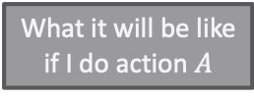
Contents in this Lecture Related to Utility-based Agents
Further topics
  Modelling formalisms
  Inference (in episodic models)
  Learning (of episodic models)
  Sequential models and inference
  Decision-theoretic models and inference
Agent
Environment
Sensors
State
What the world
is like now
How the world evolves
What my actions do
What it will be like
if I do action $A$
Utility
How happy I will be
in such a state
What action I
should do now
Actuators

Slide 4
Outline: 3. Inference
Exact Inference
  (Weighted) Model Counting
    Model counting
    Weighted model counting, knowledge compilation (KC)
  Variable Elimination and the Like
    Variable elimination (VE)
    Junction tree algorithm (JT)
  Lifted Inference
    First-order KC, Lifted VE, lifted JT
Approximate Inference
  Direct sampling: Rejection sampling, (lifted) importance sampling
  (Lifted) Markov Chain Monte Carlo sampling

Slide 5
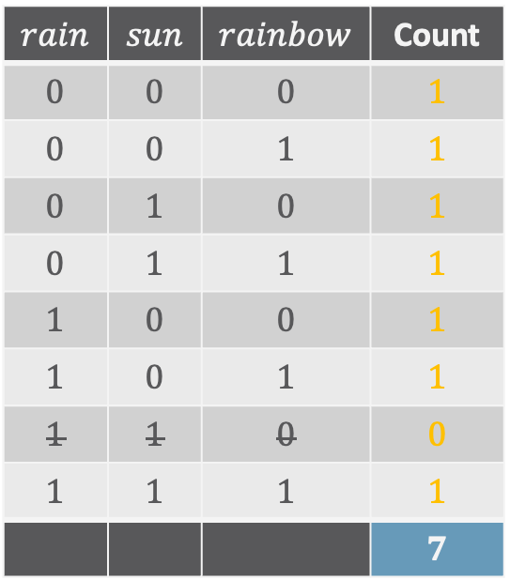
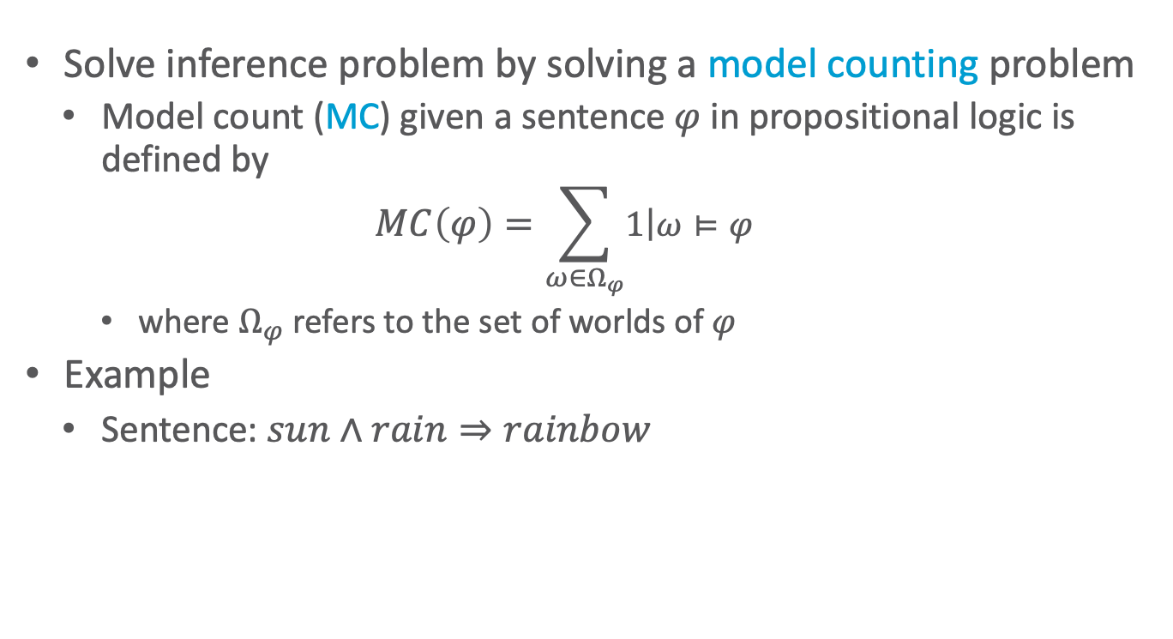

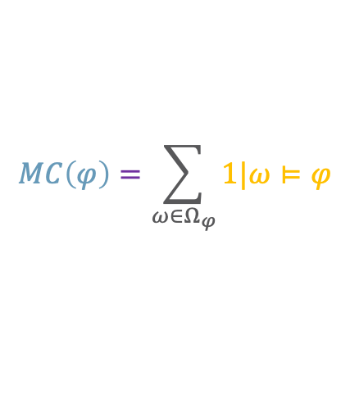
Model Counting
$$MC\left(φ\right)=\sum_{ω∈Ω_{φ}}{1|ω⊨φ}$$
Solve inference problem by solving a model counting problem
  Model count (MC) given a sentence $φ$ in propositional logic is defined by
  $$MC\left(φ\right)=\sum_{ω∈Ω_{φ}}{\left.1\right|ω⊨φ}$$
    where $Ω_{φ}$ refers to the set of worlds of $φ$
Example
  Sentence: $sun∧rain⇒rainbow$
$$rain$$ | $$sun$$ | $$rainbow$$ | Count
$$0$$ | $$0$$ | $$0$$ | $$1$$
$$0$$ | $$0$$ | $$1$$ | $$1$$
$$0$$ | $$1$$ | $$0$$ | $$1$$
$$0$$ | $$1$$ | $$1$$ | $$1$$
$$1$$ | $$0$$ | $$0$$ | $$1$$
$$1$$ | $$0$$ | $$1$$ | $$1$$
$$1$$ | $$1$$ | $$0$$ | $$0$$
$$1$$ | $$1$$ | $$1$$ | $$1$$
 |  |  | $$7$$
Each line a world $ω∈Ω_{φ}$

Slide 6
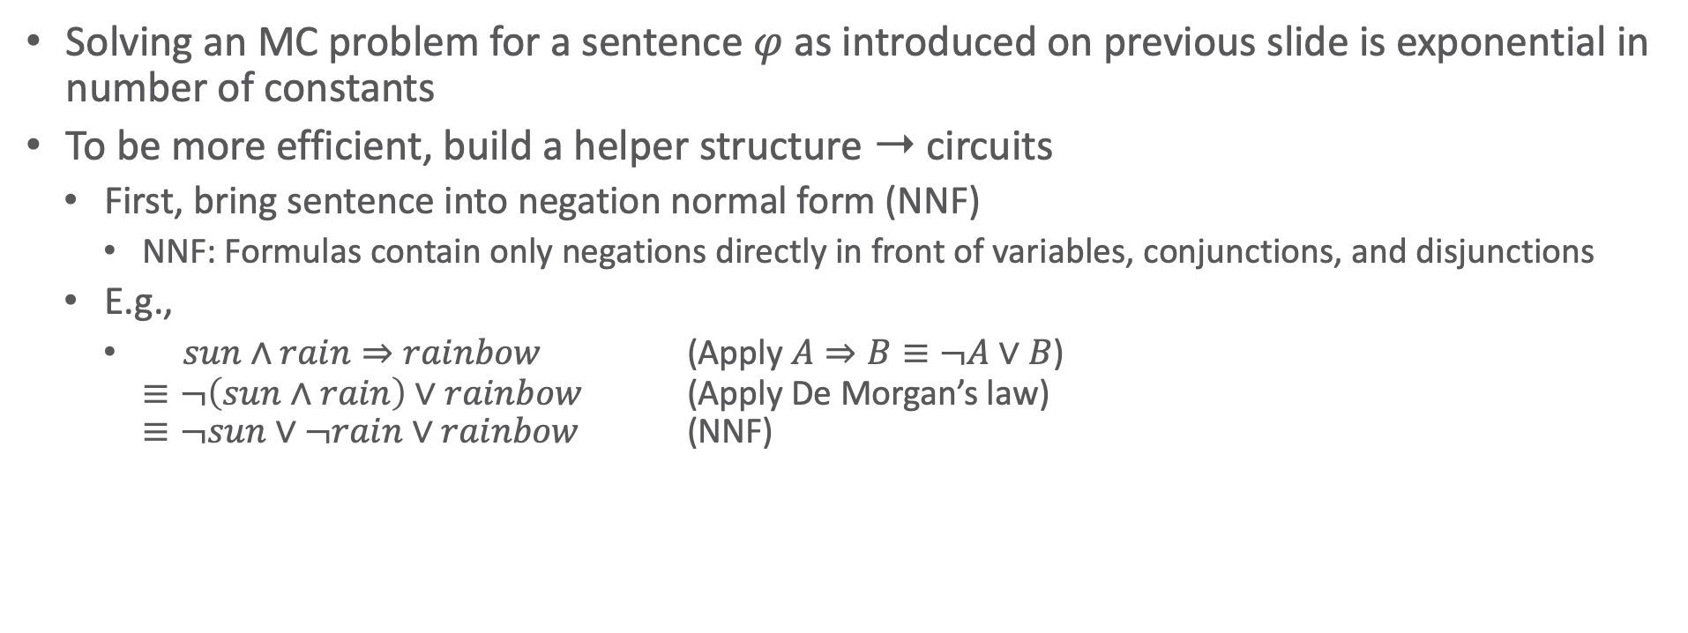
MC Complexity
Solving an MC problem for a sentence $φ$ as introduced on previous slide is exponential in number of constants
To be more efficient, build a helper structure ➝ circuits
  First, bring sentence into negation normal form (NNF)
    NNF: Formulas contain only negations directly in front of variables, conjunctions, and disjunctions
  E.g.,
    $sun∧rain⇒rainbow$ (Apply $A⇒B≡¬A∨B$)
    $≡¬\left(sun∧rain\right)∨rainbow$ (Apply De Morgan’s law)
    $≡¬sun∨¬rain∨rainbow$ (NNF)

Slide 7
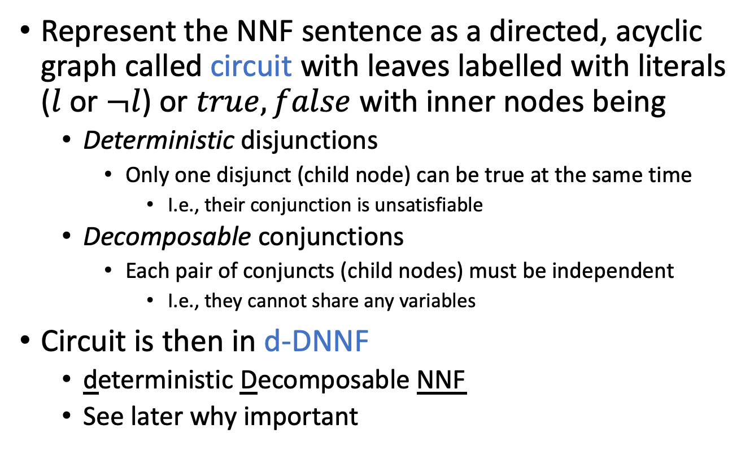
Circuits
Represent the NNF sentence as a directed, acyclic graph called circuit with leaves labelled with literals ($l$ or $¬l$) or $true,false$ with inner nodes being
  Deterministic disjunctions
    Only one disjunct (child node) can be true at the same time
      I.e., their conjunction is unsatisfiable
  Decomposable conjunctions
    Each pair of conjuncts (child nodes) must be independent
      I.e., they cannot share any variables
Circuit is then in d-DNNF
  deterministic Decomposable NNF
  See later why important
Mark Chavira and Adnan Darwiche: On probabilistic inference by weighted model counting. In: Artificial Intelligence, 2008.

Slide 8

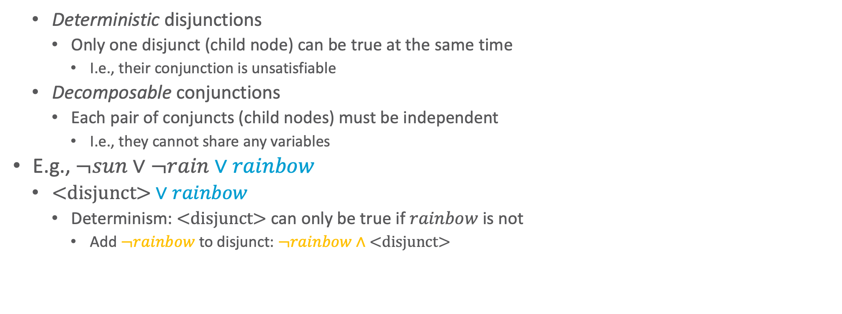


Circuits: Example
  Deterministic disjunctions
    Only one disjunct (child node) can be true at the same time
      I.e., their conjunction is unsatisfiable
  Decomposable conjunctions
    Each pair of conjuncts (child nodes) must be independent
      I.e., they cannot share any variables
E.g., $¬sun∨¬rain∨rainbow$
  $\text{<}\text{disjunct}\text{>}∨rainbow$
    Determinism: $\text{<}\text{disjunct}\text{>}$ can only be true if $rainbow$ is not
      Add $¬rainbow$ to disjunct: $¬rainbow∧\text{<}\text{disjunct}\text{>}$
$$∨$$
$$rainbow$$
$$\text{<}\text{disjunct}\text{>}$$

Slide 9


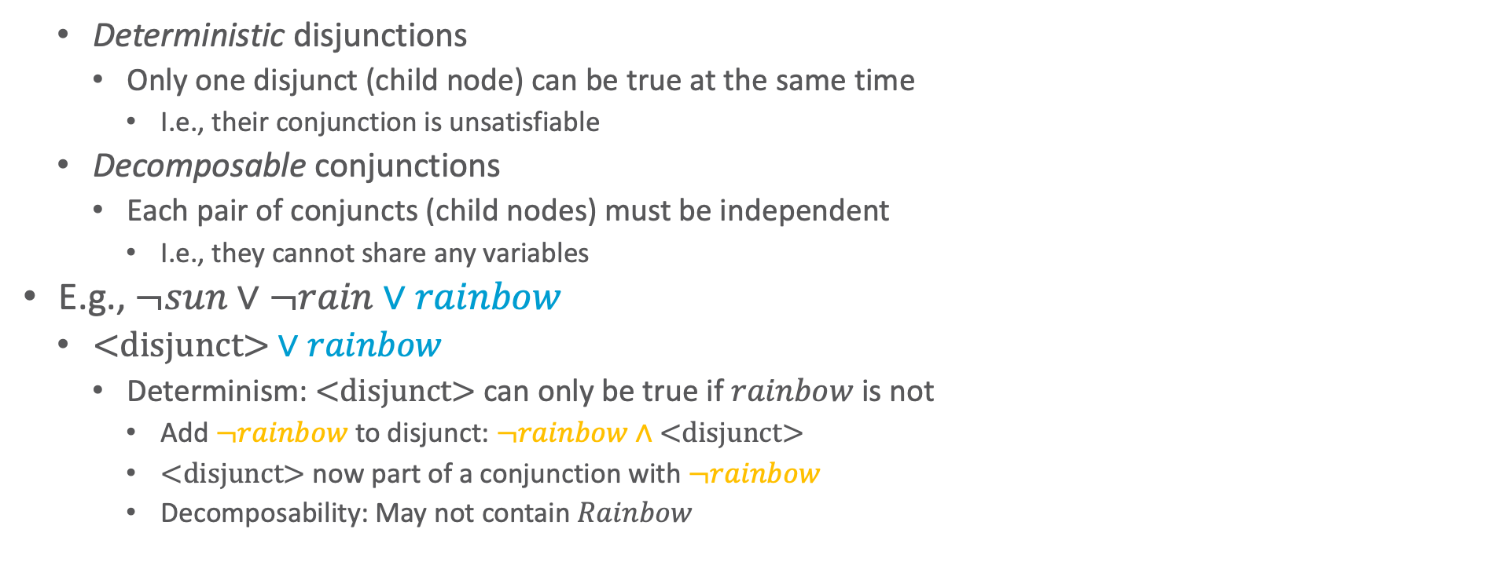

Circuits: Example
  Deterministic disjunctions
    Only one disjunct (child node) can be true at the same time
      I.e., their conjunction is unsatisfiable
  Decomposable conjunctions
    Each pair of conjuncts (child nodes) must be independent
      I.e., they cannot share any variables
E.g., $¬sun∨¬rain∨rainbow$
  $\text{<}\text{disjunct}\text{>}∨rainbow$
    Determinism: $\text{<}\text{disjunct}\text{>}$ can only be true if $rainbow$ is not
      Add $¬rainbow$ to disjunct: $¬rainbow∧\text{<}\text{disjunct}\text{>}$
      $\text{<}\text{disjunct}\text{>}$ now part of a conjunction with $¬rainbow$
        Decomposability: May not contain $Rainbow$
$$∨$$
$$rainbow$$
$$∧$$
$$\text{<}\text{disjunct}\text{>}$$
$$¬rainbow$$

Slide 10



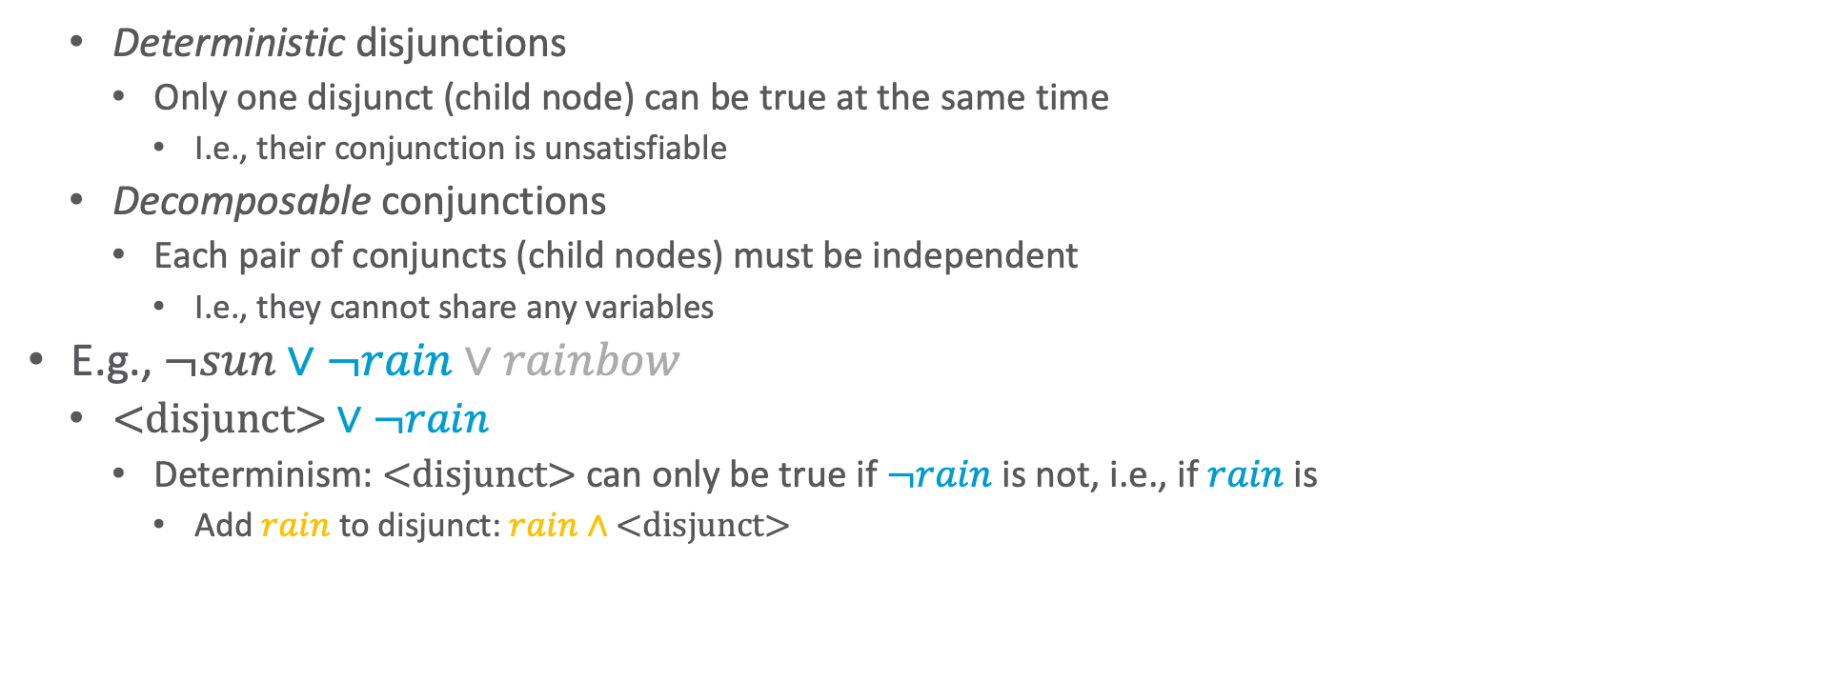




Circuits: Example
  Deterministic disjunctions
    Only one disjunct (child node) can be true at the same time
      I.e., their conjunction is unsatisfiable
  Decomposable conjunctions
    Each pair of conjuncts (child nodes) must be independent
      I.e., they cannot share any variables
E.g., $¬sun∨¬rain∨rainbow$
  $\text{<}\text{disjunct}\text{>}∨¬rain$
    Determinism: $\text{<}\text{disjunct}\text{>}$ can only be true if $¬rain$ is not, i.e., if $rain$ is
      Add $rain$ to disjunct: $rain∧\text{<}\text{disjunct}\text{>}$
$$∨$$
$$rainbow$$
$$∧$$
$$∨$$
$$¬rainbow$$
$$¬rain$$
$$\text{<}\text{disjunct}\text{>}$$

Slide 11
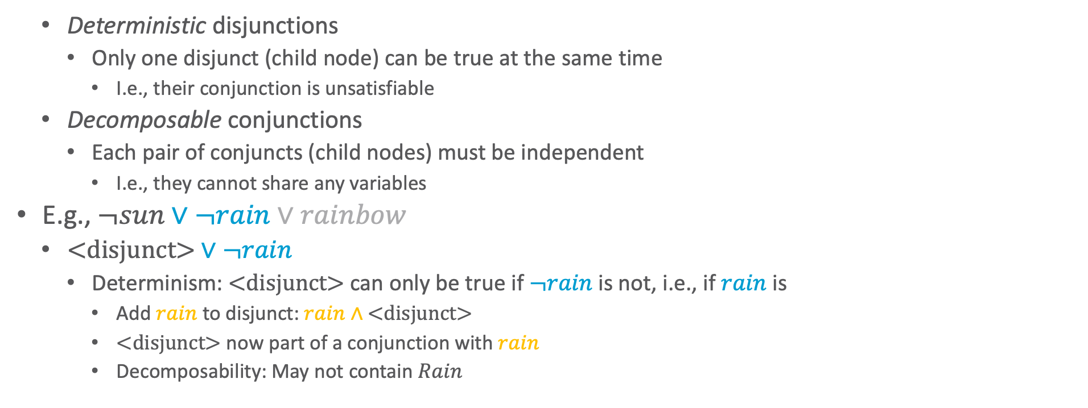



Circuits: Example
  Deterministic disjunctions
    Only one disjunct (child node) can be true at the same time
      I.e., their conjunction is unsatisfiable
  Decomposable conjunctions
    Each pair of conjuncts (child nodes) must be independent
      I.e., they cannot share any variables
E.g., $¬sun∨¬rain∨rainbow$
  $\text{<}\text{disjunct}\text{>}∨¬rain$
    Determinism: $\text{<}\text{disjunct}\text{>}$ can only be true if $¬rain$ is not, i.e., if $rain$ is
      Add $rain$ to disjunct: $rain∧\text{<}\text{disjunct}\text{>}$
      $\text{<}\text{disjunct}\text{>}$ now part of a conjunction with $rain$
        Decomposability: May not contain $Rain$
$$∨$$
$$rainbow$$
$$∧$$
$$∨$$
$$¬rainbow$$
$$¬rain$$
$$∧$$
$$\text{<}\text{disjunct}\text{>}$$
$$rain$$

Slide 12
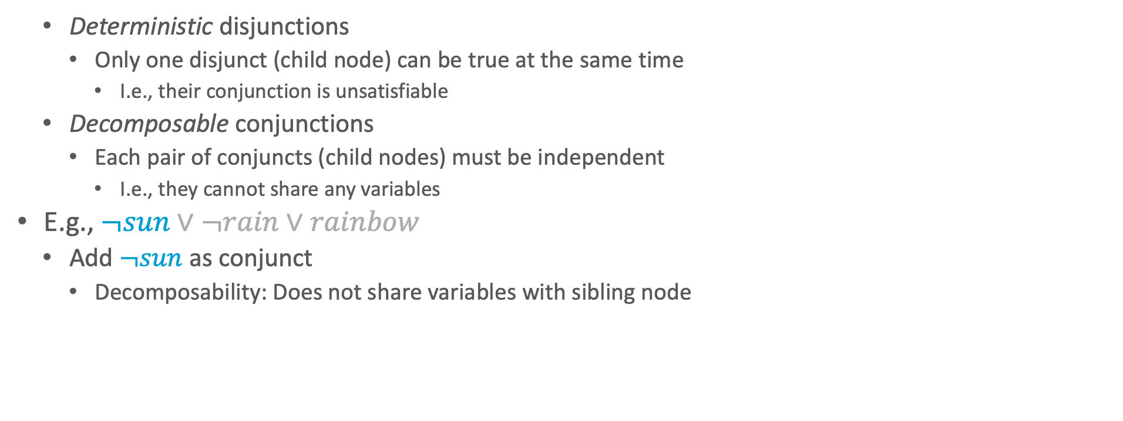





Circuits: Example
  Deterministic disjunctions
    Only one disjunct (child node) can be true at the same time
      I.e., their conjunction is unsatisfiable
  Decomposable conjunctions
    Each pair of conjuncts (child nodes) must be independent
      I.e., they cannot share any variables
E.g., $¬sun∨¬rain∨rainbow$
  Add $¬sun$ as conjunct
    Decomposability: Does not share variables with sibling node
$$∨$$
$$rainbow$$
$$∧$$
$$∨$$
$$¬rainbow$$
$$¬rain$$
$$∧$$
$$¬sun$$
$$rain$$

Slide 13
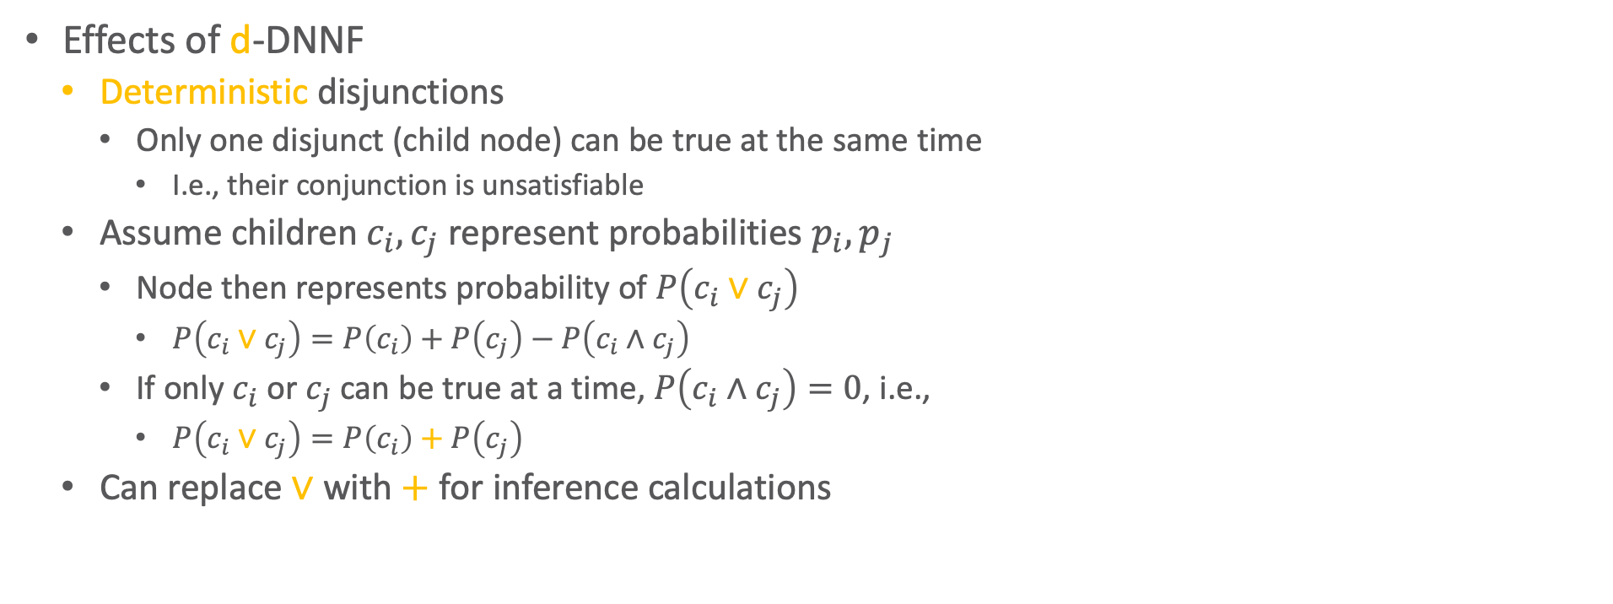



Effects of d-DNNF
Effects of d-DNNF
  Deterministic disjunctions
    Only one disjunct (child node) can be true at the same time
      I.e., their conjunction is unsatisfiable
  Assume children $c_{i},c_{j}$ represent probabilities $p_{i},p_{j}$
    Node then represents probability of $P\left(c_{i}∨c_{j}\right)$
      $P\left(c_{i}∨c_{j}\right)=P\left(c_{i}\right)+P\left(c_{j}\right)−P\left(c_{i}∧c_{j}\right)$
    If only $c_{i}$ or $c_{j}$ can be true at a time, $P\left(c_{i}∧c_{j}\right)=0$, i.e.,
      $P\left(c_{i}∨c_{j}\right)=P\left(c_{i}\right)+P\left(c_{j}\right)$
  Can replace $∨$ with $+$ for inference calculations
$$∨$$
$$rainbow$$
$$∧$$
$$∨$$
$$¬rainbow$$
$$¬rain$$
$$∧$$
$$¬sun$$
$$rain$$

Slide 14

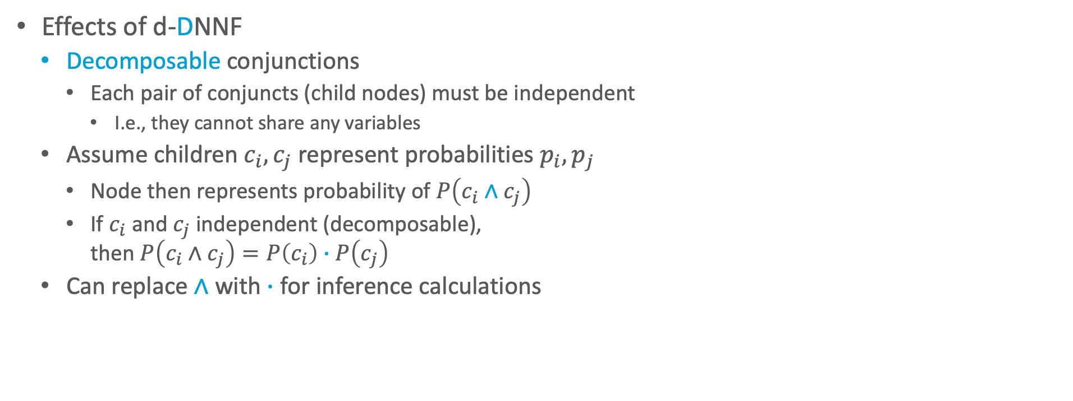

Effects of d-DNNF
Effects of d-DNNF
  Decomposable conjunctions
    Each pair of conjuncts (child nodes) must be independent
      I.e., they cannot share any variables
  Assume children $c_{i},c_{j}$ represent probabilities $p_{i},p_{j}$
    Node then represents probability of $P\left(c_{i}∧c_{j}\right)$
    If $c_{i}$ and $c_{j}$ independent (decomposable),
    then $P\left(c_{i}∧c_{j}\right)=P\left(c_{i}\right)∙P\left(c_{j}\right)$
  Can replace $∧$ with $∙$ for inference calculations
$$∨$$
$$rainbow$$
$$∧$$
$$∨$$
$$¬rainbow$$
$$¬rain$$
$$∧$$
$$¬sun$$
$$rain$$

Slide 15

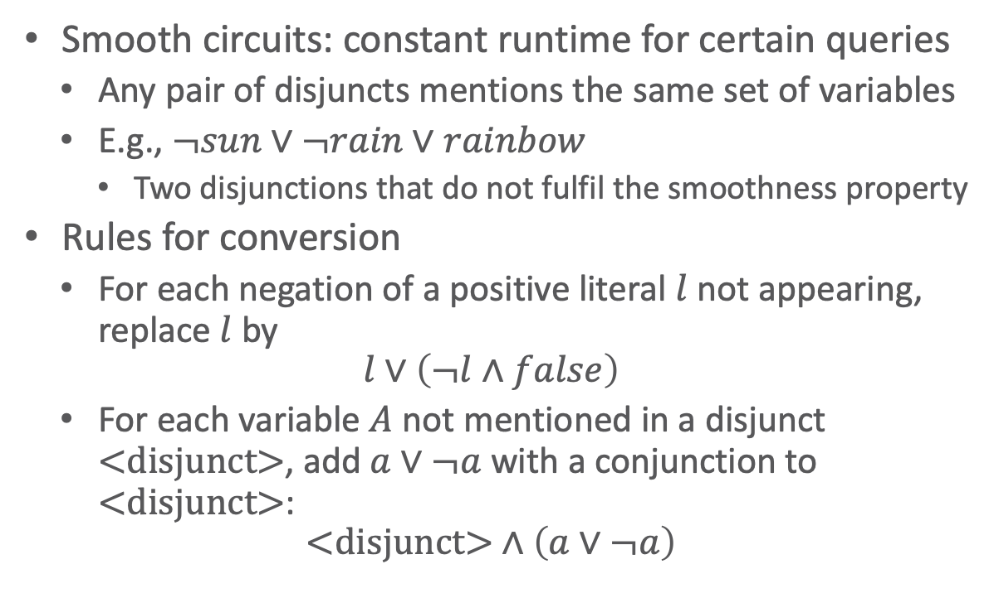

Smooth d-DNNF (sd-DNNF)
Smooth circuits: constant runtime for certain queries
  Any pair of disjuncts mentions the same set of variables
  E.g., $¬sun∨¬rain∨rainbow$
    Two disjunctions that do not fulfil the smoothness property
Rules for conversion
  For each negation of a positive literal $l$ not appearing, replace $l$ by
  $$l∨\left(¬l∧false\right)$$
  For each variable $A$ not mentioned in a disjunct $\text{<}\text{disjunct}\text{>}$, add $a∨¬a$ with a conjunction to $\text{<}\text{disjunct}\text{>}$:
  $$\text{<}\text{disjunct}\text{>}∧\left(a∨¬a\right)$$
Does not mention
$$Rain,Sun$$
$$∨$$
$$rainbow$$
$$∧$$
Does not mention
$$Sun$$
$$∨$$
$$¬rainbow$$
$$¬rain$$
$$∧$$
$$¬sun$$
$$rain$$

Slide 16





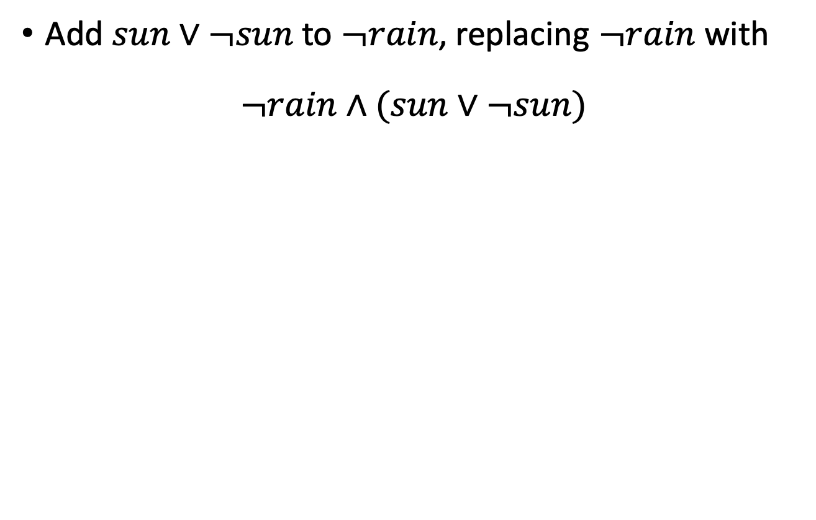








Smooth d-DNNF (sd-DNNF)
Add $sun∨¬sun$ to $¬rain$, replacing $¬rain$ with
$$¬rain∧(sun∨¬sun)$$
Does not mention
$$Rain,Sun$$
$$∨$$
Does not mention
$$Rain,Sun$$
$$∨$$
$$rainbow$$
$$∧$$
$$rainbow$$
$$∧$$
$$∨$$
$$¬rainbow$$
Does not mention
$$Sun$$
$$∨$$
$$¬rainbow$$
$$∧$$
$$∧$$
$$¬rain$$
$$∧$$
$$∨$$
$$sun$$
$$¬rain$$
$$¬sun$$
$$rain$$
$$¬sun$$
$$rain$$

Slide 17

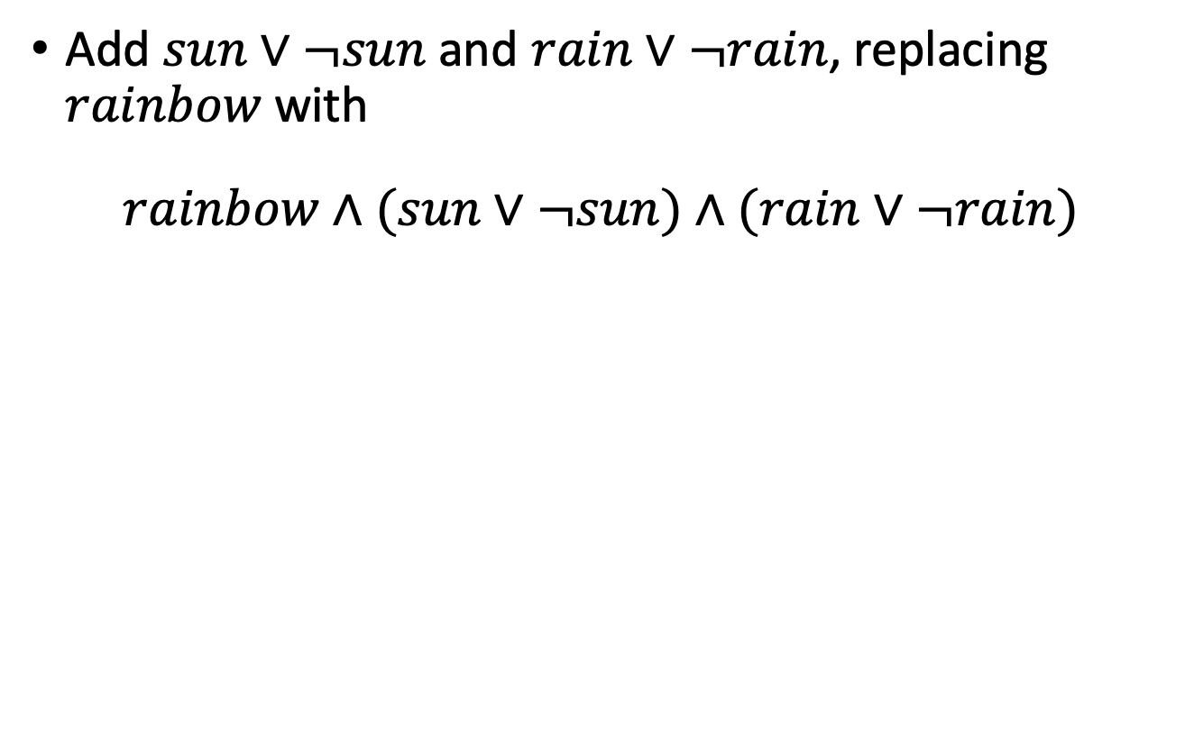








Smooth d-DNNF (sd-DNNF)
Add $sun∨¬sun$ and $rain∨¬rain$, replacing $rainbow$ with
$$rainbow∧(sun∨¬sun)∧(rain∨¬rain)$$
Does not mention
$$Rain,Sun$$
$$∨$$
$$∨$$
$$rainbow$$
$$∧$$
$$∧$$
$$∧$$
$$∨$$
$$¬rainbow$$
$$rainbow$$
$$∨$$
$$∨$$
$$¬rainbow$$
$$∧$$
$$∧$$
$$∧$$
$$∧$$
$$∨$$
$$∨$$
$$sun$$
$$¬rain$$
$$¬sun$$
$$rain$$
$$sun$$
$$¬rain$$
$$¬sun$$
$$rain$$

Slide 18





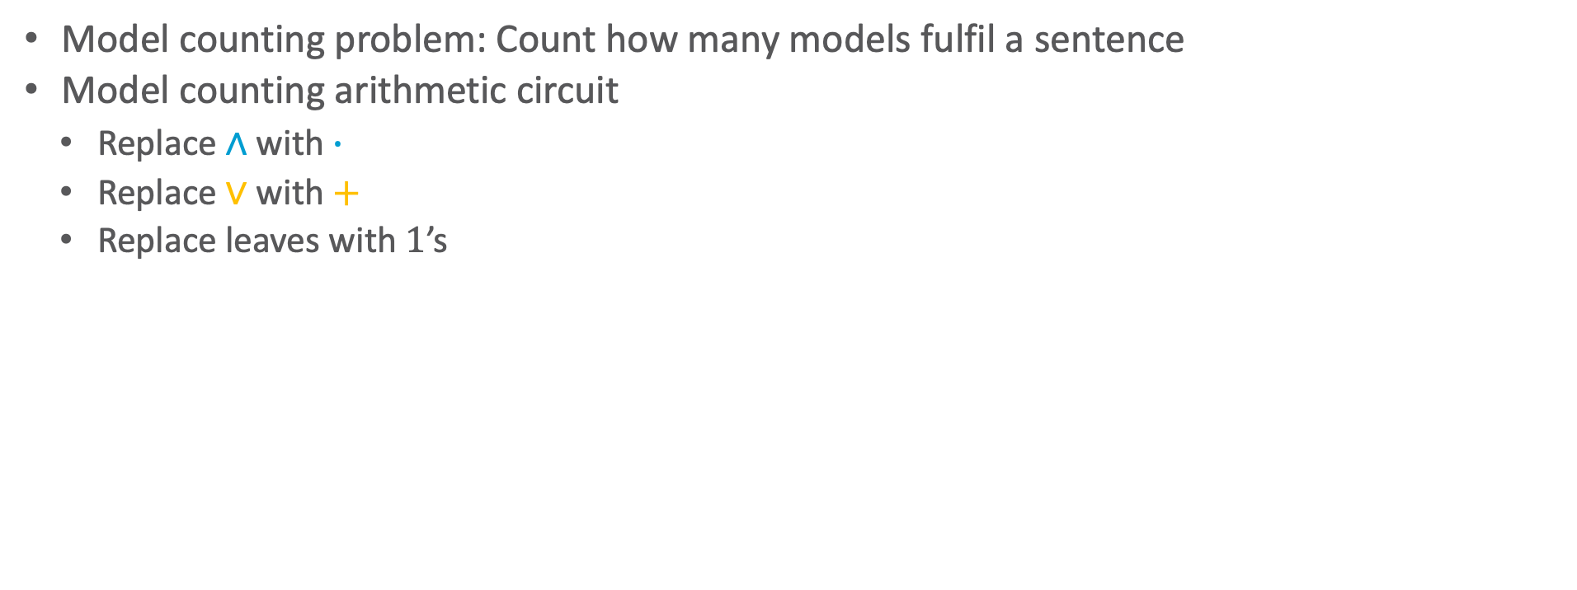









Circuit for Model Counting
Model counting problem: Count how many models fulfil a sentence
Model counting arithmetic circuit
  Replace $∧$ with $∙$
  Replace $∨$ with $+$
  Replace leaves with $1$’s
$$+$$
$$∨$$
$$∙$$
$$∙$$
$$∧$$
$$∧$$
$$1$$
$$+$$
$$+$$
$$1$$
$$rainbow$$
$$∨$$
$$∨$$
$$¬rainbow$$
$$∙$$
$$∧$$
$$∙$$
$$∧$$
$$+$$
$$∨$$
$$1$$
$$1$$
$$1$$
$$1$$
$$sun$$
$$¬rain$$
$$¬sun$$
$$rain$$

Slide 19


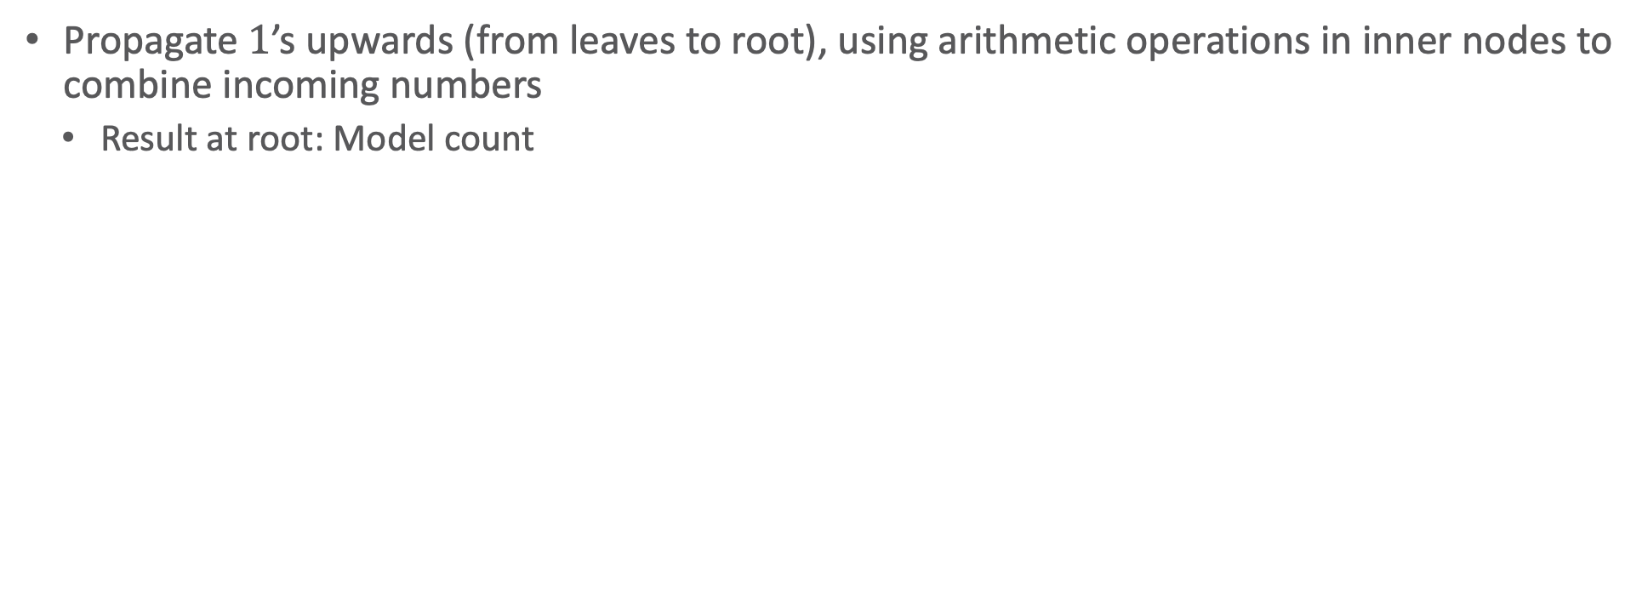

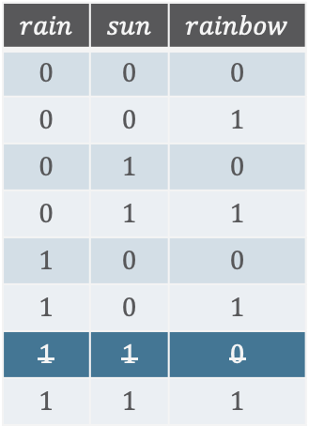






Circuit for Model Counting
Propagate $1$’s upwards (from leaves to root), using arithmetic operations in inner nodes to combine incoming numbers
  Result at root: Model count
$$7$$
$$sun∧rain⇒rainbow$$
$$+$$
$$∨$$
$$rain$$ | $$sun$$ | $$rainbow$$
$$0$$ | $$0$$ | $$0$$
$$0$$ | $$0$$ | $$1$$
$$0$$ | $$1$$ | $$0$$
$$0$$ | $$1$$ | $$1$$
$$1$$ | $$0$$ | $$0$$
$$1$$ | $$0$$ | $$1$$
$$1$$ | $$1$$ | $$0$$
$$1$$ | $$1$$ | $$1$$
$$4$$
$$3$$
$$∙$$
$$∙$$
$$∧$$
$$∧$$
$$2$$
$$3$$
$$1$$
$$+$$
$$+$$
$$1$$
$$rainbow$$
$$∨$$
$$∨$$
$$¬rainbow$$
$$2$$
$$∙$$
$$1$$
$$∧$$
$$2$$
$$∙$$
$$∧$$
$$+$$
$$∨$$
$$1$$
$$1$$
$$1$$
$$1$$
$$sun$$
$$¬rain$$
$$¬sun$$
$$rain$$

Slide 20


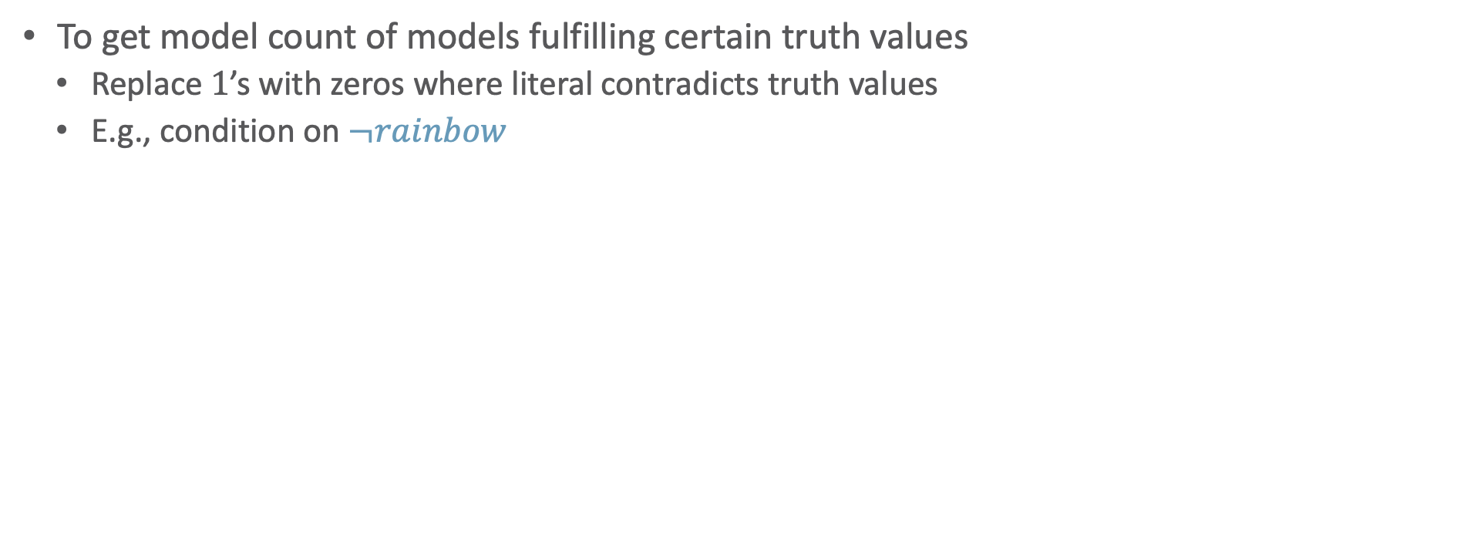
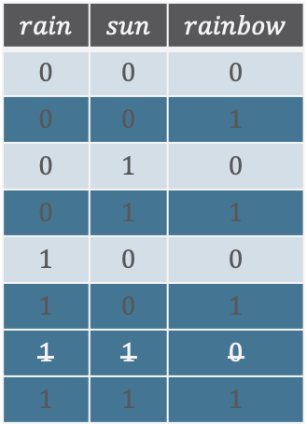

Conditioning
To get model count of models fulfilling certain truth values
  Replace $1$’s with zeros where literal contradicts truth values
  E.g., condition on $¬rainbow$
$$3$$
$$sun∧rain⇒rainbow$$
$$+$$
$$∨$$
$$rain$$ | $$sun$$ | $$rainbow$$
$$0$$ | $$0$$ | $$0$$
$$0$$ | $$0$$ | $$1$$
$$0$$ | $$1$$ | $$0$$
$$0$$ | $$1$$ | $$1$$
$$1$$ | $$0$$ | $$0$$
$$1$$ | $$0$$ | $$1$$
$$1$$ | $$1$$ | $$0$$
$$1$$ | $$1$$ | $$1$$
$$0$$
$$3$$
$$∙$$
$$∙$$
$$∧$$
$$∧$$
$$2$$
$$3$$
$$0$$
$$+$$
$$+$$
$$1$$
$$rainbow$$
$$∨$$
$$∨$$
$$¬rainbow$$
$$2$$
$$∙$$
$$1$$
$$∧$$
$$2$$
$$∙$$
$$∧$$
$$+$$
$$∨$$
$$1$$
$$1$$
$$1$$
$$1$$
$$sun$$
$$¬rain$$
$$¬sun$$
$$rain$$

Slide 21
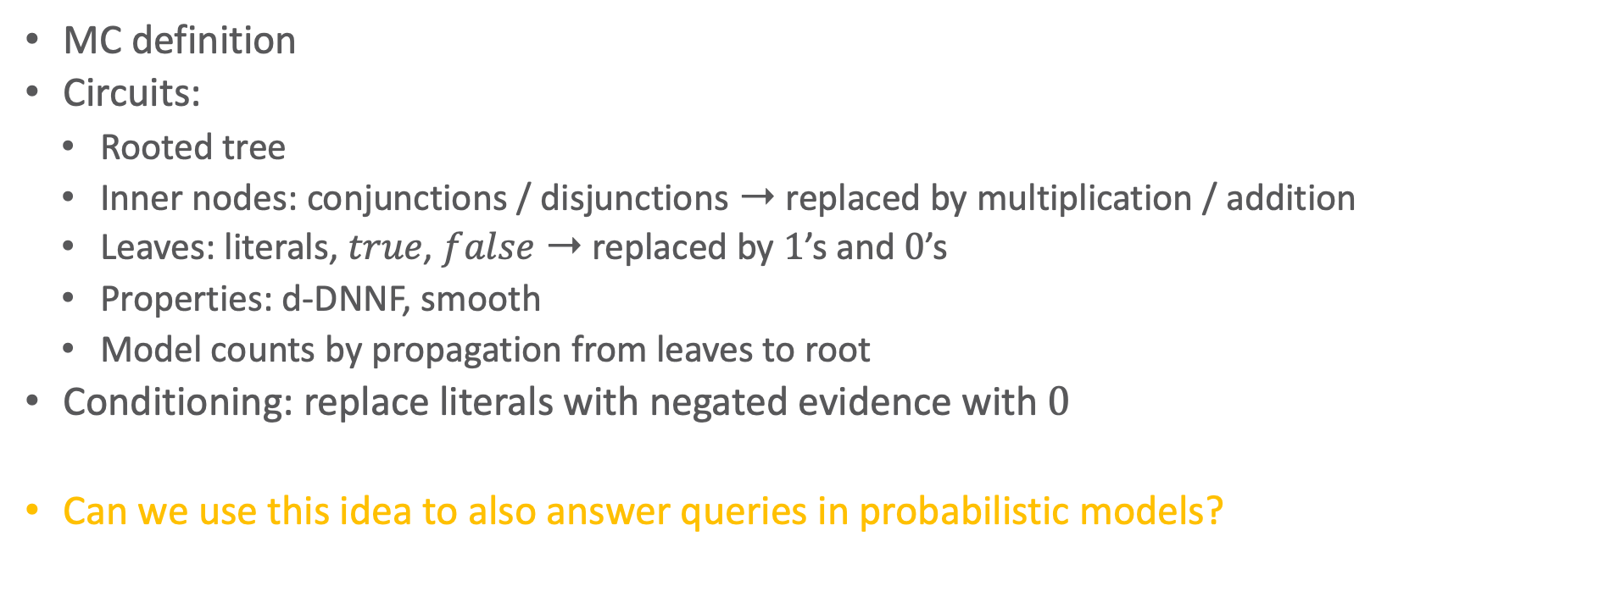
Interim Summary
MC definition
Circuits:
  Rooted tree
  Inner nodes: conjunctions / disjunctions ➝ replaced by multiplication / addition
  Leaves: literals, $true$, $false$ ➝ replaced by $1$’s and $0$’s
  Properties: d-DNNF, smooth
  Model counts by propagation from leaves to root
Conditioning: replace literals with negated evidence with $0$
Can we use this idea to also answer queries in probabilistic models?

Slide 22

Knowledge
Compilation
$$3^{2}$$
$$3^{2}$$
$$∀X \\ X∈\text{People}$$
$$.^{\left|\text{People}\right|}$$
$$3$$
$$26$$
$$∨$$
$$+$$
$$2$$
$$24$$
$$∧$$
$$∙$$
$$2$$
$$1$$
$$4$$
$$2$$
$$∨$$
$$∧$$
$$+$$
$$∙$$
$$c\left(X\right)$$
$$s\left(X\right)$$
$$¬s\left(X\right)$$
$$¬c\left(X\right)$$
$$6$$
$$3$$
$$1$$
$$2$$
$$∀X∈\text{People} :smokes\left(X\right)⇒cancer\left(X\right)$$
Weighted model counting problem, knowledge compilation algorithm

Slide 23
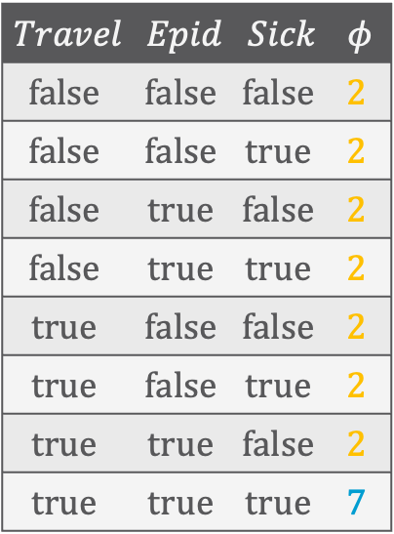
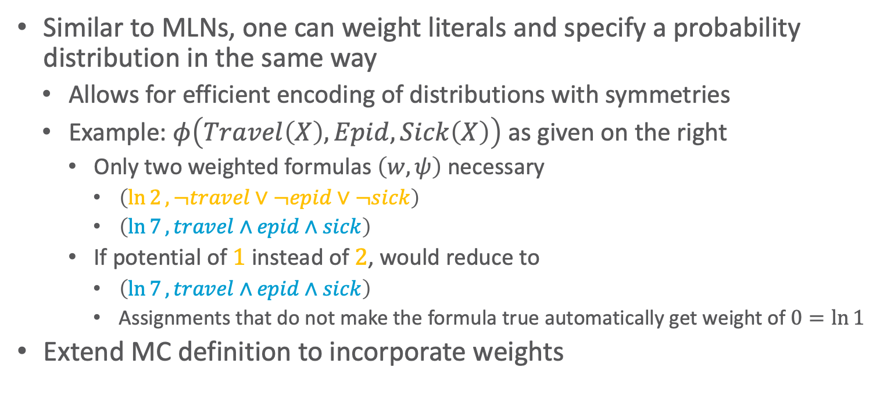
Local Symmetries and Structure
Similar to MLNs, one can weight literals and specify a probability distribution in the same way
  Allows for efficient encoding of distributions with symmetries
  Example: $φ\left(Travel\left(X\right),Epid,Sick\left(X\right)\right)$ as given on the right
    Only two weighted formulas $\left(w,ψ\right)$ necessary
      $\left(\ln{2}, ¬travel∨¬epid∨¬sick\right)$
      $\left(\ln{7}, travel∧epid∧sick\right)$
    If potential of $1$ instead of $2$, would reduce to
      $\left(\ln{7}, travel∧epid∧sick\right)$
      Assignments that do not make the formula true automatically get weight of $0=\ln{1}$
Extend MC definition to incorporate weights
$$Travel$$ | $$Epid$$ | $$Sick$$ | $$φ$$
$$false$$ | $$false$$ | $$false$$ | $$2$$
$$false$$ | $$false$$ | $$true$$ | $$2$$
$$false$$ | $$true$$ | $$false$$ | $$2$$
$$false$$ | $$true$$ | $$true$$ | $$2$$
$$true$$ | $$false$$ | $$false$$ | $$2$$
$$true$$ | $$false$$ | $$true$$ | $$2$$
$$true$$ | $$true$$ | $$false$$ | $$2$$
$$true$$ | $$true$$ | $$true$$ | $$7$$

Slide 24
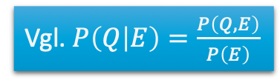
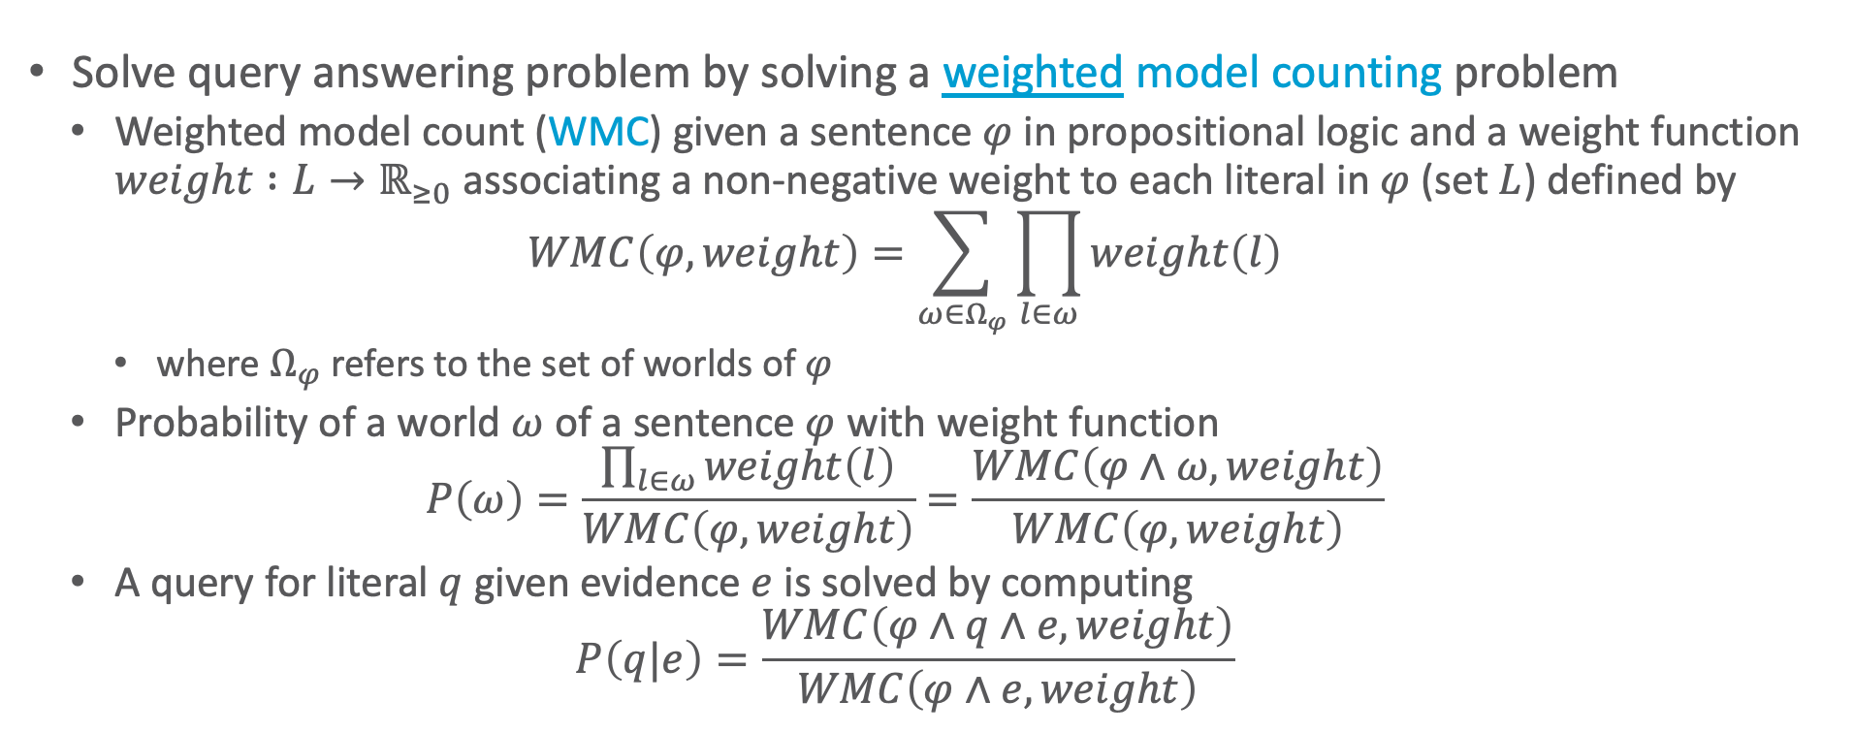
Weighted Model Counting
Solve query answering problem by solving a weighted model counting problem
  Weighted model count (WMC) given a sentence $φ$ in propositional logic and a weight function $weight :L→ℝ_{≥0}$ associating a non-negative weight to each literal in $φ$ (set $L$) defined by
  $$WMC\left(φ,weight\right)=\sum_{ω∈Ω_{φ}}{\prod_{l∈ω}{weight\left(l\right)}}$$
    where $Ω_{φ}$ refers to the set of worlds of $φ$
  Probability of a world $ω$ of a sentence $φ$ with weight function
  $$P\left(ω\right)=\frac{\prod_{l∈ω}{weight\left(l\right)}}{WMC\left(φ,weight\right)}=\frac{WMC\left(φ∧ω,weight\right)}{WMC\left(φ,weight\right)}$$
  A query for literal $q$ given evidence $e$ is solved by computing
  $$P\left(q|e\right)=\frac{WMC\left(φ∧q∧e,weight\right)}{WMC\left(φ∧e,weight\right)}$$
Vgl. $P\left(Q | E\right)=\frac{P\left(Q,E\right)}{P\left(E\right)}$
T. Sang, P. Beame, and H. Kautz: Solving Bayesian networks by weighted model counting. In: Proceedings of the Twentieth National Conference on Artificial Intelligence, 2005.

Slide 25
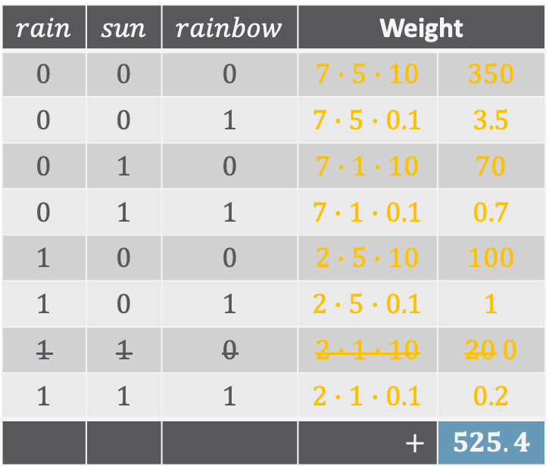
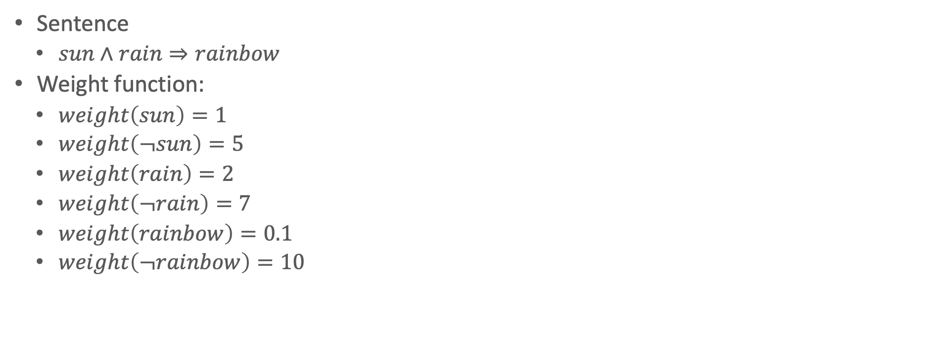

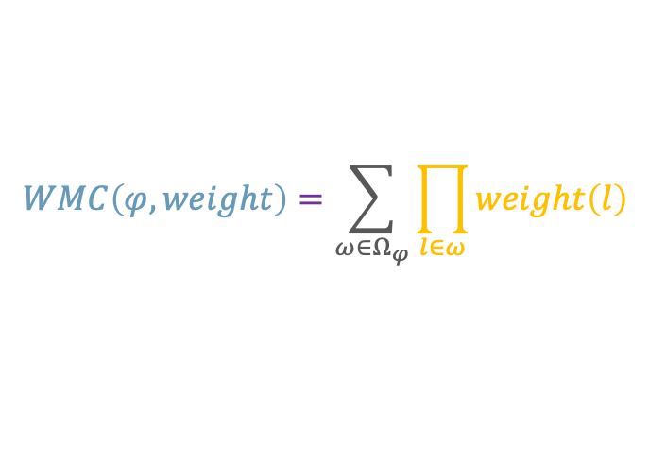
Weighted Model Counting: Example
$$WMC\left(φ,weight\right)=\sum_{ω∈Ω_{φ}}{\prod_{l∈ω}{weight\left(l\right)}}$$
Sentence
  $sun∧rain⇒rainbow$
Weight function:
  $weight\left(sun\right)=1$
  $weight\left(¬sun\right)=5$
  $weight\left(rain\right)=2$
  $weight\left(¬rain\right)=7$
  $weight\left(rainbow\right)=0.1$
  $weight\left(¬rainbow\right)=10$
$$rain$$ | $$sun$$ | $$rainbow$$ | Weight
$$0$$ | $$0$$ | $$0$$ | $$7∙5∙10$$ | $$350$$
$$0$$ | $$0$$ | $$1$$ | $$7∙5∙0.1$$ | $$3.5$$
$$0$$ | $$1$$ | $$0$$ | $$7∙1∙10$$ | $$70$$
$$0$$ | $$1$$ | $$1$$ | $$7∙1∙0.1$$ | $$0.7$$
$$1$$ | $$0$$ | $$0$$ | $$2∙5∙10$$ | $$100$$
$$1$$ | $$0$$ | $$1$$ | $$2∙5∙0.1$$ | $$1$$
$$1$$ | $$1$$ | $$0$$ | $$2∙1∙10$$ | $$20 0$$
$$1$$ | $$1$$ | $$1$$ | $$2∙1∙0.1$$ | $$0.2$$
 |  |  | $$+$$ | $$525.4$$
Each line a world $ω∈Ω_{φ}$

Slide 26
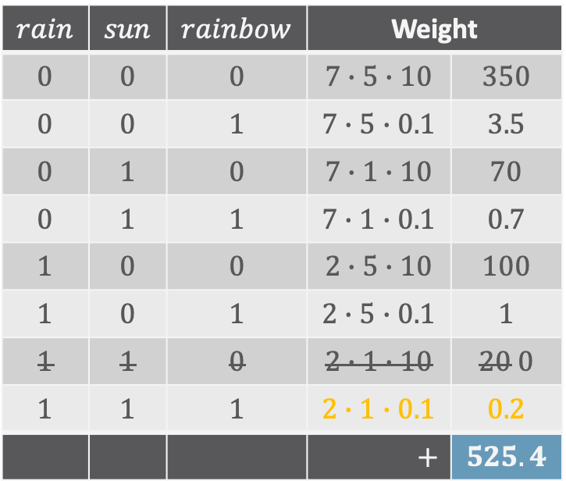
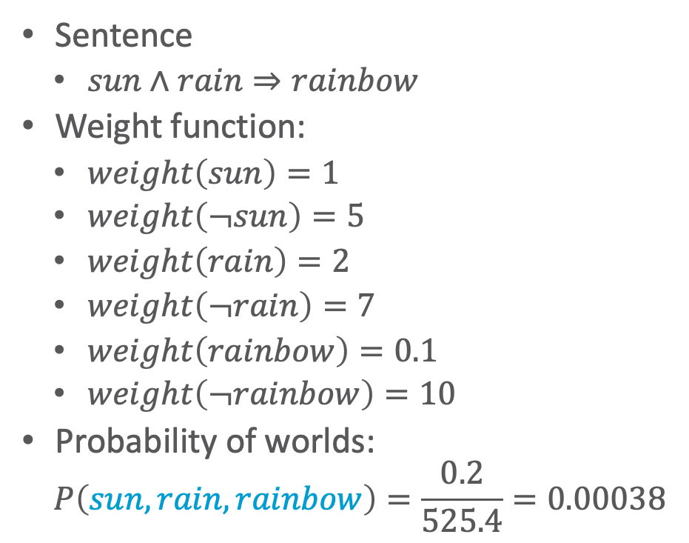
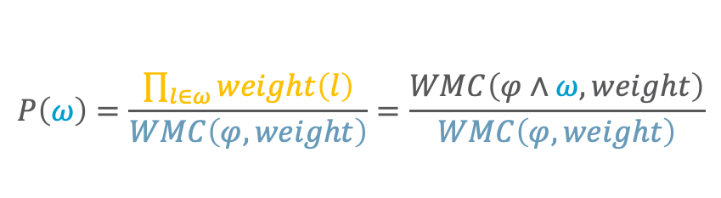

Weighted Model Counting: Example
$$P\left(ω\right)=\frac{\prod_{l∈ω}{weight\left(l\right)}}{WMC\left(φ,weight\right)}=\frac{WMC\left(φ∧ω,weight\right)}{WMC\left(φ,weight\right)}$$
Sentence
  $sun∧rain⇒rainbow$
Weight function:
  $weight\left(sun\right)=1$
  $weight\left(¬sun\right)=5$
  $weight\left(rain\right)=2$
  $weight\left(¬rain\right)=7$
  $weight\left(rainbow\right)=0.1$
  $weight\left(¬rainbow\right)=10$
Probability of worlds:
  $$P\left(sun,rain,rainbow\right)=\frac{0.2}{525.4}=0.00038$$
$$\left(sun∧rain⇒rainbow\right)∧sun∧rain∧rainbow$$
$$rain$$ | $$sun$$ | $$rainbow$$ | Weight
$$0$$ | $$0$$ | $$0$$ | $$7∙5∙10$$ | $$350$$
$$0$$ | $$0$$ | $$1$$ | $$7∙5∙0.1$$ | $$3.5$$
$$0$$ | $$1$$ | $$0$$ | $$7∙1∙10$$ | $$70$$
$$0$$ | $$1$$ | $$1$$ | $$7∙1∙0.1$$ | $$0.7$$
$$1$$ | $$0$$ | $$0$$ | $$2∙5∙10$$ | $$100$$
$$1$$ | $$0$$ | $$1$$ | $$2∙5∙0.1$$ | $$1$$
$$1$$ | $$1$$ | $$0$$ | $$2∙1∙10$$ | $$20 0$$
$$1$$ | $$1$$ | $$1$$ | $$2∙1∙0.1$$ | $$0.2$$
 |  |  | $$+$$ | $$525.4$$
$$ω=\left(sun,rain,rainbow\right)∈Ω_{φ}$$

Slide 27
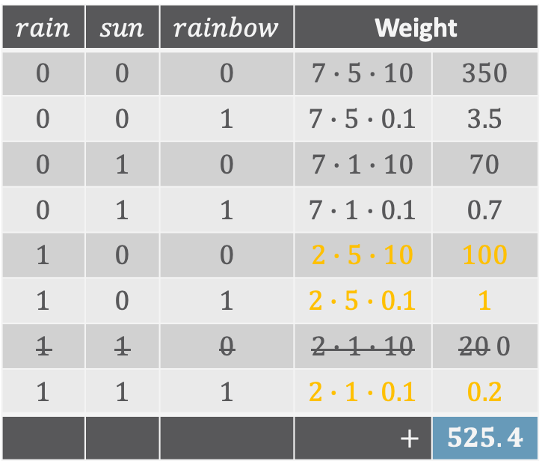
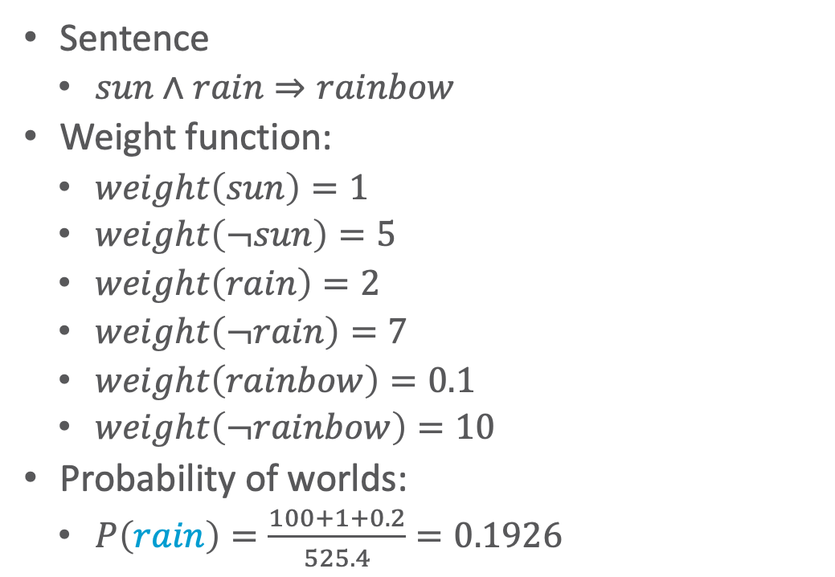



Weighted Model Counting: Example
$$P\left(q\right)=\frac{WMC\left(φ∧q,weight\right)}{WMC\left(φ,weight\right)}$$
Sentence
  $sun∧rain⇒rainbow$
Weight function:
  $weight\left(sun\right)=1$
  $weight\left(¬sun\right)=5$
  $weight\left(rain\right)=2$
  $weight\left(¬rain\right)=7$
  $weight\left(rainbow\right)=0.1$
  $weight\left(¬rainbow\right)=10$
Probability of worlds:
  $P\left(rain\right)=\frac{100+1+0.2}{525.4}=0.1926$
$$\left(sun∧rain⇒rainbow\right)∧rain$$
$$rain$$ | $$sun$$ | $$rainbow$$ | Weight
$$0$$ | $$0$$ | $$0$$ | $$7∙5∙10$$ | $$350$$
$$0$$ | $$0$$ | $$1$$ | $$7∙5∙0.1$$ | $$3.5$$
$$0$$ | $$1$$ | $$0$$ | $$7∙1∙10$$ | $$70$$
$$0$$ | $$1$$ | $$1$$ | $$7∙1∙0.1$$ | $$0.7$$
$$1$$ | $$0$$ | $$0$$ | $$2∙5∙10$$ | $$100$$
$$1$$ | $$0$$ | $$1$$ | $$2∙5∙0.1$$ | $$1$$
$$1$$ | $$1$$ | $$0$$ | $$2∙1∙10$$ | $$20 0$$
$$1$$ | $$1$$ | $$1$$ | $$2∙1∙0.1$$ | $$0.2$$
 |  |  | $$+$$ | $$525.4$$
All $ω∈Ω_{φ}$ where $rain$ holds

Slide 28
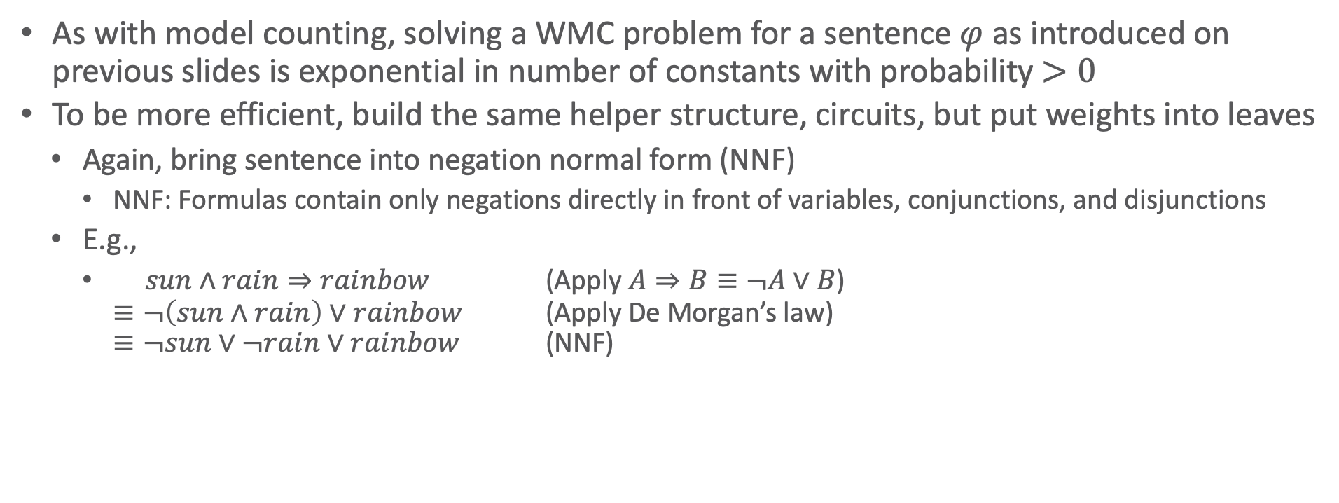
WMC and Inference
As with model counting, solving a WMC problem for a sentence $φ$ as introduced on previous slides is exponential in number of constants with probability $>0$
To be more efficient, build the same helper structure, circuits, but put weights into leaves
  Again, bring sentence into negation normal form (NNF)
    NNF: Formulas contain only negations directly in front of variables, conjunctions, and disjunctions
  E.g.,
    $sun∧rain⇒rainbow$ (Apply $A⇒B≡¬A∨B$)
    $≡¬\left(sun∧rain\right)∨rainbow$ (Apply De Morgan’s law)
    $≡¬sun∨¬rain∨rainbow$ (NNF)

Slide 29




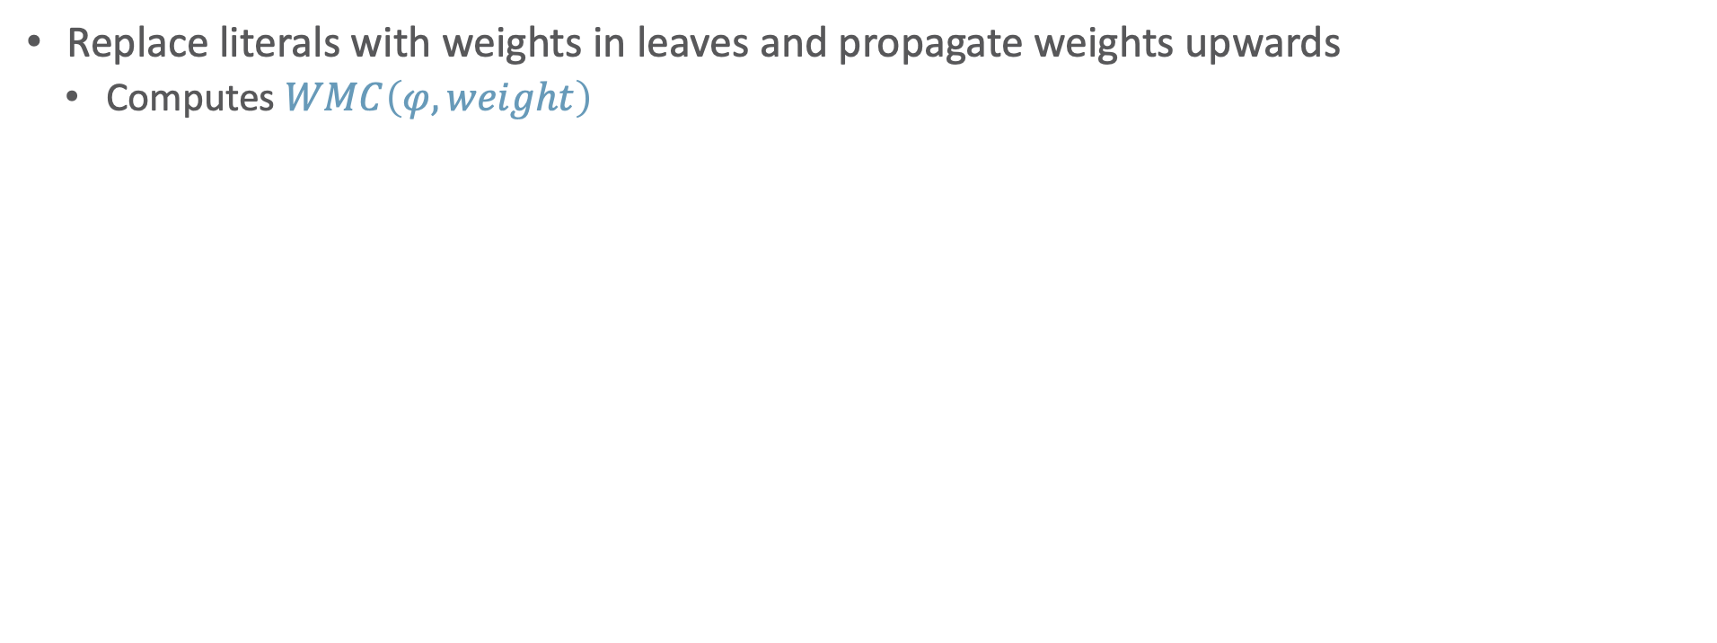




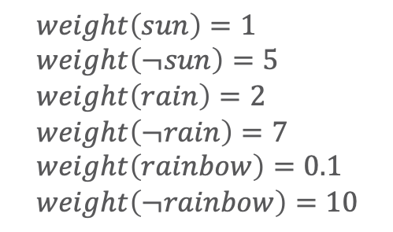





Circuit for Weighted Model Counting
Replace literals with weights in leaves and propagate weights upwards
  Computes $WMC\left(φ,weight\right)$
  $$weight\left(sun\right)=1 \\ weight\left(¬sun\right)=5 \\ weight\left(rain\right)=2 \\ weight\left(¬rain\right)=7 \\ weight\left(rainbow\right)=0.1 \\ weight\left(¬rainbow\right)=10$$
$$525.4$$
$$+$$
$$∨$$
$$5.4$$
$$520$$
$$∙$$
$$∙$$
$$∧$$
$$∧$$
$$9$$
$$52$$
$$0.1$$
$$+$$
$$+$$
$$10$$
$$rainbow$$
$$∨$$
$$∨$$
$$¬rainbow$$
$$42$$
$$∙$$
$$10$$
$$∧$$
$$6$$
$$∙$$
$$∧$$
$$+$$
$$∨$$
$$1$$
$$7$$
$$5$$
$$2$$
$$sun$$
$$¬rain$$
$$¬sun$$
$$rain$$

Slide 30




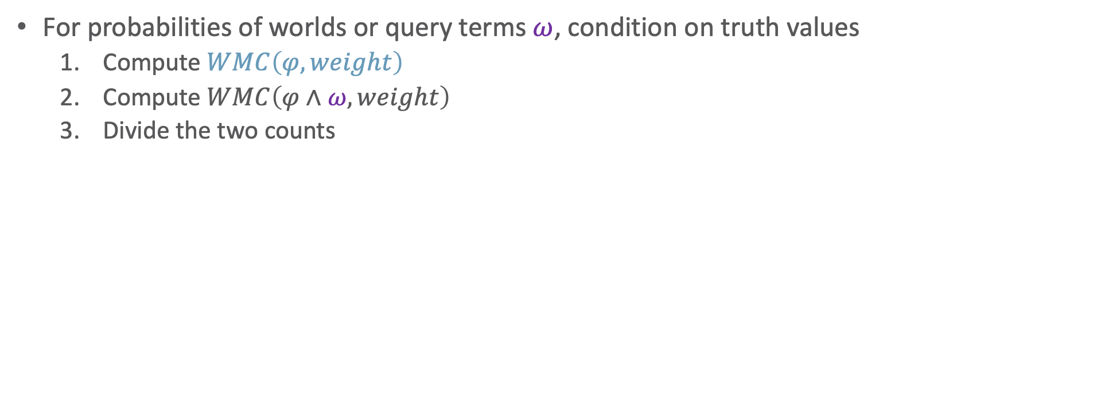







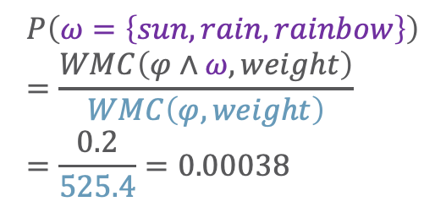
Circuit for Weighted Model Counting
For probabilities of worlds or query terms $ω$, condition on truth values
  Compute $WMC\left(φ,weight\right)$
  Compute $WMC\left(φ∧ω,weight\right)$
  Divide the two counts
Reuse for different queries
$$0.2$$
$$+$$
$$∨$$
  $$P\left(ω=\left\{sun,rain,rainbow\right\}\right)=\frac{WMC\left(φ∧ω,weight\right)}{WMC\left(φ,weight\right)} \\ =\frac{0.2}{525.4}=0.00038$$
$$0.2$$
$$0$$
$$∙$$
$$∙$$
$$∧$$
$$∧$$
$$2$$
$$0$$
$$0.1$$
$$+$$
$$+$$
$$0$$
$$rainbow$$
$$∨$$
$$∨$$
$$¬rainbow$$
$$0$$
$$∙$$
$$0$$
$$∧$$
$$1$$
$$∙$$
$$∧$$
$$+$$
$$∨$$
$$1$$
$$0$$
$$0$$
$$2$$
$$sun$$
$$¬rain$$
$$¬sun$$
$$rain$$

Slide 31
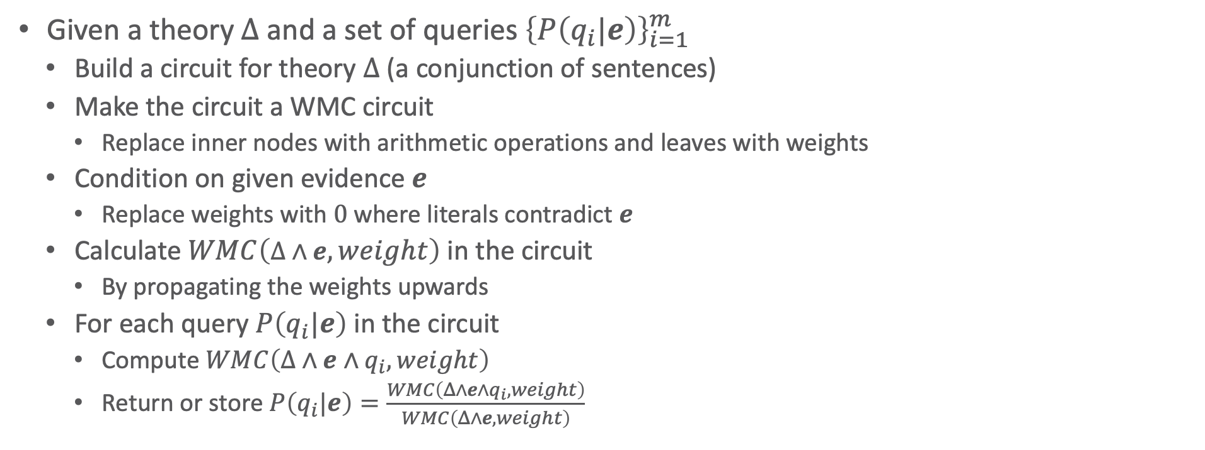
Knowledge Compilation
Given a theory $Δ$ and a set of queries ${\left\{P\left(q_{i}|e\right)\right\}}_{i=1}^{m}$
  Build a circuit for theory $Δ$ (a conjunction of sentences)
  Make the circuit a WMC circuit
    Replace inner nodes with arithmetic operations and leaves with weights
  Condition on given evidence $e$
    Replace weights with $0$ where literals contradict $e$
  Calculate $WMC\left(Δ∧e,weight\right)$ in the circuit
    By propagating the weights upwards
  For each query $P\left(q_{i}|e\right)$ in the circuit
    Compute $WMC\left(Δ∧e∧q_{i},weight\right)$
    Return or store $P\left(q_{i}|e\right)=\frac{WMC\left(Δ∧e∧q_{i},weight\right)}{WMC\left(Δ∧e,weight\right)}$
Knowledge Compilation

Slide 32
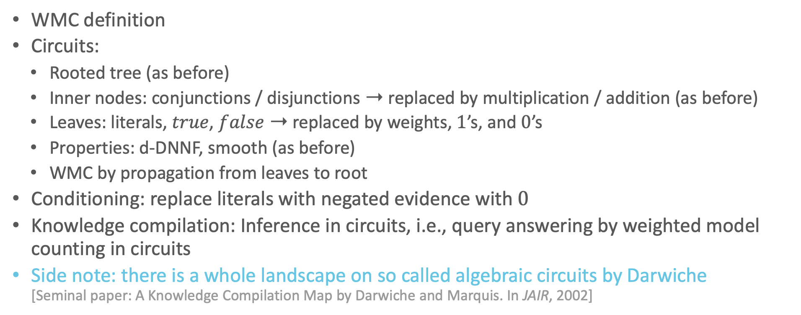
Interim Summary
WMC definition
Circuits:
  Rooted tree (as before)
  Inner nodes: conjunctions / disjunctions ➝ replaced by multiplication / addition (as before)
  Leaves: literals, $true$, $false$ ➝ replaced by weights, $1$’s, and $0$’s
  Properties: d-DNNF, smooth (as before)
  WMC by propagation from leaves to root
Conditioning: replace literals with negated evidence with $0$
Knowledge compilation: Inference in circuits, i.e., query answering by weighted model counting in circuits
Side note: there is a whole landscape on so called algebraic circuits by Darwiche
[Seminal paper: A Knowledge Compilation Map by Darwiche and Marquis. In JAIR, 2002]

Slide 33
Outline: 3. Inference
Exact Inference
  (Weighted) Model Counting
    Model counting
    Weighted model counting, knowledge compilation (KC)
  Variable Elimination and the Like
    Variable elimination (VE)
    Junction tree algorithm (JT)
  Lifted Inference
    First-order KC, Lifted VE, lifted JT
Approximate Inference
  Direct sampling: Rejection sampling, (lifted) importance sampling
  (Lifted) Markov Chain Monte Carlo sampling

