Slide 1











Modelling Formalisms:
Probabilistic Relational Models
(PRMs)
Statistical Relational Artificial Intelligence
(StaRAI)
$$Nat\left(D\right)$$
$$g_{1}$$
$$Acc\left(I\right)$$
$$Epid$$
$$g_{0}$$
$$Travel\left(X\right)$$
$$g_{2}$$
$$g_{3}$$
$$Treat\left(X,M\right)$$
$$Sick\left(X\right)$$
$$10 Presents\left(X, P, C\right)⇒Attends\left(X, C\right)$$
$$3.75 Publishes\left(X, C\right)∧FarAway\left(C\right)⇒Attends\left(X, C\right)$$
Tanya Braun

Slide 2
Contents
Introduction
  Notions of AI, agents, StaRAI
Modelling Formalisms
  Logic
  Probabilistic Graphical Models (PGMs)
  Probabilistic Relational Models (PRMs)
  Syntax, semantics, inference tasks
Inference
  Exact Inference
    (Weighted) Model Counting
    Variable Elimination
    Lifted Inference
  Approximate Inference
  Inference algorithms
Learning
  Relation learning in logic
  Parameter / structure learning for PGMs
  From PGMs to PRMs, PRM learning
Sequential Models and Inference
  Syntax, semantics, inference tasks, algorithms
Decision-theoretic Models and Inference
  Preferences, utility
  Syntax, semantics, inference task, algorithm

Slide 3
Overview: 2. Modelling Formalisms
Logic
  Propositional logic: alphabet, grammar, normal forms, rules
  First-order logic: introducing quantifiers, domain constraints
Probabilistic Graphical Models (PGMs)
  Syntax, semantics, inference problems
  Correctness
Probabilistic Relational Models (PRMs)
  Parfactor models (PMs)
  Markov logic networks (MLNs)
  Turning MLNs into PMs and vice versa, comparison

Slide 4
Parfactor models (PMs)
$$Nat\left(D\right)$$
$$Acc\left(I\right)$$
$$g_{1}$$
$$Epid$$
$$g_{0}$$
$$Travel\left(X\right)$$
$$g_{2}$$
$$g_{3}$$
$$Treat\left(X,M\right)$$
$$Sick\left(X\right)$$
Motivation
Syntax, semantics, graphical representation
Inference tasks

Slide 5

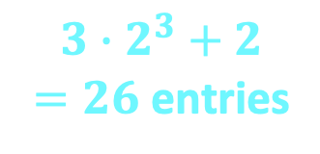

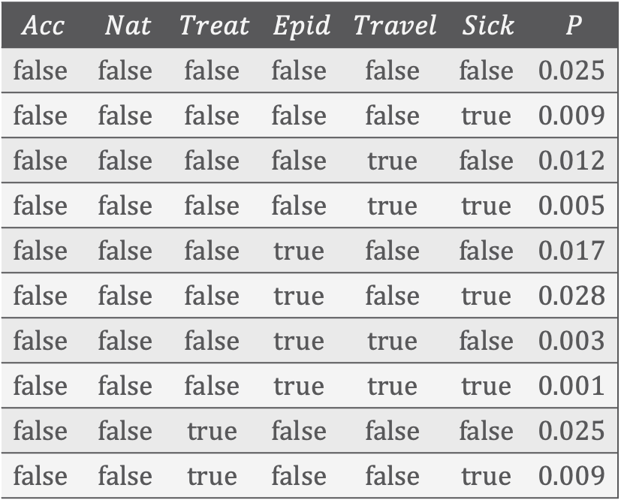








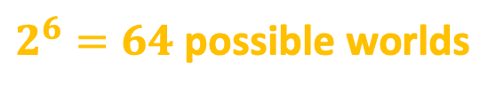








Exponential Blowup! ➝ Sparse Encoding
$$Acc$$ | $$Nat$$ | $$Treat$$ | $$Epid$$ | $$Travel$$ | $$Sick$$ | $$P$$
$$false$$ | $$false$$ | $$false$$ | $$false$$ | $$false$$ | $$false$$ | $$0.025$$
$$false$$ | $$false$$ | $$false$$ | $$false$$ | $$false$$ | $$true$$ | $$0.009$$
$$false$$ | $$false$$ | $$false$$ | $$false$$ | $$true$$ | $$false$$ | $$0.012$$
$$false$$ | $$false$$ | $$false$$ | $$false$$ | $$true$$ | $$true$$ | $$0.005$$
$$false$$ | $$false$$ | $$false$$ | $$true$$ | $$false$$ | $$false$$ | $$0.017$$
$$false$$ | $$false$$ | $$false$$ | $$true$$ | $$false$$ | $$true$$ | $$0.028$$
$$false$$ | $$false$$ | $$false$$ | $$true$$ | $$true$$ | $$false$$ | $$0.003$$
$$false$$ | $$false$$ | $$false$$ | $$true$$ | $$true$$ | $$true$$ | $$0.001$$
$$false$$ | $$false$$ | $$true$$ | $$false$$ | $$false$$ | $$false$$ | $$0.025$$
$$false$$ | $$false$$ | $$true$$ | $$false$$ | $$false$$ | $$true$$ | $$0.009$$
$$Nat$$
$$Acc$$
$$Acc$$
$$f_{1}$$
$$Nat$$
$$Epid$$
$$Epid$$
$$P_{R}$$
$$f_{0}$$
$$Travel$$
$$Treat$$
$$Travel$$
$$Sick$$
$$f_{2}$$
$$f_{3}$$
$$Sick$$
$$Treat.m_{2}$$
$$3∙2^{3}+2$$
$=26$ entries
$2^{6}=64$ possible worlds
Adding relations means adding $Sick$, $Treat$, $Travel$ variables for each person, blowing up the model further
Notes:
Vocabulary

Slide 6

















Problem: Adding Objects and Relations in Propositional Formalisms Clunky…
$$Acc\text{.}chem$$
$$Acc\text{.}nucl$$
$$f_{1}$$
$$Nat\text{.}flood$$
$$f_{1}$$
$$f_{1}$$
$$Nat\text{.}fire$$
$$f_{1}$$
$$Epid$$
$$f_{0}$$
$$f_{2}$$
$$f_{3}$$
$$Treat\text{.}m_{1}$$
$$f_{3}$$
$$Sick$$
$$Travel\text{.}eve$$
$$Treat\text{.}m_{2}$$

Slide 7






















Problem: … and Models Explode with Them
$$Acc\text{.}chem$$
And an epidemic depends on more than three people. One would want to have populations of millions…
$$Acc\text{.}nucl$$
$$f_{1}$$
$$Nat\text{.}flood$$
$$f_{1}$$
$$f_{1}$$
$$Nat\text{.}fire$$
$$f_{1}$$
$$f_{2}$$
$$Epid$$
$$f_{0}$$
$$f_{2}$$
$$f_{3}$$
$$f_{3}$$
$$Treat\text{.}alice\text{.}m_{1}$$
$$Treat\text{.}bob\text{.}m_{1}$$
$$Travel\text{.}alice$$
$$f_{2}$$
$$f_{3}$$
$$f_{3}$$
$$Travel.bob$$
$$f_{3}$$
$$Treat\text{.}eve\text{.}m_{1}$$
$$f_{3}$$
$$Sick\text{.}alice$$
$$Sick\text{.}bob$$
$$Sick\text{.}eve$$
$$Treat\text{.}alice\text{.}m_{2}$$
$$Travel\text{.}eve$$
$$Treat\text{.}eve\text{.}m_{2}$$
$$Treat\text{.}bob\text{.}m_{2}$$
${13∙2}^{3}+2=104$ entries in 14 factors, 17 variables

Slide 8



























Propositional ➝ First-order View
$$Acc\text{.}chem$$
$$Acc\text{.}nucl$$
$$f_{1}$$
$$Nat\text{.}flood$$
$$f_{1}$$
$$f_{1}$$
$$Nat\text{.}fire$$
$$f_{1}$$
$$f_{2}$$
$$Epid$$
$$f_{0}$$
$$f_{2}$$
$$f_{3}$$
$$f_{3}$$
$$Treat\text{.}alice\text{.}m_{1}$$
$$Treat\text{.}bob\text{.}m_{1}$$
$$Travel\text{.}alice$$
$$f_{2}$$
$$f_{3}$$
$$f_{3}$$
$$Travel.bob$$
$$f_{3}$$
$$Treat\text{.}eve\text{.}m_{1}$$
$$f_{3}$$
$$Sick\text{.}alice$$
$$Sick\text{.}bob$$
$$Sick\text{.}eve$$
$$Treat\text{.}alice\text{.}m_{2}$$
$$Travel\text{.}eve$$
$$Treat\text{.}eve\text{.}m_{2}$$
$$Treat\text{.}bob\text{.}m_{2}$$
Symmetries in graph / relations in scenario

Slide 9
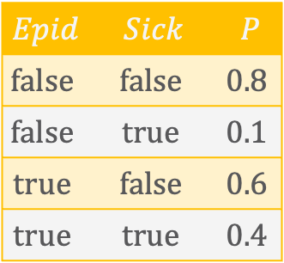
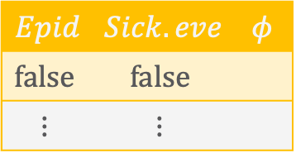

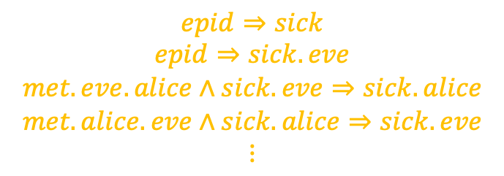
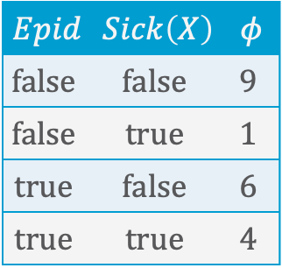
Propositional ➝ First-order View
From logic perspective
From probabilistic perspective
Instead of propositional constraints, we have first-order constraints:
But probabilistic perspective allows soft constraints with a probability assigned
Add logical variables to random variables
$$Epid$$ | $$Sick$$ | $$P$$
$$false$$ | $$false$$ | $$0.8$$
$$false$$ | $$true$$ | $$0.1$$
$$true$$ | $$false$$ | $$0.6$$
$$true$$ | $$true$$ | $$0.4$$
$$epid⇒sick$$
$$epid⇒sick.eve$$
$$met.eve.alice∧sick.eve⇒sick.alice$$
$$met.alice.eve∧sick.alice⇒sick.eve$$
$$⋮$$
$$Epid$$ | $$Sick\left(X\right)$$ | $$φ$$
$$false$$ | $$false$$ | $$9$$
$$false$$ | $$true$$ | $$1$$
$$true$$ | $$false$$ | $$6$$
$$true$$ | $$true$$ | $$4$$
$$∀x :epid⇒sick\left(x\right)$$
$$∀x\left(∃y :met\left(x,y\right)∧sick\left(x\right)⇒sick\left(y\right)\right)$$
$$Epid$$ | $$Sick.eve$$ | $$φ$$
$$false$$ | $$false$$
$$⋮$$ | $$⋮$$
Notes:
epid implies sick makes at least sense a bit; met and sick implies sick is a tautology that does not help at all

Slide 10
Encoding Relations and Symmetries
Logical variables to encode
  Recurring structures in graphs
  Relational structures in data
By parameterising random variables with logical variables
And using those parameterised random variables (PRVs) as inputs to factors
  Forming parametric factors (parfactors)
Allowing to encode
  Duplicate factors only once
  That factors apply to multiple individuals (constants)
David Poole: First-order Probabilistic Inference. In IJCAI-03 Proceedings of the 18th International Joint Conference on Artificial Intelligence, 2003.
Brian Milch, Luke S. Zettelmoyer, Kristian Kersting, Michael Haimes, and Leslie Pack Kaelbling. Lifted Probabilistic Inference with Counting Formulas AAAI-08 Proceedings of the 23rd Conference on Artificial Intelligence, 2008.
Nima Taghipour: Lifted Probabilistic Inference by Variable Elimination. KU Leuven, 2013.
Tanya B: Rescued from a Sea of Queries: Exact Inference in Probabilistic Relational Models. UzL, 2020.

Slide 11
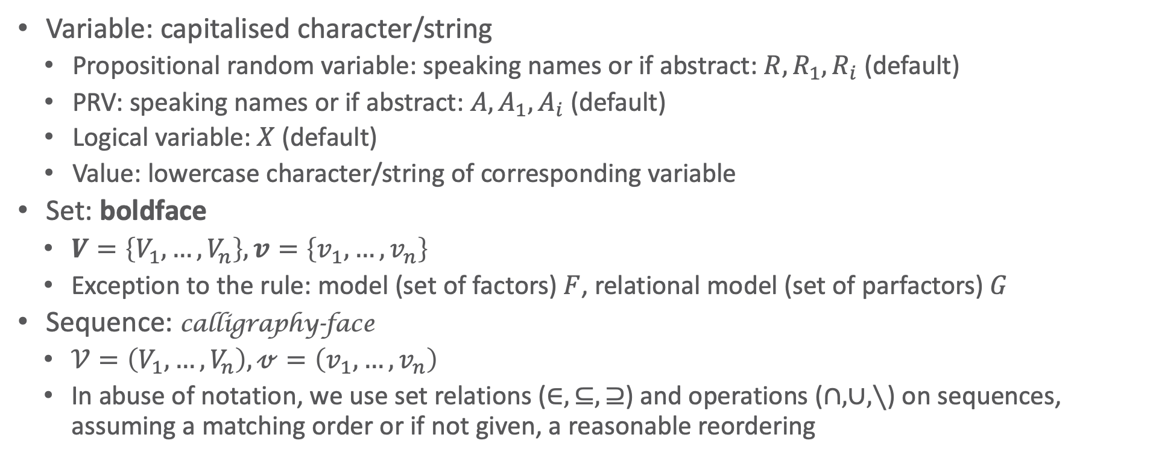
Notations
Variable: capitalised character/string
  Propositional random variable: speaking names or if abstract: $R,R_{1},R_{i}$ (default)
  PRV: speaking names or if abstract: $A, A_{1},A_{i}$ (default)
  Logical variable: $X$ (default)
  Value: lowercase character/string of corresponding variable
Set: boldface
  $V=\left\{V_{1},…,V_{n}\right\},v=\left\{v_{1},…,v_{n}\right\}$
  Exception to the rule: model (set of factors) $F$, relational model (set of parfactors) $G$
Sequence: calligraphy-face
  $𝒱=\left(V_{1},…,V_{n}\right),𝓋=\left(v_{1},…,v_{n}\right)$
  In abuse of notation, we use set relations ($∈,⊆,⊇$) and operations ($∩,∪,∖$) on sequences, assuming a matching order or if not given, a reasonable reordering

Slide 12
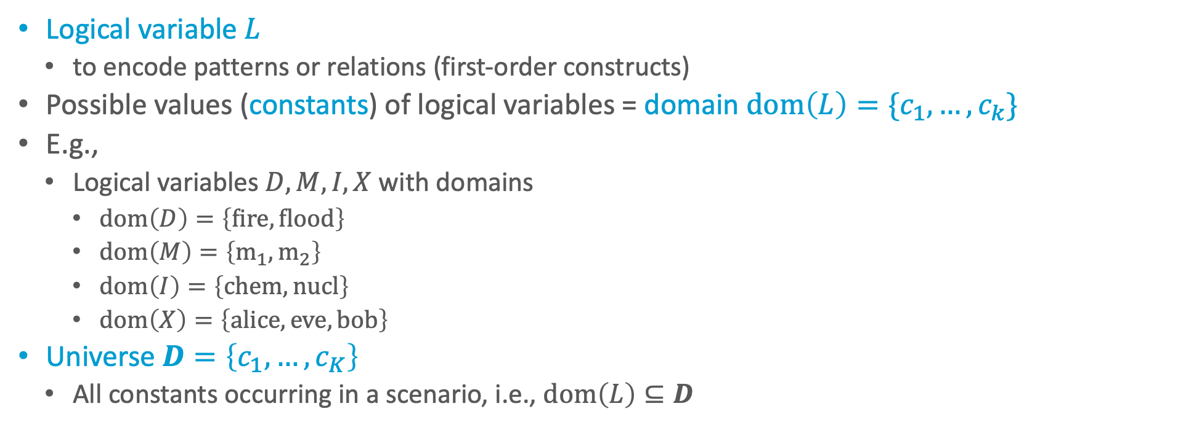
Logical Variables, Domains, Universe
Logical variable $L$
  to encode patterns or relations (first-order constructs)
Possible values (constants) of logical variables = domain $dom\left(L\right)=\{c_{1},…, c_{k}\}$
E.g.,
  Logical variables $D,M,I,X$ with domains
    $dom\left(D\right)=\left\{fire,flood\right\}$
    $dom\left(M\right)=\left\{m_{1},m_{2}\right\}$
    $dom\left(I\right)=\left\{chem, nucl\right\}$
    $dom\left(X\right)=\left\{alice, eve, bob\right\}$
Universe $D=\left\{c_{1}, …, c_{K}\right\}$
  All constants occurring in a scenario, i.e., $dom\left(L\right)⊆D$

Slide 13
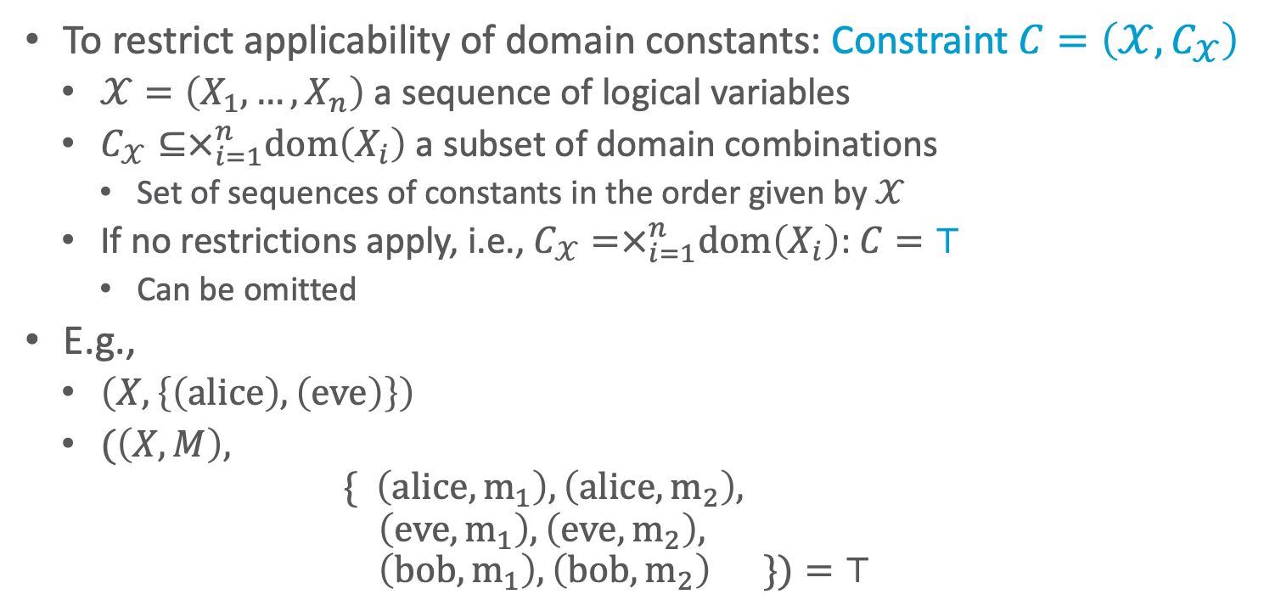
Constraints
To restrict applicability of domain constants: Constraint $C=\left(𝒳,C_{𝒳}\right)$
  $𝒳=\left(X_{1},…,X_{n}\right)$ a sequence of logical variables
  $C_{𝒳}⊆×_{i=1}^{n}dom\left(X_{i}\right)$ a subset of domain combinations
    Set of sequences of constants in the order given by $𝒳$
  If no restrictions apply, i.e., $C_{𝒳}=×_{i=1}^{n}dom\left(X_{i}\right)$: $C=⊤$
    Can be omitted
E.g.,
  $\left(X, \left\{\left(alice\right),\left(eve\right)\right\}\right)$
  $(\left(X,M\right),$
  $\{ \left(alice,m_{1}\right),\left(alice,m_{2}\right),$
  $\left(eve,m_{1}\right), \left(eve,m_{2}\right),$
  $\left(bob,m_{1}\right), \left(bob,m_{2}\right) \})=⊤$
Constraints =
Abstraction of a database
The constraint apparatus appears overwhelming but it just tells you for which constants something applies
Necessary for proofs but not for general understanding

Slide 14



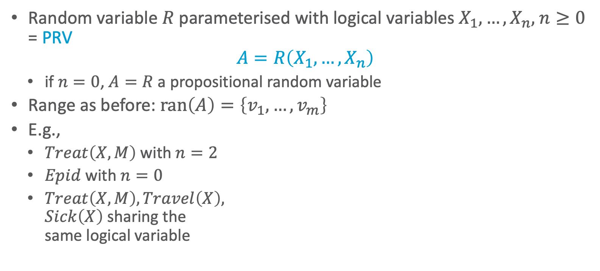



PRVs
Random variable $R$ parameterised with logical variables $X_{1},…, X_{n}$, $n≥0$
= PRV
$$A=R\left(X_{1},…, X_{n}\right)$$
  if $n=0$, $A=R$ a propositional random variable
Range as before: $ran\left(A\right)=\left\{v_{1},…,v_{m}\right\}$
E.g.,
  $Treat\left(X,M\right)$ with $n=2$
  $Epid$ with $n=0$
  $Treat\left(X,M\right),Travel\left(X\right),$
  $Sick\left(X\right)$ sharing the
  same logical variable
$$Nat\left(D\right)$$
$$Acc\left(I\right)$$
$$Epid$$
$$Travel\left(X\right)$$
$$Treat\left(X,M\right)$$
$$Sick\left(X\right)$$

Slide 15
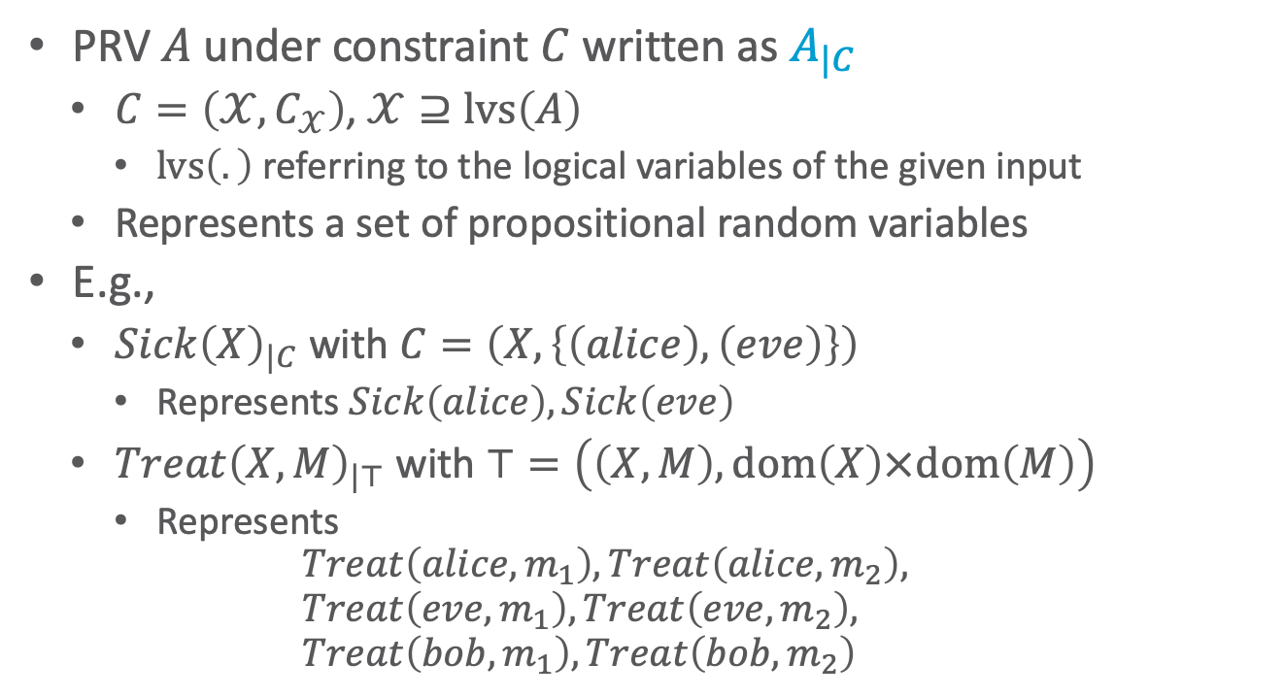
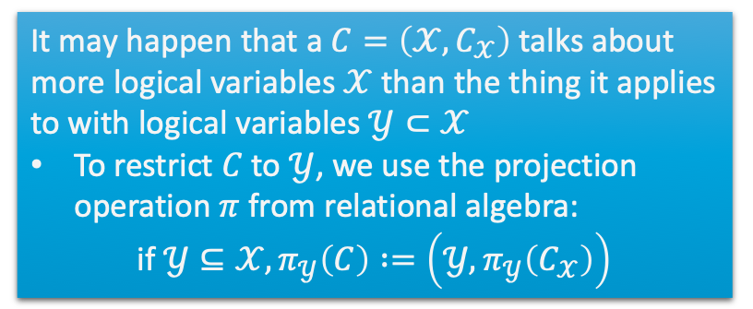
Restricting PRVs
PRV $A$ under constraint $C$ written as $A_{|C}$
  $C=\left(𝒳,C_{𝒳}\right)$, $𝒳⊇lvs\left(A\right)$
    $lvs\left(.\right)$ referring to the logical variables of the given input
  Represents a set of propositional random variables
E.g.,
  $Sick{\left(X\right)}_{|C}$ with $C=\left(X, \left\{\left(alice\right),\left(eve\right)\right\}\right)$
    Represents $Sick\left(alice\right),Sick\left(eve\right)$
  $Treat{\left(X,M\right)}_{|⊤}$ with $⊤=\left(\left(X,M\right),dom\left(X\right)×dom\left(M\right)\right)$
    Represents
    $$Treat\left(alice, m_{1}\right), Treat\left(alice,m_{2}\right), \\ Treat\left(eve, m_{1}\right), Treat\left(eve,m_{2}\right), \\ Treat\left(bob, m_{1}\right), Treat\left(bob,m_{2}\right)$$
It may happen that a $C=\left(𝒳,C_{𝒳}\right)$ talks about more logical variables $𝒳$ than the thing it applies to with logical variables $𝒴⊂𝒳$
To restrict $C$ to $𝒴$, we use the projection operation $π$ from relational algebra:
$$\text{if} 𝒴⊆𝒳,π_{𝒴}\left(C\right) :=\left(𝒴,π_{𝒴}\left(C_{𝒳}\right)\right)$$
$$Nat\left(D\right)$$
$$Acc\left(I\right)$$
$$Epid$$
$$Travel\left(X\right)$$
$$Treat\left(X,M\right)$$
$$Sick\left(X\right)$$

Slide 16
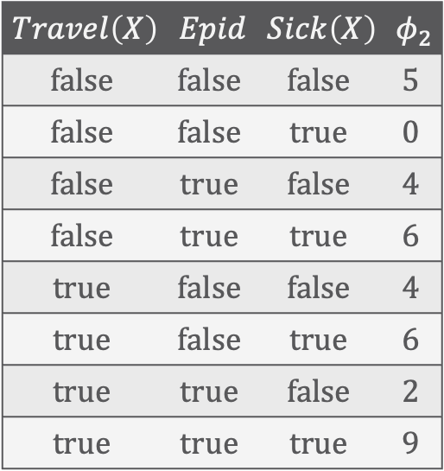
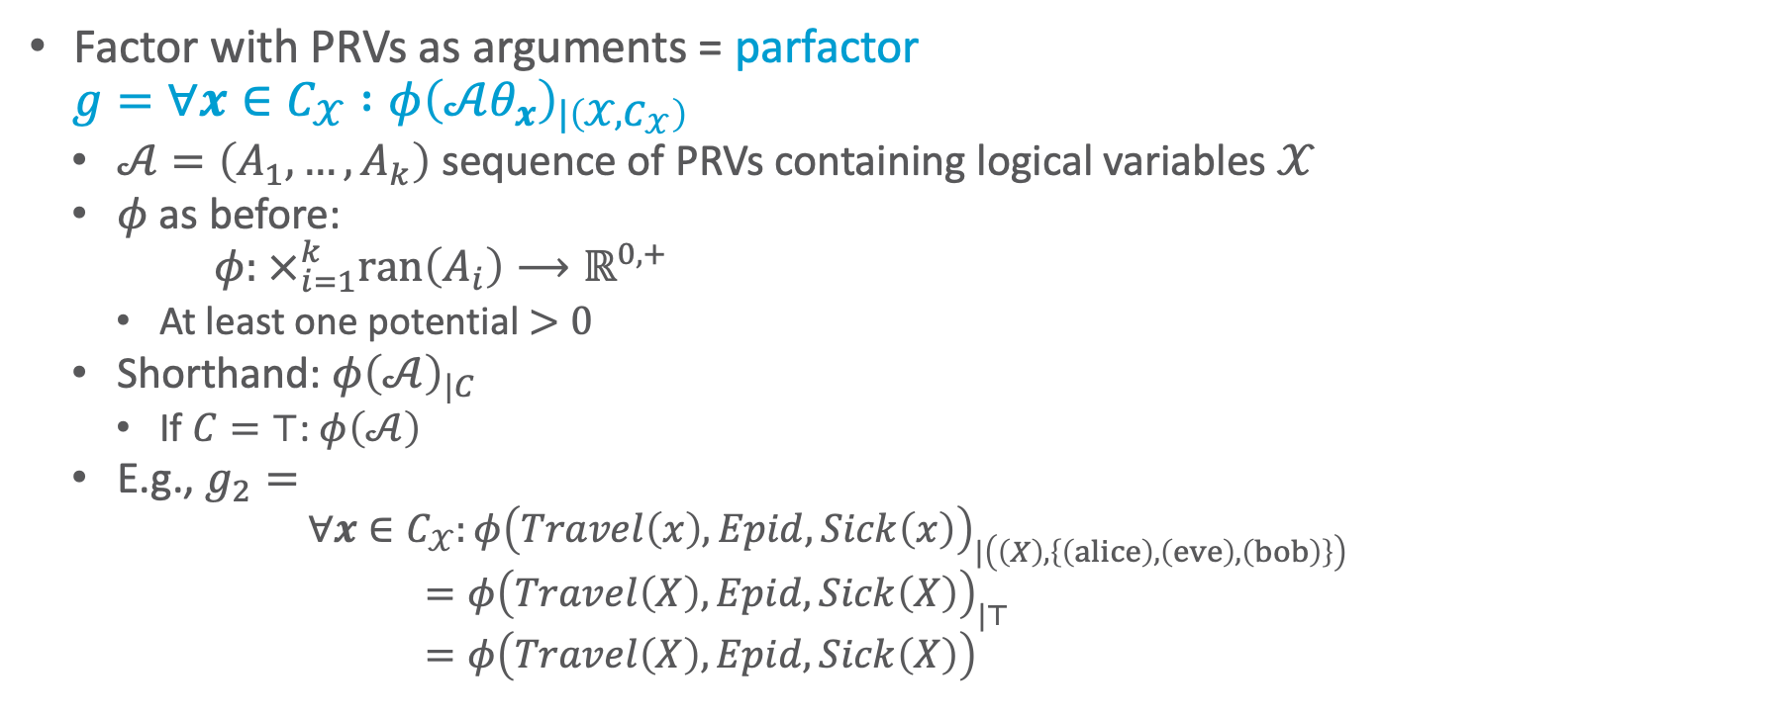
Parfactors
Factor with PRVs as arguments = parfactor
$$g=∀x∈C_{𝒳} :φ{\left(𝒜θ_{x}\right)}_{|\left(𝒳,C_{𝒳}\right)}$$
  $𝒜=\left(A_{1}, …, A_{k}\right)$ sequence of PRVs containing logical variables $𝒳$
  $φ$ as before:
  $$φ: ×_{i=1}^{k}ran\left(A_{i}\right)⟶ℝ^{0,+}$$
    At least one potential $>0$
  Shorthand: $φ{\left(𝒜\right)}_{|C}$
    If $C=⊤$: $φ\left(𝒜\right)$
  E.g., $g_{2}=$
    $$∀x∈C_{𝒳}:φ{\left(Travel\left(x\right),Epid,Sick\left(x\right)\right)}_{|\left(\left(X\right),\left\{\left(alice\right),\left(eve\right), \left(bob\right)\right\}\right)} \\ =φ{\left(Travel\left(X\right),Epid,Sick\left(X\right)\right)}_{|⊤} \\ =φ\left(Travel\left(X\right),Epid,Sick\left(X\right)\right)$$
$$Travel\left(X\right)$$ | $$Epid$$ | $$Sick\left(X\right)$$ | $$φ_{2}$$
$$false$$ | $$false$$ | $$false$$ | $$5$$
$$false$$ | $$false$$ | $$true$$ | $$0$$
$$false$$ | $$true$$ | $$false$$ | $$4$$
$$false$$ | $$true$$ | $$true$$ | $$6$$
$$true$$ | $$false$$ | $$false$$ | $$4$$
$$true$$ | $$false$$ | $$true$$ | $$6$$
$$true$$ | $$true$$ | $$false$$ | $$2$$
$$true$$ | $$true$$ | $$true$$ | $$9$$

Slide 17
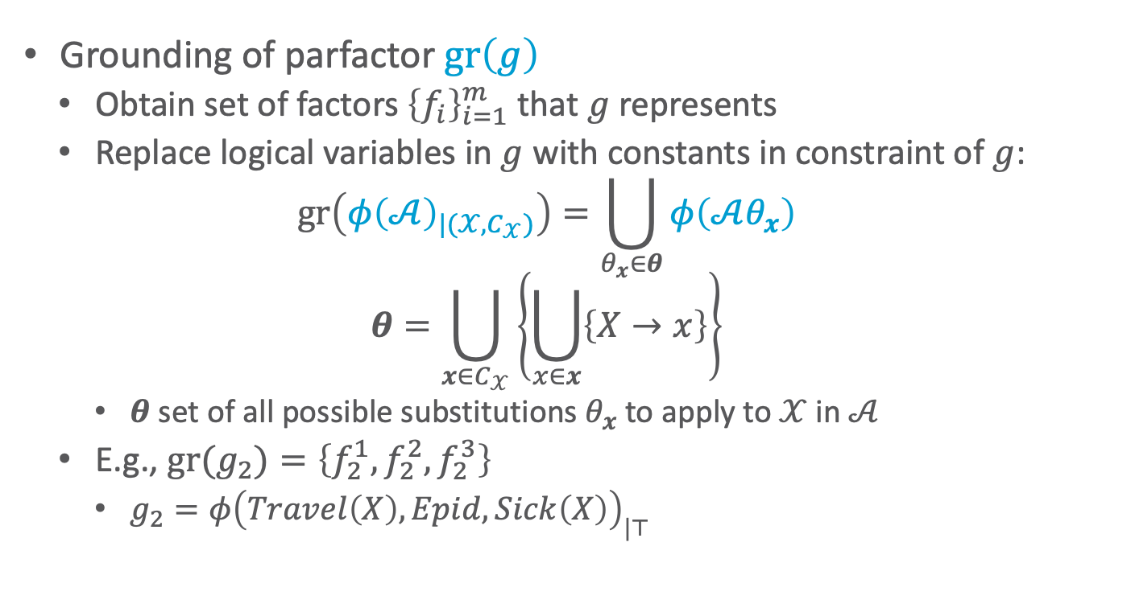
Grounding of Parfactors
Grounding of parfactor $gr\left(g\right)$
  Obtain set of factors ${\left\{f_{i}\right\}}_{i=1}^{m}$ that $g$ represents
  Replace logical variables in $g$ with constants in constraint of $g$:
  $$gr\left({φ\left(𝒜\right)}_{|{(𝒳,C}_{𝒳})}\right)=\bigcup_{θ_{x}∈θ}{φ\left(𝒜θ_{x}\right)}$$
  $$θ=\bigcup_{x∈C_{𝒳}}{\left\{\bigcup_{x∈x}{\left\{X→x\right\}}\right\}}$$
    $θ$ set of all possible substitutions $θ_{x}$ to apply to $𝒳$ in $𝒜$
  E.g., ${gr(g}_{2})=\left\{f_{2}^{1},f_{2}^{2},f_{2}^{3}\right\}$
    $g_{2}=φ{\left(Travel\left(X\right),Epid,Sick\left(X\right)\right)}_{|⊤}$
$$Travel\left(X\right)$$ | $$Epid$$ | $$Sick\left(X\right)$$ | $$φ_{2}$$
$$false$$ | $$false$$ | $$false$$ | $$5$$
$$false$$ | $$false$$ | $$true$$ | $$0$$
$$false$$ | $$true$$ | $$false$$ | $$4$$
$$false$$ | $$true$$ | $$true$$ | $$6$$
$$true$$ | $$false$$ | $$false$$ | $$4$$
$$true$$ | $$false$$ | $$true$$ | $$6$$
$$true$$ | $$true$$ | $$false$$ | $$2$$
$$true$$ | $$true$$ | $$true$$ | $$9$$

Slide 18
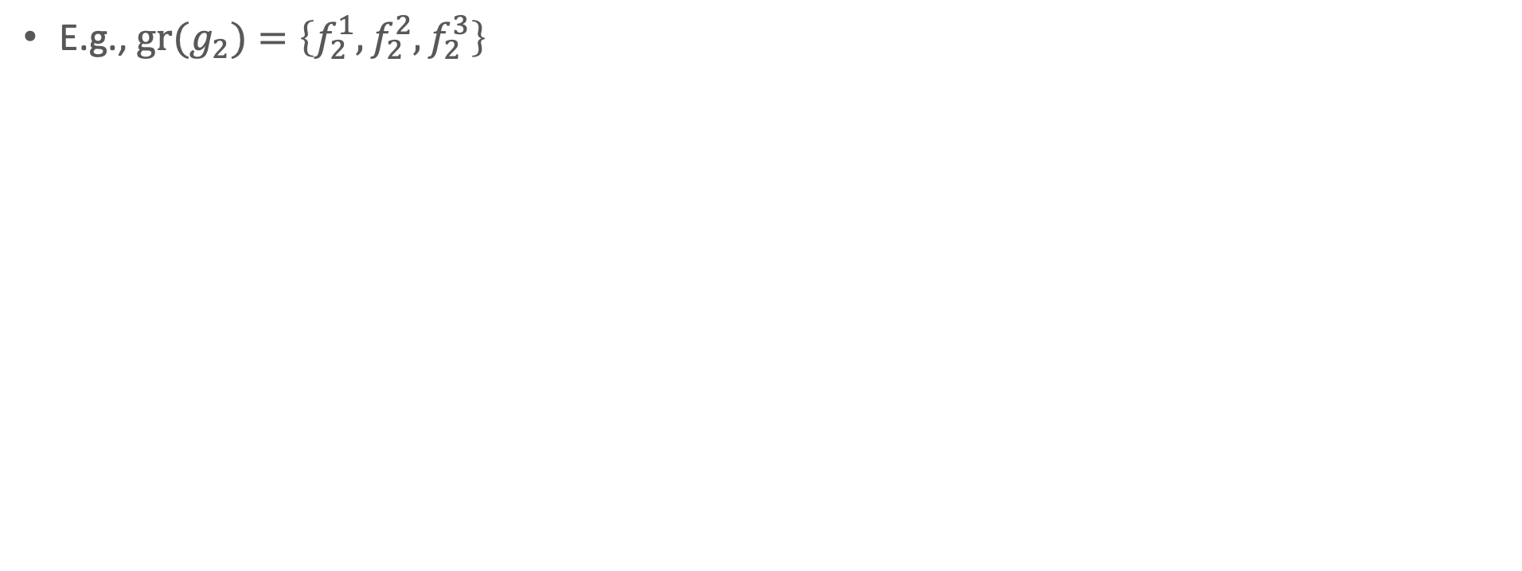


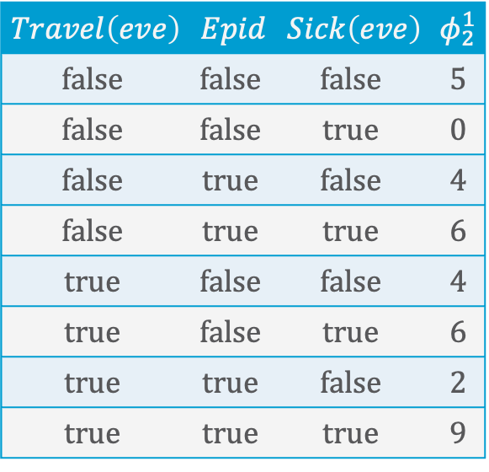
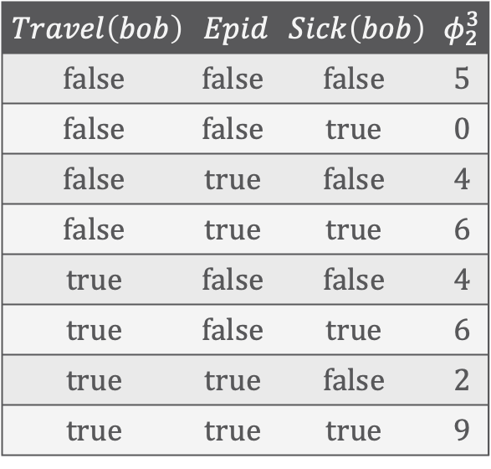
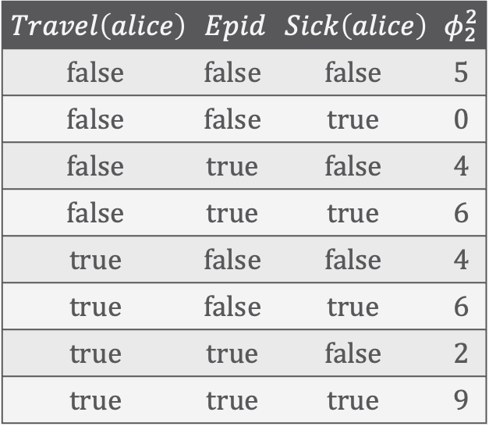
Grounding: Example
$$Travel\left(X\right)$$ | $$Epid$$ | $$Sick\left(X\right)$$ | $$φ_{2}$$
$$false$$ | $$false$$ | $$false$$ | $$5$$
$$false$$ | $$false$$ | $$true$$ | $$0$$
$$false$$ | $$true$$ | $$false$$ | $$4$$
$$false$$ | $$true$$ | $$true$$ | $$6$$
$$true$$ | $$false$$ | $$false$$ | $$4$$
$$true$$ | $$false$$ | $$true$$ | $$6$$
$$true$$ | $$true$$ | $$false$$ | $$2$$
$$true$$ | $$true$$ | $$true$$ | $$9$$
E.g., ${gr(g}_{2})=\left\{f_{2}^{1},f_{2}^{2},f_{2}^{3}\right\}$
$$Travel\left(eve\right)$$ | $$Epid$$ | $$Sick\left(eve\right)$$ | $$φ_{2}^{1}$$
$$false$$ | $$false$$ | $$false$$ | 5
$$false$$ | $$false$$ | $$true$$ | 0
$$false$$ | $$true$$ | $$false$$ | 4
$$false$$ | $$true$$ | $$true$$ | 6
$$true$$ | $$false$$ | $$false$$ | 4
$$true$$ | $$false$$ | $$true$$ | 6
$$true$$ | $$true$$ | $$false$$ | 2
$$true$$ | $$true$$ | $$true$$ | 9
$$Travel\left(bob\right)$$ | $$Epid$$ | $$Sick\left(bob\right)$$ | $$φ_{2}^{3}$$
$$false$$ | $$false$$ | $$false$$ | 5
$$false$$ | $$false$$ | $$true$$ | 0
$$false$$ | $$true$$ | $$false$$ | 4
$$false$$ | $$true$$ | $$true$$ | 6
$$true$$ | $$false$$ | $$false$$ | 4
$$true$$ | $$false$$ | $$true$$ | 6
$$true$$ | $$true$$ | $$false$$ | 2
$$true$$ | $$true$$ | $$true$$ | 9
$$Travel\left(alice\right)$$ | $$Epid$$ | $$Sick\left(alice\right)$$ | $$φ_{2}^{2}$$
$$false$$ | $$false$$ | $$false$$ | 5
$$false$$ | $$false$$ | $$true$$ | 0
$$false$$ | $$true$$ | $$false$$ | 4
$$false$$ | $$true$$ | $$true$$ | 6
$$true$$ | $$false$$ | $$false$$ | 4
$$true$$ | $$false$$ | $$true$$ | 6
$$true$$ | $$true$$ | $$false$$ | 2
$$true$$ | $$true$$ | $$true$$ | 9
$$=$$

Slide 19
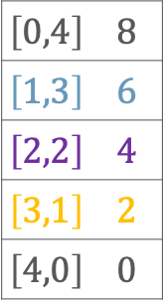
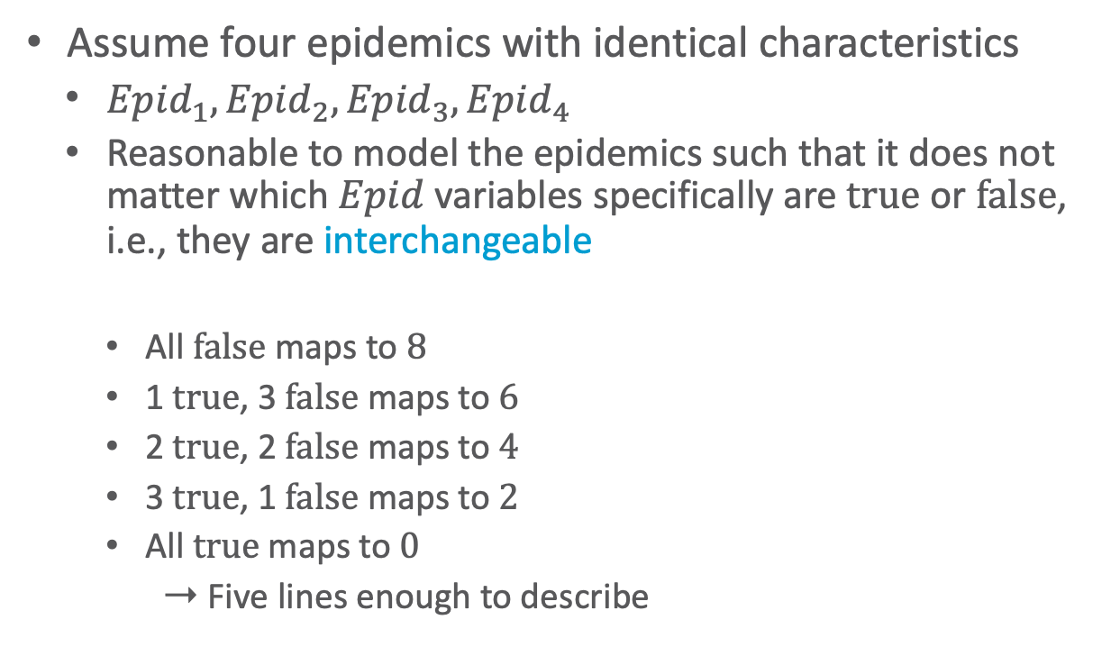
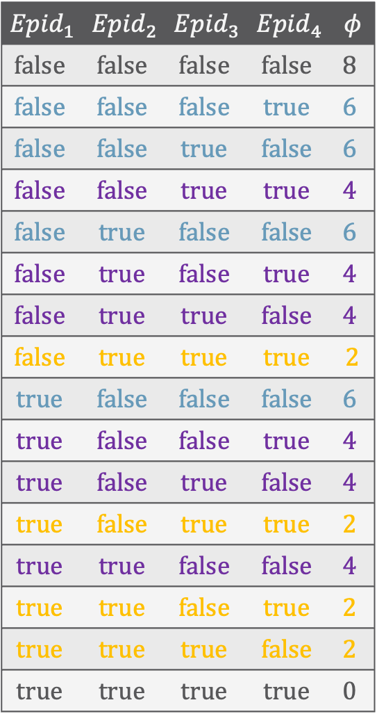


Symmetries Within
$${Epid}_{1}$$ | $${Epid}_{2}$$ | $${Epid}_{3}$$ | $${Epid}_{4}$$ | $$φ$$
$$false$$ | $$false$$ | $$false$$ | $$false$$ | $$8$$
$$false$$ | $$false$$ | $$false$$ | $$true$$ | $$6$$
$$false$$ | $$false$$ | $$true$$ | $$false$$ | $$6$$
$$false$$ | $$false$$ | $$true$$ | $$true$$ | $$4$$
$$false$$ | $$true$$ | $$false$$ | $$false$$ | $$6$$
$$false$$ | $$true$$ | $$false$$ | $$true$$ | $$4$$
$$false$$ | $$true$$ | $$true$$ | $$false$$ | $$4$$
$$false$$ | $$true$$ | $$true$$ | $$true$$ | 2
$$true$$ | $$false$$ | $$false$$ | $$false$$ | $$6$$
$$true$$ | $$false$$ | $$false$$ | $$true$$ | $$4$$
$$true$$ | $$false$$ | $$true$$ | $$false$$ | $$4$$
$$true$$ | $$false$$ | $$true$$ | $$true$$ | $$2$$
$$true$$ | $$true$$ | $$false$$ | $$false$$ | $$4$$
$$true$$ | $$true$$ | $$false$$ | $$true$$ | $$2$$
$$true$$ | $$true$$ | $$true$$ | $$false$$ | $$2$$
$$true$$ | $$true$$ | $$true$$ | $$true$$ | $$0$$
Assume four epidemics with identical characteristics
  ${Epid}_{1},{Epid}_{2},{Epid}_{3},{Epid}_{4}$
  Reasonable to model the epidemics such that it does not matter which $Epid$ variables specifically are $true$ or $false$, i.e., they are interchangeable
    All $false$ maps to $8$
    1 $true$, 3 $false$ maps to $6$
    2 $true$, 2 $false$ maps to $4$
    3 $true$, 1 $false$ maps to $2$
    All $true$ maps to $0$
    ➝ Five lines enough to describe
$$\#_{true}$$
$$\#_{false}$$
$$\left[0,4\right]$$ | $$8$$
$$\left[1,3\right]$$ | $$6$$
$$\left[2,2\right]$$ | $$4$$
$$\left[3,1\right]$$ | $$2$$
$$\left[4,0\right]$$ | $$0$$

Slide 20
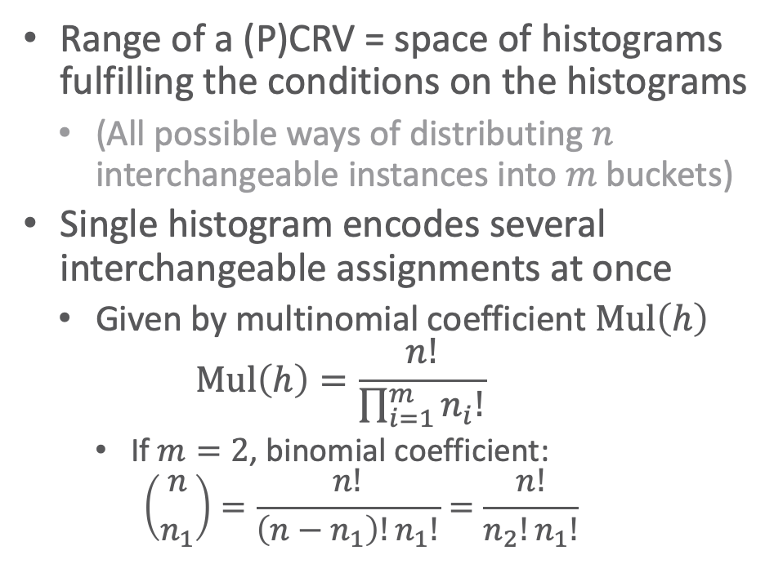
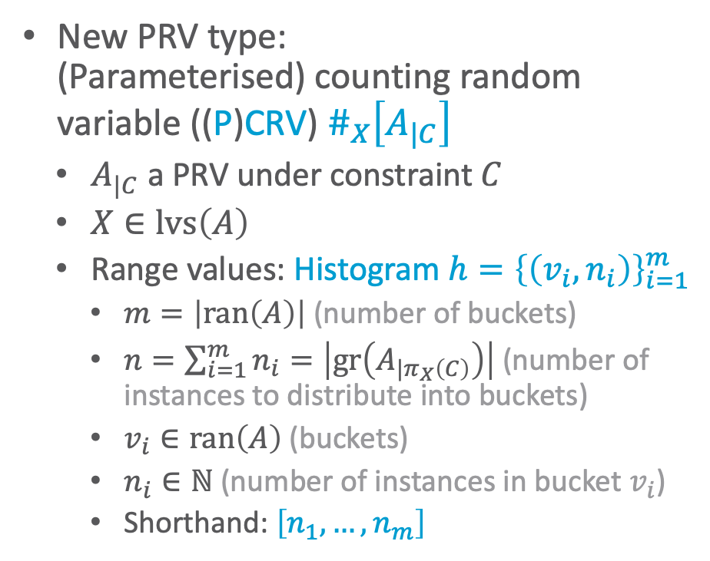
Counting Random Variable
New PRV type:
(Parameterised) counting random variable ((P)CRV) $\#_{X}\left[A_{|C}\right]$
  $A_{|C}$ a PRV under constraint $C$
  $X∈lvs\left(A\right)$
  Range values: Histogram ${h=\left\{\left(v_{i},n_{i}\right)\right\}}_{i=1}^{m}$
    $m=\left|ran\left(A\right)\right|$ (number of buckets)
    $n=\sum_{i=1}^{m}{n_{i}=\left|gr\left(A_{|π_{X}\left(C\right)}\right)\right|}$ (number of instances to distribute into buckets)
    $v_{i}∈ran\left(A\right)$ (buckets)
    $n_{i}∈ℕ$ (number of instances in bucket $v_{i}$)
    Shorthand: $\left[n_{1},…,n_{m}\right]$
Range of a (P)CRV = space of histograms fulfilling the conditions on the histograms
  (All possible ways of distributing $n$ interchangeable instances into $m$ buckets)
Single histogram encodes several interchangeable assignments at once
  Given by multinomial coefficient $Mul\left(h\right)$
  $$Mul\left(h\right)=\frac{n!}{\prod_{i=1}^{m}{n_{i}!}}$$
    If $m=2$, binomial coefficient:
    $$\left({n \atop n_{1}}\right)=\frac{n!}{\left(n−n_{1}\right)!n_{1}!}=\frac{n!}{n_{2}!n_{1}!}$$

Slide 21
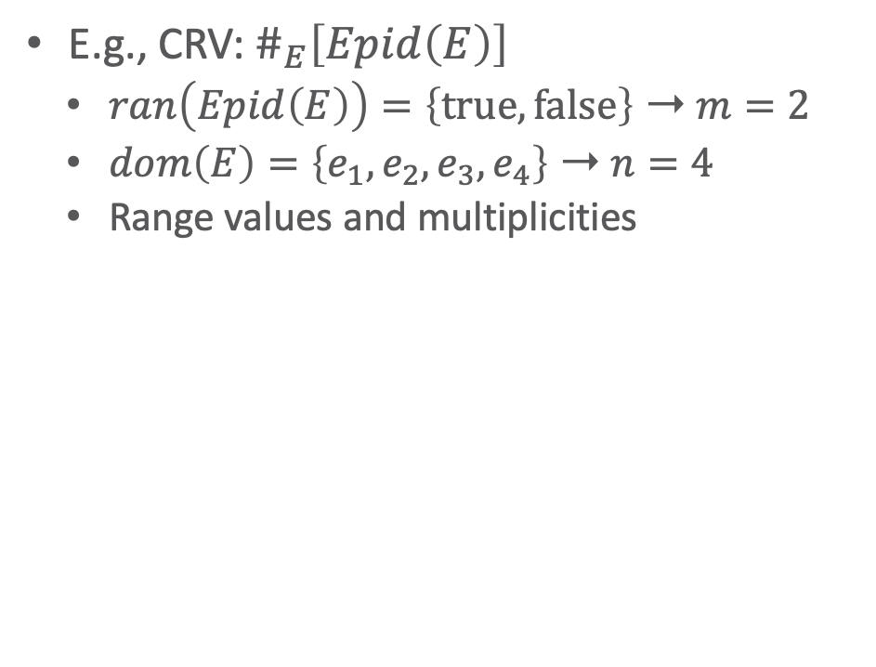
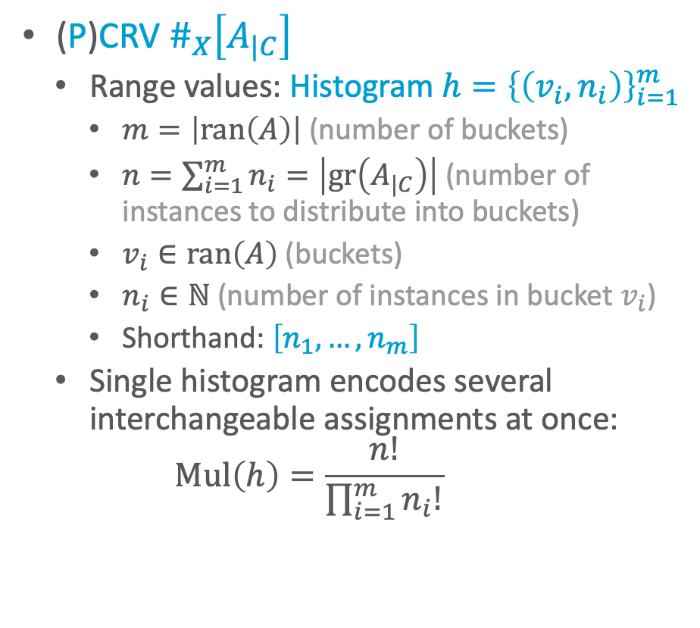
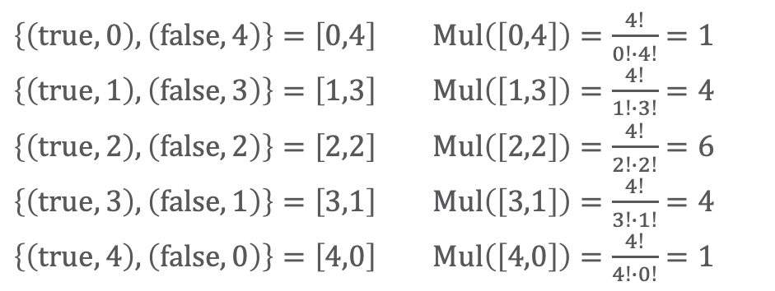
CRV: Example
(P)CRV $\#_{X}\left[A_{|C}\right]$
  Range values: Histogram ${h=\left\{\left(v_{i},n_{i}\right)\right\}}_{i=1}^{m}$
    $m=\left|ran\left(A\right)\right|$ (number of buckets)
    $n=\sum_{i=1}^{m}{n_{i}=\left|gr\left(A_{|C}\right)\right|}$ (number of instances to distribute into buckets)
    $v_{i}∈ran\left(A\right)$ (buckets)
    $n_{i}∈ℕ$ (number of instances in bucket $v_{i}$)
    Shorthand: $\left[n_{1},…,n_{m}\right]$
  Single histogram encodes several interchangeable assignments at once:
  $$Mul\left(h\right)=\frac{n!}{\prod_{i=1}^{m}{n_{i}!}}$$
E.g., CRV: $\#_{E}\left[Epid\left(E\right)\right]$
  $ran\left(Epid\left(E\right)\right)=\left\{true,false\right\}$ ➝ $m=2$
  $dom\left(E\right)=\left\{e_{1},e_{2},e_{3},e_{4}\right\}$ ➝ $n=4$
  Range values and multiplicities
$\left\{\left(true,0\right),\left(false,4\right)\right\}=\left[0,4\right]$ $Mul\left(\left[0,4\right]\right)=\frac{4!}{0!∙4!}=1$
$\left\{\left(true,1\right),\left(false,3\right)\right\}=\left[1,3\right]$ $Mul\left(\left[1,3\right]\right)=\frac{4!}{1!∙3!}=4$
$\left\{\left(true,2\right),\left(false,2\right)\right\}=\left[2,2\right]$ $Mul\left(\left[2,2\right]\right)=\frac{4!}{2!∙2!}=6$
$\left\{\left(true,3\right),\left(false,1\right)\right\}=\left[3,1\right]$ $Mul\left(\left[3,1\right]\right)=\frac{4!}{3!∙1!}=4$
$\left\{\left(true,4\right),\left(false,0\right)\right\}=\left[4,0\right]$ $Mul\left(\left[4,0\right]\right)=\frac{4!}{4!∙0!}=1$

Slide 22
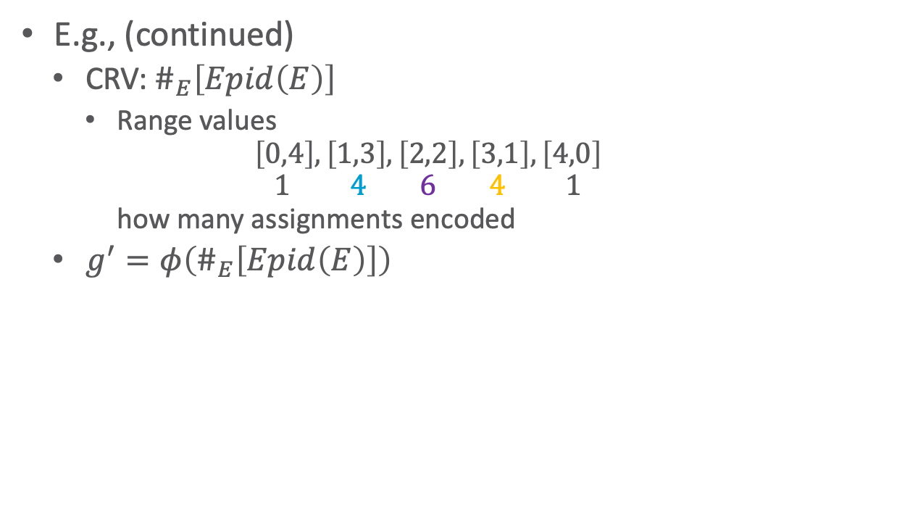
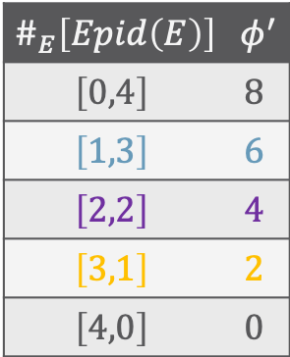
CRV: Example
$${Epid}_{1}$$ | $${Epid}_{2}$$ | $${Epid}_{3}$$ | $${Epid}_{4}$$ | $$φ$$
$$false$$ | $$false$$ | $$false$$ | $$false$$ | $$8$$
$$false$$ | $$false$$ | $$false$$ | $$true$$ | $$6$$
$$false$$ | $$false$$ | $$true$$ | $$false$$ | $$6$$
$$false$$ | $$false$$ | $$true$$ | $$true$$ | $$4$$
$$false$$ | $$true$$ | $$false$$ | $$false$$ | $$6$$
$$false$$ | $$true$$ | $$false$$ | $$true$$ | $$4$$
$$false$$ | $$true$$ | $$true$$ | $$false$$ | $$4$$
$$false$$ | $$true$$ | $$true$$ | $$true$$ | 2
$$true$$ | $$false$$ | $$false$$ | $$false$$ | $$6$$
$$true$$ | $$false$$ | $$false$$ | $$true$$ | $$4$$
$$true$$ | $$false$$ | $$true$$ | $$false$$ | $$4$$
$$true$$ | $$false$$ | $$true$$ | $$true$$ | $$2$$
$$true$$ | $$true$$ | $$false$$ | $$false$$ | $$4$$
$$true$$ | $$true$$ | $$false$$ | $$true$$ | $$2$$
$$true$$ | $$true$$ | $$true$$ | $$false$$ | $$2$$
$$true$$ | $$true$$ | $$true$$ | $$true$$ | $$0$$
E.g., (continued)
  CRV: $\#_{E}\left[Epid\left(E\right)\right]$
    Range values
    $\left[0,4\right],\left[1,3\right],\left[2,2\right],\left[3,1\right],\left[4,0\right]$
    $1 4 6 4 1$
    how many assignments encoded
  $g^{′}=φ\left(\#_{E}\left[Epid\left(E\right)\right]\right)$
$$\#_{E}\left[Epid\left(E\right)\right]$$ | $$φ^{′}$$
$$\left[0,4\right]$$ | $$8$$
$$\left[1,3\right]$$ | $$6$$
$$\left[2,2\right]$$ | $$4$$
$$\left[3,1\right]$$ | $$2$$
$$\left[4,0\right]$$ | $$0$$

Slide 23
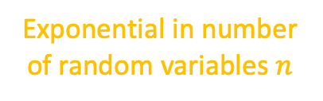
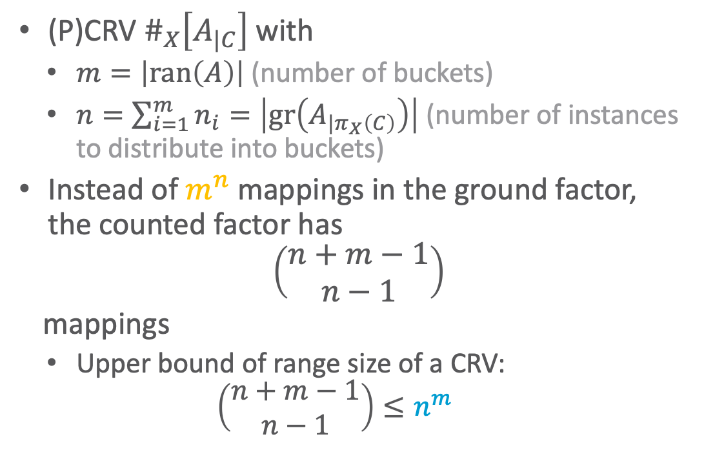

CRVs Continued
(P)CRV $\#_{X}\left[A_{|C}\right]$with
  $m=\left|ran\left(A\right)\right|$ (number of buckets)
  $n=\sum_{i=1}^{m}{n_{i}=\left|gr\left(A_{|π_{X}\left(C\right)}\right)\right|}$ (number of instances to distribute into buckets)
Instead of $m^{n}$ mappings in the ground factor,
the counted factor has
$$\left(\begin{aligned}n+m−1 \\ n−1\end{aligned}\right)$$
mappings
  Upper bound of range size of a CRV:
  $$\left(\begin{aligned}n+m−1 \\ n−1\end{aligned}\right)≤n^{m}$$
Exponential in number of random variables $n$
Polynomial in number of random variables $n$

Slide 24
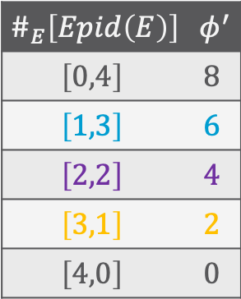
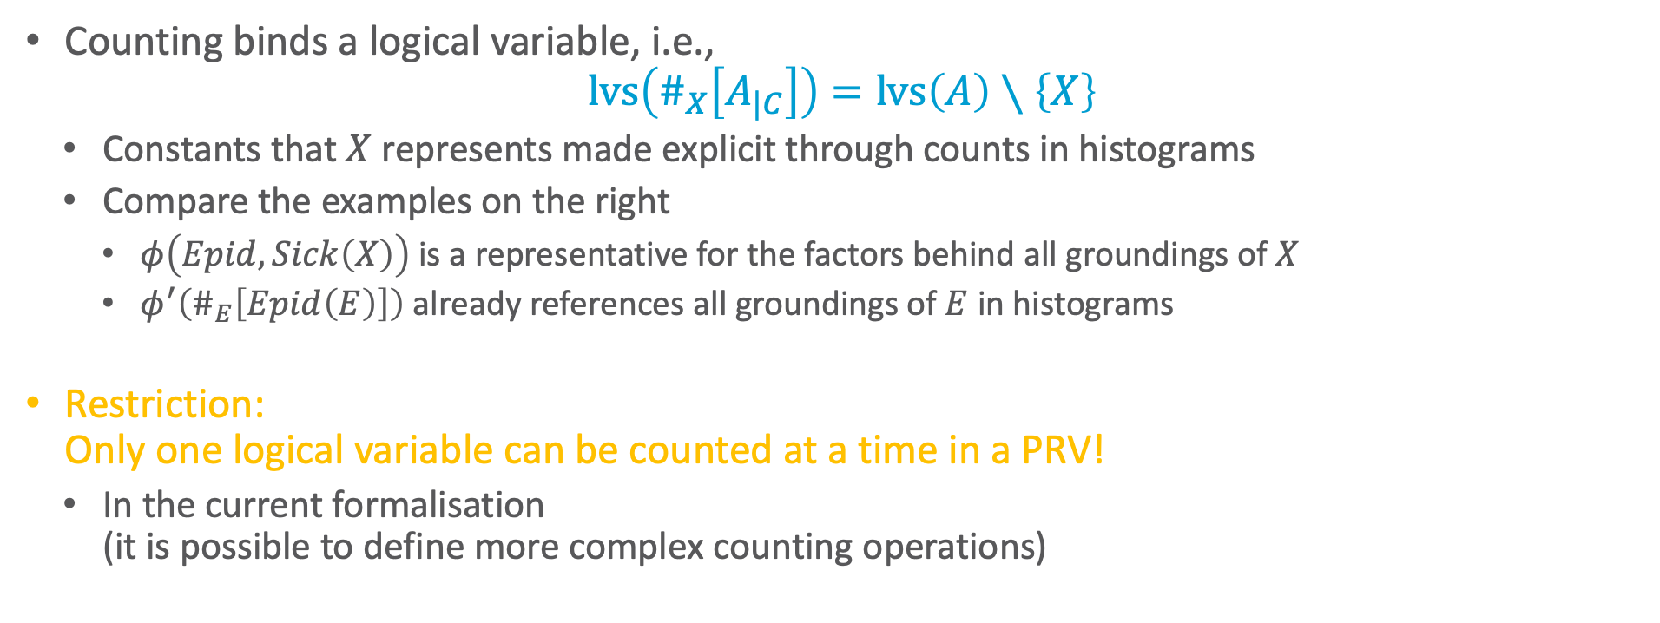
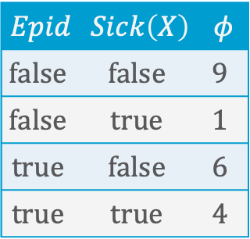
CRVs Continued
$$Epid$$ | $$Sick\left(X\right)$$ | $$φ$$
$$false$$ | $$false$$ | $$9$$
$$false$$ | $$true$$ | $$1$$
$$true$$ | $$false$$ | $$6$$
$$true$$ | $$true$$ | $$4$$
Counting binds a logical variable, i.e.,
$$lvs\left(\#_{X}\left[A_{|C}\right]\right)=lvs\left(A\right)∖\left\{X\right\}$$
  Constants that $X$ represents made explicit through counts in histograms
  Compare the examples on the right
    $φ\left(Epid,Sick\left(X\right)\right)$ is a representative for the factors behind all groundings of $X$
    $φ^{′}\left(\#_{E}\left[Epid\left(E\right)\right]\right)$ already references all groundings of $E$ in histograms
Restriction:
Only one logical variable can be counted at a time in a PRV!
  In the current formalisation
  (it is possible to define more complex counting operations)
$$\#_{E}\left[Epid\left(E\right)\right]$$ | $$φ^{′}$$
$$\left[0,4\right]$$ | $$8$$
$$\left[1,3\right]$$ | $$6$$
$$\left[2,2\right]$$ | $$4$$
$$\left[3,1\right]$$ | $$2$$
$$\left[4,0\right]$$ | $$0$$

Slide 25

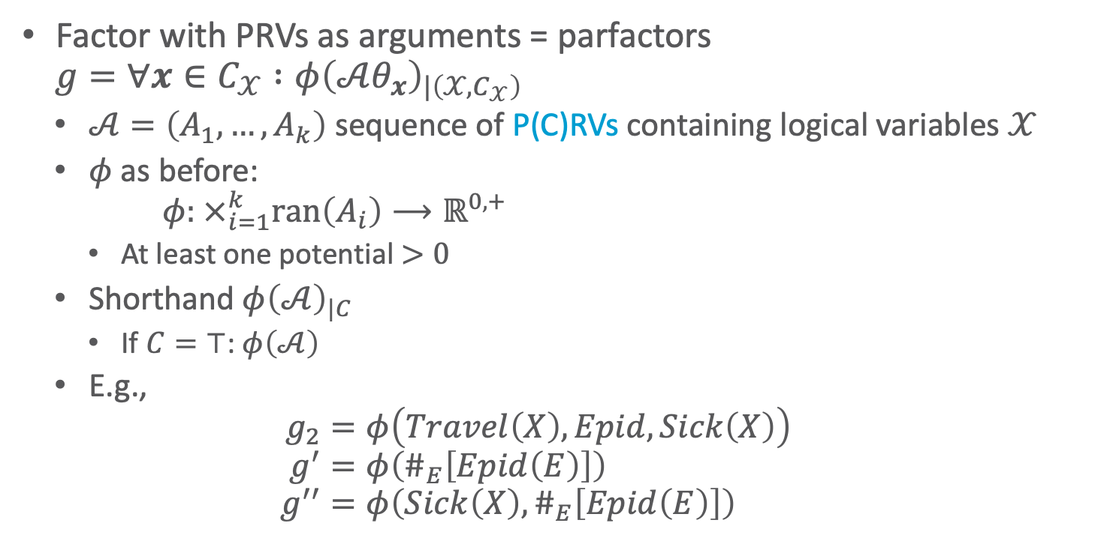
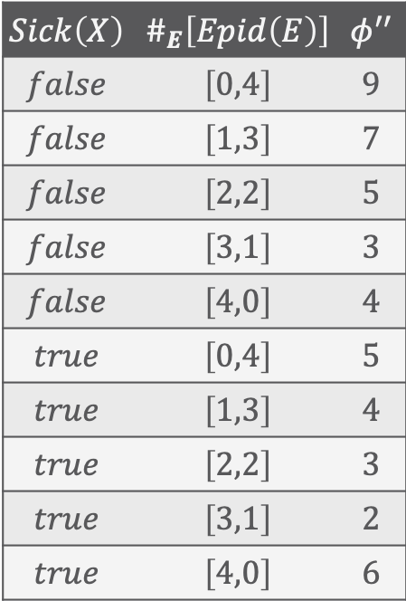
Parfactors Revisited
Factor with PRVs as arguments = parfactors
$$g=∀x∈C_{𝒳} :φ{\left(𝒜θ_{x}\right)}_{|\left(𝒳,C_{𝒳}\right)}$$
  $𝒜=\left(A_{1}, …, A_{k}\right)$ sequence of P(C)RVs containing logical variables $𝒳$
  $φ$ as before:
  $$φ: ×_{i=1}^{k}ran\left(A_{i}\right)⟶ℝ^{0,+}$$
    At least one potential $>0$
  Shorthand $φ{\left(𝒜\right)}_{|C}$
    If $C=⊤$: $φ\left(𝒜\right)$
  E.g.,
  $$g_{2}=φ\left(Travel\left(X\right),Epid,Sick\left(X\right)\right) \\ g^{′}=φ\left(\#_{E}\left[Epid\left(E\right)\right]\right) \\ g^{′′}=φ\left(Sick\left(X\right),\#_{E}\left[Epid\left(E\right)\right]\right)$$
$$Sick\left(X\right)$$ | $$\#_{E}\left[Epid\left(E\right)\right]$$ | $$φ^{′′}$$
$$false$$ | $$\left[0,4\right]$$ | $$9$$
$$false$$ | $$\left[1,3\right]$$ | $$7$$
$$false$$ | $$\left[2,2\right]$$ | $$5$$
$$false$$ | $$\left[3,1\right]$$ | $$3$$
$$false$$ | $$\left[4,0\right]$$ | $$4$$
$$true$$ | $$\left[0,4\right]$$ | $$5$$
$$true$$ | $$\left[1,3\right]$$ | $$4$$
$$true$$ | $$\left[2,2\right]$$ | $$3$$
$$true$$ | $$\left[3,1\right]$$ | $$2$$
$$true$$ | $$\left[4,0\right]$$ | $$6$$
$𝒜$may contain ground random variables, PRVs, CRVs, PCRVs

Slide 26


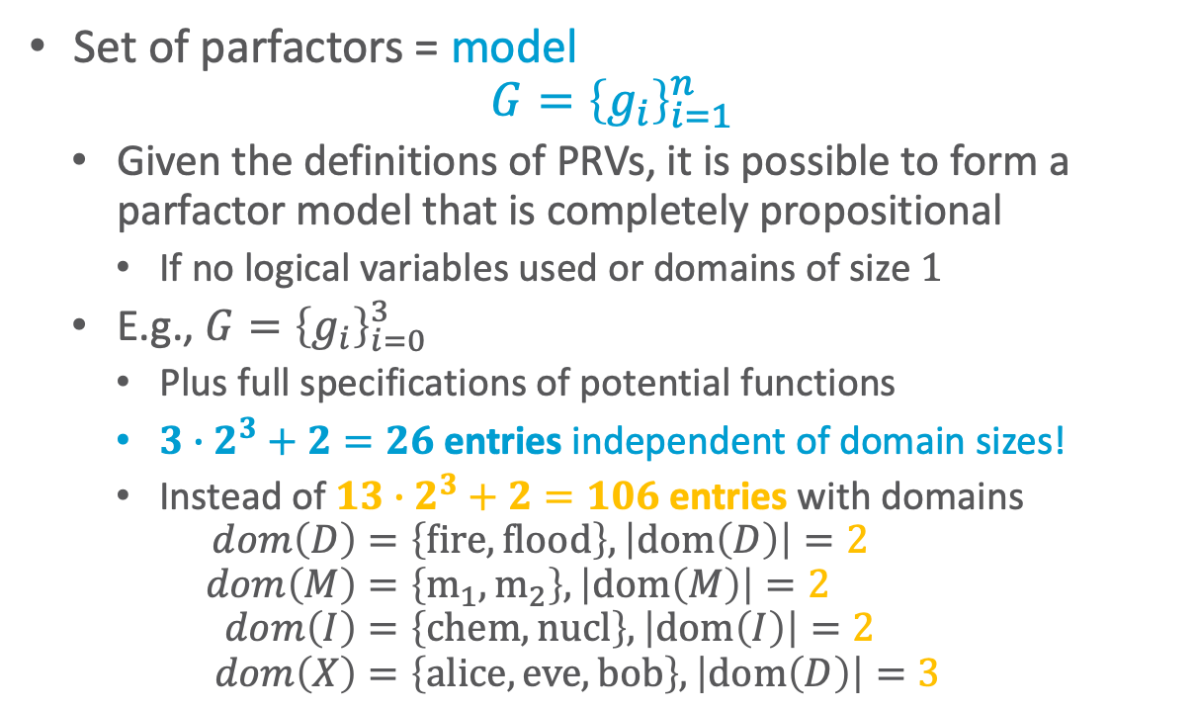


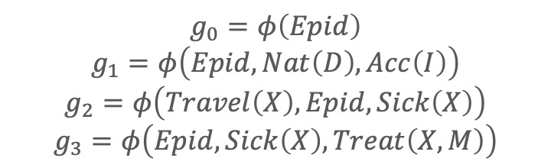
Parfactor Model
Set of parfactors = model
$$G={\left\{g_{i}\right\}}_{i=1}^{n}$$
  Given the definitions of PRVs, it is possible to form a parfactor model that is completely propositional
    If no logical variables used or domains of size $1$
  E.g., $G={\left\{g_{i}\right\}}_{i=0}^{3}$
    Plus full specifications of potential functions
    ${3∙2}^{3}+2=26$ entries independent of domain sizes!
    Instead of ${13∙2}^{3}+2=106$ entries with domains
    $$dom\left(D\right)=\left\{fire,flood\right\}, \left|dom\left(D\right)\right|=2 \\ dom\left(M\right)=\left\{m_{1},m_{2}\right\}, \left|dom\left(M\right)\right|=2 \\ dom\left(I\right)=\left\{chem,nucl\right\}, \left|dom\left(I\right)\right|=2 \\ dom\left(X\right)=\left\{alice, eve, bob\right\},\left|dom\left(D\right)\right|=3$$
    $$g_{0}=φ\left(Epid\right)$$
    $$g_{1}=φ\left(Epid,Nat\left(D\right), Acc\left(I\right)\right)$$
    $$g_{2}=φ\left(Travel\left(X\right),Epid,Sick\left(X\right)\right)$$
    $$g_{3}=φ\left(Epid, Sick\left(X\right),Treat\left(X,M\right)\right)$$
$$Nat\left(D\right)$$
$$Acc\left(I\right)$$
$$g_{1}$$
$$Epid$$
$$g_{0}$$
$$Travel\left(X\right)$$
$$Treat\left(X,M\right)$$
$$g_{2}$$
$$g_{3}$$
$$Sick\left(X\right)$$

Slide 27
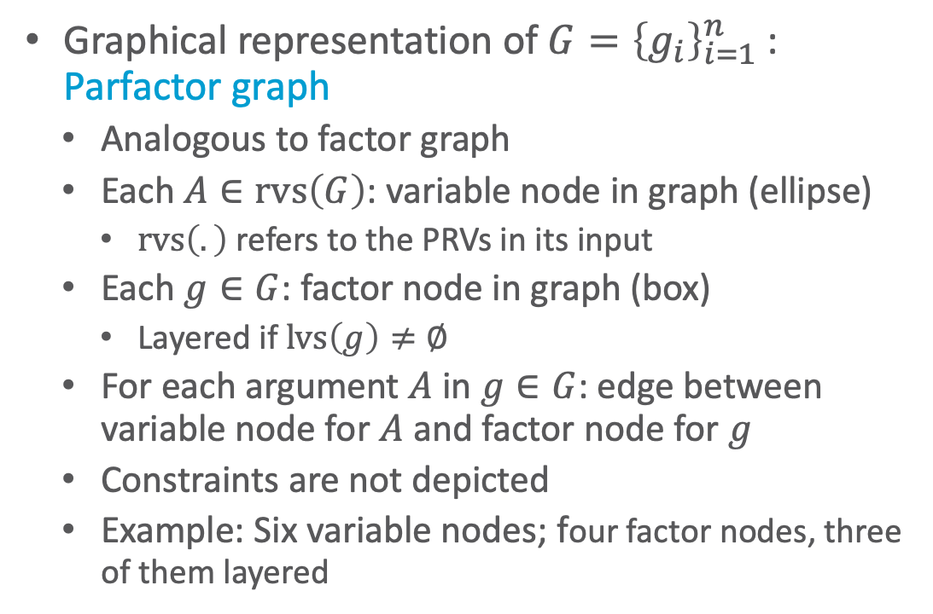
Parfactor Graphs
Graphical representation of $G={\left\{g_{i}\right\}}_{i=1}^{n}$:
Parfactor graph
  Analogous to factor graph
  Each $A∈rvs\left(G\right)$: variable node in graph (ellipse)
    $rvs\left(.\right)$ refers to the PRVs in its input
  Each $g∈G$: factor node in graph (box)
    Layered if $lvs\left(g\right)≠∅$
  For each argument $A$ in $g∈G$: edge between variable node for $A$ and factor node for $g$
  Constraints are not depicted
  Example: Six variable nodes; four factor nodes, three of them layered
    $$g_{0}=φ\left(Epid\right)$$
    $$g_{1}=φ\left(Epid,Nat\left(D\right), Acc\left(I\right)\right)$$
    $$g_{2}=φ\left(Travel\left(X\right),Epid,Sick\left(X\right)\right)$$
    $$g_{3}=φ\left(Epid, Sick\left(X\right),Treat\left(X,M\right)\right)$$
$$Nat\left(D\right)$$
$$Acc\left(I\right)$$
$$g_{1}$$
$$Epid$$
$$g_{0}$$
$$Travel\left(X\right)$$
$$Treat\left(X,M\right)$$
$$g_{2}$$
$$g_{3}$$
$$Sick\left(X\right)$$

Slide 28
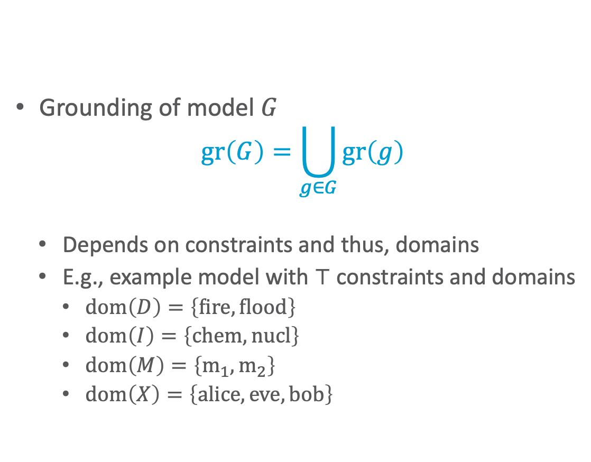
Grounding of Models
Grounding of model $G$
$$gr\left(G\right)=\bigcup_{g∈G}{gr\left(g\right)}$$
  Depends on constraints and thus, domains
  E.g., example model with $⊤$ constraints and domains
    $dom\left(D\right)=\left\{fire,flood\right\}$
    $dom\left(I\right)=\left\{chem,nucl\right\}$
    $dom\left(M\right)=\left\{m_{1},m_{2}\right\}$
    $dom\left(X\right)=\left\{alice, eve, bob\right\}$
$$Nat\left(D\right)$$
$$Acc\left(I\right)$$
$$g_{1}$$
$$Epid$$
$$g_{0}$$
$$Travel\left(X\right)$$
$$Treat\left(X,M\right)$$
$$g_{2}$$
$$g_{3}$$
$$Sick\left(X\right)$$

Slide 29
Grounding of Models
$$Acc\text{.}chem$$
Graphical representation
of grounding
$$Acc\text{.}nucl$$
$$f_{1}$$
$$Nat\text{.}flood$$
$$f_{1}$$
$$f_{1}$$
$$Nat\text{.}fire$$
$$f_{1}$$
$$f_{2}$$
$$Epid$$
$$f_{0}$$
$$f_{2}$$
$$f_{3}$$
$$f_{3}$$
$$Treat\text{.}alice\text{.}m_{1}$$
$$Treat\text{.}bob\text{.}m_{1}$$
$$Travel\text{.}alice$$
$$f_{2}$$
$$f_{3}$$
$$f_{3}$$
$$Travel.bob$$
$$f_{3}$$
$$Treat\text{.}eve\text{.}m_{1}$$
$$f_{3}$$
$$Sick\text{.}alice$$
$$Sick\text{.}bob$$
$$Sick\text{.}eve$$
$$Treat\text{.}alice\text{.}m_{2}$$
$$Travel\text{.}eve$$
$$Treat\text{.}eve\text{.}m_{2}$$
$$Treat\text{.}bob\text{.}m_{2}$$

Slide 30
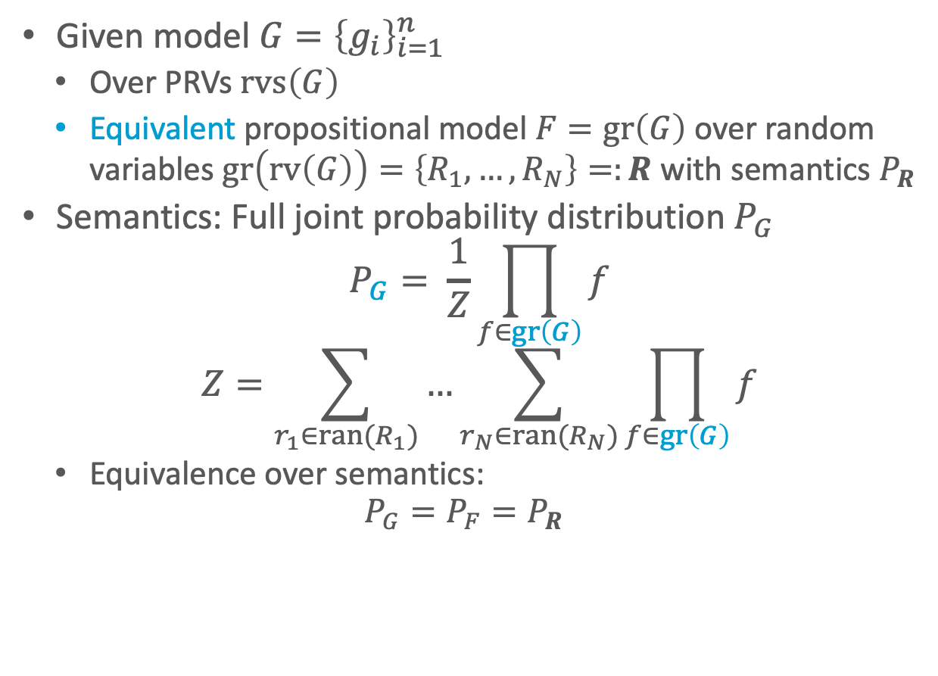
Semantics
Given model $G={\left\{g_{i}\right\}}_{i=1}^{n}$
  Over PRVs $rvs\left(G\right)$
  Equivalent propositional model $F=gr\left(G\right)$ over random variables $gr\left(rv\left(G\right)\right)=\left\{R_{1},…, R_{N}\right\}=:R$ with semantics $P_{R}$
Semantics: Full joint probability distribution $P_{G}$
  $$P_{G}= \frac{1}{Z}\prod_{f∈gr\left(G\right)}{f}$$
  $$Z=\sum_{r_{1}∈ran(R_{1})}{…\sum_{r_{N}∈ran(R_{N})}{\prod_{f∈gr\left(G\right)}{f}}}$$
  Equivalence over semantics:
  $$P_{G}=P_{F}=P_{R}$$
$$Nat\left(D\right)$$
$$Acc\left(I\right)$$
$$g_{1}$$
$$Epid$$
$$g_{0}$$
$$Travel\left(X\right)$$
$$Treat\left(X,M\right)$$
$$g_{2}$$
$$g_{3}$$
$$Sick\left(X\right)$$

Slide 31
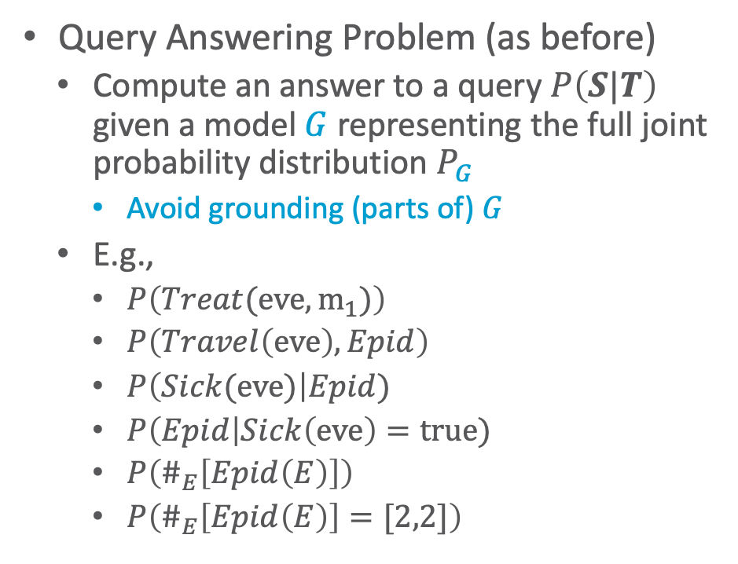
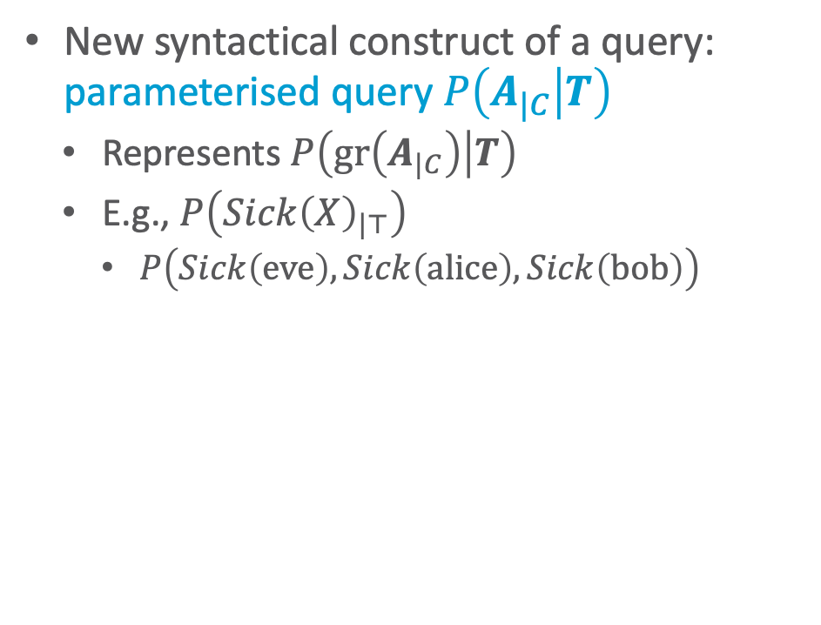
Inference Tasks
Query Answering Problem (as before)
  Compute an answer to a query $P\left(S|T\right)$ given a model $G$ representing the full joint probability distribution $P_{G}$
    Avoid grounding (parts of) $G$
  E.g.,
    $P\left(Treat(eve,m_{1})\right)$
    $P\left(Travel\left(eve\right),Epid\right)$
    $P\left(Sick(eve)\right|Epid)$
    $P\left(Epid\right|Sick\left(eve\right)=true)$
    $P\left(\#_{E}\left[Epid\left(E\right)\right]\right)$
    $P\left(\#_{E}\left[Epid\left(E\right)\right]=[2,2]\right)$
New syntactical construct of a query:
parameterised query $P\left(A_{|C} | T\right)$
  Represents $P\left(gr\left(A_{|C}\right) | T\right)$
  E.g., $P\left(Sick{\left(X\right)}_{|⊤}\right)$
    $P\left(Sick\left(eve\right),Sick\left(alice\right),Sick\left(bob\right)\right)$
$$Nat\left(D\right)$$
$$Acc\left(I\right)$$
$$g_{1}$$
$$Epid$$
$$g_{0}$$
$$Travel\left(X\right)$$
$$Treat\left(X,M\right)$$
$$g_{2}$$
$$g_{3}$$
$$Sick\left(X\right)$$
Notes:
Argmax and sum not commutative

Slide 32
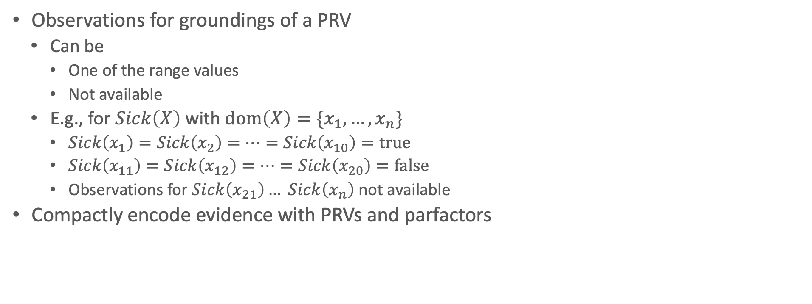
Evidence in Parameterised Models
Observations for groundings of a PRV
  Can be
    One of the range values
    Not available
  E.g., for $Sick\left(X\right)$ with $dom\left(X\right)=\{x_{1},…, x_{n}\}$
    $Sick\left(x_{1}\right)=Sick\left(x_{2}\right)=…=Sick\left(x_{10}\right)=true$
    $Sick\left(x_{11}\right)=Sick\left(x_{12}\right)=…=Sick\left(x_{20}\right)=false$
    Observations for $Sick\left(x_{21}\right)… Sick\left(x_{n}\right)$ not available
Compactly encode evidence with PRVs and parfactors
$$Nat\left(D\right)$$
$$Acc\left(I\right)$$
$$g_{1}$$
$$Epid$$
$$g_{0}$$
$$Travel\left(X\right)$$
$$Treat\left(X,M\right)$$
$$g_{2}$$
$$g_{3}$$
$$Sick\left(X\right)$$

Slide 33
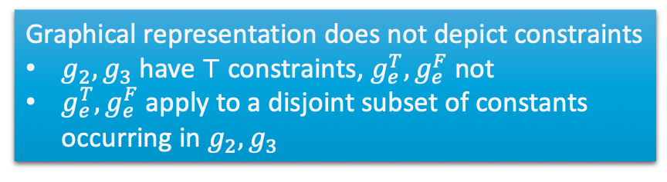
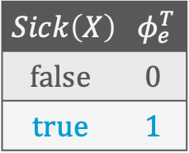

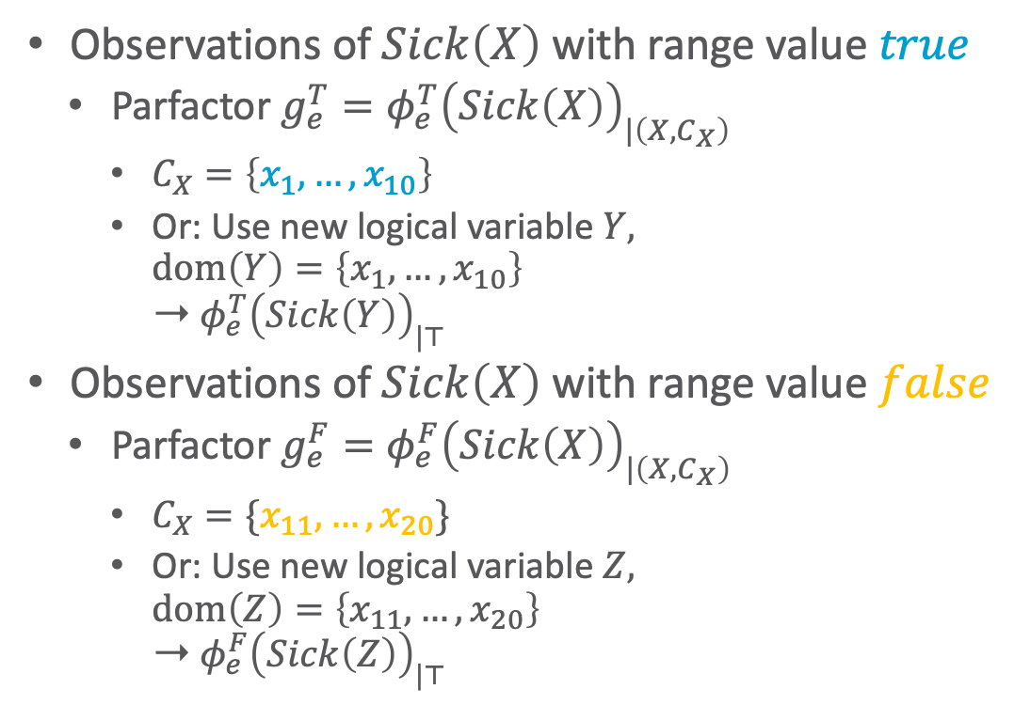

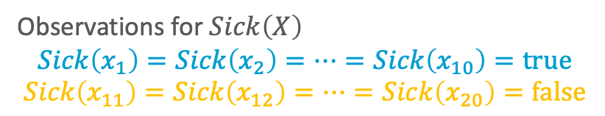
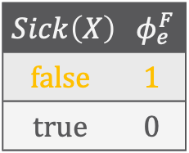
Evidence Parfactors: Example
Observations of $Sick\left(X\right)$ with range value $true$
  Parfactor $g_{e}^{T}=φ_{e}^{T}{\left(Sick\left(X\right)\right)}_{|\left(X,C_{X}\right)}$
    $C_{X}=\left\{x_{1}, …, x_{10}\right\}$
    Or: Use new logical variable $Y,$
    $dom\left(Y\right)=\left\{x_{1},…,x_{10}\right\}$
    ➝ $φ_{e}^{T}{\left(Sick\left(Y\right)\right)}_{|⊤}$
Observations of $Sick\left(X\right)$ with range value $false$
  Parfactor $g_{e}^{F}=φ_{e}^{F}{\left(Sick\left(X\right)\right)}_{|\left(X,C_{X}\right)}$
    $C_{X}=\{x_{11}, …, x_{20}\}$
    Or: Use new logical variable $Z,$
    $dom\left(Z\right)=\left\{x_{11},…,x_{20}\right\}$
    ➝ $φ_{e}^{F}{\left(Sick\left(Z\right)\right)}_{|⊤}$
  Observations for $Sick\left(X\right)$
    $$Sick\left(x_{1}\right)=Sick\left(x_{2}\right)=…=Sick\left(x_{10}\right)=true$$
    $$Sick\left(x_{11}\right)=Sick\left(x_{12}\right)=…=Sick\left(x_{20}\right)=false$$
$$Sick\left(X\right)$$ | $$φ_{e}^{T}$$
$$false$$ | $$0$$
$$true$$ | $$1$$
Graphical representation does not depict constraints
$g_{2},g_{3}$ have $⊤$ constraints, $g_{e}^{T},g_{e}^{F}$ not
$g_{e}^{T},g_{e}^{F}$ apply to a disjoint subset of constants occurring in $g_{2},g_{3}$
$$Nat\left(D\right)$$
$$Acc\left(I\right)$$
$$g_{1}$$
$$Sick\left(X\right)$$ | $$φ_{e}^{F}$$
$$false$$ | $$1$$
$$true$$ | $$0$$
$$Epid$$
$$g_{0}$$
$$Travel\left(X\right)$$
$$Treat\left(X,M\right)$$
$$g_{2}$$
$$g_{3}$$
$$Sick\left(X\right)$$
$$g_{e}^{T}$$
$$g_{e}^{F}$$

Slide 34

Evidence Parfactors
Let $e$ be the set of observations (evidence)
For each PRV $A$ referenced in $rvs\left(e\right)$
  For each range value $r$ observed for a grounding of $A$
    Set up a parfactor $g_{e}$ with
      $A$ as argument
      Range value $r$ mapped to $1$and all range values $r′≠r$ to $0$
      $C_{𝒳}$in constraint $\left(𝒳,C_{𝒳}\right)$ restricting the constants of $𝒳$to the constants observed of $A$ with $r$
        Alternative: Use new logical variables $𝒳$’ in $A$ with domains corresponding to observed constants and ⊤ constraints in $g_{e}$
  Observations for $Sick\left(X\right)$
    $$Sick\left(x_{1}\right)=Sick\left(x_{2}\right)=…=Sick\left(x_{10}\right)=true$$
    $$Sick\left(x_{11}\right)=Sick\left(x_{12}\right)=…=Sick\left(x_{20}\right)=false$$
$$Nat\left(D\right)$$
$$Acc\left(I\right)$$
$$g_{1}$$
$$Epid$$
$$g_{0}$$
$$Travel\left(X\right)$$
$$Treat\left(X,M\right)$$
$$g_{2}$$
$$g_{3}$$
$$Sick\left(X\right)$$
$$g_{e}^{T}$$
$$g_{e}^{F}$$

Slide 35
Interim Summary
First-order view on probabilistic modelling
  Relations in data
  Symmetries in graph
Parameterised models
  Logical variables with domains of constants
    Universe
  Constraints to restrict domains to certain constants
  PRVs to encode sets of propositional random variables
  CRVs to encode symmetries within factors
  Parfactors to build a model with recurring patterns
    Semantics over grounding and full joint distribution
  Inference tasks
    Query terms with logical variables, evidence parfactors

Slide 36
Markov logic networks (MLNs)
$$10 Presents\left(X, P, C\right)⇒Attends\left(X, C\right)$$
$$3.75 Publishes\left(X, C\right)∧FarAway\left(C\right)⇒Attends\left(X, C\right)$$
Syntax, semantics, graphical representation

Slide 37



Markov Logic Networks (MLNs)
Again: First-order view on probabilistic modelling
Use logical formulas to specify potential functions
  Weights for each formula induce a full joint again
    Lower weight if constraint does not hold all the time
    $∞$ weight for hard constraints, in practice either a high weight or only worlds considered that satisfy hard constraints
Next slides
  Syntax of MLNs
  Semantics of MLNs
Hard constraint
Soft constraint,
weight = $exp⁡(3.75)$
$$∞ Presents\left(X, P, C\right)⇒Attends\left(X, C\right)$$
$$3.75 Publishes\left(X, C\right)∧FarAway\left(C\right)⇒Attends\left(X, C\right)$$
Matthew Richardson and Pedro Domingos: Markov Logic Networks. In: Machine Learning, 2006.

Slide 38


Markov Logic Networks (MLNs)
Weighted formulas for modelling constraints ($≠$ domain constraints)
An MLN is a set of constraints $Ψ={\left\{\left(w_{i}, ψ_{i}\right)\right\}}_{i=1}^{n}$
  $w_{i}∈ℝ^{+}$ weight
  $ψ_{i}$ FOL formula
    Originally without a constraint language for domains
    Mostly used with implicit all-quantifiers
  Implicitly connected via conjunction
    I.e., set of formulas $ψ_{i}$ = knowledge base/theory
Hard constraint
Soft constraint,
weight = $exp⁡(3.75)$
$$∞ Presents\left(X, P, C\right)⇒Attends\left(X, C\right)$$
$$3.75 Publishes\left(X, C\right)∧FarAway\left(C\right)⇒Attends\left(X, C\right)$$

Slide 39

Intuition behind Weights
Soften logic using weights
  Worlds that violate constraint become less likely but not impossible
    As $w_{i}$ increases, so does the strength of $ψ_{i}$
    Infinite weight: Hard constraint = pure logic formula
      Probabilities of worlds that do not satisfy hard constraint set to $0$
    Standard MLNs only use weights in $ℝ;$ otherwise semantics break (special handling of hard constraints required)
      E.g., use hard constraints to filter worlds, probabilities of remaining worlds based on soft constraints
Hard constraint
Soft constraint,
weight = $exp⁡(3.75)$
$$∞ Presents\left(X, P, C\right)⇒Attends\left(X, C\right)$$
$$3.75 Publishes\left(X, C\right)∧FarAway\left(C\right)⇒Attends\left(X, C\right)$$

Slide 40



Grounding
Each $\left(w_{i}, ψ_{i}\right)$ represents a set of propositional sentences, each sentence with weight $w_{i}$
  One sentence for each possible substitution of the free variables $free\left(ψ_{i}\right)$ in $ψ_{i}$ given a finite domain (or a constraint set) $D$ over $free\left(ψ_{i}\right)$
    $θ_{D}=\bigcup_{d∈D}{\left\{\bigcup_{t∈d}{\left\{X_{d}→t\right\}}\right\}}$
  Example: MLN $Ψ={\left\{\left(w_{i},ψ_{i}\right)\right\}}_{i=1}^{2}$
    Domains
      $dom\left(X\right)=\left\{alice\right\}$
      $dom\left(P\right)=\left\{p_{1},p_{2}\right\}$
      $dom\left(C\right)=\left\{ijcai,ki\right\}$
    Groundings on the right
    $$\left(10, Presents\left(alice,p_{1},ijcai\right)⇒Attends\left(alice,ijcai\right)\right) \\ \left(10, Presents\left(alice,p_{1},ki\right)⇒Attends\left(alice,ki\right)\right) \\ \left(10, Presents\left(alice,p_{2},ijcai\right)⇒Attends\left(alice,ijcai\right)\right) \\ \left(10, Presents\left(alice,p_{2},ki\right)⇒Attends\left(alice,ki\right)\right) \\ \left(3.75, Publishes\left(alice, ijcai\right)∧FarAway\left(ijcai\right)⇒Attends\left(alice,ijcai\right)\right) \\ \left(3.75,Publishes\left(alice, ki\right)∧FarAway\left(ki\right)⇒Attends\left(alice,ki\right)\right)$$
$$10 Presents\left(X, P, C\right)⇒Attends\left(X, C\right)$$
$$3.75 Publishes\left(X, C\right)∧FarAway\left(C\right)⇒Attends\left(X, C\right)$$

Slide 41










MLN: Graphical Representation?
Usually not depicted by a graph but by the logical formulas with their weights to the left
Since the name invokes Markov networks, let us build an analogue:
  Logical atoms as nodes
  Edges between atoms whenever atoms occur together in a formula
    Form cliques in graph
    Potential functions (factors) for cliques from weights
    Can also build an equivalent parfactor graph as graphical representation
$$Publishes\left(X,C\right)$$
$$Presents\left(X,P,C\right)$$
$$Attends\left(X,C\right)$$
$$g_{2}$$
$$g_{1}$$
$$FarAway\left(C\right)$$
$$Publishes\left(X,C\right)$$
$$Presents\left(X,P,C\right)$$
$$Attends\left(X,C\right)$$
$$FarAway\left(C\right)$$
$$10 Presents\left(X, P, C\right)⇒Attends\left(X, C\right)$$
$$3.75 Publishes\left(X, C\right)∧FarAway\left(C\right)⇒Attends\left(X, C\right)$$

Slide 42

MLNs: Semantics
MLN $Ψ={\left\{\left(w_{i},ψ_{i}\right)\right\}}_{i=1}^{n}$, with $w_{i}∈ℝ$, induces a probability distribution over possible interpretations $ω$ (world) of the grounded atoms in $Ψ$
$ω∈{\left\{true,false\right\}}^{N}$
  $N$ = the number of ground atoms in the grounded $Ψ$
  Probability of one interpretation $ω$
$$P\left(ω\right)=\frac{1}{Z}exp\left(\sum_{i=1}^{n}{w_{i}n_{i}\left(ω\right)}\right)$$
    $n_{i}\left(ω\right)$ = number of propositional sentences of $ψ_{i}$ that evaluate to $true$ given the assignments of $ω$

Slide 43

MLNs: Semantics – Derivation
Let an MLN $Ψ={\left\{\left(w_{i},ψ_{i}\right)\right\}}_{i=1}^{n}$ and a domain $D$ be given
The grounded MLN is the following
$gr\left(Ψ\right)=\bigcup_{i=1}^{n}{\bigcup_{θ∈θ_{D}}{\left\{\left(w_{i},ψ_{i}θ\right)\right\}}}$
The semantics of $gr\left(Ψ\right)$ induces a probability distribution over possible interpretations $ω$
  $ω$ assigns a truth value to each (ground) atom in $gr\left(Ψ\right)$
  I.e., a normalised product over all weights of formulas (potential functions of cliques) with $\exp{w_{j}}$ if $ω$ makes $ψ_{j}θ$ true and$\exp{0}$ otherwise, i.e.,
    $$P\left(ω\right)=\frac{1}{Z} \prod_{j=1}^{\left|gr\left(Ψ\right)\right|}{exp\left(w_{j}\right)}=\frac{1}{Z}weight\left(ω\right)$$
    Product called weight of a world

Slide 44

MLNs: Semantics – Derivation
Consider the weight of $ω$
$$weight\left(ω\right)=\prod_{j=1}^{\left|gr\left(Ψ\right)\right|}{exp\left(w_{j}\right)}$$
To simplify, use the following:
  Sentences in $gr\left(Ψ\right)$ are groundings of $n$ formulas where each set of propositional sentences per formula carries the same weight
  If a propositional sentences evaluates to $false$, its contribution to the product is $exp\left(0\right)=1$.
  Rewrite expression:
$$weight\left(ω\right)=\prod_{i=1}^{n}{exp{\left(w_{i}\right)}^{n_{i}\left(ω\right)}}=\prod_{i=1}^{n}{exp\left(w_{i}∙n_{i}\left(ω\right)\right)}$$
  $n_{i}\left(ω\right)$ = number of propositional sentences of $ψ_{i}$ that evaluate to $true$ given $ω$

Slide 45

MLNs: Semantics – Derivation
Therefore, $Ψ={\left\{\left(w_{i},ψ_{i}\right)\right\}}_{i=1}^{n}$ induces a probability distribution over possible worlds $ω$
$$P\left(ω\right)=\frac{1}{Z} weight\left(ω\right) \\ =\frac{1}{Z} \prod_{i=1}^{n}{exp\left(w_{i}∙n_{i}\left(ω\right)\right)} \\ =\frac{1}{Z}exp\left(\sum_{i=1}^{n}{w_{i}n_{i}\left(ω\right)}\right)$$
  $Z=\sum_{ω∈{\left\{true,false\right\}}^{N}}{weight\left(ω\right)}$
    $N$ = the number of ground atoms in $gr\left(Ψ\right)$

Slide 46

Why $exp$?
Weight of a world $ω$:
$$weight\left(ω\right)=exp\left(\sum_{i=1}^{n}{w_{i}n_{i}\left(ω\right)}\right)$$
Taking the logarithm yields
$$lweight\left(ω\right)=\ln{exp\left(\sum_{i=1}^{n}{w_{i}n_{i}\left(ω\right)}\right)}=\sum_{i=1}^{n}{w_{i}n_{i}\left(ω\right)}$$
  Sum allows for component-wise optimisation during weight learning
    Referred to as log-linear models
Semantics:
$$P\left(ω\right)=\frac{1}{Z^{′}}\sum_{i=1}^{n}{w_{i}n_{i}\left(ω\right)}$$
  $Z^{′}=\sum_{ω∈{\left\{true,false\right\}}^{N}}{lweight\left(ω\right)}=\sum_{ω∈{\left\{true,false\right\}}^{N}}{\sum_{i=1}^{n}{w_{i}n_{i}\left(ω\right)}}$

Slide 47
Interim Summary
MLNs
  Weighted formulas
  Semantics again over groundings and full joint distribution
  Log-linear version allows for local optimisation during learning

Slide 48








Turning MLNs into PMs and vice versa
$$Publishes\left(X,C\right)$$
$$Presents\left(X,P,C\right)$$
$$Attends\left(X,C\right)$$
$$g_{2}$$
$$g_{1}$$
$$FarAway\left(C\right)$$
$$10 Presents\left(X, P, C\right)⇒Attends\left(X, C\right)$$
$$3.75 Publishes\left(X, C\right)∧FarAway\left(C\right)⇒Attends\left(X, C\right)$$
Transformations
Comparison

Slide 49
MLN: Graphical Representation?
Usually not depicted by a graph but by the logical formulas with their weights to the left
Since the name invokes Markov networks, let us build an analogue:
  Logical atoms as nodes
  Edges between atoms whenever atoms occur together in a formula
    Form cliques in graph
    Potential functions (factors) for cliques from weights
    Can also build an equivalent parfactor graph as graphical representation
$$Publishes\left(X,C\right)$$
$$Presents\left(X,P,C\right)$$
$$Attends\left(X,C\right)$$
$$g_{2}$$
$$g_{1}$$
$$FarAway\left(C\right)$$
$$Publishes\left(X,C\right)$$
$$Presents\left(X,P,C\right)$$
$$Attends\left(X,C\right)$$
$$FarAway\left(C\right)$$
$$10 Presents\left(X, P, C\right)⇒Attends\left(X, C\right)$$
$$3.75 Publishes\left(X, C\right)∧FarAway\left(C\right)⇒Attends\left(X, C\right)$$

Slide 50

Weights to Potential Functions (Factors)
How to get from weights to potential functions (factors)?
  Arguments = Atoms
    Only Boolean ranges
  Map input to $exp\left(w_{i}\right)$ if input makes $ψ_{i}$ true
    Input = assignments to atoms in $ψ_{i}$
  Otherwise map to $exp\left(0\right)=1$
  If indeed $w_{i}=∞$: choose large number
    In implementation: maximum number of chosen number format
$$Publishes\left(X,C\right)$$
$$Presents\left(X,P,C\right)$$
$$Attends\left(X,C\right)$$
$$g_{2}$$
$$g_{1}$$
$$FarAway\left(C\right)$$
$$Publishes\left(X,C\right)$$
$$Presents\left(X,P,C\right)$$
$$Attends\left(X,C\right)$$
$$FarAway\left(C\right)$$
$$10 Presents\left(X, P, C\right)⇒Attends\left(X, C\right)$$
$$3.75 Publishes\left(X, C\right)∧FarAway\left(C\right)⇒Attends\left(X, C\right)$$

Slide 51












Weights to Potential Functions (Factors) – Examples
$$Presents\left(X,P,C\right)$$ | $$Attends\left(X,C\right)$$ | $$φ_{1}$$
$$false$$ | $$false$$ | $$\exp{10}$$
$$false$$ | $$true$$ | $$\exp{10}$$
$$true$$ | $$false$$ | $$\exp{0}$$
$$true$$ | $$true$$ | $$\exp{10}$$
$$Publishes\left(X,C\right)$$
$$Presents\left(X,P,C\right)$$
$$Attends\left(X,C\right)$$
$$g_{2}$$
$$g_{1}$$
$$FarAway\left(C\right)$$
$$Publishes(X,C)$$
$$Presents(X,P,C)$$
$$Attends(X,C)$$
$$FarAway(C)$$
$$10 Presents\left(X, P, C\right)⇒Attends\left(X, C\right)$$
$$3.75 Publishes\left(X, C\right)∧FarAway\left(C\right)⇒Attends\left(X, C\right)$$

Slide 52







Weights to Potential Functions (Factors) – Examples
$$Publishes\left(X,C\right)$$ | $$FarAway\left(C\right)$$ | $$Attends\left(X,C\right)$$ | $$φ$$
$$false$$ | $$false$$ | $$false$$ | $$\exp{3.75}$$
$$false$$ | $$false$$ | $$true$$ | $$\exp{3.75}$$
$$false$$ | $$true$$ | $$false$$ | $$\exp{3.75}$$
$$false$$ | $$true$$ | $$true$$ | $$\exp{3.75}$$
$$true$$ | $$false$$ | $$false$$ | $$\exp{3.75}$$
$$true$$ | $$false$$ | $$true$$ | $$\exp{3.75}$$
$$true$$ | $$true$$ | $$false$$ | $$\exp{0}$$
$$true$$ | $$true$$ | $$true$$ | $$\exp{3.75}$$
$$Publishes\left(X,C\right)$$
$$Presents\left(X,P,C\right)$$
$$Attends\left(X,C\right)$$
$$g_{2}$$
$$g_{1}$$
$$FarAway\left(C\right)$$
$$Publishes\left(X,C\right)$$
$$Presents\left(X,P,C\right)$$
$$Attends\left(X,C\right)$$
$$FarAway\left(C\right)$$
$$10 Presents\left(X, P, C\right)⇒Attends\left(X, C\right)$$
$$3.75 Publishes\left(X, C\right)∧FarAway\left(C\right)⇒Attends\left(X, C\right)$$

Slide 53

Graphical Representation for Groundings
Each $\left(w_{i}, ψ_{i}\right)$ represents a set of propositional sentences, each sentence with weight $w_{i}$
Can also form a Markov network graphical representation (or factor graph) for this set of propositional sentences
  Nodes = random variables = ground atoms
  Edges connect literals that appear together in a sentence
  Potential functions (as before, now with instances)
    Map to $exp\left(w_{i}\right)$ if assignment to ground atoms makes $ψ_{i}$ true
    Otherwise map to $exp\left(0\right)=1$
    If indeed $w_{i}=∞$: choose large number
$$10 Presents\left(X, P, C\right)⇒Attends\left(X, C\right)$$
$$3.75 Publishes\left(X, C\right)∧FarAway\left(C\right)⇒Attends\left(X, C\right)$$

Slide 54











Instances: Example – MN
    $\left(10, Presents\left(alice,p_{1},ijcai\right)⇒Attends\left(alice,ijcai\right)\right)$
    $\left(10, Presents\left(alice,p_{1},ki\right)⇒Attends\left(alice,ki\right)\right)$
    $\left(10, Presents\left(alice,p_{2},ijcai\right)⇒Attends\left(alice,ijcai\right)\right)$
    $\left(10, Presents\left(alice,p_{2},ki\right)⇒Attends\left(alice,ki\right)\right)$
    $\left(3.75, Publishes\left(alice, ijcai\right)∧FarAway\left(ijcai\right)⇒Attends\left(alice,ijcai\right)\right)$
    $\left(3.75,Publishes\left(alice, ki\right)∧FarAway\left(ki\right)⇒Attends\left(alice,ki\right)\right)$
$$Presents\left(alice,p_{1},ijcai\right)$$
$$Publishes\left(alice,ijcai\right)$$
$$Attends\left(alice,ijcai\right)$$
$$Presents\left(alice,p_{2},ijcai\right)$$
$$FarAway\left(ijcai\right)$$
$$Presents\left(alice,p_{1},ki\right)$$
$$Publishes\left(alice,ki\right)$$
$$Attends\left(alice,ki\right)$$
$$Presents\left(alice,p_{2},ki\right)$$
$$FarAway\left(ki\right)$$

Slide 55



Example – Potential Functions
$$Publishes\left(x,c\right)$$ | $$FarAway\left(c\right)$$ | $$Attends\left(x,c\right)$$ | $$φ_{2}$$
$$false$$ | $$false$$ | $$false$$ | $$\exp{3.75}$$
$$false$$ | $$false$$ | $$true$$ | $$\exp{3.75}$$
$$false$$ | $$true$$ | $$false$$ | $$\exp{3.75}$$
$$false$$ | $$true$$ | $$true$$ | $$\exp{3.75}$$
$$true$$ | $$false$$ | $$false$$ | $$\exp{3.75}$$
$$true$$ | $$false$$ | $$true$$ | $$\exp{3.75}$$
$$true$$ | $$true$$ | $$false$$ | $$\exp{0}$$
$$true$$ | $$true$$ | $$true$$ | $$\exp{3.75}$$
$$Presents\left(x,p,c\right)$$ | $$Attends\left(x,c\right)$$ | $$φ_{1}$$
$$false$$ | $$false$$ | $$\exp{10}$$
$$false$$ | $$true$$ | $$\exp{10}$$
$$true$$ | $$false$$ | $$\exp{0}$$
$$true$$ | $$true$$ | $$\exp{10}$$
$$Presents\left(alice,p_{1},ijcai\right)$$
$$Publishes\left(alice,ijcai\right)$$
$$Attends\left(alice,ijcai\right)$$
$$Presents\left(alice,p_{2},ijcai\right)$$
$$FarAway\left(ijcai\right)$$
$$Presents\left(alice,p_{1},ki\right)$$
$$Publishes\left(alice,ki\right)$$
$$Attends\left(alice,ki\right)$$
$$Presents\left(alice,p_{2},ki\right)$$
$$FarAway\left(ki\right)$$

Slide 56
















Example – Factor Graph
$$Publishes\left(x,c\right)$$ | $$FarAway\left(c\right)$$ | $$Attends\left(x,c\right)$$ | $$φ_{2}$$
$$false$$ | $$false$$ | $$false$$ | $$\exp{3.75}$$
$$false$$ | $$false$$ | $$true$$ | $$\exp{3.75}$$
$$false$$ | $$true$$ | $$false$$ | $$\exp{3.75}$$
$$false$$ | $$true$$ | $$true$$ | $$\exp{3.75}$$
$$true$$ | $$false$$ | $$false$$ | $$\exp{3.75}$$
$$true$$ | $$false$$ | $$true$$ | $$\exp{3.75}$$
$$true$$ | $$true$$ | $$false$$ | $$\exp{0}$$
$$true$$ | $$true$$ | $$true$$ | $$\exp{3.75}$$
$$Presents\left(x,p,c\right)$$ | $$Attends\left(x,c\right)$$ | $$φ_{1}$$
$$false$$ | $$false$$ | $$\exp{10}$$
$$false$$ | $$true$$ | $$\exp{10}$$
$$true$$ | $$false$$ | $$\exp{0}$$
$$true$$ | $$true$$ | $$\exp{10}$$
$$f_{1}$$
$$Presents\left(alice,p_{1},ijcai\right)$$
$$Publishes\left(alice,ijcai\right)$$
$$f_{1}$$
$$Attends\left(alice,ijcai\right)$$
$$f_{2}$$
$$Presents\left(alice,p_{2},ijcai\right)$$
$$FarAway\left(ijcai\right)$$
$$f_{1}$$
$$Presents\left(alice,p_{1},ki\right)$$
$$Publishes\left(alice,ki\right)$$
$$f_{1}$$
$$Attends\left(alice,ki\right)$$
$$f_{2}$$
$$Presents\left(alice,p_{2},ki\right)$$
$$FarAway\left(ki\right)$$

Slide 57

Transforming MLNs into PMs
Follows the same idea of generating a graphical representation
  Logical atoms = PRVs $𝒜$
  Potential function
    Map $𝒶$ to $exp\left(w_{i}\right)$ if truth values in $𝒶$ as assignments to atoms makes $ψ_{i}$ true
    Otherwise map to $exp\left(0\right)=1$
    If indeed $w_{i}=∞$: choose large number
      In implementation: maximum number of chosen number encoding
  Constraints
    If no domain constraints given: $\left(𝒳,C_{𝒳}\right)=⊤$, i.e.,
    $$𝒳=lvs\left(𝒜\right), C_{𝒳}=×_{X∈𝒳}dom\left(X\right)$$
    Otherwise: build constraint according to domain constraints
$$10 Presents\left(X, P, C\right)⇒Attends\left(X, C\right)$$
$$3.75 Publishes\left(X, C\right)∧FarAway\left(C\right)⇒Attends\left(X, C\right)$$

Slide 58









Transforming MLNs into PMs: Example
E.g.,
  $g_{1}=φ{\left(Presents\left(X,P,C\right),Attends\left(X,C\right)\right)}_{|C_{1}}$
    $C_{1}=\left(\left(X, P, C\right),dom\left(X\right) × dom\left(P\right) × dom\left(C\right)\right)$
$$Publishes\left(X,C\right)$$
$$Presents\left(X,P,C\right)$$
$$Attends\left(X,C\right)$$
$$g_{2}$$
$$Presents\left(X,P,C\right)$$ | $$Attends\left(X,C\right)$$ | $$φ_{1}$$
$$false$$ | $$false$$ | $$\exp{10}$$
$$false$$ | $$true$$ | $$\exp{10}$$
$$true$$ | $$false$$ | $$\exp{0}$$
$$true$$ | $$true$$ | $$\exp{10}$$
$$g_{1}$$
$$FarAway\left(C\right)$$
$$10 Presents\left(X, P, C\right)⇒Attends\left(X, C\right)$$
$$3.75 Publishes\left(X, C\right)∧FarAway\left(C\right)⇒Attends\left(X, C\right)$$

Slide 59







Transforming MLNs into PMs: Example
$g_{2}=φ{\left(Publishes\left(X,C\right),FarAway\left(C\right),Attends\left(X,C\right)\right)}_{|C_{2}}$
  $C_{2}=\left(\left(X, C\right),dom\left(X\right) × dom\left(C\right)\right)$
$$Publishes\left(X,C\right)$$ | $$FarAway\left(C\right)$$ | $$Attends\left(X,C\right)$$ | $$φ$$
$$false$$ | $$false$$ | $$false$$ | $$\exp{3.75}$$
$$false$$ | $$false$$ | $$true$$ | $$\exp{3.75}$$
$$false$$ | $$true$$ | $$false$$ | $$\exp{3.75}$$
$$false$$ | $$true$$ | $$true$$ | $$\exp{3.75}$$
$$true$$ | $$false$$ | $$false$$ | $$\exp{3.75}$$
$$true$$ | $$false$$ | $$true$$ | $$\exp{3.75}$$
$$true$$ | $$true$$ | $$false$$ | $$\exp{0}$$
$$true$$ | $$true$$ | $$true$$ | $$\exp{3.75}$$
$$Publishes\left(X,C\right)$$
$$Presents\left(X,P,C\right)$$
$$Attends\left(X,C\right)$$
$$g_{2}$$
$$g_{1}$$
$$FarAway\left(C\right)$$
$$10 Presents\left(X, P, C\right)⇒Attends\left(X, C\right)$$
$$3.75 Publishes\left(X, C\right)∧FarAway\left(C\right)⇒Attends\left(X, C\right)$$

Slide 60


Transforming PMs into MLNs
Inverse of Transforming MLNs into PMs
Given ${G=\left\{φ_{i}{\left(𝒜_{i}\right)}_{|C_{i}}\right\}}_{i=1}^{n}$
  Precondition: All $A∈rvs\left(G\right)$ need to have Boolean ranges
  PRVs $𝒜$ = logical atoms
  Constraint $C_{i}$
    If $C_{i}=⊤$: original MLN without further restrictions
    Otherwise: encode in constraint set per formula
Potential function $φ_{i}$
  For each input-output mapping $𝒶→p$
    Build formula $ψ=\bigwedge_{A∈𝒜}{t\left(A,𝒶\right)}$ with weight $w=\ln{p}$
      $t\left(A,a\right)=\left\{\begin{aligned}\begin{matrix}a & \text{Assignment} \text{of} A \text{in} 𝒶 \text{is} true\end{matrix} \\ \begin{matrix}¬a & \text{Assignment} \text{of} A \text{in} 𝒶 \text{is} false\end{matrix}\end{aligned}\right.$
      If the potentials are in $\left[0,1\right]$, then $w$ is negative
        If potential is $0$, choose large negative number
          Compare to the inverse with a weight of infinity
      Best: ensure that potentials are in either $\left(0,1\right]$ or $ℝ_{≥1}$

Slide 61

Inverse Example
E.g., $G={\left\{g_{i}\right\}}_{i=0}^{3}$
  $g_{1}=φ\left(Epid\right)$
  $g_{1}=φ\left(Epid,Nat\left(D\right), Acc\left(I\right)\right)$
  $g_{2}=φ\left(Travel\left(X\right),Epid,Sick\left(X\right)\right)$
  $g_{3}=φ\left(Epid, Sick\left(X\right),Treat\left(X,M\right)\right)$
  Logical atoms:
  $Epid,Nat\left(D\right), Acc\left(I\right),$
  $Travel\left(X\right),Sick\left(X\right),$
  $Treat\left(X,M\right)$
  Domains as given for $G$
$$Nat\left(D\right)$$
$$Acc\left(I\right)$$
$$g_{1}$$
$$Epid$$
$$g_{0}$$
$$Travel\left(X\right)$$
$$Treat\left(X,M\right)$$
$$g_{2}$$
$$g_{3}$$
$$Sick\left(X\right)$$

Slide 62


Inverse Example
Weighted formulas $\left(w_{i},ψ_{i}\right)$ for $g_{2}$
  $\left(\ln{5}, ¬travel(X)∧¬epid∧¬sick\left(X\right)\right)$
  $\left(\ln{1}, ¬travel(X)∧¬epid∧sick\left(X\right)\right)$
  $\left(\ln{4}, ¬travel(X)∧epid∧¬sick\left(X\right)\right)$
  $\left(\ln{6}, ¬travel(X)∧epid∧sick\left(X\right)\right)$
  $\left(\ln{4}, travel(X)∧¬epid∧¬sick\left(X\right)\right)$
  $\left(\ln{6}, travel(X)∧¬epid∧sick\left(X\right)\right)$
  $\left(\ln{2}, travel(X)∧epid∧¬sick\left(X\right)\right)$
  $\left(\ln{9}, travel(X)∧epid∧sick\left(X\right)\right)$
Same has to be done for $g_{0},g_{1},g_{3}$
$$Travel\left(X\right)$$ | $$Epid$$ | $$Sick\left(X\right)$$ | $$φ_{2}$$
$$false$$ | $$false$$ | $$false$$ | $$5$$
$$false$$ | $$false$$ | $$true$$ | $$1$$
$$false$$ | $$true$$ | $$false$$ | $$4$$
$$false$$ | $$true$$ | $$true$$ | $$6$$
$$true$$ | $$false$$ | $$false$$ | $$4$$
$$true$$ | $$false$$ | $$true$$ | $$6$$
$$true$$ | $$true$$ | $$false$$ | $$2$$
$$true$$ | $$true$$ | $$true$$ | $$9$$
    If some potentials appear multiple times, use an algorithm such as Quine-McCluskey to minimise formulas needed to encode the same information [Marwitz et al. (2021)]
Florian Marwitz, Tanya B, and Ralf Möller: A First Step Towards Even More Sparse Encodings of Probability Distributions. In ILP-21 Proceedings of the 30th International Conference on Inductive Logic Programming, 2021.

Slide 63


Inverse Example
Consider $φ\left(Travel\left(X\right),Epid,Sick\left(X\right)\right)$
as given by the table on the right
Only two weighted formulas $\left(w_{i},ψ_{i}\right)$ necessary
  $\left(\ln{2}, ¬travel(X)∨¬epid∨¬sick\left(X\right)\right)$
  $\left(\ln{7}, travel(X)∧epid∧sick\left(X\right)\right)$
  If potential of $1$ instead of $2$, would reduce to
    $\left(\ln{7}, travel(X)∧epid∧sick\left(X\right)\right)$
    Assignments that do not make the formula true automatically get weight of $0=\ln{1}$
$$Travel\left(X\right)$$ | $$Epid$$ | $$Sick\left(X\right)$$ | $$φ$$
$$false$$ | $$false$$ | $$false$$ | $$2$$
$$false$$ | $$false$$ | $$true$$ | $$2$$
$$false$$ | $$true$$ | $$false$$ | $$2$$
$$false$$ | $$true$$ | $$true$$ | $$2$$
$$true$$ | $$false$$ | $$false$$ | $$2$$
$$true$$ | $$false$$ | $$true$$ | $$2$$
$$true$$ | $$true$$ | $$false$$ | $$2$$
$$true$$ | $$true$$ | $$true$$ | $$7$$
Size of resulting MLN depends on the local symmetries in the potentials!
Florian Marwitz, Tanya B, and Ralf Möller: A First Step Towards Even More Sparse Encodings of Probability Distributions. In ILP-21 Proceedings of the 30th International Conference on Inductive Logic Programming, 2021.

Slide 64
MLNs vs. PMs
MLNs: soft constraints in FOL-DC
  Requires knowing interactions to build formulas with logical connectives
  Allows humans to interpret a knowledge base more easily
  Space-efficient encoding if different truth value assignments have the same weight and fewer rules can encode them
PMs are more blurred
  Interaction described via distributions
    Does not enforce connectives between variables
    But: Interpretation not that easy
In propositional case
  MNs and FGs are different graphical representations of the same factor-based model
In relational case
  MLNs and PMs are more different
    Semantics still the same: full joint
    Can transform one into the other
    ➝ same expressivity
    But the syntax is considered differently
Possible to start with PMs
  Extract rules if necessary

Slide 65

Other Formalisms*
Relational BNs
  Nodes in BNs are n-ary relations, labelled with so-called probability formulas, which define the semantics as a probability measure over interpretations of the relations
  Implementation: http://people.cs.aau.dk/~jaeger/Primula/
Hinge-loss MNs
  Continuous variables in the $\left[0,1\right]$ unit interval combined in constraints of first-order logic syntax
    Distance of each constraint to satisfaction = hinge loss
  Implemented with Probabilistic Soft Logic https://psl.linqs.org
ProbLog: Probabilistic Prolog (probabilistic logic programming)
  Defines a probability distribution over logic programs
  Typically Horn clauses annotated with probabilities
  Implementation: https://dtai.cs.kuleuven.be/problog/
* Relations not necessarily used for efficient inference
Manfred Jaeger: Relational Bayesian Networks. In: UAI-97 Proceedings of the 13th Conference on Uncertainty in Artificial Intelligence, 1997.
Stephen H. Bach, Matthias Broecheler, Bert Huang, and Lise Getoor: Hinge-loss Markov Random Fields and Probabilistic Soft Logic. In: Journal of Machine Learning Research, 2017
Luc De Raedt, Angelika Kimmig, and Hannu Toivonen: ProbLog: A Probabilistic Prolog and its Application in Link Discovery. In: IJCAI-07 Proceedings of the 20th International Joint Conference on Artificial Intelligence, 2007.

Slide 66
Interim Summary
Transformations between MLNs and PMs
  One weighted rule ➝ one potential function
  One potential function ➝ possibly # of input-output mappings different rules
  If local symmetries exist (in potentials or weights), then MLNs offer compact encoding
Comparison
  Rules as logical statements with weights (relations first, uncertainty later)
  vs.
  Local distributions parameterised with logical variables (uncertainty first, relations later)
  Further relational models: relational BNs, Probabilistic Soft Logic, ProbLog

Slide 67
Overview: 2. Modelling Formalisms
Logic
  Propositional logic: alphabet, grammar, normal forms, rules
  First-order logic: introducing quantifiers, domain constraints
Probabilistic Graphical Models (PGMs)
  Syntax, semantics, inference problems
  Correctness
Probabilistic Relational Models (PRMs)
  Parfactor models (PMs)
  Markov logic networks (MLNs)
  Turning MLNs into PMs and vice versa, comparison
➝ Inference

