Slide 1







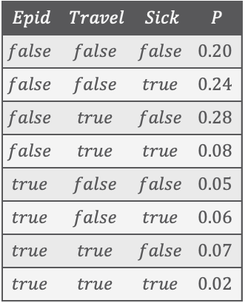





Modelling Formalisms:
Probabilistic Graphical Models
(PGMs)
$$Epid$$ | $$Travel$$ | $$Sick$$ | $$P$$
$$false$$ | $$false$$ | $$false$$ | $$0.20$$
$$false$$ | $$false$$ | $$true$$ | $$0.24$$
$$false$$ | $$true$$ | $$false$$ | $$0.28$$
$$false$$ | $$true$$ | $$true$$ | $$0.08$$
$$true$$ | $$false$$ | $$false$$ | $$0.05$$
$$true$$ | $$false$$ | $$true$$ | $$0.06$$
$$true$$ | $$true$$ | $$false$$ | $$0.07$$
$$true$$ | $$true$$ | $$true$$ | $$0.02$$
$$Epid$$
$$Travel$$
$$Sick$$
Statistical Relational Artificial Intelligence
(StaRAI)
$$Epid$$
$$Travel$$
$$Sick$$
$$Epid$$
$$Epid$$
$$Travel$$
$$Sick$$
$$Travel$$
$$Sick$$
$$P_{R}$$
Tanya Braun

Slide 2
Contents
Introduction
  Notions of AI, agents, StaRAI
Modelling Formalisms
  Logic
  Probabilistic Graphical Models (PGMs)
  Probabilistic Relational Models (PRMs)
  Syntax, semantics, inference tasks
Inference
  Exact Inference
    (Weighted) Model Counting
    Variable Elimination
    Lifted Inference
  Approximate Inference
  Inference algorithms
Learning
  Relation learning in logic
  Parameter / structure learning for PGMs
  From PGMs to PRMs, PRM learning
Sequential Models and Inference
  Syntax, semantics, inference tasks, algorithms
Decision-theoretic Models and Inference
  Preferences, utility
  Syntax, semantics, inference task, algorithm

Slide 3
Overview: 2. Modelling Formalisms
Logic
  Propositional logic: alphabet, grammar, normal forms, rules
  First-order logic: introducing quantifiers, domain constraints
Probabilistic Graphical Models (PGMs)
  Syntax, semantics, inference problems
  Correctness
Probabilistic Relational Models (PRMs)
  Parfactor models (PMs): motivation, syntax, semantics, graphical representation, inference tasks
  Markov logic networks (MLNs): Syntax, semantics of MLNs, graphical representation
  Turning MLNs into PMs and vice versa

Slide 4



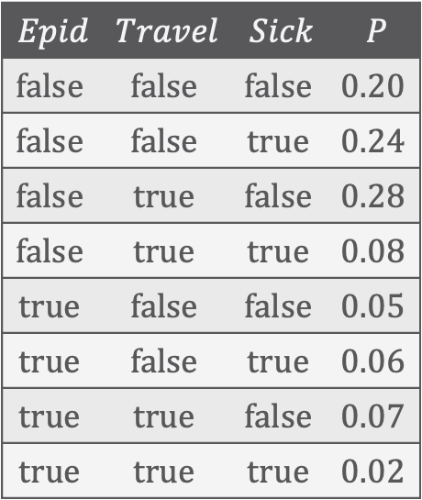





Probabilistic Graphical Models (PGMs)
Factorisation of a full joint according to (conditional) independences in the full joint
$$Epid$$ | $$Travel$$ | $$Sick$$ | $$P$$
$$false$$ | $$false$$ | $$false$$ | $$0.20$$
$$false$$ | $$false$$ | $$true$$ | $$0.24$$
$$false$$ | $$true$$ | $$false$$ | $$0.28$$
$$false$$ | $$true$$ | $$true$$ | $$0.08$$
$$true$$ | $$false$$ | $$false$$ | $$0.05$$
$$true$$ | $$false$$ | $$true$$ | $$0.06$$
$$true$$ | $$true$$ | $$false$$ | $$0.07$$
$$true$$ | $$true$$ | $$true$$ | $$0.02$$
$$Epid$$
$$Epid$$
$$Travel$$
$$Sick$$
$$Travel$$
$$Sick$$
Factor graph (FG)
$$Epid$$
Markov network (MN)
$$Travel$$
$$Sick$$
Bayesian network (BN)
Full joint probability distribution
Variants of PGMs

Slide 5
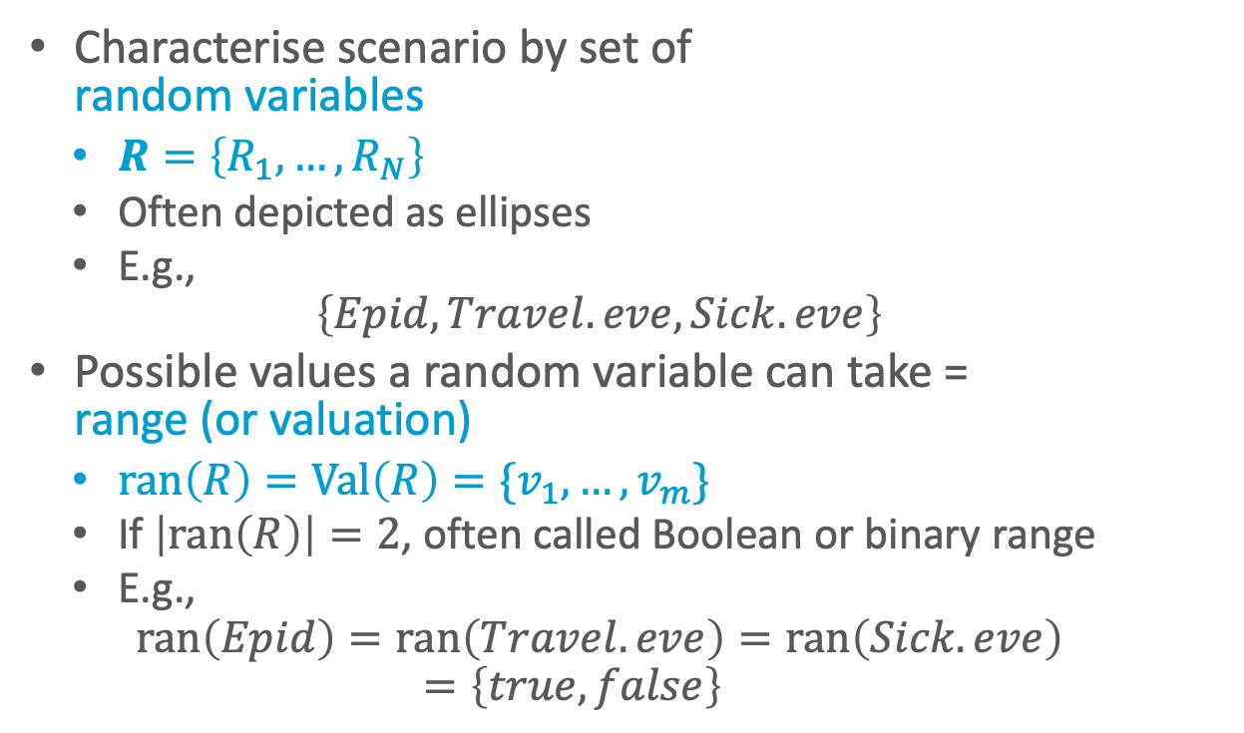


Random Variables
Characterise scenario by set of
random variables
  $R=\left\{R_{1}, …, R_{N}\right\}$
  Often depicted as ellipses
  E.g.,
  $$\left\{Epid, Travel.eve, Sick.eve\right\}$$
Possible values a random variable can take =
range (or valuation)
  $ran\left(R\right)=Val\left(R\right)=\{v_{1},…, v_{m}\}$
  If $\left|ran\left(R\right)\right|=2$, often called Boolean or binary range
  E.g.,
  $$ran\left(Epid\right)=ran\left(Travel.eve\right)=ran\left(Sick.eve\right) \\ =\left\{true,false\right\}$$
$$Epid$$
$$Travel$$
$$Sick$$
Notes:
Vocabulary

Slide 6
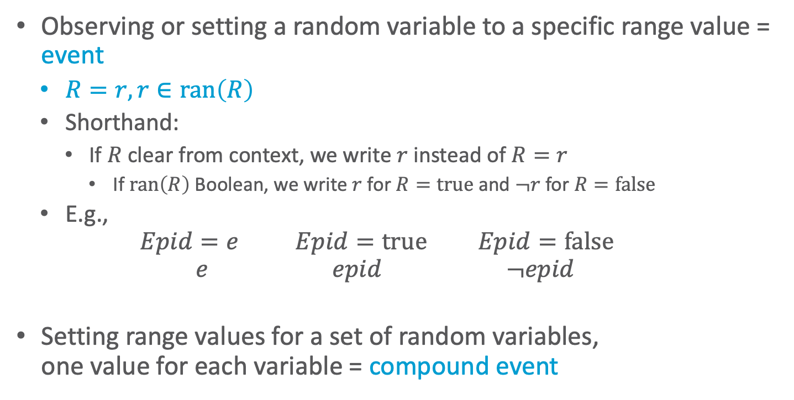
Events
Observing or setting a random variable to a specific range value = event
  $R=r, r∈ran\left(R\right)$
  Shorthand:
    If $R$ clear from context, we write $r$ instead of $R=r$
      If $ran\left(R\right)$ Boolean, we write $r$ for $R=true$ and $¬r$ for $R=false$
  E.g.,
  $$Epid=e Epid=true Epid=false$$
  $$e epid ¬epid$$
Setting range values for a set of random variables,
one value for each variable = compound event
$$Epid$$
$$Travel$$
$$Sick$$
Notes:
Vocabulary

Slide 7
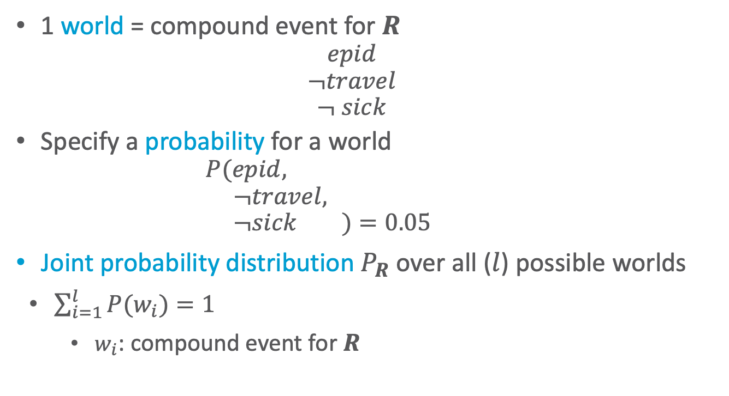

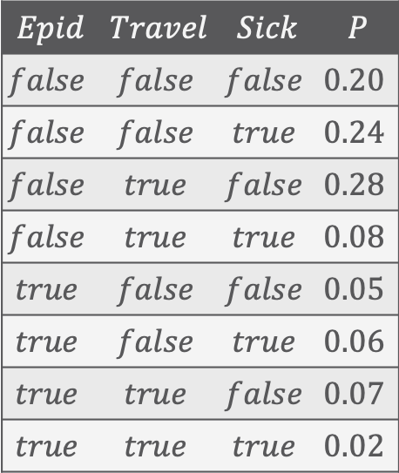


Full Joint Probability Distribution
$$Epid$$ | $$Travel$$ | $$Sick$$ | $$P$$
$$false$$ | $$false$$ | $$false$$ | $$0.20$$
$$false$$ | $$false$$ | $$true$$ | $$0.24$$
$$false$$ | $$true$$ | $$false$$ | $$0.28$$
$$false$$ | $$true$$ | $$true$$ | $$0.08$$
$$true$$ | $$false$$ | $$false$$ | $$0.05$$
$$true$$ | $$false$$ | $$true$$ | $$0.06$$
$$true$$ | $$true$$ | $$false$$ | $$0.07$$
$$true$$ | $$true$$ | $$true$$ | $$0.02$$
1 world = compound event for $R$
  $$epid \\ ¬travel \\ ¬ sick$$
Specify a probability for a world
  $$P(epid, \\ ¬travel, \\ ¬sick )=0.05$$
  Joint probability distribution $P_{R}$ over all ($l$) possible worlds
  $\sum_{i=1}^{l}{P(w_{i})}=1$
    $w_{i}$: compound event for $R$
$$Epid$$
How large is $l$?
$$P_{R}$$
$$Travel$$
$$Sick$$
Notes:
Vocabulary

Slide 8
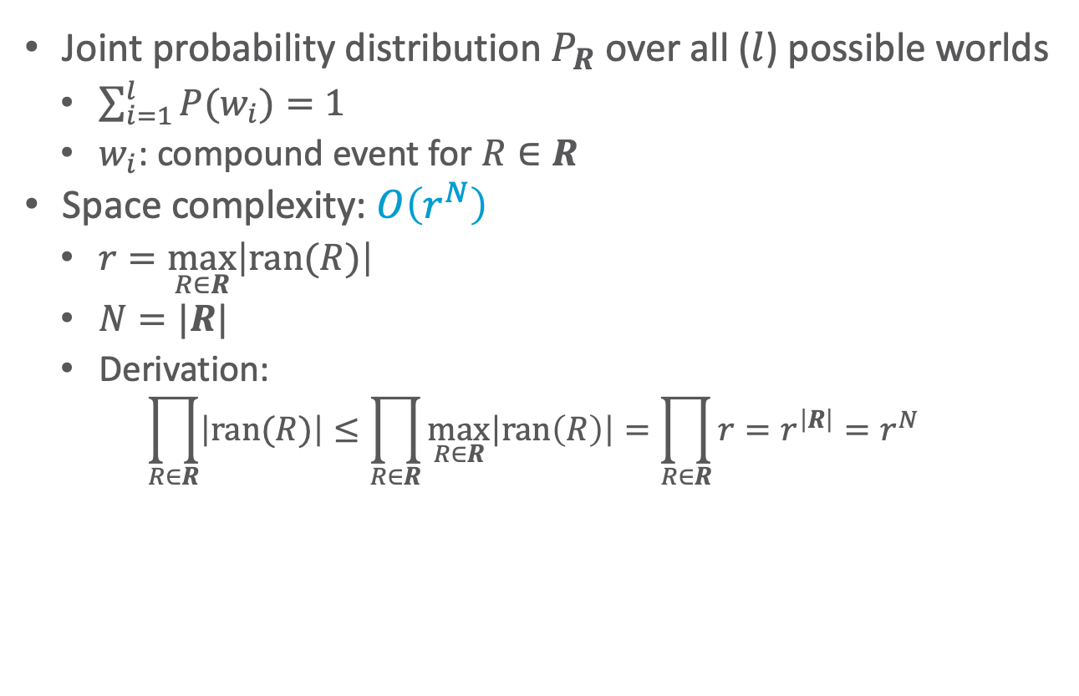

Space Complexity
$$Epid$$ | $$Travel$$ | $$Sick$$ | $$P$$
$$false$$ | $$false$$ | $$false$$ | $$0.20$$
$$false$$ | $$false$$ | $$true$$ | $$0.24$$
$$false$$ | $$true$$ | $$false$$ | $$0.28$$
$$false$$ | $$true$$ | $$true$$ | $$0.08$$
$$true$$ | $$false$$ | $$false$$ | $$0.05$$
$$true$$ | $$false$$ | $$true$$ | $$0.06$$
$$true$$ | $$true$$ | $$false$$ | $$0.07$$
$$true$$ | $$true$$ | $$true$$ | $$0.02$$
Joint probability distribution $P_{R}$ over all ($l$) possible worlds
  $\sum_{i=1}^{l}{P(w_{i})}=1$
  $w_{i}$: compound event for $R∈R$
Space complexity: $O\left(r^{N}\right)$
  $r=\max_{R∈R}\left|ran(R)\right|$
  $N=|R|$
  Derivation:
  $$\prod_{R∈R}{\left|ran(R)\right|}≤\prod_{R∈R}{\max_{R∈R}\left|ran\left(R\right)\right|}=\prod_{R∈R}{r}=r^{\left|R\right|}=r^{N}$$
$$Epid$$
Exact size
Exponential in $N$!
$$P_{R}$$
$$Travel$$
$$Sick$$
Notes:
As in example: ${r=2, n=3, r^{n}=2}^{3}=8, 2∙2∙2=8$
If one variable range size 3: ${r=3, n=3, r^{n}=3}^{3}=27, 3∙2∙2=12$

Slide 9
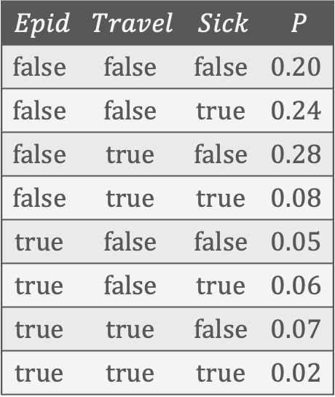
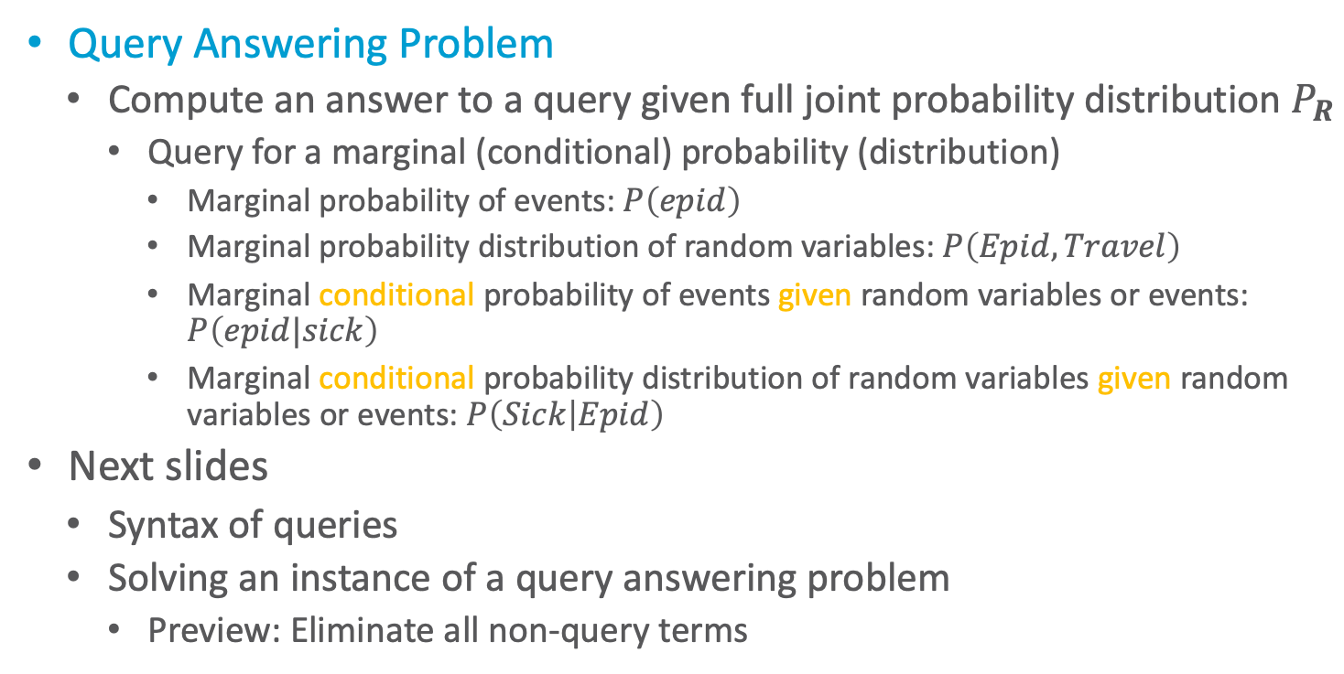
Inference Tasks
$$Epid$$ | $$Travel$$ | $$Sick$$ | $$P$$
$$false$$ | $$false$$ | $$false$$ | $$0.20$$
$$false$$ | $$false$$ | $$true$$ | $$0.24$$
$$false$$ | $$true$$ | $$false$$ | $$0.28$$
$$false$$ | $$true$$ | $$true$$ | $$0.08$$
$$true$$ | $$false$$ | $$false$$ | $$0.05$$
$$true$$ | $$false$$ | $$true$$ | $$0.06$$
$$true$$ | $$true$$ | $$false$$ | $$0.07$$
$$true$$ | $$true$$ | $$true$$ | $$0.02$$
Query Answering Problem
  Compute an answer to a query given full joint probability distribution $P_{R}$
    Query for a marginal (conditional) probability (distribution)
      Marginal probability of events: $P\left(epid\right)$
      Marginal probability distribution of random variables: $P\left(Epid,Travel\right)$
      Marginal conditional probability of events given random variables or events: $P\left(epid|sick\right)$
      Marginal conditional probability distribution of random variables given random variables or events: $P\left(Sick | Epid\right)$
Next slides
  Syntax of queries
  Solving an instance of a query answering problem
    Preview: Eliminate all non-query terms
$$Epid$$
$$P_{R}$$
$$Travel$$
$$Sick$$

Slide 10
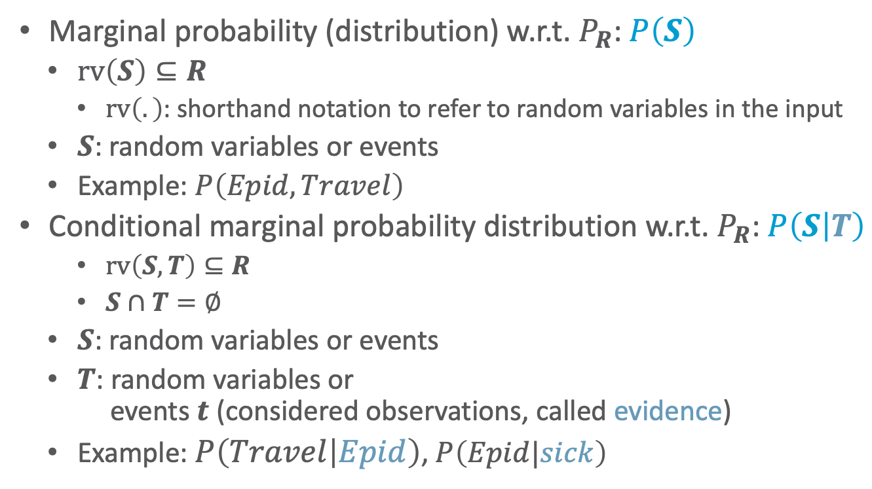
Query Syntax
$$Epid$$ | $$Travel$$ | $$Sick$$ | $$P$$
$$false$$ | $$false$$ | $$false$$ | $$0.20$$
$$false$$ | $$false$$ | $$true$$ | $$0.24$$
$$false$$ | $$true$$ | $$false$$ | $$0.28$$
$$false$$ | $$true$$ | $$true$$ | $$0.08$$
$$true$$ | $$false$$ | $$false$$ | $$0.05$$
$$true$$ | $$false$$ | $$true$$ | $$0.06$$
$$true$$ | $$true$$ | $$false$$ | $$0.07$$
$$true$$ | $$true$$ | $$true$$ | $$0.02$$
Marginal probability (distribution) w.r.t. $P_{R}$: $P\left(S\right)$
  $rv\left(S\right)⊆R$
    $rv\left(.\right)$: shorthand notation to refer to random variables in the input
  $S$: random variables or events
  Example: $P\left(Epid,Travel\right)$
Conditional marginal probability distribution w.r.t. $P_{R}$: $P\left(S | T\right)$
    $rv\left(S,T\right)⊆R$
    $S∩T=∅$
  $S$: random variables or events
  $T$: random variables or
  events $t$ (considered observations, called evidence)
  Example: $P\left(Travel | Epid\right)$, $P\left(Epid|sick\right)$
$$Epid$$
$$P_{R}$$
$$Travel$$
$$Sick$$

Slide 11
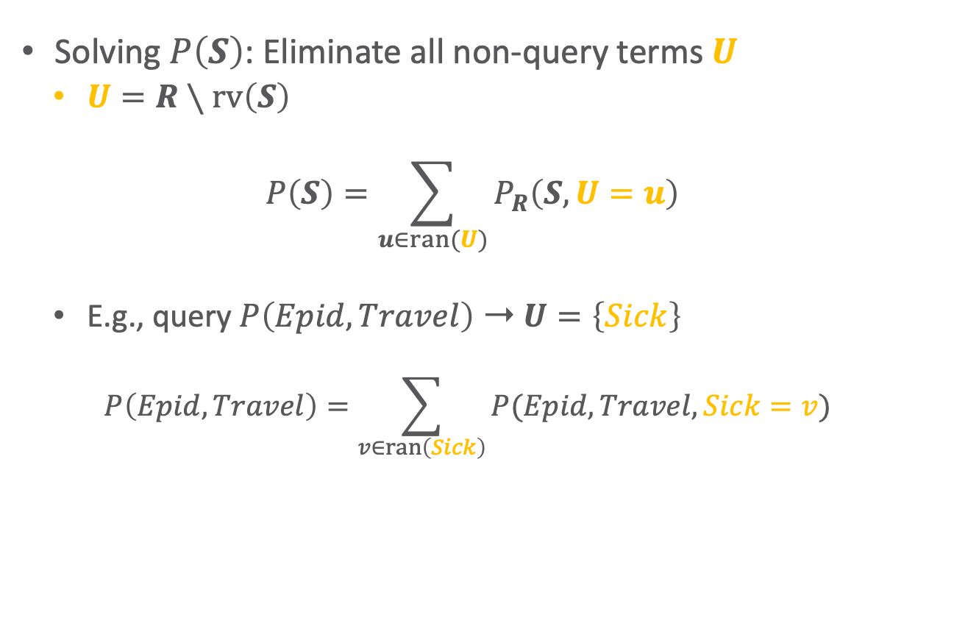

Answering Marginal Queries
$$Epid$$ | $$Travel$$ | $$Sick$$ | $$P$$
$$false$$ | $$false$$ | $$false$$ | $$0.20$$
$$false$$ | $$false$$ | $$true$$ | $$0.24$$
$$false$$ | $$true$$ | $$false$$ | $$0.28$$
$$false$$ | $$true$$ | $$true$$ | $$0.08$$
$$true$$ | $$false$$ | $$false$$ | $$0.05$$
$$true$$ | $$false$$ | $$true$$ | $$0.06$$
$$true$$ | $$true$$ | $$false$$ | $$0.07$$
$$true$$ | $$true$$ | $$true$$ | $$0.02$$
Solving $P\left(S\right)$: Eliminate all non-query terms $U$
  $U=R∖rv\left(S\right)$
  $$P\left(S\right)=\sum_{u∈ran(U)}{P_{R}\left(S,U=u\right)}$$
  E.g., query $P\left(Epid,Travel\right)$ ➝ $U=\left\{Sick\right\}$
    $$P\left(Epid,Travel\right)=\sum_{v∈ran\left(Sick\right)}{P(Epid,Travel,Sick=v)}$$
$$Epid$$
$$P_{R}$$
$$Travel$$
$$Sick$$

Slide 12


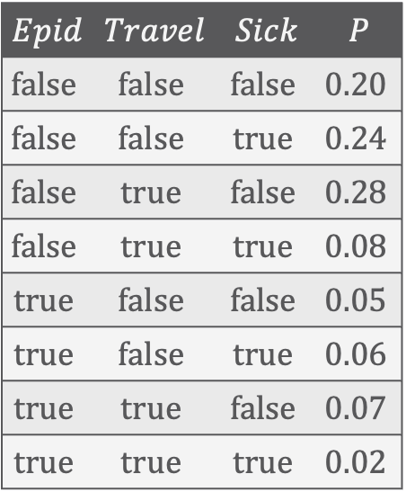

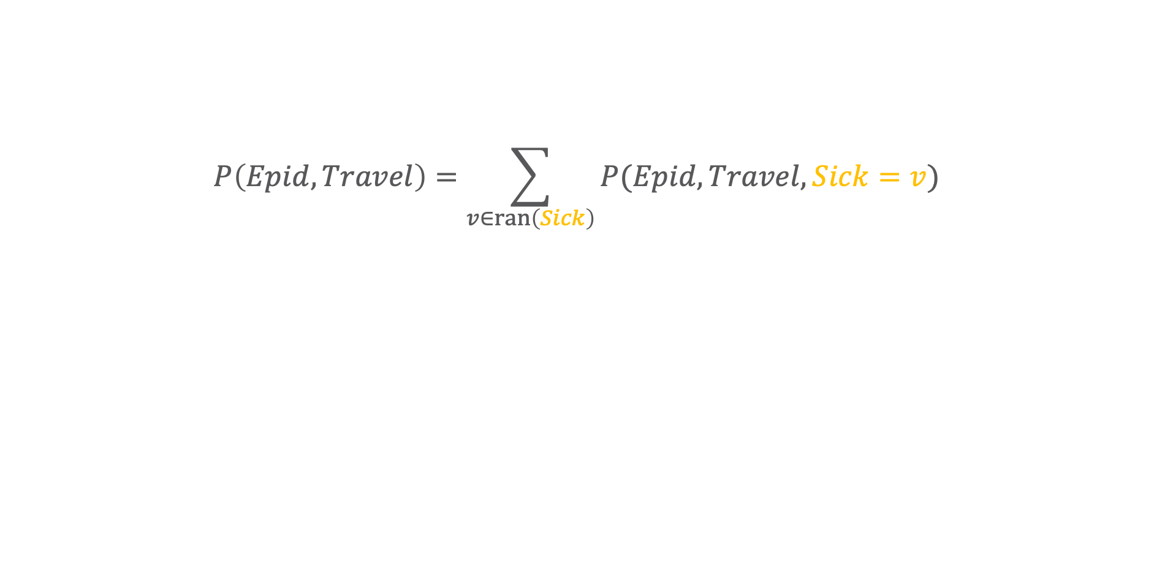




Answering Marginal Queries
$$P\left(Epid,Travel\right)=\sum_{v∈ran\left(Sick\right)}{P(Epid,Travel,Sick=v)}$$
$$Epid$$ | $$Travel$$ | $$Sick$$ | $$P$$
$$false$$ | $$false$$ | $$false$$ | $$0.20$$
$$false$$ | $$false$$ | $$true$$ | $$0.24$$
$$false$$ | $$true$$ | $$false$$ | $$0.28$$
$$false$$ | $$true$$ | $$true$$ | $$0.08$$
$$true$$ | $$false$$ | $$false$$ | $$0.05$$
$$true$$ | $$false$$ | $$true$$ | $$0.06$$
$$true$$ | $$true$$ | $$false$$ | $$0.07$$
$$true$$ | $$true$$ | $$true$$ | $$0.02$$
$$Epid$$ | $$Travel$$ | $$P$$
+
$$false$$ | $$false$$ | $$0.44$$
$$Epid$$
+
$$false$$ | $$true$$ | $$0.36$$
$$P\left(Epid, Travel\right)$$
$$Travel$$
+
$$true$$ | $$false$$ | $$0.11$$
$$Epid$$
+
$$true$$ | $$true$$ | $$0.09$$
$$P_{R}$$
$$Travel$$
$$Sick$$

Slide 13

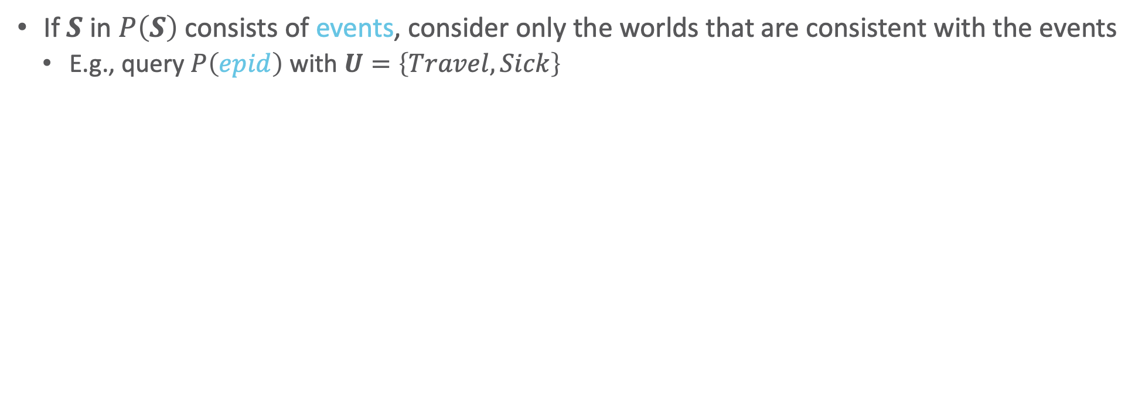
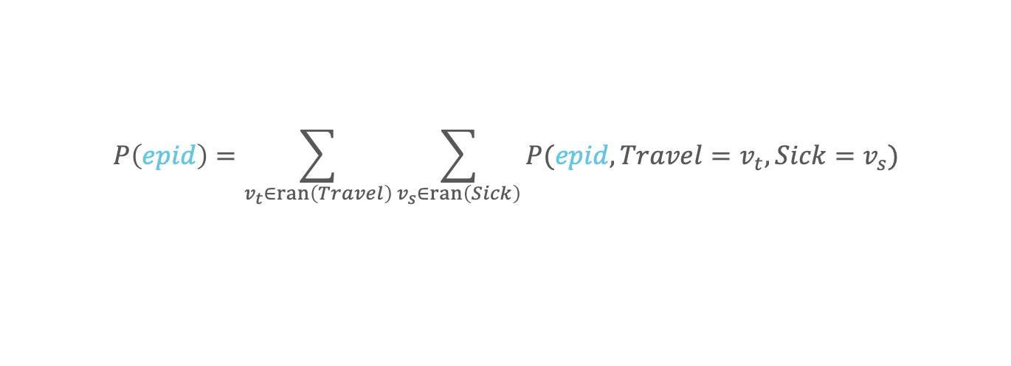









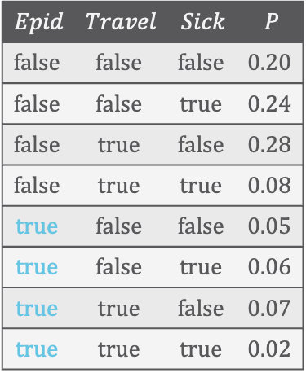


Answering Marginal Queries
If $S$ in $P\left(S\right)$ consists of events, consider only the worlds that are consistent with the events
  E.g., query $P\left(epid\right)$ with $U=\left\{Travel,Sick\right\}$
$$Epid$$
$$P\left(epid\right)=\sum_{v_{t}∈ran\left(Travel\right)}{\sum_{v_{s}∈ran\left(Sick\right)}{P(epid,Travel=v_{t},Sick=v_{s})}}$$
$$P\left(epid\right)$$
$$Epid$$ | $$Travel$$ | $$Sick$$ | $$P$$
$$false$$ | $$false$$ | $$false$$ | $$0.20$$
$$false$$ | $$false$$ | $$true$$ | $$0.24$$
$$false$$ | $$true$$ | $$false$$ | $$0.28$$
$$false$$ | $$true$$ | $$true$$ | $$0.08$$
$$true$$ | $$false$$ | $$false$$ | $$0.05$$
$$true$$ | $$false$$ | $$true$$ | $$0.06$$
$$true$$ | $$true$$ | $$false$$ | $$0.07$$
$$true$$ | $$true$$ | $$true$$ | $$0.02$$
$$Epid$$
No probability distribution at this point (in the middle of the computation)
$$φ\left(epid, Travel\right)$$
$$Travel$$
$$Epid$$ | $$Travel$$ | $$φ$$
$$Epid$$ | $$P$$
$$Epid$$
+
$$true$$ | $$false$$ | $$0.11$$
+
$$true$$ | $$0.20$$
+
$$true$$ | $$true$$ | $$0.09$$
$$P_{R}$$
$$Travel$$
$$Sick$$
Notes:
Sum over range values of random variables in $U$

Slide 14
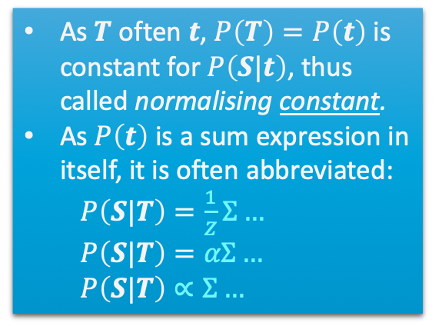
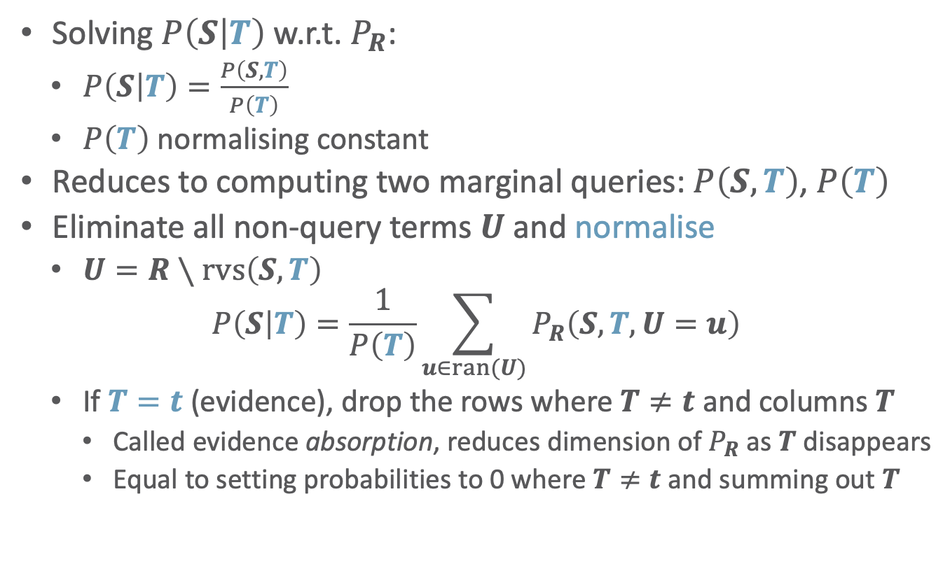
Answering Conditional Queries
Solving $P\left(S | T\right)$ w.r.t. $P_{R}$:
  $P\left(S | T\right)=\frac{P\left(S,T\right)}{P\left(T\right)}$
  $P\left(T\right)$ normalising constant
Reduces to computing two marginal queries: $P\left(S,T\right)$, $P\left(T\right)$
Eliminate all non-query terms $U$ and normalise
  $U=R∖rvs\left(S,T\right)$
  $$P\left(S | T\right)=\frac{1}{P\left(T\right)}\sum_{u∈ran(U)}{P_{R}\left(S,T,U=u\right)}$$
  If $T=t$ (evidence), drop the rows where $T≠t$ and columns $T$
    Called evidence absorption, reduces dimension of $P_{R}$ as $T$ disappears
    Equal to setting probabilities to 0 where $T≠t$ and summing out $T$
As $T$ often $t$, $P\left(T\right)=P\left(t\right)$ is constant for $P\left(S|t\right)$, thus called normalising constant.
As $P\left(t\right)$ is a sum expression in itself, it is often abbreviated:
$P\left(S|T\right)=\frac{1}{Z}Σ…$
$P\left(S|T\right)=αΣ…$
$P\left(S|T\right)∝Σ…$
(Zustandssumme)
(proportional to)
$$Epid$$
$$P_{R}$$
$$Travel$$
$$Sick$$

Slide 15
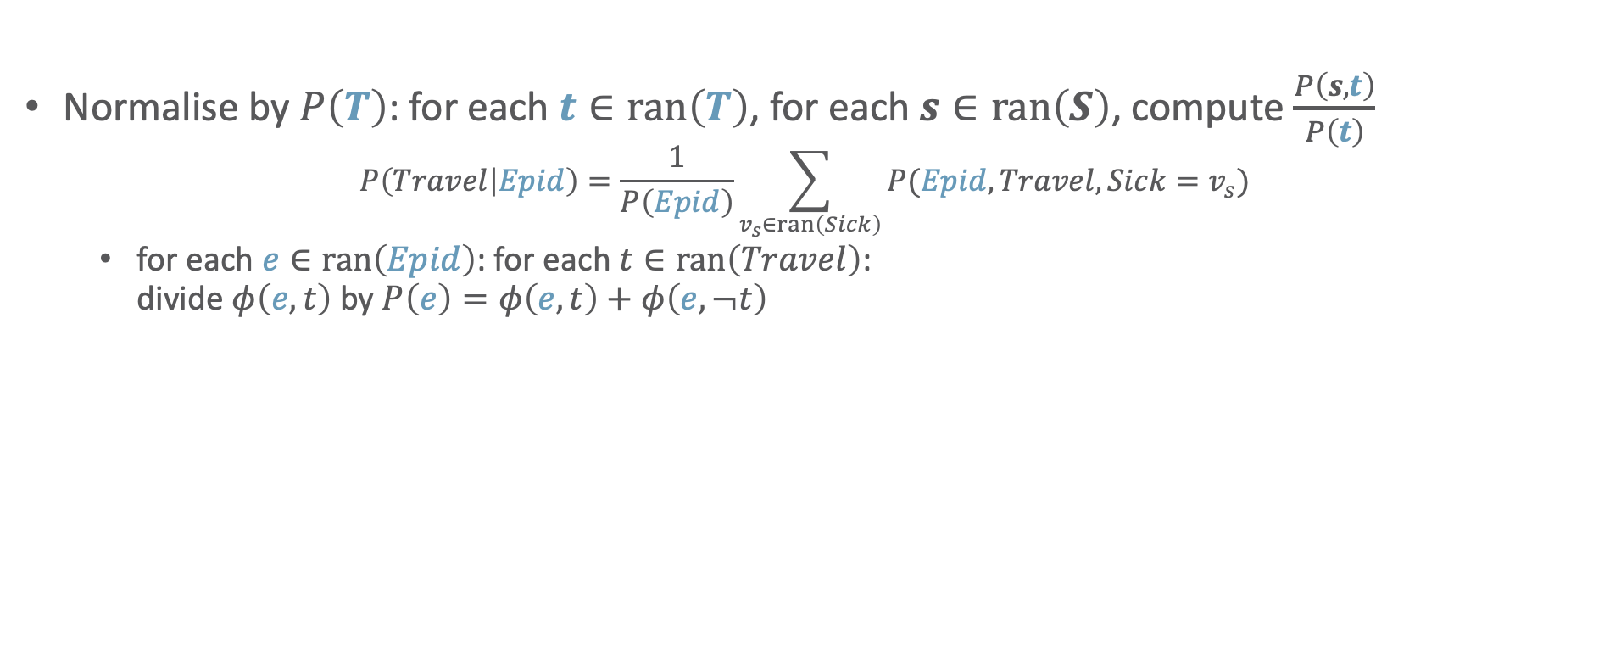



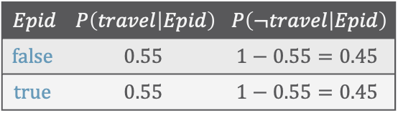

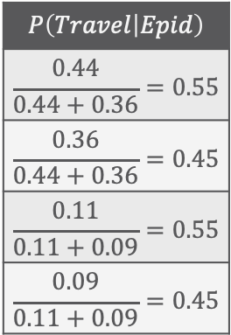

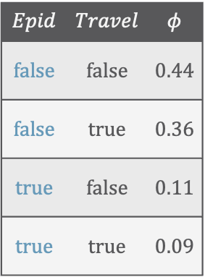


Answering Conditional Queries: Normalisation
Normalise by $P\left(T\right)$: for each $t∈ran\left(T\right)$, for each $s∈ran\left(S\right)$, compute $\frac{P\left(s,t\right)}{P\left(t\right)}$
  $$P\left(Travel | Epid\right)=\frac{1}{P\left(Epid\right)}\sum_{v_{s}∈ran\left(Sick\right)}{P(Epid,Travel,Sick=v_{s})}$$
    for each $e∈ran\left(Epid\right)$: for each $t∈ran\left(Travel\right)$:
    divide $φ\left(e,t\right)$ by $P\left(e\right)=φ\left(e,t\right)+φ\left(e,¬t\right)$
$$φ$$
$$Epid$$
What do we need to do?
$$P\left(Travel | Epid\right)$$
$$\frac{0.44}{0.44+0.36}=0.55$$
$$\frac{0.36}{0.44+0.36}=0.45$$
$$\frac{0.11}{0.11+0.09}=0.55$$
$$\frac{0.09}{0.11+0.09}=0.45$$
$$Epid$$ | $$Travel$$ | $$φ$$
$$false$$ | $$false$$ | $$0.44$$
$$false$$ | $$true$$ | $$0.36$$
$$true$$ | $$false$$ | $$0.11$$
$$true$$ | $$true$$ | $$0.09$$
$$P\left(Travel | Epid\right)$$
$$Travel$$
$$φ\left(Epid, Travel\right)$$
$$Epid$$ | $$P\left(travel | Epid\right)$$ | $$P\left(¬travel | Epid\right)$$
$$false$$ | $$0.55$$ | $$1−0.55=0.45$$
$$true$$ | $$0.55$$ | $$1−0.55=0.45$$
$$Epid$$
$$P_{R}$$
$$Travel$$
$$Sick$$
Notes:
Sum over range values of random variables in $U$

Slide 16


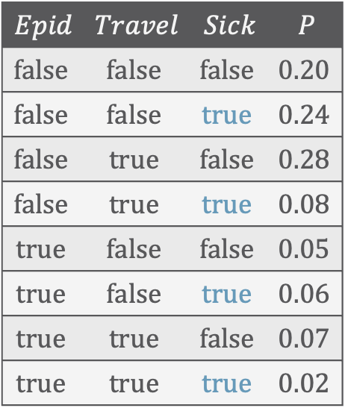


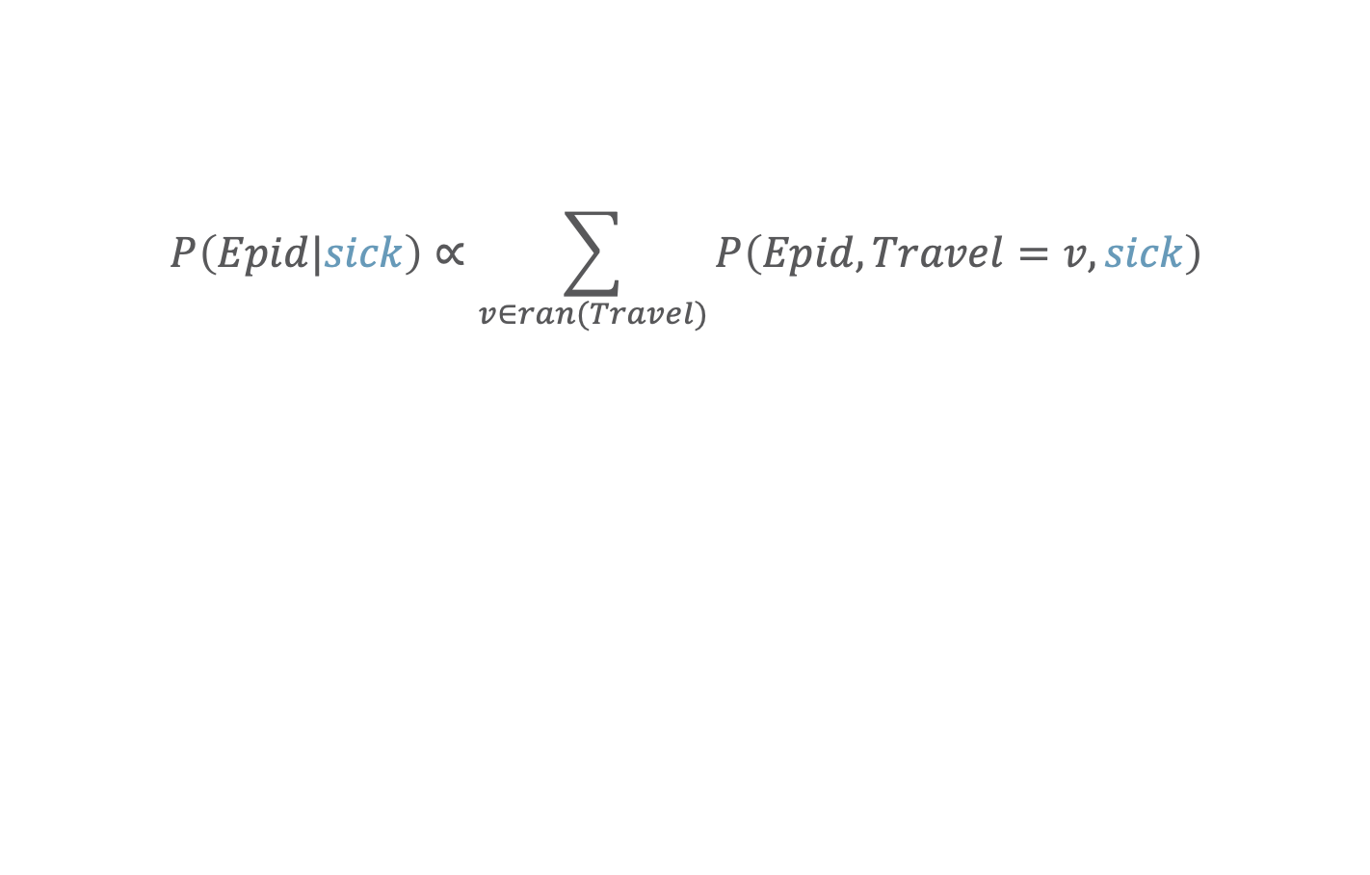






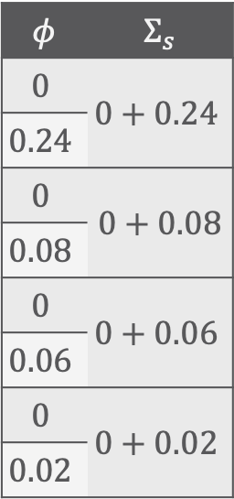


Answering Conditional Queries: Evidence – Absorption
$$Epid$$
$$P\left(Epid|sick\right)∝\sum_{v∈ran(Travel)}{P\left(Epid,Travel=v,sick\right)}$$
$$φ^{′}$$
$$Travel$$
$$Epid$$ | $$Travel$$ | $$Sick$$ | $$P$$
$$false$$ | $$false$$ | $$false$$ | $$0.20$$
$$false$$ | $$false$$ | $$true$$ | $$0.24$$
$$false$$ | $$true$$ | $$false$$ | $$0.28$$
$$false$$ | $$true$$ | $$true$$ | $$0.08$$
$$true$$ | $$false$$ | $$false$$ | $$0.05$$
$$true$$ | $$false$$ | $$true$$ | $$0.06$$
$$true$$ | $$true$$ | $$false$$ | $$0.07$$
$$true$$ | $$true$$ | $$true$$ | $$0.02$$
$$Epid$$ | $$Travel$$ | $$φ^{′}$$
$$φ$$ | $$Σ_{s}$$
$$0$$ | $$0+0.24$$
$$0.24$$
$$0$$ | $0+0.$08
$$0.08$$
$$0$$ | $$0+0.06$$
$$0.06$$
$$0$$ | $$0+0.02$$
$$0.02$$
$$Epid$$
$$false$$ | $$false$$ | $$0.24$$
$$φ$$
$$Travel$$
$$sick$$
$$false$$ | $$true$$ | $$0.08$$
$$Epid$$
$$true$$ | $$false$$ | $$0.06$$
$$P_{R}$$
$$true$$ | $$true$$ | $$0.02$$
$$Travel$$
$$sick$$
select + project
set to $0$ + sum out

Slide 17


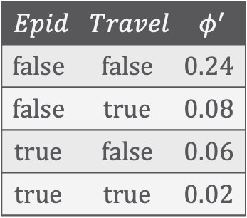



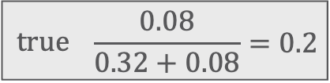


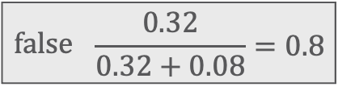


Answering Conditional Queries: Evidence – Normalisation
$$P\left(Epid|sick\right)∝\sum_{v∈ran(Travel)}{P\left(Epid,Travel=v,sick\right)}$$
$$Epid$$
normalise
$$P\left(Epid|sick\right)$$
$$Epid$$ | $$Travel$$ | $$φ^{′}$$
$$false$$ | $$false$$ | $$0.24$$
$$false$$ | $$true$$ | $$0.08$$
$$true$$ | $$false$$ | $$0.06$$
$$true$$ | $$true$$ | $$0.02$$
$$Epid$$ | $$φ^{′}′$$
$$Epid$$ | $$P$$
$$Epid$$
+
$$false$$ | $$0.32$$
$$false$$ | $$\frac{0.32}{0.32+0.08}=0.8$$
$$true$$ | $$\frac{0.08}{0.32+0.08}=0.2$$
$$φ^{′′}$$
+
$$true$$ | $$0.08$$
$$Epid$$
for each $t∈ran\left(T\right)$, for each $s∈ran\left(S\right)$, compute $\frac{P\left(s,t\right)}{P\left(t\right)}$
$$φ^{′}$$
with $T=t$, only one case $t$
$$Travel$$

Slide 18
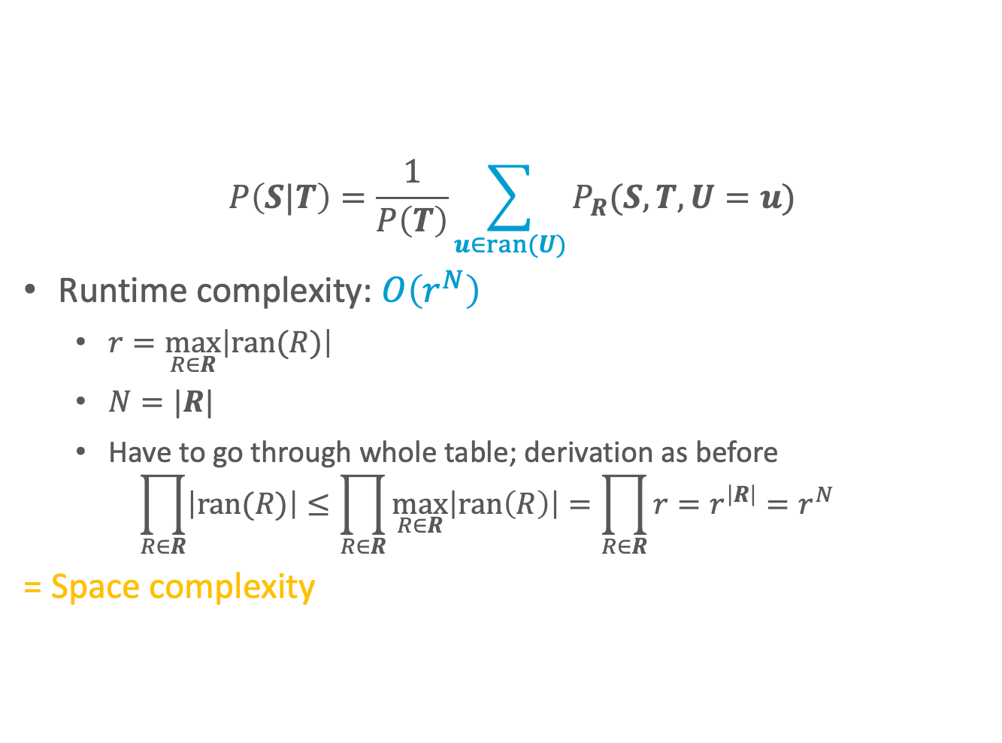
Runtime Complexity
$$Epid$$ | $$Travel$$ | $$Sick$$ | $$P$$
$$false$$ | $$false$$ | $$false$$ | $$0.20$$
$$false$$ | $$false$$ | $$true$$ | $$0.24$$
$$false$$ | $$true$$ | $$false$$ | $$0.28$$
$$false$$ | $$true$$ | $$true$$ | $$0.08$$
$$true$$ | $$false$$ | $$false$$ | $$0.05$$
$$true$$ | $$false$$ | $$true$$ | $$0.06$$
$$true$$ | $$true$$ | $$false$$ | $$0.07$$
$$true$$ | $$true$$ | $$true$$ | $$0.02$$
  $$P\left(S|T\right)=\frac{1}{P\left(T\right)}\sum_{u∈ran(U)}{P_{R}(S,T,U=u)}$$
  Runtime complexity: $O\left(r^{N}\right)$
    $r=\max_{R∈R}\left|ran(R)\right|$
    $N=|R|$
    Have to go through whole table; derivation as before
    $$\prod_{R∈R}{\left|ran(R)\right|}≤\prod_{R∈R}{\max_{R∈R}\left|ran\left(R\right)\right|}=\prod_{R∈R}{r}=r^{\left|R\right|}=r^{N}$$
  = Space complexity
$$Epid$$
Exponential in $N$!
$$P_{R}$$
$$Travel$$
$$Sick$$
Notes:
As in example: ${r=2, n=3, r^{n}=2}^{3}=8, 2∙2∙2=8$
If one variable range size 3: ${r=3, n=3, r^{n}=3}^{3}=27, 3∙2∙2=12$

Slide 19

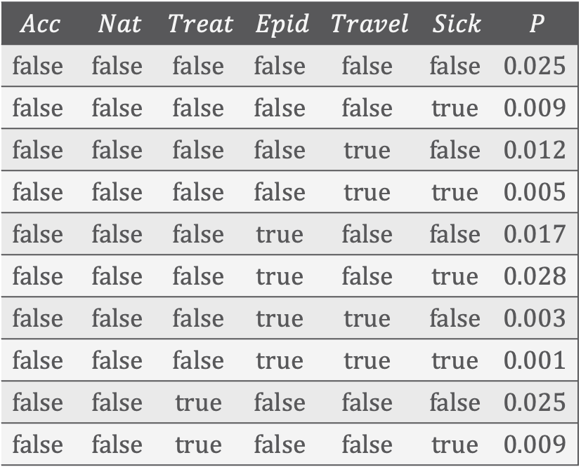






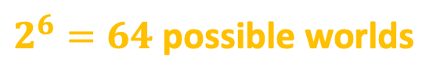

Exponential Blowup!
$$Acc$$ | $$Nat$$ | $$Treat$$ | $$Epid$$ | $$Travel$$ | $$Sick$$ | $$P$$
$$false$$ | $$false$$ | $$false$$ | $$false$$ | $$false$$ | $$false$$ | $$0.025$$
$$false$$ | $$false$$ | $$false$$ | $$false$$ | $$false$$ | $$true$$ | $$0.009$$
$$false$$ | $$false$$ | $$false$$ | $$false$$ | $$true$$ | $$false$$ | $$0.012$$
$$false$$ | $$false$$ | $$false$$ | $$false$$ | $$true$$ | $$true$$ | $$0.005$$
$$false$$ | $$false$$ | $$false$$ | $$true$$ | $$false$$ | $$false$$ | $$0.017$$
$$false$$ | $$false$$ | $$false$$ | $$true$$ | $$false$$ | $$true$$ | $$0.028$$
$$false$$ | $$false$$ | $$false$$ | $$true$$ | $$true$$ | $$false$$ | $$0.003$$
$$false$$ | $$false$$ | $$false$$ | $$true$$ | $$true$$ | $$true$$ | $$0.001$$
$$false$$ | $$false$$ | $$true$$ | $$false$$ | $$false$$ | $$false$$ | $$0.025$$
$$false$$ | $$false$$ | $$true$$ | $$false$$ | $$false$$ | $$true$$ | $$0.009$$
$$Acc$$
$$Nat$$
$$Epid$$
$$P_{R}$$
$$Travel$$
$$Sick$$
$$Treat$$
$2^{6}=64$ possible worlds
Adding relations means adding $Sick$, $Treat$, $Travel$ variables for each person, blowing up the model further
Notes:
Vocabulary

Slide 20



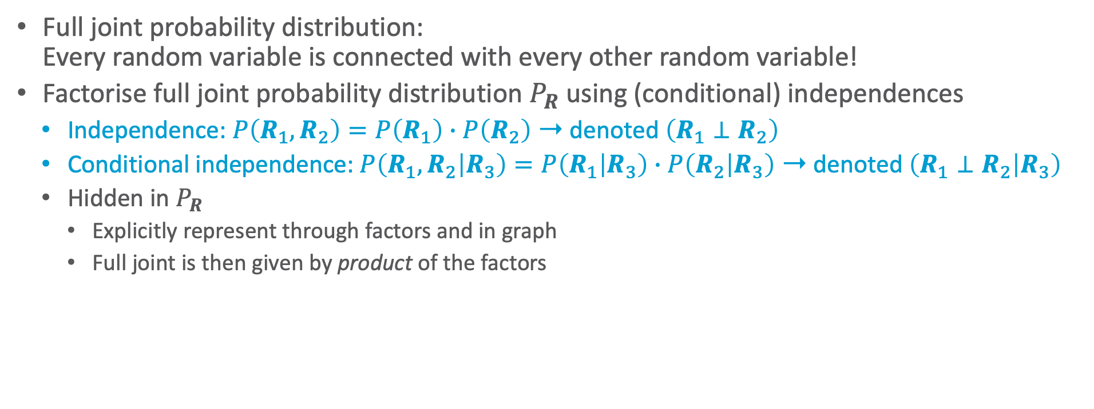


Compact Encoding
Full joint probability distribution:
Every random variable is connected with every other random variable!
Factorise full joint probability distribution $P_{R}$ using (conditional) independences
  Independence: $P\left(R_{1},R_{2}\right)=P\left(R_{1}\right)∙P\left(R_{2}\right)$ ➝ denoted $\left(R_{1}⊥R_{2}\right)$
  Conditional independence: $P\left(R_{1},R_{2} | R_{3}\right)=P\left(R_{1} | R_{3}\right)∙P\left(R_{2} | R_{3}\right)$ ➝ denoted $\left(R_{1}⊥R_{2} | R_{3}\right)$
  Hidden in $P_{R}$
    Explicitly represent through factors and in graph
    Full joint is then given by product of the factors
$$Epid$$
$$Epid$$
$$P_{R}$$
$$Travel$$
$$Sick$$
$$Travel$$
$$Sick$$

Slide 21
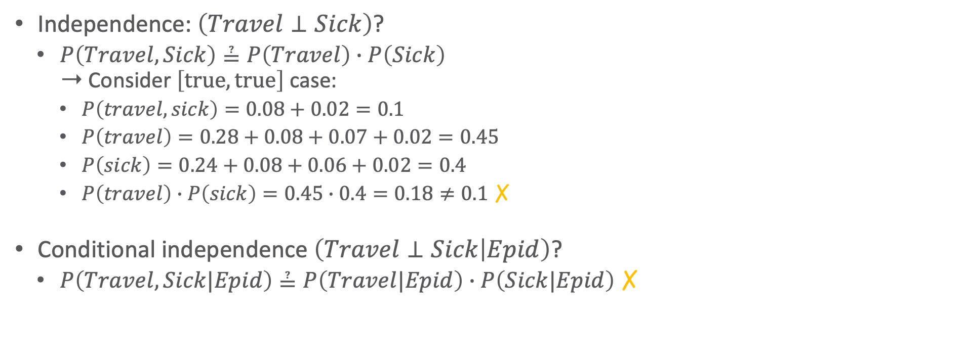
Independences: Examples
$$Epid$$ | $$Travel$$ | $$Sick$$ | $$P$$
$$false$$ | $$false$$ | $$false$$ | $$0.20$$
$$false$$ | $$false$$ | $$true$$ | $$0.24$$
$$false$$ | $$true$$ | $$false$$ | $$0.28$$
$$false$$ | $$true$$ | $$true$$ | $$0.08$$
$$true$$ | $$false$$ | $$false$$ | $$0.05$$
$$true$$ | $$false$$ | $$true$$ | $$0.06$$
$$true$$ | $$true$$ | $$false$$ | $$0.07$$
$$true$$ | $$true$$ | $$true$$ | $$0.02$$
Independence: $\left(Travel⊥Sick\right)$?
  $P\left(Travel, Sick\right)≟P\left(Travel\right)∙P\left(Sick\right)$
  ➝ Consider $\left[true,true\right]$ case:
    $P\left(travel, sick\right)=0.08+0.02=0.1$
    $P\left(travel\right)=0.28+0.08+0.07+0.02=0.45$
    $P\left(sick\right)=0.24+0.08+0.06+0.02=0.4$
    $P\left(travel\right)∙P\left(sick\right)=0.45∙0.4=0.18≠0.1$ ✗
Conditional independence $\left(Travel⊥Sick | Epid\right)$?
  $P\left(Travel, Sick|Epid\right)≟P\left(Travel|Epid\right)∙P\left(Sick|Epid\right)$ ✗
$$Epid$$
$$P_{R}$$
$$Travel$$
$$Sick$$

Slide 22
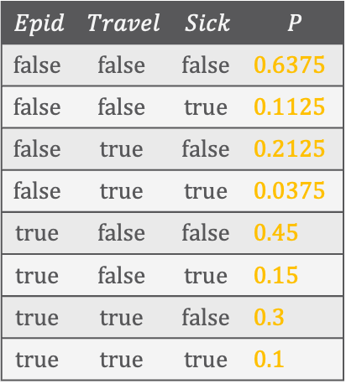
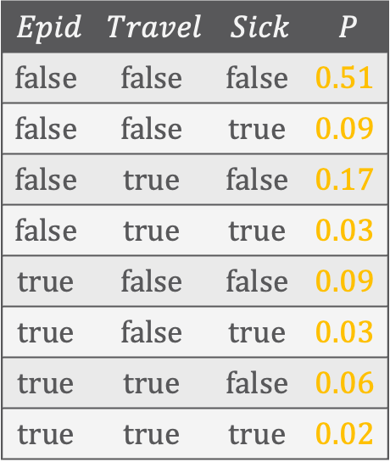
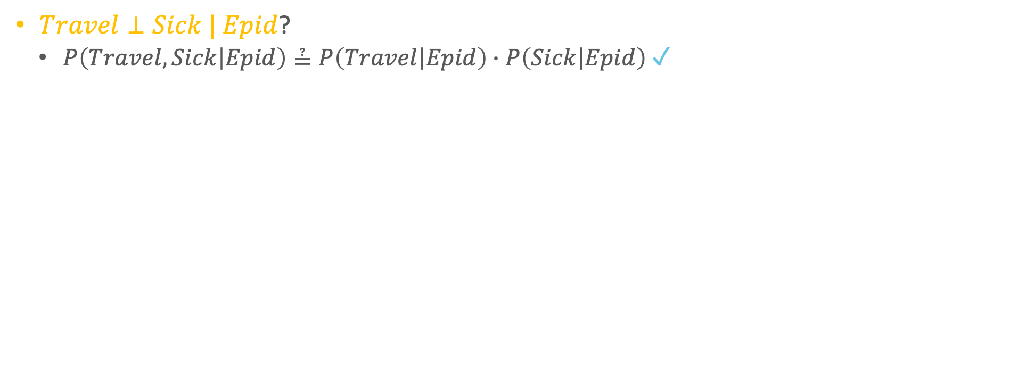
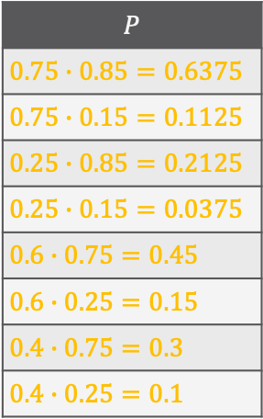
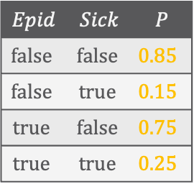
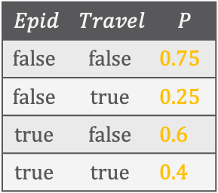
Independences: Examples
$$Epid$$ | $$Travel$$ | $$Sick$$ | $$P$$
$$false$$ | $$false$$ | $$false$$ | $$0.51$$
$$false$$ | $$false$$ | $$true$$ | $$0.09$$
$$false$$ | $$true$$ | $$false$$ | $$0.17$$
$$false$$ | $$true$$ | $$true$$ | $$0.03$$
$$true$$ | $$false$$ | $$false$$ | $$0.09$$
$$true$$ | $$false$$ | $$true$$ | $$0.03$$
$$true$$ | $$true$$ | $$false$$ | $$0.06$$
$$true$$ | $$true$$ | $$true$$ | $$0.02$$
$Travel⊥Sick | Epid$?
  $P\left(Travel, Sick | Epid\right)≟P\left(Travel | Epid\right)∙P\left(Sick | Epid\right)$ ✓
$$Epid$$ | $$Travel$$ | $$Sick$$ | $$P$$
$$false$$ | $$false$$ | $$false$$ | $0.6375$
$$false$$ | $$false$$ | $$true$$ | $0.1125$
$$false$$ | $$true$$ | $$false$$ | $0.2125$
$$false$$ | $$true$$ | $$true$$ | $0.0375$
$$true$$ | $$false$$ | $$false$$ | $0.45$
$$true$$ | $$false$$ | $$true$$ | $0.15$
$$true$$ | $$true$$ | $$false$$ | $0.3$
$$true$$ | $$true$$ | $$true$$ | $0.1$
$$Epid$$ | $$Travel$$ | $$P$$
$$false$$ | $$false$$ | $0.75$
$$false$$ | $$true$$ | $0.25$
$$true$$ | $$false$$ | $0.6$
$$true$$ | $$true$$ | $0.4$
$$Epid$$ | $$Sick$$ | $$P$$
$$false$$ | $$false$$ | $0.85$
$$false$$ | $$true$$ | $0.15$
$$true$$ | $$false$$ | $0.75$
$$true$$ | $$true$$ | $0.25$
$$P$$
$0.75∙0.85=0.6375$
$0.75∙0.15=0.1125$
$0.25∙0.85=0.2125$
$0.25∙0.15=0.0375$
$0.6∙0.75=0.45$
$0.6∙0.25=0.15$
$0.4∙0.75=0.3$
$0.4∙0.25=0.1$
$$Epid$$
$$P_{R}$$
$$Travel$$
$$Sick$$

Slide 23
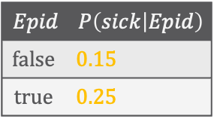
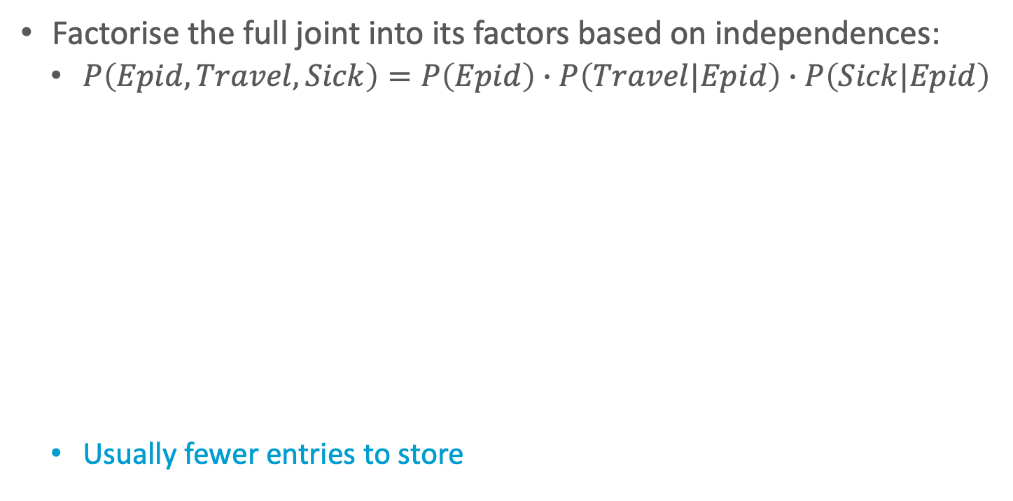
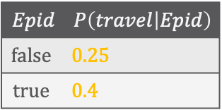

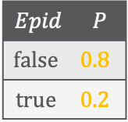
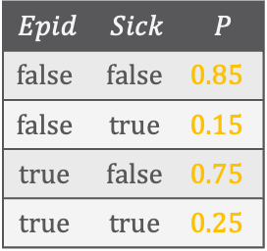

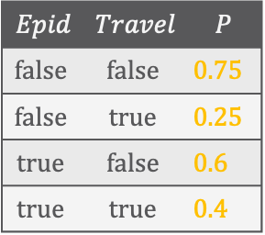
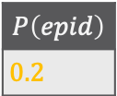
Independences: Examples
$$Epid$$ | $$Travel$$ | $$Sick$$ | $$P$$
$$false$$ | $$false$$ | $$false$$ | $$0.51$$
$$false$$ | $$false$$ | $$true$$ | $$0.09$$
$$false$$ | $$true$$ | $$false$$ | $$0.17$$
$$false$$ | $$true$$ | $$true$$ | $$0.03$$
$$true$$ | $$false$$ | $$false$$ | $$0.09$$
$$true$$ | $$false$$ | $$true$$ | $$0.03$$
$$true$$ | $$true$$ | $$false$$ | $$0.06$$
$$true$$ | $$true$$ | $$true$$ | $$0.02$$
Factorise the full joint into its factors based on independences:
  $P\left(Epid,Travel,Sick\right)=P\left(Epid\right)∙P\left(Travel|Epid\right)∙P\left(Sick|Epid\right)$
  Usually fewer entries to store
$$Epid$$
$$Epid$$ | $$P$$
$$false$$ | $0.8$
$$true$$ | $0.2$
$$Epid$$ | $$Travel$$ | $$P$$
$$false$$ | $$false$$ | $0.75$
$$false$$ | $$true$$ | $0.25$
$$true$$ | $$false$$ | $0.6$
$$true$$ | $$true$$ | $0.4$
$$Epid$$ | $$Sick$$ | $$P$$
$$false$$ | $$false$$ | $0.85$
$$false$$ | $$true$$ | $0.15$
$$true$$ | $$false$$ | $0.75$
$$true$$ | $$true$$ | $0.25$
$$Travel$$
$$Sick$$
$$P\left(epid\right)$$
$0.2$
$$Epid$$ | $$P\left(travel | Epid\right)$$
$$false$$ | $0.25$
$$true$$ | $0.4$
$$Epid$$ | $$P\left(sick | Epid\right)$$
$$false$$ | $0.15$
$$true$$ | $0.25$
$$Epid$$
$$P_{R}$$
$$Travel$$
$$Sick$$
Notes:
$2+4+4=10$ entries instead of $8$
Because probability distributions sum up to $1$:
$1+2+2=5$ entries instead of $7$, which is less

Slide 24
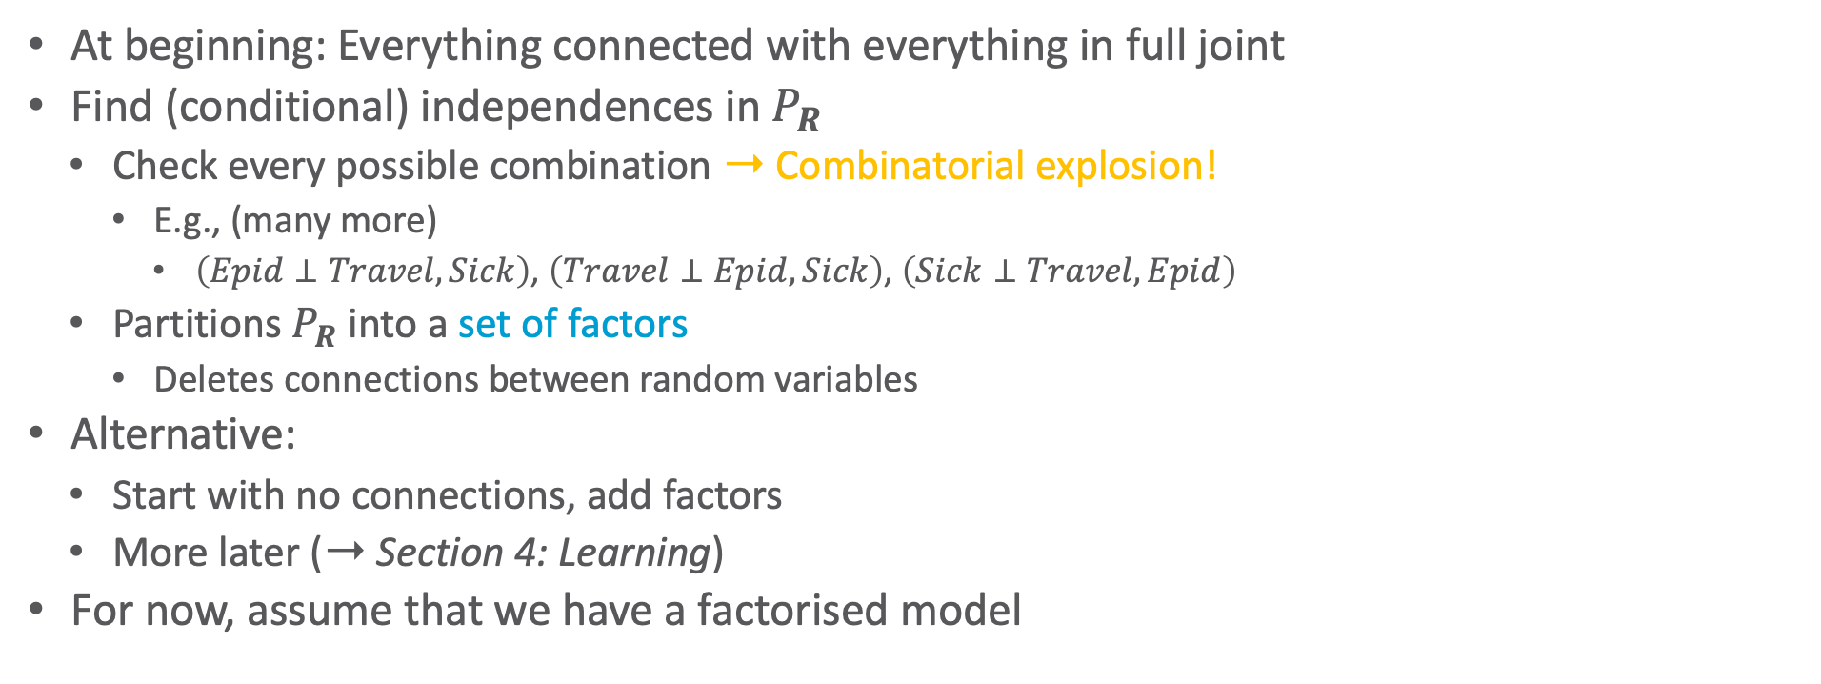
Finding a Compact Encoding
At beginning: Everything connected with everything in full joint
Find (conditional) independences in $P_{R}$
  Check every possible combination ➝ Combinatorial explosion!
    E.g., (many more)
      $\left(Epid⊥Travel,Sick\right)$, $\left(Travel⊥Epid,Sick\right)$, $\left(Sick⊥Travel,Epid\right)$
  Partitions $P_{R}$ into a set of factors
    Deletes connections between random variables
Alternative:
  Start with no connections, add factors
  More later (➝ Section 4: Learning)
For now, assume that we have a factorised model
$$Acc$$
$$Nat$$
$$Epid$$
$$P_{R}$$
$$Travel$$
$$Sick$$
$$Treat$$
$$Epid$$
$$P_{R}$$
$$Travel$$
$$Sick$$

Slide 25



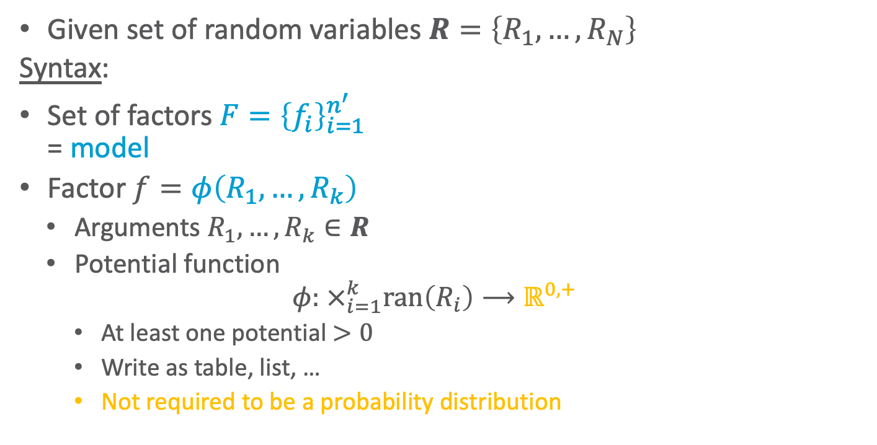







Model Representation: Factors
Given set of random variables $R=\left\{R_{1}, …, R_{N}\right\}$
Syntax:
Set of factors $F={\left\{f_{i}\right\}}_{i=1}^{n^{′}}$
= model
Factor $f=φ\left(R_{1},…, R_{k}\right)$
  Arguments $R_{1},…, R_{k}∈R$
  Potential function
  $φ: ×_{i=1}^{k}ran\left(R_{i}\right)⟶ℝ^{0,+}$
    At least one potential $>0$
    Write as table, list, …
    Not required to be a probability distribution
$$Nat$$
$$Acc$$
$$f_{1}$$
$$Epid$$
$$f_{0}$$
$$Travel$$
$$Treat$$
$$f_{2}$$
$$f_{3}$$
$$Sick$$

Slide 26
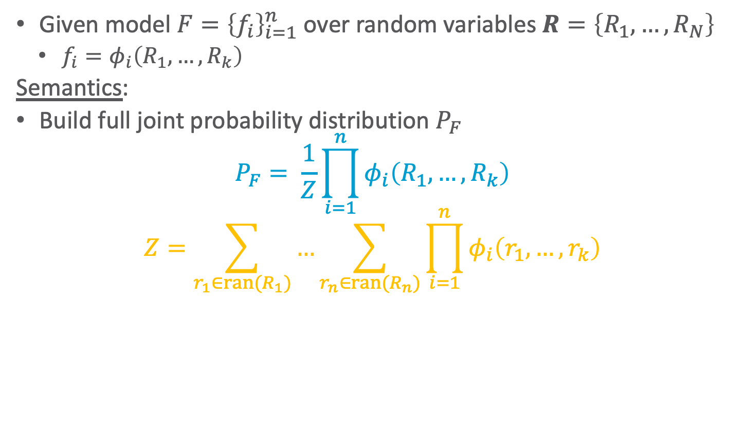
Model Representation: Factors
Given model $F={\left\{f_{i}\right\}}_{i=1}^{n}$ over random variables $R=\left\{R_{1}, …, R_{N}\right\}$
  $f_{i}=φ_{i}\left(R_{1},…, R_{k}\right)$
Semantics:
Build full joint probability distribution $P_{F}$
  $$P_{F}= \frac{1}{Z}\prod_{i=1}^{n}{φ_{i}\left(R_{1},…, R_{k}\right)}$$
  $$Z=\sum_{r_{1}∈ran(R_{1})}{…\sum_{r_{n}∈ran(R_{n})}{\prod_{i=1}^{n}{φ_{i}\left(r_{1},…, r_{k}\right)}}}$$
$$Nat$$
$$Acc$$
$$f_{1}$$
$$Epid$$
$$f_{0}$$
$$Travel$$
$$Treat$$
$$f_{2}$$
$$f_{3}$$
$$Sick$$

Slide 27
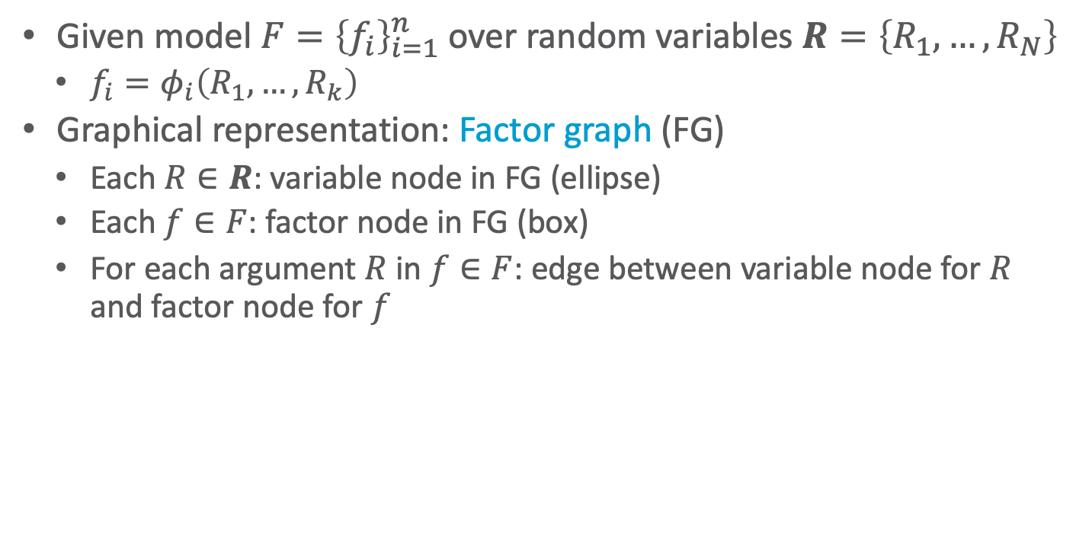
Model Representation: Factors
Given model $F={\left\{f_{i}\right\}}_{i=1}^{n}$ over random variables $R=\left\{R_{1}, …, R_{N}\right\}$
  $f_{i}=φ_{i}\left(R_{1},…, R_{k}\right)$
Graphical representation: Factor graph (FG)
  Each $R∈R$: variable node in FG (ellipse)
  Each $f∈F$: factor node in FG (box)
  For each argument $R$ in $f∈F$: edge between variable node for $R$ and factor node for $f$
$$Nat$$
$$Acc$$
$$f_{1}$$
$$Epid$$
$$f_{0}$$
$$Travel$$
$$Treat$$
$$f_{2}$$
$$f_{3}$$
$$Sick$$

Slide 28

Other Model Representations
Markov network (MN)
  Alternative graphical representation of a factor-based model
  Undirected graph
  Factors: potential function for each clique in graph
    If given a set of factors: add an edge between all random variables that occur together in a factor
    With further information or the factors themselves, not clear what factors a model actually has just from an MN ➝ disadvantage!
  Semantics: Product of all factors, normalisation to get full joint
  Neighbourhood directly defined between variables (not with factor nodes in between) ➝ easier analysis (advantage)
MNs and factor graphs have equivalent expressiveness
$$Epid$$
$$Travel$$
$$Sick$$
$$Epid$$
$$Travel$$
$$Sick$$

Slide 29




Other Model Representations
Bayesian network (BN)
  Directed acyclic graph
    Explicit representation of (conditional) independences
    Cannot model bidirectional influences ➝ disadvantage!
  Factors: set of probability distributions, one for each node
    Prior probability tables for roots $R$: $P\left(R\right)$
    Conditional probability tables (CPTs) for all other nodes $N$ given its parents $Pa\left(N\right)$: $P\left(N | Pa\left(N\right)\right)$
  Semantics
    Product of tables, $Z=1$ as tables are all probability distributions ➝ advantage!
Which distributions does the BN have
$$P\left(Epid\right)$$
$$Epid$$
$$Travel$$
$$Sick$$
$$P\left(Travel | Epid\right)$$
$$P\left(Sick | Epid\right)$$
$$Epid$$
$$Travel$$
$$Sick$$

Slide 30

Space Complexity
Given model $F={\left\{f_{i}\right\}}_{i=1}^{n}$ over random variables $R$
Space complexity: $O\left(n∙r^{k}\right)$
  $r=\max_{R∈R}\left|ran(R)\right|$
  $k=\max_{f∈F}\left|rv\left(f\right)\right|$
  Derivation:
  $$\sum_{f∈F}{\prod_{R∈rv\left(f\right)}{\left|ran\left(R\right)\right|}}≤\sum_{f∈F}{\prod_{R∈rv\left(f\right)}{r}}=\sum_{f∈F}{r^{\left|rvs\left(f\right)\right|}}≤\sum_{f∈F}{r^{\max_{f∈F}\left|rvs\left(f\right)\right|}}=\sum_{f∈F}{r^{k}}=n∙r^{k}$$
  No longer exponential in $N=\left|R\right|$, but in $k$
    If $k≪N$, $n$ not depending exponentially on $N$: $O\left(n∙r^{k}\right)≪O\left(r^{N}\right)$
$$Nat$$
$$Acc$$
$$f_{1}$$
$$Epid$$
$$f_{0}$$
$$Travel$$
$$Treat$$
$$f_{2}$$
$$f_{3}$$
$$Sick$$
Notes:
As in example: ${r=2, n=3, r^{n}=2}^{3}=8, 2∙2∙2=8$
If one variable range size 3: ${r=3, n=3, r^{n}=3}^{3}=27, 3∙2∙2=12$

Slide 31

Interim Summary
Inference tasks: Answer query for (conditional) marginal probability (distribution)
  Full joint: Exponential dependence on number of random variables (space, runtime) ➝ $O\left(r^{N}\right)$
Factorised model
  Use (conditional) independences for factorisation: $P\left(R,S|T\right)=P\left(R|T\right)∙P\left(S|T\right)$
    Independence: $T=∅$
  Model = set of factors
    Factor graphs, Markov network, Bayesian network, Markov properties (briefly)
  Reduces space complexity ➝ $O\left(n∙r^{k}\right)$

Slide 32












Correctness
$$Q_{1}$$
…
$$Q_{m}$$
…
$$N_{n}$$
$$R$$
$$N_{1}$$
$$T_{1j}$$
$$R$$
$$T_{nj}$$
$$N_{3}$$
$$N_{2}$$
$$S_{1}$$
…
$$S_{n}$$
Why can we represent the factorised distribution
in a graph structure with cliques over factors?

Slide 33

Conditional Independences in the Graph Structure
Graphs allows for reading of (conditional) independences
Given a model $F$ over random variables $R$
Local independences in $F$
Each $R∈R$ is independent of all other random variables given its neighbourhood, i.e.,
$$\left\{\left(R⊥R^{′} | Nb\left(R\right)\right) | R∈R∧R^{′}=\left(R∖\left\{R\right\}\right)∖Nb\left(R\right)\right\}$$
Neighbourhood blocks all paths to non-neighbours
Neighbourhood also called Markov blanket: $MB\left(R\right)=Nb\left(R\right)$
  With analogue definition of local independences:
  $$\left\{\left(R⊥R^{′} | MB\left(R\right)\right) | R∈R∧R^{′}=\left(R∖\left\{R\right\}\right)∖MB\left(R\right)\right\}$$
$$Epid$$
$$Travel$$
$$Sick$$
$$Epid$$
$$Travel$$
$$Sick$$

Slide 34

Further Conditional Independences in the Graph Structure
Given a model $F$ over random variables $R$
Pairwise independences in $F$
Each pair of non-neighbours $R_{i}, R_{j}∈R$ is independent given all other random variables, i.e.,
$$\left\{\left(R_{i}⊥R_{j} | R^{′}\right) | R_{i}, R_{j}∈R∧\left\{R_{i}, R_{j}\right\}∉E∧R^{′}=R∖\left\{R_{i}, R_{j}\right\}\right\}$$
If conditioning on all remaining variables, all paths between $R_{i}, R_{j}$ must be blocked
Weaker statement than local independences
$$Epid$$
$$Travel$$
$$Sick$$
Why?
$$Epid$$
$$Travel$$
$$Sick$$
Notes:
Neighbourhood is enough (not all variables necessary)

Slide 35

Further Conditional Independences in the Graph Structure
Given a model $F$ over random variables $R$ with MN $\left(V,E\right)$
Active paths
  Given a set $S⊆R$, path $R_{1}\text{—}…\text{—}R_{k}$ in $\left(V,E\right)$ is active given $S$, if no $R_{i}, i∈\left\{1,…,k\right\}$ in $S$ is, i.e.: $∀ i∈\left\{1,…,k\right\} :R_{i}∉S$
  That is, a path is inactive given $S$ if at least one $R_{i}$ is in $S$
Separation (also called m-Separation after Markov)
  A set $S$ separates two sets $T,U$ in $\left(V,E\right)$ if there is no active path between any variable $T∈T$ and any variable $U∈U$ given $S$
    That is, all paths between the variables in $T,U$ have to be inactive given $S$
      On each path between $T,U$, there must be an $R_{i}$ that is in $S$
    Denoted by $sep\left(T;U | S\right)$
    $S$ also called separator
$$Epid$$
$$Travel$$
$$Sick$$
$$Epid$$
$$Travel$$
$$Sick$$
Notes:
Neighbourhood is enough (not all variables necessary)

Slide 36


Further Conditioanal Independences in the Graph Structure
Given a model $F$ over random variables $R$ with MN $\left(V,E\right)$
Global independences in $F$:
$$\left\{\left(T⊥U | S\right) | sep\left(T;U | S\right)\right\}$$
Proof: Given $sep\left(T;U | S\right)$, does $\left(T⊥U | S\right)$ hold?
  Initially: $T∪U∪S=R$
    As $S$ is a separator between $T$ and $U$, there are no direct edges between $T$ and $U$
    As such, each clique in $\left(V,E\right)$ (i.e., each factor in $F$) either in $T∪S$ or in $U∪S$
    With $F_{T}$ the set of factors, whose cliques are in $T∪S$, and $F_{U}$ the remaining factors
      $$P_{F}=\frac{1}{Z}\prod_{f∈F}{f}=\frac{1}{Z}\prod_{f∈F_{T}}{f}∙\prod_{g∈F_{U}}{g}=\frac{1}{Z}f\left(T,S\right)∙g\left(U,S\right)$$
      As factors in $F_{T}$ do not contain variables from $U$ and factors in $F_{U}$ not from $T$, the factor product can be split into a factor over $T∪S$ and a factor over $U∪S$
    Given the factorisation $f\left(T,S\right)∙g\left(U,S\right)$, $\left(T⊥U | S\right)$ holds (Bayes Theorem, def. of cond. indep.)
$$=\frac{1}{Z}f\left(T,S\right)∙g\left(U,S\right)$$
Notes:
Impliziert die Faktorisierung, die zu der Graphstruktur bzw. den Separatoren darin führt, die Unabhängigkeiten in der Verteilung?

Slide 37

Further Conditioanal Independences in the Graph Structure
Given a model $F$ over random variables $R$ with MN $\left(V,E\right)$
Global independences in $F$:
$$\left\{\left(T⊥U | S\right) | sep\left(T;U | S\right)\right\}$$
Proof: Given $sep\left(T;U | S\right)$, does $\left(T⊥U | S\right)$ hold?
  In general: $T∪U∪S⊂R$ with $V=R∖\left(T∪U∪S\right)$
    $V$ can be split into two sets $V_{1},V_{2}$ such that $S$ is a separator between $T∪V_{1}$ and $U∪V_{2}$
    Afterwards, the initial argument holds:
    With $F_{T}$ the set of factors with its cliques in $T∪V_{1}∪S$, and $F_{U}$ the remaining factors
    $$P_{F}=\frac{1}{Z}\prod_{f∈F}{f}=\frac{1}{Z}\prod_{f∈F_{T}}{f}∙\prod_{g∈F_{U}}{g}=\frac{1}{Z}f\left(T,V_{1},S\right)∙g\left(U,V_{2}, S\right)$$
    Decomposition rule of conditional independences $\left(A⊥B,C | D\right)⇒\left(A⊥B| D\right)$ ➝ $\left(T⊥U | S\right)$ holds
Monotone: if $sep\left(T;U | S\right)$ holds, then $sep\left(T;U | S′\right)$ holds for all $S′⊇S$
Notes:
Aufteilung möglich, da sonst S kein Separator wäre zwischen T und U bzw. sonst Teile von V schon in T, U oder S drin wären und damit nicht (mehr) in V

Slide 38


















Example: Independences in Factor Models
  Pairwise: $\left(R_{i}⊥R_{j} | R^{′}\right),R^{′}=R∖\left\{R_{i},R_{j}\right\}$
  Local: $\left(R⊥R^{′} | MB\left(R\right)\right),R^{′}=R∖MB\left(R\right)∖\left\{R\right\}$
  Global: $\left\{\left(T⊥U | S\right) | sep\left(T;U | S\right)\right\}$
Pairwise independences:
  $NatDis⊥Travel | \left\{Artif,Epid,Treat,Sick\right\}$
    $NatDis$ with $Artif$ exchangeable
    $Travel$ with $Treat,Sick$ exchangeable
  $Treat⊥Travel | \left\{NatDis,Artif,Epid,Sick\right\}$
  $Epid$ has no non-neighbours
Local independences
  $NatDis⊥\left\{Travel,Treat,Sick\right\} | \left\{Artif,Epid\right\}$
    $NatDis$ with $Artif$ exchangeable
  $Treat⊥\left\{NatDis,Artif,Travel\right\} | \left\{Epid,Sick\right\}$
    $Treat$ with $Travel$ exchangeable
  $Sick⊥\left\{NatDis,Artif\right\} | \left\{Epid,Travel,Treat\right\}$
$$NatDis$$
$$Artif$$
$$NatDis$$
$$Artif$$
$$f_{1}$$
$$Epid$$
$$Epid$$
$$f_{0}$$
$$Travel$$
$$Treat$$
$$Travel$$
$$Treat$$
$$f_{2}=f$$
$$f_{3}$$
$$Sick$$
$$Sick$$

Slide 39

Example: Independences in Factor Models
Global independences:
  Pairwise and local independences can be mapped on $\left\{\left(T⊥U | S\right) | sep\left(T;U | S\right)\right\}$
  $\left\{NatDis,Artif\right\}⊥\left\{Travel ,Treat,Sick\right\} | Epid$
    Decomposition: Subsets of $\left\{NatDis,Artif\right\}$ and $\left\{Travel ,Treat,Sick\right\}$ possible
      Monotone ➝ Set right of $|$ extendable
  Set of representative independences, from which we can infer all other independences:
    $\left\{NatDis,Artif\right\}⊥\left\{Travel ,Treat,Sick\right\} | Epid$
    $Treat⊥Travel | \left\{Epid,Sick\right\}$
  Pairwise: $\left(R_{i}⊥R_{j} | R^{′}\right),R^{′}=R∖\left\{R_{i},R_{j}\right\}$
  Local: $\left(R⊥R^{′} | MB\left(R\right)\right),R^{′}=R∖MB\left(R\right)∖\left\{R\right\}$
  Global: $\left\{\left(T⊥U | S\right) | sep\left(T;U | S\right)\right\}$
$$NatDis$$
$$Artif$$
$$NatDis$$
$$Artif$$
$$f_{1}$$
$$Epid$$
$$Epid$$
$$f_{0}$$
$$Travel$$
$$Treat$$
$$Travel$$
$$Treat$$
$$f_{2}=f$$
$$f_{3}$$
$$Sick$$
$$Sick$$

Slide 40




Conditional Independences in BNs
BNs encode local independences as follows:
  For each random variable $R∈R$, $R$ is independent from its non-descendants given its parents, i.e.,
  $$\left(R⊥Ndesc\left(R\right) | Pa\left(R\right)\right)$$
Why is it different from factor models?
  Compare: In a factor model, each $R∈R$ is independent of all other random variables given its neighbourhood, i.e.,
  $$\left(R⊥R^{′} | Nb\left(R\right)\right) \text{or} \left(R⊥R^{′} | MB\left(R\right)\right)$$
    $R∈R,R^{′}=\left(R∖\left\{R\right\}\right)∖Nb\left(R\right)$
$$P\left(Epid\right)$$
$$Epid$$
$$Travel$$
$$Sick$$
$$P\left(Travel | Epid\right)$$
$$P\left(Sick | Epid\right)$$
$$Epid$$
$$Travel$$
$$Sick$$

Slide 41













Influences in BNs
Direct edge: Direct influence
Indirect connection: Case distinction
  Indirect causal effect
  Indirect evidential effect
  Common cause
  Common effect ➝ v-structure
Given by local independences
  Case a-c: $R$ influences $S$ via $T$, but only if $T$ is not observed
  Case d: If $T$ not observed, $R$ and $S$ independent
    If $T$ observed, $R$ and $S$ are dependent
      Value $z$ has to happen through $R$ or $S$
  Statements also hold in larger nets with more nodes on the path between $R$, $S$
    Case d: neither $T$ nor a descendent observed
$$R$$
$$S$$
$$T$$
$$T$$
$$T$$
$$R$$
v
$$S$$
Statements for BNs regarding pairweise, local, and global independences need to consider v-structures
$$S$$
$$R$$
$$R$$
$$S$$
$$T$$
a.
b.
c.
d.

Slide 42

Conditional Independences in BNs
Given a BN $B$ over random variables $R$
Markov blanket in BNs:
Parents, children and all other parents of children, i.e.,
$$MB\left(R\right)=Pa\left(R\right)∪Ch\left(R\right)∪\bigcup_{R^{′}∈Ch\left(R\right)}{Pa\left(R^{′}\right)}∖\left\{R\right\}$$
Local independences in $B$ analogue to an MN:
Each $R∈R$ is independent of all other random variables given its Markov blanket, i.e.,
$$\left\{\left(R⊥R^{′} | MB\left(R\right)\right) | R∈R∧R^{′}=R∖\left\{R\right\}∖MB\left(R\right)\right\}$$
  Markov blanket blocks all paths, including v-structures
Includes all v-structures
Notes:
Analoge Definition von lokalen Unabhängigkeiten

Slide 43








Illustration of Local Independences in MNs and BNs
$$Q_{1}$$
…
$$Q_{m}$$
Markov blanket of a random variable $R$
  in a factor model:
    Set of direct neighbours $N_{i}$ of $R$ in MN
  in a BN:
    Union of
      Parents $Q_{k}$ of $R$
      Children $S_{i}$ of $R$
      Parents $T_{ij}$ of children $S_{i}$ that are not $R$
$R$ conditionally independent of all other variables in the model given its Markov blanket as separator
  In BNs, given parents as separators, then independent of all non-descendants
…
$$N_{n}$$
$$R$$
$$N_{1}$$
$$T_{1j}$$
$$R$$
$$T_{nj}$$
$$N_{3}$$
$$N_{2}$$
$$S_{1}$$
…
$$S_{n}$$
Neighbours
$$Q_{1}$$
…
$$Q_{m}$$
Separators
$$T_{1j}$$
$$R$$
$$T_{nj}$$
$$S_{1}$$
…
$$S_{n}$$
Notes:
v-Struktur Abhängigkeit bedingt, dass wir die Eltern der Kinder brauchen
Würden im MN zu Nachbarn werden ➝ damit quasi das gleiche im MB

Slide 44

Conditional Independences in BNs
Given a BN $B$ over random variables $R$
Pairwise independences in $B$:
  Usually not considered for BNs
  Usual definition: two non-neighbours $R_{i}, R_{j}∈R$ independent given all other variables $R^{′}$
    Common descendant $R^{′}$ between two non-neighbours $R_{i}, R_{j}∈R$ would make $R_{i}, R_{j}$ dependent and would be included in $R^{′}$
  That is, definition would need to exclude v-structures
  Statement would be possible if
    Only considering $R_{i}, R_{j}$ that do not have a common descendant or
    Excluding common descendants from $R^{′}$
Notes:
Lokale Unabhängigkeiten: es reicht die Nachbarschaft aus, um die Pfade zu blocken

Slide 45

Conditional Independences in BNs
Given disjoint sets $S,T,U$ of random variables $B$
Active connection between two random variables $T,U$
  Connection: undirected path between $T,U$
  Connection between $T,U$ is active given $S$ if
    If there is a v-structure $R_{i−1}→R_{i}←R_{i+1}$ on the connection, than $R_{i}$ or a descendant of $R_{i}$ is in $S$
    No further node of the connection is in $S$
Directed separation (d-separation)
  $T$ and $U$ are d-separated given $S$ if there is no active connection between any variable $T∈T$ and any variable $U∈U$ given $S$, denoted by $d\text{−}sep\left(T;U | S\right)$
Global independences that hold in $B$ and $P_{B}$ respectively*
$$\left\{\left(T⊥U | S\right) |d\text{−}sep\left(T;U | S\right)\right\}$$
Includes all
v-structures
*Without proof
For interested parties: Section 4.5.1 in the PGM book

Slide 46

Conditional Independences
Connection between the independences
  Pairwise: $\left(R_{i}⊥R_{j} | R^{′}\right),R^{′}=R∖\left\{R_{i},R_{j}\right\}$ in MNs
  Local: $\left(R⊥R^{′} | MB\left(R\right)\right), R^{′}=R∖MB\left(R\right)∖\left\{R\right\}$
  Global: $\left\{\left(T⊥U | S\right) | sep\left(T;U | S\right)\right\}$ or $\left\{\left(T⊥U | S\right) | d\text{−}sep\left(T;U | S\right)\right\}$
  Equivalent in strictly positive distributions
    Strictly positive: $P\left(ω\right)>0$ for all $ω∈Val\left(R\right)$
    Otherwise, a conditional probability might not be defined because the divisor might be $0$
Pairwise, local, and global independences sometimes also called
pairwise, local, and global Markov property

Slide 47


Conditional Independences
Hammersley-Clifford Theorem
  $P$ fulfils one of the Markov properties with respect to an undirect graph if and only if $P$ can be factorised over the cliques of the graph
    If $P$ fulfils a Markov property, then $P$ can be factorised over the cliques
    If the factorisation of $P$ can be represented using the cliques of the graph, than the graph fulfils the Markov properties
The theorem does not state that the factorisation is unique nor how to find such a factorisation
Figure: Screenshot of the first page of the Hammersley und Clifford manuscript
Reference: John Hammersley and Peter Clifford: Markov Fields on Finite Graphs and Lattices. Unpublished, 1971.

Slide 48

















Turning BNs into Factor Models
Each CPD $P\left(R | Pa\left(R\right)\right)$ becomes a factor $φ\left(R,Pa\left(R\right)\right)$
  Effect: Conditional probability hidden in factor
Effect on graph structure
  All parent nodes get directly connected
    Moralising the graph: Make edges undirected and connect all former parents through direct edges
  As such, explicit representation of independences due to v-structures gets lost
    In example,
      Independence of $Burglary,Error, Earthquake$ if $Alarm,JohnCall,MaryCall$ not given
      Independence of $Alarm,TV$ if $JohnCall$ not given and of $Alarm,Nap$ if $MaryCall$ not given
$$Error$$
$$Burglary$$
$$Earthquake$$
$$TV$$
$$Alarm$$
$$Nap$$
$$JohnCall$$
$$MaryCall$$
$$Error$$
$$Burglary$$
$$Earthquake$$
$$TV$$
$$Alarm$$
$$Nap$$
$$JohnCall$$
$$MaryCall$$
Notes:
Unabhängigkeit verloren: Wurzelknoten sind unabhängig von Kindknoten nicht gegeben

Slide 49

Turning BNs into Factor Models
No explicit representation of independences gets lost if BN is a moral graph
  BN $B=\left(V,E\right)$ is a moral graph if all pairs of parents of a child node are already connected by an edge
  Formally, for each $R_{i},R_{j}∈V$ with $R_{i},R_{j}∈Pa\left(R_{k}\right)$ for any $R_{k}∈V$, it holds that $\left(R_{i},R_{j}\right)∈E∨\left(R_{j},R_{i}\right)∈E$
If a BN $B=\left(V,E\right)$ is a moral graph, then there exists a factor model $F$ with an MN $\left(V,E^{′}\right)$ such that the independences are equal
  Because then connecting all parents in the graph does not add any edge and thus no independences get lost
$$Error$$
$$Burglary$$
$$Earthquake$$
$$TV$$
$$Alarm$$
$$Nap$$
$$JohnCall$$
$$MaryCall$$
$$Error$$
$$Burglary$$
$$Earthquake$$
$$TV$$
$$Alarm$$
$$Nap$$
$$JohnCall$$
$$MaryCall$$
Notes:
Zum Beispiel wenn Error auch auf Burglary und Earthquake zeigen würde

Slide 50













The Other Direction: Turning Factor Models into BNs
Informally: Given an ordering, add nodes to the BN and add an edge whenever there is a dependence in the MN between the already added nodes and the new one
  Example: $A,B,C,D,E,F$
    Add $A$
    Add $B$, $B$ dependent on $A$ in MN ➝ edge
    Add $C$, $C$ dependent on $A$ in MN ➝ edge
      But $C$ also dependent of $B$ through $E,F,D$ ➝ edge
    Add $D$, $D$ dependent on $B$, $C$ ➝ edges
    Add $E$, $E$ dependent on $C$, $D$ ➝ edges
    Add $F$, $F$ dependent on $D,E$ ➝ edges
$$A$$
$$A$$
$$B$$
$$C$$
$$B$$
$$C$$
$$D$$
$$E$$
$$D$$
$$E$$
$$F$$
$$F$$
Transforming an MN into a BN usually leads to adding much more edges to the BN than the MN contained and as such, leads to losing the explicit representation of independences

Slide 51






The Other Direction: Turning Factor Models into BNs
Transformation is called triangulation of the MN
  All cycles are partitioned into triangles
  Result is always a chordal graph
    Chordal / triangulated: All cylces with at least four nodes have a chord
      Chord: Edge that is not part of the cycle but connects two nodes of the cylce
If an MN is chordal, then there is a BN that represents the same independences
$$A$$
$$A$$
$$B$$
$$C$$
$$B$$
$$C$$
$$D$$
$$E$$
$$D$$
$$E$$
$$F$$
$$F$$
$$NatDis$$
$$Artif$$
What about this graph?
$$Epid$$
Stronger statement: An MN and a BN represent the same independences if and only if the undirected graph is chordal.
$$Travel$$
$$Treat$$
$$Sick$$
Notes:
Frage: Chordal

Slide 52










































The Other Direction: Turning Factor Models into BNs
$$NatDis$$
$$Artif$$
Example: Chordal MN
  Results given different orderings
    Not all orders possible as some add more edges, then independences get lost: $Treat⊥Travel | Epid,Sick$
$$Epid$$
$$Travel$$
$$Treat$$
$$Sick$$
$$NatDis$$
$$Artif$$
$$NatDis$$
$$Artif$$
$$NatDis$$
$$Artif$$
$$NatDis$$
$$Artif$$
$$NatDis$$
$$Artif$$
$$Epid$$
$$Epid$$
$$Epid$$
$$Epid$$
$$Epid$$
$$Travel$$
$$Treat$$
$$Travel$$
$$Treat$$
$$Travel$$
$$Treat$$
$$Travel$$
$$Treat$$
$$Travel$$
$$Treat$$
$$Sick$$
$$Sick$$
$$Sick$$
$$Sick$$
$$Sick$$
$$N,A,E,S,Tl,Tt$$
$$N,A,E,Tl,S,Tt$$
$$N,A,E,Tl,Tt,S$$
$$E,N,A,S,Tl,Tt$$
$$S,Tl,Tt,E,N,A$$

Slide 53























Factors to CPDs
Turning a chordal MN into a BN relatively simple
However, number of CPDs can increase compared to number of factors:
  Example:
    In factor model, four factors $f_{0},f_{1},f_{2},f_{3}$
    In BN, six CPDs $P\left(E\right)$, $P\left(N | E\right)$, $P\left(A | N,E\right)$, $P\left(S | E\right)$, $P\left(Tl | E,S\right)$, $P\left(Tt | E,S\right)$
Get CPDs by asking queries in factor model
  Queries: $P\left(E\right)$, $P\left(N | E\right)$, $P\left(A | N,E\right)$, $P\left(S | E\right)$, $P\left(Tl | E,S\right)$, $P\left(Tt | E,S\right)$
$$NatDis$$
$$Artif$$
$$NatDis$$
$$Artif$$
$$Epid$$
$$Epid$$
$$Travel$$
$$Treat$$
$$Travel$$
$$Treat$$
$$Sick$$
$$Sick$$
$$NatDis$$
$$Artif$$
$$f_{1}$$
$$Epid$$
$$f_{0}$$
$$Travel$$
$$Treat$$
$$f_{2}=f$$
$$f_{3}$$
$$Sick$$
$$E≜Epid,N≜NatDis,A≜Artif,S≜Sick,Tr≜Travel,Tt≜Treat$$

Slide 54
Interim Summary
Pairwise, local, and global independences / Markov properties
  Equivalent in strictly positive distributions
  v-structures in BNs
    Changes to Markov blanket definition
    Result in losing explicit representation of independences if turning a BN into a factor model
Hammersley-Clifford Theorem: there is a factorisation if and only if one of the Markov properties holds
Turning BNs into MNs by moralisation, turning MNs into BNs by triangulation
  Equivalent representation of independences if undirected graph is chordal
  If no edges get added during transformation, then represented independences are identical

Slide 55
Overview: 2. Modelling Formalisms
Logic
  Propositional logic: alphabet, grammar, normal forms, rules
  First-order logic: introducing quantifiers, domain constraints
Probabilistic Graphical Models (PGMs)
  Syntax, semantics, inference problems
  Correctness
Probabilistic Relational Models (PRMs)
  Parfactor models (PMs): motivation, syntax, semantics, graphical representation, inference tasks
  Markov logic networks (MLNs): Syntax, semantics of MLNs, graphical representation
  Turning MLNs into PMs and vice versa

Slide 56





Appendix
$$Epid$$ | $$Travel$$ | $$P$$
$$false$$ | $$false$$ | $$0.10$$
$$false$$ | $$true$$ | $$0.20$$
$$true$$ | $$false$$ | $$0.30$$
$$true$$ | $$true$$ | $$0.40$$
$$Travel$$ | $$Sick$$ | $$P$$
$$false$$ | $$false$$ | $$0.25$$
$$false$$ | $$true$$ | $$0.30$$
$$true$$ | $$false$$ | $$0.35$$
$$true$$ | $$true$$ | $$0.10$$
$$∙$$
$$Epid$$ | $$Travel$$ | $$Sick$$ | $$P$$
$$false$$ | $$false$$ | $$false$$ | $$0.10∙0.25$$
$$false$$ | $$false$$ | $$true$$ | $$0.10∙0.30$$
Multiplication example

Slide 57




Excursion: Multiplication
Join over arguments + product of probabilities:
  $$φ\left(R_{1},…,R_{l}\right)=φ_{1}\left(R_{11},…, R_{1k}\right)∙φ_{2}\left(R_{21},…, R_{2m}\right)$$
  $\left\{R_{1},…,R_{l}\right\}=\left\{R_{11},…, R_{1k}\right\}∪\left\{R_{21},…, R_{2m}\right\}$
  No common arguments
  = cross product of ranges
  E.g.,
  $$P\left(Epid,Travel\right)∙P\left(Travel,Sick\right)$$
$$Epid$$ | $$Travel$$ | $$P$$
$$false$$ | $$false$$ | $$0.10$$
$$false$$ | $$true$$ | $$0.20$$
$$true$$ | $$false$$ | $$0.30$$
$$true$$ | $$true$$ | $$0.40$$
$$Travel$$ | $$Sick$$ | $$P$$
$$false$$ | $$false$$ | $$0.25$$
$$false$$ | $$true$$ | $$0.30$$
$$true$$ | $$false$$ | $$0.35$$
$$true$$ | $$true$$ | $$0.10$$
$$∙$$
$$Epid$$ | $$Travel$$ | $$Sick$$ | $$P$$
$$false$$ | $$false$$ | $$false$$ | $$0.10∙0.25$$

Slide 58
Excursion: Multiplication
Join over arguments + product of probabilities:
  $$φ\left(R_{1},…,R_{l}\right)=φ_{1}\left(R_{11},…, R_{1k}\right)∙φ_{2}\left(R_{21},…, R_{2m}\right)$$
  $\left\{R_{1},…,R_{l}\right\}=\left\{R_{11},…, R_{1k}\right\}∪\left\{R_{21},…, R_{2m}\right\}$
  No common arguments
  = cross product of ranges
  E.g.,
  $$P\left(Epid,Travel\right)∙P\left(Travel,Sick\right)$$
$$Epid$$ | $$Travel$$ | $$P$$
$$false$$ | $$false$$ | $$0.10$$
$$false$$ | $$true$$ | $$0.20$$
$$true$$ | $$false$$ | $$0.30$$
$$true$$ | $$true$$ | $$0.40$$
$$Travel$$ | $$Sick$$ | $$P$$
$$false$$ | $$false$$ | $$0.25$$
$$false$$ | $$true$$ | $$0.30$$
$$true$$ | $$false$$ | $$0.35$$
$$true$$ | $$true$$ | $$0.10$$
$$∙$$
$$Epid$$ | $$Travel$$ | $$Sick$$ | $$P$$
$$false$$ | $$false$$ | $$false$$ | $$0.10∙0.25$$
$$false$$ | $$false$$ | $$true$$ | $$0.10∙0.30$$

Slide 59


Excursion: Multiplication
Join over arguments + product of probabilities:
  $$φ\left(R_{1},…,R_{l}\right)=φ_{1}\left(R_{11},…, R_{1k}\right)∙φ_{2}\left(R_{21},…, R_{2m}\right)$$
  $\left\{R_{1},…,R_{l}\right\}=\left\{R_{11},…, R_{1k}\right\}∪\left\{R_{21},…, R_{2m}\right\}$
  No common arguments
  = cross product of ranges
  E.g.,
  $$P\left(Epid,Travel\right)∙P\left(Travel,Sick\right)$$
$$Epid$$ | $$Travel$$ | $$P$$
$$false$$ | $$false$$ | $$0.10$$
$$false$$ | $$true$$ | $$0.20$$
$$true$$ | $$false$$ | $$0.30$$
$$true$$ | $$true$$ | $$0.40$$
$$Travel$$ | $$Sick$$ | $$P$$
$$false$$ | $$false$$ | $$0.25$$
$$false$$ | $$true$$ | $$0.30$$
$$true$$ | $$false$$ | $$0.35$$
$$true$$ | $$true$$ | $$0.10$$
$$∙$$
$$Epid$$ | $$Travel$$ | $$Sick$$ | $$P$$
$$false$$ | $$false$$ | $$false$$ | $$0.10∙0.25$$
$$false$$ | $$false$$ | $$true$$ | $$0.10∙0.30$$
$$false$$ | $$true$$ | $$false$$ | $$0.20∙0.35$$
$$⋮$$

