Slide 1
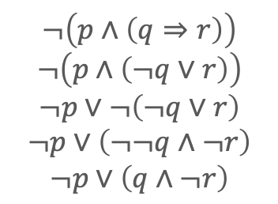
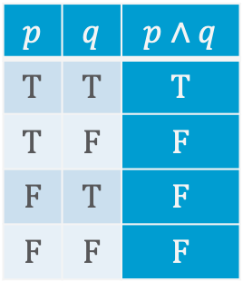
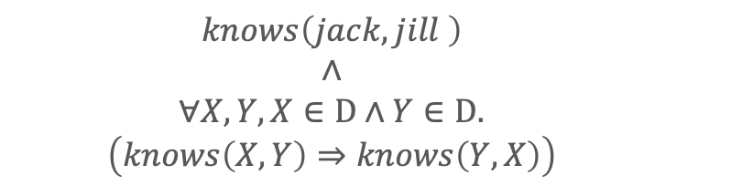
Modelling Formalisms:
Logic
$$p$$ | $$q$$ | $$p∧q$$
$$T$$ | $$T$$ | $$T$$
$$T$$ | $$F$$ | $$F$$
$$F$$ | $$T$$ | $$F$$
$$F$$ | $$F$$ | $$F$$
$$¬\left(p∧\left(q⇒r\right)\right)$$
$$¬\left(p∧\left(¬q∨r\right)\right)$$
$$¬p∨¬\left(¬q∨r\right)$$
$$¬p∨\left(¬¬q∧¬r\right)$$
$$¬p∨\left(q∧¬r\right)$$
Statistical Relational Artificial Intelligence
(StaRAI)
    $$knows\left(jack, jill \right)$$
    $$∧$$
    $$∀X,Y,X∈D∧Y∈D.$$
    $$\left(knows\left(X,Y\right)⇒knows\left(Y,X\right)\right)$$
Tanya Braun

Slide 2
Contents
Introduction
  Notions of AI, agents, StaRAI
Modelling Formalisms
  Logic
  Probabilistic Graphical Models (PGMs)
  Probabilistic Relational Models (PRMs)
  Syntax, semantics, inference tasks
Inference
  Exact Inference
    (Weighted) Model Counting
    Variable Elimination
    Lifted Inference
  Approximate Inference
  Inference algorithms
Learning
  Relation learning in logic
  Parameter / structure learning for PGMs
  From PGMs to PRMs, PRM learning
Sequential Models and Inference
  Syntax, semantics, inference tasks, algorithms
Decision-theoretic Models and Inference
  Preferences, utility
  Syntax, semantics, inference task, algorithm

Slide 3
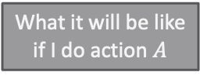
Contents in this Lecture Related to Utility-based Agents
Further topics
  Modelling formalisms
  Inference (in episodic models)
  Learning (of episodic models)
  Sequential models and inference
  Decision-theoretic models and inference
Agent
Environment
Sensors
State
What the world
is like now
How the world evolves
What my actions do
What it will be like
if I do action $A$
Utility
How happy I will be
in such a state
What action I
should do now
Actuators

Slide 4
Overview: 2. Modelling Formalisms
Logic
  Propositional logic: alphabet, grammar, normal forms, rules
  First-order logic: introducing quantifiers, domain constraints
Probabilistic Graphical Models (PGMs)
  Syntax, semantics, inference problems
  Correctness
Probabilistic Relational Models (PRMs)
  Parfactor models (PMs): motivation, syntax, semantics, graphical representation, inference tasks
  Markov logic networks (MLNs): Syntax, semantics of MLNs, graphical representation
  Turning MLNs into PMs and vice versa

Slide 5
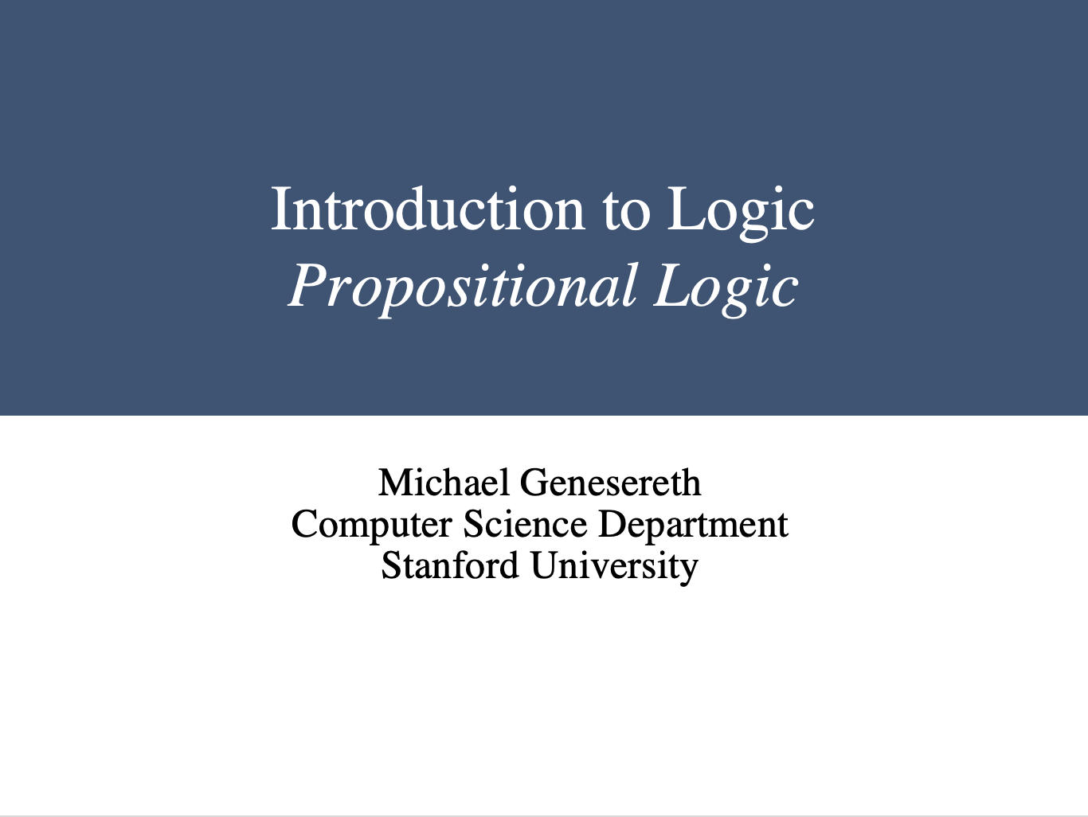
Sources
Slides based on the lecture “Introduction to Logic” by Michael Genesereth at Stanford University, which has a book: “Introduction to Logic” by Michael Genesereth & Eric J. Kao

Slide 6
Logic
Logic for natural language modelling, hardware + software engineering, games etc.
Describe hard constraints about a world
Components
  Logical language
  Logical reasoning
Andy likes Cody.
Abby does not like Dana.
Bess likes everyone that Bess likes.
Dana does not like Abby.
Bess likes Cody or Dana.
Premises:
Dana likes Cody.
Abby does not like Dana.
Everybody likes somebody.
Bess likes Cody or Dana.
Abby likes everyone that Bess likes.
Cody likes everyone who likes her.
Nobody likes herself.
Truths:
Bess likes Cody.
Bess does not like Dana.
Everybody likes someone.
Falsehoods:
Bess likes Dana.
Everybody likes everybody.
Unknowns:
Dana likes Bess.
Rules of inference
Soundness and completeness
Model checking (enumeration of cases)

Slide 7
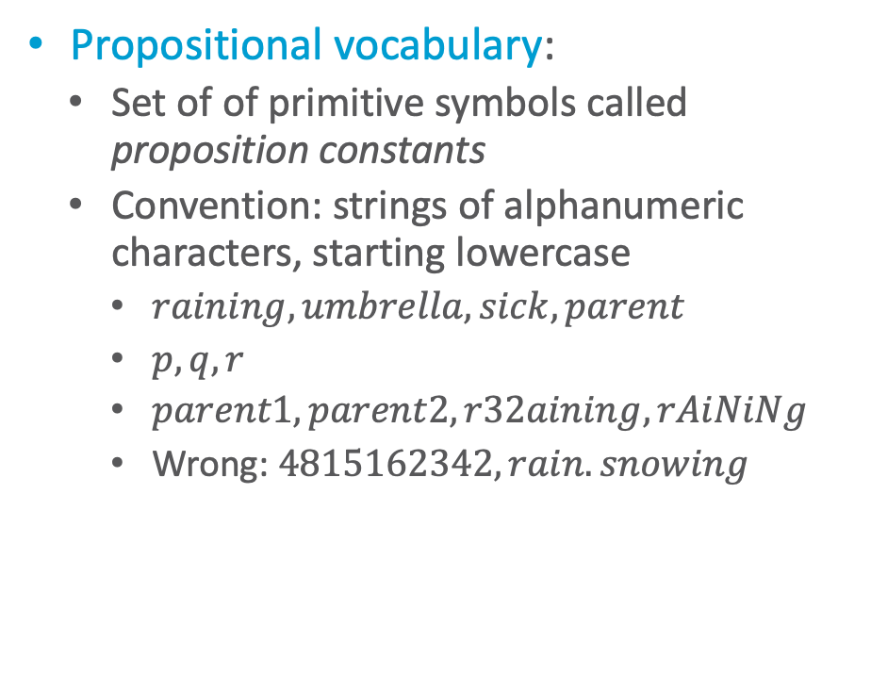
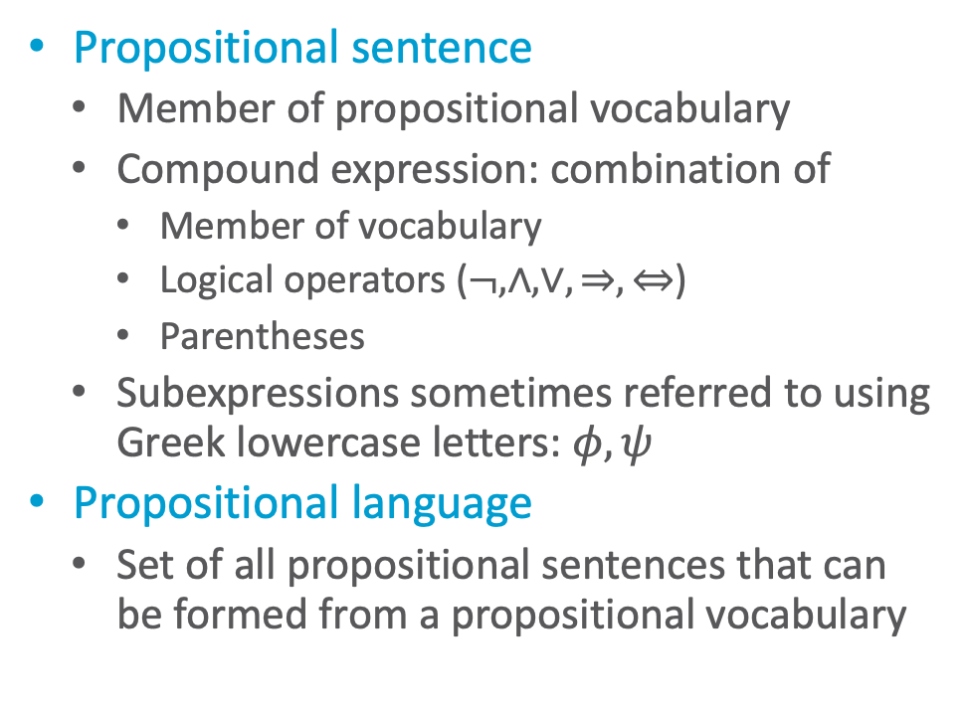
Syntax
Propositional vocabulary:
  Set of of primitive symbols called proposition constants
  Convention: strings of alphanumeric characters, starting lowercase
    $raining, umbrella, sick, parent$
    $p,q,r$
    $parent1, parent2, r32aining, rAiNiNg$
    Wrong: $4815162342, rain.snowing$
Propositional sentence
  Member of propositional vocabulary
  Compound expression: combination of
    Member of vocabulary
    Logical operators ($¬,∧,∨,⇒,⇔$)
    Parentheses
  Subexpressions sometimes referred to using Greek lowercase letters: $φ,ψ$
Propositional language
  Set of all propositional sentences that can be formed from a propositional vocabulary

Slide 8
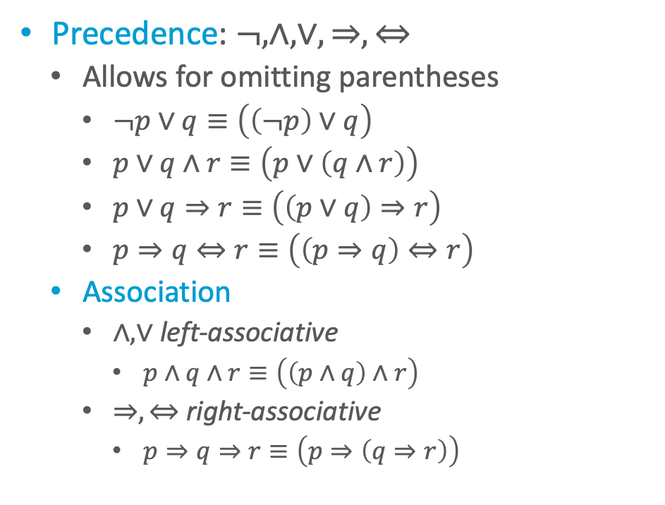
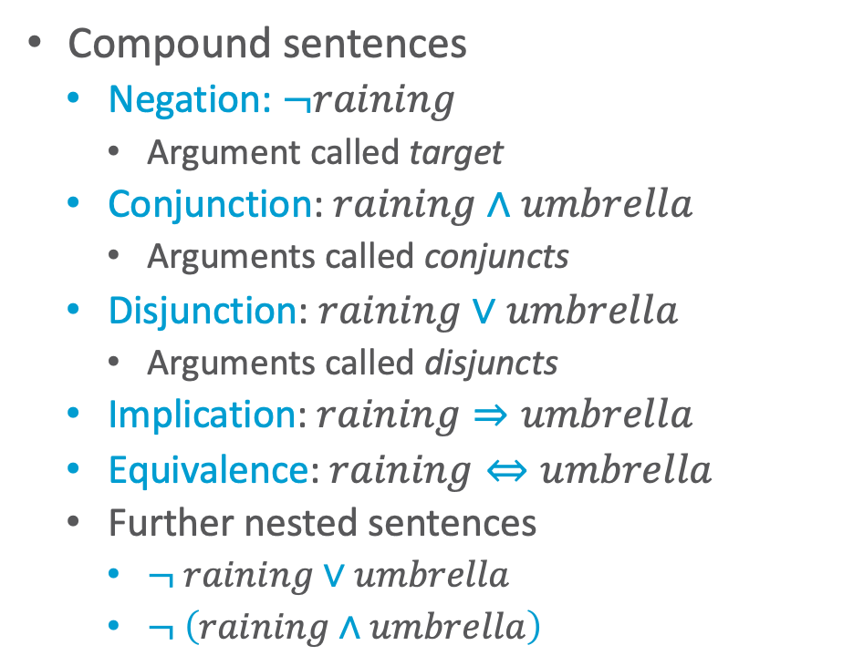
Syntax
Compound sentences
  Negation: $¬raining$
    Argument called target
  Conjunction: $raining∧umbrella$
    Arguments called conjuncts
  Disjunction: $raining∨umbrella$
    Arguments called disjuncts
  Implication: $raining⇒umbrella$
  Equivalence: $raining⇔umbrella$
  Further nested sentences
    $¬ raining∨umbrella$
    $¬ \left(raining∧umbrella\right)$
Precedence: $¬,∧,∨,⇒,⇔$
  Allows for omitting parentheses
    $¬p∨q≡\left(\left(¬p\right)∨q\right)$
    $p∨q∧r≡\left(p∨\left(q∧r\right)\right)$
    $p∨q⇒r≡\left(\left(p∨q\right)⇒r\right)$
    $p⇒q⇔r≡\left(\left(p⇒q\right)⇔r\right)$
  Association
    $∧,∨$ left-associative
      $p∧q∧r≡\left(\left(p∧q\right)∧r\right)$
    $⇒,⇔$ right-associative
      $p⇒q⇒r≡\left(p⇒\left(q⇒r\right)\right)$

Slide 9
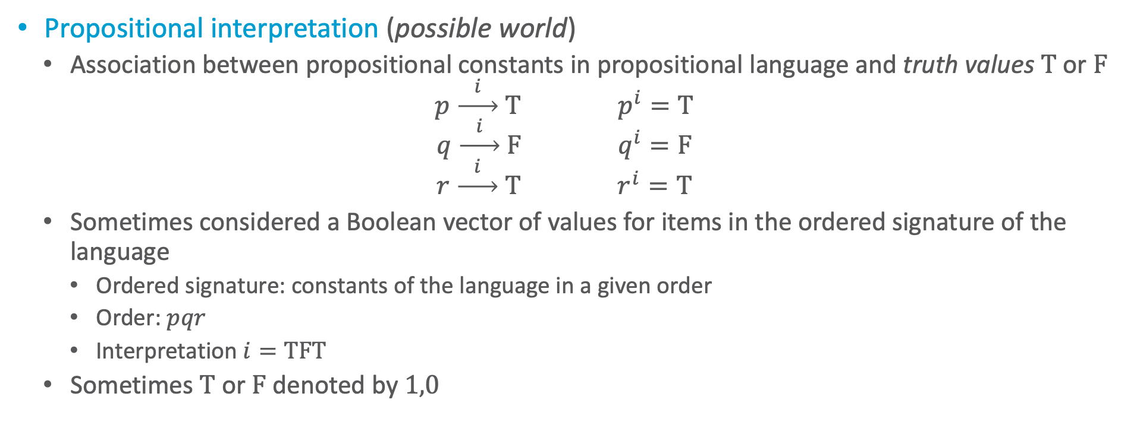
Semantics
Propositional interpretation (possible world)
  Association between propositional constants in propositional language and truth values $T$ or $F$
  $$p \underset{→}{ i } T p^{i}=T$$
  $$q \underset{→}{ i } F q^{i}=F \\ r \underset{→}{ i } T r^{i}=T$$
  Sometimes considered a Boolean vector of values for items in the ordered signature of the language
    Ordered signature: constants of the language in a given order
    Order: $pqr$
    Interpretation $i=TFT$
  Sometimes $T$ or $F$ denoted by $1,0$

Slide 10
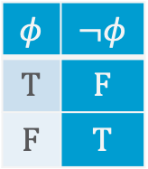
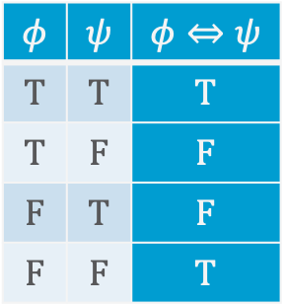
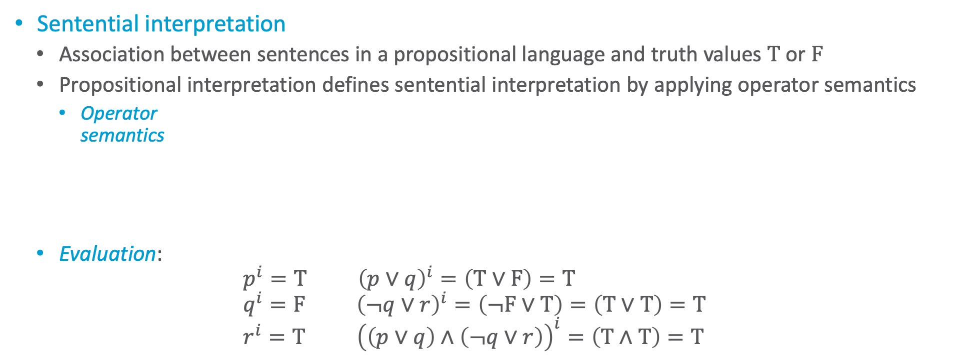
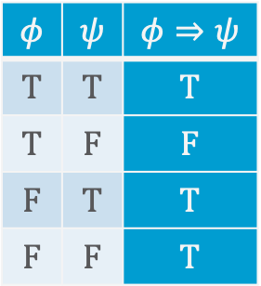
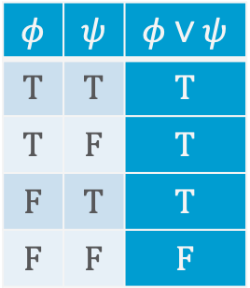
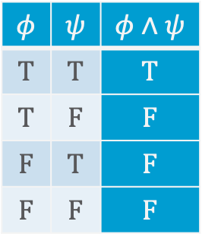
Semantics
One interpretation is as good as any other in absence of additional information.
Sentential interpretation
  Association between sentences in a propositional language and truth values $T$ or $F$
  Propositional interpretation defines sentential interpretation by applying operator semantics
    Operator
    semantics
  Evaluation:
  $$p^{i}=T {\left(p∨q\right)}^{i}=\left(T∨F\right)=T \\ q^{i}=F {\left(¬q∨r\right)}^{i}=\left(¬F∨T\right)=\left(T∨T\right)=T \\ r^{i}=T {\left(\left(p∨q\right)∧\left(¬q∨r\right)\right)}^{i}=\left(T∧T\right)=T$$
$$φ$$ | $$¬φ$$
$$T$$ | $$F$$
$$F$$ | $$T$$
$$φ$$ | $$ψ$$ | $$φ∧ψ$$
$$T$$ | $$T$$ | $$T$$
$$T$$ | $$F$$ | $$F$$
$$F$$ | $$T$$ | $$F$$
$$F$$ | $$F$$ | $$F$$
$$φ$$ | $$ψ$$ | $$φ∨ψ$$
$$T$$ | $$T$$ | $$T$$
$$T$$ | $$F$$ | $$T$$
$$F$$ | $$T$$ | $$T$$
$$F$$ | $$F$$ | $$F$$
$$φ$$ | $$ψ$$ | $$φ⇒ψ$$
$$T$$ | $$T$$ | $$T$$
$$T$$ | $$F$$ | $$F$$
$$F$$ | $$T$$ | $$T$$
$$F$$ | $$F$$ | $$T$$
$$φ$$ | $$ψ$$ | $$φ⇔ψ$$
$$T$$ | $$T$$ | $$T$$
$$T$$ | $$F$$ | $$F$$
$$F$$ | $$T$$ | $$F$$
$$F$$ | $$F$$ | $$T$$

Slide 11
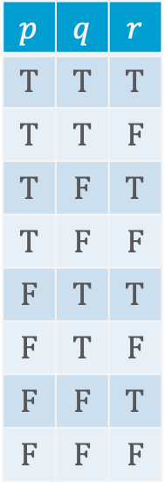
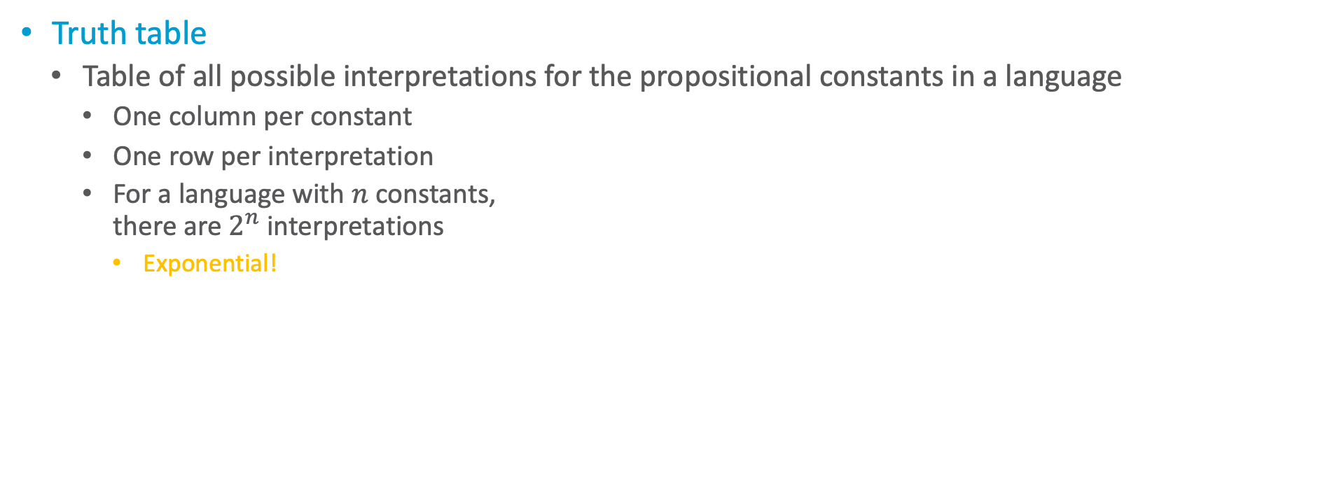
Semantics
Truth table
  Table of all possible interpretations for the propositional constants in a language
    One column per constant
    One row per interpretation
    For a language with $n$ constants,
    there are $2^{n}$ interpretations
      Exponential!
$$p$$ | $$q$$ | $$r$$
$$T$$ | $$T$$ | $$T$$
$$T$$ | $$T$$ | $$F$$
$$T$$ | $$F$$ | $$T$$
$$T$$ | $$F$$ | $$F$$
$$F$$ | $$T$$ | $$T$$
$$F$$ | $$T$$ | $$F$$
$$F$$ | $$F$$ | $$T$$
$$F$$ | $$F$$ | $$F$$

Slide 12
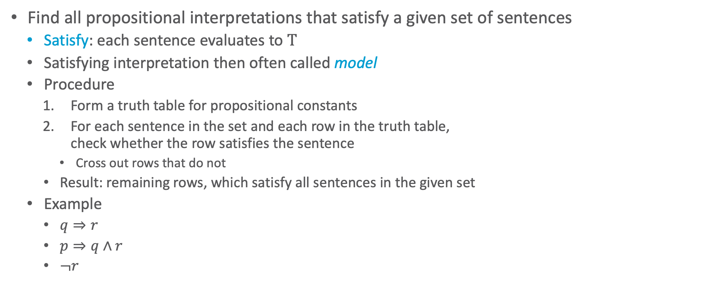
Satisfaction (Model Checking)
Proofs (symbolic manipulation of sentences) usually smaller than truth tables and thus often less work.
Find all propositional interpretations that satisfy a given set of sentences
  Satisfy: each sentence evaluates to $T$
  Satisfying interpretation then often called model
  Procedure
    Form a truth table for propositional constants
    For each sentence in the set and each row in the truth table,
    check whether the row satisfies the sentence
      Cross out rows that do not
    Result: remaining rows, which satisfy all sentences in the given set
  Example
    $q⇒r$
    $p⇒q∧r$
    $¬r$
$$p$$ | $$q$$ | $$r$$
$$T$$ | $$T$$ | $$T$$
$$T$$ | $$T$$ | $$F$$
$$T$$ | $$F$$ | $$T$$
$$T$$ | $$F$$ | $$F$$
$$F$$ | $$T$$ | $$T$$
$$F$$ | $$T$$ | $$F$$
$$F$$ | $$F$$ | $$T$$
$$F$$ | $$F$$ | $$F$$
model

Slide 13
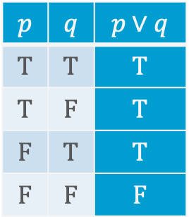
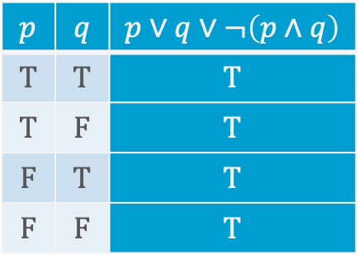
Satisfaction: Properties of Sentences
Valid sentence
  If and only if every interpretation satisfies it
Contingent sentence
  If and only if some interpretation satisfies it and some interpretation falsifies it
Unsatisfiable sentence
  If and only if no interpretation satisfies it
Satisfiable
  If and only if it is either valid or contingent
Falsifiable
  If and only if it is either contingent or unsatisfiable
$$p$$ | $$q$$ | $$p∨q$$
$$T$$ | $$T$$ | $$T$$
$$T$$ | $$F$$ | $$T$$
$$F$$ | $$T$$ | $$T$$
$$F$$ | $$F$$ | $$F$$
$$p$$ | $$q$$ | $$p∨q∨¬\left(p∧q\right)$$
$$T$$ | $$T$$ | $$T$$
$$T$$ | $$F$$ | $$T$$
$$F$$ | $$T$$ | $$T$$
$$F$$ | $$F$$ | $$T$$
Which properties hold?

Slide 14
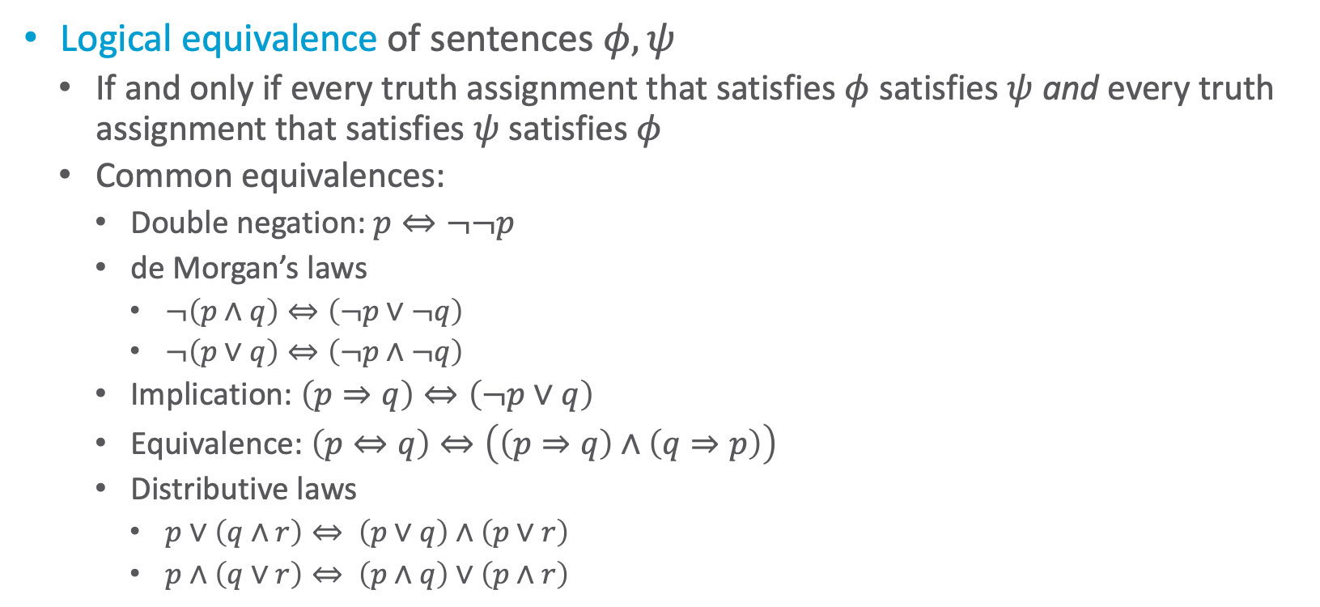
Satisfaction: Logical Equivalence
Logical equivalence of sentences $φ,ψ$
  If and only if every truth assignment that satisfies $φ$ satisfies $ψ$ and every truth assignment that satisfies $ψ$ satisfies $φ$
  Common equivalences:
    Double negation: $p⇔¬¬p$
    de Morgan’s laws
      $¬\left(p∧q\right)⇔\left(¬p∨¬q\right)$
      $¬\left(p∨q\right)⇔\left(¬p∧¬q\right)$
    Implication: $\left(p⇒q\right)⇔\left(¬p∨q\right)$
    Equivalence: $\left(p⇔q\right)⇔\left(\left(p⇒q\right)∧\left(q⇒p\right)\right)$
    Distributive laws
      $p∨\left(q∧r\right)⇔ \left(p∨q\right)∧\left(p∨r\right)$
      $p∧\left(q∨r\right)⇔ \left(p∧q\right)∨\left(p∧r\right)$

Slide 15
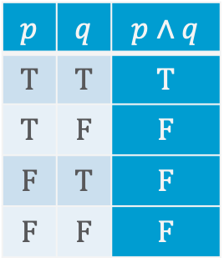
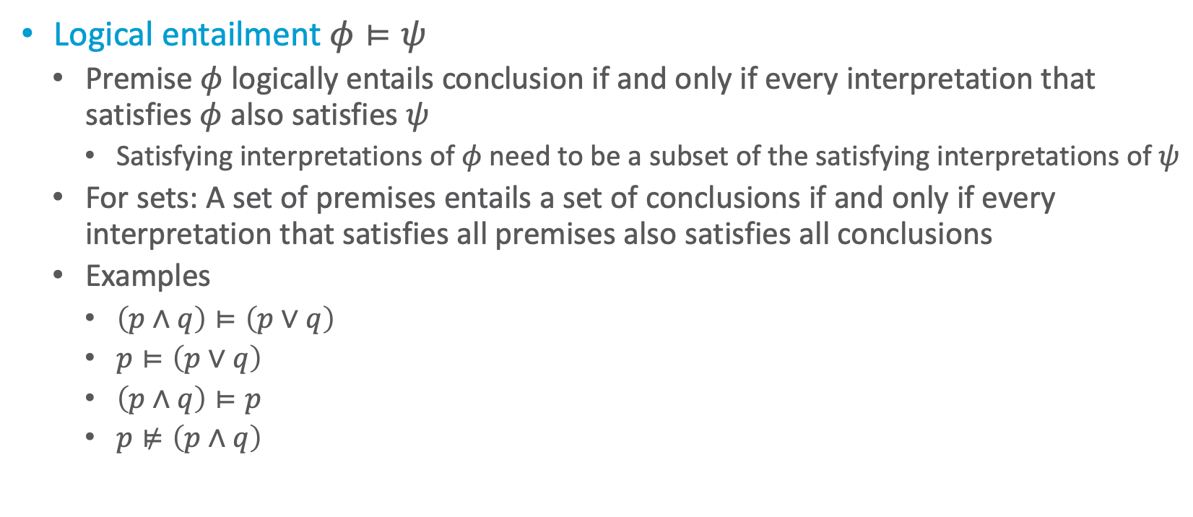
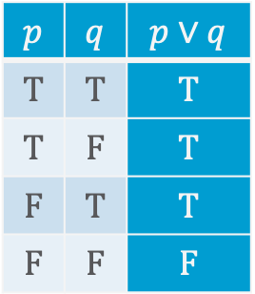
Satisfaction: Logical Entailment
Logical entailment $φ⊨ψ$
  Premise $φ$ logically entails conclusion if and only if every interpretation that satisfies $φ$ also satisfies $ψ$
    Satisfying interpretations of $φ$ need to be a subset of the satisfying interpretations of $ψ$
  For sets: A set of premises entails a set of conclusions if and only if every interpretation that satisfies all premises also satisfies all conclusions
  Examples
    $\left(p∧q\right)⊨\left(p∨q\right)$
    $p⊨\left(p∨q\right)$
    $\left(p∧q\right)⊨p$
    $p⊭\left(p∧q\right)$
$$p$$ | $$q$$ | $$p∧q$$
$$T$$ | $$T$$ | $$T$$
$$T$$ | $$F$$ | $$F$$
$$F$$ | $$T$$ | $$F$$
$$F$$ | $$F$$ | $$F$$
$$p$$ | $$q$$ | $$p∨q$$
$$T$$ | $$T$$ | $$T$$
$$T$$ | $$F$$ | $$T$$
$$F$$ | $$T$$ | $$T$$
$$F$$ | $$F$$ | $$F$$

Slide 16
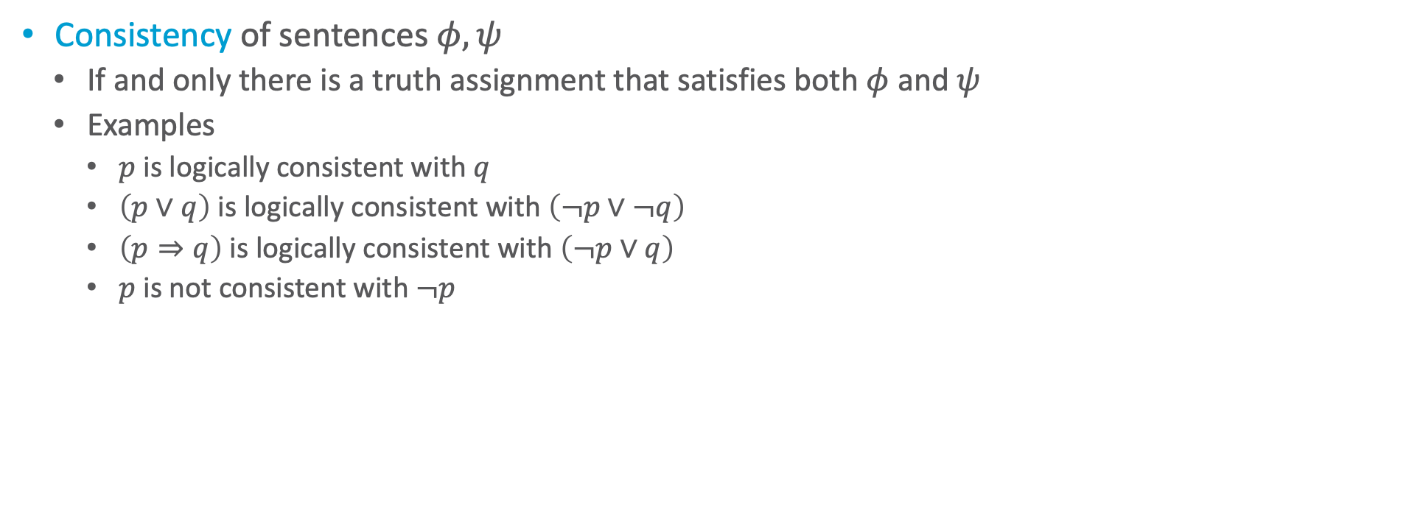
Satisfaction: Consistency
Consistency of sentences $φ,ψ$
  If and only there is a truth assignment that satisfies both $φ$ and $ψ$
  Examples
    $p$ is logically consistent with $q$
    $\left(p∨q\right)$ is logically consistent with $\left(¬p∨¬q\right)$
    $\left(p⇒q\right)$ is logically consistent with $\left(¬p∨q\right)$
    $p$ is not consistent with $¬p$
$$p$$ | $$q$$ | $$p∧q$$
$$T$$ | $$T$$ | $$T$$
$$T$$ | $$F$$ | $$F$$
$$F$$ | $$T$$ | $$F$$
$$F$$ | $$F$$ | $$F$$
$$p$$ | $$q$$ | $$p∨q$$
$$T$$ | $$T$$ | $$T$$
$$T$$ | $$F$$ | $$T$$
$$F$$ | $$T$$ | $$T$$
$$F$$ | $$F$$ | $$F$$

Slide 17
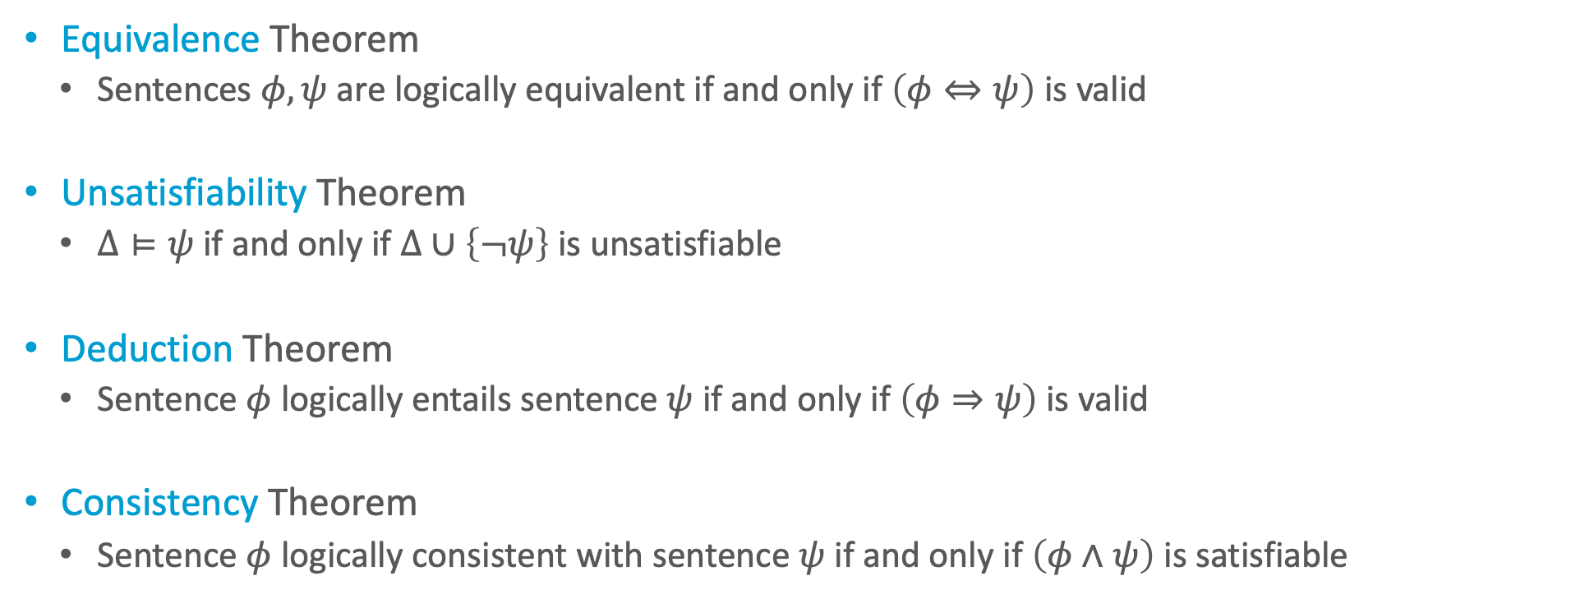
Some Connections between These Concepts
Equivalence Theorem
  Sentences $φ,ψ$ are logically equivalent if and only if $\left(φ⇔ψ\right)$ is valid
Unsatisfiability Theorem
  $Δ⊨ψ$ if and only if $Δ∪\left\{¬ψ\right\}$ is unsatisfiable
Deduction Theorem
  Sentence $φ$ logically entails sentence $ψ$ if and only if $\left(φ⇒ψ\right)$ is valid
Consistency Theorem
  Sentence $φ$ logically consistent with sentence $ψ$ if and only if $\left(φ∧ψ\right)$ is satisfiable

Slide 18
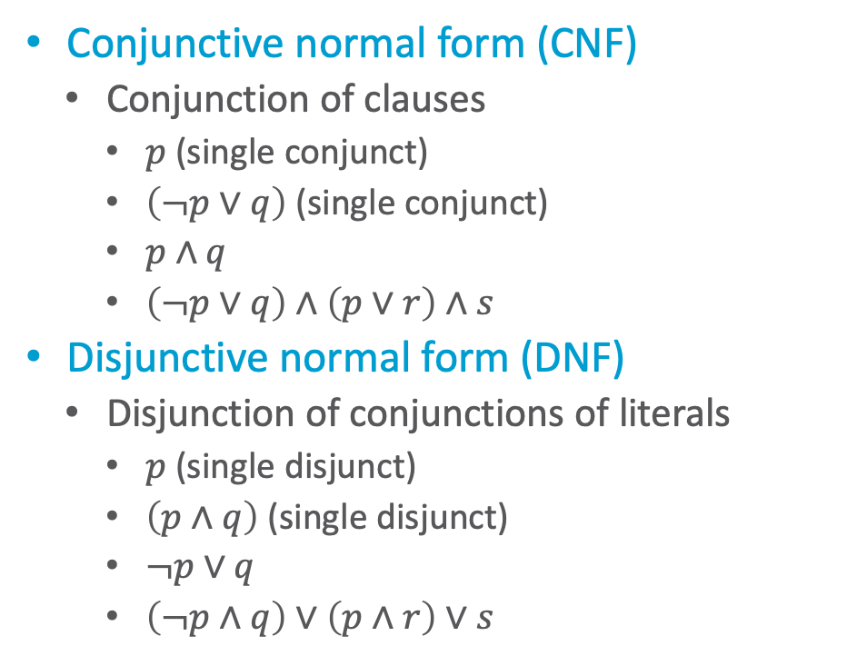
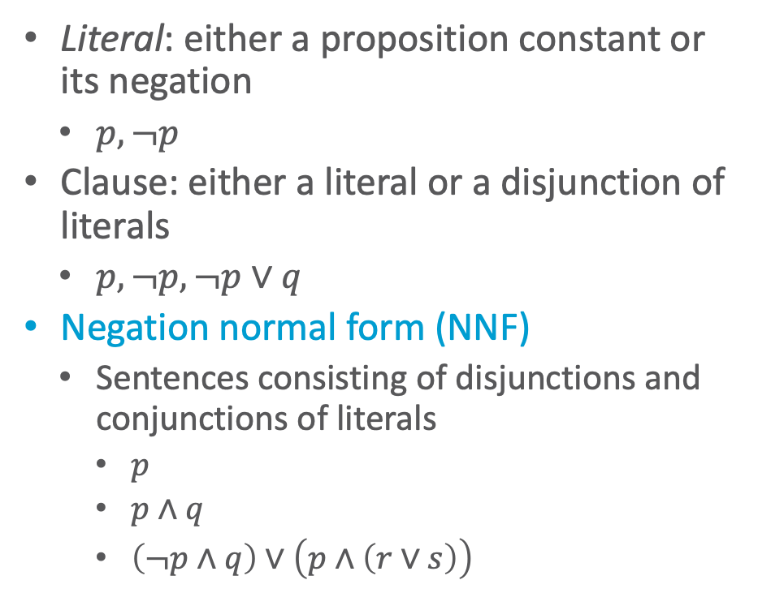
Normal Forms (NFs)
Literal: either a proposition constant or its negation
  $p,¬p$
Clause: either a literal or a disjunction of literals
  $p,¬p,¬p∨q$
Negation normal form (NNF)
  Sentences consisting of disjunctions and conjunctions of literals
    $p$
    $p∧q$
    $\left(¬p∧q\right)∨\left(p∧\left(r∨s\right)\right)$
Conjunctive normal form (CNF)
  Conjunction of clauses
    $p$ (single conjunct)
    $\left(¬p∨q\right)$ (single conjunct)
    $p∧q$
    $\left(¬p∨q\right)∧\left(p∨r\right)∧s$
Disjunctive normal form (DNF)
  Disjunction of conjunctions of literals
    $p$ (single disjunct)
    $\left(p∧q\right)$ (single disjunct)
    $¬p∨q$
    $\left(¬p∧q\right)∨\left(p∧r\right)∨s$

Slide 19
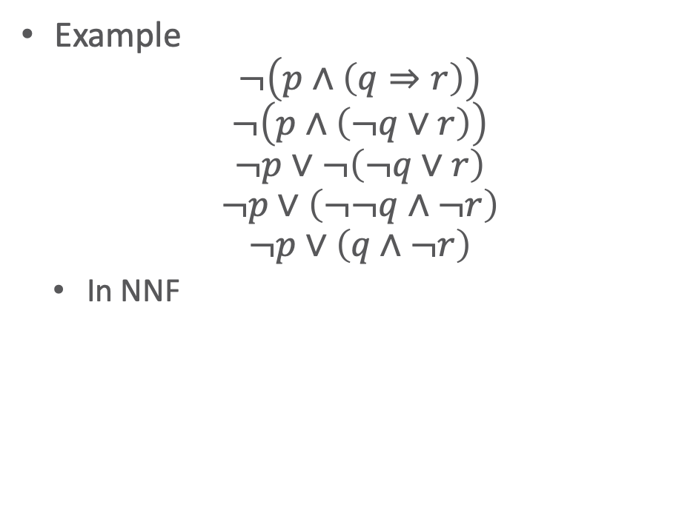
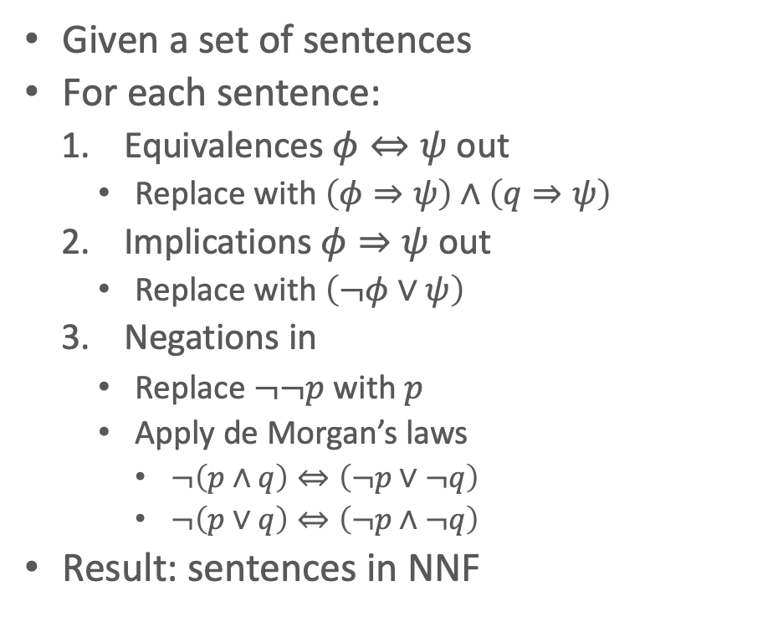
Normal Forms (NFs): Conversion into NNF
Given a set of sentences
For each sentence:
  Equivalences $φ⇔ψ$ out
    Replace with $\left(φ⇒ψ\right)∧\left(q⇒ψ\right)$
  Implications $φ⇒ψ$ out
    Replace with $\left(¬φ∨ψ\right)$
  Negations in
    Replace $¬¬p$ with $p$
    Apply de Morgan’s laws
      $¬\left(p∧q\right)⇔\left(¬p∨¬q\right)$
      $¬\left(p∨q\right)⇔\left(¬p∧¬q\right)$
Result: sentences in NNF
Example
$$¬\left(p∧\left(q⇒r\right)\right)$$
$$¬\left(p∧\left(¬q∨r\right)\right)$$
$$¬p∨¬\left(¬q∨r\right)$$
$$¬p∨\left(¬¬q∧¬r\right)$$
$$¬p∨\left(q∧¬r\right)$$
  In NNF

Slide 20
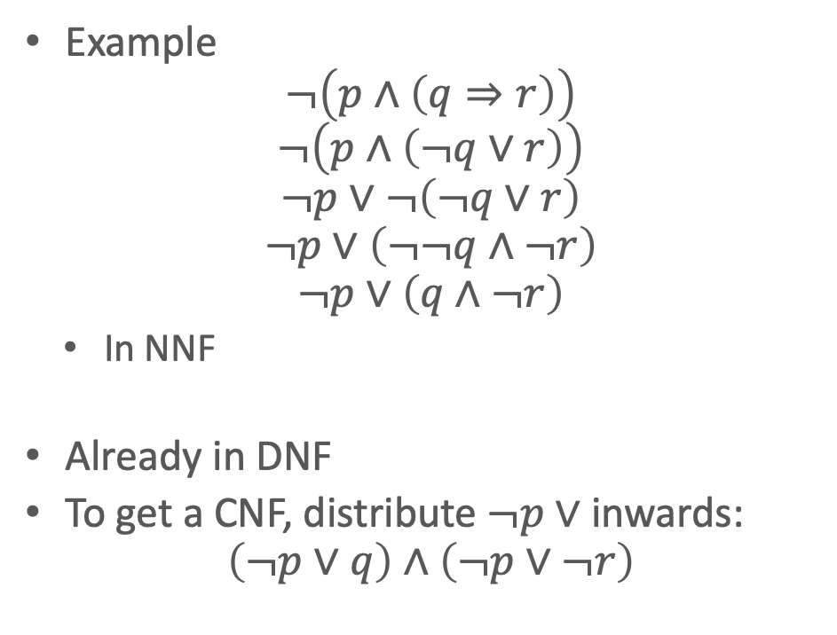
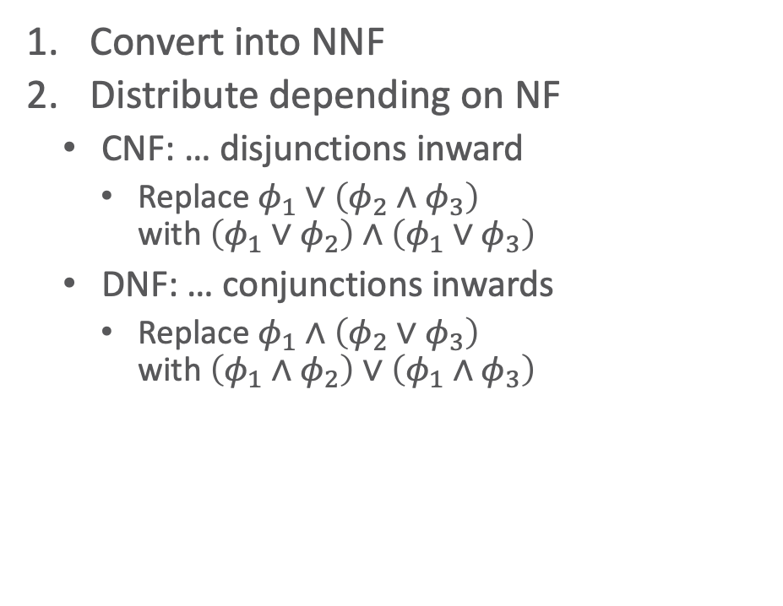
Normal Forms (NFs): Conversion into CNF / DNF
Convert into NNF
Distribute depending on NF
  CNF: … disjunctions inward
    Replace $φ_{1}∨\left(φ_{2}∧φ_{3}\right)$
    with $\left(φ_{1}∨φ_{2}\right)∧\left({φ_{1}∨φ}_{3}\right)$
  DNF: … conjunctions inwards
    Replace $φ_{1}∧\left(φ_{2}∨φ_{3}\right)$
    with $\left(φ_{1}∧φ_{2}\right)∨\left({φ_{1}∧φ}_{3}\right)$
Example
$$¬\left(p∧\left(q⇒r\right)\right)$$
$$¬\left(p∧\left(¬q∨r\right)\right)$$
$$¬p∨¬\left(¬q∨r\right)$$
$$¬p∨\left(¬¬q∧¬r\right)$$
$$¬p∨\left(q∧¬r\right)$$
  In NNF
Already in DNF
To get a CNF, distribute $¬p∨$ inwards:
$$\left(¬p∨q\right)∧\left(¬p∨¬r\right)$$
What about CNF / DNF?

Slide 21
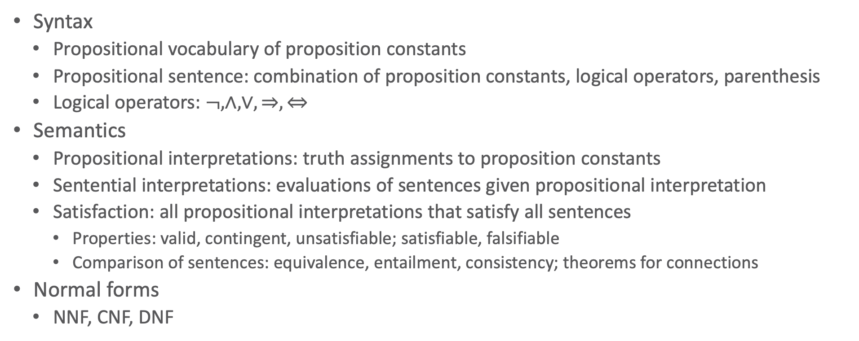
Interim Summary
Syntax
  Propositional vocabulary of proposition constants
  Propositional sentence: combination of proposition constants, logical operators, parenthesis
  Logical operators: $¬,∧,∨,⇒,⇔$
Semantics
  Propositional interpretations: truth assignments to proposition constants
  Sentential interpretations: evaluations of sentences given propositional interpretation
  Satisfaction: all propositional interpretations that satisfy all sentences
    Properties: valid, contingent, unsatisfiable; satisfiable, falsifiable
    Comparison of sentences: equivalence, entailment, consistency; theorems for connections
Normal forms
  NNF, CNF, DNF

Slide 22
First-order Logic with Domain Constraints
Introducing quantifiers and domain constraints
Based on “Lifted Inference and Learning in Statistical Relational Models” by Guy Van den Broeck, 2013
➝ Some notions are used a bit differently than in some classical logic literature but I want to keep the slides consistent with this source

Slide 23
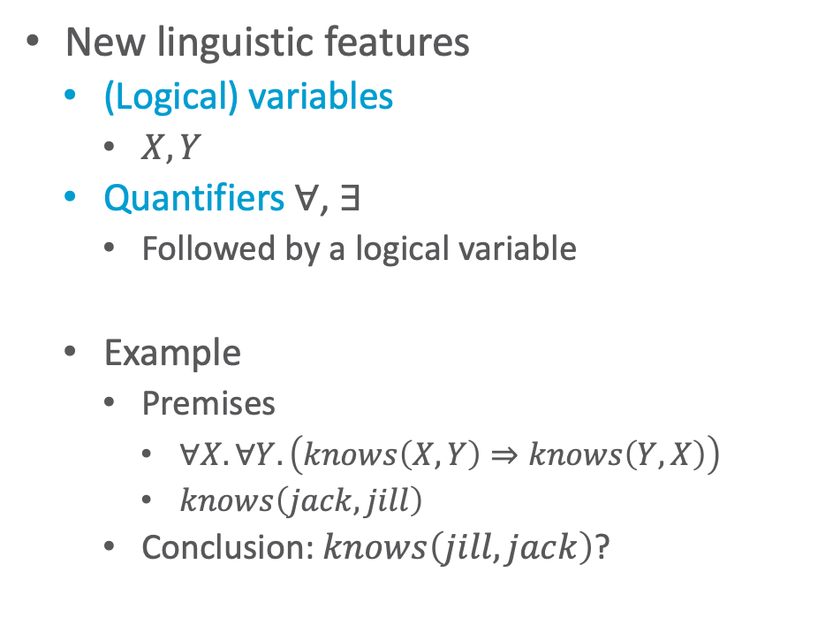
Propositional ➝ First-order Logic (FOL)
Motivation: Being able to talk about objects and relations among them
  Example: in propositional logic
    Premises
      If Jack knows Jill, then Jill knows Jack.
      Jack knows Jill.
    Conclusion: Does Jill know Jack? (Yes.)
  Example: in first-order (or relational) logic
    Premises
      If one person knows another person, then the other person knows the first person.
      Jack knows Jill.
    Conclusion: Does Jill know Jack? (Yes.)
New linguistic features
  (Logical) variables
    $X,Y$
  Quantifiers $∀$, $∃$
    Followed by a logical variable
  Example
    Premises
      $∀X.∀Y.\left(knows\left(X,Y\right)⇒knows\left(Y,X\right)\right)$
      $knows\left(jack,jill\right)$
    Conclusion: $knows\left(jill,jack\right)$?

Slide 24
FOL with Domain Constraints (FOL-DC)
FOL has a domain of discourse that is possibly infinite
  Quantifiers can range over infinite sets of objects
Domain constraints
  Restrict quantifiers to finite domains
Why?
  For probabilistic inference, infinity is hard to handle
    Restriction allows for obtaining a well-defined probability distribution over the ground terms
    Enables weighted model counting as a way to answer queries about probability (distributions)
  Tasks like checking validity or satisfiability become decidable in FOL-DC
    Undecidable in full FOL
    Not the only decidable subclass that exists, but the one that we need for the lecture

Slide 25
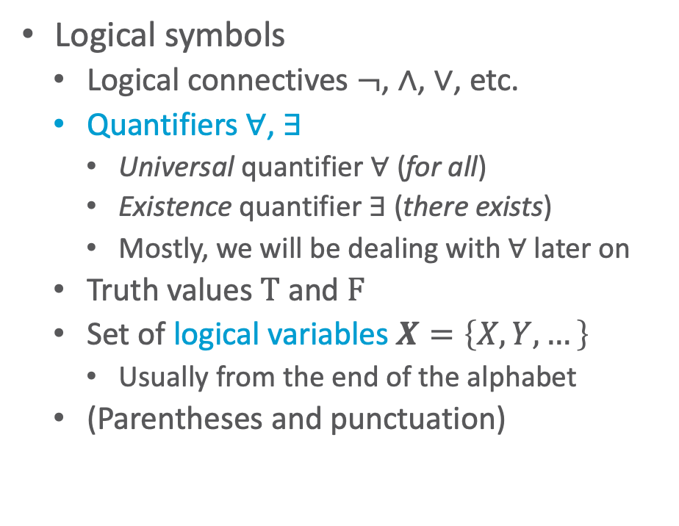
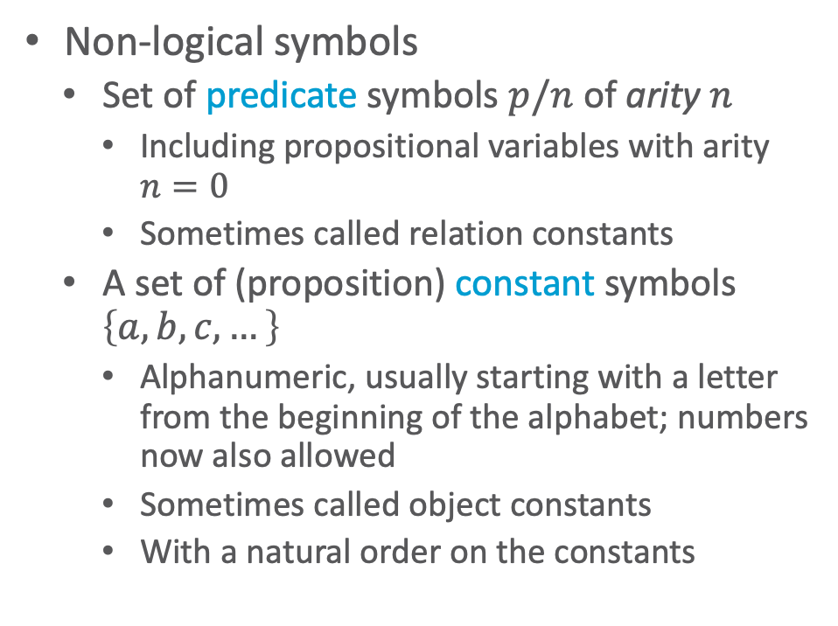
Syntax: Function-free FOL
Logical symbols
  Logical connectives $¬$, $∧$, $∨$, etc.
  Quantifiers $∀$, $∃$
    Universal quantifier $∀$ (for all)
    Existence quantifier $∃$ (there exists)
    Mostly, we will be dealing with $∀$ later on
  Truth values $T$ and $F$
  Set of logical variables $X=\left\{X,Y, …\right\}$
    Usually from the end of the alphabet
  (Parentheses and punctuation)
Non-logical symbols
  Set of predicate symbols $p/n$ of arity $n$
    Including propositional variables with arity $n=0$
    Sometimes called relation constants
  A set of (proposition) constant symbols $\left\{a,b,c, …\right\}$
    Alphanumeric, usually starting with a letter from the beginning of the alphabet; numbers now also allowed
    Sometimes called object constants
    With a natural order on the constants

Slide 26
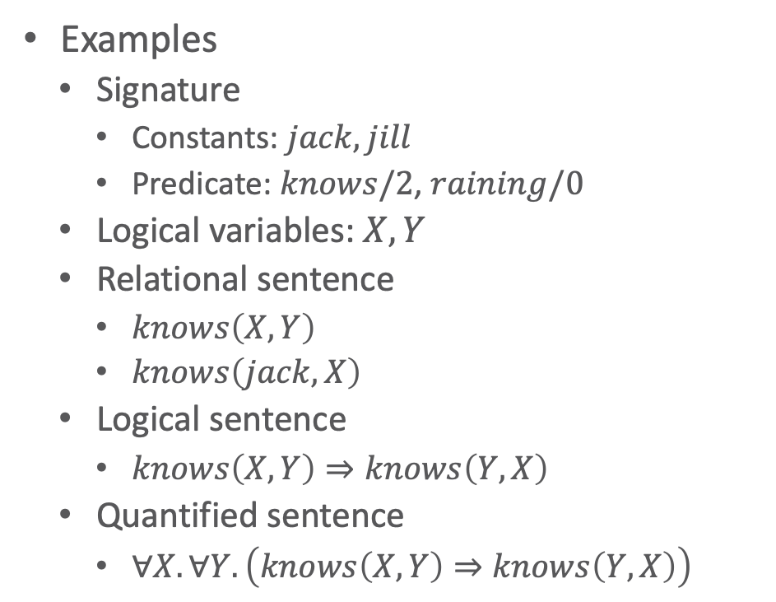
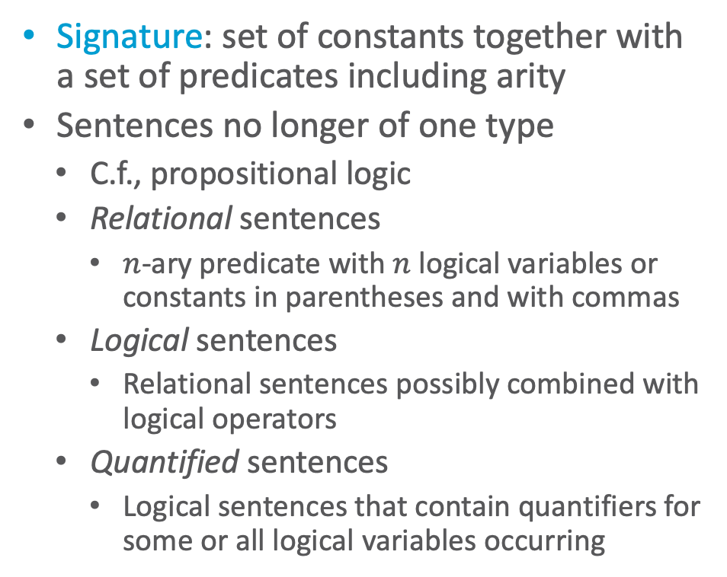
Syntax: Function-free FOL
Signature: set of constants together with a set of predicates including arity
Sentences no longer of one type
  C.f., propositional logic
  Relational sentences
    $n$-ary predicate with $n$ logical variables or constants in parentheses and with commas
  Logical sentences
    Relational sentences possibly combined with logical operators
  Quantified sentences
    Logical sentences that contain quantifiers for some or all logical variables occurring
Examples
  Signature
    Constants: $jack,jill$
    Predicate: $knows/2$, $raining/0$
  Logical variables: $X,Y$
  Relational sentence
    $knows\left(X,Y\right)$
    $knows\left(jack,X\right)$
  Logical sentence
    $knows\left(X,Y\right)⇒knows\left(Y,X\right)$
  Quantified sentence
    $∀X.∀Y.\left(knows\left(X,Y\right)⇒knows\left(Y,X\right)\right)$

Slide 27
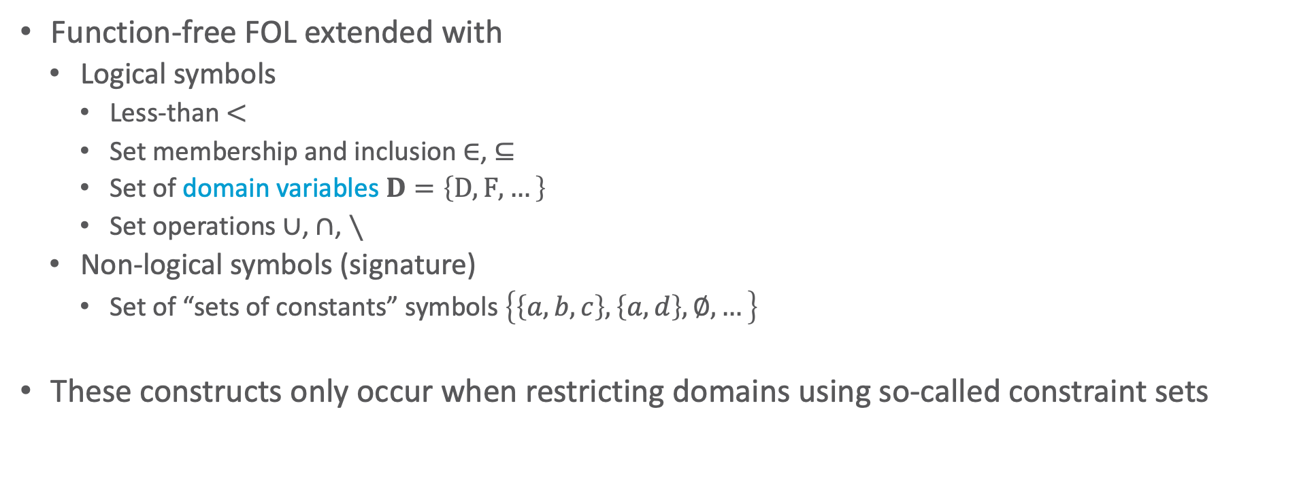
Syntax: Function-free FOL-DC
Function-free FOL extended with
  Logical symbols
    Less-than $<$
    Set membership and inclusion $∈$, $⊆$
    Set of domain variables $D=\left\{D,F, …\right\}$
    Set operations $∪$, $∩$, $∖$
  Non-logical symbols (signature)
    Set of “sets of constants” symbols $\left\{\left\{a,b,c\right\},\left\{a,d\right\},∅,…\right\}$
These constructs only occur when restricting domains using so-called constraint sets

Slide 28
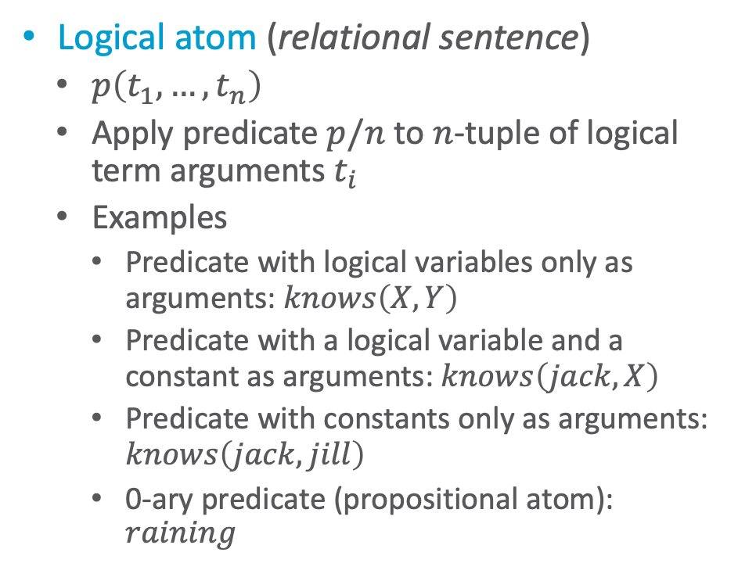
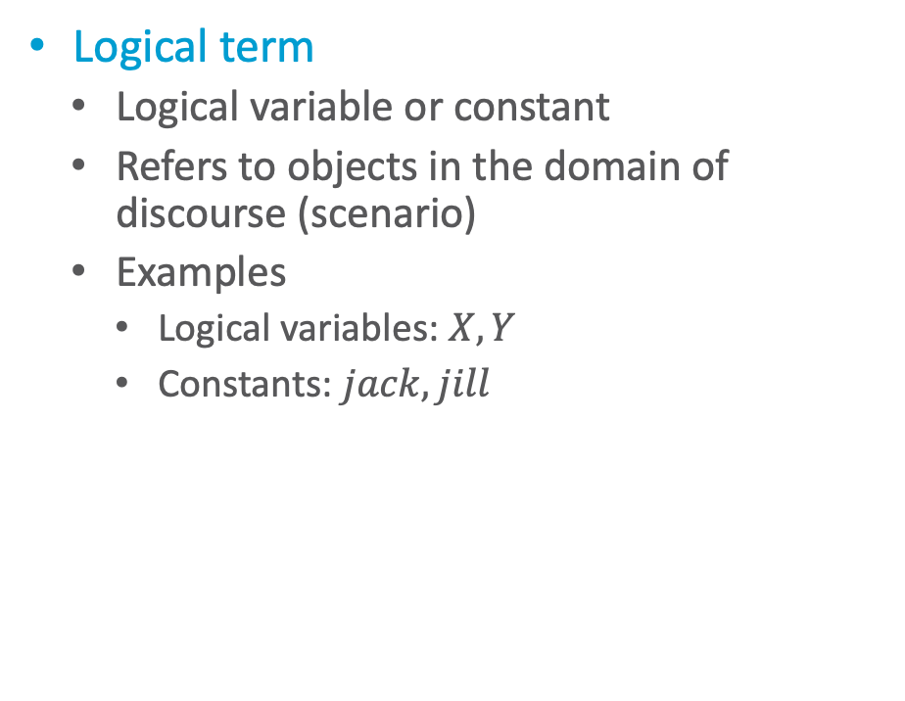
Syntax: FOL-DC – Grammar
Logical term
  Logical variable or constant
  Refers to objects in the domain of discourse (scenario)
  Examples
    Logical variables: $X,Y$
    Constants: $jack,jill$
Logical atom (relational sentence)
  $p\left(t_{1},…,t_{n}\right)$
  Apply predicate $p/n$ to $n$-tuple of logical term arguments $t_{i}$
  Examples
    Predicate with logical variables only as arguments: $knows\left(X,Y\right)$
    Predicate with a logical variable and a constant as arguments: $knows\left(jack,X\right)$
    Predicate with constants only as arguments: $knows\left(jack,jill\right)$
    0-ary predicate (propositional atom):
    $raining$

Slide 29
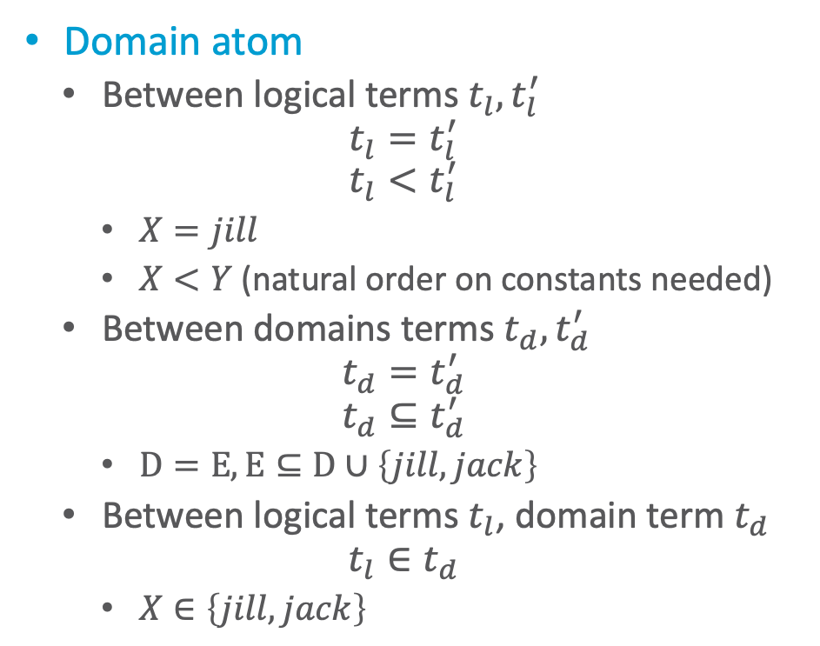
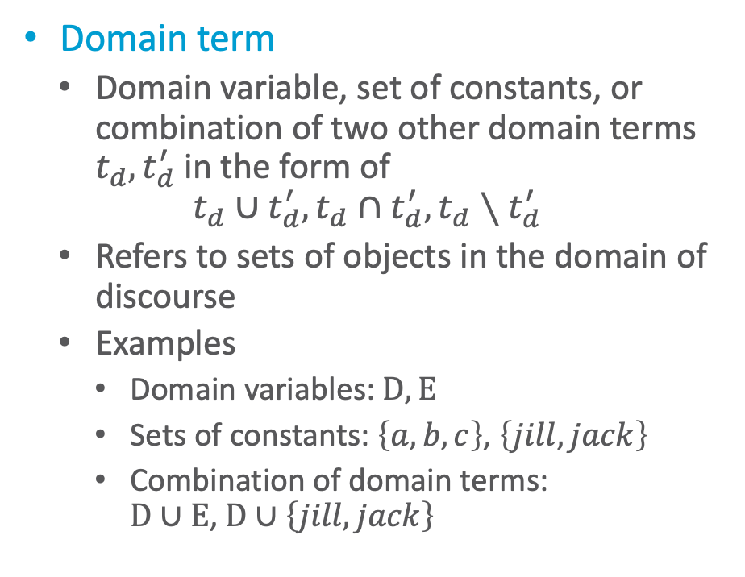
Syntax: FOL-DC – Grammar
Domain term
  Domain variable, set of constants, or combination of two other domain terms $t_{d},t_{d}^{′}$ in the form of
  $$t_{d}∪t_{d}^{′},t_{d}∩t_{d}^{′},t_{d}∖t_{d}^{′}$$
  Refers to sets of objects in the domain of discourse
  Examples
    Domain variables: $D,E$
    Sets of constants: $\left\{a,b,c\right\}$, $\left\{jill,jack\right\}$
    Combination of domain terms:
    $D∪E$, $D∪\left\{jill,jack\right\}$
Domain atom
  Between logical terms $t_{l},t_{l}^{′}$
  $$t_{l}=t_{l}^{′}$$
  $$t_{l}<t_{l}^{′}$$
    $X=jill$
    $X<Y$ (natural order on constants needed)
  Between domains terms $t_{d},t_{d}^{′}$
  $$t_{d}=t_{d}^{′}$$
  $$t_{d}⊆t_{d}^{′}$$
    $D=E,E⊆D∪\left\{jill,jack\right\}$
  Between logical terms $t_{l}$, domain term $t_{d}$
  $$t_{l}∈t_{d}$$
    $X∈\left\{jill,jack\right\}$

Slide 30
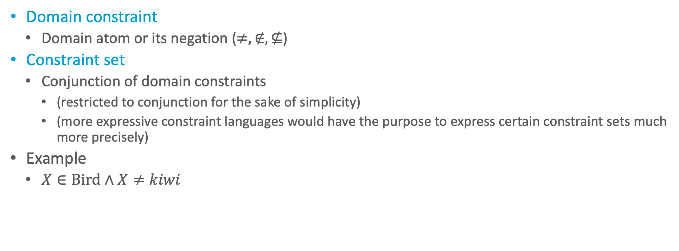
Syntax: FOL-DC – Grammar
Domain constraint
  Domain atom or its negation ($≠,∉,⊈$)
Constraint set
  Conjunction of domain constraints
    (restricted to conjunction for the sake of simplicity)
    (more expressive constraint languages would have the purpose to express certain constraint sets much more precisely)
Example
  $X∈Bird∧X≠kiwi$

Slide 31
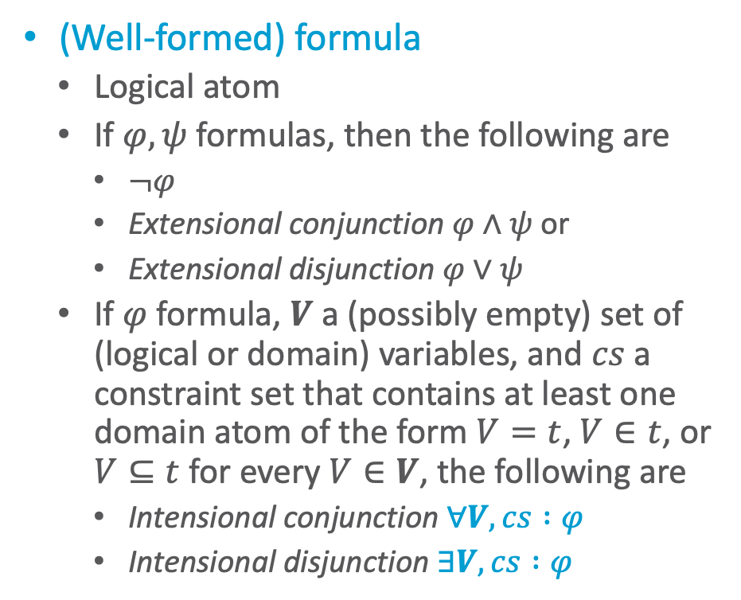
Syntax: FOL-DC – Grammar
(Well-formed) formula
  Logical atom
  If $φ,ψ$ formulas, then the following are
    $¬φ$
    Extensional conjunction $φ∧ψ$ or
    Extensional disjunction $φ∨ψ$
  If $φ$ formula, $V$ a (possibly empty) set of (logical or domain) variables, and $cs$ a constraint set that contains at least one domain atom of the form $V=t$, $V∈t$, or $V⊆t$ for every $V∈V$, the following are
    Intensional conjunction $∀V,cs :φ$
    Intensional disjunction $∃V,cs :φ$
A variable is bound
  If it is quantified by an enclosing intensional conjunction or disjunction
A variable is free
  If it is not bound
Sentence
  Formula without free variables
Formula is ground
  If it does not contain any variables

Slide 32
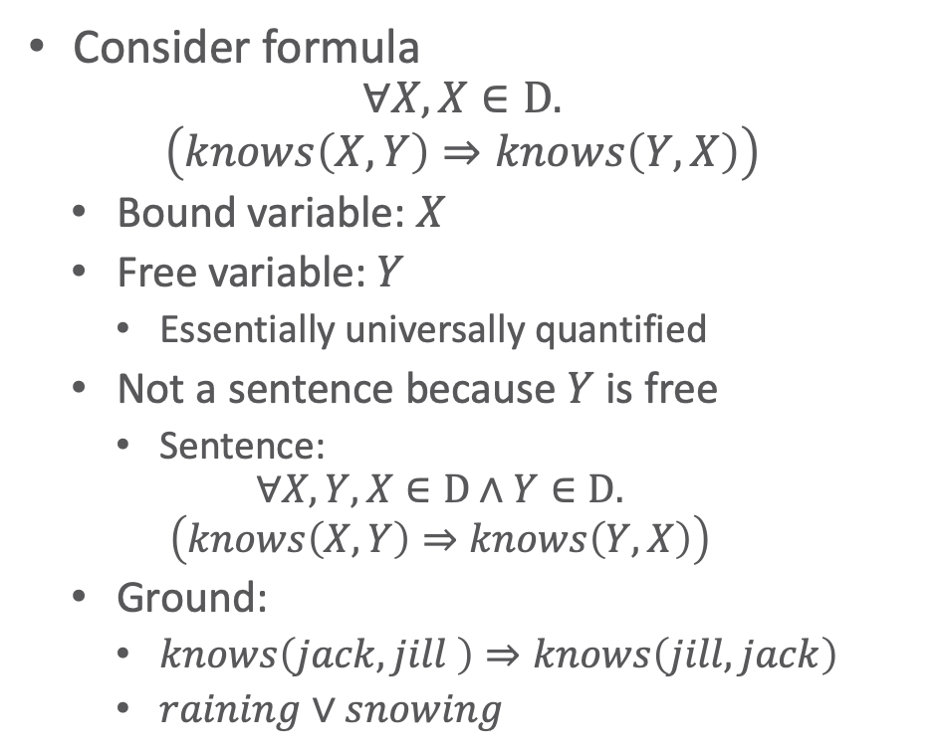
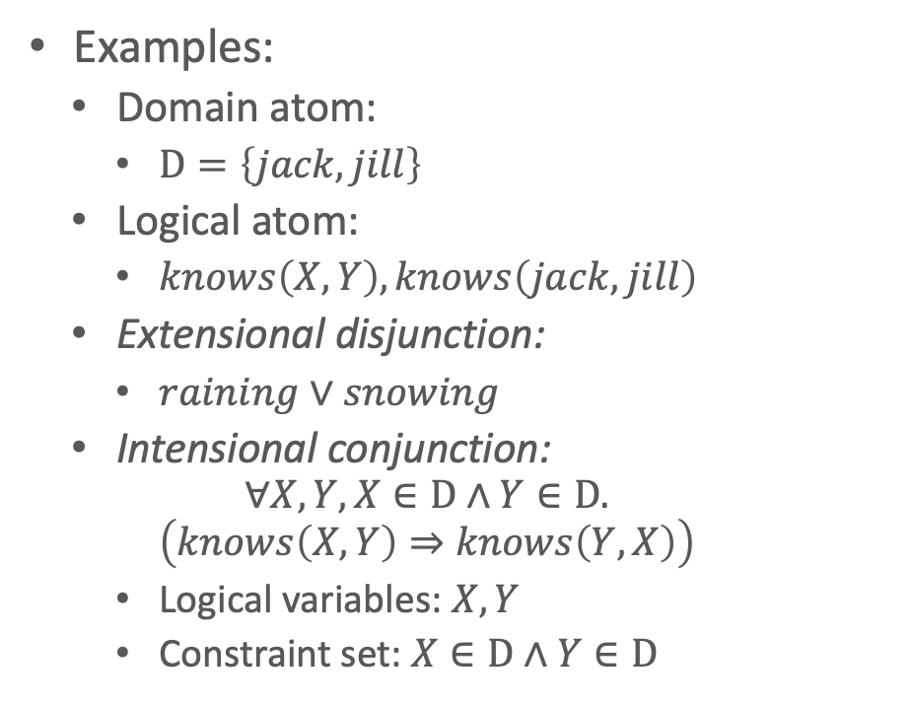
Syntax: FOL-DC – Grammar
Examples:
  Domain atom:
    $D=\left\{jack, jill\right\}$
  Logical atom:
    $knows\left(X,Y\right),knows\left(jack,jill\right)$
  Extensional disjunction:
    $raining∨snowing$
  Intensional conjunction:
    $$∀X,Y,X∈D∧Y∈D.$$
    $$\left(knows\left(X,Y\right)⇒knows\left(Y,X\right)\right)$$
    Logical variables: $X,Y$
    Constraint set: $X∈D∧Y∈D$
Consider formula
  $$∀X,X∈D.$$
  $$\left(knows\left(X,Y\right)⇒knows\left(Y,X\right)\right)$$
  Bound variable: $X$
  Free variable: $Y$
    Essentially universally quantified
  Not a sentence because $Y$ is free
    Sentence:
    $∀X,Y,X∈D∧Y∈D.$
    $$\left(knows\left(X,Y\right)⇒knows\left(Y,X\right)\right)$$
  Ground:
    $knows\left(jack, jill \right)⇒knows\left(jill,jack\right)$
    $raining∨snowing$

Slide 33
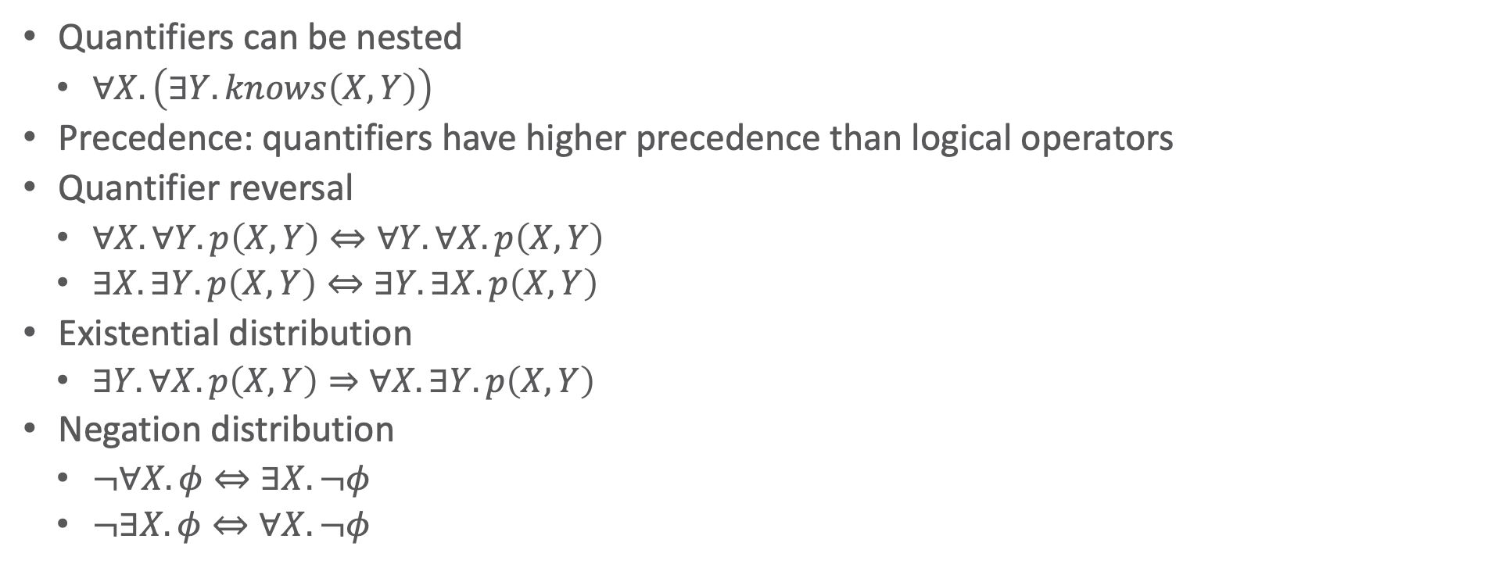
Some More Information about Quantifiers
Quantifiers can be nested
  $∀X.\left(∃Y.knows\left(X,Y\right)\right)$
Precedence: quantifiers have higher precedence than logical operators
Quantifier reversal
  $∀X.∀Y.p\left(X,Y\right)⇔∀Y.∀X.p\left(X,Y\right)$
  $∃X.∃Y.p\left(X,Y\right)⇔∃Y.∃X.p\left(X,Y\right)$
Existential distribution
  $∃Y.∀X.p\left(X,Y\right)⇒∀X.∃Y.p\left(X,Y\right)$
Negation distribution
  $¬∀X.φ⇔∃X.¬φ$
  $¬∃X.φ⇔∀X.¬φ$

Slide 34
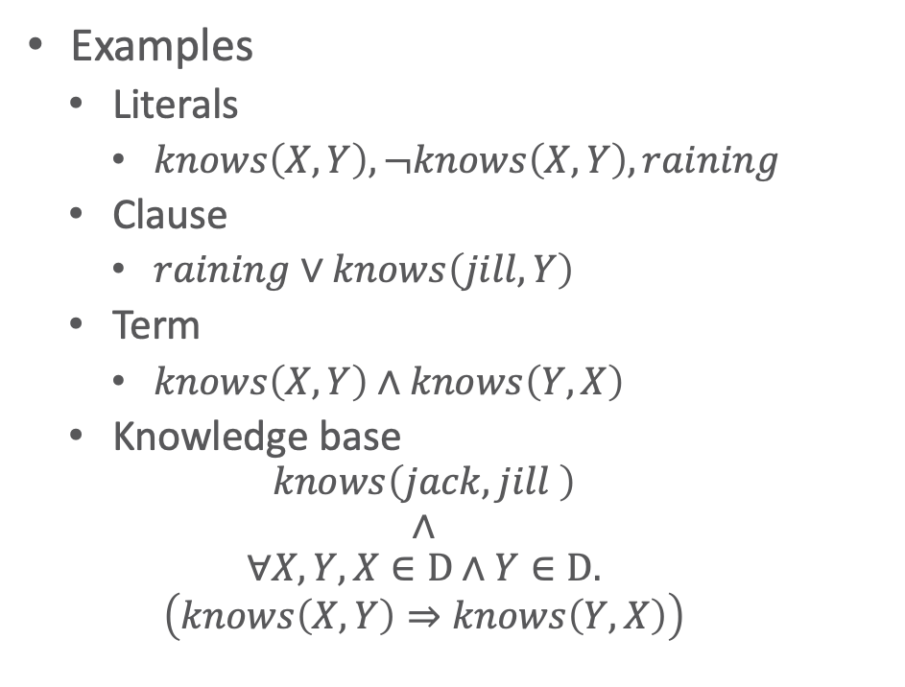

Further Terminology
Literal $l$
  Logical atom $a$ or its negation $¬a$
Clause
  Disjunction of literals
Theory in conjunctive normal form (CNF)
  Conjunction of clauses
Term
  Conjunction of literals
Theory in disjunctive normal form (DNF)
  Disjunction of terms
Theory or knowledge base
  Conjunction of formulas
Examples
  Literals
    $knows\left(X,Y\right), ¬knows\left(X,Y\right),raining$
  Clause
    $raining∨knows\left(jill,Y\right)$
  Term
    $knows\left(X,Y\right)∧knows\left(Y,X\right)$
  Knowledge base
    $$knows\left(jack, jill \right)$$
    $$∧$$
    $$∀X,Y,X∈D∧Y∈D.$$
    $$\left(knows\left(X,Y\right)⇒knows\left(Y,X\right)\right)$$

Slide 35

Semantics: Herbrand Base
Herbrand base
  Set of all grounded logical atoms that can be formed
  Leads to a propositional language
Instance
  Consistently replace every occurrence of a free variable with a constant
    Consistent replacement: If one occurrence of a variable replaced by a constant, then all occurrences of that variable replaced by the same constant
Example
  Herbrand base
    Constants: $jack,jill$
    Predicate: $knows/2$, $raining/0$
    $knows\left(jack,jill\right)$, $knows\left(jack,jack\right)$, $knows\left(jill,jack\right)$. $knows\left(jill,jill\right)$, $raining$
  Example instances
    $knows\left(X,Y\right)$
      $knows\left(jack,jill\right)$
      $knows\left(jill,jill\right)$
    $p\left(X\right)⇒q\left(X\right)$
      $p\left(a\right)⇒q\left(a\right)$

Slide 36

Semantics: Truth Assignment
Evaluation and satisfaction then work as before. Thus, properties may also hold or not and formulas may be compared (equivalence, entailment, consistency).
Truth assignments to a Herbrand base works as in propositional languages
  Propositional truth assignments
  Sentential truth assignments
    Same operator semantics
  Universally quantified formula true for a truth assignment if and only if every instance of the scope of the quantified formula is true for that assignment
  Existentially quantified formula is true for a truth assignment if and only if some instance of the scope of the quantified sentence is true for that assignment
Example
  Formula
    $$∀X,Y,X∈D∧Y∈D.$$
    $$\left(knows\left(X,Y\right)⇒knows\left(Y,X\right)\right)$$
  $knows\left(jack,jill\right)$, $knows\left(jack,jack\right)$, $knows\left(jill,jack\right)$. $knows\left(jill,jill\right)$
  Truth assignment $TTTT$
    Formula true
  Truth assignment $FTTF$
    Formula true
  Truth assignment $FTTT$
    Formula false

Slide 37
Interim Summary
Function-free first-order logic with domain constraints contains new constructs
  Logical variables
  Quantifiers
  Domain variables and domain constraints
  Quantifier equivalences
Semantics
  Herbrand base: grounding
  Interpretations work as before
    Quantifiers semantics
    Evaluation and satisfaction work as before
      Properties, comparison as well

Slide 38
Overview: 2. Modelling Formalisms
Logic
  Propositional logic: alphabet, grammar, normal forms, rules
  First-order logic: introducing quantifiers, domain constraints
Probabilistic Graphical Models (PGMs)
  Syntax, semantics, inference problems
  Correctness
Probabilistic Relational Models (PRMs)
  Parfactor models (PMs): motivation, syntax, semantics, graphical representation, inference tasks
  Markov logic networks (MLNs): Syntax, semantics of MLNs, graphical representation
  Turning MLNs into PMs and vice versa

