Slide 1
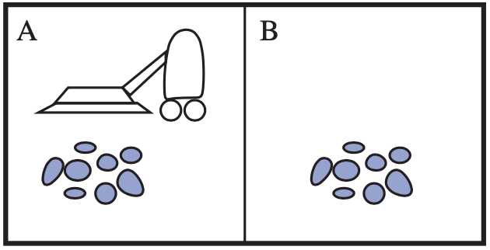
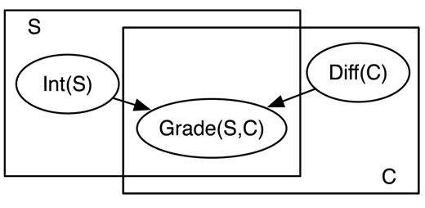


Introduction
Agent
Environment
Sensors
Percepts
?
Statistical Relational Artificial Intelligence
(StaRAI)
Actuators
Actions
$$∞ Presents\left(X, P, C\right)⇒Attends\left(X, C\right)$$
$$3.75 Publishes\left(X, C\right)∧FarAway\left(C\right)⇒Attends\left(X, C\right)$$
Tanya Braun

Slide 2
Contents
Introduction
  Notions of AI, agents, StaRAI
Modelling Formalisms
  Logic
  Probabilistic Graphical Models (PGMs)
  Probabilistic Relational Models (PRMs)
  Syntax, semantics, inference tasks
Inference
  Exact Inference
    (Weighted) Model Counting
    Variable Elimination
    Lifted Inference
  Approximate Inference
  Inference algorithms
Learning
  Relation learning in logic
  Parameter / structure learning for PGMs
  From PGMs to PRMs, PRM learning
Sequential Models and Inference
  Syntax, semantics, inference tasks, algorithms
Decision-theoretic Models and Inference
  Preferences, utility
  Syntax, semantics, inference task, algorithm

Slide 3
Overview: 1. Introduction
Artificial Intelligence (AI)
  Approaches: thinking / acting humanly / rationally
Framework: Agent Theory
  Agent
  Task environment
  Agent structure
Topic: Statistical Relational AI
  Motivation, context
  Relational examples, outlook on probabilistic relational models (PRMs)

Slide 4
Approaches to Artificial Intelligence (AI)
Success measure
Fidelity of human performance
Ideal performance measure rationality
All approaches researched
  Supported and hindered each other
Rationality
  System is rational if it does the “right thing,” given what it knows
Thinking Humanly | Thinking Rationally
“The exciting new effort to make computers think . . . machines with minds, in the full and literal sense.” (Haugeland, 1985) “[The automation of] activities that we associate with human thinking, activities such as decision-making, problem solving, learning…” (Bellman, 1978) | “The study of mental faculties through the use of computational models.” (Charniak and McDermott, 1985) “The study of the computations that make it possible to perceive, reason, and act.” (Winston, 1992)
Acting Humanly | Acting Rationally
“The art of creating machines that perform functions that require intelligence when performed by people.” (Kurzweil, 1990) “The study of how to make computers do things at which, at the moment, people are better.” (Rich and Knight, 1991) | “Computational Intelligence is the study of the design of intelligent agents.” (Poole et al., 1998) “AI … is concerned with intelligent behaviour in artefacts.” (Nilsson, 1998)
Thought
processes,
reasoning
Behaviour
S. Russel and P. Norvig: Artificial Intelligence – A Modern Approach, 2020.

Slide 5
Acting Humanly
Turing Test (Turing, 1950)
  Computer passes test, if a human, who asks written questions, cannot tell if the the written answers come from a human or not
    Example: Eliza, program for superficially simulating a psychiatrist
    See also Ch. 26, “Artificial Intelligence – A Modern Approach” by Russel & Norvig, including a discussion whether a computer would really be intelligent if it passed
      Regarding Eliza: human’s example closure tendencies are more pronounced for emotional/social intelligence aspects
                Cf. robot Shakey: No on who saw Shakey the first time thought it could shoot hoops, yet the first people interacting with Eliza assumed it was a real doctor
  Total Turing Test: includes a video signal to test perceptual abilities, opportunity to pass physical objects
https://en.wikipedia.org/wiki/ELIZA
https://thenewstack.io/remembering-shakey-first-intelligent-robot/
Notes:
Pass as a human

Slide 6
Acting Humanly
Subproblems to solve as part of the Turing Test
  Natural Language Processing
    Communication
  Knowledge representation
    Store knowledge and observations
  Automated reasoning
    Answer questions, draw new conclusions
  Machine learning
    Adapt to new circumstances, detect and extrapolate patterns
  Total Turing Test
    Computer vision: perceive objects
    Robotics: manipulate objects, move about
The Turing Test covers a majority of disciplines that make up AI nowadays.
But:
little research effort devoted to pass test
Instead:
Study underlying principles of intelligence
S. Russel and P. Norvig: Artificial Intelligence – A Modern Approach, 2020.
Notes:
natural language processing to enable it to communicate successfully in English;
knowledge representation to store what it knows or hears;
automated reasoning to use the stored information to answer questions and to draw new conclusions;
machine learning to adapt to new circumstances and to detect and extrapolate patterns.
computer vision to perceive objects, and
robotics to manipulate objects and move about.
The quest for “artificial flight” succeeded when the Wright brothers and others stopped imitating birds and started using wind tunnels and learning about aerodynamics. Aeronautical engineering texts do not define the goal of their field as making “machines that fly so exactly like pigeons that they can fool even other pigeons.”

Slide 7
Approaches to Artificial Intelligence (AI)
Success measure
Fidelity of human performance
Ideal performance measure rationality
All approaches followed
  Supported and hindered each other
Rationality
  System is rational if it does the “right thing,” given what it knows
Thinking Humanly | Thinking Rationally
“The exciting new effort to make computers think . . . machines with minds, in the full and literal sense.” (Haugeland, 1985) “[The automation of] activities that we associate with human thinking, activities such as decision-making, problem solving, learning…” (Bellman, 1978) | “The study of mental faculties through the use of computational models.” (Charniak and McDermott, 1985) “The study of the computations that make it possible to perceive, reason, and act.” (Winston, 1992)
Acting Humanly | Acting Rationally
“The art of creating machines that perform functions that require intelligence when performed by people.” (Kurzweil, 1990) “The study of how to make computers do things at which, at the moment, people are better.” (Rich and Knight, 1991) | “Computational Intelligence is the study of the design of intelligent agents.” (Poole et al., 1998) “AI … is concerned with intelligent behaviour in artefacts.” (Nilsson, 1998)
Thought
processes,
reasoning
Behaviour
S. Russel and P. Norvig: Artificial Intelligence – A Modern Approach, 2020.

Slide 8
Thinking Humanly
A “program thinks like a human“
  Requires a way to determine how humans think ➝ workings of the human mind
  Given theory of the mind, express theory as computer program
    If program’s input-output behaviour matches corresponding human behaviour, evidence that some of program’s mechanisms could also be operating in humans
Approach complementary to AI: Cognitive Science
  Interdisciplinary:
    Computer models from AI
    Experimental techniques from psychology
  Goal:
  Construct precise and testable theories of human mind
S. Russel and P. Norvig: Artificial Intelligence – A Modern Approach, 2020.

Slide 9
Approaches to Artificial Intelligence (AI)
Success measure
Fidelity of human performance
Ideal performance measure rationality
All approaches followed
  Supported and hindered each other
Rationality
  System is rational if it does the “right thing,” given what it knows
Thinking Humanly | Thinking Rationally
“The exciting new effort to make computers think . . . machines with minds, in the full and literal sense.” (Haugeland, 1985) “[The automation of] activities that we associate with human thinking, activities such as decision-making, problem solving, learning…” (Bellman, 1978) | “The study of mental faculties through the use of computational models.” (Charniak and McDermott, 1985) “The study of the computations that make it possible to perceive, reason, and act.” (Winston, 1992)
Acting Humanly | Acting Rationally
“The art of creating machines that perform functions that require intelligence when performed by people.” (Kurzweil, 1990) “The study of how to make computers do things at which, at the moment, people are better.” (Rich and Knight, 1991) | “Computational Intelligence is the study of the design of intelligent agents.” (Poole et al., 1998) “AI … is concerned with intelligent behaviour in artefacts.” (Nilsson, 1998)
Thought
processes,
reasoning
Behaviour
S. Russel and P. Norvig: Artificial Intelligence – A Modern Approach, 2020.

Slide 10
Thinking Rationally
Codify thinking ➝ rules
  Irrefutable reasoning processes
  Argument structures that always yield correct conclusions when given correct premises
Field of Logic
  Precise notation for statements about objects in a world and relations among them
  Programs that could, in principle, solve any solvable problem described in logical notation
  Obstacles:
    Informal knowledge
      Unstructured data
      Uncertainty
    Solving any solvable problem in practice
      Limited computational resources
Obstacles apply to any attempt to build computational reasoning systems
Formulated first in logic
S. Russel and P. Norvig: Artificial Intelligence – A Modern Approach, 2020.
Notes:
Greek philosopher Aristotle was one of the first to attempt to codify “right thinking,” that is, irrefutable reasoning processes. His syllogisms provided patterns for argument structures that always yielded correct conclusions when given correct premises—for example, “Socrates is a man; all men are mortal; therefore, Socrates is mortal.” These laws of thought were supposed to govern the operation of the mind

Slide 11
Approaches to Artificial Intelligence (AI)
Success measure
Fidelity of human performance
Ideal performance measure rationality
All approaches followed
  Supported and hindered each other
Rationality
  System is rational if it does the “right thing,” given what it knows
Thinking Humanly | Thinking Rationally
“The exciting new effort to make computers think . . . machines with minds, in the full and literal sense.” (Haugeland, 1985) “[The automation of] activities that we associate with human thinking, activities such as decision-making, problem solving, learning…” (Bellman, 1978) | “The study of mental faculties through the use of computational models.” (Charniak and McDermott, 1985) “The study of the computations that make it possible to perceive, reason, and act.” (Winston, 1992)
Acting Humanly | Acting Rationally
“The art of creating machines that perform functions that require intelligence when performed by people.” (Kurzweil, 1990) “The study of how to make computers do things at which, at the moment, people are better.” (Rich and Knight, 1991) | “Computational Intelligence is the study of the design of intelligent agents.” (Poole et al., 1998) “AI … is concerned with intelligent behaviour in artefacts.” (Nilsson, 1998)
Thought
processes,
reasoning
Behaviour
S. Russel and P. Norvig: Artificial Intelligence – A Modern Approach, 2020.

Slide 12
Acting Rationally
Rational agent approach
Agent = something that acts
  Operate autonomously
  Perceive environment
  Persist over a prolonged time period
  Adapt to change
  Create and pursue goals
Rational agent
  One that acts so as to achieve the best outcome or, when there is uncertainty, the best expected outcome
  May include thinking rationally or acting humanly, but more general
Advantage: Standard of rationality mathematically well defined
Better suited to generate agent designs that provably achieve rationality
Focus of the next slides
S. Russel and P. Norvig: Artificial Intelligence – A Modern Approach, 2020.
Notes:
Korrektes Schlussfolgern nur einen Mechanismus von vielen zur Erzielung der Rationalität
Eher geeignet, den Fortschritt zu befördern als Ansätze, die sich menschliches Handeln zum Vorbild nehmen oder auf menschlichen Gedanken basieren
Menschliche Verhalten an eine bestimmte Umgebung gut angepasst und praktisch durch die Summe der Dinge definiert, die Menschen tun

Slide 13
Interim Summary
Four approaches to define AI
  Acting humanly
    Turing test
    Subproblems: Natural language processing, knowledge representation, reasoning, machine learning, computer vision, robotics
  Thinking humanly
    Cognitive sciences as an interdisciplinary science between AI and psychology
  Thinking rationally
    Logic for knowledge representation and correct reasoning
  Acting rationally
    Rational agent as a generalisation of thinking rationally with a mathematical definition of rationality as a formal criterion
    Also contains subproblems, which the Turing test identifies
S. Russel and P. Norvig: Artificial Intelligence – A Modern Approach, 2020.

Slide 14
Overview: 1. Introduction
Artificial Intelligence
  Approaches: thinking / acting humanly / rationally
Framework: Agent Theory
  Agent
  Task environment
  Agent structure
Topic: StaRAI
  Motivation, context
  Relational examples, outlook on probabilistic relational models (PRMs)

Slide 15
Agent
Something that perceives its environment through sensors and acts through actuators
  Human agent
    Sensors: eyes, ears, further organs
    Actuators: hands, legs, mouth, other body parts
  Robot agent
    Sensors: cameras, infra-red sensors, etc.
    Actuators: motors
  Software agent
    Goal: document retrieval, DR
    Sensors: input interface for textual queries
    Actuators: output interface for documents
Agent
Environment
Sensors
Percepts
?
Actions
Actuators
S. Russel and P. Norvig: Artificial Intelligence – A Modern Approach, 2020.

Slide 16
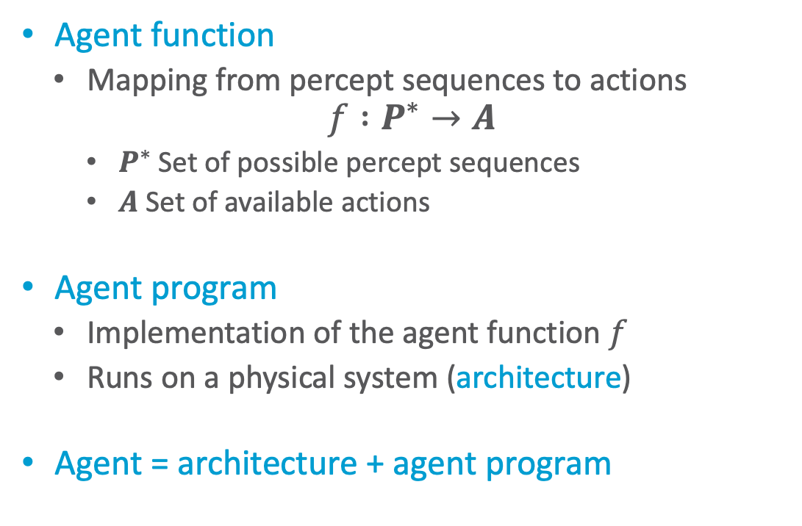
Agent Behaviour
Agent function
  Mapping from percept sequences to actions
$$f :P^{∗}→A$$
    $P^{∗}$ Set of possible percept sequences
    $A$ Set of available actions
Agent program
  Implementation of the agent function $f$
  Runs on a physical system (architecture)
Agent = architecture + agent program
Agent
Environment
Sensors
Percepts
?
Actions
Actuators
S. Russel and P. Norvig: Artificial Intelligence – A Modern Approach, 2020.
Notes:
Bildverarbeitung/NN: Abfolge der Pixel, Aktion: Klassifikation
Roboter: Videobildsequenz, andere Sensorwerte, Aktion: Bewegung
Doc. Retr.: Dok (Sequenz von Worten); Aktion: Auswahl von Dokumenten

Slide 17
Simple Example
Vacuum cleaner
  Two locations: squares A, B
  Possible percepts: location; location clean, dirty
  Available actions: right, left, vacuum
Agent function in table
  Mapping increasingly longer percept sequences to actions
    Optimisable, as action only depends on last observation (and not the sequence)
  How table is filled defines the agent
    Different agents possible
Percept sequence | Action
[A, Clean] | Right
[A, Dirty] | Vacuum
[B, Clean] | Left
[B, Dirty] | Vacuum
[A, Clean], [A, Clean] | Right
[A, Clean], [A, Dirty] | Vacuum
… | …
[A, Clean], [A, Clean], [A, Clean] | Right
[A, Clean], [A, Clean], [A, Dirty] | Vacuum
… | …
S. Russel and P. Norvig: Artificial Intelligence – A Modern Approach, 2020.

Slide 18
Rationality
Rationality is not omniscience!
Depends on four things:
  Performance measure, defines criterion of success
  Agent’s prior knowledge of environment
  Actions that agent can perform
  Agent’s percept sequence to date
Rational agent:
  For each possible percept sequence, a rational agent should select an action
  expected to maximize its performance measure,
  given evidence provided by percept sequence and
  whatever built-in knowledge the agent has.
➝ Rational = intelligent
Agent
Environment
Sensors
Percepts
?
Actions
Actuators
Notes:
What is rational at any given time depends on four things:
• The performance measure that defines the criterion of success.
• The agent’s prior knowledge of the environment.
• The actions that the agent can perform.
• The agent’s percept sequence to date.

Slide 19
Further Agent Properties
Properties that agent behaviour can exhibit:
  Rationality
  Flexibility
    Reactive
    Proactive
    Social (in multi-agent systems)
  Autonomy
  Mobility
  Veracity
  Benevolence
  Ability to learn / adapt
Agent
Environment
Sensors
Percepts
?
Actions
Actuators
Notes:
Veracity: no knowingly false information passed along
Benevolence: agents do what is expected of them

Slide 20
Task Environment
Task environments
  Essentially the “problems” to which rational agents are the “solutions”
  Specify using PEAS description
    Performance measure
    Environment
    Actuators
    Sensors
Properties of task environment
Modelling the environment
Determine agent design
Attention: Name collision between
task environment und environment.
We will after this part usually only talk about the environment.
S. Russel and P. Norvig: Artificial Intelligence – A Modern Approach, 2020.

Slide 21
PEAS – Example
Medical diagnosis system
Software agent for document retrieval, DR
  Sensors: input interface for textual queries
  Actuators: output interface for documents
Agent Type | Performance Measure | Environment | Actuators | Sensors
Medical diagnosis system | Healthy patient, reduced costs | Patient, hospital, staff | Display of questions, tests, diagnoses, treatments, referrals | Keyboard entry of symptoms, findings, patient’s answers
What makes up the environment? What is a fitting performance measure?
S. Russel and P. Norvig: Artificial Intelligence – A Modern Approach, 2020.
Notes:
Um optimal zu arbeiten, braucht er Verarbeitungsfähigkeiten für natürliche Sprache, er muss lernen, woran jeder Benutzer und Inserent interessiert ist, und er muss seine Pläne dynamisch ändern können – wenn beispielsweise die Verbindung zu einer Nachrichtenquelle ausfällt oder wenn eine neue Quelle online geht. Das Internet ist eine Umgebung, deren Komplexität der physischen Welt gleichkommt und zu deren Einwohnern viele künstliche und menschliche Agenten gehören.

Slide 22
Properties of Task Environments
Fully observable (vs. partially observable)
  Agent‘s sensors give access to complete state of environment at each point in time
Single agent (vs. multiple agents)
  Single agent acts in environment
  Can depend on modelling if something in environment is an object or another agent
  Multi-agent systems:
    Cooperative vs. competitive
    Communication possible?
Deterministic (vs. stochastic)
  Next state of environment completely determined by current state and action executed by agent
  Strategic: if environment deterministic except for actions of other agents
S. Russel and P. Norvig: Artificial Intelligence – A Modern Approach, 2020.

Slide 23
Properties of Task Environments
Special property: known (vs. unknown)
Agent’s (or designer’s) state of knowledge about its environment beforehand
No property of the environment
Episodic (vs. sequential)
  Agent‘s experience divided into atomic “episodes”
    Episode = agent perceives a single percept and then performs a single action
  Choice of action in each episode depends only on episode itself
Static (vs. dynamic)
  Environment unchanged while agent is deliberating
  Semi-dynamic: environment itself does not change with passage of time but agent's performance score does
Discrete (vs. continuous)
  Applies to state of the environment, to the way time is handled, and to the percepts and actions
  Finite number of distinct states, percepts, actions, time steps
S. Russel and P. Norvig: Artificial Intelligence – A Modern Approach, 2020.

Slide 24
Properties of Task Environments – Example
Task environment | Observable | Single agent | Deterministic | Episodic | Static | Discrete
Medical diagnosis | Partially | Single | Stochastic | Sequential | Dynamic | Continuous
Self-driving taxi | Partially | Multi | Stochastic | Sequential | Dynamic | Continuous
Chess with a clock | Fully | Multi | Deterministic | Sequential | Semi | Discrete
How about image classification?
S. Russel and P. Norvig: Artificial Intelligence – A Modern Approach, 2020.
Notes:
Wir haben die Aufgabe der medizinischen Diagnose als Einzelagent eingeordnet, weil der Krankheitsprozess eines Patienten nicht profitabel als Agent modelliert wird; ein System zur medizinischen Diagnose könnte jedoch auch mit widerspenstigen Patienten und einem skeptischen Team zu tun haben, sodass die Umgebung auch einen Multiagentenaspekt haben könnte. Darüber hinaus ist die medizinische Diagnose episodisch, wenn man die Aufgabe als Auswahl einer Diagnose anhand einer gegebenen Liste von Symptomen betrachtet; das Problem ist sequenziell, wenn die Aufgabe den Vorschlag einer Testreihe, die Auswertung von Fortschritten im Laufe der Behandlung usw. beinhalten kann
Image classification: Fully Single Deterministic Episodic Semi Continuous

Slide 25
Representation of the Environment
Depends on properties of the task environment
  Discrete/continuous, static/dynamic, episodic/sequential, ...
Determine expressiveness of representation
  Increasing complexity and expressiveness
  Atomic
    Each state not further dividable (no internal structure)
  Factorised
    Partitioning of state into fixed set of variables / attributes that can take a value
    Representation: state-variable models, propositional logic, probabilistic graphical models (PGMs)
  Structured
    Objects, relations among them
    Representation: relational databases + PGMs, first-order logic
    Advertisement:
    Lecture „Automated Planning and Acting“
    This lecture on StaRAI!
S. Russel and P. Norvig: Artificial Intelligence – A Modern Approach, 2020.

Slide 26
Performance Measure: Good Behaviour
What is the right thing to do?
  Agent generates sequence of actions given percepts
  Causes environment to go through sequence of states
  If sequence desirable / conforms to our expectations, then agent performed well
Performance measure that evaluates any given sequence of environemnt states
Agent
Environment
Sensors
Percepts
?
Actions
Actuators
S. Russel and P. Norvig: Artificial Intelligence – A Modern Approach, 2020.

Slide 27
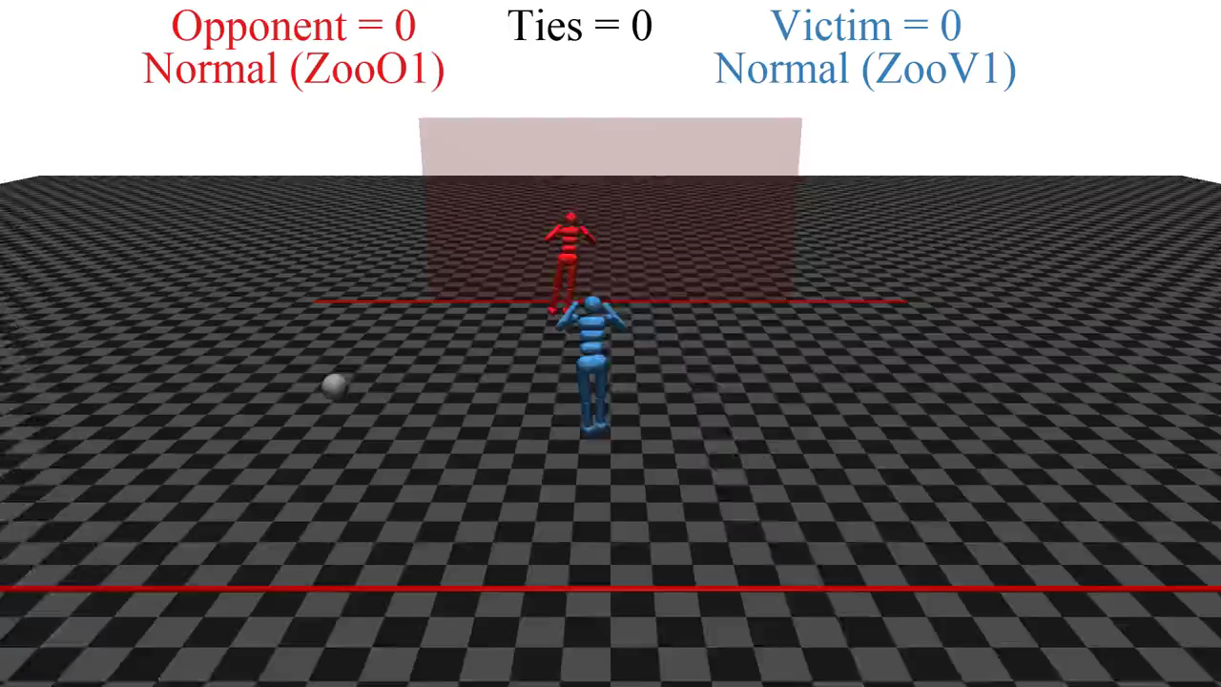
Quelle: https://people.eecs.berkeley.edu/~russell/talks/2020/russell-aaai20-hntdtwwai-4x3.pptx
Notes:
Open AI
RL 1-2 hrs (one goalie, one shooter)
two simulated robots

Slide 28
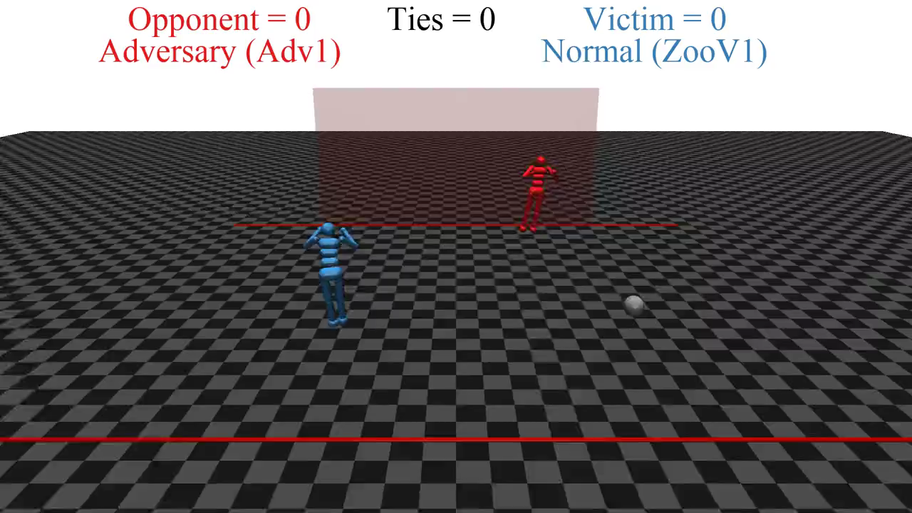
Quelle: https://people.eecs.berkeley.edu/~russell/talks/2020/russell-aaai20-hntdtwwai-4x3.pptx
Notes:
Keep blue robot as is
Red robot continues to learn

Slide 29
Performance Measure
Amount of dirt?
Hard to determine
  Not one fixed performance measure for all tasks and agents
Clean locations?
Percept sequence | Action
[A, Clean] | Right
[A, Dirty] | Vacuum
[B, Clean] | Left
[B, Dirty] | Vacuum
[A, Clean], [A, Clean] | Right
[A, Clean], [A, Dirty] | Vacuum
… | …
[A, Clean], [A, Clean], [A, Clean] | Right
[A, Clean], [A, Clean], [A, Dirty] | Vacuum
… | …
As a general rule, it is better to design performance measures according to what one actually wants in the environment, rather than according to how one thinks the agent should behave.
S. Russel and P. Norvig: Artificial Intelligence – A Modern Approach, 2020.
Notes:
Wenn wir Erfolg als Meinung des Agenten zu seiner eigenen Leistung definieren, könnte ein Agent perfekte Rationalität erreichen, indem er einfach von sich selbst behauptet, seine Leistung sei perfekt.
We might propose to measure performance by the amount of dirt cleaned up in a single eight-hour shift. With a rational agent, of course, what you ask for is what you get. A rational agent can maximize this performance measure by cleaning up the dirt, then dumping it all on the floor, then cleaning it up again, and so on. A more suitable performance measure would reward the agent for having a clean floor
Beispielsweise könnte je ein Punkt für jedes saubere Quadrat pro Zeitschritt erteilt werden (und vielleicht Strafpunkte für verbrauchte Elektrizität und erzeugten Lärm).

Slide 30
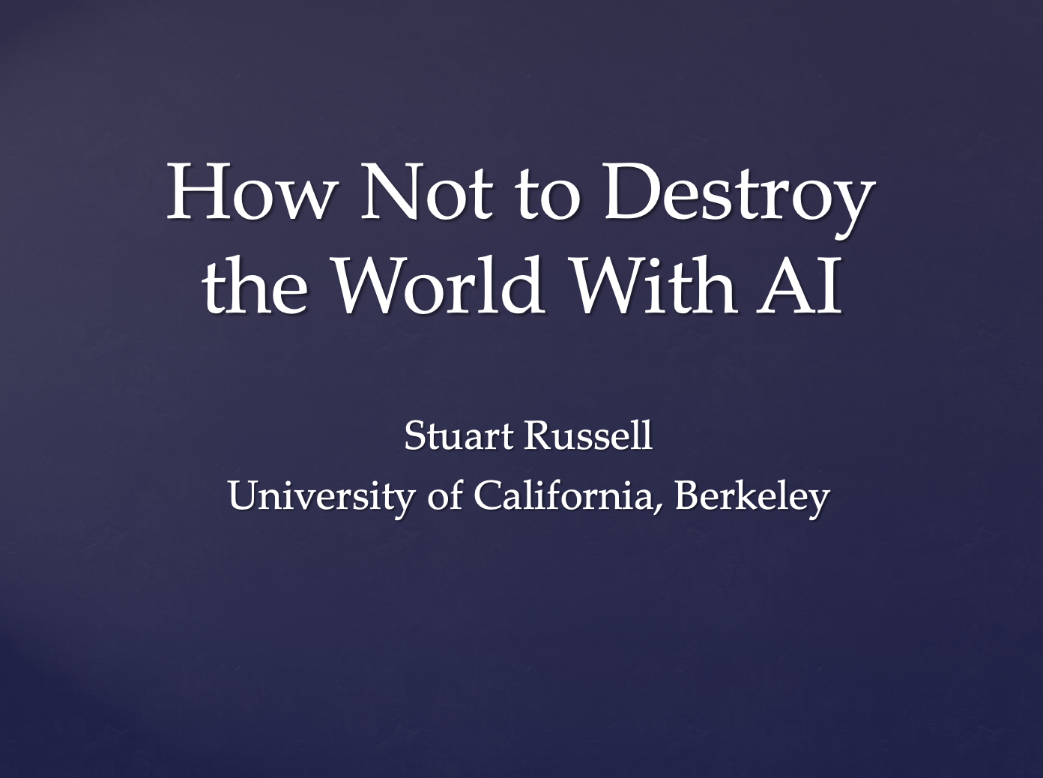
Side Note: Current Research
Idea:
    Humans: intelligent to the extent that our actions can be expected to achieve our goals
    Maschines: intelligent to the extent that their actions can be expected to achieve their goals
    Maschines are beneficial to the extent that their actions can be expected to achieve our goals n
  Approach: Performance measure unknown, human as assistant
Goal: Provably beneficial AI
  See for example Stuart Russell
Human goal
Human behaviour
Agent behaviour
Presentation: https://www.youtube.com/watch?v=QPSgM13hTK8
Slides: https://people.eecs.berkeley.edu/~russell/talks/2020/russell-aaai20-hntdtwwai-4x3.pptx

Slide 31
Implementing Agents
Agent = architecture + program
  Architecture
    Entity with corresponding physical sensors and actuators
      Entity = computer, robot, software (interfaces as sensors and actuators)
  Program
    Implementation of an agent function
    Runs on an architecture
  Both depend on task environment
Implementation necessary, but how?
Agent
Environment
Sensors
Percepts
?
Actions
Actuators
S. Russel and P. Norvig: Artificial Intelligence – A Modern Approach, 2020.

Slide 32
Agent Structure
General agent structures for implementing agent functions:
  Ordered by increasing generalisation
  Simple reflex agent
  Model-based reflex agent
  Goal-based agent
  Utility-based agent
  Learning agent
  Human-aware agent (current research)
Agent
Environment
Sensors
Percepts
?
Actions
Actuators
S. Russel and P. Norvig: Artificial Intelligence – A Modern Approach, 2020.

Slide 33
Agent Structure: Simple Reflex Agent
Actions chosen based on current percept
  Ignores previous percepts
  No modelling of the environemnt
Only correct decision on action if environment fully observable
  If partially observable, inifinite loops possible
    (Partial) solution:
    Choose random action
Agent
Environemnt
Sensors
What the world
is like now
Condition-action rules
What action I
should do now
Actuators
S. Russel and P. Norvig: Artificial Intelligence – A Modern Approach, 2020.

Slide 34
Agent Structure: Model-based Reflex Agent
Given partial observability, keep track of not observable part
  Using internal state
    Depends on percept sequence
    Encode not observable aspects of the current state
      Encoding of environment atomic, factorised or structured
Update internal state with information over
  How environment evolves independently of agent
  Effect of actions on environment
Agent
Environment
Sensors
State
What the world
looks like now
How the world evolves
What my actions do
Condition-action rules
What action I
should do now
Actuators
S. Russel and P. Norvig: Artificial Intelligence – A Modern Approach, 2020.

Slide 35
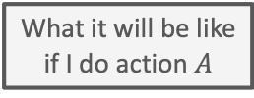
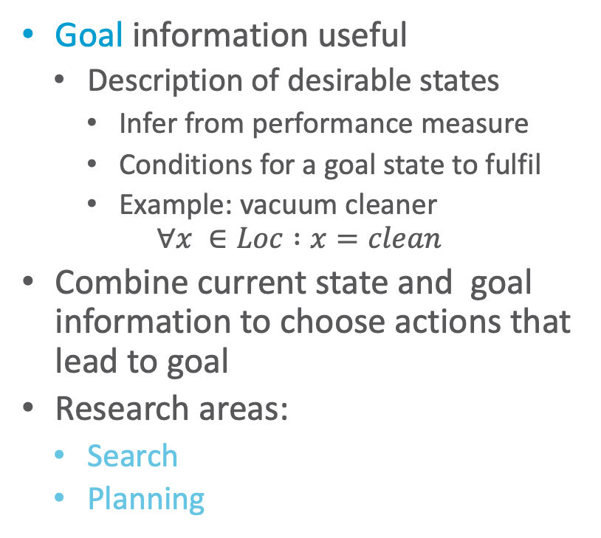
Agent Structure: Goal-based Agent
Goal information useful
  Description of desirable states
    Infer from performance measure
    Conditions for a goal state to fulfil
    Example: vacuum cleaner
    $$∀x ∈Loc :x=clean$$
Combine current state and goal information to choose actions that lead to goal
Research areas:
  Search
  Planning
Agent
Environment
Sensors
State
What the world
is like now
How the world evolves
What my actions do
What it will be like
if I do action $A$
Goals
What action I
should do now
Actuators
S. Russel and P. Norvig: Artificial Intelligence – A Modern Approach, 2020.

Slide 36
Agent Structure: Utility-based Agent
Goal-based: binary distinction between happy and unhappy
Utility as a distribution over possible states
  What we look at later in the lecture
  Essentially an internalisation of the performance measure
    If internal utility function agrees with external performance measure:
    Agent that chooses actions to maximize its utility will be rational according to the external performance measure
Agent
Environment
Sensors
State
What the world
is like now
How the world evolves
What my actions do
What it will be like
if I do action $A$
Utility
How happy I will be
in such a state
What action I
should do now
Actuators
S. Russel and P. Norvig: Artificial Intelligence – A Modern Approach, 2020.
Notes:
Conflicting goals ➝ allows for trade-off
Several goals that each cannot be reached with certainty ➝ weigh likelihood of success against importance of goals

Slide 37
Agent Structure: Learning Agent
Performance standard
So far: Agents select actions
  Make decisions about actions
How do agent programs emerge?
  Too laborious to do by hand
Generate learning agent, let it learn
  Allows agent to operate in initially unknown environments and to become more competent
  Research area:
  Reinforcement Learning
Agent
Environment
Critic
Sensors
feedback
Learning
element
changes
Performance
element
knowledge
learning
goals
Problem
generator
    Advertisement: Lecture „Deep Reinforcement Learning“ (PI, 4) by Malte Schilling
Actuators
S. Russel and P. Norvig: Artificial Intelligence – A Modern Approach, 2020.
Notes:
In seinem berühmten frühen Aufsatz betrachtet Turing (1950) die Idee, seine intelligenten Maschinen tatsächlich manuell zu programmieren. Er schätzt, wie viel Arbeit das bedeuten würde, und kommt zu dem Schluss: „Eine schnellere Methode scheint wünschenswert“

Slide 38
Agent Structure: Learning Agent
Performance standard
4 conceptual components
  Learning element
    Make improvements
  Performance element (agent so far)
    Select actions
  Critic
    Feedback on results
    Used by learning element to determine how performance element should be modified to do better
  Problem generator (for exploration)
    Suggest actions that will lead to new and informative experiences
Agent
Environment
Critic
Sensors
feedback
Learning
element
changes
Performance
element
knowledge
learning
goals
Problem
generator
Actuators
S. Russel and P. Norvig: Artificial Intelligence – A Modern Approach, 2020.
Notes:
Wenn wir versuchen, einen Agenten zu entwerfen, der eine bestimmte Fertigkeit erlernt, ist die erste Frage nicht: „Wie schaffe ich es, dies zu lernen?“, sondern: „Welche Art Leistungselement braucht mein Agent, um dies zu tun, nachdem er gelernt hat?“
Beispiel des automatisierten Taxis zurückkommen. Das Leistungselement besteht aus einer Sammlung von Wissen und Prozeduren, die dem Taxi zur Auswahl seiner Fahrtaktionen zur Verfügung stehen. Das Taxi gelangt auf die Straße und fährt unter Verwendung dieses Leistungselementes. Die Kritik beobachtet die Welt und gibt Informationen an das Lernelement weiter. Nachdem das Taxi beispielsweise schnell über drei Spuren hinweg links abgebogen ist, beobachtet die Kritik die Beschimpfungen durch andere Fahrer. Aus dieser Erfahrung kann das Lernelement eine Regel formulieren, die besagt, dass dies eine schlechte Aktion war, und das Leistungselement wird verändert, indem die neue Regel installiert wird. Der Problemgenerator könnte bestimmte Verhaltensbereiche identifizieren, die verbessert werden müssen, und Experimente vorschlagen, wie beispielsweise das Ausprobieren von Bremsen auf unterschiedlichen Straßenbelägen unter unterschiedlichen Bedingungen.
RL: Der Taxifahrer-Agent erhält keinerlei Trinkgeld von den Fahrgästen, die während der Fahrt völlig durchgeschüttelt wurden. Der externe Leistungsstandard muss den Agenten darüber informieren, dass der Verlust von Trinkgeldern ein negativer Beitrag zu seiner Gesamtleistung ist. Auf diese Weise könnte der Agent lernen, dass aggressive Manöver nicht zu seinem eigenen Nutzen beitragen. In gewisser Weise identifiziert der Leistungsstandard einen Teil der eintreffenden Wahrnehmung als Belohnung (oder Strafe), die ein direktes Feedback zur Qualität des Verhaltens des Agenten bereitstellt.

Slide 39
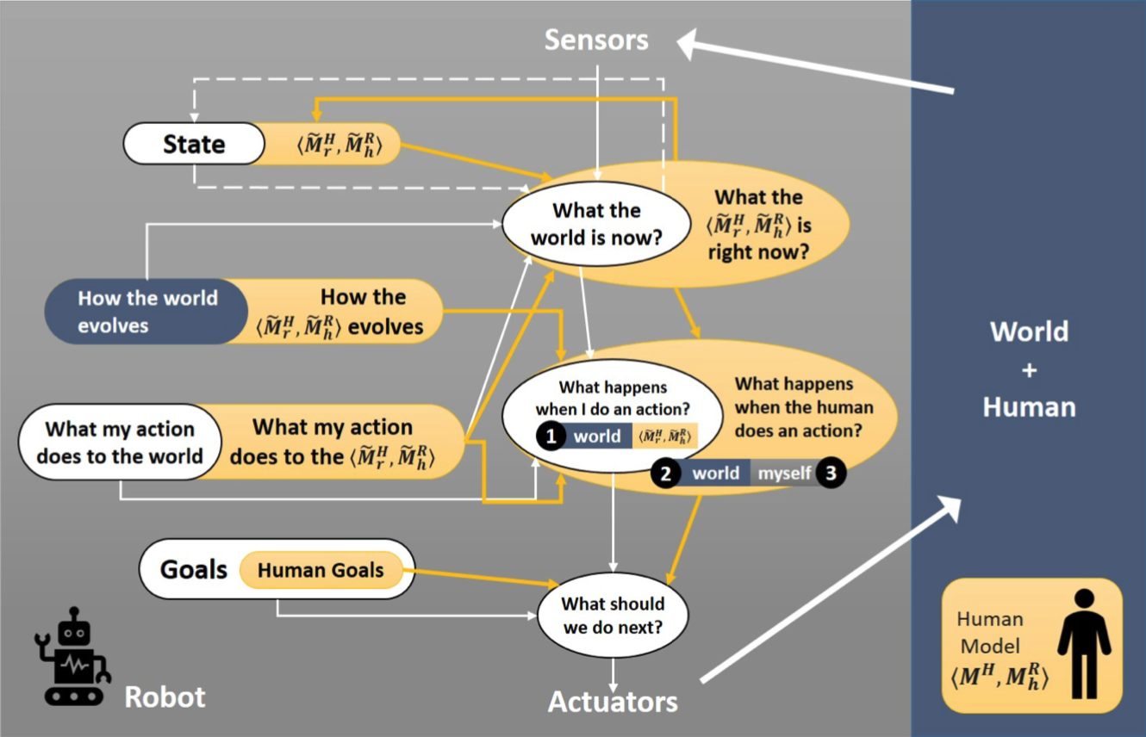
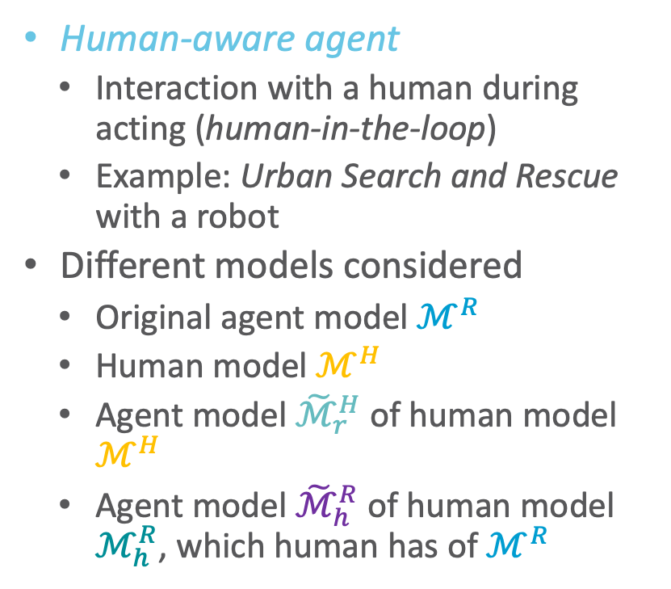
Side Note: Current Research
Human-aware agent
  Interaction with a human during acting (human-in-the-loop)
  Example: Urban Search and Rescue with a robot
Different models considered
  Original agent model $ℳ^{R}$
  Human model $ℳ^{H}$
  Agent model ${\tilde{ℳ}}_{r}^{H}$ of human model $ℳ^{H}$
  Agent model ${\tilde{ℳ}}_{h}^{R}$ of human model $ℳ_{h}^{R}$, which human has of $ℳ^{R}$
http://bit.ly/3bno2io
Notes:
Darstellung als Erweiterung des zielbasierten Agenten

Slide 40



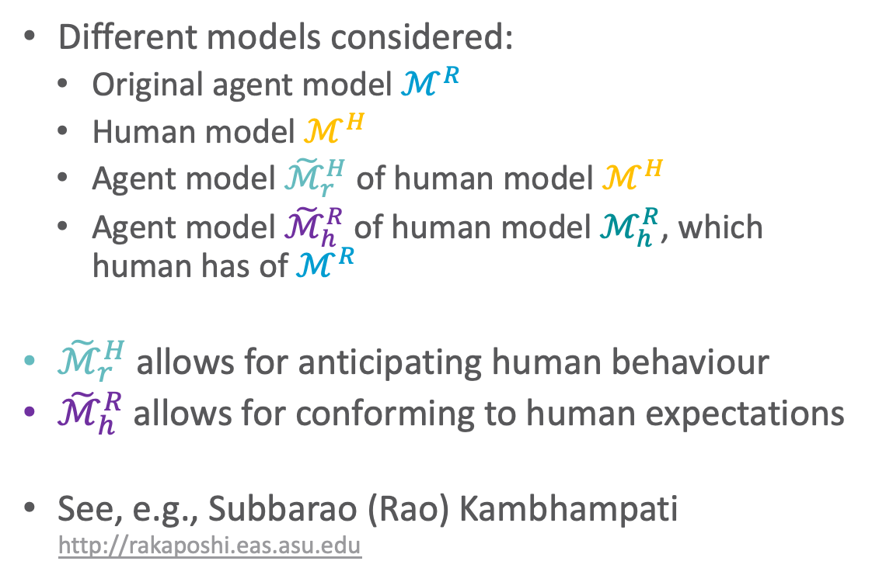


Side Note: Current Research
Different models considered:
  Original agent model $ℳ^{R}$
  Human model $ℳ^{H}$
  Agent model ${\tilde{ℳ}}_{r}^{H}$ of human model $ℳ^{H}$
  Agent model ${\tilde{ℳ}}_{h}^{R}$ of human model $ℳ_{h}^{R}$, which human has of $ℳ^{R}$
${\tilde{ℳ}}_{r}^{H}$ allows for anticipating human behaviour
${\tilde{ℳ}}_{h}^{R}$ allows for conforming to human expectations
See, e.g., Subbarao (Rao) Kambhampati
http://rakaposhi.eas.asu.edu
$${\tilde{ℳ}}_{h}^{R}$$
$${\tilde{ℳ}}_{r}^{H}$$
$$ℳ_{h}^{R}$$
$$ℳ^{H}$$
$$ℳ^{R}$$
http://bit.ly/3bno2io

Slide 41
Interim Summary
Agent = architecture + agent program
Task environment
  Description: PEAS
    Performance measure not easy to formalise
  Properties of task environment
    Fully observable (vs. partially observable); single agent (vs. multiple agents); deterministic (vs. stochastic), strategic; episodic (vs. sequential); static (vs. dynamic), semi-dynamic; discrete (vs. continuous); special: known (vs. unknown)
  Environment encoding
    Atomic, factorised, structured
Agent structure
  Simple / model-based reflex agent, goal- / utility-based agent; learning agent

Slide 42
Overview: 1. Introduction
Artificial Intelligence
  Approaches: thinking / acting humanly / rationally
Framework: Agent Theory
  Agent
  Task environment
  Agent structure
Topic: StaRAI
  Motivation, context
  Relational examples, outlook on probabilistic relational models (PRMs)

Slide 43
Connection to AI, Agents, and Environments
AI: intelligent systems in the real world
The world has things in it!
The world is uncertain!
Probabilistic graphical models
First-order logic
The world is uncertain!
The world has things in it!
First-order probabilistic languages
Figure based on Stuart Russell
Notes:
Bayes nets, markov networks, factor graphs

Slide 44
Connection to AI, Agents, and Environments
AI: intelligent systems in the real world
The world has things in it!
The world is uncertain!
Probabilistic graphical models
First-order logic
The world is uncertain!
The world has things in it!
First-order probabilistic languages
Figure based on Stuart Russell
Notes:
Bayes nets, markov networks, factor graphs

Slide 45
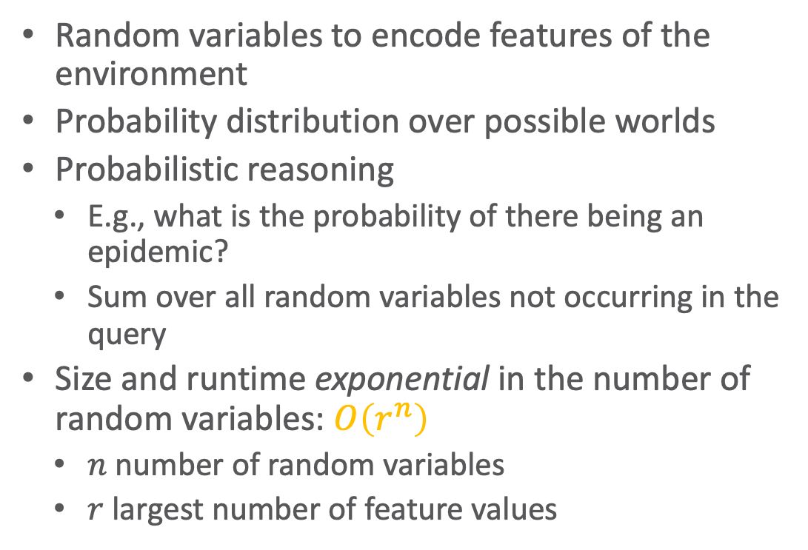



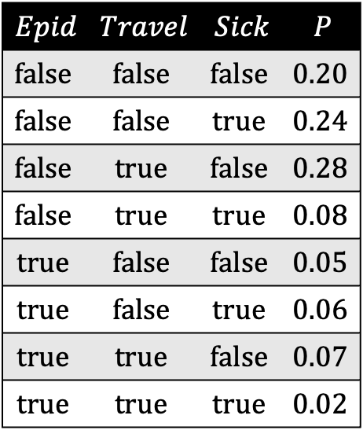
The World is Uncertain: Probability Distribution
Random variables to encode features of the environment
Probability distribution over possible worlds
Probabilistic reasoning
  E.g., what is the probability of there being an epidemic?
  Sum over all random variables not occurring in the query
Size and runtime exponential in the number of random variables: $O\left(r^{n}\right)$
  $n$ number of random variables
  $r$ largest number of feature values
$$Epid$$ | $$P$$
$$Epid$$ | $$Travel$$ | $$Sick$$ | $$P$$
$$false$$ | $$false$$ | $$false$$ | $$0.20$$
$$false$$ | $$false$$ | $$true$$ | $$0.24$$
$$false$$ | $$true$$ | $$false$$ | $$0.28$$
$$false$$ | $$true$$ | $$true$$ | $$0.08$$
$$true$$ | $$false$$ | $$false$$ | $$0.05$$
$$true$$ | $$false$$ | $$true$$ | $$0.06$$
$$true$$ | $$true$$ | $$false$$ | $$0.07$$
$$true$$ | $$true$$ | $$true$$ | $$0.02$$
$$false$$ | $$0.80$$
+
$$true$$ | $$0.20$$
+
Full joint probability distribution

Slide 46








Probabilistic Graphical Models (PGMs)
Factorisation of a full joint according to (conditional) independences in the full joint
$$Epid$$ | $$Travel$$ | $$Sick$$ | $$P$$
$$false$$ | $$false$$ | $$false$$ | $$0.20$$
$$false$$ | $$false$$ | $$true$$ | $$0.24$$
$$false$$ | $$true$$ | $$false$$ | $$0.28$$
$$false$$ | $$true$$ | $$true$$ | $$0.08$$
$$true$$ | $$false$$ | $$false$$ | $$0.05$$
$$true$$ | $$false$$ | $$true$$ | $$0.06$$
$$true$$ | $$true$$ | $$false$$ | $$0.07$$
$$true$$ | $$true$$ | $$true$$ | $$0.02$$
$$Epid$$
$$Epid$$
$$Travel$$
$$Sick$$
$$Travel$$
$$Sick$$
Factor graph (FG)
$$Epid$$
Markov network (MN)
$$Travel$$
$$Sick$$
Bayesian network (BN)
Full joint probability distribution

Slide 47

















Problem: Adding Objects and Relations in Propositional Formalisms Clunky…
$$Acc\text{.}chem$$
$$Acc\text{.}nucl$$
$$f_{1}$$
$$Nat\text{.}flood$$
$$f_{1}$$
$$f_{1}$$
$$Nat\text{.}fire$$
$$f_{1}$$
$$Epid$$
$$f_{0}$$
$$f_{2}$$
$$f_{3}$$
$$Treat\text{.}eve\text{.}m_{1}$$
$$f_{3}$$
$$Sick\text{.}eve$$
$$Travel\text{.}eve$$
$$Treat\text{.}eve\text{.}m_{2}$$

Slide 48












Problem: … and Models Explode with Them
$$Acc\text{.}chem$$
And an epidemic depends on more than three people. One would want to have populations of millions…
$$Acc\text{.}nucl$$
$$f_{1}$$
$$Nat\text{.}flood$$
$$f_{1}$$
$$f_{1}$$
$$Nat\text{.}fire$$
$$f_{1}$$
$$f_{2}$$
$$f_{2}$$
$$f_{3}$$
$$Epid$$
$$f_{0}$$
$$f_{3}$$
$$Treat\text{.}alice\text{.}m_{1}$$
$$Treat\text{.}bob\text{.}m_{1}$$
$$Travel\text{.}alice$$
$$Travel.bob$$
$$Sick\text{.}alice$$
$$f_{3}$$
$$f_{3}$$
$$Sick\text{.}bob$$
$$f_{2}$$
$$f_{3}$$
$$Treat\text{.}eve\text{.}m_{1}$$
$$f_{3}$$
$$Treat\text{.}alice\text{.}m_{2}$$
$$Treat\text{.}bob\text{.}m_{2}$$
$$Sick\text{.}eve$$
$$Travel\text{.}eve$$
$$Treat\text{.}eve\text{.}m_{2}$$

Slide 49





































Propositional ➝ First-order View
$$Nat\left(D\right)$$
$$Acc\left(A\right)$$
$$g_{1}$$
$$Epid$$
$$g_{0}$$
$$Travel\left(X\right)$$
$$Treat\left(X,M\right)$$
$$Acc\text{.}chem$$
$$g_{2}$$
$$g_{3}$$
$$Acc\text{.}nucl$$
$$Sick\left(X\right)$$
$$f_{1}$$
$$Nat\text{.}flood$$
$$f_{1}$$
$$f_{1}$$
$$Nat\text{.}fire$$
$$f_{1}$$
$$f_{2}$$
$$f_{2}$$
$$f_{3}$$
$$Epid$$
$$f_{0}$$
$$f_{3}$$
$$Treat\text{.}alice\text{.}m_{1}$$
$$Treat\text{.}bob\text{.}m_{1}$$
$$Travel\text{.}alice$$
$$Travel.bob$$
$$Sick\text{.}alice$$
$$f_{3}$$
$$f_{3}$$
$$Sick\text{.}bob$$
$$f_{2}$$
$$f_{3}$$
$$Treat\text{.}eve\text{.}m_{1}$$
$$f_{3}$$
$$Treat\text{.}alice\text{.}m_{2}$$
$$Treat\text{.}bob\text{.}m_{2}$$
$$Sick\text{.}eve$$
$$Travel\text{.}eve$$
$$Treat\text{.}eve\text{.}m_{2}$$
Symmetries in graph / relations in scenario

Slide 50
Connection to AI, Agents, and Environments
AI: intelligent systems in the real world
The world has things in it!
The world is uncertain!
Probabilistic graphical models
First-order logic
The world is uncertain!
The world has things in it!
First-order probabilistic languages
Figure based on Stuart Russell
Notes:
Bayes nets, markov networks, factor graphs

Slide 51


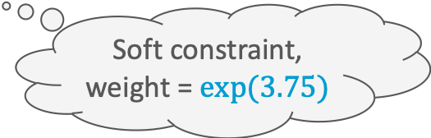

From Logics to Probabilistic Relational Models
Propositional: Descriptions about world
  Form of constraints on an environment
First-order: Objects, relations among them
  Groundings to get to propositional logic
Denote either true or false statements
Approach to soften constraints: Introduce weights to denote that statements hold to a certain degree over all possible worlds
  Example: Markov Logic Network
    We will see more of them later
$$Presents⇒Attends$$
$$Presents\left(eve,paper1,IJCAI\right)⇒Attends\left(eve,IJCAI\right)$$
Hard constraint
$$∞ Presents\left(X, P, C\right)⇒Attends\left(X, C\right)$$
$$Presents\left(X, P, C\right)⇒Attends\left(X, C\right)$$
$$3.75 Publishes\left(X, C\right)∧FarAway\left(C\right)⇒Attends\left(X, C\right)$$
Soft constraint,
weight = $exp⁡(3.75)$

Slide 52
Connection to AI, Agents, and Environments
AI: intelligent systems in the real world
The world has things in it!
The world is uncertain!
Probabilistic graphical models
First-order logic
The world is uncertain!
The world has things in it!
First-order probabilistic languages
One way of looking at it:
Statistical Relational AI
Probabilistic relational models
Figure based on Stuart Russell
Notes:
Bayes nets, markov networks, factor graphs

Slide 53

Probabilistic Relational Models (PRMs)
$$Nat\left(D\right)$$
$$Acc\left(A\right)$$
$$g_{1}$$
$$Epid$$
$$g_{0}$$
$$Travel\left(X\right)$$
$$Treat\left(X,M\right)$$
$$g_{2}$$
$$g_{3}$$
Random variables for combinations of individuals in populations
  Build a probabilistic model before knowing (all of) the individuals
  Learn the model for one set of individuals
  Apply the model to existing and new individuals
  Allow complex relationships between individuals
Exchangeability:
  Before we know anything about individuals, they are indistinguishable, and so should be treated identically.
Uncertainty about:
  Properties of individuals
  Relationships among individuals
  Identity (equality) of individuals
  Existence (and number) if individuals
Depicted formalisms: Parfactor graphs, Markov logic networks
$$Sick\left(X\right)$$
$$∞ Presents\left(X, P, C\right)⇒Attends\left(X, C\right)$$
$$3.75 Publishes\left(X, C\right)∧FarAway\left(C\right)⇒Attends\left(X, C\right)$$

Slide 54
PRMs for Modelling the Environment in this Lecture
Different types of PGMs for a (relational) factorised representation of the environment and decision making
Possible to model environment with following properties
  Fully or partially observable
  Single agent
  Stochastic
  Episodic or sequential
  Static
  Discrete or continuous
Not considered in this lecture
  Multiple agents
  Deterministic, strategic
  Dynamic
Approaches exist to deal with such environments to a certain degree
Attention: In the PGM literature, the notions of static and dynamic are used instead of the notions of episodic and sequential, while the notions of static and dynamic are covered by the so-called Markov assumption or (Non-) Markovian abstraction
S. Russel and P. Norvig: Artificial Intelligence – A Modern Approach, 2020.

Slide 55
Interim Summary
Environment characterised by
  Objects and relations between them
  Uncertainty
PRMs combine both logic and probability theory
  Models covered here can model the following environment properties
    Fully or partially observable
    Single agent
    Stochastic
    Episodic or sequential
    Static
    Discrete or continuous

Slide 56
Contents
Introduction
  Notions of AI, agents, StaRAI
Modelling formalisms
  Logic
  Probabilistic graphical models (PGMs)
  Probabilistic relational models (PRMs)
  Syntax, semantics
Inference
  Logical inference
  Probabilistic inference
    Exact inference
    Approximate inference
  Inference tasks, algorithms
Learning
  Relation learning in logic
  Parameter / structure learning for PGMs
  From PGMs to PRMs, PRM learning
Sequential Models and Inference
  Syntax, semantics, inference tasks, algorithms
Decision-theoretic Models and Inference
  Preferences, utility
  Syntax, semantics, inference task, algorithm

Slide 57
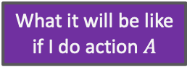
Contents in this Lecture Related to Utility-based Agents
Further topics
  Modelling formalisms
  Inference (in episodic models)
  Learning (of episodic models)
  Sequential models and inference
  Decision-theoretic models and inference
Agent
Environment
Sensors
State
What the world
is like now
How the world evolves
What my actions do
What it will be like
if I do action $A$
Utility
How happy I will be
in such a state
What action I
should do now
Actuators

Slide 58
Overview: 1. Introduction
Artificial Intelligence (AI)
  Approaches: thinking / acting humanly / rationally
Framework: Agent Theory
  Agent
  Task environment
  Agent structure
Topic: Statistical Relational AI
  Motivation, context
  Relational examples, outlook on probabilistic relational models (PRMs)
➝ Modelling Formalisms

