Slide 1
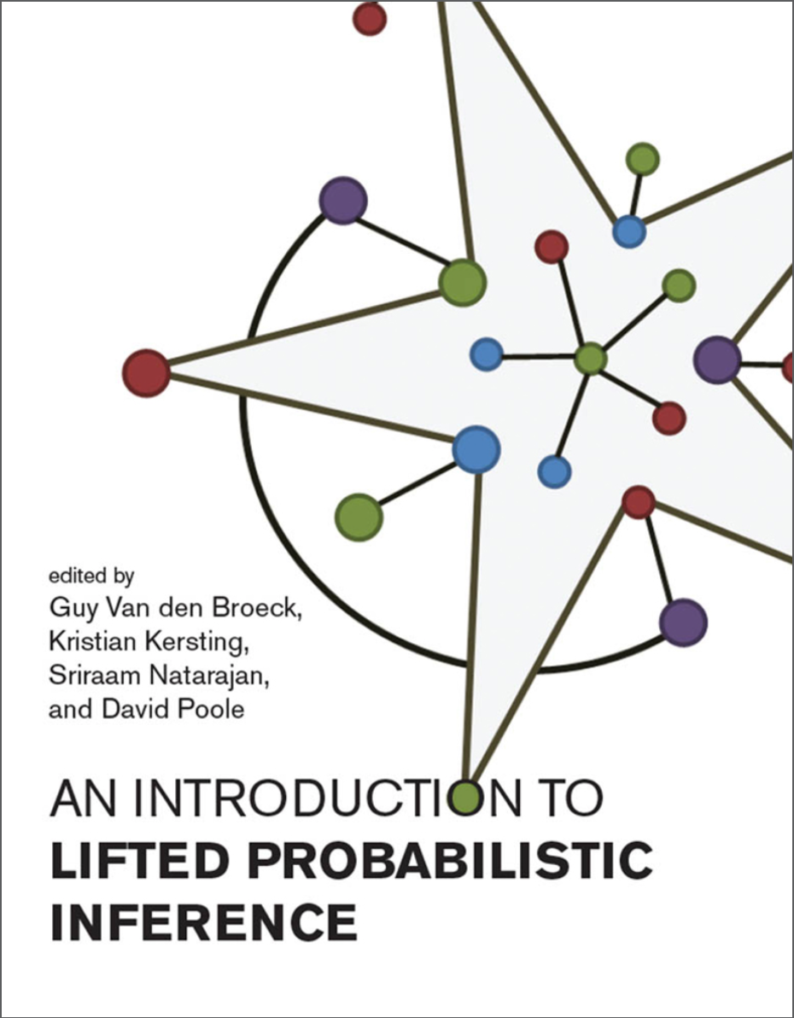
Statistical Relational
Artificial Intelligence (StaRAI)
End
Tanya Braun
Data Science Group, Computer Science Department

Slide 2
Contents (preliminary)
Not part of the winter 2022 / 23 term
(mis-planned on my part as I still did not know that the term ends a week before the official semester end)
Introduction
  Context, motivation
  Agent framework
Foundations
  First-order logic
  Probability theory
  Probabilistic graphical models (PGMs)
Probabilistic Relational Models (PRMs)
  Parfactor models, Markov logic networks
  Semantics, inference tasks
Lifted Inference
  Exact inference
  Approximate inference, specifically sampling
Lifted Learning
  Parameter learning
  Relation learning
  Approximating symmetries
Lifted Sequential Models and Inference
  Parameterised models
  Semantics, inference tasks, algorithm
Lifted Decision Making
  Preferences, utility
  Decision-theoretic models, tasks, algorithm
Continuous Space and Lifting
  Lifted Gaussian Bayesian networks (BNs)
  Probabilistic soft logic (PSL)

Slide 3
Goals
On a technical level
  Understand and explain the modelling, algorithm, solution approach, …
  in terms of
    Main idea
    Use cases
    Advantages / disadvantages
  Understand and explain the connection between the different models and algorithms
On a more general level
  Assess problems and current research in the context of artificial intelligence
  Insight into combining apparently diametrically opposed disciplines (here logic & probability)
Get a well-rounded overview of different aspects of lifted inference up to state-of-the art research (we should get up to at least 2020)

Slide 4
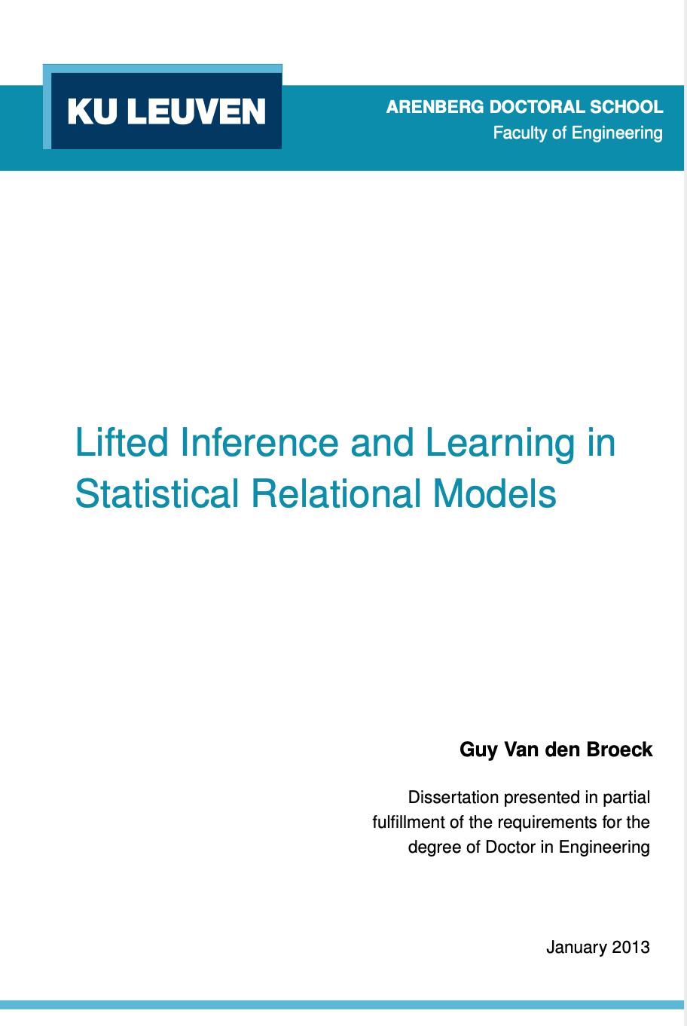
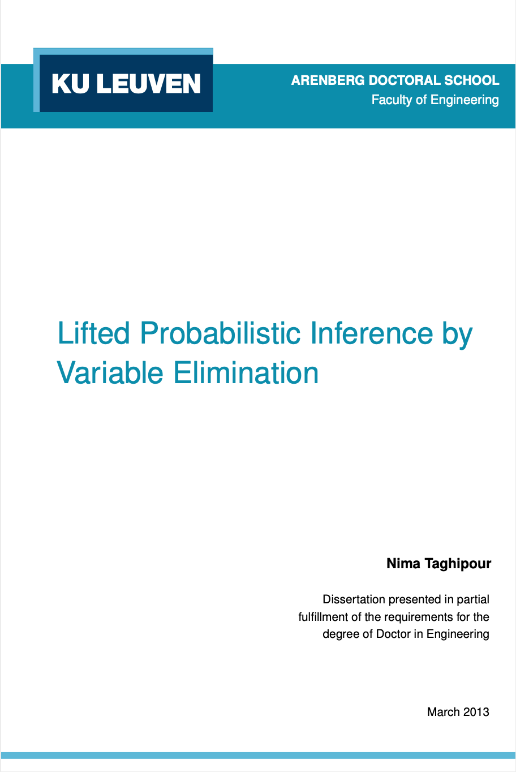
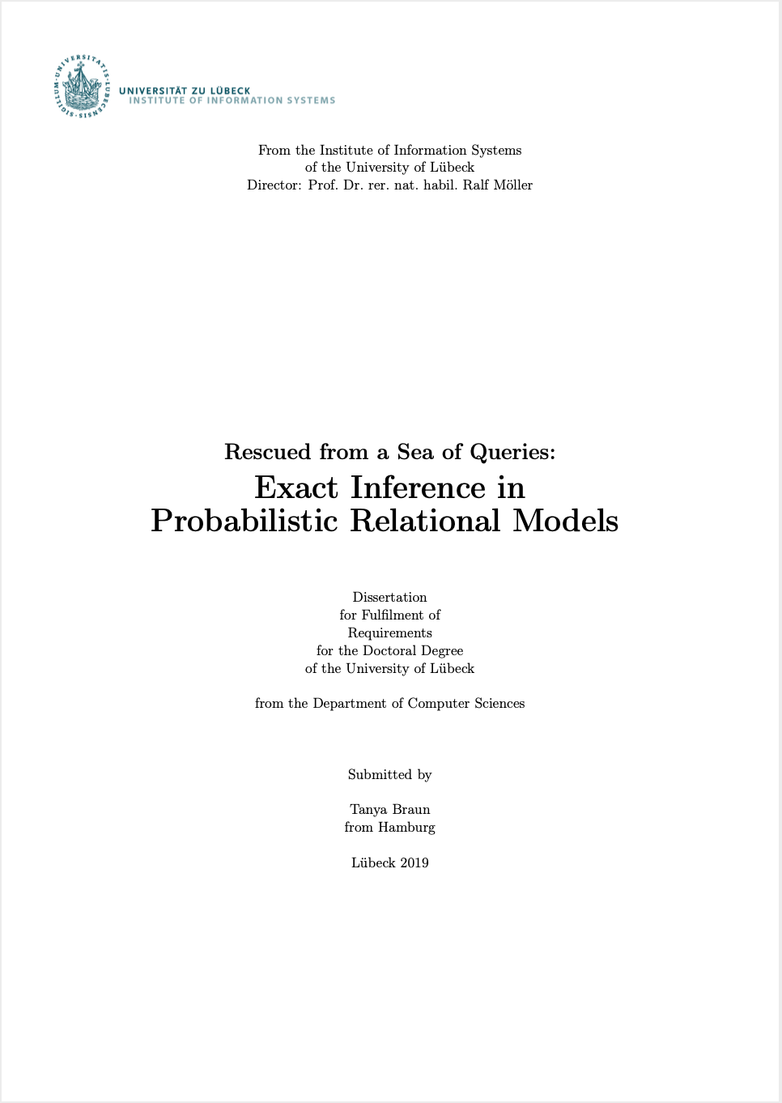
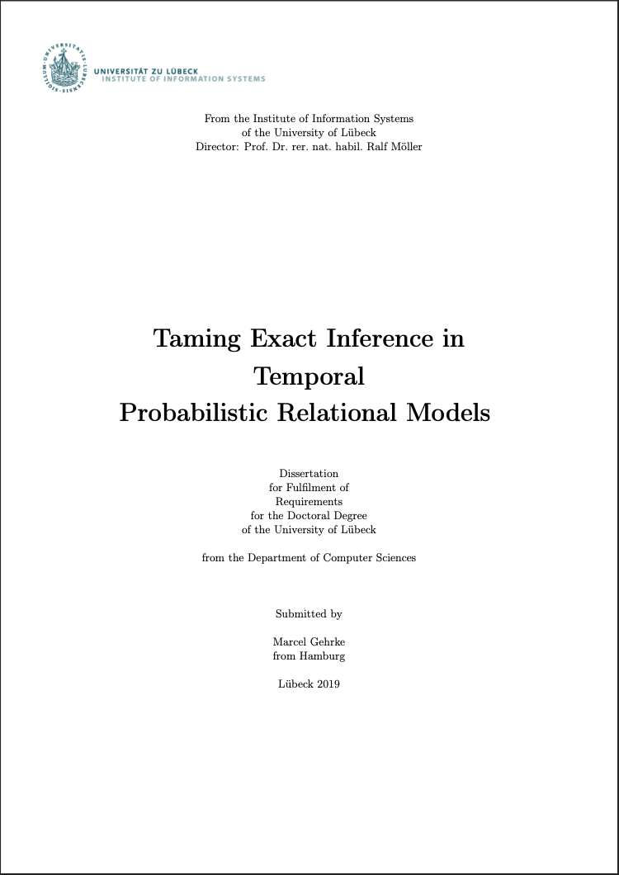
Main Sources
Further research papers referenced in slides
Lifted Inference and Learning in Statistical Relational Models
  Guy Van den Broeck, PhD thesis, 2013
Lifted Probabilistic Inference by Variable Elimination
  Nima Taghipour, PhD thesis, 2013
Rescued from a Sea of Queries: Exact Inference in Probabilistic Relational Models
  Tanya Braun, PhD thesis, 2020
Taming Exact Inference in Temporal Probabilistic Relational Models
  Marcel Gehrke, PhD thesis, 2022
http://web.cs.ucla.edu/~guyvdb/phd/guyvdb-phdthesis.pdf
https://lirias.kuleuven.be/1656026?limo=0
https://www.ifis.uni-luebeck.de/~braun/Diss/Braun_diss.pdf
https://www.ifis.uni-luebeck.de/uploads/tx_wapublications/Diss_Gehrke_public_02.pdf
Notes:
Main sources for this course

Slide 5
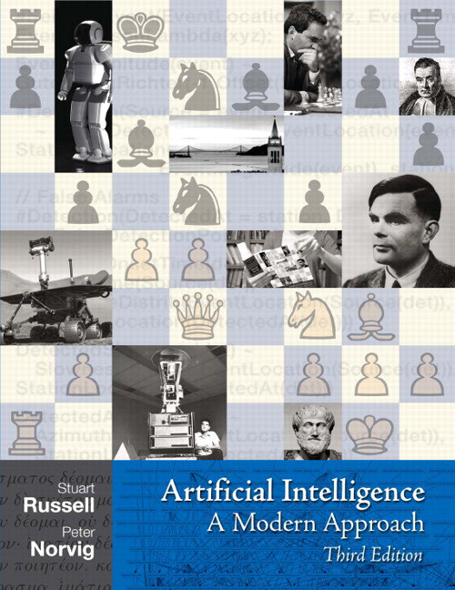
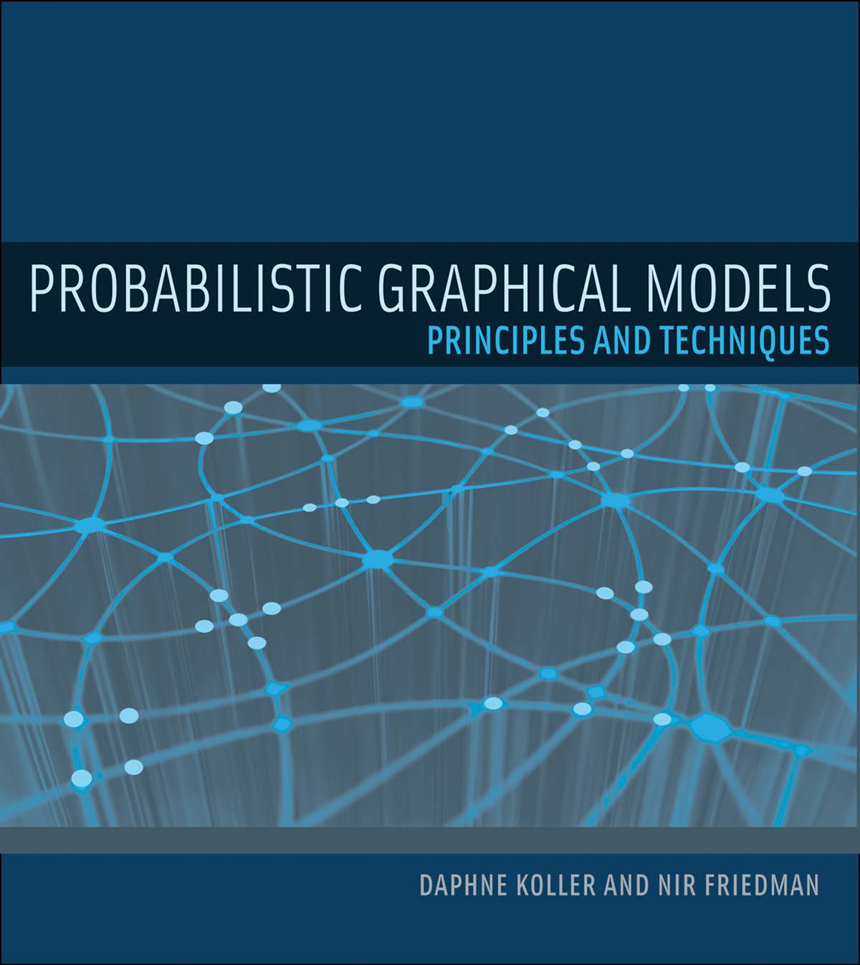
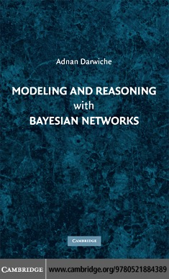
Literature: Introductory Books & Books on Foundations
Artificial Intelligence – A Modern Approach (3rd ed.)
  Stuart Russell, Peter Norvig
  Basics on agents, logic, reasoning under uncertainty
Probabilistic Graphical Models
  Daphne Koller, Nir Friedman
  General PGMs for reasoning under uncertainty
Modelling and Reasoning with Bayesian Networks
  Adnan Darwiche
  BNs for reasoning under uncertainty
http://aima.cs.berkeley.edu
https://mitpress.mit.edu/books/probabilistic-graphical-models
https://www.cambridge.org/core/books/modeling-and-reasoning-with-bayesian-networks/8A3769B81540EA93B525C4C2700C9DE6
Notes:
Find online

Slide 6
Literature: Books on StaRAI
Introduction to Statistical Relational Learning
  Editors:
  Lise Getoor, Ben Taskar
An Introduction to Lifted Probabilistic Inference
  Editors:
  Guy Van den Broeck, Kristian Kersting, Sriraam Natarajan, David Poole
https://mitpress.mit.edu/books/introduction-statistical-relational-learning
https://mitpress.mit.edu/books/introduction-lifted-probabilistic-inference
Notes:
Find online

Slide 7
Oral Exam: Organisational Stuff
Days:
  7 Feb, afternoon
  8 Feb, afternoon
  9 Feb, morning
Schedule
  Announced via Learnweb last week
  In case of changes, I will notify you via Learnweb
Place
  My office
  (Room 609, Einsteinstr. 62, 6th floor)
If necessary according to your “Prüfungsordnung”: Registration
  One week before the exam

Slide 8
Questions?
Q&A Session as part of last exercise session
  26th January, 2023, 4.15pm – 5.45pm
Use Learnweb discussion forum
  So everybody can participate and possibly learn something from the exchange
Write an email
  Less preferable than the previous method because of the given reason but still a totally valid form of contact
Now?

