Slide 1
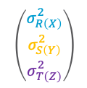
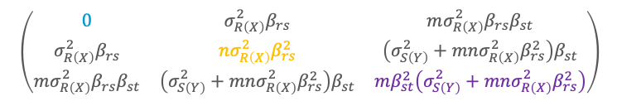

Continuous Space
NOT PART OF WINTER TERM 2022 / 23
$$\left(\begin{matrix}\begin{matrix}Σ_{r_{1}r_{1}} & … & Σ_{r_{1}r_{n}} \\ ⋮ & ⋱ & ⋮ \\ Σ_{r_{n}r_{1}} & … & Σ_{r_{n}r_{n}}\end{matrix} & \begin{matrix}Σ_{r_{1}s_{1}} & … & Σ_{r_{1}s_{m}} \\ ⋮ & ⋱ & ⋮ \\ Σ_{r_{n}s_{1}} & … & Σ_{r_{n}s_{m}}\end{matrix} & \begin{matrix}Σ_{r_{1}t_{1}} & … & Σ_{r_{1}t_{l}} \\ ⋮ & ⋱ & ⋮ \\ Σ_{r_{n}t_{1}} & … & Σ_{r_{n}t_{l}}\end{matrix} \\ \begin{matrix}Σ_{s_{1}r_{1}} & … & Σ_{s_{1}r_{n}} \\ ⋮ & ⋱ & ⋮ \\ Σ_{s_{m}r_{1}} & … & Σ_{s_{m}r_{n}}\end{matrix} & \begin{matrix}Σ_{s_{1}s_{1}} & … & Σ_{s_{1}s_{m}} \\ ⋮ & ⋱ & ⋮ \\ Σ_{s_{m}s} & … & Σ_{s_{m}s_{m}}\end{matrix} & \begin{matrix}Σ_{s_{1}t_{1}} & … & Σ_{s_{1}t_{l}} \\ ⋮ & ⋱ & ⋮ \\ Σ_{s_{m}t_{1}} & … & Σ_{s_{m}t_{n}}\end{matrix} \\ \begin{matrix}Σ_{t_{1}r_{1}} & … & Σ_{t_{1}r_{n}} \\ ⋮ & ⋱ & ⋮ \\ Σ_{t_{l}r_{1}} & … & Σ_{t_{l}r_{n}}\end{matrix} & \begin{matrix}Σ_{t_{1}s_{1}} & … & Σ_{t_{1}s_{m}} \\ ⋮ & ⋱ & ⋮ \\ Σ_{t_{l}s_{1}} & … & Σ_{t_{l}s_{m}}\end{matrix} & \begin{matrix}Σ_{t_{1}t_{1}} & … & Σ_{t_{1}t_{l}} \\ ⋮ & ⋱ & ⋮ \\ Σ_{t_{l}t_{1}} & … & Σ_{t_{l}t_{l}}\end{matrix}\end{matrix}\right)$$
Statistical Relational Artificial Intelligence
(StaRAI)
$$\left(\begin{aligned}σ_{R\left(X\right)}^{2} \\ σ_{S\left(Y\right)}^{2} \\ σ_{T\left(Z\right)}^{2}\end{aligned}\right)$$
$$\left(\begin{matrix}0 & σ_{R\left(X\right)}^{2}β_{rs} & mσ_{R\left(X\right)}^{2}β_{rs}β_{st} \\ σ_{R\left(X\right)}^{2}β_{rs} & nσ_{R\left(X\right)}^{2}β_{rs}^{2} & \left(σ_{S\left(Y\right)}^{2}+mnσ_{R\left(X\right)}^{2}β_{rs}^{2}\right)β_{st} \\ mσ_{R\left(X\right)}^{2}β_{rs}β_{st} & \left(σ_{S\left(Y\right)}^{2}+mnσ_{R\left(X\right)}^{2}β_{rs}^{2}\right)β_{st} & mβ_{st}^{2}\left(σ_{S\left(Y\right)}^{2}+mnσ_{R\left(X\right)}^{2}β_{rs}^{2}\right)\end{matrix}\right)$$
Tanya Braun

Slide 2
Contents
Introduction
  Artificial intelligence
  Agent framework
  StaRAI: context, motivation
Foundations
  Logic
  Probability theory
  Probabilistic graphical models (PGMs)
Probabilistic Relational Models (PRMs)
  Parfactor models, Markov logic networks
  Semantics, inference tasks
Lifted Inference
  Exact inference
  Approximate inference, specifically sampling
Lifted Learning
  Overview propositional learning
  Relation learning
  Approximating symmetries
Lifted Sequential Models and Inference
  Parameterised models
  Semantics, inference tasks, algorithm
Lifted Decision Making
  Preferences, utility
  Decision-theoretic models, tasks, algorithm
Continuous Space and Lifting
  Lifted Gaussian Bayesian networks (BNs)
  Probabilistic soft logic (PSL)

Slide 3
Models with Continuous Variables
Discretisation of continuous variables
  Discrete model again
  Own set of problems
    Hard to find good discretisation
    High granularity might be necessary
    ➝ large ranges ➝ large factors
    Lose characteristics of variable
      Not each value necessarily associated with a probability
      Nearby values have similar probabilities ➝ hard to capture in a discrete distribution (no notion of closeness between range values)
Therefore, use models with continuous variables

Slide 4
Outline: 8. Continuous Space
Basics
  Continuous variables, probability density function, cumulative probability distribution
  Joint distribution, marginal density, conditional density
Gaussian models
  (Multivariate) Gaussian distribution
  (Parameterised) Gaussian Bayesian networks
Probabilistic Soft Logic (PSL)
  Modelling, semantics, inference task

Slide 5
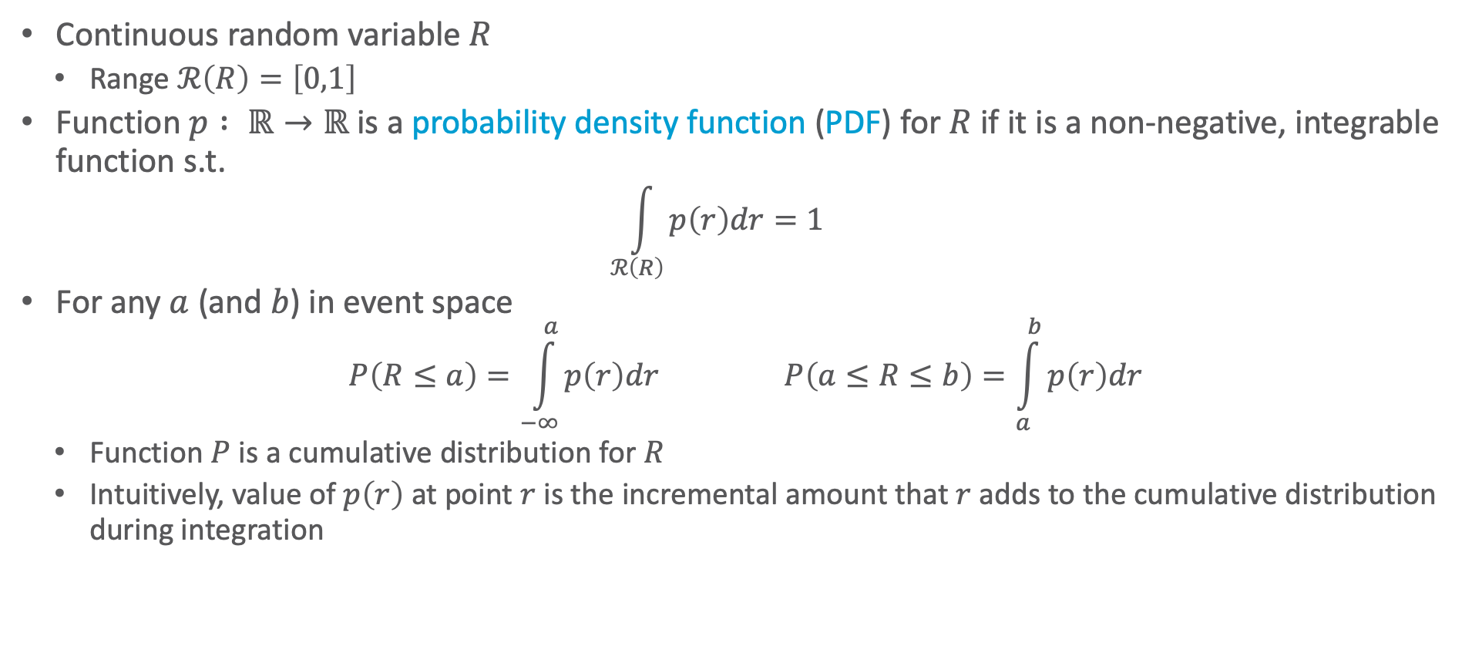
Probability Density Function
Continuous random variable $R$
  Range $ℛ\left(R\right)=\left[0,1\right]$
Function $p : ℝ→ℝ$ is a probability density function (PDF) for $R$ if it is a non-negative, integrable function s.t.
  $$\int_{ℛ\left(R\right)}{p\left(r\right)dr}=1$$
For any $a$ (and $b$) in event space
  $$P\left(R≤a\right)=\int_{−∞}^{a}{p\left(r\right)dr} P\left(a≤R≤b\right)=\int_{a}^{b}{p\left(r\right)dr}$$
  Function $P$ is a cumulative distribution for $R$
  Intuitively, value of $p\left(r\right)$ at point $r$ is the incremental amount that $r$ adds to the cumulative distribution during integration

Slide 6
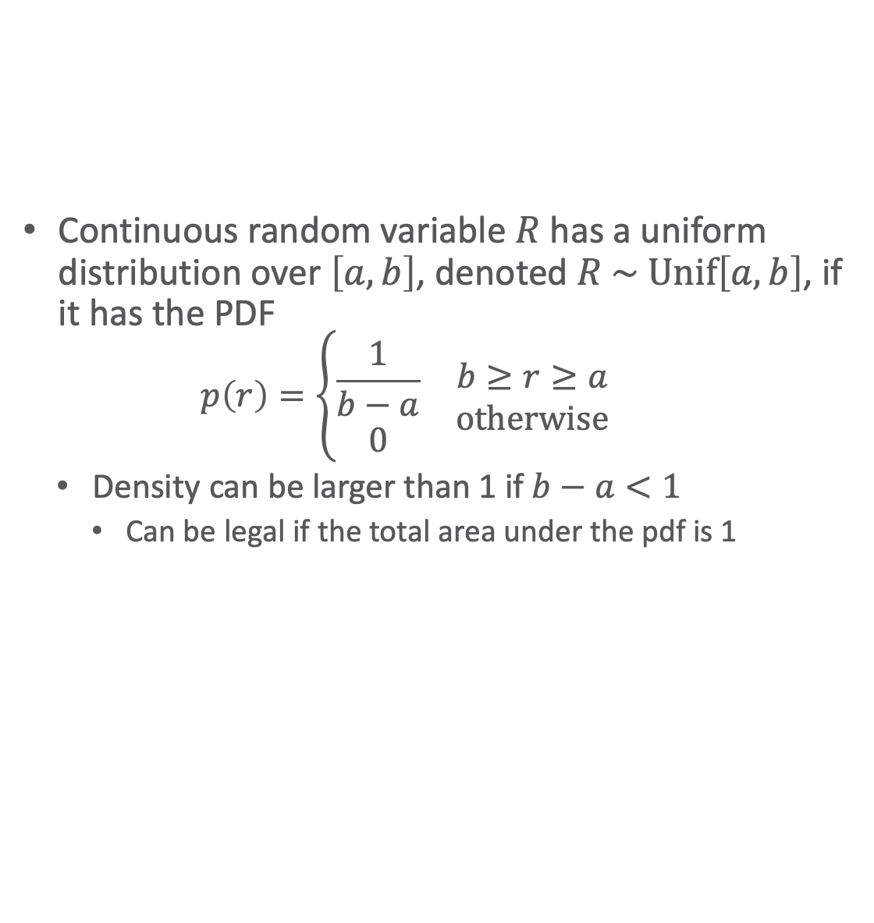
PDFs: Uniform Distribution
Continuous random variable $R$ has a uniform distribution over $\left[a,b\right]$, denoted $R \sim \text{Unif}\left[a,b\right]$, if it has the PDF
  $$p\left(r\right)=\left\{\begin{matrix}\begin{matrix}\frac{1}{b−a} \\ 0\end{matrix} & \begin{matrix}b≥r≥a \\ \text{otherwise}\end{matrix}\end{matrix}\right.$$
  Density can be larger than 1 if $b−a<1$
    Can be legal if the total area under the pdf is 1

Slide 7
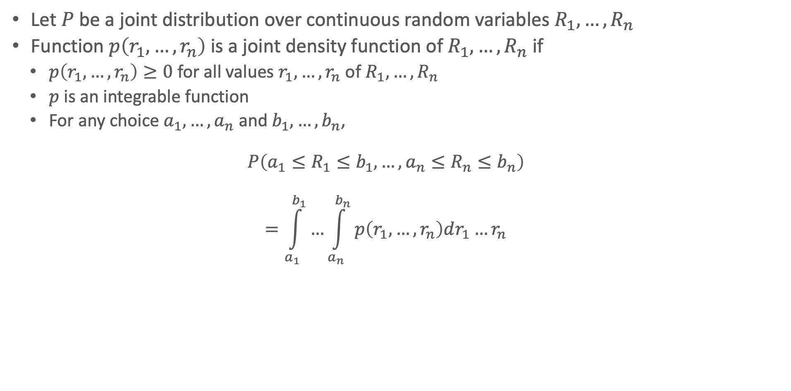
Joint/Multivariate Distribution
Let $P$ be a joint distribution over continuous random variables $R_{1},…,R_{n}$
Function $p\left(r_{1},…,r_{n}\right)$ is a joint density function of $R_{1},…,R_{n}$ if
  $p\left(r_{1},…,r_{n}\right)≥0$ for all values $r_{1},…,r_{n}$ of $R_{1},…,R_{n}$
  $p$ is an integrable function
  For any choice $a_{1},…,a_{n}$ and $b_{1},…,b_{n}$,
  $$P\left(a_{1}≤R_{1}≤b_{1},…,a_{n}≤R_{n}≤b_{n}\right)$$
  $$=\int_{a_{1}}^{b_{1}}{…\int_{a_{n}}^{b_{n}}{p\left(r_{1},…,r_{n}\right)dr_{1}…r_{n}}}$$

Slide 8
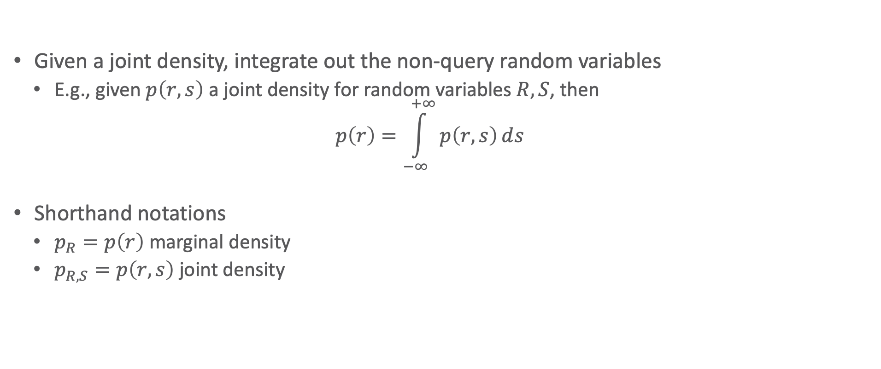
Marginal Density
Given a joint density, integrate out the non-query random variables
  E.g., given $p\left(r,s\right)$ a joint density for random variables $R,S$, then
  $$p\left(r\right)=\int_{−∞}^{+∞}{p\left(r,s\right)ⅆs}$$
Shorthand notations
  $p_{R}=p\left(r\right)$ marginal density
  $p_{R,S}=p\left(r,s\right)$ joint density

Slide 9
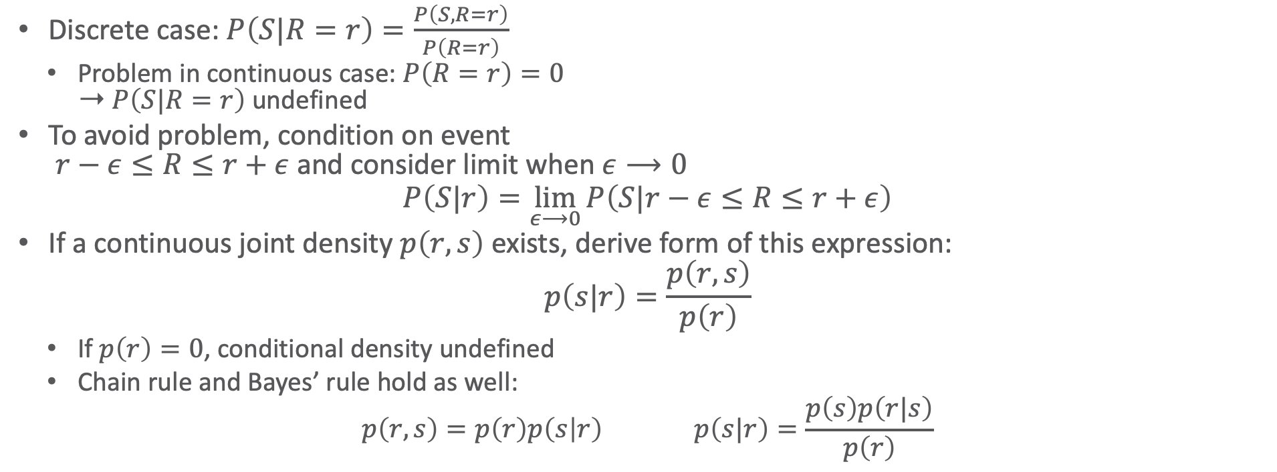
Conditional Density Function
Discrete case: $P\left(S|R=r\right)=\frac{P\left(S,R=r\right)}{P\left(R=r\right)}$
  Problem in continuous case: $P\left(R=r\right)=0$
  ➝ $P\left(S|R=r\right)$ undefined
To avoid problem, condition on event
$r−ε≤R≤r+ε$ and consider limit when $ε⟶0$
$$P\left(S|r\right)=\lim_{ε⟶0}{P\left(S|r−ε≤R≤r+ε\right)}$$
If a continuous joint density $p\left(r,s\right)$ exists, derive form of this expression:
$$p\left(s|r\right)=\frac{p\left(r,s\right)}{p\left(r\right)}$$
  If $p\left(r\right)=0$, conditional density undefined
  Chain rule and Bayes’ rule hold as well:
  $$p\left(r,s\right)=p\left(r\right)p\left(s | r\right) p\left(s|r\right)=\frac{p\left(s\right)p\left(r|s\right)}{p\left(r\right)}$$

Slide 10
Outline: 8. Continuous Space
Basics
  Continuous variables, probability density function, cumulative probability distribution
  Joint distribution, marginal density, conditional density
Gaussian models
  (Multivariate) Gaussian distribution
  (Parameterised) Gaussian Bayesian networks
Probabilistic Soft Logic (PSL)
  Modelling, semantics, inference task

Slide 11
Models with Continuous Variables
Problem: Space of possible parameterisation essentially unbounded
Special case: (Multivariate) Gaussian distributions
  Two parameters per variable: mean, variance
  Strong assumptions, e.g.,
    Exponential decay away from its mean
    Linearity of interactions between random variables
    Assumptions often invalid but still work as a good approximation for many real-world distributions
  Many generalisations exist which use Gaussians as a foundation
    Non-linear interactions
    Mixture of Gaussians

Slide 12
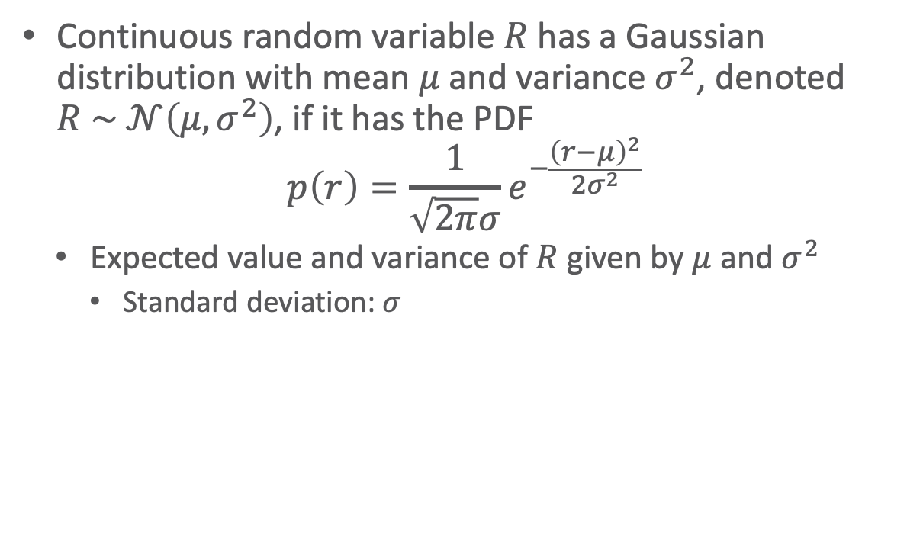
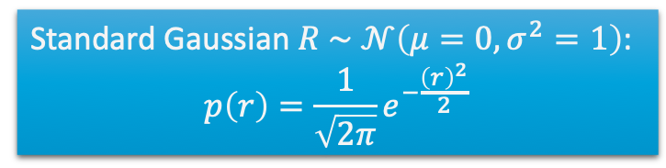
PDFs: Gaussian/Normal Distribution
Continuous random variable $R$ has a Gaussian distribution with mean $μ$ and variance $σ^{2}$, denoted $R \sim 𝒩\left(μ,σ^{2}\right)$, if it has the PDF
$$p\left(r\right)=\frac{1}{\sqrt{2π}σ}e^{−\frac{{\left(r−μ\right)}^{2}}{2σ^{2}}}$$
  Expected value and variance of $R$ given by $μ$ and $σ^{2}$
    Standard deviation: $σ$
Standard Gaussian $R \sim$ $𝒩\left(μ=0,σ^{2}=1\right)$:
$$p\left(r\right)=\frac{1}{\sqrt{2π}}e^{−\frac{{\left(r\right)}^{2}}{2}}$$

Slide 13
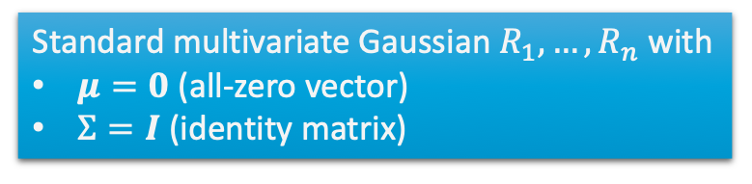
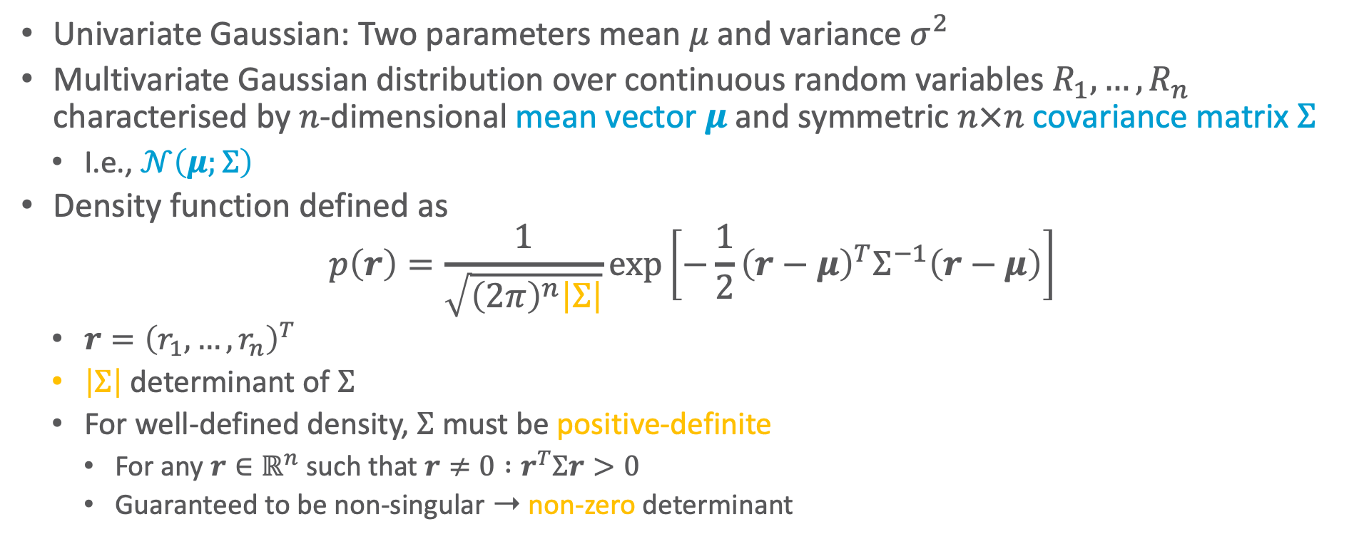
Multivariate Gaussian
Univariate Gaussian: Two parameters mean $μ$ and variance $σ^{2}$
Multivariate Gaussian distribution over continuous random variables $R_{1},…,R_{n}$ characterised by $n$-dimensional mean vector $μ$ and symmetric $n×n$ covariance matrix $Σ$
  I.e., $𝒩\left(μ;Σ\right)$
Density function defined as
$$p\left(r\right)=\frac{1}{\sqrt{{\left(2π\right)}^{n}\left|Σ\right|}}\exp\left[−\frac{1}{2}{\left(r−μ\right)}^{T}Σ^{−1}\left(r−μ\right)\right]$$
  $r={\left(r_{1},…,r_{n}\right)}^{T}$
  $\left|Σ\right|$ determinant of $Σ$
  For well-defined density, $Σ$ must be positive-definite
    For any $r∈ℝ^{n}$ such that $r≠0 :r^{T}Σr>0$
    Guaranteed to be non-singular ➝ non-zero determinant
Standard multivariate Gaussian $R_{1},…,R_{n}$ with
$μ=0$ (all-zero vector)
$Σ=I$ (identity matrix)

Slide 14
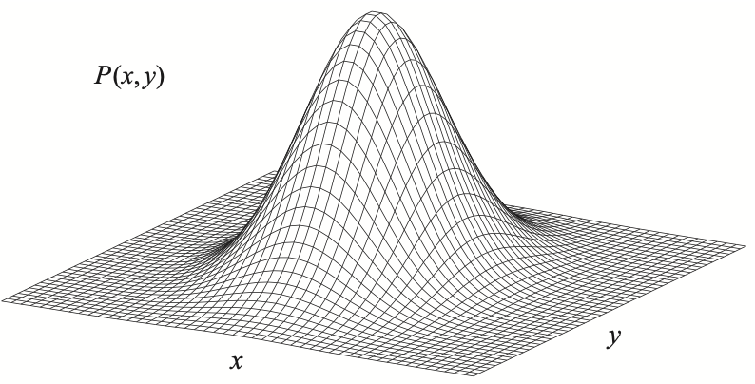
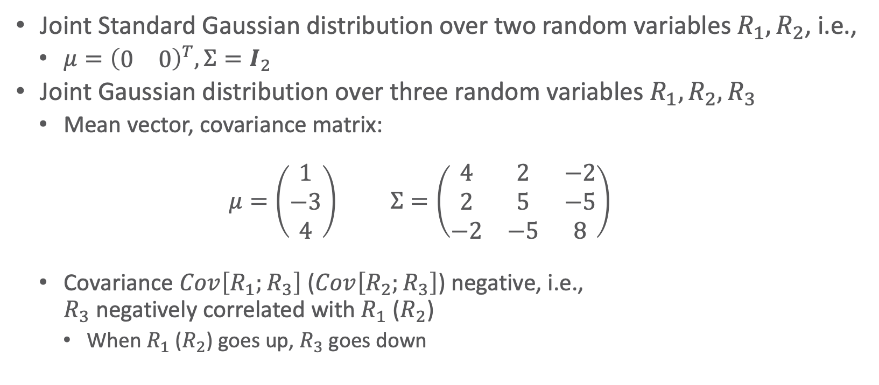



Example
Joint Standard Gaussian distribution over two random variables $R_{1},R_{2}$, i.e.,
  $μ={\left(\begin{matrix}0 & 0\end{matrix}\right)}^{T},Σ=I_{2}$
Joint Gaussian distribution over three random variables $R_{1},R_{2},R_{3}$
  Mean vector, covariance matrix:
  $$μ=\left(\begin{matrix}1 \\ −3 \\ 4\end{matrix}\right) Σ=\left(\begin{matrix}4 & 2 & −2 \\ 2 & 5 & −5 \\ −2 & −5 & 8\end{matrix}\right)$$
  Covariance $Cov\left[R_{1};R_{3}\right]$ ($Cov\left[R_{2};R_{3}\right]$) negative, i.e.,
  $R_{3}$ negatively correlated with $R_{1}$ ($R_{2}$)
    When $R_{1}$ ($R_{2}$) goes up, $R_{3}$ goes down
$$p\left(r_{1},r_{2}\right)$$
$$r_{1}$$
$$r_{2}$$

Slide 15
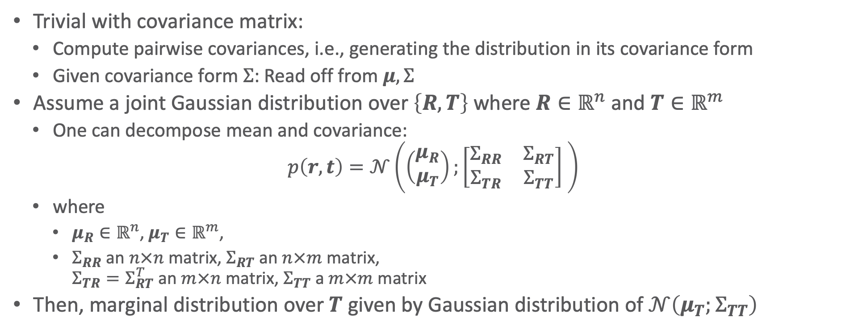
Marginalisation
Trivial with covariance matrix:
  Compute pairwise covariances, i.e., generating the distribution in its covariance form
  Given covariance form $Σ$: Read off from $μ,Σ$
Assume a joint Gaussian distribution over $\left\{R,T\right\}$ where $R∈ℝ^{n}$ and $T∈ℝ^{m}$
  One can decompose mean and covariance:
  $$p\left(r,t\right)=𝒩\left(\left(\begin{matrix}μ_{R} \\ μ_{T}\end{matrix}\right);\left[\begin{matrix}Σ_{RR} & Σ_{RT} \\ Σ_{TR} & Σ_{TT}\end{matrix}\right] \right)$$
  where
    $μ_{R}∈ℝ^{n}$, $μ_{T}∈ℝ^{m}$,
    $Σ_{RR}$ an $n×n$ matrix, $Σ_{RT}$ an $n×m$ matrix,
    $Σ_{TR}=Σ_{RT}^{T}$ an $m×n$ matrix, $Σ_{TT}$ a $m×m$ matrix
Then, marginal distribution over $T$ given by Gaussian distribution of $𝒩\left(μ_{T};Σ_{TT}\right)$

Slide 16
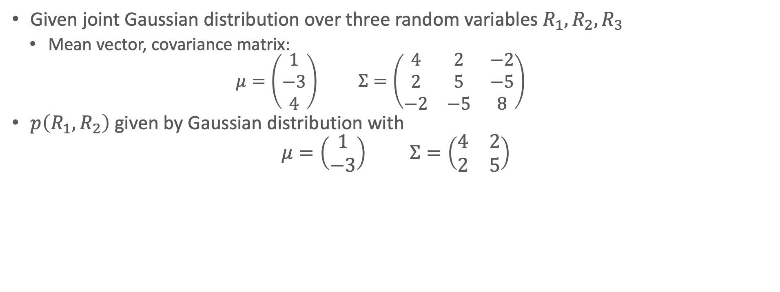
Example
Given joint Gaussian distribution over three random variables $R_{1},R_{2},R_{3}$
  Mean vector, covariance matrix:
  $$μ=\left(\begin{matrix}1 \\ −3 \\ 4\end{matrix}\right) Σ=\left(\begin{matrix}4 & 2 & −2 \\ 2 & 5 & −5 \\ −2 & −5 & 8\end{matrix}\right)$$
$p\left(R_{1},R_{2}\right)$ given by Gaussian distribution with
$$μ=\left(\begin{matrix}1 \\ −3\end{matrix}\right) Σ=\left(\begin{matrix}4 & 2 \\ 2 & 5\end{matrix}\right)$$

Slide 17
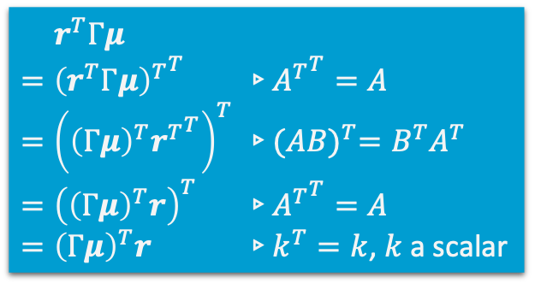


Dual: Information/Precision Form
Rewrite $\exp\left[−\frac{1}{2}{\left(r−μ\right)}^{T}Σ^{−1}\left(r−μ\right)\right]$ by setting $Γ=Σ^{−1}$ and multiplying out:
  $$−\frac{1}{2}{\left(r−μ\right)}^{T}Γ\left(r−μ\right)=−\frac{1}{2}\left[r^{T}Γr−2r^{T}Γμ+μ^{T}Γμ\right]$$
$μ^{T}Γμ$ is constant over the different $r$, therefore,
  $Γμ$ called potential vector
$$p\left(r\right)∝\exp\left(−\frac{1}{2}\left[r^{T}Γr−2r^{T}Γμ\right]\right) \\ =\exp\left[−\frac{1}{2}r^{T}Γr+r^{T}Γμ\right] \\ =\exp\left[−\frac{1}{2}r^{T}Γr+{\left(Γμ\right)}^{T}r\right]$$
$=r^{T}Γμ$
$={{\left(r^{T}Γμ\right)}^{T}}^{T}$ ▹${A^{T}}^{T}=A$
$={\left({\left(Γμ\right)}^{T}{r^{T}}^{T}\right)}^{T}$ ▹${(AB)}^{T}=B^{T}A^{T}$
$={\left({\left(Γμ\right)}^{T}r\right)}^{T}$ ▹${A^{T}}^{T}=A$
$={\left(Γμ\right)}^{T}r$ ▹$k^{T}=k$, $k$ a scalar

Slide 18
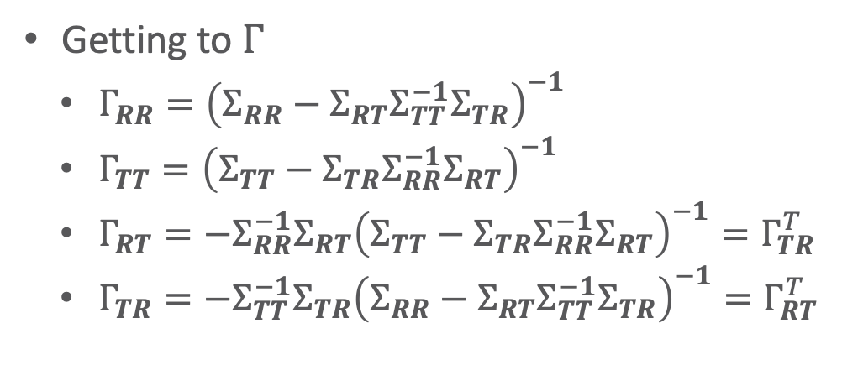
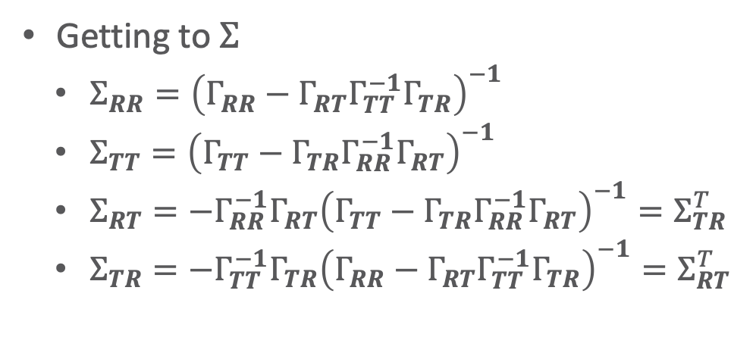

Dual: Information/Precision Form
For a decomposition $\left\{R,T\right\}$ where $R∈ℝ^{n}$ and $T∈ℝ^{m}$:
$$Γ=Σ^{−1}={\left[\begin{matrix}Σ_{RR} & Σ_{RT} \\ Σ_{TR} & Σ_{TT}\end{matrix}\right]}^{−1}=\left[\begin{matrix}Γ_{RR} & Γ_{RT} \\ Γ_{TR} & Γ_{TT}\end{matrix}\right]$$
Getting to $Σ$
  $Σ_{RR}={\left(Γ_{RR}−Γ_{RT}Γ_{TT}^{−1}Γ_{TR}\right)}^{−1}$
  $Σ_{TT}={\left(Γ_{TT}−Γ_{TR}Γ_{RR}^{−1}Γ_{RT}\right)}^{−1}$
  $Σ_{RT}=−Γ_{RR}^{−1}Γ_{RT}{\left(Γ_{TT}−Γ_{TR}Γ_{RR}^{−1}Γ_{RT}\right)}^{−1}=Σ_{TR}^{T}$
  $Σ_{TR}=−Γ_{TT}^{−1}Γ_{TR}{\left(Γ_{RR}−Γ_{RT}Γ_{TT}^{−1}Γ_{TR}\right)}^{−1}=Σ_{RT}^{T}$
Getting to $Γ$
  $Γ_{RR}={\left(Σ_{RR}−Σ_{RT}Σ_{TT}^{−1}Σ_{TR}\right)}^{−1}$
  $Γ_{TT}={\left(Σ_{TT}−Σ_{TR}Σ_{RR}^{−1}Σ_{RT}\right)}^{−1}$
  $Γ_{RT}=−Σ_{RR}^{−1}Σ_{RT}{\left(Σ_{TT}−Σ_{TR}Σ_{RR}^{−1}Σ_{RT}\right)}^{−1}=Γ_{TR}^{T}$
  $Γ_{TR}=−Σ_{TT}^{−1}Σ_{TR}{\left(Σ_{RR}−Σ_{RT}Σ_{TT}^{−1}Σ_{TR}\right)}^{−1}=Γ_{RT}^{T}$

Slide 19
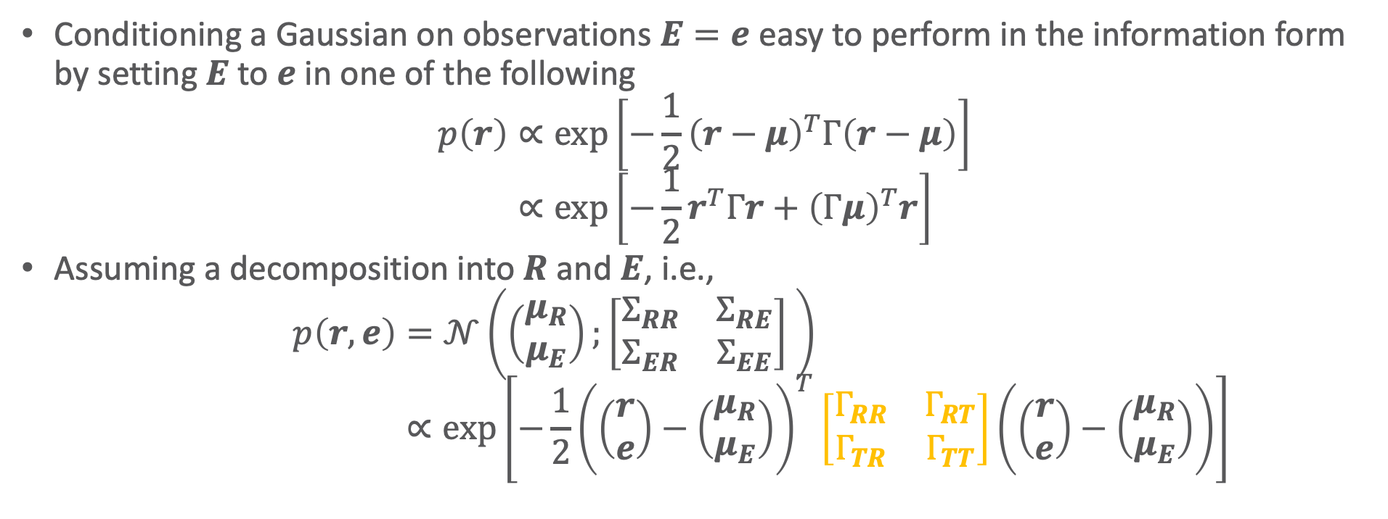
Conditioning
Conditioning a Gaussian on observations $E=e$ easy to perform in the information form by setting $E$ to $e$ in one of the following
$$p\left(r\right)∝\exp\left[−\frac{1}{2}{\left(r−μ\right)}^{T}Γ\left(r−μ\right)\right] \\ ∝\exp\left[−\frac{1}{2}r^{T}Γr+{\left(Γμ\right)}^{T}r\right]$$
Assuming a decomposition into $R$ and $E$, i.e.,
$$p\left(r,e\right)=𝒩\left(\left(\begin{matrix}μ_{R} \\ μ_{E}\end{matrix}\right);\left[\begin{matrix}Σ_{RR} & Σ_{RE} \\ Σ_{ER} & Σ_{EE}\end{matrix}\right] \right) \\ ∝\exp\left[−\frac{1}{2}{\left(\left(\begin{matrix}r \\ e\end{matrix}\right)−\left(\begin{matrix}μ_{R} \\ μ_{E}\end{matrix}\right)\right)}^{T}\left[\begin{matrix}Γ_{RR} & Γ_{RT} \\ Γ_{TR} & Γ_{TT}\end{matrix}\right]\left(\left(\begin{matrix}r \\ e\end{matrix}\right)−\left(\begin{matrix}μ_{R} \\ μ_{E}\end{matrix}\right)\right)\right]$$

Slide 20

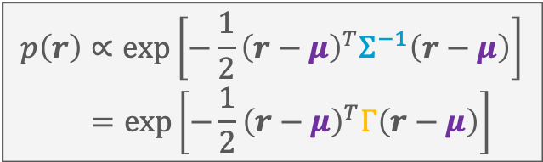

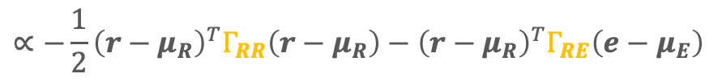
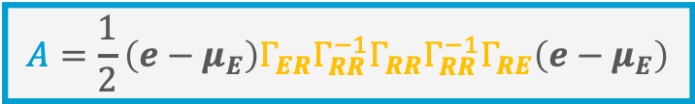

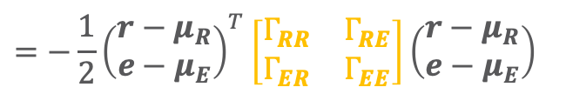
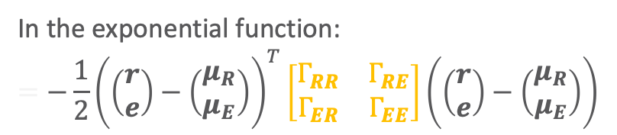
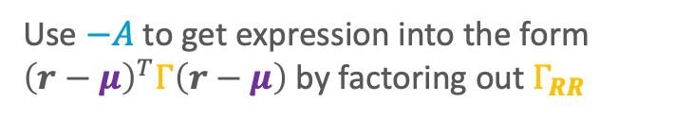
In the exponential function:
$$=−\frac{1}{2}{\left(\left(\begin{matrix}r \\ e\end{matrix}\right)−\left(\begin{matrix}μ_{R} \\ μ_{E}\end{matrix}\right)\right)}^{T}\left[\begin{matrix}Γ_{RR} & Γ_{RE} \\ Γ_{ER} & Γ_{EE}\end{matrix}\right]\left(\left(\begin{matrix}r \\ e\end{matrix}\right)−\left(\begin{matrix}μ_{R} \\ μ_{E}\end{matrix}\right)\right)$$
$$p\left(r\right)∝\exp\left[−\frac{1}{2}{\left(r−μ\right)}^{T}Σ^{−1}\left(r−μ\right)\right] \\ =\exp\left[−\frac{1}{2}{\left(r−μ\right)}^{T}Γ\left(r−μ\right)\right]$$
$$=−\frac{1}{2}{\left(\begin{matrix}r−μ_{R} \\ e−μ_{E}\end{matrix}\right)}^{T}\left[\begin{matrix}Γ_{RR} & Γ_{RE} \\ Γ_{ER} & Γ_{EE}\end{matrix}\right]\left(\begin{matrix}r−μ_{R} \\ e−μ_{E}\end{matrix}\right)$$
$$=−\frac{1}{2}{\left(r−μ_{R}\right)}^{T}Γ_{RR}\left(r−μ_{R}\right)−\frac{1}{2}2{\left(r−μ_{R}\right)}^{T}Γ_{RE}\left(e−μ_{E}\right)−\frac{1}{2}{\left(e−μ_{E}\right)}^{T}Γ_{EE}\left(e−μ_{E}\right)$$
$$∝−\frac{1}{2}{\left(r−μ_{R}\right)}^{T}Γ_{RR}\left(r−μ_{R}\right)−{\left(r−μ_{R}\right)}^{T}Γ_{RE}\left(e−μ_{E}\right)$$
Does not depend on $r$
$$=−\frac{1}{2}{\left(r−μ_{R}\right)}^{T}Γ_{RR}\left(r−μ_{R}\right)−{\left(r−μ_{R}\right)}^{T}Γ_{RE}\left(e−μ_{E}\right)−A+A$$
Use $−A$ to get expression into the form ${\left(r−μ\right)}^{T}Γ\left(r−μ\right)$ by factoring out $Γ_{RR}$
$$A=\frac{1}{2}\left(e−μ_{E}\right)Γ_{ER}Γ_{RR}^{−1}Γ_{RR}Γ_{RR}^{−1}Γ_{RE}\left(e−μ_{E}\right)$$
$$=\exp\left[−\frac{1}{2}\left({\left(r−μ_{R}+Γ_{RR}^{−1}Γ_{ER}\left(e−μ_{E}\right)\right)}^{T}Γ_{RR}\left(r−μ_{R}+Γ_{RR}^{−1}Γ_{RE}\left(e−μ_{E}\right)\right)\right)\right]\exp\left[A\right]$$
$$∝\exp\left[−\frac{1}{2}\left({\left(r−μ_{R}+Γ_{RR}^{−1}Γ_{ER}\left(e−μ_{E}\right)\right)}^{T}Γ_{RR}\left(r−μ_{R}+Γ_{RR}^{−1}Γ_{ER}\left(e−μ_{E}\right)\right)\right)\right]$$
$$μ^{∗}=μ_{R}−Γ_{R}^{−1}Γ_{ER}\left(e−μ_{E}\right)$$
$$Σ^{∗}=Γ_{RR}$$

Slide 21
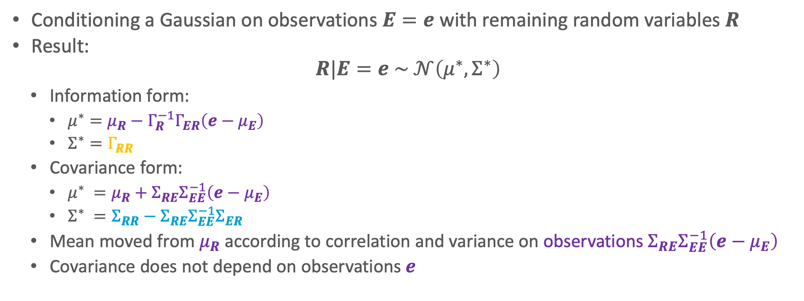
Conditioning
Conditioning a Gaussian on observations $E=e$ with remaining random variables $R$
Result:
$$R|E=e \sim 𝒩\left(μ^{∗},Σ^{∗}\right)$$
  Information form:
    $μ^{∗}=μ_{R}−Γ_{R}^{−1}Γ_{ER}\left(e−μ_{E}\right)$
    $Σ^{∗}=Γ_{RR}$
  Covariance form:
    $μ^{∗} =μ_{R}+Σ_{RE}Σ_{EE}^{−1}\left(e−μ_{E}\right)$
    $Σ^{∗} =Σ_{RR}−Σ_{RE}Σ_{EE}^{−1}Σ_{ER}$
  Mean moved from $μ_{R}$ according to correlation and variance on observations $Σ_{RE}Σ_{EE}^{−1}\left(e−μ_{E}\right)$
  Covariance does not depend on observations $e$

Slide 22
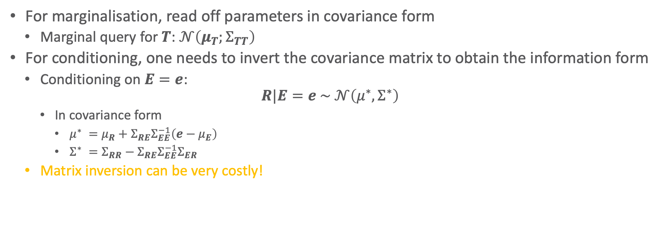
Query Answering: Summary
For marginalisation, read off parameters in covariance form
  Marginal query for $T$: $𝒩\left(μ_{T};Σ_{TT}\right)$
For conditioning, one needs to invert the covariance matrix to obtain the information form
  Conditioning on $E=e$:
  $$R|E=e \sim 𝒩\left(μ^{∗},Σ^{∗}\right)$$
    In covariance form
      $μ^{∗} =μ_{R}+Σ_{RE}Σ_{EE}^{−1}\left(e−μ_{E}\right)$
      $Σ^{∗} =Σ_{RR}−Σ_{RE}Σ_{EE}^{−1}Σ_{ER}$
  Matrix inversion can be very costly!

Slide 23
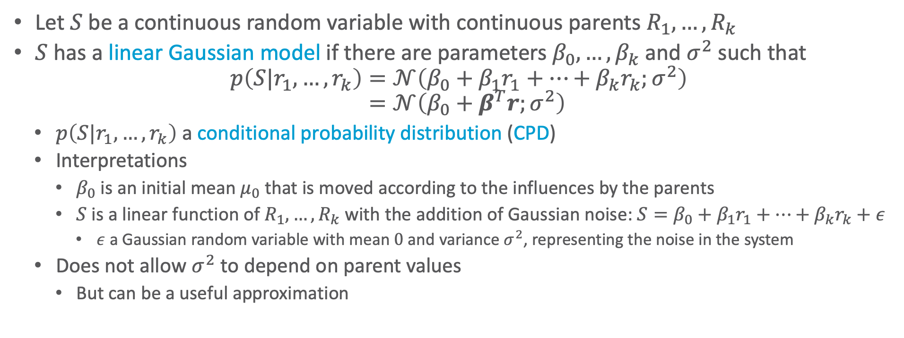
Linear Gaussian Model
Let $S$ be a continuous random variable with continuous parents $R_{1},…,R_{k}$
$S$ has a linear Gaussian model if there are parameters $β_{0},…,β_{k}$ and $σ^{2}$ such that
$$p\left(S|r_{1},…,r_{k}\right)=𝒩\left(β_{0}+β_{1}r_{1}+…+β_{k}r_{k};σ^{2}\right) \\ =𝒩\left(β_{0}+β^{T}r;σ^{2}\right)$$
  $p\left(S|r_{1},…,r_{k}\right)$ a conditional probability distribution (CPD)
  Interpretations
    $β_{0}$ is an initial mean $μ_{0}$ that is moved according to the influences by the parents
    $S$ is a linear function of $R_{1},…,R_{k}$ with the addition of Gaussian noise: $S=β_{0}+β_{1}r_{1}+…+β_{k}r_{k}+ε$
      $ε$ a Gaussian random variable with mean $0$ and variance $σ^{2}$, representing the noise in the system
  Does not allow $σ^{2}$ to depend on parent values
    But can be a useful approximation
(vector notation)

Slide 24
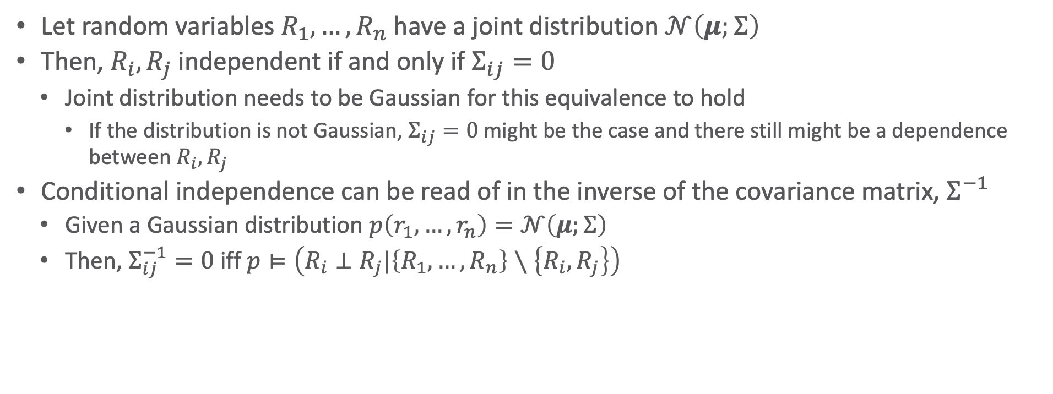
Independencies in Gaussians
Let random variables $R_{1},…,R_{n}$ have a joint distribution $𝒩\left(μ;Σ\right)$
Then, $R_{i},R_{j}$ independent if and only if $Σ_{ij}=0$
  Joint distribution needs to be Gaussian for this equivalence to hold
    If the distribution is not Gaussian, $Σ_{ij}=0$ might be the case and there still might be a dependence between $R_{i},R_{j}$
Conditional independence can be read of in the inverse of the covariance matrix, $Σ^{−1}$
  Given a Gaussian distribution $p\left(r_{1},…, r_{n}\right)=𝒩\left(μ;Σ\right)$
  Then, $Σ_{ij}^{−1}=0$ iff $p⊨\left(R_{i}⊥R_{j}|\left\{R_{1},…,R_{n}\right\}∖\left\{R_{i},R_{j}\right\}\right)$

Slide 25
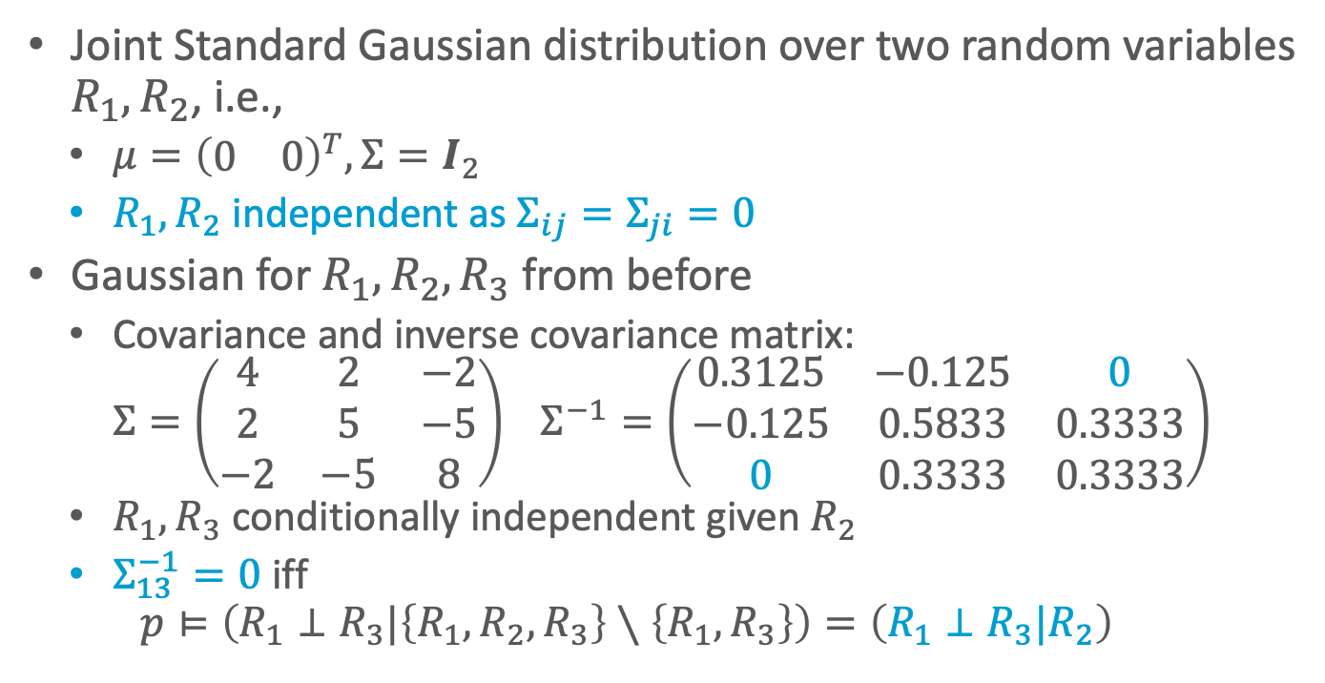
Example
Joint Standard Gaussian distribution over two random variables $R_{1},R_{2}$, i.e.,
  $μ={\left(\begin{matrix}0 & 0\end{matrix}\right)}^{T},Σ=I_{2}$
  $R_{1},R_{2}$ independent as $Σ_{ij}=Σ_{ji}=0$
Gaussian for $R_{1},R_{2},R_{3}$ from before
  Covariance and inverse covariance matrix:
  $$Σ=\left(\begin{matrix}4 & 2 & −2 \\ 2 & 5 & −5 \\ −2 & −5 & 8\end{matrix}\right) Σ^{−1}=\left(\begin{matrix}0.3125 & −0.125 & 0 \\ −0.125 & 0.5833 & 0.3333 \\ 0 & 0.3333 & 0.3333\end{matrix}\right)$$
  $R_{1},R_{3}$ conditionally independent given $R_{2}$
  $Σ_{13}^{−1}=0$ iff
  $$p⊨\left(R_{1}⊥R_{3}|\left\{R_{1},R_{2},R_{3}\right\}∖\left\{R_{1},R_{3}\right\}\right)=\left(R_{1}⊥R_{3}|R_{2}\right)$$
$$p\left(r_{1},r_{2}\right)$$
$$r_{1}$$
$$r_{2}$$

Slide 26

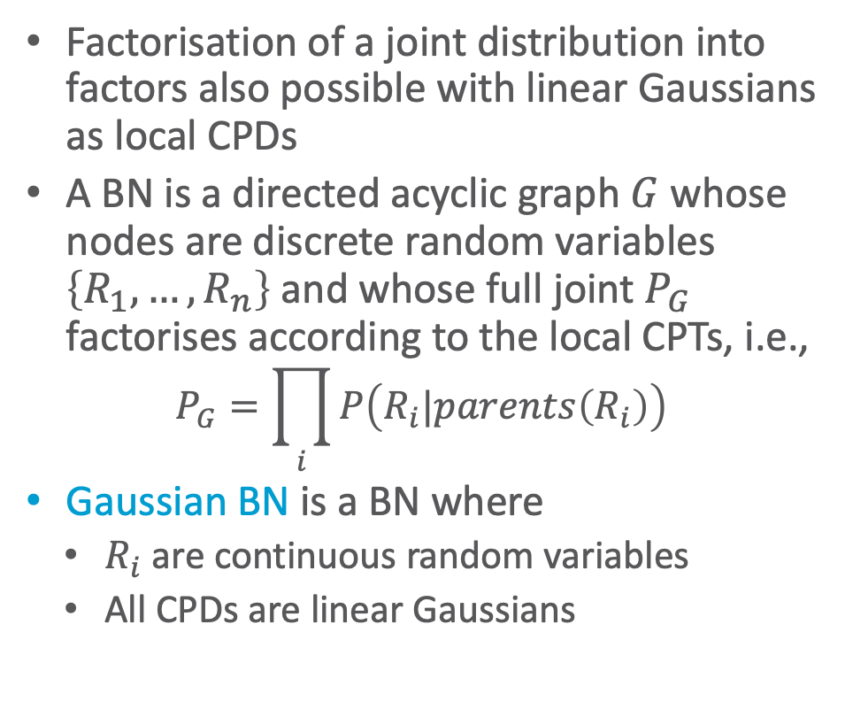



Gaussian Bayesian Network (GBN)
Factorisation of a joint distribution into factors also possible with linear Gaussians as local CPDs
A BN is a directed acyclic graph $G$ whose nodes are discrete random variables $\left\{R_{1},…,R_{n}\right\}$ and whose full joint $P_{G}$ factorises according to the local CPTs, i.e.,
  $$P_{G}=\prod_{i}{P\left(R_{i}|parents\left(R_{i}\right)\right)}$$
Gaussian BN is a BN where
  $R_{i}$ are continuous random variables
  All CPDs are linear Gaussians
E.g., $T_{1}→T_{2}→T_{3}$ (also depicted below)
  $p\left(T_{1}\right)=𝒩\left(1;4\right)$
  $p\left(T_{2}|T_{1}\right)=𝒩\left(−3.5+0.5∙T_{1};4\right)$
  $p\left(T_{3}|T_{2}\right)=𝒩\left(1+\left(−1\right)∙T_{2};3\right)$
$$T_{1}$$
$$T_{2}$$
$$T_{3}$$

Slide 27
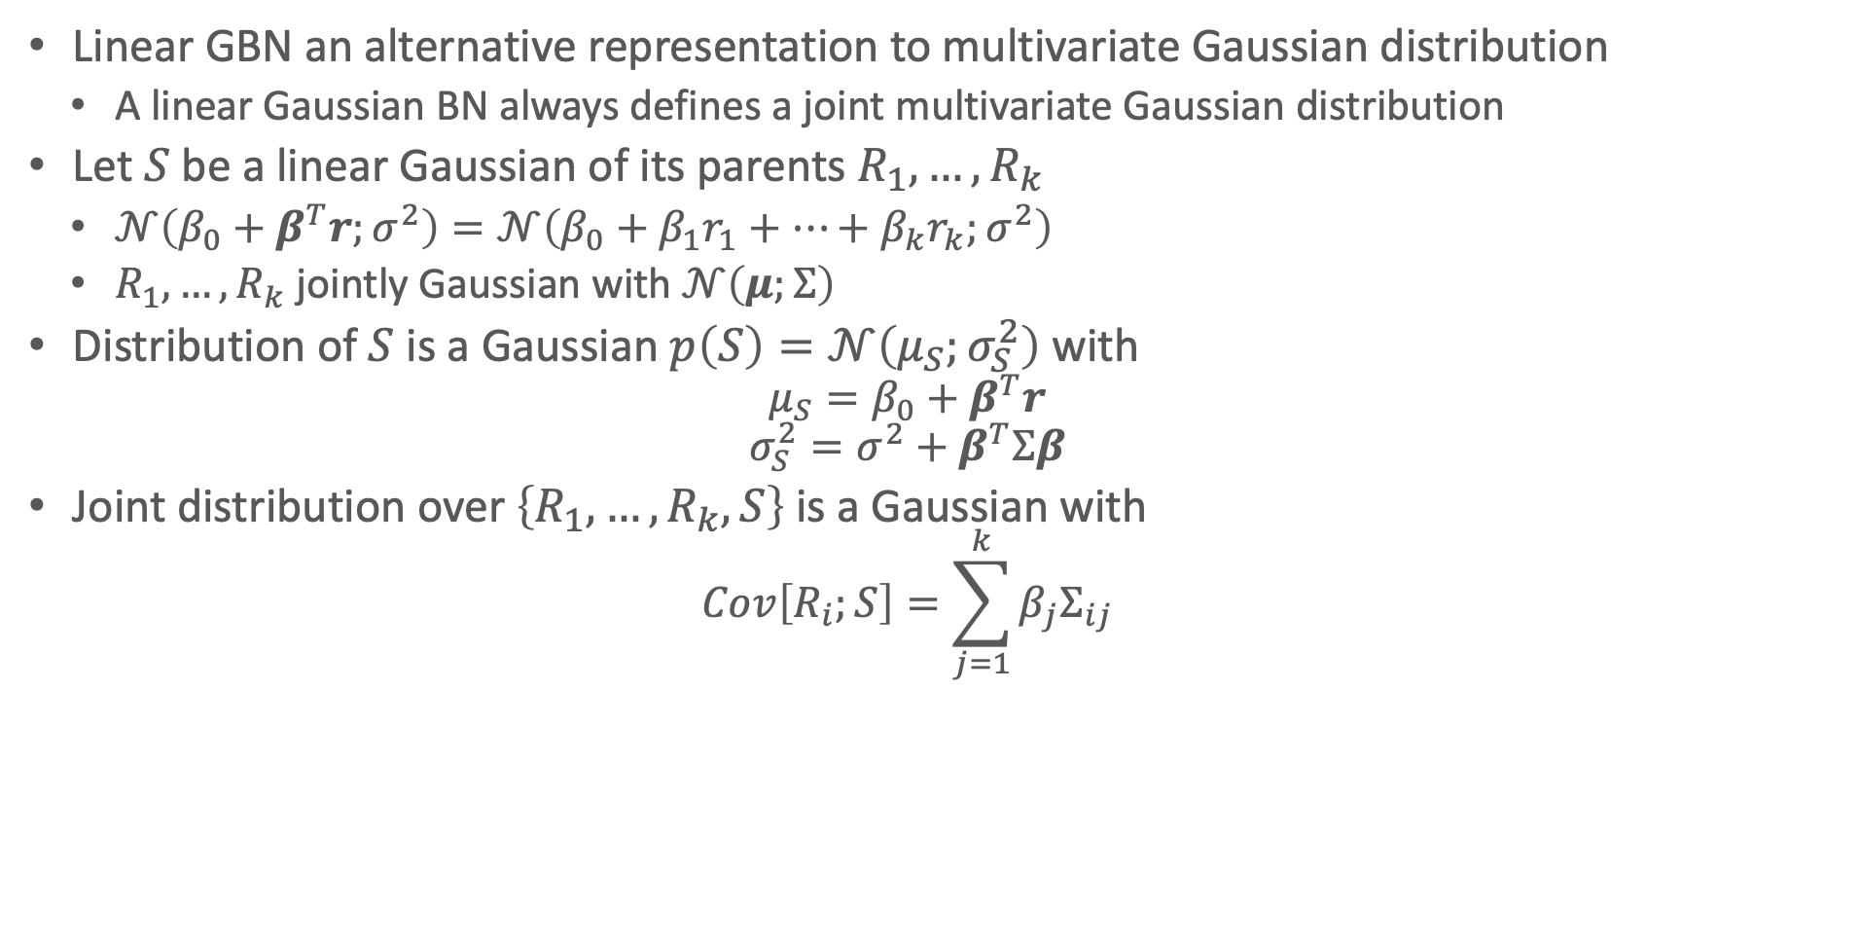
Connection to Multivariate Gaussian
Linear GBN an alternative representation to multivariate Gaussian distribution
  A linear Gaussian BN always defines a joint multivariate Gaussian distribution
Let $S$ be a linear Gaussian of its parents $R_{1},…,R_{k}$
  $𝒩\left(β_{0}+β^{T}r;σ^{2}\right)=𝒩\left(β_{0}+β_{1}r_{1}+…+β_{k}r_{k};σ^{2}\right)$
  $R_{1},…,R_{k}$ jointly Gaussian with $𝒩\left(μ;Σ\right)$
Distribution of $S$ is a Gaussian $p\left(S\right)=𝒩\left(μ_{S};σ_{S}^{2}\right)$ with
  $$μ_{S}=β_{0}+β^{T}r$$
  $$σ_{S}^{2}=σ^{2}+β^{T}Σβ$$
Joint distribution over $\left\{R_{1},…,R_{k},S\right\}$ is a Gaussian with
  $$Cov\left[R_{i};S\right]=\sum_{j=1}^{k}{β_{j}Σ_{ij}}$$

Slide 28
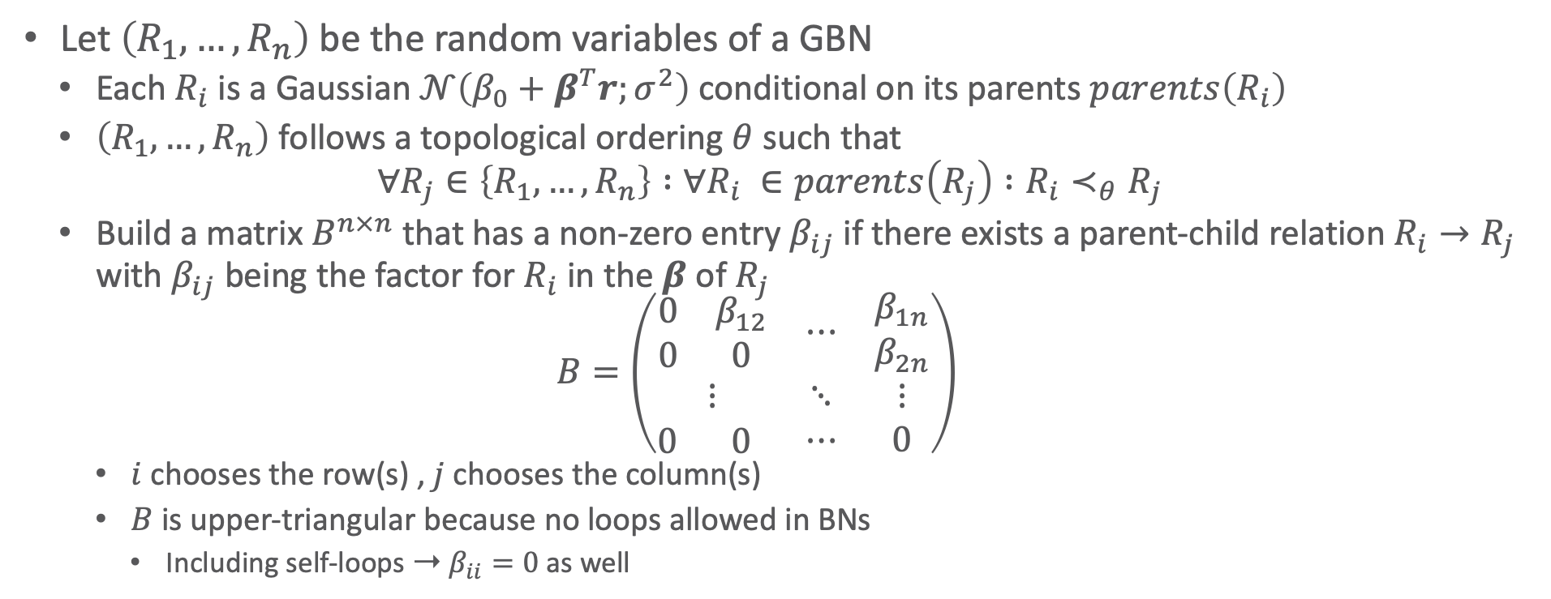
General Procedure for Conversion
Let $\left(R_{1},…,R_{n}\right)$ be the random variables of a GBN
  Each $R_{i}$ is a Gaussian $𝒩\left(β_{0}+β^{T}r;σ^{2}\right)$ conditional on its parents $parents\left(R_{i}\right)$
  $\left(R_{1},…,R_{n}\right)$ follows a topological ordering $θ$ such that
  $∀R_{j}∈\left\{R_{1},…,R_{n}\right\} :∀R_{i} ∈parents\left(R_{j}\right) :R_{i}≺_{θ}R_{j}$
  Build a matrix $B^{n×n}$ that has a non-zero entry $β_{ij}$ if there exists a parent-child relation $R_{i}→R_{j}$ with $β_{ij}$ being the factor for $R_{i}$ in the $β$ of $R_{j}$
  $$B=\left(\begin{matrix}\begin{matrix}0 & β_{12} \\ 0 & 0\end{matrix} & ⋯ & \begin{matrix}β_{1n} \\ β_{2n}\end{matrix} \\ ⋮ & ⋱ & ⋮ \\ \begin{matrix}0 & 0 \end{matrix} & ⋯ & 0\end{matrix}\right)$$
    $i$ chooses the row(s) , $j$ chooses the column(s)
    $B$ is upper-triangular because no loops allowed in BNs
      Including self-loops ➝ $β_{ii}=0$ as well
Ross D. Shachter and C. Robert Kenley: Gaussian Influence Diagrams. In: Management Science, 1989.

Slide 29
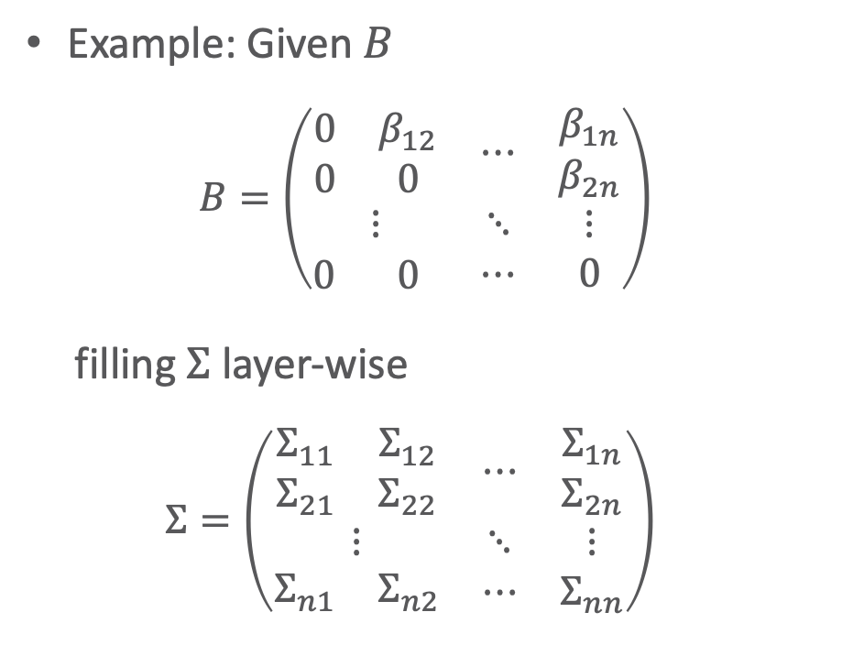
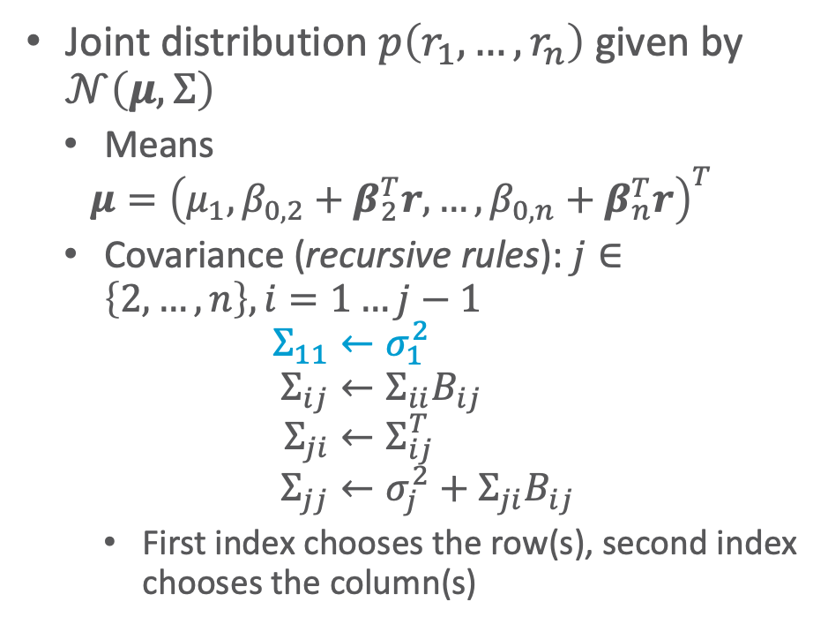
General Procedure for Conversion
Joint distribution $p\left(r_{1},…,r_{n}\right)$ given by $𝒩\left(μ,Σ\right)$
  Means
  $$μ={\left(μ_{1},β_{0,2}+β_{2}^{T}r,…,β_{0,n}+β_{n}^{T}r\right)}^{T}$$
  Covariance (recursive rules): $j∈\left\{2,…,n\right\}, i=1…j−1$
  $$Σ_{11}←σ_{1}^{2} \\ Σ_{ij}←Σ_{ii}B_{ij} \\ Σ_{ji}←Σ_{ij}^{T} \\ Σ_{jj}←σ_{j}^{2}+Σ_{ji}B_{ij}$$
    First index chooses the row(s), second index chooses the column(s)
Example: Given $B$
  $$B=\left(\begin{matrix}\begin{matrix}0 & β_{12} \\ 0 & 0\end{matrix} & ⋯ & \begin{matrix}β_{1n} \\ β_{2n}\end{matrix} \\ ⋮ & ⋱ & ⋮ \\ \begin{matrix}0 & 0 \end{matrix} & ⋯ & 0\end{matrix}\right)$$
filling $Σ$layer-wise
  $$Σ=\left(\begin{matrix}\begin{matrix}Σ_{11} & Σ_{12} \\ Σ_{21} & Σ_{22}\end{matrix} & ⋯ & \begin{matrix}Σ_{1n} \\ Σ_{2n}\end{matrix} \\ ⋮ & ⋱ & ⋮ \\ \begin{matrix}Σ_{n1} & Σ_{n2}\end{matrix} & ⋯ & Σ_{nn}\end{matrix}\right)$$
Ross D. Shachter and C. Robert Kenley: Gaussian Influence Diagrams. In: Management Science, 1989.

Slide 30


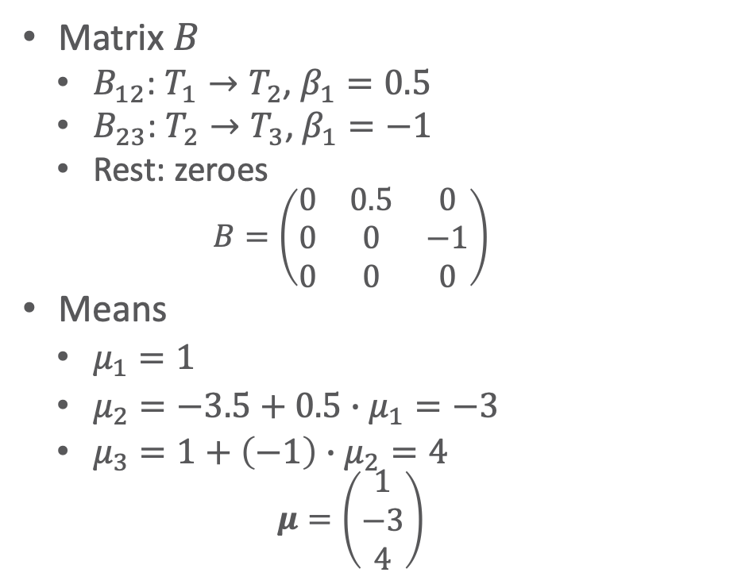



GBN: Conversion Example
$$T_{1}$$
  $p\left(T_{1}\right)=𝒩\left(1;4\right)$
  $p\left(T_{2}|T_{1}\right)=𝒩\left(−3.5+0.5∙T_{1};4\right)$
  $p\left(T_{3}|T_{2}\right)=𝒩\left(1+\left(−1\right)∙T_{2};3\right)$
GBN
Goal: Joint
distribution
Matrix $B$
  $B_{12}$: $T_{1}→T_{2}$, $β_{1}=0.5$
  $B_{23}$: $T_{2}→T_{3}$, $β_{1}=−1$
  Rest: zeroes
    $$B=\left(\begin{matrix}0 & 0.5 & 0 \\ 0 & 0 & −1 \\ 0 & 0 & 0\end{matrix}\right)$$
Means
  $μ_{1}=1$
  $μ_{2}=−3.5+0.5∙μ_{1}=−3$
  $μ_{3}=1+\left(−1\right)∙μ_{2}=4$
    $$μ=\left(\begin{matrix}1 \\ −3 \\ 4\end{matrix}\right)$$
$$T_{2}$$
$$T_{3}$$
$p\left(t_{1},t_{2},t_{3}\right)=𝒩\left(μ;Σ\right)$
$μ=\left(\begin{matrix}μ_{1} \\ μ_{2} \\ μ_{3}\end{matrix}\right)$
$Σ=\left(\begin{matrix}Σ_{11} & Σ_{12} & Σ_{13} \\ Σ_{21} & Σ_{22} & Σ_{23} \\ Σ_{31} & Σ_{32} & Σ_{33}\end{matrix}\right)$

Slide 31
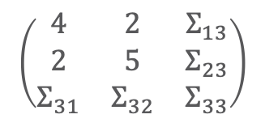


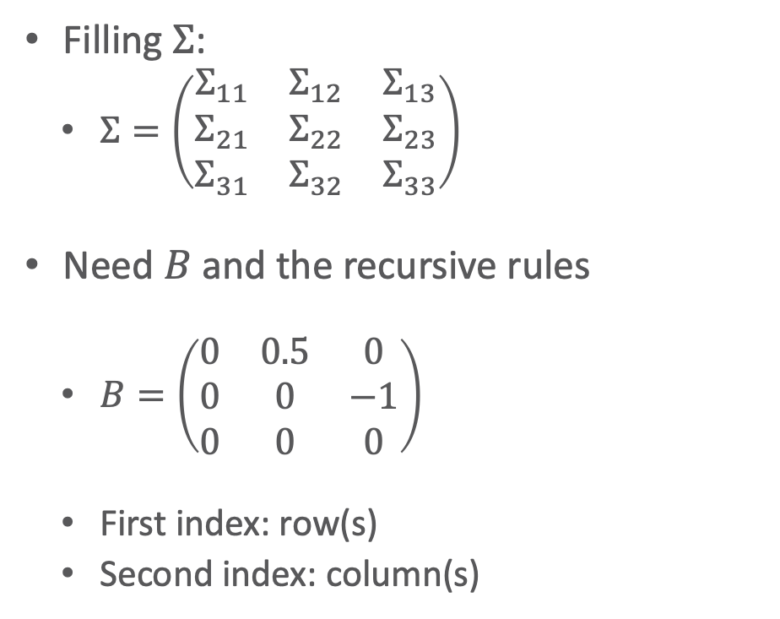


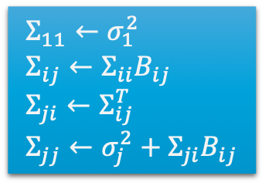
GBN: Conversion Example
Filling $Σ$:
  $Σ=\left(\begin{matrix}Σ_{11} & Σ_{12} & Σ_{13} \\ Σ_{21} & Σ_{22} & Σ_{23} \\ Σ_{31} & Σ_{32} & Σ_{33}\end{matrix}\right)$
Need $B$ and the recursive rules
  $B=\left(\begin{matrix}0 & 0.5 & 0 \\ 0 & 0 & −1 \\ 0 & 0 & 0\end{matrix}\right)$
  First index: row(s)
  Second index: column(s)
$$\left(\begin{matrix}4 & Σ_{12} & Σ_{13} \\ Σ_{21} & Σ_{22} & Σ_{23} \\ Σ_{31} & Σ_{32} & Σ_{33}\end{matrix}\right)$$
$Σ_{11}=σ_{1}^{2}=4$
$j=2,i=1$
  $Σ_{12}$
  $=Σ_{11}B_{12}$
  $=4∙0.5=2$
  $Σ_{21}$
  $=Σ_{12}^{T}$
  $=2^{T}=2$
  $Σ_{22}$
  $=σ_{2}^{2}+Σ_{21}B_{12}$
  $=4+2∙0.5=5$
$$\left(\begin{matrix}4 & 2 & Σ_{13} \\ Σ_{21} & Σ_{22} & Σ_{23} \\ Σ_{31} & Σ_{32} & Σ_{33}\end{matrix}\right)$$
  $$Σ_{11}←σ_{1}^{2} \\ Σ_{ij}←Σ_{ii}B_{ij} \\ Σ_{ji}←Σ_{ij}^{T} \\ Σ_{jj}←σ_{j}^{2}+Σ_{ji}B_{ij}$$
$$\left(\begin{matrix}4 & 2 & Σ_{13} \\ 2 & Σ_{22} & Σ_{23} \\ Σ_{31} & Σ_{32} & Σ_{33}\end{matrix}\right)$$
$$\left(\begin{matrix}4 & 2 & Σ_{13} \\ 2 & 5 & Σ_{23} \\ Σ_{31} & Σ_{32} & Σ_{33}\end{matrix}\right)$$

Slide 32










GBN: Conversion Example
Filling $Σ$:
  $Σ=\left(\begin{matrix}Σ_{11} & Σ_{12} & Σ_{13} \\ Σ_{21} & Σ_{22} & Σ_{23} \\ Σ_{31} & Σ_{32} & Σ_{33}\end{matrix}\right)$
Need $B$ and the recursive rules
  $B=\left(\begin{matrix}0 & 0.5 & 0 \\ 0 & 0 & −1 \\ 0 & 0 & 0\end{matrix}\right)$
  First index: row(s)
  Second index: column(s)
$$\left(\begin{matrix}4 & 2 & Σ_{13} \\ 2 & 5 & Σ_{23} \\ Σ_{31} & Σ_{32} & Σ_{33}\end{matrix}\right)$$
$j=3,i=12$
  $Σ_{(12)3}$
  $=Σ_{\left(12\right)\left(12\right)}B_{\left(12\right)3}$
  $=\left(\begin{matrix}4 & 2 \\ 2 & 5\end{matrix}\right)\left(\begin{matrix}0 \\ −1\end{matrix}\right)=\left(\begin{matrix}−2 \\ −5\end{matrix}\right)$
  $Σ_{3(12)}$
  $=Σ_{\left(12\right)3}^{T}$
  $={\left(\begin{matrix}−2 \\ −5\end{matrix}\right)}^{T}=\left(\begin{matrix}−2 & −5\end{matrix}\right)$
  $Σ_{33}$
  $=σ_{3}^{2}+Σ_{3(12)}B_{\left(12\right)3}$
  $=3+\left(\begin{matrix}−2 & −5\end{matrix}\right)\left(\begin{matrix}0 \\ −1\end{matrix}\right)$
  $=3+5=8$
$$\left(\begin{matrix}4 & 2 & Σ_{13} \\ 2 & 5 & Σ_{23} \\ Σ_{31} & Σ_{32} & Σ_{33}\end{matrix}\right)$$
$$−2$$
$$−5$$
  $$Σ_{11}←σ_{1}^{2} \\ Σ_{ij}←Σ_{ii}B_{ij} \\ Σ_{ji}←Σ_{ij}^{T} \\ Σ_{jj}←σ_{j}^{2}+Σ_{ji}B_{ij}$$
$$\left(\begin{matrix}4 & 2 & −2 \\ 2 & 5 & −5 \\ Σ_{31} & Σ_{32} & Σ_{33}\end{matrix}\right)$$
$$−2$$
$$−5$$
$$\left(\begin{matrix}4 & 2 & −2 \\ 2 & 5 & −5 \\ −2 & −5 & Σ_{33}\end{matrix}\right)$$
$$8$$

Slide 33

Inference in GBNs
Inference in linear Gaussians with Variable Elimination
  Representation through linear Gaussian CPDs instead of CPTs/factors
  Modified operations for multiply/sum-out
Message passing formulation
  Approximate belief propagation
Sampling in the continuous space
  Rejection sampling, importance sampling, MCMC methods for GBNs
Actually using the full joint
  Marginalisation, conditioning as sketched in Basics
See Ch. 14 of PGM book for further information

Slide 34















Lifting the Full Joint
Lifting conversion method by Shachter and Kenley for parameterised GBNs
  GBN with PRVs $A_{1},…,A_{m}$ as nodes
    PDF for each $A_{i}$ applies to each $R∈gr\left(A_{i}\right)$
    $m≪n$, $n=\left|\bigcup_{i}{gr\left(A_{i}\right)}\right|$
    Semantics: grounding and forming full joint $p\left(\bigcup_{i}{gr\left(A_{i}\right)}\right)$
    Simple case: For all parent-child relations $R\left(X\right)→S\left(Y\right)$, it holds that $X∩Y=∅$
      Each child instance has
      the same parent instances
      as its siblings
    General case a bit more
    involved
    [Hartwig et al., 2021]
  $$Σ_{11}←σ_{1}^{2} \\ Σ_{ij}←Σ_{ii}B_{ij} \\ Σ_{ji}←Σ_{ij}^{T} \\ Σ_{jj}←σ_{j}^{2}+Σ_{ji}B_{ij}$$
$$R\left(X\right)$$
  $p\left(R\left(X\right)\right)=𝒩\left(1;4\right)$
  $p\left(S\left(Y\right)|R\left(X\right)\right)=𝒩\left(−3.5+0.5∙T_{1};4\right)$
  $p\left(T\left(Z\right)|S\left(Y\right)\right)=𝒩\left(1+\left(−1\right)∙T_{2};3\right)$
$$R\left(x_{1}\right)$$
$$R\left(x_{2}\right)$$
…
$$R\left(x_{n}\right)$$
$$S\left(Y\right)$$
$$S\left(y_{1}\right)$$
$$S\left(y_{2}\right)$$
…
$$S\left(y_{m}\right)$$
$$T\left(Z\right)$$
$$T\left(z_{1}\right)$$
$$T\left(z_{2}\right)$$
…
$$T\left(z_{l}\right)$$
Mattis Hartwig and Ralf Möller. Lifted Query Answering in Gaussian Bayesian Networks. In: PGM-20 Proceedings of the 10th International Conference on Probabilistic Graphical Models, 2020.

Slide 35

















Lifting the Full Joint: Simple Case
With PRVs, matrix $B$ and covariance matrix have liftable blocks for each PRV
  Given the case of no overlaps in logical variables: $B$
$$R\left(X\right)$$
$$S\left(Y\right)$$
$$T\left(Z\right)$$
$$\left(\begin{matrix}\begin{matrix}0 & … & 0 \\ ⋮ & ⋱ & ⋮ \\ 0 & … & 0\end{matrix} & \begin{matrix}β_{r_{1}s_{1}} & … & β_{r_{1}s_{m}} \\ ⋮ & ⋱ & ⋮ \\ β_{r_{n}s_{1}} & … & β_{r_{n}s_{m}}\end{matrix} & \begin{matrix} 0 & … & 0 \\ ⋮ & ⋱ & ⋮ \\ 0 & … & 0\end{matrix} \\ \begin{matrix}0 & … & 0 \\ ⋮ & ⋱ & ⋮ \\ 0 & … & 0\end{matrix} & \begin{matrix} 0 & … & 0 \\ ⋮ & ⋱ & ⋮ \\ 0 & … & 0\end{matrix} & \begin{matrix}β_{s_{1}t_{1}} & … & β_{s_{1}t_{l}} \\ ⋮ & ⋱ & ⋮ \\ β_{s_{m}t_{1}} & … & β_{s_{m}t_{l}}\end{matrix} \\ \begin{matrix}0 & … & 0 \\ ⋮ & ⋱ & ⋮ \\ 0 & … & 0\end{matrix} & \begin{matrix} 0 & … & 0 \\ ⋮ & ⋱ & ⋮ \\ 0 & … & 0\end{matrix} & \begin{matrix} 0 & … & 0 \\ ⋮ & ⋱ & ⋮ \\ 0 & … & 0\end{matrix}\end{matrix}\right)$$
$$R\left(X\right)$$
$$R\left(x_{1}\right)$$
$$R\left(x_{2}\right)$$
…
$$R\left(x_{n}\right)$$
$$S\left(Y\right)$$
$$S\left(y_{1}\right)$$
$$S\left(y_{2}\right)$$
…
$$S\left(y_{m}\right)$$
$$T\left(Z\right)$$
$$T\left(z_{1}\right)$$
$$T\left(z_{2}\right)$$
…
$$T\left(z_{l}\right)$$

Slide 36



Lifting the Full Joint: Simple Case
Each $R\left(x_{i}\right)$ has the same influence on each $S\left(y_{j}\right)$. Given $P\left(s\left(Y\right) | r\left(X\right)\right)=𝒩\left(β_{0}+β_{1}r\left(X\right);σ^{2}\right)$,
$$β_{r_{i}s_{j}}=β_{1}$$
for all $i∈\left\{1,…,n\right\},j∈\left\{1,…,m\right\}$. The same holds for $S\left(y_{j}\right)$ and $T\left(z_{k}\right)$ (as well as $R\left(x_{i}\right)$ and $T\left(z_{k}\right)$, which has $β_{r_{i}t_{k}}=0$).
$$R\left(X\right)$$
$$S\left(Y\right)$$
$$T\left(Z\right)$$
$$\left(\begin{matrix}\begin{matrix}0 & … & 0 \\ ⋮ & ⋱ & ⋮ \\ 0 & … & 0\end{matrix} & \begin{matrix}β_{r_{1}s_{1}} & … & β_{r_{1}s_{m}} \\ ⋮ & ⋱ & ⋮ \\ β_{r_{n}s_{1}} & … & β_{r_{n}s_{m}}\end{matrix} & \begin{matrix} 0 & … & 0 \\ ⋮ & ⋱ & ⋮ \\ 0 & … & 0\end{matrix} \\ \begin{matrix}0 & … & 0 \\ ⋮ & ⋱ & ⋮ \\ 0 & … & 0\end{matrix} & \begin{matrix} 0 & … & 0 \\ ⋮ & ⋱ & ⋮ \\ 0 & … & 0\end{matrix} & \begin{matrix}β_{s_{1}t_{1}} & … & β_{s_{1}t_{l}} \\ ⋮ & ⋱ & ⋮ \\ β_{s_{m}t_{1}} & … & β_{s_{m}t_{l}}\end{matrix} \\ \begin{matrix}0 & … & 0 \\ ⋮ & ⋱ & ⋮ \\ 0 & … & 0\end{matrix} & \begin{matrix} 0 & … & 0 \\ ⋮ & ⋱ & ⋮ \\ 0 & … & 0\end{matrix} & \begin{matrix} 0 & … & 0 \\ ⋮ & ⋱ & ⋮ \\ 0 & … & 0\end{matrix}\end{matrix}\right)$$
Lifted $B^{′}$
$$\left(\begin{matrix}0 & β_{rs} & 0 \\ 0 & 0 & β_{st} \\ 0 & 0 & 0\end{matrix}\right)$$
$$R\left(X\right)$$
$$R\left(x_{1}\right)$$
$$R\left(x_{2}\right)$$
…
$$R\left(x_{n}\right)$$
$$S\left(Y\right)$$
Lifted $B^{′}$
$$\left(\begin{matrix}0 & 0.5 & 0 \\ 0 & 0 & −1 \\ 0 & 0 & 0\end{matrix}\right)$$
$$S\left(y_{1}\right)$$
$$S\left(y_{2}\right)$$
…
$$S\left(y_{m}\right)$$
$$T\left(Z\right)$$
$$T\left(z_{1}\right)$$
$$T\left(z_{2}\right)$$
…
$$T\left(z_{l}\right)$$

Slide 37








Lifting the Full Joint: Simple Case
With PRVs, matrix $B$ and covariance matrix have liftable blocks for each PRV
  Given the case of no overlaps in logical variables: $Σ$
$$R\left(X\right)$$
$$S\left(Y\right)$$
$$T\left(Z\right)$$
$$\left(\begin{matrix}\begin{matrix}Σ_{r_{1}r_{1}} & … & Σ_{r_{1}r_{n}} \\ ⋮ & ⋱ & ⋮ \\ Σ_{r_{n}r_{1}} & … & Σ_{r_{n}r_{n}}\end{matrix} & \begin{matrix}Σ_{r_{1}s_{1}} & … & Σ_{r_{1}s_{m}} \\ ⋮ & ⋱ & ⋮ \\ Σ_{r_{n}s_{1}} & … & Σ_{r_{n}s_{m}}\end{matrix} & \begin{matrix}Σ_{r_{1}t_{1}} & … & Σ_{r_{1}t_{l}} \\ ⋮ & ⋱ & ⋮ \\ Σ_{r_{n}t_{1}} & … & Σ_{r_{n}t_{l}}\end{matrix} \\ \begin{matrix}Σ_{s_{1}r_{1}} & … & Σ_{s_{1}r_{n}} \\ ⋮ & ⋱ & ⋮ \\ Σ_{s_{m}r_{1}} & … & Σ_{s_{m}r_{n}}\end{matrix} & \begin{matrix}Σ_{s_{1}s_{1}} & … & Σ_{s_{1}s_{m}} \\ ⋮ & ⋱ & ⋮ \\ Σ_{s_{m}s} & … & Σ_{s_{m}s_{m}}\end{matrix} & \begin{matrix}Σ_{s_{1}t_{1}} & … & Σ_{s_{1}t_{l}} \\ ⋮ & ⋱ & ⋮ \\ Σ_{s_{m}t_{1}} & … & Σ_{s_{m}t_{n}}\end{matrix} \\ \begin{matrix}Σ_{t_{1}r_{1}} & … & Σ_{t_{1}r_{n}} \\ ⋮ & ⋱ & ⋮ \\ Σ_{t_{l}r_{1}} & … & Σ_{t_{l}r_{n}}\end{matrix} & \begin{matrix}Σ_{t_{1}s_{1}} & … & Σ_{t_{1}s_{m}} \\ ⋮ & ⋱ & ⋮ \\ Σ_{t_{l}s_{1}} & … & Σ_{t_{l}s_{m}}\end{matrix} & \begin{matrix}Σ_{t_{1}t_{1}} & … & Σ_{t_{1}t_{l}} \\ ⋮ & ⋱ & ⋮ \\ Σ_{t_{l}t_{1}} & … & Σ_{t_{l}t_{l}}\end{matrix}\end{matrix}\right)$$
$$R\left(X\right)$$
$$R\left(x_{1}\right)$$
$$R\left(x_{2}\right)$$
…
$$R\left(x_{n}\right)$$
$$S\left(Y\right)$$
$$S\left(y_{1}\right)$$
$$S\left(y_{2}\right)$$
…
$$S\left(y_{m}\right)$$
$$T\left(Z\right)$$
$$T\left(z_{1}\right)$$
$$T\left(z_{2}\right)$$
…
$$T\left(z_{l}\right)$$

Slide 38







Lifting the Full Joint: Simple Case
$$\left(\begin{matrix}\begin{matrix}Σ_{r_{1}r_{1}} & … & Σ_{r_{1}r_{n}} \\ ⋮ & ⋱ & ⋮ \\ Σ_{r_{n}r_{1}} & … & Σ_{r_{n}r_{n}}\end{matrix} & \begin{matrix}Σ_{r_{1}s_{1}} & … & Σ_{r_{1}s_{m}} \\ ⋮ & ⋱ & ⋮ \\ Σ_{r_{n}s_{1}} & … & Σ_{r_{n}s_{m}}\end{matrix} & \begin{matrix}Σ_{r_{1}t_{1}} & … & Σ_{r_{1}t_{l}} \\ ⋮ & ⋱ & ⋮ \\ Σ_{r_{n}t_{1}} & … & Σ_{r_{n}t_{l}}\end{matrix} \\ \begin{matrix}Σ_{s_{1}r_{1}} & … & Σ_{s_{1}r_{n}} \\ ⋮ & ⋱ & ⋮ \\ Σ_{s_{m}r_{1}} & … & Σ_{s_{m}r_{n}}\end{matrix} & \begin{matrix}Σ_{s_{1}s_{1}} & … & Σ_{s_{1}s_{m}} \\ ⋮ & ⋱ & ⋮ \\ Σ_{s_{m}s} & … & Σ_{s_{m}s_{m}}\end{matrix} & \begin{matrix}Σ_{s_{1}t_{1}} & … & Σ_{s_{1}t_{l}} \\ ⋮ & ⋱ & ⋮ \\ Σ_{s_{m}t_{1}} & … & Σ_{s_{m}t_{n}}\end{matrix} \\ \begin{matrix}Σ_{t_{1}r_{1}} & … & Σ_{t_{1}r_{n}} \\ ⋮ & ⋱ & ⋮ \\ Σ_{t_{l}r_{1}} & … & Σ_{t_{l}r_{n}}\end{matrix} & \begin{matrix}Σ_{t_{1}s_{1}} & … & Σ_{t_{1}s_{m}} \\ ⋮ & ⋱ & ⋮ \\ Σ_{t_{l}s_{1}} & … & Σ_{t_{l}s_{m}}\end{matrix} & \begin{matrix}Σ_{t_{1}t_{1}} & … & Σ_{t_{1}t_{l}} \\ ⋮ & ⋱ & ⋮ \\ Σ_{t_{l}t_{1}} & … & Σ_{t_{l}t_{l}}\end{matrix}\end{matrix}\right)$$
$Σ_{r_{1}r_{1}}=σ_{R\left(X\right)}^{2}$
$Σ_{r_{1}r_{2}}=σ_{R\left(X\right)}^{2}B_{r_{1}r_{2}}=σ_{R\left(X\right)}^{2}B_{11}^{′}=σ_{R\left(X\right)}^{2}∙0=0$
$Σ_{r_{2}r_{1}}=0$
$Σ_{r_{2}r_{2}}=σ_{R\left(X\right)}^{2}+Σ_{r_{2}r_{1}}B_{r_{1}r_{2}}=σ_{R\left(X\right)}^{2}+0=σ_{R\left(X\right)}^{2}$
$…$
  $$Σ_{11}←σ_{1}^{2} \\ Σ_{ij}←Σ_{ii}B_{ij} \\ Σ_{ji}←Σ_{ij}^{T} \\ Σ_{jj}←σ_{j}^{2}+Σ_{ji}B_{ij}$$
$$R\left(X\right)$$
$$\begin{matrix}σ_{R\left(X\right)}^{2} & … & 0 \\ ⋮ & ⋱ & ⋮ \\ 0 & … & σ_{R\left(X\right)}^{2}\end{matrix}=\begin{matrix}4 & … & 0 \\ ⋮ & ⋱ & ⋮ \\ 0 & … & 4\end{matrix}⟶\begin{matrix}\text{on}\text{−}\text{diagonal}\text{: }σ_{R\left(X\right)}^{2} \\ \text{off}\text{−}\text{diagonal}\text{: }0 \end{matrix}$$
$$R\left(X\right)$$
Lifted $B^{′}$
$$\left(\begin{matrix}0 & β_{rs} & 0 \\ 0 & 0 & β_{st} \\ 0 & 0 & 0\end{matrix}\right)$$

Slide 39



Lifting the Full Joint: Simple Case
$$\left(\begin{matrix}\begin{matrix}σ_{R\left(X\right)}^{2} & … & 0 \\ ⋮ & ⋱ & ⋮ \\ 0 & … & σ_{R\left(X\right)}^{2}\end{matrix} & \begin{matrix}Σ_{r_{1}s_{1}} & … & Σ_{r_{1}s_{m}} \\ ⋮ & ⋱ & ⋮ \\ Σ_{r_{n}s_{1}} & … & Σ_{r_{n}s_{m}}\end{matrix} & \begin{matrix}Σ_{r_{1}t_{1}} & … & Σ_{r_{1}t_{l}} \\ ⋮ & ⋱ & ⋮ \\ Σ_{r_{n}t_{1}} & … & Σ_{r_{n}t_{l}}\end{matrix} \\ \begin{matrix}Σ_{s_{1}r_{1}} & … & Σ_{s_{1}r_{n}} \\ ⋮ & ⋱ & ⋮ \\ Σ_{s_{m}r_{1}} & … & Σ_{s_{m}r_{n}}\end{matrix} & \begin{matrix}Σ_{s_{1}s_{1}} & … & Σ_{s_{1}s_{m}} \\ ⋮ & ⋱ & ⋮ \\ Σ_{s_{m}s} & … & Σ_{s_{m}s_{m}}\end{matrix} & \begin{matrix}Σ_{s_{1}t_{1}} & … & Σ_{s_{1}t_{l}} \\ ⋮ & ⋱ & ⋮ \\ Σ_{s_{m}t_{1}} & … & Σ_{s_{m}t_{n}}\end{matrix} \\ \begin{matrix}Σ_{t_{1}r_{1}} & … & Σ_{t_{1}r_{n}} \\ ⋮ & ⋱ & ⋮ \\ Σ_{t_{l}r_{1}} & … & Σ_{t_{l}r_{n}}\end{matrix} & \begin{matrix}Σ_{t_{1}s_{1}} & … & Σ_{t_{1}s_{m}} \\ ⋮ & ⋱ & ⋮ \\ Σ_{t_{l}s_{1}} & … & Σ_{t_{l}s_{m}}\end{matrix} & \begin{matrix}Σ_{t_{1}t_{1}} & … & Σ_{t_{1}t_{l}} \\ ⋮ & ⋱ & ⋮ \\ Σ_{t_{l}t_{1}} & … & Σ_{t_{l}t_{l}}\end{matrix}\end{matrix}\right)$$
$$Σ_{\left(r_{1}…r_{n}\right)s_{1}} \\ =Σ_{\left(r_{1}…r_{n}\right)\left(r_{1}…r_{n}\right)}B_{\left(r_{1}…r_{n}\right)s_{1}} \\ =\left(\begin{matrix}σ_{R\left(X\right)}^{2} & … & 0 \\ ⋮ & ⋱ & ⋮ \\ 0 & … & σ_{R\left(X\right)}^{2}\end{matrix}\right)\left(\begin{matrix}β_{rs} \\ ⋮ \\ β_{rs}\end{matrix}\right)=\left(\begin{matrix}σ_{R\left(X\right)}^{2}β_{rs} \\ ⋮ \\ σ_{R\left(X\right)}^{2}β_{rs}\end{matrix}\right)=\left(\begin{matrix}4∙0.5 \\ ⋮ \\ 4∙0.5\end{matrix}\right)=\left(\begin{matrix}2 \\ ⋮ \\ 2\end{matrix}\right)$$
$$Σ_{s_{1}s_{1}} \\ =σ_{S\left(Y\right)}^{2}+Σ_{s_{1}\left(r_{1}…r_{n}\right)}B_{\left(r_{1}…r_{n}\right)s_{1}} \\ =σ_{S\left(Y\right)}^{2}+\left(\begin{matrix}σ_{R\left(X\right)}^{2}β_{rs} & … & σ_{R\left(X\right)}^{2}β_{rs}\end{matrix}\right)\left(\begin{matrix}β_{rs} \\ ⋮ \\ β_{rs}\end{matrix}\right)=σ_{S\left(Y\right)}^{2}+nσ_{R\left(X\right)}^{2}β_{rs}^{2} \\ =4+n∙4∙{0.5}^{2}=4+n$$
  $$Σ_{11}←σ_{1}^{2} \\ Σ_{ij}←Σ_{ii}B_{ij} \\ Σ_{ji}←Σ_{ij}^{T} \\ Σ_{jj}←σ_{j}^{2}+Σ_{ji}B_{ij}$$
Lifted $B^{′}$
$$\left(\begin{matrix}0 & β_{rs} & 0 \\ 0 & 0 & β_{st} \\ 0 & 0 & 0\end{matrix}\right)$$

Slide 40




Lifting the Full Joint: Simple Case
$$\left(\begin{matrix}\begin{matrix}σ_{R\left(X\right)}^{2} & … & 0 \\ ⋮ & ⋱ & ⋮ \\ 0 & … & σ_{R\left(X\right)}^{2}\end{matrix} & \begin{matrix}Σ_{r_{1}s_{1}} & … & Σ_{r_{1}s_{m}} \\ ⋮ & ⋱ & ⋮ \\ Σ_{r_{n}s_{1}} & … & Σ_{r_{n}s_{m}}\end{matrix} & \begin{matrix}Σ_{r_{1}t_{1}} & … & Σ_{r_{1}t_{l}} \\ ⋮ & ⋱ & ⋮ \\ Σ_{r_{n}t_{1}} & … & Σ_{r_{n}t_{l}}\end{matrix} \\ \begin{matrix}Σ_{s_{1}r_{1}} & … & Σ_{s_{1}r_{n}} \\ ⋮ & ⋱ & ⋮ \\ Σ_{s_{m}r_{1}} & … & Σ_{s_{m}r_{n}}\end{matrix} & \begin{matrix}Σ_{s_{1}s_{1}} & … & Σ_{s_{1}s_{m}} \\ ⋮ & ⋱ & ⋮ \\ Σ_{s_{m}s} & … & Σ_{s_{m}s_{m}}\end{matrix} & \begin{matrix}Σ_{s_{1}t_{1}} & … & Σ_{s_{1}t_{l}} \\ ⋮ & ⋱ & ⋮ \\ Σ_{s_{m}t_{1}} & … & Σ_{s_{m}t_{n}}\end{matrix} \\ \begin{matrix}Σ_{t_{1}r_{1}} & … & Σ_{t_{1}r_{n}} \\ ⋮ & ⋱ & ⋮ \\ Σ_{t_{l}r_{1}} & … & Σ_{t_{l}r_{n}}\end{matrix} & \begin{matrix}Σ_{t_{1}s_{1}} & … & Σ_{t_{1}s_{m}} \\ ⋮ & ⋱ & ⋮ \\ Σ_{t_{l}s_{1}} & … & Σ_{t_{l}s_{m}}\end{matrix} & \begin{matrix}Σ_{t_{1}t_{1}} & … & Σ_{t_{1}t_{l}} \\ ⋮ & ⋱ & ⋮ \\ Σ_{t_{l}t_{1}} & … & Σ_{t_{l}t_{l}}\end{matrix}\end{matrix}\right)$$
$$\left(\begin{matrix}\begin{matrix}σ_{R\left(X\right)}^{2} & … & 0 \\ ⋮ & ⋱ & ⋮ \\ 0 & … & σ_{R\left(X\right)}^{2}\end{matrix} & \begin{matrix}Σ_{r_{1}s_{1}} & … & Σ_{r_{1}s_{m}} \\ ⋮ & ⋱ & ⋮ \\ Σ_{r_{n}s_{1}} & … & Σ_{r_{n}s_{m}}\end{matrix} & \begin{matrix}Σ_{r_{1}t_{1}} & … & Σ_{r_{1}t_{l}} \\ ⋮ & ⋱ & ⋮ \\ Σ_{r_{n}t_{1}} & … & Σ_{r_{n}t_{l}}\end{matrix} \\ \begin{matrix}Σ_{s_{1}r_{1}} & … & Σ_{s_{1}r_{n}} \\ ⋮ & ⋱ & ⋮ \\ Σ_{s_{m}r_{1}} & … & Σ_{s_{m}r_{n}}\end{matrix} & \begin{matrix}Σ_{s_{1}s_{1}} & … & Σ_{s_{1}s_{m}} \\ ⋮ & ⋱ & ⋮ \\ Σ_{s_{m}s} & … & Σ_{s_{m}s_{m}}\end{matrix} & \begin{matrix}Σ_{s_{1}t_{1}} & … & Σ_{s_{1}t_{l}} \\ ⋮ & ⋱ & ⋮ \\ Σ_{s_{m}t_{1}} & … & Σ_{s_{m}t_{n}}\end{matrix} \\ \begin{matrix}Σ_{t_{1}r_{1}} & … & Σ_{t_{1}r_{n}} \\ ⋮ & ⋱ & ⋮ \\ Σ_{t_{l}r_{1}} & … & Σ_{t_{l}r_{n}}\end{matrix} & \begin{matrix}Σ_{t_{1}s_{1}} & … & Σ_{t_{1}s_{m}} \\ ⋮ & ⋱ & ⋮ \\ Σ_{t_{l}s_{1}} & … & Σ_{t_{l}s_{m}}\end{matrix} & \begin{matrix}Σ_{t_{1}t_{1}} & … & Σ_{t_{1}t_{l}} \\ ⋮ & ⋱ & ⋮ \\ Σ_{t_{l}t_{1}} & … & Σ_{t_{l}t_{l}}\end{matrix}\end{matrix}\right)$$
$$Σ_{\left(r_{1}…r_{n}s_{1}\right)s_{2}}=Σ_{\left(r_{1}…r_{n}s_{1}\right)\left(r_{1}…r_{n}s_{1}\right)}B_{\left(r_{1}…r_{n}s_{1}\right)s_{2}} \\ =\left(\begin{matrix}σ_{R\left(X\right)}^{2} & … & 0 & σ_{R\left(X\right)}^{2}β_{rs} \\ ⋮ & ⋱ & ⋮ & ⋮ \\ 0 & … & σ_{R\left(X\right)}^{2} & σ_{R\left(X\right)}^{2}β_{rs} \\ σ_{R\left(X\right)}^{2}β_{rs} & … & σ_{R\left(X\right)}^{2}β_{rs} & σ_{S\left(Y\right)}^{2}+nσ_{R\left(X\right)}^{2}β_{rs}^{2}\end{matrix}\right)\left(\begin{aligned}\begin{matrix}β_{rs} \\ ⋮ \\ β_{rs}\end{matrix} \\ 0\end{aligned}\right) \\ =\left(\begin{matrix}σ_{R\left(X\right)}^{2}β_{rs} \\ ⋮ \\ σ_{R\left(X\right)}^{2}β_{rs} \\ nσ_{R\left(X\right)}^{2}β_{rs}^{2}\end{matrix}\right)=\left(\begin{matrix}4∙0.5 \\ ⋮ \\ 4∙0.5 \\ n∙4∙{0.5}^{2}\end{matrix}\right)=\left(\begin{matrix}2 \\ ⋮ \\ 2 \\ n\end{matrix}\right)$$
$$Σ_{s_{1}s_{1}}$$
  $$Σ_{11}←σ_{1}^{2} \\ Σ_{ij}←Σ_{ii}B_{ij} \\ Σ_{ji}←Σ_{ij}^{T} \\ Σ_{jj}←σ_{j}^{2}+Σ_{ji}B_{ij}$$
$$Σ_{s_{2}s_{2}} \\ =σ_{S\left(Y\right)}^{2}+Σ_{s_{2}\left(r_{1}…r_{n}s_{1}\right)}B_{\left(r_{1}…r_{n}s_{1}\right)s_{2}} \\ =σ_{S\left(Y\right)}^{2}+\left(\begin{matrix}σ_{R\left(X\right)}^{2}β_{rs} & … & σ_{R\left(X\right)}^{2}β_{rs} & nσ_{R\left(X\right)}^{2}β_{rs}^{2}\end{matrix}\right)\left(\begin{aligned}\begin{matrix}β_{rs} \\ ⋮ \\ β_{rs}\end{matrix} \\ 0\end{aligned}\right) \\ =σ_{S\left(Y\right)}^{2}+nσ_{R\left(X\right)}^{2}β_{rs}^{2}=4+n$$
Lifted $B^{′}$
$$\left(\begin{matrix}0 & β_{rs} & 0 \\ 0 & 0 & β_{st} \\ 0 & 0 & 0\end{matrix}\right)$$

Slide 41










$$\begin{matrix}σ_{R\left(X\right)}^{2} & … & 0 \\ ⋮ & ⋱ & ⋮ \\ 0 & … & σ_{R\left(X\right)}^{2}\end{matrix}⟶\begin{matrix}\text{on}\text{−}\text{diagonal}\text{: }σ_{R\left(X\right)}^{2} \\ \text{off}\text{−}\text{diagonal}\text{: }0 \end{matrix}$$
$$\begin{matrix}σ_{R\left(X\right)}^{2}β_{rs} & … & σ_{R\left(X\right)}^{2}β_{rs} \\ ⋮ & ⋱ & ⋮ \\ σ_{R\left(X\right)}^{2}β_{rs} & … & σ_{R\left(X\right)}^{2}β_{rs}\end{matrix}⟶\text{all}\text{:} σ_{R\left(X\right)}^{2}β_{rs}$$
$$\begin{matrix}σ_{S\left(Y\right)}^{2}+nσ_{R\left(X\right)}^{2}β_{rs}^{2} & … & nσ_{R\left(X\right)}^{2}β_{rs}^{2} \\ ⋮ & ⋱ & ⋮ \\ nσ_{R\left(X\right)}^{2}β_{rs}^{2} & … & σ_{S\left(Y\right)}^{2}+nσ_{R\left(X\right)}^{2}β_{rs}^{2}\end{matrix}⟶\begin{matrix}\text{on}\text{−}\text{diagonal}\text{:} σ_{S\left(Y\right)}^{2}+nσ_{R\left(X\right)}^{2}β_{rs}^{2} \\ \text{off}\text{−}\text{diagonal}\text{:} nσ_{R\left(X\right)}^{2}β_{rs}^{2} \end{matrix}$$
$$R\left(X\right)$$
$$S\left(Y\right)$$
$$T\left(Z\right)$$
$$\left(\begin{matrix}\begin{matrix}Σ_{r_{1}r_{1}} & … & Σ_{r_{1}r_{n}} \\ ⋮ & ⋱ & ⋮ \\ Σ_{r_{n}r_{1}} & … & Σ_{r_{n}r_{n}}\end{matrix} & \begin{matrix}Σ_{r_{1}s_{1}} & … & Σ_{r_{1}s_{m}} \\ ⋮ & ⋱ & ⋮ \\ Σ_{r_{n}s_{1}} & … & Σ_{r_{n}s_{m}}\end{matrix} & \begin{matrix}Σ_{r_{1}t_{1}} & … & Σ_{r_{1}t_{l}} \\ ⋮ & ⋱ & ⋮ \\ Σ_{r_{n}t_{1}} & … & Σ_{r_{n}t_{l}}\end{matrix} \\ \begin{matrix}Σ_{s_{1}r_{1}} & … & Σ_{s_{1}r_{n}} \\ ⋮ & ⋱ & ⋮ \\ Σ_{s_{m}r_{1}} & … & Σ_{s_{m}r_{n}}\end{matrix} & \begin{matrix}Σ_{s_{1}s_{1}} & … & Σ_{s_{1}s_{m}} \\ ⋮ & ⋱ & ⋮ \\ Σ_{s_{m}s} & … & Σ_{s_{m}s_{m}}\end{matrix} & \begin{matrix}Σ_{s_{1}t_{1}} & … & Σ_{s_{1}t_{l}} \\ ⋮ & ⋱ & ⋮ \\ Σ_{s_{m}t_{1}} & … & Σ_{s_{m}t_{n}}\end{matrix} \\ \begin{matrix}Σ_{t_{1}r_{1}} & … & Σ_{t_{1}r_{n}} \\ ⋮ & ⋱ & ⋮ \\ Σ_{t_{l}r_{1}} & … & Σ_{t_{l}r_{n}}\end{matrix} & \begin{matrix}Σ_{t_{1}s_{1}} & … & Σ_{t_{1}s_{m}} \\ ⋮ & ⋱ & ⋮ \\ Σ_{t_{l}s_{1}} & … & Σ_{t_{l}s_{m}}\end{matrix} & \begin{matrix}Σ_{t_{1}t_{1}} & … & Σ_{t_{1}t_{l}} \\ ⋮ & ⋱ & ⋮ \\ Σ_{t_{l}t_{1}} & … & Σ_{t_{l}t_{l}}\end{matrix}\end{matrix}\right)$$
$$R\left(X\right)$$
$$S\left(Y\right)$$
$$T\left(Z\right)$$

Slide 42










Lifting the Full Joint: Simple Case
$$T\left(Z\right)$$
$$\begin{matrix}mσ_{R\left(X\right)}^{2}β_{rs}β_{st} & … & mσ_{R\left(X\right)}^{2}β_{rs}β_{st} \\ ⋮ & ⋱ & ⋮ \\ mσ_{R\left(X\right)}^{2}β_{rs}β_{rs} & … & mσ_{R\left(X\right)}^{2}β_{rs}β_{rs}\end{matrix}⟶\text{all}\text{:} mσ_{R\left(X\right)}^{2}β_{rs}β_{st}=m∙4∙0.5∙\left(−1\right)=−2m$$
$$R\left(X\right)$$
$$T\left(Z\right)$$
$$\begin{matrix}\left(σ_{S\left(Y\right)}^{2}+mnσ_{R\left(X\right)}^{2}β_{rs}^{2}\right)β_{st} & … & \left(σ_{S\left(Y\right)}^{2}+mnσ_{R\left(X\right)}^{2}β_{rs}^{2}\right)β_{st} \\ ⋮ & ⋱ & ⋮ \\ \left(σ_{S\left(Y\right)}^{2}+mnσ_{R\left(X\right)}^{2}β_{rs}^{2}\right)β_{st} & … & \left(σ_{S\left(Y\right)}^{2}+mnσ_{R\left(X\right)}^{2}β_{rs}^{2}\right)β_{st}\end{matrix}⟶\text{all}\text{:} \left(σ_{S\left(Y\right)}^{2}+mnσ_{R\left(X\right)}^{2}β_{rs}^{2}\right)β_{st}$$
$$S\left(Y\right)$$
$$=−4−mn$$
$$T\left(Z\right)$$
$$\begin{matrix}σ_{T\left(Z\right)}^{2}+mβ_{st}^{2}\left(σ_{S\left(Y\right)}^{2}+mnσ_{R\left(X\right)}^{2}β_{rs}^{2}\right) & … & mβ_{st}^{2}\left(σ_{S\left(Y\right)}^{2}+mnσ_{R\left(X\right)}^{2}β_{rs}^{2}\right) \\ ⋮ & ⋱ & ⋮ \\ mβ_{st}^{2}\left(σ_{S\left(Y\right)}^{2}+mnσ_{R\left(X\right)}^{2}β_{rs}^{2}\right) & … & σ_{T\left(Z\right)}^{2}+mβ_{st}^{2}\left(σ_{S\left(Y\right)}^{2}+mnσ_{R\left(X\right)}^{2}β_{rs}^{2}\right)\end{matrix}$$
$$⟶\begin{matrix}\text{on}\text{−}\text{diagonal}\text{:} σ_{T\left(Z\right)}^{2}+mβ_{st}^{2}\left(σ_{S\left(Y\right)}^{2}+mnσ_{R\left(X\right)}^{2}β_{rs}^{2}\right)=3+4m+m^{2}n \\ \text{off}\text{−}\text{diagonal}\text{:} mβ_{st}^{2}\left(σ_{S\left(Y\right)}^{2}+mnσ_{R\left(X\right)}^{2}β_{rs}^{2}\right)=4m+m^{2}n \end{matrix}$$
$$T\left(Z\right)$$

Slide 43











Lifted Joint
Only two structures required for covariance matrix
  A matrix
  A vector for on-diagonal covariance entries
    Individual variances
      Have to be stored anyway
$$R\left(X\right)$$
$$S\left(Y\right)$$
$$T\left(Z\right)$$
$$R\left(X\right)$$
$\left(\begin{matrix}0 & σ_{R\left(X\right)}^{2}β_{rs} & mσ_{R\left(X\right)}^{2}β_{rs}β_{st} \\ σ_{R\left(X\right)}^{2}β_{rs} & nσ_{R\left(X\right)}^{2}β_{rs}^{2} & \left(σ_{S\left(Y\right)}^{2}+mnσ_{R\left(X\right)}^{2}β_{rs}^{2}\right)β_{st} \\ mσ_{R\left(X\right)}^{2}β_{rs}β_{st} & \left(σ_{S\left(Y\right)}^{2}+mnσ_{R\left(X\right)}^{2}β_{rs}^{2}\right)β_{st} & mβ_{st}^{2}\left(σ_{S\left(Y\right)}^{2}+mnσ_{R\left(X\right)}^{2}β_{rs}^{2}\right)\end{matrix}\right)$
$=\left(\begin{matrix}4 & 2 & −2m \\ 2 & n & −4−mn \\ −2m & −4−mn & 4m+m^{2}n\end{matrix}\right)$
$$S\left(Y\right)$$
$$T\left(Z\right)$$
$$R\left(X\right)$$
$$\left(\begin{aligned}σ_{R\left(X\right)}^{2} \\ σ_{S\left(Y\right)}^{2} \\ σ_{T\left(Z\right)}^{2}\end{aligned}\right)=\left(\begin{aligned}4 \\ 4 \\ 3\end{aligned}\right)$$
$$S\left(Y\right)$$
$$T\left(Z\right)$$
Mattis Hartwig and Ralf Möller. Lifted Query Answering in Gaussian Bayesian Networks. In: PGM-20 Proceedings of the 10th International Conference on Probabilistic Graphical Models, 2020.

Slide 44

Lifted Joint
Only two structures required for covariance matrix
Depend only on the number of PRVs, not the domain sizes!
Mattis Hartwig and Ralf Möller. Lifted Query Answering in Gaussian Bayesian Networks. In: PGM-20 Proceedings of the 10th International Conference on Probabilistic Graphical Models, 2020.

Slide 45

Lifted Query Answering
Marginal queries: Read off values in (lifted) covariance representation
Conditional queries $R|E=e \sim 𝒩\left(μ^{∗},Σ^{∗}\right)$
  $μ^{∗} =μ_{R}+Σ_{RE}Σ_{EE}^{−1}\left(e−μ_{E}\right)$
  $Σ^{∗} =Σ_{RR}−Σ_{RE}Σ_{EE}^{−1}Σ_{ER}$
  Matrix multiplication, inversion required
    Possible to compute in a lifted manner due to block structure
      Proof in paper by Hartwig and Möller (2020)
  Evidence is ground
    Probably no symmetries in observations with real numbers
    as range values ➝ unlikely to get identical observations
        Fig.: 50% of ground instances get random values assigned as evidence
Mattis Hartwig and Ralf Möller. Lifted Query Answering in Gaussian Bayesian Networks. In: PGM-20 Proceedings of the 10th International Conference on Probabilistic Graphical Models, 2020.

Slide 46
Interim Summary
Linear Gaussian models
  Linear dependency between child and parent random variables
  Full joint given by vector of means and covariance matrix
    Information form as inverse of covariance form
  Query answering
    Marginal using covariance matrix
    Conditional using information form
Gaussian BNs
  Explicitly encode independencies in network structure
    Conditional linear Gaussian
  GBN = multivariate Gaussian distribution
  Lifting for PRVs without an overlap in logvars between parent and child

Slide 47




Hybrid Models
Models that contain discrete ($D_{i}$ in fig.)
and continuous random variables ($X_{i}$ in fig.)
Some general results
  Even representing the correct marginal distribution in a hybrid network can require space that is exponential in the size of the network
  Query answering problem is NP-hard even if the GBN is a polytree where all discrete random variables are Boolean-valued and where every continuous random variable has at most one discrete ancestor
    There are not even approximate algorithms to solve the problem in polynomial time with a useful error bound without further restrictions
Joint marginal of $X_{1},X_{2}$
Figures from PGM book by Koller and Friedman, p. 615+616.

Slide 48
Outline: 8. Continuous Space
Basics
  Continuous variables, probability density function, cumulative probability distribution
  Joint distribution, marginal density, conditional density
Gaussian models
  (Multivariate) Gaussian distribution
  (Parameterised) Gaussian Bayesian networks
Probabilistic Soft Logic (PSL)
  Modelling, semantics, inference task

Slide 49

Probabilistic Soft Logic (PSL)
Logic-based approach
Probabilistic programming language
  Predicate = relationship or property
  Atom = continuous random variable
  Rule = dependency or constraint
  Set = define aggregates
PSL program = rules + input database
Implementation: https://psl.linqs.org
Based on slides by Lise Getoor, “Scalable Collective Inference for Richly Structured Data”, MMDS Workshop 2016.

Slide 50

Syntax & Semantics
Let $R$ be a set of weighted logical rules, each $R_{j}$ has the form
$$w_{j} : \bigwedge_{i∈I_{j}^{−}}{x_{i}}⇒\bigvee_{i∈I_{j}^{+}}{x_{i}}$$
  $w_{j}≥0$
  Sets $I_{j}^{−},I_{j}^{+}$ index conjuncted / disjuncted literals
  Equivalent clausal form:
  $$\left(\bigvee_{i∈I_{j}^{+}}{x_{i}}\right)⋁\left(\bigvee_{i∈I_{j}^{−}}{¬x_{i}}\right)$$
Probability distribution (compare: MLNs)
  $$P\left(x\right)∝\exp\left(\sum_{R_{j}∈R}{w_{j}}\left(\bigvee_{i∈I_{j}^{+}}{x_{i}}\right)⋁\left(\bigvee_{i∈I_{j}^{−}}{¬x_{i}}\right)\right)$$

Slide 51

MPE Inference
MPE: Find the most probable assignment to the unobserved random variables
  I.e., given a model ground over an input database,
  $$\underset{x}{argmax}{\sum_{R_{j}∈R}{w_{j}\left(\bigvee_{i∈I_{j}^{+}}{x_{i}}\right)⋁\left(\bigvee_{i∈I_{j}^{−}}{¬x_{i}}\right)}}$$
  Combinatorial, NP-hard
Approximation:
View as optimising rounding probabilities

Slide 52




Expected Score
Expected score of a clause is the weight times the probability that
at least one literal is true:
Then, expected total score is
But, $\underset{p}{argmax}{\hat{W}}$ highly non-convex due to product
At least one literal true
➝ or-semantics ➝ trick:
Instead of computing
$$P\left(A∨B\right)=P\left(A\right)+P\left(B\right)−P\left(A∧B\right)$$
compute
$$P\left(¬¬\left(A∨B\right)\right)=1−P\left(¬A∧¬B\right)$$
$$w_{j}\left(1−\prod_{i∈I_{j}^{+}}{(1−p_{i})}\prod_{i∈I_{j}^{−}}{p_{i}}\right)$$
$$\hat{W}=\sum_{R_{j}∈R}{w_{j}\left(1−\prod_{i∈I_{j}^{+}}{(1−p_{i})}\prod_{i∈I_{j}^{−}}{p_{i}}\right)}$$

Slide 53


Approximate Inference
Instead: Optimise a linear program that bounds expected score
  Can give $\left(1−\frac{1}{e}\right)$-optimal discrete solution
$$\sum_{R_{j}∈R}{w_{j}\left(1−\prod_{i∈I_{j}^{+}}{(1−p_{i})}\prod_{i∈I_{j}^{−}}{p_{i}}\right)}≥\left(1−\frac{1}{e}\right)\sum_{R_{j}∈R}{w_{j}\min\left\{\sum_{i∈I_{j}^{+}}{p_{i}}+\sum_{i∈I_{j}^{−}}{\left(1−p_{i}\right)},1\right\}}$$

Slide 54

Scalable Approximate Inference
Linear programming algorithms do not scale well to big probabilistic models
Instead of solving the problem as one big optimisation, decompose the problem based on its graphical structure
  Compare: cliques/clusters

Slide 55

Consensus Optimisation
Decompose problem and solve sub-problems independently (in parallel), then merge results
  Sub-problems are ground rules
  Auxiliary variables enforce consensus across sub-problems
Framework:
Alternating direction method of multipliers (ADMM) (Boyd, 2011)
  Guaranteed to converge for convex problems
  Inference with ADMM fast, scalable, straightforward to implement (Bach et al, 2017)
S. Boyd, N. Parikh, E. Chu, B. Peleato, and J. Eckstein. Distributed Optimization and Statistical Learning Via the Alternating Direction Method of Multipliers. Now Publishers, 2011.
Stephan H. Bach. Matthias Broecheler, Bert Huang, and Lise Getoor: Hinge-Loss Markov Random Fields and Probabilistic Soft Logic. In: Journal of Machine Learning Research 18, 2017.

Slide 56


Local Consistency Relaxation
Relax search over consistent marginals to simpler set
$$\underset{μ∈{\left[0,1\right]}^{n}}{argmax}{\sum_{R_{j}∈R}{w_{j}\min\left\{\sum_{i∈I_{j}^{+}}{μ_{i}}+\sum_{i∈I_{j}^{−}}{\left(1−μ_{i}\right)},1\right\}}}$$

Slide 57

Continuous Variables & Similarity
Continuous values interpreted as similarities
  E.g., multiple ontologies
  ➝ alignment
    Match/Don’t match
    ➝ similar to what extent?
  Soft logic

Slide 58

Soft Logic
Logical operators defined for continuous values in the $\left[0,1\right]$ interval
  Interpret as similarities or degree of truth
Łukasiewicz logic
  $p∧q=\max\left\{p+q−1,0\right\}$
  $p∨q=\min\left\{p+q,1\right\}$
  $¬p=1−p$
PSL: Use Łukasiewicz logic to interpret rules
  Hinge-loss MNs (or Markov random fields as called in the publications by the PSL team) formalise this

Slide 59

Hinge-loss MNs
Relaxed, logic-based MNs can reason about both discrete and continuous graph data scalably and accurately
  General objective
  $$\underset{y∈{\left[0,1\right]}^{n}}{argmax}{P\left(y\right)} \\ =\underset{y∈{\left[0,1\right]}^{n}}{argmax}{\sum_{j=1}^{m}{w_{j}\min\left\{\sum_{i∈I_{j}^{+}}{y_{i}}+\sum_{i∈I_{j}^{−}}{\left(1−y_{i}\right)},1\right\}}} \\ =\underset{y∈{\left[0,1\right]}^{n}}{argmin}{\sum_{j=1}^{m}{w_{j}\max\left\{1−\sum_{i∈I_{j}^{+}}{y_{i}}−\sum_{i∈I_{j}^{−}}{\left(1−y_{i}\right)},0\right\}}}$$
  Notion of distance to satisfaction
Stephen H. Bach. Matthias Broecheler, Bert Huang, and Lise Getoor: Hinge-Loss Markov Random Fields and Probabilistic Soft Logic. In: Journal of Machine Learning Research 18, 2017.

Slide 60

Distance to Satisfaction
$$\underset{y∈{\left[0,1\right]}^{n}}{argmin}{\sum_{j=1}^{m}{w_{j}\max\left\{1−\sum_{i∈I_{j}^{+}}{y_{i}}−\sum_{i∈I_{j}^{−}}{\left(1−y_{i}\right)},0\right\}}}$$
Maximum value of any unweighted term is $1$
  Term is satisfied
Unsatisfied term ➝ distance to satisfaction
  How far it is from achieving its maximum value
  Each unweighted objective term measures how far the linear constraint is away from being satisfied:
  $$1−\sum_{i∈I_{j}^{+}}{y_{i}}−\sum_{i∈I_{j}^{−}}{\left(1−y_{i}\right)}≤0$$
Stephen H. Bach. Matthias Broecheler, Bert Huang, and Lise Getoor: Hinge-Loss Markov Random Fields and Probabilistic Soft Logic. In: Journal of Machine Learning Research 18, 2017.

Slide 61

Relaxed Linear Constraints
Instead of requiring logical clauses, each term can be defined using any function $ℓ_{j}\left(y\right)$ linear in $y$
$$\underset{y∈{\left[0,1\right]}^{n}}{argmin}{\sum_{j=1}^{m}{w_{j}\max\left\{ℓ_{j}\left(y\right),0\right\}}}$$
  Each term represents the distance to satisfaction of a linear constraint $ℓ_{j}\left(y\right)≤0$
    Can use logical clauses or something else based on domain knowledge
    Also called hinge losses
    Sometimes $\max\left\{ℓ_{j}\left(y\right),0\right\}$ gets squared to better trade off conflicting objective terms
  Weight indicates how important it is to satisfy a constraint relative to others by scaling the distance to satisfaction
Stephen H. Bach. Matthias Broecheler, Bert Huang, and Lise Getoor: Hinge-Loss Markov Random Fields and Probabilistic Soft Logic. In: Journal of Machine Learning Research 18, 2017.

Slide 62

Hinge-loss MNs
Let $y=\left(y_{1},…,y_{n}\right)$ be a vector of $n$ random variables and $x=\left(x_{1},…,x_{n^{′}}\right)$ be a vector of $n^{′}$ random variables with joint range $D={\left[0,1\right]}^{n+n^{′}}$
Let $φ=\left(φ_{1},…,φ_{m}\right)$ be a vector of $m$ continuous potentials of the form
$$φ_{j}\left(y,x\right)={\left(\max\left\{ℓ_{j}\left(y,x\right),0\right\}\right)}^{p_{j}}$$
  $ℓ_{j}\left(y,x\right)$ linear function of $y,x$
  $p_{j}∈\left\{1,2\right\}$
For$\left(y,x\right)∈D$ and given a vector of $m$ weights $w=\left(w_{1},…,w_{m}\right)$, constrained hinge-loss energy function $f_{w}$ is defined as
$$f_{w}\left(y,x\right)=\sum_{j=1}^{m}{w_{j}φ_{j}\left(y,x\right)}$$
Stephen H. Bach. Matthias Broecheler, Bert Huang, and Lise Getoor: Hinge-Loss Markov Random Fields and Probabilistic Soft Logic. In: Journal of Machine Learning Research 18, 2017.

Slide 63

Hinge-loss MNs
Let $c=\left(c_{1},…, c_{r}\right)$ be a vector of linear constraint functions which further restrict the domain $D$ to $D^{′}$
Hinge-loss MN over random variables $y$ and conditioned on random variables $x$ is a PDF defined as follows
  if $\left(y,x\right)∉D^{′}$, then $P\left(y|x\right)=0$
  if $\left(y,x\right)∈D^{′}$, then
  $$P\left(y|x\right)=\frac{1}{Z\left(w,x\right)}\exp\left(−f_{w}\left(y,x\right)\right)$$
    where
  $$Z\left(w,x\right)=\int_{y|\left(y,x\right)∈D^{′}}{\exp\left(−f_{w}\left(y,x\right)\right)dy}$$
Define hinge-loss MNs using PSL
Stephen H. Bach. Matthias Broecheler, Bert Huang, and Lise Getoor: Hinge-Loss Markov Random Fields and Probabilistic Soft Logic. In: Journal of Machine Learning Research 18, 2017.

Slide 64






Application: E.g., Entity Resolution
Goal: Identify references that denote the same person
  Use model to express dependencies
  “If A=B and B=C, then A and C must also denote the same person“
  “If two people have similar names, they are probably the same”
  “If two people have similar friends, they are probably the same”

Slide 65
Interim Summary
PSL
  Logic programming language
  Approximations
    Linear program that bounds MPE solution from below
    Decomposition of PGM to optimise set of subproblems (consensus optimisation)
    Local consistency relaxation
  Soft logic: Łukasiewicz logic
    Interpret continuous values as similarities/degree of truth
Hinge-loss MNs
  Notion of distance to satisfaction
  Define using PSL

Slide 66
Outline: 8. Continuous Space
Basics
  Continuous variables, probability density function, cumulative probability distribution
  Joint distribution, marginal density, conditional density
Gaussian models
  (Multivariate) Gaussian distribution
  (Parameterised) Gaussian Bayesian networks
Probabilistic Soft Logic (PSL)
  Modelling, semantics, inference task
The End

