Slide 1





Automated Planning and Acting
$$ℳ_{r}^{H}$$
$$ℳ^{H}$$
$$ℳ^{R}$$
Human-aware Planning
Tanya Braun
Research Group Data Science, Computer Science Department

Slide 2
Content: Planning and Acting
With Deterministic Models
With Temporal Models
With Nondeterministic Models
With Probabilistic Models
By Decision Making
Foundations
Extensions
Structure
Human-aware Planning
Mental Models
Interpretable Behaviour
Explanations
Notes:
1-4, 6: Planning book
5, 7: AIMA
8: Rao

Slide 3
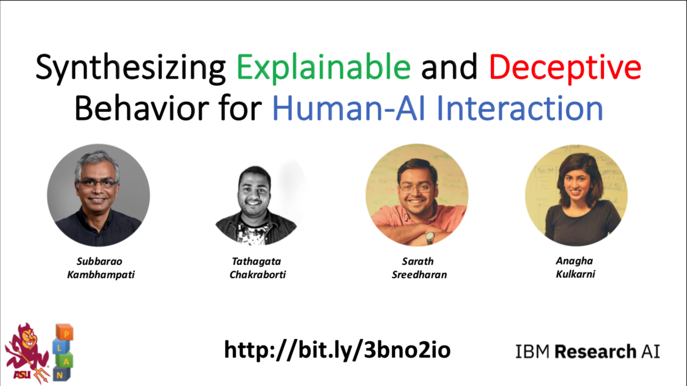
Acknowledgements
Slides based on material provided by Subbarao (Rao) Kambhampati and his colleagues (for more material on human-aware planning by Rao: http://rakaposhi.eas.asu.edu)
Content can also be found in the HA-AI book
Notes:
Rao also on how to give a talk/write a paper: http://rakaposhi.eas.asu.edu/ijcai-dc-talk.html

Slide 4
Outline: Human-awareness
Mental Models
Human-aware agent
Interpretable Behaviour
Explicability
Legibility
Predictability
Explanations
Model reconciliation

Slide 5
Motivation
Collaborations between people and AI systems
I.e., systems with humans in the loop
Augment perception, cognition, problem-solving abilities of people
Examples
Help physicians make more timely and accurate diagnoses
Assistance provided to drivers of cars to help them avoid dangerous situations and crashes
Objective: Systems that can interact intuitively with users and enable seamless machine-human collaborations
Explainable behaviour
Explainable AI = XAI

Slide 6
Proposed Solution
Goal: Synthesise explainable behaviour
Take into account the mental model of the human in the loop
Mental model:
Goals + capabilities of the humans in the loop
Human’s model of AI agent’s goals + capabilities
Notes:
go beyond planning with their own models of the world

Slide 7
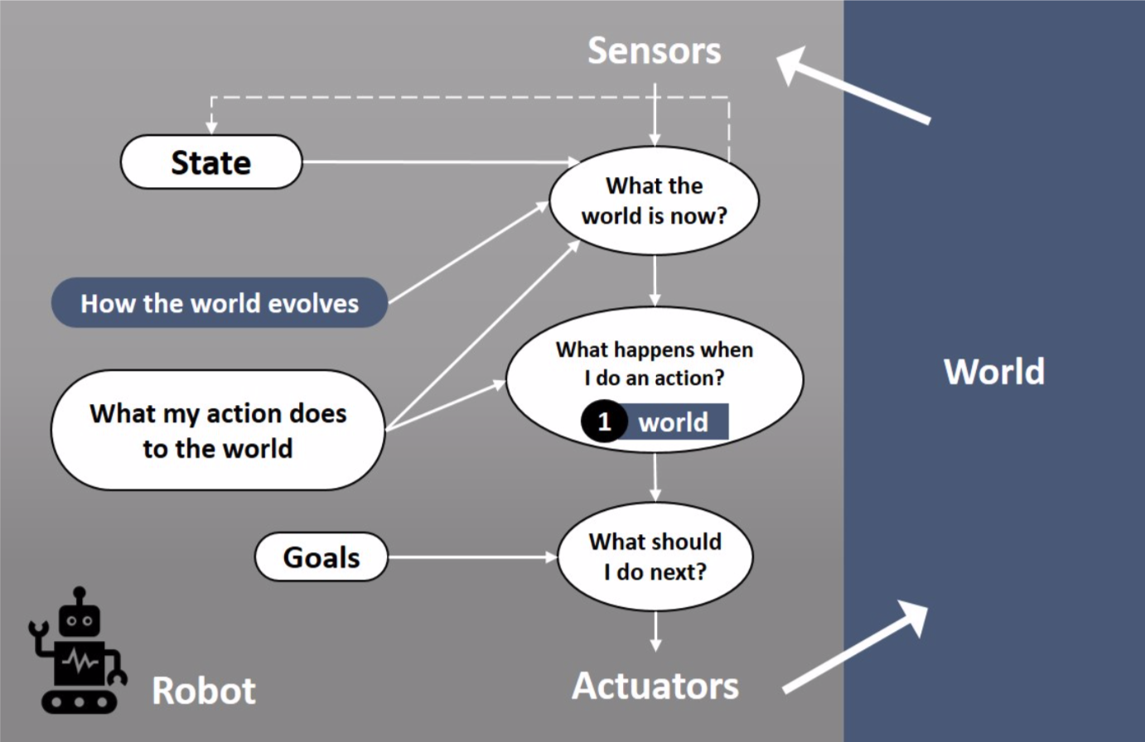
Classical Intelligent Agent
http://bit.ly/3bno2io

Slide 8
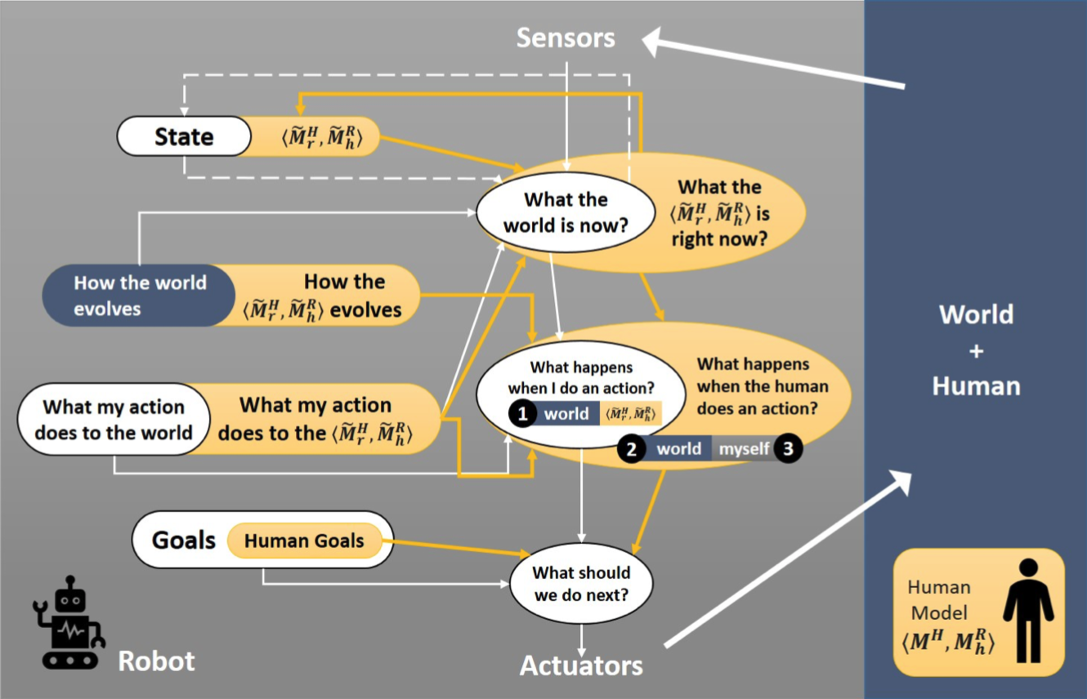
Human-aware Intelligent Agent
http://bit.ly/3bno2io

Slide 9



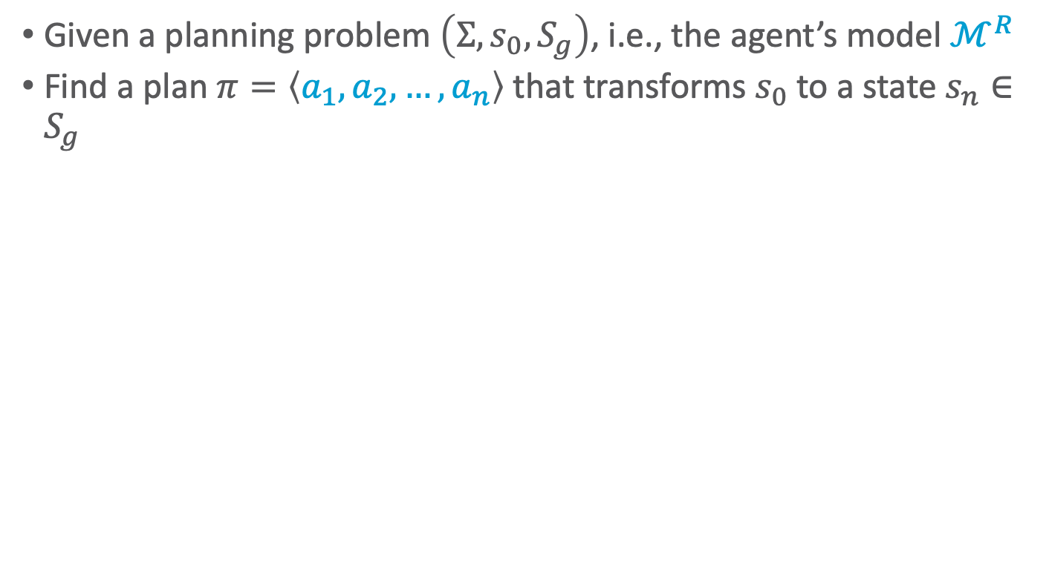





Classical Planning
Given a planning problem $\left(Σ,s_{0},S_{g}\right)$, i.e., the agent’s model $ℳ^{R}$
Find a plan $π=\left\langle a_{1},a_{2}, …, a_{n}\right\rangle$ that transforms $s_{0}$ to a state $s_{n}∈S_{g}$
$$ℳ^{R}$$
$$s_{0}$$
$$a_{1}$$
$$s_{1}$$
$$a_{2}$$
$$s_{2}$$
$$a_{3}$$
$$a_{n}$$
$$s_{n}^{+}$$

Slide 10





Collaborative Planning
Given a planning problem $\left(Σ,s_{0},S_{g}\right)$, i.e., the agent’s model $ℳ^{R}$
Find a joint plan $π=\left\langle a_{1}^{R},a_{2}^{H},…, a_{n}^{?}\right\rangle$ that transforms $s_{0}$ to a state $s_{n}^{+}∈S_{g}$
$$ℳ^{H}$$
$$ℳ^{R}$$
$$s_{0}$$
$$a_{1}^{R}$$
$$s_{1}$$
$$a_{2}^{H}$$
$$s_{2}$$
$$a_{3}^{R}$$
$$a_{n}^{?}$$
$$s_{n}^{+}$$

Slide 11



Human-aware Planning
Next to agent’s model $ℳ^{R}$
Agent’s model $ℳ_{r}^{H}$ of the human’s model $ℳ^{H}$
Allows the agent to anticipate human behaviour to
assist
avoid
team
$$ℳ_{r}^{H}$$
$$ℳ^{H}$$
$$ℳ^{R}$$
$$s_{0}$$
$$a_{1}^{R}$$
$$s_{1}$$
$$a_{2}^{H}$$
$$s_{2}$$
$$a_{3}^{R}$$
$$a_{n}^{?}$$
$$s_{n}^{+}$$

Slide 12

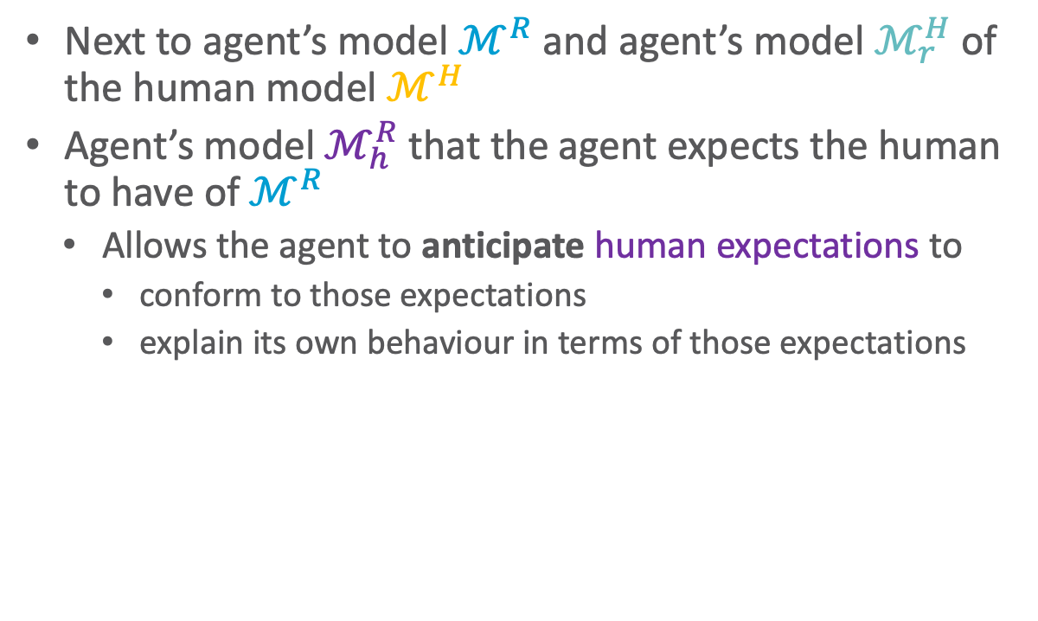



Human-aware Planning
$$ℳ_{h}^{R}$$
Next to agent’s model $ℳ^{R}$ and agent’s model $ℳ_{r}^{H}$ of the human model $ℳ^{H}$
Agent’s model $ℳ_{h}^{R}$ that the agent expects the human to have of $ℳ^{R}$
Allows the agent to anticipate human expectations to
conform to those expectations
explain its own behaviour in terms of those expectations
$$ℳ_{r}^{H}$$
$$ℳ_{h}^{R}$$
$$ℳ^{H}$$
$$ℳ^{R}$$
$$s_{0}$$
$$a_{1}^{R}$$
$$s_{1}$$
$$a_{2}^{H}$$
$$s_{2}$$
$$a_{3}^{R}$$
$$a_{n}^{?}$$
$$s_{n}^{+}$$

Slide 13
Generating Mental Models
Known beforehand (handcrafted/researched)
Urban Search and Rescue
Teaching
Learning simple models for generating explanations/explicability
Learning full models (transition functions, rewards)
Through interaction with users

Slide 14
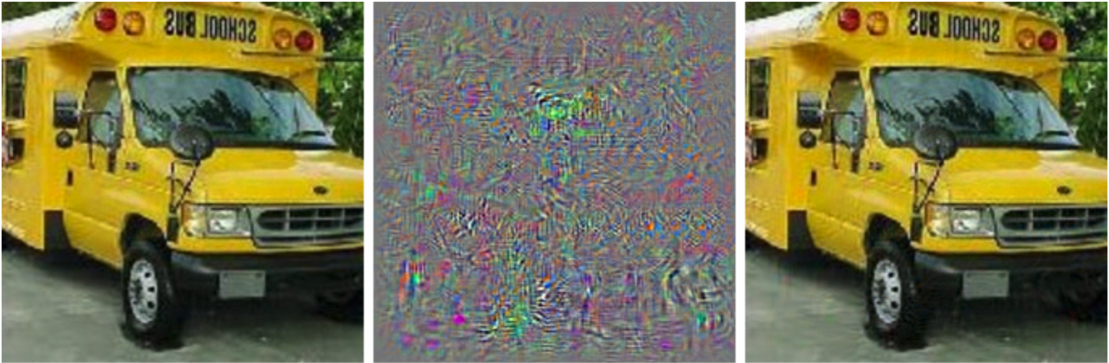
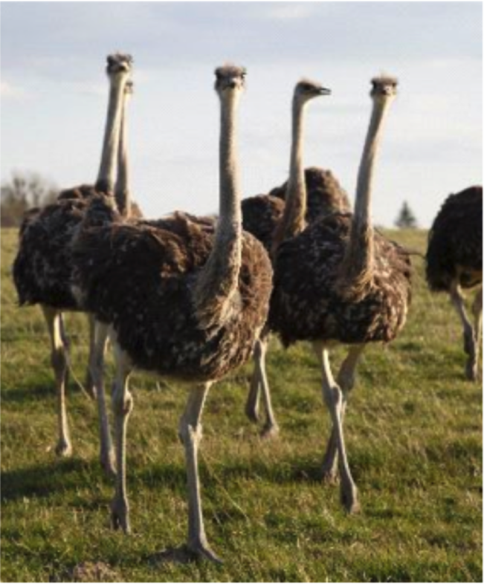
XAI & Explanations
Standard XAI: view of explanations too simple
Debugging tool for “inscrutable” representations
“Pointing” explanations (primitive)
Explaining decisions will involve pointing over space-time tubes
Explanations critical for collaboration
But not as a monologue from the agent ➝ interaction
Please point to the “ostrich” part
Prediction: School bus
Difference between left and right magnified by 10
Prediction: Ostrich

Slide 15
Ethical Quandaries of Interaction
Evolutionary, mental modelling allowed us to both cooperate or compete/sabotage each other
Lying is only possible because we can model others’ mental states
Human-aware AI systems with mental modelling capabilities bring additional ethical quandaries
E.g., automated negotiating agents that misrepresent their intentions to gain material advantage
Your personal assistant that tells you white lies to get you to eat healthy (or not…)
Every tool is a weapon, if you hold it right.
--Ani Difranco

Slide 16

Ethical Quandaries of Interaction
Humans’ example closure tendencies are more pronounced for emotional/social intelligence aspects
No one who saw Shakey the first time thought it could shoot hoops, yet the first people interacting with Eliza assumed it was a real doctor
Concerns about human-aware AI ”toys” such as Cozmo (e.g., Sherry Turkle)
https://thenewstack.io/remembering-shakey-first-intelligent-robot/
https://en.wikipedia.org/wiki/ELIZA https://anki.com/en-us/cozmo.html
Notes:
Example closure: fill in the gaps in things it perceives

Slide 17
Differences in Mental Models
Expectations on capabilities
Human may have misconceptions about robot’s actions
Certain actions in human’s mental model may not be feasible for robot
Expected state of the world
Human may assume certain facts are true (when they are not true)
Expected goals
Human may have misconceptions about robot’s objectives/intentions
Sensor model differences
Human may have partial observability of robot’s activities
Human may have incorrect beliefs about robot’s observational capabilities
Different representations
Robot’s innate representation scheme might be too complex for human
Human may be thinking in terms of a different vocabulary

Slide 18
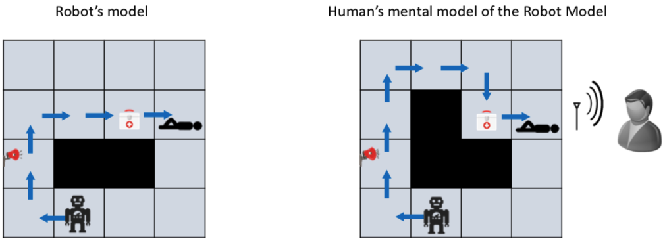
Urban Search and Rescue (USAR)
Robot deployed to a disaster area
Tasks robot can perform tasks:
Survey particular rooms
Identify survivors
Perform triage
Two agents in domain
Internal agent – Robot
External agent – Human
Their models may diverge – leading to different expectation on behaviours

Slide 19
Model Differences
Robot and human may have different models of same task
Divergence in models can lead to expectation mismatch
Consequence: Plans that are optimal to robot may not be so in model of human
Inexplicable plans
Robot has two options
Explicable planning – sacrifice optimality in own model to be explicable to human ➝ interpretable behaviour
Plan Explanations – resolve perceived suboptimality by revealing relevant model differences ➝ model reconciliation
Chakraborti T, Sreedharan S, Zhang Y, Kambhampati S. Plan explanations as model reconciliation: Moving beyond explanation as soliloquy. IJCAI 2017.

Slide 20
Intermediate Summary
Different mental models
Mental model of the human
Mental model that the human has of the agent
Mental model that the agent assumes the human has of the agent
Differences between mental models
May lead to inexplicable behaviour
Ethical quandaries
Modelling mental state of humans requires ethical behaviour of agent

Slide 21
Outline: Human-awareness
Mental Models
Human-aware agent
Interpretable Behaviour
Explicability
Legibility
Predictability
Explanations
Model reconciliation

Slide 22
Interpretable Behaviour
Explicable behaviour
Acting in a way that makes sense to the user
Legible behaviour
Acting in a way that conveys necessary information to the user
Predictable behaviour
Acting in a way that allows users to accurately anticipate future behaviour

Slide 23




Why Explicable Behaviour?
Robot’s behaviour may diverge from human’s expectations of it
Human may get surprised by robot’s inexplicable behaviour
One way to avoid surprising a human involves generating explicable behaviour by conforming to human’s expectations
Account for human’s mental model
$$ℳ_{h}^{R}$$
$$ℳ^{R}$$
$$π_{ℳ_{h}^{R}}^{∗}$$
Explicable Plan
Generation
$$\hat{π}≈π_{ℳ_{h}^{R}}^{∗}$$

Slide 24
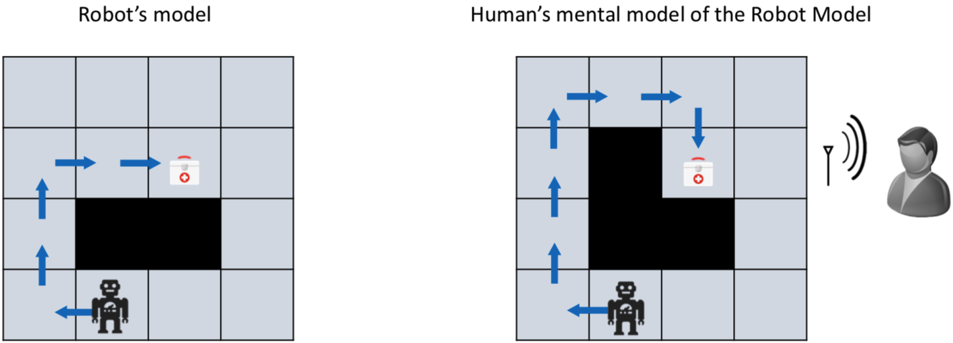
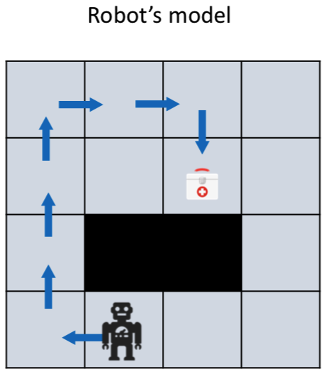
Explicable Behaviour
Example: Robot may have to sacrifice its optimality to improve explicability

Slide 25
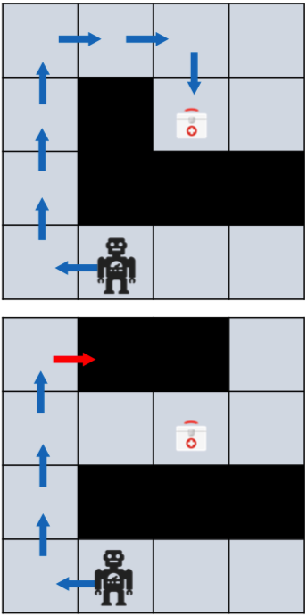

Model-based Explicable Behaviour
Human’s mental model is available to the robot
But robot may not be able to plan directly with human mental model
Find a valid plan that is closest to the expected plan
Involves minimising distance w.r.t. expected plans, e.g.,
Cost difference in human model
Action set difference
Kulkarni A, Zha Y, Chakraborti T, Vadlamudi SG, Zhang Y, Kambhampati S. Explicable planning as minimizing distance from expected behavior. In Proceedings of AAMAS 2019 as extended abstract

Slide 26
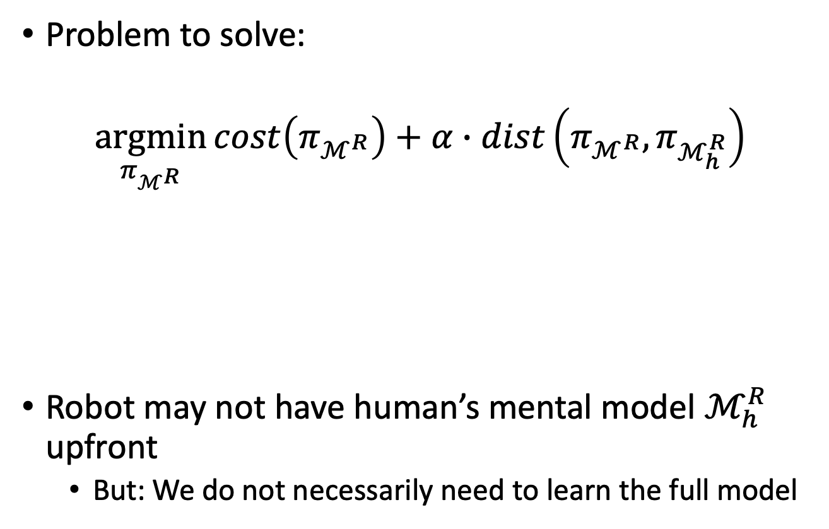
Model-free Explicable Planning
Problem to solve:
$$\underset{π_{ℳ^{R}}}{argmin}{cost\left(π_{ℳ^{R}}\right)+α∙dist\left(π_{ℳ^{R}},π_{ℳ_{h}^{R}}\right)}$$
Robot may not have human’s mental model $ℳ_{h}^{R}$ upfront
But: We do not necessarily need to learn the full model
Distance between robot plan and human’s expectation of robot plan
Cost of robot plan
Zhang Y, Sreedharan S, Kulkarni A, Chakraborti T, Zhuo HH, Kambhampati S. Plan explicability and predictability for robot task planning. In Proceedings of ICRA 2017

Slide 27
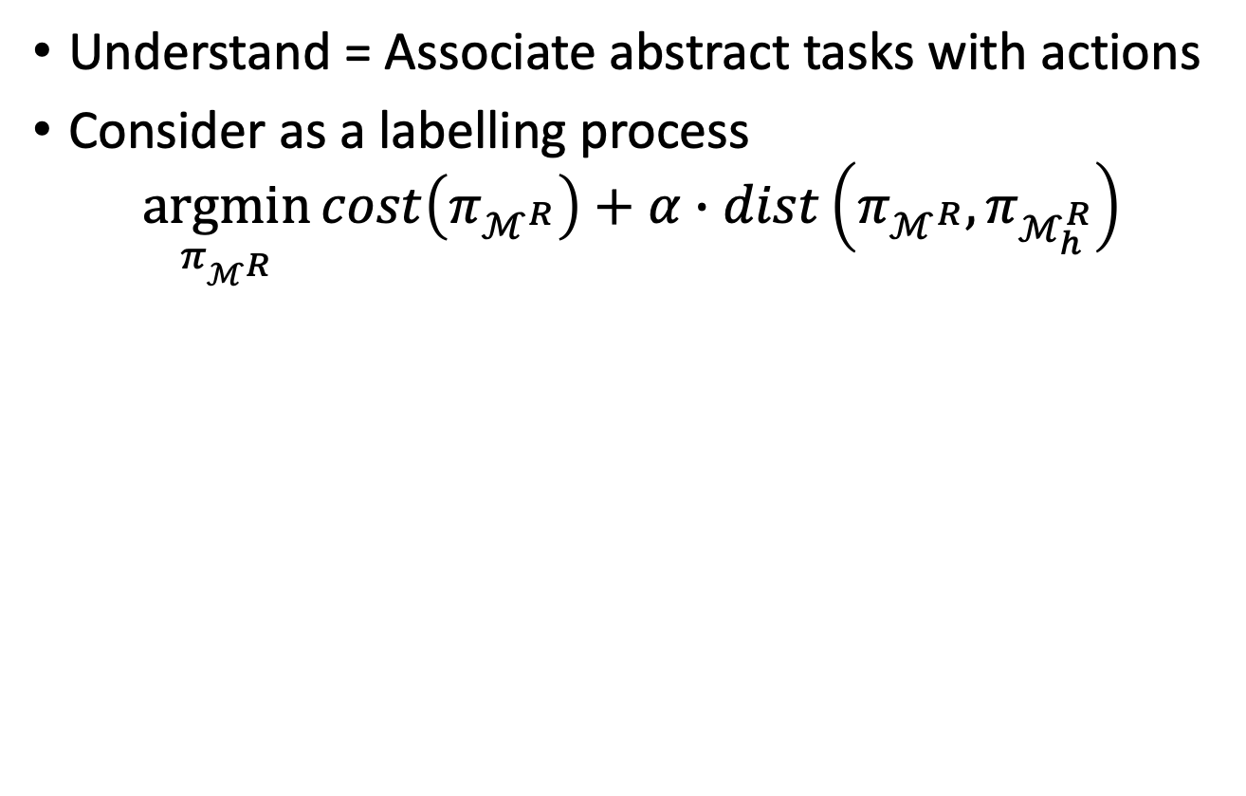

Model-free Explicable Planning
Understand = Associate abstract tasks with actions
Consider as a labelling process
$$\underset{π_{ℳ^{R}}}{argmin}{cost\left(π_{ℳ^{R}}\right)+α∙dist\left(π_{ℳ^{R}},π_{ℳ_{h}^{R}}\right)}$$
Domain-independent function taking task labels as inputs, returning approx. distance value
Labelling scheme of human for agent plans (to be learned)
$$F∘ℒ_{h}\left(π_{ℳ^{R}}\right)$$
Input
Input
Function composition
F (task₁, task₂, task₃)
Plan = {a₁, a₂, a₃, …, a_{n}}
E.g., the ratio between number of actions with non-empty labels and the number of all actions
L_{h} = task₁ ⊥ task₂ task₁
No label – inexplicable
Output
Output
Zhang Y, Sreedharan S, Kulkarni A, Chakraborti T, Zhuo HH, Kambhampati S. Plan explicability and predictability for robot task planning. In Proceedings of ICRA 2017

Slide 28
Why Legible Behaviour?
In human-robot teams, essential for the robot to communicate its intentions and objectives to the human
Explicitly communicate its intentions to the human
Generating a behaviour which implicitly reveals robot’s intentions to the human
Might be easier for the human teammate

Slide 29
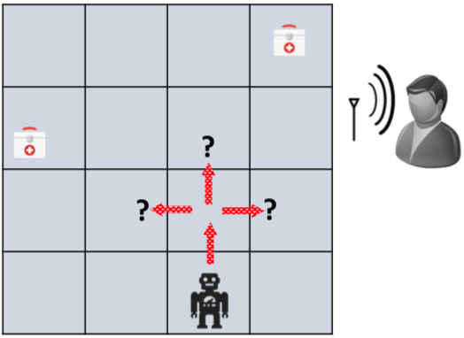
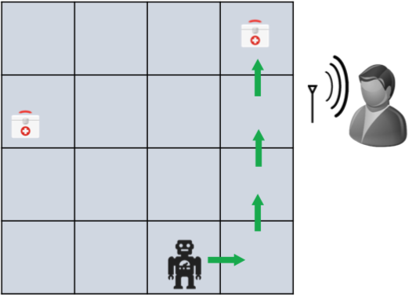
Legible Behaviour
In general, involves a setting where
Human has access to candidate goals but does not know true goal
Robot’s objective: Convey true goal implicitly through its behaviour
Human updates its belief on set of candidate goals when it receives observations
By synthesising legible behaviour, robot reduces human’s uncertainty over candidate goals

Slide 30
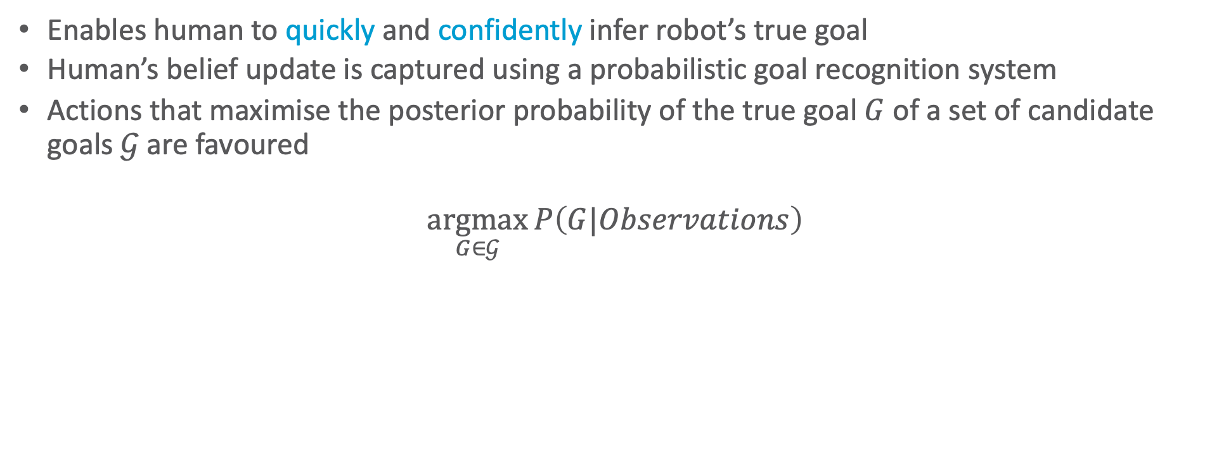
Online Legible Behaviour
Enables human to quickly and confidently infer robot’s true goal
Human’s belief update is captured using a probabilistic goal recognition system
Actions that maximise the posterior probability of the true goal $G$ of a set of candidate goals $𝒢$ are favoured
$$\underset{G∈𝒢}{argmax}{P\left(G|Observations\right)}$$

Slide 31
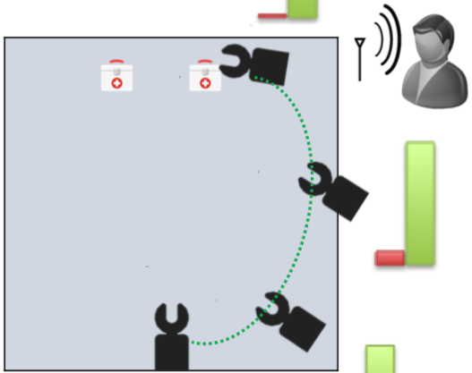
Legible Robot Motion
Example: Which med kit will the robot pick up?
While performing goal recognition, human considers shortest distances
Approach involves finding a trajectory endpoint between start point and true goal such that posterior probability of true goal is maximised
The sooner the goal is recognised in the trajectory, the better is the trajectory’s legibility
Dragan AD, Lee KC, Srinivasa SS. Legibility and predictability of robot motion. In Proceedings of HRI 2013.

Slide 32
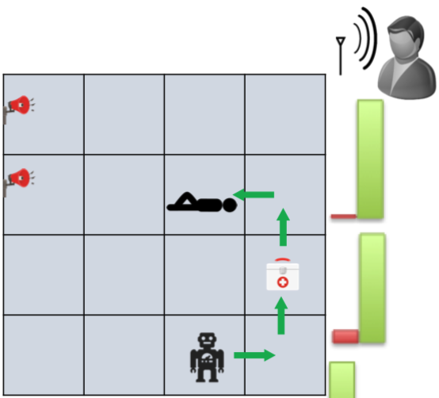
Transparent Planning
Example: Is the robot surveying the rooms or performing triage?
Whenever an action is performed, goal recognition system is used to update human’s belief
Objective: Reach a target belief where true goal is more probable than other goals
Take the first applicable action associated with a belief of highest utility (closest to target belief)
MacNally AM, Lipovetzky N, Ramirez M, Pearce AR. Action selection for transparent planning. In Proceedings of AAMAS 2018.

Slide 33
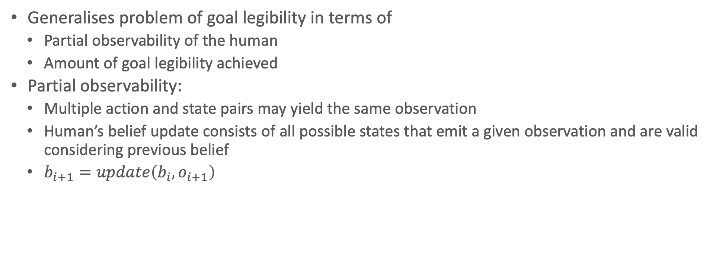
Offline Goal Legibility
Generalises problem of goal legibility in terms of
Partial observability of the human
Amount of goal legibility achieved
Partial observability:
Multiple action and state pairs may yield the same observation
Human’s belief update consists of all possible states that emit a given observation and are valid considering previous belief
$b_{i+1}=update\left(b_{i}, o_{i+1}\right)$
Kulkarni A, Srivastava S, Kambhampati S. A unified framework for planning in adversarial and cooperative environments. In Proceedings of the AAAI 2019.

Slide 34
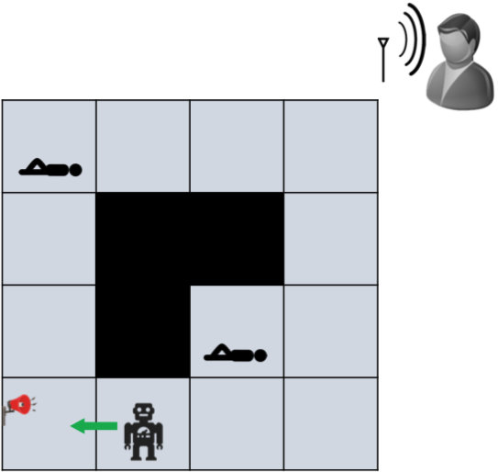
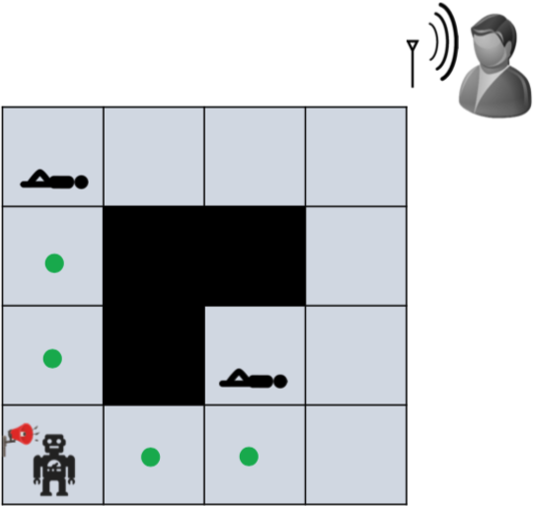
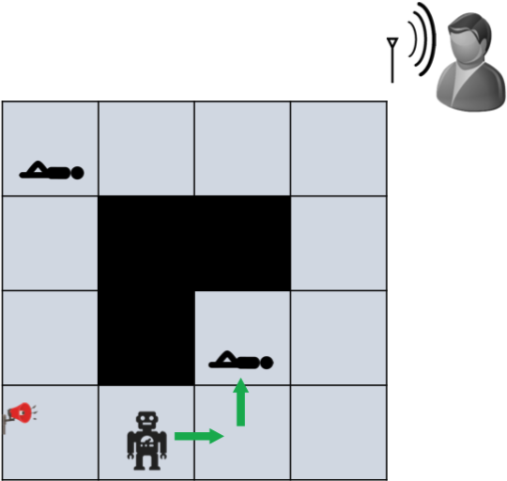
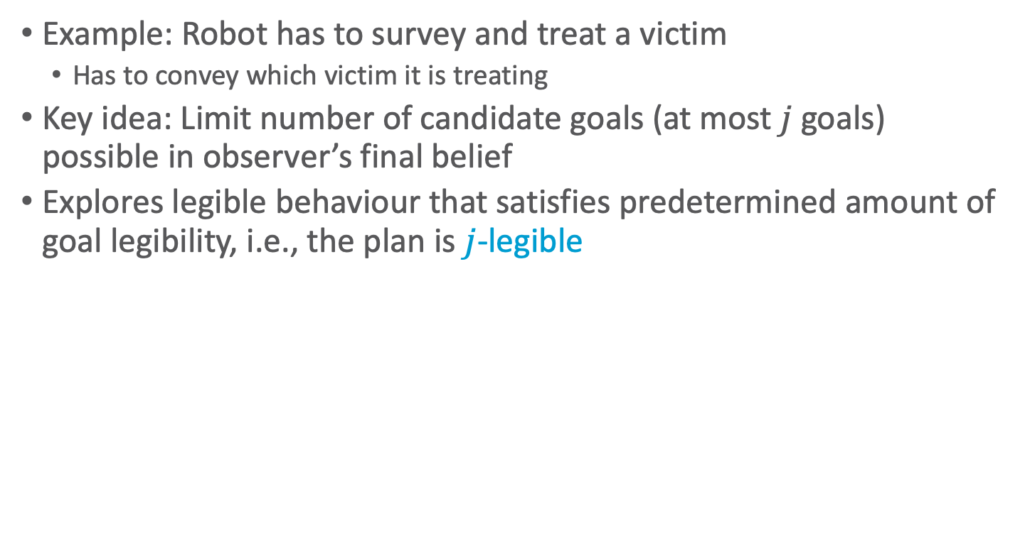
Offline Goal Legibility
Example: Robot has to survey and treat a victim
Has to convey which victim it is treating
Key idea: Limit number of candidate goals (at most $j$ goals) possible in observer’s final belief
Explores legible behaviour that satisfies predetermined amount of goal legibility, i.e., the plan is $j$-legible
Kulkarni A, Srivastava S, Kambhampati S. A unified framework for planning in adversarial and cooperative environments. In Proceedings of the AAAI 2019.

Slide 35
Why Predictable Behaviour?
In human-robot teams, if robot’s behaviour cannot be anticipated by human, it can hamper team performance
Predictable robot behaviours are easy for the human to understand and help in engendering trust in the robot
Predictability and legibility are fundamentally different and often contradictory properties of motion

Slide 36
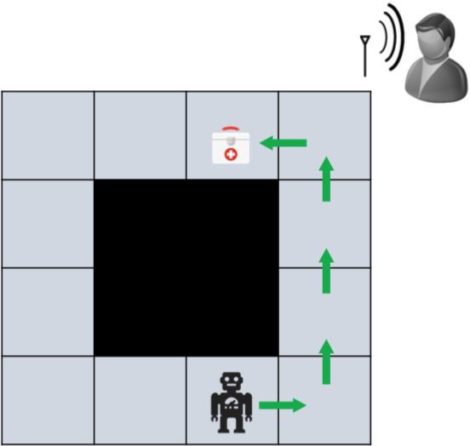
Predictable Behaviour
In general, involves a setting where
Human knows start state and goal but does not know which plan will be executed
Robot’s objective is to behave in a way that can be anticipated by the human
Observer updates its belief on set of valid plans when it receives observations
By synthesising predictable behaviour, robot reduces human’s uncertainty over possible behaviours

Slide 37
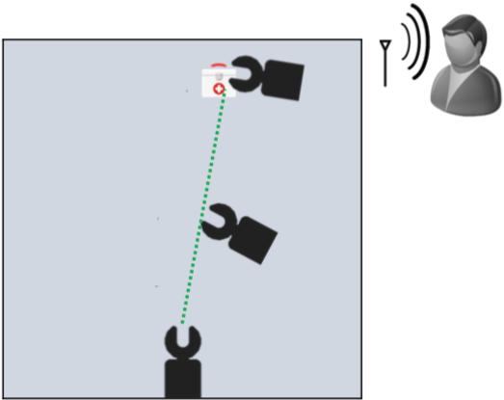
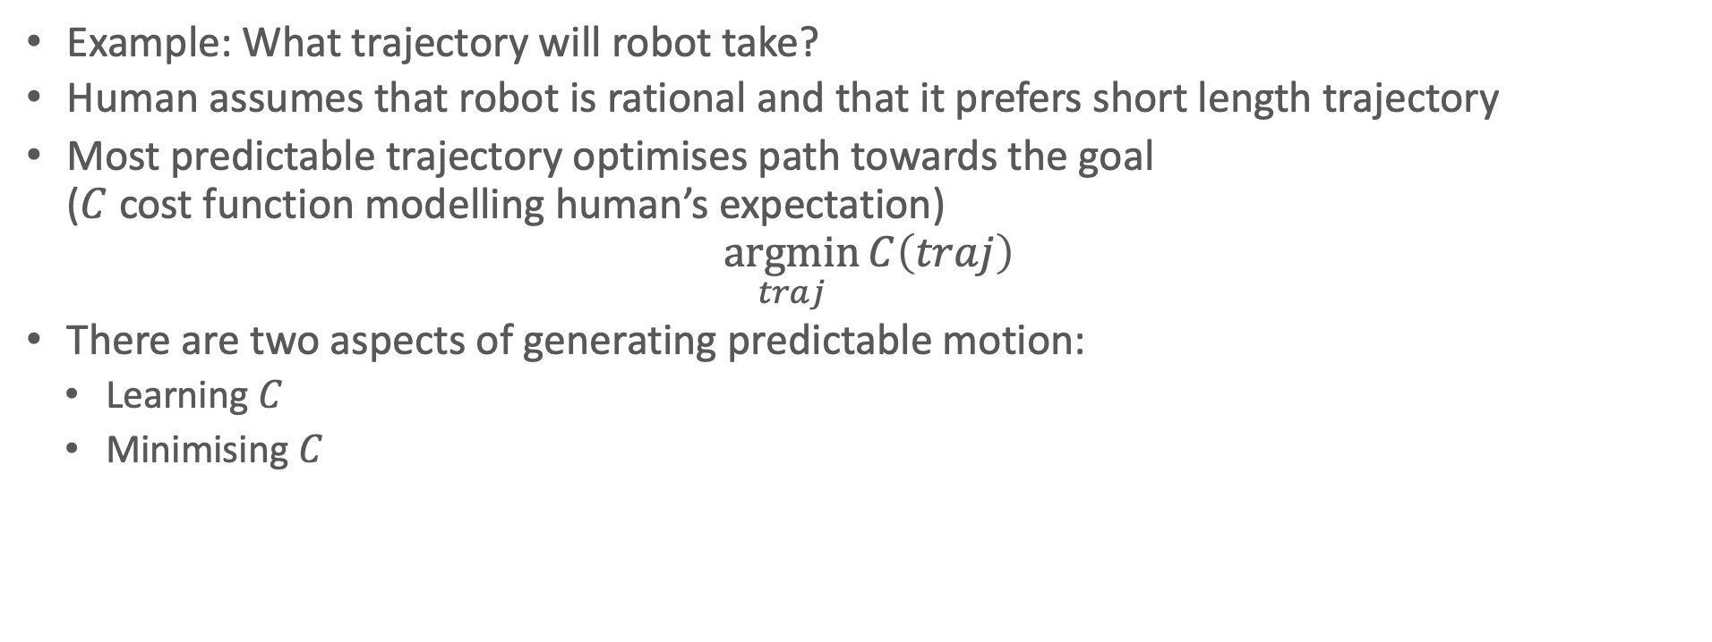
Predictable Robot Motion
Example: What trajectory will robot take?
Human assumes that robot is rational and that it prefers short length trajectory
Most predictable trajectory optimises path towards the goal ($C$ cost function modelling human’s expectation)
$$\underset{traj}{argmin}{C\left(traj\right)}$$
There are two aspects of generating predictable motion:
Learning $C$
Minimising $C$
Dragan AD, Lee KC, Srinivasa SS. Legibility and predictability of robot motion. In Proceedings of HRI 2013.

Slide 38
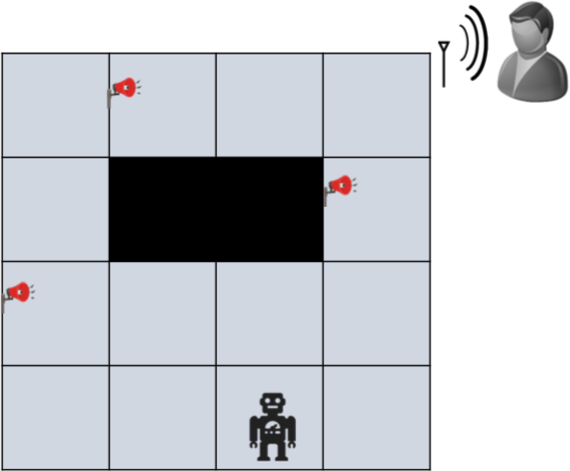
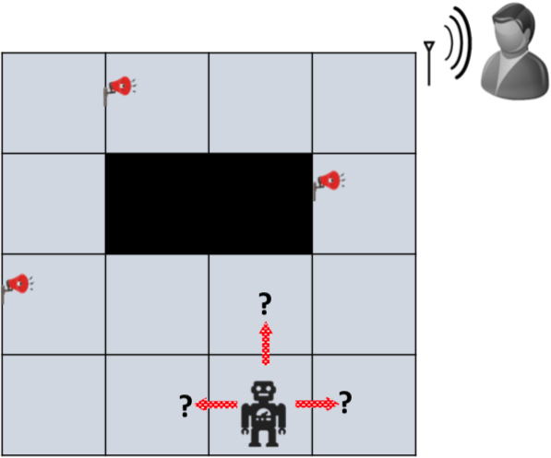
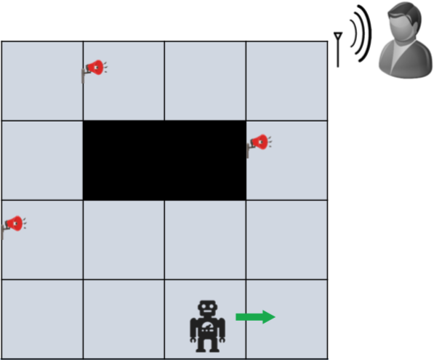
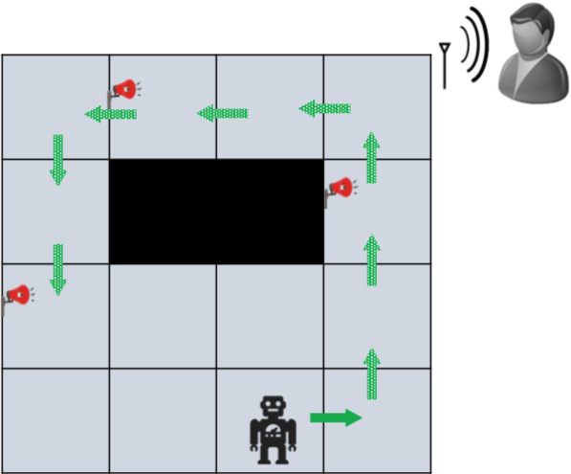
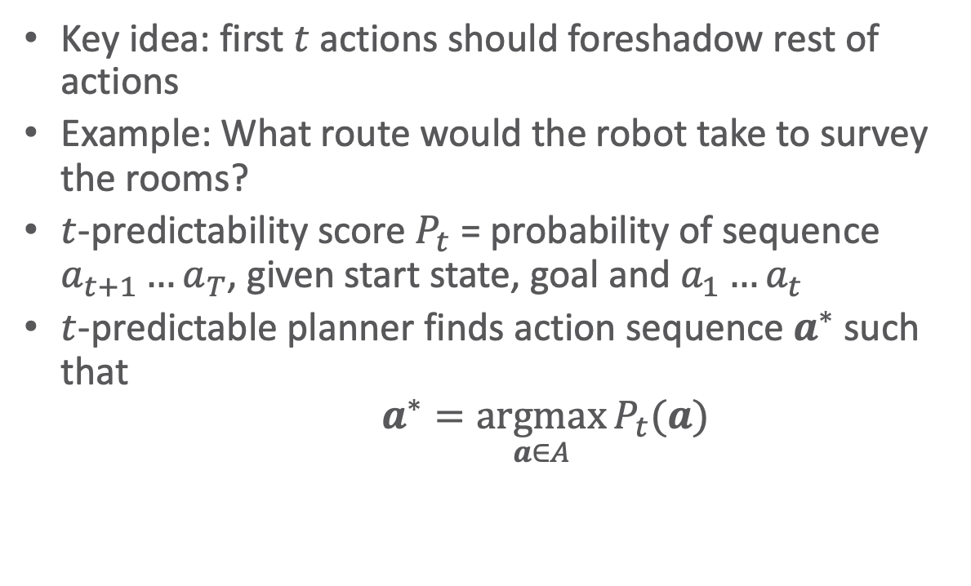
$t$-Predictability
Key idea: first $t$ actions should foreshadow rest of actions
Example: What route would the robot take to survey the rooms?
$t$-predictability score $P_{t}$ = probability of sequence $a_{t+1}…a_{T}$, given start state, goal and $a_{1}…a_{t}$
$t$-predictable planner finds action sequence $a^{∗}$ such that
$$a^{∗}=\underset{a∈A}{argmax}{P_{t}(a)}$$
Fisac JF, Liu C, Hamrick JB, Sastry SS, Hedrick JK, Griffiths TL, Dragan AD. Generating plans that predict themselves. In Proceedings of WAFR 2016.

Slide 39
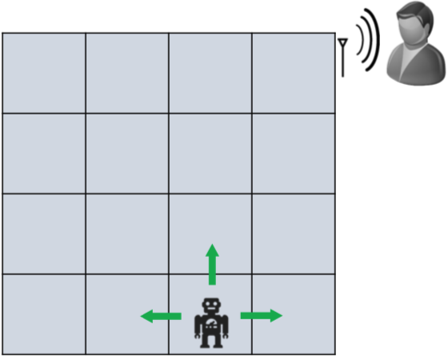
Offline Plan Predictability
Assume offline setting
Human has partial observability
Belief update performed after receiving all observations
Human guesses robot’s actions based on plans that
Are consistent with observation sequence
Achieve goal
Generalises the problem of conveying actions to observer
Kulkarni A, Srivastava S, Kambhampati S. A unified framework for planning in adversarial and cooperative environments. In Proceedings of the AAAI 2019.

Slide 40
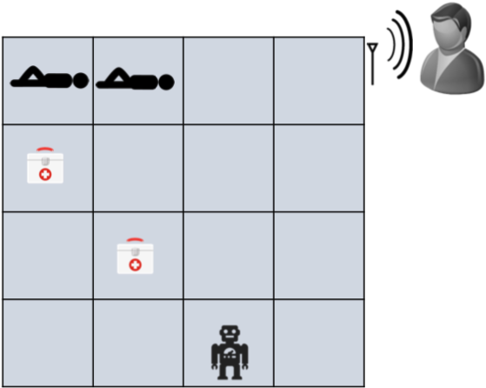
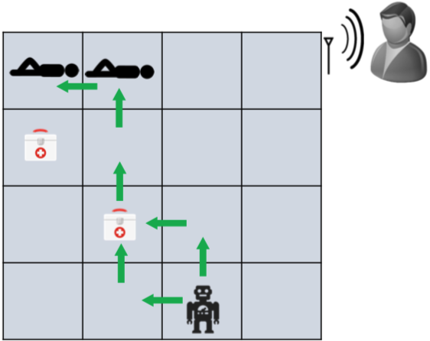
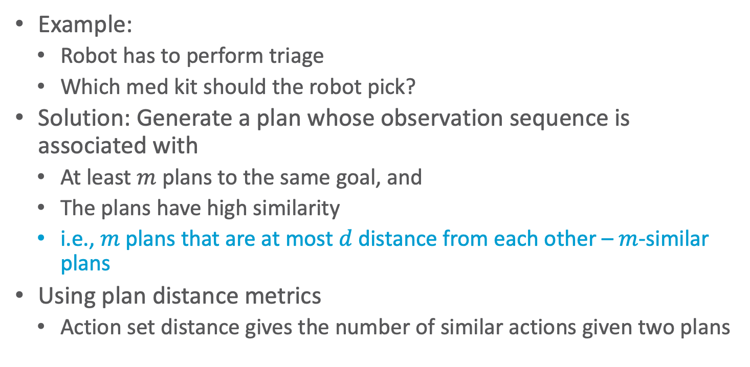
Offline Plan Predictability
Example:
Robot has to perform triage
Which med kit should the robot pick?
Solution: Generate a plan whose observation sequence is associated with
At least $m$ plans to the same goal, and
The plans have high similarity
i.e., $m$ plans that are at most $d$ distance from each other – $m$-similar plans
Using plan distance metrics
Action set distance gives the number of similar actions given two plans
Kulkarni A, Srivastava S, Kambhampati S. A unified framework for planning in adversarial and cooperative environments. In Proceedings of the AAAI 2019.

Slide 41
Summary
Aspects of interpretable behaviour
Explicability
Act in a way that is comprehensible to the human agent
Legibility
Act in a way such that a human agent can determine which goal is pursued by agent
Predictability
Act in a way such that a human agent can predict the next steps given the previous steps

Slide 42
Outline: Human-awareness
Mental Models
Human-aware agent
Interpretable Behaviour
Explicability
Legibility
Predictability
Explanations
Model reconciliation

Slide 43






Plan Explanations
Plan Explanation via
Model Reconciliation
$$\hat{ℳ}$$
Conforming to expectations of human
E.g., by explicable planning; may involve giving up optimal plan
But: May not be feasible
Model reconciliation: Bring mental model closer by explanations
Planner is optimal in own but not in human’s model
Given a plan, explanation is a model update
After explanation, plan is also optimal in the updated human model
$$ℳ_{h}^{R}$$
$$ℳ^{R}$$
$$π_{ℳ_{h}^{R}}^{∗}$$
$$π_{ℳ^{R}}^{∗}$$
$$π_{\hat{ℳ}}^{∗}=π_{ℳ^{R}}^{∗}$$
Chakraborti T, Sreedharan S, Zhang Y, Kambhampati S. Plan explanations as model reconciliation: Moving beyond explanation as soliloquy. IJCAI 2017.

Slide 44
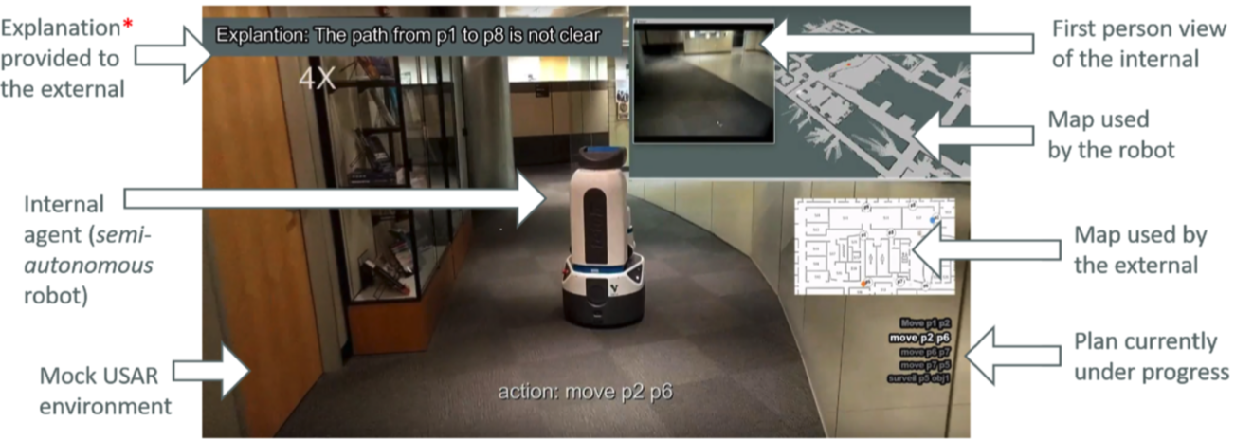
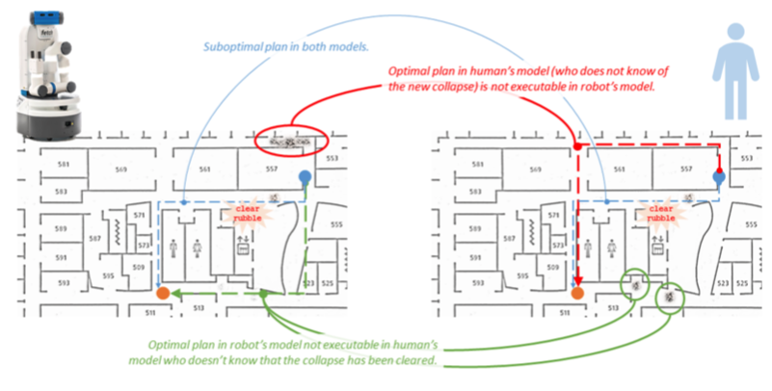
Example
Mock search and reconnaissance scenario with internal robot and external human

Slide 45
Aspects to Explanations
Completeness: No better explanation exists, no aspect of plan remains inexplicable
Requires explanations of a plan to be comparable
Conciseness: Explanations are easily understandable to the explainee
The larger an explanation, the harder for the human to incorporate information into deliberation process
Monotonicity: Remaining model differences cannot change completeness of explanation, i.e., all aspects of model that yielded plan are reconciled
Subsumes completeness
Computability: Ease of computing explanation from robot’s point of view
Chakraborti T, Sreedharan S, Zhang Y, Kambhampati S. Plan explanations as model reconciliation: Moving beyond explanation as soliloquy. IJCAI 2017.

Slide 46
Types of Explanations
Plan Patch Explanation (PPE)
Provide model differences pertaining to only the actions present in the plan that need to be explained
Model Patch Explanation (MPE)
Provide all model differences to the human
Minimally Complete Explanation (MCE)
Shortest complete explanation
Can be rendered invalid given further updates
Minimally Monotonic Explanation (MME)
Shortest explanation preserving monotonicity
Not necessarily unique as there may be model differences supporting the same causal links in the plan; exposing one link is enough (to guarantee optimality in the updated model)
Chakraborti T, Sreedharan S, Zhang Y, Kambhampati S. Plan explanations as model reconciliation: Moving beyond explanation as soliloquy. IJCAI 2017.
Notes:
PPE: concise by focus on plan, easy to compute; may reveal too much/irrelevant info, ignores other differences that may have contributed (not complete)
MPE: easy to compute, complete; not concise; may reveal too much/irrelevant info
Assume PDDL planning problem

Slide 47
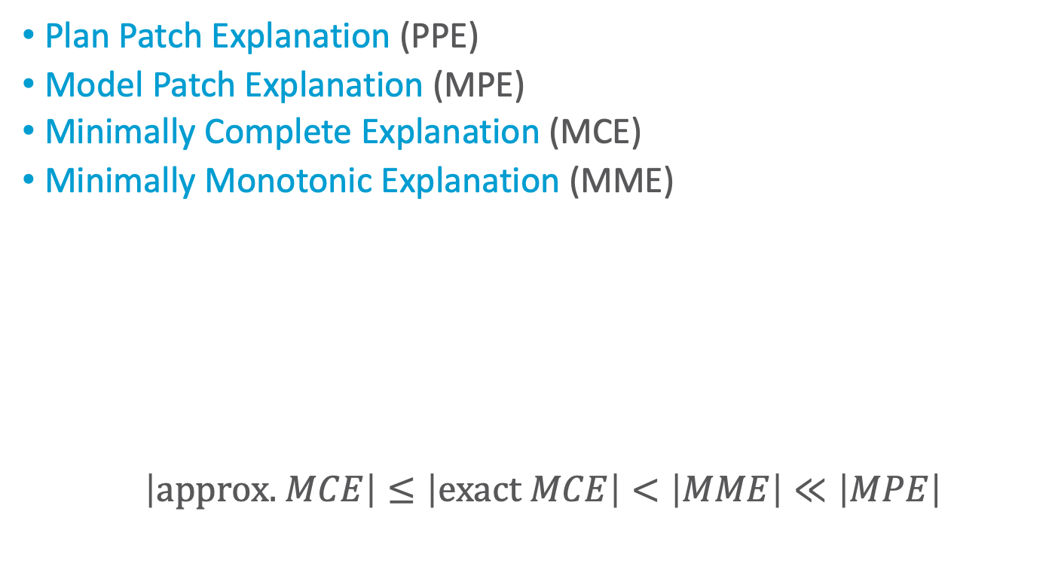
Aspects of Types of Explanations
Plan Patch Explanation (PPE)
Model Patch Explanation (MPE)
Minimally Complete Explanation (MCE)
Minimally Monotonic Explanation (MME)
$$\left|\text{approx}\text{. }MCE\right|≤\left|\text{exact} MCE\right|<\left|MME\right|≪\left|MPE\right|$$
In the sense that it focuses on the differences w.r.t. the plan but not necessarily a short explanation
Explanation Type | Completeness | Conciseness | Monotonicity | Computability
PPE | ✘ | ✓* | ✘ | ✓
MPE | ✓ | ✘ | ✓ | ✓
MCE | ✓ | ✓ | ✘ | ?
MME | ✓ | ✓ | ✓ | ?
Chakraborti T, Sreedharan S, Zhang Y, Kambhampati S. Plan explanations as model reconciliation: Moving beyond explanation as soliloquy. IJCAI 2017.

Slide 48
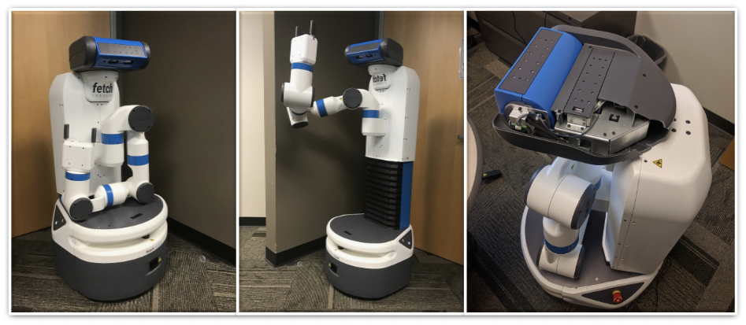
Example – FetchWorld
Robot design requires to tuck arms and lower torso or crouch before moving – not obvious
Robot’s Model
(:action move
:parameters (?from ?to – location)
:precondition (and (robot-at ?from)
(hand-tucked) (crouched))
:effect (and (robot-at ?to)
(not (robot-at ?from))))
(:action tuck
:parameters ()
:precondition ()
:effect (and (hand-tucked)
(crouched)))
(:action crouch
:parameters ()
:precondition ()
:effect (and (crouched)))
Human’s Model
(:action move
:parameters (?from ?to – location)
:precondition (and (robot-at ?from))
:effect (and (robot-at ?to)
(not (robot-at ?from))))
(:action tuck
:parameters ()
:precondition ()
:effect (and (hand-tucked)))
(:action crouch
:parameters ()
:precondition ()
:effect (and (crouched)))
Chakraborti T, Sreedharan S, Zhang Y, Kambhampati S. Plan explanations as model reconciliation: Moving beyond explanation as soliloquy. IJCAI 2017.

Slide 49
Example – FetchWorld
Initial state and goal:
Robot’s optimal plan:
Human’s expected plan:
(:init (block-at b1 loc1) (robot-at loc1) (hand-empty))
(:goal (and (block-at b1 loc2)))
pick-up b1 -> tuck -> move loc1 loc2 -> put-down b1
pick-up b1 -> move loc1 loc2 -> put-down b1
Robot’s Model
(:action move
:parameters (?from ?to – location)
:precondition (and (robot-at ?from)
(hand-tucked) (crouched))
:effect (and (robot-at ?to)
(not (robot-at ?from))))
(:action tuck
:parameters ()
:precondition ()
:effect (and (hand-tucked)
(crouched)))
(:action crouch
:parameters ()
:precondition ()
:effect (and (crouched)))
Human’s Model
(:action move
:parameters (?from ?to – location)
:precondition (and (robot-at ?from))
:effect (and (robot-at ?to)
(not (robot-at ?from))))
(:action tuck
:parameters ()
:precondition ()
:effect (and (hand-tucked)))
(:action crouch
:parameters ()
:precondition ()
:effect (and (crouched)))
Chakraborti T, Sreedharan S, Zhang Y, Kambhampati S. Plan explanations as model reconciliation: Moving beyond explanation as soliloquy. IJCAI 2017.

Slide 50
Example – FetchWorld
Initial state and goal:
Robot’s optimal plan:
Human’s expected plan:
(:init (block-at b1 loc1) (robot-at loc1) (hand-empty))
(:goal (and (block-at b1 loc2)))
pick-up b1 -> tuck -> move loc1 loc2 -> put-down b1
pick-up b1 -> move loc1 loc2 -> put-down b1
Robot’s Model
(:action move
:parameters (?from ?to – location)
:precondition (and (robot-at ?from)
(hand-tucked) (crouched))
:effect (and (robot-at ?to)
(not (robot-at ?from))))
(:action tuck
:parameters ()
:precondition ()
:effect (and (hand-tucked)
(crouched)))
(:action crouch
:parameters ()
:precondition ()
:effect (and (crouched)))
Human’s Model
(:action move
:parameters (?from ?to – location)
:precondition (and (robot-at ?from))
:effect (and (robot-at ?to)
(not (robot-at ?from))))
(:action tuck
:parameters ()
:precondition ()
:effect (and (hand-tucked)))
(:action crouch
:parameters ()
:precondition ()
:effect (and (crouched)))
MCE
PPE = MPE
MME
Chakraborti T, Sreedharan S, Zhang Y, Kambhampati S. Plan explanations as model reconciliation: Moving beyond explanation as soliloquy. IJCAI 2017.
Notes:
MCE = hand-tucked : hand-tucked is already in effect of tuck of human’s model
If human were to find out that crouched is a precondition of move, then MCE no longer valid (according to model including MCE update: robot now has to tuck and crouch before move); MME still holds

Slide 51



















Model Space Search
Search algorithms for finding MCEs and MMEs
MME
$$C\left(π^{∗},\hat{ℳ}\right)=C_{\hat{ℳ}}^{∗}$$
$$C\left(π^{∗},\hat{ℳ}\right)>C_{\hat{ℳ}}^{∗}$$
$$\hat{ℳ}$$
$$\hat{ℳ}$$
$$C\left(π^{∗},\hat{ℳ}\right)>C_{\hat{ℳ}}^{∗}$$
$$C\left(π^{∗},\hat{ℳ}\right)=C_{\hat{ℳ}}^{∗}$$
$$\hat{ℳ}$$
$$\hat{ℳ}$$
$$\hat{ℳ}$$
$$\hat{ℳ}$$
$$\hat{ℳ}$$
$$C\left(π^{∗},\hat{ℳ}\right)=C_{\hat{ℳ}}^{∗}$$
$$\hat{ℳ}$$
$$ℳ_{h}^{R}$$
$$\hat{ℳ}$$
$$ℳ^{R}$$
$$\hat{ℳ}$$
$$C\left(π^{∗},\hat{ℳ}\right)=C_{\hat{ℳ}}^{∗}$$
$$C\left(π^{∗},\hat{ℳ}\right)>C_{\hat{ℳ}}^{∗}$$
$$\hat{ℳ}$$
$$\hat{ℳ}$$
MCE
Chakraborti T, Sreedharan S, Zhang Y, Kambhampati S. Plan explanations as model reconciliation: Moving beyond explanation as soliloquy. IJCAI 2017.
Notes:
MCE search starts from MH , computes updates Mc towards MR and re- turns the first node (indicated in yellow) where $C\left(π^{∗},\hat{ℳ}\right)=C_{\hat{ℳ}}^{∗}$; To compute MCEs, we employ A∗ search, similar to [Wayllace et al., 2016], in the space of models; we start off with the initial state Γ(MH) derived from the human’s expectation of a given planning problem MR, and modify it incrementally until we arrive at a planning problem
Mc with C(π∗, Mc) = C∗ , i.e. the given plan is explained.
MME search starts from MR and moves towards MH; The goal here is to find the largest set of model changes for which the explica- bility criterion becomes invalid for the first time (due to either suboptimality or inexecutability)

Slide 52













Trade-off Explicability and Explanation in Model Space Search
Given model of planning problem and mental model of human, find right model to plan in
Minimise
$$cost/length of explanations+α∙departure from optimality$$
$$\hat{ℳ}$$
$$\hat{ℳ}$$
Stopping Condition
$$\hat{ℳ}$$
$$C\left(π^{∗},\hat{ℳ}\right)=C_{\hat{ℳ}}^{∗}$$
$$\hat{ℳ}$$
$$ℳ_{h}^{R}$$
$$\hat{ℳ}$$
$$\hat{ℳ}$$
$$\hat{ℳ}$$
$$ℳ^{R}$$
$$\hat{ℳ}$$
Solution Updated model containing the plan
$$\hat{ℳ}$$
Explanation / Model Update
Chakraborti T, Sreedharan S, Kambhampati S. Balancing explicability and explanation in human-aware planning. IJCAI 2019.

Slide 53














Extensions (Outlook)
Explanation ordering
MME
$$C\left(π^{∗},\hat{ℳ}\right)=C_{\hat{ℳ}}^{∗}$$
$$C\left(π^{∗},\hat{ℳ}\right)>C_{\hat{ℳ}}^{∗}$$
$$\hat{ℳ}$$
$$\hat{ℳ}$$
$$C\left(π^{∗},\hat{ℳ}\right)>C_{\hat{ℳ}}^{∗}$$
$$C\left(π^{∗},\hat{ℳ}\right)=C_{\hat{ℳ}}^{∗}$$
$$\hat{ℳ}$$
$$\hat{ℳ}$$
$$\hat{ℳ}$$
$$\hat{ℳ}$$
$$\hat{ℳ}$$
$$C\left(π^{∗},\hat{ℳ}\right)=C_{\hat{ℳ}}^{∗}$$
$$\hat{ℳ}$$
$$ℳ_{h}^{R}$$
$$\hat{ℳ}$$
$$ℳ^{R}$$
$$\hat{ℳ}$$
$$C\left(π^{∗},\hat{ℳ}\right)=C_{\hat{ℳ}}^{∗}$$
$$C\left(π^{∗},\hat{ℳ}\right)>C_{\hat{ℳ}}^{∗}$$
$$\hat{ℳ}$$
$$\hat{ℳ}$$
MCE
Handling incomplete models
Handling foils
Reconciling logic programs
Reconciling MDPs
Reconciling task allocation models
Learning model approximation
Handling cases with abstract human models
Handling multiple observers
Handling vocabulary differences

Slide 54
Summary
Model reconciliation
Explain differences in model
PPE, MPE, MCE, MME

Slide 55
Outline: Human-awareness
Mental Models
Human-aware agent
Interpretable Behaviour
Explicability
Legibility
Predictability
Explanations
Model reconciliation
The End

