Slide 1
Automated Planning and Acting
🚚
🛩️
Paris
Moscow
London
Berlin
📦
🚚
Rome
📦
Decision Making: Structure
Tanya Braun
Research Group Data Science, Computer Science Department

Slide 2
Content: Planning and Acting
With Deterministic Models
With Temporal Models
With Nondeterministic Models
With Probabilistic Models
By Decision Making
  Foundations
  Extensions
  Structure
    Symmetries
    Relations
Human-aware Planning
Notes:
1-4, 6: Planning book
5, 7: AIMA
8: Rao

Slide 3
Outline: Decision Making – Structure
Structure by Groups in the Agent Set
  Agent types
  Partitioned decPOMDPs
Structure by Relations in the State Space
  Situation calculus
  First-order MDPs
Structure by Features in the State Space
  Dynamic Bayesian networks
  Factored MDPs

Slide 4
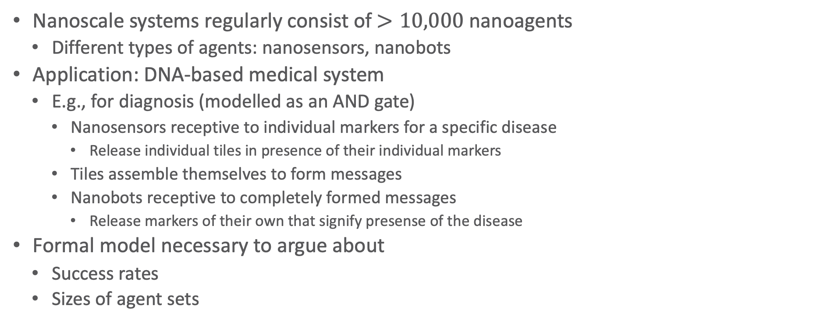
Example: Medical Nanoscale Systems
Nanoscale systems regularly consist of $>10,000$ nanoagents
  Different types of agents: nanosensors, nanobots
Application: DNA-based medical system
  E.g., for diagnosis (modelled as an AND gate)
    Nanosensors receptive to individual markers for a specific disease
      Release individual tiles in presence of their individual markers
    Tiles assemble themselves to form messages
    Nanobots receptive to completely formed messages
      Release markers of their own that signify presense of the disease
Formal model necessary to argue about
  Success rates
  Sizes of agent sets
Florian Lau, Tanya Braun, Ralf Möller, and Stefan Fischer: An Extended Framework to Holistically Model Nanostructures and Nanonetworks as decPOMDPcoms. In ACM-NanoCom-22 Proceedings of the 9th ACM International Conference on Nanoscale Computing and Communication, 2022

Slide 5
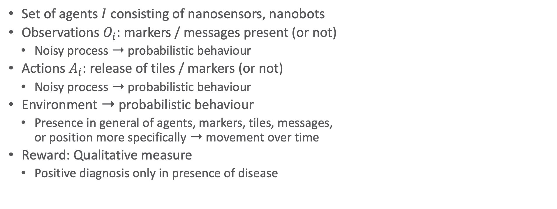
Example: Medical Nanoscale Systems as a DecPOMDP
Set of agents $I$ consisting of nanosensors, nanobots
Observations $O_{i}$: markers / messages present (or not)
  Noisy process ➝ probabilistic behaviour
Actions $A_{i}$: release of tiles / markers (or not)
  Noisy process ➝ probabilistic behaviour
Environment ➝ probabilistic behaviour
  Presence in general of agents, markers, tiles, messages,
  or position more specifically ➝ movement over time
Reward: Qualitative measure
  Positive diagnosis only in presence of disease
Florian Lau, TB, Ralf Möller, and Stefan Fischer: An Extended Framework to Holistically Model Nanostructures and Nanonetworks as decPOMDPcoms. In ACM-NanoCom-22 Proceedings of the 9th ACM International Conference on Nanoscale Computing and Communication, 2022

Slide 6
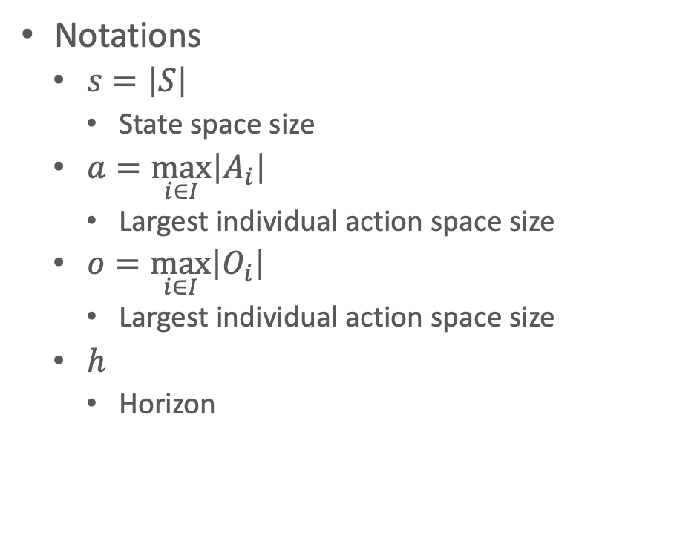
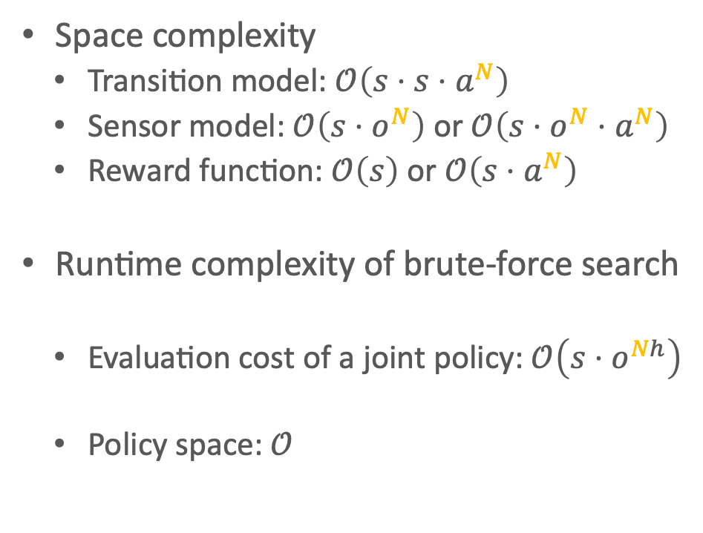

Reprise: Worst-case Complexity of DecPOMDP
Space complexity
  Transition model: $𝒪\left(s⋅s⋅a^{N}\right)$
  Sensor model: $𝒪\left(s⋅o^{N}\right)$ or $𝒪\left(s⋅o^{N}⋅a^{N}\right)$
  Reward function: $𝒪\left(s\right)$ or $𝒪\left(s⋅a^{N}\right)$
Runtime complexity of brute-force search
  Evaluation cost of a joint policy: $𝒪\left(s⋅o^{Nh}\right)$
  Policy space: $𝒪$
Notations
  $s=\left|S\right|$
    State space size
  $a=\max_{i∈I}\left|A_{i}\right|$
    Largest individual action space size
  $o=\max_{i∈I}\left|O_{i}\right|$
    Largest individual action space size
  $h$
    Horizon
$$\left(a^{\frac{N\left(o^{h}−1\right)}{o−1}}\right)$$

Slide 7
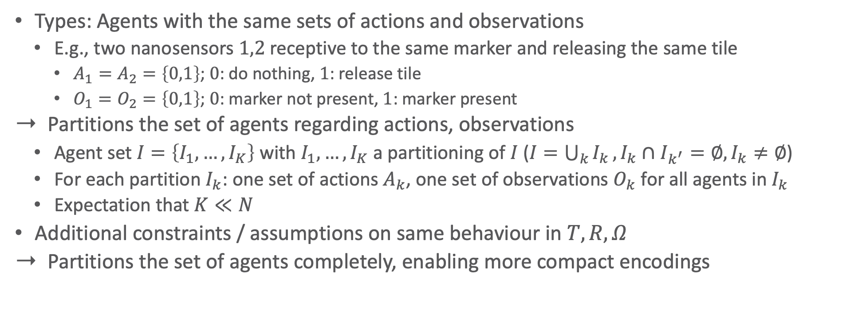
Agent Types & Partitioned DecPOMDPs
Types: Agents with the same sets of actions and observations
  E.g., two nanosensors $1,2$ receptive to the same marker and releasing the same tile
    $A_{1}=A_{2}=\left\{0,1\right\}$; $0$: do nothing, $1$: release tile
    $O_{1}=O_{2}=\left\{0,1\right\}$; $0$: marker not present, $1$: marker present
Partitions the set of agents regarding actions, observations
  Agent set $I=\left\{I_{1},…,I_{K}\right\}$ with $I_{1},…,I_{K}$ a partitioning of $I$ ($I=\bigcup_{k}{I_{k}},I_{k}∩I_{k^{′}}=∅,I_{k}≠∅$)
  For each partition $I_{k}$: one set of actions $A_{k}$, one set of observations $O_{k}$ for all agents in $I_{k}$
  Expectation that $K≪N$
Additional constraints / assumptions on same behaviour in $T,R,Ω$
Partitions the set of agents completely, enabling more compact encodings
TB, Marcel Gehrke, Florian Lau, and Ralf Möller: Lifting in Multi-agent Systems under Uncertainty. In UAI-22 International Conference on Uncertainty in Artificial Intelligence, 2022

Slide 8
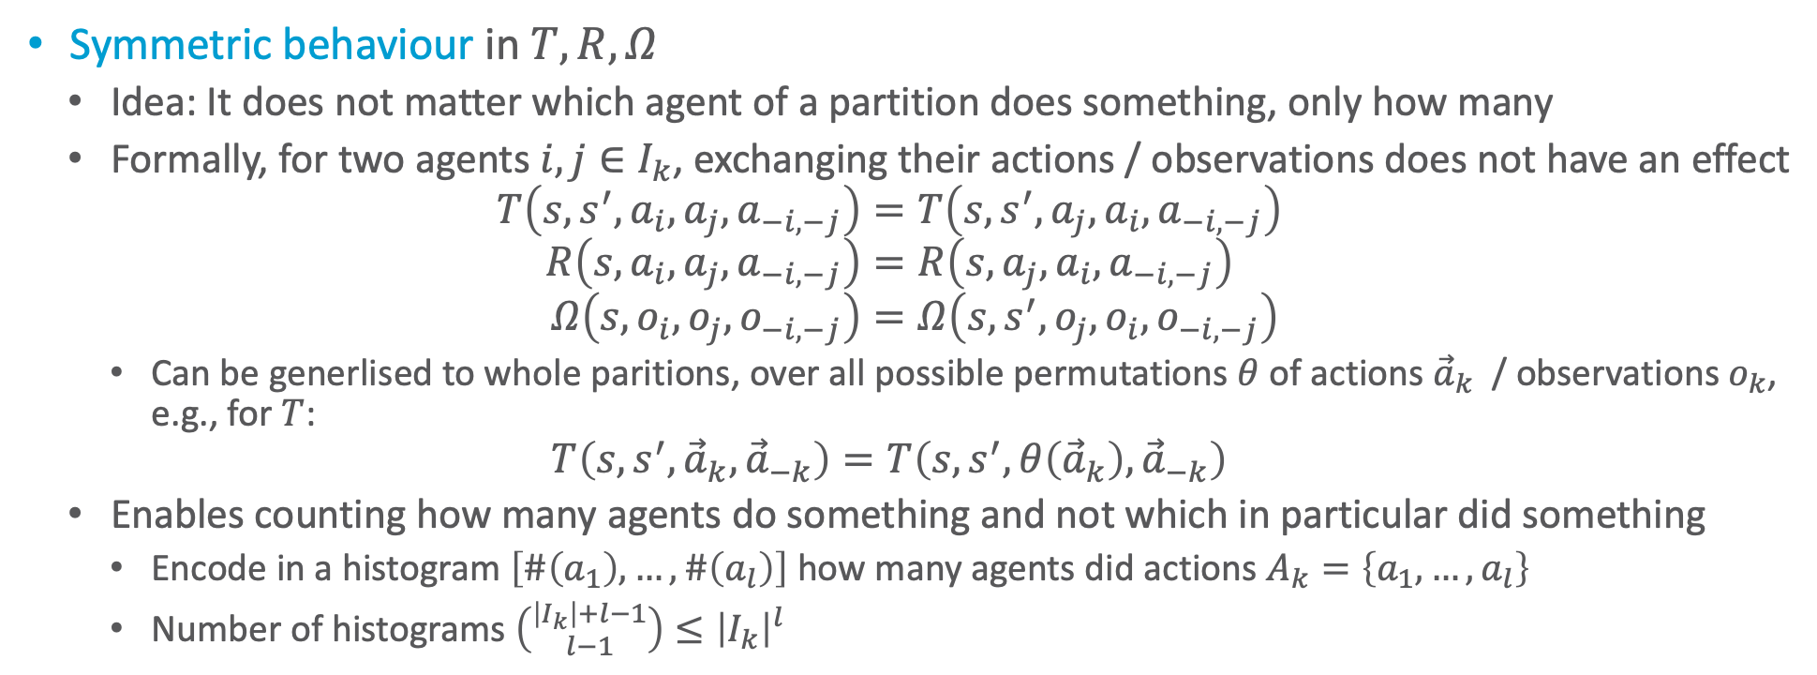
Additional Assumption 1
Symmetric behaviour in $T,R,Ω$
  Idea: It does not matter which agent of a partition does something, only how many
  Formally, for two agents $i,j∈I_{k}$, exchanging their actions / observations does not have an effect
  $$T\left(s,s^{′}, a_{i}, a_{j}, a_{−i,−j}\right)=T\left(s,s^{′}, a_{j}, a_{i}, a_{−i,−j}\right) \\ R\left(s, a_{i}, a_{j}, a_{−i,−j}\right)=R\left(s, a_{j}, a_{i}, a_{−i,−j}\right) \\ Ω\left(s, o_{i}, o_{j}, o_{−i,−j}\right)=Ω\left(s,s^{′}, o_{j}, o_{i}, o_{−i,−j}\right)$$
    Can be generlised to whole paritions, over all possible permutations $θ$ of actions ${\vec{a}}_{k}$ / observations $o_{k}$, e.g., for $T$:
  $$T\left(s,s^{′},{\vec{a}}_{k},{\vec{a}}_{−k}\right)=T\left(s,s^{′},θ\left({\vec{a}}_{k}\right),{\vec{a}}_{−k}\right)$$
  Enables counting how many agents do something and not which in particular did something
    Encode in a histogram $\left[\#\left(a_{1}\right),…,\#\left(a_{l}\right)\right]$ how many agents did actions $A_{k}=\left\{a_{1},…,a_{l}\right\}$
    Number of histograms $\left({\left|I_{k}\right|+l−1 \atop l−1}\right)≤{\left|I_{k}\right|}^{l}$

Slide 9
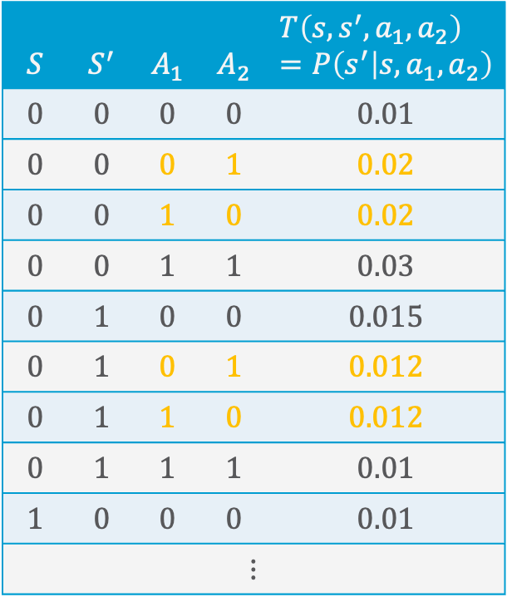

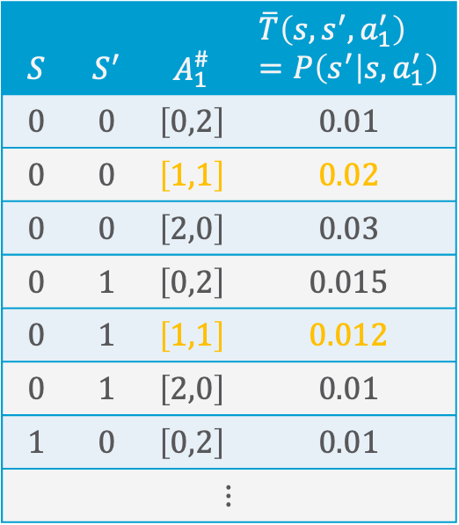
Counting in DecPOMDPs
Also called counting constraint / assumption in $T,R,Ω$
  All permutations $θ\left({\vec{a}}_{k}\right)$
  of a partition action ${\vec{a}}_{k}$ map to
  the same probability
  Allows for replacing joint actions
  / observations over $N$ agents in
  $T,R,Ω$ with histograms for each
  partition
  Example with two possible
  actions and a single partition
$$S$$ | $$S^{′}$$ | $$A_{1}$$ | $$A_{2}$$ | $$T\left(s,s^{′}, a_{1},a_{2}\right)=P\left(s^{′} | s,a_{1},a_{2}\right)$$
$$0$$ | $$0$$ | $$0$$ | $$0$$ | $$0.01$$
$$0$$ | $$0$$ | $$0$$ | $$1$$ | $$0.02$$
$$0$$ | $$0$$ | $$1$$ | $$0$$ | $$0.02$$
$$0$$ | $$0$$ | $$1$$ | $$1$$ | $$0.03$$
$$0$$ | $$1$$ | $$0$$ | $$0$$ | $$0.015$$
$$0$$ | $$1$$ | $$0$$ | $$1$$ | $$0.012$$
$$0$$ | $$1$$ | $$1$$ | $$0$$ | $$0.012$$
$$0$$ | $$1$$ | $$1$$ | $$1$$ | $$0.01$$
$$1$$ | $$0$$ | $$0$$ | $$0$$ | $$0.01$$
$$⋮$$
$$S$$ | $$S^{′}$$ | $$A_{1}^{\#}$$ | $$\overline{T}\left(s,s^{′}, a_{1}^{′}\right) \\ =P\left(s^{′} | s,a_{1}^{′}\right)$$
$$0$$ | $$0$$ | $$\left[0,2\right]$$ | $$0.01$$
$$0$$ | $$0$$ | $$\left[1,1\right]$$ | $$0.02$$
$$0$$ | $$0$$ | $$\left[2,0\right]$$ | $$0.03$$
$$0$$ | $$1$$ | $$\left[0,2\right]$$ | $$0.015$$
$$0$$ | $$1$$ | $$\left[1,1\right]$$ | $$0.012$$
$$0$$ | $$1$$ | $$\left[2,0\right]$$ | $$0.01$$
$$1$$ | $$0$$ | $$\left[0,2\right]$$ | $$0.01$$
$$⋮$$

Slide 10
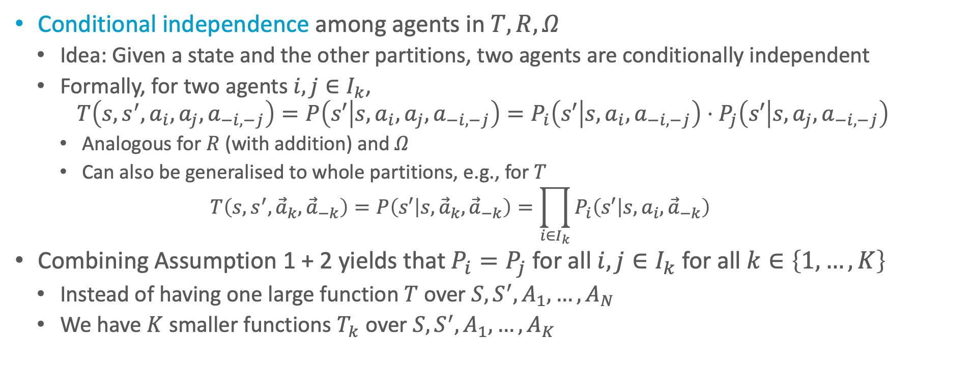
Additional Assumption 2
Conditional independence among agents in $T,R,Ω$
  Idea: Given a state and the other partitions, two agents are conditionally independent
  Formally, for two agents $i,j∈I_{k}$,
  $$T\left(s,s^{′}, a_{i}, a_{j}, a_{−i,−j}\right)=P\left(s′ | s,a_{i}, a_{j}, a_{−i,−j}\right)=P_{i}\left(s′ | s,a_{i}, a_{−i,−j}\right)⋅P_{j}\left(s′ | s, a_{j}, a_{−i,−j}\right)$$
    Analogous for $R$ (with addition) and $Ω$
    Can also be generalised to whole partitions, e.g., for $T$
    $T\left(s,s^{′},{\vec{a}}_{k},{\vec{a}}_{−k}\right)=P\left(s′ | s,{\vec{a}}_{k},{\vec{a}}_{−k}\right)=\prod_{i∈I_{k}}{P_{i}\left(s′ | s,a_{i},{\vec{a}}_{−k}\right)}$
Combining Assumption 1 + 2 yields that $P_{i}=P_{j}$ for all $i,j∈I_{k}$ for all $k∈\left\{1,…,K\right\}$
  Instead of having one large function $T$ over $S,S^{′},A_{1},…,A_{N}$
  We have $K$ smaller functions $T_{k}$ over $S,S^{′},A_{1},…,A_{K}$

Slide 11
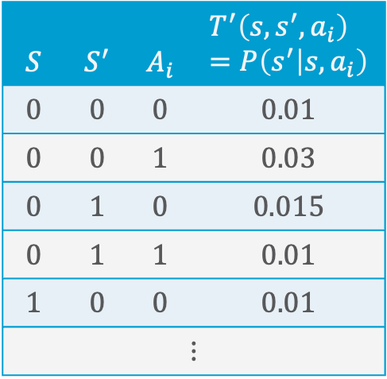
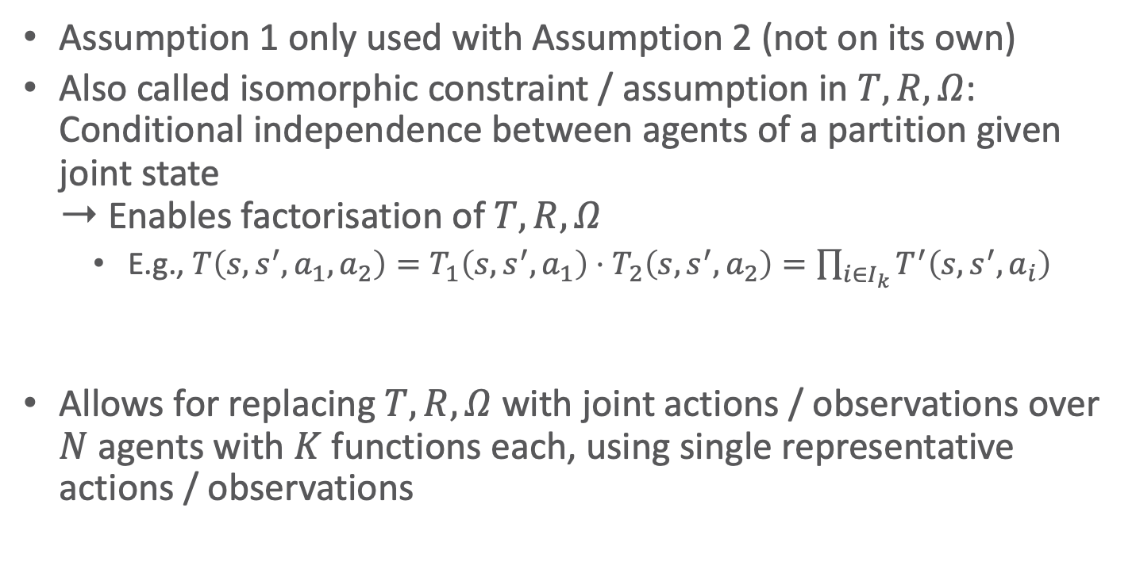

Isomorphism in DecPOMDPs
Assumption 1 only used with Assumption 2 (not on its own)
Also called isomorphic constraint / assumption in $T,R,Ω$:
Conditional independence between agents of a partition given joint state
➝ Enables factorisation of $T,R,Ω$
    E.g., $T\left(s,s^{′}, a_{1},a_{2}\right)=T_{1}\left(s,s^{′}, a_{1}\right)⋅T_{2}\left(s,s^{′}, a_{2}\right)=\prod_{i∈I_{k}}{T^{′}\left(s,s^{′}, a_{i}\right)}$
Allows for replacing $T,R,Ω$ with joint actions / observations over $N$ agents with $K$ functions each, using single representative actions / observations
$$S$$ | $$S^{′}$$ | $$A_{i}$$ | $$T^{′}\left(s,s^{′}, a_{i}\right) \\ =P\left(s^{′} | s,a_{i}\right)$$
$$0$$ | $$0$$ | $$0$$ | $$0.01$$
$$0$$ | $$0$$ | $$1$$ | $$0.03$$
$$0$$ | $$1$$ | $$0$$ | $$0.015$$
$$0$$ | $$1$$ | $$1$$ | $$0.01$$
$$1$$ | $$0$$ | $$0$$ | $$0.01$$
$$⋮$$
$$T_{1}=T_{2}=T^{′}$$

Slide 12
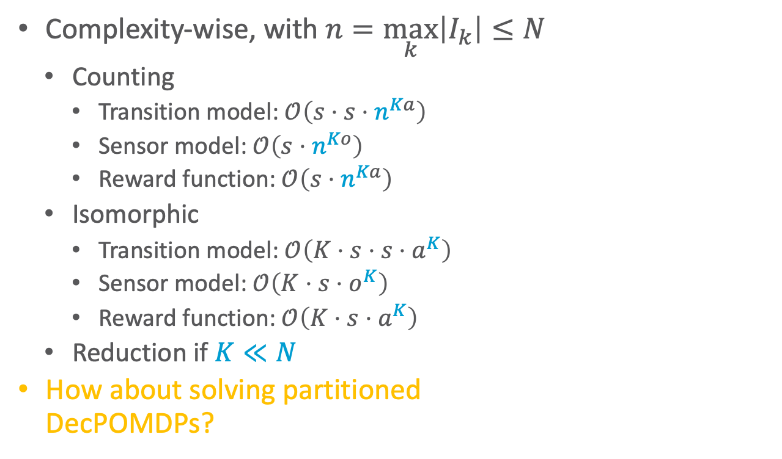
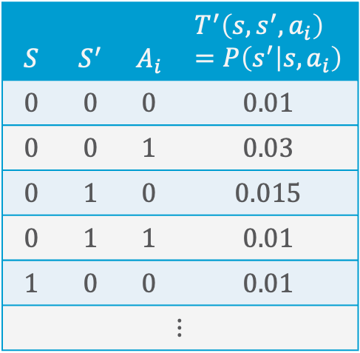
Complexities
$$S$$ | $$S^{′}$$ | $$A_{i}$$ | $$T^{′}\left(s,s^{′}, a_{i}\right) \\ =P\left(s^{′} | s,a_{i}\right)$$
$$0$$ | $$0$$ | $$0$$ | $$0.01$$
$$0$$ | $$0$$ | $$1$$ | $$0.03$$
$$0$$ | $$1$$ | $$0$$ | $$0.015$$
$$0$$ | $$1$$ | $$1$$ | $$0.01$$
$$1$$ | $$0$$ | $$0$$ | $$0.01$$
$$⋮$$
Complexity-wise, with $n=\max_{k}\left|I_{k}\right|≤N$
  Counting
    Transition model: $𝒪\left(s⋅s⋅n^{Ka}\right)$
    Sensor model: $𝒪\left(s⋅n^{Ko}\right)$
    Reward function: $𝒪\left(s⋅n^{Ka}\right)$
  Isomorphic
    Transition model: $𝒪\left(K⋅s⋅s⋅a^{K}\right)$
    Sensor model: $𝒪\left(K⋅s⋅o^{K}\right)$
    Reward function: $𝒪\left(K⋅s⋅a^{K}\right)$
  Reduction if $K≪N$
How about solving partitioned
DecPOMDPs?
$$S$$ | $$S^{′}$$ | $$A_{1}$$ | $$A_{2}$$ | $$T\left(s,s^{′}, a_{1},a_{2}\right)=P\left(s^{′} | s,a_{1},a_{2}\right)$$
$$0$$ | $$0$$ | $$0$$ | $$0$$ | $$0.01$$
$$0$$ | $$0$$ | $$0$$ | $$1$$ | $$0.02$$
$$0$$ | $$0$$ | $$1$$ | $$0$$ | $$0.02$$
$$0$$ | $$0$$ | $$1$$ | $$1$$ | $$0.03$$
$$0$$ | $$1$$ | $$0$$ | $$0$$ | $$0.015$$
$$0$$ | $$1$$ | $$0$$ | $$1$$ | $$0.012$$
$$0$$ | $$1$$ | $$1$$ | $$0$$ | $$0.012$$
$$0$$ | $$1$$ | $$1$$ | $$1$$ | $$0.01$$
$$1$$ | $$0$$ | $$0$$ | $$0$$ | $$0.01$$
$$⋮$$
$$S$$ | $$S^{′}$$ | $$A_{1}^{\#}$$ | $$\overline{T}\left(s,s^{′}, a_{1}^{′}\right) \\ =P\left(s^{′} | s,a_{1}^{′}\right)$$
$$0$$ | $$0$$ | $$\left[0,2\right]$$ | $$0.01$$
$$0$$ | $$0$$ | $$\left[1,1\right]$$ | $$0.02$$
$$0$$ | $$0$$ | $$\left[2,0\right]$$ | $$0.03$$
$$0$$ | $$1$$ | $$\left[0,2\right]$$ | $$0.015$$
$$0$$ | $$1$$ | $$\left[1,1\right]$$ | $$0.012$$
$$0$$ | $$1$$ | $$\left[2,0\right]$$ | $$0.01$$
$$1$$ | $$0$$ | $$\left[0,2\right]$$ | $$0.01$$
$$⋮$$

Slide 13

Remember: Multi-agent Dynamic Programming
Iteratively eliminate weakly-dominated policy trees using a dynamic programming
  A policy $π_{i,j}^{t}$ of agent $i$ is weakly dominated if there always exists another policy $π_{i,j^{′}}^{t}$ with higher value over all possible states $s$ and all possible policies of the other agents $π_{−i}^{t}$:
  $$∀s∈S, π_{−i}^{t}∈Π_{−i}^{t} ∃π_{i,j^{′}}^{t}∈Π_{i}^{t}:V_{i}\left(s,π_{i,j}^{t},π_{−i}^{t}\right)≤V_{i}\left(s,π_{i,j^{′}}^{t},π_{−i}^{t}\right)$$
    Solvable by a linear programme
Dynamic Programming Operator:
Input: sets of policies and corresponding value vectors for each agent.
Process:
  Perform exhaustive backup using policies for each agent.
  Calculate new value vectors.
  Prune weakly dominated policies per agent.
Output: Updated sets of policies and value vectors for each agent.
Hansen, E. A., Bernstein, D. S., & Zilberstein, S. 2004

Slide 14
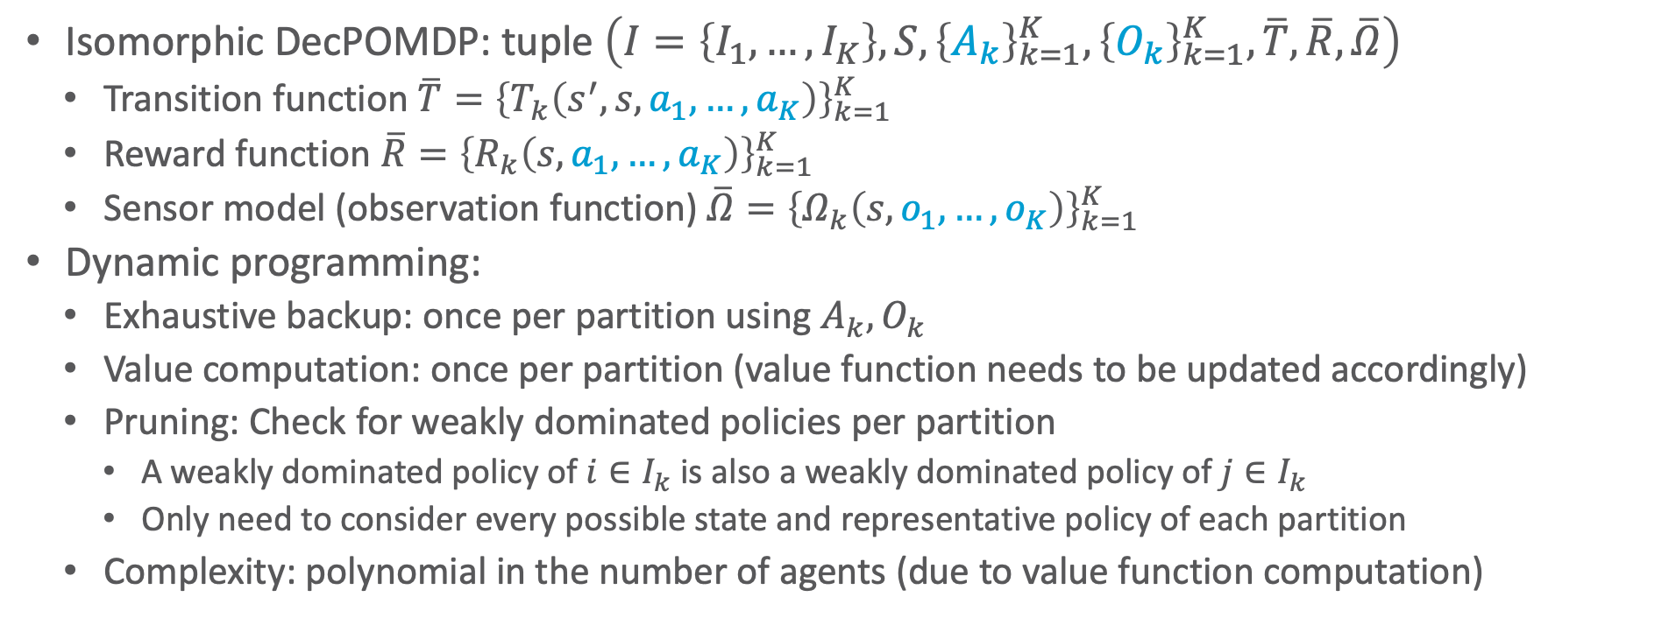
Multi-agent Dynamic Programming for Isomorphic DecPOMDPs
Isomorphic DecPOMDP: tuple $\left(I=\left\{I_{1},…,I_{K}\right\},S, {\left\{A_{k}\right\}}_{k=1}^{K}, {\left\{O_{k}\right\}}_{k=1}^{K},\overline{T},\overline{R},\overline{Ω}\right)$
  Transition function $\overline{T}={\left\{T_{k}\left(s^{′},s,a_{1},…,a_{K}\right)\right\}}_{k=1}^{K}$
  Reward function $\overline{R}={\left\{R_{k}\left(s,a_{1},…,a_{K}\right)\right\}}_{k=1}^{K}$
  Sensor model (observation function) $\overline{Ω}={\left\{Ω_{k}\left(s,o_{1},…,o_{K}\right)\right\}}_{k=1}^{K}$
Dynamic programming:
  Exhaustive backup: once per partition using $A_{k}, O_{k}$
  Value computation: once per partition (value function needs to be updated accordingly)
  Pruning: Check for weakly dominated policies per partition
    A weakly dominated policy of $i∈I_{k}$ is also a weakly dominated policy of $j∈I_{k}$
    Only need to consider every possible state and representative policy of each partition
  Complexity: polynomial in the number of agents (due to value function computation)

Slide 15
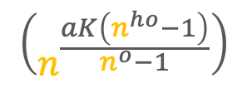
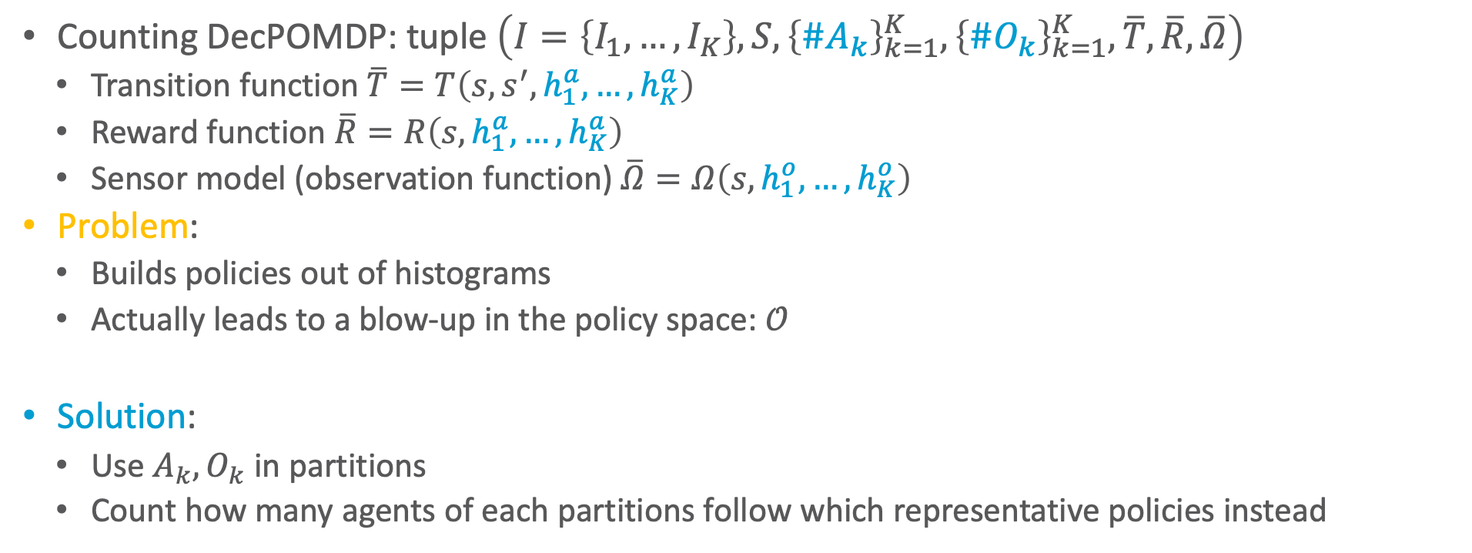
Counting DecPOMDPs
Counting DecPOMDP: tuple $\left(I=\left\{I_{1},…,I_{K}\right\},S, {\left\{{\#A}_{k}\right\}}_{k=1}^{K}, {\left\{{\#O}_{k}\right\}}_{k=1}^{K},\overline{T},\overline{R},\overline{Ω}\right)$
  Transition function $\overline{T}=T\left(s,s^{′},h_{1}^{a},…, h_{K}^{a}\right)$
  Reward function $\overline{R}=R\left(s,h_{1}^{a},…, h_{K}^{a}\right)$
  Sensor model (observation function) $\overline{Ω}=Ω\left(s,h_{1}^{o},…, h_{K}^{o}\right)$
Problem:
  Builds policies out of histograms
  Actually leads to a blow-up in the policy space: $𝒪$
Solution:
  Use $A_{k}, O_{k}$ in partitions
  Count how many agents of each partitions follow which representative policies instead
$$\left(n^{\frac{aK\left(n^{ho}−1\right)}{n^{o}−1}}\right)$$

Slide 16
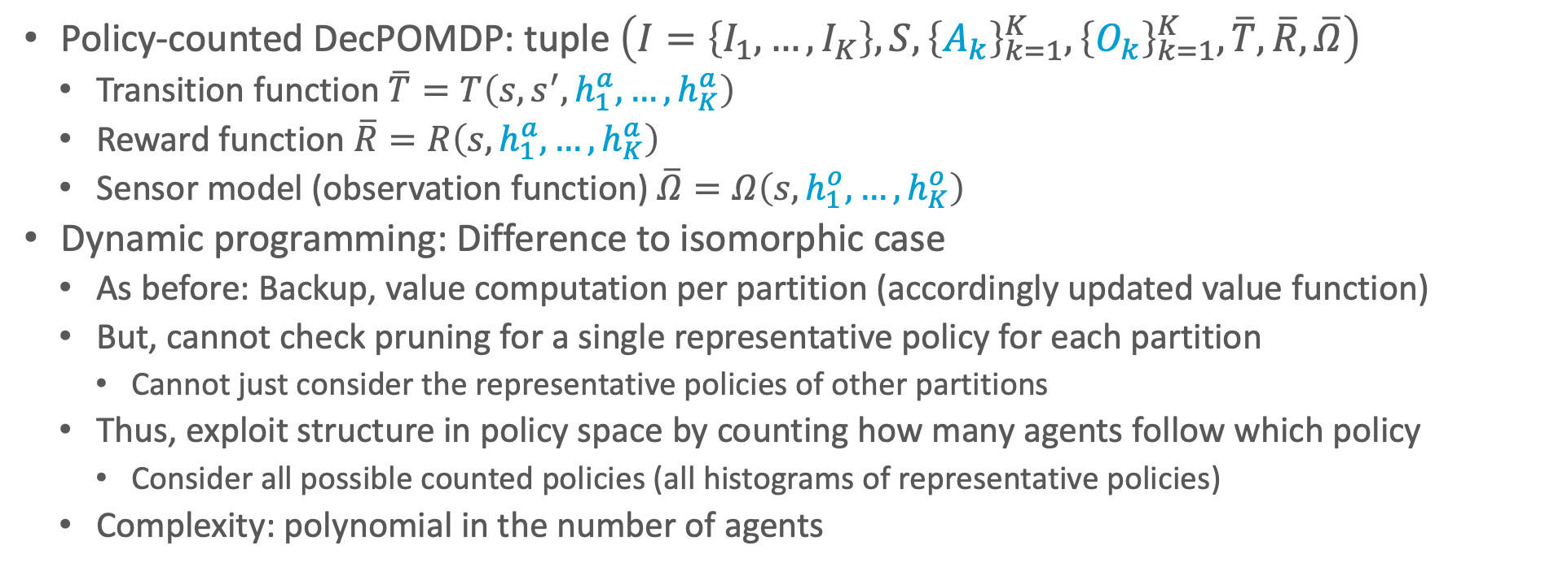
Multi-agent Dynamic Programming for Policy-counted DecPOMDPs
Policy-counted DecPOMDP: tuple $\left(I=\left\{I_{1},…,I_{K}\right\},S, {\left\{A_{k}\right\}}_{k=1}^{K}, {\left\{O_{k}\right\}}_{k=1}^{K},\overline{T},\overline{R},\overline{Ω}\right)$
  Transition function $\overline{T}=T\left(s,s^{′},h_{1}^{a},…, h_{K}^{a}\right)$
  Reward function $\overline{R}=R\left(s,h_{1}^{a},…, h_{K}^{a}\right)$
  Sensor model (observation function) $\overline{Ω}=Ω\left(s,h_{1}^{o},…, h_{K}^{o}\right)$
Dynamic programming: Difference to isomorphic case
  As before: Backup, value computation per partition (accordingly updated value function)
  But, cannot check pruning for a single representative policy for each partition
    Cannot just consider the representative policies of other partitions
  Thus, exploit structure in policy space by counting how many agents follow which policy
    Consider all possible counted policies (all histograms of representative policies)
  Complexity: polynomial in the number of agents

Slide 17
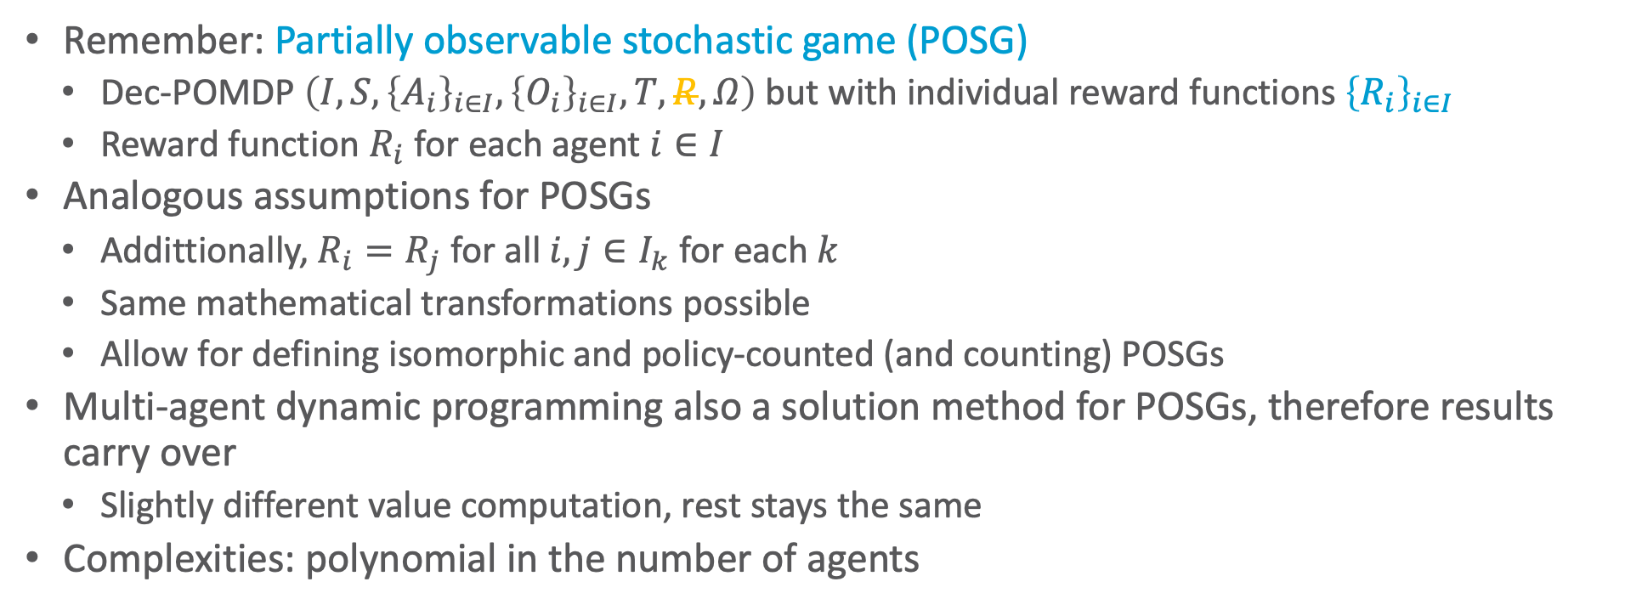
Partitioned POSGs
Remember: Partially observable stochastic game (POSG)
  Dec-POMDP $\left(I,S, {\left\{A_{i}\right\}}_{i∈I}, {\left\{O_{i}\right\}}_{i∈I},T,R,Ω\right)$but with individual reward functions ${\left\{R_{i}\right\}}_{i∈I}$
  Reward function $R_{i}$ for each agent $i∈I$
Analogous assumptions for POSGs
  Addittionally, $R_{i}=R_{j}$ for all $i,j∈I_{k}$ for each $k$
  Same mathematical transformations possible
  Allow for defining isomorphic and policy-counted (and counting) POSGs
Multi-agent dynamic programming also a solution method for POSGs, therefore results carry over
  Slightly different value computation, rest stays the same
Complexities: polynomial in the number of agents
Nazlı Nur Karabulut and TB: Lifting Partially Observable Stochastic Games. In SUM-24 Proceedings of the 16th International Conference on Scalable Uncertainty Management, 2024
Nazlı Nur Karabulut and TB: Counting Agents in Partially Observable Stochastic Games. In ECSQARU-25 Proceedings of the 18th European Conference on Symbolic and Quantitative Approaches to Reasoning with Uncertainty, 2025

Slide 18
Interim Summary: Structure by Groups in the Agent Set
Types of agents with identical action and observation space
Assumptions: symmetric behaviour, conditional independence
  Counting
    Permutations of actions of agents of the same partition map to the same probability / reward
    Count occurrences ➝ encode in histograms
  Model complexity polynomial in the number of agents
Isomorphic DecPOMDP: Use single representative agent per partition for policies
Counting DecPOMDPs: Use histograms for policies ➝ blows up state space
Policy-counted DecPOMDP: Count how many agents follow each representative policy
Dynamic programming possible per partition in all cases
  Dynamic programming for isomorphic and policy-counted DecPOMDPs polynomial in the number of agents

Slide 19
Outline: Decision Making – Structure
Structure by Groups in the Agent Set
  Agent types
  Partitioned decPOMDPs
Structure by Relations in the State Space
  Situation calculus
  First-order MDPs
Structure by Features in the State Space
  Dynamic Bayesian networks
  Factored MDPs

Slide 20
Acknowledgement
Thanks to Scott Sanner!

Slide 21
Motivation: Planning Languages
Common languages:
  STRIPS
  PDDL
    More expressive than STRIPS
    For example, universal and conditional effects:
      (:action put-all-blue-blocks-on-table
                :parameters ( )
        :precondition ( )
      :effect (forall (?b)
      (when (Blue ?b)
      (not (OnTable ?b)))))
  General Game Playing (GGP)
    One or more agents

Slide 22
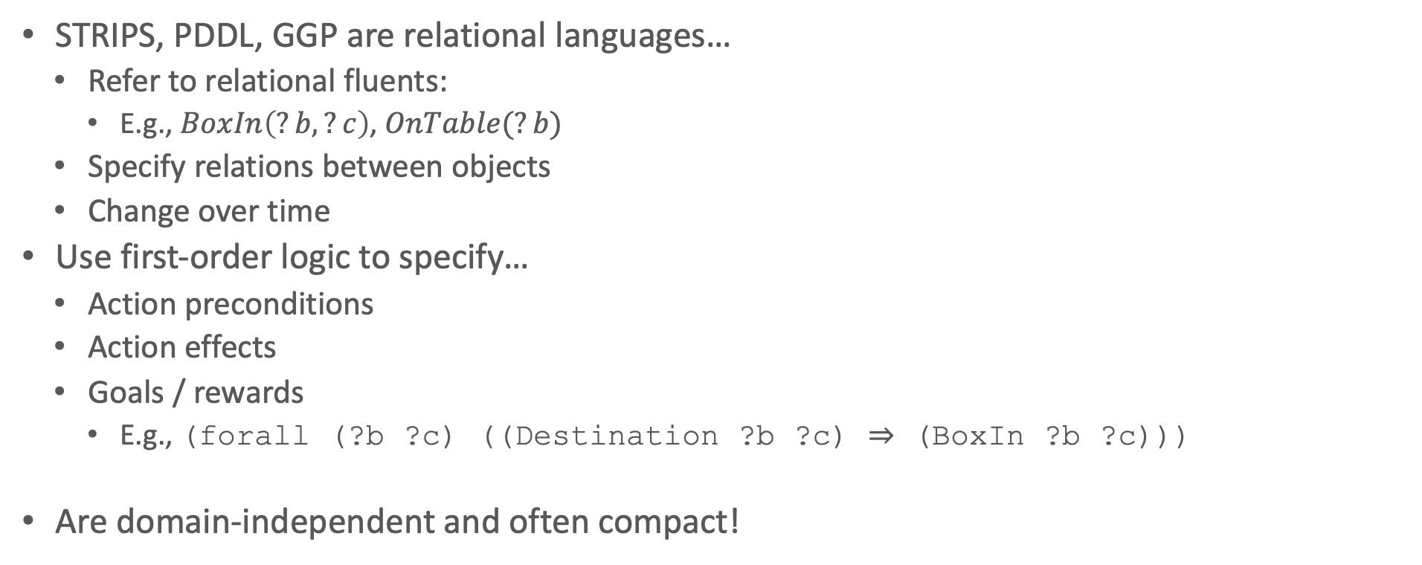
Motivation: Benefits of Relational Languages
STRIPS, PDDL, GGP are relational languages…
  Refer to relational fluents:
    E.g., $BoxIn\left(?b,?c\right)$, $OnTable(?b)$
  Specify relations between objects
  Change over time
Use first-order logic to specify…
  Action preconditions
  Action effects
  Goals / rewards
    E.g., (forall (?b ?c) ((Destination ?b ?c) ⇒ (BoxIn ?b ?c)))
Are domain-independent and often compact!

Slide 23
Motivation: How to Solve?
Relational planning problem
  E.g., box world
      (:action load-box-on-truck-in-city
      :parameters (?b - box ?t - truck ?c – city)
      :precondition (and (BoxIn ?b ?c) (TruckIn ?t ?c))
      :effect (and (On ?b ?t) (not (BoxIn ?b ?c))))
Solve ground problem for each domain instance?
  E.g., instance with 3 trucks 🚚 🚚 🚚, 2 planes 🛩️ 🛩️, 3 boxes 📦 📦 📦
Or solve lifted specification for all domains at once?
🚚
🛩️
Paris
Moscow
London
Berlin
📦
🚚
Rome
📦

Slide 24
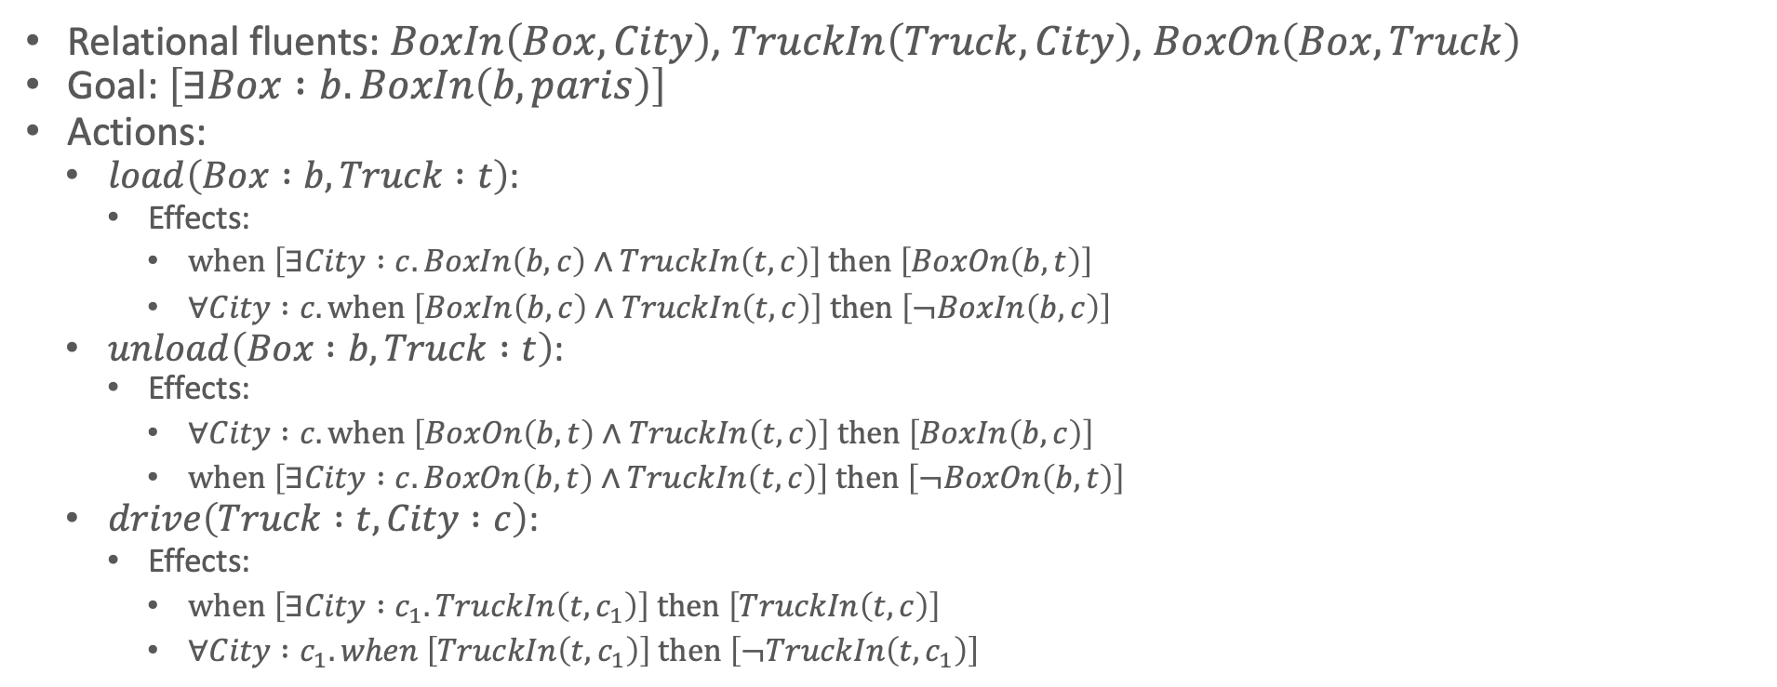
Box World: Full (Relational) Specification
Relational fluents: $BoxIn\left(Box, City\right)$, $TruckIn\left(Truck, City\right)$, $BoxOn\left(Box, Truck\right)$
Goal: $\left[∃Box :b.BoxIn\left(b, paris\right)\right]$
Actions:
  $load\left(Box :b, Truck :t\right)$:
    Effects:
      $when \left[∃City :c. BoxIn\left(b, c\right)∧TruckIn\left(t, c\right)\right] then \left[BoxOn\left(b, t\right)\right]$
      $∀City :c. when \left[BoxIn\left(b, c\right)∧TruckIn\left(t, c\right)\right] then \left[¬BoxIn\left(b, c\right)\right]$
  $unload\left(Box :b, Truck :t\right)$:
    Effects:
      $∀City :c. when \left[BoxOn\left(b, t\right)∧TruckIn\left(t, c\right)\right] then \left[BoxIn\left(b, c\right)\right]$
      $when \left[∃City :c. BoxOn\left(b, t\right)∧TruckIn\left(t, c\right)\right] then \left[¬BoxOn\left(b, t\right)\right]$
  $drive\left(Truck :t, City :c\right)$:
    Effects:
      $when \left[∃City :c_{1}. TruckIn\left(t, c_{1}\right)\right] then \left[TruckIn\left(t, c\right)\right]$
      $∀City :c_{1}. when \left[TruckIn\left(t, c_{1}\right)\right] then \left[¬TruckIn\left(t, c_{1}\right)\right]$

Slide 25
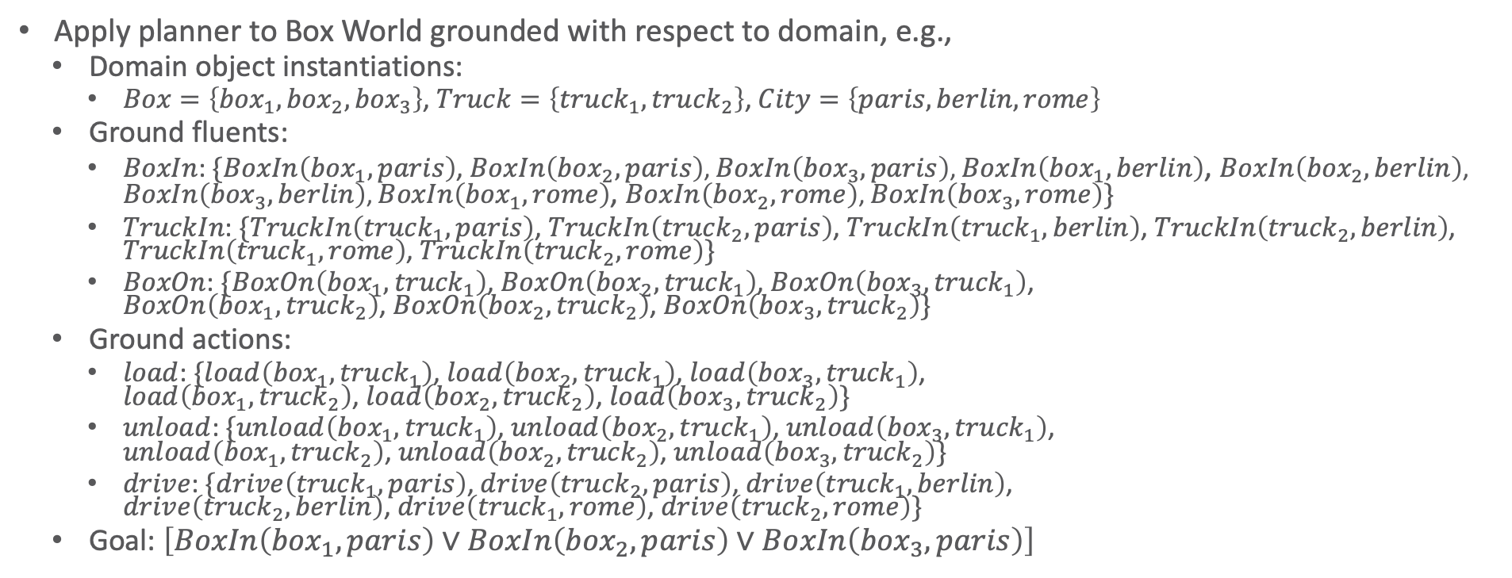
Solving Ground Box World
Apply planner to Box World grounded with respect to domain, e.g.,
  Domain object instantiations:
    $Box=\left\{{box}_{1},{box}_{2},{box}_{3}\right\}$, $Truck=\left\{{truck}_{1},{truck}_{2}\right\}$, $City=\left\{paris,berlin,rome\right\}$
  Ground fluents:
    $BoxIn$: $\{BoxIn\left({box}_{1}, paris\right)$, $BoxIn\left({box}_{2}, paris\right)$, $BoxIn\left({box}_{3}, paris\right)$, $BoxIn\left({box}_{1}, berlin\right)$, $BoxIn\left({box}_{2}, berlin\right)$, $BoxIn\left({box}_{3}, berlin\right)$, $BoxIn\left({box}_{1}, rome\right)$, $BoxIn\left({box}_{2}, rome\right)$, $BoxIn\left({box}_{3}, rome\right)\}$
    $TruckIn$: $\{TruckIn\left({truck}_{1}, paris\right)$, $TruckIn\left({truck}_{2},paris\right)$, $TruckIn\left({truck}_{1}, berlin\right)$, $TruckIn\left({truck}_{2},berlin\right)$, $TruckIn\left({truck}_{1}, rome\right)$, $TruckIn\left({truck}_{2}, rome\right)\}$
    $BoxOn$: $\{BoxOn\left({box}_{1},{truck}_{1}\right)$, $BoxOn\left({box}_{2},{truck}_{1}\right)$, $BoxOn\left({box}_{3},{truck}_{1}\right)$,
    $BoxOn\left({box}_{1},{truck}_{2}\right)$, $BoxOn\left({box}_{2},{truck}_{2}\right)$, $BoxOn\left({box}_{3},{truck}_{2}\right)\}$
  Ground actions:
    $load$: $\{load\left({box}_{1},{truck}_{1}\right)$, $load\left({box}_{2},{truck}_{1}\right)$, $load\left({box}_{3},{truck}_{1}\right)$,
    $load\left({box}_{1},{truck}_{2}\right)$, $load\left({box}_{2},{truck}_{2}\right)$, $load\left({box}_{3},{truck}_{2}\right)\}$
    $unload$: $\{unload\left({box}_{1},{truck}_{1}\right)$, $unload\left({box}_{2},{truck}_{1}\right)$, $unload\left({box}_{3},{truck}_{1}\right)$,
    $unload\left({box}_{1},{truck}_{2}\right)$, $unload\left({box}_{2},{truck}_{2}\right)$, $unload\left({box}_{3},{truck}_{2}\right)\}$
    $drive$: $\{drive\left({truck}_{1}, paris\right)$, $drive\left({truck}_{2},paris\right)$, $drive\left({truck}_{1}, berlin\right)$,
    $drive\left({truck}_{2},berlin\right)$, $drive\left({truck}_{1}, rome\right)$, $drive\left({truck}_{2}, rome\right)\}$
  Goal: $\left[BoxIn\left({box}_{1}, paris\right)∨BoxIn\left({box}_{2}, paris\right)∨BoxIn\left({box}_{3}, paris\right)\right]$
Number of fluents exponential in arity
Number of actions exponential in arity
Goal description exponential in number of nested quantifiers

Slide 26
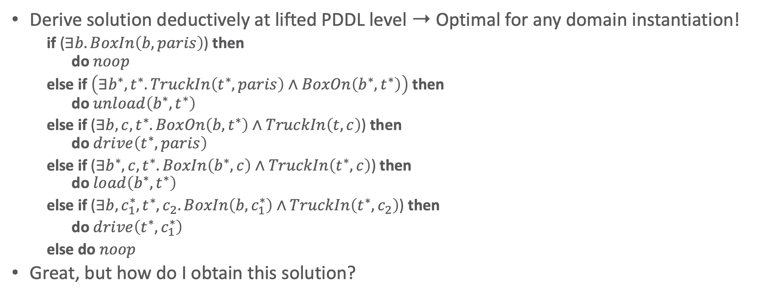
A First-order Solution to Box World
Derive solution deductively at lifted PDDL level ➝ Optimal for any domain instantiation!
    if ($∃b.BoxIn\left(b, paris\right)$) then
    do $noop$
    else if $\left(∃b^{∗},t^{∗}.TruckIn\left(t^{∗},paris\right)∧BoxOn\left(b^{∗},t^{∗}\right)\right)$ then
    do $unload\left(b^{∗}, t^{∗}\right)$
    else if ($∃b,c,t^{∗}.BoxOn\left(b,t^{∗}\right)∧TruckIn\left(t,c\right)$) then
    do $drive\left(t^{∗}, paris\right)$
    else if ($∃b^{∗},c,t^{∗}.BoxIn\left(b^{∗},c\right)∧TruckIn\left(t^{∗},c\right)$) then
    do $load\left(b^{∗},t^{∗}\right)$
    else if ($∃b,c_{1}^{∗},t^{∗},c_{2}.BoxIn\left(b,c_{1}^{∗}\right)∧TruckIn\left(t^{∗},c_{2}\right)$) then
    do $drive\left(t^{∗},c_{1}^{∗}\right)$
    else do $noop$
Great, but how do I obtain this solution?
Notes:
Answer: Situation calculus

Slide 27
Situation Calculus
Logic formalism designed for representing and reasoning about dynamic domains
  First introduced by John McCarthy in 1963
Basic elements
  Actions that can be performed in the world
  Situations
  Fluents that describe the state of the world
Domain
  Action precondition axioms, one for each action
  Successor state axioms, one for each fluent
  Axioms describing the world in various situations
  Foundational axioms of the situation calculus: situations are histories, induction on situations

Slide 28
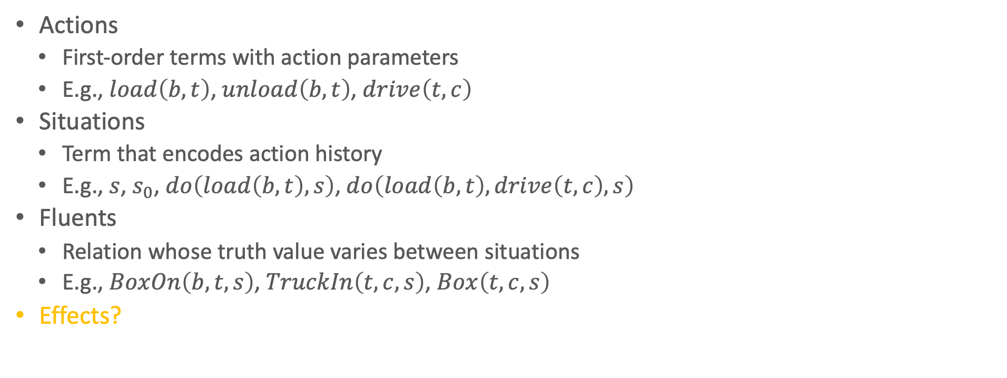
Situation Calculus: Ingredients
Actions
  First-order terms with action parameters
  E.g., $load\left(b,t\right)$, $unload\left(b,t\right)$, $drive\left(t,c\right)$
Situations
  Term that encodes action history
  E.g., $s$, $s_{0}$, $do\left(load\left(b,t\right),s\right)$, $do\left(load\left(b,t\right),drive\left(t,c\right),s\right)$
Fluents
  Relation whose truth value varies between situations
  E.g., $BoxOn\left(b,t,s\right)$, $TruckIn\left(t,c,s\right)$, $Box\left(t,c,s\right)$
Effects?

Slide 29

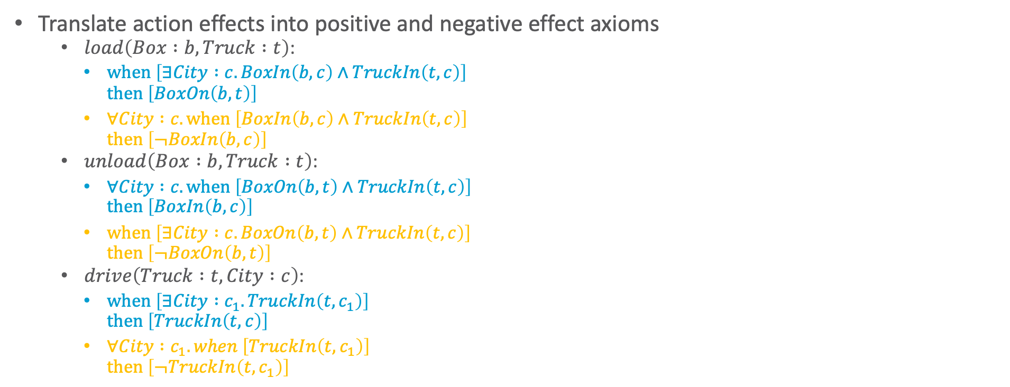
Situation Calculus: PDDL to Effects
Translate action effects into positive and negative effect axioms
    $load\left(Box :b, Truck :t\right)$:
      $when \left[∃City :c. BoxIn\left(b, c\right)∧TruckIn\left(t, c\right)\right]$
      $then \left[BoxOn\left(b, t\right)\right]$
      $∀City :c. when \left[BoxIn\left(b, c\right)∧TruckIn\left(t, c\right)\right]$
      $then \left[¬BoxIn\left(b, c\right)\right]$
    $unload\left(Box :b, Truck :t\right)$:
      $∀City :c. when \left[BoxOn\left(b, t\right)∧TruckIn\left(t, c\right)\right]$
      $then \left[BoxIn\left(b, c\right)\right]$
      $when \left[∃City :c. BoxOn\left(b, t\right)∧TruckIn\left(t, c\right)\right]$
      $then \left[¬BoxOn\left(b, t\right)\right]$
    $drive\left(Truck :t, City :c\right)$:
      $when \left[∃City :c_{1}. TruckIn\left(t, c_{1}\right)\right]$
      $then \left[TruckIn\left(t, c\right)\right]$
      $∀City :c_{1}. when \left[TruckIn\left(t, c_{1}\right)\right]$
      $then \left[¬TruckIn\left(t, c_{1}\right)\right]$
      $\left[∃c. a=load\left(b,t\right)∧BoxIn\left(b, c,s\right)∧TruckIn\left(t, c,s\right)\right]$
      $⇒BoxOn\left(b, t,do\left(a,s\right)\right)$
      $\left[∃t. a=load\left(b,t\right)∧BoxIn\left(b, c,s\right)∧TruckIn\left(t, c,s\right)\right]$
      $⇒¬BoxIn\left(b, c,do\left(a,s\right)\right)$
      $\left[∃t. a=unload\left(b,t\right)∧BoxOn\left(b, t,s\right)∧TruckIn\left(t, c,s\right)\right]$
      $⇒BoxIn\left(b, c,do\left(a,s\right)\right)$
      $\left[∃c. a=unload\left(b,t\right)∧BoxOn\left(b, t,s\right)∧TruckIn\left(t, c,s\right)\right]$
      $⇒¬BoxOn\left(b, t,do\left(a,s\right)\right)$
      $\left[∃c_{1}. a=drive\left(t,c\right)∧TruckIn\left(t, c_{1},s\right)\right]$
      $⇒TruckIn\left(t, c,do\left(a,s\right)\right)$
      $\left[∃c. a=drive\left(t,c\right)∧TruckIn\left(t, c_{1},s\right)\right]$
      $⇒¬TruckIn\left(t,c_{1},do\left(a,s\right)\right)$

Slide 30
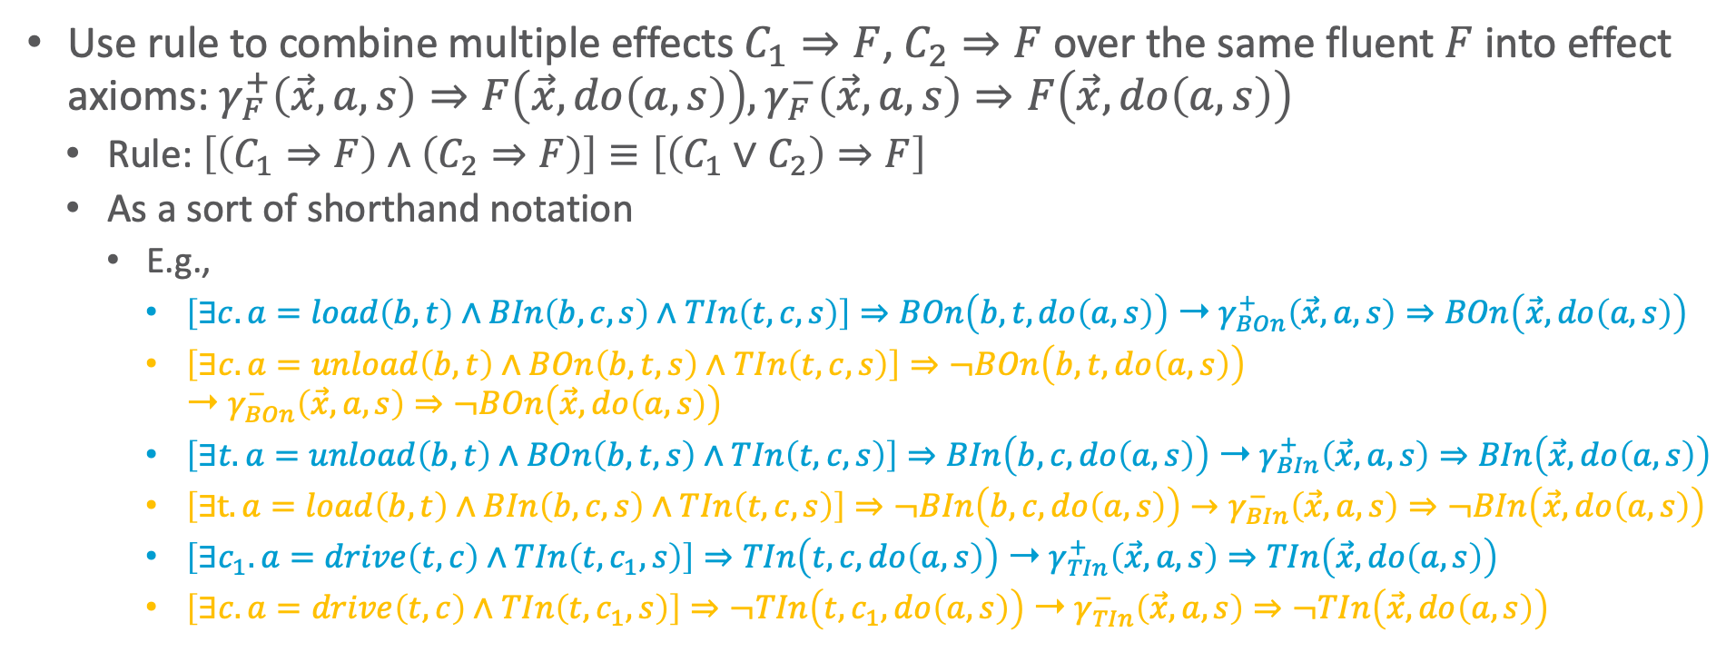
Situation Calculus: PDDL to Effects
Use rule to combine multiple effects $C_{1}⇒F$, $C_{2}⇒F$ over the same fluent $F$ into effect axioms: $γ_{F}^{+}\left(\vec{x},a,s\right)⇒F\left(\vec{x},do\left(a,s\right)\right),γ_{F}^{−}\left(\vec{x},a,s\right)⇒F\left(\vec{x},do\left(a,s\right)\right)$
  Rule: $\left[\left(C_{1}⇒F\right)∧\left(C_{2}⇒F\right)\right]≡\left[\left(C_{1}∨C_{2}\right)⇒F\right]$
  As a sort of shorthand notation
    E.g.,
      $\left[∃c. a=load\left(b,t\right)∧BIn\left(b, c,s\right)∧TIn\left(t, c,s\right)\right]⇒BOn\left(b, t,do\left(a,s\right)\right)$ ➝ $γ_{BOn}^{+}\left(\vec{x}, a,s\right)⇒BOn\left(\vec{x},do\left(a,s\right)\right)$
      $\left[∃c. a=unload\left(b,t\right)∧BOn\left(b, t,s\right)∧TIn\left(t, c,s\right)\right]⇒¬BOn\left(b, t,do\left(a,s\right)\right)$
      ➝ $γ_{BOn}^{−}\left(\vec{x}, a,s\right)⇒¬BOn\left(\vec{x},do\left(a,s\right)\right)$
      $\left[∃t. a=unload\left(b,t\right)∧BOn\left(b, t,s\right)∧TIn\left(t, c,s\right)\right]⇒BIn\left(b, c,do\left(a,s\right)\right)$ ➝ $γ_{BIn}^{+}\left(\vec{x}, a,s\right)⇒BIn\left(\vec{x},do\left(a,s\right)\right)$
      $\left[∃t. a=load\left(b,t\right)∧BIn\left(b, c,s\right)∧TIn\left(t, c,s\right)\right]⇒¬BIn\left(b, c,do\left(a,s\right)\right)→γ_{BIn}^{−}\left(\vec{x}, a,s\right)⇒¬BIn\left(\vec{x},do\left(a,s\right)\right)$
      $\left[∃c_{1}. a=drive\left(t,c\right)∧TIn\left(t, c_{1},s\right)\right]⇒TIn\left(t, c,do\left(a,s\right)\right)$ ➝ $γ_{TIn}^{+}\left(\vec{x}, a,s\right)⇒TIn\left(\vec{x},do\left(a,s\right)\right)$
      $\left[∃c. a=drive\left(t,c\right)∧TIn\left(t, c_{1},s\right)\right]⇒¬TIn\left(t,c_{1},do\left(a,s\right)\right)$ ➝ $γ_{TIn}^{−}\left(\vec{x}, a,s\right)⇒¬TIn\left(\vec{x},do\left(a,s\right)\right)$

Slide 31
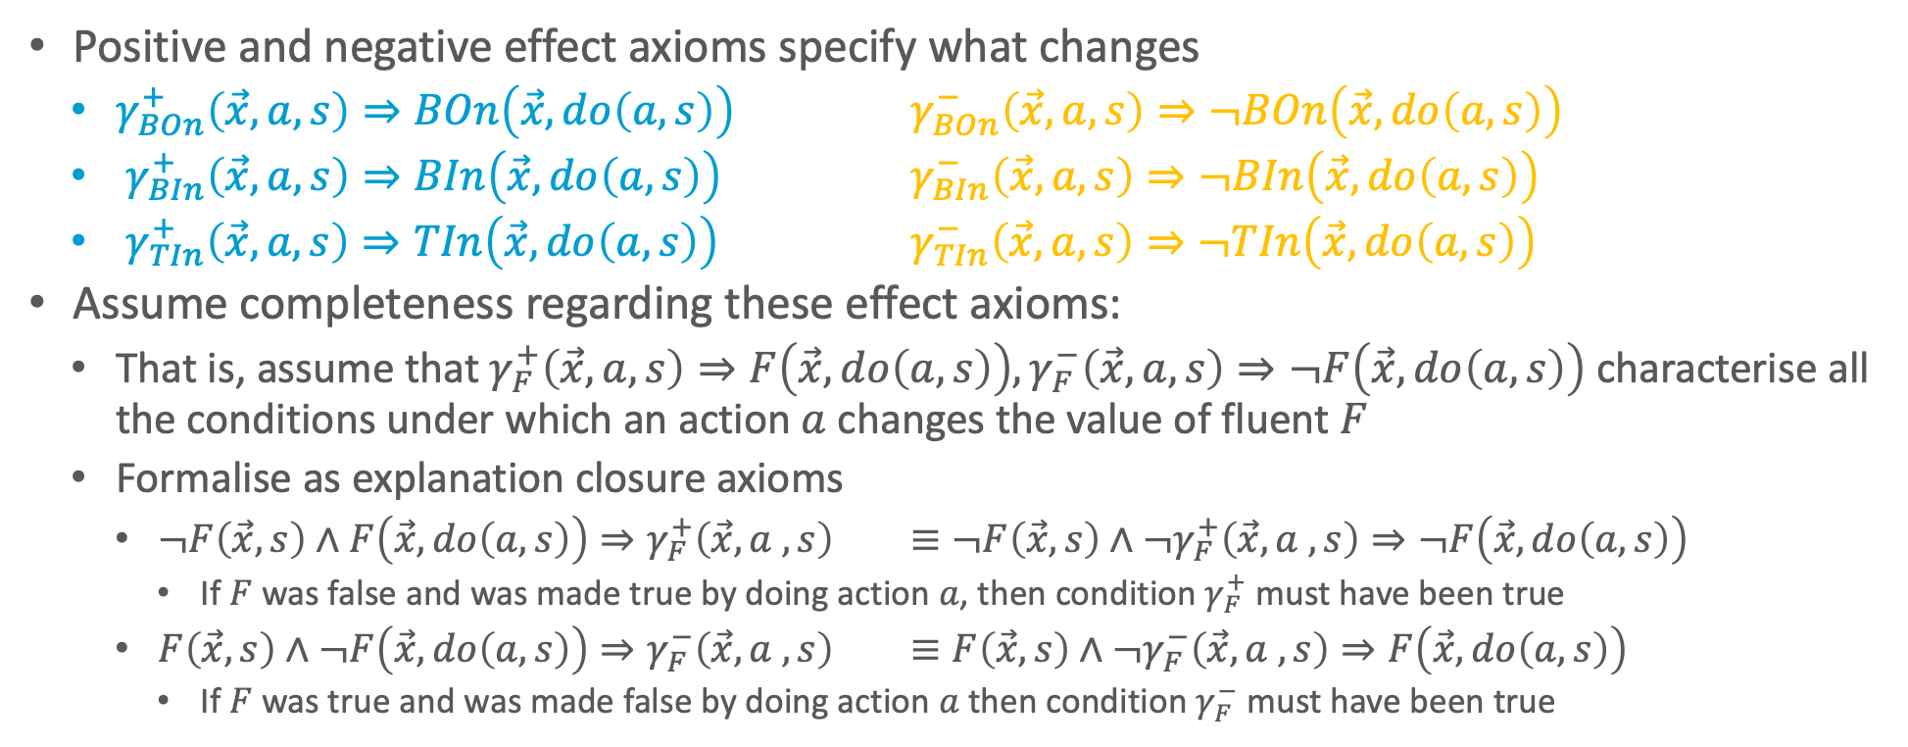
Frame Problem
Positive and negative effect axioms specify what changes
  $γ_{BOn}^{+}\left(\vec{x}, a,s\right)⇒BOn\left(\vec{x},do\left(a,s\right)\right)$ $γ_{BOn}^{−}\left(\vec{x}, a,s\right)⇒¬BOn\left(\vec{x},do\left(a,s\right)\right)$
  $γ_{BIn}^{+}\left(\vec{x}, a,s\right)⇒BIn\left(\vec{x},do\left(a,s\right)\right)$ $γ_{BIn}^{−}\left(\vec{x}, a,s\right)⇒¬BIn\left(\vec{x},do\left(a,s\right)\right)$
  $γ_{TIn}^{+}\left(\vec{x}, a,s\right)⇒TIn\left(\vec{x},do\left(a,s\right)\right)$ $γ_{TIn}^{−}\left(\vec{x}, a,s\right)⇒¬TIn\left(\vec{x},do\left(a,s\right)\right)$
Assume completeness regarding these effect axioms:
  That is, assume that $γ_{F}^{+}\left(\vec{x},a,s\right)⇒F\left(\vec{x},do\left(a,s\right)\right),γ_{F}^{−}\left(\vec{x},a,s\right)⇒¬F\left(\vec{x},do\left(a,s\right)\right)$ characterise all the conditions under which an action $a$ changes the value of fluent $F$
  Formalise as explanation closure axioms
    $¬F\left(\vec{x}, s\right)∧F\left(\vec{x}, do\left(a,s\right)\right)⇒γ_{F}^{+}\left(\vec{x}, a ,s\right)$ $≡¬F\left(\vec{x}, s\right)∧¬γ_{F}^{+}\left(\vec{x}, a ,s\right)⇒¬F\left(\vec{x}, do\left(a,s\right)\right)$
      If $F$ was false and was made true by doing action $a$, then condition $γ_{F}^{+}$ must have been true
    $F\left(\vec{x}, s\right)∧¬F\left(\vec{x}, do\left(a,s\right)\right)⇒γ_{F}^{−}\left(\vec{x}, a ,s\right)$ $≡F\left(\vec{x}, s\right)∧¬γ_{F}^{−}\left(\vec{x}, a ,s\right)⇒F\left(\vec{x}, do\left(a,s\right)\right)$
      If $F$ was true and was made false by doing action $a$ then condition $γ_{F}^{−}$ must have been true

Slide 32
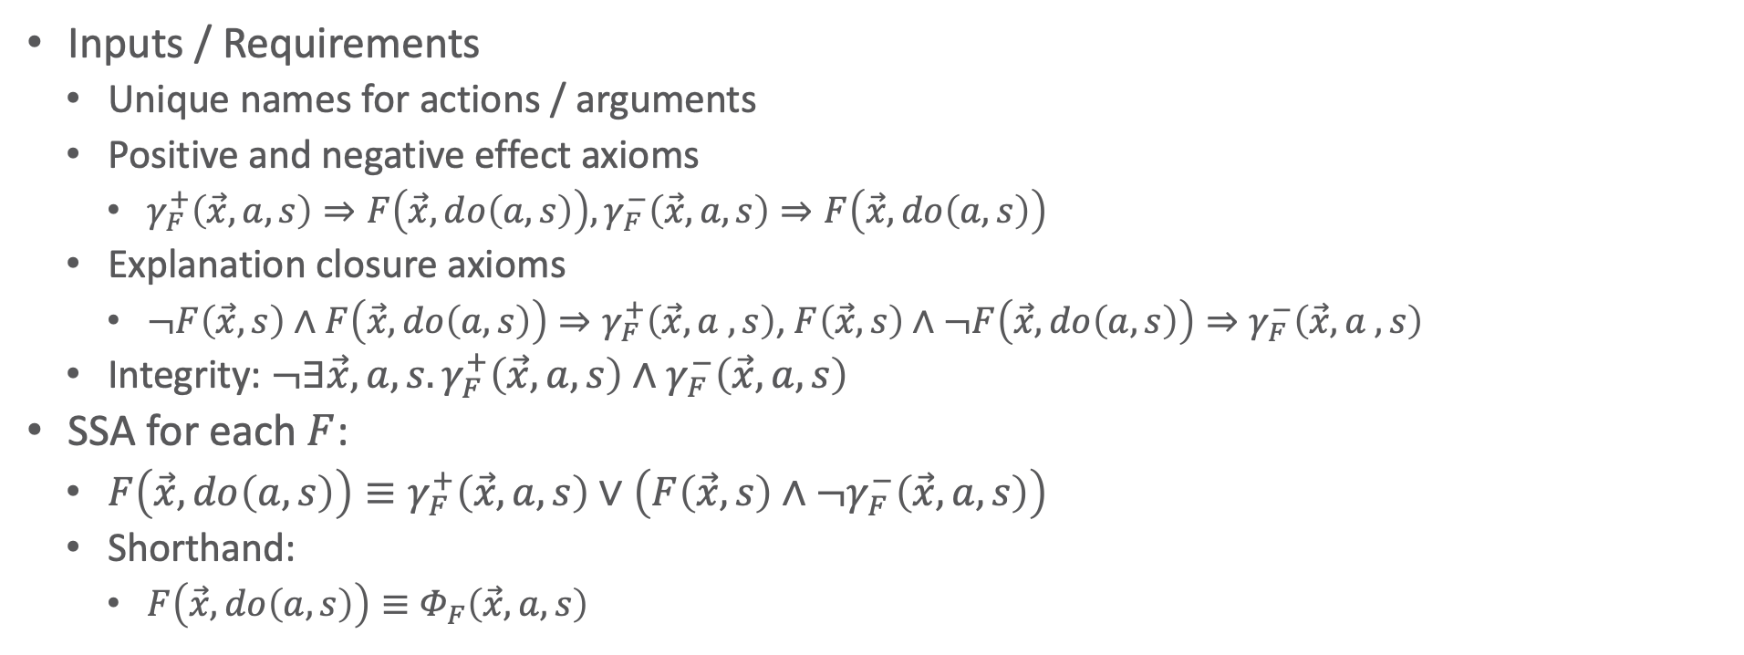
Successor State Axioms (SSAs)
Inputs / Requirements
  Unique names for actions / arguments
  Positive and negative effect axioms
    $γ_{F}^{+}\left(\vec{x},a,s\right)⇒F\left(\vec{x},do\left(a,s\right)\right),γ_{F}^{−}\left(\vec{x},a,s\right)⇒F\left(\vec{x},do\left(a,s\right)\right)$
  Explanation closure axioms
    $¬F\left(\vec{x}, s\right)∧F\left(\vec{x}, do\left(a,s\right)\right)⇒γ_{F}^{+}\left(\vec{x}, a ,s\right)$, $F\left(\vec{x}, s\right)∧¬F\left(\vec{x}, do\left(a,s\right)\right)⇒γ_{F}^{−}\left(\vec{x}, a ,s\right)$
  Integrity: $¬∃\vec{x},a,s.γ_{F}^{+}\left(\vec{x},a,s\right)∧γ_{F}^{−}\left(\vec{x},a,s\right)$
SSA for each $F$:
  $F\left(\vec{x},do\left(a,s\right)\right)≡γ_{F}^{+}\left(\vec{x},a,s\right)∨\left(F\left(\vec{x},s\right)∧¬γ_{F}^{−}\left(\vec{x},a,s\right)\right)$
  Shorthand:
    $F\left(\vec{x},do\left(a,s\right)\right)≡Φ_{F}\left(\vec{x},a,s\right)$

Slide 33
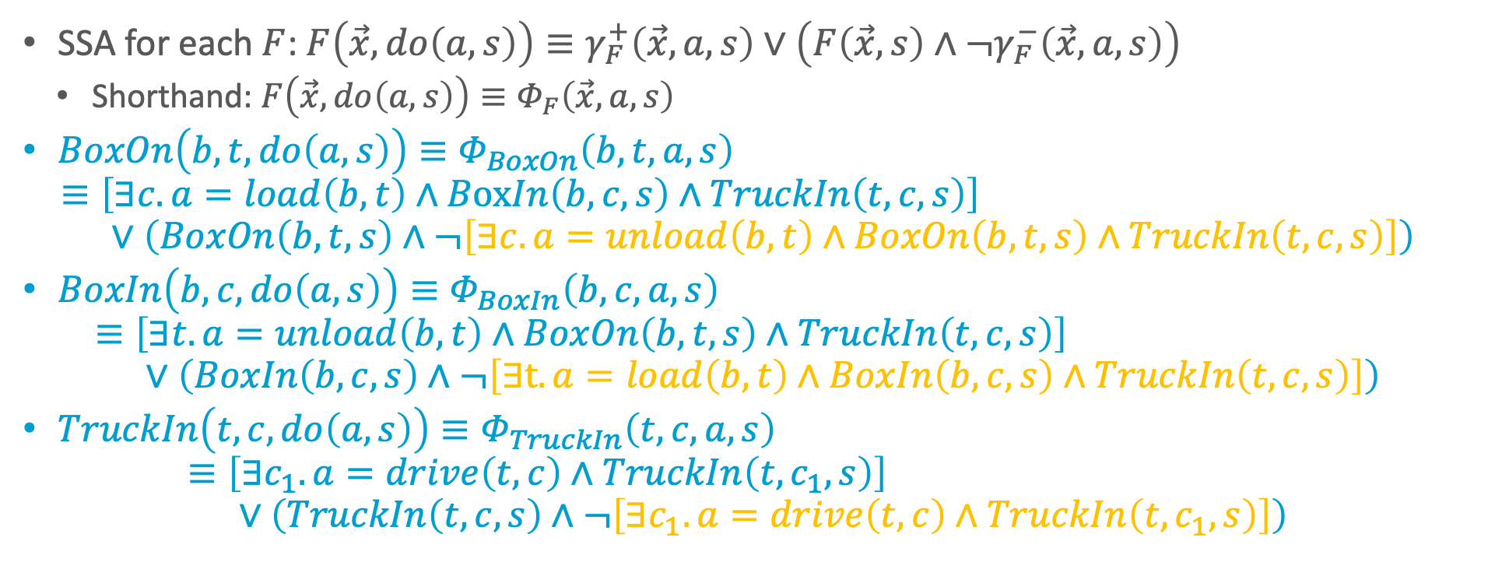
Successor State Axioms (SSAs): Example
SSA for each $F$: $F\left(\vec{x},do\left(a,s\right)\right)≡γ_{F}^{+}\left(\vec{x},a,s\right)∨\left(F\left(\vec{x},s\right)∧¬γ_{F}^{−}\left(\vec{x},a,s\right)\right)$
  Shorthand: $F\left(\vec{x},do\left(a,s\right)\right)≡Φ_{F}\left(\vec{x},a,s\right)$
$BoxOn\left(b,t,do\left(a,s\right)\right)≡Φ_{BoxOn}\left(b,t,a,s\right)$
$≡\left[∃c. a=load\left(b,t\right)∧BoxIn\left(b, c,s\right)∧TruckIn\left(t, c,s\right)\right]$
$∨\left(BoxOn\left(b,t,s\right)∧¬\left[∃c. a=unload\left(b,t\right)∧BoxOn\left(b, t,s\right)∧TruckIn\left(t, c,s\right)\right]\right)$
$BoxIn\left(b,c,do\left(a,s\right)\right)≡Φ_{BoxIn}\left(b,c,a,s\right)$
$≡\left[∃t. a=unload\left(b,t\right)∧BoxOn\left(b, t,s\right)∧TruckIn\left(t, c,s\right)\right]$
$∨\left(BoxIn\left(b,c,s\right)∧¬\left[∃t. a=load\left(b,t\right)∧BoxIn\left(b, c,s\right)∧TruckIn\left(t, c,s\right)\right]\right)$
$TruckIn\left(t,c,do\left(a,s\right)\right)≡Φ_{TruckIn}\left(t,c,a,s\right)$
$≡\left[∃c_{1}. a=drive\left(t,c\right)∧TruckIn\left(t, c_{1},s\right)\right]$
$∨\left(TruckIn\left(t,c,s\right)∧¬\left[∃c_{1}. a=drive\left(t,c\right)∧TruckIn\left(t, c_{1},s\right)\right]\right)$

Slide 34
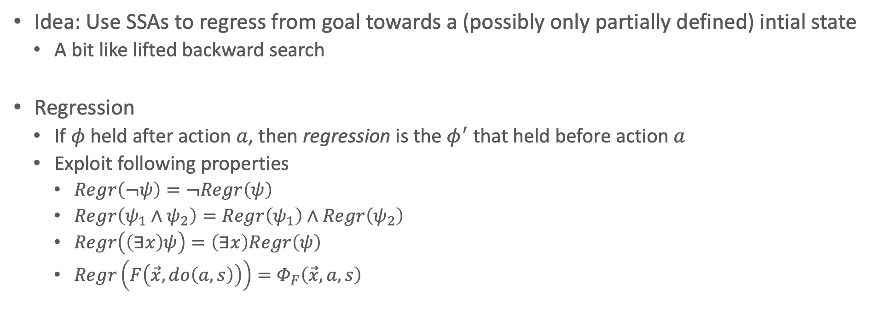
Regression
Idea: Use SSAs to regress from goal towards a (possibly only partially defined) intial state
  A bit like lifted backward search
Regression
  If $φ$ held after action $a$, then regression is the $φ^{′}$ that held before action $a$
  Exploit following properties
    $Regr\left(¬ψ\right)=¬Regr\left(ψ\right)$
    $Regr\left(ψ_{1}∧ψ_{2}\right)=Regr\left(ψ_{1}\right)∧Regr\left(ψ_{2}\right)$
    $Regr\left(\left(∃x\right)ψ\right)=\left(∃x\right)Regr\left(ψ\right)$
    $Regr\left(F\left(\vec{x}, do\left(a,s\right)\right)\right)=Φ_{F}\left(\vec{x},a,s\right)$

Slide 35

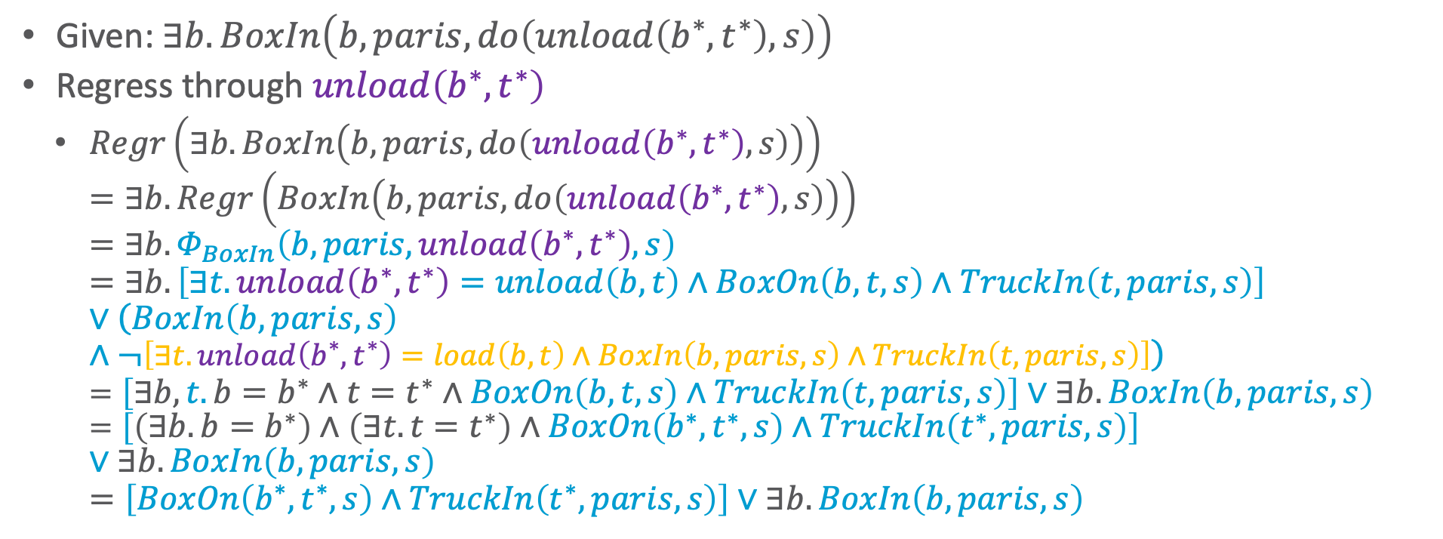
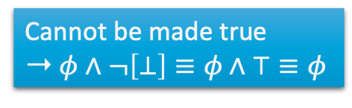
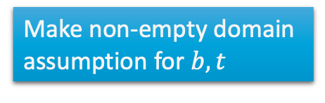
Regression: Example
  If $φ$ held after action $a$, then regression is the $φ^{′}$ that held before action $a$
  Exploit following properties
    $Regr\left(¬ψ\right)=¬Regr\left(ψ\right)$
    $Regr\left(ψ_{1}∧ψ_{2}\right)=Regr\left(ψ_{1}\right)∧Regr\left(ψ_{2}\right)$
    $Regr\left(\left(∃x\right)ψ\right)=\left(∃x\right)Regr\left(ψ\right)$
    $Regr\left(F\left(\vec{x}, do\left(a,s\right)\right)\right)=Φ_{F}\left(\vec{x},a,s\right)$
Given: $∃b.BoxIn\left(b, paris,do\left(unload\left(b^{∗},t^{∗}\right),s\right)\right)$
Regress through $unload\left(b^{∗},t^{∗}\right)$
  $Regr\left(∃b.BoxIn\left(b, paris,do\left(unload\left(b^{∗},t^{∗}\right),s\right)\right)\right)$
  $=∃b.Regr\left(BoxIn\left(b, paris,do\left(unload\left(b^{∗},t^{∗}\right),s\right)\right)\right)$
  $=∃b.Φ_{BoxIn}\left(b,paris,unload\left(b^{∗},t^{∗}\right),s\right)$
  $=∃b.\left[∃t. unload\left(b^{∗},t^{∗}\right)=unload\left(b,t\right)∧BoxOn\left(b, t,s\right)∧TruckIn\left(t, paris,s\right)\right]∨\left(BoxIn\left(b,paris,s\right)∧¬\left[∃t. unload\left(b^{∗},t^{∗}\right)=load\left(b,t\right)∧BoxIn\left(b, paris,s\right)∧TruckIn\left(t, paris,s\right)\right]\right)$
  $=\left[∃b,t. b=b^{∗}∧t=t^{∗}∧BoxOn\left(b, t,s\right)∧TruckIn\left(t, paris,s\right)\right]∨∃b.BoxIn\left(b,paris,s\right)$
  $=\left[\left(∃b. b=b^{∗}\right)∧\left(∃t.t=t^{∗}\right)∧BoxOn\left(b^{∗}, t^{∗},s\right)∧TruckIn\left(t^{∗}, paris,s\right)\right]∨∃b.BoxIn\left(b,paris,s\right)$
  $=\left[BoxOn\left(b^{∗},t^{∗},s\right)∧TruckIn\left(t^{∗},paris,s\right)\right]∨∃b.BoxIn\left(b,paris,s\right)$
Cannot be made true
➝ $φ∧¬\left[⊥\right]≡φ∧⊤≡φ$
Make non-empty domain assumption for $b,t$

Slide 36
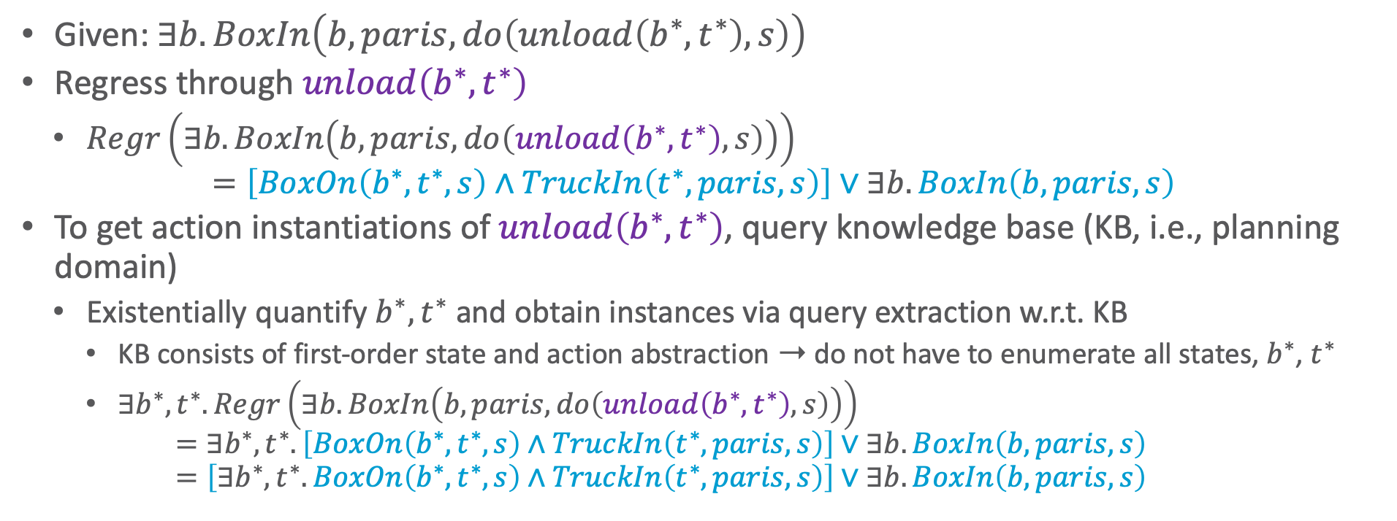
Regression: Example
Given: $∃b.BoxIn\left(b, paris,do\left(unload\left(b^{∗},t^{∗}\right),s\right)\right)$
Regress through $unload\left(b^{∗},t^{∗}\right)$
  $Regr\left(∃b.BoxIn\left(b, paris,do\left(unload\left(b^{∗},t^{∗}\right),s\right)\right)\right)$
  $=\left[BoxOn\left(b^{∗},t^{∗},s\right)∧TruckIn\left(t^{∗},paris,s\right)\right]∨∃b.BoxIn\left(b,paris,s\right)$
To get action instantiations of $unload\left(b^{∗},t^{∗}\right)$, query knowledge base (KB, i.e., planning domain)
  Existentially quantify $b^{∗},t^{∗}$ and obtain instances via query extraction w.r.t. KB
    KB consists of first-order state and action abstraction ➝ do not have to enumerate all states, $b^{∗}$, $t^{∗}$
    $∃b^{∗},t^{∗}.Regr\left(∃b.BoxIn\left(b, paris,do\left(unload\left(b^{∗},t^{∗}\right),s\right)\right)\right)$
    $=∃b^{∗},t^{∗}.\left[BoxOn\left(b^{∗},t^{∗},s\right)∧TruckIn\left(t^{∗},paris,s\right)\right]∨∃b.BoxIn\left(b,paris,s\right)$
    $=\left[∃b^{∗},t^{∗}.BoxOn\left(b^{∗},t^{∗},s\right)∧TruckIn\left(t^{∗},paris,s\right)\right]∨∃b.BoxIn\left(b,paris,s\right)$

Slide 37

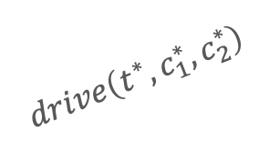
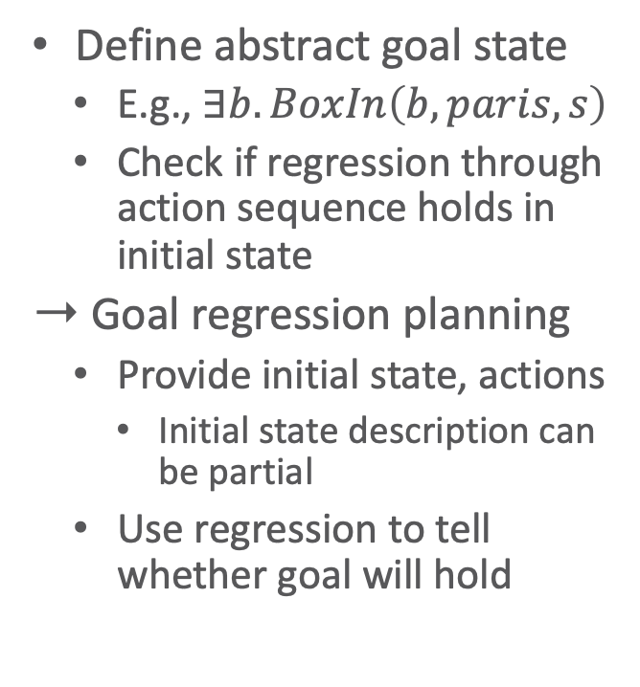
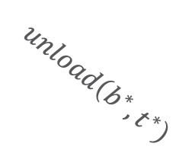

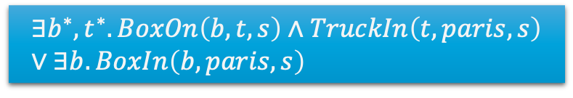
Regression Planning
Define abstract goal state
  E.g., $∃b.BoxIn\left(b,paris,s\right)$
  Check if regression through action sequence holds in initial state
Goal regression planning
  Provide initial state, actions
    Initial state description can be partial
  Use regression to tell whether goal will hold
…
$$∃b^{∗},t^{∗}.BoxOn\left(b,t,s\right)∧TruckIn\left(t,paris,s\right) \\ ∨∃b.BoxIn\left(b,paris,s\right)$$
Captures initial state?
…
$$unload\left(b^{∗},t^{∗}\right)$$
$$∃b.BoxIn\left(b,paris,s\right)$$
$$drive\left(t^{∗},c_{1}^{∗},c_{2}^{∗}\right)$$
Goal State: Captures initial state?
…
$$∃b.BoxIn\left(b,paris,s\right)$$
Captures initial state?
…

Slide 38
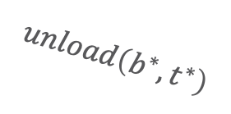
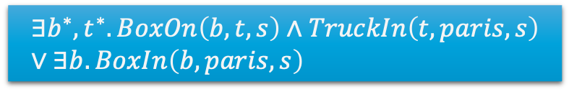
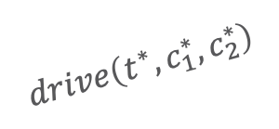
Progression and Forward Search?
Can we do lifted forward-search planning?
Progression not first-order definable! (Reiter, 2001)
Could progress ground state
  But this does not exploit first-order structure
?
Captures goal state?
$$drive\left(t^{∗},c_{1}^{∗},c_{2}^{∗}\right)$$
$$∃b^{∗},t^{∗}.BoxOn\left(b,t,s\right)∧TruckIn\left(t,paris,s\right) \\ ∨∃b.BoxIn\left(b,paris,s\right)$$
$$unload\left(b^{∗},t^{∗}\right)$$
?
Captures goal state?
Intial State: Captures goal state?

Slide 39
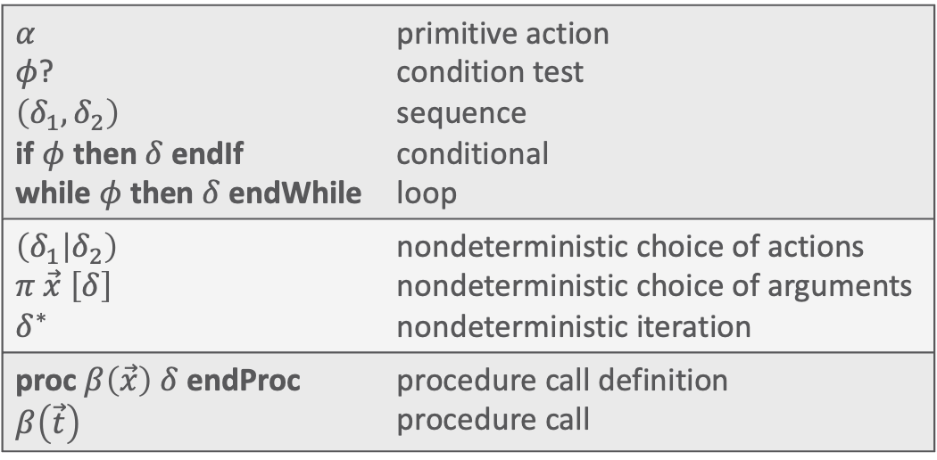
Golog: Restricted Plan Search
AlGOl in LOGic
  Search the space of sequential action plans
  Regress actions to initial state to test reachability
  Restrict action space with program:
$α$ $φ$? $\left(δ_{1},δ_{2}\right)$ if $φ$ then $δ$ endIf while $φ$ then $δ$ endWhile | primitive action condition test sequence conditional loop
$\left(δ_{1} | δ_{2}\right)$ $π \vec{x} \left[δ\right]$ $δ^{∗}$ | nondeterministic choice of actions nondeterministic choice of arguments nondeterministic iteration
proc $β\left(\vec{x}\right) δ$ endProc $β\left(\vec{t}\right)$ | procedure call definition procedure call

Slide 40
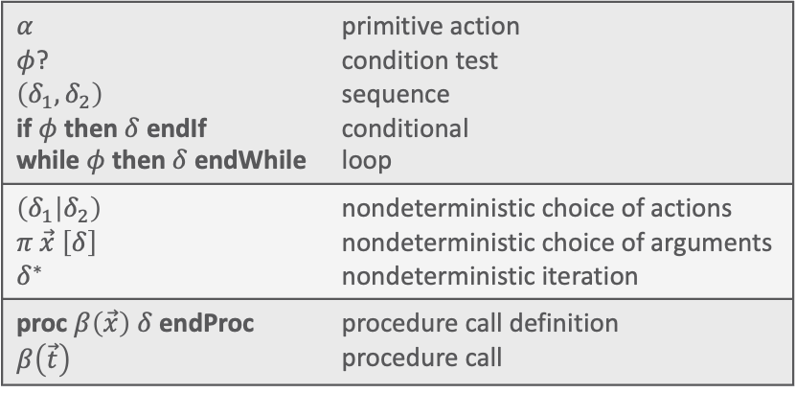
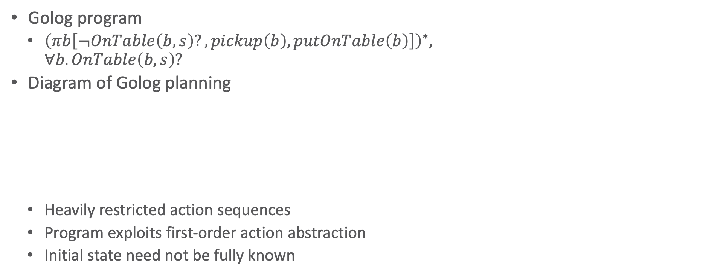
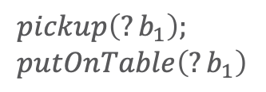
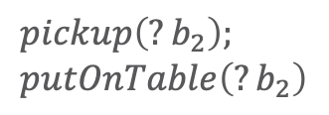

Golog: Example
$α$ $φ$? $\left(δ_{1},δ_{2}\right)$ if $φ$ then $δ$ endIf while $φ$ then $δ$ endWhile | primitive action condition test sequence conditional loop
$\left(δ_{1} | δ_{2}\right)$ $π \vec{x} \left[δ\right]$ $δ^{∗}$ | nondeterministic choice of actions nondeterministic choice of arguments nondeterministic iteration
proc $β\left(\vec{x}\right) δ$ endProc $β\left(\vec{t}\right)$ | procedure call definition procedure call
Golog program
  ${\left(πb\left[¬OnTable\left(b,s\right)?,pickup\left(b\right),putOnTable\left(b\right)\right]\right)}^{∗},$
  $∀b.OnTable\left(b,s\right)?$
Diagram of Golog planning
  Heavily restricted action sequences
  Program exploits first-order action abstraction
  Initial state need not be fully known
Initial State
$$pickup\left(?b_{1}\right); \\ putOnTable\left(?b_{1}\right)$$
$$pickup\left(?b_{2}\right); \\ putOnTable\left(?b_{2}\right)$$
$$∃b.¬OnTable\left(b,s\right)?$$
Initial state?
Initial state?

Slide 41
Frame Problem
Frame problem: How to (compactly) specify what does not change?
  Intuition: “What does not change, remains the same.”
    Reiter’s so-called Default Solution
  Not so easy to specify
    Moving one thing might move another thing, even though the other thing is never directly touched
    How to distinguish between relevant and irrelevant side effects? And use that efficiently?
Default solution to frame problem given as successor state axioms (SSAs), which we construct next

Slide 42
Interim (Interim) Summary
Situation calculus to describe a relational world
  Can convert PDDL (and state-variable domains) into effect axioms
  Derive SSAs from effect axioms
    Using default solution to frame problem
Regression operator
  Extract action instantiation to achieve goal
Regression planning
  Initial state need not be fully specified
  Exploit state and action abstraction
    Avoid enumerating all state and action instances
Frame problem
Next step: Extend this idea for decision-theoretic planning with uncertain action outcomes

Slide 43

First-order MDPs
$$rCase\left(s\right)=$$ | $$∀b,c.Dest\left(b,c\right)⇒BoxIn\left(b,c,s\right)$$ | $$1$$
 | $$¬\left(∀b,c.Dest\left(b,c\right)⇒BoxIn\left(b,c,s\right)\right)$$ | $$0$$
Structure by Relations in the State Space

Slide 44



First-order MDP (FOMDP)
🚚
🛩️
Components of MDP in an FOMDP specified as
a collection of case statements
  E.g., express reward in Box World FOMDP as
Operators: define unary and binary case operations
  E.g., cross-sum $⊕$ (or $⊖$, $⊗$) of cases
Paris
Moscow
London
Berlin
📦
🚚
Rome
📦
$$rCase\left(s\right)=$$ | $$∀b,c.Dest\left(b,c\right)⇒BoxIn\left(b,c,s\right)$$ | $$1$$
 | $$¬\left(∀b,c.Dest\left(b,c\right)⇒BoxIn\left(b,c,s\right)\right)$$ | $$0$$
 |  |  |  |  |  | $$φ∧φ$$ | $$10+3$$
$$φ$$ | $$10$$ | $$⊕$$ | $$φ$$ | $$3$$ | $$=$$ | $$φ∧¬φ$$ | $$10+4$$
$$¬φ$$ | $$20$$ |  | $$¬φ$$ | $$4$$ |  | $$¬φ∧φ$$ | $$20+3$$
 |  |  |  |  |  | $$¬φ∧¬φ$$ | $$20+4$$

Slide 45




Stochastic Actions and First-order Decision-theoretic Regression (FODTR)
Stochastic actions using deterministic situation calculus
  User’s stochastic action, e.g., $A\left(x\right)=load\left(b,t\right)$
  Nature’s choice, e.g., $n\left(x\right)∈\left\{loadS\left(b,t\right),loadF\left(b,t\right)\right\}$
  Probability distribution over nature’s choice, e.g.,
First-order decision-theoretic regression (FODTR)
  FODTR = expectation of regression:
  $$FODTR\left[vCase\left(s\right),A\left(\vec{x}\right)\right]=E_{P(n\left(\vec{x}\right)|A\left(\vec{x}\right))}\left[Regr\left(vCase\left(s\right),n\left(\vec{x}\right)\right)\right]$$
Probability distribution ➝ Adds up to 1 over success and failure choice
$$0.1+0.9=1$$
$$0.6+0.4=1$$
$$P\left(loadS\left(b,t\right) | load\left(b,t\right)\right)=$$ | $$snow\left(s\right)$$ | $$0.1$$
 | $$¬snow\left(s\right)$$ | $$0.6$$
$$P\left(loadF\left(b,t\right) | load\left(b,t\right)\right)=$$ | $$snow\left(s\right)$$ | $$0.9$$
 | $$¬snow\left(s\right)$$ | $$0.4$$
Notes:
S = Success
F = Failure
vCase: instance of value function in case statement form

Slide 46




FODTR & Q-Functions
Result of FODTR is a case statement encoding a first-order Q-function
  $$FODTR\left[vCase\left(s\right),A\left(\vec{x}\right)\right]=R\left(s\right)⊕γ⨁_{j=1}^{k}{P\left(n_{j}\left(\vec{x}\right),A\left(\vec{x}\right),s\right)⊗Regr\left(V\left(do\left(n_{j}\left(\vec{x}\right)\right),s\right)\right)}$$
  E.g.,
$$FODTR\left[vCase\left(s\right),unload\left(b^{∗},t^{∗}\right)\right] \\ =rCase\left(s\right)⊕γ⨁_{j=1}^{k}{pCase\left(n_{j}\left(\vec{x}\right),unload\left(b^{∗},t^{∗}\right),s\right)}$$
$$rCase\left(s\right)=$$ | $$∃b. BoxIn\left(b,paris,s\right)$$ | $$10$$
 | $$¬\left(∃b. BoxIn\left(b,paris,s\right)\right)$$ | $$0$$
$$pCase\left(loadS\left(b,t\right),load\left(b,t\right),s\right)=$$ | $$⊤$$ | $$0.9$$
$$⊗$$ | $$Regr\left(∃b. BoxIn\left(b,paris,do\left(n_{j}\left(\vec{x}\right),s\right)\right)\right)$$ | $$10$$
 | $$Regr\left(¬∃b. BoxIn\left(b,paris,do\left(n_{j}\left(\vec{x}\right),s\right)\right)\right)$$ | $$0$$
$$pCase\left(unloadS\left(b,t\right),unload\left(b,t\right),s\right)=$$ | $$⊤$$ | $$0.9$$
$$pCase\left(driveS\left(c,t\right),drive\left(c,t\right),s\right)=$$ | $$⊤$$ | $$1$$

Slide 47






FODTR & Q-Functions
$$FODTR\left[vCase\left(s\right),unload\left(b^{∗},t^{∗}\right)\right] \\ =rCase\left(s\right)⊕γ⨁_{j=1}^{k}{pCase\left(n_{j}\left(\vec{x}\right),unload\left(b^{∗},t^{∗}\right),s\right)} \\ = \\ = \\ = \\ =rCase\left(s\right)⊕γ$$
$$⊗$$ | $$Regr\left(∃b. BoxIn\left(b,paris,do\left(n_{j}\left(\vec{x}\right),s\right)\right)\right)$$ | $$10$$
 | $$Regr\left(¬∃b. BoxIn\left(b,paris,do\left(n_{j}\left(\vec{x}\right),s\right)\right)\right)$$ | $$0.0$$
$$⊗$$ | $$Regr\left(∃b. BoxIn\left(b,paris,do\left(unloadS\left(b^{∗},t^{∗}\right),s\right)\right)\right)$$ | $$10$$
 | $$Regr\left(¬∃b. BoxIn\left(b,paris,do\left(unloadS\left(b^{∗},t^{∗}\right),s\right)\right)\right)$$ | $$0.0$$
$$⊤$$ | $$0.9$$
$$⊗$$ | $$Regr\left(∃b. BoxIn\left(b,paris,do\left(unloadF\left(b^{∗},t^{∗}\right)\right)\right)\right)$$ | $$10$$
 | $$Regr\left(¬∃b. BoxIn\left(b,paris,do\left(unloadF\left(b^{∗},t^{∗}\right)\right)\right)\right)$$ | $$0.0$$
$$⊕$$ | $$⊤$$ | $$0.1$$

Slide 48




FODTR & Q-Functions
$$FODTR\left[vCase\left(s\right),unload\left(b^{∗},t^{∗}\right)\right] \\ =rCase\left(s\right)⊕γ⨁_{j=1}^{k}{pCase\left(n_{j}\left(\vec{x}\right),unload\left(b^{∗},t^{∗}\right),s\right)} \\ = \\ = \\ = \\ = \\ = \\ = \\ = \\ = \\ = \\ =$$
$$⊗$$ | $$Regr\left(∃b. BoxIn\left(b,paris,do\left(n_{j}\left(\vec{x}\right),s\right)\right)\right)$$ | $$10$$
 | $$Regr\left(¬∃b. BoxIn\left(b,paris,do\left(n_{j}\left(\vec{x}\right),s\right)\right)\right)$$ | $$0.0$$
$$∃b. BoxIn\left(b,paris,s\right)$$ | $$10$$
$$¬“$$ | $$0.0$$
$$⊕$$ | $$∃b. BoxIn\left(b,paris,s\right)$$ | $$9.0$$
 | $$¬“$$ | $$0.0$$
$$⊕$$ | $$∃b^{∗},t^{∗}.BoxOn\left(b,t,s\right)∧TruckIn\left(t,paris,s\right)∨∃b.BoxIn\left(b,paris,s\right)$$ | $$8.1$$
 | $$¬“$$ | $$0.0$$
$$∃b.BoxIn\left(b,paris,s\right)$$ | $$19.0$$ | ➝ $noop$
$$¬“∧\left[∃b,t.BoxOn\left(b,t,s\right)∧TruckIn\left(t,paris,s\right)\right]$$ | $$8.1$$ | ➝ $unload\left(b^{∗},t^{∗}\right)$
$$¬“$$ | $$0.0$$ | ➝ $noop$
Notes:
unloadF = noop

Slide 49







Symbolic Dynamic Programming (SDP)
What value if 0-stages-to-go?
  Immediate reward: $V^{0}\left(s\right)=rCase\left(s\right)$
What value if 1-state-to-go?
  We know value for each action ➝ Take maximum for each state
Value iteration
  Obtain $V^{n+1}$ from $V^{n}$ until $\left(V^{n−1}⊖V^{n}\right)<ε$
$$V^{1}\left(s\right)=\max_{s}\left\{\begin{aligned} \\ \\ \\ \\ \\ \\ \end{aligned}\right.$$ | $$φ_{1}$$ | $$9$$ | $$=V^{0}\left(s,A_{1}\right)$$
 | $$φ_{2}$$ | $$0$$
 | $$φ_{3}$$ | $$3$$ | $$=V^{0}\left(s,A_{2}\right)$$
 | $$φ_{4}$$ | $$1$$
$V^{1}\left(s\right)=$ | $$φ_{1}$$ | $$9$$ | $$=V^{0}\left(s,A_{1}\right)$$
 | $$φ_{2}$$ | $$0$$
 | $$φ_{3}$$ | $$3$$ | $$V^{0}\left(s,A_{2}\right)$$
 | $$φ_{4}$$ | $$1$$
$$φ_{1}$$ | $$9$$
else $φ_{3}$ | $$3$$
else $φ_{4}$ | $$1$$
else $φ_{2}$ | $$0$$
$$φ_{1}$$ | $$9$$
else $φ_{3}$ | $$3$$
else $φ_{4}$ | $$1$$
$$φ_{1}$$ | $$9$$
else $φ_{3}$ | $$3$$
$$φ_{1}$$ | $$9$$

Slide 50





Value Iteration for $t=1,2$ of the Box World Example
With increasing iterations, the sequence of
actions considered gets longer
$$∃b.BoxIn\left(b,paris,s\right)$$ | $$19.0$$
$$¬“∧\left[∃c.BoxOn\left(b,t,s\right)∧TruckIn\left(t^{∗},paris,s\right)\right]$$ | $$8.1$$
$$¬“$$ | $$0.0$$
$${vCase}^{1}\left(s\right)=$$
$$∃b.BoxIn\left(b,paris,s\right)$$ | $$26.1$$
$$¬“∧\left[∃b,t.BoxOn\left(b,t,s\right)∧TruckIn\left(t,paris,s\right)\right]$$ | $$15.4$$
$$¬“∧\left[∃b,c,t.BoxOn\left(b,t,s\right)∧TruckIn\left(t,c,s\right)\right]$$ | $$7.3$$
$$¬“$$ | $$0.0$$
$${vCase}^{2}\left(s\right)=$$
Notes:
unloadF = noop

Slide 51













First-order Algebraic Decision Diagrams (FOADDs)
We want to compactly represent arbitrary case statements
  E.g.,
Push down quantifiers, expose propositional structure ➝ convert into FOADD
  $$\left[∃x.A\left(x\right)\right]∨\left(\left[∃x.A\left(x\right)∧B\left(x\right)\right]∧\left[∀y. ¬A\left(y\right)\right]\right)$$
$$case\left(s\right)=$$ | $$∃x.\left[A\left(x\right)∨∀y.A\left(x\right)∧B\left(x\right)∧¬A\left(y\right)\right]$$ | $$1$$
 | $$¬\left(∃x.\left[A\left(x\right)∨∀y.A\left(x\right)∧B\left(x\right)∧¬A\left(y\right)\right]\right)$$ | $$0$$
$$a$$
Variable | Variable $⇔$ FOL KB
$$a$$ | $$≡\left[∃x.A\left(x\right)\right]$$
$$b$$ | $$≡\left[∃x.A\left(x\right)∧B\left(x\right)\right]$$
$$a$$
$$case\left(s\right)=$$ | $$a∨\left(b∧¬a\right)$$ | $$1$$
 | $$¬\left(a∨\left(b∧¬a\right)\right)$$ | $$0$$
$$case\left(s\right)=$$
$$b$$
$$=$$
$$1$$
$$0$$
$$1$$
$$0$$
First-order context-specific independence
Notes:
If a is false, then there is not x such that A(x). That means that b can also not be true as it asks for an x such that A(x) and B(x) are true, where we already know that A(x) cannot be true und thus the conjunction can never be true

Slide 52















Results for SDP with FOADDs
$$∃b.BoxIn\left(b,paris,s\right)$$
Encode case statements with FOADDs
  Solid line: true case
  Dotted line: false case
Use FOADD operations for structured SDP
  E.g., Box World
    Using $γ=0.9$
$$rCase\left(s\right)=$$
$$10$$
$$0$$
$$vCase\left(s\right)=$$
$$∃b.BIn\left(b,paris,s\right)$$
$$100 :noop$$
$$∃b,t.TIn\left(b,paris,s\right)∧BOn\left(b,t,s\right)$$
$$89 :unload\left(b,t\right)$$
$$∃b,t.BOn\left(b,t,s\right)$$
$$80 :drive\left(t,paris\right)$$
$$∃b,c.BIn\left(b,c,s\right)∧∃t.TIn\left(t,c,s\right)$$
Factored SDP for factored FOMDPs
[Sanner and Boutilier, 2007]
$$72 :load\left(b,t\right)$$
$$…$$

Slide 53
Correctness of SDP
Show SDP for FOMDPs is correct w.r.t. ground MDP
FOMDP Value
Function
FOMDP
Lifted FOMDP Solution
Ground
Ground
Ground
MDP
Ground MDP
Value Function
Ground MDP Solution

Slide 54



Caveats of First-order Planning
🚚
🛩️
Many problems have topologies
  E.g., reachability constraints in logistics
If topology not fixed a priori
  First-order solution must consider $∞$ topologies
  In general case, leads to $∞$ values / policies
    Universal rewards
    Value function must distinguish $∞$ cases
    Policy will also likely be $∞$
Paris
Moscow
London
Berlin
📦
🚚
Rome
📦
$$rCase\left(s\right)=$$ | $$∀b,c.Dest\left(b,c\right)⇒BoxIn\left(b,c,s\right)$$ | $$1$$
 | $$¬\left(∀b,c.Dest\left(b,c\right)⇒BoxIn\left(b,c,s\right)\right)$$ | $$0$$
$$V^{t}\left(s\right)=$$ | $$∀b,c.Dest\left(b,c\right)⇒BoxIn\left(b,c,s\right)$$ | $$1$$
 | One box not at destination | $$γ$$
 | Two boxes not at destination | $$γ^{2}$$
 | $$⋮$$ | $$⋮$$
 | $t−1$ boxes not at destination | $$γ^{t−1}$$

Slide 55
Caveats of First-order Planning
Unreachable states
  PDDL domains often under-constrained
    E.g., logistics: one box cannot be in two cities at once
  Constraints implicitly obeyed in initial state
    Action effects cannot violate constraints
      Reachable legal states are small subset of all states
    But (P)PDDL does not constrain legal states
If no background theory to restrict legal states
  First-order planning must solve for all states
    When initial state unknown
  Where majority of states are actually illegal
First-order planning w/o initial state solves more difficult problem than search-based solutions
  Initial state contains implicit constraint information
  Reachable state space is small subset of all states
Suggests need for hybrid
first-order / search-based approaches

Slide 56
A Note on First-order Modelling in Reinforcement Learning
Novel propositional situations worth exploring may be instances of a well-known context in the relational setting ➝ exploitation promising
  E.g., household robot learning water-taps
    Having opened one or two water-taps in a kitchen, one can expect other water-taps in kitchens to work similarly
    Priority for exploring water-taps in kitchens in general reduced
    Information gathered likely to carry over to water-taps in other places
    Hard to model in propositional setting: each water-tap is novel

Slide 57
Interim Summary
FOMDPs are one model for lifted decision-theoretic planning
  Exploit state and action abstraction for MDPs
Use situation calculus specified action theory
Use case statements to represent reward, probabilities
Symbolic dynamic programming = lifted DP
  Use FOADDs to compactly represent case statements
  First-order context-specific independence to compactify FOADDs

Slide 58
Outline: Decision Making – Structure
Structure by Groups in the Agent Set
  Agent types
  Partitioned decPOMDPs
Structure by Relations in the State Space
  Situation calculus
  First-order MDPs
Structure by Features in the State Space
  Dynamic Bayesian networks
  Factored MDPs

Slide 59

State Space
Often has structure
  Not just a black box with $n$ states, leading to a probability distribution $T\left(s^{′},s,a\right)=P\left(s^{′} | s,a\right)$
  Can be structured by relations (FO MDPs), regularities (robot navigation; harbour management)
Generally, $n$ different features that describe a state space
  Encode in $n$ individual random variables $S_{i}$ with respective domains $dom\left(S_{i}\right)=\left\{v_{1}, …,v_{d_{i}}\right\}$
    State space size then describable as $\left|S\right|=\prod_{i}{d_{i}}≤d^{n}, d=\max_{i}{d_{i}}$
      I.e., exponential in the number of random variables
Given (conditional) independences between different $S_{i}$, factorisation of probability distributions in model possible
  Applicable to MDPs, POMDPs, DecPOMDPs, partitioned DecPOMDPs
  Most work exists for factored MDPs (also the simplest case to consider)

Slide 60

Factorisation in General
(Conditional) independences:
  $A⊥B$ ($A,B$ independent) ⇔ $P\left(A,B\right)=P\left(A\right)⋅P\left(B\right)$
  $A⊥B | C$ ($A,B$ conditionally independent given $C$) ⇔ $P\left(A,B | C\right)=P\left(A | C\right)⋅P\left(B | C\right)$
    Alternate version: $A⊥B | C \text{⇔} P\left(A | B,C\right)=P\left(A | C\right)$
(Conditional) independences allow for factorising a distribution into smaller factors
  In general: Factorisation of a full joint probability distribution $P\left(S_{1},…, S_{n}\right)$ into $m$ factors over subsets $C$ of random variables that form $P\left(S_{1},…, S_{n}\right)$ after multiplication (and normalisation):
$$P\left(S_{1},…, S_{n}\right)=\frac{1}{Z}\prod_{j=1}^{m}{φ\left(C_{j}\right)}$$
    Where $C_{j}$ refers to sets of random variables that are mutually dependent on each other
    Memory complexity: $𝒪\left(d^{n}\right)$ vs. $𝒪\left(m⋅d^{\left|C_{max}\right|}\right)$

Slide 61












Probabilistic Graphical Models (PGMs)
PGMs use a graph structure to represent dependences
  Common formalism: Bayesian network (BN) $B$
    Directed acyclic graph
      Nodes: random variables $S_{i}$
      Edges: if $S_{i}$ depends on $S_{j}$, edge $S_{j}⟶S_{i}$
    Factors: conditional probability distributions (CPDs) $∀i P\left(S_{i} | pa\left(S_{i}\right)\right)$
      Roots: $pa\left(S_{i}\right)=∅$ ➝ Prior distributions $P\left(S_{i}\right)$
      Usually not depicted in graph; have to be denoted somewhere
      Semantics: $P\left(S_{1},…,S_{n}\right)=\prod_{i=1}^{n}{P\left(S_{i} | pa\left(S_{i}\right)\right)}$
  Not further considered here:
  Undirected version with potential functions $φ$ as factors:
    Factor graphs, Markov networks
    Same semantics, different graphical representation
$$P\left(Burglary\right)$$
$$P\left(Earthquake\right)$$
$$Burglary$$
$$Earthquake$$
  $$P\left(Alarm | Burglary,Earthquake\right)$$
$$Alarm$$
$$JohnCall$$
$$MaryCall$$
$$P\left(JohnCall | Alarm\right)$$
$$P\left(MaryCall | Alarm\right)$$
Full joint probability distribution size: $d^{5}$
Sizes of CPDs: $d+d+d^{3}+d^{2}+d^{2}$
Given $d=2$: $2^{5}=32$ vs. $20$
(As probabilities add to $1$:
size $−1$ for each probability distribution in each CPD,
i.e., $1+1+4+2+2=10$)

Slide 62

Dynamic Bayesian Networks
MDP models a sequential, i.e., temporal, stationary, Markovian probabilistic setting
  Factorisation also needs to encode a sequential, stationary, Markovian probabilistic setting
Popular modeling formalism used:
Dynamic BN (DBN) is a two-tuple $\left(B^{\left(0\right)},B^{\left(→\right)}\right)$
  Template variables $S_{i}$ indexed by time step $τ$ in BNs
  ➝ Can be instantiated for particular time steps $t$
  BN $B^{\left(0\right)}$ for time step $0$ to encode
    If set to uniform distributions or using DBN for fix point calculations, can be safely ignored
  BN $B^{\left(→\right)}$ for time step $τ$ with connections from time step $τ−1$ (copy pattern)
    Markov-$1$ ➝ Only connections from $τ−1$ to $τ$
    Stationary ➝ $B^{\left(→\right)}$ identical for all $t∈\left\{1,…\right\}$
  Semantics: unroll for $T$ time steps and multiply

Slide 63































Dynamic Bayesian Networks: Example
Left: vehicle localization task, where a moving car tries to track its current location using the data obtained from a, possibly faulty, sensor
Right: Toy example of a special case of a DBN with one latent and one observable variable (hidden Markov model, HMM)
$${Weather}^{\left(0\right)}$$
$${Weather}^{\left(τ−1\right)}$$
$${Weather}^{\left(τ\right)}$$
$$P\left(W^{\left(0\right)}\right)$$
$$P\left(W^{\left(τ\right)} | W^{\left(τ−1\right)}\right)$$
$${Rain}^{\left(0\right)}$$
$$P\left(r^{\left(0\right)}\right)$$
$$0.5$$
$${Velocity}^{\left(0\right)}$$
$${Velocity}^{\left(τ−1\right)}$$
$${Velocity}^{\left(τ\right)}$$
$$P\left(V^{\left(0\right)}\right)$$
$$P\left(V^{\left(τ\right)} | W^{\left(τ−1\right)},V^{\left(τ−1\right)}\right)$$
$${Rain}^{\left(τ−1\right)}$$
$${Rain}^{\left(τ\right)}$$
$${Location}^{\left(0\right)}$$
$${Location}^{\left(τ−1\right)}$$
$${Location}^{\left(τ\right)}$$
$$P\left(L^{\left(0\right)}\right)$$
$$P\left(L^{\left(τ\right)} | V^{\left(τ−1\right)},L^{\left(τ−1\right)}\right)$$
$${Umbrella}^{\left(τ\right)}$$
$${Failure}^{\left(0\right)}$$
$${Failure}^{\left(τ−1\right)}$$
$${Failure}^{\left(τ\right)}$$
$$P\left(F^{\left(0\right)}\right)$$
$$P\left(F^{\left(τ\right)} | W^{\left(τ−1\right)},F^{\left(τ−1\right)}\right)$$
$$R^{\left(t−1\right)}$$ | $$P\left(r^{\left(t\right)} | R^{\left(t−1\right)}\right)$$
$$true$$ | $$0.7$$
$$false$$ | $$0.3$$
$$R^{\left(t\right)}$$ | $$P\left(u^{\left(t\right)} | R^{\left(t\right)}\right)$$
$$true$$ | $$0.9$$
$$false$$ | $$0.2$$
$${Obs}^{\left(0\right)}$$
$${Obs}^{\left(τ\right)}$$
$$P\left(O^{\left(0\right)} | L^{\left(0\right)},F^{\left(0\right)}\right)$$
$$P\left(O^{\left(τ\right)} | L^{\left(τ\right)},F^{\left(τ\right)}\right)$$

Slide 64

Factored MDPs
MDP with its state space $S$ structured according to $S_{1},…,S_{n}$, which in general means that
  Transition probability distribution $T\left(S^{′},S,A\right)=P\left(S^{′} | S,A\right)$ is given by $T\left(S_{1}^{′},…,S_{n}^{′},S_{1},…,S_{n},A\right)=P\left(S_{1}^{′},…,S_{n}^{′} | S_{1},…,S_{n},A\right)$
    Or using the template notation: $T\left(S^{\left(τ\right)},S^{\left(τ−1\right)},A^{\left(τ−1\right)}\right)=P\left(S^{\left(τ\right)} | S^{\left(τ−1\right)},A^{\left(τ−1\right)}\right)$ is given by $T\left(S_{1}^{\left(τ\right)},…,S_{n}^{\left(τ\right)},S_{1}^{\left(τ−1\right)},…,S_{n}^{\left(τ−1\right)},A^{\left(τ−1\right)}\right)=P\left(S_{1}^{\left(τ\right)},…,S_{n}^{\left(τ\right)} | S_{1}^{\left(τ−1\right)},…,S_{n}^{\left(τ−1\right)},A^{\left(τ−1\right)}\right)$
    Note that the overall size of $T$ does not increase as the state space size is identical
  Given that $S_{1},…,S_{n}$ represent features of (hopefully weakly) connected parts of a system, $T$ can be factored according to (conditional) independences ➝ often represented using a DBN
    Factorisation of $T$:
    $$T\left(S^{′},S,A\right)=P\left(S_{1}^{′},…,S_{n}^{′} | S_{1},…,S_{n},A\right)=\prod_{i=1}^{n}{P\left(S_{i}^{′} | pa\left(S_{i}^{′}\right)\right)}= :T_{B}$$

Slide 65
Factored MDPs: Actions and Rewards
To be correct, the DBN just described is a standard DBN extended with random variable nodes for actions, whose assignment we want to determine, and reward nodes to denote that a reward function outputs a reward depending on the state (and action)
  BN extended with so-called decision and utility nodes called influence or decision diagram
    Side note: Since the state in MDPs is fully observable, every random variable in a DBN is observable, which is not the general case for DBNs, where usually there is a set of latent variables, which are never observed and as such often queried, and a set of evidence variables, which are usually observed (save for sensor failures).

Slide 66

Factored MDPs: Actions and Rewards
What about rewards?
If the reward remains a function over the complete state space without any factorisation, we have not gained much
But remember: Multi-attribute utility theory
  Reward function with preference independence between subsets of random variables
  ➝ additive reward function
    Factorisation of $R$:
    $$R\left(S\right)=R\left(S_{1},…,S_{n}\right)=\sum_{j=1}^{m}{R_{j}\left(C_{j}\right)}$$
      Best case $R\left(S_{1},…,S_{n}\right)=\sum_{i=1}^{n}{R_{i}\left(S_{i}\right)}$
    Compare factorisation of $T$: $T\left(S^{′},S,A\right)=P\left(S_{1}^{′},…,S_{n}^{′} | S_{1},…,S_{n},A\right)=\prod_{i=1}^{n}{P\left(S_{i}^{′} | pa\left(S_{i}^{′}\right)\right)}$

Slide 67

Factored MDPs: Space Complexity
With a structured state space, representation size down
  Given
    State space with $n$ features and a maximum domain size of $d$
    DBN over $n$ features and a maximum domain size of $d$, with $c=\max_{i∈\left\{1,…,n\right\}}\left|pa\left(S_{i}\right)\right|+1$
    Given action space of size $a$
  Space complexity
    Transition function $T\left(S^{′}, S,A\right)$: $𝒪\left(d^{n}⋅a\right)$ vs. $𝒪\left(n⋅d^{c}⋅a\right)$
    Reward function $R\left(S\right)$: $𝒪\left(d^{n}\right)$ vs. $𝒪\left(n⋅d^{c}\right)$

Slide 68

Solving Factored MDPs
Bellman equation:
  $$U\left(s\right)=R\left(s\right)+γ\max_{a∈A\left(s\right)}{\sum_{s^{′}∈dom\left(S\right)}{P\left(s^{′} | a,s\right)U\left(s^{′}\right)}}$$
  Becomes
  $U\left(s_{1},…,s_{n}\right)$
  $$=\sum_{j=1}^{m}{R_{j}\left(C_{j}\right)}+γ\max_{a∈A\left(s_{1},…,s_{n}\right)}{\sum_{s_{1}^{′}∈dom\left(S_{1}\right)}{…\sum_{s_{n}^{′}∈dom\left(S_{n}\right)}{\prod_{i=1}^{N}{P\left(s_{i}^{\left(τ\right)} | pa\left(s_{i}^{\left(τ\right)}\right)\right)U\left(s_{1}^{′},…,s_{n}^{′}\right)}}}}$$
Unfortunately, a factored MDP does not induce a factored value function $U$
  One way to go: concentrate on value functions that have a factored representation
    Approximate the unfactored value function with a factored one

Slide 69

Linear Value Functions
Linear value function $𝒱$ over a set of basis functions $H=\left\{h_{1},…, h_{k}\right\}$
  Function $𝒱$ that can be written as $𝒱\left(s_{1},…,s_{n}\right)=\sum_{j=1}^{k}{w_{j}⋅h_{j}\left(s_{1},…,s_{n}\right)}$ for some coefficients $w={\left(w_{1},…,w_{k}\right)}^{′}$
    Let $ℋ$ be the linear subspace of $ℝ^{n}$ spanned by $H$
    Let $H$ be an $n×k$ matrix whose columns are the $k$ basis functions viewed as vectors
    Then, $𝒱$ can be written as $Hw$
  Equivalent expressive power to, e.g., single layer neural network
    Features corresponding to the basis functions
    Optimise the coefficients $w$ to obtain a good approximation for true value function
  Separates the problem of defining a reasonable space of features and the induced space $ℋ$, from the problem of searching within the space
    Former problem is typically purview of domain experts, latter is focus of analysis + algorithmic design
Carlos Guestrin, Daphne Koller, Ronald Parr, and Shobha Venkataraman: Efficient Solution Algorithms for Factored MDPs. In Journal of Artificial Intelligence Research, 2003.
Notes:
So far, h over whole state space; we will make that over subsets in a few slides

Slide 70

Approximate Policy Iteration with Linear Value Functions
Restrict policy iteration algorithm to only use
value functions $𝒱$ within the provided $ℋ$
  Policy improvement as before
  Policy evaluation changes
    Whenever policy iteration takes a step that results
    in a $𝒱$ outside of $ℋ$, project result back into $ℋ$ by
    finding a value function within $ℋ$ closest to $𝒱$
Projection operator $Π$
  Mapping $Π : ℝ^{n}→ℋ$
  $Π$ is said to be a projection w.r.t. a norm $\left\|⋅\right\|$ if $Π𝒱=Hw^{∗}$ such that $w^{∗}∈\underset{w}{arg min}\left\|Hw−𝒱\right\|$
    $Π$ is the linear combination of the basis functions that is closest to $𝒱$ w.r.t. chosen norm
Carlos Guestrin, Daphne Koller, Ronald Parr, and Shobha Venkataraman: Efficient Solution Algorithms for Factored MDPs. In Journal of Artificial Intelligence Research, 2003.

Slide 71

Approximate Policy Iteration with Linear Value Functions
Policy evaluation for a policy $π^{\left(t\right)}$
  Value function — the value of acting according to the current policy $π^{\left(t\right)}$ — is approximated through a linear combination of basis functions
Given $π^{\left(t\right)}$, i.e., actions are fixed,
  $T\left(S^{′}, S,A\right)=T\left(S^{′}, S,π^{\left(t\right)}\right)=T\left(S^{′}, S\right)$
Policy evaluation can be written in terms of matrices and vectors
  $𝒱$ and $R$ as $n$-dimensional vectors and $T$ as an $n×n$-dimensional matrix, denoted $V,R,T$
  Then, $𝒱=R+γT𝒱$
    System of linear equations with one equation for each state ➝ approximate solution within $ℋ$:
    $$w^{\left(t\right)}=\underset{w}{arg min}\left\|Hw−\left(R+γTHw\right)\right\|=\underset{w}{arg min}\left\|\left(H−γTH\right)w^{\left(t\right)}−R\right\|$$
      Problem: How to choose $\left\|⋅\right\|$ wisely, i.e., providing error bounds?

Slide 72


Approximate Policy Iteration with Linear Value Functions
Convergence and error analysis for MDPs use max-norm ($ℒ_{∞}$)
➝ Tie projection operator to $ℒ_{∞}$ norm
Minimising the $ℒ_{∞}$ norm studied in optimisation literature as the problem of finding the Chebyshev solution to an overdetermined linear system of equations
  I.e., finding $w^{∗}$ such that $w^{∗}∈{arg min}_{w}{{\left\|Cw−b\right\|}_{∞}}$
    $C=\left(H−γTH\right)$, $b=R$
  Algorithm due to Stiefel (1960) solves problem by linear programming:
    Variables: $w_{1},…,w_{k},φ$;
    Minimise: $φ$;
    Subject to: $φ≥\sum_{j=1}^{k}{c_{ij}⋅w_{j}−b_{i}}$ and
    $φ≥b_{i}−\sum_{j=1}^{k}{c_{ij}⋅w_{j}}$, $i=1,…,n$.
      At solution $\left(w^{∗},φ^{∗}\right)$, $w^{∗}$ is the Chebyshev solution and $φ^{∗}$ is the $ℒ_{∞}$ projection error
      Only $k+1$ variables but $2n$ constraints:
      Impractical in general but in factored MDPs with linear value functions, constraints can be represented efficiently ➝ tractable

Slide 73

Factored Value Functions
Efficient computation of value function using $h_{1},…,h_{k}$ ($s=s_{1},…,s_{n}$) using Q value function
  $$Q\left(s,a\right)=R\left(s,a\right)+γ\sum_{s^{′}∈S}{P\left(s^{′} | s,a\right)𝒱\left(s\right)}=R\left(s,a\right)+γ\sum_{s^{′}∈S}{P\left(s^{′} | s,a\right)\sum_{i}{w_{i}h_{i}\left(s^{′}\right)}}$$
  Define $G\left(s,a\right)$ with $g_{i}\left(s,a\right)≔\sum_{s^{′}∈S}{P\left(s^{′} | s,a\right)h_{i}\left(s^{′}\right)}$
  $$G\left(s,a\right) :=\sum_{s^{′}∈S}{P\left(s^{′} | s,a\right)\sum_{i}{w_{i}h_{i}\left(s^{′}\right)}}=\sum_{i}{w_{i}\sum_{s^{′}∈S}{P\left(s^{′} | s,a\right)h_{i}\left(s^{′}\right)}}=\sum_{i}{w_{i}g_{i}\left(s,a\right)}$$
    Can compute each basis function separately
Factored (linear) value function
  Linear function over the basis set $h_{1},…,h_{k}$ where scope of each basis function $h_{i}$ restricted to some subset of variables $C_{i}⊂S$
  Goal: scopes of $h_{1},…,h_{k}$ correspond to cliques in graph of DBN representing transition model $T$

Slide 74


Factored Value Functions: Use in Q Value Function
Consider $g\left(s,a\right)≔\sum_{s^{′}∈S}{P\left(s^{′} | s,a\right)h\left(s^{′}\right)}=T_{B}h$
  $P\left(s^{′} | s,a\right)$ factored as a DBN $T_{B}$
  $h$ has restricted scope over $C$
Sum over $C^{′}$ conditioned on ancestors $R=anc\left(C^{′}\right)$ of $C^{′}$ in $T_{B}$
  $$g_{i}\left(s,a\right)=\sum_{s^{′}∈S^{′}}{P\left(s^{′} | s,a\right)h_{i}\left(s^{′}\right)}=\sum_{s^{′}∈S^{′}}{P\left(s^{′} | s,a\right)h_{i}\left(c^{′}\right)} \\ =\sum_{c^{′}∈C^{′}}{P\left(c^{′} | s,a\right)h_{i}\left(c^{′}\right)}\sum_{r^{′}∈S^{′}∖C^{′}}{P\left(r^{′} | s,a\right)}=\sum_{c^{′}∈C^{′}}{P\left(c^{′} | r,a\right)h_{i}\left(c^{′}\right)}$$
    Depends on the number of values $R$ can take, which depends on $C^{′}$ and complexity of dynamics represented in $T_{B}$, i.e., connectivity of graph $B$
$$=1$$

Slide 75

Factored Value Functions: Use in LP with Exponentially Many Constraints
Constraints of form $φ≥\sum_{i}{w_{i}c_{i}\left(s\right)}−b\left(s\right), ∀s∈S$
  $φ,w_{1},…,w_{k}$ free variables
  $s$ ranges over all states
Can be replaced by one equivalent non-linear constraint $φ≥\max_{s}{\sum_{i}{w_{i}c_{i}\left(s\right)}−b\left(s\right)}$
  Tackle problem of representing non-linear constraint by
    Computing maximum assignment for a fixed set of weights
      Simpler problem: Given fixed weights $w_{i}$, compute $φ^{∗}=\max_{s}{\sum_{i}{w_{i}c_{i}\left(s\right)}−b\left(s\right)}$
    Representing non-linear constraint by small set of linear constraints using a construction called factored LP

Slide 76
























Relations and Symmetries in a Factored State Space
$$R^{\left(t−1\right)}$$
$$R^{\left(t\right)}$$
$$V^{\left(t−1\right)}$$
$$V^{\left(t\right)}$$
Can add additional assumptions about relations and symmetries in the DBN
  DBN may describe objects and relations among them
  Objects may be considered indistinguishable
Possible to group (and then count) objects in the transition and reward functions
  Basis function for each group
$$E^{\left(t−1\right)}$$
$$E^{\left(t\right)}$$
$${Epid}^{\left(τ−1\right)}$$
$$f_{E}$$
$${Epid}^{\left(τ\right)}$$
$${Travel}^{\left(τ\right)}$$
$${Treat}^{\left(τ\right)}$$
$$f_{2}^{\left(τ\right)}$$
$$f_{3}^{\left(τ\right)}$$
$${Sick}^{\left(τ−1\right)}$$
$${Sick}^{\left(τ\right)}$$
$${Epid}^{\left(τ−1\right)}$$
$$g_{E}^{\left(τ−1,τ\right)}$$
$${Epid}^{\left(τ\right)}$$
$${Travel\left(X\right)}^{\left(τ\right)}$$
$${Treat\left(X,M\right)}^{\left(τ\right)}$$
$$g_{2}^{\left(τ\right)}$$
$$g_{3}^{\left(τ\right)}$$
$${Sick\left(X\right)}^{\left(τ−1\right)}$$
$${Sick\left(X\right)}^{\left(τ\right)}$$

Slide 77
Interim Summary: Structure by Features in the State Space
State space characterised by set of attributes
  (Conditional) independences allow for factorisation of functions in MDP
  Probabilistic graphical models represent such factorisations
Factored MDP: MDP with a DBN as a representation of the transition model
  Reduction in space complexity
  Factored transition function does not lead to factored value function
Factored (linear) value functions over a set of basis functions
  Enable computing policy evaluation efficiently
Approximate policy iteration
  Project results outside of subspace spanned by basis functions back into subspace

Slide 78
Outline: Decision Making – Structure
Structure by Groups in the Agent Set
  Agent types
  Partitioned decPOMDPs
Structure by Relations in the State Space
  Situation calculus
  First-order MDPs
Structure by Features in the State Space
  Dynamic Bayesian networks
  Factored MDPs
⟹ Next: Human-awareness

