Slide 1
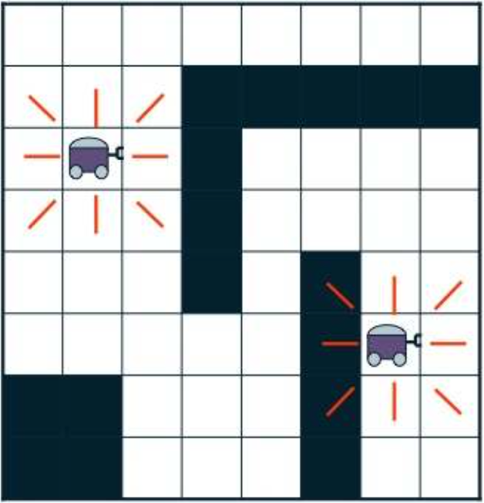
Automated Planning and Acting
3
2.5
2
Utility
1.5
1
0.5
Decision Making: Extensions
0
0
0.2
0.4
0.6
0.8
1
Probability of state 1
Tanya Braun
Research Group Data Science, Computer Science Department

Slide 2
Content: Planning and Acting
With Deterministic Models
With Temporal Models
With Nondeterministic Models
With Probabilistic Models
By Decision Making
  Foundations
  Extensions
    Partially observable MDPs (POMDPs)
    Decentralised POMDPs (decPOMDPs)
  Structure
With Human-awareness
Notes:
1-4, 6: Planning book
5, 7: AIMA
8: Rao

Slide 3

Acknowledgements
Part 1 based on material from Lise Getoor, Jean-Claude Latombe, Daphne Koller, and Stuart Russell, Xiaoli Fern compiled by Ralf Möller
  In part based on AIMA Book, Chapter 17.4
Part 2 based on tutorial by Matthijs Spaan, Christopher Amato, Shlomo Zilberstein on Decision Making in Multiagent Settings: Team Decision Making
  In part based on DecPOMDP book
http://rbr.cs.umass.edu/camato/decpomdp/overview.html

Slide 4
Outline: Decision Making – Extensions
Partially Observable Markov Decision Process (POMDP)
  POMDP agent, belief state, belief MDP
  Conditional plans, value iteration
Decentralised POMDP (Dec-POMDP)
  Dec-POMDP, local policy, joint policy, value function
  Communication, full observability, Dec-MDP
  Solutions for finite, infinite, indefinite horizon

Slide 5
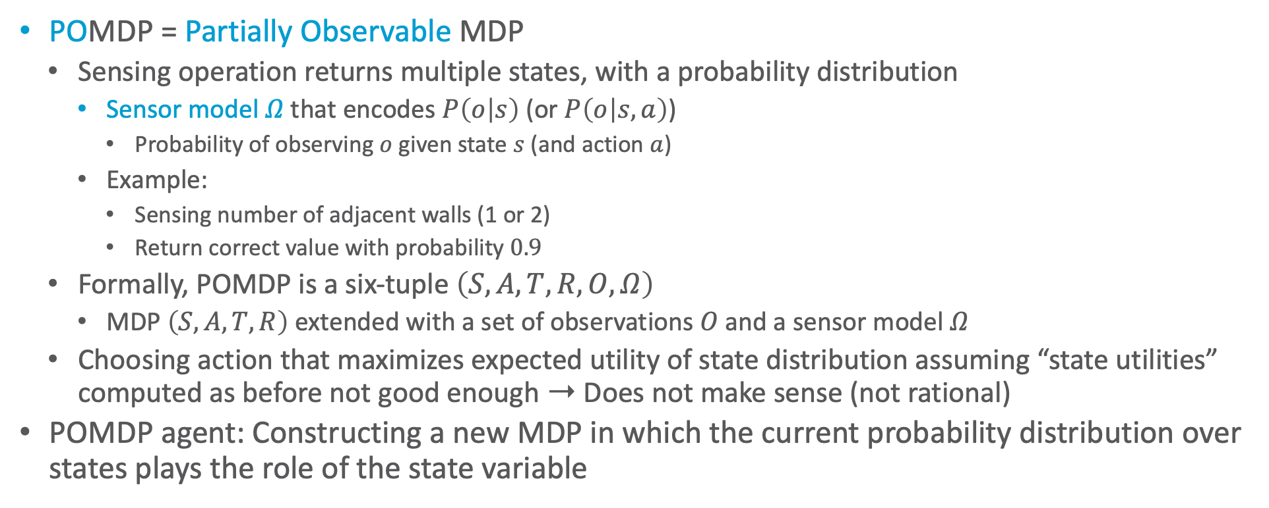
POMDP
POMDP = Partially Observable MDP
  Sensing operation returns multiple states, with a probability distribution
    Sensor model $Ω$ that encodes $P\left(o | s\right)$ (or $P\left(o | s,a\right)$)
      Probability of observing $o$ given state $s$ (and action $a$)
    Example:
      Sensing number of adjacent walls (1 or 2)
      Return correct value with probability $0.9$
  Formally, POMDP is a six-tuple $\left(S,A,T,R,O,Ω\right)$
    MDP $\left(S,A,T,R\right)$ extended with a set of observations $O$ and a sensor model $Ω$
  Choosing action that maximizes expected utility of state distribution assuming “state utilities” computed as before not good enough ➝ Does not make sense (not rational)
POMDP agent: Constructing a new MDP in which the current probability distribution over states plays the role of the state variable
+1
3
-1
2
1
1
2
3
4

Slide 6





Decision cycle of a POMDP agent
Given the current belief state $b$ and a policy $π$, execute the action
$a=π\left(b\right)$
Receive observation $o$
Set the current belief state to $SE\left(b,a,o\right)$ and repeat
  SE = State Estimation
World
Observation $o$
Action $a$
$$b$$
SE
$$π$$
Agent

Slide 7

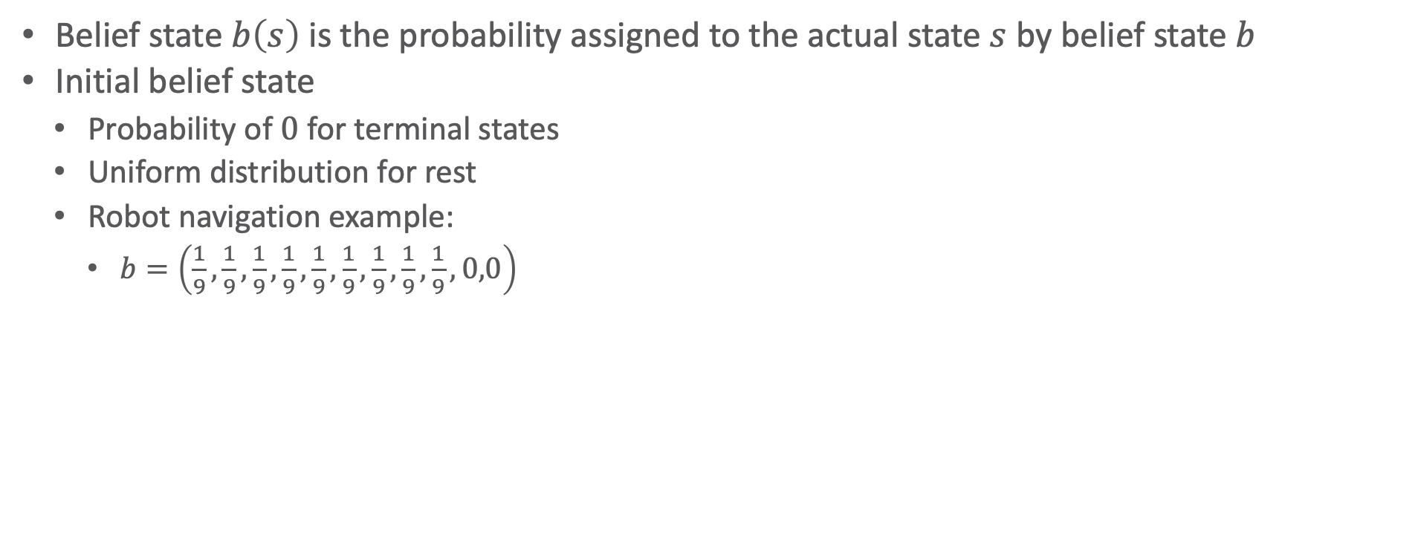








Belief State & Update
Belief state $b\left(s\right)$ is the probability assigned to the actual state $s$ by belief state $b$
Initial belief state
  Probability of $0$ for terminal states
  Uniform distribution for rest
  Robot navigation example:
    $b=\left(\frac{1}{9},\frac{1}{9},\frac{1}{9},\frac{1}{9},\frac{1}{9},\frac{1}{9},\frac{1}{9},\frac{1}{9},\frac{1}{9},0,0\right)$
$$0.\overline{1}$$
$$0.\overline{1}$$
$$0.0$$
3
$$0.\overline{1}$$
$$0.\overline{1}$$
$$0.\overline{1}$$
$$0.0$$
2
1
$$0.\overline{1}$$
$$0.\overline{1}$$
$$0.\overline{1}$$
$$0.\overline{1}$$
1
2
3
4
Notes:
RM: I think there is only one belief state. Having more means a distribution over belief states. What should this be?
But this one belief state distribution is orthogonal to Utilities, these are the same for all belief states.

Slide 8



































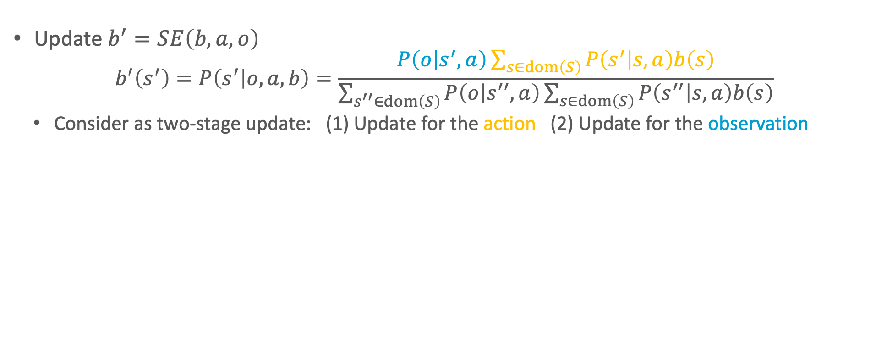
Belief State & Update
Update $b^{′}=SE\left(b,a,o\right)$
  $$b^{′}\left(s^{′}\right)=P\left(s^{′} | o,a,b\right)=\frac{P\left(o | s^{′},a\right)\sum_{s∈dom\left(S\right)}{P\left(s^{′} | s,a\right)b\left(s\right)}}{\sum_{s^{′′}∈dom\left(S\right)}{P\left(o | s^{′′},a\right)}\sum_{s∈dom\left(S\right)}{P\left(s^{′′} | s,a\right)b\left(s\right)}}$$
  Consider as two-stage update: (1) Update for the action (2) Update for the observation
$$b$$
$b^{\left(1\right)}$
${b^{\left(2\right)}=b}^{′}$
$$0.\overline{1}$$
$$0.\overline{1}$$
$$0.0$$
$$0.2$$
$$0.\overline{1}$$
$$0.0\overline{2}$$
$$0.0$$
$$0.0$$
3
$$0.\overline{1}$$
3
3
$$0.06569$$
$$0.03650$$
$$0.06569$$
$$0.\overline{1}$$
$$0.0$$
Move L once
$$0.\overline{1}$$
$$0.\overline{1}$$
$$0.0\overline{1}$$
Perceive 1 wall
$$0.03285$$
2
$$0.\overline{1}$$
2
2
$$0.03650$$
$$0.32847$$
1
$$0.\overline{1}$$
$$0.\overline{1}$$
$$0.\overline{1}$$
$$0.\overline{1}$$
1
$$0.2$$
$$0.\overline{1}$$
$$0.\overline{1}$$
$$0.0\overline{1}$$
1
$$0.06569$$
$$0.03650$$
$$0.32847$$
$$0.00365$$
1
2
3
4
1
2
3
4
1
2
3
4

Slide 9


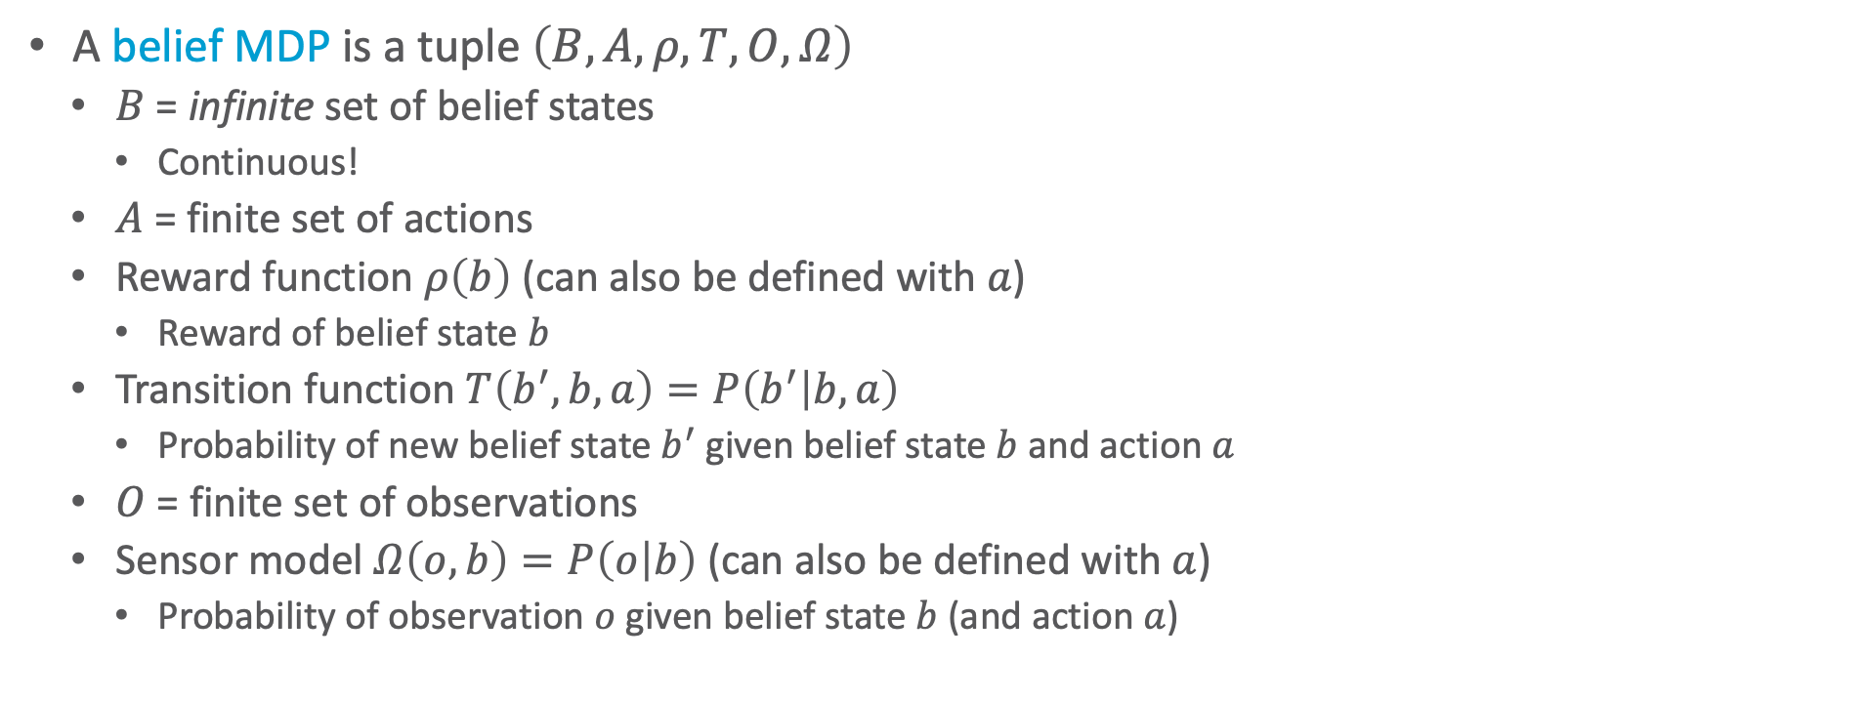








Belief MDP
$$b$$
$$0.\overline{1}$$
$$0.\overline{1}$$
$$0.0$$
3
$$0.\overline{1}$$
$$0.0$$
A belief MDP is a tuple $\left(B, A, ρ,T,O,Ω\right)$
  $B$ = infinite set of belief states
    Continuous!
  $A$ = finite set of actions
  Reward function $ρ\left(b\right)$ (can also be defined with $a$)
    Reward of belief state $b$
  Transition function $T\left(b^{′}, b,a\right)=P\left(b^{′} | b, a\right)$
    Probability of new belief state $b^{′}$ given belief state $b$ and action $a$
  $O$ = finite set of observations
  Sensor model $Ω\left(o,b\right)=P\left(o | b\right)$ (can also be defined with $a$)
    Probability of observation $o$ given belief state $b$ (and action $a$)
2
$$0.\overline{1}$$
$$0.\overline{1}$$
1
$$0.\overline{1}$$
$$0.\overline{1}$$
$$0.\overline{1}$$
$$0.\overline{1}$$
1
2
3
4
Move L once,
perceive 1 wall
$b^{′}$
$$0.0$$
3
$$0.06569$$
$$0.03650$$
$$0.06569$$
$$0.03285$$
2
$$0.03650$$
$$0.32847$$
1
$$0.06569$$
$$0.03650$$
$$0.32847$$
$$0.00365$$
1
2
3
4

Slide 10
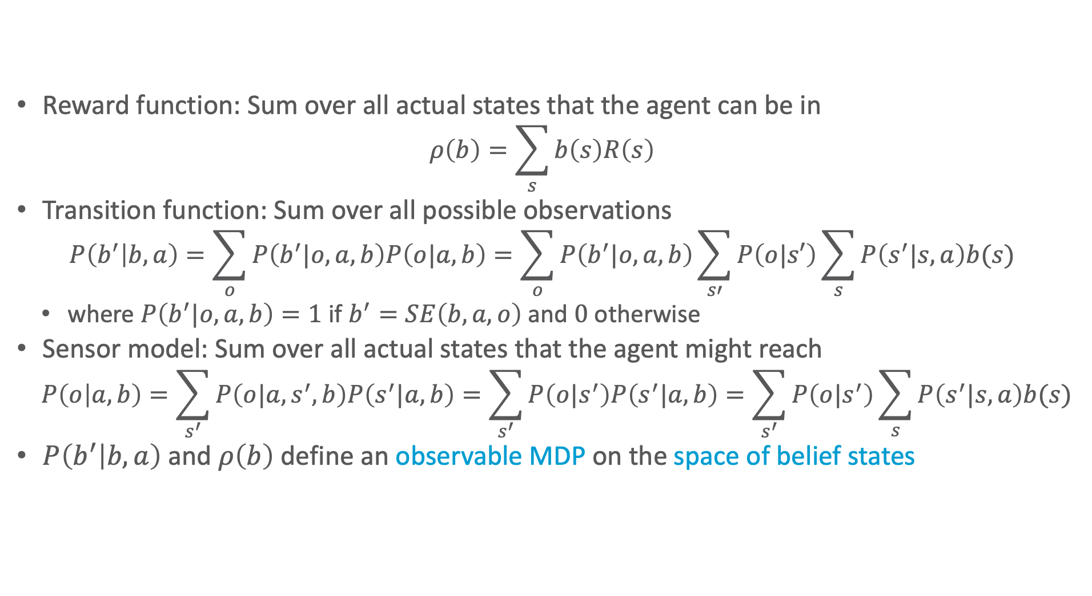
Belief MDP: Express Functions using POMDP Functions
Reward function: Sum over all actual states that the agent can be in
  $$ρ\left(b\right)=\sum_{s}{b\left(s\right)R\left(s\right)}$$
Transition function: Sum over all possible observations
  $$P\left(b^{′} | b, a\right)=\sum_{o}{P\left(b^{′}|o,a,b\right)P\left(o|a,b\right)}=\sum_{o}{P\left(b^{′}|o,a,b\right)\sum_{s′}{P\left(o|s′\right)\sum_{s}{P\left(s^{′}|s,a\right)b(s)}}}$$
  where $P\left(b^{′}|o,a,b\right)=1$ if $b^{′}=SE\left(b,a,o\right)$ and $0$ otherwise
Sensor model: Sum over all actual states that the agent might reach
  $$P\left(o | a,b\right)=\sum_{s^{′}}{P\left(o|a,s^{′},b\right)P\left(s^{′}|a,b\right)}=\sum_{s^{′}}{P\left(o|s^{′}\right)P\left(s^{′}|a,b\right)}=\sum_{s^{′}}{P\left(o|s^{′}\right)\sum_{s}{P\left(s^{′}|s,a\right)b(s)}}$$
$P\left(b^{′} | b, a\right)$ and $ρ\left(b\right)$ define an observable MDP on the space of belief states
Notes:
Define belief MDP functions based on POMDP functions

Slide 11
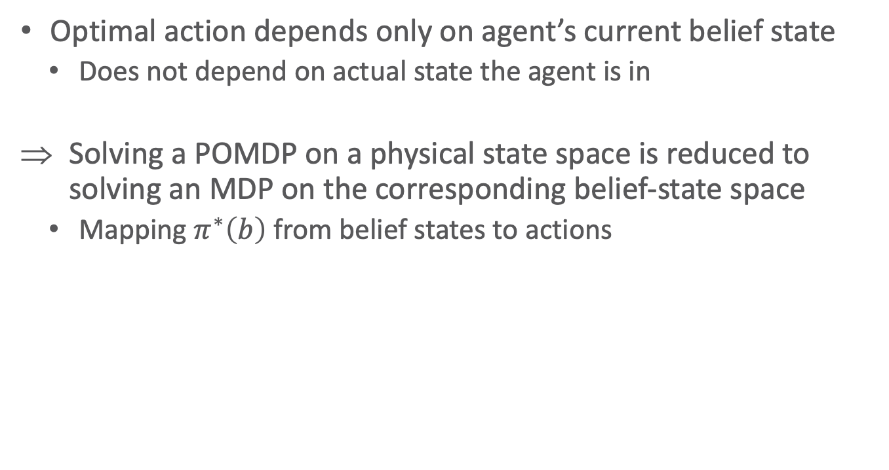
Belief MDP
$$b$$
$$0.\overline{1}$$
$$0.\overline{1}$$
$$0.0$$
3
$$0.\overline{1}$$
Optimal action depends only on agent’s current belief state
  Does not depend on actual state the agent is in
Solving a POMDP on a physical state space is reduced to solving an MDP on the corresponding belief-state space
  Mapping $π^{∗}\left(b\right)$ from belief states to actions
$$0.\overline{1}$$
$$0.\overline{1}$$
$$0.0$$
2
1
$$0.\overline{1}$$
$$0.\overline{1}$$
$$0.\overline{1}$$
$$0.\overline{1}$$
1
2
3
4
Move L once,
perceive 1 wall
$b^{′}$
$$0.0$$
3
$$0.06569$$
$$0.03650$$
$$0.06569$$
$$0.03285$$
2
$$0.03650$$
$$0.32847$$
1
$$0.06569$$
$$0.03650$$
$$0.32847$$
$$0.00365$$
1
2
3
4
Notes:
Belief state continuous ➝ map from hyperplanes / intervals to actions

Slide 12
Example Scenario
0.622
0.221
0.071
0.024
3
0.022
2
0.005
0.003
1
0.003
0.024
0.003
0.000
1
2
3
4
After moving U five times
0.300
0.010
0.008
0.000
0.111
0.111
0.111
0.000
0.005
0.007
0.019
0.775
3
3
3
0.221
0.059
0.012
0.111
0.111
0.000
0.034
0.007
0.105
2
2
2
1
0.371
0.012
0.008
0.000
1
0.111
0.111
0.111
0.111
1
0.005
0.006
0.008
0.030
1
2
3
4
1
2
3
4
1
2
3
4
After moving L five times
Initial distribution
After moving R five times

Slide 13
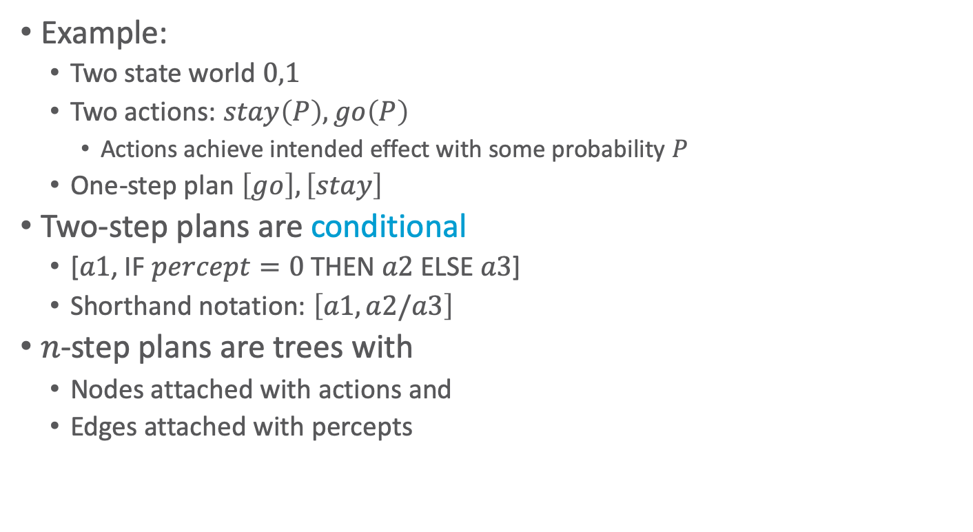
Conditional Plans
Example:
  Two state world $0,1$
  Two actions: $stay\left(P\right), go\left(P\right)$
    Actions achieve intended effect with some probability $P$
  One-step plan $\left[go\right], \left[stay\right]$
Two-step plans are conditional
  [$a1$, IF $percept=0$ THEN $a2$ ELSE $a3$]
  Shorthand notation: $\left[a1, a2\text{/}a3\right]$
$n$-step plans are trees with
  Nodes attached with actions and
  Edges attached with percepts

Slide 14
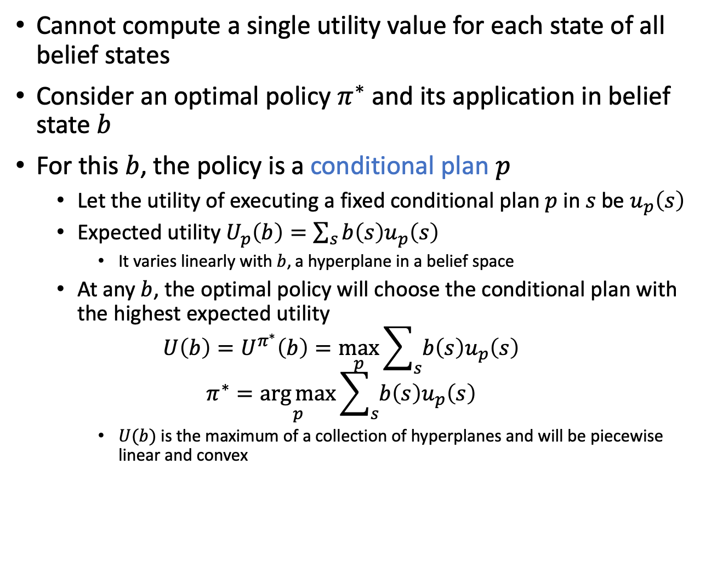
Value Iteration for POMDPs
Cannot compute a single utility value for each state of all belief states
Consider an optimal policy $π^{∗}$ and its application in belief state $b$
For this $b$, the policy is a conditional plan $p$
  Let the utility of executing a fixed conditional plan $p$ in $s$ be $u_{p}\left(s\right)$
  Expected utility $U_{p}\left(b\right)=\sum_{s}{b\left(s\right)u_{p}\left(s\right)}$
    It varies linearly with $b$, a hyperplane in a belief space
  At any $b$, the optimal policy will choose the conditional plan with the highest expected utility
  $$U\left(b\right)=U^{π^{∗}}\left(b\right)=\max_{p}{\sum_{s}{b\left(s\right)u_{p}\left(s\right)}}$$
  $$π^{∗}=\underset{p}{\arg{max}}{\sum_{s}{b\left(s\right)u_{p}\left(s\right)}}$$
    $U(b)$ is the maximum of a collection of hyperplanes and will be piecewise linear and convex

Slide 15
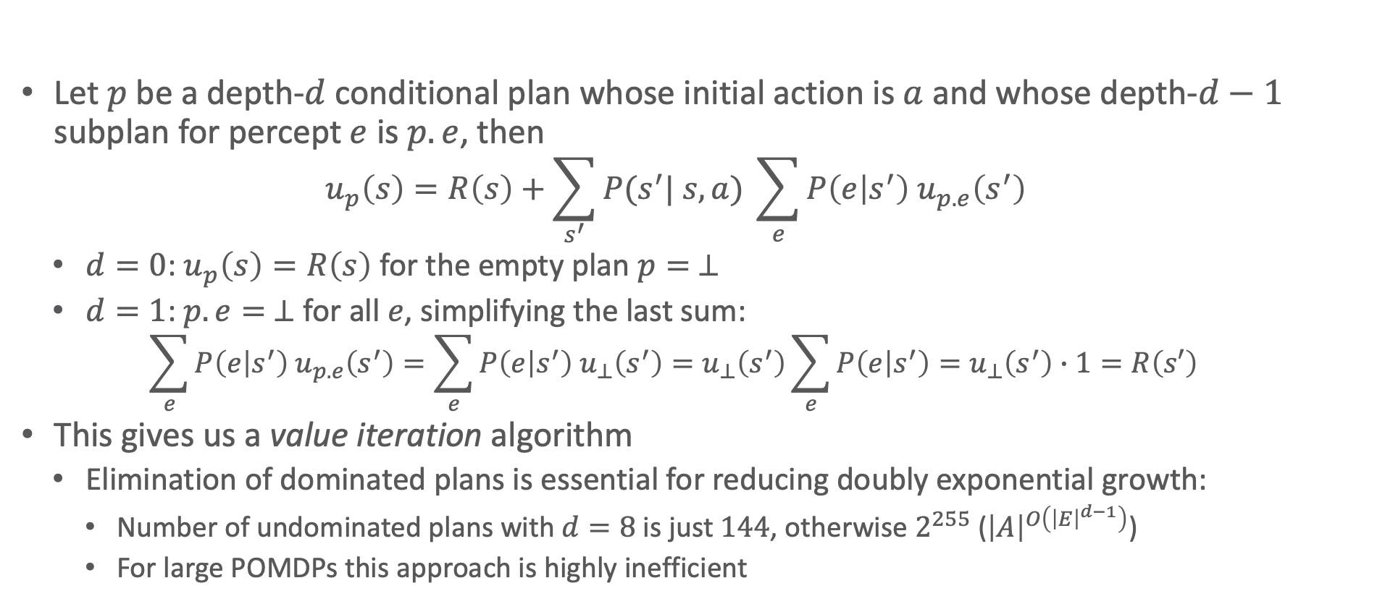
General Formula
Let $p$ be a depth-$d$ conditional plan whose initial action is $a$ and whose depth-$d−1$ subplan for percept $e$ is $p.e$, then
  $$u_{p}\left(s\right)=R\left(s\right)+\sum_{s^{′}}{P(s^{′}| s,a) }\sum_{e}{P\left(e | s^{′}\right) u_{p.e}\left(s^{′}\right)}$$
  $d=0$: $u_{p}\left(s\right)=R\left(s\right)$ for the empty plan $p= ⊥$
  $d=1$: $p.e= ⊥$ for all $e$, simplifying the last sum:
    $$\sum_{e}{P\left(e | s^{′}\right) u_{p.e}\left(s^{′}\right)}=\sum_{e}{P\left(e | s^{′}\right) u_{⊥}\left(s^{′}\right)}=u_{⊥}\left(s^{′}\right)\sum_{e}{P\left(e | s^{′}\right)}=u_{⊥}\left(s^{′}\right)∙1=R\left(s′\right)$$
This gives us a value iteration algorithm
  Elimination of dominated plans is essential for reducing doubly exponential growth:
    Number of undominated plans with $d=8$ is just $144$, otherwise $2^{255}$ (${\left|A\right|}^{O\left({\left|E\right|}^{d−1}\right)}$)
    For large POMDPs this approach is highly inefficient

Slide 16
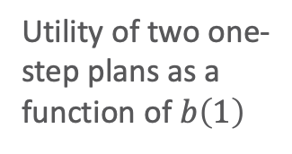
Example
Compute the utilities for conditional plans of depth 2 by
  considering each possible first action
  each possible subsequent percept
  each way of choosing a depth-1 plan to execute for each percept
3
Utility of two one-step plans as a function of $b\left(1\right)$
2.5
2
Utility
1.5
[Stay]
1
[Go]
0.5
0
0
0.2
0.4
0.6
0.8
1
Probability of state 1

Slide 17
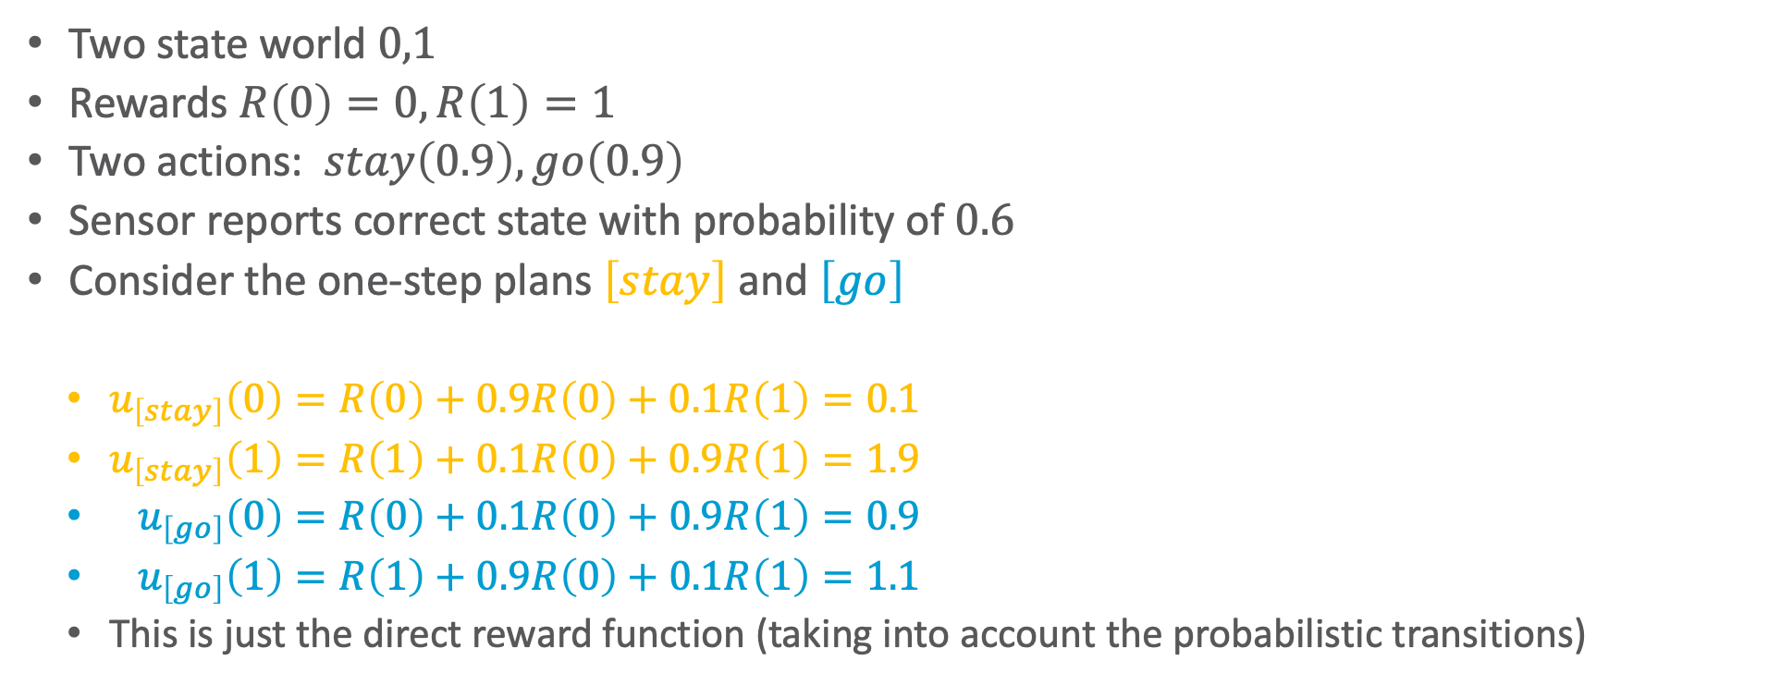
Example
Two state world $0,1$
Rewards $R\left(0\right)=0, R\left(1\right)=1$
Two actions: $stay\left(0.9\right), go\left(0.9\right)$
Sensor reports correct state with probability of $0.6$
Consider the one-step plans $\left[stay\right]$ and $\left[go\right]$
  $u_{\left[stay\right]}\left(0\right)=R\left(0\right)+0.9R\left(0\right)+0.1R\left(1\right)=0.1$
  $u_{\left[stay\right]}\left(1\right)=R\left(1\right)+0.1R\left(0\right)+0.9R\left(1\right)=1.9$
  $u_{\left[go\right]}\left(0\right)=R\left(0\right)+0.1R\left(0\right)+0.9R\left(1\right)=0.9$
  $u_{\left[go\right]}\left(1\right)=R\left(1\right)+0.9R\left(0\right)+0.1R\left(1\right)=1.1$
  This is just the direct reward function (taking into account the probabilistic transitions)
3
2.5
2
Utility
1.5
[Stay]
1
[Go]
0.5
state 0
state 1
0
0
0.2
0.4
0.6
0.8
1
Probability of state 1

Slide 18
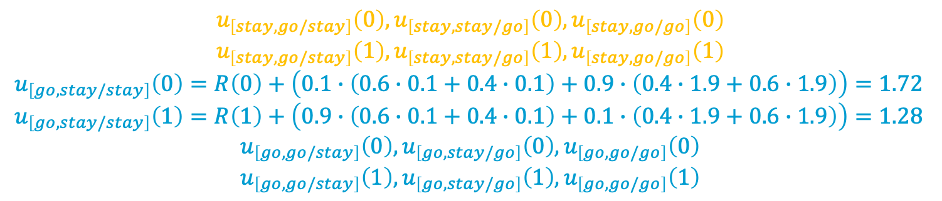
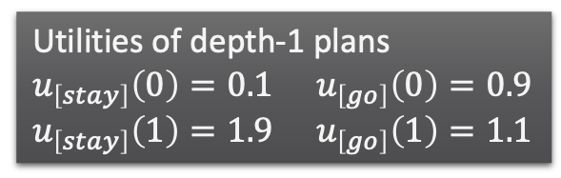
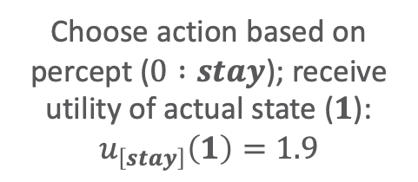
8 distinct depth-2 plans for each state (16 plans)
Utility of depth-1 plan given state, outcome of first action, and percept
Choose action based on percept ($0 :stay$); receive utility of actual state ($1$):
$$u_{\left[stay\right]}\left(1\right)=1.9$$
  Utilities of depth-1 plans
  $u_{\left[stay\right]}\left(0\right)=0.1$ $u_{\left[go\right]}\left(0\right)=0.9$
  $u_{\left[stay\right]}\left(1\right)=1.9$ $u_{\left[go\right]}\left(1\right)=1.1$
Reward of state
Probability of next state
Probability of percept
  $u_{\left[stay,stay/stay\right]}\left(0\right)=R\left(0\right)+\left(0.9∙\left(0.6∙0.1+0.4∙0.1\right)+0.1∙\left(0.4∙1.9+0.6∙1.9\right)\right)=0.28$
  $u_{\left[stay,stay/stay\right]}\left(1\right)=R\left(1\right)+\left(0.1∙\left(0.6∙0.1+0.4∙0.1\right)+0.9∙\left(0.4∙1.9+0.6∙1.9\right)\right)=2.72$
percept 0
percept 1
percept 0
percept 1
Sum over states reachable with first action
state 0
state 1
Sum over possible percepts
  $$u_{\left[stay,go/stay\right]}\left(0\right), u_{\left[stay,stay/go\right]}\left(0\right),u_{\left[stay,go/go\right]}\left(0\right)$$
  $$u_{\left[stay,go/stay\right]}\left(1\right), u_{\left[stay,stay/go\right]}\left(1\right),u_{\left[stay,go/go\right]}\left(1\right)$$
  $u_{\left[go,stay/stay\right]}\left(0\right)=R\left(0\right)+\left(0.1∙\left(0.6∙0.1+0.4∙0.1\right)+0.9∙\left(0.4∙1.9+0.6∙1.9\right)\right)=1.72$
  $u_{\left[go,stay/stay\right]}\left(1\right)=R\left(1\right)+\left(0.9∙\left(0.6∙0.1+0.4∙0.1\right)+0.1∙\left(0.4∙1.9+0.6∙1.9\right)\right)=1.28$
  $$u_{\left[go,go/stay\right]}\left(0\right), u_{\left[go,stay/go\right]}\left(0\right),u_{\left[go,go/go\right]}\left(0\right)$$
  $$u_{\left[go,go/stay\right]}\left(1\right), u_{\left[go,stay/go\right]}\left(1\right),u_{\left[go,go/go\right]}\left(1\right)$$

Slide 19

Example
8 distinct depth-2 plans for state $1$
  4 are suboptimal across the entire belief space (dashed lines)
  With probability $b(1)=0$
    $u_{\left[stay,stay/stay\right]}\left(0\right)=0.2$
    $u_{\left[go,stay/stay\right]}\left(0\right)=1.7$
  With probability $b(1)=1$:
    $u_{\left[stay,stay/stay\right]}\left(1\right)=2.72$
    $u_{\left[go,stay/stay\right]}\left(1\right)=1.28$
3
2.5
2
Utility
1.5
1
0.5
0
0
0.2
0.4
0.6
0.8
1
Probability of state 1

Slide 20
Example
3
7.5
2.5
7
2
6.5
Utility
1.5
Utility
6
1
5.5
0.5
5
0
4.5
0
0.2
0.4
0.6
0.8
1
0
0.2
0.4
0.6
0.8
1
Probability of state 1
Probability of state 1
Utility of four undominated
two-step plans
Utility function for optimal
eight step plans

Slide 21

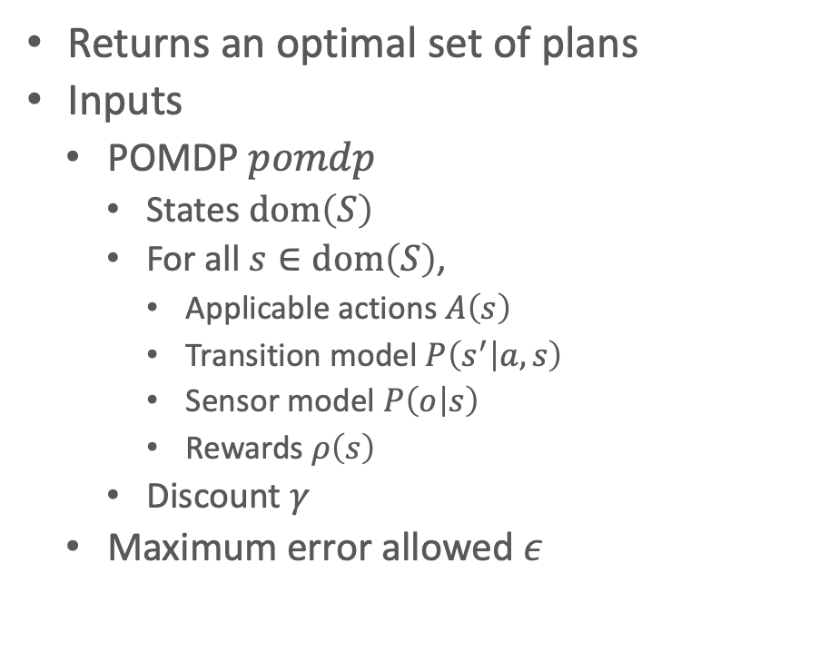
Value Iteration: Algorithm
Returns an optimal set of plans
Inputs
  POMDP $pomdp$
    States $dom\left(S\right)$
    For all $s∈dom\left(S\right)$,
      Applicable actions $A\left(s\right)$
      Transition model $P\left(s^{′} | a,s\right)$
      Sensor model $P\left(o | s\right)$
      Rewards $ρ\left(s\right)$
    Discount $γ$
  Maximum error allowed $ε$
function value-iteration(pomdp,𝜖)
U’ ← a set containing the empty plan [] with u[](s)=R(s)
repeat
U ← U’
U’ ← the set of all plans consisting of an action and,
for each possible next percept, a plan in U with
utility vectors computed as on previous slide
U’ ← Remove-dominated-plans(U’)
until Max-difference(U,U’) < 𝜖(1-𝛾)/𝛾
return U
Local variables
  $U, U^{′}$ sets of plans with associated utility vectors $u_{p}$

Slide 22
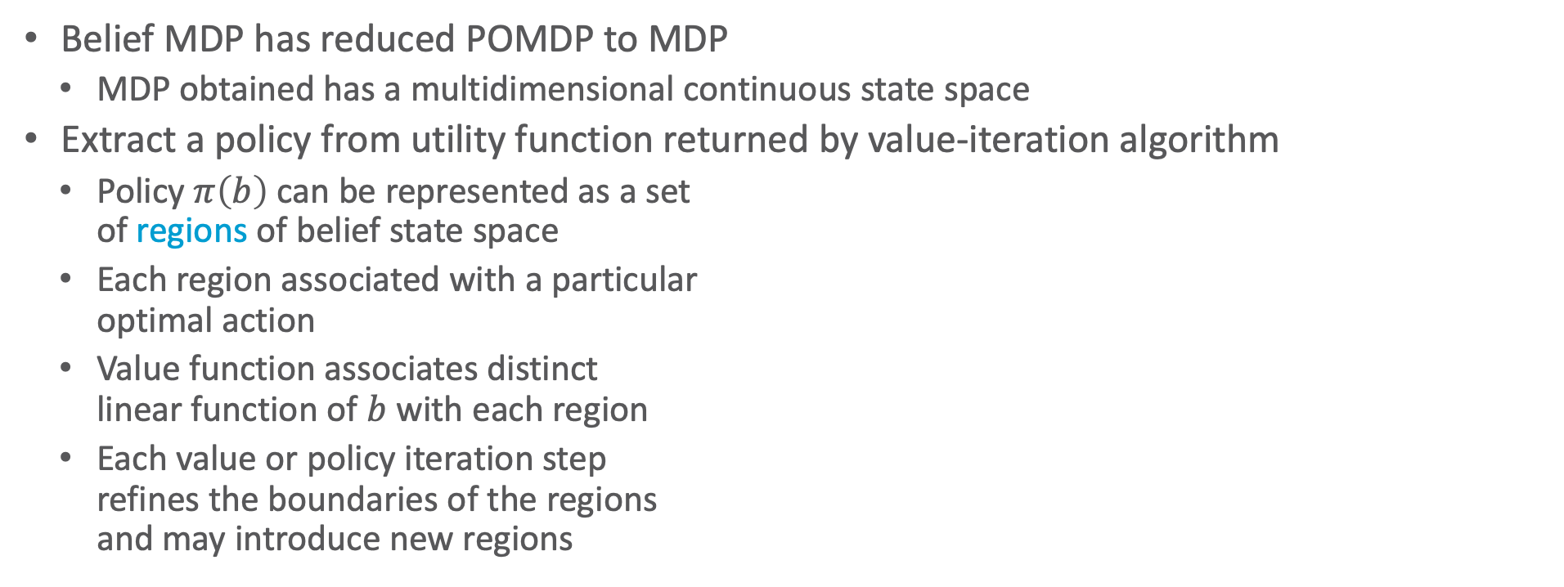
Solutions for POMDP
Belief MDP has reduced POMDP to MDP
  MDP obtained has a multidimensional continuous state space
Extract a policy from utility function returned by value-iteration algorithm
  Policy $π\left(b\right)$ can be represented as a set
  of regions of belief state space
  Each region associated with a particular
  optimal action
  Value function associates distinct
  linear function of $b$ with each region
  Each value or policy iteration step
  refines the boundaries of the regions
  and may introduce new regions
0
1
Notes:
RM: Methods based on value and policy iteration focus on finding optimal policies. For some POMDPs, the optimal policy has infinitely many regions , so the simple list-of-regions approach fails and more ingenious methods are needed.
The policy is a sequence which gives the mapping from all states to all corresponding actions. So the agents using these methods have to memorize all the possible states from the very beginning of solving the problem. If the problems are more complex with observations and with a few dozen states, the methods will not work or work inefficiently. That means maybe sometimes the agent update policy with some states they will hardly get into.
Method based on lookahead search which we will describe next is a different, approximate method for solving those complex POMDPs.

Slide 23
Intermediate Summary
POMDP
  Uncertainty about state ➝ belief state
  Solving a POMDP = Solving an MDP on space of belief states
  Policy = conditional plans
  Value iteration to find optimal policy
    Very expensive, even with deletion of dominated plans
What to do alternatively? Find sub-optimal plans
Sampling approaches
In combination with deep learning methods

Slide 24
Outline: Decision Making – Extensions
Partially Observable Markov Decision Process (POMDP)
  POMDP agent, belief state, belief MDP
  Conditional plans, value iteration
Decentralised POMDP (Dec-POMDP)
  Dec-POMDP, local policy, joint policy, value function
  Communication, full observability, Dec-MDP
  Solutions for finite, infinite, indefinite horizon

Slide 25
Multi-agent Scenarios
Ambulance allocation
  Multiple ambulance services
    Business oriented operation
    Competition for government funds and public opinion
  Given several locations that require medical assistance, how many ambulances from which firm will go to which location?
Firefighters
  Maintain effort toward saving the building or draw back and minimise spread of fire?
  Concentrate on a multitude of smaller fires or allow controlled unification and deal with only one location?
    Will transportation routes be endangered?
    Are there still civilians evacuating from the area / building?
  Push through the fire to victims or save the fire crew and pull out?
    If multiple crews are on site, which one goes? When?

Slide 26

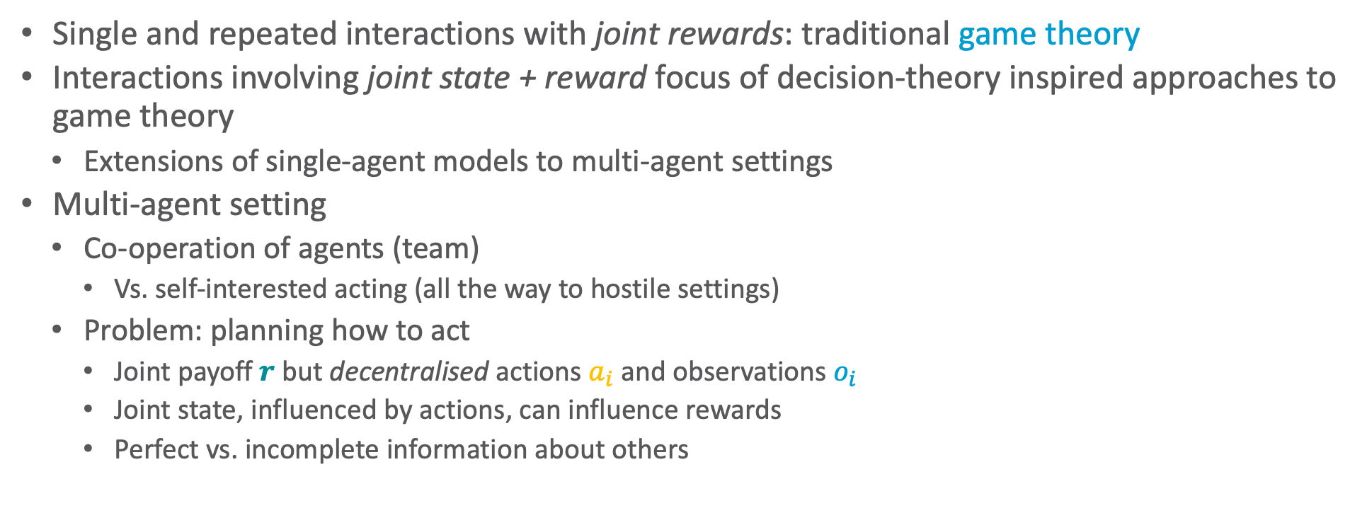




Setting
Single and repeated interactions with joint rewards: traditional game theory
Interactions involving joint state + reward focus of decision-theory inspired approaches to game theory
  Extensions of single-agent models to multi-agent settings
Multi-agent setting
  Co-operation of agents (team)
    Vs. self-interested acting (all the way to hostile settings)
  Problem: planning how to act
    Joint payoff $r$ but decentralised actions $a_{i}$ and observations $o_{i}$
    Joint state, influenced by actions, can influence rewards
    Perfect vs. incomplete information about others
$$r$$
$$o_{1}$$
Environment
$$a_{1}$$
…
…
$$o_{n}$$
$$a_{n}$$
Notes:
WWU game theory?

Slide 27
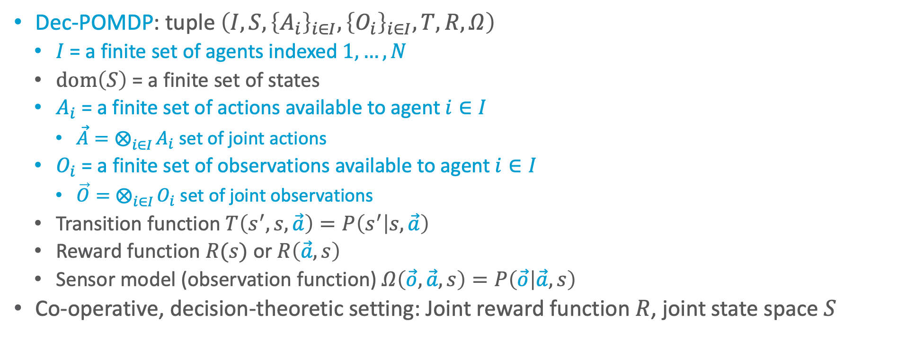
Decentralised POMDP (Dec-POMDP)
Dec-POMDP: tuple $\left(I,S, {\left\{A_{i}\right\}}_{i∈I}, {\left\{O_{i}\right\}}_{i∈I},T,R,Ω\right)$
  $I$ = a finite set of agents indexed $1,…, N$
  $dom\left(S\right)$ = a finite set of states
  $A_{i}$ = a finite set of actions available to agent $i∈I$
    $\vec{A}=⨂_{i∈I}{A_{i}}$ set of joint actions
  $O_{i}$ = a finite set of observations available to agent $i∈I$
    $\vec{O}=⨂_{i∈I}{O_{i}}$ set of joint observations
  Transition function $T\left(s^{′},s,\vec{a}\right)=P\left(s^{′} | s, \vec{a}\right)$
  Reward function $R(s)$ or $R\left(\vec{a},s\right)$
  Sensor model (observation function) $Ω\left(\vec{o},\vec{a},s\right)=P\left(\vec{o} | \vec{a},s\right)$
Co-operative, decision-theoretic setting: Joint reward function $R$, joint state space $S$

Slide 28
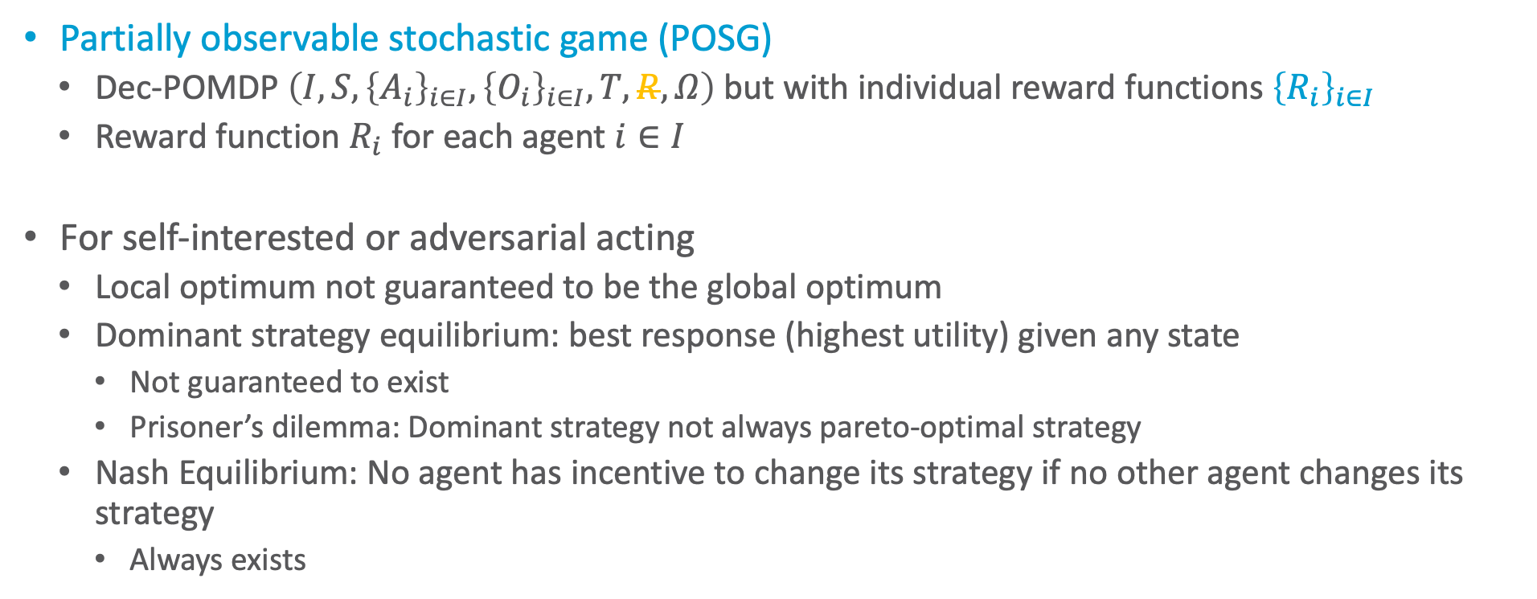
Generalising Dec-POMDPs
Partially observable stochastic game (POSG)
  Dec-POMDP $\left(I,S, {\left\{A_{i}\right\}}_{i∈I}, {\left\{O_{i}\right\}}_{i∈I},T,R,Ω\right)$but with individual reward functions ${\left\{R_{i}\right\}}_{i∈I}$
  Reward function $R_{i}$ for each agent $i∈I$
For self-interested or adversarial acting
  Local optimum not guaranteed to be the global optimum
  Dominant strategy equilibrium: best response (highest utility) given any state
    Not guaranteed to exist
    Prisoner’s dilemma: Dominant strategy not always pareto-optimal strategy
  Nash Equilibrium: No agent has incentive to change its strategy if no other agent changes its strategy
    Always exists

Slide 29
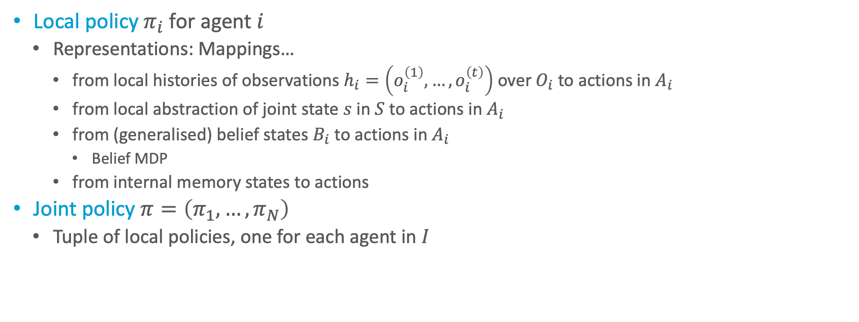
Policies for Dec-POMDPs
Local policy $π_{i}$ for agent $i$
  Representations: Mappings…
    from local histories of observations $h_{i}=\left(o_{i}^{\left(1\right)},…,o_{i}^{\left(t\right)}\right)$ over $O_{i}$ to actions in $A_{i}$
    from local abstraction of joint state $s$ in $S$ to actions in $A_{i}$
    from (generalised) belief states $B_{i}$ to actions in $A_{i}$
      Belief MDP
    from internal memory states to actions
Joint policy $π=\left(π_{1},…,π_{N}\right)$
  Tuple of local policies, one for each agent in $I$

Slide 30
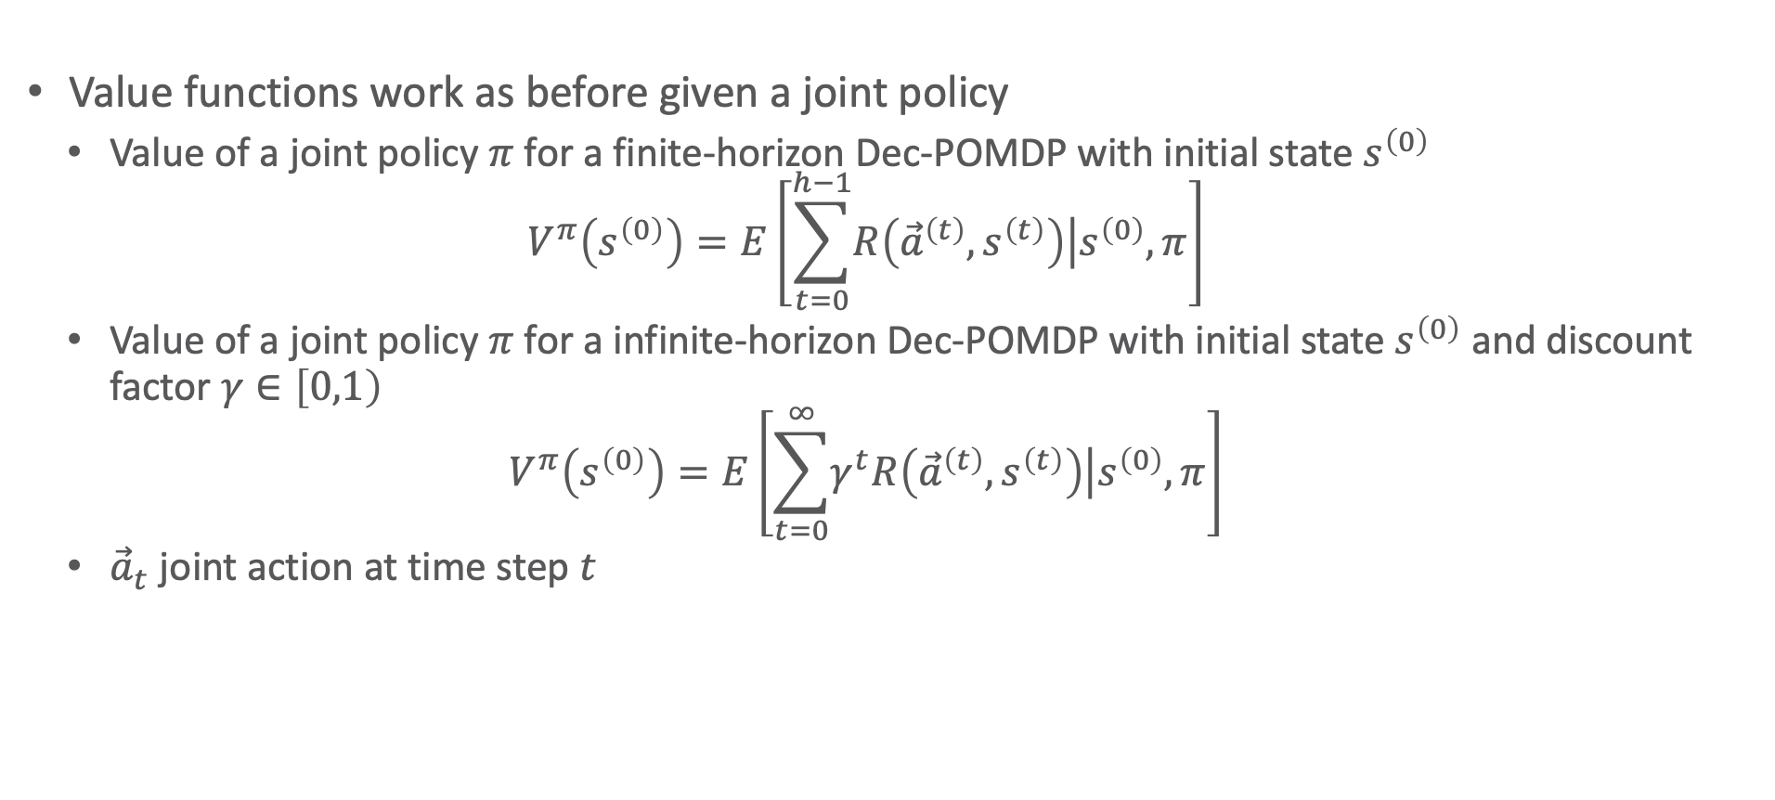
Value Functions for Dec-POMDPs
Value functions work as before given a joint policy
  Value of a joint policy $π$ for a finite-horizon Dec-POMDP with initial state $s^{\left(0\right)}$
  $$V^{π}\left(s^{\left(0\right)}\right)=E\left[\sum_{t=0}^{h−1}{\left.R\left({\vec{a}}^{\left(t\right)},s^{\left(t\right)}\right)\right|s^{\left(0\right)},π}\right]$$
  Value of a joint policy $π$ for a infinite-horizon Dec-POMDP with initial state $s^{\left(0\right)}$ and discount factor $γ∈\left[0,1\right)$
  $$V^{π}\left(s^{\left(0\right)}\right)=E\left[\sum_{t=0}^{∞}{\left.γ^{t}R\left({\vec{a}}^{\left(t\right)},s^{\left(t\right)}\right)\right|s^{\left(0\right)},π}\right]$$
  ${\vec{a}}_{t}$ joint action at time step $t$

Slide 31
Example: Two-agent Grid World
Agents: two
States: grid cell pairs
Actions: move U, D, L, R, stay
Transitions: noisy
Observations: cell occupancy in the directions of the red lines
Rewards: negative unless sharing the same square

Slide 32

Example: The Dec-Tiger Problem
A toy problem: decentralized tiger
State space:
  Position of tiger behind one of two doors (left / right)
  Treasure behind other door
Reward:
  Opening correct door: both receive treasure
  Opening wrong door: both get attacked by a tiger
Actions: Agents can open a door, or listen
  After opening a door, game is reset with tiger behind a randomly chosen door
Observations: Two noisy observations: hear tiger left or right
Agents do not know the other’s actions or observations

Slide 33
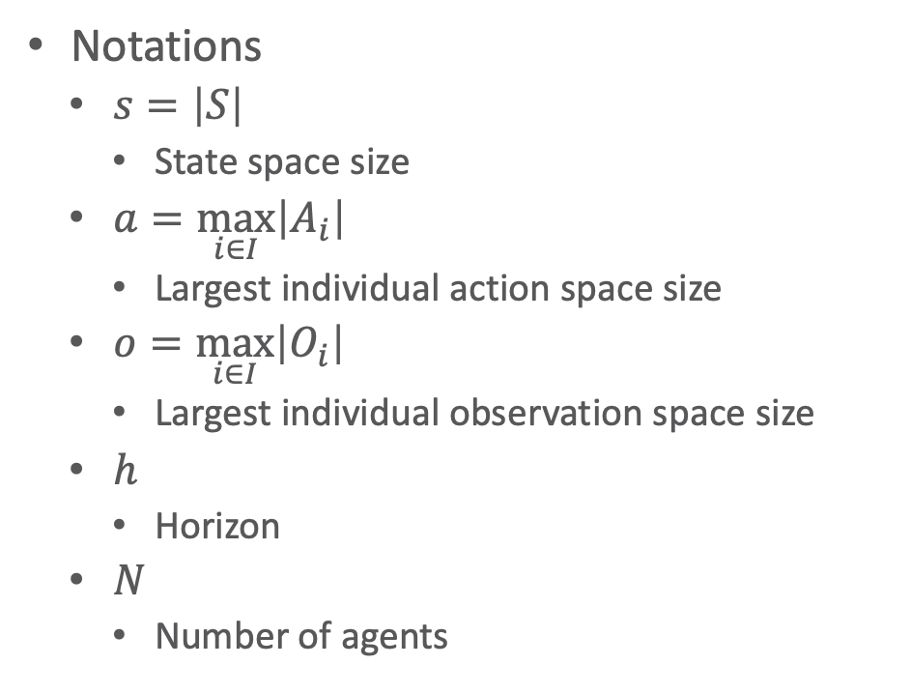
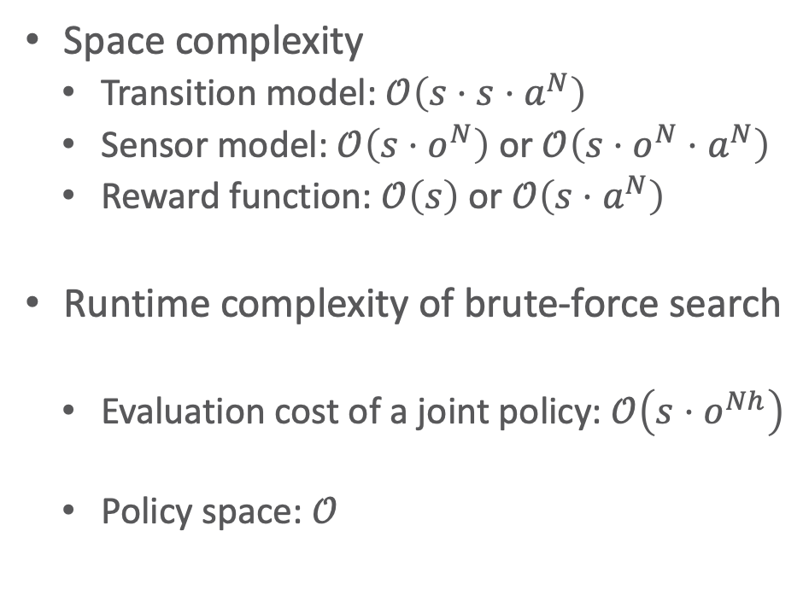

Worst-case Complexity of DecPOMDP
Space complexity
  Transition model: $𝒪\left(s⋅s⋅a^{N}\right)$
  Sensor model: $𝒪\left(s⋅o^{N}\right)$ or $𝒪\left(s⋅o^{N}⋅a^{N}\right)$
  Reward function: $𝒪\left(s\right)$ or $𝒪\left(s⋅a^{N}\right)$
Runtime complexity of brute-force search
  Evaluation cost of a joint policy: $𝒪\left(s⋅o^{Nh}\right)$
  Policy space: $𝒪$
Notations
  $s=\left|S\right|$
    State space size
  $a=\max_{i∈I}\left|A_{i}\right|$
    Largest individual action space size
  $o=\max_{i∈I}\left|O_{i}\right|$
    Largest individual observation space size
  $h$
    Horizon
  $N$
    Number of agents
$$\left(a^{\frac{N\left(o^{h}−1\right)}{o−1}}\right)$$

Slide 34
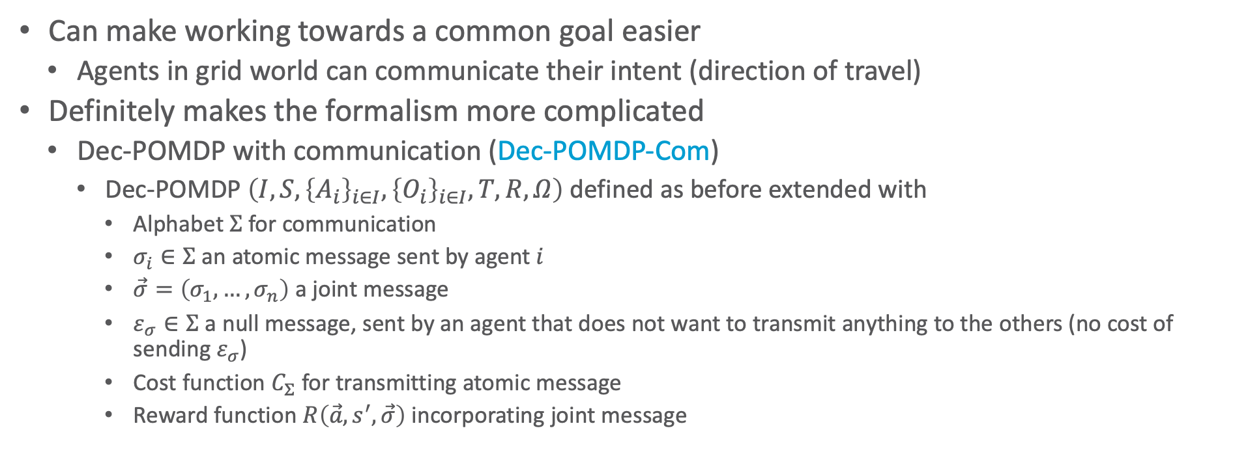
Communication?
Can make working towards a common goal easier
  Agents in grid world can communicate their intent (direction of travel)
Definitely makes the formalism more complicated
  Dec-POMDP with communication (Dec-POMDP-Com)
    Dec-POMDP $\left(I,S, {\left\{A_{i}\right\}}_{i∈I}, {\left\{O_{i}\right\}}_{i∈I},T,R,Ω\right)$ defined as before extended with
      Alphabet $Σ$ for communication
        $σ_{i}∈Σ$ an atomic message sent by agent $i$
        $\vec{σ}=\left(σ_{1},…,σ_{n}\right)$ a joint message
        $ε_{σ}∈Σ$ a null message, sent by an agent that does not want to transmit anything to the others (no cost of sending $ε_{σ}$)
      Cost function $C_{Σ}$ for transmitting atomic message
      Reward function $R\left(\vec{a},s^{′},\vec{σ}\right)$ incorporating joint message
  New dimensions:
  Do agents always share information?
  Can they intentionally withhold information?
  Can they lie?

Slide 35
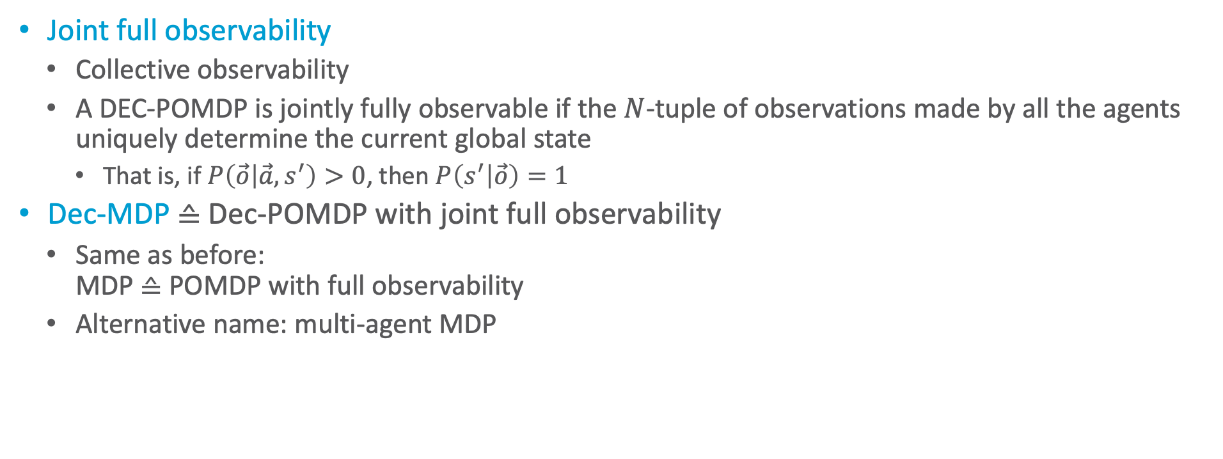
Dec-MDP
Joint full observability
  Collective observability
  A DEC-POMDP is jointly fully observable if the $N$-tuple of observations made by all the agents uniquely determine the current global state
    That is, if $P\left(\vec{o} | \vec{a}, s^{′}\right)>0$, then $P\left(s^{′} | \vec{o}\right)=1$
Dec-MDP ≙ Dec-POMDP with joint full observability
  Same as before:
  MDP ≙ POMDP with full observability
  Alternative name: multi-agent MDP

Slide 36
Solving Dec-POMDPs
Problem: No joint belief available
  Only partial information about state available to each agent
Complexity: NEXP-complete
  Optimal solutions using dynamic programming paradigm + exploiting structure if present
  Reduction to NP when agents mostly independent + communication can be explicitly modelled and analysed
    Requires that one can factorise the joint state space into a state space for each agent that is mostly independent of all others
    The same goes for the observations and the reward function

Slide 37
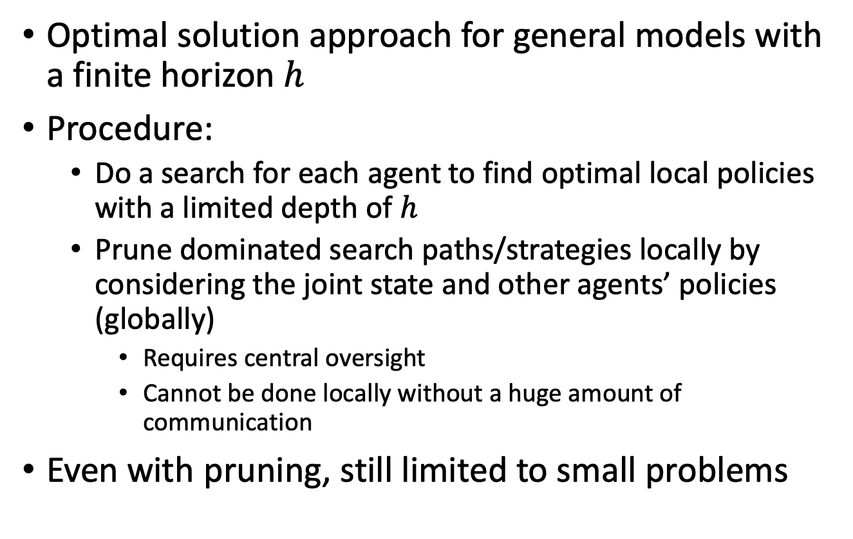
Exhaustive Search
Optimal solution approach for general models with a finite horizon $h$
Procedure:
  Do a search for each agent to find optimal local policies with a limited depth of $h$
  Prune dominated search paths/strategies locally by considering the joint state and other agents’ policies (globally)
    Requires central oversight
    Cannot be done locally without a huge amount of communication
Even with pruning, still limited to small problems

Slide 38

Multi-agent Dynamic Programming
Iteratively eliminate weakly-dominated policy trees using a dynamic programming
  A policy $π_{i,j}^{t}$ of agent $i$ is weakly dominated if there always exists another policy $π_{i,j^{′}}^{t}$ with higher value over all possible states $s$ and all possible policies of the other agents $π_{−i}^{t}$:
  $$∀s∈S, π_{−i}^{t}∈Π_{−i}^{t} ∃π_{i,j^{′}}^{t}∈Π_{i}^{t}:V_{i}\left(s,π_{i,j}^{t},π_{−i}^{t}\right)≤V_{i}\left(s,π_{i,j^{′}}^{t},π_{−i}^{t}\right)$$
    Solvable by a linear programme
Dynamic Programming Operator:
Input: sets of policies and corresponding value vectors for each agent.
Process:
  Perform exhaustive backup using policies for each agent.
  Calculate new value vectors.
  Prune weakly dominated policies per agent.
Output: Updated sets of policies and value vectors for each agent.
Hansen, E. A., Bernstein, D. S., & Zilberstein, S. 2004

Slide 39
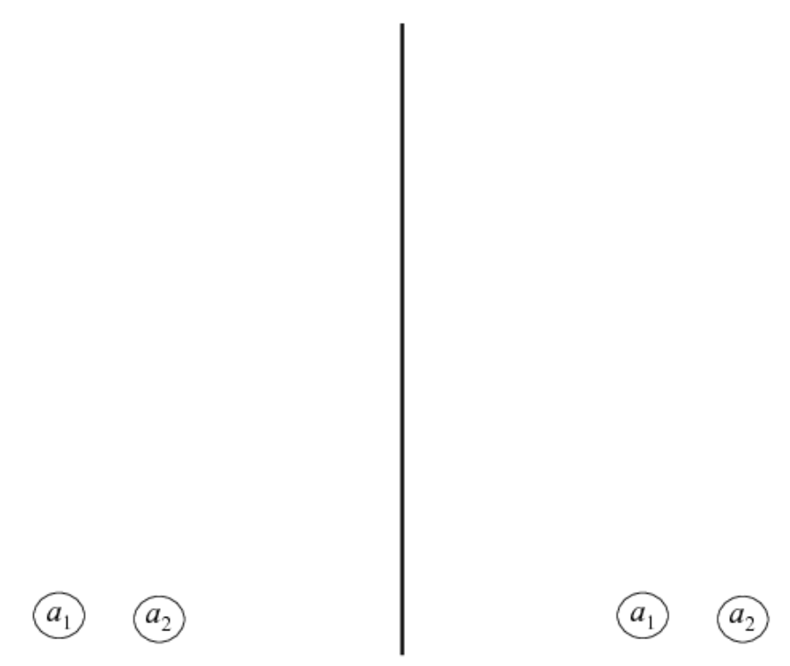
Exhaustive Search and Pruning
With Pruning
Without Pruning

Slide 40
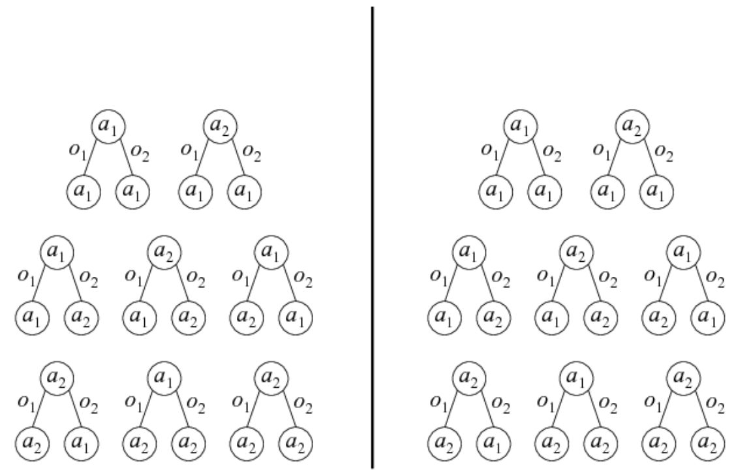
Exhaustive Search and Pruning
With Pruning
Without Pruning

Slide 41
Exhaustive Search and Pruning
With Pruning
Without Pruning

Slide 42
Exhaustive Search and Pruning
With Pruning
Without Pruning

Slide 43
Exhaustive Search and Pruning
With Pruning
Without Pruning

Slide 44
Exhaustive Search and Pruning
With Pruning
Without Pruning

Slide 45
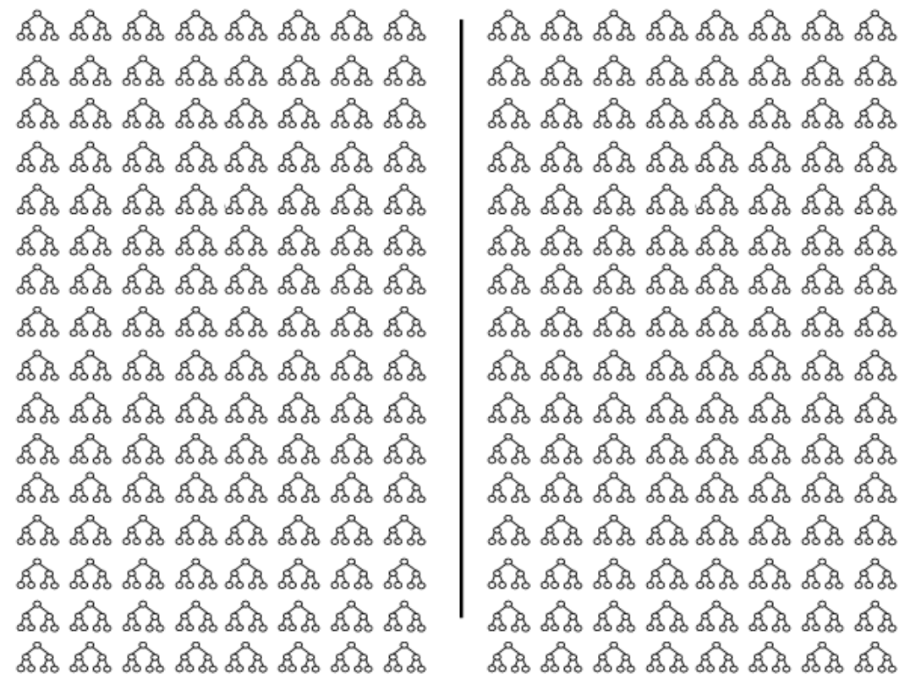
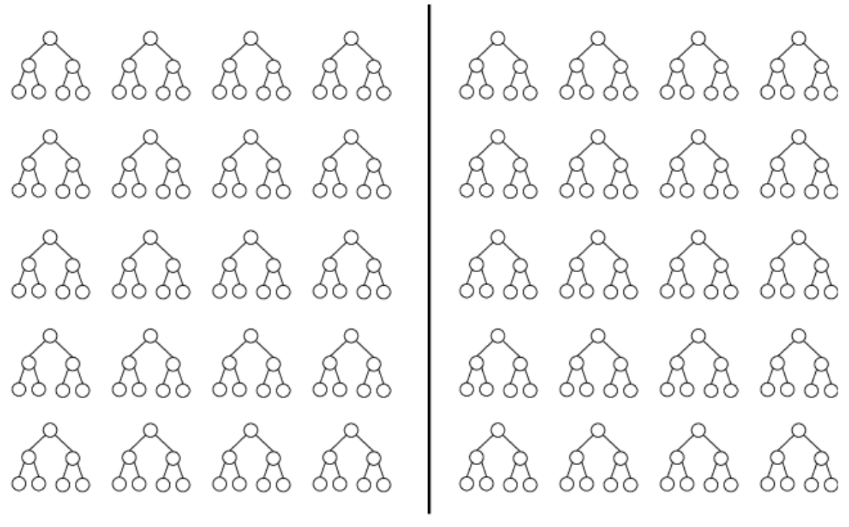
Exhaustive Search and Pruning
With Pruning
Without Pruning

Slide 46
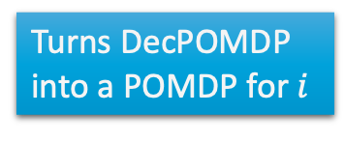
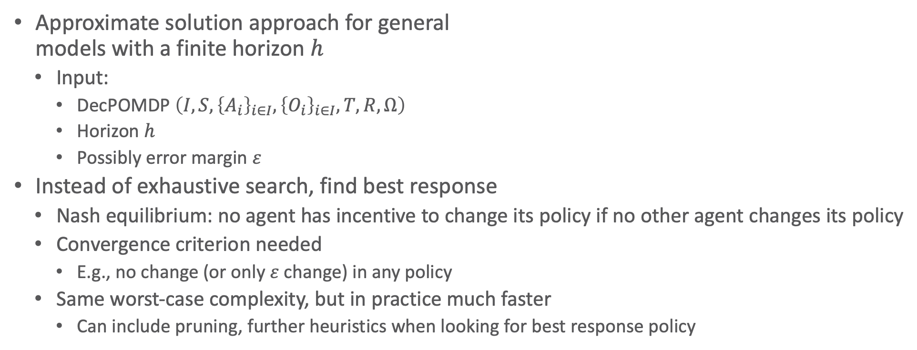
Joint Equilibrium Search for Policies
Approximate solution approach for general
models with a finite horizon $h$
  Input:
    DecPOMDP $\left(I,S, {\left\{A_{i}\right\}}_{i∈I}, {\left\{O_{i}\right\}}_{i∈I},T,R,Ω\right)$
    Horizon $h$
    Possibly error margin $ε$
Instead of exhaustive search, find best response
  Nash equilibrium: no agent has incentive to change its policy if no other agent changes its policy
  Convergence criterion needed
    E.g., no change (or only $ε$ change) in any policy
  Same worst-case complexity, but in practice much faster
    Can include pruning, further heuristics when looking for best response policy
JESP(dec-pomdp, h)
while not converged do
for i = 1 to n do
Fix other agent policies
Find a best response policy for agent i
Turns DecPOMDP into a POMDP for $i$

Slide 47




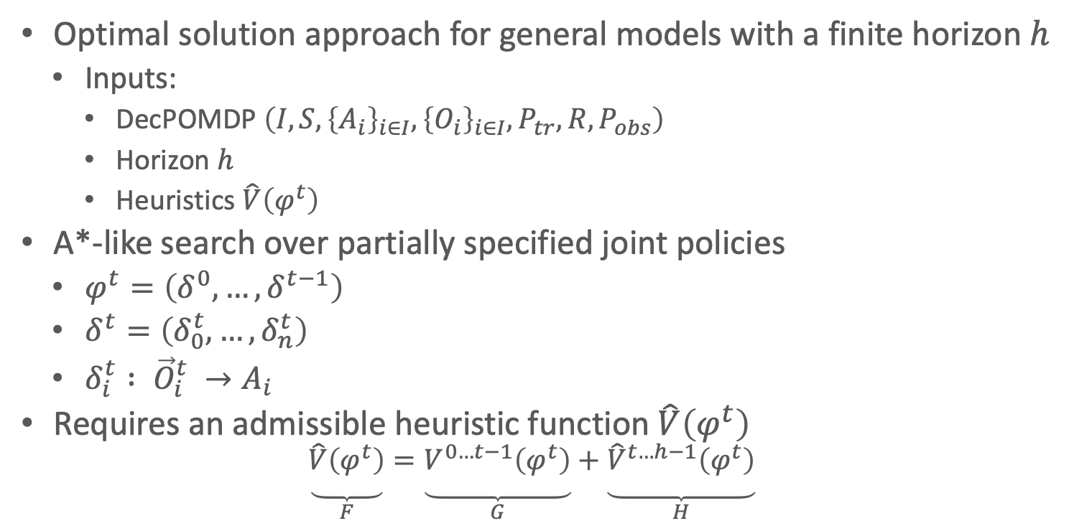







Multi-agent A* (MAA*)
Optimal solution approach for general models with a finite horizon $h$
  Inputs:
    DecPOMDP $\left(I,S, {\left\{A_{i}\right\}}_{i∈I}, {\left\{O_{i}\right\}}_{i∈I},P_{tr},R,P_{obs}\right)$
    Horizon $h$
    Heuristics $\hat{V}\left(φ^{t}\right)$
A*-like search over partially specified joint policies
  $φ^{t}=\left(δ^{0},…,δ^{t−1}\right)$
  $δ^{t}=\left(δ_{0}^{t}, …, δ_{n}^{t}\right)$
  $δ_{i}^{t} : {\vec{O}}_{i}^{t} →A_{i}$
Requires an admissible heuristic function $\hat{V}\left(φ^{t}\right)$
  $$\underset{\begin{aligned} \\ \\ F\end{aligned}}{\underbrace{\hat{V}\left(φ^{t}\right)}}=\underset{\begin{aligned} \\ \\ G\end{aligned}}{\underbrace{V^{0…t−1}\left(φ^{t}\right)}}+\underset{\begin{aligned} \\ \\ H\end{aligned}}{\underbrace{{\hat{V}}^{t…h−1}\left(φ^{t}\right)}}$$
$$φ^{0}$$
$$δ^{0}$$
$$δ^{0′′}$$
$$δ^{0′}$$
$$φ^{1}$$
$$φ^{1′}$$
. . .
$$φ^{1′′}$$
$$δ^{1}$$
$$δ^{1′}$$
$$φ^{2}$$
. . .
$$φ^{2′}$$

Slide 48
How to Get a Heuristic Function?
Solve simplified settings, e.g.,
  Solve the underlying MDP (approximately or optimally) given assumptions:
    Centralised observations
    Full observability
      Simulate / sample unobserved values
  Solve a belief MDP given assumption
    Centralised observations
Domain-specific heuristics

Slide 49
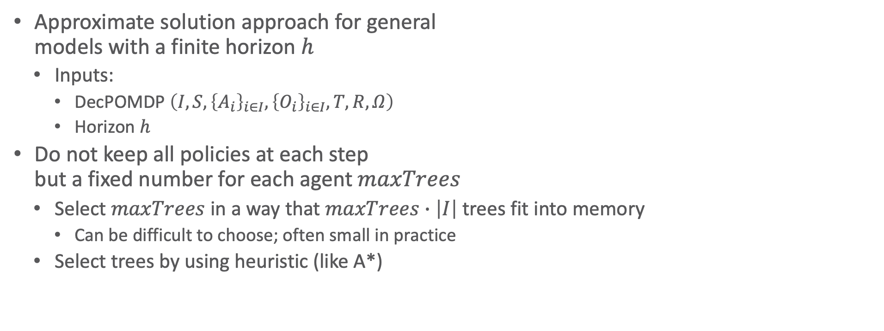
Memory Bounded Search
Approximate solution approach for general
models with a finite horizon $h$
  Inputs:
    DecPOMDP $\left(I,S, {\left\{A_{i}\right\}}_{i∈I}, {\left\{O_{i}\right\}}_{i∈I},T,R,Ω\right)$
    Horizon $h$
Do not keep all policies at each step
but a fixed number for each agent $maxTrees$
  Select $maxTrees$ in a way that $maxTrees∙\left|I\right|$ trees fit into memory
    Can be difficult to choose; often small in practice
  Select trees by using heuristic (like A*)
MBDP(dec-pomdp, h)
Start with a one-step policy for each agent
for t = h downto 1 do
Backup each agent’s policy
for k = 1 to maxTrees do
Compute heuristic policy and resulting
belief state b
Choose best set of trees starting at b
Select best set of trees for initial state b₀
MBDP =
Memory
Bounded
Dynamic
Programming

Slide 50
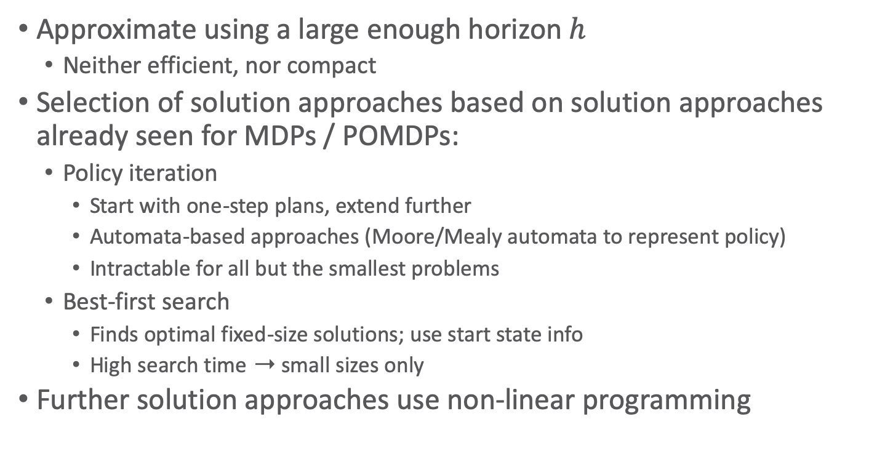
Infinite Horizon
Approximate using a large enough horizon $h$
  Neither efficient, nor compact
Selection of solution approaches based on solution approaches already seen for MDPs / POMDPs:
  Policy iteration
    Start with one-step plans, extend further
    Automata-based approaches (Moore/Mealy automata to represent policy)
    Intractable for all but the smallest problems
  Best-first search
    Finds optimal fixed-size solutions; use start state info
    High search time ➝ small sizes only
Further solution approaches use non-linear programming

Slide 51
Indefinite Horizon
Many natural problems terminate after a goal is reached
  Meeting or catching a target
  Cooperatively completing a task
Unclear how many steps are needed until termination
Under certain assumptions can produce an optimal solution
  E.g., terminal actions and negative rewards
    Such as the 4x3 grid:
    terminal states, negative rewards for all but one terminal state
Otherwise, can bound the solution quality by sampling

Slide 52
Benchmark Problems
DEC-Tiger
  (Nair et al., 2003)
BroadcastChannel
  (Hansen et al., 2004)
Meeting on a grid
  (Bernstein et al., 2005)
Cooperative Box Pushing
  (Seuken and Zilberstein, 2007a)
Recycling Robots
  (Amato et al., 2007)
FireFighting
  (Oliehoek et al., 2008b)
Sensor network problems
  (Nair et al., 2005; Kumar and Zilberstein, 2009a,b)

Slide 53
Software for Dec-POMDPs
The MADP toolbox aims to provide a software platform for research in decision-theoretic multiagent planning
(Spaan and Oliehoek, 2008)
Main features:
  Uniform representation for several popular multiagent models
  Parser for a file format for discrete Dec-POMDPs
  Shared functionality for planning algorithms
  Implementation of several Dec-POMDP planners
Released as free software, with special attention to the extensibility of the toolbox
Provides benchmark problems
  Such as on the previous slide

Slide 54
agents: 2
discount: 1
values: reward
states: tiger-left tiger-right
start:
uniform
actions:
listen open-left open-right
listen open-left open-right
observations:
hear-left hear-right
hear-left hear-right
#include "ProblemDecTiger.h"
#include "JESPExhaustivePlanner.h"
int main()
{
ProblemDecTiger dectiger;
JESPExhaustivePlanner jesp(3,&dectiger);
jesp.Plan();
std::cout
<< jesp.GetExpectedReward()
<< std::endl;
std::cout
<< jesp.GetJointPolicy()->SoftPrint()
<< std::endl;
return(0);
}
# Transitions
T: * :
uniform
T: listen listen :
identity
# Observations
O: * :
uniform
O: listen listen : tiger-left : hear-left hear-left : 0.7225
O: listen listen : tiger-left : hear-left hear-right : 0.1275
[...]
O: listen listen : tiger-right : hear-left hear-left : 0.0225
# Rewards
R: listen listen : * : * : * : -2
R: open-left open-left : tiger-left : * : * : -50
[...]
R: open-left listen: tiger-right : * : * : 9
Dec-Tiger Problem Specification and Program

Slide 55
Interim Summary
Dec-POMDPs
  Local policies, joint policy, value functions
  Communication, full observability, Dec-MDP
Solutions for
  Finite horizon
  Infinite horizon
  Indefinite horizon
MADP toolbox
  Benchmark problems

Slide 56
Hierarchy of Formalisms
Most general: POSG
  Set of agents, individual reward functions
  Environment only partially observable
Specifications
  Decentralisation
    Joint reward function
  2a. Observable environment
  2b. Multi to single agent
Most specific: MDP
  One agent, (therefore) one reward function
  Observable environment
POSG
Dec-POMDP
POMDP
MDP
Dec-MDP
Modelling without any structure
in the agent set or state space
➝ potential for efficiency wasted

Slide 57
Outline: Decision Making – Extensions
Partially Observable Markov Decision Process (POMDP)
  POMDP agent, belief state, belief MDP
  Conditional plans, value iteration
Decentralised POMDP (Dec-POMDP)
  Dec-POMDP, local policy, joint policy, value function
  Communication, full observability, Dec-MDP
  Solutions for finite, infinite, indefinite horizon
⟹ Next: Decision Making – Structure

