Slide 1
Automated Planning and Acting
0.812
0.868
0.918
+1
3
0.762
0.660
-1
2
1
0.705
0.655
0.611
0.388
Decision Making: Foundations
1
2
3
4
Tanya Braun
Research Group Data Science, Computer Science Department

Slide 2
Content: Planning and Acting
With Deterministic Models
With Temporal Models
With Nondeterministic Models
With Probabilistic Models
By Decision Making
Foundations
Utility theory
Markov decision processes
Reinforcement learning
Extensions
Structure
With Human-awareness
Notes:
1-4, 6: Planning book
5, 7: AIMA
8: Rao

Slide 3
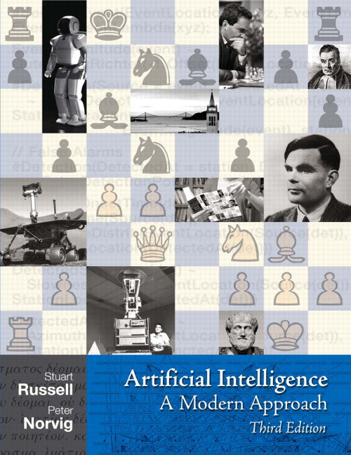

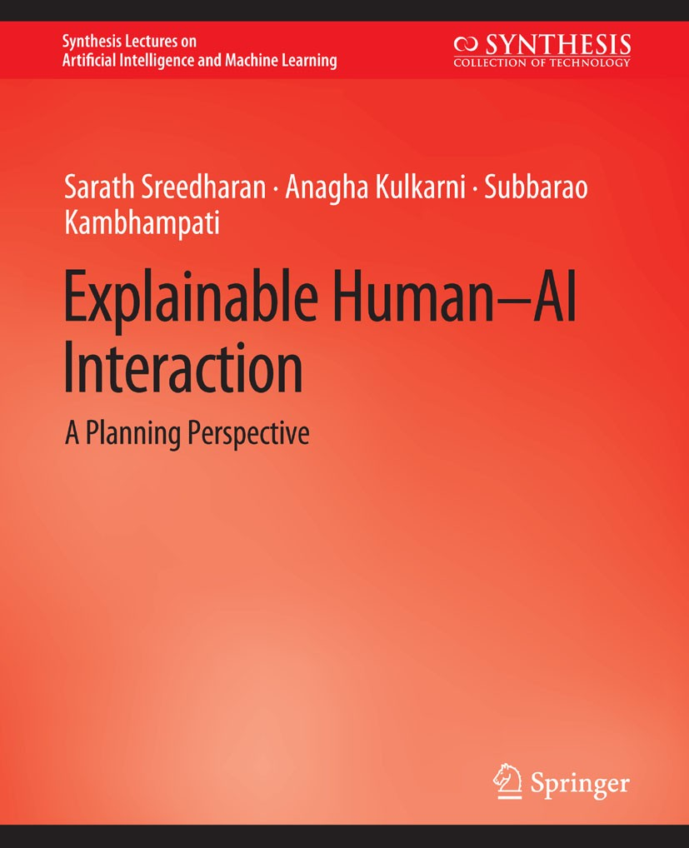
Literature
We leave behind the planning book…
Content based on
Artificial Intelligence: A Modern Approach (3rd ed.; abbreviation: AIMA)
Stuart Russell, Peter Norvig
Decision making (Chs. 16 + 17), reinforcement learning (Ch. 21)
A Concise Introduction to Decentralized POMDPs
Frans A. Oliehoek, Christopher Amato
Explainable Human-AI Interaction: A Planning Perspective
Sarath Sreedharan, Anagha Kulkarni, Subbarao Kambhampati
Further research papers announced in lectures
I do not expect you to read all the books!
http://aima.cs.berkeley.edu
https://link.springer.com/book/10.1007/978-3-319-28929-8
https://link.springer.com/book/10.1007/978-3-031-03767-2

Slide 4

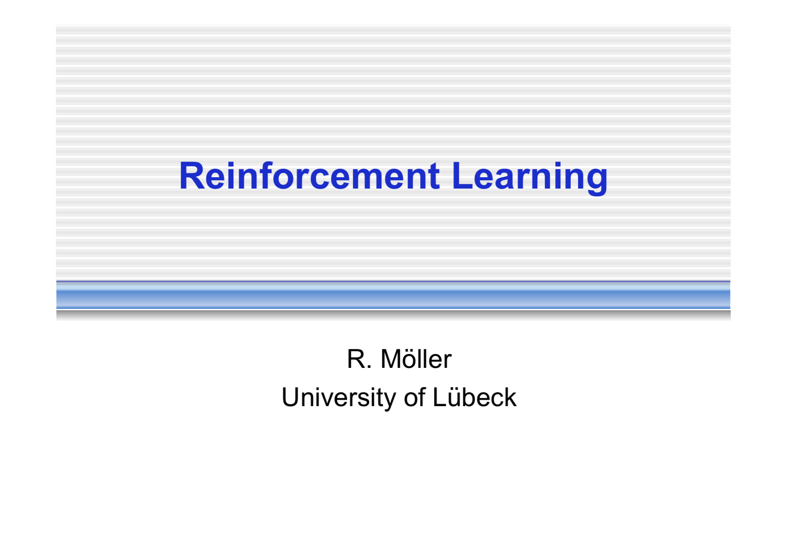

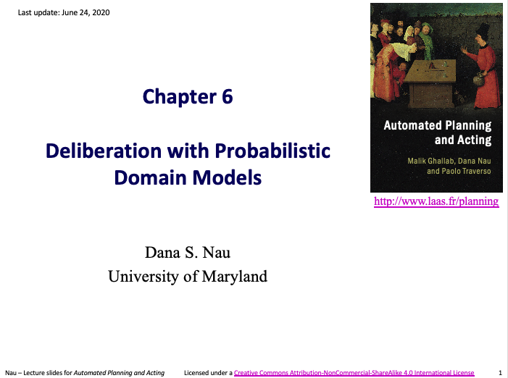
Acknowledgements
Slides based on material provided by Dana Nau, Ralf Möller, and Shengyu Zhang
In part based on AIMA Book, Chapters 16, 17, 21
http://people.eecs.berkeley.edu/~russell/talks/2020/russell-aaai20-hntdtwwai-4x3.pptx
http://rbr.cs.umass.edu/camato/decpomdp/overview.html

Slide 5
Decision Making under Uncertainty
Goal-based: binary distinction between happy and unhappy
Utility as a distribution over possible states
Essentially an internalisation of a performance measure
If internal utility function agrees with external performance measure:
Agent that chooses actions to maximize its utility will be rational according to the external performance measure
Rationality as a measure of intelligence
Agent
Environment
Sensors
State
What the world
is like now
How the world evolves
What my actions do
What it will be like if I do action $A$
Utility
How happy I will be in such a state
What action I should do now
Actuators
Figure: AIMA, Russell/Norvig

Slide 6
Setting
Agent can perform actions in an environment
Environment
Outcomes of actions not unique
Associated with probabilities (➝ probabilistic model)
Agent has preferences over states/action outcomes
Encoded in utility or utility function ➝ Utility theory
“Decision theory = Utility theory + Probability theory”
Model the world with a probabilistic model
Model preferences with a utility (function)
Find action that leads to the maximum expected utility, also called decision making

Slide 7
Outline: Decision Making – Foundations
Utility Theory
Preferences
Utilities
Preference structure
Markov Decision Process / Problem (MDP)
Sequence of actions, history, policy
Value iteration, policy iteration
Reinforcement Learning (RL)
Passive and active, model-free and model-based RL
Multi-armed bandit
Notes:
Utility theory / decision theory: background in economy / operations research / insurance industry

Slide 8
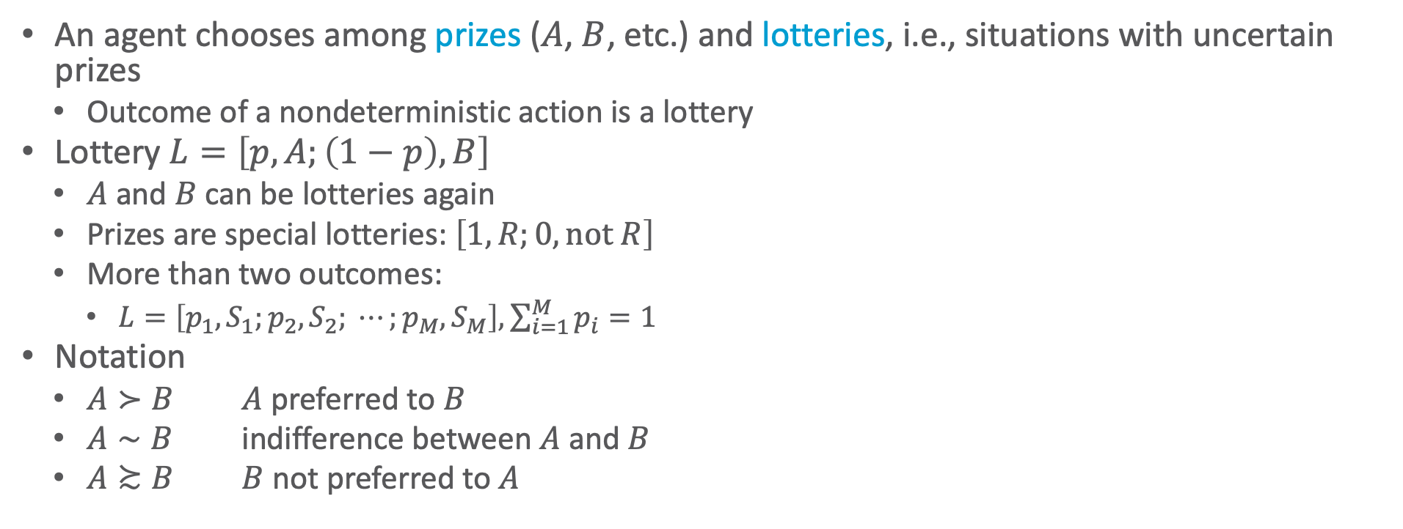
Preferences
An agent chooses among prizes ($A$, $B$, etc.) and lotteries, i.e., situations with uncertain prizes
Outcome of a nondeterministic action is a lottery
Lottery $L=\left[p,A;\left(1−p\right), B\right]$
$A$ and $B$ can be lotteries again
Prizes are special lotteries: $\left[1,R;0, \text{not} R\right]$
More than two outcomes:
$L=\left[p_{1},S_{1};p_{2}, S_{2}; ⋯;p_{M}, S_{M}\right], \sum_{i=1}^{M}{p_{i}}=1$
Notation
$A≻B$ $A$ preferred to $B$
$A∼B$ indifference between $A$ and $B$
$A≿B$ $B$ not preferred to $A$
Notes:
Think of the set of outcomes for each action as a lottery—think of each action as a ticket

Slide 9
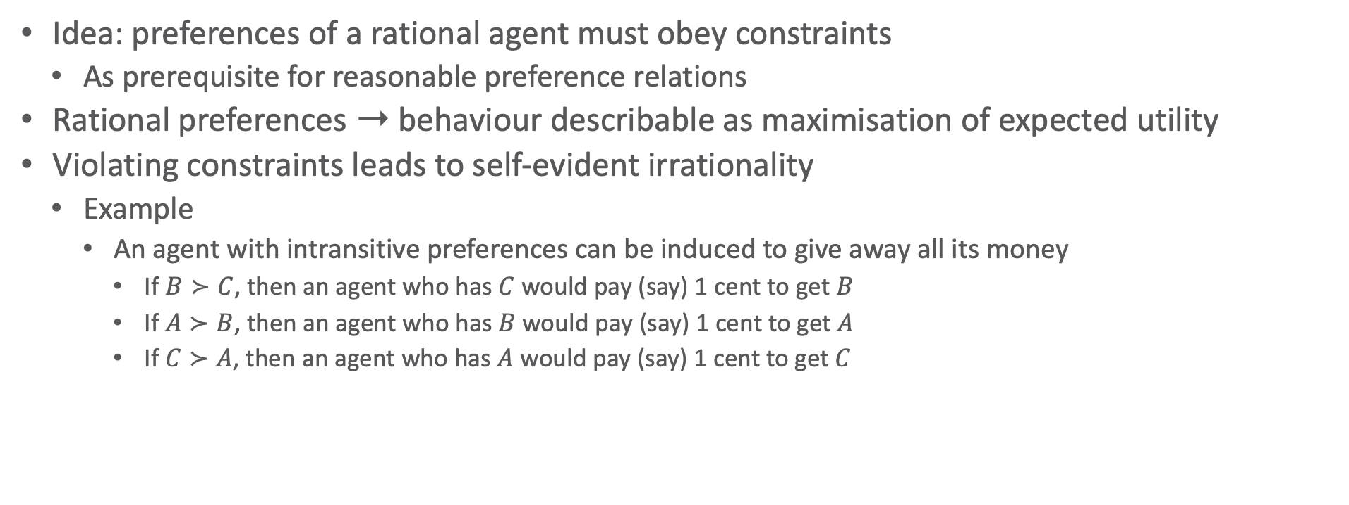
Rational Preferences
Idea: preferences of a rational agent must obey constraints
As prerequisite for reasonable preference relations
Rational preferences ➝ behaviour describable as maximisation of expected utility
Violating constraints leads to self-evident irrationality
Example
An agent with intransitive preferences can be induced to give away all its money
If $B≻C$, then an agent who has $C$ would pay (say) 1 cent to get $B$
If $A≻B$, then an agent who has $B$ would pay (say) 1 cent to get $A$
If $C≻A$, then an agent who has $A$ would pay (say) 1 cent to get $C$
B
A
C
1ct
1ct
1ct

Slide 10


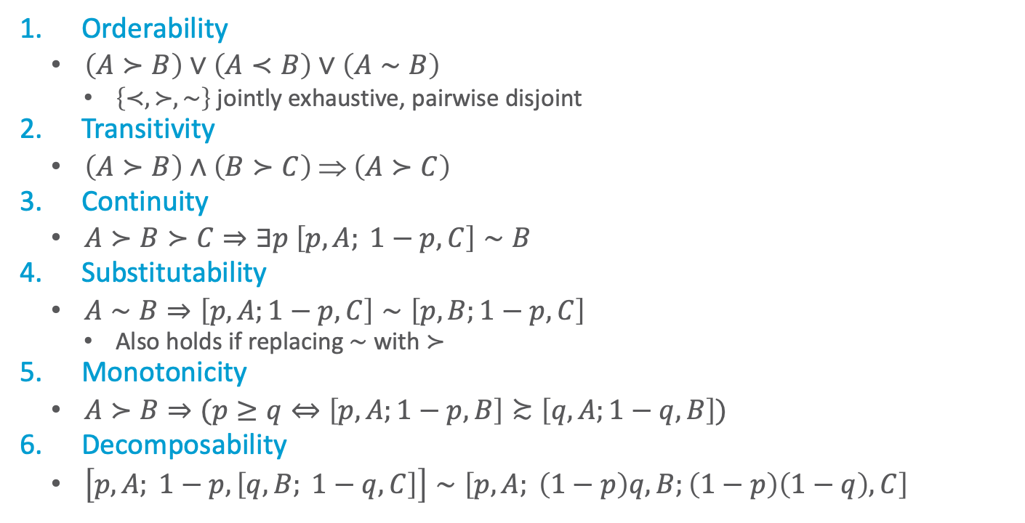










Axioms of Utility Theory
Orderability
$\left(A≻B\right)∨\left(A≺B\right)∨\left(A∼B\right)$
$\left\{≺,≻, \sim \right\}$ jointly exhaustive, pairwise disjoint
Transitivity
$\left(A≻B\right)∧\left(B≻C\right) ⇒ \left(A≻C\right)$
Continuity
$A≻B≻C⇒∃p \left[p,A; 1−p,C\right]∼B$
Substitutability
$A∼B⇒\left[p,A;1−p,C\right]∼\left[p,B;1−p,C\right]$
Also holds if replacing $∼$ with $≻$
Monotonicity
$A≻B⇒(p≥q⇔\left[p,A;1−p,B\right]≿\left[q,A;1−q,B\right])$
Decomposability
$\left[p,A; 1−p, \left[q,B; 1−q, C\right]\right]∼\left[p,A; \left(1−p\right)q, B;\left(1−p\right)\left(1−q\right), C\right]$
Decomposability:
There is no fun in gambling.
Equivalent lotteries:
$$p$$
$$A$$
$$q$$
$$B$$
$$1−p$$
$$1−q$$
$$C$$
$$p$$
$$A$$
$$B$$
$$\left(1−p\right)q$$
$$\left(1−p\right)\left(1−q\right)$$
$$C$$
Notes:
Orderability: Agent has to decide (refusing to bet is like refusing to allow time to pass)
Transitivity: example did not follow this axiom
Continuity: Agent will be indifferent between getting $B$ for sure and the lottery that yields $A$ with probability $p$ and $C$ with probability $1−p$
Substitutability: If agent is indifferent between A und B, then it is indifferent between the two if they are part of a more complex lottery
Monotonicity: A preferred over B, then lottery with higher probability for A preferred
Decomposability: Compound lotteries can be reduced to simpler ones using laws of probability (deep models equivalent to broad models); We can account for the enjoyment of gambling by encoding gambling events into the state description; for example, “Have $10 and gambled” could be preferred to “Have $10 and didn’t gamble.”

Slide 11
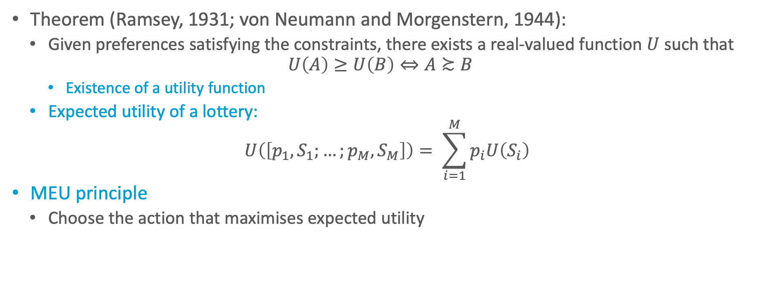
And Then There Was Utility
Theorem (Ramsey, 1931; von Neumann and Morgenstern, 1944):
Given preferences satisfying the constraints, there exists a real-valued function $U$ such that
$$U\left(A\right)≥U\left(B\right)⇔A≿B$$
Existence of a utility function
Expected utility of a lottery:
$$U\left(\left[p_{1}, S_{1};…;p_{M},S_{M}\right]\right)= \sum_{i=1}^{M}{p_{i}U\left(S_{i}\right)}$$
MEU principle
Choose the action that maximises expected utility

Slide 12
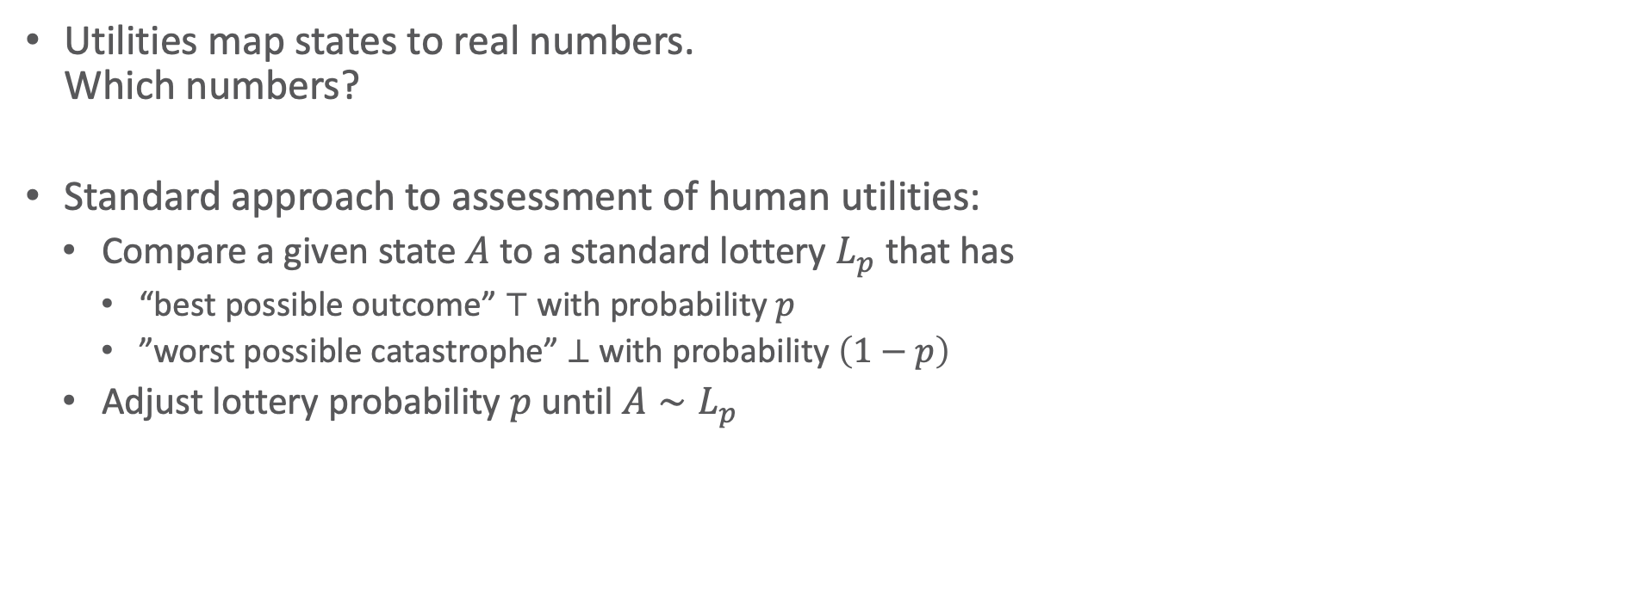



Utilities
Utilities map states to real numbers. Which numbers?
Standard approach to assessment of human utilities:
Compare a given state $A$ to a standard lottery $L_{p}$ that has
“best possible outcome” $⊤$ with probability $p$
”worst possible catastrophe” $⊥$ with probability $\left(1−p\right)$
Adjust lottery probability $p$ until $A∼L_{p}$
$$0.999999$$
continue as before
pay-$30-and-continue-as-before
$$∼L$$
$$0.000001$$
instant death

Slide 13
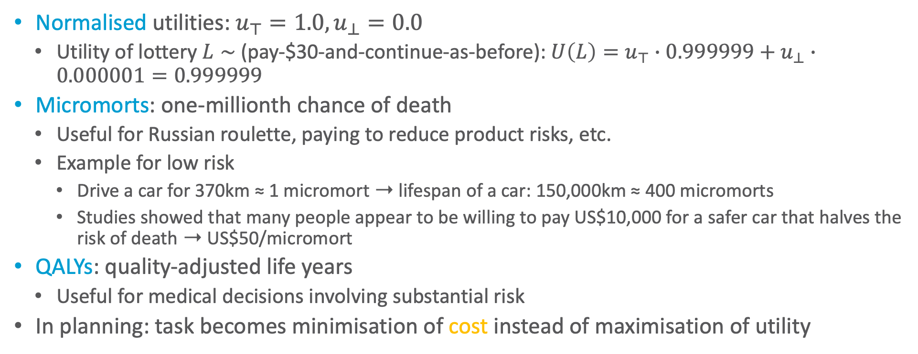
Utility Scales
Normalised utilities: $u_{⊤}=1.0,u_{⊥}=0.0$
Utility of lottery $L∼$ (pay-$30-and-continue-as-before): $U\left(L\right)=u_{⊤}∙0.999999+u_{⊥}∙0.000001=0.999999$
Micromorts: one-millionth chance of death
Useful for Russian roulette, paying to reduce product risks, etc.
Example for low risk
Drive a car for 370km ≈ 1 micromort ➝ lifespan of a car: 150,000km ≈ 400 micromorts
Studies showed that many people appear to be willing to pay US$10,000 for a safer car that halves the risk of death ➝ US$50/micromort
QALYs: quality-adjusted life years
Useful for medical decisions involving substantial risk
In planning: task becomes minimisation of cost instead of maximisation of utility

Slide 14
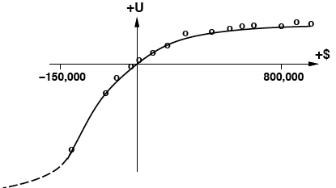
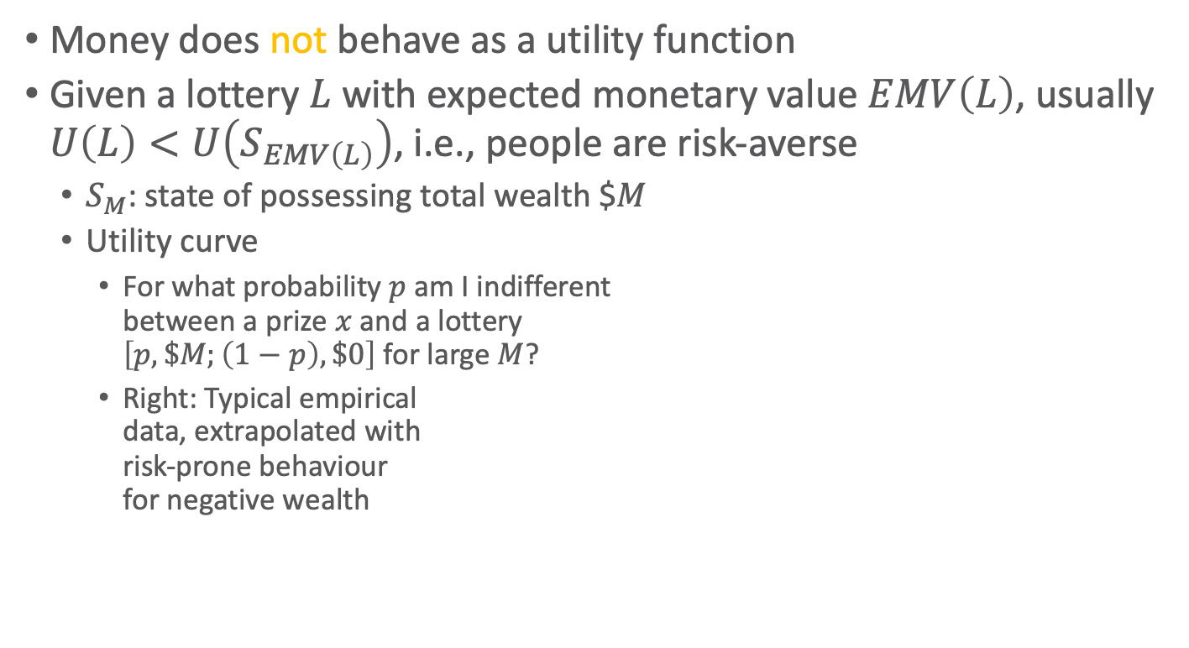
Money
Money does not behave as a utility function
Given a lottery $L$ with expected monetary value $EMV\left(L\right)$, usually $U\left(L\right)<U\left(S_{EMV\left(L\right)}\right)$, i.e., people are risk-averse
$S_{M}$: state of possessing total wealth $$M$
Utility curve
For what probability $p$ am I indifferent between a prize $x$ and a lottery $\left[p,\$M;\left(1−p\right),\$0\right]$ for large $M$?
Right: Typical empirical data, extrapolated with risk-prone behaviour for negative wealth
Figure: AIMA, Russell/Norvig
Notes:
Utility theory: roots in economics; obvious candidate: money (or an agent’s total net assets)
agent prefers more money to less, all other things being equal, exhibits a monotonic preference for more money; nothing about preferences between lotteries involving money
logarithmic utility function; should not assume that this is the definitive utility function for monetary value, but it is likely that most people have a utility function that is concave for positive wealth

Slide 15
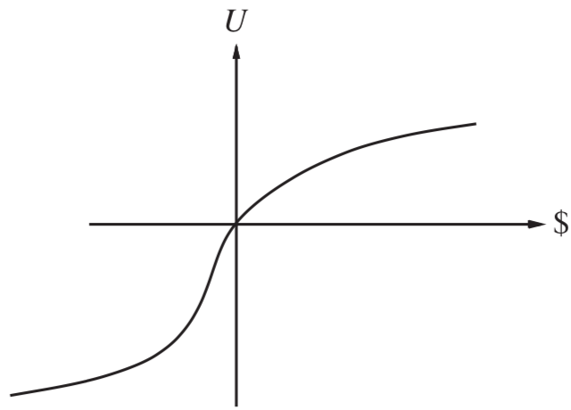

Money Versus Utility
Money $≠$ Utility
More money is better, but not always in a linear relationship to the amount of money
Expected Monetary Value
Risk-averse
$U\left(L\right)<U\left(S_{EMV\left(L\right)}\right)$
Risk-seeking
$U\left(L\right)>U\left(S_{EMV\left(L\right)}\right)$
Risk-neutral
$U\left(L\right)=U\left(S_{EMV\left(L\right)}\right)$
Linear curve
For small changes in wealth relative to current wealth
Figure: AIMA, Russell/Norvig
Notes:
Averse: prefer a sure thing with a payoff that is less than the expected monetary value of a gamble
Seeking: someone already $10,000,000 in debt might well accept a gamble on a fair coin with a gain of $10,000,000 for heads and a loss of $20,000,000 for tails; Such behaviour might be called desperate, but it is rational if one is already in a desperate situation.
Neutral: Risk aversion is the basis for the insurance industry; People would rather pay a small insurance premium than gamble the price of their house against the chance of a fire. From the insurance company’s point of view, the price of the house is very small compared with the firm’s total reserves. This means that the insurer’s utility curve is approximately linear over such a small region, and the gamble costs the company almost nothing.

Slide 16
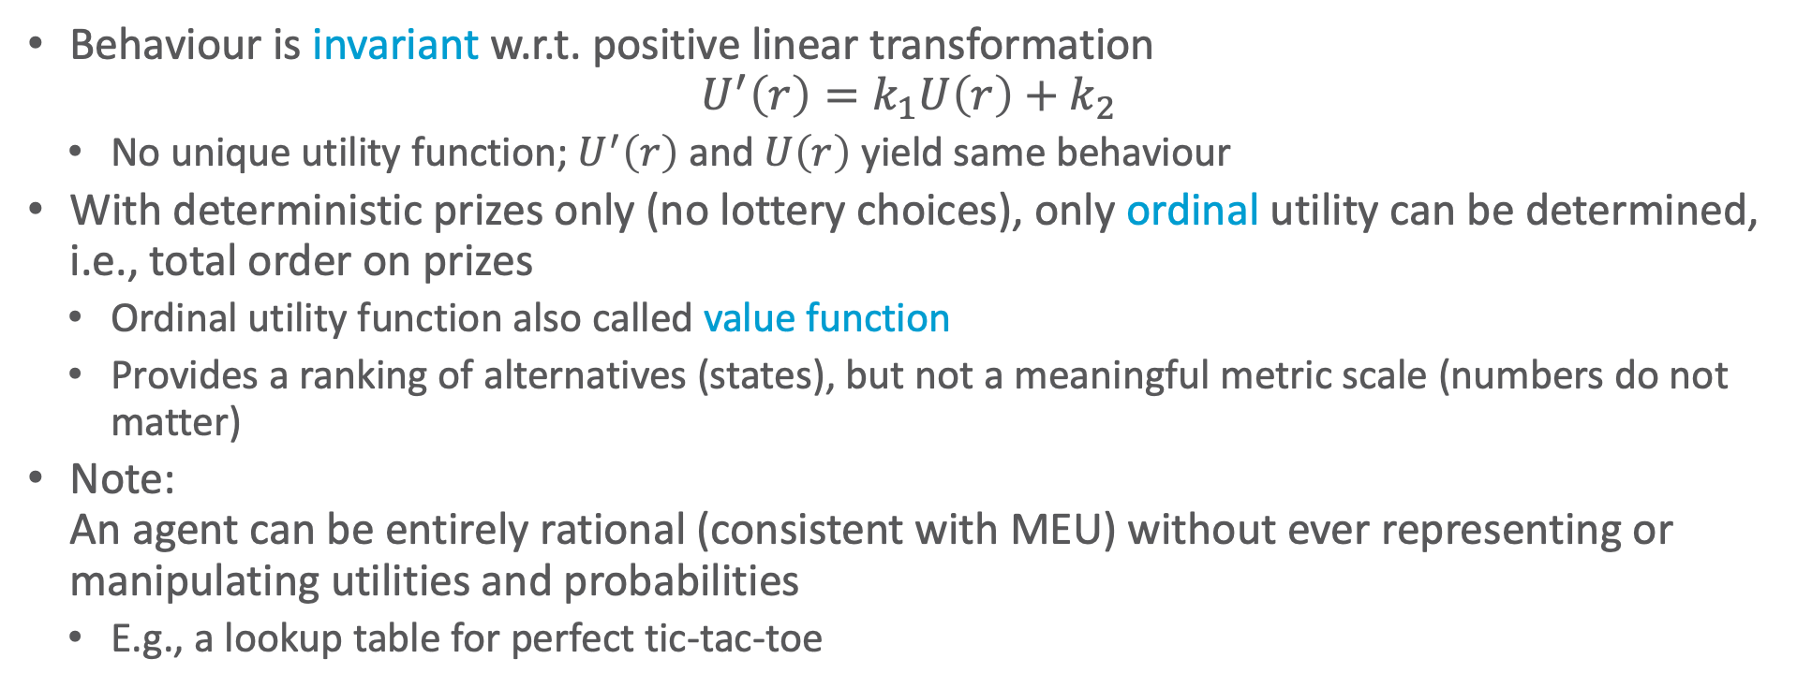
Utility Scales
Behaviour is invariant w.r.t. positive linear transformation
$$U^{′}\left(r\right)=k_{1}U\left(r\right)+k_{2}$$
No unique utility function; $U^{′}\left(r\right)$ and $U\left(r\right)$ yield same behaviour
With deterministic prizes only (no lottery choices), only ordinal utility can be determined, i.e., total order on prizes
Ordinal utility function also called value function
Provides a ranking of alternatives (states), but not a meaningful metric scale (numbers do not matter)
Note: An agent can be entirely rational (consistent with MEU) without ever representing or manipulating utilities and probabilities
E.g., a lookup table for perfect tic-tac-toe

Slide 17
Multi-attribute Utility Theory
A given state may have multiple utilities
...because of multiple evaluation criteria
...because of multiple agents (interested parties) with different utility functions
There are:
Cases in which decisions can be made without combining the attribute values into a single utility value
Strict dominance
Cases in which the utilities of attribute combinations can be specified very concisely
Preference structure
Notes:
Siting a new airport requires consideration of
disruption caused by construction;
the cost of land;
the distance from centers of population;
the noise of flight operations;
safety issues arising from local topography and weather conditions

Slide 18
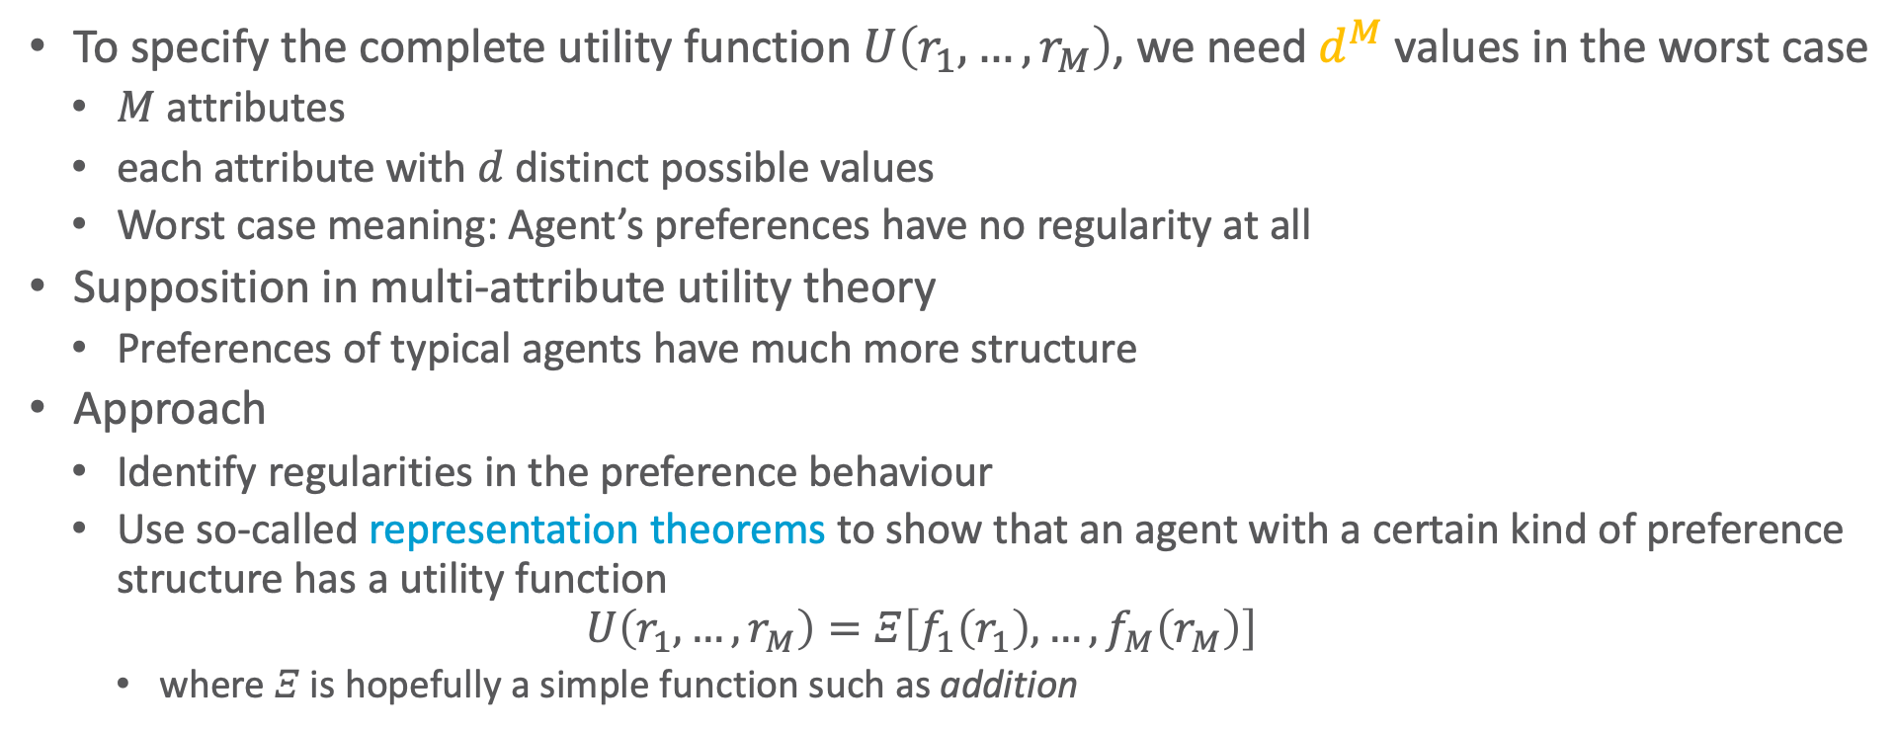
Preference Structure
To specify the complete utility function $U\left(r_{1},…,r_{M}\right)$, we need $d^{M}$ values in the worst case
$M$ attributes
each attribute with $d$ distinct possible values
Worst case meaning: Agent’s preferences have no regularity at all
Supposition in multi-attribute utility theory
Preferences of typical agents have much more structure
Approach
Identify regularities in the preference behaviour
Use so-called representation theorems to show that an agent with a certain kind of preference structure has a utility function
$$U\left(r_{1},…,r_{M}\right)=Ξ\left[f_{1}\left(r_{1}\right),…,f_{M}\left(r_{M}\right)\right]$$
where $Ξ$ is hopefully a simple function such as addition
Notes:
Similar to Bayesian networks that decompose the joint probability of several random variables

Slide 19
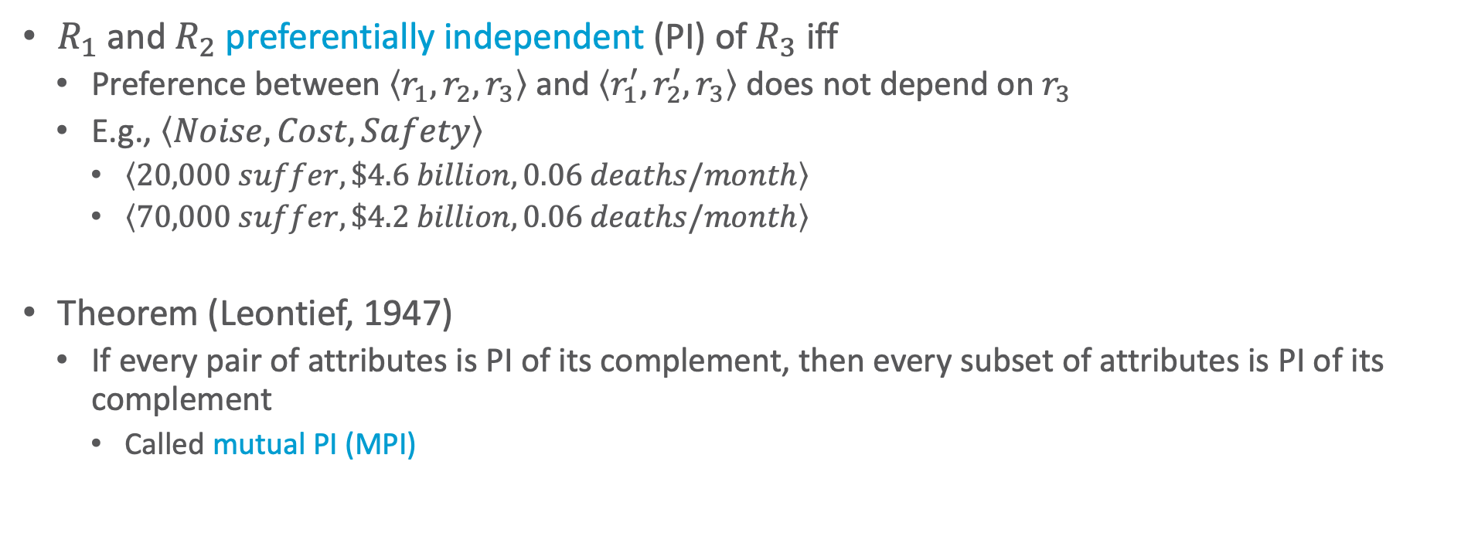
Preference Independence
$R_{1}$ and $R_{2}$ preferentially independent (PI) of $R_{3}$ iff
Preference between $\left\langle r_{1},r_{2},r_{3}\right\rangle$ and $\left\langle r_{1}^{′},r_{2}^{′},r_{3}\right\rangle$ does not depend on $r_{3}$
E.g., $\left\langle Noise, Cost, Safety\right\rangle$
$\left\langle 20,000 suffer, \$4.6 billion, 0.06 deaths/month\right\rangle$
$\left\langle 70,000 suffer, \$4.2 billion, 0.06 deaths/month\right\rangle$
Theorem (Leontief, 1947)
If every pair of attributes is PI of its complement, then every subset of attributes is PI of its complement
Called mutual PI (MPI)
Notes:
MPI, where it doesn’t hold: Suppose you are at a medieval market, considering the purchase of some hunting dogs, some chickens, and some wicker cages for the chickens. The hunting dogs are very valuable, but if you don’t have enough cages for the chickens, the dogs will eat the chickens; hence, the trade-off between dogs and chickens depends strongly on the number of cages, and MPI is violated.
The existence of these kinds of interactions among various attributes makes it much harder to assess the overall value function.

Slide 20
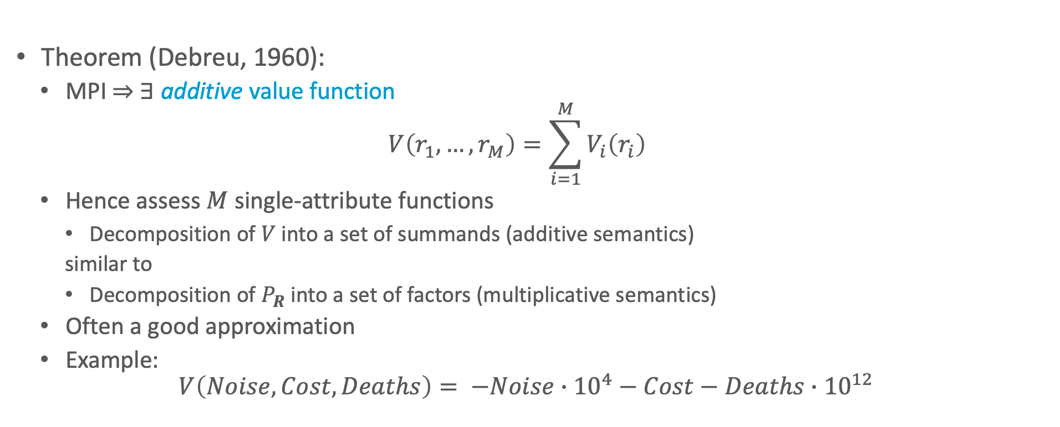
Preference Independence
Theorem (Debreu, 1960):
MPI ⇒ ∃ additive value function
$$V\left(r_{1},…, r_{M}\right)=\sum_{i=1}^{M}{V_{i}\left(r_{i}\right)}$$
Hence assess $M$ single-attribute functions
Decomposition of $V$ into a set of summands (additive semantics)
similar to
Decomposition of $P_{R}$ into a set of factors (multiplicative semantics)
Often a good approximation
Example:
$$V\left(Noise, Cost,Deaths\right)= −Noise∙{10}^{4}−Cost−Deaths∙{10}^{12}$$

Slide 21
Interim Summary
Preferences
Preferences of a rational agent must obey constraints
Utilities
Rational preferences = describable as maximisation of expected utility
Utility axioms
MEU principle
Multi-attribute utility theory
Preference structure
(Mutual) preferential independence

Slide 22
Outline: Decision Making – Foundations
Utility Theory
Preferences
Utilities
Preference structure
Markov Decision Process / Problem (MDP)
Sequence of actions, history, policy
Value iteration, policy iteration
Reinforcement Learning (RL)
Passive and active, model-free and model-based RL
Multi-armed bandit
Notes:
Utility theory / decision theory: background in economy / operations research / insurance industry

Slide 23



Simple Robot Navigation Problem
In each state, the possible actions are U, D, R, and L
The effect of action U is as follows (transition model):
With probability 0.8, move up one square
If already in top row or blocked, no move
With probability 0.1, move right one square
If already in rightmost row or blocked, no move
With probability 0.1, move left one square
If already in leftmost row or blocked, no move
Same transition model holds for D, R, and L and their respective directions
$$0.8$$
$$0.1$$
↑
$$0.1$$
Goal
Notes:
All other squares: probability of 0

Slide 24

Markov Property
Also known as Markov-$k$ with $k=1$
$k≤t$
$$P\left(x^{\left(t+1\right)} | x^{\left(t\right)}, …, x^{\left(0\right)}\right)=P\left(x^{\left(t+1\right)} | x^{\left(t\right)}, …, x^{\left(t−k+1\right)}\right)$$
$k=1$
$$P\left(x^{\left(t+1\right)} | x^{\left(t\right)}, …, x^{\left(0\right)}\right)=P\left(x^{\left(t+1\right)} | x^{\left(t\right)}\right)$$
The transition properties depend only on the current state, not on previous history (how that state was reached).
Notes:
Example: Hidden Markov Model (HMM)

Slide 25
Sequence of Actions
In each state, the possible actions are U, D, R, and L; the transition model for each action is (pictured):
Current position: [3,2]
Planned sequence of actions: (U, R)
$$0.8$$
$$0.1$$
↑
$$0.1$$
Goal
[3,2]
3
2
1
1
2
3
4

Slide 26
Sequence of Actions
In each state, the possible actions are U, D, R, and L; the transition model for each action is (pictured):
Current position: [3,2]
Planned sequence of actions: (U, R)
U is executed
$$0.8$$
$$0.1$$
↑
$$0.1$$
Goal
Goal
3
[3,2]
3
2
2
[3,2]
[3,3]
[4,2]
1
1
1
2
3
4
1
2
3
4
Notes:
U executed
up with prob. 0.8
right with prob. 0.1
left with prob. 0.1 (left is blocked, so no move)

Slide 27
Sequence of Actions
In each state, the possible actions are U, D, R, and L; the transition model for each action is (pictured):
Current position: [3,2]
Planned sequence of actions: (U, R)
U has been executed
R is executed
$$0.8$$
$$0.1$$
↑
$$0.1$$
Goal
[3,2]
3
2
[3,2]
[3,3]
[4,2]
1
[3,1]
[3,2]
[3,3]
[4,1]
[4,2]
[4,3]
1
2
3
4
Notes:
U executed
up with prob. 0.8
right with prob. 0.1
left with prob. 0.1 (left is blocked, so no move)

Slide 28
Histories
In each state, the possible actions are U, D, R, and L; the transition model for each action is (pictured):
Current position: [3,2]
Planned sequence of actions: (U, R)
U has been executed
R is executed
History: sequence of states generated by sequence of actions
9 possible sequences with 6 possible final states, only 1 of which is a goal state
$$0.8$$
$$0.1$$
↑
$$0.1$$
Goal
[3,2]
3
2
[3,2]
[3,3]
[4,2]
1
[3,1]
[3,2]
[3,3]
[4,1]
[4,2]
[4,3]
1
2
3
4
Notes:
U executed
up with prob. 0.8
right with prob. 0.1
left with prob. 0.1 (left is blocked, so no move)

Slide 29

Probability of Reaching the Goal
In each state: possible actions U, D, R, L; trans. model:
$$0.8$$
$P\left(\left[4,3\right] | \left(U,R\right),\left[3,2\right]\right)=$
$$P\left(\left[4,3\right] | R,\left[3,3\right]\right)∙P\left(\left[3,3\right] | U,\left[3,2\right]\right) \\ +P\left(\left[4,3\right] | R,\left[4,2\right]\right)∙P\left(\left[4,2\right] | U,\left[3,2\right]\right)$$
$P\left(\left[4,3\right] | R,\left[3,3\right]\right)=0.8$ $P\left(\left[3,3\right] | U,\left[3,2\right]\right)=0.8$
$P\left(\left[4,3\right] | R,\left[4,2\right]\right)=0.1$ $P\left(\left[4,2\right] | U,\left[3,2\right]\right)=0.1$
$P\left(\left[4,3\right] | \left(U,R\right),\left[3,2\right]\right)=0.8∙0.8+0.1∙0.1=0.65$
$$0.1$$
↑
$$0.1$$
Goal
[3,2]
3
Note importance of Markov property in this derivation
2
[3,2]
[3,3]
[4,2]
1
[3,1]
[3,2]
[3,3]
[4,1]
[4,2]
[4,3]
1
2
3
4
Notes:
U executed
up with prob. 0.8
right with prob. 0.1
left with prob. 0.1 (left is blocked, so no move)

Slide 30
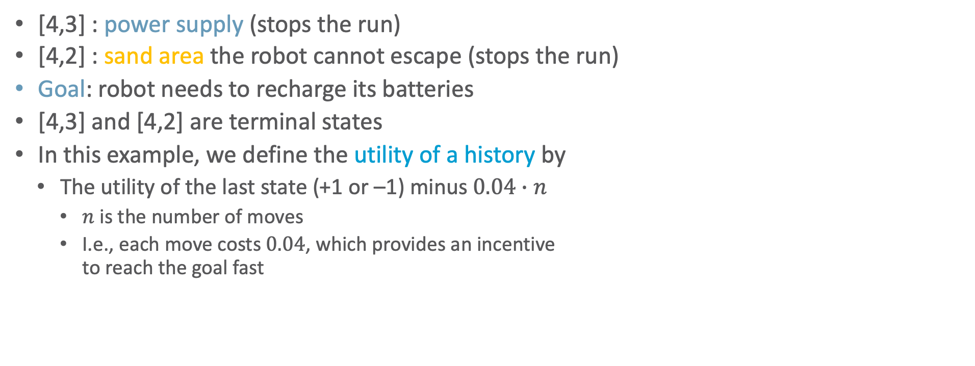
Utility Function
[4,3] : power supply (stops the run)
[4,2] : sand area the robot cannot escape (stops the run)
Goal: robot needs to recharge its batteries
[4,3] and [4,2] are terminal states
In this example, we define the utility of a history by
The utility of the last state (+1 or –1) minus $0.04∙n$
$n$ is the number of moves
I.e., each move costs $0.04$, which provides an incentive to reach the goal fast
+1
3
-1
2
1
1
2
3
4

Slide 31
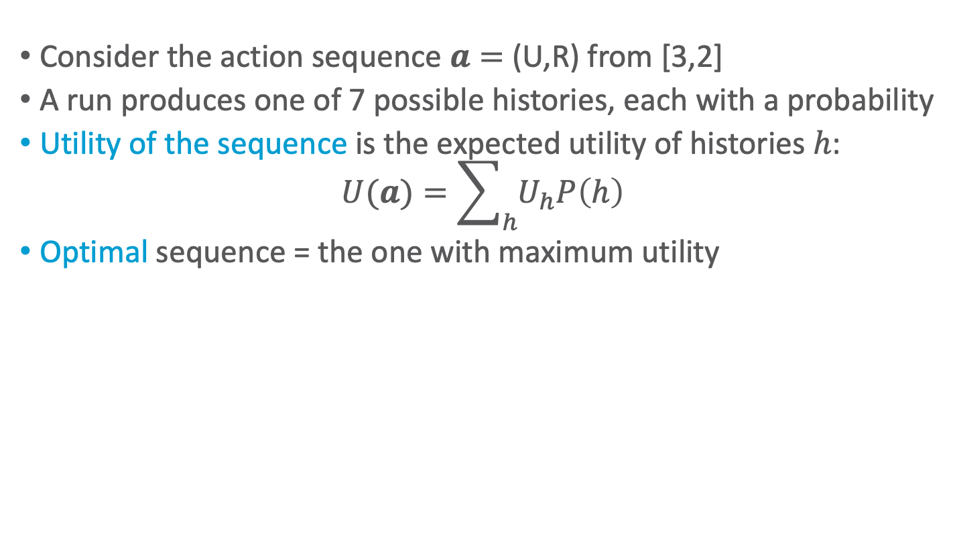
Utility of an Action Sequence
Consider the action sequence $a=$ (U,R) from [3,2]
A run produces one of 7 possible histories, each with a probability
Utility of the sequence is the expected utility of histories $h$:
$$U(a)=\sum_{h}{U_{h}P\left(h\right)}$$
Optimal sequence = the one with maximum utility
+1
[3,2]
3
Is the optimal sequence what we want?
-1
2
[3,2]
[3,3]
[4,2]
1
[3,1]
[3,2]
[3,3]
[4,1]
[4,2]
[4,3]
1
2
3
4
Notes:
only if the sequence is executed blindly!

Slide 32
Reactive Agent Algorithm
Agent
Environemnt
Act()
repeat
s ← sensed state
if s is terminal then
exit
a ← choose action (given s)
perform a
Sensors
What the world is like now
Condition-action rules
What action I should do now
Actuators
Figure: AIMA, Russell/Norvig

Slide 33

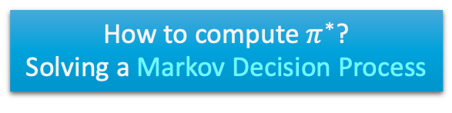
Policy (Reactive/Closed-loop Strategy)
Policy $π$
Complete mapping from states to actions
Optimal policy $π^{∗}$
Always yields a history (ending at terminal state) with maximum expected utility
Due to Markov property
Act()
repeat
s ← sensed state
if s is terminal then
exit
a ← 𝜋(s)
perform a
+1
3
Note that [3,2] is a “dangerous” state that the optimal policy tries to avoid
-1
2
1
How to compute $π^{∗}$?
Solving a Markov Decision Process
1
2
3
4

Slide 34
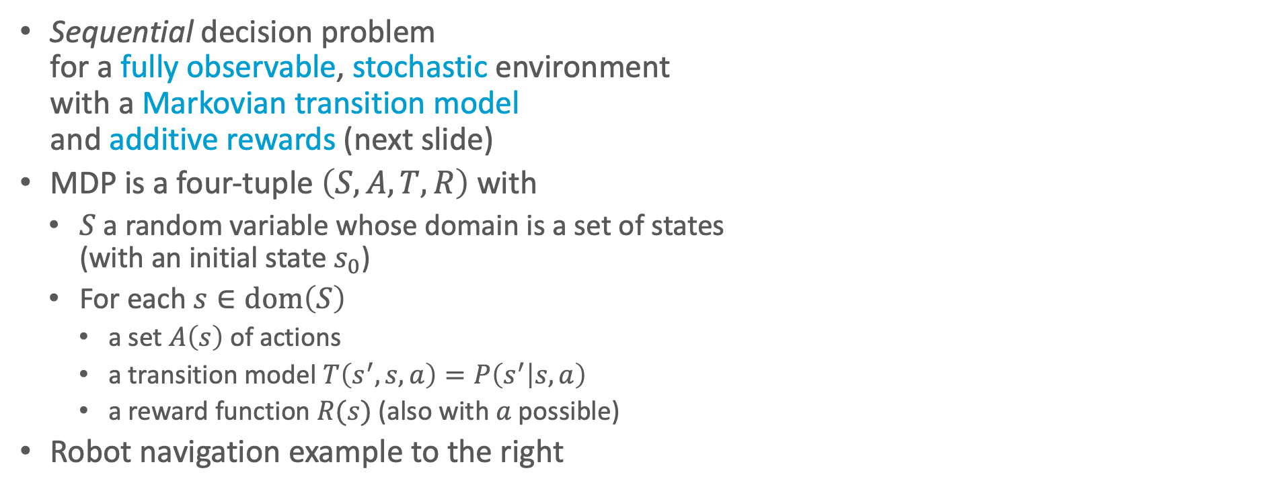

Markov Decision Process / Problem (MDP)
Sequential decision problem for a fully observable, stochastic environment with a Markovian transition model and additive rewards (next slide)
MDP is a four-tuple $\left(S,A,T,R\right)$ with
$S$ a random variable whose domain is a set of states (with an initial state $s_{0}$)
For each $s∈dom\left(S\right)$
a set $A\left(s\right)$ of actions
a transition model $T\left(s^{′}, s,a\right)=P\left(s^{′} | s, a\right)$
a reward function $R(s)$ (also with $a$ possible)
Robot navigation example to the right
$$0.8$$
$$0.1$$
↑
$$0.1$$
U, D, L, R
each move costs $0.04$
+1
3
-1
2
1
1
2
3
4

Slide 35
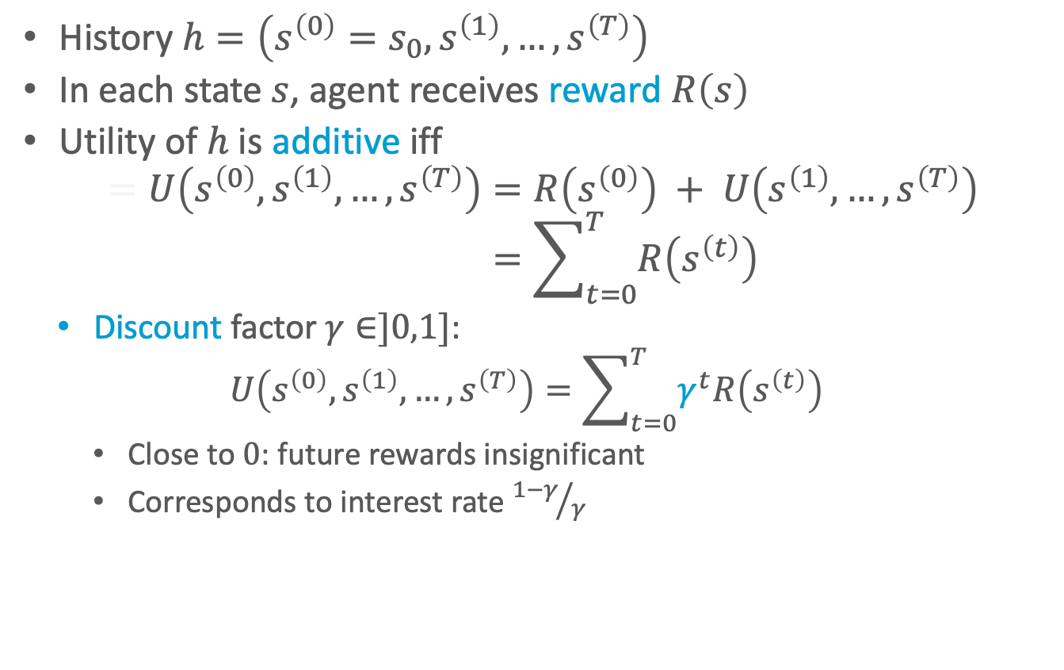
Additive Utility
History $h=\left(s^{\left(0\right)}=s_{0},s^{\left(1\right)},…,s^{\left(T\right)}\right)$
In each state $s$, agent receives reward $R\left(s\right)$
Utility of $h$ is additive iff
$$=U\left(s^{\left(0\right)},s^{\left(1\right)},…,s^{\left(T\right)}\right)=R\left(s^{\left(0\right)}\right) + U\left(s^{\left(1\right)},…,s^{\left(T\right)}\right) \\ =\sum_{t=0}^{T}{R\left(s^{\left(t\right)}\right)}$$
Discount factor $γ∈]0,1]$:
$$U\left(s^{\left(0\right)},s^{\left(1\right)},…,s^{\left(T\right)}\right)=\sum_{t=0}^{T}{γ^{t}R\left(s^{\left(t\right)}\right)}$$
Close to $0$: future rewards insignificant
Corresponds to interest rate ${1−γ}/γ$
$$0.8$$
$$0.1$$
↑
$$0.1$$
U, D, L, R
each move costs $0.04$
+1
3
-1
2
1
1
2
3
4
Notes:
Implies that reward is preferentially independent over time, which it is

Slide 36
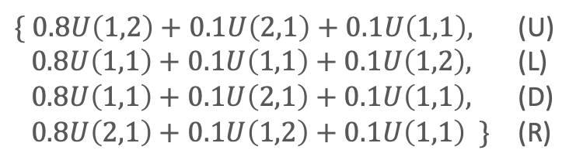
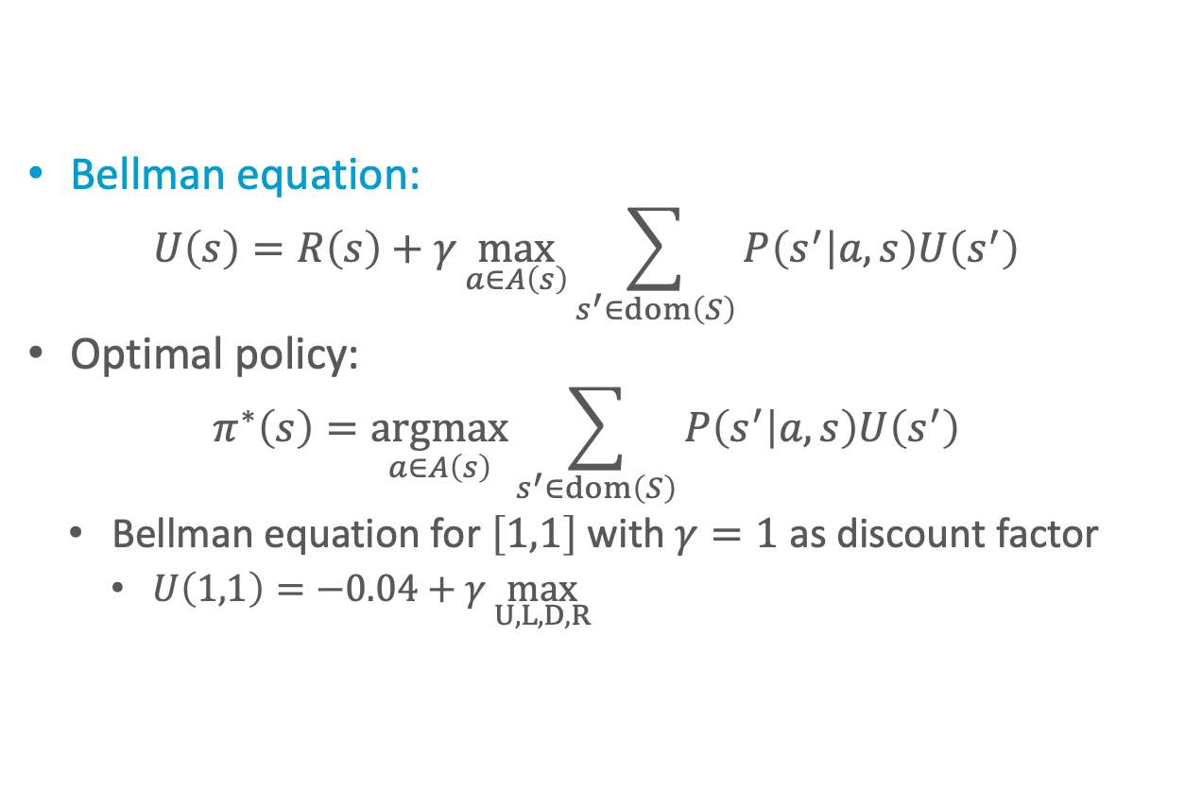
Principle of MEU
Bellman equation:
$$U\left(s\right)=R\left(s\right)+γ\max_{a∈A\left(s\right)}{\sum_{s^{′}∈dom\left(S\right)}{P\left(s^{′} | a,s\right)U\left(s^{′}\right)}}$$
Optimal policy:
$$π^{∗}\left(s\right)=\underset{a∈A\left(s\right)}{argmax}{\sum_{s^{′}∈dom\left(S\right)}{P\left(s^{′} | a,s\right)U\left(s^{′}\right)}}$$
Bellman equation for $\left[1,1\right]$ with $γ=1$ as discount factor
$U\left(1,1\right)=−0.04+γ\max_{U,L,D,R}{ }$
$$0.8$$
$$0.1$$
↑
$$0.1$$
U, D, L, R
each move costs $0.04$
+1
3
$\{ 0.8U\left(1,2\right)+0.1U\left(2,1\right)+0.1U\left(1,1\right),$ (U) $0.8U\left(1,1\right)+0.1U\left(1,1\right)+0.1U\left(1,2\right),$ (L) $0.8U\left(1,1\right)+0.1U\left(2,1\right)+0.1U\left(1,1\right),$ (D) $0.8U\left(2,1\right)+0.1U\left(1,2\right)+0.1U\left(1,1\right) \}$ (R)
-1
2
1
1
2
3
4

Slide 37
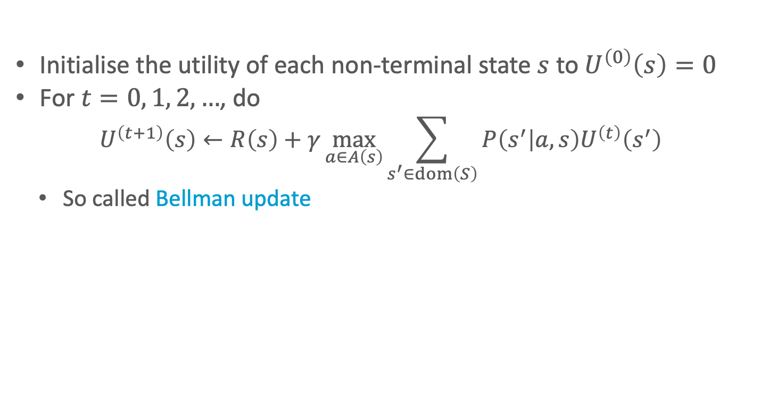


Value Iteration
0.812
0.868
0.918
+1
3
Initialise the utility of each non-terminal state $s$ to $U^{\left(0\right)}\left(s\right)=0$
For $t=0, 1, 2, …$, do
$$U^{\left(t+1\right)}\left(s\right)←R\left(s\right)+γ\max_{a∈A\left(s\right)}{\sum_{s^{′}∈dom\left(S\right)}{P\left(s^{′} | a,s\right)U^{\left(t\right)}\left(s^{′}\right)}}$$
So called Bellman update
0.762
0.660
-1
2
1
0.705
0.655
0.611
0.388
1
2
3
4
$$U^{t}\left(\left[3,1\right]\right)$$
0
0
0
+1
3
0.611
Note the importance of terminal states and connectivity of the state-transition graph
0.5
0
0
-1
2
0
0
0
0
0
1
0
10
20
30
$$t$$
1
2
3
4

Slide 38

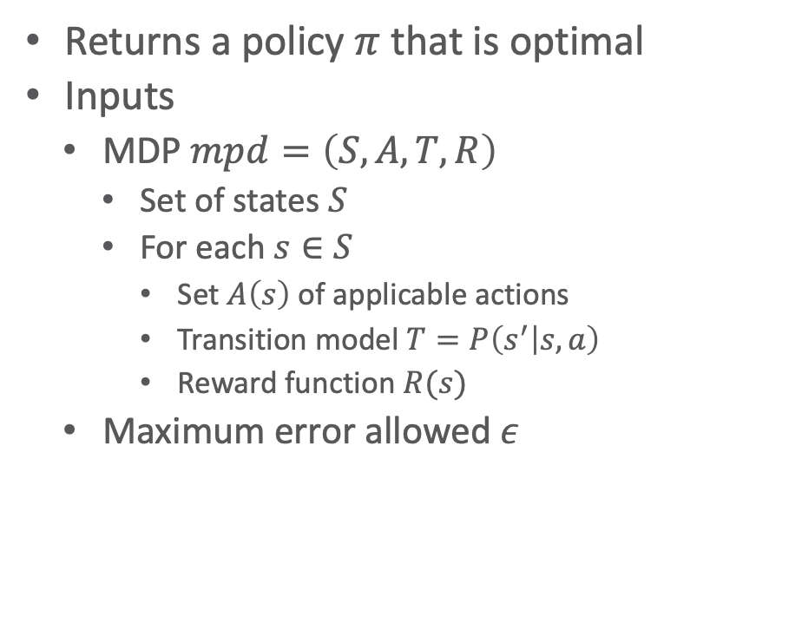
Value Iteration: Algorithm
Returns a policy $π$ that is optimal
Inputs
MDP $mpd=\left(S,A,T,R\right)$
Set of states $S$
For each $s∈S$
Set $A\left(s\right)$ of applicable actions
Transition model $T=P\left(s^{′} | s, a\right)$
Reward function $R(s)$
Maximum error allowed $ε$
Local variables
$U, U^{′}$ vectors of utilities for states in $S$
$δ$ maximum change in utility of any state in an iteration
function value-iteration(mdp,𝜖)
U’ ← 0, π ←〈〉
repeat
U ← U’
𝛿 ← 0
for each state s ∈ S do
U’[s] ← R(s) + 𝛾 max_{a∈A(s)}Σ_{s’}P(s’|a.s)U[s’]
if |U’[s] - U[s]| > 𝛿 then
𝛿 ← |U’[s] - U[s]|
until 𝛿 < 𝜖(1-𝛾)/𝛾
for each state s ∈ S do
π(s) ← argmax_{a∈A(s)}Σ_{s’}P(s’|a.s)U[s’]
return π

Slide 39
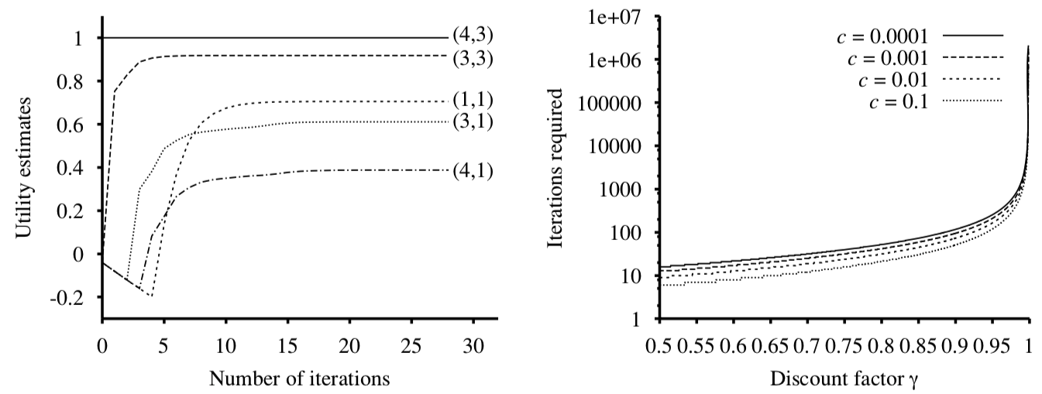
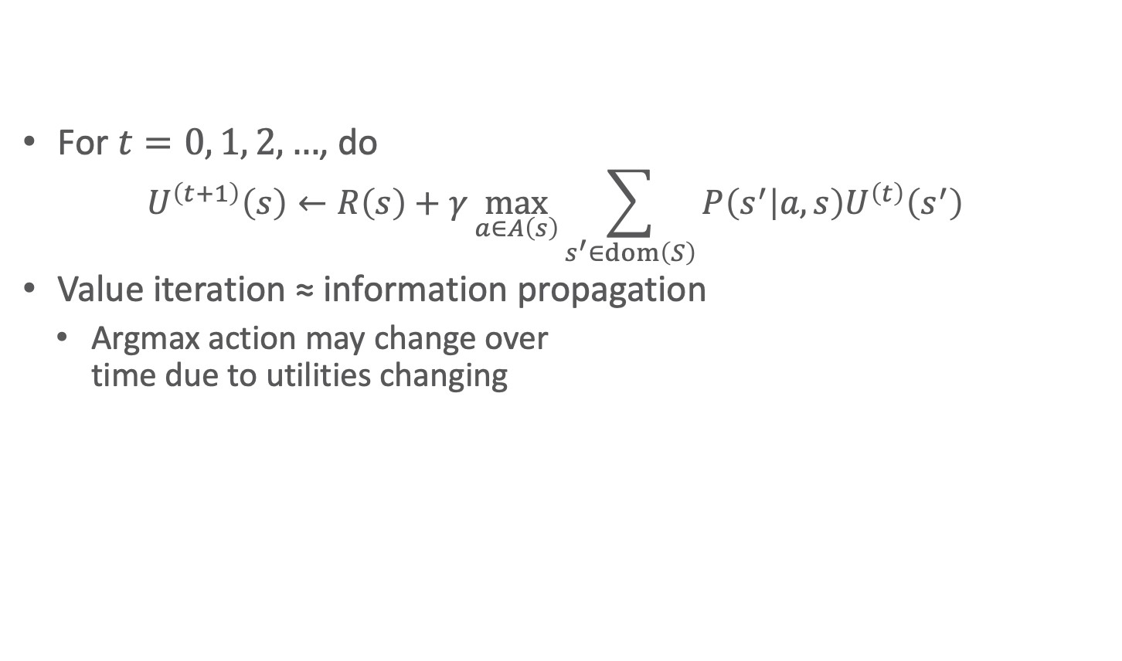
Evolution of Utilities
0.812
0.868
0.918
+1
3
For $t=0, 1, 2, …$, do
$$U^{\left(t+1\right)}\left(s\right)←R\left(s\right)+γ\max_{a∈A\left(s\right)}{\sum_{s^{′}∈dom\left(S\right)}{P\left(s^{′} | a,s\right)U^{\left(t\right)}\left(s^{′}\right)}}$$
Value iteration ≈ information propagation
Argmax action may change over time due to utilities changing
0.762
0.660
-1
2
1
0.705
0.655
0.611
0.388
1
2
3
4
0
0
0
+1
3
0
0
-1
2
1
0
0
0
0
1
2
3
4
Figure left: AIMA, Russell/Norvig

Slide 40
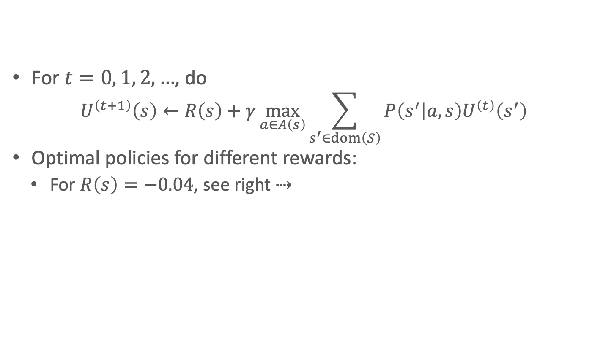




Effect of Rewards
0.812
0.868
0.918
+1
3
For $t=0, 1, 2, …$, do
$$U^{\left(t+1\right)}\left(s\right)←R\left(s\right)+γ\max_{a∈A\left(s\right)}{\sum_{s^{′}∈dom\left(S\right)}{P\left(s^{′} | a,s\right)U^{\left(t\right)}\left(s^{′}\right)}}$$
Optimal policies for different rewards:
For $R\left(s\right)=−0.04$, see right ⇢
0.762
0.660
-1
2
1
0.705
0.655
0.611
0.388
1
2
3
4
0
0
0
+1
3
+1
+1
+1
+1
0
0
-1
2
-1
-1
-1
-1
1
0
0
0
0
$$R\left(s\right)<−1.6284$$
$$−0.4278<R\left(s\right)<−0.0850$$
$$−0.0221<R\left(s\right)≤0$$
$$R\left(s\right)>0$$
1
2
3
4
Data for figures: AIMA, Russell/Norvig

Slide 41
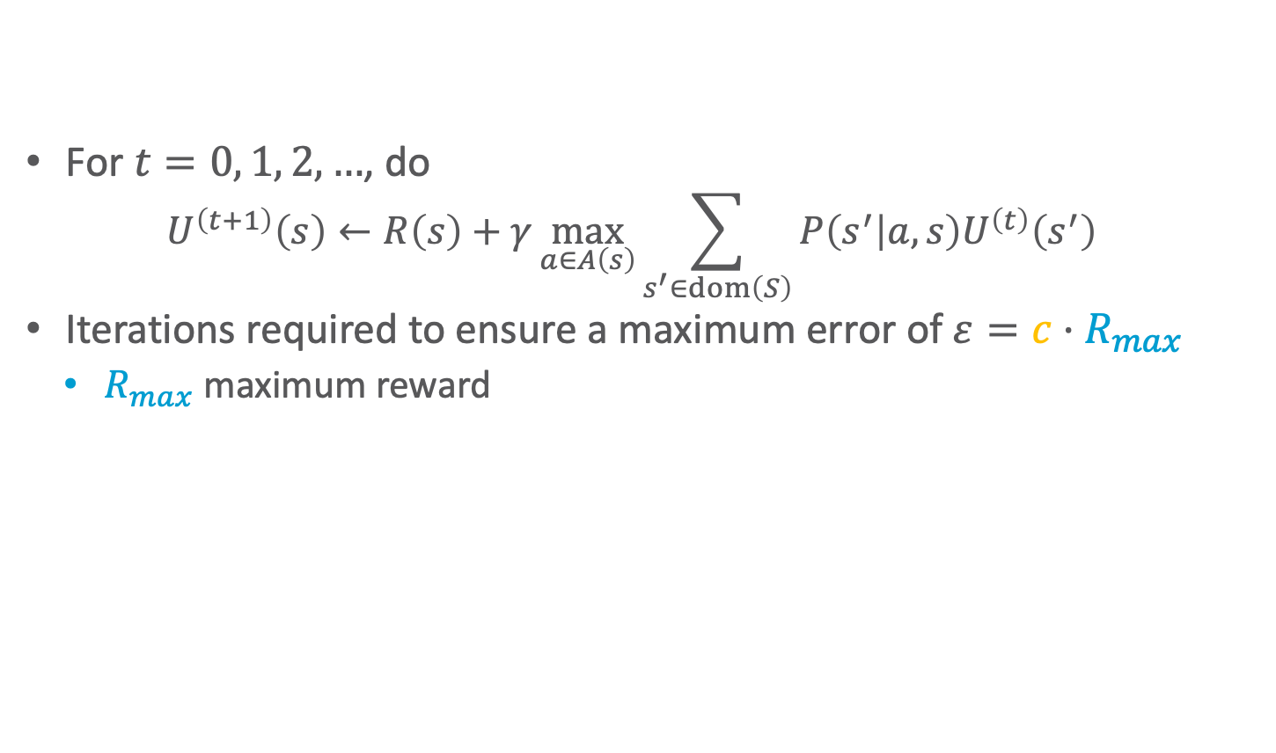
Effect of Allowed Error & Discount
0.812
0.868
0.918
+1
3
For $t=0, 1, 2, …$, do
$$U^{\left(t+1\right)}\left(s\right)←R\left(s\right)+γ\max_{a∈A\left(s\right)}{\sum_{s^{′}∈dom\left(S\right)}{P\left(s^{′} | a,s\right)U^{\left(t\right)}\left(s^{′}\right)}}$$
Iterations required to ensure a maximum error of $ε=c·R_{max}$
$R_{max}$ maximum reward
0.762
0.660
-1
2
1
0.705
0.655
0.611
0.388
1
2
3
4
0
0
0
+1
3
0
0
-1
2
1
0
0
0
0
1
2
3
4
Figure right: AIMA, Russell/Norvig

Slide 42
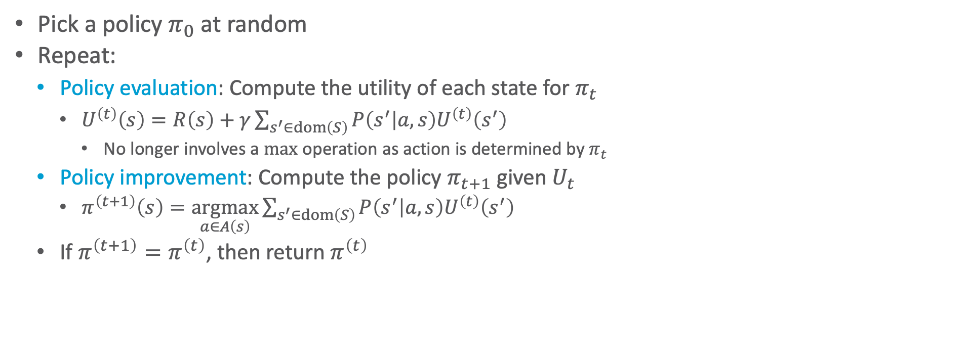
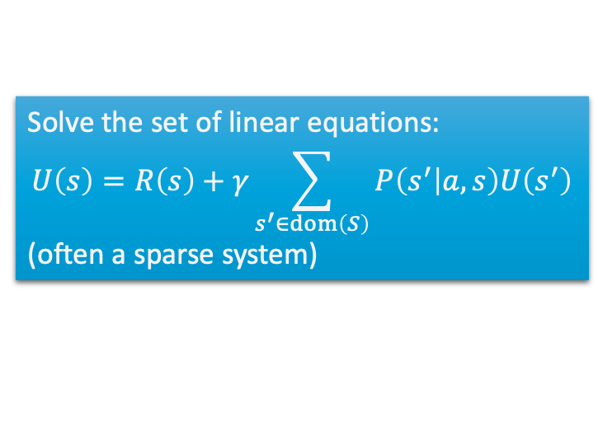
Policy Iteration
Pick a policy $π_{0}$ at random
Repeat:
Policy evaluation: Compute the utility of each state for $π_{t}$
$U^{\left(t\right)}\left(s\right)=R\left(s\right)+γ\sum_{s^{′}∈dom\left(S\right)}{P\left(s^{′} | a,s\right)U^{\left(t\right)}\left(s^{′}\right)}$
No longer involves a $max$ operation as action is determined by $π_{t}$
Policy improvement: Compute the policy $π_{t+1}$ given $U_{t}$
$π^{\left(t+1\right)}\left(s\right)=\underset{a∈A\left(s\right)}{argmax}{\sum_{s^{′}∈dom\left(S\right)}{P\left(s^{′} | a,s\right)U^{\left(t\right)}\left(s^{′}\right)}}$
If $π^{\left(t+1\right)}=π^{\left(t\right)}$, then return $π^{\left(t\right)}$
Solve the set of linear equations:
$$U\left(s\right)=R\left(s\right)+γ\sum_{s^{′}∈dom\left(S\right)}{P\left(s^{′} | a,s\right)U\left(s^{′}\right)}$$
(often a sparse system)

Slide 43
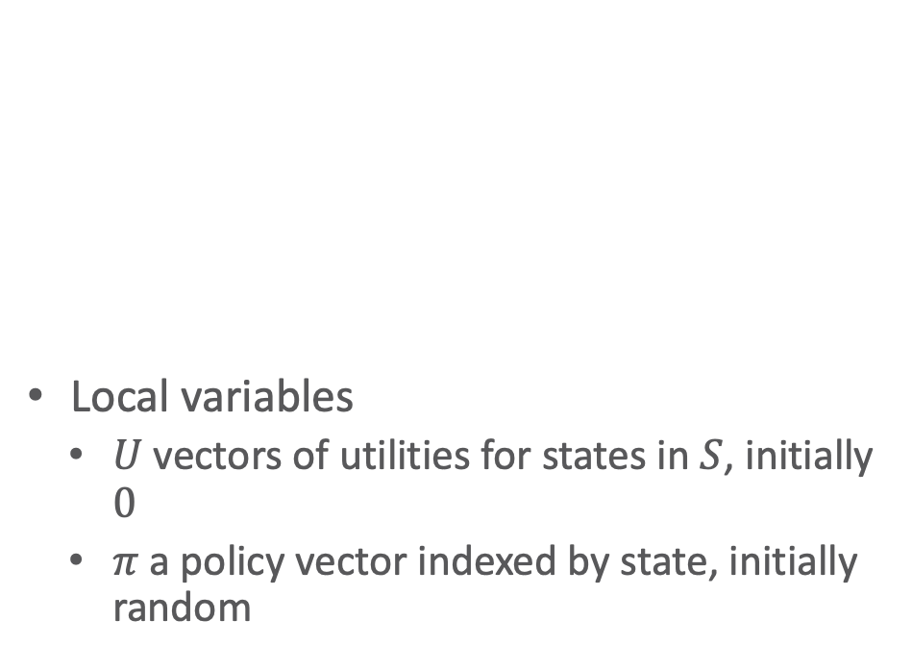
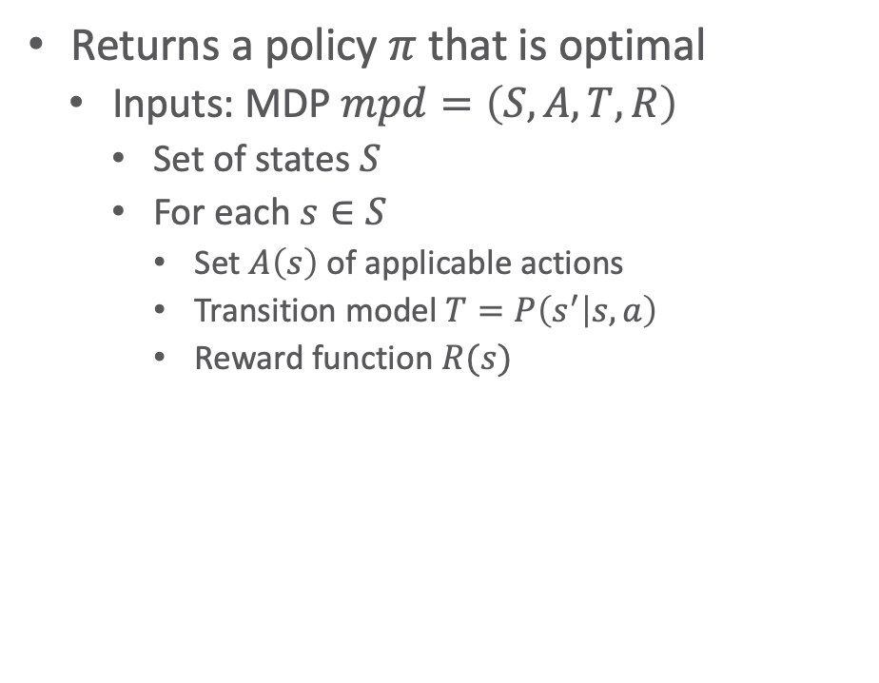
Policy Iteration: Algorithm
Returns a policy $π$ that is optimal
Inputs: MDP $mpd=\left(S,A,T,R\right)$
Set of states $S$
For each $s∈S$
Set $A\left(s\right)$ of applicable actions
Transition model $T=P\left(s^{′} | s, a\right)$
Reward function $R(s)$
function policy-iteration(mdp)
repeat
U ← policy-evaluation(𝜋,U,mdp)
unchanged ← true
for each state s ∈ S do
if max_{a∈A(s)}Σ_{s’}P(s’|a.s)U[s’] > Σ_{s’}P(s’|𝜋[s].s)U[s’] then
𝜋[s] ← argmax_{a∈A(s)}Σ_{s’}P(s’|a.s)U[s’]
unchanged ← false
until unchanged
return 𝜋
Local variables
$U$ vectors of utilities for states in $S$, initially $0$
$π$ a policy vector indexed by state, initially random

Slide 44
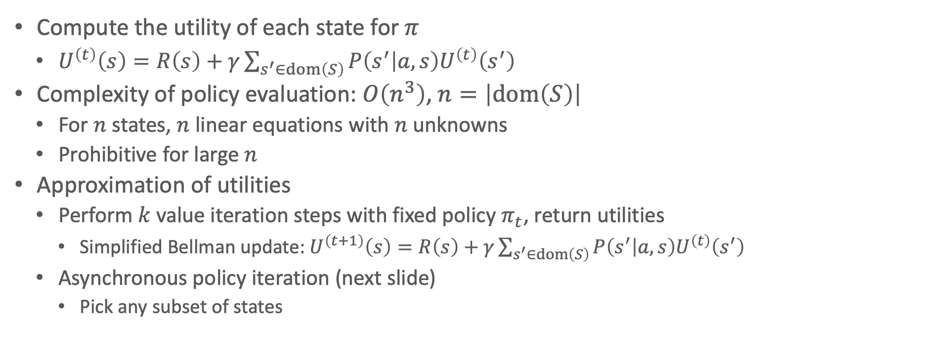
Policy Evaluation
Compute the utility of each state for $π$
$U^{\left(t\right)}\left(s\right)=R\left(s\right)+γ\sum_{s^{′}∈dom\left(S\right)}{P\left(s^{′} | a,s\right)U^{\left(t\right)}\left(s^{′}\right)}$
Complexity of policy evaluation: $O\left(n^{3}\right)$, $n=\left|dom\left(S\right)\right|$
For $n$ states, $n$ linear equations with $n$ unknowns
Prohibitive for large $n$
Approximation of utilities
Perform $k$ value iteration steps with fixed policy $π_{t}$, return utilities
Simplified Bellman update: $U^{\left(t+1\right)}\left(s\right)=R\left(s\right)+γ\sum_{s^{′}∈dom\left(S\right)}{P\left(s^{′} | a,s\right)U^{\left(t\right)}\left(s^{′}\right)}$
Asynchronous policy iteration (next slide)
Pick any subset of states

Slide 45
Asynchronous Policy Iteration
Further approximation of policy iteration
Pick any subset of states and do one of the following
Update utilities
Using simplified value iteration as described on previous slide
Update the policy
Policy improvement as before
Is not guaranteed to converge to an optimal policy
Possible if each state is still visited infinitely often, knowledge about unimportant states, etc.
Freedom to work on any states allows for design of domain-specific heuristics
Update states that are likely to be reached by a good policy

Slide 46
Intermediate Summary
Markov property
Current state depends only on previous state
Sequence of actions, history, policy
Sequence of actions may yield multiple histories, i.e., sequences of states, with a utility
Policy: complete mapping of states to actions
Optimal policy: policy with maximum expected utility
MDP
State space, actions, transition model, reward function
Value iteration, policy iteration
Algorithms for calculating an optimal policy for an MDP

Slide 47
Outline: Decision Making – Foundations
Utility Theory
Preferences
Utilities
Preference structure
Markov Decision Process / Problem (MDP)
Sequence of actions, history, policy
Value iteration, policy iteration
Reinforcement Learning (RL)
Passive and active, model-free and model-based RL
Multi-armed bandit
Notes:
Utility theory / decision theory: background in economy / operations research / insurance industry

Slide 48




Acting as Reinforcement Learning (RL)
Agent, placed in an environment, must learn to act optimally in it
Assume that the world behaves like an MDP, except
Agent can act but does not know the transition model
Agent observes its current state and its reward but does not know the reward function
Goal: learn an optimal policy
+1
$$0.8$$
3
-1
U, D, L, R
$$0.1$$
$$0.1$$
2
↑
1
each move costs $0.04$
1
2
3
4

Slide 49
Factors That Make RL Hard
Actions have non-deterministic effects
which are initially unknown and must be learned
Rewards / punishments can be infrequent
Often at the end of long sequences of actions
How does an agent determine what action(s) were really responsible for reward or punishment?
Credit assignment problem
World is large and complex

Slide 50
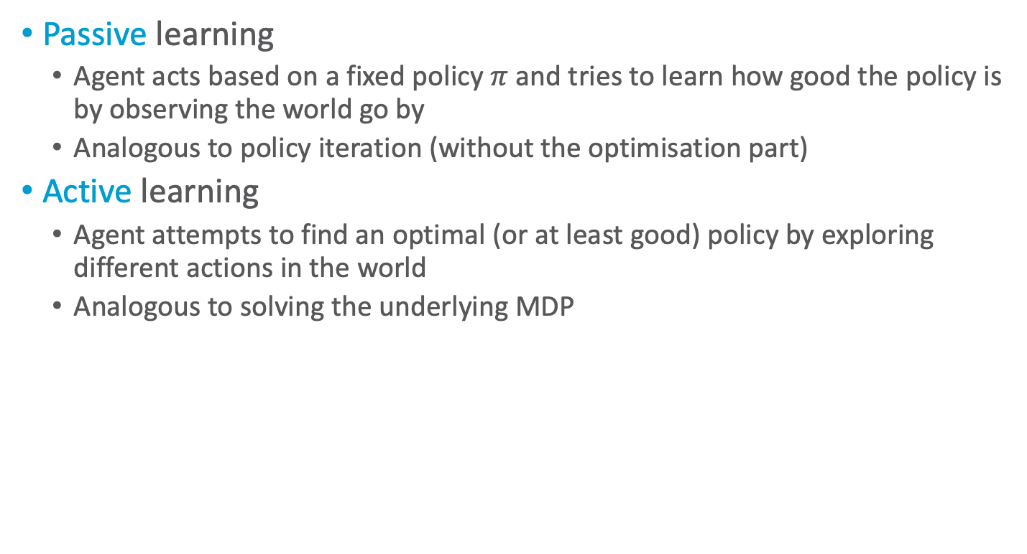
Passive vs. Active Learning
Passive learning
Agent acts based on a fixed policy $π$ and tries to learn how good the policy is by observing the world go by
Analogous to policy iteration (without the optimisation part)
Active learning
Agent attempts to find an optimal (or at least good) policy by exploring different actions in the world
Analogous to solving the underlying MDP

Slide 51
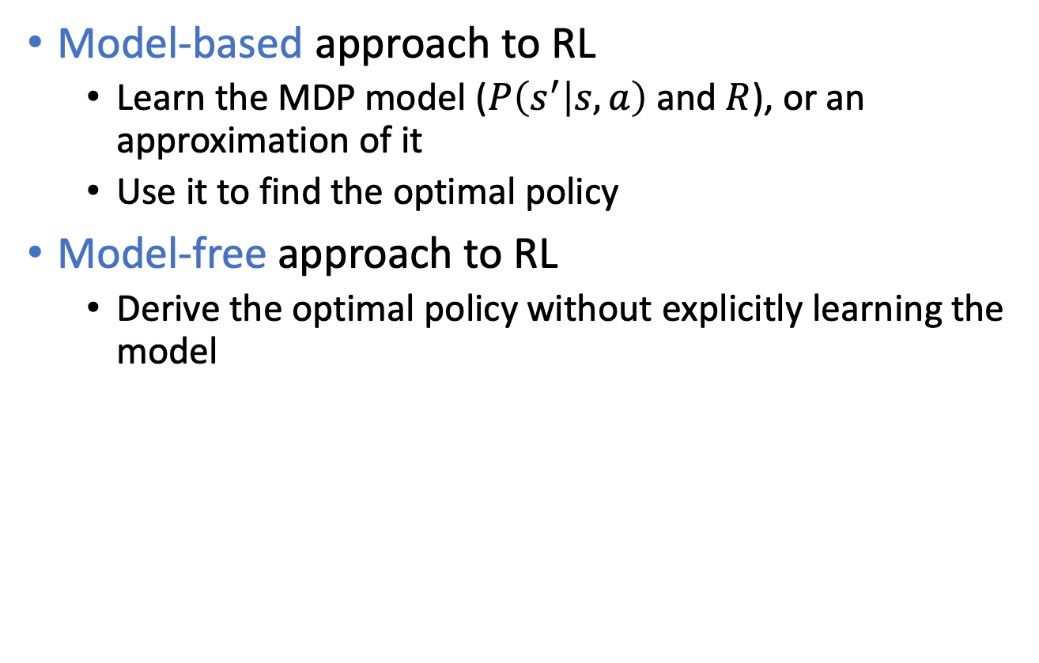
Model-based vs. Model-free RL
Model-based approach to RL
Learn the MDP model ($P\left(s^{′} | s,a\right)$ and $R$), or an approximation of it
Use it to find the optimal policy
Model-free approach to RL
Derive the optimal policy without explicitly learning the model

Slide 52
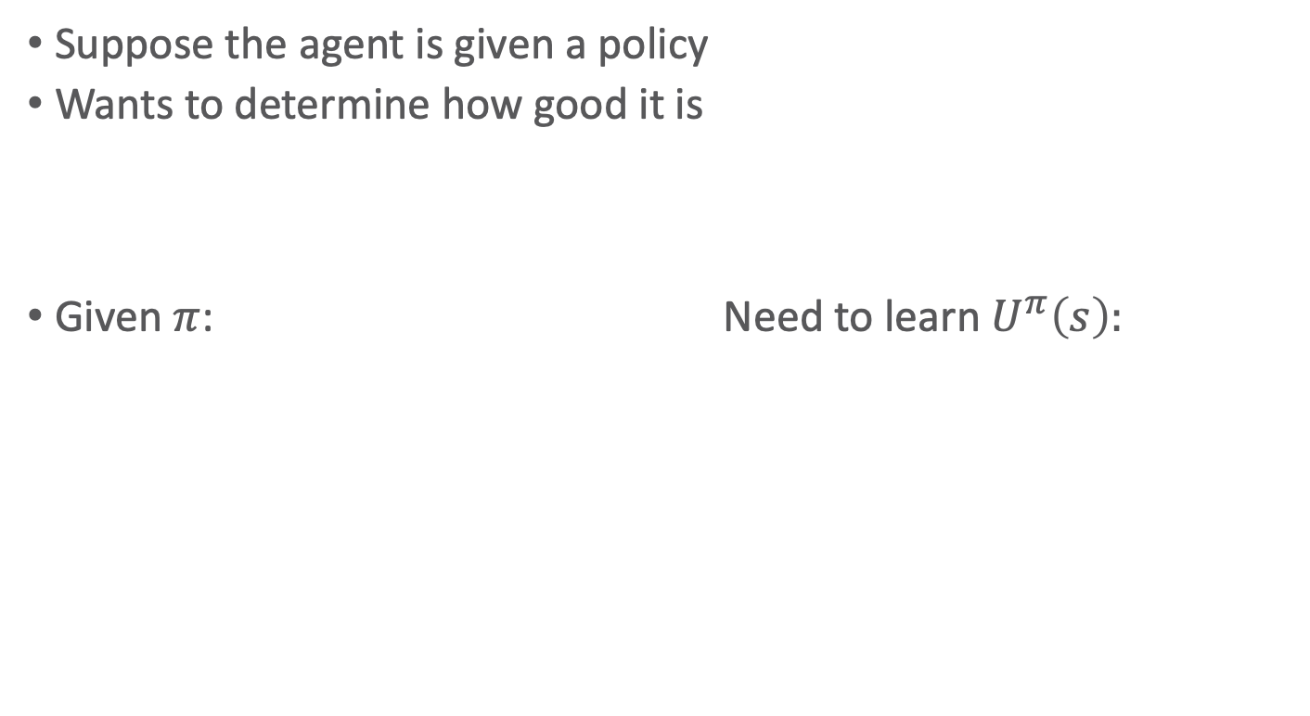
Passive RL
Suppose the agent is given a policy
Wants to determine how good it is
Given $π$: Need to learn $U^{π}\left(s\right):$
?
0.812
0.868
0.918
+1
3
3
?
0.762
0.660
-1
2
2
1
1
0.705
0.655
0.611
0.388
1
2
3
4
1
2
3
4

Slide 53
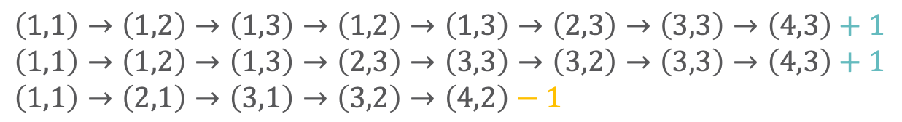
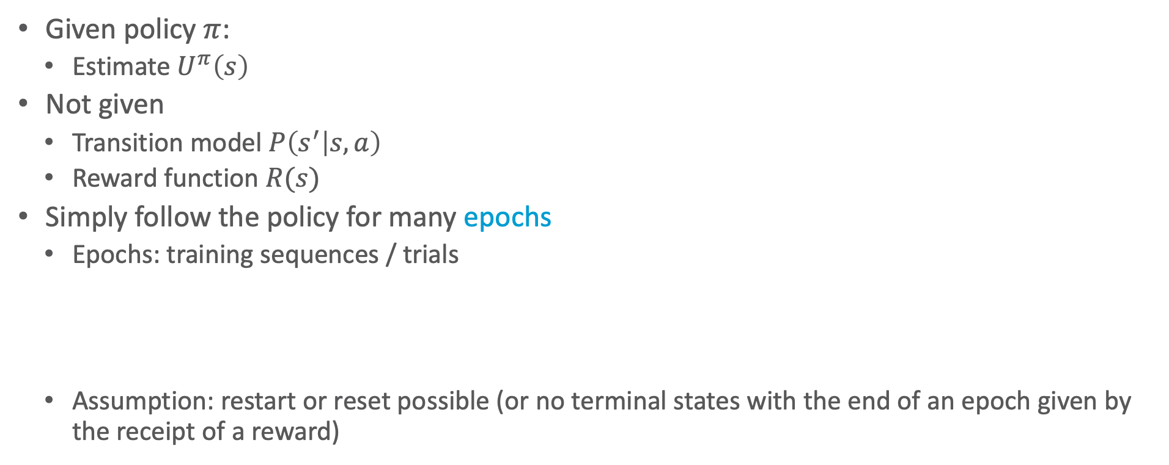
Passive RL
0.812
0.868
0.918
+1
Given policy $π$:
Estimate $U^{π}\left(s\right)$
Not given
Transition model $P\left(s^{′} | s, a\right)$
Reward function $R(s)$
Simply follow the policy for many epochs
Epochs: training sequences / trials
Assumption: restart or reset possible (or no terminal states with the end of an epoch given by the receipt of a reward)
3
0.762
0.660
-1
2
1
0.705
0.655
0.611
0.388
1
2
3
4
$$\left(1,1\right)→\left(1,2\right)→\left(1,3\right)→\left(1,2\right)→\left(1,3\right)→\left(2,3\right)→\left(3,3\right)→\left(4,3\right)+1$$
$$\left(1,1\right)→\left(1,2\right)→\left(1,3\right)→\left(2,3\right)→\left(3,3\right)→\left(3,2\right)→\left(3,3\right)→\left(4,3\right)+1$$
$$\left(1,1\right)→\left(2,1\right)→\left(3,1\right)→\left(3,2\right)→\left(4,2\right)−1$$

Slide 54
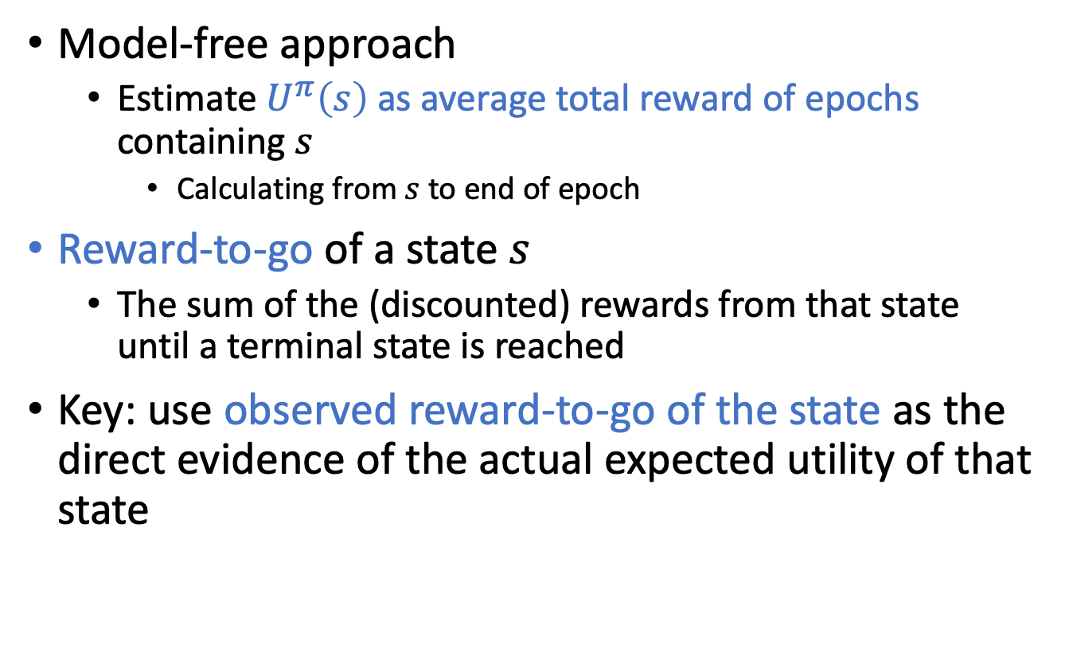
Direct Utility Estimation (DUE)
Model-free approach
Estimate $U^{π}\left(s\right)$ as average total reward of epochs containing $s$
Calculating from $s$ to end of epoch
Reward-to-go of a state $s$
The sum of the (discounted) rewards from that state until a terminal state is reached
Key: use observed reward-to-go of the state as the direct evidence of the actual expected utility of that state
Notes:
Cost to go: immediate cost of first action + expected cost of following policy afterwards

Slide 55
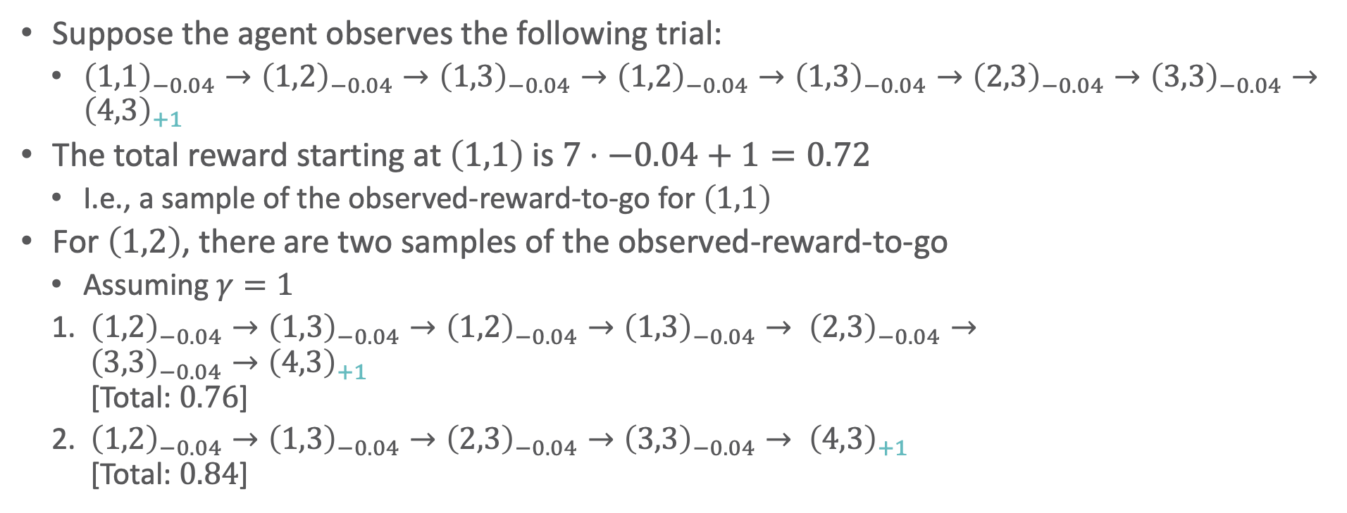
DUE: Example
Suppose the agent observes the following trial:
${\left(1,1\right)}_{−0.04}→{\left(1,2\right)}_{−0.04}→{\left(1,3\right)}_{−0.04}→{\left(1,2\right)}_{−0.04}→{\left(1,3\right)}_{−0.04}→{\left(2,3\right)}_{−0.04}→{\left(3,3\right)}_{−0.04}→{\left(4,3\right)}_{+1}$
The total reward starting at $\left(1,1\right)$ is $7⋅−0.04+1=0.72$
I.e., a sample of the observed-reward-to-go for $\left(1,1\right)$
For $\left(1,2\right)$, there are two samples of the observed-reward-to-go
Assuming $γ=1$
${\left(1,2\right)}_{−0.04}→{\left(1,3\right)}_{−0.04}→{\left(1,2\right)}_{−0.04}→{\left(1,3\right)}_{−0.04}→ {\left(2,3\right)}_{−0.04}→$ ${\left(3,3\right)}_{−0.04}→{\left(4,3\right)}_{+1}$ [Total: $0.76$]
${\left(1,2\right)}_{−0.04}→{\left(1,3\right)}_{−0.04}→{\left(2,3\right)}_{−0.04}→{\left(3,3\right)}_{−0.04}→ {\left(4,3\right)}_{+1}$ [Total: $0.84$]

Slide 56
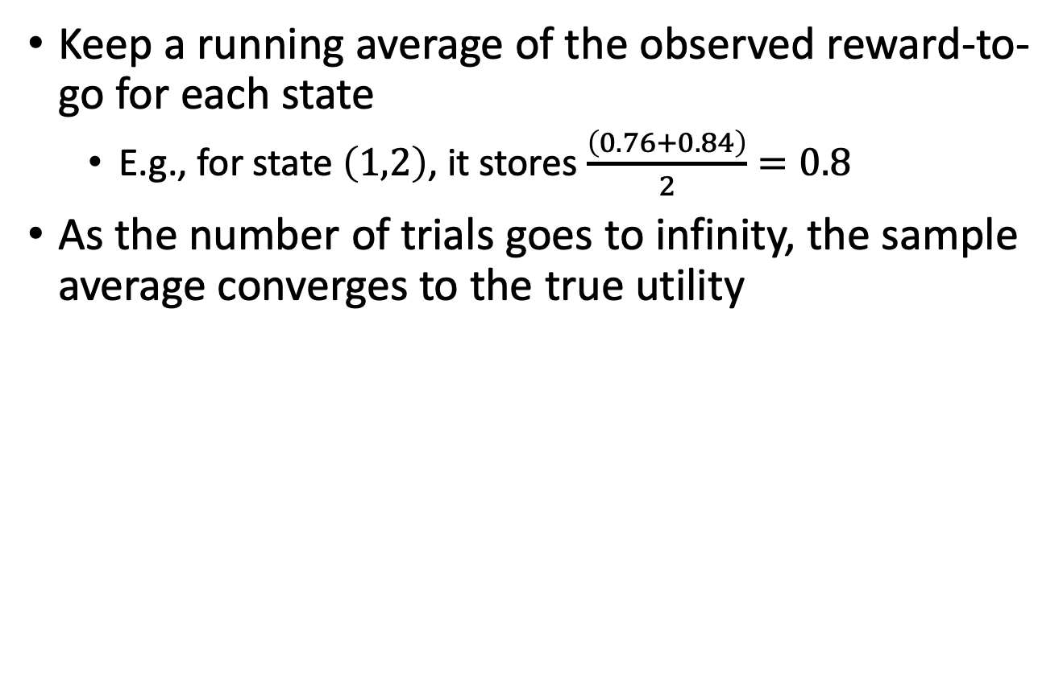
DUE: Convergence
Keep a running average of the observed reward-to-go for each state
E.g., for state $\left(1,2\right)$, it stores $\frac{\left(0.76+0.84\right)}{2}=0.8$
As the number of trials goes to infinity, the sample average converges to the true utility

Slide 57
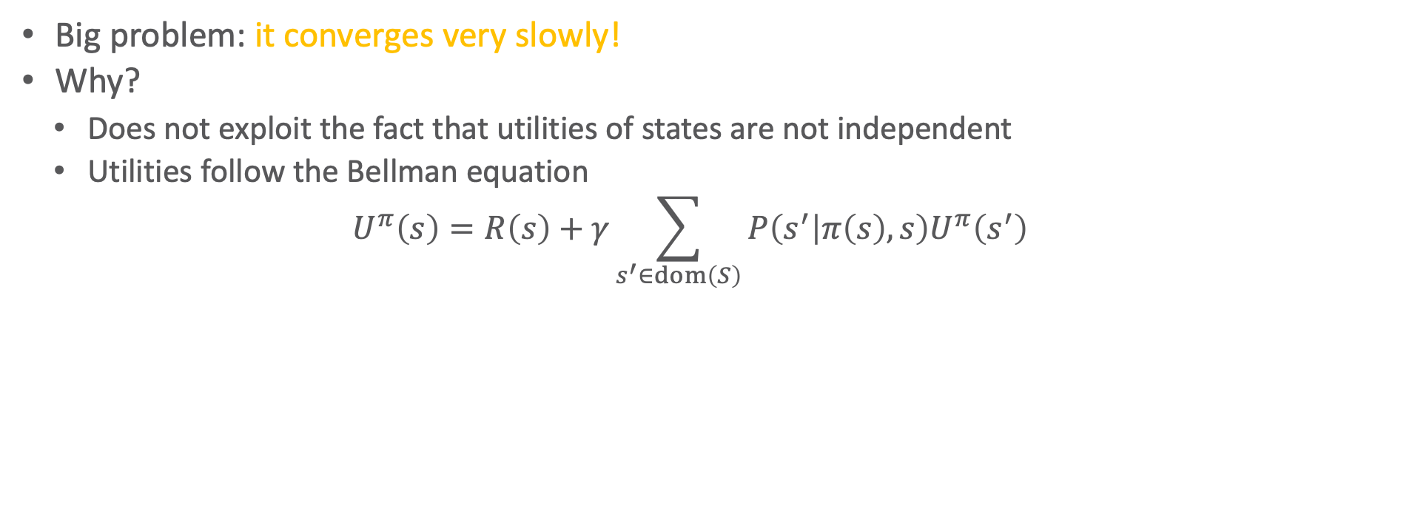
DUE: Problem
Big problem: it converges very slowly!
Why?
Does not exploit the fact that utilities of states are not independent
Utilities follow the Bellman equation
$$U^{π}\left(s\right)=R\left(s\right)+γ\sum_{s^{′}∈dom\left(S\right)}{P\left(s^{′} | π\left(s\right),s\right)U^{π}\left(s^{′}\right)}$$
Dependence on neighbouring states
Notes:
No information propagation

Slide 58
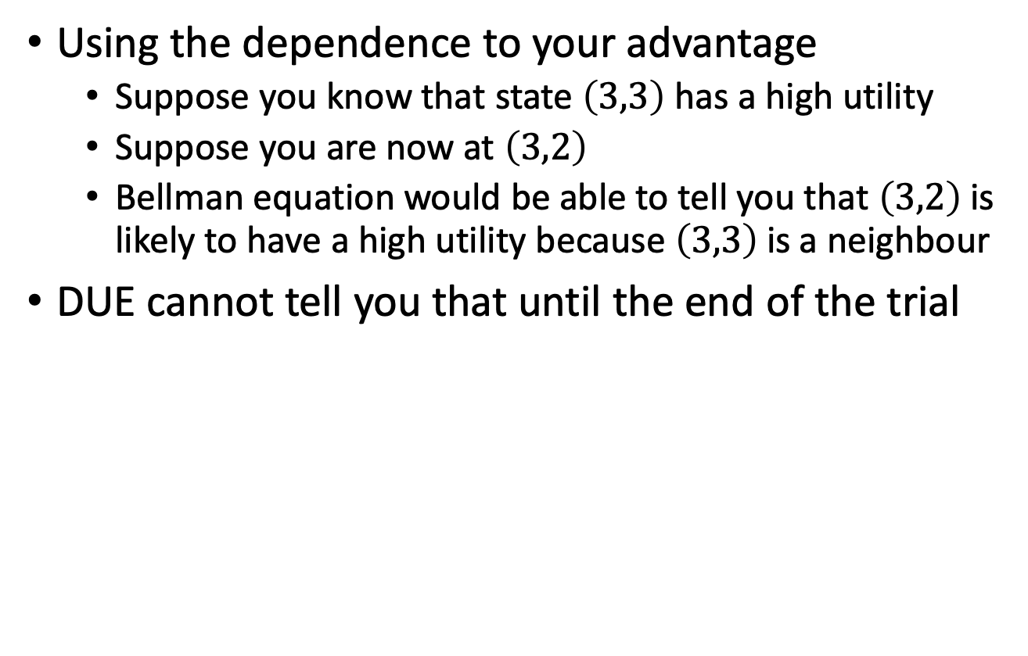
DUE: Problem
Using the dependence to your advantage
Suppose you know that state $\left(3,3\right)$ has a high utility
Suppose you are now at $\left(3,2\right)$
Bellman equation would be able to tell you that $\left(3,2\right)$ is likely to have a high utility because $\left(3,3\right)$ is a neighbour
DUE cannot tell you that until the end of the trial
?
3
?
2
1
1
2
3
4

Slide 59

Adaptive Dynamic Programming (ADP)
Model-based approach
Given policy $π$:
Estimate $U^{π}\left(s\right)$
All while acting in the environment
How?
Basically learns the transition model $P\left(s^{′} | s, a\right)$ and the reward function $R(s)$
Takes advantage of constraints in the Bellman equation
Based on $P\left(s^{′} | s, a\right)$ and $R(s)$, performs policy evaluation (part of policy iteration)

Slide 60


Recap: Policy Iteration
Pick a policy $π_{0}$ at random
Repeat:
Policy evaluation: Compute the utility of each state for $π_{t}$
$U^{\left(t\right)}\left(s\right)=R\left(s\right)+γ\sum_{s^{′}∈dom\left(S\right)}{P\left(s^{′} | a,s\right)U^{\left(t\right)}\left(s^{′}\right)}$
No longer involves a $max$ operation as action is determined by $π_{t}$
Policy improvement: Compute the policy $π_{t+1}$ given $U_{t}$
$π^{\left(t+1\right)}\left(s\right)=\underset{a∈A\left(s\right)}{argmax}{\sum_{s^{′}∈dom\left(S\right)}{P\left(s^{′} | a,s\right)U^{\left(t\right)}\left(s^{′}\right)}}$
If $π^{\left(t+1\right)}=π^{\left(t\right)}$, then return $π^{\left(t\right)}$
Solve the set of linear equations:
$$U\left(s\right)=R\left(s\right)+γ\sum_{s^{′}∈dom\left(S\right)}{P\left(s^{′} | a,s\right)U\left(s^{′}\right)}$$
(often a sparse system)
Can be solved in $O\left(n^{3}\right)$, where $n=|S|$

Slide 61

ADP: Estimate the Utilities
Make use of policy evaluation to estimate the utilities of states
To use policy equation $U^{\left(t+1\right)}\left(s\right)=R\left(s\right)+γ\sum_{s^{′}∈dom\left(S\right)}{P\left(s^{′} | π\left(s\right),s\right)U^{\left(t\right)}\left(s^{′}\right)}$ agent needs to learn $P\left(s^{′} | s, a\right)$ and $R\left(s\right)$
How?

Slide 62

ADP: Learn the Model
Learning $R\left(s\right)$
Easy because it is deterministic
Whenever you see a new state, store the observed reward value as $R\left(s\right)$
Learning $P\left(s^{′} | s, a\right)$
Keep track of how often you get to state $s^{′}$ given that you are in state $s$ and do action $a$
E.g., if you are in $s=\left(1,3\right)$ and you execute R three times and you end up in $s^{′}=\left(2,3\right)$ twice, then $P\left(s^{′} | \text{R}, s\right)=\frac{2}{3}$

Slide 63


ADP: Algorithm
function passive-ADP-agent(percept)
returns an action
input: percept, indicating current state s’, reward r’
static:
𝜋, fixed policy
mdp, MDP with P[s’|s,a], R(s), 𝛾
$\text{U}$, table of utilities, initially empty
$\text{N}\text{sa}$, table of freq. for s-a pairs, initially 0
$\text{N}\text{sas}\text{’}$, table of freq. for s-a-s’ triples, initially 0
s,a, previous state and action, initially null
if s’ is new then
U[s’] ← r’
R[s’] ← r’
if s is not null then
increment N_{sa}[s,a] and N_{sas’}[s,a,s’]
for each t s.t. N_{sas’}[s,a,t] ≠ 0 do
P[t|s,a] ← N_{sas’}[s,a,t] / N_{sa}[s,a]
U ← Policy-evaluation(𝜋,U,mdp)
if Terminal?(s’) then
s,a ← null
else
s,a ← s’,𝜋[s’]
return a
Learning the MDP while acting according to a fixed policy $π$
Update reward function
Update transition model
Notes:
for loop in Update transition model: update all probabilities that change because of the updated N_{sa}

Slide 64

ADP: Problem
Need to solve a system of simultaneous equations – costs $O\left(n^{3}\right)$
Very hard to do if you have ${10}^{50}$ states like in Backgammon
Could make things a little easier with modified policy iteration
Can the agent avoid the computational expense of full policy evaluation?

Slide 65

Temporal Difference Learning (TD)
Instead of calculating the exact utility for a state, can the agent approximate it and possibly make it less computationally expensive?
Yes, it can! Using TD:
$$U^{π}\left(s\right)=R\left(s\right)+γ\sum_{s^{′}∈dom\left(S\right)}{P\left(s^{′} | π\left(s\right),s\right)U^{π}\left(s^{′}\right)}$$
Instead of doing the sum over all successors, only adjust the utility of the state based on the successor observed in the trial
Does not estimate the transition model – model-free

Slide 66

TD: Example
Suppose you see that $U^{π}\left(1,3\right)=0.84$ and $U^{π}\left(2,3\right)=0.92$
If the transition $\left(1,3\right)→\left(2,3\right)$ happens all the time, you would expect to see: $U^{π}\left(1,3\right)=R\left(1,3\right)+U^{π}\left(2,3\right)$ $⇒U^{π}\left(1,3\right)=−0.04+U^{π}\left(2,3\right)$ $⇒U^{π}\left(1,3\right)=−0.04+0.92=0.88$
Since you observe $U^{π}\left(1,3\right)=0.84$ in the first trial and it is a little lower than $0.88$, so you might want to “bump” it towards $0.88$

Slide 67









Aside: Online Mean Estimation
Suppose that we want to incrementally compute the mean of a sequence of numbers
E.g., to estimate the mean of a random variable from a sequence of samples
$$=\frac{1}{n+1}\sum_{i=1}^{n+1}{x_{i}}$$
$$=\left(\frac{n+1−1}{n(n+1)}\sum_{i=1}^{n}{x_{i}}\right)+\frac{1}{n+1}x_{n+1}$$
$$=\left(\frac{1}{n}\sum_{i=1}^{n}{x_{i}}\right)−\left(\frac{1}{\left(n+1\right)}∙\frac{1}{n}\sum_{i=1}^{n}{x_{i}}\right)+\frac{1}{n+1}x_{n+1}$$
$$={\hat{X}}_{n}+\frac{1}{n+1}\left(x_{n+1}−{\hat{X}}_{n}\right)$$
$$=\left(\frac{1}{n+1}\sum_{i=1}^{n}{x_{i}}\right)+\frac{1}{n+1}x_{n+1}$$
$$=\left(\frac{n}{n(n+1)}\sum_{i=1}^{n}{x_{i}}\right)+\frac{1}{n+1}x_{n+1}$$
$${\hat{X}}_{n+1}$$
average of $n+1$ samples
$$=\left(\frac{n+1}{n(n+1)}\sum_{i=1}^{n}{x_{i}}\right)−\left(\frac{1}{n\left(n+1\right)}\sum_{i=1}^{n}{x_{i}}\right)+\frac{1}{n+1}x_{n+1}$$
$$=\left(\frac{1}{n}\sum_{i=1}^{n}{x_{i}}\right)+\frac{1}{n+1}\left(x_{n+1}−\frac{1}{n}\sum_{i=1}^{n}{x_{i}}\right)$$
Given a new sample $x_{n+1}$, the new mean is the old estimate (for $n$ samples) plus the weighted difference between the new sample and old estimate
sample $n+1$
learning rate

Slide 68

TD Update
TD update for transition from $s$ to $s^{′}$
$$U^{π}\left(s\right)=U^{π}\left(s\right)+α\left(R\left(s\right)+ γU^{π}\left(s′\right)−U^{π}\left(s\right)\right)$$
Similar to one step of value iteration
Equation called backup
So, the update is maintaining a “mean” of the (noisy) utility samples
If the learning rate decreases with the number of samples (e.g., $1/n$), then the utility estimates will eventually converge to true values
$$U^{π}\left(s\right)=R\left(s\right)+γ\sum_{s^{′}∈dom\left(S\right)}{P\left(s^{′} | π\left(s\right),s\right)U^{π}\left(s^{′}\right)}$$
learning rate
new (noisy) sample of utility based on next state

Slide 69

TD: Convergence
Since TD uses the observed successor $s^{′}$ instead of all the successors, what happens if the transition $s⟶s^{′}$ is very rare and there is a big jump in utilities from $s$ to $s^{′}$?
How can $U^{π}\left(s\right)$ converge to the true equilibrium value?
Answer: The average value of $U^{π}\left(s\right)$ will converge to the correct value
This means the agent needs to observe enough trials that have transitions from $s$ to its successors
Essentially, the effects of the TD backups will be averaged over a large number of transitions
Rare transitions will be rare in the set of transitions observed

Slide 70
Comparison between ADP and TD
Advantages of ADP
Converges to true utilities in fewer iterations
Utility estimates do not vary as much from the true utilities
Advantages of TD
Simpler, less computation per observation
Crude but efficient first approximation to ADP
Do not need to build a transition model to perform its updates

Slide 71


ADP and TD
Utility estimates for 4x3 grid
ADP, given optimal policy (above)
Notice the large changes occurring around the 78th trial—this is the first time that the agent falls into the −1 terminal state at (4,2)
TD (below)
More epochs required
Faster runtime per epoch
Number of epochs
Number of epochs
Figures: AIMA, Russell/Norvig

Slide 72
Overall comparisons
DUE (model-free)
Simple to implement
Each update is fast
Does not exploit Bellman constraints and converges slowly
ADP (model-based)
Harder to implement
Each update is a full policy evaluation (expensive)
Fully exploits Bellman constraints
Fast convergence (in terms of epochs)
TD (model-free)
Update speed and implementation similar to direct estimation
Partially exploits Bellman constraints – adjusts state to “agree” with observed successor
Not all possible successors
Convergence in between DUE and ADP

Slide 73

Passive Learning: Disadvantage
Learning $U^{π}\left(s\right)$ does not lead to an optimal policy, why?
Only evaluated $π$ (no optimisation)
Models are incomplete/inaccurate
Agent has only tried limited actions, cannot gain a good overall understanding of $P\left(s^{′} | s,a\right)$
Solution: Active learning

Slide 74
Goal of Active Learning
Assume that the agent still has access to some sequence of trials performed by the agent
Agent is not following any specific policy
Assume for now that the sequences should include a thorough exploration of the space
We will talk about how to get such sequences later
The goal is to learn an optimal policy from such sequences
Active RL agents
Active ADP agent
Q-learner (based on TD algorithm)

Slide 75

Active ADP Agent
Model-based approach
Using the data from its trials, agent estimates a transition model $\hat{T}$ and a reward function $\hat{R}$
With $\hat{T}\left(s,a,s^{′}\right)$ and $\hat{R}\left(s\right)$, it has an estimate of the underlying MDP
Like passive ADP using policy evaluation
Given estimate of the MDP, it can compute the optimal policy by solving the Bellman equations using value or policy iteration
$$U\left(s\right)=\hat{R}\left(s\right)+γ\max_{a∈A\left(s\right)}{\sum_{s^{′}∈dom\left(S\right)}{\hat{T}\left(s,a,s^{′}\right)U\left(s^{′}\right)}}$$
If $\hat{T}$ and $\hat{R}$ are accurate estimations of the underlying MDP model, agent can find the optimal policy this way

Slide 76

Issues with ADP Approach
Need to maintain MDP model
$T$ can be very large, $O\left({\left|S\right|}^{2}⋅\left|A\right|\right)$
Also, finding the optimal action requires solving the Bellman equation – time consuming
Can the agent avoid this large computational complexity both in terms of time and space?

Slide 77

Q-learning
So far, focus on utilities for states
$U\left(s\right)$ = utility of state $s$ = expected maximum future rewards
Alternative: store Q-values
$Q\left(a,s\right)$ = utility of taking action $a$ at state $s$ = expected maximum future reward if action $a$ taken at state $s$
Relationship between $U\left(s\right)$ and $Q\left(a,s\right)$?
$$U\left(s\right)=\max_{a∈A\left(s\right)}{Q\left(a,s\right)}$$
Notes:
like cost to go for utilities (here it more or less fits)

Slide 78

Q-learning can be model-free
Note that after computing $U\left(s\right)$, to obtain the optimal policy, the agent needs to compute
$$π\left(s\right)=\underset{a∈A\left(s\right)}{argmax}{\sum_{s^{′}∈dom\left(S\right)}{T\left(s,a,s^{′}\right)U\left(s^{′}\right)}}$$
Requires $T$, model of the world
Even if it uses TD learning (model-free), it still needs the model to get the optimal policy
However, if the agent successfully estimates $Q\left(a,s\right)$ for all $a$ and $s$, it can compute the optimal policy without using the model
$$π\left(s\right)=\underset{a∈A\left(s\right)}{argmax}{Q\left(a,s\right)}$$

Slide 79





Q-learning
At equilibrium when Q-values are correct, we can write the constraint equation:
$$Q\left(a,s\right)=R\left(s\right)+ γ\sum_{s^{′}∈dom\left(S\right)}{T\left(s,a,s^{′}\right)\max_{a^{′}∈A\left(s^{′}\right)}{Q\left(a^{′},s^{′}\right)}}$$
$$U\left(s^{′}\right)$$
Reward at state $s$
Expected value for action-state pair $\left(a,s\right)$
Expected value averaged over all possible states $s^{′}$ that can be reached from $s$ after executing action $a$

Slide 80

Q-learning
At equilibrium when Q-values are correct, we can write the constraint equation:
$$Q\left(a,s\right)=R\left(s\right)+ γ\sum_{s^{′}∈dom\left(S\right)}{T\left(s,a,s^{′}\right)\max_{a^{′}∈A\left(s^{′}\right)}{Q\left(a^{′},s^{′}\right)}}$$
Reward at state $s$
Best value at the next state = max over all actions in state $s^{′}$
Expected value for action-state pair $\left(a,s\right)$
Expected value averaged over all possible states $s^{′}$ that can be reached from $s$ after executing action $a$

Slide 81





Q-learning without a Model
Q-update: after moving from $s$ to state $s^{′}$ using action $a$
$$Q\left(a,s\right)←Q\left(a,s\right)+ α\left(R\left(s\right)+ γ\max_{a^{′}∈A\left(s^{′}\right)}{Q\left(a^{′},s^{′}\right)}−Q(a,s)\right)$$
TD approach
Transition model does not appear anywhere!
Once converged, optimal policy can be computed without transition model
Completely model-free learning algorithm
Old estimate of $Q\left(a,s\right)$
Difference between old estimate $Q\left(a,s\right)$ and the new noisy sample after taking action $a$
New estimate of $Q\left(a,s\right)$
Learning rate $$0<α<1$$

Slide 82
Q-learning: Convergence
Guaranteed to converge to true Q-values given enough exploration
Very general procedure
Because it is model-free
Converges slower than ADP agent
Because it is completely model-free and it does not enforce consistency among values through the model

Slide 83
Exploitation vs. Exploration
Actions are always taken for one of the two following purposes
Exploitation: Execute the current optimal policy to get high payoff
Exploration: Try new sequences of (possibly random) actions to improve the agent’s knowledge of the environment even though current model does not show they have a high payoff
Pure exploitation: gets stuck in a rut
Pure exploration: not much use if you do not put that knowledge into practice

Slide 84


Multi-Arm Bandit Problem
So far, we assumed that the agent has a set of epochs of sufficient exploration
Problem: How to get a set of epochs that sufficiently explores the state space?
Multi-arm bandit problem: Statistical model of sequential experiments
Name comes from a traditional slot machine (one-armed bandit)
Question: Which machine to play?

Slide 85

Actions
$n$ arms, each with a fixed but unknown distribution of reward
In terms of actions: Multiple actions $a_{1}, a_{2}, …, a_{n}$
Each $a_{i}$ provides a reward from an unknown (but stationary) probability distribution $p_{i}$
Specifically, expectation $μ_{i}$ of machine $i$’s reward unknown
If all $μ_{i}$’s were known, then the task is easy: just pick $\underset{i}{argmax} μ_{i}$
With $μ_{i}$’s unknown, question is which arm to pull

Slide 86


Formal Model
At each time step $t=1, 2, …, T$:
Each machine $i$ has a random reward $X_{i}^{\left(t\right)}$
$E\left[X_{i}^{\left(t\right)}\right]=μ_{i}$ independent of the past (Markov property again)
Pick a machine $I_{t}$ and get reward $X_{I_{t}}^{\left(t\right)}$
Other machines’ rewards hidden
Over $T$ time steps, the agent has a total reward of $\sum_{t=1}^{T}{X_{I_{t}}^{\left(t\right)}}$
If all $μ_{i}$’s known, it would have selected $\underset{i}{argmax} μ_{i}$ at each time $t$
Expected total reward $T∙\max_{i} μ_{i}$
Agent’s regret: $T∙\max_{i} μ_{i} −\sum_{t=1}^{T}{X_{I_{t}}^{\left(t\right)}}$
best machine’s reward (in expectation)
agent’s reward

Slide 87
Exploitation vs. Exploration Reprise
Exploration: to find the best
Overhead: big loss when trying bad arms
Exploitation: to exploit what the agent has discovered
Weakness: there may be better arms that it has not explored and identified
Question: With a fixed budget, how to balance exploration and exploitation such that the total loss (or regret) is small?

Slide 88

Where Does the Loss Come from?
If $μ_{i}$ is small, trying this arm too many times makes a big loss
So, the agent should try it less if it finds the previous samples from it are bad
But how to know whether an arm is good?
The more the agent tries an arm $i$, the more information it gets about its distribution
In particular, the better estimate to its mean $μ_{i}$

Slide 89

Where Does the Loss Come from?
So, the agent wants to estimate each $μ_{i}$ precisely, and at the same time, it does not want to try bad arms too often
Two competing tasks
Exploration vs. exploitation dilemma
Rough idea: the agent tries an arm if
Either it has not tried it often enough
Or its estimate of $μ_{i}$ so far is high
Notes:
Next: an algorithm implementing this idea quantitatively

Slide 90



UCB (Upper Confidence Bound) Algorithm
UCB(A)
Try each action a_{i} once
loop
choose an action a_{i} that has
the highest value of r_{i} + √2⋅ln(t)/t_{i}
perform a_{i}
update r_{i} , t_{i} , t
Input: Set of actions $A$
Assume rewards between 0 and 1
If they are not, normalise them
For each action $a_{i}$ , let
$r_{i}$ = average reward from $a_{i}$
$t_{i}$= number of times $a_{i}$ tried
$t=_{i}t_{i}$
Confidence interval around $r_{i}$
( )
$$r_{i}$$
$$r_{i}+\sqrt{\frac{2\ln{t}}{t_{i}}}$$

Slide 91



UCB: Performance
Uses principle of optimism in face of uncertainty
Agent does not have a good estimate ${\hat{μ}}_{i}$ of $μ_{i}$ before trying it many times
Thus, give a big confidence interval $[−c_{i},c_{i}]$ for such $i$
$c_{i}=\sqrt{\frac{2\ln{t}}{t_{i}}}$
And select an $i$ with maximum $μ_{i}+c_{i}$
If an action has not been tried many times, then the big confidence interval makes it still possible to be tried
I.e., in face of uncertainty (of $μ_{i}$), the agent acts optimistically by giving chances to those that have not been tried enough
( )
$$r_{i}$$
$$r_{i}+\sqrt{\frac{2\ln{t}}{t_{i}}}$$
Notes:
$μ_{i}$ expected reward
${\hat{μ}}_{i}$ estimate of reward
$r_{i}$ actual value during UCB

Slide 92

UCB: Performance
Theorem: If each distribution of reward has support in $[0,1]$, i.e., rewards are normalised, then the regret of the UCB algorithm is at most
$$O\left(\sum_{i:μ_{i}<μ^{∗}}{\frac{\ln{T}}{Δ_{i}}}+\sum_{j∈\{1,…,n\}}{Δ_{j}}\right)$$
$μ^{∗}=\max_{i} μ_{i}$
$Δ_{i}=μ^{∗}−μ_{i}$
Expected loss of choosing $a_{i}$ once
[without proof]
Loss grows very slowly with $T$

Slide 93

UCT Algorithm for Cost-based Planning
UCT(𝛴,s,h)
if s ∈ S_{g} then
return 0
if h = 0 then
return V₀(s)
if s ∉ Envelope then
add s to Envelope
n(s) ← 0
for all a ∈ Applicable(s) do
Q(s,a) ← 0
n(s,a) ← 0
Untried ← {a ∈ Applicable(s)| n(s,a)=0}
if Untried ≠ ∅ then
ã ← Choose(Untried)
else
ã ← argmin_{a∈Applicable(s)} {Q(s,a)-C⋅[log(n(s))/n(s,a)]^{½}}
s’ ← Sample(𝛴,s,ã)
cost—rollout ← cost(s,ã) + UCT(s’,h-1)
Q(s,ã) ← [n(s,ã)⋅Q(s,ã)+cost-rollout] /(1+n(s,ã))
n(s) ← n(s) + 1
n(s,ã) ← n(s,ã) + 1
return cost-rollout
Recursive UCB computation to compute $Q\left(s,a\right)$ for cost
Min ops instead of max
Planning domain $Σ$, state $s$
Horizon $h$ (steps into the future)
Constant $C$:
Relative weight of exploration of less sampled actions ($C$ high) to exploitation of promising actions ($C$ low)
Empirical tuning significantly affects performance of UCT
Anytime algorithm:
Call repeatedly until time runs out
Then choose action $\underset{a}{argmin}{Q\left(s,a\right)}$

Slide 94

UCT as an Acting Procedure
UCT(𝛴,s,h)
if s ∈ S_{g} then
return 0
if h = 0 then
return V₀(s)
if s ∉ Envelope then
add s to Envelope
n(s) ← 0
for all a ∈ Applicable(s) do
Q(s,a) ← 0
n(s,a) ← 0
Untried ← {a ∈ Applicable(s)| n(s,a)=0}
if Untried ≠ ∅ then
ã ← Choose(Untried)
else
ã ← argmin_{a∈Applicable(s)} {Q(s,a)-C⋅[log(n(s))/n(s,a)]^{½}}
s’ ← Sample(𝛴,s,ã)
cost—rollout ← cost(s,ã) + UCT(s’,h-1)
Q(s,ã) ← [n(s,ã)⋅Q(s,ã)+cost-rollout] /(1+n(s,ã))
n(s) ← n(s) + 1
n(s,ã) ← n(s,ã) + 1
return cost-rollout
Suppose probabilities and costs unknown
Suppose you can restart your actor as many times as you want
Can modify UCT to be an acting procedure
Use it to explore the environment
perform $\tilde{a}$; observe $s^{′}$

Slide 95

UCT as a Learning Procedure
UCT(𝛴,s,h)
if s ∈ S_{g} then
return 0
if h = 0 then
return V₀(s)
if s ∉ Envelope then
add s to Envelope
n(s) ← 0
for all a ∈ Applicable(s) do
Q(s,a) ← 0
n(s,a) ← 0
Untried ← {a ∈ Applicable(s)| n(s,a)=0}
if Untried ≠ ∅ then
ã ← Choose(Untried)
else
ã ← argmin_{a∈Applicable(s)} {Q(s,a)-C⋅[log(n(s))/n(s,a)]^{½}}
s’ ← Sample(𝛴,s,ã)
cost—rollout ← cost(s,ã) + UCT(s’,h-1)
Q(s,ã) ← [n(s,ã)⋅Q(s,ã)+cost-rollout] /(1+n(s,ã))
n(s) ← n(s) + 1
n(s,ã) ← n(s,ã) + 1
return cost-rollout
Suppose probabilities and costs unknown
But you have an accurate simulator for the environment
Run UCT multiple times in the simulated environment
Learn what actions work best
simulate $\tilde{a}$; observe $s^{′}$

Slide 96
Intermediate Summary
Passive learning
DUE
ADP
TD
Active learning
Active ADP
Q-learning
Multi-armed bandit problem
UCB, UCT

Slide 97
Outline: Decision Making – Foundations
Utility Theory
Preferences
Utilities
Preference structure
Markov Decision Process / Problem (MDP)
Sequence of actions, history, policy
Value iteration, policy iteration
Reinforcement Learning (RL)
Passive and active, model-free and model-based RL
Multi-armed bandit
⟹ Next: Decision Making – Extensions
Notes:
Utility theory / decision theory: background in economy / operations research / insurance industry

