Slide 1
Automated Planning and Acting
transit3
back
move
parking2
deliver
back
gate1
unload
park
on_ship
at_harbour
deliver
Nondeterministic Models
parking1
gate2
move
transit1
move
transit2
Tanya Braun
Research Group Data Science, Computer Science Department

Slide 2
Content: Planning and Acting
With Deterministic Models
With Temporal Models
With Nondeterministic Models
  Planning Problem
  And/Or Graph Search
  Determinisation
  Online Approaches
With Probabilistic Models
By Decision Making
  Foundations
  Extensions
  Structure
With human-awareness
Notes:
1-4, 6: Planning book
5, 7: AIMA
8: Rao

Slide 3

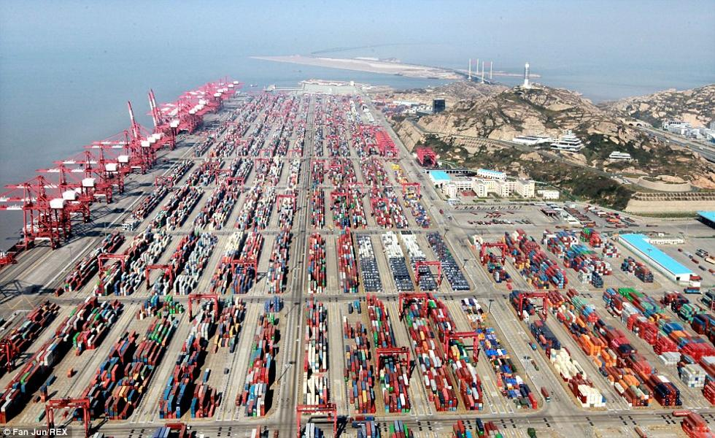
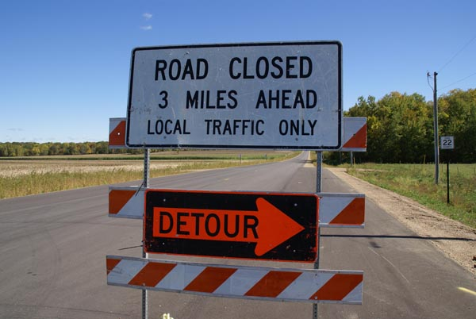
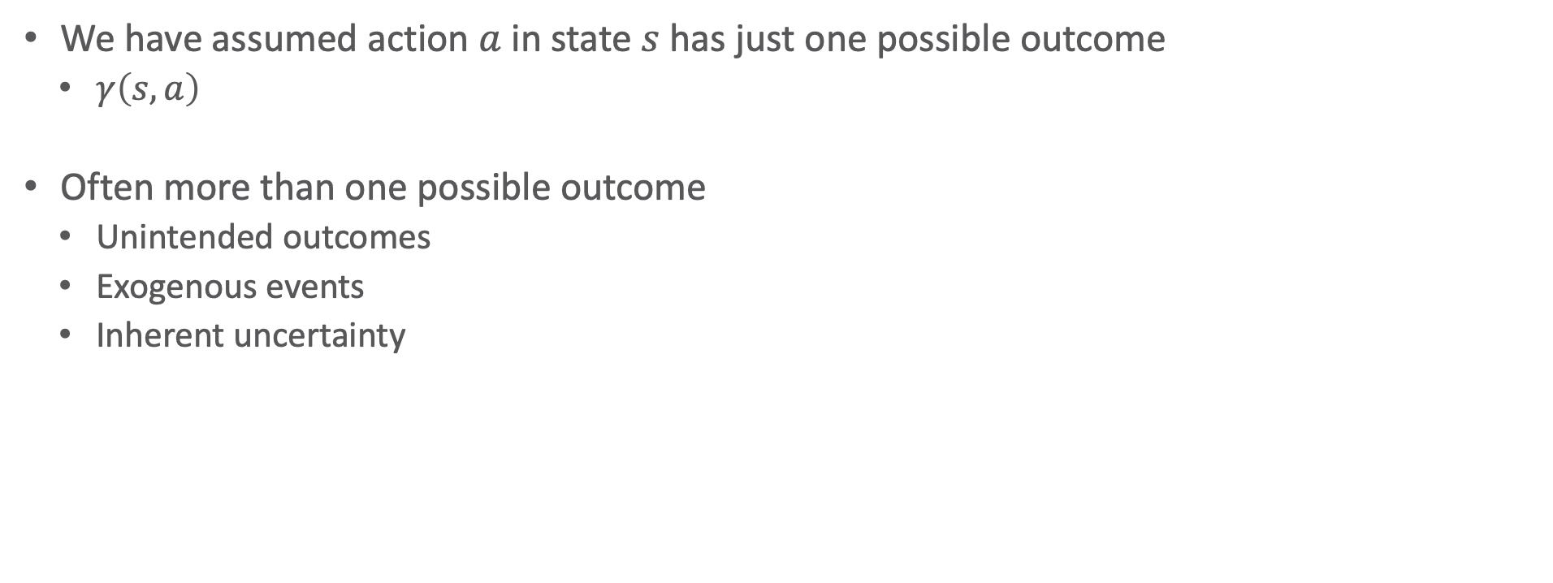
Motivation
We have assumed action $a$ in state $s$ has just one possible outcome
  $γ\left(s,a\right)$
Often more than one possible outcome
  Unintended outcomes
  Exogenous events
  Inherent uncertainty
c
a
b
grasp(c)
c
a
b
a
b
c
Notes:
In some cases, design choice.
For instance, in the real world, the execution of an action may either succeed or fail.
Despite this, in many cases, it still makes sense to model just the so-called nominal case (in which failure does not occur),
monitor execution, detect failure when it occurs, and recover,
for example by replanning or by re-acting with some failure-recovery mechanism.
no nominal case in
the throw of a dice or in the toss of a coin or in a sensing action of a robot.
the method for an online payment if the choice is left to the user (cash, credit card, or bank transfer).
the confirmation given to a Web service by the user.
And if we need to generate a software service that works, we need to consider equally all possibilities.

Slide 4
Outline per the Book
5.2 Planning Problem
  Planning domains
  Plans as policies
  Planning problems and solutions
5.3 And/Or Graph Search
  Planning by forward search
5.5 Determinisation Techniques
  Guided planning for safe solutions
  Planning for safe solutions by determinisation
5.6 Online Approaches
  Lookahead
  Lookahead by determinisation
  Lookahead with a bounded number of steps
Notes:
5.1 Intro

Slide 5
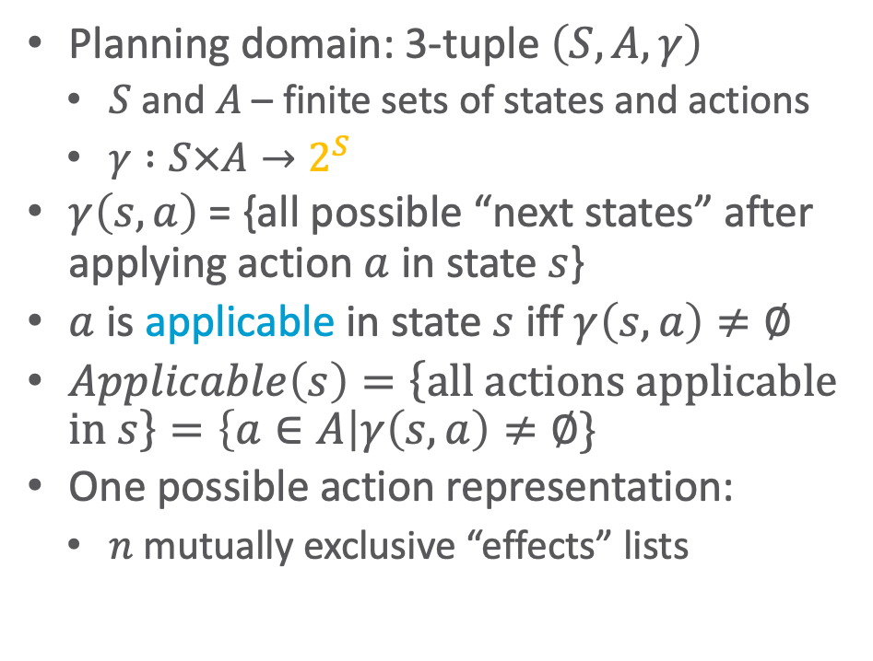
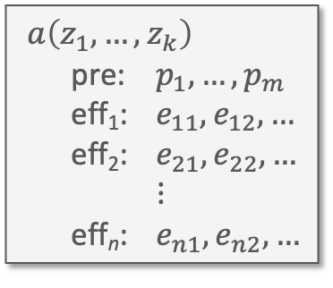
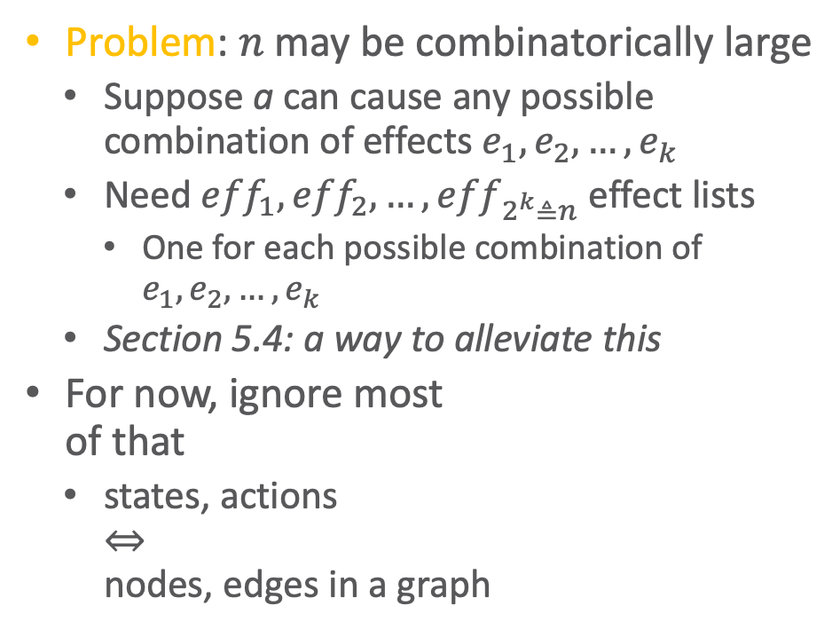
Nondeterministic Planning Domains
Planning domain: 3-tuple $\left(S,A,γ\right)$
  $S$ and $A$ – finite sets of states and actions
  $γ :S×A→2^{S}$
$γ\left(s,a\right)$ = {all possible “next states” after applying action $a$ in state $s$}
$a$ is applicable in state $s$ iff $γ\left(s,a\right)≠∅$
$Applicable\left(s\right)=\left\{\text{all} \text{actions} \text{applicable} \text{in} s\right\}=\left\{a∈A\right|γ\left(s,a\right)≠∅\}$
One possible action representation:
  $n$ mutually exclusive “effects” lists
Problem: $n$ may be combinatorically large
  Suppose a can cause any possible combination of effects $e_{1}, e_{2}, …, e_{k}$
  Need ${eff}_{1}, {eff}_{2}, …, {eff}_{2^{k}≜n}$ effect lists
    One for each possible combination of $e_{1}, e_{2}, …, e_{k}$
  Section 5.4: a way to alleviate this
For now, ignore most
of that
  states, actions
  ⇔
  nodes, edges in a graph
$a\left(z_{1}, …, z_{k}\right)$
pre: $p_{1}, …, p_{m}$
eff₁: $e_{11}, e_{12}, …$
eff₂: $e_{21}, e_{22}, …$
$⋮$
eff_{n}: $e_{n1}, e_{n2}, …$
Notes:
Section 5.4 Symbolic Model Checking Techniques: one of the seminar topics

Slide 6
Nondeterministic Planning Domains
transit3
For deterministic planning problems,
search space was a graph
Now it’s an AND/OR graph
  OR branch:
    Several applicable actions,
    which one to choose?
  AND branch:
    Multiple possible outcomes
    Must handle all of them
Analogy to PSP
  OR branch ⇔ resolver selection
  AND branch ⇔ flaw selection
back
move
parking2
deliver
back
gate1
unload
park
on_ship
at_harbour
deliver
parking1
gate2
move
move
transit1
transit2
Notes:
OR / resolver: one is enough if it leads to solution (backtracking point to try another)
AND / flaw: need to handle all (if not possible, failure)

Slide 7
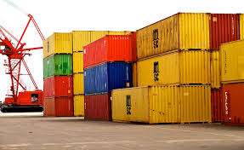
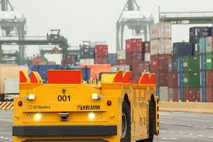
Example
transit3
Very simple harbor management domain
  Unload a single item from a ship
  Move it around a harbor
back
move
parking2
deliver
back
gate1
unload
park
on_ship
at_harbour
deliver
parking1
gate2
move
move
transit1
transit2

Slide 8
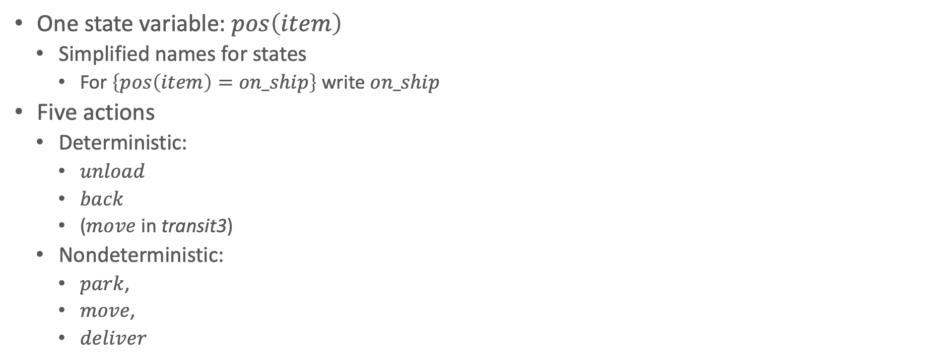
Example
transit3
One state variable: $pos\left(item\right)$
  Simplified names for states
    For $\left\{pos\left(item\right)=on\text{_}ship\right\}$ write $on\text{_}ship$
Five actions
  Deterministic:
    $unload$
    $back$
    ($move$ in transit3)
  Nondeterministic:
    $park$,
    $move$,
    $deliver$
back
move
parking2
deliver
back
gate1
unload
park
on_ship
at_harbour
deliver
parking1
gate2
move
move
transit1
transit2

Slide 9

Actions
transit3
Action example:
  $park$
  pre: $pos\left(item\right)=at_harbor$
  eff₁: $pos\left(item\right)←parking1$
  eff₂: $pos\left(item\right)←parking2$
  eff₃: $pos\left(item\right)←transit1$
Three possible outcomes
  Put item in $parking1$ or $parking2$
  if one of them has space or
  in $transit1$ if there is no parking space
back
move
parking2
deliver
back
gate1
unload
park
on_ship
at_harbour
deliver
parking1
gate2
move
move
transit1
transit2

Slide 10
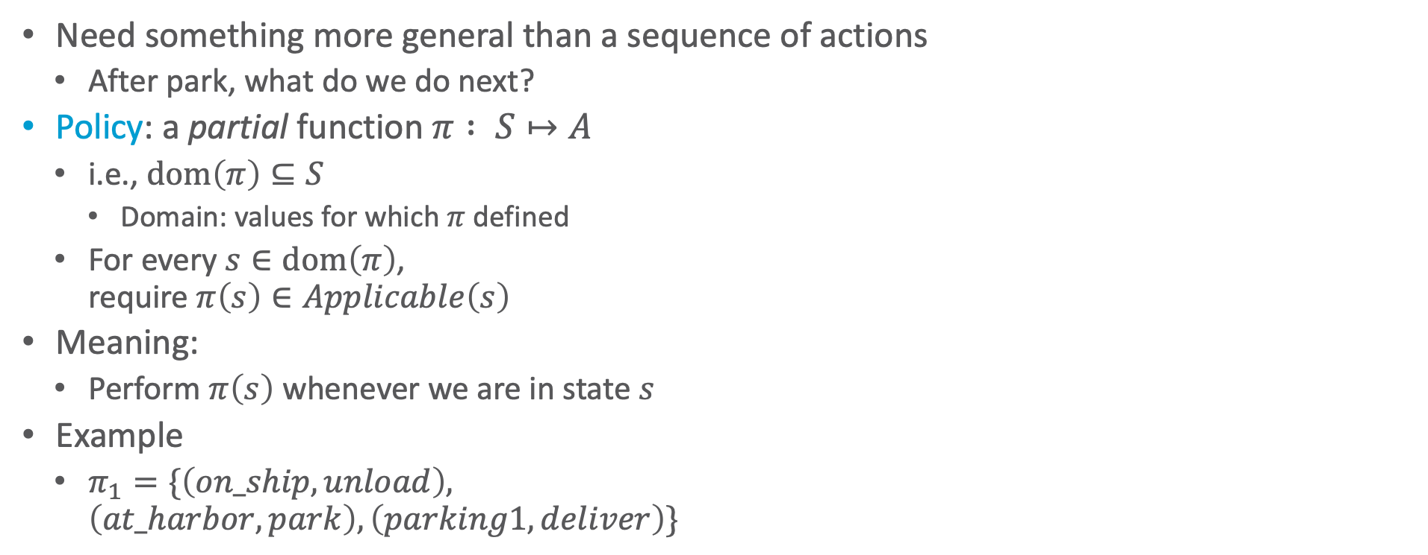
Plans Policies
transit3
Need something more general than a sequence of actions
  After park, what do we do next?
Policy: a partial function $π : S↦A$
  i.e., $dom\left(π\right)⊆S$
    Domain: values for which $π$ defined
  For every $s∈dom\left(π\right)$,
  require $π\left(s\right)∈Applicable\left(s\right)$
Meaning:
  Perform $π\left(s\right)$ whenever we are in state $s$
Example
  $π_{1}=\{\left(on\text{_}ship, unload\right),$
  $\left(at\text{_}harbor, park\right), \left(parking1, deliver\right)\}$
back
move
parking2
deliver
back
gate1
unload
park
on_ship
at_harbour
deliver
parking1
gate2
move
move
transit1
transit2

Slide 11
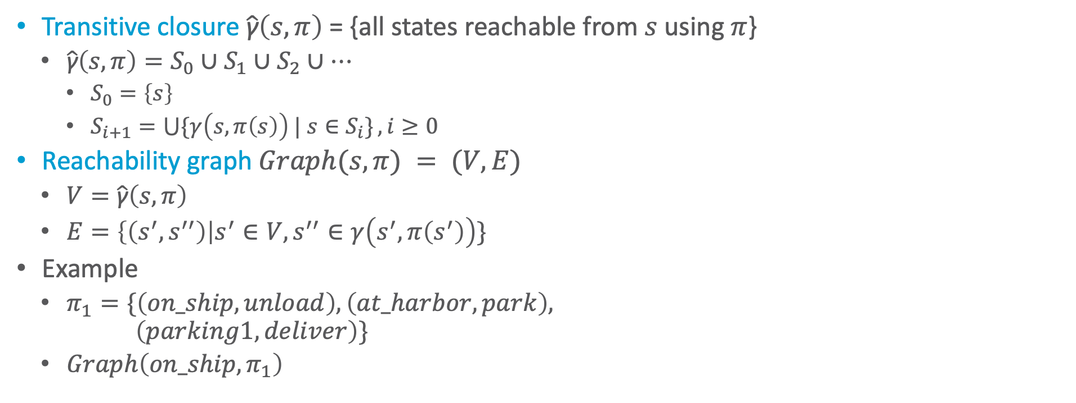
Definitions Over Policies
Transitive closure$\hat{\text{γ}}\left(s,π\right)$= {all states reachable from $s$ using $π$}
  $\hat{\text{γ}}\left(s,π\right)=S_{0}∪S_{1}∪S_{2}∪…$
    $S_{0}=\left\{s\right\}$
    $S_{i+1}=\bigcup{\{γ\left(s,π\left(s\right)\right) | s∈S_{i}\}}, i≥0$
Reachability graph $Graph(s,π) = (V,E)$
  $V=\hat{\text{γ}}\left(s,π\right)$
  $E=\left\{\left(s^{′},s^{′′}\right)\right|s^{′}∈V, s^{′′}∈γ\left(s^{′},π\left(s^{′}\right)\right)\}$
Example
  $π_{1}=\{\left(on\text{_}ship, unload\right),\left(at\text{_}harbor, park\right),$
  $\left(parking1, deliver\right)\}$
  $Graph\left(on\text{_}ship,π_{1}\right)$
parking2
gate1
on_ship
at_harbour
parking1
gate2
transit1
transit2

Slide 12
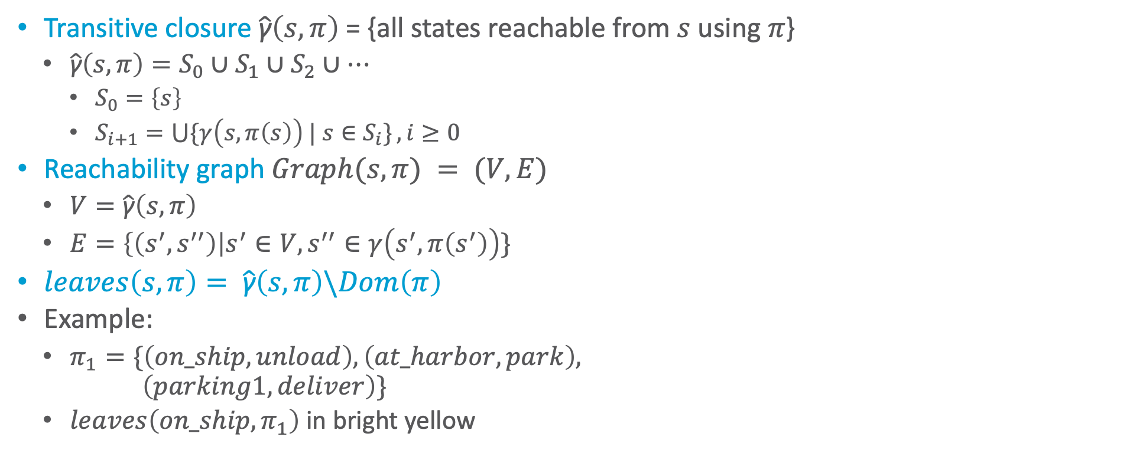
Definitions Over Policies
Transitive closure $\hat{\text{γ}}\left(s,π\right)$= {all states reachable from $s$ using $π$}
  $\hat{\text{γ}}\left(s,π\right)=S_{0}∪S_{1}∪S_{2}∪…$
    $S_{0}=\left\{s\right\}$
    $S_{i+1}=\bigcup{\{γ\left(s,π\left(s\right)\right) | s∈S_{i}\}}, i≥0$
Reachability graph $Graph(s,π) = (V,E)$
  $V=\hat{\text{γ}}\left(s,π\right)$
  $E=\left\{\left(s^{′},s^{′′}\right)\right|s^{′}∈V, s^{′′}∈γ\left(s^{′},π\left(s^{′}\right)\right)\}$
$leaves\left(s,π\right)= \hat{\text{γ}}\left(s,π\right)\backslash Dom\left(π\right)$
Example:
  $π_{1}=\{\left(on\text{_}ship, unload\right), \left(at\text{_}harbor, park\right),$
  $\left(parking1, deliver\right)\}$
  $leaves\left(on\text{_}ship,π_{1}\right)$ in bright yellow
parking2
gate1
on_ship
at_harbour
parking1
gate2
transit1
transit2

Slide 13

Performing a Policy
transit3
$π_{1}=\{\left(on\text{_}ship, unload\right),$
$\left(at\text{_}harbor, park\right),$
$\left(parking1, deliver\right)\}$
PerformPolicy(𝜋)
s ← observe current state
while s ∈ Dom(𝜋) do
perform action 𝜋(s)
s ← observe current state
back
move
parking2
deliver
back
gate1
unload
park
on_ship
at_harbour
deliver
parking1
gate2
move
move
transit1
transit2

Slide 14


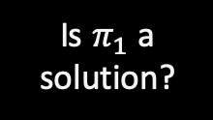
Planning Problems and Solutions
transit3
Planning problem $P=(Σ,s_{0},S_{g})$
  Planning domain $Σ=\left(S,A,γ\right)$
  Initial state $s_{0}∈S$
  Set of goal states $S_{g}⊆S$ (shown in grey)
$π$ is a solution if at least one execution
ends at a goal
  $leaves\left(s_{0},π\right)∩S_{g}≠∅$
Example
  $π_{1}=\{\left(on\text{_}ship, unload\right),$
  $\left(at\text{_}harbor, park\right),$
  $\left(parking1, deliver\right)\}$
back
move
parking2
deliver
back
$S_{g}$
gate1
unload
park
on_ship
at_harbour
deliver
parking1
gate2
move
Is $π_{1}$ a solution?
move
transit1
transit2
Notes:
Yes
Two executions end in a state of Sg

Slide 15
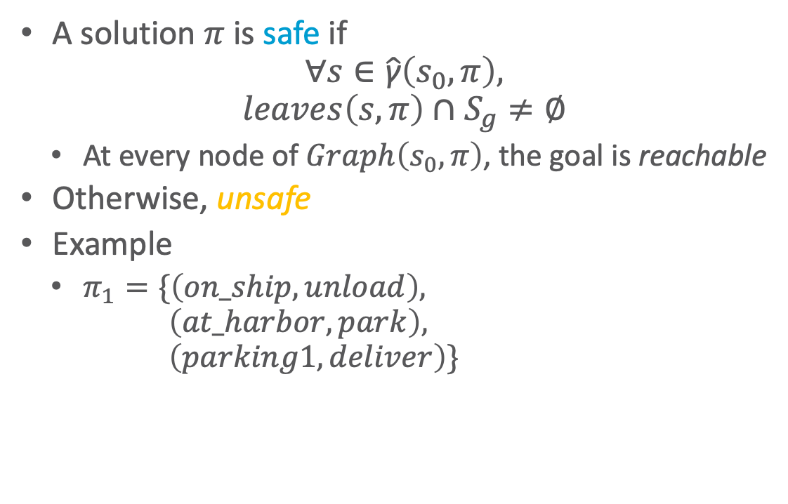

Safe Solutions
A solution $π$ is safe if
$$∀s∈\hat{\text{γ}}\left(s_{0},π\right),$$
$$leaves\left(s,π\right)∩S_{g}≠∅$$
  At every node of $Graph\left(s_{0},π\right)$, the goal is reachable
Otherwise, unsafe
Example
  $π_{1}=\{\left(on\text{_}ship, unload\right),$
  $\left(at\text{_}harbor, park\right),$
  $\left(parking1, deliver\right)\}$
parking2
$S_{g}$
gate1
unload
park
on_ship
at_harbour
deliver
parking1
gate2
Is $π_{1}$ safe?
transit1
transit2
Notes:
No, parking2, transit1, transit2 states of transitive closure but do not lead to goal state
Leaf not a goal state X

Slide 16
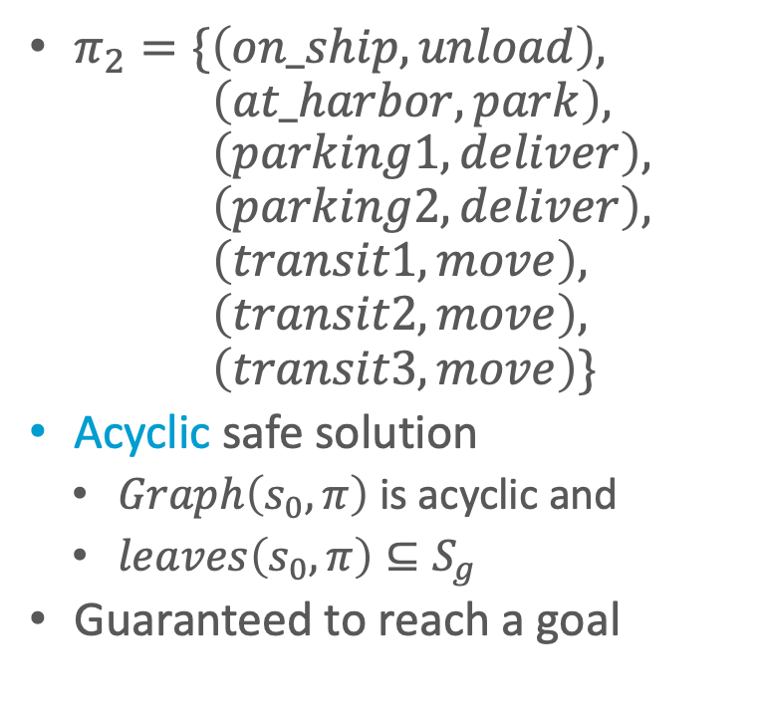
Safe Solutions
transit3
$π_{2}=\{\left(on\text{_}ship, unload\right),$
$\left(at\text{_}harbor, park\right),$
$\left(parking1, deliver\right),$
$\left(parking2, deliver\right),$
$\left(transit1, move\right),$
$\left(transit2, move\right),$
$\left(transit3, move\right)\}$
Acyclic safe solution
  $Graph\left(s_{0},π\right)$ is acyclic and
  $leaves\left(s_{0},π\right)⊆S_{g}$
Guaranteed to reach a goal
back
move
parking2
deliver
back
$S_{g}$
gate1
unload
park
on_ship
at_harbour
deliver
parking1
gate2
move
move
transit1
transit2

Slide 17
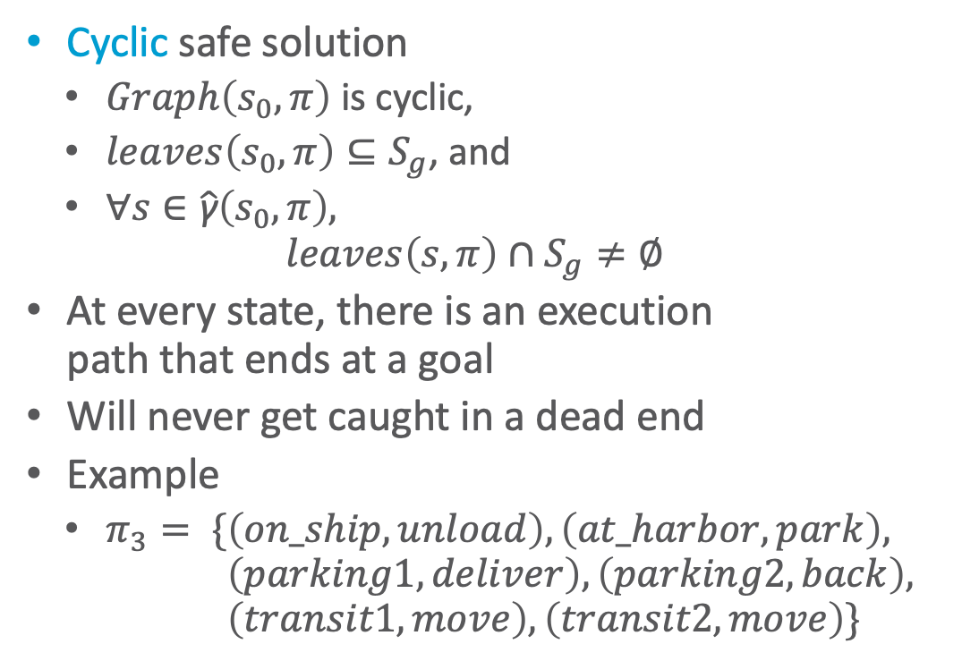
Safe Solutions
transit3
Cyclic safe solution
  $Graph\left(s_{0},π\right)$ is cyclic,
  $leaves\left(s_{0},π\right)⊆S_{g}$, and
  $∀s∈\hat{\text{γ}}\left(s_{0},π\right),$
  $leaves\left(s,π\right)∩S_{g}≠∅$
At every state, there is an execution
path that ends at a goal
Will never get caught in a dead end
Example
  $π_{3}= \{\left(on\text{_}ship, unload\right), \left(at\text{_}harbor, park\right),$
  $\left(parking1, deliver\right),\left(parking2, back\right),$
  $\left(transit1, move\right), \left(transit2, move\right)\}$
back
move
parking2
deliver
back
$S_{g}$
gate1
unload
park
on_ship
at_harbour
deliver
parking1
gate2
move
move
transit1
transit2
Notes:
$∀s$ condition necessary as otherwise we might get stuck in a cycle (states there are no leaves) without a way to a leaf (goal)

Slide 18
Kinds of Solutions
Goal
  acyclic
  solutions
  a
  safe solutions
  cyclic solutions
  c
  solutions
  unsafe solutions
  b

Slide 19
Intermediate Summary
Planning Problems
  Planning domains
  Plans as policies
  Planning problems and solutions
    Types of solutions: safe, unsafe, acyclic, cyclic

Slide 20
Outline per the Book
5.2 Planning Problem
  Planning domains
  Plans as policies
  Planning problems and solutions
5.3 And/Or Graph Search
  Planning by forward search
5.5 Determinisation Techniques
  Guided planning for safe solutions
  Planning for safe solutions by determinisation
5.6 Online Approaches
  Lookahead
  Lookahead by determinisation
  Lookahead with a bounded number of steps
Notes:
4.1 Intro

Slide 21

Finding (Unsafe) Solutions
Input: planning problem $\left(Σ,s_{0},S_{g}\right)$
Forward-search(Σ,s₀,g)
s ← s₀
𝜋 ← ⟨⟩
loop
if s satisfies g then
return 𝜋
A′ ←{a ∈ A | a is applicable in s}
if A′ = ∅ then
return failure
nondeterministically choose a ∈ A′ s ← 𝛾(s,a)
𝜋 ← 𝜋.a
Find-Solution(Σ,s₀,S_{g})
s ← s₀
𝜋 ← ∅
Visited ← {s₀}
loop
if s ∈ S_{g} then
return 𝜋
A′ ← Applicable(s)
if A′ = ∅ then
return failure
nondeterministically choose a ∈ A′ nondeterministically choose s’ ∈ 𝛾(s,a)
if s’ ∈ Visited then
return failure
𝜋(s) ← a
Visited ← Visited ∪ {s’}
s ← s’
Decide which state to plan for
Cycle-checking
For comparison: Forward-search with deterministic models

Slide 22
Example
transit3
Find-Solution(Σ,s₀,S_{g})
s ← s₀
𝜋 ← ∅
Visited ← {s₀}
...
back
move
parking2
deliver
back
$S_{g}$
gate1
unload
park
s = on_ship
deliver
on_ship
at_harbour
s
parking1
gate2
π = {}
move
move
Visited = {on_ship}
transit1
transit2

Slide 23
Example
Find-Solution(Σ,s₀,S_{g})
...
loop
if s ∈ S_{g} then
return 𝜋
...
nondeterministically choose a ∈ Applicable(s) nondeterministically choose s’ ∈ 𝛾(s,a)
...
𝜋(s) ← a
Visited ← Visited ∪ {s’}
s ← s’
transit3
back
move
parking2
deliver
back
$S_{g}$
a
gate1
unload
park
s = on_ship, a = unload
γ(s,a) = {at_harbor}
s′ = at_harbor
deliver
on_ship
at_harbour
s
s'
parking1
gate2
π = {(on_ship, unload)}
move
move
Visited = {on_ship, at_harbor}
transit1
transit2

Slide 24
Example
Find-Solution(Σ,s₀,S_{g})
...
loop
if s ∈ S_{g} then
return 𝜋
...
nondeterministically choose a ∈ Applicable(s) nondeterministically choose s’ ∈ 𝛾(s,a)
...
𝜋(s) ← a
Visited ← Visited ∪ {s’}
s ← s’
transit3
back
move
parking2
deliver
back
$S_{g}$
gate1
unload
a
park
s = at_harbor, a = park
γ(s,a) = {parking1, parking2, transit1}
s′ = parking1
deliver
on_ship
at_harbour
s
parking1
s'
gate2
π = {(on_ship, unload),
(at_harbor, park)}
move
move
Visited = {on_ship, at_harbor, parking1}
transit1
transit2

Slide 25
Example
Find-Solution(Σ,s₀,S_{g})
...
loop
if s ∈ S_{g} then
return 𝜋
...
nondeterministically choose a ∈ Applicable(s) nondeterministically choose s’ ∈ 𝛾(s,a)
...
𝜋(s) ← a
Visited ← Visited ∪ {s’}
s ← s’
transit3
back
move
parking2
deliver
back
$S_{g}$
gate1
s'
unload
park
a
s = parking1, a = deliver
γ(s,a) = {gate1, gate2, transit2}
s′ = gate1
deliver
on_ship
at_harbour
parking1
gate2
s
π = {(on_ship, unload),
(at_harbor, park),
(parking1, deliver)}
move
move
Visited = {on_ship, at_harbor, parking1, gate1}
transit1
transit2

Slide 26
Example
Find-Solution(Σ,s₀,S_{g})
...
loop
if s ∈ S_{g} then
return 𝜋
...
nondeterministically choose a ∈ Applicable(s) nondeterministically choose s’ ∈ 𝛾(s,a)
...
𝜋(s) ← a
Visited ← Visited ∪ {s’}
s ← s’
transit3
back
move
parking2
deliver
back
$S_{g}$
gate1
s
unload
park
s = gate1
deliver
on_ship
at_harbour
gate1 is a goal,
so return π
parking1
gate2
π = {(on_ship, unload),
(at_harbor, park),
(parking1, deliver)}
move
move
Visited = {on_ship, at_harbor, parking1, gate1}
transit1
transit2

Slide 27

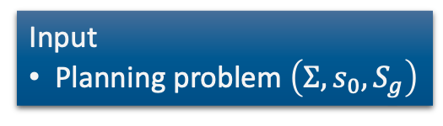
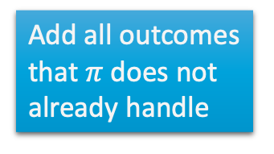
Finding Acyclic Safe Solutions
Check for cycles
  For each $s^{′}∈\left(γ\left(s,a\right)∩Dom\left(π\right)\right)$
    Is $s^{′}∈\hat{\text{γ}}\left(s^{′},π\right)$?
  Formally, $has\text{−}loops(π,s,Frontier)$ iff
  $$∃s^{′}∈\left(γ\left(s,a\right)∩dom\left(π\right)\right) : s^{′}∈\hat{\text{γ}}\left(s^{′},π\right)$$
    I.e., a state $s^{′}$ is reachable from itself
Find-Acyclic-Solution(Σ,s₀,S_{g})
𝜋 ← ∅
Frontier ← {s₀}
for every s ∈ Frontier \ S_{g} do
Frontier ← Frontier \ {s}
if Applicable(s) = ∅ then
return failure
nondeterministically choose a ∈ Applicable(s)
𝜋 ← 𝜋 ∪ (s,a)
Frontier ← Frontier ∪ (𝛾(s,a) \ dom(𝜋))
if has-loops(𝜋,s,Frontier) then
return failure
return 𝜋
Input
Planning problem $\left(Σ,s_{0},S_{g}\right)$
Keep track of
unexpanded
states, like in A*
Add all outcomes that $π$ does not already handle
Cycle-checking
Notes:
Fails if last action introduces a loop ($γ\left(s,a\right)$)

Slide 28
Example
transit3
Find-Acyclic-Solution(Σ,s₀,S_{g})
𝜋 ← ∅
Frontier ← {s₀}
for every s ∈ Frontier \ S_{g} do
...
back
move
parking2
deliver
back
$S_{g}$
gate1
Frontier ∖ S_{g} = {on_ship}
unload
park
π = {}
on_ship
at_harbour
deliver
parking1
gate2
move
move
transit1
transit2

Slide 29
Example
Find-Acyclic-Solution(Σ,s₀,S_{g})
...
for every s ∈ Frontier \ S_{g} do
Frontier ← Frontier \ {s}
...
nondeterministically choose a ∈ Applicable(s)
𝜋 ← 𝜋 ∪ (s,a)
Frontier ← Frontier ∪ (𝛾(s,a) \ dom(𝜋))
if has-loops(𝜋,s,Frontier) then
return failure
return 𝜋
transit3
back
move
parking2
deliver
back
$S_{g}$
s = on_ship
gate1
Frontier ∖ S_{g} = {at_harbor}
unload
park
π = {(on_ship, unload)}
on_ship
at_harbour
deliver
parking1
gate2
move
move
transit1
transit2

Slide 30
Example
Find-Acyclic-Solution(Σ,s₀,S_{g})
...
for every s ∈ Frontier \ S_{g} do
Frontier ← Frontier \ {s}
...
nondeterministically choose a ∈ Applicable(s)
𝜋 ← 𝜋 ∪ (s,a)
Frontier ← Frontier ∪ (𝛾(s,a) \ dom(𝜋))
if has-loops(𝜋,s,Frontier) then
return failure
return 𝜋
transit3
back
move
parking2
deliver
back
$S_{g}$
s = at_harbor
gate1
Frontier ∖ S_{g} = {parking1, parking2, transit1}
unload
park
π = {(on_ship, unload),
(at_harbor, park)}
on_ship
at_harbour
deliver
parking1
gate2
move
move
transit1
transit2

Slide 31
Example
Find-Acyclic-Solution(Σ,s₀,S_{g})
...
for every s ∈ Frontier \ S_{g} do
Frontier ← Frontier \ {s}
...
nondeterministically choose a ∈ Applicable(s)
𝜋 ← 𝜋 ∪ (s,a)
Frontier ← Frontier ∪ (𝛾(s,a) \ dom(𝜋))
if has-loops(𝜋,s,Frontier) then
return failure
return 𝜋
transit3
back
move
parking2
deliver
back
$S_{g}$
s = parking1
gate1
Frontier ∖ S_{g} = {parking2, transit1, transit2}
unload
park
π = {(on_ship, unload),
(at_harbor, park),
(parking1, deliver)}
on_ship
at_harbour
deliver
parking1
gate2
move
move
transit1
transit2

Slide 32
Example
Find-Acyclic-Solution(Σ,s₀,S_{g})
...
for every s ∈ Frontier \ S_{g} do
Frontier ← Frontier \ {s}
...
nondeterministically choose a ∈ Applicable(s)
𝜋 ← 𝜋 ∪ (s,a)
Frontier ← Frontier ∪ (𝛾(s,a) \ dom(𝜋))
if has-loops(𝜋,s,Frontier) then
return failure
return 𝜋
nondeterministically choose back or deliver
back ⇒ cycle, so return failure
deliver ⇒ no cycle, so continue
transit3
back
move
parking2
deliver
back
$S_{g}$
s = parking2
gate1
Frontier ∖ S_{g} = {transit1, transit2, transit3}
unload
park
π = {(on_ship, unload),
(at_harbor, park),
(parking1, deliver),
(parking2, deliver)}
on_ship
at_harbour
deliver
parking1
gate2
move
move
transit1
transit2

Slide 33
Example
Find-Acyclic-Solution(Σ,s₀,S_{g})
...
for every s ∈ Frontier \ S_{g} do
Frontier ← Frontier \ {s}
...
nondeterministically choose a ∈ Applicable(s)
𝜋 ← 𝜋 ∪ (s,a)
Frontier ← Frontier ∪ (𝛾(s,a) \ dom(𝜋))
if has-loops(𝜋,s,Frontier) then
return failure
return 𝜋
transit3
back
move
parking2
deliver
back
$S_{g}$
s = transit1
gate1
Frontier ∖ S_{g} = {transit2, transit3}
unload
park
π = {(on_ship, unload),
(at_harbor, park),
(parking1, deliver),
(parking2, deliver),
(transit1, move)}
on_ship
at_harbour
deliver
parking1
gate2
move
move
transit1
transit2

Slide 34
Example
Find-Acyclic-Solution(Σ,s₀,S_{g})
...
for every s ∈ Frontier \ S_{g} do
Frontier ← Frontier \ {s}
...
nondeterministically choose a ∈ Applicable(s)
𝜋 ← 𝜋 ∪ (s,a)
Frontier ← Frontier ∪ (𝛾(s,a) \ Dom(𝜋))
if has-loops(𝜋,s,Frontier) then
return failure
return 𝜋
transit3
back
move
parking2
deliver
back
$S_{g}$
s = transit2
gate1
Frontier ∖ S_{g} = {transit3}
unload
park
π = {(on_ship, unload),
(at_harbor, park),
(parking1, deliver),
(parking2, deliver),
(transit1, move),
(transit2, move)}
on_ship
at_harbour
deliver
parking1
gate2
move
move
transit1
transit2

Slide 35
Example
Find-Acyclic-Solution(Σ,s₀,S_{g})
...
for every s ∈ Frontier \ S_{g} do
Frontier ← Frontier \ {s}
...
nondeterministically choose a ∈ Applicable(s)
𝜋 ← 𝜋 ∪ (s,a)
Frontier ← Frontier ∪ (𝛾(s,a) \ dom(𝜋))
if has-loops(𝜋,s,Frontier) then
return failure
return 𝜋
transit3
back
move
parking2
deliver
back
$S_{g}$
s = transit3
gate1
Frontier ∖ S_{g} = ∅
Found a solution, so return π
unload
park
π = {(on_ship, unload),
(at_harbor, park),
(parking1, deliver),
(parking2, deliver),
(transit1, move),
(transit2, move),
(transit3, move)}
on_ship
at_harbour
deliver
parking1
gate2
move
move
transit1
transit2

Slide 36
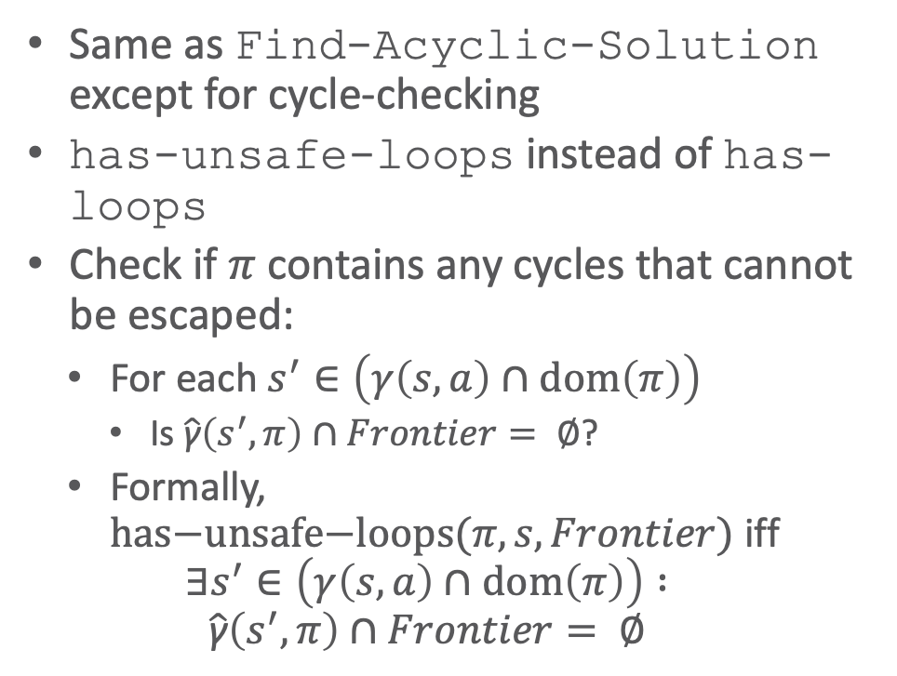

Finding Safe Solutions
Same as Find-Acyclic-Solution except for cycle-checking
has-unsafe-loops instead of has-loops
Check if $π$ contains any cycles that cannot be escaped:
  For each $s^{′}∈\left(γ\left(s,a\right)∩dom\left(π\right)\right)$
    Is $\hat{\text{γ}}\left(s^{′},π\right)∩Frontier= ∅$?
  Formally, $has\text{−}unsafe\text{−}loops(π,s,Frontier)$ iff
  $$∃s^{′}∈\left(γ\left(s,a\right)∩dom\left(π\right)\right) :$$
  $$\hat{\text{γ}}\left(s^{′},π\right)∩Frontier= ∅$$
Find-Safe-Solution(Σ,s₀,S_{g})
𝜋 ← ∅
Frontier ← {s₀}
for every s ∈ Frontier \ S_{g} do
Frontier ← Frontier \ {s}
if Applicable(s) = ∅ then
return failure
nondeterministically choose a ∈ Applicable(s)
𝜋 ← 𝜋 ∪ (s,a)
Frontier ← Frontier ∪ (𝛾(s,a) \ dom(𝜋))
if has-unsafe-loops(𝜋,s,Frontier) then
return failure
return 𝜋
Input
Planning problem $\left(Σ,s_{0},S_{g}\right)$
Different cycle-checking
Notes:
Acyclic check: $has\text{−}loops(π,s,Frontier)$ iff $∃s^{′}∈\left(γ\left(s,a\right)∩Dom\left(π\right)\right) : s^{′}∈\hat{\text{γ}}\left(s^{′},π\right)$
May find acyclic solutions

Slide 37
Example
transit3
Find-Safe-Solution(Σ,s₀,S_{g})
𝜋 ← ∅
Frontier ← {s₀}
for every s ∈ Frontier \ S_{g} do
...
back
move
parking2
deliver
back
$S_{g}$
gate1
Frontier ∖ S_{g} = {on_ship}
unload
park
π = {}
on_ship
at_harbour
deliver
parking1
gate2
move
move
transit1
transit2

Slide 38
Example
Find-Safe-Solution(Σ,s₀,S_{g})
...
for every s ∈ Frontier \ S_{g} do
Frontier ← Frontier \ {s}
...
nondeterministically choose a ∈ Applicable(s)
𝜋 ← 𝜋 ∪ (s,a)
Frontier ← Frontier ∪ (𝛾(s,a) \ dom(𝜋))
if has-unsafe-loops(𝜋,s,Frontier) then
return failure
return 𝜋
transit3
back
move
parking2
deliver
back
$S_{g}$
s = on_ship
gate1
Frontier ∖ S_{g} = {at_harbor}
unload
park
π = {(on_ship, unload)}
on_ship
at_harbour
deliver
parking1
gate2
move
move
transit1
transit2

Slide 39
Example
Find-Safe-Solution(Σ,s₀,S_{g})
...
for every s ∈ Frontier \ S_{g} do
Frontier ← Frontier \ {s}
...
nondeterministically choose a ∈ Applicable(s)
𝜋 ← 𝜋 ∪ (s,a)
Frontier ← Frontier ∪ (𝛾(s,a) \ dom(𝜋))
if has-unsafe-loops(𝜋,s,Frontier) then
return failure
return 𝜋
transit3
back
move
parking2
deliver
back
$S_{g}$
s = at_harbor
gate1
Frontier ∖ S_{g} = {parking1, parking2, transit1}
unload
park
π = {(on_ship, unload),
(at_harbor, park)}
on_ship
at_harbour
deliver
parking1
gate2
move
move
transit1
transit2

Slide 40
Example
Find-Safe-Solution(Σ,s₀,S_{g})
...
for every s ∈ Frontier \ S_{g} do
Frontier ← Frontier \ {s}
...
nondeterministically choose a ∈ Applicable(s)
𝜋 ← 𝜋 ∪ (s,a)
Frontier ← Frontier ∪ (𝛾(s,a) \ dom(𝜋))
if has-unsafe-loops(𝜋,s,Frontier) then
return failure
return 𝜋
transit3
back
move
parking2
deliver
back
$S_{g}$
s = parking1
gate1
Frontier ∖ S_{g} = {parking2, transit1, transit2}
unload
park
π = {(on_ship, unload),
(at_harbor, park),
(parking1, deliver)}
on_ship
at_harbour
deliver
parking1
gate2
move
move
transit1
transit2

Slide 41
Example
Find-Safe-Solution(Σ,s₀,S_{g})
...
for every s ∈ Frontier \ S_{g} do
Frontier ← Frontier \ {s}
...
nondeterministically choose a ∈ Applicable(s)
𝜋 ← 𝜋 ∪ (s,a)
Frontier ← Frontier ∪ (𝛾(s,a) \ dom(𝜋))
if has-unsafe-loops(𝜋,s,Frontier) then
return failure
return 𝜋
nondeterministically choose back or deliver
back is okay: escapable cycle
transit3
back
move
parking2
deliver
back
$S_{g}$
s = parking2
gate1
Frontier ∖ S_{g} = {transit1, transit2}
unload
park
π = {(on_ship, unload),
(at_harbor, park),
(parking1, deliver),
(parking2, back)}
on_ship
at_harbour
deliver
parking1
gate2
move
move
transit1
transit2

Slide 42
Example
Find-Safe-Solution(Σ,s₀,S_{g})
...
for every s ∈ Frontier \ S_{g} do
Frontier ← Frontier \ {s}
...
nondeterministically choose a ∈ Applicable(s)
𝜋 ← 𝜋 ∪ (s,a)
Frontier ← Frontier ∪ (𝛾(s,a) \ dom(𝜋))
if has-unsafe-loops(𝜋,s,Frontier) then
return failure
return 𝜋
transit3
back
move
parking2
deliver
back
$S_{g}$
s = transit1
gate1
Frontier ∖ S_{g} = {transit2}
unload
park
π = {(on_ship, unload),
(at_harbor, park),
(parking1, deliver),
(parking2, back),
(transit1, move)}
on_ship
at_harbour
deliver
parking1
gate2
move
move
transit1
transit2

Slide 43
Example
Find-Safe-Solution(Σ,s₀,S_{g})
...
for every s ∈ Frontier \ S_{g} do
Frontier ← Frontier \ {s}
...
nondeterministically choose a ∈ Applicable(s)
𝜋 ← 𝜋 ∪ (s,a)
Frontier ← Frontier ∪ (𝛾(s,a) \ dom(𝜋))
if has-unsafe-loops(𝜋,s,Frontier) then
return failure
return 𝜋
transit3
back
move
parking2
deliver
back
$S_{g}$
s = transit2
gate1
Frontier ∖ S_{g} = ∅
Found a solution, so return π
unload
park
π = {(on_ship, unload),
(at_harbor, park),
(parking1, deliver),
(parking2, back),
(transit1, move),
(transit2, move)}
on_ship
at_harbour
deliver
parking1
gate2
move
move
transit1
transit2

Slide 44
Intermediate Summary
And/Or Graph Search
  Analogue to forward search in deterministic models
  Algorithms for each type of solution
    Unsafe
    Cyclic safe
    Acyclic safe

Slide 45
Outline per the Book
5.2 Planning Problem
  Planning domains
  Plans as policies
  Planning problems and solutions
5.3 And/Or Graph Search
  Planning by forward search
5.5 Determinisation Techniques
  Guided planning for safe solutions
  Planning for safe solutions by determinisation
5.6 Online Approaches
  Lookahead
  Lookahead by determinisation
  Lookahead with a bounded number of steps
Notes:
4.1 Intro

Slide 46
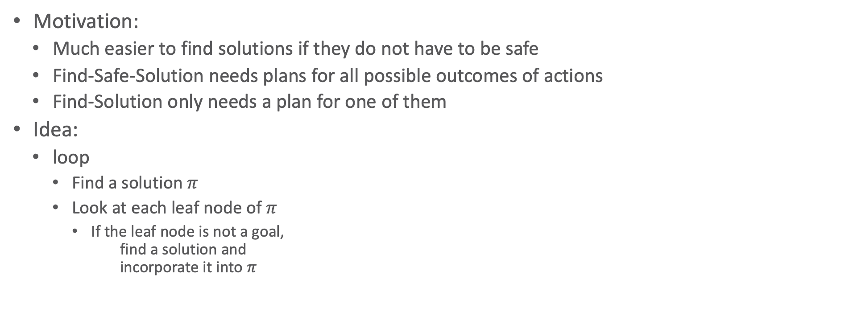
Guided-Find-Safe-Solution
Motivation:
  Much easier to find solutions if they do not have to be safe
  Find-Safe-Solution needs plans for all possible outcomes of actions
  Find-Solution only needs a plan for one of them
Idea:
  loop
    Find a solution $π$
    Look at each leaf node of $π$
      If the leaf node is not a goal,
      find a solution and
      incorporate it into $π$

Slide 47

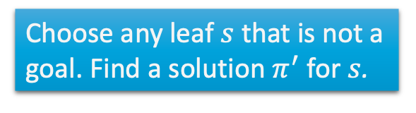

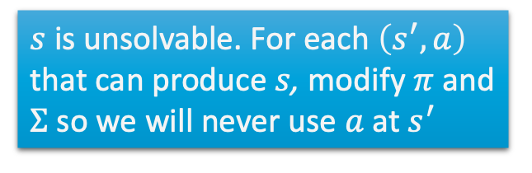
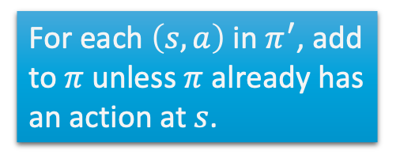
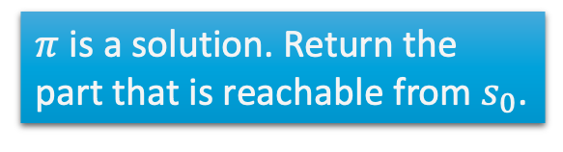
Guided-Find-Safe-Solution
Guided-Find-Safe-Solution(Σ,s₀,S_{g})
if s₀ ∈ S_{g} then
return ∅
if Applicable(s₀) = ∅ then
return failure
𝜋 ← ∅
loop
Q ← leaves(s₀,𝜋) \ S_{g}
if Q = ∅ then
𝜋 ← 𝜋 \ {(s,a) ∈ 𝜋 | s ∉ $\hat{\text{γ}}$(s₀,𝜋)}
return 𝜋
arbitrarily select s ∈ Q
𝜋′ ← Find-Solution(Σ,s,S_{g})
if 𝜋′ ≠ failure then
𝜋 ← 𝜋 ∪ {(s,a) ∈ 𝜋’ | s ∉ dom(𝜋)}
else if s = s₀ then
return failure
else
for every s’,a s.t. s ∈ 𝛾(s’,a) do
𝜋 ← 𝜋 \ {(s’,a)}
make a not applicable in s’
Input: Planning problem $\left(Σ,s_{0},S_{g}\right)$
$π$ is a solution. Return the part that is reachable from $s_{0}$.
Choose any leaf $s$ that is not a goal. Find a solution $π^{′}$ for $s$.
For each $\left(s,a\right)$ in $π^{′}$, add to $π$ unless $π$ already has an action at $s$.
⇐ not in the book
$s$ is unsolvable. For each $\left(s^{′},a\right)$ that can produce $s$, modify $π$ and $Σ$ so we will never use $a$ at $s^{′}$

Slide 48
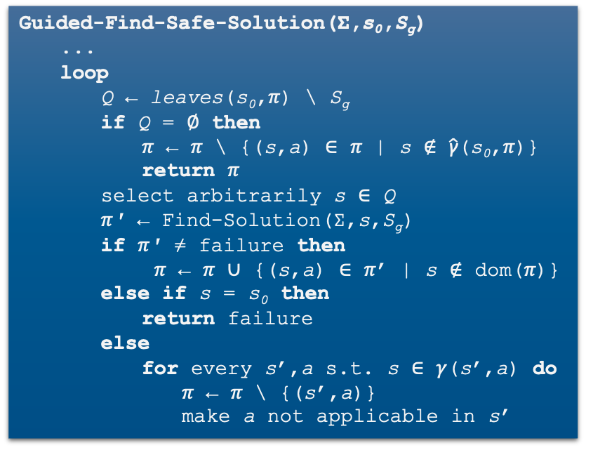
Example
transit3
Guided-Find-Safe-Solution(Σ,s₀,S_{g})
...
loop
Q ← leaves(s₀,𝜋) \ S_{g}
if Q = ∅ then
𝜋 ← 𝜋 \ {(s,a) ∈ 𝜋 | s ∉ $\hat{\text{γ}}$(s₀,𝜋)}
return 𝜋
select arbitrarily s ∈ Q
𝜋′ ← Find-Solution(Σ,s,S_{g})
if 𝜋′ ≠ failure then
𝜋 ← 𝜋 ∪ {(s,a) ∈ 𝜋’ | s ∉ dom(𝜋)}
else if s = s₀ then
return failure
else
for every s’,a s.t. s ∈ 𝛾(s’,a) do
𝜋 ← 𝜋 \ {(s’,a)}
make a not applicable in s’
π = {}
s₀ = on_ship
move
back
parking2
deliver
foo
back
move
$S_{g}$
gate1
unload
park
on_ship
at_harbour
deliver
parking1
gate2
move
move
transit1
transit2
Notes:
Q = {on_ship}

Slide 49
Example
transit3
Guided-Find-Safe-Solution(Σ,s₀,S_{g})
...
loop
Q ← leaves(s₀,𝜋) \ S_{g}
if Q = ∅ then
𝜋 ← 𝜋 \ {(s,a) ∈ 𝜋 | s ∉ $\hat{\text{γ}}$(s₀,𝜋)}
return 𝜋
select arbitrarily s ∈ Q
𝜋′ ← Find-Solution(Σ,s,S_{g})
if 𝜋′ ≠ failure then
𝜋 ← 𝜋 ∪ {(s,a) ∈ 𝜋’ | s ∉ dom(𝜋)}
else if s = s₀ then
return failure
else
for every s’,a s.t. s ∈ 𝛾(s’,a) do
𝜋 ← 𝜋 \ {(s’,a)}
make a not applicable in s’
π = {(on_ship, unload),
(at_harbor, park),
(parking1, deliver)}
move
back
parking2
deliver
foo
back
move
$S_{g}$
gate1
unload
park
on_ship
at_harbour
deliver
parking1
gate2
move
move
transit1
transit2

Slide 50
Example
transit3
Guided-Find-Safe-Solution(Σ,s₀,S_{g})
...
loop
Q ← leaves(s₀,𝜋) \ S_{g}
if Q = ∅ then
𝜋 ← 𝜋 \ {(s,a) ∈ 𝜋 | s ∉ $\hat{\text{γ}}$(s₀,𝜋)}
return 𝜋
select arbitrarily s ∈ Q
𝜋′ ← Find-Solution(Σ,s,S_{g})
if 𝜋′ ≠ failure then
𝜋 ← 𝜋 ∪ {(s,a) ∈ 𝜋’ | s ∉ dom(𝜋)}
else if s = s₀ then
return failure
else
for every s’,a s.t. s ∈ 𝛾(s’,a) do
𝜋 ← 𝜋 \ {(s’,a)}
make a not applicable in s’
π = {(on_ship, unload),
(at_harbor, park),
(parking1, deliver).
(parking2, deliver)}
move
back
parking2
deliver
foo
back
move
$S_{g}$
gate1
unload
park
on_ship
at_harbour
deliver
parking1
gate2
move
move
transit1
transit2

Slide 51
Example
transit3
Guided-Find-Safe-Solution(Σ,s₀,S_{g})
...
loop
Q ← leaves(s₀,𝜋) \ S_{g}
if Q = ∅ then
𝜋 ← 𝜋 \ {(s,a) ∈ 𝜋 | s ∉ $\hat{\text{γ}}$(s₀,𝜋)}
return 𝜋
select arbitrarily s ∈ Q
𝜋′ ← Find-Solution(Σ,s,S_{g})
if 𝜋′ ≠ failure then
𝜋 ← 𝜋 ∪ {(s,a) ∈ 𝜋’ | s ∉ dom(𝜋)}
else if s = s₀ then
return failure
else
for every s’,a s.t. s ∈ 𝛾(s’,a) do
𝜋 ← 𝜋 \ {(s’,a)}
make a not applicable in s’
π = {(on_ship, unload),
(at_harbor, park),
(parking1, deliver),
(parking2, deliver),
(transit3, move),
(foo, move)}
move
back
parking2
deliver
foo
back
move
$S_{g}$
gate1
unload
park
on_ship
at_harbour
deliver
parking1
gate2
move
move
transit1
transit2

Slide 52
Example
transit3
Guided-Find-Safe-Solution(Σ,s₀,S_{g})
...
loop
Q ← leaves(s₀,𝜋) \ S_{g}
if Q = ∅ then
𝜋 ← 𝜋 \ {(s,a) ∈ 𝜋 | s ∉ $\hat{\text{γ}}$(s₀,𝜋)}
return 𝜋
select arbitrarily s ∈ Q
𝜋′ ← Find-Solution(Σ,s,S_{g})
if 𝜋′ ≠ failure then
𝜋 ← 𝜋 ∪ {(s,a) ∈ 𝜋’ | s ∉ dom(𝜋)}
else if s = s₀ then
return failure
else
for every s’,a s.t. s ∈ 𝛾(s’,a) do
𝜋 ← 𝜋 \ {(s’,a)}
make a not applicable in s’
π = {(on_ship, unload),
(at_harbor, park),
(parking1, deliver),
(parking2, deliver),
(transit3, move),
(foo, move)}
move
back
parking2
foo
fail
deliver
back
move
$S_{g}$
gate1
unload
park
on_ship
at_harbour
deliver
parking1
gate2
move
move
transit1
transit2

Slide 53
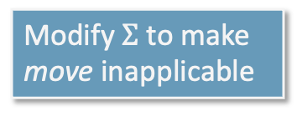
Example
Modify $Σ$ to make move inapplicable
transit3
Guided-Find-Safe-Solution(Σ,s₀,S_{g})
...
loop
Q ← leaves(s₀,𝜋) \ S_{g}
if Q = ∅ then
𝜋 ← 𝜋 \ {(s,a) ∈ 𝜋 | s ∉ $\hat{\text{γ}}$(s₀,𝜋)}
return 𝜋
select arbitrarily s ∈ Q
𝜋′ ← Find-Solution(Σ,s,S_{g})
if 𝜋′ ≠ failure then
𝜋 ← 𝜋 ∪ {(s,a) ∈ 𝜋’ | s ∉ dom(𝜋)}
else if s = s₀ then
return failure
else
for every s’,a s.t. s ∈ 𝛾(s’,a) do
𝜋 ← 𝜋 \ {(s’,a)}
make a not applicable in s’
π = {(on_ship, unload),
(at_harbor, park),
(parking1, deliver),
(parking2, deliver),
(transit3, move),
(foo, move)}
move
back
parking2
deliver
foo
back
move
$S_{g}$
gate1
unload
park
on_ship
at_harbour
deliver
parking1
gate2
move
move
transit1
transit2
Notes:
d too much

Slide 54
Example
fail
transit3
Guided-Find-Safe-Solution(Σ,s₀,S_{g})
...
loop
Q ← leaves(s₀,𝜋) \ S_{g}
if Q = ∅ then
𝜋 ← 𝜋 \ {(s,a) ∈ 𝜋 | s ∉ $\hat{\text{γ}}$(s₀,𝜋)}
return 𝜋
select arbitrarily s ∈ Q
𝜋′ ← Find-Solution(Σ,s,S_{g})
if 𝜋′ ≠ failure then
𝜋 ← 𝜋 ∪ {(s,a) ∈ 𝜋’ | s ∉ dom(𝜋)}
else if s = s₀ then
return failure
else
for every s’,a s.t. s ∈ 𝛾(s’,a) do
𝜋 ← 𝜋 \ {(s’,a)}
make a not applicable in s’
π = {(on_ship, unload),
(at_harbor, park),
(parking1, deliver),
(parking2, deliver),
(foo, move)}
move
back
parking2
deliver
foo
back
move
$S_{g}$
gate1
unload
park
on_ship
at_harbour
deliver
parking1
gate2
move
move
transit1
transit2

Slide 55
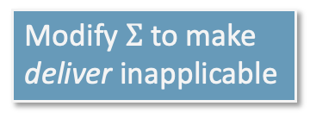
Example
Modify $Σ$ to make deliver inapplicable
transit3
Guided-Find-Safe-Solution(Σ,s₀,S_{g})
...
loop
Q ← leaves(s₀,𝜋) \ S_{g}
if Q = ∅ then
𝜋 ← 𝜋 \ {(s,a) ∈ 𝜋 | s ∉ $\hat{\text{γ}}$(s₀,𝜋)}
return 𝜋
select arbitrarily s ∈ Q
𝜋′ ← Find-Solution(Σ,s,S_{g})
if 𝜋′ ≠ failure then
𝜋 ← 𝜋 ∪ {(s,a) ∈ 𝜋’ | s ∉ dom(𝜋)}
else if s = s₀ then
return failure
else
for every s’,a s.t. s ∈ 𝛾(s’,a) do
𝜋 ← 𝜋 \ {(s’,a)}
make a not applicable in s’
π = {(on_ship, unload),
(at_harbor, park),
(parking1, deliver),
(parking2, deliver),
(foo, move)}
move
back
parking2
foo
back
move
$S_{g}$
gate1
unload
park
on_ship
at_harbour
deliver
parking1
gate2
move
move
transit1
transit2

Slide 56
Example
transit3
Guided-Find-Safe-Solution(Σ,s₀,S_{g})
...
loop
Q ← leaves(s₀,𝜋) \ S_{g}
if Q = ∅ then
𝜋 ← 𝜋 \ {(s,a) ∈ 𝜋 | s ∉ $\hat{\text{γ}}$(s₀,𝜋)}
return 𝜋
select arbitrarily s ∈ Q
𝜋′ ← Find-Solution(Σ,s,S_{g})
if 𝜋′ ≠ failure then
𝜋 ← 𝜋 ∪ {(s,a) ∈ 𝜋’ | s ∉ dom(𝜋)}
else if s = s₀ then
return failure
else
for every s’,a s.t. s ∈ 𝛾(s’,a) do
𝜋 ← 𝜋 \ {(s’,a)}
make a not applicable in s’
π = {(on_ship, unload),
(at_harbor, park),
(parking1, deliver),
(foo, move),
(parking2, back)}
move
back
parking2
foo
back
move
$S_{g}$
gate1
unload
park
on_ship
at_harbour
deliver
parking1
gate2
move
move
transit1
transit2

Slide 57
Example
transit3
Guided-Find-Safe-Solution(Σ,s₀,S_{g})
...
loop
Q ← leaves(s₀,𝜋) \ S_{g}
if Q = ∅ then
𝜋 ← 𝜋 \ {(s,a) ∈ 𝜋 | s ∉ $\hat{\text{γ}}$(s₀,𝜋)}
return 𝜋
select arbitrarily s ∈ Q
𝜋′ ← Find-Solution(Σ,s,S_{g})
if 𝜋′ ≠ failure then
𝜋 ← 𝜋 ∪ {(s,a) ∈ 𝜋’ | s ∉ dom(𝜋)}
else if s = s₀ then
return failure
else
for every s’,a s.t. s ∈ 𝛾(s’,a) do
𝜋 ← 𝜋 \ {(s’,a)}
make a not applicable in s’
π = {(on_ship, unload),
(at_harbor, park),
(parking1, deliver),
(foo, move),
(parking2, back),
(transit1, move)}
move
back
parking2
foo
back
move
$S_{g}$
gate1
unload
park
on_ship
at_harbour
deliver
parking1
gate2
move
move
transit1
transit2

Slide 58
Example
transit3
Guided-Find-Safe-Solution(Σ,s₀,S_{g})
...
loop
Q ← leaves(s₀,𝜋) \ S_{g}
if Q = ∅ then
𝜋 ← 𝜋 \ {(s,a) ∈ 𝜋 | s ∉ $\hat{\text{γ}}$(s₀,𝜋)}
return 𝜋
select arbitrarily s ∈ Q
𝜋′ ← Find-Solution(Σ,s,S_{g})
if 𝜋′ ≠ failure then
𝜋 ← 𝜋 ∪ {(s,a) ∈ 𝜋’ | s ∉ dom(𝜋)}
else if s = s₀ then
return failure
else
for every s’,a s.t. s ∈ 𝛾(s’,a) do
𝜋 ← 𝜋 \ {(s’,a)}
make a not applicable in s’
π = {(on_ship, unload),
(at_harbor, park),
(parking1, deliver),
(foo, move),
(parking2, back),
(transit1, move),
(transit2, move)}
move
back
parking2
foo
back
move
$S_{g}$
gate1
unload
park
on_ship
at_harbour
deliver
parking1
gate2
move
move
transit1
transit2

Slide 59
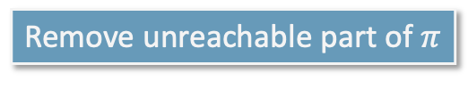
Example
Remove unreachable part of $π$
transit3
Guided-Find-Safe-Solution(Σ,s₀,S_{g})
...
loop
Q ← leaves(s₀,𝜋) \ S_{g}
if Q = ∅ then
𝜋 ← 𝜋 \ {(s,a) ∈ 𝜋 | s ∉ $\hat{\text{γ}}$(s₀,𝜋)}
return 𝜋
select arbitrarily s ∈ Q
𝜋′ ← Find-Solution(Σ,s,S_{g})
if 𝜋′ ≠ failure then
𝜋 ← 𝜋 ∪ {(s,a) ∈ 𝜋’ | s ∉ dom(𝜋)}
else if s = s₀ then
return failure
else
for every s’,a s.t. s ∈ 𝛾(s’,a) do
𝜋 ← 𝜋 \ {(s’,a)}
make a not applicable in s’
π = {(on_ship, unload),
(at_harbor, park),
(parking1, deliver),
(foo, move),
(parking2, back),
(transit1, move),
(transit2, move)}
move
back
parking2
foo
back
move
$S_{g}$
gate1
unload
park
on_ship
at_harbour
deliver
parking1
gate2
move
move
transit1
transit2

Slide 60

Determinisation
Guided-Find-Safe-Solution(Σ,s₀,S_{g})
if s₀ ∈ S_{g} then
return ∅
if Applicable(s₀) = ∅ then
return failure
𝜋 ← ∅
loop
Q ← leaves(s₀,𝜋) \ S_{g}
if Q = ∅ then
𝜋 ← 𝜋 \ {(s,a) ∈ 𝜋 | s ∉ $\hat{\text{γ}}$(s₀,𝜋)}
return 𝜋
select arbitrarily s ∈ Q
𝜋′ ← Find-Solution(Σ,s,S_{g})
if 𝜋′ ≠ failure then
𝜋 ← 𝜋 ∪ {(s,a) ∈ 𝜋’ | s ∉ Dom(𝜋)}
else if s = s₀ then
return failure
else
for every s’,a s.t. s ∈ 𝛾(s’,a) do
𝜋 ← 𝜋 \ {(s’,a)}
make a not applicable in s’
How to implement it?
  Need implementation of Find-Solution
  Need it to be very efficient
    Called many times
Idea: instead, use a classical planner
  Any algorithm from Ch. 2
  Efficient algorithms, search heuristics
For that, determinise actions

Slide 61
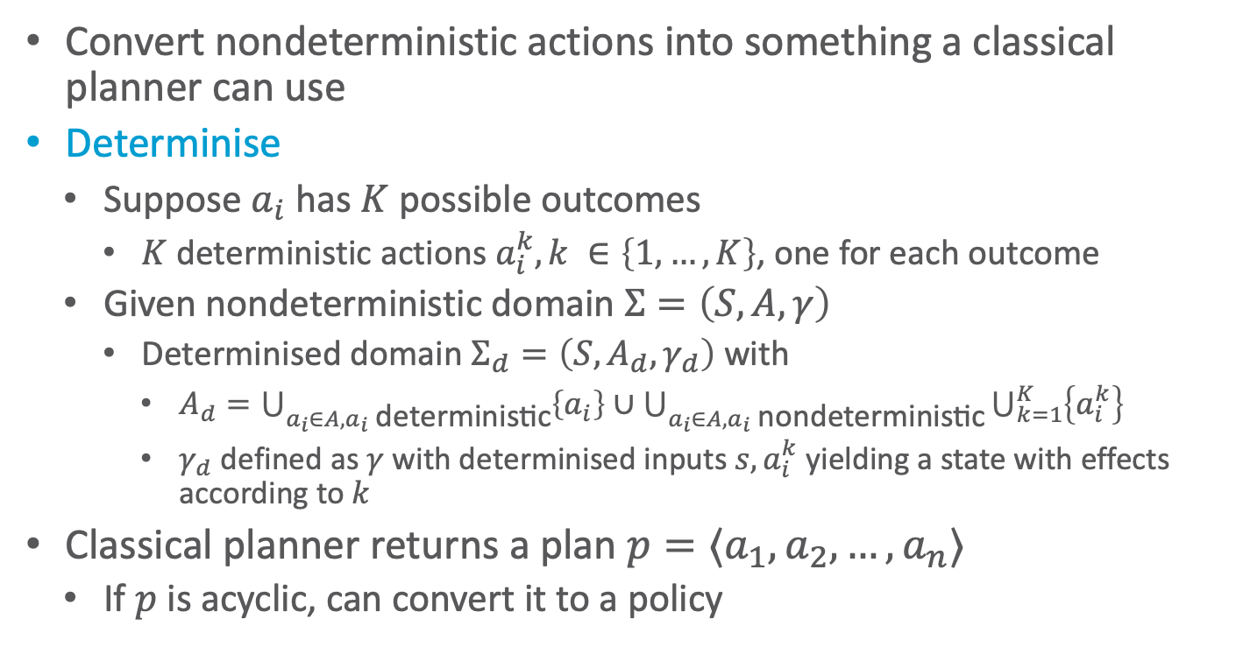
Determinisation
at_harbor
Convert nondeterministic actions into something a classical planner can use
Determinise
  Suppose $a_{i}$ has $K$ possible outcomes
    $K$ deterministic actions $a_{i}^{k}, k ∈\left\{1,…,K\right\}$, one for each outcome
  Given nondeterministic domain $Σ=\left(S,A,γ\right)$
    Determinised domain $Σ_{d}=\left(S,A_{d},γ_{d}\right)$ with
      $A_{d}=\bigcup_{a_{i}∈A,a_{i} \text{d}\text{eterministic}}{\left\{a_{i}\right\}}∪\bigcup_{a_{i}∈A,a_{i} \text{nond}\text{eterministic}}{\bigcup_{k=1}^{K}{\left\{a_{i}^{k}\right\}}}$
      $γ_{d}$ defined as $γ$ with determinised inputs ${s,a}_{i}^{k}$ yielding a state with effects according to $k$
Classical planner returns a plan $p=⟨a_{1}, a_{2}, …, a_{n}⟩$
  If $p$ is acyclic, can convert it to a policy
park
parking1
transit1
parking2
at_harbor
park1
park3
park2
parking1
transit1
parking2

Slide 62
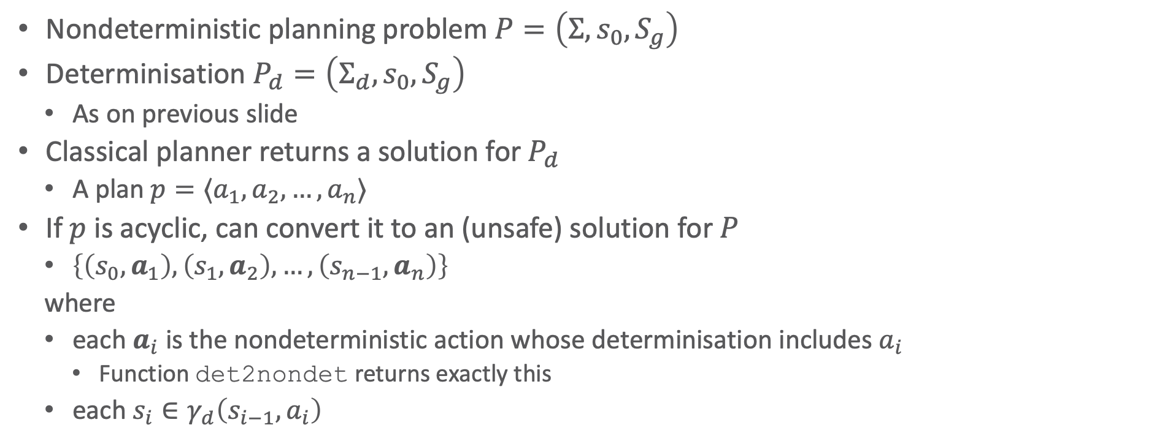
Determinisation
Nondeterministic planning problem $P=\left(Σ, s_{0}, S_{g}\right)$
Determinisation $P_{d}=\left(Σ_{d}, s_{0}, S_{g}\right)$
  As on previous slide
Classical planner returns a solution for $P_{d}$
  A plan $p=⟨a_{1}, a_{2}, …, a_{n}⟩$
If $p$ is acyclic, can convert it to an (unsafe) solution for $P$
  $\left\{\left(s_{0},a_{1}\right), \left(s_{1},a_{2}\right), …, \left(s_{n−1},a_{n}\right)\right\}$
  where
  each $a_{i}$ is the nondeterministic action whose determinisation includes $a_{i}$
    Function det2nondet returns exactly this
  each $s_{i}∈γ_{d}\left(s_{i−1},a_{i}\right)$
Plan2policy(p=⟨a₁,...,a_{n}⟩,s)
𝜋 ← ∅
for i from 1 to n do
𝜋 ← 𝜋 ∪ {s,det2nondet(a_{i})}
s ← 𝛾_{d}(s,a_{i})
return π

Slide 63


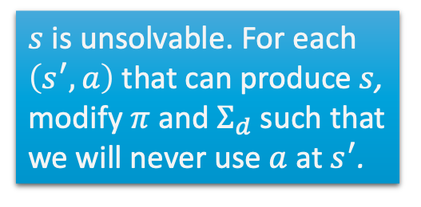
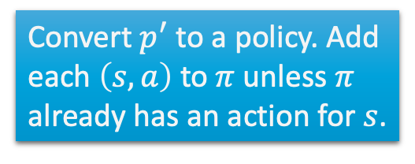
Determinisation
Find-Safe-Solution-by-Determinisation(Σ,s₀,S_{g})
if s₀ ∈ S_{g} then
return ∅
if Applicable(s₀) = ∅ then
return failure
𝜋 ← ∅
Σ_{d} ← mk-deterministic(Σ)
loop
Q ← leaves(s₀,𝜋) \ S_{g}
if Q = ∅ then
𝜋 ← 𝜋 \ {(s,a) ∈ 𝜋 | s ∉ $\hat{\text{γ}}$(s₀,𝜋)}
return 𝜋
select arbitrarily s ∈ Q
p′ ← Forward-search(Σ_{d},s,S_{g})
if p′ ≠ fail then
𝜋 ← Plan2policy(p’,s)
𝜋 ← 𝜋 ∪ {(s,a) ∈ 𝜋’ | s ∉ dom(𝜋)}
else if s = s₀ then
return failure
else
for every s’, a s.t. s ∈ 𝛾(s’,a) do
𝜋 ← 𝜋 \ {(s’,a)}
make the actions in the
determinisation not
applicable in s’
Input: Planning
problem $\left(Σ,s_{0},S_{g}\right)$
Same as Guided-Find-Safe-Solution
Any classical planner that does not return cyclic plans.
Convert $p^{′}$ to a policy. Add each $\left(s,a\right)$ to $π$ unless $π$ already has an action for $s$.
$s$ is unsolvable. For each $\left(s^{′},a\right)$ that can produce $s$, modify $π$ and $Σ_{d}$ such that we will never use $a$ at $s^{′}$.

Slide 64
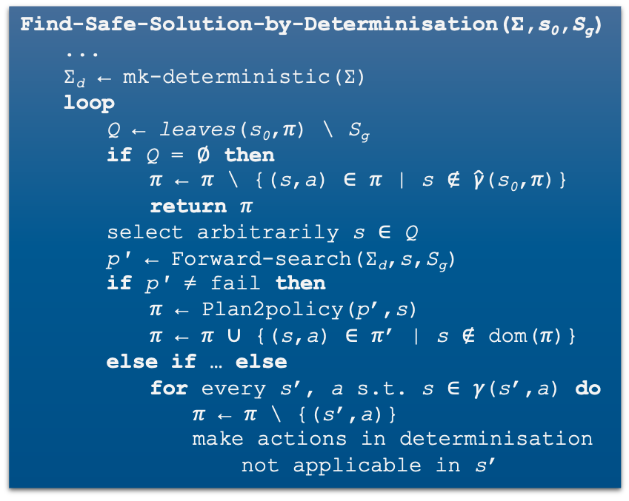
Example
p’ = ⟨unload, park₂, deliver₂ ⟩
transit3
Find-Safe-Solution-by-Determinisation(Σ,s₀,S_{g})
...
Σ_{d} ← mk-deterministic(Σ)
loop
Q ← leaves(s₀,𝜋) \ S_{g}
if Q = ∅ then
𝜋 ← 𝜋 \ {(s,a) ∈ 𝜋 | s ∉ $\hat{\text{γ}}$(s₀,𝜋)}
return 𝜋
select arbitrarily s ∈ Q
p′ ← Forward-search(Σ_{d},s,S_{g})
if p′ ≠ fail then
𝜋 ← Plan2policy(p’,s)
𝜋 ← 𝜋 ∪ {(s,a) ∈ 𝜋’ | s ∉ dom(𝜋)}
else if … else
for every s’, a s.t. s ∈ 𝛾(s’,a) do
𝜋 ← 𝜋 \ {(s’,a)}
make actions in determinisation
not applicable in s’
π = {}
move
back
parking2
deliver
foo
back
move
$S_{g}$
gate1
unload
park
on_ship
at_harbour
deliver
parking1
gate2
move
move
transit1
transit2

Slide 65
Example
p’ = ⟨unload, park₂, deliver₂ ⟩
transit3
Find-Safe-Solution-by-Determinisation(Σ,s₀,S_{g})
...
Σ_{d} ← mk-deterministic(Σ)
loop
Q ← leaves(s₀,𝜋) \ S_{g}
if Q = ∅ then
𝜋 ← 𝜋 \ {(s,a) ∈ 𝜋 | s ∉ $\hat{\text{γ}}$(s₀,𝜋)}
return 𝜋
select arbitrarily s ∈ Q
p′ ← Forward-search(Σ_{d},s,S_{g})
if p′ ≠ fail then
𝜋 ← Plan2policy(p’,s)
𝜋 ← 𝜋 ∪ {(s,a) ∈ 𝜋’ | s ∉ dom(𝜋)}
else if … else
for every s’, a s.t. s ∈ 𝛾(s’,a) do
𝜋 ← 𝜋 \ {(s’,a)}
make actions in determinisation
not applicable in s’
π = {(on_ship, unload),
(at_harbor, park),
(parking1, deliver)}
move
back
parking2
deliver
foo
back
move
$S_{g}$
gate1
unload
park
on_ship
at_harbour
deliver
parking1
gate2
move
move
transit1
transit2

Slide 66
Example
p’ = ⟨deliver₂⟩
transit3
Find-Safe-Solution-by-Determinisation(Σ,s₀,S_{g})
...
Σ_{d} ← mk-deterministic(Σ)
loop
Q ← leaves(s₀,𝜋) \ S_{g}
if Q = ∅ then
𝜋 ← 𝜋 \ {(s,a) ∈ 𝜋 | s ∉ $\hat{\text{γ}}$(s₀,𝜋)}
return 𝜋
select arbitrarily s ∈ Q
p′ ← Forward-search(Σ_{d},s,S_{g})
if p′ ≠ fail then
𝜋 ← Plan2policy(p’,s)
𝜋 ← 𝜋 ∪ {(s,a) ∈ 𝜋’ | s ∉ dom(𝜋)}
else if … else
for every s’, a s.t. s ∈ 𝛾(s’,a) do
𝜋 ← 𝜋 \ {(s’,a)}
make actions in determinisation
not applicable in s’
π = {(on_ship, unload),
(at_harbor, park),
(parking1, deliver)}
move
back
parking2
deliver
foo
back
move
$S_{g}$
gate1
unload
park
on_ship
at_harbour
deliver
parking1
gate2
move
move
transit1
transit2

Slide 67
Example
p’ = ⟨deliver₂⟩
transit3
Find-Safe-Solution-by-Determinisation(Σ,s₀,S_{g})
...
Σ_{d} ← mk-deterministic(Σ)
loop
Q ← leaves(s₀,𝜋) \ S_{g}
if Q = ∅ then
𝜋 ← 𝜋 \ {(s,a) ∈ 𝜋 | s ∉ $\hat{\text{γ}}$(s₀,𝜋)}
return 𝜋
select arbitrarily s ∈ Q
p′ ← Forward-search(Σ_{d},s,S_{g})
if p′ ≠ fail then
𝜋 ← Plan2policy(p’,s)
𝜋 ← 𝜋 ∪ {(s,a) ∈ 𝜋’ | s ∉ dom(𝜋)}
else if … else
for every s’, a s.t. s ∈ 𝛾(s’,a) do
𝜋 ← 𝜋 \ {(s’,a)}
make actions in determinisation
not applicable in s’
π = {(on_ship, unload),
(at_harbor, park),
(parking1, deliver),
(parking2, deliver)}
move
back
parking2
deliver
foo
back
move
$S_{g}$
gate1
unload
park
on_ship
at_harbour
deliver
parking1
gate2
move
move
transit1
transit2

Slide 68
Example
p’ = ⟨move₂, move⟩
transit3
Find-Safe-Solution-by-Determinisation(Σ,s₀,S_{g})
...
Σ_{d} ← mk-deterministic(Σ)
loop
Q ← leaves(s₀,𝜋) \ S_{g}
if Q = ∅ then
𝜋 ← 𝜋 \ {(s,a) ∈ 𝜋 | s ∉ $\hat{\text{γ}}$(s₀,𝜋)}
return 𝜋
select arbitrarily s ∈ Q
p′ ← Forward-search(Σ_{d},s,S_{g})
if p′ ≠ fail then
𝜋 ← Plan2policy(p’,s)
𝜋 ← 𝜋 ∪ {(s,a) ∈ 𝜋’ | s ∉ dom(𝜋)}
else if … else
for every s’, a s.t. s ∈ 𝛾(s’,a) do
𝜋 ← 𝜋 \ {(s’,a)}
make actions in determinisation
not applicable in s’
π = {(on_ship, unload),
(at_harbor, park),
(parking1, deliver),
(parking2, deliver)}
move
back
parking2
deliver
foo
back
move
$S_{g}$
gate1
unload
park
on_ship
at_harbour
deliver
parking1
gate2
move
move
transit1
transit2

Slide 69
Example
p’ = ⟨move₂, move⟩
transit3
Find-Safe-Solution-by-Determinisation(Σ,s₀,S_{g})
...
Σ_{d} ← mk-deterministic(Σ)
loop
Q ← leaves(s₀,𝜋) \ S_{g}
if Q = ∅ then
𝜋 ← 𝜋 \ {(s,a) ∈ 𝜋 | s ∉ $\hat{\text{γ}}$(s₀,𝜋)}
return 𝜋
select arbitrarily s ∈ Q
p′ ← Forward-search(Σ_{d},s,S_{g})
if p′ ≠ fail then
𝜋 ← Plan2policy(p’,s)
𝜋 ← 𝜋 ∪ {(s,a) ∈ 𝜋’ | s ∉ dom(𝜋)}
else if … else
for every s’, a s.t. s ∈ 𝛾(s’,a) do
𝜋 ← 𝜋 \ {(s’,a)}
make actions in determinisation
not applicable in s’
π = {(on_ship, unload),
(at_harbor, park),
(parking1, deliver),
(parking2, deliver),
(transit3, move),
(foo, move)}
move
back
parking2
deliver
foo
back
move
$S_{g}$
gate1
unload
park
on_ship
at_harbour
deliver
parking1
gate2
move
move
transit1
transit2

Slide 70
Example
p’ = fail
transit3
Find-Safe-Solution-by-Determinisation(Σ,s₀,S_{g})
...
Σ_{d} ← mk-deterministic(Σ)
loop
Q ← leaves(s₀,𝜋) \ S_{g}
if Q = ∅ then
𝜋 ← 𝜋 \ {(s,a) ∈ 𝜋 | s ∉ $\hat{\text{γ}}$(s₀,𝜋)}
return 𝜋
select arbitrarily s ∈ Q
p′ ← Forward-search(Σ_{d},s,S_{g})
if p′ ≠ fail then
𝜋 ← Plan2policy(p’,s)
𝜋 ← 𝜋 ∪ {(s,a) ∈ 𝜋’ | s ∉ dom(𝜋)}
else if … else
for every s’, a s.t. s ∈ 𝛾(s’,a) do
𝜋 ← 𝜋 \ {(s’,a)}
make actions in determinisation
not applicable in s’
π = {(on_ship, unload),
(at_harbor, park),
(parking1, deliver),
(parking2, deliver),
(transit3, move),
(foo, move)}
move
back
parking2
foo
fail
deliver
back
move
$S_{g}$
gate1
unload
park
on_ship
at_harbour
deliver
parking1
gate2
move
move
transit1
transit2

Slide 71
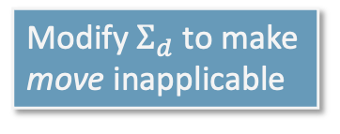
Example
Modify $Σ_{d}$ to make move inapplicable
p’ = fail
transit3
Find-Safe-Solution-by-Determinisation(Σ,s₀,S_{g})
...
Σ_{d} ← mk-deterministic(Σ)
loop
Q ← leaves(s₀,𝜋) \ S_{g}
if Q = ∅ then
𝜋 ← 𝜋 \ {(s,a) ∈ 𝜋 | s ∉ $\hat{\text{γ}}$(s₀,𝜋)}
return 𝜋
select arbitrarily s ∈ Q
p′ ← Forward-search(Σ_{d},s,S_{g})
if p′ ≠ fail then
𝜋 ← Plan2policy(p’,s)
𝜋 ← 𝜋 ∪ {(s,a) ∈ 𝜋’ | s ∉ dom(𝜋)}
else if … else
for every s’, a s.t. s ∈ 𝛾(s’,a) do
𝜋 ← 𝜋 \ {(s’,a)}
make actions in determinisation
not applicable in s’
π = {(on_ship, unload),
(at_harbor, park),
(parking1, deliver),
(parking2, deliver),
(transit3, move),
(foo, move)}
move
back
parking2
deliver
foo
back
move
$S_{g}$
gate1
unload
park
on_ship
at_harbour
deliver
parking1
gate2
move
move
transit1
transit2

Slide 72
Example
p’ = fail
fail
transit3
Find-Safe-Solution-by-Determinisation(Σ,s₀,S_{g})
...
Σ_{d} ← mk-deterministic(Σ)
loop
Q ← leaves(s₀,𝜋) \ S_{g}
if Q = ∅ then
𝜋 ← 𝜋 \ {(s,a) ∈ 𝜋 | s ∉ $\hat{\text{γ}}$(s₀,𝜋)}
return 𝜋
select arbitrarily s ∈ Q
p′ ← Forward-search(Σ_{d},s,S_{g})
if p′ ≠ fail then
𝜋 ← Plan2policy(p’,s)
𝜋 ← 𝜋 ∪ {(s,a) ∈ 𝜋’ | s ∉ dom(𝜋)}
else if … else
for every s’, a s.t. s ∈ 𝛾(s’,a) do
𝜋 ← 𝜋 \ {(s’,a)}
make actions in determinisation
not applicable in s’
π = {(on_ship, unload),
(at_harbor, park),
(parking1, deliver),
(parking2, deliver),
(foo, move)}
move
back
parking2
deliver
foo
back
move
$S_{g}$
gate1
unload
park
on_ship
at_harbour
deliver
parking1
gate2
move
move
transit1
transit2

Slide 73
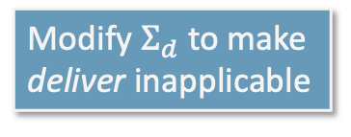
Example
Modify $Σ_{d}$ to make deliver inapplicable
p’ = fail
transit3
Find-Safe-Solution-by-Determinisation(Σ,s₀,S_{g})
...
Σ_{d} ← mk-deterministic(Σ)
loop
Q ← leaves(s₀,𝜋) \ S_{g}
if Q = ∅ then
𝜋 ← 𝜋 \ {(s,a) ∈ 𝜋 | s ∉ $\hat{\text{γ}}$(s₀,𝜋)}
return 𝜋
select arbitrarily s ∈ Q
p′ ← Forward-search(Σ_{d},s,S_{g})
if p′ ≠ fail then
𝜋 ← Plan2policy(p’,s)
𝜋 ← 𝜋 ∪ {(s,a) ∈ 𝜋’ | s ∉ dom(𝜋)}
else if … else
for every s’, a s.t. s ∈ 𝛾(s’,a) do
𝜋 ← 𝜋 \ {(s’,a)}
make actions in determinisation
not applicable in s’
π = {(on_ship, unload),
(at_harbor, park),
(parking1, deliver),
(parking2, deliver),
(foo, move)}
move
back
parking2
foo
back
move
$S_{g}$
gate1
unload
park
on_ship
at_harbour
deliver
parking1
gate2
move
move
transit1
transit2

Slide 74
Example
p’ = ⟨back, park₂, deliver₁⟩
transit3
Find-Safe-Solution-by-Determinisation(Σ,s₀,S_{g})
...
Σ_{d} ← mk-deterministic(Σ)
loop
Q ← leaves(s₀,𝜋) \ S_{g}
if Q = ∅ then
𝜋 ← 𝜋 \ {(s,a) ∈ 𝜋 | s ∉ $\hat{\text{γ}}$(s₀,𝜋)}
return 𝜋
select arbitrarily s ∈ Q
p′ ← Forward-search(Σ_{d},s,S_{g})
if p′ ≠ fail then
𝜋 ← Plan2policy(p’,s)
𝜋 ← 𝜋 ∪ {(s,a) ∈ 𝜋’ | s ∉ dom(𝜋)}
else if … else
for every s’, a s.t. s ∈ 𝛾(s’,a) do
𝜋 ← 𝜋 \ {(s’,a)}
make actions in determinisation
not applicable in s’
π = {(on_ship, unload),
(at_harbor, park),
(parking1, deliver),
(foo, move)}
move
back
parking2
foo
back
move
$S_{g}$
gate1
unload
park
on_ship
at_harbour
deliver
parking1
gate2
move
move
transit1
transit2

Slide 75
Example
p’ = ⟨back, park₂, deliver₁⟩
transit3
Find-Safe-Solution-by-Determinisation(Σ,s₀,S_{g})
...
Σ_{d} ← mk-deterministic(Σ)
loop
Q ← leaves(s₀,𝜋) \ S_{g}
if Q = ∅ then
𝜋 ← 𝜋 \ {(s,a) ∈ 𝜋 | s ∉ $\hat{\text{γ}}$(s₀,𝜋)}
return 𝜋
select arbitrarily s ∈ Q
p′ ← Forward-search(Σ_{d},s,S_{g})
if p′ ≠ fail then
𝜋 ← Plan2policy(p’,s)
𝜋 ← 𝜋 ∪ {(s,a) ∈ 𝜋’ | s ∉ dom(𝜋)}
else if … else
for every s’, a s.t. s ∈ 𝛾(s’,a) do
𝜋 ← 𝜋 \ {(s’,a)}
make actions in determinisation
not applicable in s’
π = {(on_ship, unload),
(at_harbor, park),
(parking1, deliver),
(foo, move),
(parking2, back)}
move
back
parking2
foo
back
move
$S_{g}$
gate1
unload
park
on_ship
at_harbour
deliver
parking1
gate2
move
move
transit1
transit2

Slide 76
Example
p’ = ⟨move₂, deliver₁⟩
transit3
Find-Safe-Solution-by-Determinisation(Σ,s₀,S_{g})
...
Σ_{d} ← mk-deterministic(Σ)
loop
Q ← leaves(s₀,𝜋) \ S_{g}
if Q = ∅ then
𝜋 ← 𝜋 \ {(s,a) ∈ 𝜋 | s ∉ $\hat{\text{γ}}$(s₀,𝜋)}
return 𝜋
select arbitrarily s ∈ Q
p′ ← Forward-search(Σ_{d},s,S_{g})
if p′ ≠ fail then
𝜋 ← Plan2policy(p’,s)
𝜋 ← 𝜋 ∪ {(s,a) ∈ 𝜋’ | s ∉ dom(𝜋)}
else if … else
for every s’, a s.t. s ∈ 𝛾(s’,a) do
𝜋 ← 𝜋 \ {(s’,a)}
make actions in determinisation
not applicable in s’
π = {(on_ship, unload),
(at_harbor, park),
(parking1, deliver),
(foo, move),
(parking2, back)}
move
back
parking2
foo
back
move
$S_{g}$
gate1
unload
park
on_ship
at_harbour
deliver
parking1
gate2
move
move
transit1
transit2

Slide 77
Example
p’ = ⟨move₂, deliver₁⟩
transit3
Find-Safe-Solution-by-Determinisation(Σ,s₀,S_{g})
...
Σ_{d} ← mk-deterministic(Σ)
loop
Q ← leaves(s₀,𝜋) \ S_{g}
if Q = ∅ then
𝜋 ← 𝜋 \ {(s,a) ∈ 𝜋 | s ∉ $\hat{\text{γ}}$(s₀,𝜋)}
return 𝜋
select arbitrarily s ∈ Q
p′ ← Forward-search(Σ_{d},s,S_{g})
if p′ ≠ fail then
𝜋 ← Plan2policy(p’,s)
𝜋 ← 𝜋 ∪ {(s,a) ∈ 𝜋’ | s ∉ dom(𝜋)}
else if … else
for every s’, a s.t. s ∈ 𝛾(s’,a) do
𝜋 ← 𝜋 \ {(s’,a)}
make actions in determinisation
not applicable in s’
π = {(on_ship, unload),
(at_harbor, park),
(parking1, deliver),
(foo, move),
(parking2, back),
(transit1, move)}
move
back
parking2
foo
back
move
$S_{g}$
gate1
unload
park
on_ship
at_harbour
deliver
parking1
gate2
move
move
transit1
transit2

Slide 78
Example
p’ = ⟨move₂⟩
transit3
Find-Safe-Solution-by-Determinisation(Σ,s₀,S_{g})
...
Σ_{d} ← mk-deterministic(Σ)
loop
Q ← leaves(s₀,𝜋) \ S_{g}
if Q = ∅ then
𝜋 ← 𝜋 \ {(s,a) ∈ 𝜋 | s ∉ $\hat{\text{γ}}$(s₀,𝜋)}
return 𝜋
select arbitrarily s ∈ Q
p′ ← Forward-search(Σ_{d},s,S_{g})
if p′ ≠ fail then
𝜋 ← Plan2policy(p’,s)
𝜋 ← 𝜋 ∪ {(s,a) ∈ 𝜋’ | s ∉ dom(𝜋)}
else if … else
for every s’, a s.t. s ∈ 𝛾(s’,a) do
𝜋 ← 𝜋 \ {(s’,a)}
make actions in determinisation
not applicable in s’
π = {(on_ship, unload),
(at_harbor, park),
(parking1, deliver),
(foo, move),
(parking2, back),
(transit1, move)}
move
back
parking2
foo
back
move
$S_{g}$
gate1
unload
park
on_ship
at_harbour
deliver
parking1
gate2
move
move
transit1
transit2

Slide 79
Example
p’ = ⟨move₂⟩
transit3
Find-Safe-Solution-by-Determinisation(Σ,s₀,S_{g})
...
Σ_{d} ← mk-deterministic(Σ)
loop
Q ← leaves(s₀,𝜋) \ S_{g}
if Q = ∅ then
𝜋 ← 𝜋 \ {(s,a) ∈ 𝜋 | s ∉ $\hat{\text{γ}}$(s₀,𝜋)}
return 𝜋
select arbitrarily s ∈ Q
p′ ← Forward-search(Σ_{d},s,S_{g})
if p′ ≠ fail then
𝜋 ← Plan2policy(p’,s)
𝜋 ← 𝜋 ∪ {(s,a) ∈ 𝜋’ | s ∉ dom(𝜋)}
else if … else
for every s’, a s.t. s ∈ 𝛾(s’,a) do
𝜋 ← 𝜋 \ {(s’,a)}
make actions in determinisation
not applicable in s’
π = {(on_ship, unload),
(at_harbor, park),
(parking1, deliver),
(foo, move),
(parking2, back),
(transit1, move),
(transit2, move)}
move
back
parking2
foo
back
move
$S_{g}$
gate1
unload
park
on_ship
at_harbour
deliver
parking1
gate2
move
move
transit1
transit2

Slide 80
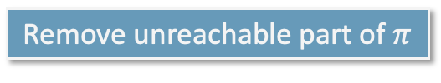
Example
Remove unreachable part of $π$
transit3
Find-Safe-Solution-by-Determinisation(Σ,s₀,S_{g})
...
Σ_{d} ← mk-deterministic(Σ)
loop
Q ← leaves(s₀,𝜋) \ S_{g}
if Q = ∅ then
𝜋 ← 𝜋 \ {(s,a) ∈ 𝜋 | s ∉ $\hat{\text{γ}}$(s₀,𝜋)}
return 𝜋
select arbitrarily s ∈ Q
p′ ← Forward-search(Σ_{d},s,S_{g})
if p′ ≠ fail then
𝜋 ← Plan2policy(p’,s)
𝜋 ← 𝜋 ∪ {(s,a) ∈ 𝜋’ | s ∉ dom(𝜋)}
else if … else
for every s’, a s.t. s ∈ 𝛾(s’,a) do
𝜋 ← 𝜋 \ {(s’,a)}
make actions in determinisation
not applicable in s’
π = {(on_ship, unload),
(at_harbor, park),
(parking1, deliver),
(foo, move),
(parking2, back),
(transit1, move),
(transit2, move)}
move
back
parking2
foo
back
move
$S_{g}$
gate1
unload
park
on_ship
at_harbour
deliver
parking1
gate2
move
move
transit1
transit2

Slide 81
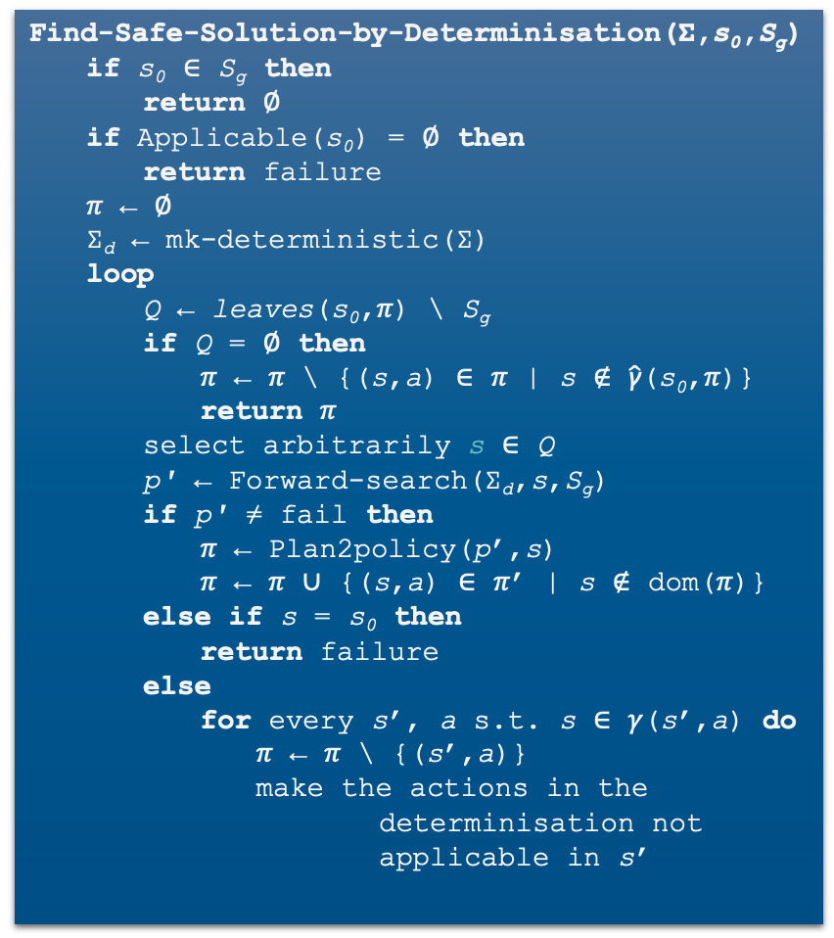
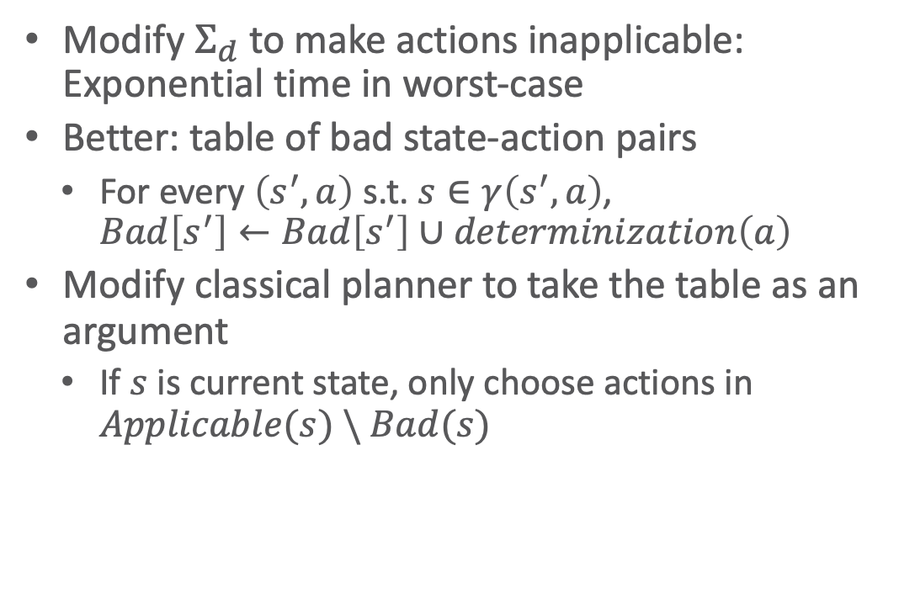
Making Actions Inapplicable
Find-Safe-Solution-by-Determinisation(Σ,s₀,S_{g})
if s₀ ∈ S_{g} then
return ∅
if Applicable(s₀) = ∅ then
return failure
𝜋 ← ∅
Σ_{d} ← mk-deterministic(Σ)
loop
Q ← leaves(s₀,𝜋) \ S_{g}
if Q = ∅ then
𝜋 ← 𝜋 \ {(s,a) ∈ 𝜋 | s ∉ $\hat{\text{γ}}$(s₀,𝜋)}
return 𝜋
select arbitrarily s ∈ Q
p′ ← Forward-search(Σ_{d},s,S_{g})
if p′ ≠ fail then
𝜋 ← Plan2policy(p’,s)
𝜋 ← 𝜋 ∪ {(s,a) ∈ 𝜋’ | s ∉ dom(𝜋)}
else if s = s₀ then
return failure
else
for every s’, a s.t. s ∈ 𝛾(s’,a) do
𝜋 ← 𝜋 \ {(s’,a)}
make the actions in the
determinisation not
applicable in s’
Modify $Σ_{d}$ to make actions inapplicable: Exponential time in worst-case
Better: table of bad state-action pairs
  For every $\left(s^{′},a\right)$ s.t. $s∈γ\left(s^{′},a\right)$,
  $Bad\left[s^{′}\right]←Bad\left[s^{′}\right]∪determinization\left(a\right)$
Modify classical planner to take the table as an argument
  If $s$ is current state, only choose actions in $Applicable(s) \backslash Bad(s)$

Slide 82
Intermediate Summary
Determinisation Techniques
  Guided-find-safe-solution
    Call find-solution to get an unsafe solution
    Call find-solution additional times on the leaves
  Find-safe-solution-by-determinization
    Use determinized actions
    Call classical planner rather than find-solution
    If dead-ends are encountered, modify actions that lead to them

Slide 83
Outline per the Book
5.2 Planning Problem
  Planning domains
  Plans as policies
  Planning problems and solutions
5.3 And/Or Graph Search
  Planning by forward search
5.5 Determinisation Techniques
  Guided planning for safe solutions
  Planning for safe solutions by determinisation
5.6 Online Approaches
  Lookahead
  Lookahead by determinisation
  Lookahead with a bounded number of steps
Notes:
5.1 Intro

Slide 84
Online Approaches
Motivation
  Planning models are approximate – execution seldom works out as planned
  Large problems may require too much planning time
2nd motivation even more stronger in nondeterministic domains
  Nondeterminism makes planning exponentially harder
    Exponentially more time, exponentially larger policies
Offline vs. Runtime
Search Spaces

Slide 85
Online Approaches
Need to identify good actions without exploring entire search space (partial planning)
  Can be done using heuristic estimates
Some domains are safely explorable
  Safe to create partial plans, because goal states are reachable from all situations
Other domains contain dead-ends, partial planning will not guarantee success
  Can get trapped in dead ends that we would have detected if we had planned fully
    No applicable actions
      Robot goes down a steep incline and cannot come back up
    Applicable actions, but caught in a loop
      Robot goes into a collection of rooms from which there is no exit
  However, partial planning can still make success more likely

Slide 86
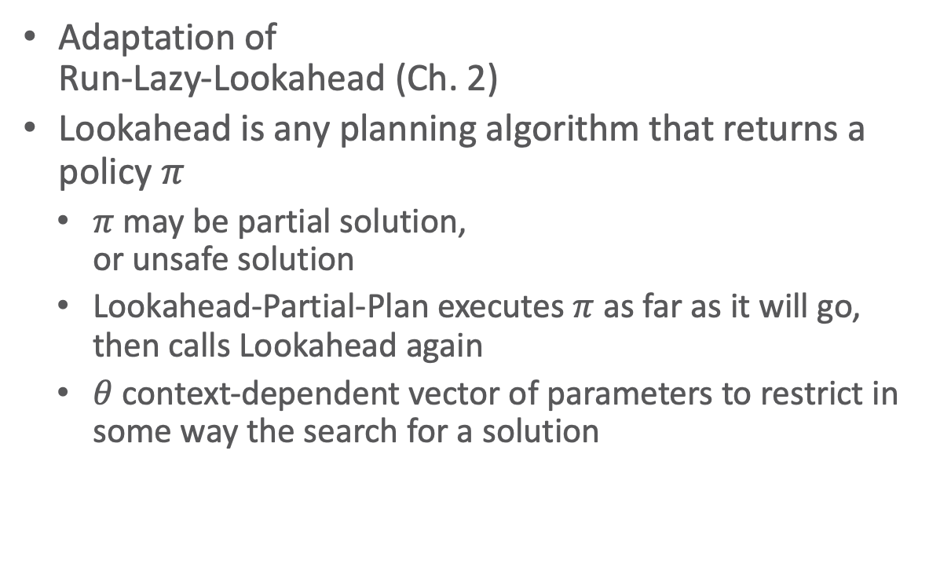
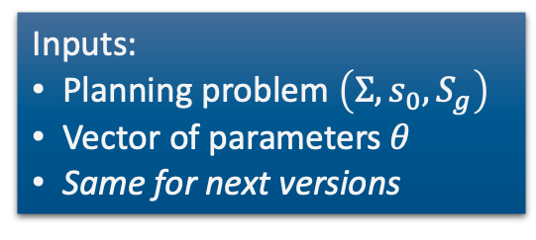
Lookahead-Partial-Plan
Adaptation of
Run-Lazy-Lookahead (Ch. 2)
Lookahead is any planning algorithm that returns a policy $π$
  $π$ may be partial solution,
  or unsafe solution
  Lookahead-Partial-Plan executes $π$ as far as it will go, then calls Lookahead again
  $θ$ context-dependent vector of parameters to restrict in some way the search for a solution
Lookahead-Partial-Plan(Σ,s₀,S_{g},𝜃)
s ← s₀
while s ∉ S_{g} and Applicable(s) ≠ ∅ do
𝜋 ← Lookahead(s,𝜃)
if 𝜋 = ∅ then
return failure
else
perform partial plan 𝜋
s ← observe current state
Inputs:
Planning problem $\left(Σ,s_{0},S_{g}\right)$
Vector of parameters $θ$
Same for next versions
Notes:
$θ$ can determine that a search goes on only to a certain depth or considers only a certain number of outcomes or cuts off after a certain time

Slide 87
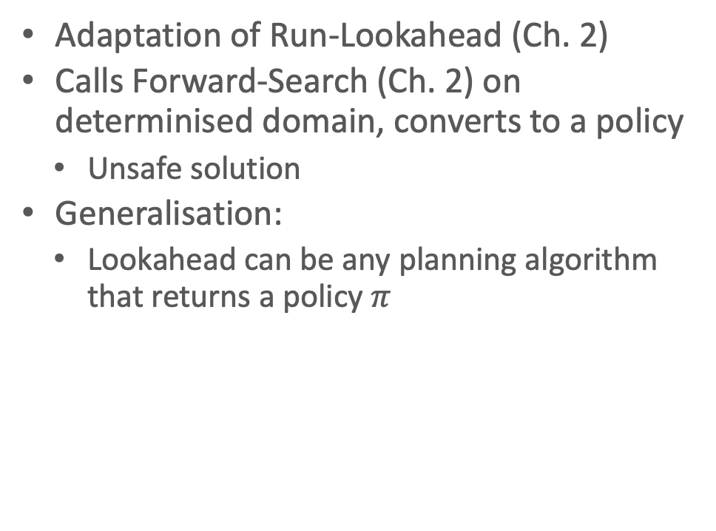
FS-Replan
Adaptation of Run-Lookahead (Ch. 2)
Calls Forward-Search (Ch. 2) on determinised domain, converts to a policy
  Unsafe solution
Generalisation:
  Lookahead can be any planning algorithm that returns a policy $π$
FS-Replan(Σ,s,S_{g})
𝜋_{d} ← ∅
while s ∉ S_{g} and Applicable(s) ≠ ∅ do
if 𝜋_{d} undefined for s then
𝜋_{d} ← Plan2policy(Forward-search(Σ_{d},s,S_{g}),s)
if 𝜋_{d} = failure then
return failure
perform action 𝜋_{d}(s)
s ← observe resulting state
Generalised-FS-Replan(Σ,s,S_{g},𝜃)
𝜋_{d} ← ∅
while s ∉ S_{g} and Applicable(s) ≠ ∅ do
if 𝜋_{d} undefined for s then
𝜋_{d} ← Lookahead(s,𝜃)
if 𝜋_{d} = failure then
return failure
perform action 𝜋_{d}(s)
s ← observe resulting state

Slide 88
Possibilities for Lookahead
Lookahead could be one of the algorithms we discussed earlier
  Find-Safe-Solution
  Find-Acyclic-Solution
  Guided-Find-Safe-Solution
  Find-Safe-Solution-by-Determinization
What if it does not have time to run to completion?
  Can use the same techniques, we discussed earlier
    Receding horizon
    Sampling
    Subgoaling
    Iterative Deepening
Planning stage
Acting stage

Slide 89
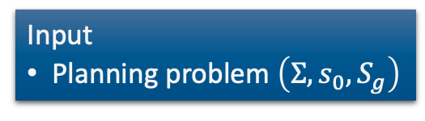

Possibilities for Lookahead (cont’d)
Full horizon, limited breadth:
  Look for solution that works for some of the outcomes
  E.g., modify Find-Acyclic-Solution to examine $i$ outcomes of every action
Iterative broadening:
  For $i=1$, increase $i$ by $1$ until time runs out
    Look for a solution that handles $i$ outcomes per action
Find-Acyclic-Solution(Σ,s₀,S_{g})
𝜋 ← ∅
Frontier ← {s₀}
for every s ∈ Frontier \ S_{g} do
Frontier ← Frontier \ {s}
if Applicable(s) = ∅ then
return failure
nondeterministically choose a ∈ Applicable(s)
𝜋 ← 𝜋 ∪ (s,a)
Frontier ← Frontier ∪ (𝛾(s,a) \ Dom(𝜋))
if has-loops(𝜋,s,Frontier) then
return failure
return 𝜋
T ← i elements of 𝛾(s,a)\Dom(𝜋)
Frontier ← Frontier ∪ T
Input
Planning problem $\left(Σ,s_{0},S_{g}\right)$

Slide 90



MinMax Learning Real Time A* (MinMax LRTA*)
Lookahead with a bounded number of steps
Input: Planning problem $\left(Σ,s_{0},S_{g}\right)$
Loop
  Choose an action $a$ that (according to a heuristics $h$) has optimal worst-case cost
    Update $h\left(s\right)$ to use $a$’s worst-case cost
    Perform $a$
Min-Max-LRTA*(Σ,s₀,S_{g})
s ← s₀
while s ∉ S_{g} and Applicable(s) ≠ ∅ do
a ← argmin_{a∈Applicable(s)} max_{s’∈𝛾(s,a)} h(s’)
h(s) ← max{h(s),1 + max_{s’∈𝛾(s,a)} h(s’)}
perform action a
s ← the current state
Looks ahead $1$ step; can be modified to look ahead $k$ steps
Assumes each action has cost $1$; can easily be modified to use cost $≠1$ by replacing $1$ with $c\left(s\right)$
Notes:
action with minimal maximum cost over all states to reach

Slide 91

Example
transit3
Min-Max-LRTA*(Σ,s₀,S_{g})
s ← s₀
while s ∉ S_{g} and Applicable(s) ≠ ∅ do
a ← argmin_{a∈Applicable(s)} max_{s’∈𝛾(s,a)} h(s’)
h(s) ← max{h(s),1 + max_{s’∈𝛾(s,a)} h(s’)}
perform action a
s ← the current state
move
back
parking2
deliver
foo
back
move
$S_{g}$
gate1
Suppose that initially,
$h(s)=0$ for every state $s$
h = 0
unload
park
on_ship
at_harbour
deliver
parking1
gate2
move
move
transit1
transit2

Slide 92
Example
transit3
Min-Max-LRTA*(Σ,s₀,S_{g})
s ← s₀
while s ∉ S_{g} and Applicable(s) ≠ ∅ do
a ← argmin_{a∈Applicable(s)} max_{s’∈𝛾(s,a)} h(s’)
h(s) ← max{h(s),1 + max_{s’∈𝛾(s,a)} h(s’)}
perform action a
s ← the current state
back
move
parking2
deliver
back
$S_{g}$
a = unload
gate1
h = max{0,1+max{0}} = 1
Suppose that initially,
$h(s)=0$ for every state $s$
unload
park
on_ship
at_harbour
deliver
a = park
parking1
gate2
move
move
transit1
transit2

Slide 93
Example
transit3
Min-Max-LRTA*(Σ,s₀,S_{g})
s ← s₀
while s ∉ S_{g} and Applicable(s) ≠ ∅ do
a ← argmin_{a∈Applicable(s)} max_{s’∈𝛾(s,a)} h(s’)
h(s) ← max{h(s),1 + max_{s’∈𝛾(s,a)} h(s’)}
perform action a
s ← the current state
back
move
h = 0
parking2
deliver
back
$S_{g}$
a = unload
gate1
Suppose that initially,
$h(s)=0$ for every state $s$
h = 1
unload
park
h = 0
on_ship
at_harbour
deliver
a = park
parking1
gate2
h = max{0,1+max{0,0,0}}
= 1
move
h = 0
move
transit1
transit2

Slide 94
Example
h = 0
transit3
Min-Max-LRTA*(Σ,s₀,S_{g})
s ← s₀
while s ∉ S_{g} and Applicable(s) ≠ ∅ do
a ← argmin_{a∈Applicable(s)} max_{s’∈𝛾(s,a)} h(s’)
h(s) ← max{h(s),1 + max_{s’∈𝛾(s,a)} h(s’)}
perform action a
s ← the current state
a = deliver
back
h = 0
move
h = max{0,1+0} = 1
parking2
deliver
back
h = 0
max{1} = 1
max{0,0} = 0
$S_{g}$
a = unload
gate1
Suppose that initially,
$h(s)=0$ for every state $s$
h = 1
unload
park
h = 0
on_ship
at_harbour
deliver
a = park
parking1
gate2
h = 1
move
h = 0
move
transit1
transit2

Slide 95

Safely Explorable Domains
Safely explorable domain
  For every state $s$, at least one goal state is reachable from $s$
    No dead ends
In a safely explorable domain,
  Using Lookahead-Partial-Plan or FS-Replan
    Lookahead never returns failure
    Then we will eventually reach a goal
  Using MinMax LRTA*
    Algorithm is guaranteed to terminate and generate a solution
What about picking a random action?
Notes:
Random action: in safely explorable domains, might take a while but ok since we will not run into a dead end

Slide 96
Intermediate Summary
Online approaches
  Lookahead-partial-plan
    Adaptation of Run-Lazy-Lookahead
  FS-replan
    Adaptation of Run-Lookahead
Ways to do the lookahead
  Full breadth with limited depth: Iterative deepening
  Full depth with limited breadth: Iterative broadening
Min-Max-LRTA*
Convergence in safely explorable domains
Can also adapt
Run-Concurrent-Lookahead
Can put bounds on both depth and breadth

Slide 97
Outline per the Book
5.2 Planning Problem
  Planning domains
  Plans as policies
  Planning problems and solutions
5.3 And/Or Graph Search
  Planning by forward search
5.5 Determinisation Techniques
  Guided planning for safe solutions
  Planning for safe solutions by determinisation
5.6 Online Approaches
  Lookahead
  Lookahead by determinisation
  Lookahead with a bounded number of steps
⟹ Next: Probabilistic Models
Notes:
4.1 Intro

