Slide 1
Automated Planning and Acting
Deterministic Models
Tanya Braun
Research Group Data Science, Computer Science Department

Slide 2
Content: Planning and Acting
With Deterministic Models
State-variable representation
Forward State-Space Search
Heuristic Functions
Backward Search
Plan-Space Search
With Temporal Models
With Nondeterministic Models
With Probabilistic Models
By Decision Making
Foundations
Extensions
Structure
With Human-awareness
Notes:
1-4, 6: Planning book
5, 7: AIMA
8: Rao

Slide 3
Outline per the Book
2.1 State-variable representation
State = {values of variables}; action = changes to those values
2.2 Forward state-space search
Start at initial state, look for sequence of actions that achieve goal
2.3 Heuristic functions
How to guide a forward state-space search
2.6 Incorporating planning into an actor
Online lookahead, unexpected events
2.4 Backward search
Start at goal state, go backwards toward initial state
2.5 Plan-space search
Start with incomplete plan for getting from initial state to goal state, make transformations to fix flaws in the plan

Slide 4
Motivation
How to model a complex environment?
Generally, need simplifying assumptions
Classical planning
Finite, static world: Change occurs only when the actor causes it
No concurrent actions, no explicit time: Just a sequence of states and actions ⟨s₀, a₁, s₁, a₂, s₂, …⟩
Determinism, no uncertainty: Can predict exactly what each action will do
No accidents, no “chance” outcomes
Avoids a lot of complications
But most real-world environments do not satisfy the assumptions
Errors in prediction
OK if they are infrequent and do not have severe consequences

Slide 5
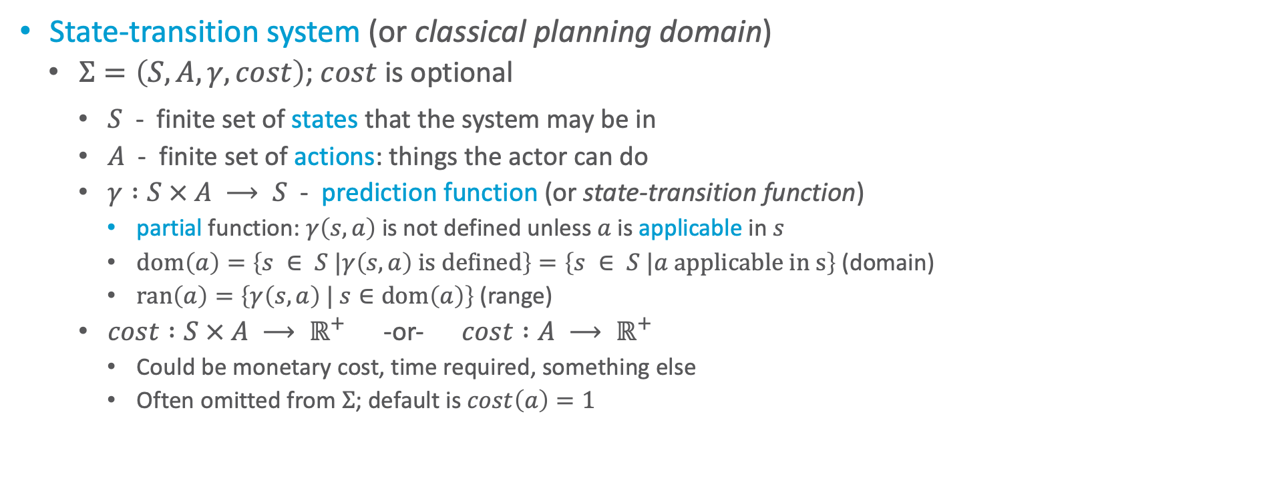
Domain Model
State-transition system (or classical planning domain)
$Σ=\left(S, A, γ, cost\right)$; $cost$ is optional
$S$ - finite set of states that the system may be in
$A$ - finite set of actions: things the actor can do
$γ :S × A ⟶ S$ - prediction function (or state-transition function)
partial function: $γ\left(s, a\right)$ is not defined unless $a$ is applicable in $s$
$dom\left(a\right)=\left\{s ∈ S |γ\left(s, a\right) \text{is} \text{defined}\right\}=\left\{s ∈ S |a \text{applicable} \text{in} \text{s}\right\}$ (domain)
$ran\left(a\right)=\left\{γ\left(s, a\right) | s∈dom\left(a\right)\right\}$ (range)
$cost :S × A ⟶ ℝ^{+}$ -or- $cost :A ⟶ ℝ^{+}$
Could be monetary cost, time required, something else
Often omitted from $Σ$; default is $cost\left(a\right)=1$
Notes:
Reach one state of S_g
Can also think of it as an automaton
Next: Representing \Sigma

Slide 6
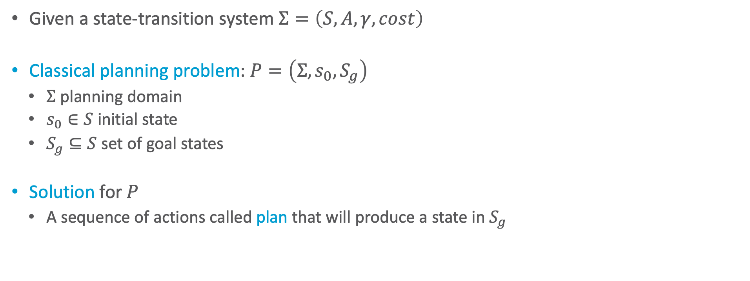
Domain Model
Given a state-transition system $Σ=\left(S, A, γ, cost\right)$
Classical planning problem: $P=\left(Σ, s_{0}, S_{g}\right)$
$Σ$ planning domain
$s_{0}∈S$ initial state
$S_{g}⊆S$ set of goal states
Solution for $P$
A sequence of actions called plan that will produce a state in $S_{g}$
Notes:
Reach one state of S_g
Can also think of it as an automaton
Next: Representing \Sigma

Slide 7

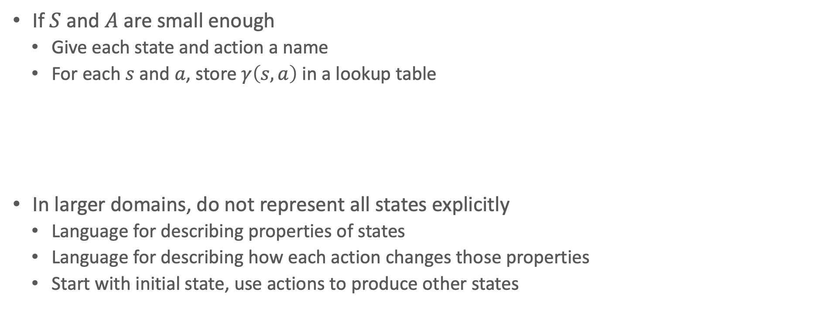
Representing $Σ$
If $S$ and $A$ are small enough
Give each state and action a name
For each $s$ and $a$, store $γ\left(s, a\right)$ in a lookup table
In larger domains, do not represent all states explicitly
Language for describing properties of states
Language for describing how each action changes those properties
Start with initial state, use actions to produce other states
Notes:
Loc_i: possible states of actor in road network
Actions move actor form one state to another
Cost: e.g. distance

Slide 8
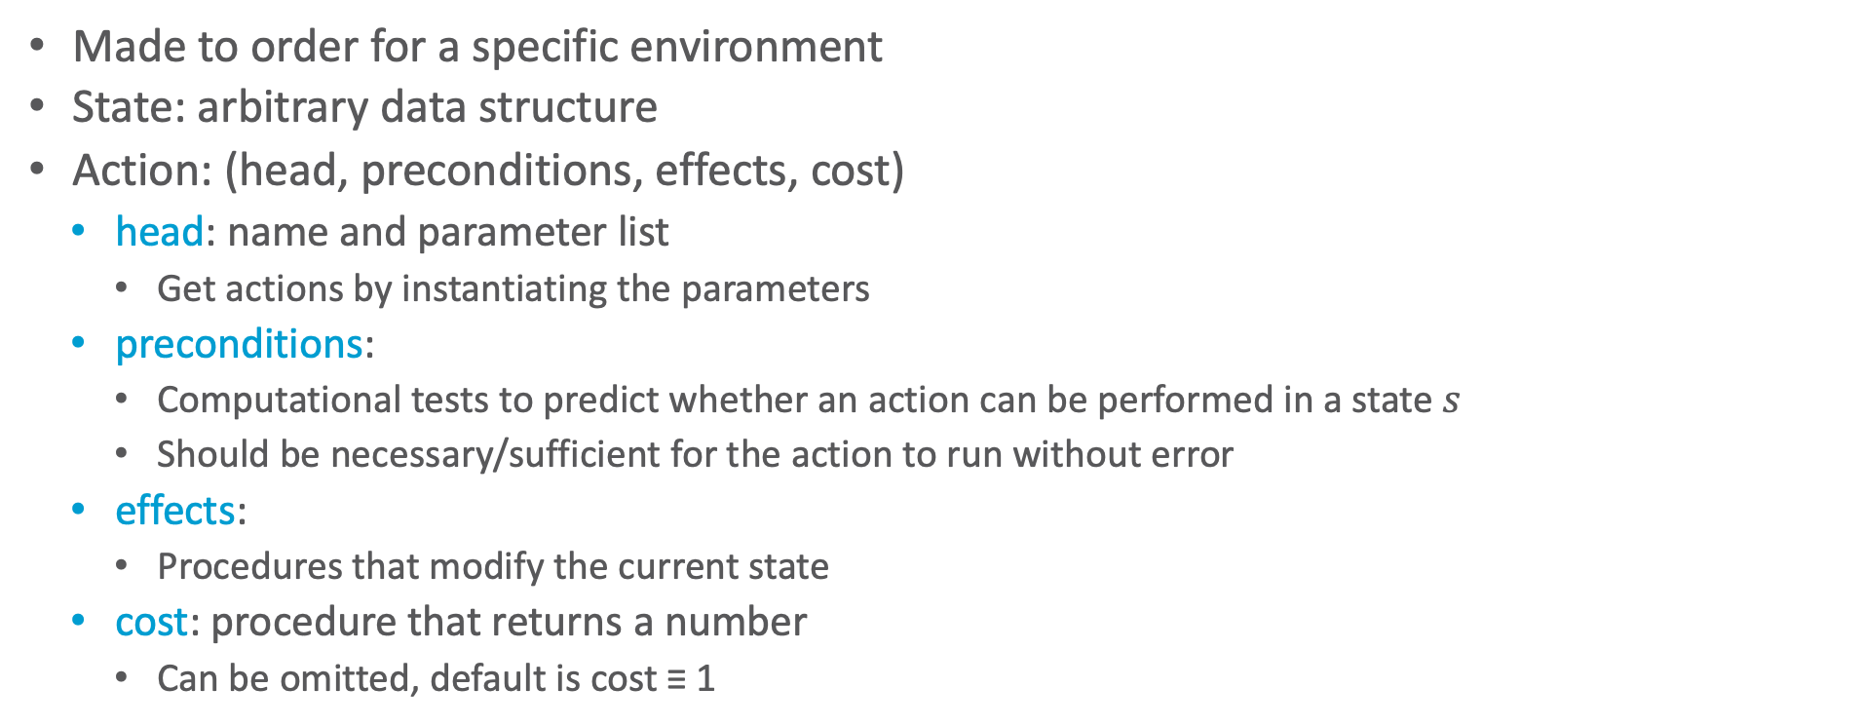
Domain-specific Representation
Made to order for a specific environment
State: arbitrary data structure
Action: (head, preconditions, effects, cost)
head: name and parameter list
Get actions by instantiating the parameters
preconditions:
Computational tests to predict whether an action can be performed in a state $s$
Should be necessary/sufficient for the action to run without error
effects:
Procedures that modify the current state
cost: procedure that returns a number
Can be omitted, default is cost ≡ 1

Slide 9
Example
Drilling holes in a metal workpiece
A state
Geometric model of the workpiece, information about its location and orientation
Capabilities and status of drilling machine and drill bit
Several actions
Putting the workpiece onto the drilling machine
Clamping it
Loading a drill bit
Drilling (next slide)

Slide 10
Drilling
Name and parameters:
drill-hole(machine, drill-bit, workpiece, geometry, machining-tolerances)
Preconditions
Can the drilling machine and drill bit produce a hole having the desired geometry and machining tolerances?
Is the drill bit installed? Is the workpiece clamped onto the drilling platform? Etc.
Effects
Geometric model of new workpiece geometry, annotated with tolerances
Cost
Estimate of time or monetary cost

Slide 11
Discussion
Advantage of domain-specific representation:
Can choose whatever works best for that particular domain
Disadvantage:
For each new domain, need new representation and deliberation algorithms
Alternative: domain-independent representation
Try to create a “standard format” that can be used for many different planning domains
Deliberation algorithms that work for anything in this format
State-variable representation
Simple formats for describing states and actions
Limited representational capability but easy to compute, easy to reason about
Domain-independent search algorithms and heuristic functions that can be used in all state-variable planning problems

Slide 12
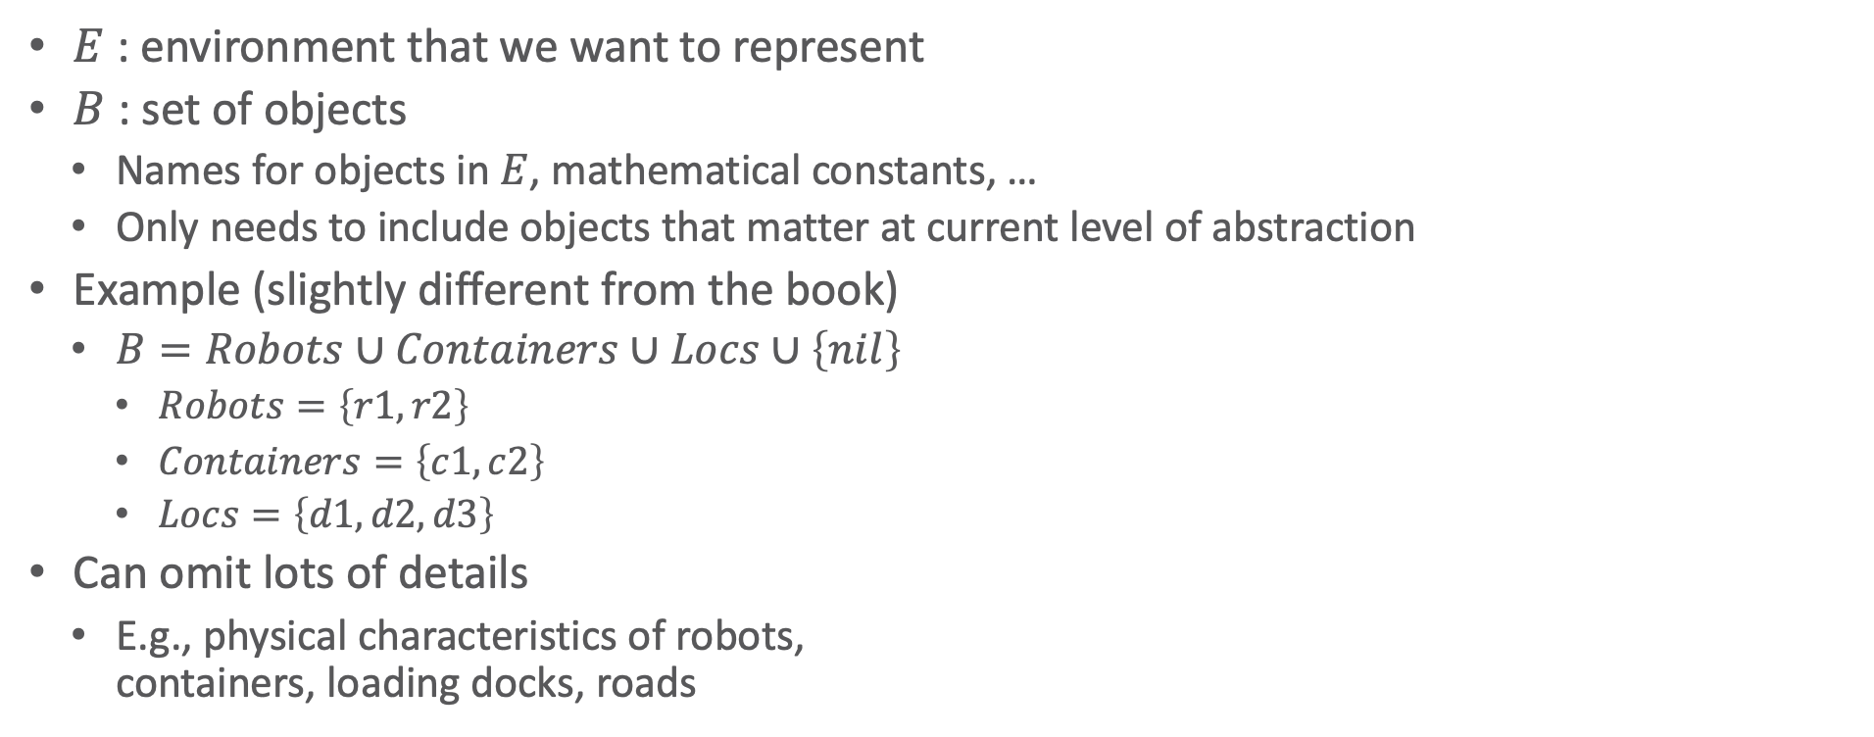
State-Variable Representation
$E$ : environment that we want to represent
$B$ : set of objects
Names for objects in $E$, mathematical constants, …
Only needs to include objects that matter at current level of abstraction
Example (slightly different from the book)
$B=Robots∪Containers∪Locs∪\left\{nil\right\}$
$Robots=\left\{r1, r2\right\}$
$Containers=\left\{c1, c2\right\}$
$Locs=\left\{d1, d2,d3\right\}$
Can omit lots of details
E.g., physical characteristics of robots, containers, loading docks, roads
d3
r1
r2
c1
c2
d1
d2

Slide 13
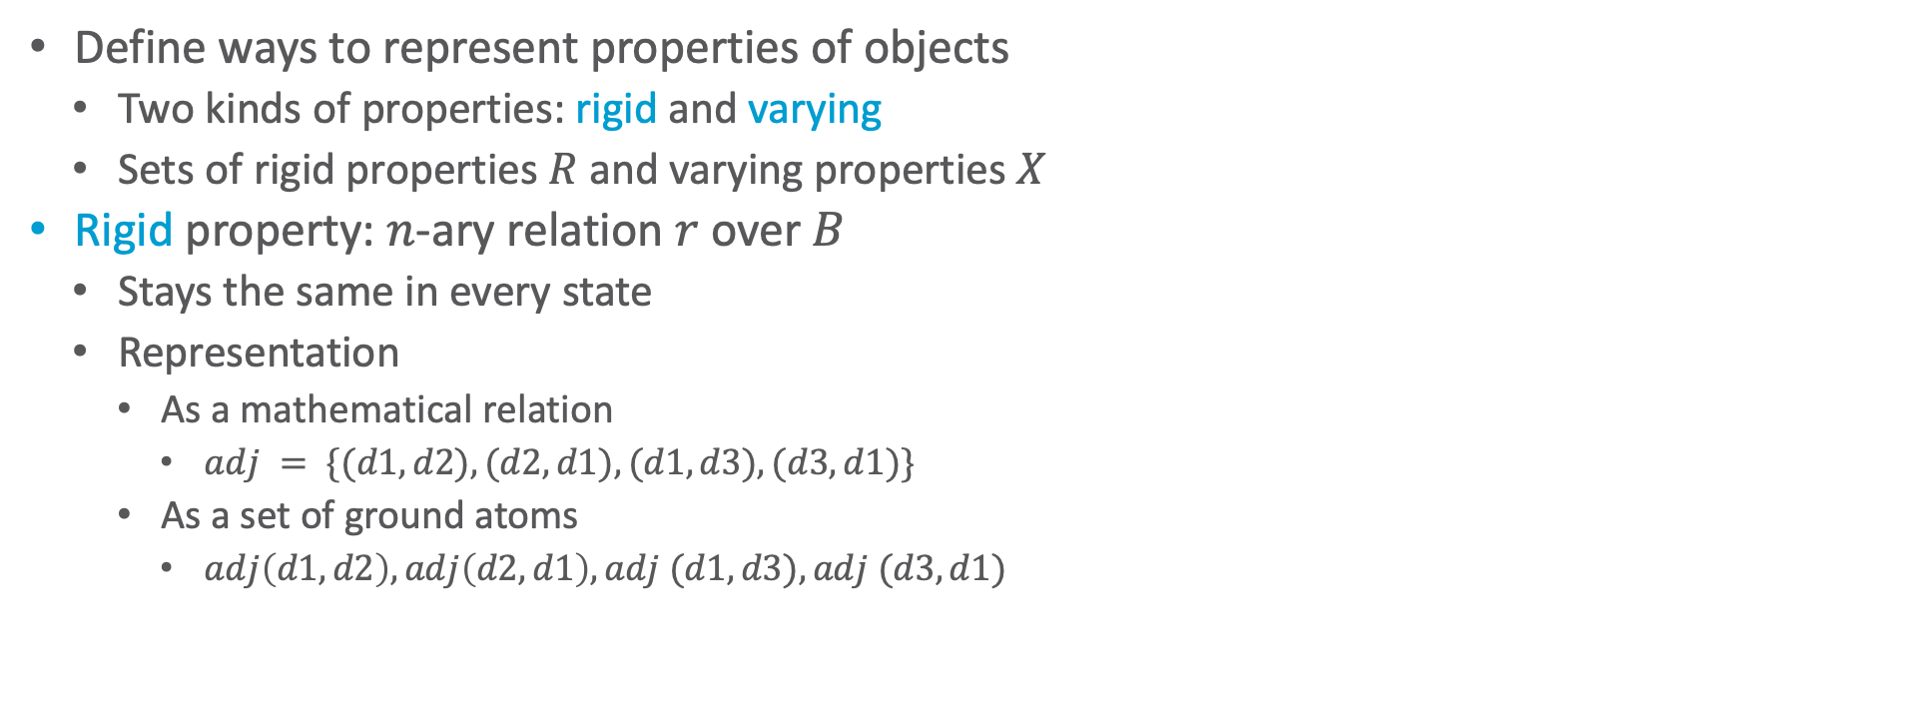
Properties of Objects
Define ways to represent properties of objects
Two kinds of properties: rigid and varying
Sets of rigid properties $R$ and varying properties $X$
Rigid property: $n$-ary relation $r$ over $B$
Stays the same in every state
Representation
As a mathematical relation
$adj = \{(d1,d2), (d2,d1), (d1,d3), (d3,d1)\}$
As a set of ground atoms
$adj\left(d1,d2\right), adj\left(d2,d1\right),adj (d1,d3), adj (d3,d1)$
d3
r1
r2
c1
c2
d1
d2
Notes:
adj = adjacent; loc is adjacent if connected by road
Terminology from first-order logic:
ground: fully instantiated, no variable symbols
atom ≡ atomic formula ≡ positive literal ≡ predicate symbol with list of arguments
negative literal ≡ negated atom ≡ atom with a negation sign in front of it

Slide 14
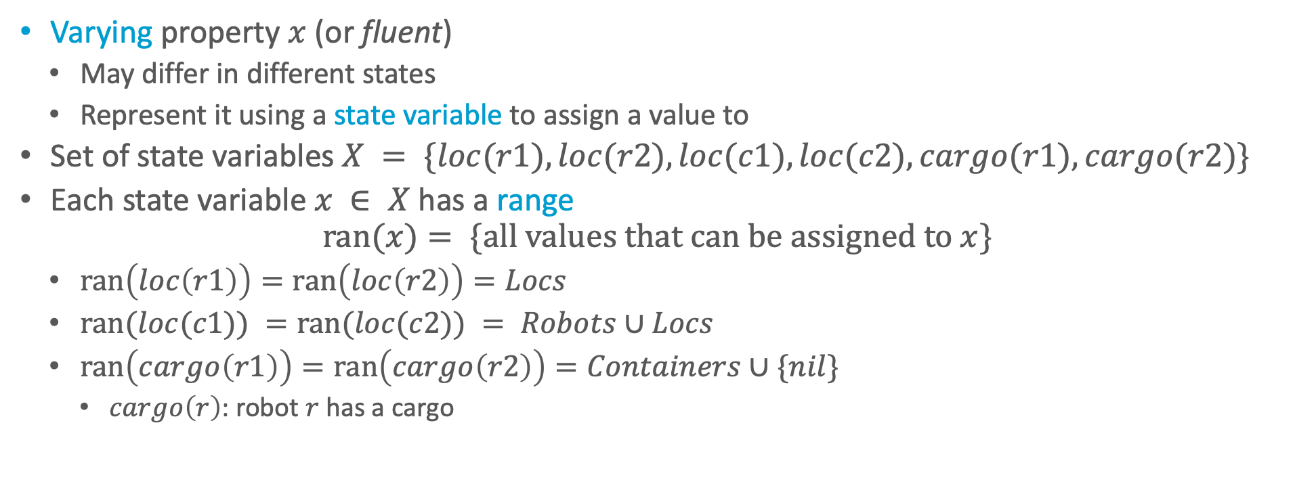
Varying Properties
Varying property $x$ (or fluent)
May differ in different states
Represent it using a state variable to assign a value to
Set of state variables $X = \{loc(r1), loc(r2), loc(c1), loc(c2), cargo(r1), cargo(r2)\}$
Each state variable $x ∈ X$ has a range
$$ran(x)= \{\text{all} \text{values} \text{that} \text{can} \text{be} \text{assigned} \text{to} x\}$$
$ran\left(loc\left(r1\right)\right)=ran\left(loc\left(r2\right)\right)=Locs$
$ran(loc(c1)) =ran(loc(c2)) = Robots∪Locs$
$ran\left(cargo\left(r1\right)\right)=ran\left(cargo\left(r2\right)\right)=Containers∪\{nil\}$
$cargo\left(r\right)$: robot $r$ has a cargo
d3
r1
r2
c1
c2
d1
d2
Notes:
cargo(r) : robot r carries a cargo

Slide 15
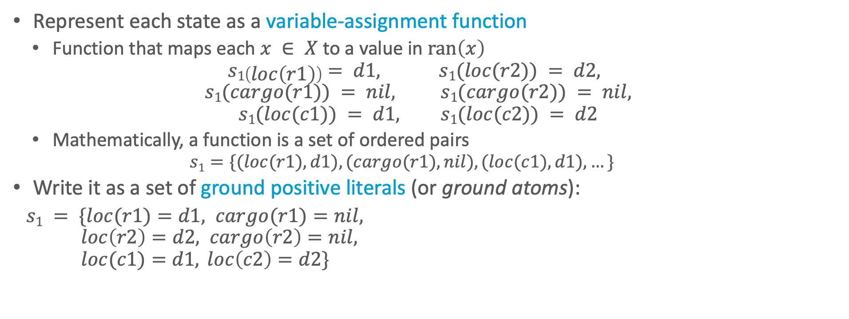
States as Functions
Represent each state as a variable-assignment function
Function that maps each $x ∈ X$ to a value in $ran\left(x\right)$
$$s1\left(loc\left(r1\right)\right)= d1, s1(loc(r2)) = d2,$$
$$s1(cargo(r1)) = nil, s1(cargo(r2)) = nil,$$
$$s1(loc(c1)) = d1, s1(loc(c2)) = d2$$
Mathematically, a function is a set of ordered pairs
$$s1=\{(loc(r1), d1), (cargo(r1), nil), (loc(c1), d1), …\}$$
Write it as a set of ground positive literals (or ground atoms):
$s1 = \{loc(r1)=d1, cargo(r1)=nil,$ $loc\left(r2\right)=d2, cargo\left(r2\right)=nil,$ $loc(c1)=d1, loc\left(c2\right)=d2\}$
d3
r1
r2
c1
c2
d1
d2

Slide 16
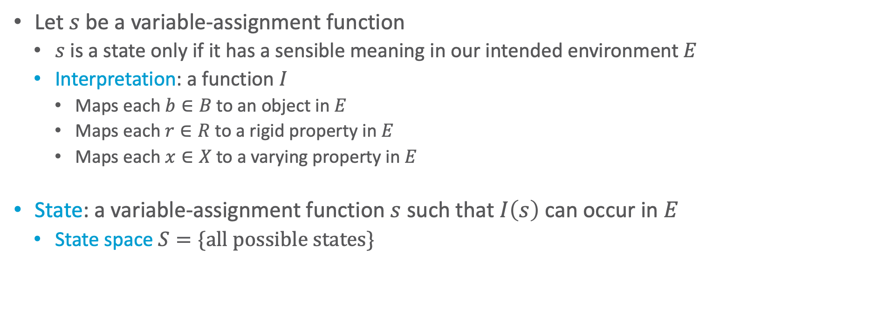
States as Functions
Let $s$ be a variable-assignment function
$s$ is a state only if it has a sensible meaning in our intended environment $E$
Interpretation: a function $I$
Maps each $b∈B$ to an object in $E$
Maps each $r∈R$ to a rigid property in $E$
Maps each $x∈X$ to a varying property in $E$
State: a variable-assignment function $s$ such that $I\left(s\right)$ can occur in $E$
State space $S=\{\text{all} \text{possible} \text{states}\}$
d3
r1
r2
c1
c2
d1
d2
Notes:
Map strings like d1, c1, etc to objects in environment (loading docks)

Slide 17
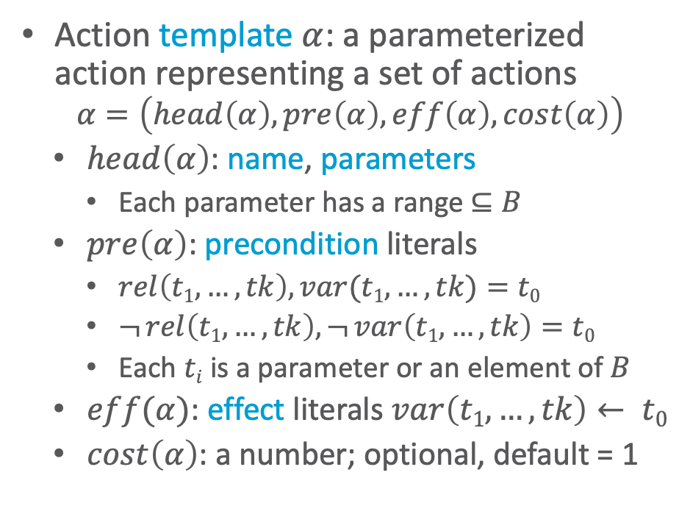
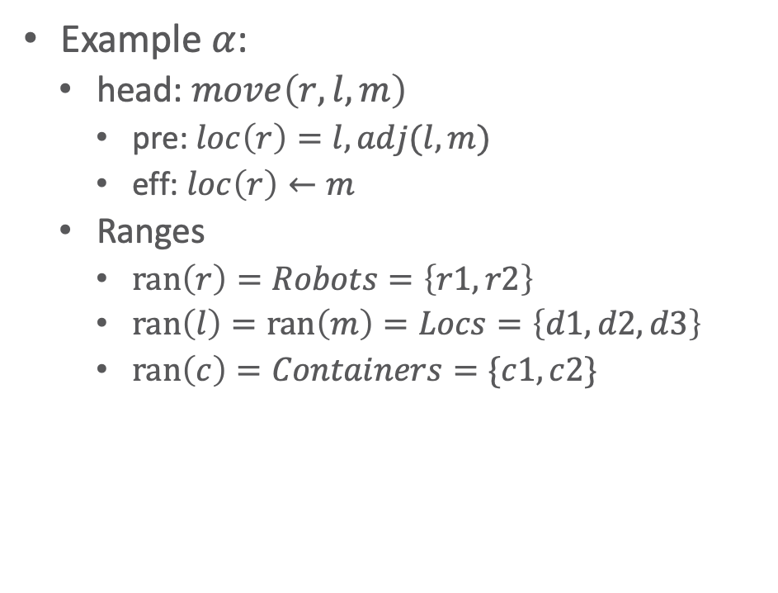
Action Templates
Action template $α$: a parameterized action representing a set of actions
$$α=\left(head\left(α\right), pre\left(α\right), eff\left(α\right), cost\left(α\right)\right)$$
$head\left(α\right)$: name, parameters
Each parameter has a range $⊆B$
$pre\left(α\right)$: precondition literals
$rel\left(t1,…,tk\right),var(t1,…,tk)=t0$
$¬ rel\left(t1,…,tk\right), ¬ var\left(t1,…,tk\right)=t0$
Each $ti$ is a parameter or an element of $B$
$eff(α)$: effect literals $var\left(t1,…,tk\right)← t0$
$cost\left(α\right)$: a number; optional, default = 1
Example $α$:
head: $move\left(r,l,m\right)$
pre: $loc\left(r\right)=l, adj(l,m)$
eff: $loc\left(r\right)←m$
Ranges
$ran\left(r\right)=Robots=\left\{r1,r2\right\}$
$ran\left(l\right)=ran\left(m\right)=Locs=\left\{d1,d2,d3\right\}$
$ran\left(c\right)=Containers=\{c1,c2\}$
d3
r1
r2
c1
c2
d1
d2
Notes:
Head: syntactic way to refer to an action in a unique way

Slide 18
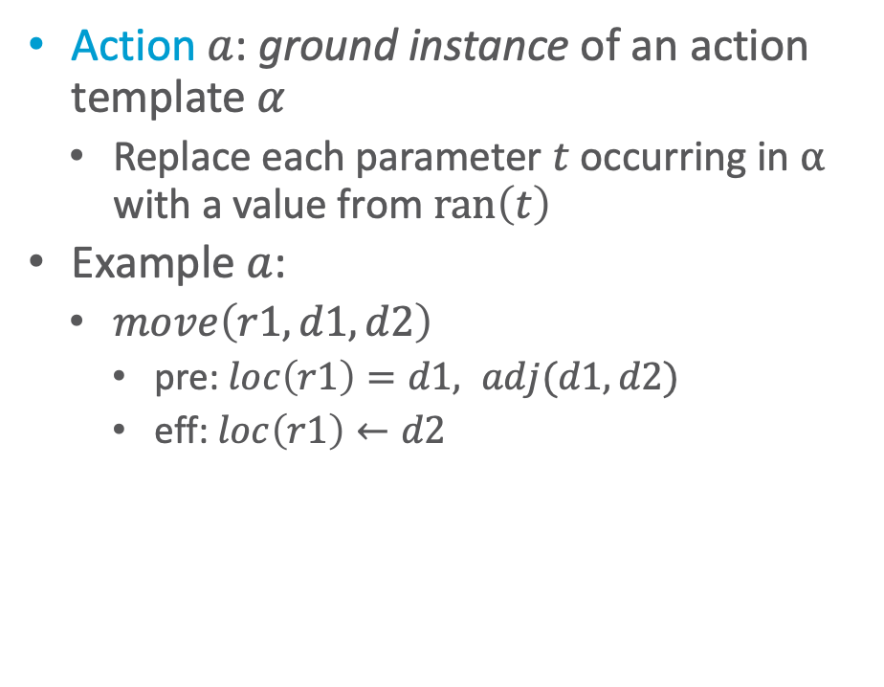

Actions
How many move actions exist?
Action $a$: ground instance of an action template $α$
Replace each parameter $t$ occurring in $α$ with a value from $ran\left(t\right)$
Example $a$:
$move\left(r1,d1,d2\right)$
pre: $loc\left(r1\right)=d1, adj(d1,d2)$
eff: $loc\left(r1\right)←d2$
Example $α$:
head: $move\left(r,l,m\right)$
pre: $loc\left(r\right)=l, adj(l,m)$
eff: $loc\left(r\right)←m$
Ranges
$ran\left(r\right)=Robots=\left\{r1,r2\right\}$
$ran\left(l\right)=ran\left(m\right)=Locs=\left\{d1,d2,d3\right\}$
$ran\left(c\right)=Containers=\left\{c1,c2\right\}$
d3
r1
r2
c1
c2
d1
d2
Notes:
|gr(move(r,l,m))| = 2 * 3 * 3 = 18
|Robots| = 2
|Locs| = 3

Slide 19

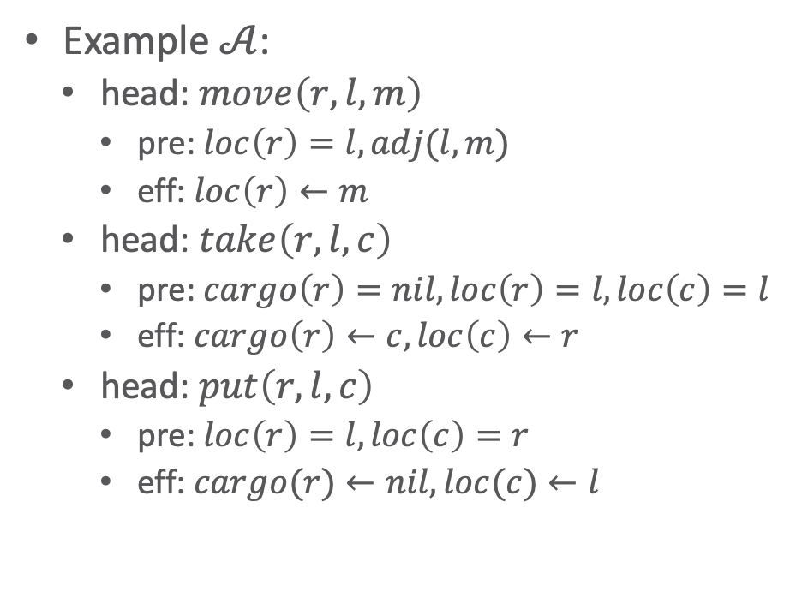
Action Space
$𝒜$ set of action templates
Action space $A$ $=\left\{\text{all} \text{actions} \text{we} \text{can} \text{get} \text{from} 𝒜\right\}=\left\{\text{all} \text{ground} \text{instances} \text{of} a∈𝒜\right\}$
Example $𝒜$:
head: $move\left(r,l,m\right)$
pre: $loc\left(r\right)=l, adj(l,m)$
eff: $loc\left(r\right)←m$
head: $take\left(r,l,c\right)$
pre: $cargo\left(r\right)=nil, loc\left(r\right)=l, loc\left(c\right)=l$
eff: $cargo\left(r\right)←c, loc\left(c\right)←r$
head: $put\left(r,l,c\right)$
pre: $loc\left(r\right)=l, loc\left(c\right)=r$
eff: $cargo(r)←nil, loc(c)←l$
d3
r1
r2
c1
c2
d1
d2
Notes:
Head: syntactic way to refer to an action in a unique way

Slide 20
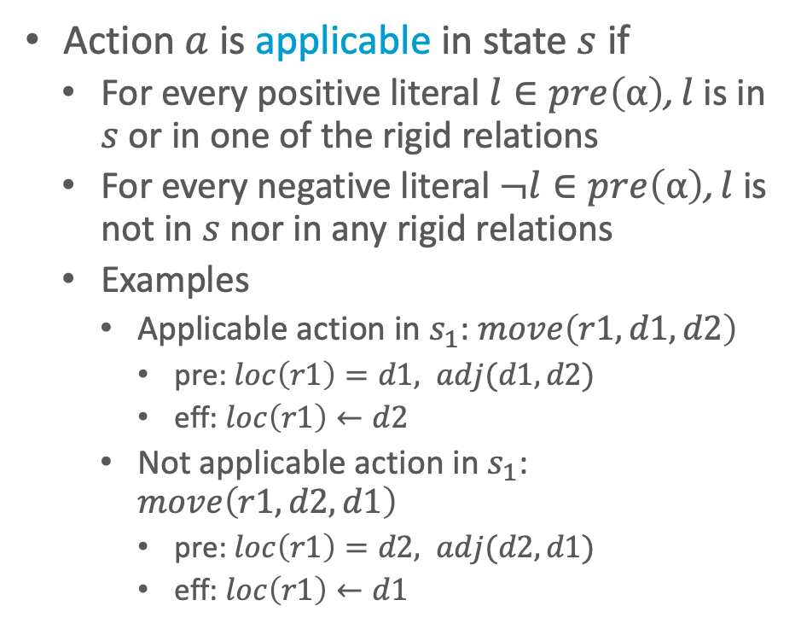
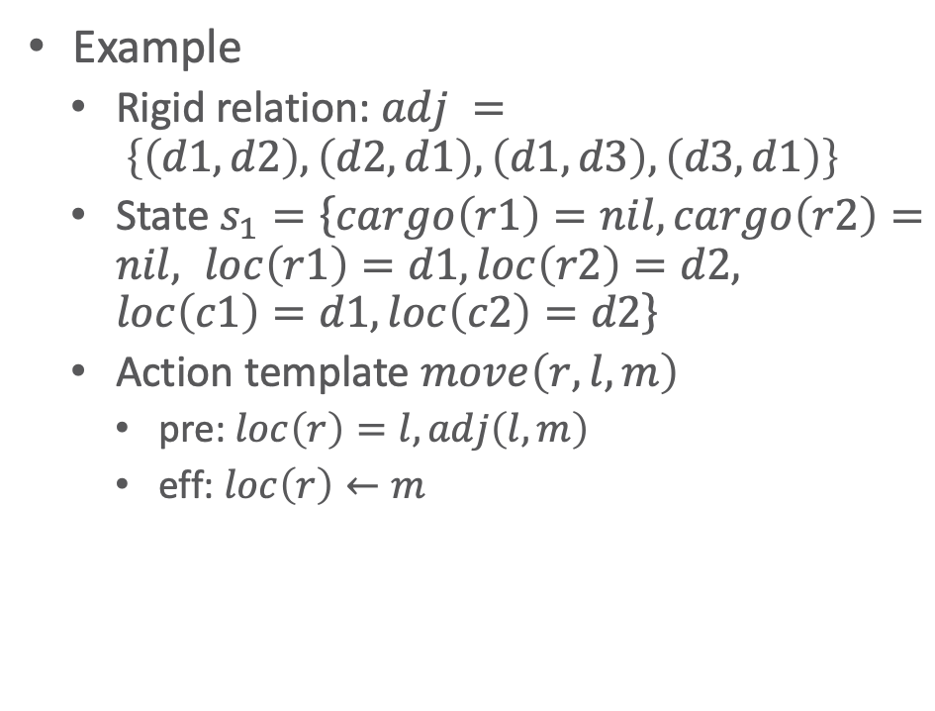
Applicability
Action $a$ is applicable in state $s$ if
For every positive literal $l∈pre\left(α\right)$, $l$ is in $s$ or in one of the rigid relations
For every negative literal $¬l∈pre\left(α\right)$, $l$ is not in $s$ nor in any rigid relations
Examples
Applicable action in $s_{1}$: $move\left(r1,d1,d2\right)$
pre: $loc\left(r1\right)=d1, adj(d1,d2)$
eff: $loc\left(r1\right)←d2$
Not applicable action in $s_{1}$: $move\left(r1,d2,d1\right)$
pre: $loc\left(r1\right)=d2, adj(d2,d1)$
eff: $loc\left(r1\right)←d1$
Example
Rigid relation: $adj = \left\{\left(d1,d2\right), \left(d2,d1\right), \left(d1,d3\right), \left(d3,d1\right)\right\}$
State $s_{1}=\left\{cargo\left(r1\right)=nil, cargo\left(r2\right)=nil, loc\left(r1\right)=d1, loc\left(r2\right)=d2, loc\left(c1\right)=d1, loc\left(c2\right)=d2\right\}$
Action template $move\left(r,l,m\right)$
pre: $loc\left(r\right)=l, adj\left(l,m\right)$
eff: $loc\left(r\right)←m$
How many applicable move actions exist?
d3
Why?
r1
r2
c1
c2
d1
d2
Notes:
Not applicable: r1 not at d2
Applicable move actions: 3 (of 18 possible move actions)
r1: 2 moves (d1->d2, d1 ->d3)
r2: 1 move (d2->d1)

Slide 21
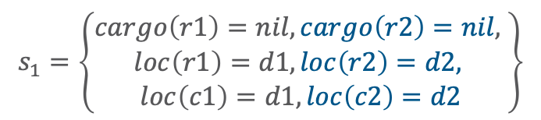
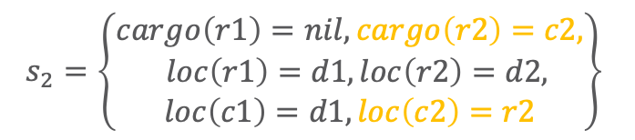


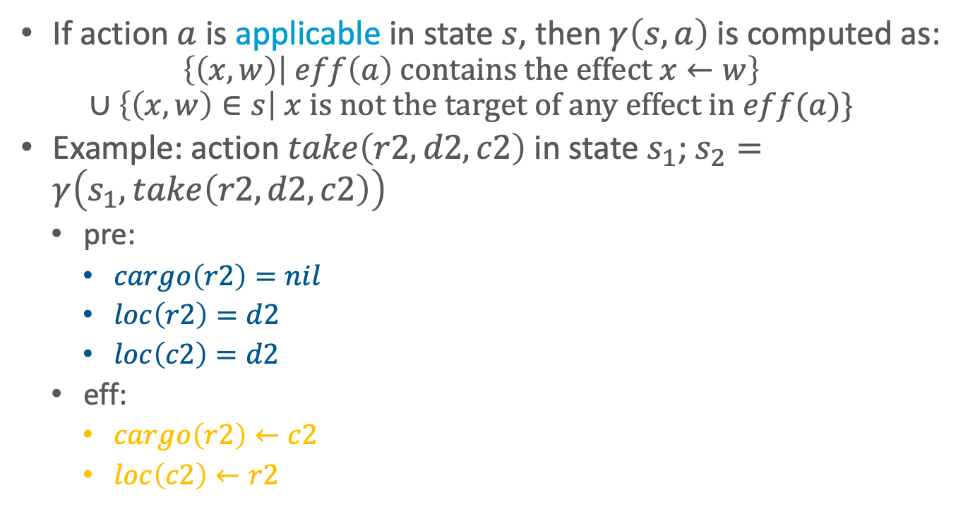
Computing Prediction Function $γ$
If action $a$ is applicable in state $s$, then $γ\left(s,a\right)$ is computed as:
$$\left\{\left(x,w\right) | eff\left(a\right) \text{contains} \text{the} \text{effect} x←w\right\}$$
$$∪\left\{\left(x,w\right)∈s\right| x \text{is} \text{n}\text{o}\text{t} \text{the} \text{target} \text{of} \text{any} \text{effect} \text{in} eff(a)\}$$
Example: action $take\left(r2,d2,c2\right)$ in state $s_{1}$; $s_{2}=γ\left(s_{1},take\left(r2, d2, c2\right)\right)$
pre:
$cargo\left(r2\right)=nil$
$loc\left(r2\right)=d2$
$loc\left(c2\right)=d2$
eff:
$cargo\left(r2\right)←c2$
$loc\left(c2\right)←r2$
d3
r1
r2
c1
c2
d1
$$s_{1}$$
d2
$$s_{1}=\left\{\begin{aligned}cargo\left(r1\right)=nil, cargo\left(r2\right)=nil, \\ loc\left(r1\right)=d1, loc\left(r2\right)=d2, \\ loc\left(c1\right)=d1, loc\left(c2\right)=d2\end{aligned}\right\}$$
$$s_{2}=\left\{\begin{aligned}cargo\left(r1\right)=nil, cargo\left(r2\right)=c2, \\ loc\left(r1\right)=d1, loc\left(r2\right)=d2, \\ loc\left(c1\right)=d1, loc\left(c2\right)=r2\end{aligned}\right\}$$
d3
r1
r2
c2
c1
d1
$$s_{2}$$
d2
Notes:
State transition function or prediction function

Slide 22
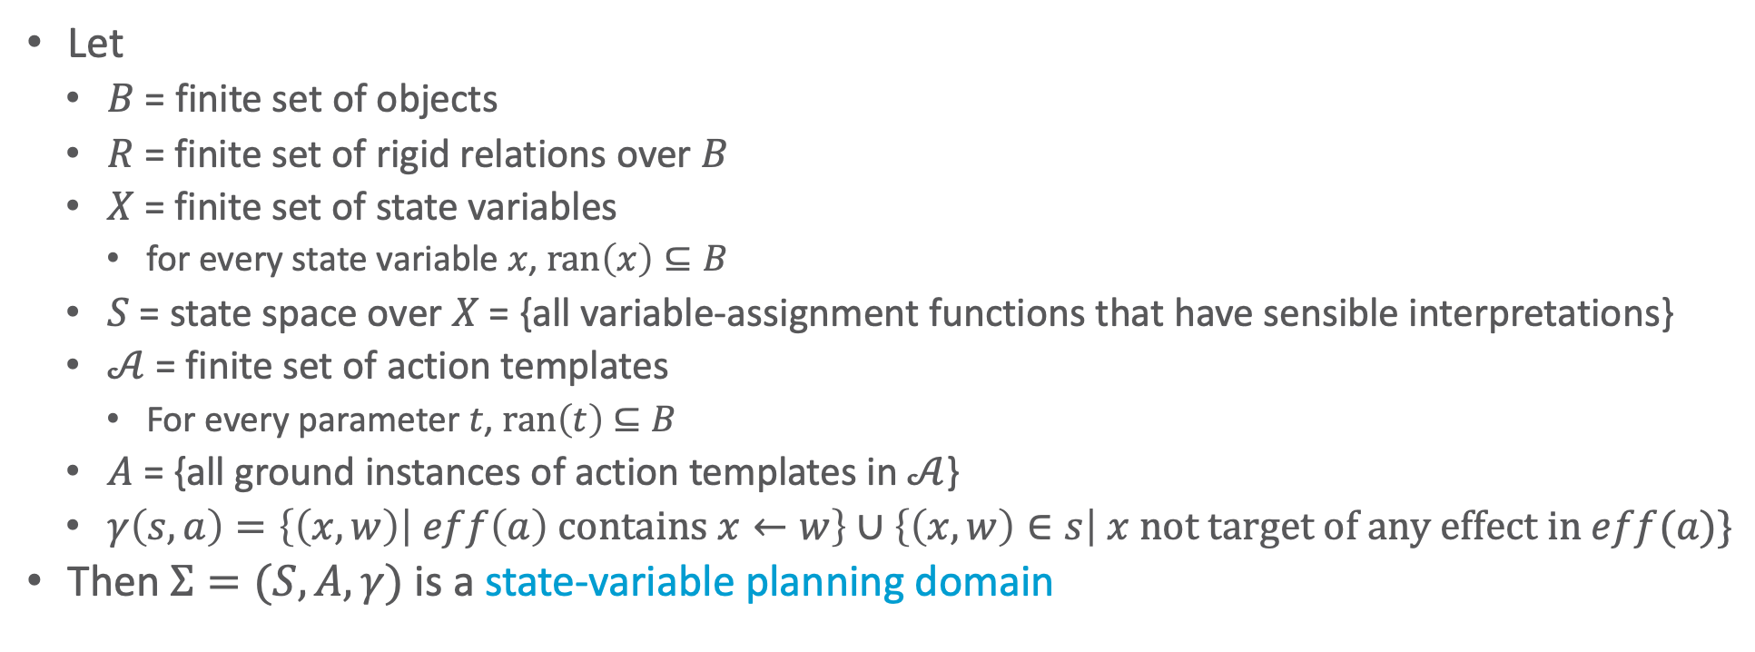
State-Variable Planning Domain
Let
$B$ = finite set of objects
$R$ = finite set of rigid relations over $B$
$X$ = finite set of state variables
for every state variable $x$, $ran\left(x\right)⊆B$
$S$ = state space over $X$ = {all variable-assignment functions that have sensible interpretations}
$𝒜$ = finite set of action templates
For every parameter $t$, $ran\left(t\right)$ $⊆B$
$A$ = {all ground instances of action templates in $𝒜$}
$γ\left(s,a\right)=\left\{\left(x,w\right) | eff\left(a\right) \text{contains} x←w\right\}∪\left\{\left(x,w\right)∈s\right| x \text{not} \text{target} \text{of} \text{any} \text{effect} \text{in} eff(a)\}$
Then $Σ=(S,A,γ)$ is a state-variable planning domain
Notes:
Instead of a state-transition system (classical planning domain)

Slide 23

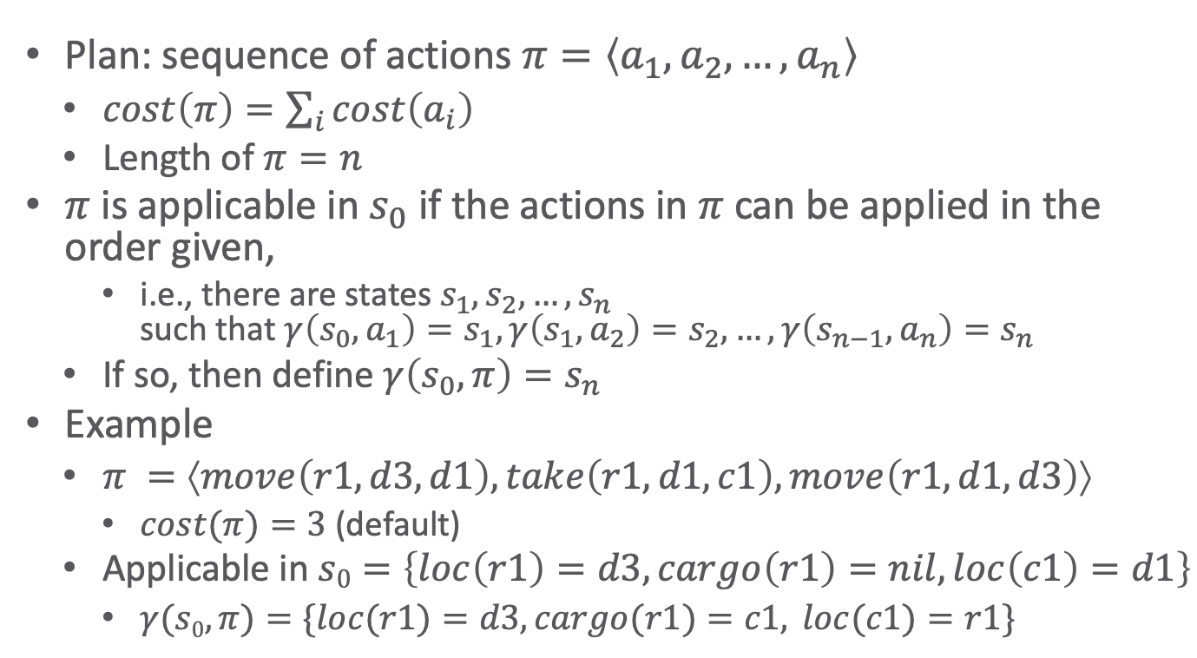

Plans
Plan: sequence of actions $π=\left\langle a_{1},a_{2},…, a_{n}\right\rangle$
$cost\left(π\right)=\sum_{i}{cost\left(a_{i}\right)}$
Length of $π=n$
$π$ is applicable in $s_{0}$ if the actions in $π$can be applied in the order given,
i.e., there are states $s_{1},s_{2},…, s_{n}$ such that $γ\left(s_{0}, a_{1}\right)=s_{1},γ\left(s_{1}, a_{2}\right)=s_{2}, …,γ\left(s_{n−1}, a_{n}\right)=s_{n}$
If so, then define $γ\left(s_{0}, π\right)=s_{n}$
Example
$π =⟨move\left(r1,d3,d1\right), take\left(r1,d1,c1\right), move\left(r1,d1,d3\right)⟩$
$cost(π)=3$ (default)
Applicable in $s0=\left\{loc\left(r1\right)=d3, cargo\left(r1\right)=nil, loc\left(c1\right)=d1\right\}$
$γ(s0,π)=\{loc(r1)=d3, cargo(r1)=c1, loc(c1)=r1\}$
r1
d3
c1
d1
$$s_{0}$$
d2
r1
c1
d3
d1
$$s_{3}=γ\left(s_{0},π\right)$$
d2

Slide 24



State Space
$s0$:
Directed graph
Nodes = states of the world
Edges: $γ$
If $π=\left\langle a_{1},a_{2},…, a_{n}\right\rangle$ is applicable in $s0$ , it produces a path $\left\langle s_{1},s_{2},…, s_{n}\right\rangle$
$γ\left(s_{0}, a_{1}\right)=s_{1},$ $γ\left(s_{1}, a_{2}\right)=s_{2}, …,$ $γ\left(s_{n−1}, a_{n}\right)=s_{n}$
$s1$:

Slide 25
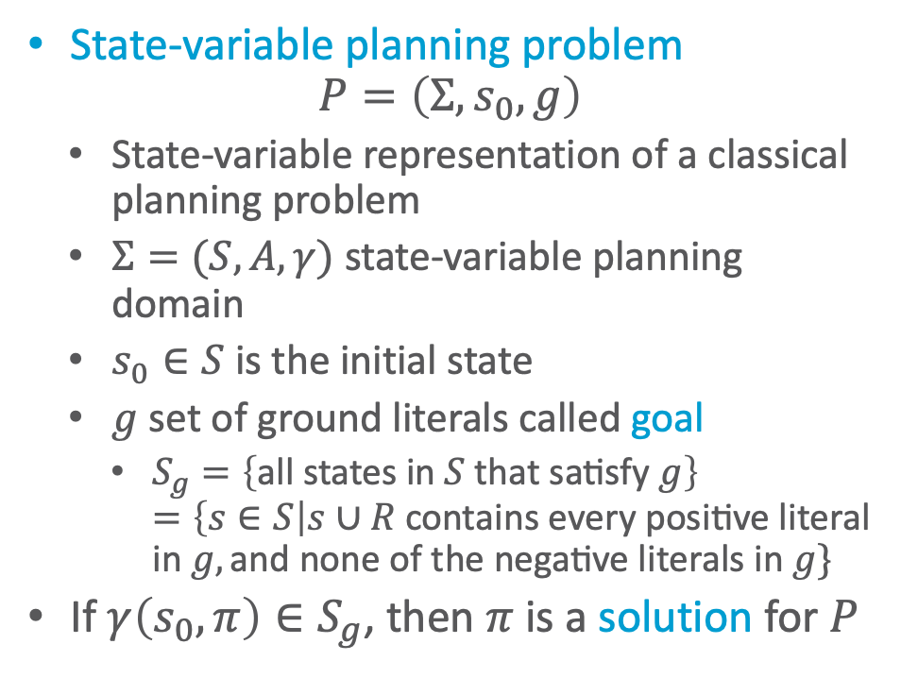


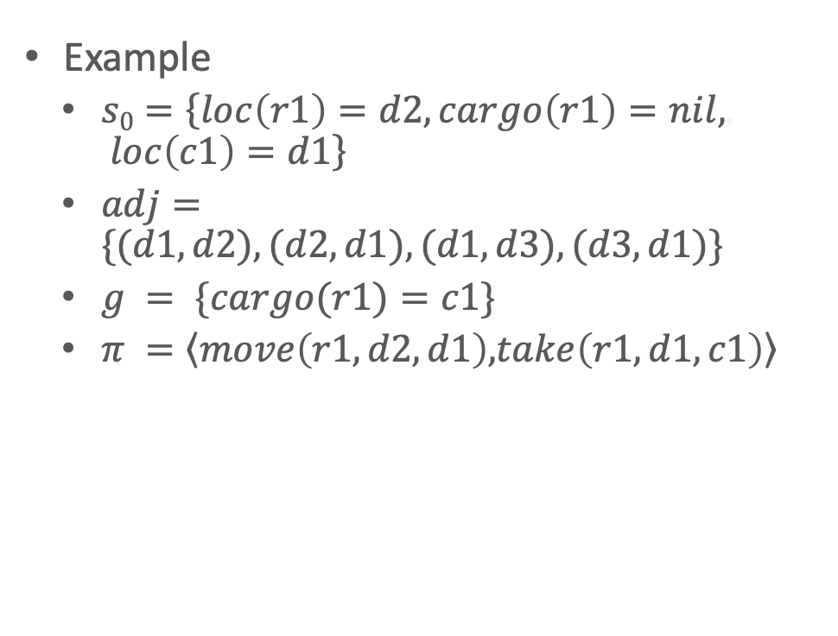
Planning Problems
How many solutions of length 3 exist?
State-variable planning problem
$$P=\left(Σ,s_{0},g\right)$$
State-variable representation of a classical planning problem
$Σ=(S,A,γ)$ state-variable planning domain
$s_{0}∈S$ is the initial state
$g$ set of ground literals called goal
$S_{g}=\left\{\text{all} \text{states} \text{in} S \text{that} \text{satisfy} g\right\}$ $=\left\{s∈S\right|s∪R \text{contains} \text{every} \text{positive} \text{literal} \text{i}\text{n} g,\text{and} \text{none} \text{of} \text{the} \text{negative} \text{literals} \text{in} g\}$
If $γ\left(s_{0}, π\right)∈S_{g}$, then $π$ is a solution for $P$
Example
$s0=\left\{loc\left(r1\right)=d2, cargo\left(r1\right)=nil,, loc\left(c1\right)=d1\right\}$
$adj=\{(d1,d2), (d2,d1), (d1,d3), (d3,d1)\}$
$g = \{cargo(r1)=c1\}$
$π =\left\langle move\left(r1,d2,d1\right),\right.\left.take\left(r1,d1,c1\right)\right\rangle$
d3
r1
r1
c1
c1
d1
$$s_{0}$$
d2
$$g$$
Notes:
None

Slide 26
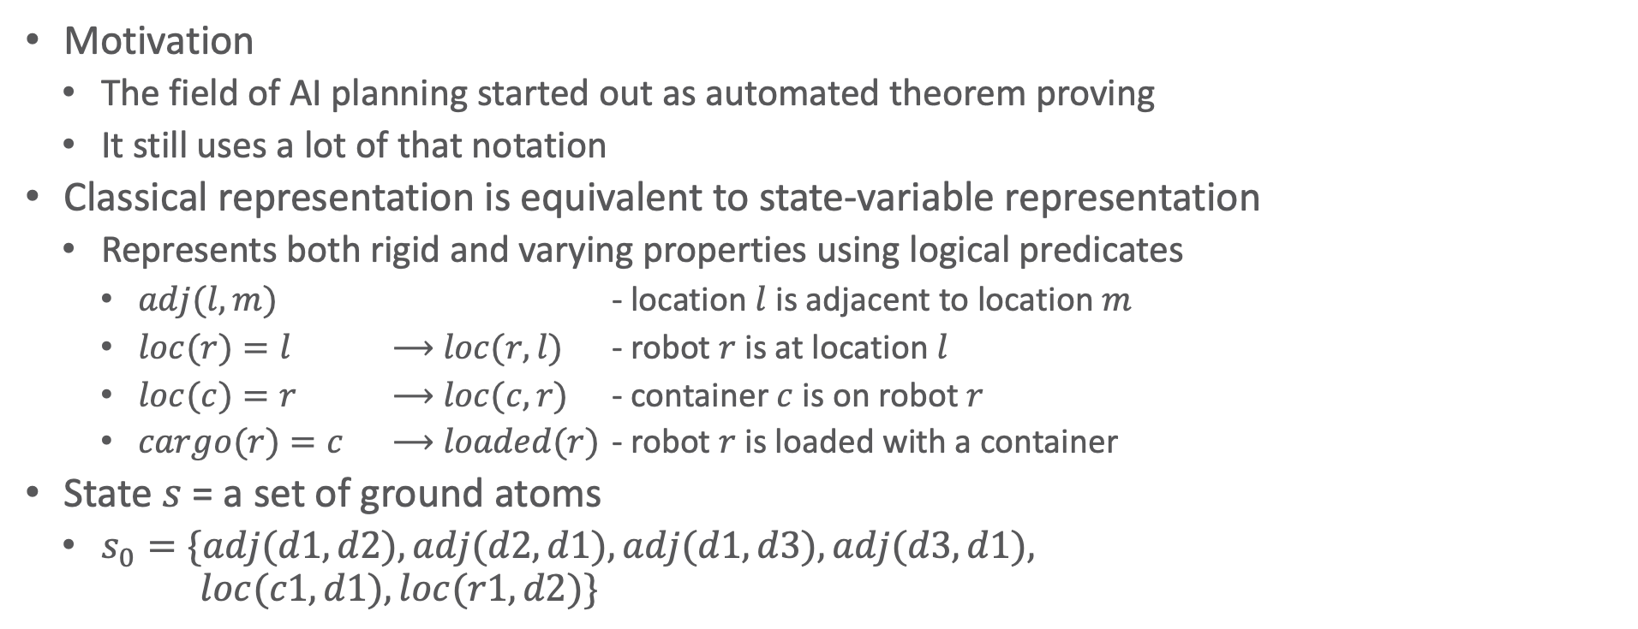
Classical Representation
Motivation
The field of AI planning started out as automated theorem proving
It still uses a lot of that notation
Classical representation is equivalent to state-variable representation
Represents both rigid and varying properties using logical predicates
$adj(l,m)$ - location $l$ is adjacent to location $m$
$loc(r)=l$ ⟶ $loc(r,l)$ - robot $r$ is at location $l$
$loc(c)=r$ ⟶ $loc(c,r)$ - container $c$ is on robot $r$
$cargo(r)=c$ ⟶ $loaded(r)$ - robot $r$ is loaded with a container
State $s$ = a set of ground atoms
$s_{0}=\{adj(d1,d2), adj(d2,d1),adj(d1,d3), adj(d3,d1),$ $loc(c1,d1), loc(r1,d2)\}$
d3
r1
c1
d1
d2
Notes:
nil – false, c – true, which c on which r through loc of c
could also do cargo(r,c)

Slide 27

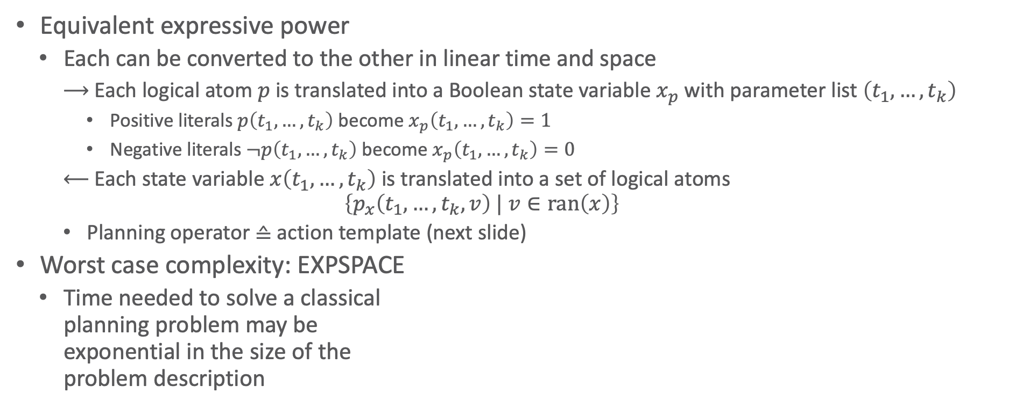

Classical Representation
Equivalent expressive power
Each can be converted to the other in linear time and space
Each logical atom $p$ is translated into a Boolean state variable $x_{p}$ with parameter list $\left(t_{1},…,t_{k}\right)$
Positive literals $p\left(t_{1},…,t_{k}\right)$ become $x_{p}\left(t_{1},…,t_{k}\right)=1$
Negative literals $¬p\left(t_{1},…,t_{k}\right)$ become $x_{p}\left(t_{1},…,t_{k}\right)=0$
Each state variable $x\left(t_{1},…,t_{k}\right)$ is translated into a set of logical atoms
$$\left\{p_{x}\left(t_{1},…,t_{k}, v\right) | v∈ran\left(x\right)\right\}$$
Planning operator ≙ action template (next slide)
Worst case complexity: EXPSPACE
Time needed to solve a classical planning problem may be exponential in the size of the problem description
$p\left(t_{1},…,t_{k}\right)$ becomes $x_{p}\left(t_{1},…,t_{k}\right)=1$
Classical
representation
$$x\left(t_{1},…,t_{n}\right)=t_{0}$$ becomes $$p_{x}\left(t_{1},…,t_{n},t_{0}\right)$$
State-variable
representation

Slide 28
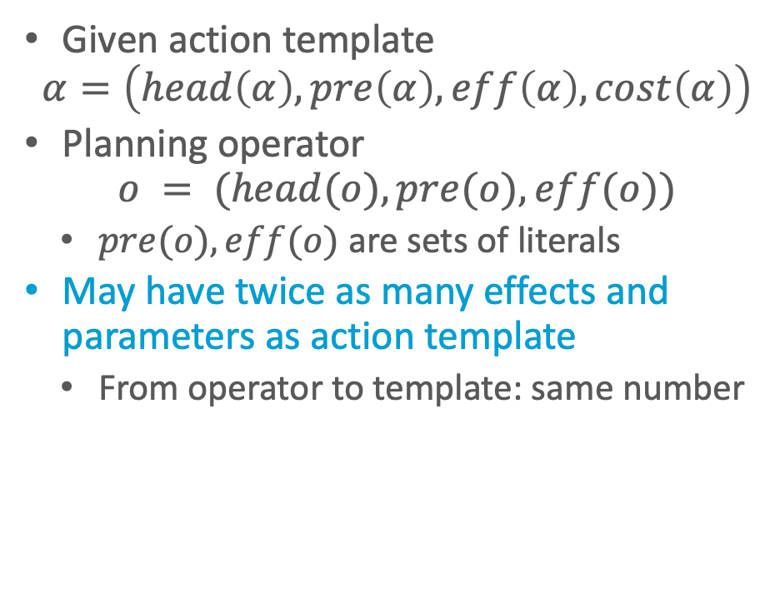
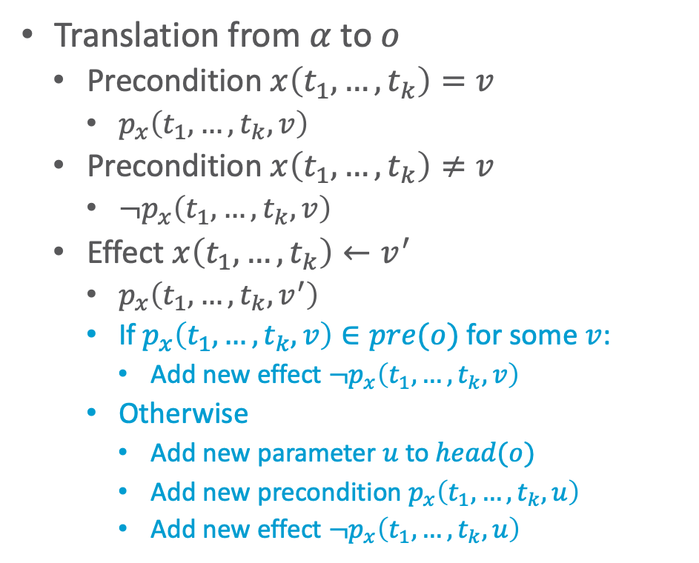
Classical Planning Operators
Given action template
$$α=\left(head\left(α\right), pre\left(α\right), eff\left(α\right), cost\left(α\right)\right)$$
Planning operator
$$o = (head(o), pre(o), eff(o))$$
$pre(o), eff(o)$ are sets of literals
May have twice as many effects and parameters as action template
From operator to template: same number
Translation from $α$ to $o$
Precondition $x\left(t_{1},…,t_{k}\right)=v$
$p_{x}\left(t_{1},…,t_{k},v\right)$
Precondition $x\left(t_{1},…,t_{k}\right)≠v$
$¬p_{x}\left(t_{1},…,t_{k},v\right)$
Effect $x\left(t_{1},…,t_{k}\right)←v^{′}$
$p_{x}\left(t_{1},…,t_{k},v^{′}\right)$
If $p_{x}\left(t_{1},…,t_{k},v\right)∈pre(o)$ for some $v$:
Add new effect $¬p_{x}\left(t_{1},…,t_{k},v\right)$
Otherwise
Add new parameter $u$ to $head(o)$
Add new precondition $p_{x}\left(t_{1},…,t_{k},u\right)$
Add new effect $¬p_{x}\left(t_{1},…,t_{k},u\right)$
Notes:
Add u: says that p_x has a value before the action and that value no longer holds after the action as it is now v’
Why: The reason is that each state variable x(t1, . . . , tn) has only one value at a time, so the planning operator must ensure that px(t1,...,tn,v) is true for only one v at a time. In the state-variable representation, this happens automatically; but in the classical representation, asserting a new value requires explicitly deleting the old one.

Slide 29
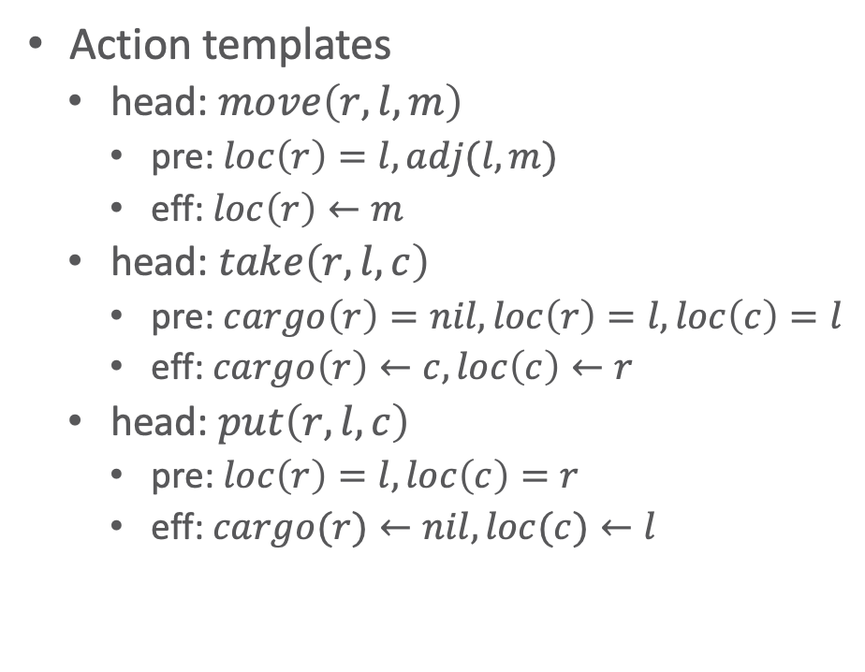
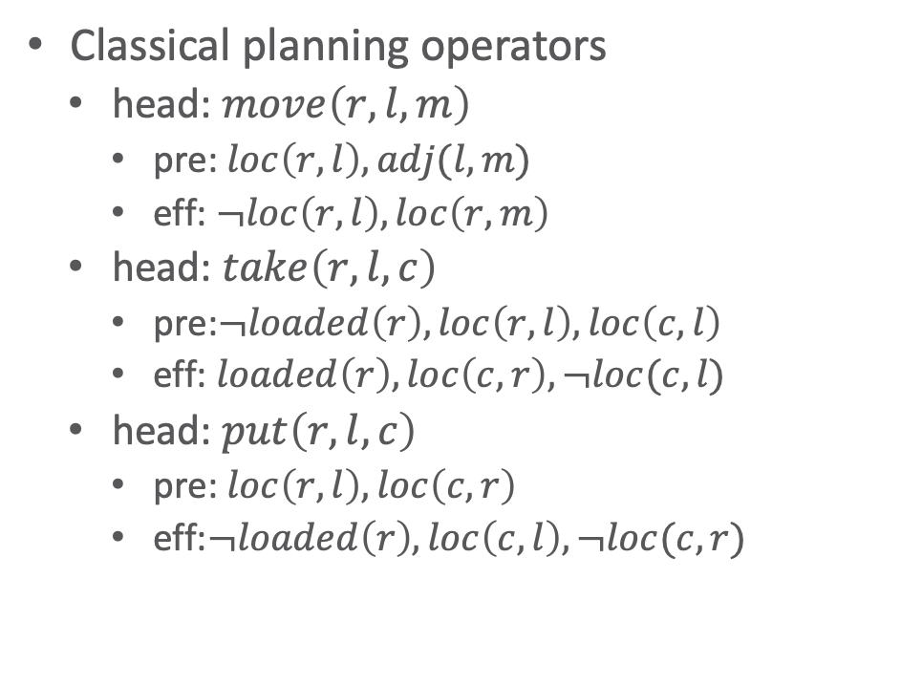
Classical Planning Operators: Example
Action templates
head: $move\left(r,l,m\right)$
pre: $loc\left(r\right)=l, adj(l,m)$
eff: $loc\left(r\right)←m$
head: $take\left(r,l,c\right)$
pre: $cargo\left(r\right)=nil, loc\left(r\right)=l, loc\left(c\right)=l$
eff: $cargo\left(r\right)←c, loc\left(c\right)←r$
head: $put\left(r,l,c\right)$
pre: $loc\left(r\right)=l, loc\left(c\right)=r$
eff: $cargo(r)←nil, loc(c)←l$
Classical planning operators
head: $move\left(r,l,m\right)$
pre: $loc\left(r,l\right), adj(l,m)$
eff: $¬loc\left(r,l\right),loc\left(r,m\right)$
head: $take\left(r,l,c\right)$
pre:$¬loaded\left(r\right), loc\left(r,l\right), loc\left(c,l\right)$
eff: $loaded\left(r\right), loc\left(c,r\right),¬loc(c,l)$
head: $put\left(r,l,c\right)$
pre: $loc\left(r,l\right), loc\left(c,r\right)$
eff:$¬loaded\left(r\right), loc\left(c,l\right),¬loc(c,r)$
Notes:
Add u: says that p_x has a value before the action and that value no longer holds after the action as it is now v’
Why: The reason is that each state variable x(t1, . . . , tn) has only one value at a time, so the planning operator must ensure that px(t1,...,tn,v) is true for only one v at a time. In the state-variable representation, this happens automatically; but in the classical representation, asserting a new value requires explicitly deleting the old one.

Slide 30
PDDL – Planning Domain Definition Language
Language for defining planning domains and problems
LISP-like syntax
Original version ≈ 1996
Just classical planning
Multiple revisions and extensions
Different subsets accommodate different kinds of planning
We will discuss the classical-planning subset
Chapter 2 of the PDDL book

Slide 31
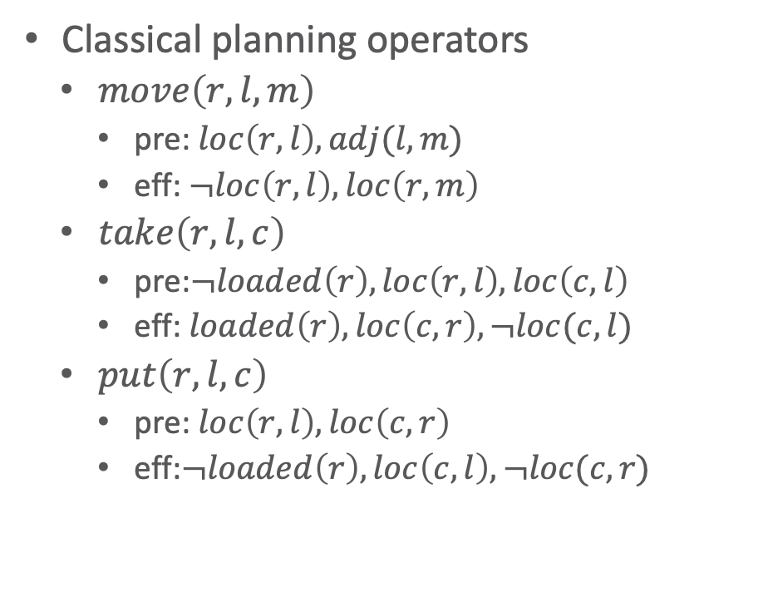
Example Domain
(define (domain example-domain-1)
(requirements :negative-preconditions)
(:action move
:parameters (?r ?l ?m)
:precondition (and (loc ?r ?l)
(adj ?l ?m))
:effect (and (not (loc ?r ?l))
(loc ?r ?m)))
(:action take
:parameters (?r ?l ?c)
:precondition (and (loc ?r ?l)
(loc ?c ?l)
(not (loaded ?r)))
:effect (and (not (loc ?r ?l))
(loc ?r ?m)))
(:action put
:parameters (?r ?l ?c)
:precondition (and (loc ?r ?l)
(loc ?c ?r))
:effect (and (loc ?c ?l)
(not (loc ?c ?r))
(not (loaded ?r)))))
Classical planning operators
$move\left(r,l,m\right)$
pre: $loc\left(r,l\right), adj(l,m)$
eff: $¬loc\left(r,l\right),loc\left(r,m\right)$
$take\left(r,l,c\right)$
pre:$¬loaded\left(r\right), loc\left(r,l\right), loc\left(c,l\right)$
eff: $loaded\left(r\right), loc\left(c,r\right),¬loc(c,l)$
$put\left(r,l,c\right)$
pre: $loc\left(r,l\right), loc\left(c,r\right)$
eff:$¬loaded\left(r\right), loc\left(c,l\right),¬loc(c,r)$
Notes:
prefix notation of logical formulas

Slide 32


Example Problem
(define (problem example-problem-1)
(:domain example-domain-1))
(:init
(adj d1 d2)
(adj d2 d1)
(adj d1 d3)
(adj d3 d1)
(loc c1 d1)
(loc r1 d2)
(:goal (loc c1 r1)))
Initial state $s_{0}=$ $\{adj(d1,d2), adj(d2,d1),$ $adj(d1,d3), adj(d3,d1),$ $loc(c1,d1), loc(r1,d2)\}$
Goal state $g = \{loc(c1,r1)\}$
d3
r1
r1
c1
c1
$$g$$
d1
$$s_{0}$$
d2

Slide 33
Example Typed Domain
(define (domain example-domain-2)
(:requirements :negative-preconditions :typing)
(:types
location movable-obj - object
robot container - movable-obj)
(:predicates
(loc ?r - movable-obj
?l - location)
(loaded ?r - robot)
(adjacent ?l ?m - location))
(:action move
:parameters (?r - robot
?l ?m - location)
<<as before>>
(:action take
:parameters (?r - robot
?l - location
?c - container)
<<as before>>
(:action put
:parameters (?r - robot
?l - location
?c - container)
<<as before>>

Slide 34
Example Typed Problem
(define (problem example-problem-2)
(:domain example-domain-2))
(:objects
r1 - robot
c1 - container
d1 d2 d3 - location)
(:init
(adjacent d1 d2)
(adjacent d2 d1)
(adjacent d1 d3)
(adjacent d3 d1)
(loc c1 d1)
(loc r1 d2)
(:goal (loc c1 r1)))
(define (problem example-problem-1)
(:domain example-domain-1))
(:init
(adj d1 d2)
(adj d2 d1)
(adj d1 d3)
(adj d3 d1)
(loc c1 d1)
(loc r1 d2)
(:goal (loc c1 r1)))
d3
r1
r1
c1
c1
$$g$$
d1
$$s_{0}$$
d2

Slide 35
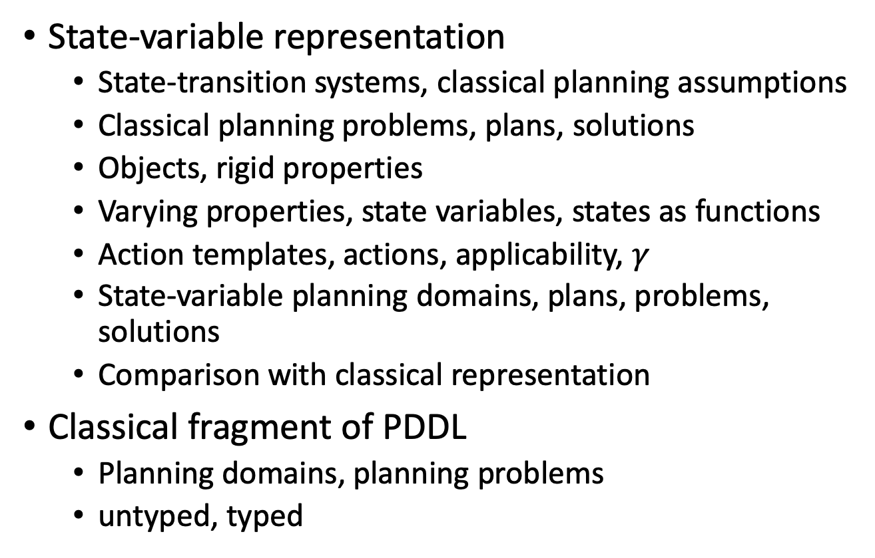
Intermediate Summary
State-variable representation
State-transition systems, classical planning assumptions
Classical planning problems, plans, solutions
Objects, rigid properties
Varying properties, state variables, states as functions
Action templates, actions, applicability, $γ$
State-variable planning domains, plans, problems, solutions
Comparison with classical representation
Classical fragment of PDDL
Planning domains, planning problems
untyped, typed

Slide 36
Outline per the Book
2.1 State-variable representation
State = {values of variables}; action = changes to those values
2.2 Forward state-space search
Start at initial state, look for sequence of actions that achieve goal
2.3 Heuristic functions
How to guide a forward state-space search
2.6 Incorporating planning into an actor
Online lookahead, unexpected events
2.4 Backward search
Start at goal state, go backwards toward initial state
2.5 Plan-space search
Start with incomplete plan for getting from initial state to goal state, make transformations to fix flaws in the plan

Slide 37
Planning as Search
Nearly all planning procedures are search procedures
Search tree: the data structure the procedure uses to keep track of which paths it has explored
Example: Russell & Norvig, Artificial Intelligence: A Modern Approach

Slide 38
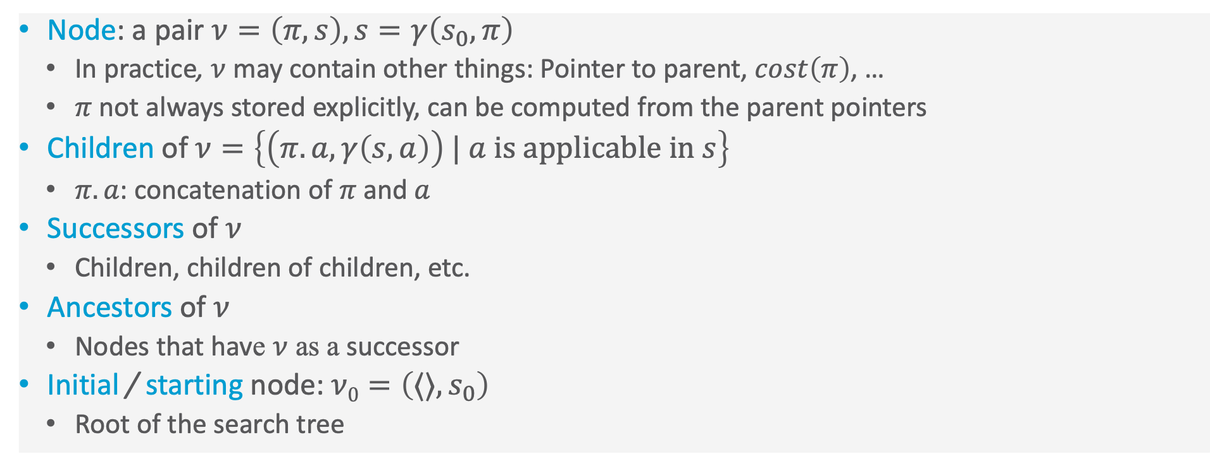
Search-Tree Terminology
Node: a pair $ν=\left(π,s\right),s=γ\left(s_{0},π\right)$
In practice, $ν$ may contain other things: Pointer to parent, $cost\left(π\right)$, …
$π$ not always stored explicitly, can be computed from the parent pointers
Children of $ν=\left\{\left(π.a, γ\left(s,a\right)\right) | a \text{is} \text{applicable} \text{in} s\right\}$
$π.a$: concatenation of $π$ and $a$
Successors of $ν$
Children, children of children, etc.
Ancestors of $ν$
Nodes that have $ν$ as a successor
Initial / starting node: $ν0=\left(⟨⟩, s_{0}\right)$
Root of the search tree

Slide 39
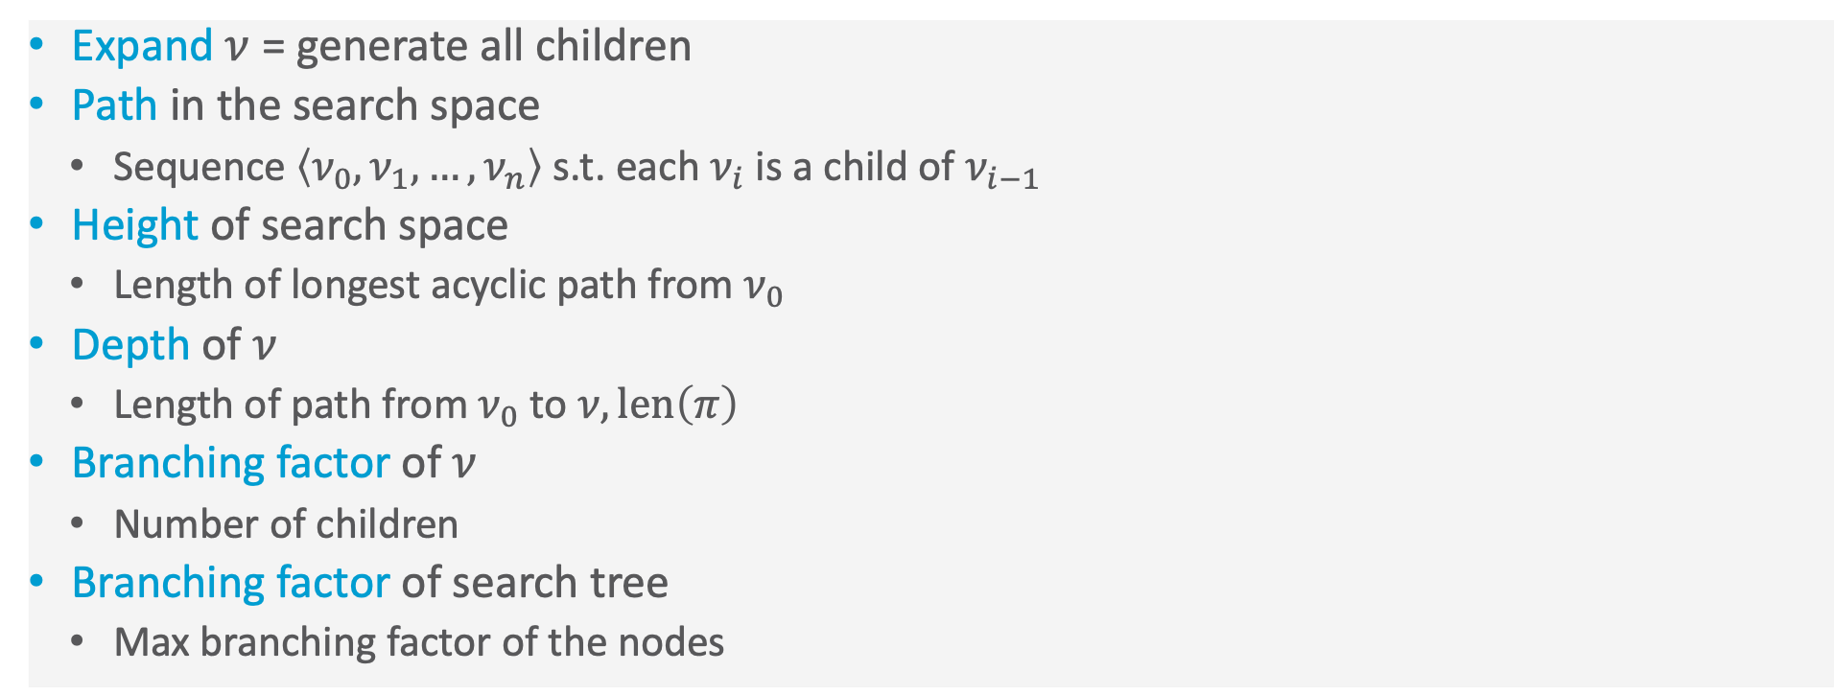
Search-Tree Terminology
Expand $ν$ = generate all children
Path in the search space
Sequence $\left\langle ν_{0}, ν_{1}, …, ν_{n}\right\rangle$ s.t. each $ν_{i}$ is a child of $ν_{i−1}$
Height of search space
Length of longest acyclic path from $ν_{0}$
Depth of $ν$
Length of path from $ν_{0}$ to $ν,len\left(π\right)$
Branching factor of $ν$
Number of children
Branching factor of search tree
Max branching factor of the nodes

Slide 40
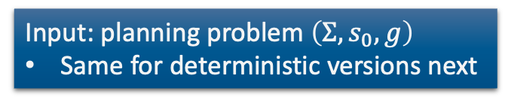
Forward Search
Nondeterministic algorithm
Sound: if an execution trace returns a plan π, it is a solution
Complete: if the planning problem is solvable, at least one of the possible execution traces will return a solution
Represents a class of deterministic search algorithms
Depends on how you implement the nondeterministic choice
Which leaf node to expand next, which nodes to prune
Sound but not necessarily complete
Forward-search(Σ,s₀,g)
s ← s₀
𝜋 ← ⟨⟩
loop
if s satisfies g then
return 𝜋
A′ ←{a ∈ A | a is applicable in s}
if A′ = ∅ then
return failure
nondeterministically choose a ∈ A′ s ← 𝛾(s,a)
𝜋 ← 𝜋.a
Input: planning problem $\left(Σ,s_{0},g\right)$
Same for deterministic versions next

Slide 41
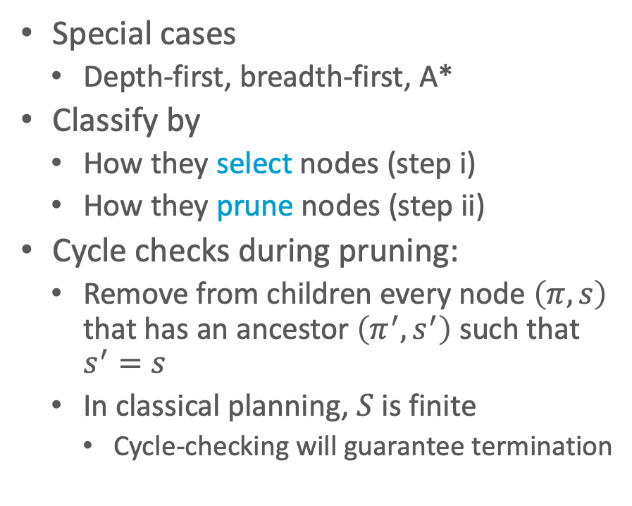
Deterministic Version
Deterministic-Search(Σ,s₀,g)
Frontier ← {(⟨⟩, s₀)}
Expanded ← ∅
while Frontier ≠ ∅ do
select a node 𝜈 = (𝜋,s) ∈ Frontier (i)
remove 𝜈 from Frontier
add 𝜈 to Expanded
if s satisfies g then
return 𝜋
Children ← {(𝜋.a, 𝛾(s,a)) | s satisfies pre(a)}
prune 0 or more nodes from Children, Frontier, Expanded (ii)
Frontier ← Frontier ∪ Children
return failure
Special cases
Depth-first, breadth-first, A*
Classify by
How they select nodes (step i)
How they prune nodes (step ii)
Cycle checks during pruning:
Remove from children every node $\left(π,s\right)$ that has an ancestor $\left(π^{′},s^{′}\right)$ such that $s^{′}=s$
In classical planning, $S$ is finite
Cycle-checking will guarantee termination
Notes:
Frontier: set of candidate nodes to be visited
Expanded: already visited nodes

Slide 42
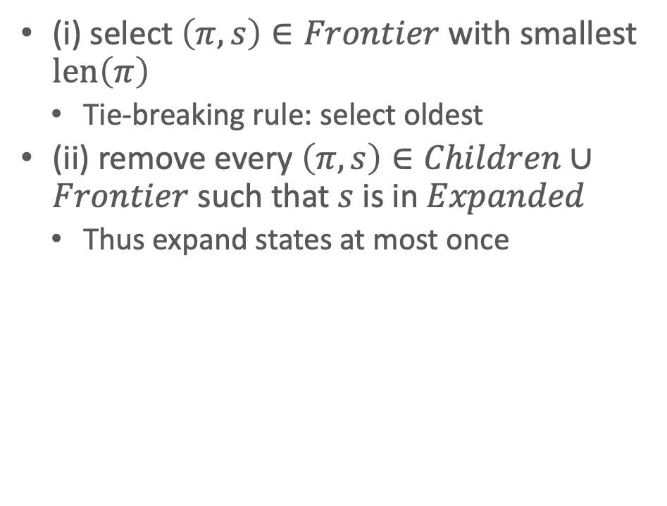
Breadth-first search (BFS)
Deterministic-Search(Σ,s₀,g)
Frontier ← {(⟨⟩, s₀)}
Expanded ← ∅
while Frontier ≠ ∅ do
select a node 𝜈 = (𝜋,s) ∈ Frontier (i)
remove 𝜈 from Frontier
add 𝜈 to Expanded
if s satisfies g then
return 𝜋
Children ← {(𝜋.a, 𝛾(s,a)) | s satisfies pre(a)}
prune 0 or more nodes from Children, Frontier, Expanded (ii)
Frontier ← Frontier ∪ Children
return failure
(i) select $\left(π,s\right)∈Frontier$ with smallest $len\left(π\right)$
Tie-breaking rule: select oldest
(ii) remove every $\left(π,s\right)∈Children∪Frontier$ such that $s$ is in $Expanded$
Thus expand states at most once
Notes:
Implementation: FIFO queue

Slide 43
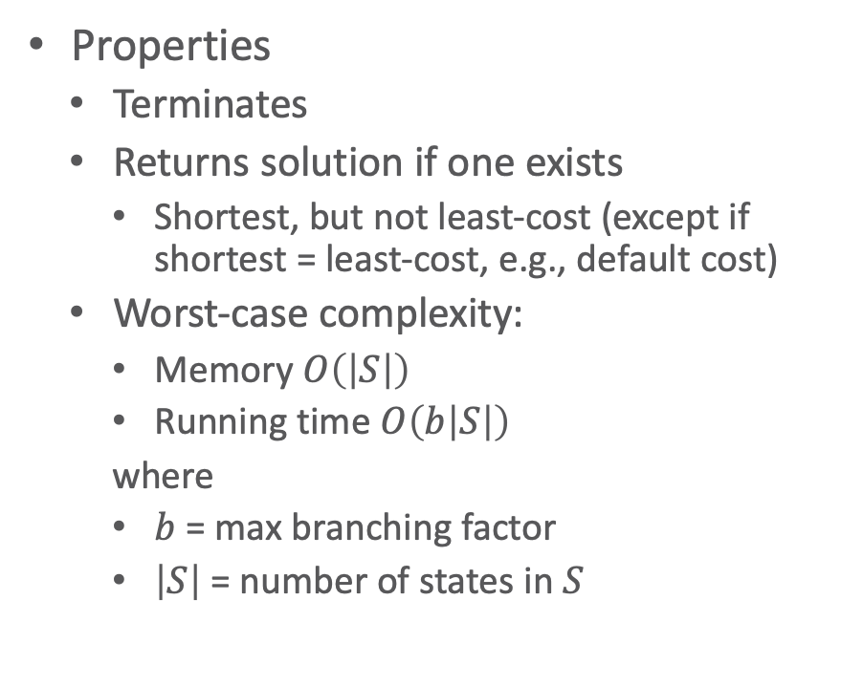
Breadth-first search (BFS)
Deterministic-Search(Σ,s₀,g)
Frontier ← {(⟨⟩, s₀)}
Expanded ← ∅
while Frontier ≠ ∅ do
select a node 𝜈 = (𝜋,s) ∈ Frontier (i)
remove 𝜈 from Frontier
add 𝜈 to Expanded
if s satisfies g then
return 𝜋
Children ← {(𝜋.a, 𝛾(s,a)) | s satisfies pre(a)}
prune 0 or more nodes from Children, Frontier, Expanded (ii)
Frontier ← Frontier ∪ Children
return failure
Properties
Terminates
Returns solution if one exists
Shortest, but not least-cost (except if shortest = least-cost, e.g., default cost)
Worst-case complexity:
Memory $O\left(\left|S\right|\right)$
Running time $O\left(b\left|S\right|\right)$
where
$b$ = max branching factor
$\left|S\right|$ = number of states in $S$
Notes:
Implementation: FIFO queue

Slide 44
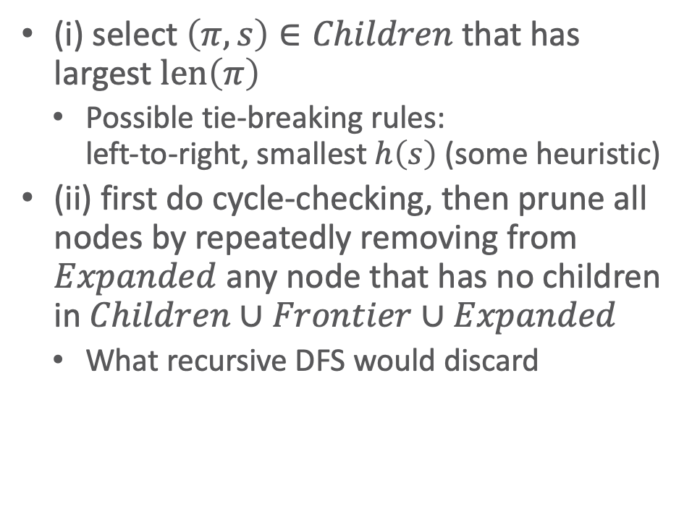
Depth-First Search (DFS)
Deterministic-Search(Σ,s₀,g)
Frontier ← {(⟨⟩, s₀)}
Expanded ← ∅
while Frontier ≠ ∅ do
select a node 𝜈 = (𝜋,s) ∈ Frontier (i)
remove 𝜈 from Frontier
add 𝜈 to Expanded
if s satisfies g then
return 𝜋
Children ← {(𝜋.a, 𝛾(s,a)) | s satisfies pre(a)}
prune 0 or more nodes from Children, Frontier, Expanded (ii)
Frontier ← Frontier ∪ Children
return failure
(i) select $\left(π,s\right)∈Children$ that has largest $len\left(π\right)$
Possible tie-breaking rules: left-to-right, smallest $h\left(s\right)$ (some heuristic)
(ii) first do cycle-checking, then prune all nodes by repeatedly removing from $Expanded$ any node that has no children in $Children∪Frontier∪Expanded$
What recursive DFS would discard
Notes:
(ii) basically garbage collection, keep only nodes along current path (same happens in recursive DFS when a recursive call returns)
basically just has current path in memory therefore efficient in terms of memory, namely, only O(bl)
runtime possibly worse than BFS if many paths to each state

Slide 45

Depth-First Search (DFS)
Deterministic-Search(Σ,s₀,g)
Frontier ← {(⟨⟩, s₀)}
Expanded ← ∅
while Frontier ≠ ∅ do
select a node 𝜈 = (𝜋,s) ∈ Frontier (i)
remove 𝜈 from Frontier
add 𝜈 to Expanded
if s satisfies g then
return 𝜋
Children ← {(𝜋.a, 𝛾(s,a)) | s satisfies pre(a)}
prune 0 or more nodes from Children, Frontier, Expanded (ii)
Frontier ← Frontier ∪ Children
return failure
Properties
Terminates
Returns solution if there is one
No guarantees on quality
Worst-case complexity
Running time $O\left(b^{l}\right)$
Memory $O\left(bl\right)$
where
$b$ = max branching factor
$l$ = max depth of any node
Notes:
(ii) basically garbage collection, keep only nodes along current path (same happens in recursive DFS when a recursive call returns)
basically just has current path in memory therefore efficient in terms of memory, namely, only O(bl)
runtime possibly worse than BFS if many paths to each state

Slide 46
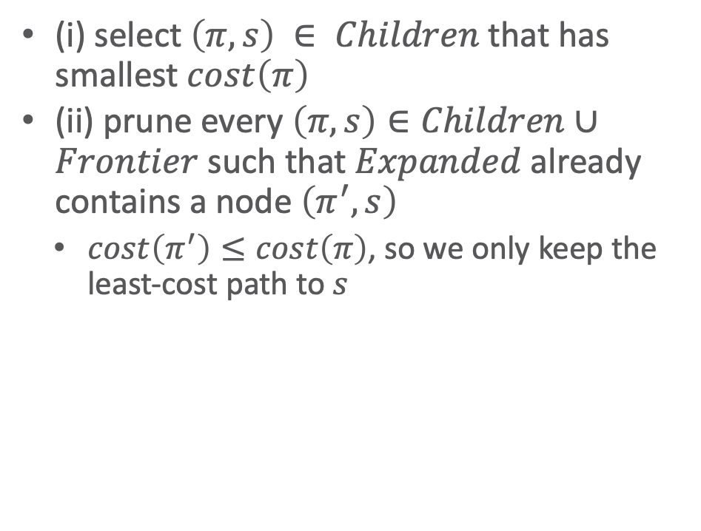
Uniform-Cost Search
Deterministic-Search(Σ,s₀,g)
Frontier ← {(⟨⟩, s₀)}
Expanded ← ∅
while Frontier ≠ ∅ do
select a node 𝜈 = (𝜋,s) ∈ Frontier (i)
remove 𝜈 from Frontier
add 𝜈 to Expanded
if s satisfies g then
return 𝜋
Children ← {(𝜋.a, 𝛾(s,a)) | s satisfies pre(a)}
prune 0 or more nodes from Children, Frontier, Expanded (ii)
Frontier ← Frontier ∪ Children
return failure
(i) select $\left(π,s\right) ∈ Children$that has smallest $cost\left(π\right)$
(ii) prune every $\left(π,s\right)∈Children∪Frontier$ such that $Expanded$ already contains a node $\left(π^{′},s\right)$
$cost\left(π^{′}\right)≤cost\left(π\right)$, so we only keep the least-cost path to $s$
Notes:
Similar to BFS

Slide 47
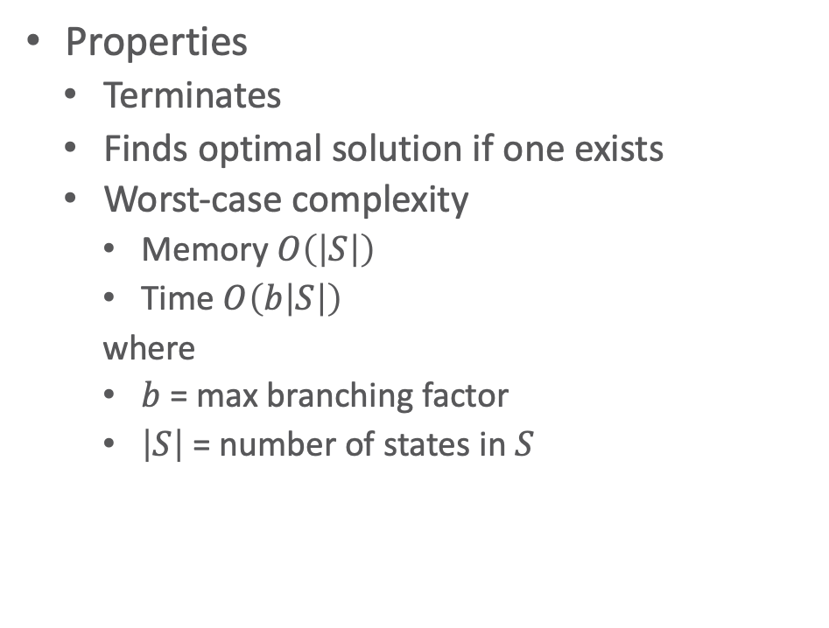
Uniform-Cost Search
Deterministic-Search(Σ,s₀,g)
Frontier ← {(⟨⟩, s₀)}
Expanded ← ∅
while Frontier ≠ ∅ do
select a node 𝜈 = (𝜋,s) ∈ Frontier (i)
remove 𝜈 from Frontier
add 𝜈 to Expanded
if s satisfies g then
return 𝜋
Children ← {(𝜋.a, 𝛾(s,a)) | s satisfies pre(a)}
prune 0 or more nodes from Children, Frontier, Expanded (ii)
Frontier ← Frontier ∪ Children
return failure
Properties
Terminates
Finds optimal solution if one exists
Worst-case complexity
Memory $O\left(\left|S\right|\right)$
Time $O\left(b\left|S\right|\right)$
where
$b$ = max branching factor
$\left|S\right|$ = number of states in $S$
Notes:
Similar to BFS

Slide 48
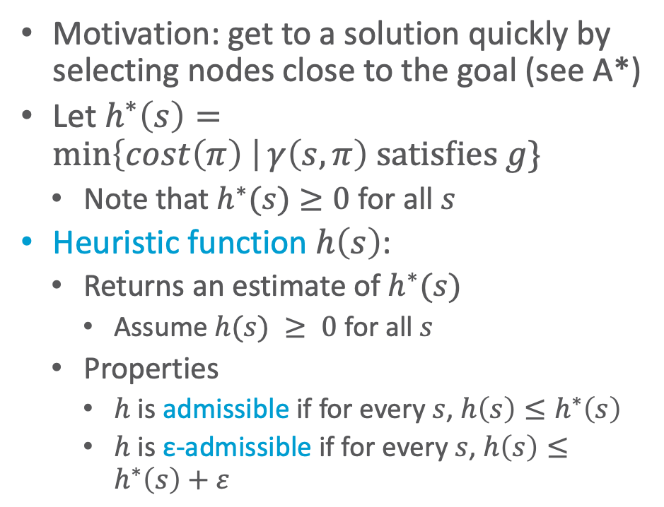

Heuristic Function
Motivation: get to a solution quickly by selecting nodes close to the goal (see A*)
Let $h^{∗}\left(s\right)=\min\left\{cost\left(π\right) \right|γ\left(s,π\right) \text{satisfies} g\}$
Note that $h^{∗}(s)≥0$ for all $s$
Heuristic function $h\left(s\right)$:
Returns an estimate of $h^{∗}(s)$
Assume $h(s) ≥ 0$ for all $s$
Properties
$h$ is admissible if for every $s$, $h\left(s\right)≤h^{∗}\left(s\right)$
$h$ is ε-admissible if for every $s$, $h\left(s\right)≤h^{∗}\left(s\right)+ε$
Let $ν=\left(π,s\right)$ be a node
$f^{∗}\left(ν\right)=cost\left(π\right)+h^{∗}\left(s\right)$
Min cost of all paths to goal that start with $π$
$f\left(ν\right)=cost\left(π\right)+h\left(s\right)$
Estimate of $f^{∗}\left(ν\right)$
Notes:
h(s): Minimal cost from s to g

Slide 49
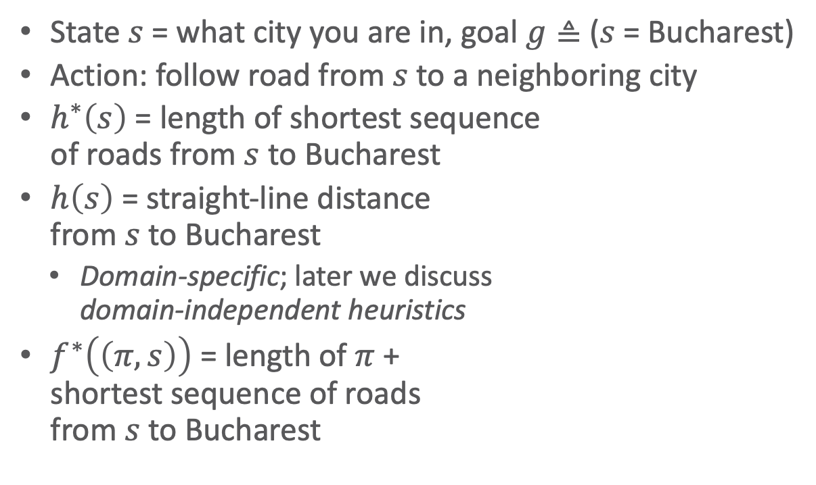

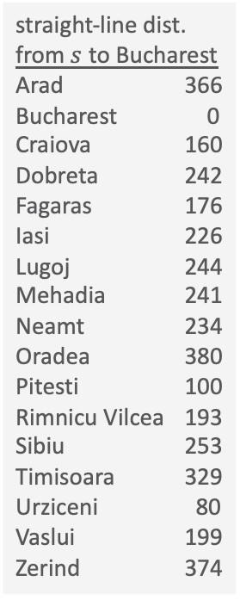
Example
State $s$ = what city you are in, goal $g≜$ ($s$ = Bucharest)
Action: follow road from $s$ to a neighboring city
$h^{∗}\left(s\right)$ = length of shortest sequence of roads from $s$ to Bucharest
$h\left(s\right)$ = straight-line distance from $s$ to Bucharest
Domain-specific; later we discuss domain-independent heuristics
$f^{∗}\left(\left(π,s\right)\right)$ = length of $π$ + shortest sequence of roads from $s$ to Bucharest
straight-line dist. from $s$ to Bucharest
Arad 366
Bucharest 0
Craiova 160
Dobreta 242
Fagaras 176
Iasi 226
Lugoj 244
Mehadia 241
Neamt 234
Oradea 380
Pitesti 100
Rimnicu Vilcea 193
Sibiu 253
Timisoara 329
Urziceni 80
Vaslui 199
Zerind 374
$$s_{0}$$
goal
Example: Russell & Norvig, Artificial Intelligence: A Modern Approach

Slide 50
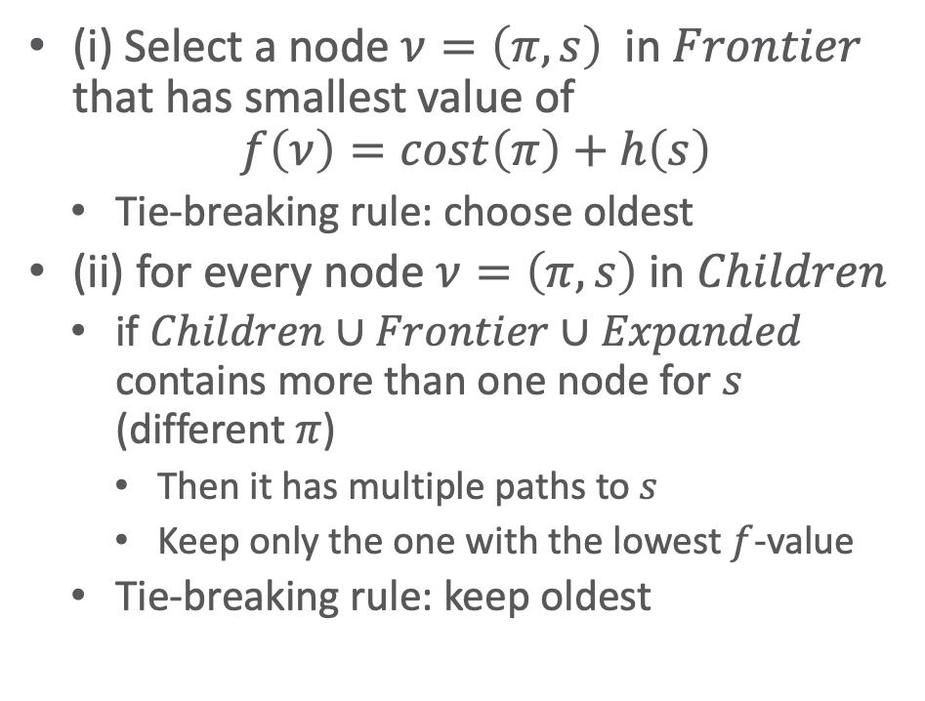
A*
Deterministic-Search(Σ,s₀,g)
Frontier ← {(⟨⟩, s₀)}
Expanded ← ∅
while Frontier ≠ ∅ do
select a node 𝜈 = (𝜋,s) ∈ Frontier (i)
remove 𝜈 from Frontier
add 𝜈 to Expanded
if s satisfies g then
return 𝜋
Children ← {(𝜋.a, 𝛾(s,a)) | s satisfies pre(a)}
prune 0 or more nodes from Children, Frontier, Expanded (ii)
Frontier ← Frontier ∪ Children
return failure
(i) Select a node $ν=\left(π,s\right)$ in $Frontier$ that has smallest value of
$$f\left(ν\right)=cost\left(π\right)+h\left(s\right)$$
Tie-breaking rule: choose oldest
(ii) for every node $ν=\left(π,s\right)$ in $Children$
if $Children∪Frontier∪Expanded$ contains more than one node for $s$ (different $π$)
Then it has multiple paths to $s$
Keep only the one with the lowest $f$-value
Tie-breaking rule: keep oldest

Slide 51
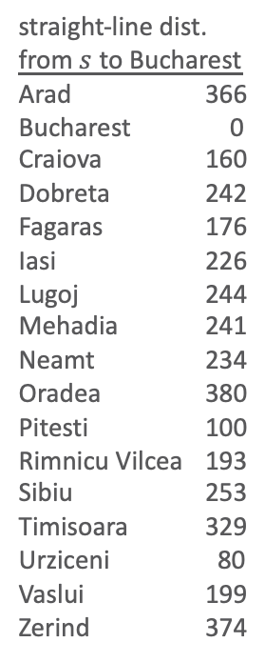
straight-line dist. from $s$ to Bucharest
Arad 366
Bucharest 0
Craiova 160
Dobreta 242
Fagaras 176
Iasi 226
Lugoj 244
Mehadia 241
Neamt 234
Oradea 380
Pitesti 100
Rimnicu Vilcea 193
Sibiu 253
Timisoara 329
Urziceni 80
Vaslui 199
Zerind 374

Slide 52
straight-line dist. from $s$ to Bucharest
Arad 366
Bucharest 0
Craiova 160
Dobreta 242
Fagaras 176
Iasi 226
Lugoj 244
Mehadia 241
Neamt 234
Oradea 380
Pitesti 100
Rimnicu Vilcea 193
Sibiu 253
Timisoara 329
Urziceni 80
Vaslui 199
Zerind 374

Slide 53
straight-line dist. from $s$ to Bucharest
Arad 366
Bucharest 0
Craiova 160
Dobreta 242
Fagaras 176
Iasi 226
Lugoj 244
Mehadia 241
Neamt 234
Oradea 380
Pitesti 100
Rimnicu Vilcea 193
Sibiu 253
Timisoara 329
Urziceni 80
Vaslui 199
Zerind 374
X

Slide 54
straight-line dist. from $s$ to Bucharest
Arad 366
Bucharest 0
Craiova 160
Dobreta 242
Fagaras 176
Iasi 226
Lugoj 244
Mehadia 241
Neamt 234
Oradea 380
Pitesti 100
Rimnicu Vilcea 193
Sibiu 253
Timisoara 329
Urziceni 80
Vaslui 199
Zerind 374
X
X

Slide 55
straight-line dist. from $s$ to Bucharest
Arad 366
Bucharest 0
Craiova 160
Dobreta 242
Fagaras 176
Iasi 226
Lugoj 244
Mehadia 241
Neamt 234
Oradea 380
Pitesti 100
Rimnicu Vilcea 193
Sibiu 253
Timisoara 329
Urziceni 80
Vaslui 199
Zerind 374
X
X
X

Slide 56
straight-line dist. from $s$ to Bucharest
Arad 366
Bucharest 0
Craiova 160
Dobreta 242
Fagaras 176
Iasi 226
Lugoj 244
Mehadia 241
Neamt 234
Oradea 380
Pitesti 100
Rimnicu Vilcea 193
Sibiu 253
Timisoara 329
Urziceni 80
Vaslui 199
Zerind 374
X
X
X
X
X

Slide 57

Properties of A*
In classical planning problems, A* will always terminate
Completeness: if the problem is solvable, A* will return a solution
If $h$ is admissible, then the solution will be optimal (least cost)
If $h$ is ε-admissible, then the solution will be ε-optimal
If $h$ is monotone, then
$f\left(ν\right)≤f\left(ν^{′}\right)$ for every child $ν^{′}$ of a node $ν$
A* will expand nodes in non-decreasing order of $f$ values
A* will never prune any nodes from $Expanded$
A* will expand no state more than once

Slide 58

Properties of A*
Definition: $h$ dominates $h^{′}$ if $h^{′}\left(s\right)≤h\left(s\right)≤h^{∗}\left(s\right)$ for every $s$
If $h$ dominates $h^{′}$, then (assuming ties are always resolved in favour of the same node)
A* will never expand more nodes with $h$ than with $h^{′}$
In most cases A* will expand fewer nodes with $h$ than with $h^{′}$
A* needs to store every node it visits
Running time $O\left(b\left|S\right|\right)$ and memory $O\left(\left|S\right|\right)$ in worst case
With good heuristic function, usually much smaller

Slide 59

Greedy Best-First Search (GBFS)
Deterministic-Search(Σ,s₀,g)
Frontier ← {(⟨⟩, s₀)}
Expanded ← ∅
while Frontier ≠ ∅ do
select a node 𝜈 = (𝜋,s) ∈ Frontier (i)
remove 𝜈 from Frontier
add 𝜈 to Expanded
if s satisfies g then
return 𝜋
Children ← {(𝜋.a, 𝛾(s,a)) | s satisfies pre(a)}
prune 0 or more nodes from Children, Frontier, Expanded (ii)
Frontier ← Frontier ∪ Children
return failure
Find a solution as quickly as possible, even if it is not optimal
Select nodes that are likely to be on the least-cost path from where you are now
(i) select a node $\left(π,s\right)∈Frontier$ that has smallest $h\left(s\right)$
(ii) same as in A*: for every node $ν=\left(π,s\right)$ in 𝐶ℎ𝑖𝑙𝑑𝑟𝑒𝑛
If $Children∪Frontier∪Expanded$ contains more than one node for $s$
Then it has multiple paths to $s$
Keep only the one with the lowest f-value
Tie-breaking rule: keep oldest

Slide 60
Greedy Best-First Search (GBFS)
Deterministic-Search(Σ,s₀,g)
Frontier ← {(⟨⟩, s₀)}
Expanded ← ∅
while Frontier ≠ ∅ do
select a node 𝜈 = (𝜋,s) ∈ Frontier (i)
remove 𝜈 from Frontier
add 𝜈 to Expanded
if s satisfies g then
return 𝜋
Children ← {(𝜋.a, 𝛾(s,a)) | s satisfies pre(a)}
prune 0 or more nodes from Children, Frontier, Expanded (ii)
Frontier ← Frontier ∪ Children
return failure
Properties
Terminates
Returns a solution if one exists
Often near-optimal
Will usually find it quickly

Slide 61
straight-line dist. from $s$ to Bucharest
Arad 366
Bucharest 0
Craiova 160
Dobreta 242
Fagaras 176
Iasi 226
Lugoj 244
Mehadia 241
Neamt 234
Oradea 380
Pitesti 100
Rimnicu Vilcea 193
Sibiu 253
Timisoara 329
Urziceni 80
Vaslui 199
Zerind 374
366

Slide 62
straight-line dist. from $s$ to Bucharest
Arad 366
Bucharest 0
Craiova 160
Dobreta 242
Fagaras 176
Iasi 226
Lugoj 244
Mehadia 241
Neamt 234
Oradea 380
Pitesti 100
Rimnicu Vilcea 193
Sibiu 253
Timisoara 329
Urziceni 80
Vaslui 199
Zerind 374
253
329 374

Slide 63
straight-line dist. from $s$ to Bucharest
Arad 366
Bucharest 0
Craiova 160
Dobreta 242
Fagaras 176
Iasi 226
Lugoj 244
Mehadia 241
Neamt 234
Oradea 380
Pitesti 100
Rimnicu Vilcea 193
Sibiu 253
Timisoara 329
Urziceni 80
Vaslui 199
Zerind 374
X
329 374
366 176 380 193

Slide 64
Expanded 4 nodes
Instead of 6
Solution cost 450
Instead of 418
straight-line dist. from $s$ to Bucharest
Arad 366
Bucharest 0
Craiova 160
Dobreta 242
Fagaras 176
Iasi 226
Lugoj 244
Mehadia 241
Neamt 234
Oradea 380
Pitesti 100
Rimnicu Vilcea 193
Sibiu 253
Timisoara 329
Urziceni 80
Vaslui 199
Zerind 374
X
329 374
366
X
380 193
253 0

Slide 65

Depth-First Branch and Bound (DFBB)
Deterministic-Search(Σ,s₀,g)
Frontier ← {(⟨⟩, s₀)}
Expanded ← ∅
c*← ∞
𝜋*← failure
while Frontier ≠ ∅ do
select a node 𝜈 = (𝜋,s) ∈ Frontier (i)
remove 𝜈 from Frontier
add 𝜈 to Expanded
if s satisfies g then
return 𝜋
if s satisfies g and cost(𝜋) < c* then
c*← cost(𝜋); 𝜋*← 𝜋
else if f(𝜈) < c* then
Children ← {(𝜋.a, 𝛾(s,a)) |
s satisfies pre(a)}
prune 0 or more nodes from Children, Frontier, Expanded (ii)
Frontier ← Frontier ∪ Children
return failure 𝜋*
(i) same as DFS
Select $ν=(π,s)∈Children$ that has largest $len\left(π\right)$
Tie-breaking: smallest $f\left(s\right)$
(ii) prune
Like DFS
Do cycle-checking and prune what recursive DFS would discard
Additional pruning during node expansion:
If $f\left(ν\right)≥c^{∗}$, then discard $ν$

Slide 66

Depth-First Branch and Bound (DFBB)
Deterministic-Search(Σ,s₀,g)
Frontier ← {(⟨⟩, s₀)}
Expanded ← ∅
c*← ∞
𝜋*← failure
while Frontier ≠ ∅ do
select a node 𝜈 = (𝜋,s) ∈ Frontier (i)
remove 𝜈 from Frontier
add 𝜈 to Expanded
if s satisfies g then
return 𝜋
if s satisfies g and cost(𝜋) < c* then
c*← cost(𝜋); 𝜋*← 𝜋
else if f(𝜈) < c* then
Children ← {(𝜋.a, 𝛾(s,a)) |
s satisfies pre(a)}
prune 0 or more nodes from Children, Frontier, Expanded (ii)
Frontier ← Frontier ∪ Children
return failure 𝜋*
Properties
Termination, completeness, optimality same as A*
Usually less memory than A*, but more time
Worst-case like DFS:
$O\left(bl\right)$ memory
$O\left(b^{l}\right)$ running time

Slide 67
straight-line dist. from $s$ to Bucharest
Arad 366
Bucharest 0
Craiova 160
Dobreta 242
Fagaras 176
Iasi 226
Lugoj 244
Mehadia 241
Neamt 234
Oradea 380
Pitesti 100
Rimnicu Vilcea 193
Sibiu 253
Timisoara 329
Urziceni 80
Vaslui 199
Zerind 374

Slide 68
straight-line dist. from $s$ to Bucharest
Arad 366
Bucharest 0
Craiova 160
Dobreta 242
Fagaras 176
Iasi 226
Lugoj 244
Mehadia 241
Neamt 234
Oradea 380
Pitesti 100
Rimnicu Vilcea 193
Sibiu 253
Timisoara 329
Urziceni 80
Vaslui 199
Zerind 374

Slide 69
straight-line dist. from $s$ to Bucharest
Arad 366
Bucharest 0
Craiova 160
Dobreta 242
Fagaras 176
Iasi 226
Lugoj 244
Mehadia 241
Neamt 234
Oradea 380
Pitesti 100
Rimnicu Vilcea 193
Sibiu 253
Timisoara 329
Urziceni 80
Vaslui 199
Zerind 374
X

Slide 70
straight-line dist. from $s$ to Bucharest
Arad 366
Bucharest 0
Craiova 160
Dobreta 242
Fagaras 176
Iasi 226
Lugoj 244
Mehadia 241
Neamt 234
Oradea 380
Pitesti 100
Rimnicu Vilcea 193
Sibiu 253
Timisoara 329
Urziceni 80
Vaslui 199
Zerind 374
X
X

Slide 71
straight-line dist. from $s$ to Bucharest
Arad 366
Bucharest 0
Craiova 160
Dobreta 242
Fagaras 176
Iasi 226
Lugoj 244
Mehadia 241
Neamt 234
Oradea 380
Pitesti 100
Rimnicu Vilcea 193
Sibiu 253
Timisoara 329
Urziceni 80
Vaslui 199
Zerind 374
X
X
X
X
X

Slide 72
c*=418
π*= ⟨a_{AS}, a_{SR}, a_{RP}, a_{PB}⟩
straight-line dist. from $s$ to Bucharest
Arad 366
Bucharest 0
Craiova 160
Dobreta 242
Fagaras 176
Iasi 226
Lugoj 244
Mehadia 241
Neamt 234
Oradea 380
Pitesti 100
Rimnicu Vilcea 193
Sibiu 253
Timisoara 329
Urziceni 80
Vaslui 199
Zerind 374
X
X
X
X
X

Slide 73
c*=418
π*= ⟨a_{AS}, a_{SR}, a_{RP}, a_{PB}⟩
straight-line dist. from $s$ to Bucharest
Arad 366
Bucharest 0
Craiova 160
Dobreta 242
Fagaras 176
Iasi 226
Lugoj 244
Mehadia 241
Neamt 234
Oradea 380
Pitesti 100
Rimnicu Vilcea 193
Sibiu 253
Timisoara 329
Urziceni 80
Vaslui 199
Zerind 374
X
X
X
X
X
X

Slide 74
c*=418
π*= ⟨a_{AS}, a_{SR}, a_{RP}, a_{PB}⟩
straight-line dist. from $s$ to Bucharest
Arad 366
Bucharest 0
Craiova 160
Dobreta 242
Fagaras 176
Iasi 226
Lugoj 244
Mehadia 241
Neamt 234
Oradea 380
Pitesti 100
Rimnicu Vilcea 193
Sibiu 253
Timisoara 329
Urziceni 80
Vaslui 199
Zerind 374
X
X
X
X
X
X
X
X

Slide 75
c*=418
π*= ⟨a_{AS}, a_{SR}, a_{RP}, a_{PB}⟩
straight-line dist. from $s$ to Bucharest
Arad 366
Bucharest 0
Craiova 160
Dobreta 242
Fagaras 176
Iasi 226
Lugoj 244
Mehadia 241
Neamt 234
Oradea 380
Pitesti 100
Rimnicu Vilcea 193
Sibiu 253
Timisoara 329
Urziceni 80
Vaslui 199
Zerind 374
X
X
X
X
X
X
X
X
X
X

Slide 76
c*=418
π*= ⟨a_{AS}, a_{SR}, a_{RP}, a_{PB}⟩
straight-line dist. from $s$ to Bucharest
Arad 366
Bucharest 0
Craiova 160
Dobreta 242
Fagaras 176
Iasi 226
Lugoj 244
Mehadia 241
Neamt 234
Oradea 380
Pitesti 100
Rimnicu Vilcea 193
Sibiu 253
Timisoara 329
Urziceni 80
Vaslui 199
Zerind 374
X
X
X
X
X
X
X
X
X

Slide 77
c*=418
π*= ⟨a_{AS}, a_{SR}, a_{RP}, a_{PB}⟩
straight-line dist. from $s$ to Bucharest
Arad 366
Bucharest 0
Craiova 160
Dobreta 242
Fagaras 176
Iasi 226
Lugoj 244
Mehadia 241
Neamt 234
Oradea 380
Pitesti 100
Rimnicu Vilcea 193
Sibiu 253
Timisoara 329
Urziceni 80
Vaslui 199
Zerind 374
X
X
X
X
X
X
X
X
X
X
X

Slide 78

Iterative Deepening Search (IDS)
IDS(Σ,s₀,g)
for k = 1 to ∞ do
𝜋* ← do DFS, backtracking at every
node of depth k
if 𝜋* ≠ failure then
return 𝜋*
if the search generated
no nodes of depth k then
return failure
Example:
($k=1$) Expand $a$
($k=2$) Expand $a, b, c$
($k=3$) Expand $a, b, c, d, e, f, g$
($k=4$) Expand $a, b, c, d, e, f, g, h, i, j, k, l, m, n, o$
Solution path $\left\langle a,c,g,o\right\rangle$
Total number of node expansions: $1+3+7+15 = 26$
If goal is at depth $d$ and branching factor is $2$:
$$\sum_{i=1}^{d}{\left(2^{i}–1\right)}=\left(\sum_{i=1}^{d}{2^{i}}\right)−d=2^{d+1}–2–d=O\left(2^{d}\right)$$
Generalisation: If goal is at depth $d$ and branching factor is $b$:
$$\sum_{i=1}^{d}{\left(b^{i}–1\right)}=\left(\sum_{i=1}^{d}{b^{i}}\right)−d=b^{d+1}–b–d=O\left(b^{d}\right)$$
Notes:
A bit like BFS with each iteration going a step further
Within an iteration: DFS ➝ so DFS does not follow inexplicably long paths

Slide 79

Iterative Deepening Search (IDS)
IDS(Σ,s₀,g)
for k = 1 to ∞ do
𝜋* ← do DFS, backtracking at every
node of depth k
if 𝜋* ≠ failure then
return 𝜋*
if the search generated
no nodes of depth k then
return failure
Properties
Termination, completeness, optimality
Same as BFS
Worst-case complexity
Memory requirement $O\left(bd\right)$
vs. $O\left(bd\right)$ with BFS
Worst-case running time $O\left(bd\right)$
vs. $O\left(bl\right)$ for DFS
If the number of nodes at depth $d$ grows exponentially with $d$
where
$b$ = max branching factor
$d$ = min solution depth if there is one, otherwise max depth of any node

Slide 80

IDA*
IDA*(Σ,s₀,g)
c ← 0
loop
𝜋* ← do DFS, backtracking whenever f(𝜈) > c
if 𝜋* ≠ failure then
return π*
if DFS didn’t generate
an f(𝜈) > c then
return failure
c ← the smallest f(𝜈) > c
where backtracking occurred
Basically A* + IDS: Not using path length but $f\left(v\right)$, i.e., estimated cost, as cut-off criterion of IDS
Properties
Termination, completeness, and optimality same as A*
Worst-case complexity
If $h$ admissible, memory requirement $O\left(bd\right)$ instead of $O\left(b^{d}\right)$
If number of nodes grows exponentially with $c$, running time $O\left(b^{d}\right)$
Can be much worse if the number of nodes grows subexponentially
e.g., real-valued costs
IDA* is not much used in practice

Slide 81

Discussion
If $h$ is admissible, both A* and DFBB will return optimal solutions
Usually DFBB takes more time, A* takes more memory
A* better than DFBB in highly connected graphs (many paths to states)
DFBB can have exponentially worse running time than A*
DFBB best in problems where $S$ is a tree of uniform height + all solutions at the bottom (e.g., constraint satisfaction)
DFBB and A* have similar running time
A* takes exponentially more memory than DFBB
DFS returns the first solution it finds
Less backtracking than DFBB, but solution can be very far from optimal
GBFS returns the first solution it finds
With a good heuristic function, usually near-optimal without much backtracking
Used by most classical planners nowadays

Slide 82
Intermediate Summary
Forward-search, Deterministic-Search
Cycle-checking
Breadth-first, depth-first, uniform-cost search
A*, GBFS, DFBB
IDS, IDA*

Slide 83
Outline per the Book
2.1 State-variable representation
State = {values of variables}; action = changes to those values
2.2 Forward state-space search
Start at initial state, look for sequence of actions that achieve goal
2.3 Heuristic functions
How to guide a forward state-space search
2.6 Incorporating planning into an actor
Online lookahead, unexpected events
2.4 Backward search
Start at goal state, go backwards toward initial state
2.5 Plan-space search
Start with incomplete plan for getting from initial state to goal state, make transformations to fix flaws in the plan

Slide 84


Heuristic Functions
Planning problem P in domain $Σ$
Creating a heuristic function:
Weaken some of the constraints that
Restrict what the states, actions, and plans are
Restrict when an action or plan is applicable, what goals it achieves
Increase the costs of actions and plans
Relaxed planning domain $Σ^{′}=\left(S^{′},A^{′},γ^{′}\right)$ and problem $P^{′}=\left(Σ^{′},s_{0}^{′},g^{′}\right)$
For every solution $π$ for $P$, $P^{′}$ has a solution $π^{′}$ with $cost^{′}\left(π^{′}\right)≤cost\left(π\right)$
Suppose we have an algorithm $A$ for solving planning problems in $Σ^{′}$
Heuristic function $h^{A}\left(s\right)$ for $P$:
Find a solution $π^{′}$ for $\left(Σ^{′},s,g^{′}\right)$; return $cost\left(π^{′}\right)$
If $A$ runs quickly, then $h^{A}$ may be a useful heuristic function
If $A$ always finds optimal solutions, then $h^{A}$ is admissible
Notes:
Xi

Slide 85

Example from A*
Relaxation: let vehicle travel in a straight line between any pair of cities
Straight-line-distance ≤ distance by road
straight-line dist. from $s$ to Bucharest
Arad 366
Bucharest 0
Craiova 160
Dobreta 242
Fagaras 176
Iasi 226
Lugoj 244
Mehadia 241
Neamt 234
Oradea 380
Pitesti 100
Rimnicu Vilcea 193
Sibiu 253
Timisoara 329
Urziceni 80
Vaslui 199
Zerind 374

Slide 86
Domain-independent Heuristics
Heuristic functions that can be used work in any classical planning problem
Additive-cost heuristics
Max-cost heuristics
Delete-relaxation heuristics
Optimal relaxed solution
Fast-forward heuristics
Landmark heuristics
In the book, but I will skip them

Slide 87



Delete-Relaxation
Relaxation: State variable can have multiple values at a time
When assigning a new value, keep the old one too
Suppose state $s$ includes an atom $x=v$, action $a$ has effect $x←w$
$γ^{+}\left(s,a\right)$ is a relaxed state that includes both $x=v$ and $x=w$
Example
$s_{0}=\{loc\left(r1\right)=d3, cargo\left(r1\right)=nil,loc\left(c1\right)=d1\}$
$move\left(r1, d3, d1\right)$
Pre: $loc\left(r1\right)=d3$
Eff: $loc\left(r1\right)←d1$
${\hat{s}}_{1}= γ^{+}\left(s_{0}, move\left(r1,d3,d1\right)\right)=\{loc\left(r1\right)=d3,$ $loc\left(r1\right)=d1,cargo\left(r1\right)=nil, loc\left(c1\right)=d1\}$
r1
d3
c1
d1
$$s_{0}$$
d2
r1
d3
c1
d1
d2
$$\hat{s}$$

Slide 88



Relaxed States
Relaxed state (or r-state):
Set $\hat{s}$ of ground atoms that includes at least one value for each state variable
Represents {all states that are subsets of $\hat{s}$}
Note: every state $s$ is also a relaxed state that represents $\left\{s\right\}$
Examples
${\hat{s}}_{1}=\{loc\left(r1\right)=d1, loc\left(r1\right)=d3,cargo\left(r1\right)=nil, loc\left(c1\right)=d1\}$
${\hat{s}}_{2}=γ^{+}\left({\hat{s}}_{1},take\left(r1,d1,c1\right)\right)=\{loc\left(r1\right)=d1, loc\left(r1\right)=d3, cargo\left(r1\right)=nil , loc\left(c1\right)=r1, loc\left(c1\right)=d1,cargo\left(r1\right)=c1\}$
r1
d3
c1
d1
$${\hat{s}}_{0}$$
d2
r1
d3
c1
d1
d2
$${\hat{s}}_{2}$$
Notes:
state = exactly one value for each variable

Slide 89

R-applicability
An r-state $\hat{s}$ r-satisfies a set of literals $g$ if a set $s⊆\hat{s}$ satisfies g
Action $a$ is r-applicable in $\hat{s}$ if $\hat{s}$ r-satisfies $pre\left(a\right)$
i.e., $\hat{s}$contains a subset $s$ that satisfies the preconditions of $a$
If $a$ is r-applicable, then $γ^{+}\left(\hat{s},a\right)=\hat{s}∪γ\left(s,a\right)$
$π=\left\langle a_{1}, …, a_{n}\right\rangle$ is r-applicable in ${\hat{s}}_{0}$ if there are r-states ${\hat{s}}_{1},{\hat{s}}_{2}, …, {\hat{s}}_{n}$such that
$a_{1}$ is r-applicable in ${\hat{s}}_{0}$ and $γ^{+}\left({\hat{s}}_{0},a_{1}\right)={\hat{s}}_{1}$
$a_{2}$ is r-applicable in ${\hat{s}}_{1}$ and $γ^{+}\left({\hat{s}}_{1},a_{2}\right)={\hat{s}}_{2}$
…
$a_{n}$ is r-applicable in ${\hat{s}}_{n−1}$ and $γ^{+}\left({\hat{s}}_{n−1},a_{n}\right)={\hat{s}}_{n}$
In this case, $γ^{+}\left({\hat{s}}_{n−1},π\right)={\hat{s}}_{n}$
Notes:
Subset: not necessarily strict

Slide 90




Example
r1
d3
$$s_{0}$$
$s_{0}=\{loc\left(r1\right)=d3, cargo\left(r1\right)=nil, loc\left(c1\right)=d1\}$
$move\left(r1, d3, d1\right)$
Pre: $loc\left(r1\right)=d3$
Eff: $loc\left(r1\right)←d1$
${\hat{s}}_{1}=γ^{+}\left({\hat{s}}_{1},move\left(r1,d1,c1\right)\right)=\{loc\left(r1\right)=d1,$ $loc\left(r1\right)=d3,cargo\left(r1\right)=nil,loc\left(c1\right)=d1\}$
$take\left(r,l,c\right)$
pre: $cargo\left(r\right)=nil, loc\left(r\right)=l, loc\left(c\right)=l$
eff: $cargo\left(r\right)←c, loc\left(c\right)←r$
${\hat{s}}_{2}=γ^{+}\left({\hat{s}}_{1},take\left(r1,d1,c1\right)\right)$ $=\{loc\left(r1\right)=d1,loc\left(r1\right)=d3,cargo\left(r1\right)=nil,$ $loc\left(c1\right)=r1,loc\left(c1\right)=d1,cargo\left(r1\right)=c1\}$
c1
d1
d2
r1
d3
$${\hat{s}}_{1}$$
c1
d1
d2
r1
d3
$${\hat{s}}_{2}$$
c1
d1
d2

Slide 91


Relaxed Solution
r1
d3
$$s_{0}$$
Planning problem $P=\left(Σ, s_{0}, g\right)$
Plan $π$ is a relaxed solution for $P$ if $γ^{+}\left({\hat{s}}_{0},π\right)$ r-satisfies $g$
Example:
Initial $s_{0}=\{loc\left(r1\right)=d3, cargo\left(r1\right)=nil, loc\left(c1\right)=d1\}$
Goal states $g=\left\{loc\left(r1\right)=d3, loc\left(c1\right)=r1\right\}$
Plan $π =\left\langle move\left(r1,d3,d1\right), \right.\left.take\left(r1,c1,d1\right)\right\rangle$
End state $γ^{+}\left(s_{0},π\right)$ $=\{loc\left(r1\right)=d1, loc\left(r1\right)=d3,cargo\left(r1\right)=nil,$ $loc\left(c1\right)=r1, loc\left(c1\right)=d1,cargo\left(r1\right)=c1\}$
c1
d1
d2
r1
c1
d3
$$g$$
r1
d3
$${\hat{s}}_{2}$$
c1
d1
d2

Slide 92




Optimal Relaxed Solution Heuristics
How does this compare with $h^{∗}\left(s\right)$?
Given a planning problem $P=\left(Σ, s_{0}, g\right)$
Optimal relaxed solution heuristics:
$h^{+}\left(s\right)$ = minimum cost of all relaxed solutions for $P$
Example:
Initial $s_{0}=\left\{loc\left(r1\right)=d3, cargo\left(r1\right)=nil, loc\left(c1\right)=d1\right\}$
Goal states $g=\left\{loc\left(r1\right)=d3,loc\left(c1\right)=r1\right\}$
$π =\left\langle move\left(r1,d3,d1\right), \right.\left.take\left(r1,c1,d1\right)\right\rangle$
$cost\left(π\right)=2$
No less-costly relaxed solution, so $h^{+}\left(s_{0}\right)=2$
r1
d3
$$s_{0}$$
c1
d1
d2
r1
c1
d3
$$g$$
Notes:
Heuristics $h^{+}≤h^{∗}$ as each ordinary solution is also a solution to P, therefore admissible heuristics
Expensive to compute

Slide 93






Example
r1
$s_{0}=\{loc\left(r1\right)=d3, cargo\left(r1\right)=nil, loc\left(c1\right)=d1\}$
In $s_{0}$, two applicable actions
$a_{1}=move\left(r1,d3,d1\right)$
$s_{1}=\{loc\left(r1\right)=d1, cargo\left(r1\right)=nil, loc\left(c1\right)=d1\}$
$a_{2}=move\left(r1,d3,d2\right)$
$s_{2}=\{loc\left(r1\right)=d2, cargo\left(r1\right)=nil, loc\left(c1\right)=d1\}$
GBFS evaluates $h^{+}\left(s_{1}\right)$ and $h^{+}\left(s_{2}\right)$, and chooses to move to whichever is smaller
d3
$$s_{0}$$
c1
d1
d2
d3
$$s_{1}$$
r1
c1
d1
d2
What are $h^{+}\left(s_{1}\right)$ and $h^{+}\left(s_{2}\right)$ and where does GBFS move?
r1
c1
d3
$$s_{2}$$
r1
d3
c1
$g=\left\{loc\left(r1\right)=d3,loc\left(c1\right)=r1\right\}$
d1
d2
Notes:
Both relaxed states contain $loc\left(r1\right)=d3$
$s_{1}$: Action take: $h^{+}\left(s_{1}\right)=1$
$s_{2}$: Action move d3 (cycle): $h^{+}\left(s_{2}\right)= ?$
$s_{2}$: Action move d1, take: $h^{+}\left(s_{2}\right)=2$

Slide 94

Fast-Forward Heuristics
Every state is also a relaxed state
Every solution is also a relaxed solution
$h^{+}\left(s\right)$ = minimum cost of all relaxed solutions
Thus $h^{+}$ is admissible
Problem: computing it is NP-hard
Fast-Forward Heuristics $h^{FF}$
An approximation of $h^{+}$ that is easier to compute
Upper bound on $h^{+}$
Name comes from a planner called Fast Forward

Slide 95

Preliminaries
Let $A_{1}$ be a set of actions that are r-applicable in $\hat{s}$
Can apply them in any order and get same result
Define result of applying $A_{1}$ in $\hat{s}$ as
$$γ^{+}\left(\hat{s},A_{1}\right)=\hat{s}∪\bigcup_{a∈A_{1}}{eff\left(a\right)}$$
Let ${\hat{s}}_{1}=γ^{+}\left({\hat{s}}_{0},A_{1}\right)$
Suppose $A_{2}$ is a set of actions that are r-applicable in ${\hat{s}}_{1}$
Define $γ^{+}\left({\hat{s}}_{0},\left\langle A_{1},A_{2}\right\rangle \right)=γ^{+}\left({\hat{s}}_{1},A_{2}\right)$
...
Define $γ^{+}\left({\hat{s}}_{0},\left\langle A_{1},A_{2}, …, A_{n}\right\rangle \right)$ in the obvious way
Notes:
since r-state is a union of all states

Slide 96



Fast-Forward Heuristics
Find a minimal relaxed solution and return its cost
Input: planning problem $\left(Σ,s,g\right)$
Generates a sequence of successively larger r-states and sets of applicable actions until ${\hat{s}}_{k}$ r-satisfies $g:$
$${\hat{s}}_{0}, A_{1},{\hat{s}}_{1}, A_{2},{\hat{s}}_{2}, …,A_{k−1},{\hat{s}}_{k−1},A_{k},{\hat{s}}_{k}$$
Extract minimal relaxed solution from that sequence
Return value is ambiguous
Each $â_{i}$ in $h^{FF}\left(s\right)$ is a minimal set of actions s.t. $γ^{+}\left({\hat{s}}_{i−1},â_{i}\right)$ r-satisfies $pre(â_{i})$
Depends on which minimal subsets chosen
HFF(Σ,s,g)
// construct a relaxed solution ⟨A₁,A₂,…,A_{k}⟩:
ŝ₀ ← s
for k = 1; k++; a subset of ŝ_{k} r-satisfies g do
A_{k} = {all actions r-applicable in ŝ_{k–1}}
ŝ_{k} = 𝛾⁺(s_{k–1}, A_{k})
if k > 1 and ŝ_{k} = ŝ_{k–1} then
return ∞ // there is no solution
// extract minimal relaxed solution ⟨â₁,â₂,…,â_{k}⟩:
ĝ_{k} = g
for i = k down to 1 do
â_{i} = any minimal subset of A_{i}
such that 𝛾⁺(ŝ_{i-1},â_{i}) r-satisfies ĝ_{i}
ĝ_{i−1} ← (ĝ_{i} ∖ eff(â_{i})) ∪ pre(â_{i})
$\hat{π}$ ← ⟨â₁,…,â_{k}⟩
return ∑_{a is an action in} $\hat{π}$ cost(a) // upper bound on h⁺
Define $h^{FF}\left(s\right) :=$ value returned by HFF($Σ,s,g$)

Slide 97

Example (as before)
r1
$$s_{0}$$
$s_{0}=\{loc\left(r1\right)=d3, cargo\left(r1\right)=nil, loc\left(c1\right)=d1\}$
In $s_{0}$, two applicable actions
$a_{1}=move\left(r1,d3,d1\right)$
$s_{1}=\{loc\left(r1\right)=d1, cargo\left(r1\right)=nil, loc\left(c1\right)=d1\}$
$a_{2}=move\left(r1,d3,d2\right)$
$s_{2}=\{loc\left(r1\right)=d2, cargo\left(r1\right)=nil, loc\left(c1\right)=d1\}$
GBFS using $h^{FF}$
Compute $h^{FF}\left(s_{1}\right)$ and $h^{FF}\left(s_{2}\right)$
Move to whichever is smaller
d3
c1
d1
d2
d3
$$s_{1}$$
r1
c1
d1
d2
r1
c1
d3
$$s_{2}$$
r1
d3
c1
$g=\left\{loc\left(r1\right)=d3,loc\left(c1\right)=r1\right\}$
d1
d2
Notes:
Both relaxed states contain $loc\left(r1\right)=d3$

Slide 98








Example
// construct a relaxed solution ⟨A₁,A₂,…,A_{k}⟩:
ŝ₀ ← s
for k = 1; k++; subset of ŝ_{k} r-satisfies g do
A_{k} = {all actions r-applicable in ŝ_{k–1}}
ŝ_{k} = 𝛾⁺(s_{k–1}, A_{k})
if k > 1 and ŝ_{k} = ŝ_{k–1} then
return ∞ // there is no solution
Relaxed Planning Graph (RPG) from ${\hat{s}}_{0}=s_{1}$ to $g$ (solid lines indicate preconditions/effects):
Atoms in ${\hat{s}}_{0}=s_{1}$:
$loc\left(r1\right)=d1$
$loc\left(c1\right)=d1$
$cargo\left(r1\right)=nil$
Actions in $A_{1}$:
$move(r1,d1,d2)$
$move(r1,d1,d3)$
$take(r1,c1,d1)$
Atoms in ${\hat{s}}_{1}$:
$loc\left(r1\right)=d2$
$loc\left(r1\right)=d3$
$loc\left(c1\right)=r1$
$cargo\left(r1\right)=c1$
$loc\left(r1\right)=d1$
$loc\left(c1\right)=d1$
$cargo\left(r1\right)=nil$
$\left\langle A_{1}\right\rangle$ is a relaxed solution
r1
c1
d3
$γ^{+}(s_{0}, A_{1})$ r-satisfies $g$
$g=\left\{loc\left(r1\right)=d3, loc\left(c1\right)=r1\right\}$
from ${\hat{s}}_{0}$:
d3
r1
c1
d1
d2
$$s_{1}=\left\{loc\left(r1\right)=d1, cargo\left(r1\right)=nil, loc\left(c1\right)=d1\right\}$$

Slide 99









Example
// extract minimal relaxed solution
ĝ_{k} = g
for i = k down to 1 do
â_{i} = minimal subset of A_{i} s.t. 𝛾⁺(ŝ_{i-1},â_{i}) r-satisfies ĝ_{i}
ĝ_{i−1} ← (ĝ_{i} ∖ eff(â_{i})) ∪ pre(â_{i})
Relaxed Planning Graph (RPG) from ${\hat{s}}_{0}=s_{1}$ to $g$ (follow lines from atoms in $g$: all if precond.; one if eff.)
Atoms in ${\hat{s}}_{0}=s_{1}$:
$loc\left(r1\right)=d1$
$loc\left(c1\right)=d1$
$cargo\left(r1\right)=nil$
Actions in $A_{1}$:
$move(r1,d1,d2)$
$move(r1,d1,d3)$
$take(r1,c1,d1)$
Atoms in ${\hat{s}}_{1}$:
$loc\left(r1\right)=d2$
$loc\left(r1\right)=d3$
$loc\left(c1\right)=r1$
$cargo\left(r1\right)=c1$
$loc\left(r1\right)=d1$
$loc\left(c1\right)=d1$
$cargo\left(r1\right)=nil$
$\left\langle {\hat{a}}_{1}\right\rangle$ is a minimal relaxed solution
Cost of each action is 1, so $h^{FF}\left(s_{1}\right)=2$
$loc\left(r1\right)=d1$
$loc\left(c1\right)=d1$
$cargo\left(r1\right)=nil$
r1
c1
$move(r1,d1,d3)$
$take(r1,c1,d1)$
d3
$g=\left\{loc\left(r1\right)=d3, loc\left(c1\right)=r1\right\}$
$$\left\langle {\hat{a}}_{1}\right\rangle$$
from ${\hat{s}}_{0}$:
d3
r1
c1
d1
d2
$$s_{1}=\left\{loc\left(r1\right)=d1, cargo\left(r1\right)=nil, loc\left(c1\right)=d1\right\}$$

Slide 100









Example
// construct a relaxed solution ⟨A₁,A₂,…,A_{k}⟩:
ŝ₀ ← s
for k = 1; k++; subset of ŝ_{k} r-satisfies g do
A_{k} = {all actions r-applicable in ŝ_{k–1}}
ŝ_{k} = 𝛾⁺(s_{k–1}, A_{k})
if k > 1 and ŝ_{k} = ŝ_{k–1} then
return ∞ // there’s no solution
RPG from ${\hat{s}}_{0}=s_{2}$ to $g$
Atoms in ${\hat{s}}_{0}=s_{2}$:
$loc\left(r1\right)=d2$
$loc\left(c1\right)=d1$
$cargo\left(r1\right)=nil$
Actions in $A_{1}$:
$move(r1,d2,d3)$
$move(r1,d2,d1)$
Atoms in ${\hat{s}}_{1}$:
$loc\left(r1\right)=d3$
$loc\left(r1\right)=d1$
$loc\left(r1\right)=d2$
$loc\left(c1\right)=d1$
$cargo\left(r1\right)=nil$
Actions in $A_{2}$:
$move(r1,d3,d2)$
$move(r1,d1,d2)$
$move(r1,d3,d1)$
$move(r1,d1,d3)$
$move(r1,d2,d1)$
$move(r1,d2,d3)$
$take(r1,c1,d1)$
Atoms in ${\hat{s}}_{2}$:
$loc\left(r1\right)=d2$
$loc\left(c1\right)=d1$
$cargo\left(r1\right)=nil$
$loc\left(r1\right)=d1$
$loc\left(r1\right)=d3$
$cargo\left(r1\right)=c1$
$loc\left(c1\right)=r1$
r1
c1
from ${\hat{s}}_{1}$
d3
from ${\hat{s}}_{0}$:
$g=\left\{loc\left(r1\right)=d3, loc\left(c1\right)=r1\right\}$
$\left\langle A_{1},A_{2}\right\rangle$ is a relaxed solution
d3
r1
c1
d1
d2
$$s_{2}=\left\{loc\left(r1\right)=d2, cargo\left(r1\right)=nil, loc\left(c1\right)=d1\right\}$$

Slide 101











Example
// extract minimal relaxed solution
ĝ_{k} = g
for i = k down to 1 do
â_{i} = minimal subset of A_{i} s.t. 𝛾⁺(ŝ_{i-1},â_{i}) r-satisfies ĝ_{i}
ĝ_{i−1} ← (ĝ_{i} ∖ eff(â_{i})) ∪ pre(â_{i})
Could have followed other eff. line
RPG from ${\hat{s}}_{0}=s_{2}$ to $g$
Atoms in ${\hat{s}}_{0}=s_{2}$:
$loc\left(r1\right)=d2$
$loc\left(c1\right)=d1$
$cargo\left(r1\right)=nil$
Actions in $A_{1}$:
$move(r1,d2,d3)$
$move(r1,d2,d1)$
Atoms in ${\hat{s}}_{1}$:
$loc\left(r1\right)=d3$
$loc\left(r1\right)=d1$
$loc\left(r1\right)=d2$
$loc\left(c1\right)=d1$
$cargo\left(r1\right)=nil$
Actions in $A_{2}$:
$move(r1,d3,d2)$
$move(r1,d1,d2)$
$move(r1,d3,d1)$
$move(r1,d1,d3)$
$move(r1,d2,d1)$
$move(r1,d2,d3)$
$take(r1,c1,d1)$
Atoms in ${\hat{s}}_{2}$:
$loc\left(r1\right)=d2$
$loc\left(c1\right)=d1$
$cargo\left(r1\right)=nil$
$loc\left(r1\right)=d1$
$loc\left(r1\right)=d3$
$cargo\left(r1\right)=c1$
$loc\left(c1\right)=r1$
r1
c1
$$\left\langle {\hat{a}}_{1}\right\rangle$$
from ${\hat{s}}_{1}$
d3
from ${\hat{s}}_{0}$:
$g=\left\{loc\left(r1\right)=d3, loc\left(c1\right)=r1\right\}$
$\left\langle {\hat{a}}_{1},{\hat{a}}_{2}\right\rangle$ is a minimal relaxed solution
Cost of each action is 1, so $h^{FF}\left(s_{2}\right)=3$
$$\left\langle {\hat{a}}_{2}\right\rangle$$
d3
r1
c1
d1
d2
$$s_{2}=\left\{loc\left(r1\right)=d2, cargo\left(r1\right)=nil, loc\left(c1\right)=d1\right\}$$

Slide 102

Properties
Running time is polynomial in $|A|+ \sum_{x∈X}{|ran(x)|}$
Minimal solution does not mean smallest cost
A solution $π$ to $P$is minimal if
no subsequence of $π$ is also a solution for $P$.
A solution $π$ to $P$is shortest if
there is no solution $π^{′}$ such that $\left|π^{′}\right|<|π|$.
A solution $π$ to $P$is cost-optimal if
$cost\left(π\right)=\min\left\{cost\left(π^{′}\right)\right|π^{′}\text{is} \text{a} \text{solution} \text{for} P\}$.
$h^{FF}\left(s\right)$ = value returned by HFF($Σ,s,g$)
$h^{FF}\left(s\right)=Σ$ costs of ${\hat{a}}_{1},…,{\hat{a}}_{k}$
$h^{FF}\left(s\right)≥h^{+}\left(s\right)=$ smallest cost of any relaxed plan from $s$ to goal
$h^{FF}$ not admissible
Notes:
|A| as each action might occur at one point in the planning graph
sum over all possible values of state variables as each value might occur at one point and the relaxed state accumulates all descriptions at which point the previous and current state would be the same and HFF stops

Slide 103

Example
Suppose the goal atoms are c7, c8, c9. How many minimal solutions are there?
Assume default cost of $1$
Notes:
a5, a7 + a1, a2, a4 = 5 (at + c3, c4, c5, c6 have to hold; with a6 or a3 not minimal)
a6, a7 + a2, a4 = 4 (at + c5, c6 have to hold)
a6, a7 + a3, a4 = 4 (at + c5, c6 have to hold)
(with a3/a2,a5,a6,a7 not minimal)
3 minimal solutions
Shortest solution = minimal cost: 4
Strategy so far: Make state description larger s.t. we reach the goal state earlier (start at start and move to goal)
Alternative strategy: break goal down/find intermediate goals necessary to reach final goal (start at goal and move to start)

Slide 104


Landmark Heuristics
$P=(Σ,s_{0},g)$ be a planning problem
Let $φ=φ_{1}∨…∨φ_{m}$ be a disjunction of ground atoms
$φ$ is a landmark for $P$ if $φ$ is true at some point in every solution for $P$
Example landmarks
$loc\left(r1\right)=d1$
$loc\left(r1\right)=d3 ∨ loc\left(r1\right)=d2$
$loc\left(r1\right)=d3$
r1
d3
r1
c1
c1
d3
d1
d2
$g=\left\{loc\left(r1\right)=d3, loc\left(c1\right)=r1\right\}$
$$s_{0}=\left\{loc\left(r1\right)=d3,cargo\left(r1\right)=nil, loc\left(c1\right)=d1\right\}$$
Notes:
$loc\left(r1\right)=d1$ has to hold at some point for r1 to pick up c1 and thus have c1 at location r1

Slide 105










Why are Landmarks Useful?
Breaks down a problem into smaller subproblems
Suppose $m_{1},m_{2}, m_{3}$ are landmarks
Every solution to $P$ must achieve $m_{1},m_{2}, m_{3}$
Possible strategy:
Find a plan to go from $s_{0}$ to any state $s_{1}$ that satisfies $m_{1}$
Find a plan to go from $s_{1}$ to any state $s_{2}$ that satisfies $m_{2}$
…
$$s_{0}$$
$$m_{1}$$
$$m_{2}$$
$$m_{3}$$
$$g$$
$$P_{1}$$
$$P_{2}$$
$$P_{3}$$
$$P_{4}$$

Slide 106

Computing Landmarks
Worst-case complexity:
Deciding whether $φ$ is a landmark is PSPACE-complete
As hard as solving the planning problem itself
But there are often useful landmarks that can be found more easily
Polynomial time
Going to see one such procedure based on RPGs
Why RPGs?
Solving relaxed planning problems easier
Computing landmarks for relaxed planning problems easier
A landmark for a relaxed planning problem is a landmark for the original planning problem as well

Slide 107







RPG-based Landmark Computation
Main intuition: If $φ$ is a landmark, can get new landmarks from the preconditions of the actions that achieve $φ$
Example:
Goal $g$
$\left\{a_{1}, a_{2}\right\}$ = all actions that achieve $g$
$pre\left(a_{1}\right)=\left\{p_{1}, q\right\}$
$pre\left(a_{2}\right)=\left\{q, p_{2}\right\}$
To achieve $g$, must achieve $(q∧p_{1})∨(q∧p_{2})$
Same as $q∧\left(p_{1}∨p_{2}\right)$
Landmarks:
$q$
$p_{1}∨p_{2}$
$$p_{1}$$
$$a_{1}$$
$$q$$
$$g$$
$$a_{2}$$
$$p_{2}$$

Slide 108


RPG-based Landmark Computation
Suppose goal is $g=\left\{g_{1}, g_{2},…, g_{k}\right\}$
Trivially, every $g_{i}$ is a landmark
Suppose $g_{1}=\left(loc\left(r1\right)=d1\right)$
Two actions can achieve g₁:
$move\left(r1,d3,d1\right)$
$move\left(r1,d2,d1\right)$
Preconditions
$loc\left(r1\right)=d3$
$loc\left(r1\right)=d2$
New landmark: $φ^{′}=$
$$\left(loc\left(r1\right)=d3∨loc\left(r1\right)=d2\right)$$
$move\left(r,l,m\right)$
pre: $loc\left(r\right)=l$
eff: $loc\left(r\right)←m$
r1
d3
c1
d1
d2
$$s_{0}=\left\{loc\left(r1\right)=d3,cargo\left(r1\right)=nil, loc\left(c1\right)=d1\right\}$$

Slide 109











RPG-based Landmark Computation
RPG-Landmarks(𝚺,s₀,g = {g₁, g₂,…, g_{k}})
queue ← {g_{i} ∈ g | s₀ does not satisfy g_{i}};
Landmarks ← ∅
A ← all actions
while queue ≠ ∅ do
remove a g_{i} from queue
Landmarks ← Landmarks ∪ g_{i}
R ← {actions whose effects include g_{i}}
if s₀ satisfies pre(a) for some a ∈ R then
return Landmarks
generate RPG from s₀ and A ∖ R, stop when ŝ_{k}=ŝ_{k–1}
N ← {a ∈ R | a r-applicable in ŝ_{k}}
if N = ∅ then
return failure
Pre ← ⋃{pre(a)|a ∈ N}∖ s₀
𝛷 ← {p₁∨p₂∨…∨p_{m}|m≤4,∀a∈N ∃i:p_{i}∈pre(a),∀i:p_{i}∈Pre}
for each 𝜑 ∈ 𝛷 do
add 𝜑 to queue
return Landmarks
$$p_{1}$$
$$a_{1}$$
$$q_{1}$$
$$p_{2}$$
$$g_{i}$$
$$a_{2}$$
$$q_{2}$$
$$p_{3}$$
Inputs:
Planning domain $Σ$
Initial state $s_{0}$
Set of goal atoms $g$
$$a_{3}$$
$$q_{3}$$

Slide 110











RPG-based Landmark Computation
RPG-Landmarks(s₀, g = {g₁, g₂,…, g_{k}})
queue ← {g_{i} ∈ g | s₀ doesn’t satisfy g_{i}};
Landmarks ← ∅
A ← all actions
while queue ≠ ∅ do
remove a g_{i} from queue
Landmarks ← Landmarks ∪ g_{i}
R ← {actions whose effects include g_{i}}
if s₀ satisfies pre(a) for some a ∈ R then
return Landmarks
generate RPG from s₀ and A ∖ R, stop when ŝ_{k}=ŝ_{k–1}
N ← {a ∈ R | a r-applicable in ŝ_{k}}
if N = ∅ then
return failure
Pre ← ⋃{pre(a)|a ∈ N}∖ s₀
𝛷 ← {p₁∨p₂∨…∨p_{m}|m≤4,∀a∈N ∃i:p_{i}∈pre(a),∀i:p_{i}∈Pre}
for each 𝜑 ∈ 𝛷 do
add 𝜑 to queue
return Landmarks
$$p_{1}$$
$$a_{1}$$
$$q_{1}$$
$$p_{2}$$
$$g_{i}$$
$$a_{2}$$
$$q_{2}$$
$$p_{3}$$
$$a_{3}$$
$$q_{3}$$
“relevant” actions $R$

Slide 111










RPG-based Landmark Computation
RPG-Landmarks(s₀, g = {g₁, g₂,…, g_{k}})
queue ← {g_{i} ∈ g | s₀ doesn’t satisfy g_{i}};
Landmarks ← ∅
A ← all actions
while queue ≠ ∅ do
remove a g_{i} from queue
Landmarks ← Landmarks ∪ g_{i}
R ← {actions whose effects include g_{i}}
if s₀ satisfies pre(a) for some a ∈ R then
return Landmarks
generate RPG from s₀ and A ∖ R, stop when ŝ_{k}=ŝ_{k–1}
N ← {a ∈ R | a r-applicable in ŝ_{k}}
if N = ∅ then
return failure
Pre ← ⋃{pre(a)|a ∈ N}∖ s₀
𝛷 ← {p₁∨p₂∨…∨p_{m}|m≤4,∀a∈N ∃i:p_{i}∈pre(a),∀i:p_{i}∈Pre}
for each 𝜑 ∈ 𝛷 do
add 𝜑 to queue
return Landmarks
$$p_{1}$$
$$a_{1}$$
$$q_{1}$$
$$p_{2}$$
all r-achievable atoms
$$g_{i}$$
$$a_{2}$$
$$q_{2}$$
$$p_{3}$$
$$a_{3}$$
$$q_{3}$$
Notes:
Produce an r-state that contains every atom that can be produced by the “non-relevant” actions (keep going beyond where HFF stops)
Find out which actions of those that reach the goal are reachable from the start

Slide 112

RPG-based Landmark Computation
RPG-Landmarks(s₀, g = {g₁, g₂,…, g_{k}})
queue ← {g_{i} ∈ g | s₀ doesn’t satisfy g_{i}};
Landmarks ← ∅
A ← all actions
while queue ≠ ∅ do
remove a g_{i} from queue
Landmarks ← Landmarks ∪ g_{i}
R ← {actions whose effects include g_{i}}
if s₀ satisfies pre(a) for some a ∈ R then
return Landmarks
generate RPG from s₀ and A ∖ R, stop when ŝ_{k}=ŝ_{k–1}
N ← {a ∈ R | a r-applicable in ŝ_{k}}
if N = ∅ then
return failure
Pre ← ⋃{pre(a)|a ∈ N}∖ s₀
𝛷 ← {p₁∨p₂∨…∨p_{m}|m≤4,∀a∈N ∃i:p_{i}∈pre(a),∀i:p_{i}∈Pre}
for each 𝜑 ∈ 𝛷 do
add 𝜑 to queue
return Landmarks
$$p_{1}$$
$$a_{1}$$
$$q_{1}$$
“necessary” actions $N$: the only ones that can be r-applied and achieve $g_{i}$
$$p_{2}$$
$$g_{i}$$
$$a_{2}$$
$$q_{2}$$
$$p_{3}$$
$$a_{3}$$
$$q_{3}$$

Slide 113
RPG-based Landmark Computation
RPG-Landmarks(s₀, g = {g₁, g₂,…, g_{k}})
queue ← {g_{i} ∈ g | s₀ doesn’t satisfy g_{i}};
Landmarks ← ∅
A ← all actions
while queue ≠ ∅ do
remove a g_{i} from queue
Landmarks ← Landmarks ∪ g_{i}
R ← {actions whose effects include g_{i}}
if s₀ satisfies pre(a) for some a ∈ R then
return Landmarks
generate RPG from s₀ and A ∖ R, stop when ŝ_{k}=ŝ_{k–1}
N ← {a ∈ R | a r-applicable in ŝ_{k}}
if N = ∅ then
return failure
Pre ← ⋃{pre(a)|a ∈ N}∖ s₀
𝛷 ← {p₁∨p₂∨…∨p_{m}|m≤4,∀a∈N ∃i:p_{i}∈pre(a),∀i:p_{i}∈Pre}
for each 𝜑 ∈ 𝛷 do
add 𝜑 to queue
return Landmarks
$$p_{1}$$
$$a_{1}$$
$$q_{1}$$
$$p_{2}$$
$$g_{i}$$
$$a_{2}$$
$$q_{2}$$
$$p_{3}$$
$$a_{3}$$
New disjunctive landmark
$$q_{3}$$
Notes:
Consider every possible disjunction of atoms with the given properties
m <= 4 to avoid combinatorial explosion, 4 more or less arbitrary
for each action in N there is a precondition atom in the disjunction
p_i a precondition of at least one action in N
means that none of the actions in N will be applicable until the disjunction is true

Slide 114



Example
RPG-Landmarks(s₀, g = {g₁, g₂,…, g_{k}})
queue ← {g_{i} ∈ g | s₀ doesn’t satisfy g_{i}};
Landmarks ← ∅
A ← all actions
while queue ≠ ∅ do
...
$move\left(r,l,m\right)$
pre: $loc\left(r\right)=l$
eff: $loc\left(r\right)←m$
$take\left(r,l,c\right)$
pre: $cargo\left(r\right)=nil, loc\left(r\right)=l, loc\left(c\right)=l$
eff: $cargo\left(r\right)←c,loc\left(c\right)←r$
$put\left(r,l,c\right)$
pre: $loc\left(r\right)=l, loc\left(c\right)=r$
eff: $cargo\left(r\right)←nil,loc(c)←l$
$queue = \left\{loc\left(c1\right)=r1\right\}$
$Landmarks=∅$
r1
d3
true in s₀
r1
c1
c1
d3
d1
d2
$g=\left\{loc\left(r1\right)=d3, loc\left(c1\right)=r1\right\}$
$$s_{0}=\left\{loc\left(r1\right)=d3,cargo\left(r1\right)=nil, loc\left(c1\right)=d1\right\}$$

Slide 115

Example
RPG-Landmarks(s₀, g = {g₁, g₂,…, g_{k}})
...
while queue ≠ ∅ do
remove a g_{i} from queue
Landmarks ← Landmarks ∪ g_{i}
R ← {actions whose effects include g_{i}}
if s₀ satisfies pre(a) for some a ∈ R then
return Landmarks
$move\left(r,l,m\right)$
pre: $loc\left(r\right)=l$
eff: $loc\left(r\right)←m$
$take\left(r,l,c\right)$
pre: $cargo\left(r\right)=nil, loc\left(r\right)=l, loc\left(c\right)=l$
eff: $cargo\left(r\right)←c,loc\left(c\right)←r$
$put\left(r,l,c\right)$
pre: $loc\left(r\right)=l, loc\left(c\right)=r$
eff: $cargo\left(r\right)←nil,loc(c)←l$
$queue =∅$
$Landmarks=\left\{loc\left(c1\right)=r1\right\}$
$R=\{take\left(r1,d1,c1\right),take\left(r1,d2,c1\right),take\left(r1,d3,c1\right)\}$
r1
d3
true in s₀
r1
c1
c1
d3
d1
d2
$g=\left\{loc\left(r1\right)=d3, loc\left(c1\right)=r1\right\}$
$$s_{0}=\left\{loc\left(r1\right)=d3,cargo\left(r1\right)=nil, loc\left(c1\right)=d1\right\}$$

Slide 116







Example
RPG-Landmarks(s₀, g = {g₁, g₂,…, g_{k}})
...
while queue ≠ ∅ do
...
generate RPG from s₀ and A ∖ R, stop when ŝ_{k}=ŝ_{k–1}
N ← {a ∈ R | a r-applicable in ŝ_{k}}
if N = ∅ then
return failure
$move\left(r,l,m\right)$
pre: $loc\left(r\right)=l$
eff: $loc\left(r\right)←m$
$take\left(r,l,c\right)$
pre: $cargo\left(r\right)=nil, loc\left(r\right)=l, loc\left(c\right)=l$
eff: $cargo\left(r\right)←c,loc\left(c\right)←r$
$put\left(r,l,c\right)$
pre: $loc\left(r\right)=l, loc\left(c\right)=r$
eff: $cargo\left(r\right)←nil,loc(c)←l$
$queue =∅$
$Landmarks=\left\{loc\left(c1\right)=r1\right\}$
$R=\{take\left(r1,d1,c1\right),take\left(r1,d2,c1\right),take\left(r1,d3,c1\right)\}$
${\hat{s}}_{0}:$
$loc\left(c1\right)=d1$
$loc\left(r1\right)=d3$
$cargo\left(r1\right)=nil$
$A_{1}:$
$move\left(r1,d3,d1\right)$
$move\left(r1,d3,d2\right)$
both ${\hat{s}}_{1}$ and ${\hat{s}}_{2}$:
$loc\left(r1\right)=d1$
$loc(r1)=d2$
$loc(c1)=d1$
$loc(r1)=d3$
$cargo(r1)=nil$
RPG using $A\backslash R$
$$take\left(r1,c1,d1\right)$$
From ${\hat{s}}_{0}$

Slide 117





Example
RPG-Landmarks(s₀, g = {g₁, g₂,…, g_{k}})
...
while queue ≠ ∅ do
...
Pre ← ⋃{pre(a)|a ∈ N}∖ s₀
𝛷 ← {p₁∨p₂∨…∨p_{m}|m≤4,∀a∈N ∃i:p_{i}∈pre(a),∀i:p_{i}∈Pre}
for each 𝜑 ∈ 𝛷 do
add 𝜑 to queue
$move\left(r,l,m\right)$
pre: $loc\left(r\right)=l$
eff: $loc\left(r\right)←m$
$take\left(r,l,c\right)$
pre: $cargo\left(r\right)=nil, loc\left(r\right)=l, loc\left(c\right)=l$
eff: $cargo\left(r\right)←c,loc\left(c\right)←r$
$put\left(r,l,c\right)$
pre: $loc\left(r\right)=l, loc\left(c\right)=r$
eff: $cargo\left(r\right)←nil,loc(c)←l$
$queue =∅$
$Landmarks=\left\{loc\left(c1\right)=r1\right\}$
$R=\{take\left(r1,d1,c1\right),take\left(r1,d2,c1\right), take\left(r1,d3,c1\right)\}$
$N=\left\{take\left(r1,d1,c1\right)\right\}$
$take\left(r1,d1,c1 \right)$
pre: $cargo\left(r1\right)=nil,$ $loc\left(c1\right)=d1,$ $loc\left(r1\right)=d1$
satisfied in ${\hat{s}}_{0}$
add to $queue$

Slide 118






Landmark Heuristics
Every solution to the problem needs to achieve all the computed landmarks
One possible heuristics:
$h^{sl}\left(s\right)$ = number of landmarks returned by RPG-Landmarks
Is this heuristics admissible?
No
There are other more-advanced landmark heuristics
Some of them are admissible
Check textbook for references
$$g_{1}$$
$$g = \left\{g_{1}, g_{2}\right\}$$
Two landmarks: $g_{1}, g_{2}$
Optimal plan: $\left\langle a_{1}\right\rangle$, length = 1
$$s_{0}$$
$$a_{1}$$
$$g2$$

Slide 119

Intermediate Summary
Heuristic functions
Straight-line distance example
Delete-relaxation heuristics
Relaxed states, $γ^{+}$, $h^{+}$, HFF, $h^{FF}$
Disjunctive landmarks, RPG-Landmark, $h^{sl}$
Get necessary actions by making RPG for all non-relevant actions

Slide 120
Outline per the Book
2.1 State-variable representation
State = {values of variables}; action = changes to those values
2.2 Forward state-space search
Start at initial state, look for sequence of actions that achieve goal
2.3 Heuristic functions
How to guide a forward state-space search
2.6 Incorporating planning into an actor
Online lookahead, unexpected events
2.4 Backward search
Start at goal state, go backwards toward initial state
2.5 Plan-space search
Start with incomplete plan for getting from initial state to goal state, make transformations to fix flaws in the plan

Slide 121
Incorporating Planning into an Actor
Plans are abstract
Need additional refinement
(Chapter 3 / next lecture)
The best laid schemes o’ mice an’ men, Gang aft agley. –Robert Burns
Plans do not always work
What to do about it?
Actor
Deliberation components
Objectives
Queries
Planning
Other
actors
Acting
Plans
Messages
Commands
Percepts
Execution platform
Actuations
Signals
External world

Slide 122






Service Robot
respond to user requests
$s_{0}=\{loc\left(r1\right)=loc3, loc\left(o7\right)=loc1, cargo\left(r1\right)=nil\}$
$g=\left\{loc\left(o7\right)=loc2\right\}$
$π = \left\langle a1, a2, a3, a4, a5\right\rangle$
$a1 = go\left(r1,loc3,hall\right)$
$a2 = navigate\left(r1,hall,loc1\right)$
$a3 = take\left(r1,loc1,o7\right)$
$a4 = navigate\left(r1,loc1,loc2\right)$
$a5 = put\left(r1,loc2,o7\right)$
…
bring o7 to loc2
…
$$a_{1}$$
$$a_{2}$$
$$a_{3}$$
$$a_{4}$$
$$a_{5}$$
go to
hallway
navigate
to loc1
fetch
o7
navigate
to loc2
deliver
o7
…
…
…
…
move to door
open door
get out
close door
…
…
…
What are possible issues?
identify
type
of
door
move
close
to
knob
grasp
knob
turn
knob
maintain
move
back
ungrasp
pull
monitor
pull
monitor
Notes:
Execution failures – “open door” fails
Unexpected events – someone loads an object onto r1
Incorrect info – navigation error, a₂ goes to wrong place
Partial information – don’t know loc(o7)
$go\left(r, l, m\right)$
pre: $adj\left(l,m\right), loc\left(r\right)=l$
eff: $loc\left(r\right)←m$
$navigate(r, l, m)$
pre: $¬adj\left(l, m\right), loc\left(r\right)=l$
eff: $loc\left(r\right)←m$
$take\left(r, l, o\right)$
pre: $loc\left(r\right)=l, loc\left(o\right)=l,cargo\left(r\right)=nil$
eff: $loc(o)←r, cargo\left(r\right)←o$

Slide 123


Using Planning in Acting
Lookahead is the planner
Receding horizon:
Call Lookahead, obtain $π$, perform 1st action, call Lookahead again …
Like game-tree search (chess, checkers, etc.)
Useful when unpredictable things are likely to happen
Re-plans immediately
Potential problem:
May pause repeatedly while waiting for Lookahead to return
What if $ξ$ changes during the wait?
Run-Lookahead(Σ,g)
while s ← abstraction of observed state 𝜉 ⊭ g do
𝜋 ← Lookahead(Σ,s,g)
if 𝜋 = failure then
return failure
a ← pop-first-action(𝜋)
perform a
Inputs:
Planning domain $Σ$
Goal description $g$
Planning stage
Acting stage
Notes:
Abstraction of observed state (may omit parts that are irrelevant or include hypothesised values of state variables that the actor cannot currently observe)
Useful, for example, in unpredictable or dynamic environments in which some of the states are likely to be different from what the planner predicted.

Slide 124

Using Planning in Acting
Call Lookahead, execute the plan as far as possible, do not call Lookahead again unless necessary
Simulate tests if the plan will execute correctly
Could just compute $γ\left(s,π\right)$, or could do something more detailed
Lower-level refinement, physics-based simulation
Potential problems
May might miss opportunities to replace $π$ with a better plan
Without Simulate, may not detect problems until it is too late
Run-Lazy-Lookahead(Σ,g)
s ← abstraction of observed state 𝜉
while s ⊭ g do
𝜋 ← Lookahead(Σ,s,g)
if π = failure then
return failure
while 𝜋 ≠ ⟨⟩ and s ⊭ g and
Simulate(Σ,s,g,𝜋) ≠ failure do
a ← pop-first-action(𝜋)
perform a
s ← abstraction of observed state 𝜉
Planning stage
Acting stage
Notes:
Useful in environments where it is computationally expensive to call Lookahead and the actions in π are likely to produce the predicted outcomes.
Sometimes it can be difficult to predict that replanning is needed without actually doing the replanning to find out.

Slide 125

Using Planning in Acting
May detect opportunities earlier than Run-Lazy-Lookahead
But may miss some that Run-Lookahead would find
Without Simulate, may fail to detect problems until it is too late
Not as bad at this as Run-Lazy-Lookahead
Possible work-around: restart Lookahead each time $s$ changes
Run-Concurrent-Lookahead(Σ,g)
𝜋 ← ⟨⟩
s ← abstraction of observed state 𝜉
// thread 1 + 2 run concurrently
thread 1:
loop
𝜋 ← Lookahead(Σ,s,g)
thread 2:
loop
if s ⊨ g then
return success
else if 𝜋 = failure then
return failure
else if 𝜋 ≠ ⟨⟩ and s ⊭ g and
Simulate(Σ,s,g,𝜋) ≠ failure then
a ← pop-first-action(𝜋)
perform a
s ← abstraction of observed state 𝜉
Notes:
Costs more resources with two threads

Slide 126


How to do Lookahead
Subgoaling: Instead of planning for $g$, plan for a subgoal $g^{′}$
Once $g^{′}$ is achieved, plan for next subgoal
E.g., using landmarks
Receding horizon: Return a plan that goes just part-way to $g^{′}$
E.g., cut off search when
Plan’s cost exceeds some value $c_{max}$
Plan’s length exceeds some value $l_{max}$
No time left
Horizon recedes on the actor’s successive calls to the planner
Sampling: Try a few (e.g., randomly chosen) depth-first rollouts, take the one that looks best
Can use combinations of these
$$g$$
Planning stage
Acting stage
Notes:
Subgoaling: e.g., domain specific or ordered sequence of landmarks

Slide 127


Receding-Horizon Search
Deterministic-Search(Σ,s₀,g)
Frontier ← {(⟨⟩,s₀)}
Expanded ← ∅
while Frontier ≠ ∅ do
select a node 𝜈 = (𝜋,s) ∈ Frontier (i)
remove 𝜈 from Frontier
add 𝜈 to Expanded
if s satisfies g then
return 𝜋
Children ← {(𝜋.a, 𝛾(s,a)) | s satisfies pre(a)}
prune 0 or more nodes from Children, Frontier, Expanded (ii)
Frontier ← Frontier ∪ Children
return failure
After line (i), put something like these:
Cost-based cutoff: if $cost\left(π\right)+h\left(s\right)>c_{max}$ then return $π$
Length-based cutoff: if $\left|π\right|>l_{max}$ then return $π$
Time-based cutoff: if $time\text{−}left()=0$ then return $π$
Input:
Planning problem $\left(Σ,s_{0},g\right)$

Slide 128
Partial or Non-optimal Plans
Greedy(Σ,s₀,g,Visited)
if s satisfies g then
return 𝜋
Act ← {a ∈ A| s satisfies pre(a) and
𝛾(s,a) ∉ Visited}
if Act = ∅ then
return failure
a ← argmin_{a∈Act} h(𝛾(s,a)) (i)
𝜋 ← Greedy(Σ, 𝛾(s,a),g,Visited ∪ {s})
if 𝜋 ≠ failure then
return a.𝜋
return failure
Sampling
Planner is a modified version of greedy algorithm
Make randomized choice at (i)
Run several times, get several solutions
Return best one
Actor calls the planner repeatedly as it acts
An analogous technique is used in the game of Go
Planning stage
Acting stage
Notes:
h = estimate of the minimum cost of getting from s to goal

Slide 129
Intermediate Summary
Incorporating Planning into an actor
Things that can go wrong while acting
Algorithms
Run-Lookahead
Run-Lazy-Lookahead
Run-Concurrent-Lookahead
Lookahead
Subgoaling
Receding-horizon search
Sampling

Slide 130
Outline per the Book
2.1 State-variable representation
State = {values of variables}; action = changes to those values
2.2 Forward state-space search
Start at initial state, look for sequence of actions that achieve goal
2.3 Heuristic functions
How to guide a forward state-space search
2.6 Incorporating planning into an actor
Online lookahead, unexpected events
2.4 Backward search
Start at goal state, go backwards toward initial state
2.5 Plan-space search
Start with incomplete plan for getting from initial state to goal state, make transformations to fix flaws in the plan

Slide 131


Backward Search
Forward search starts at the initial state
Choose applicable action
Compute state transition $s^{′}=γ\left(s,a\right)$
Backward search starts at the goal
Chooses relevant action
A possible “last action” before the goal
Computes inverse state transition $g^{′}=γ^{−1}\left(g,a\right)$
$g^{′}$ = properties a state $s^{′}$ should satisfy for $γ\left(s^{′},a\right)$ to satisfy $g$
Sometimes has a lower branching factor
Example
Forward: 7 applicable actions
Five load actions, two move actions
Backward: $g=\left\{loc\left(r1\right)=d3\right\}$
Two relevant actions:
$move\left(r1,d1,d3\right),$ $move\left(r1,d2,d3\right)$
d3
r1
c1
c2
c3
c4
c5
d1
d2

Slide 132

Relevance
Idea: when can $a$ be useful as the last action of a plan $π$ for achieving $g$?
$a$ can make at least one atom in $g$ true that was not true already
$a$ does not make any part of $g$ false
Formally,
$a$ is relevant for $g=\left\{x_{1}=c_{1}, …, x_{k}=c_{k}\right\}$ if
At least one atom in $g$ is also in $eff\left(a\right)$
i.e., $g$ contains $x=c$ and $eff\left(a\right)$ contains $x←c$
For every atom $x=c$ in $g$
$a$ does not make $x=c$ false
i.e., $eff\left(a\right)$ doesn’t contain $x←c^{′}$ for some $c^{′}≠c$
if $pre\left(a\right)$ requires $x=c$ to be false, then $eff\left(a\right)$ makes it true
i.e., if $pre\left(a\right)$ contains $x≠c$ or $x=c^{′}$, then $eff\left(a\right)$ contains $x←c$

Slide 133



Relevance
$move\left(r,l,m\right)$
pre: $loc\left(r\right)=l, adj(l,m)$
eff: $loc\left(r\right)←m$
$take\left(r,l,c\right)$
pre: $cargo\left(r\right)=nil, loc\left(r\right)=l,$ $loc\left(c\right)=l$
eff: $cargo\left(r\right)←c, loc\left(c\right)←r$
$put\left(r,l,c\right)$
pre: $loc\left(r\right)=l, loc\left(c\right)=r$
eff: $cargo(r)←nil, loc(c)←l$
$adj=\{\left(d1,d2\right), \left(d1,d3\right), \left(d2,d1\right),\left(d2,d3\right), \left(d3,d1\right), \left(d3,d2\right)\}$
$s=\{loc\left(c1\right)=d1, loc\left(c2\right)=d1,loc\left(c3\right)=d1, loc\left(r1\right)=d2,$ $cargo\left(r1\right)=nil,loc\left(r2\right)=d2,cargo\left(r2\right)=nil\}$
$g=\{loc\left(c1\right)=r1, loc\left(r1\right)=d3\}$
For each action below, is it relevant for $g$?
$take\left(r1,d1,c1\right)$
$take\left(r1,d2,c1\right)$
$put\left(r2,d3,c1\right)$
$move\left(r1,d1,d3\right)$
$move\left(r1,d3,d1\right)$
$move\left(r1,d2,d3\right)$
r1
c1
d3
r1
r2
d3
c1
c2
c3
$$g$$
d1
$$s$$
d2
Notes:
Relevant (g_1 = (loc(c1)=r1), g_2 = (loc(r1) = d3))
take(r1,d1,c1) → g_1
take(r1,d2,c1) → g_1
move(r1,d1,d3) → g_2
move(r1,d2,d3) → g_2
Not relevant
put(r2,d3,c1) has no effect on goal
move(r1,d3,d1) makes g_2 false

Slide 134


Inverse State Transitions
$move\left(r,l,m\right)$
pre: $loc\left(r\right)=l, adj(l,m)$
eff: $loc\left(r\right)←m$
$take\left(r,l,c\right)$
pre: $cargo\left(r\right)=nil, loc\left(r\right)=l,$ $loc\left(c\right)=l$
eff: $cargo\left(r\right)←c, loc\left(c\right)←r$
$put\left(r,l,c\right)$
pre: $loc\left(r\right)=l, loc\left(c\right)=r$
eff: $cargo(r)←nil, loc(c)←l$
If $a$ is relevant for $g$, then
$$γ^{−1}\left(g,a\right)=pre\left(a\right)∪\left(g – eff\left(a\right)\right)$$
If $a$ is not relevant for $g$, then $γ^{−1}\left(g,a\right)$ is undefined
Example:
$g = \{loc(c1)=r1\}$
What is $γ^{−1}\left(g, take\left(r1,d3,c1\right)\right)$?
What is $γ^{−1}\left(g, take\left(r2,d1,c1\right)\right)$?
r1
c1
d3
r1
r2
d3
c1
c2
c3
$$g$$
d1
$$s$$
d2
Notes:
Relevance the inverse concept to applicability
Take(r1,d3,c1)
pre: cargo(r1)=nil, loc(r1)=d3, loc(c1)=d3
eff: cargo(r1) <- c1, loc(c1) <- r1 (in g)
Inv: cargo(r1)=nil, loc(r1)=d3, loc(c1)=d3
Take(r2,d1,c1)
pre: cargo(r2)=nil, loc(r2)=d1, loc(c1)=c1
eff: cargo(r2) <- c1, loc(c1) <- r2 (makes g false -> not relevant; also, no effect makes an atom of g true)
Inv: undefined

Slide 135


Backward Search
Backward-search(Σ,s₀,g₀)
g ← g₀
𝜋 ← ⟨⟩ (i)
loop
if s₀ satisfies g then
return 𝜋
A′ ←{a ∈ A | a is relevant for g}
if A′ = ∅ then
return failure
nondeterministically choose a ∈ A′ g ← 𝛾⁻¹(g,a)
𝜋 ← a.𝜋 (ii)
Cycle checking:
After line (i), put $Solved←\left\{g\right\}$
After line (ii), put either of the following two:
if $g∈Solved$ then return failure $Solved←Solved∪\left\{g\right\}$
if $∃g^{′}∈Solved :g^{′}⊆g$ then return failure $Solved←Solved∪\left\{g\right\}$
With cycle checking, sound and complete
If $\left(Σ,s_{0},g_{0}\right)$ is solvable, then at least one of the execution traces will find a solution
Input:
Planning problem $\left(Σ,s_{0},g\right)$
g₁
a₁
g₄
a₄
s₀
g₂
g
a₂
g₅
a₅
a₃
g₃
Notes:
Solved represents the set of all states that are “already solved,” that is, states from which π or one of π’s suffixes will achieve g0;
and g′ represents the set of all states from which the plan a.π will achieve g0.
If every state that a.π can solve is already solved, then it is useless to prepend a to π.
For any solution that we can find this way, another branch of the search space will contain a shorter solution that omits a.

Slide 136









Branching Factor
Motivation for Backward-search was to reduce the branching factor
As written, does not accomplish that
Solve this by lifting:
When possible, leave variables uninstantiated
d7
d5
d6
$$move\left(r1,d1,d3\right)$$
d4
d3
$$move\left(r1,d2,d3\right)$$
r1
$$move\left(r1,d4,d3\right)$$
$$γ^{−1}$$
$$g = \left\{loc\left(r1\right)=d3\right\}$$
d1
d2
. . .
$$γ^{−1}$$
$$move\left(r1,d7,d3\right)$$
$$move\left(r1,y,d3\right)$$
$$g=\left\{loc\left(r1\right)=d3\right\}$$

Slide 137
Lifted Backward Search
Backward-search(Σ,s₀,g₀)
g ← g₀
𝜋 ← ⟨⟩
loop
if s₀ satisfies g then
return 𝜋
A′ ←{a ∈ A | a is relevant for g}
if A′ = ∅ then
return failure
nondeterministically choose a ∈ A′ g ← 𝛾⁻¹(g,a)
𝜋 ← a.𝜋
Like Backward-search but much smaller branching factor
Keep track of what values were substituted for which parameters
I will not discuss the details
Plan-space planning (next) does something similar
Lifted-Backward-search(𝒜,s₀,g)
𝜋 ← ⟨⟩
loop
if s₀ satisfies g then
return 𝜋
A ← {(a,𝜃)| a is a standardisation of an action template in 𝒜,
𝜃 is an mgu for an atom of g and an atom of eff⁺(a), and
𝛾⁻¹(𝜃(g),𝜃(a)) is defined}
if A = ∅ then
return failure
nondeterministically choose (a,𝜃) ∈ A
g ← 𝛾 ⁻¹(𝜃(g),𝜃(a)), 𝜋 ← a.𝜋
Notes:
mgu = most general unifier

Slide 138

Intermediate Summary
Backward State-space Search
Relevance, inverse state transition $γ^{−1}$
Backward search, cycle checking
Lifted backward search (briefly)

Slide 139
Outline per the Book
2.1 State-variable representation
State = {values of variables}; action = changes to those values
2.2 Forward state-space search
Start at initial state, look for sequence of actions that achieve goal
2.3 Heuristic functions
How to guide a forward state-space search
2.6 Incorporating planning into an actor
Online lookahead, unexpected events
2.4 Backward search
Start at goal state, go backwards toward initial state
2.5 Plan-space search
Start with incomplete plan for getting from initial state to goal state, make transformations to fix flaws in the plan

Slide 140
Plan-Space Search
Formulate planning as a constraint satisfaction problem (CSP)
Use constraint-satisfaction techniques to produce solutions that are more flexible than ordinary plans
E.g., plans in which the actions are partially ordered
Postpone ordering decisions until the plan is being executed
The actor may have a better idea about which ordering is best
First step toward temporal planning (Chapter 4 in book)
Basic idea:
Backward search from the goal
Each node of the search space is a partial plan that contains flaws
Remove the flaws by making refinements
If successful, we will get a partially ordered solution

Slide 141














Definitions
d
c
Partially ordered plan
Partially ordered set of nodes
Each node contains an action
Partially ordered solution
Partially ordered plan $π$ such that every total ordering of $π$ is a solution
Partial plan
Partially ordered set of nodes that contain partially instantiated actions
Inequality constraints
E.g., $z≠x$ or $w≠p1$
Causal links (dashed arcs)
Use action $a$ to establish precondition $p$ of action $b$
$$move\left(d,a,p3\right)$$
$$move\left(c,b,p4\right)$$
a
b
p3
p4
$$move\left(a,p3,d\right)$$
$$move\left(b,p4,c\right)$$
p1
p2
$$s_{0}$$
a
b
$$g$$
d
c
pre: $loc\left(y\right)=p1$
pre: $loc\left(z\right)=p2$
$$foo\left(y\right)$$
$$bar\left(y\right)$$
$$baz\left(z\right)$$
eff: $loc\left(y\right)=p1$
$$z≠y$$
Notes:
Partial plan = partially ordered plan but actions may be only partially instantiated + there are constraints (inequality constraints + causal links)

Slide 142










Flaws: 1. Open Goals
A precondition $p$ of an action $b$ is an open goal if there is no causal link for $p$
Resolve the flaw by creating a causal link
Find an action $a$ (either already in $π$, or can add it to $π$) that can establish $p$
Can precede $b$
Can have $p$ as an effect
Do substitutions on variables to make $a$ assert $p$
E.g., replace $x$ with $y$
Add an ordering constraint $a≺b$
Create a causal link from $a$ to $p$
pre: $loc\left(y\right)=p1$
$$bar\left(y\right)$$
$$foo\left(x\right)$$
eff: $loc\left(x\right)=p1$
pre: $loc\left(y\right)=p1$
$$foo\left(y\right)$$
$$bar(y)$$
eff: $loc\left(y\right)←p1$
replace $x$ with $y$

Slide 143







Flaws: 2. Threats
Suppose we have a causal link from action $a$ to precondition $p$ of action $b$
Action $c$ threatens the link if $c$ may affect $p$ and may come between $a$ and $b$
$c$ is a threat even if it makes $p$ true rather than false
Causal link means $a$, not $c$, is supposed to establish $p$ for $b$
Plan in which $c$ establishes $p$ will be generated on another path in the search space
Three possible ways to resolve the flaw:
Make $c≺a$
Make $b≺c$
Add inequality constraints to prevent $c$ from affecting $p$
$$clobber\left(z\right)$$
eff: $loc\left(z\right)←p2$
pre: $loc\left(y\right)=p1$
$$foo\left(y\right)$$
$$bar\left(y\right)$$
eff: $loc\left(y\right)←p1$

Slide 144






PSP Algorithm
PSP(Σ,𝜋)
loop
if Flaws(𝜋) = ∅ then
return 𝜋
arbitrarily select f ∈ Flaws(𝜋)
R ←{all feasible resolvers for f}
if R = ∅ then
return failure
nondeterministically choose 𝜌 ∈ R
𝜋 ← 𝜌(𝜋)
Initial plan is always $\left\{Start, Finish\right\}$ with $Start≺Finish$
Start
No preconditions
Effects: atoms in $s_{0}$
Finish
Preconditions: atoms in $g$
No effects
PSP is sound and complete
Returns a partially ordered plan $π$ s.t. any total ordering of $π$ will achieve $g$
In some environments, could execute actions in parallel
Inputs:
Planning domain $Σ$
Initial plan $π$
pre: $g$
$Start$
$Finish$
eff: $s_{0}$

Slide 145
Example
d
c
a
b
Finish has two open goals: pos(a)=d, pos(b)=c
p3
p4
p1
p2
Start
clear(p1)=T clear(p2)=T clear(p3)=F clear(p4)=F
clear(a)=F clear(b)=F clear(c)=T clear(d)=T
pos(a)=p3 pos(b)=p4 pos(c)=b pos(d)=a
loop
if Flaws(𝜋) = ∅ then
return 𝜋
arbitrarily select f ∈ Flaws(π)
R ←{all feasible resolvers for f}
if R = ∅ then
return failure
nondeterministically choose 𝜌 ∈ R
𝜋 ← ρ(𝜋)
move(c, y, z) pre: pos(c)=y, clear(c)=T, clear(z)=T eff: pos(c)←z, clear(y)←T, clear(z)←F
ran(c) = Containers
ran(y) = ran(z) = Container ∪ pallets
pos(a)=d
pos(b)=c
a
b
d
c
Finish

Slide 146
Example
d
c
a
b
For each open goal, add a new action
Every new action a must have Start ≺ a ≺ Finish
p3
p4
p1
p2
Start
clear(p1)=T clear(p2)=T clear(p3)=F clear(p4)=F
clear(a)=F clear(b)=F clear(c)=T clear(d)=T
pos(a)=p3 pos(b)=p4 pos(c)=b pos(d)=a
clear(d)=T
clear(a)=T
pos(a)=y₁
pos(b)=y₂
clear(b)=T
clear(c)=T
move(a,y₁,d)
move(b,y₂,c)
move(c, y, z) pre: pos(c)=y, clear(c)=T, clear(z)=T eff: pos(c)←z, clear(y)←T, clear(z)←F
ran(c) = Containers
ran(y) = ran(z) = Container ∪ pallets
pos(a)=d
pos(b)=c
a
b
d
c
Finish

Slide 147
Example
d
c
a
b
Resolve four open goals using the Start action
Substitute y₁=p3, y₂=p4
p3
p4
p1
p2
Start
clear(p1)=T clear(p2)=T clear(p3)=F clear(p4)=F
clear(a)=F clear(b)=F clear(c)=T clear(d)=T
pos(a)=p3 pos(b)=p4 pos(c)=b pos(d)=a
y₁
y₂
clear(d)=T
clear(a)=T
pos(a)=p3
pos(b)=p4
clear(b)=T
clear(c)=T
move(a,p3,d)
move(b,p4,c)
move(c, y, z) pre: pos(c)=y, clear(c)=T, clear(z)=T eff: pos(c)←z, clear(y)←T, clear(z)←F
ran(c) = Containers
ran(y) = ran(z) = Container ∪ pallets
pos(a)=d
pos(b)=c
a
b
d
c
Finish

Slide 148
Example
d
c
a
b
New action to resolve open goal
1st threat has one resolver: z₃≠d
2nd threat has two resolvers:
move(b,p4,c) ≺ move(x₃,a,z₃)
z₃≠c
p3
p4
p1
p2
Start
clear(p1)=T clear(p2)=T clear(p3)=F clear(p4)=F
clear(a)=F clear(b)=F clear(c)=T clear(d)=T
pos(a)=p3 pos(b)=p4 pos(c)=b pos(d)=a
clear(z₃)=T
clear(x₃)=T
pos(x₃)=a
move(x₃,a,z₃)
1
2
clear(d)=T
clear(a)=T
pos(a)=p3
pos(b)=p4
clear(b)=T
clear(c)=T
move(a,p3,d)
move(b,p4,c)
move(c, y, z) pre: pos(c)=y, clear(c)=T, clear(z)=T eff: pos(c)←z, clear(y)←T, clear(z)←F
ran(c) = Containers
ran(y) = ran(z) = Container ∪ pallets
pos(a)=d
pos(b)=c
a
b
d
c
Finish

Slide 149
Example
z₃≠c
z₃≠d
d
c
a
b
Threats resolved
p3
p4
p1
p2
Start
clear(p1)=T clear(p2)=T clear(p3)=F clear(p4)=F
clear(a)=F clear(b)=F clear(c)=T clear(d)=T
pos(a)=p3 pos(b)=p4 pos(c)=b pos(d)=a
clear(z₃)=T
clear(x₃)=T
pos(x₃)=a
move(x₃,a,z₃)
clear(d)=T
clear(a)=T
pos(a)=p3
pos(b)=p4
clear(b)=T
clear(c)=T
move(a,p3,d)
move(b,p4,c)
move(c, y, z) pre: pos(c)=y, clear(c)=T, clear(z)=T eff: pos(c)←z, clear(y)←T, clear(z)←F
ran(c) = Containers
ran(y) = ran(z) = Container ∪ pallets
pos(a)=d
pos(b)=c
a
b
d
c
Finish

Slide 150
Example
z₃≠c
z₃≠d
d
c
a
b
1st threat has two resolvers:
An ordering constraint, and z₄≠d
2nd threat has three resolvers:
Two ordering constraints, and z₄≠a
3rd threat has one: z₄≠c
p3
p4
p1
p2
Start
Start
clear(z₃)=T
clear(x₃)=T
pos(x₃)=a
pos(x₄)=b
clear(x₄)=T
clear(z₄)=T
move(x₃,a,z₃)
move(x₄,b,z₄)
3
1
2
clear(d)=T
clear(a)=T
pos(a)=p3
pos(b)=p4
clear(b)=T
clear(c)=T
move(a,p3,d)
move(b,p4,c)
move(c, y, z) pre: pos(c)=y, clear(c)=T, clear(z)=T eff: pos(c)←z, clear(y)←T, clear(z)←F
ran(c) = Containers
ran(y) = ran(z) = Container ∪ pallets
pos(a)=d
pos(b)=c
a
b
d
c
Finish

Slide 151
Example
z₃≠c
z₃≠d
z₄≠a
z₄≠c
z₄≠d
d
c
a
b
Resolve the three threats using inequality constraints
p3
p4
p1
p2
Start
clear(z₃)=T
clear(x₃)=T
pos(x₃)=a
pos(x₄)=b
clear(x₄)=T
clear(z₄)=T
move(x₃,a,z₃)
move(x₄,b,z₄)
clear(d)=T
clear(a)=T
pos(a)=p3
pos(b)=p4
clear(b)=T
clear(c)=T
move(a,p3,d)
move(b,p4,c)
move(c, y, z) pre: pos(c)=y, clear(c)=T, clear(z)=T eff: pos(c)←z, clear(y)←T, clear(z)←F
ran(c) = Containers
ran(y) = ran(z) = Container ∪ pallets
pos(a)=d
pos(b)=c
a
b
d
c
Finish

Slide 152
Example
z₃≠c
z₃≠d
satisfied
z₄≠a
z₄≠c
z₄≠d
d
c
a
b
Resolve five open goals using the Start action
Substitute x₃=d, x₄=c, z₃=p1
p3
p4
p1
p2
Start
x₃
x₃
x₄
x₄
clear(p1)=T
clear(d)=T
pos(d)=a
pos(c)=b
clear(c)=T
clear(z₄)=T
z₃
move(d,a,p1)
move(c,b,z₄)
clear(d)=T
clear(a)=T
pos(a)=p3
pos(b)=p4
clear(b)=T
clear(c)=T
move(a,p3,d)
move(b,p4,c)
move(c, y, z) pre: pos(c)=y, clear(c)=T, clear(z)=T eff: pos(c)←z, clear(y)←T, clear(z)←F
ran(c) = Containers
ran(y) = ran(z) = Container ∪ pallets
pos(a)=d
pos(b)=c
a
b
d
c
Finish

Slide 153
Example
z₄≠a
z₄≠c
z₄≠d
d
c
a
b
Threatened causal link
Resolvers:
move(d,a,p1) ≺ move(c,b,z₄)
z₄≠p1
p3
p4
p1
p2
Start
clear(p1)=T
clear(d)=T
pos(d)=a
pos(c)=b
clear(c)=T
clear(z₄)=T
move(d,a,p1)
move(c,b,z₄)
clear(d)=T
clear(a)=T
pos(a)=p3
pos(b)=p4
clear(b)=T
clear(c)=T
move(a,p3,d)
move(b,p4,c)
move(c, y, z) pre: pos(c)=y, clear(c)=T, clear(z)=T eff: pos(c)←z, clear(y)←T, clear(z)←F
ran(c) = Containers
ran(y) = ran(z) = Container ∪ pallets
pos(a)=d
pos(b)=c
a
b
d
c
Finish

Slide 154
Example
z₄≠a
z₄≠c
z₄≠d
z₄≠p1
d
c
a
b
Threat resolved
p3
p4
p1
p2
Start
clear(p1)=T
clear(d)=T
pos(d)=a
pos(c)=b
clear(c)=T
clear(z₄)=T
move(d,a,p1)
move(c,b,z₄)
clear(d)=T
clear(a)=T
pos(a)=p3
pos(b)=p4
clear(b)=T
clear(c)=T
move(a,p3,d)
move(b,p4,c)
move(c, y, z) pre: pos(c)=y, clear(c)=T, clear(z)=T eff: pos(c)←z, clear(y)←T, clear(z)←F
ran(c) = Containers
ran(y) = ran(z) = Container ∪ pallets
pos(a)=d
pos(b)=c
a
b
d
c
Finish

Slide 155

Example
z₄≠a
z₄≠c
z₄≠d
z₄≠p1
satisfied
d
c
a
b
Resolve open goal using the Start action
substitute $z_{4}=p2$
No more flaws, so we are done!
p3
p4
p1
p2
Start
z₄
clear(p1)=T
clear(d)=T
pos(d)=a
pos(c)=b
clear(c)=T
clear(p2)=T
move(d,a,p1)
move(c,b,p2)
clear(d)=T
clear(a)=T
pos(a)=p3
pos(b)=p4
clear(b)=T
clear(c)=T
move(a,p3,d)
move(b,p4,c)
move(c, y, z) pre: pos(c)=y, clear(c)=T, clear(z)=T eff: pos(c)←z, clear(y)←T, clear(z)←F
ran(c) = Containers
ran(y) = ran(z) = Container ∪ pallets
pos(a)=d
pos(b)=c
a
b
d
c
Finish

Slide 156
Example
d
c
a
b
PSP returns this solution:
p3
p4
p1
p2
Start
move(d,a,p1)
move(c,b,p2)
move(a,p3,d)
move(b,p4,c)
a
b
d
c
Finish

Slide 157

Example 2
d
c
a
b
Go back to the last threat, choose the other resolver:
$move\left(d,a,p1\right)≺move\left(c,b,z_{4}\right)$
$z_{4}≠p1$
z₄≠a
z₄≠c
z₄≠d
p3
p4
p1
p2
Start
clear(p1)=T
clear(d)=T
pos(d)=a
pos(c)=b
clear(c)=T
clear(z₄)=T
move(d,a,p1)
move(c,b,z₄)
clear(d)=T
clear(a)=T
pos(a)=p3
pos(b)=p4
clear(b)=T
clear(c)=T
move(a,p3,d)
move(b,p4,c)
pos(a)=d
pos(b)=c
a
b
d
c
Finish

Slide 158
Example 2
d
c
a
b
Threat resolved
z₄≠a
z₄≠c
z₄≠d
p3
p4
p1
p2
Start
clear(p1)=T
clear(d)=T
pos(d)=a
pos(c)=b
clear(c)=T
clear(z₄)=T
move(d,a,p1)
move(c,b,z₄)
clear(d)=T
clear(a)=T
pos(a)=p3
pos(b)=p4
clear(b)=T
clear(c)=T
move(a,p3,d)
move(b,p4,c)
pos(a)=d
pos(b)=c
a
b
d
c
Finish

Slide 159

Example 2
d
c
a
b
Resolve open goal
Substitute $z_{4}=p2$
No more flaws, so we are done
z₄≠a
z₄≠c
z₄≠d
satisfied
p3
p4
p1
p2
Start
z₄
clear(p1)=T
clear(d)=T
pos(d)=a
pos(c)=b
clear(c)=T
clear(p2)=T
move(d,a,p1)
move(c,b,p2)
clear(d)=T
clear(a)=T
pos(a)=p3
pos(b)=p4
clear(b)=T
clear(c)=T
move(a,p3,d)
move(b,p4,c)
pos(a)=d
pos(b)=c
a
b
d
c
Finish

Slide 160
Example 2
d
c
a
b
Like previous solution, but has another ordering constraint
p3
p4
p1
p2
Start
move(d,a,p1)
move(c,b,p2)
move(a,p3,d)
move(b,p4,c)
a
b
d
c
Finish

Slide 161
Node-selection Heuristics
Analogy to CSP
Resolving a flaw in PSP ≈ assigning a value to a variable in a CSP
What flaw to work on next?
Fewest Alternatives First (FAF)
Choose a flaw having the fewest resolvers ≈ Minimum Remaining Values (MRV) heuristics for CSPs
To resolve the flaw, which resolver to try first?
Least Constraining Resolver (LCR)
Choose a resolver that rules out the fewest resolvers for the other flaws ≈ Least Constraining Value (LCV) heuristics for CSPs

Slide 162






















Example
Fewest Alternatives First:
1st threat has two resolvers: an ordering constraint, and $z_{4}≠d$
2nd threat has three resolvers: 2 ordering constraints, and $z_{4}≠a$
3rd threat has one resolver: $z_{4}≠c$
So, resolve the 3rd threat first
$$Start$$
$$z_{3}≠c$$
$$z_{3}≠d$$
$$pos\left(x_{3}\right)=a$$
$$pos\left(x_{4}\right)=b$$
$$clear\left(z_{3}\right)=T$$
$$clear\left(x_{3}\right)=T$$
$$clear\left(x_{4}\right)=T$$
$$clear(z_{4})=T$$
$$move\left(x_{3},a,z_{3}\right)$$
$$move\left(x_{4},b,z_{4}\right)$$
1
3
2
$$clear\left(d\right)=T$$
$$clear\left(a\right)=T$$
$$pos\left(a\right)=p3$$
$$pos\left(b\right)=p4$$
$$clear\left(b\right)=T$$
$$move\left(a,p3,d\right)$$
$$move\left(b,p4,c\right)$$
$$clear\left(c\right)=T$$
$$pos\left(a\right)=d$$
$$pos\left(b\right)=c$$
$$Finish$$

Slide 163

Node-selection Heuristics
In PSP, introducing a new action introduces new flaws to resolve
The plan can get arbitrarily large; want it to be as small as possible
Not like CSPs, where the search tree always has a fixed depth
Avoid introducing new actions unless necessary
To choose between actions $a$ and $b$, estimate distance from $s_{0}$ to $Pre\left(a\right)$ and $Pre\left(b\right)$
Can use the heuristic functions we discussed earlier

Slide 164





Discussion
Problem: how to prune infinitely long paths in the search space?
Loop detection is based on recognizing states or goals we have seen before
In a partially ordered plan, we do not know the states
Can we prune if $π$ contains the same action more than once?
$\left\langle a1, a2, …, a1, …\right\rangle$
No. Sometimes we might need the same action several times in different states of the world
E.g., Towers of Hanoi problem
Do this action many times:
stack disk1 onto disk2
…
$$s$$
$$s^{′}$$
$$s$$

Slide 165

A Weak Pruning Technique
Can prune all partial plans of $n$ or more actions, where $n=\left|S\right|$
Not very helpful
“I’m not sure whether there’s a good pruning technique for plan-space planning.”
– Dana Nau

Slide 166
Intermediate Summary
Plan-space Search
Partially ordered plans and solutions
partial plans, causal links
flaws: open goals, threats, resolvers
PSP algorithm, long example, node-selection heuristics

Slide 167
Summary
2.1 State-variable representation
State = {values of variables}; action = changes to those values
2.2 Forward state-space search
Start at initial state, look for sequence of actions that achieve goal
2.3 Heuristic functions
How to guide a forward state-space search
2.6 Incorporating planning into an actor
Online lookahead, unexpected events
2.4 Backward search
Start at goal state, go backwards toward initial state
2.5 Plan-space search
Start with incomplete plan for getting from initial state to goal state, make transformations to fix flaws in the plan
⟹ Next: Planning and Acting with Temporal Models

