Slide 1







Automated Planning and Acting
$$A^{\left(τ−1\right)}$$
$$T$$
$$S^{\left(τ−1\right)}$$
$$S^{\left(τ\right)}$$
$$Ω$$
$$O^{\left(τ\right)}$$
$$R^{\left(τ\right)}$$
Decision Making: Structure
Tanya Braun
Research Group Data Science, Computer Science Department

Slide 2
Content: Planning and Acting
With Deterministic Models
With Refinement Methods
With Temporal Models
With Nondeterministic Models
With Probabilistic Models
By Decision Making
Foundations
Extensions
Structure
Lifted DecPOMDPs
Factored MDPs
First-order MDPs
Human-aware Planning
Notes:
1-4, 6: Planning book
5, 7: AIMA
8: Rao

Slide 3
Outline: Decision Making – Structure
Structure by Groups in the Agent Set
Agent types
Partitioned decPOMDPs
Structure by Features in the State Space
Dynamic Bayesian networks
Factored MDPs
Structure by Relations in the State Space
Situation calculus
First-order MDPs

Slide 4
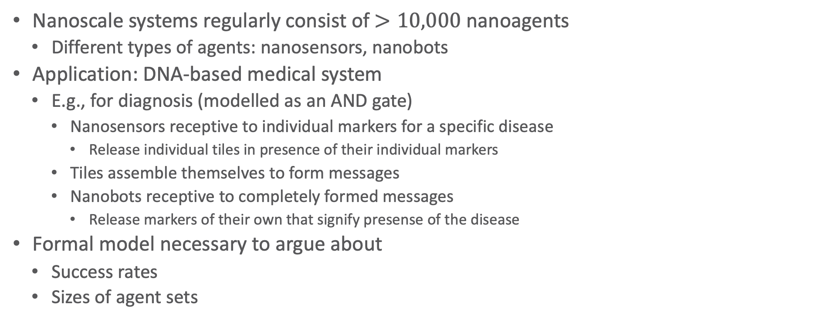
Example: Medical Nanoscale Systems
Nanoscale systems regularly consist of $>10,000$ nanoagents
Different types of agents: nanosensors, nanobots
Application: DNA-based medical system
E.g., for diagnosis (modelled as an AND gate)
Nanosensors receptive to individual markers for a specific disease
Release individual tiles in presence of their individual markers
Tiles assemble themselves to form messages
Nanobots receptive to completely formed messages
Release markers of their own that signify presense of the disease
Formal model necessary to argue about
Success rates
Sizes of agent sets

Slide 5
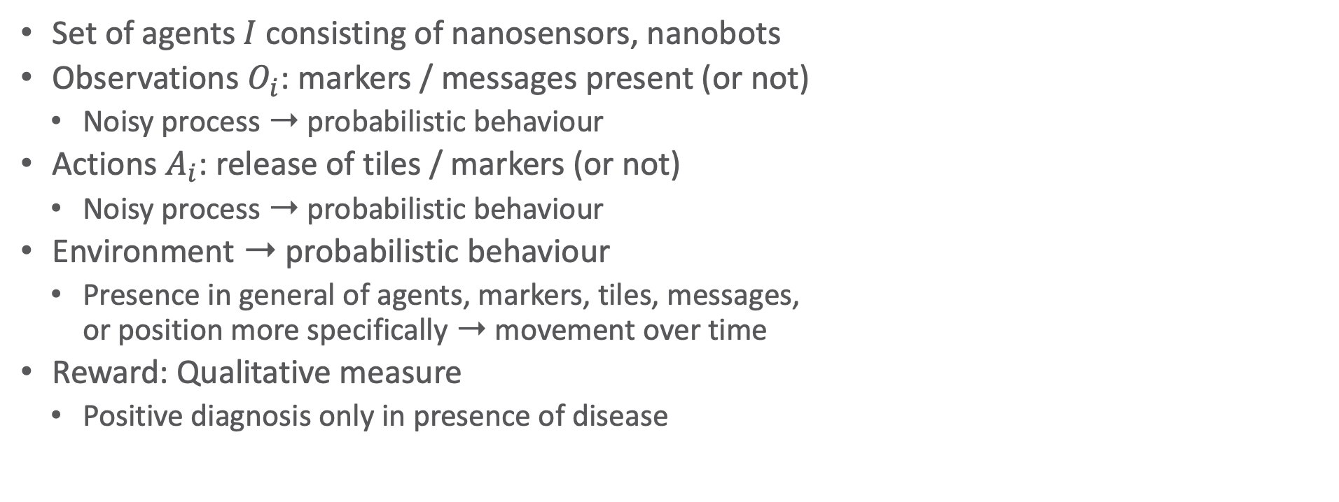
Example: Medical Nanoscale Systems as a DecPOMDP
Set of agents $I$ consisting of nanosensors, nanobots
Observations $O_{i}$: markers / messages present (or not)
Noisy process ➝ probabilistic behaviour
Actions $A_{i}$: release of tiles / markers (or not)
Noisy process ➝ probabilistic behaviour
Environment ➝ probabilistic behaviour
Presence in general of agents, markers, tiles, messages, or position more specifically ➝ movement over time
Reward: Qualitative measure
Positive diagnosis only in presence of disease

Slide 6
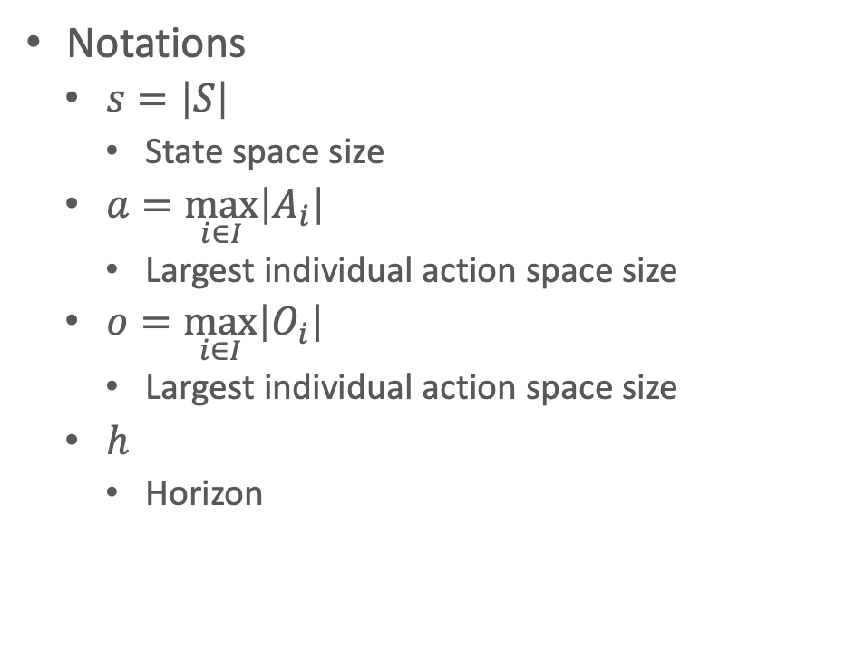
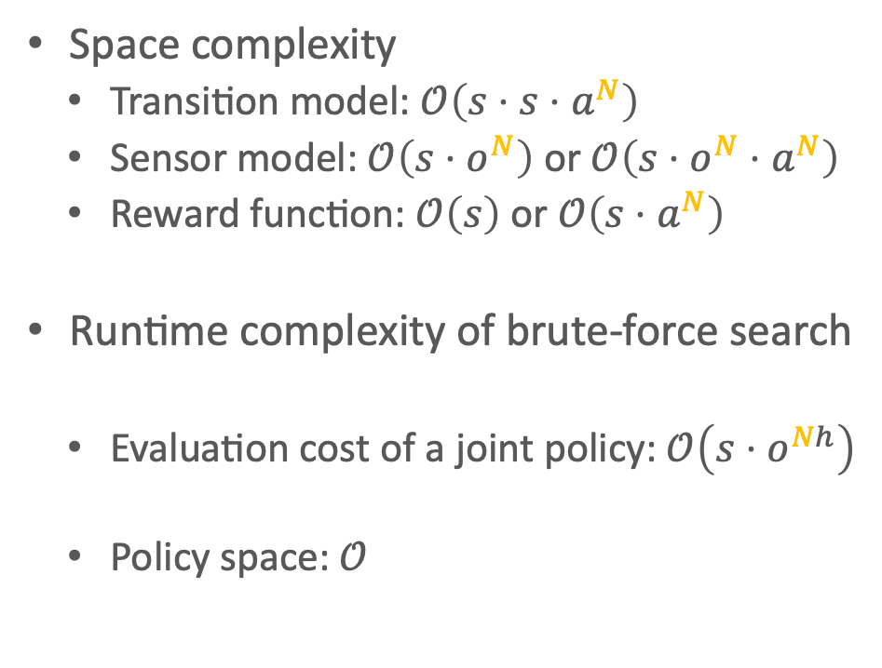

Reprise: Worst-case Complexity of DecPOMDP
Space complexity
Transition model: $𝒪\left(s⋅s⋅a^{N}\right)$
Sensor model: $𝒪\left(s⋅o^{N}\right)$ or $𝒪\left(s⋅o^{N}⋅a^{N}\right)$
Reward function: $𝒪\left(s\right)$ or $𝒪\left(s⋅a^{N}\right)$
Runtime complexity of brute-force search
Evaluation cost of a joint policy: $𝒪\left(s⋅o^{Nh}\right)$
Policy space: $𝒪$
Notations
$s=\left|S\right|$
State space size
$a=\max_{i∈I}\left|A_{i}\right|$
Largest individual action space size
$o=\max_{i∈I}\left|O_{i}\right|$
Largest individual action space size
$h$
Horizon
$$\left(a^{\frac{N\left(o^{h}−1\right)}{o−1}}\right)$$

Slide 7
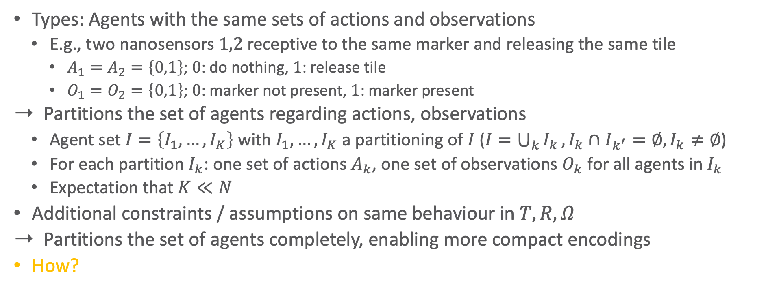
Agent Types & Partitioned DecPOMDPs
Types: Agents with the same sets of actions and observations
E.g., two nanosensors $1,2$ receptive to the same marker and releasing the same tile
$A_{1}=A_{2}=\left\{0,1\right\}$; $0$: do nothing, $1$: release tile
$O_{1}=O_{2}=\left\{0,1\right\}$; $0$: marker not present, $1$: marker present
Partitions the set of agents regarding actions, observations
Agent set $I=\left\{I_{1},…,I_{K}\right\}$ with $I_{1},…,I_{K}$ a partitioning of $I$ ($I=\bigcup_{k}{I_{k}},I_{k}∩I_{k^{′}}=∅,I_{k}≠∅$)
For each partition $I_{k}$: one set of actions $A_{k}$, one set of observations $O_{k}$ for all agents in $I_{k}$
Expectation that $K≪N$
Additional constraints / assumptions on same behaviour in $T,R,Ω$
Partitions the set of agents completely, enabling more compact encodings
How?

Slide 8
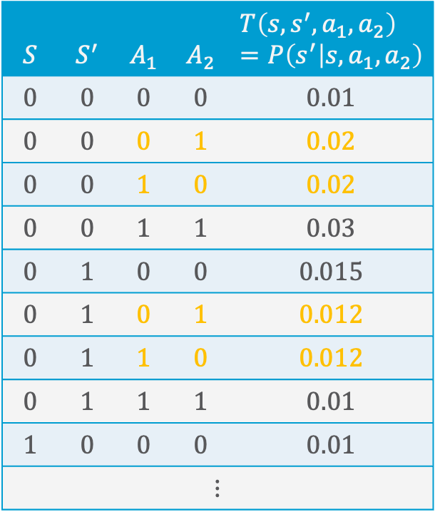

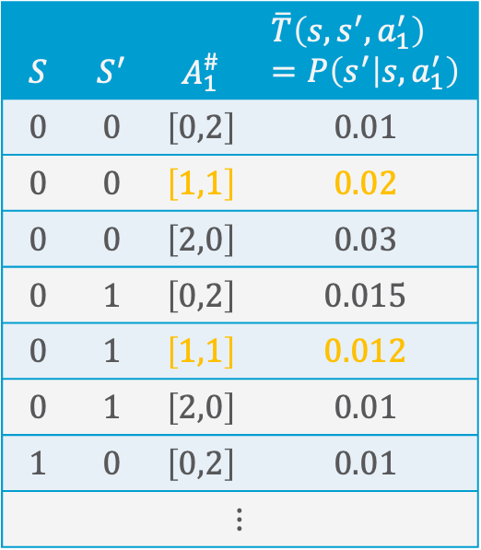
Counting DecPOMDPs
Counting constraint / assumption in $T,R,Ω$
Formal: All permutations $σ\left({\vec{a}}_{k}\right)$ of a partition action ${\vec{a}}_{k}$ map to the same probability
Enables counting how many agents do something and not which in particular did
Encode in a histogram $\left[\#\left(a_{1}\right),…,\#\left(a_{l}\right)\right]$ how many agents did actions $A_{k}=\left\{a_{1},…,a_{l}\right\}$
Number of histograms $\left({\left|I_{k}\right|+l−1 \atop l−1}\right)≤{\left|I_{k}\right|}^{l}$
$$S$$ | $$S^{′}$$ | $$A_{1}$$ | $$A_{2}$$ | $$T\left(s,s^{′}, a_{1},a_{2}\right)=P\left(s^{′} | s,a_{1},a_{2}\right)$$
$$0$$ | $$0$$ | $$0$$ | $$0$$ | $$0.01$$
$$0$$ | $$0$$ | $$0$$ | $$1$$ | $$0.02$$
$$0$$ | $$0$$ | $$1$$ | $$0$$ | $$0.02$$
$$0$$ | $$0$$ | $$1$$ | $$1$$ | $$0.03$$
$$0$$ | $$1$$ | $$0$$ | $$0$$ | $$0.015$$
$$0$$ | $$1$$ | $$0$$ | $$1$$ | $$0.012$$
$$0$$ | $$1$$ | $$1$$ | $$0$$ | $$0.012$$
$$0$$ | $$1$$ | $$1$$ | $$1$$ | $$0.01$$
$$1$$ | $$0$$ | $$0$$ | $$0$$ | $$0.01$$
$$⋮$$
$$S$$ | $$S^{′}$$ | $$A_{1}^{\#}$$ | $$\overline{T}\left(s,s^{′}, a_{1}^{′}\right) \\ =P\left(s^{′} | s,a_{1}^{′}\right)$$
$$0$$ | $$0$$ | $$\left[0,2\right]$$ | $$0.01$$
$$0$$ | $$0$$ | $$\left[1,1\right]$$ | $$0.02$$
$$0$$ | $$0$$ | $$\left[2,0\right]$$ | $$0.03$$
$$0$$ | $$1$$ | $$\left[0,2\right]$$ | $$0.015$$
$$0$$ | $$1$$ | $$\left[1,1\right]$$ | $$0.012$$
$$0$$ | $$1$$ | $$\left[2,0\right]$$ | $$0.01$$
$$1$$ | $$0$$ | $$\left[0,2\right]$$ | $$0.01$$
$$⋮$$

Slide 9
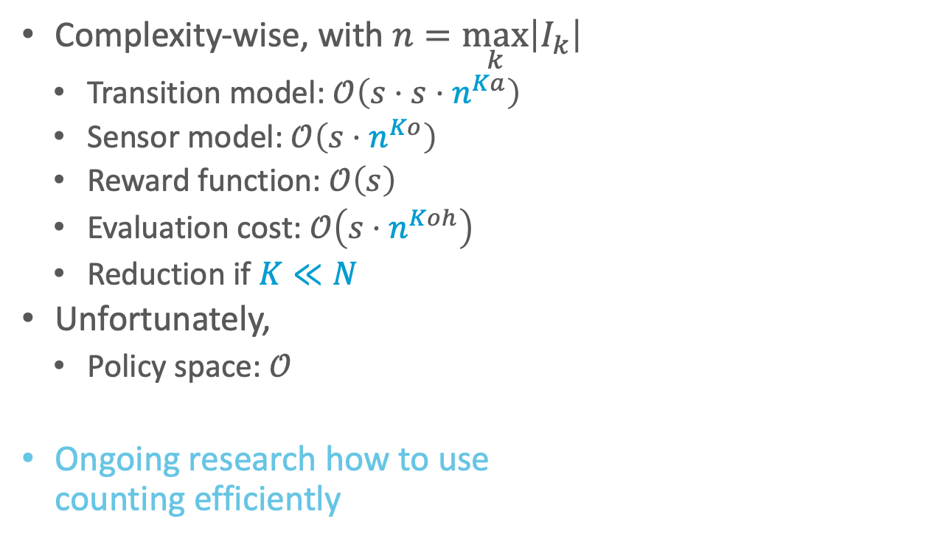

Counting DecPOMDPs
Complexity-wise, with $n=\max_{k}\left|I_{k}\right|$
Transition model: $𝒪\left(s⋅s⋅n^{Ka}\right)$
Sensor model: $𝒪\left(s⋅n^{Ko}\right)$
Reward function: $𝒪\left(s\right)$
Evaluation cost: $𝒪\left(s⋅n^{Koh}\right)$
Reduction if $K≪N$
Unfortunately,
Policy space: $𝒪$
Ongoing research how to use counting efficiently
$$S$$ | $$S^{′}$$ | $$A_{1}$$ | $$A_{2}$$ | $$T\left(s,s^{′}, a_{1},a_{2}\right)=P\left(s^{′} | s,a_{1},a_{2}\right)$$
$$0$$ | $$0$$ | $$0$$ | $$0$$ | $$0.01$$
$$0$$ | $$0$$ | $$0$$ | $$1$$ | $$0.02$$
$$0$$ | $$0$$ | $$1$$ | $$0$$ | $$0.02$$
$$0$$ | $$0$$ | $$1$$ | $$1$$ | $$0.03$$
$$0$$ | $$1$$ | $$0$$ | $$0$$ | $$0.015$$
$$0$$ | $$1$$ | $$0$$ | $$1$$ | $$0.012$$
$$0$$ | $$1$$ | $$1$$ | $$0$$ | $$0.012$$
$$0$$ | $$1$$ | $$1$$ | $$1$$ | $$0.01$$
$$1$$ | $$0$$ | $$0$$ | $$0$$ | $$0.01$$
$$⋮$$
$$S$$ | $$S^{′}$$ | $$A_{1}^{\#}$$ | $$\overline{T}\left(s,s^{′}, a_{1}^{′}\right) \\ =P\left(s^{′} | s,a_{1}^{′}\right)$$
$$0$$ | $$0$$ | $$\left[0,2\right]$$ | $$0.01$$
$$0$$ | $$0$$ | $$\left[1,1\right]$$ | $$0.02$$
$$0$$ | $$0$$ | $$\left[2,0\right]$$ | $$0.03$$
$$0$$ | $$1$$ | $$\left[0,2\right]$$ | $$0.015$$
$$0$$ | $$1$$ | $$\left[1,1\right]$$ | $$0.012$$
$$0$$ | $$1$$ | $$\left[2,0\right]$$ | $$0.01$$
$$1$$ | $$0$$ | $$\left[0,2\right]$$ | $$0.01$$
$$⋮$$
$$\left(n^{\frac{aK\left(n^{ho}−1\right)}{n^{o}−1}}\right)$$

Slide 10
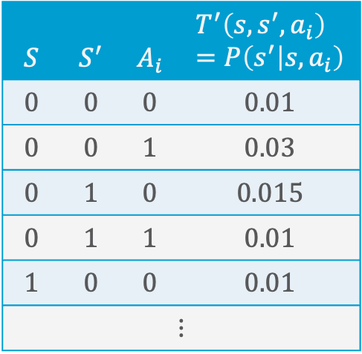
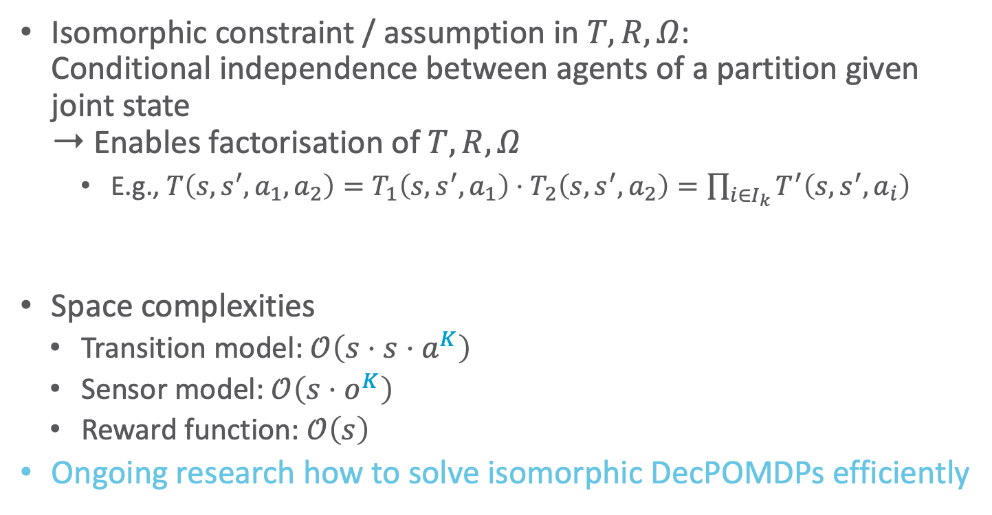

Ismorphic DecPOMDPs
Isomorphic constraint / assumption in $T,R,Ω$: Conditional independence between agents of a partition given joint state ➝ Enables factorisation of $T,R,Ω$
E.g., $T\left(s,s^{′}, a_{1},a_{2}\right)=T_{1}\left(s,s^{′}, a_{1}\right)⋅T_{2}\left(s,s^{′}, a_{2}\right)=\prod_{i∈I_{k}}{T^{′}\left(s,s^{′}, a_{i}\right)}$
Space complexities
Transition model: $𝒪\left(s⋅s⋅a^{K}\right)$
Sensor model: $𝒪\left(s⋅o^{K}\right)$
Reward function: $𝒪\left(s\right)$
Ongoing research how to solve isomorphic DecPOMDPs efficiently
$$S$$ | $$S^{′}$$ | $$A_{i}$$ | $$T^{′}\left(s,s^{′}, a_{i}\right) \\ =P\left(s^{′} | s,a_{i}\right)$$
$$0$$ | $$0$$ | $$0$$ | $$0.01$$
$$0$$ | $$0$$ | $$1$$ | $$0.03$$
$$0$$ | $$1$$ | $$0$$ | $$0.015$$
$$0$$ | $$1$$ | $$1$$ | $$0.01$$
$$1$$ | $$0$$ | $$0$$ | $$0.01$$
$$⋮$$
$$T_{1}=T_{2}=T^{′}$$

Slide 11
Interim Summary: Structure by Groups in the Agent Set
Types of agents with identical action and observation space
Partitioned DecPOMDP if agent types + constraints of transition / sensor / reward function
Counting DecPOMDP
Permutations of actions of agents of the same partition map to the same probability / reward
Count occurrences ➝ encode in histograms
Isomorphic DecPOMDP
Further independences between agents of a partition
Space complexity polynomial at worst but using compact encoding for efficient decision making not yet solved

Slide 12
Outline: Decision Making – Structure
Structure by Groups in the Agent Set
Agent types
Partitioned decPOMDPs
Structure by Features in the State Space
Dynamic Bayesian networks
Factored MDPs
Structure by Relations in the State Space
Situation calculus
First-order MDPs

Slide 13
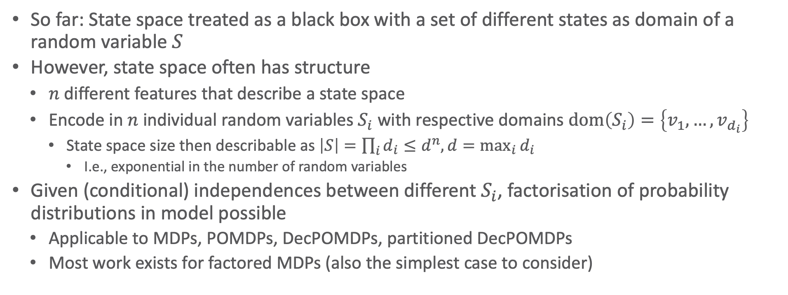
State Space
So far: State space treated as a black box with a set of different states as domain of a random variable $S$
However, state space often has structure
$n$ different features that describe a state space
Encode in $n$ individual random variables $S_{i}$ with respective domains $dom\left(S_{i}\right)=\left\{v_{1}, …,v_{d_{i}}\right\}$
State space size then describable as $\left|S\right|=\prod_{i}{d_{i}}≤d^{n}, d=\max_{i}{d_{i}}$
I.e., exponential in the number of random variables
Given (conditional) independences between different $S_{i}$, factorisation of probability distributions in model possible
Applicable to MDPs, POMDPs, DecPOMDPs, partitioned DecPOMDPs
Most work exists for factored MDPs (also the simplest case to consider)

Slide 14
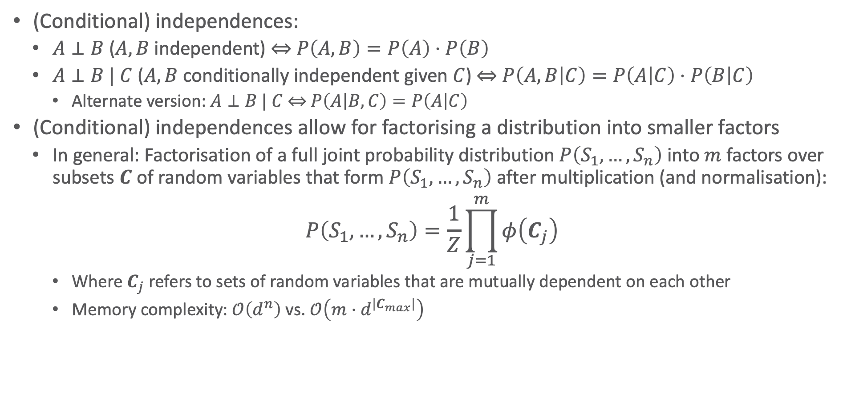
Factorisation in General
(Conditional) independences:
$A⊥B$ ($A,B$ independent) ⇔ $P\left(A,B\right)=P\left(A\right)⋅P\left(B\right)$
$A⊥B | C$ ($A,B$ conditionally independent given $C$) ⇔ $P\left(A,B | C\right)=P\left(A | C\right)⋅P\left(B | C\right)$
Alternate version: $A⊥B | C \text{⇔} P\left(A | B,C\right)=P\left(A | C\right)$
(Conditional) independences allow for factorising a distribution into smaller factors
In general: Factorisation of a full joint probability distribution $P\left(S_{1},…, S_{n}\right)$ into $m$ factors over subsets $C$ of random variables that form $P\left(S_{1},…, S_{n}\right)$ after multiplication (and normalisation):
$$P\left(S_{1},…, S_{n}\right)=\frac{1}{Z}\prod_{j=1}^{m}{φ\left(C_{j}\right)}$$
Where $C_{j}$ refers to sets of random variables that are mutually dependent on each other
Memory complexity: $𝒪\left(d^{n}\right)$ vs. $𝒪\left(m⋅d^{\left|C_{max}\right|}\right)$

Slide 15

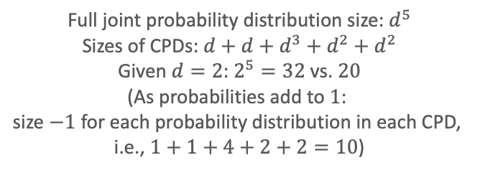



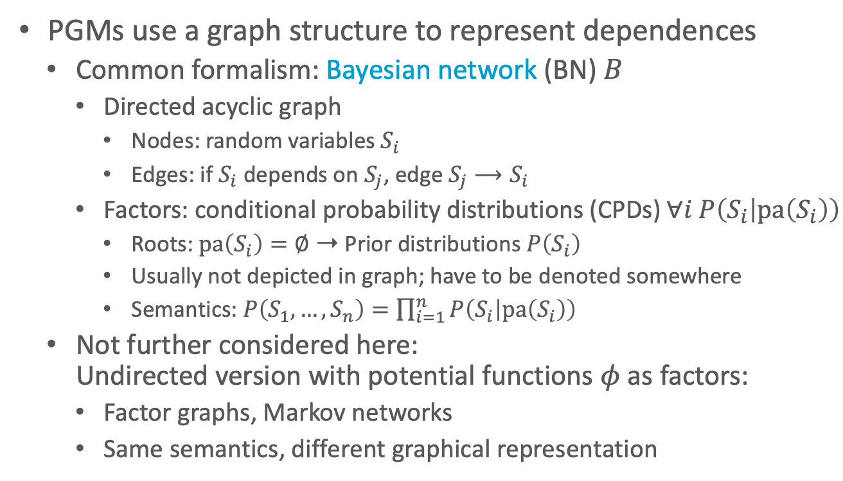






Probabilistic Graphical Models (PGMs)
PGMs use a graph structure to represent dependences
Common formalism: Bayesian network (BN) $B$
Directed acyclic graph
Nodes: random variables $S_{i}$
Edges: if $S_{i}$ depends on $S_{j}$, edge $S_{j}⟶S_{i}$
Factors: conditional probability distributions (CPDs) $∀i P\left(S_{i} | pa\left(S_{i}\right)\right)$
Roots: $pa\left(S_{i}\right)=∅$ ➝ Prior distributions $P\left(S_{i}\right)$
Usually not depicted in graph; have to be denoted somewhere
Semantics: $P\left(S_{1},…,S_{n}\right)=\prod_{i=1}^{n}{P\left(S_{i} | pa\left(S_{i}\right)\right)}$
Not further considered here: Undirected version with potential functions $φ$ as factors:
Factor graphs, Markov networks
Same semantics, different graphical representation
$$P\left(Burglary\right)$$
$$P\left(Earthquake\right)$$
$$Burglary$$
$$Earthquake$$
$$P\left(Alarm | Burglary,Earthquake\right)$$
$$Alarm$$
$$JohnCall$$
$$MaryCall$$
$$P\left(JohnCall | Alarm\right)$$
$$P\left(MaryCall | Alarm\right)$$
Full joint probability distribution size: $d^{5}$
Sizes of CPDs: $d+d+d^{3}+d^{2}+d^{2}$
Given $d=2$: $2^{5}=32$ vs. $20$
(As probabilities add to $1$: size $−1$ for each probability distribution in each CPD, i.e., $1+1+4+2+2=10$)

Slide 16
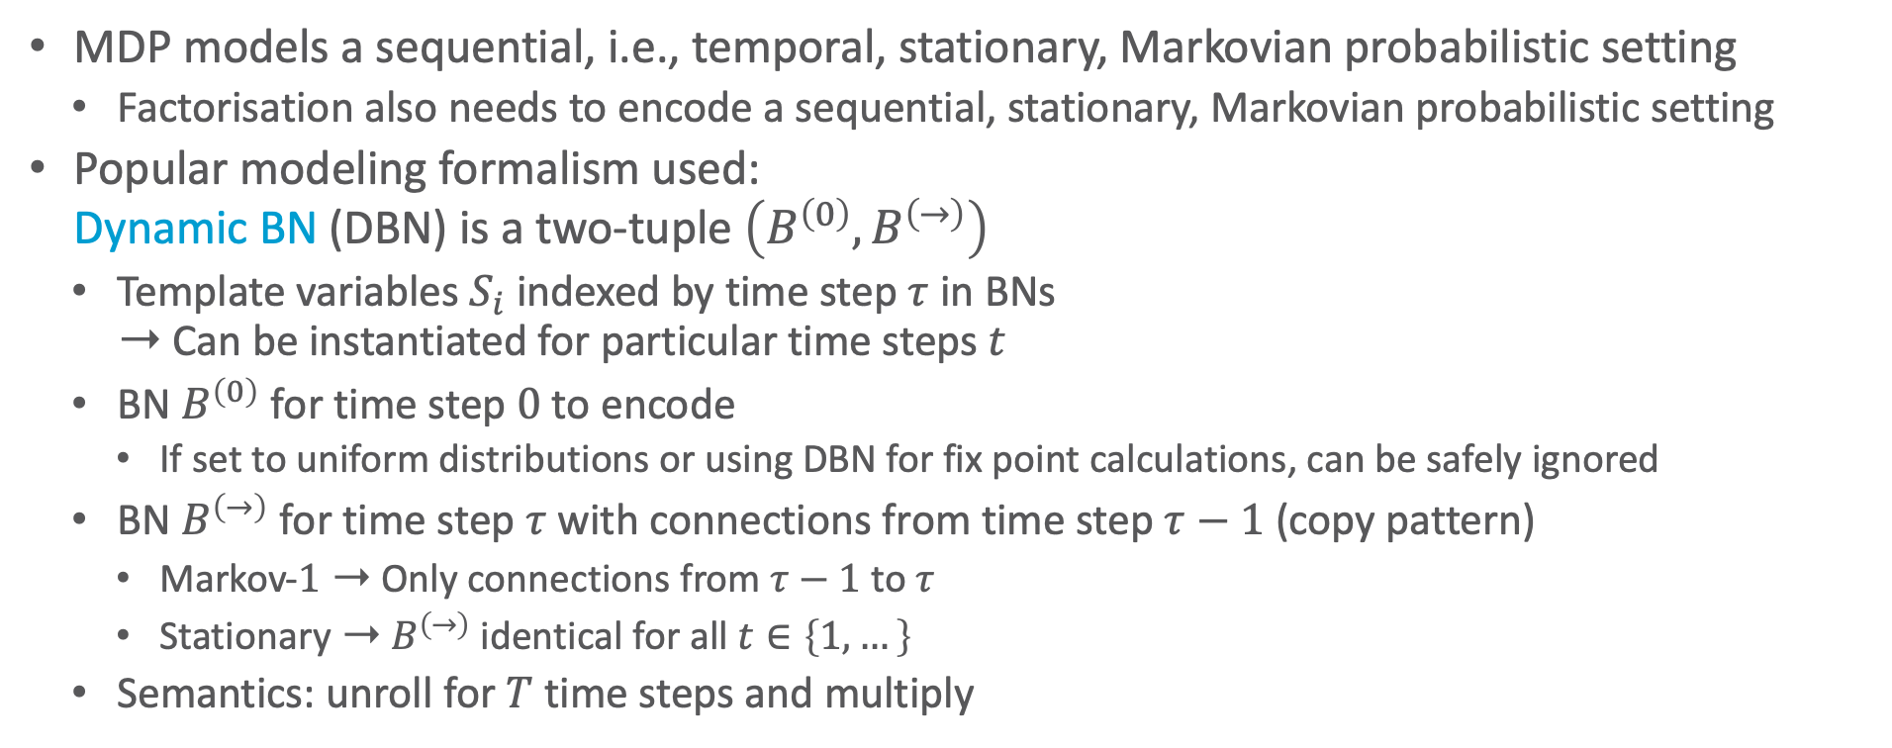
Dynamic Bayesian Networks
MDP models a sequential, i.e., temporal, stationary, Markovian probabilistic setting
Factorisation also needs to encode a sequential, stationary, Markovian probabilistic setting
Popular modeling formalism used: Dynamic BN (DBN) is a two-tuple $\left(B^{\left(0\right)},B^{\left(→\right)}\right)$
Template variables $S_{i}$ indexed by time step $τ$ in BNs ➝ Can be instantiated for particular time steps $t$
BN $B^{\left(0\right)}$ for time step $0$ to encode
If set to uniform distributions or using DBN for fix point calculations, can be safely ignored
BN $B^{\left(→\right)}$ for time step $τ$ with connections from time step $τ−1$ (copy pattern)
Markov-$1$ ➝ Only connections from $τ−1$ to $τ$
Stationary ➝ $B^{\left(→\right)}$ identical for all $t∈\left\{1,…\right\}$
Semantics: unroll for $T$ time steps and multiply

Slide 17













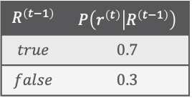







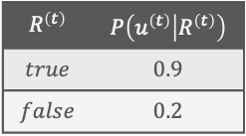









Dynamic Bayesian Networks: Example
Left: vehicle localization task, where a moving car tries to track its current location using the data obtained from a, possibly faulty, sensor
Right: Toy example of a special case of a DBN with one latent and one observable variable (hidden Markov model, HMM)
$${Weather}^{\left(0\right)}$$
$${Weather}^{\left(τ−1\right)}$$
$${Weather}^{\left(τ\right)}$$
$$P\left(W^{\left(0\right)}\right)$$
$$P\left(W^{\left(τ\right)} | W^{\left(τ−1\right)}\right)$$
$${Rain}^{\left(0\right)}$$
$$P\left(r^{\left(0\right)}\right)$$
$$0.5$$
$${Velocity}^{\left(0\right)}$$
$${Velocity}^{\left(τ−1\right)}$$
$${Velocity}^{\left(τ\right)}$$
$$P\left(V^{\left(0\right)}\right)$$
$$P\left(V^{\left(τ\right)} | W^{\left(τ−1\right)},V^{\left(τ−1\right)}\right)$$
$${Rain}^{\left(τ−1\right)}$$
$${Rain}^{\left(τ\right)}$$
$${Location}^{\left(0\right)}$$
$${Location}^{\left(τ−1\right)}$$
$${Location}^{\left(τ\right)}$$
$$P\left(L^{\left(0\right)}\right)$$
$$P\left(L^{\left(τ\right)} | V^{\left(τ−1\right)},L^{\left(τ−1\right)}\right)$$
$${Umbrella}^{\left(τ\right)}$$
$${Failure}^{\left(0\right)}$$
$${Failure}^{\left(τ−1\right)}$$
$${Failure}^{\left(τ\right)}$$
$$P\left(F^{\left(0\right)}\right)$$
$$P\left(F^{\left(τ\right)} | W^{\left(τ−1\right)},F^{\left(τ−1\right)}\right)$$
$$R^{\left(t−1\right)}$$ | $$P\left(r^{\left(t\right)} | R^{\left(t−1\right)}\right)$$
$$true$$ | $$0.7$$
$$false$$ | $$0.3$$
$$R^{\left(t\right)}$$ | $$P\left(u^{\left(t\right)} | R^{\left(t\right)}\right)$$
$$true$$ | $$0.9$$
$$false$$ | $$0.2$$
$${Obs}^{\left(0\right)}$$
$${Obs}^{\left(τ\right)}$$
$$P\left(O^{\left(0\right)} | L^{\left(0\right)},F^{\left(0\right)}\right)$$
$$P\left(O^{\left(τ\right)} | L^{\left(τ\right)},F^{\left(τ\right)}\right)$$

Slide 18
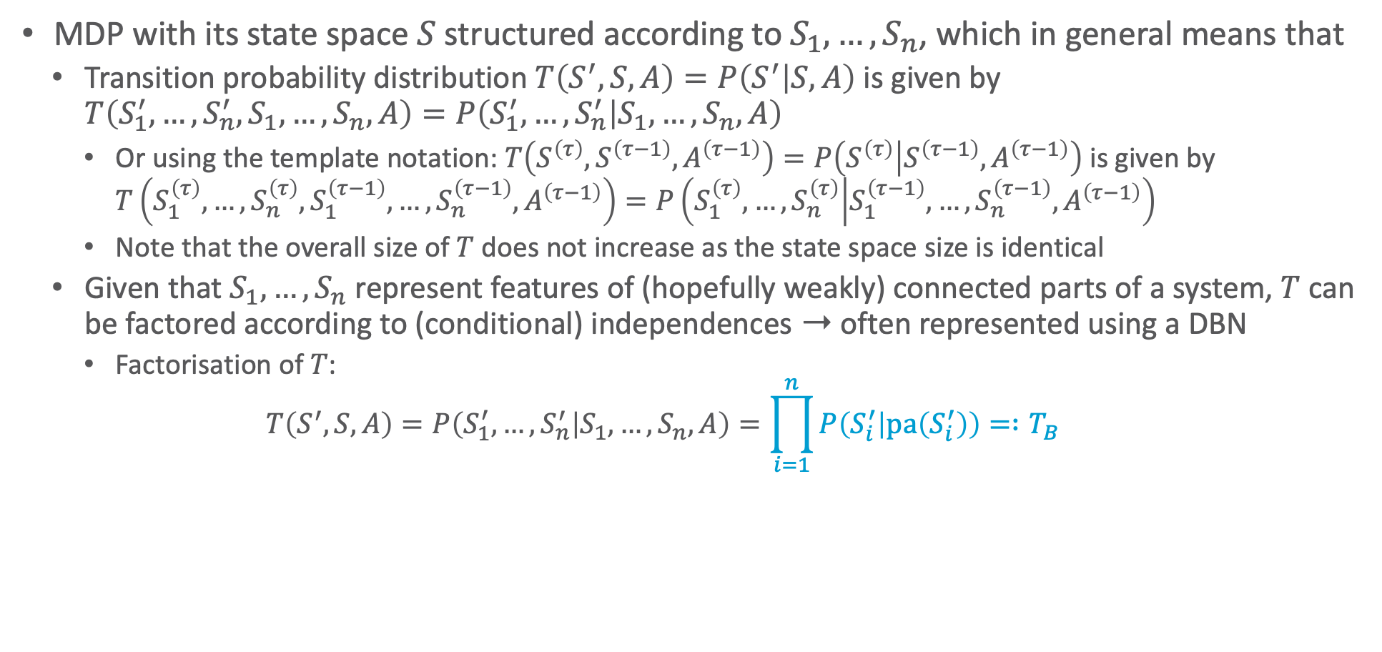
Factored MDPs
MDP with its state space $S$ structured according to $S_{1},…,S_{n}$, which in general means that
Transition probability distribution $T\left(S^{′},S,A\right)=P\left(S^{′} | S,A\right)$ is given by $T\left(S_{1}^{′},…,S_{n}^{′},S_{1},…,S_{n},A\right)=P\left(S_{1}^{′},…,S_{n}^{′} | S_{1},…,S_{n},A\right)$
Or using the template notation: $T\left(S^{\left(τ\right)},S^{\left(τ−1\right)},A^{\left(τ−1\right)}\right)=P\left(S^{\left(τ\right)} | S^{\left(τ−1\right)},A^{\left(τ−1\right)}\right)$ is given by $T\left(S_{1}^{\left(τ\right)},…,S_{n}^{\left(τ\right)},S_{1}^{\left(τ−1\right)},…,S_{n}^{\left(τ−1\right)},A^{\left(τ−1\right)}\right)=P\left(S_{1}^{\left(τ\right)},…,S_{n}^{\left(τ\right)} | S_{1}^{\left(τ−1\right)},…,S_{n}^{\left(τ−1\right)},A^{\left(τ−1\right)}\right)$
Note that the overall size of $T$ does not increase as the state space size is identical
Given that $S_{1},…,S_{n}$ represent features of (hopefully weakly) connected parts of a system, $T$ can be factored according to (conditional) independences ➝ often represented using a DBN
Factorisation of $T$:
$$T\left(S^{′},S,A\right)=P\left(S_{1}^{′},…,S_{n}^{′} | S_{1},…,S_{n},A\right)=\prod_{i=1}^{n}{P\left(S_{i}^{′} | pa\left(S_{i}^{′}\right)\right)}= :T_{B}$$

Slide 19
Factored MDPs: Actions and Rewards
To be correct, the DBN just described is a standard DBN extended with random variable nodes for actions, whose assignment we want to determine, and reward nodes to denote that a reward function outputs a reward depending on the state (and action)
BN extended with so-called decision and utility nodes called influence or decision diagram
Side note: Since the state in MDPs is fully observable, every random variable in a DBN is observable, which is not the general case for DBNs, where usually there is a set of latent variables, which are never observed and as such often queried, and a set of evidence variables, which are usually observed (save for sensor failures).

Slide 20
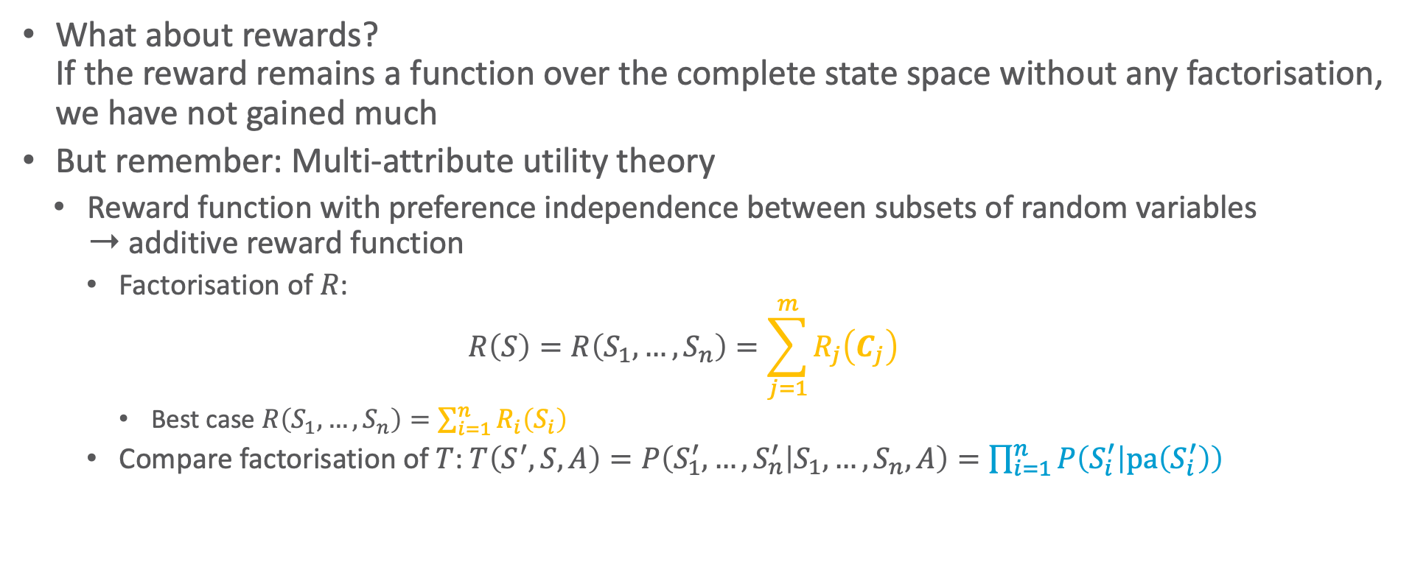
Factored MDPs: Actions and Rewards
What about rewards? If the reward remains a function over the complete state space without any factorisation, we have not gained much
But remember: Multi-attribute utility theory
Reward function with preference independence between subsets of random variables ➝ additive reward function
Factorisation of $R$:
$$R\left(S\right)=R\left(S_{1},…,S_{n}\right)=\sum_{j=1}^{m}{R_{j}\left(C_{j}\right)}$$
Best case $R\left(S_{1},…,S_{n}\right)=\sum_{i=1}^{n}{R_{i}\left(S_{i}\right)}$
Compare factorisation of $T$: $T\left(S^{′},S,A\right)=P\left(S_{1}^{′},…,S_{n}^{′} | S_{1},…,S_{n},A\right)=\prod_{i=1}^{n}{P\left(S_{i}^{′} | pa\left(S_{i}^{′}\right)\right)}$

Slide 21
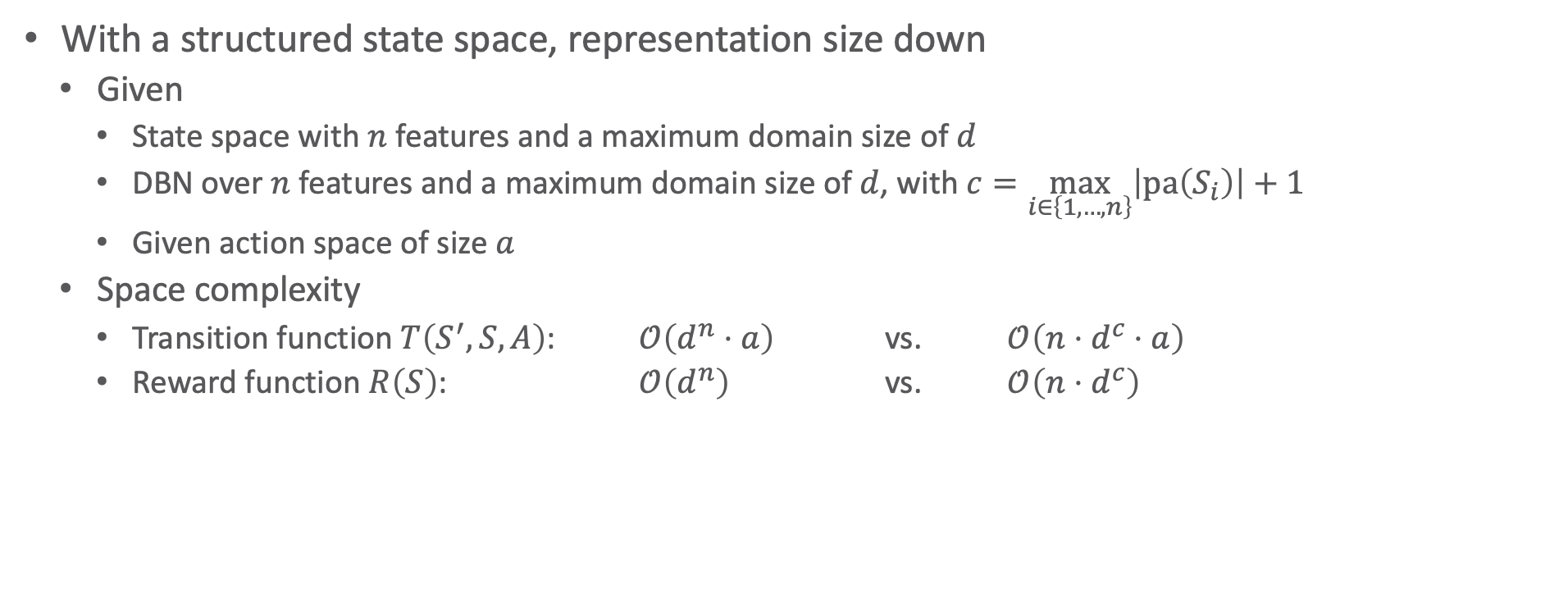
Factored MDPs: Space Complexity
With a structured state space, representation size down
Given
State space with $n$ features and a maximum domain size of $d$
DBN over $n$ features and a maximum domain size of $d$, with $c=\max_{i∈\left\{1,…,n\right\}}\left|pa\left(S_{i}\right)\right|+1$
Given action space of size $a$
Space complexity
Transition function $T\left(S^{′}, S,A\right)$: $𝒪\left(d^{n}⋅a\right)$ vs. $𝒪\left(n⋅d^{c}⋅a\right)$
Reward function $R\left(S\right)$: $𝒪\left(d^{n}\right)$ vs. $𝒪\left(n⋅d^{c}\right)$

Slide 22
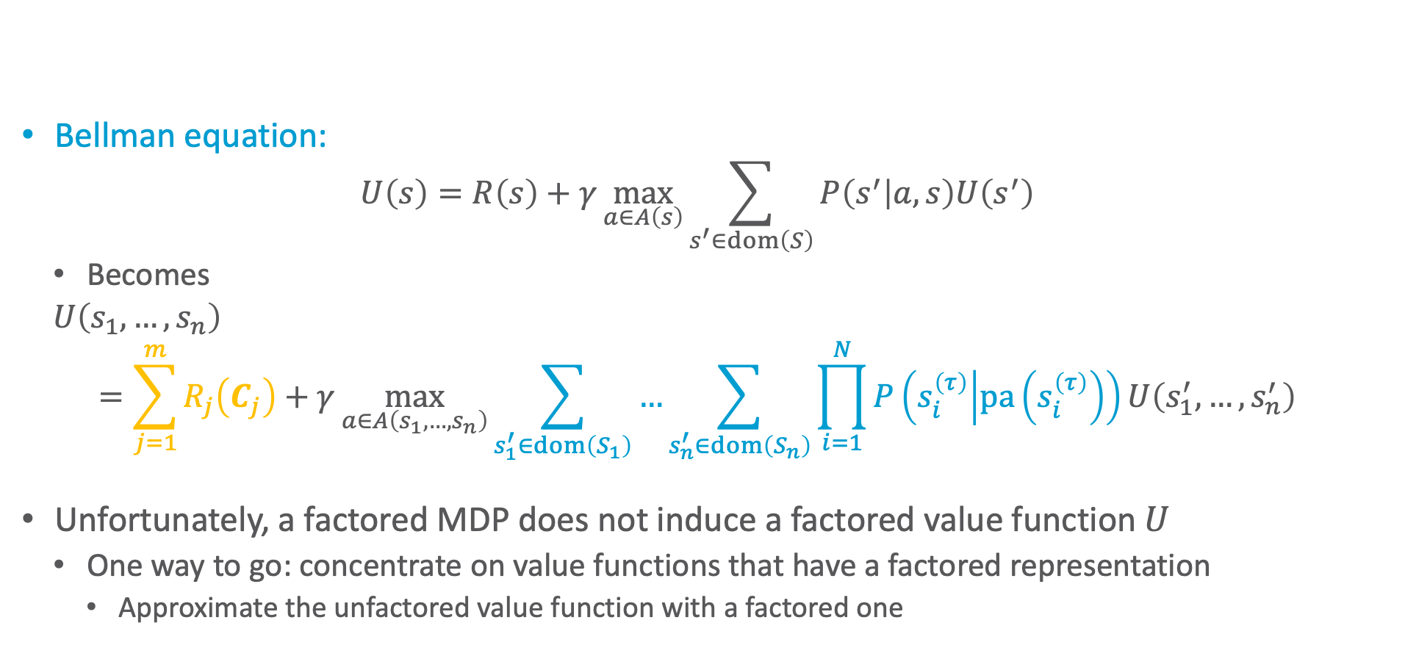
Solving Factored MDPs
Bellman equation:
$$U\left(s\right)=R\left(s\right)+γ\max_{a∈A\left(s\right)}{\sum_{s^{′}∈dom\left(S\right)}{P\left(s^{′} | a,s\right)U\left(s^{′}\right)}}$$
Becomes
$U\left(s_{1},…,s_{n}\right)$ $$=\sum_{j=1}^{m}{R_{j}\left(C_{j}\right)}+γ\max_{a∈A\left(s_{1},…,s_{n}\right)}{\sum_{s_{1}^{′}∈dom\left(S_{1}\right)}{…\sum_{s_{n}^{′}∈dom\left(S_{n}\right)}{\prod_{i=1}^{N}{P\left(s_{i}^{\left(τ\right)} | pa\left(s_{i}^{\left(τ\right)}\right)\right)U\left(s_{1}^{′},…,s_{n}^{′}\right)}}}}$$
Unfortunately, a factored MDP does not induce a factored value function $U$
One way to go: concentrate on value functions that have a factored representation
Approximate the unfactored value function with a factored one

Slide 23
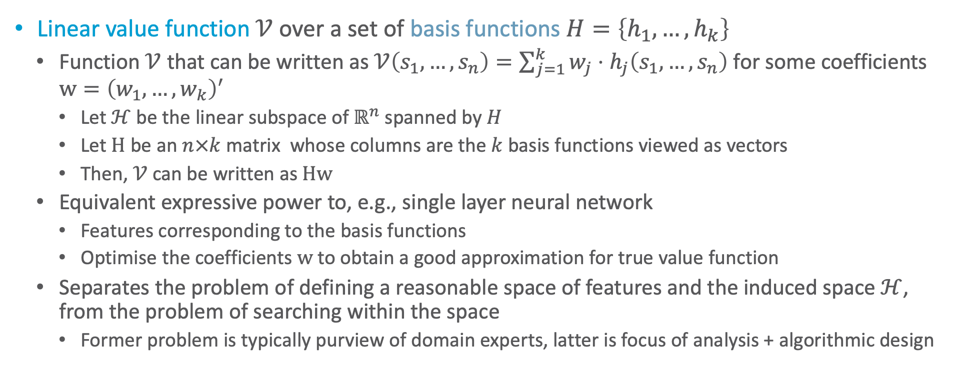
Linear Value Functions
Linear value function $𝒱$ over a set of basis functions $H=\left\{h_{1},…, h_{k}\right\}$
Function $𝒱$ that can be written as $𝒱\left(s_{1},…,s_{n}\right)=\sum_{j=1}^{k}{w_{j}⋅h_{j}\left(s_{1},…,s_{n}\right)}$ for some coefficients $w={\left(w_{1},…,w_{k}\right)}^{′}$
Let $ℋ$ be the linear subspace of $ℝ^{n}$ spanned by $H$
Let $H$ be an $n×k$ matrix whose columns are the $k$ basis functions viewed as vectors
Then, $𝒱$ can be written as $Hw$
Equivalent expressive power to, e.g., single layer neural network
Features corresponding to the basis functions
Optimise the coefficients $w$ to obtain a good approximation for true value function
Separates the problem of defining a reasonable space of features and the induced space $ℋ$, from the problem of searching within the space
Former problem is typically purview of domain experts, latter is focus of analysis + algorithmic design
Carlos Guestrin, Daphne Koller, Ronald Parr, and Shobha Venkataraman: Efficient Solution Algorithms for Factored MDPs. In Journal of Artificial Intelligence Research, 2003.
Notes:
So far, h over whole state space; we will make that over subsets in a few slides

Slide 24
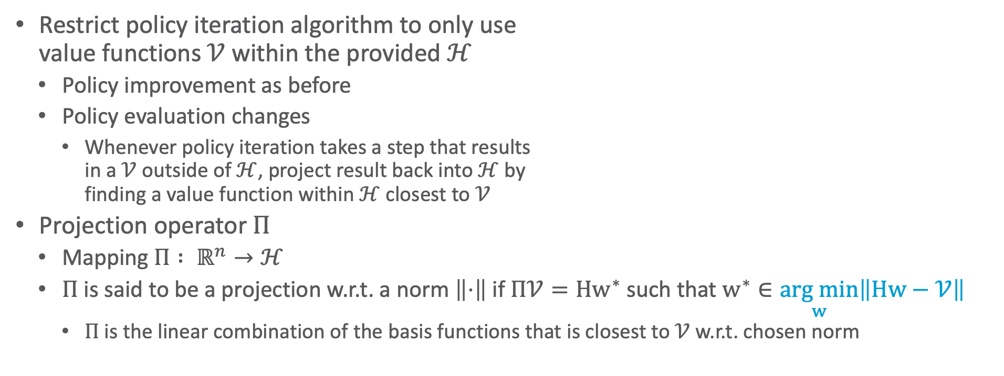
Approximate Policy Iteration with Linear Value Functions
Restrict policy iteration algorithm to only use value functions $𝒱$ within the provided $ℋ$
Policy improvement as before
Policy evaluation changes
Whenever policy iteration takes a step that results in a $𝒱$ outside of $ℋ$, project result back into $ℋ$ by finding a value function within $ℋ$ closest to $𝒱$
Projection operator $Π$
Mapping $Π : ℝ^{n}→ℋ$
$Π$ is said to be a projection w.r.t. a norm $\left\|⋅\right\|$ if $Π𝒱=Hw^{∗}$ such that $w^{∗}∈\underset{w}{arg min}\left\|Hw−𝒱\right\|$
$Π$ is the linear combination of the basis functions that is closest to $𝒱$ w.r.t. chosen norm
Carlos Guestrin, Daphne Koller, Ronald Parr, and Shobha Venkataraman: Efficient Solution Algorithms for Factored MDPs. In Journal of Artificial Intelligence Research, 2003.

Slide 25
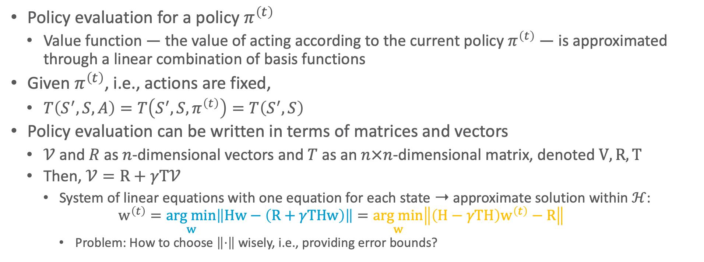
Approximate Policy Iteration with Linear Value Functions
Policy evaluation for a policy $π^{\left(t\right)}$
Value function — the value of acting according to the current policy $π^{\left(t\right)}$ — is approximated through a linear combination of basis functions
Given $π^{\left(t\right)}$, i.e., actions are fixed,
$T\left(S^{′}, S,A\right)=T\left(S^{′}, S,π^{\left(t\right)}\right)=T\left(S^{′}, S\right)$
Policy evaluation can be written in terms of matrices and vectors
$𝒱$ and $R$ as $n$-dimensional vectors and $T$ as an $n×n$-dimensional matrix, denoted $V,R,T$
Then, $𝒱=R+γT𝒱$
System of linear equations with one equation for each state ➝ approximate solution within $ℋ$:
$$w^{\left(t\right)}=\underset{w}{arg min}\left\|Hw−\left(R+γTHw\right)\right\|=\underset{w}{arg min}\left\|\left(H−γTH\right)w^{\left(t\right)}−R\right\|$$
Problem: How to choose $\left\|⋅\right\|$ wisely, i.e., providing error bounds?

Slide 26
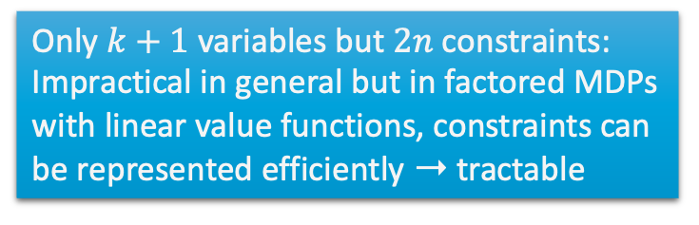
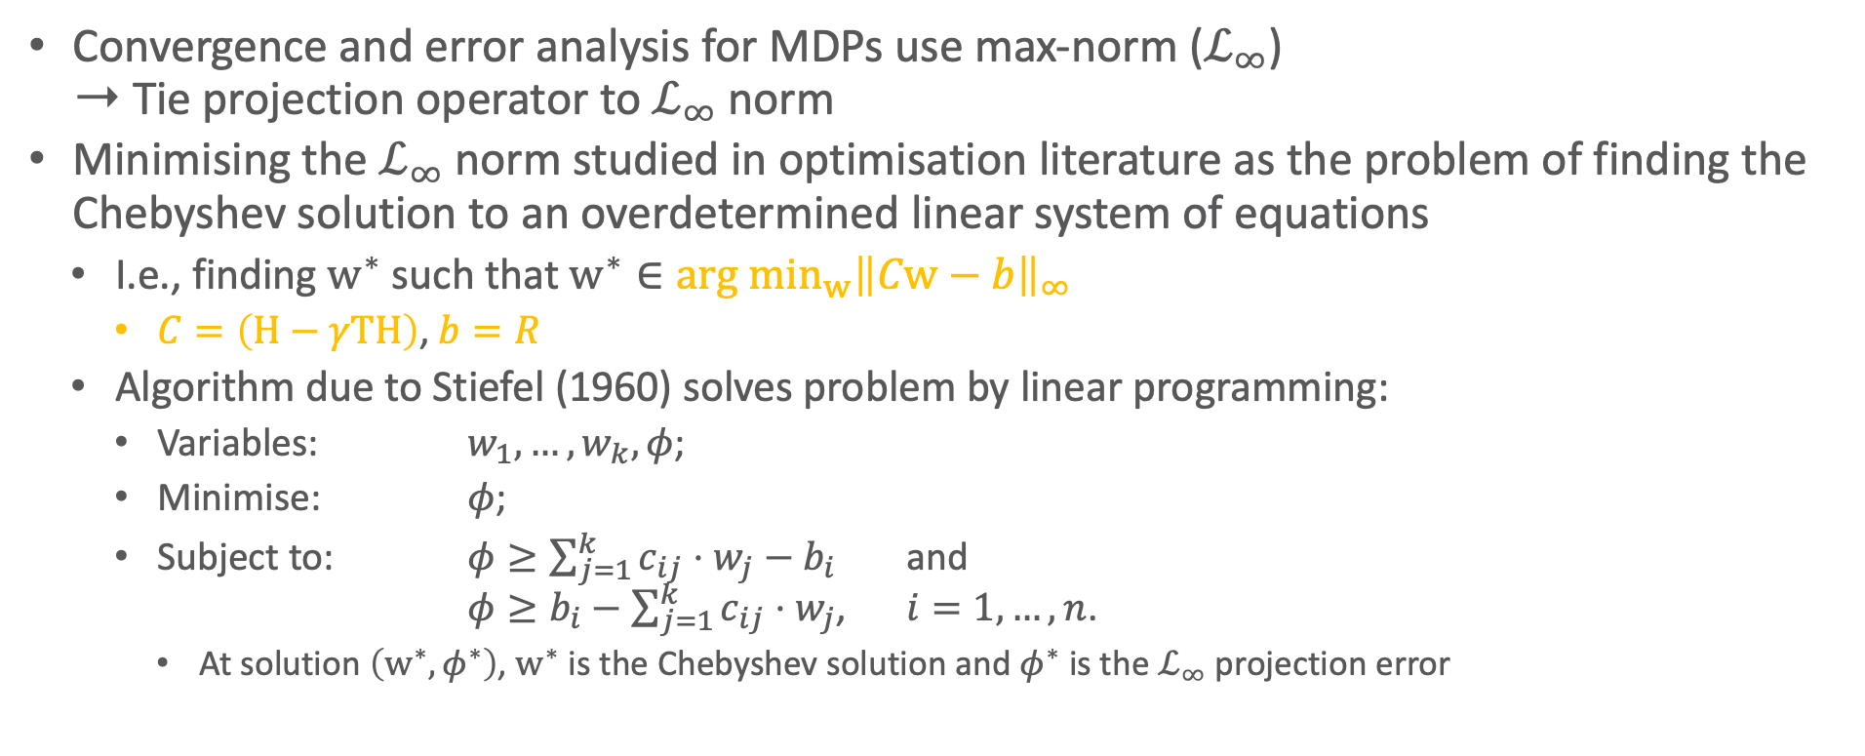
Approximate Policy Iteration with Linear Value Functions
Convergence and error analysis for MDPs use max-norm ($ℒ_{∞}$) ➝ Tie projection operator to $ℒ_{∞}$ norm
Minimising the $ℒ_{∞}$ norm studied in optimisation literature as the problem of finding the Chebyshev solution to an overdetermined linear system of equations
I.e., finding $w^{∗}$ such that $w^{∗}∈{arg min}_{w}{{\left\|Cw−b\right\|}_{∞}}$
$C=\left(H−γTH\right)$, $b=R$
Algorithm due to Stiefel (1960) solves problem by linear programming:
Variables: $w_{1},…,w_{k},φ$;
Minimise: $φ$;
Subject to: $φ≥\sum_{j=1}^{k}{c_{ij}⋅w_{j}−b_{i}}$ and $φ≥b_{i}−\sum_{j=1}^{k}{c_{ij}⋅w_{j}}$, $i=1,…,n$.
At solution $\left(w^{∗},φ^{∗}\right)$, $w^{∗}$ is the Chebyshev solution and $φ^{∗}$ is the $ℒ_{∞}$ projection error
Only $k+1$ variables but $2n$ constraints:
Impractical in general but in factored MDPs with linear value functions, constraints can be represented efficiently ➝ tractable

Slide 27
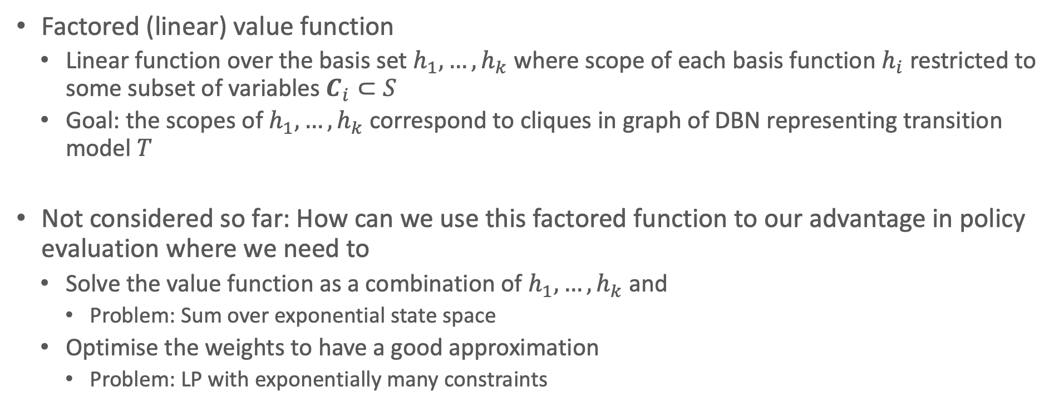
Factored Value Functions
Factored (linear) value function
Linear function over the basis set $h_{1},…,h_{k}$ where scope of each basis function $h_{i}$ restricted to some subset of variables $C_{i}⊂S$
Goal: the scopes of $h_{1},…,h_{k}$ correspond to cliques in graph of DBN representing transition model $T$
Not considered so far: How can we use this factored function to our advantage in policy evaluation where we need to
Solve the value function as a combination of $h_{1},…,h_{k}$ and
Problem: Sum over exponential state space
Optimise the weights to have a good approximation
Problem: LP with exponentially many constraints

Slide 28
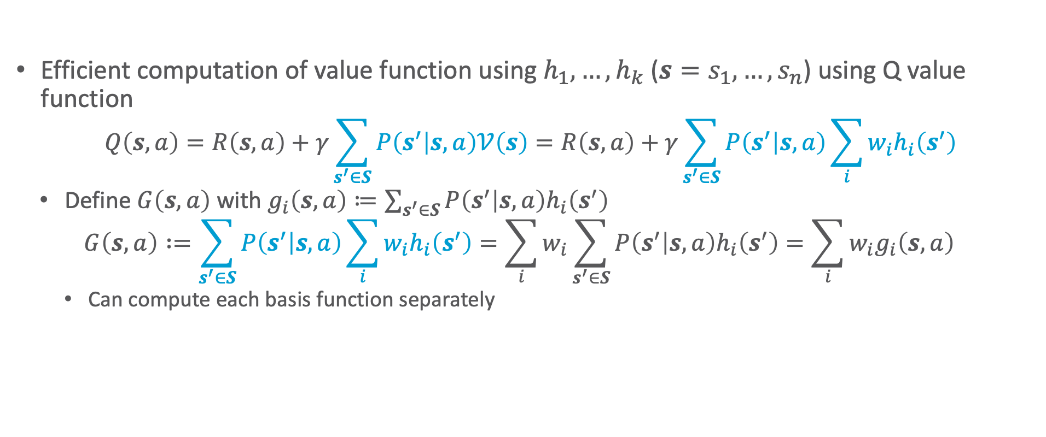
Factored Value Functions: Use in Q Value Function
Efficient computation of value function using $h_{1},…,h_{k}$ ($s=s_{1},…,s_{n}$) using Q value function
$$Q\left(s,a\right)=R\left(s,a\right)+γ\sum_{s^{′}∈S}{P\left(s^{′} | s,a\right)𝒱\left(s\right)}=R\left(s,a\right)+γ\sum_{s^{′}∈S}{P\left(s^{′} | s,a\right)\sum_{i}{w_{i}h_{i}\left(s^{′}\right)}}$$
Define $G\left(s,a\right)$ with $g_{i}\left(s,a\right)≔\sum_{s^{′}∈S}{P\left(s^{′} | s,a\right)h_{i}\left(s^{′}\right)}$
$$G\left(s,a\right) :=\sum_{s^{′}∈S}{P\left(s^{′} | s,a\right)\sum_{i}{w_{i}h_{i}\left(s^{′}\right)}}=\sum_{i}{w_{i}\sum_{s^{′}∈S}{P\left(s^{′} | s,a\right)h_{i}\left(s^{′}\right)}}=\sum_{i}{w_{i}g_{i}\left(s,a\right)}$$
Can compute each basis function separately

Slide 29

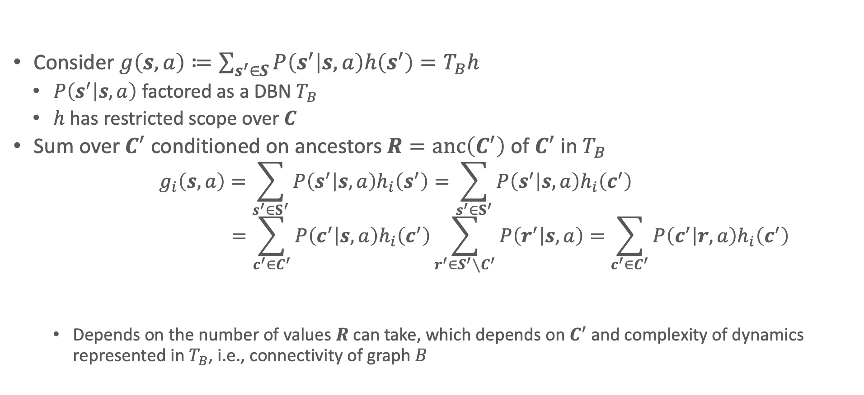
Factored Value Functions: Use in Q Value Function
Consider $g\left(s,a\right)≔\sum_{s^{′}∈S}{P\left(s^{′} | s,a\right)h\left(s^{′}\right)}=T_{B}h$
$P\left(s^{′} | s,a\right)$ factored as a DBN $T_{B}$
$h$ has restricted scope over $C$
Sum over $C^{′}$ conditioned on ancestors $R=anc\left(C^{′}\right)$ of $C^{′}$ in $T_{B}$
$$g_{i}\left(s,a\right)=\sum_{s^{′}∈S^{′}}{P\left(s^{′} | s,a\right)h_{i}\left(s^{′}\right)}=\sum_{s^{′}∈S^{′}}{P\left(s^{′} | s,a\right)h_{i}\left(c^{′}\right)} \\ =\sum_{c^{′}∈C^{′}}{P\left(c^{′} | s,a\right)h_{i}\left(c^{′}\right)}\sum_{r^{′}∈S^{′}∖C^{′}}{P\left(r^{′} | s,a\right)}=\sum_{c^{′}∈C^{′}}{P\left(c^{′} | r,a\right)h_{i}\left(c^{′}\right)}$$
Depends on the number of values $R$ can take, which depends on $C^{′}$ and complexity of dynamics represented in $T_{B}$, i.e., connectivity of graph $B$
$$=1$$

Slide 30
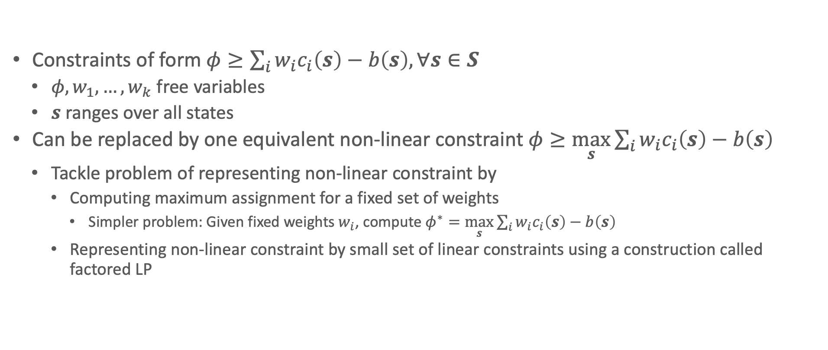
Factored Value Functions: Use in LP with Exponentially Many Constraints
Constraints of form $φ≥\sum_{i}{w_{i}c_{i}\left(s\right)}−b\left(s\right), ∀s∈S$
$φ,w_{1},…,w_{k}$ free variables
$s$ ranges over all states
Can be replaced by one equivalent non-linear constraint $φ≥\max_{s}{\sum_{i}{w_{i}c_{i}\left(s\right)}−b\left(s\right)}$
Tackle problem of representing non-linear constraint by
Computing maximum assignment for a fixed set of weights
Simpler problem: Given fixed weights $w_{i}$, compute $φ^{∗}=\max_{s}{\sum_{i}{w_{i}c_{i}\left(s\right)}−b\left(s\right)}$
Representing non-linear constraint by small set of linear constraints using a construction called factored LP

Slide 31
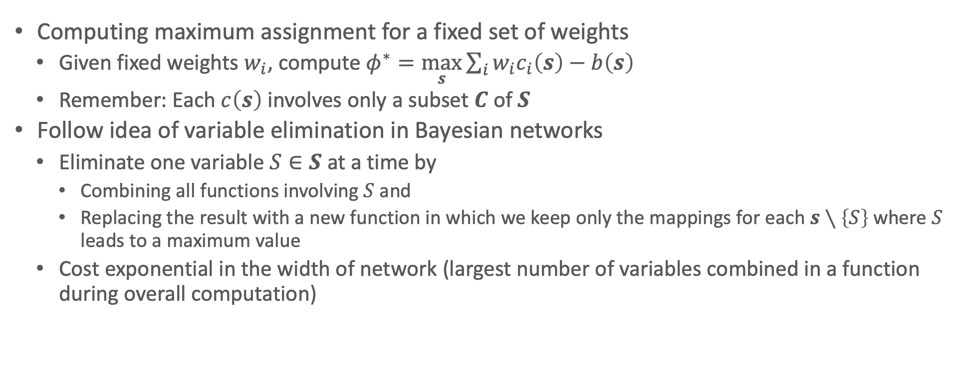
Factored Value Functions: Use in LP with Exponentially Many Constraints
Computing maximum assignment for a fixed set of weights
Given fixed weights $w_{i}$, compute $φ^{∗}=\max_{s}{\sum_{i}{w_{i}c_{i}\left(s\right)}−b\left(s\right)}$
Remember: Each $c\left(s\right)$ involves only a subset $C$ of $S$
Follow idea of variable elimination in Bayesian networks
Eliminate one variable $S∈S$ at a time by
Combining all functions involving $S$ and
Replacing the result with a new function in which we keep only the mappings for each $s∖\left\{S\right\}$ where $S$ leads to a maximum value
Cost exponential in the width of network (largest number of variables combined in a function during overall computation)

Slide 32
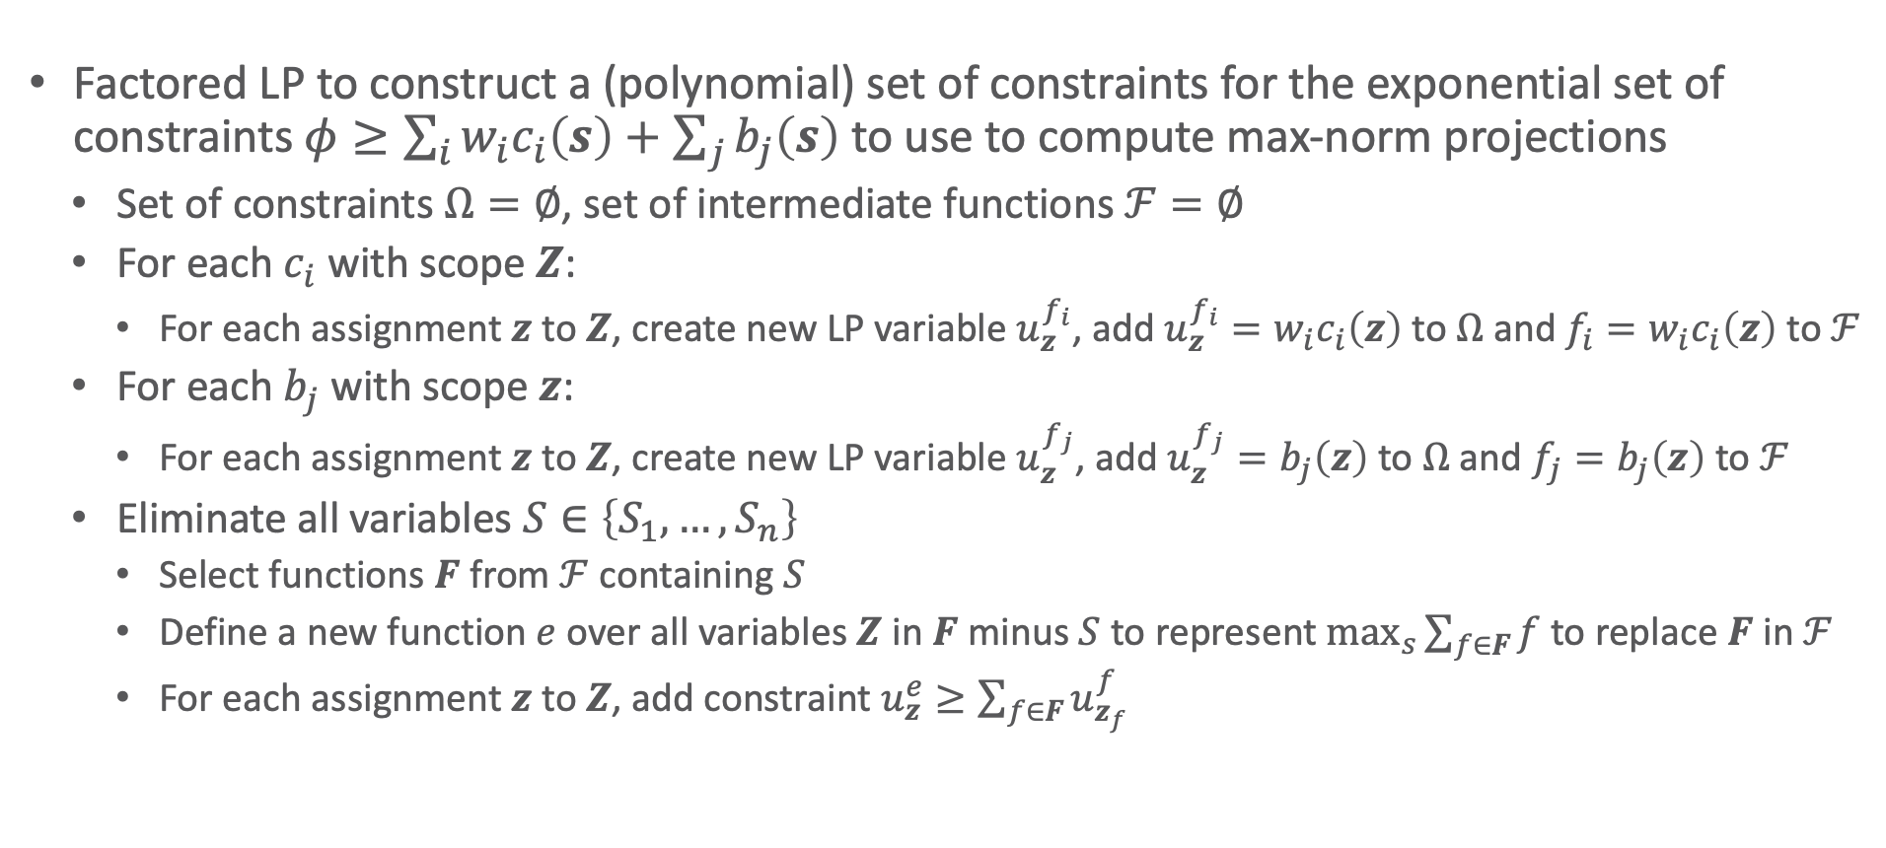
Factored Value Functions: Use in LP with Exponentially Many Constraints
Factored LP to construct a (polynomial) set of constraints for the exponential set of constraints $φ≥\sum_{i}{w_{i}c_{i}\left(s\right)}+\sum_{j}{b_{j}\left(s\right)}$ to use to compute max-norm projections
Set of constraints $Ω=∅$, set of intermediate functions $ℱ=∅$
For each $c_{i}$ with scope $Z$:
For each assignment $z$ to $Z$, create new LP variable $u_{z}^{f_{i}}$, add $u_{z}^{f_{i}}=w_{i}c_{i}\left(z\right)$ to $Ω$ and $f_{i}=w_{i}c_{i}\left(z\right)$ to $ℱ$
For each $b_{j}$ with scope $z$:
For each assignment $z$ to $Z$, create new LP variable $u_{z}^{f_{j}}$, add $u_{z}^{f_{j}}=b_{j}\left(z\right)$ to $Ω$ and $f_{j}=b_{j}\left(z\right)$ to $ℱ$
Eliminate all variables $S∈\left\{S_{1},…, S_{n}\right\}$
Select functions $F$ from $ℱ$ containing $S$
Define a new function $e$ over all variables $Z$ in $F$ minus $S$ to represent $\max_{s}{\sum_{f∈F}{f}}$ to replace $F$ in $ℱ$
For each assignment $z$ to $Z$, add constraint $u_{z}^{e}≥\sum_{f∈F}{u_{z_{f}}^{f}}$

Slide 33
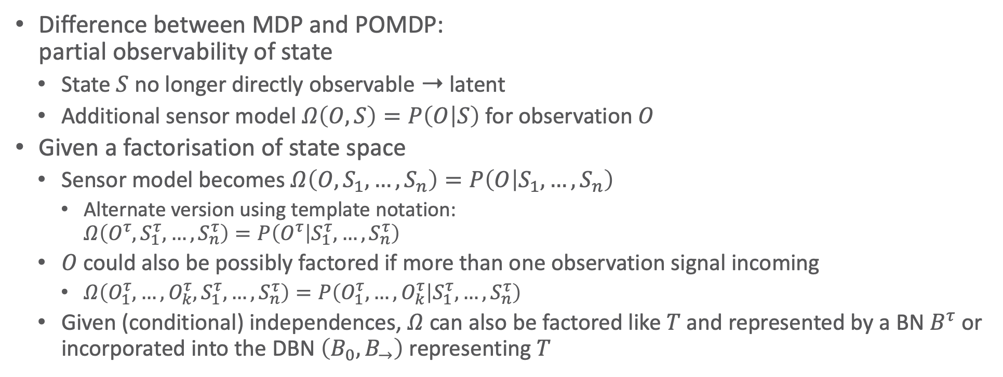
Factored POMDP
Difference between MDP and POMDP: partial observability of state
State $S$ no longer directly observable ➝ latent
Additional sensor model $Ω\left(O,S\right)=P\left(O | S\right)$ for observation $O$
Given a factorisation of state space
Sensor model becomes $Ω\left(O,S_{1},…,S_{n}\right)=P\left(O | S_{1},…,S_{n}\right)$
Alternate version using template notation: $Ω\left(O^{τ},S_{1}^{τ},…,S_{n}^{τ}\right)=P\left(O^{τ} | S_{1}^{τ},…,S_{n}^{τ}\right)$
$O$ could also be possibly factored if more than one observation signal incoming
$Ω\left(O_{1}^{τ},…,O_{k}^{τ},S_{1}^{τ},…,S_{n}^{τ}\right)=P\left(O_{1}^{τ},…,O_{k}^{τ} | S_{1}^{τ},…,S_{n}^{τ}\right)$
Given (conditional) independences, $Ω$ can also be factored like $T$ and represented by a BN $B^{τ}$ or incorporated into the DBN $\left(B_{0},B_{→}\right)$ representing $T$
$$A^{\left(τ−1\right)}$$
$$T$$
$$S^{\left(τ−1\right)}$$
$$S^{\left(τ\right)}$$
$$Ω$$
$$O^{\left(τ\right)}$$
$$R^{\left(τ\right)}$$
Graph representation of a POMDP

Slide 34
Interim Summary: Structure by Features in the State Space
State space characterised by set of attributes
(Conditional) independences allow for factorisation of functions in MDP
Probabilistic graphical models represent such factorisations
Factored MDP: MDP with a DBN as a representation of the transition model
Reduction in space complexity
Factored transition function does not lead to factored value function
Factored (linear) value functions over a set of basis functions
Enable computing policy evaluation efficiently
Approximate policy iteration
Project results outside of subspace spanned by basis functions back into subspace

Slide 35
Outline: Decision Making – Structure
Structure by Groups in the Agent Set
Agent types
Partitioned decPOMDPs
Structure by Features in the State Space
Dynamic Bayesian networks
Factored MDPs
Structure by Relations in the State Space
Situation calculus
First-order MDPs

Slide 36
Acknowledgement
Thanks to Scott Sanner!

Slide 37
Motivation: Planning Languages
Common languages:
STRIPS
PDDL
More expressive than STRIPS
For example, universal and conditional effects:
(:action put-all-blue-blocks-on-table
:parameters ( )
:precondition ( )
:effect (forall (?b)
(when (Blue ?b)
(not (OnTable ?b)))))
General Game Playing (GGP)
One or more agents

Slide 38
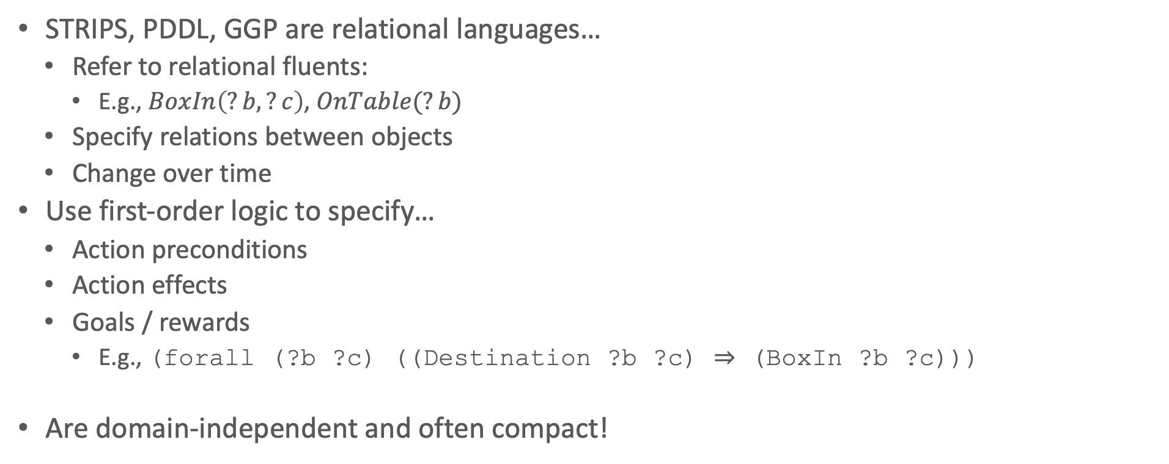
Motivation: Benefits of Relational Languages
STRIPS, PDDL, GGP are relational languages…
Refer to relational fluents:
E.g., $BoxIn\left(?b,?c\right)$, $OnTable(?b)$
Specify relations between objects
Change over time
Use first-order logic to specify…
Action preconditions
Action effects
Goals / rewards
E.g., (forall (?b ?c) ((Destination ?b ?c) ⇒ (BoxIn ?b ?c)))
Are domain-independent and often compact!

Slide 39
Motivation: How to Solve?
Relational planning problem
E.g., box world
(:action load-box-on-truck-in-city
:parameters (?b - box ?t - truck ?c – city)
:precondition (and (BoxIn ?b ?c) (TruckIn ?t ?c))
:effect (and (On ?b ?t) (not (BoxIn ?b ?c))))
Solve ground problem for each domain instance?
E.g., instance with 3 trucks 🚚 🚚 🚚, 2 planes 🛩️ 🛩️, 3 boxes 📦 📦 📦
Or solve lifted specification for all domains at once?
🚚
🛩️
Paris
Moscow
London
Berlin
📦
🚚
Rome
📦

Slide 40
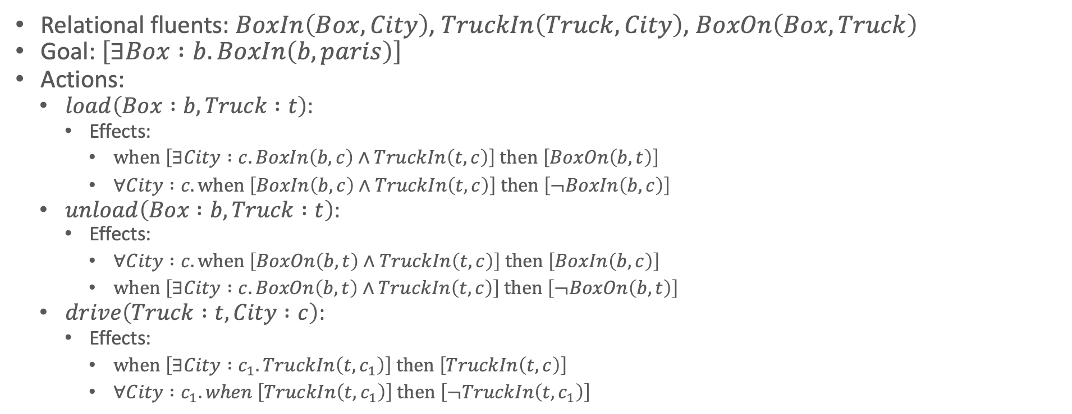
Box World: Full (Relational) Specification
Relational fluents: $BoxIn\left(Box, City\right)$, $TruckIn\left(Truck, City\right)$, $BoxOn\left(Box, Truck\right)$
Goal: $\left[∃Box :b.BoxIn\left(b, paris\right)\right]$
Actions:
$load\left(Box :b, Truck :t\right)$:
Effects:
$when \left[∃City :c. BoxIn\left(b, c\right)∧TruckIn\left(t, c\right)\right] then \left[BoxOn\left(b, t\right)\right]$
$∀City :c. when \left[BoxIn\left(b, c\right)∧TruckIn\left(t, c\right)\right] then \left[¬BoxIn\left(b, c\right)\right]$
$unload\left(Box :b, Truck :t\right)$:
Effects:
$∀City :c. when \left[BoxOn\left(b, t\right)∧TruckIn\left(t, c\right)\right] then \left[BoxIn\left(b, c\right)\right]$
$when \left[∃City :c. BoxOn\left(b, t\right)∧TruckIn\left(t, c\right)\right] then \left[¬BoxOn\left(b, t\right)\right]$
$drive\left(Truck :t, City :c\right)$:
Effects:
$when \left[∃City :c_{1}. TruckIn\left(t, c_{1}\right)\right] then \left[TruckIn\left(t, c\right)\right]$
$∀City :c_{1}. when \left[TruckIn\left(t, c_{1}\right)\right] then \left[¬TruckIn\left(t, c_{1}\right)\right]$

Slide 41
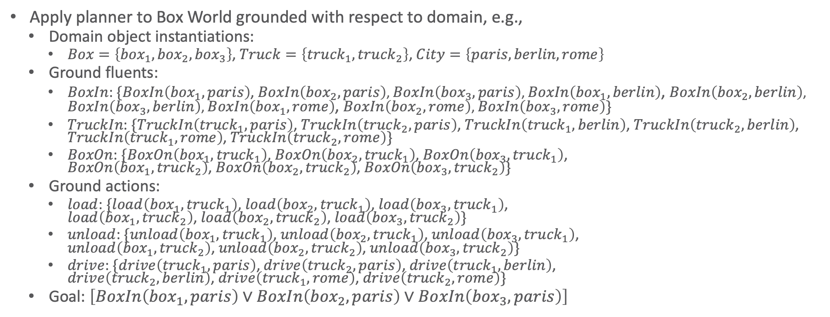
Solving Ground Box World
Apply planner to Box World grounded with respect to domain, e.g.,
Domain object instantiations:
$Box=\left\{{box}_{1},{box}_{2},{box}_{3}\right\}$, $Truck=\left\{{truck}_{1},{truck}_{2}\right\}$, $City=\left\{paris,berlin,rome\right\}$
Ground fluents:
$BoxIn$: $\{BoxIn\left({box}_{1}, paris\right)$, $BoxIn\left({box}_{2}, paris\right)$, $BoxIn\left({box}_{3}, paris\right)$, $BoxIn\left({box}_{1}, berlin\right)$, $BoxIn\left({box}_{2}, berlin\right)$, $BoxIn\left({box}_{3}, berlin\right)$, $BoxIn\left({box}_{1}, rome\right)$, $BoxIn\left({box}_{2}, rome\right)$, $BoxIn\left({box}_{3}, rome\right)\}$
$TruckIn$: $\{TruckIn\left({truck}_{1}, paris\right)$, $TruckIn\left({truck}_{2},paris\right)$, $TruckIn\left({truck}_{1}, berlin\right)$, $TruckIn\left({truck}_{2},berlin\right)$, $TruckIn\left({truck}_{1}, rome\right)$, $TruckIn\left({truck}_{2}, rome\right)\}$
$BoxOn$: $\{BoxOn\left({box}_{1},{truck}_{1}\right)$, $BoxOn\left({box}_{2},{truck}_{1}\right)$, $BoxOn\left({box}_{3},{truck}_{1}\right)$, $BoxOn\left({box}_{1},{truck}_{2}\right)$, $BoxOn\left({box}_{2},{truck}_{2}\right)$, $BoxOn\left({box}_{3},{truck}_{2}\right)\}$
Ground actions:
$load$: $\{load\left({box}_{1},{truck}_{1}\right)$, $load\left({box}_{2},{truck}_{1}\right)$, $load\left({box}_{3},{truck}_{1}\right)$, $load\left({box}_{1},{truck}_{2}\right)$, $load\left({box}_{2},{truck}_{2}\right)$, $load\left({box}_{3},{truck}_{2}\right)\}$
$unload$: $\{unload\left({box}_{1},{truck}_{1}\right)$, $unload\left({box}_{2},{truck}_{1}\right)$, $unload\left({box}_{3},{truck}_{1}\right)$, $unload\left({box}_{1},{truck}_{2}\right)$, $unload\left({box}_{2},{truck}_{2}\right)$, $unload\left({box}_{3},{truck}_{2}\right)\}$
$drive$: $\{drive\left({truck}_{1}, paris\right)$, $drive\left({truck}_{2},paris\right)$, $drive\left({truck}_{1}, berlin\right)$, $drive\left({truck}_{2},berlin\right)$, $drive\left({truck}_{1}, rome\right)$, $drive\left({truck}_{2}, rome\right)\}$
Goal: $\left[BoxIn\left({box}_{1}, paris\right)∨BoxIn\left({box}_{2}, paris\right)∨BoxIn\left({box}_{3}, paris\right)\right]$
Number of fluents exponential in arity
Number of actions exponential in arity
Goal description exponential in number of nested quantifiers

Slide 42
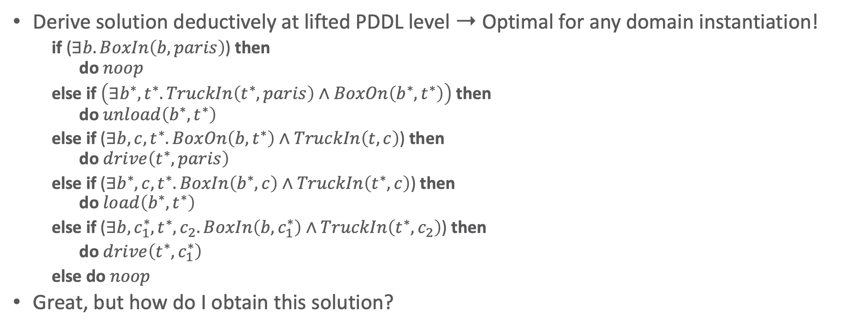
A First-order Solution to Box World
Derive solution deductively at lifted PDDL level ➝ Optimal for any domain instantiation!
if ($∃b.BoxIn\left(b, paris\right)$) then do $noop$
else if $\left(∃b^{∗},t^{∗}.TruckIn\left(t^{∗},paris\right)∧BoxOn\left(b^{∗},t^{∗}\right)\right)$ then do $unload\left(b^{∗}, t^{∗}\right)$
else if ($∃b,c,t^{∗}.BoxOn\left(b,t^{∗}\right)∧TruckIn\left(t,c\right)$) then do $drive\left(t^{∗}, paris\right)$
else if ($∃b^{∗},c,t^{∗}.BoxIn\left(b^{∗},c\right)∧TruckIn\left(t^{∗},c\right)$) then do $load\left(b^{∗},t^{∗}\right)$
else if ($∃b,c_{1}^{∗},t^{∗},c_{2}.BoxIn\left(b,c_{1}^{∗}\right)∧TruckIn\left(t^{∗},c_{2}\right)$) then
do $drive\left(t^{∗},c_{1}^{∗}\right)$
else do $noop$
Great, but how do I obtain this solution?
Notes:
Answer: Situation calculus

Slide 43
Situation Calculus
Logic formalism designed for representing and reasoning about dynamic domains
First introduced by John McCarthy in 1963
Basic elements
Actions that can be performed in the world
Situations
Fluents that describe the state of the world
Domain
Action precondition axioms, one for each action
Successor state axioms, one for each fluent
Axioms describing the world in various situations
Foundational axioms of the situation calculus: situations are histories, induction on situations

Slide 44
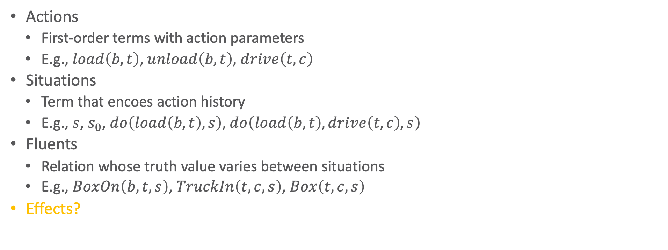
Situation Calculus: Ingredients
Actions
First-order terms with action parameters
E.g., $load\left(b,t\right)$, $unload\left(b,t\right)$, $drive\left(t,c\right)$
Situations
Term that encoes action history
E.g., $s$, $s_{0}$, $do\left(load\left(b,t\right),s\right)$, $do\left(load\left(b,t\right),drive\left(t,c\right),s\right)$
Fluents
Relation whose truth value varies between situations
E.g., $BoxOn\left(b,t,s\right)$, $TruckIn\left(t,c,s\right)$, $Box\left(t,c,s\right)$
Effects?

Slide 45

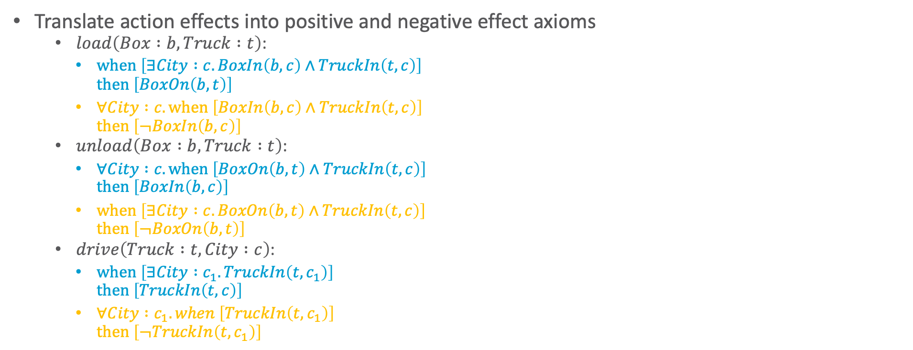
Situation Calculus: PDDL to Effects
Translate action effects into positive and negative effect axioms
$load\left(Box :b, Truck :t\right)$:
$when \left[∃City :c. BoxIn\left(b, c\right)∧TruckIn\left(t, c\right)\right]$ $then \left[BoxOn\left(b, t\right)\right]$
$∀City :c. when \left[BoxIn\left(b, c\right)∧TruckIn\left(t, c\right)\right]$ $then \left[¬BoxIn\left(b, c\right)\right]$
$unload\left(Box :b, Truck :t\right)$:
$∀City :c. when \left[BoxOn\left(b, t\right)∧TruckIn\left(t, c\right)\right]$ $then \left[BoxIn\left(b, c\right)\right]$
$when \left[∃City :c. BoxOn\left(b, t\right)∧TruckIn\left(t, c\right)\right]$ $then \left[¬BoxOn\left(b, t\right)\right]$
$drive\left(Truck :t, City :c\right)$:
$when \left[∃City :c_{1}. TruckIn\left(t, c_{1}\right)\right]$ $then \left[TruckIn\left(t, c\right)\right]$
$∀City :c_{1}. when \left[TruckIn\left(t, c_{1}\right)\right]$ $then \left[¬TruckIn\left(t, c_{1}\right)\right]$
$\left[∃c. a=load\left(b,t\right)∧BoxIn\left(b, c,s\right)∧TruckIn\left(t, c,s\right)\right]$ $⇒BoxOn\left(b, t,do\left(a,s\right)\right)$
$\left[∃t. a=load\left(b,t\right)∧BoxIn\left(b, c,s\right)∧TruckIn\left(t, c,s\right)\right]$ $⇒¬BoxIn\left(b, c,do\left(a,s\right)\right)$
$\left[∃t. a=unload\left(b,t\right)∧BoxOn\left(b, t,s\right)∧TruckIn\left(t, c,s\right)\right]$ $⇒BoxIn\left(b, c,do\left(a,s\right)\right)$
$\left[∃c. a=unload\left(b,t\right)∧BoxOn\left(b, t,s\right)∧TruckIn\left(t, c,s\right)\right]$ $⇒¬BoxOn\left(b, t,do\left(a,s\right)\right)$
$\left[∃c_{1}. a=drive\left(t,c\right)∧TruckIn\left(t, c_{1},s\right)\right]$ $⇒TruckIn\left(t, c,do\left(a,s\right)\right)$
$\left[∃c. a=drive\left(t,c\right)∧TruckIn\left(t, c_{1},s\right)\right]$ $⇒¬TruckIn\left(t,c_{1},do\left(a,s\right)\right)$

Slide 46
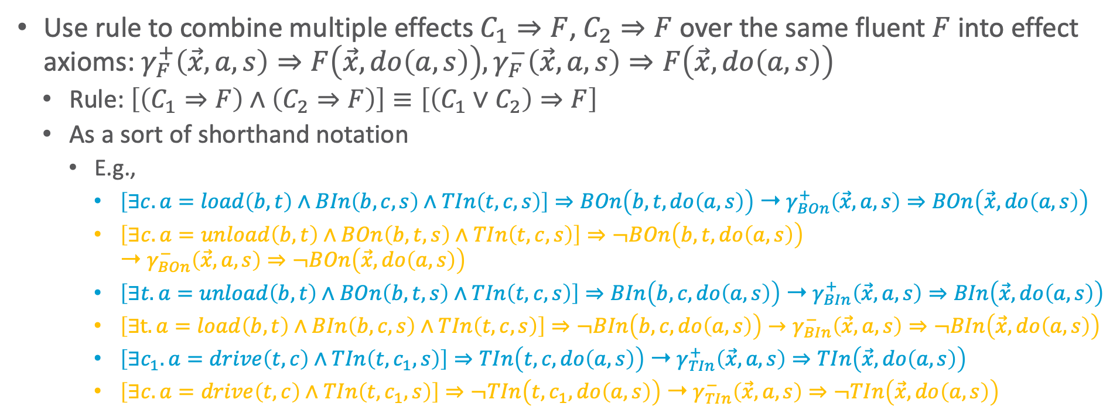
Situation Calculus: PDDL to Effects
Use rule to combine multiple effects $C_{1}⇒F$, $C_{2}⇒F$ over the same fluent $F$ into effect axioms: $γ_{F}^{+}\left(\vec{x},a,s\right)⇒F\left(\vec{x},do\left(a,s\right)\right),γ_{F}^{−}\left(\vec{x},a,s\right)⇒F\left(\vec{x},do\left(a,s\right)\right)$
Rule: $\left[\left(C_{1}⇒F\right)∧\left(C_{2}⇒F\right)\right]≡\left[\left(C_{1}∨C_{2}\right)⇒F\right]$
As a sort of shorthand notation
E.g.,
$\left[∃c. a=load\left(b,t\right)∧BIn\left(b, c,s\right)∧TIn\left(t, c,s\right)\right]⇒BOn\left(b, t,do\left(a,s\right)\right)$ ➝ $γ_{BOn}^{+}\left(\vec{x}, a,s\right)⇒BOn\left(\vec{x},do\left(a,s\right)\right)$
$\left[∃c. a=unload\left(b,t\right)∧BOn\left(b, t,s\right)∧TIn\left(t, c,s\right)\right]⇒¬BOn\left(b, t,do\left(a,s\right)\right)$ ➝ $γ_{BOn}^{−}\left(\vec{x}, a,s\right)⇒¬BOn\left(\vec{x},do\left(a,s\right)\right)$
$\left[∃t. a=unload\left(b,t\right)∧BOn\left(b, t,s\right)∧TIn\left(t, c,s\right)\right]⇒BIn\left(b, c,do\left(a,s\right)\right)$ ➝ $γ_{BIn}^{+}\left(\vec{x}, a,s\right)⇒BIn\left(\vec{x},do\left(a,s\right)\right)$
$\left[∃t. a=load\left(b,t\right)∧BIn\left(b, c,s\right)∧TIn\left(t, c,s\right)\right]⇒¬BIn\left(b, c,do\left(a,s\right)\right)→γ_{BIn}^{−}\left(\vec{x}, a,s\right)⇒¬BIn\left(\vec{x},do\left(a,s\right)\right)$
$\left[∃c_{1}. a=drive\left(t,c\right)∧TIn\left(t, c_{1},s\right)\right]⇒TIn\left(t, c,do\left(a,s\right)\right)$ ➝ $γ_{TIn}^{+}\left(\vec{x}, a,s\right)⇒TIn\left(\vec{x},do\left(a,s\right)\right)$
$\left[∃c. a=drive\left(t,c\right)∧TIn\left(t, c_{1},s\right)\right]⇒¬TIn\left(t,c_{1},do\left(a,s\right)\right)$ ➝ $γ_{TIn}^{−}\left(\vec{x}, a,s\right)⇒¬TIn\left(\vec{x},do\left(a,s\right)\right)$

Slide 47
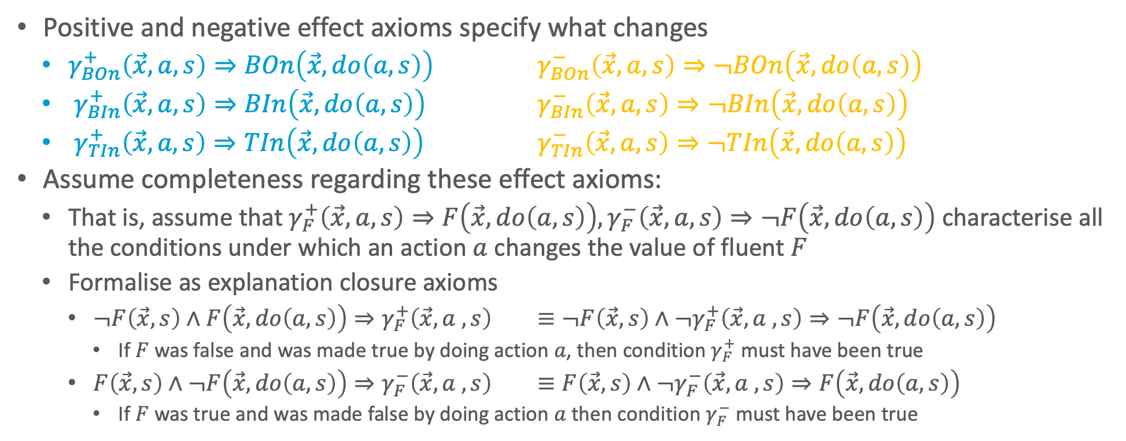
Frame Problem
Positive and negative effect axioms specify what changes
$γ_{BOn}^{+}\left(\vec{x}, a,s\right)⇒BOn\left(\vec{x},do\left(a,s\right)\right)$ $γ_{BOn}^{−}\left(\vec{x}, a,s\right)⇒¬BOn\left(\vec{x},do\left(a,s\right)\right)$
$γ_{BIn}^{+}\left(\vec{x}, a,s\right)⇒BIn\left(\vec{x},do\left(a,s\right)\right)$ $γ_{BIn}^{−}\left(\vec{x}, a,s\right)⇒¬BIn\left(\vec{x},do\left(a,s\right)\right)$
$γ_{TIn}^{+}\left(\vec{x}, a,s\right)⇒TIn\left(\vec{x},do\left(a,s\right)\right)$ $γ_{TIn}^{−}\left(\vec{x}, a,s\right)⇒¬TIn\left(\vec{x},do\left(a,s\right)\right)$
Assume completeness regarding these effect axioms:
That is, assume that $γ_{F}^{+}\left(\vec{x},a,s\right)⇒F\left(\vec{x},do\left(a,s\right)\right),γ_{F}^{−}\left(\vec{x},a,s\right)⇒¬F\left(\vec{x},do\left(a,s\right)\right)$ characterise all the conditions under which an action $a$ changes the value of fluent $F$
Formalise as explanation closure axioms
$¬F\left(\vec{x}, s\right)∧F\left(\vec{x}, do\left(a,s\right)\right)⇒γ_{F}^{+}\left(\vec{x}, a ,s\right)$ $≡¬F\left(\vec{x}, s\right)∧¬γ_{F}^{+}\left(\vec{x}, a ,s\right)⇒¬F\left(\vec{x}, do\left(a,s\right)\right)$
If $F$ was false and was made true by doing action $a$, then condition $γ_{F}^{+}$ must have been true
$F\left(\vec{x}, s\right)∧¬F\left(\vec{x}, do\left(a,s\right)\right)⇒γ_{F}^{−}\left(\vec{x}, a ,s\right)$ $≡F\left(\vec{x}, s\right)∧¬γ_{F}^{−}\left(\vec{x}, a ,s\right)⇒F\left(\vec{x}, do\left(a,s\right)\right)$
If $F$ was true and was made false by doing action $a$ then condition $γ_{F}^{−}$ must have been true

Slide 48
Frame Problem
Frame problem: How to (compactly) specify what does not change?
Intuition: “What does not change, remains the same.”
Reiter’s so-called Default Solution
Not so easy to specify
Moving one thing might move another thing, even though the other thing is never directly touched
How to distinguish between relevant and irrelevant side effects? And use that efficiently?
Default solution to frame problem given as successor state axioms (SSAs), which we construct next

Slide 49
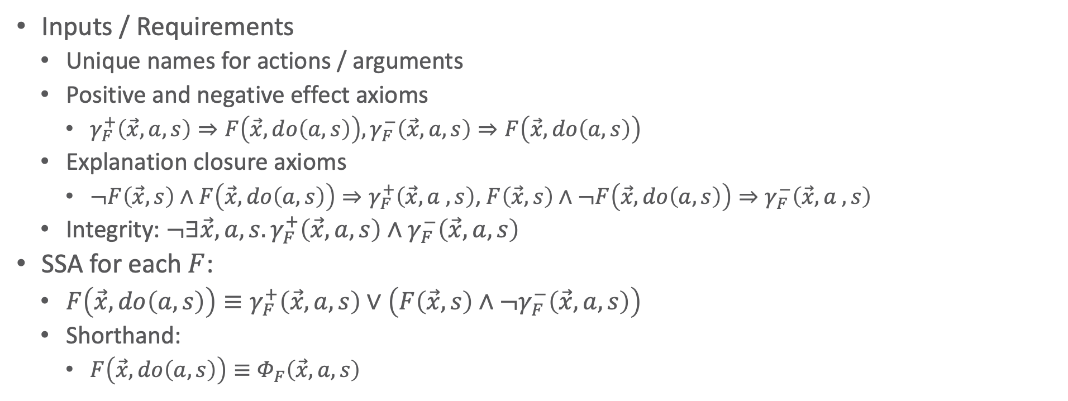
Successor State Axioms (SSAs)
Inputs / Requirements
Unique names for actions / arguments
Positive and negative effect axioms
$γ_{F}^{+}\left(\vec{x},a,s\right)⇒F\left(\vec{x},do\left(a,s\right)\right),γ_{F}^{−}\left(\vec{x},a,s\right)⇒F\left(\vec{x},do\left(a,s\right)\right)$
Explanation closure axioms
$¬F\left(\vec{x}, s\right)∧F\left(\vec{x}, do\left(a,s\right)\right)⇒γ_{F}^{+}\left(\vec{x}, a ,s\right)$, $F\left(\vec{x}, s\right)∧¬F\left(\vec{x}, do\left(a,s\right)\right)⇒γ_{F}^{−}\left(\vec{x}, a ,s\right)$
Integrity: $¬∃\vec{x},a,s.γ_{F}^{+}\left(\vec{x},a,s\right)∧γ_{F}^{−}\left(\vec{x},a,s\right)$
SSA for each $F$:
$F\left(\vec{x},do\left(a,s\right)\right)≡γ_{F}^{+}\left(\vec{x},a,s\right)∨\left(F\left(\vec{x},s\right)∧¬γ_{F}^{−}\left(\vec{x},a,s\right)\right)$
Shorthand:
$F\left(\vec{x},do\left(a,s\right)\right)≡Φ_{F}\left(\vec{x},a,s\right)$

Slide 50
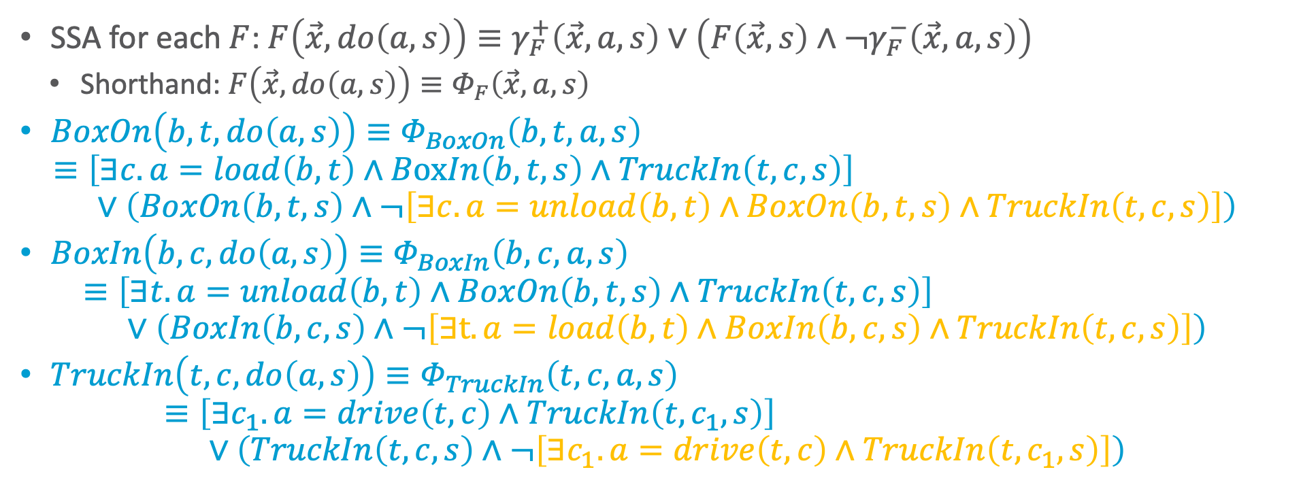
Successor State Axioms (SSAs): Example
SSA for each $F$: $F\left(\vec{x},do\left(a,s\right)\right)≡γ_{F}^{+}\left(\vec{x},a,s\right)∨\left(F\left(\vec{x},s\right)∧¬γ_{F}^{−}\left(\vec{x},a,s\right)\right)$
Shorthand: $F\left(\vec{x},do\left(a,s\right)\right)≡Φ_{F}\left(\vec{x},a,s\right)$
$BoxOn\left(b,t,do\left(a,s\right)\right)≡Φ_{BoxOn}\left(b,t,a,s\right)$ $≡\left[∃c. a=load\left(b,t\right)∧BoxIn\left(b, t,s\right)∧TruckIn\left(t, c,s\right)\right]$ $∨\left(BoxOn\left(b,t,s\right)∧¬\left[∃c. a=unload\left(b,t\right)∧BoxOn\left(b, t,s\right)∧TruckIn\left(t, c,s\right)\right]\right)$
$BoxIn\left(b,c,do\left(a,s\right)\right)≡Φ_{BoxIn}\left(b,c,a,s\right)$ $≡\left[∃t. a=unload\left(b,t\right)∧BoxOn\left(b, t,s\right)∧TruckIn\left(t, c,s\right)\right]$ $∨\left(BoxIn\left(b,c,s\right)∧¬\left[∃t. a=load\left(b,t\right)∧BoxIn\left(b, c,s\right)∧TruckIn\left(t, c,s\right)\right]\right)$
$TruckIn\left(t,c,do\left(a,s\right)\right)≡Φ_{TruckIn}\left(t,c,a,s\right)$ $≡\left[∃c_{1}. a=drive\left(t,c\right)∧TruckIn\left(t, c_{1},s\right)\right]$ $∨\left(TruckIn\left(t,c,s\right)∧¬\left[∃c_{1}. a=drive\left(t,c\right)∧TruckIn\left(t, c_{1},s\right)\right]\right)$

Slide 51
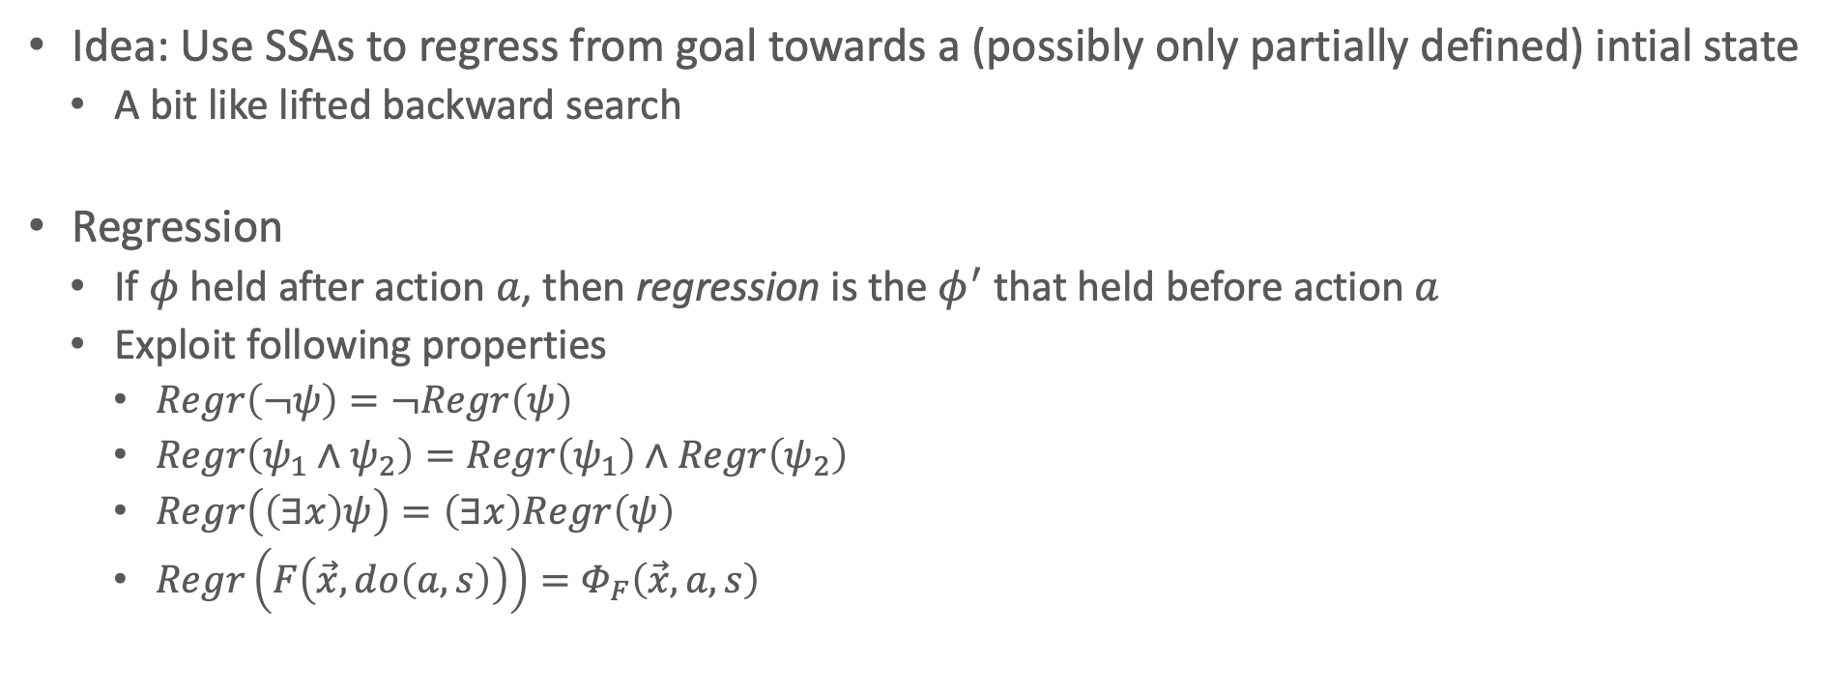
Regression
Idea: Use SSAs to regress from goal towards a (possibly only partially defined) intial state
A bit like lifted backward search
Regression
If $φ$ held after action $a$, then regression is the $φ^{′}$ that held before action $a$
Exploit following properties
$Regr\left(¬ψ\right)=¬Regr\left(ψ\right)$
$Regr\left(ψ_{1}∧ψ_{2}\right)=Regr\left(ψ_{1}\right)∧Regr\left(ψ_{2}\right)$
$Regr\left(\left(∃x\right)ψ\right)=\left(∃x\right)Regr\left(ψ\right)$
$Regr\left(F\left(\vec{x}, do\left(a,s\right)\right)\right)=Φ_{F}\left(\vec{x},a,s\right)$

Slide 52




Regression: Example
If $φ$ held after action $a$, then regression is the $φ^{′}$ that held before action $a$
Exploit following properties
$Regr\left(¬ψ\right)=¬Regr\left(ψ\right)$
$Regr\left(ψ_{1}∧ψ_{2}\right)=Regr\left(ψ_{1}\right)∧Regr\left(ψ_{2}\right)$
$Regr\left(\left(∃x\right)ψ\right)=\left(∃x\right)Regr\left(ψ\right)$
$Regr\left(F\left(\vec{x}, do\left(a,s\right)\right)\right)=Φ_{F}\left(\vec{x},a,s\right)$
Given: $∃b.BoxIn\left(b, paris,do\left(unload\left(b^{∗},t^{∗}\right),s\right)\right)$
Regress through $unload\left(b^{∗},t^{∗}\right)$
$Regr\left(∃b.BoxIn\left(b, paris,do\left(unload\left(b^{∗},t^{∗}\right),s\right)\right)\right)$ $=∃b.Regr\left(BoxIn\left(b, paris,do\left(unload\left(b^{∗},t^{∗}\right),s\right)\right)\right)$ $=∃b.Φ_{BoxIn}\left(b,paris,unload\left(b^{∗},t^{∗}\right),s\right)$ $=∃b.\left[∃t. unload\left(b^{∗},t^{∗}\right)=unload\left(b,t\right)∧BoxOn\left(b, t,s\right)∧TruckIn\left(t, paris,s\right)\right]∨\left(BoxIn\left(b,paris,s\right)∧¬\left[∃t. unload\left(b^{∗},t^{∗}\right)=load\left(b,t\right)∧BoxIn\left(b, paris,s\right)∧TruckIn\left(t, paris,s\right)\right]\right)$ $=\left[∃b,t. b=b^{∗}∧t=t^{∗}∧BoxOn\left(b, t,s\right)∧TruckIn\left(t, paris,s\right)\right]∨∃b.BoxIn\left(b,paris,s\right)$ $=\left[\left(∃b. b=b^{∗}\right)∧\left(∃t.t=t^{∗}\right)∧BoxOn\left(b^{∗}, t^{∗},s\right)∧TruckIn\left(t^{∗}, paris,s\right)\right]∨∃b.BoxIn\left(b,paris,s\right)$ $=\left[BoxOn\left(b^{∗},t^{∗},s\right)∧TruckIn\left(t^{∗},paris,s\right)\right]∨∃b.BoxIn\left(b,paris,s\right)$
Cannot be made true ➝ $φ∧¬\left[⊥\right]≡φ∧⊤≡φ$
Make non-empty domain assumption for $b,t$

Slide 53

Regression: Example
Given: $∃b.BoxIn\left(b, paris,do\left(unload\left(b^{∗},t^{∗}\right),s\right)\right)$
Regress through $unload\left(b^{∗},t^{∗}\right)$
$Regr\left(∃b.BoxIn\left(b, paris,do\left(unload\left(b^{∗},t^{∗}\right),s\right)\right)\right)$ $=\left[BoxOn\left(b^{∗},t^{∗},s\right)∧TruckIn\left(t^{∗},paris,s\right)\right]∨∃b.BoxIn\left(b,paris,s\right)$
To get action instantiations of $unload\left(b^{∗},t^{∗}\right)$, query knowledge base (KB, i.e., planning domain)
Existentially quantify $b^{∗},t^{∗}$ and obtain instances via query extraction w.r.t. KB
KB consists of first-order state and action abstraction ➝ do not have to enumerate all states, $b^{∗}$, $t^{∗}$
$∃b^{∗},t^{∗}.Regr\left(∃b.BoxIn\left(b, paris,do\left(unload\left(b^{∗},t^{∗}\right),s\right)\right)\right)$ $=∃b^{∗},t^{∗}.\left[BoxOn\left(b^{∗},t^{∗},s\right)∧TruckIn\left(t^{∗},paris,s\right)\right]∨∃b.BoxIn\left(b,paris,s\right)$ $=\left[∃b^{∗},t^{∗}.BoxOn\left(b^{∗},t^{∗},s\right)∧TruckIn\left(t^{∗},paris,s\right)\right]∨∃b.BoxIn\left(b,paris,s\right)$

Slide 54






Regression Planning
Define abstract goal state
E.g., $∃b.BoxIn\left(b,paris,s\right)$
Check if regression through action sequence holds in initial state
Goal regression planning
Provide initial state, actions
Initial state description can be partial
Use regression to tell whether goal will hold
…
$$∃b^{∗},t^{∗}.BoxOn\left(b,t,s\right)∧TruckIn\left(t,paris,s\right) \\ ∨∃b.BoxIn\left(b,paris,s\right)$$
Captures initial state?
…
$$unload\left(b^{∗},t^{∗}\right)$$
$$∃b.BoxIn\left(b,paris,s\right)$$
$$drive\left(t^{∗},c_{1}^{∗},c_{2}^{∗}\right)$$
Goal State: Captures initial state?
…
$$∃b.BoxIn\left(b,paris,s\right)$$
Captures initial state?
…

Slide 55



Progression and Forward Search?
Can we do lifted forward-search planning?
Progression not first-order definable! (Reiter, 2001)
Could progress ground state
But this does not exploit first-order structure
?
Captures goal state?
$$drive\left(t^{∗},c_{1}^{∗},c_{2}^{∗}\right)$$
$$∃b^{∗},t^{∗}.BoxOn\left(b,t,s\right)∧TruckIn\left(t,paris,s\right) \\ ∨∃b.BoxIn\left(b,paris,s\right)$$
$$unload\left(b^{∗},t^{∗}\right)$$
?
Captures goal state?
Intial State: Captures goal state?

Slide 56

Golog: Restricted Plan Search
AlGOl in LOGic
Search the space of sequential action plans
Regress actions to initial state to test reachability
Restrict action space with program:
$α$ $φ$? $\left(δ_{1},δ_{2}\right)$ if $φ$ then $δ$ endIf while $φ$ then $δ$ endWhile | primitive action condition test sequence conditional loop
$\left(δ_{1} | δ_{2}\right)$ $π \vec{x} \left[δ\right]$ $δ^{∗}$ | nondeterministic choice of actions nondeterministic choice of arguments nondeterministic iteration
proc $β\left(\vec{x}\right) δ$ endProc $β\left(\vec{t}\right)$ | procedure call definition procedure call

Slide 57





Golog: Example
$α$ $φ$? $\left(δ_{1},δ_{2}\right)$ if $φ$ then $δ$ endIf while $φ$ then $δ$ endWhile | primitive action condition test sequence conditional loop
$\left(δ_{1} | δ_{2}\right)$ $π \vec{x} \left[δ\right]$ $δ^{∗}$ | nondeterministic choice of actions nondeterministic choice of arguments nondeterministic iteration
proc $β\left(\vec{x}\right) δ$ endProc $β\left(\vec{t}\right)$ | procedure call definition procedure call
Golog program
${\left(πb\left[¬OnTable\left(b,s\right)?,pickup\left(b\right),putOnTable\left(b\right)\right]\right)}^{∗},$ $∀b.OnTable\left(b,s\right)?$
Diagram of Golog planning
Heavily restricted action sequences
Program exploits first-order action abstraction
Initial state need not be fully known
Initial State
$$pickup\left(?b_{1}\right); \\ putOnTable\left(?b_{1}\right)$$
$$pickup\left(?b_{2}\right); \\ putOnTable\left(?b_{2}\right)$$
$$∃b.¬OnTable\left(b,s\right)?$$
Initial state?
Initial state?

Slide 58
Interim (Interim) Summary
Situation calculus to describe a relational world
Can convert PDDL (and state-variable domains) into effect axioms
Derive SSAs from effect axioms
Using default solution to frame problem
Regression operator
Extract action instantiation to achieve goal
Regression planning
Initial state need not be fully specified
Exploit state and action abstraction
Avoid enumerating all state and action instances
Next step: Extend this idea for decision-theoretic planning with uncertain action outcomes

Slide 59






First-order MDPs: MDPs
MDP with discount factor
Tuple $\left(S,A,T,R,γ\right)$
State space $S$
E.g., $S=\left\{1,2\right\}$
Actions $A$
E.g., $A=\left\{stay,go\right\}$
Immediate reward function $R$
E.g., $R\left(s=1,a=stay\right)=2,…$
Transition function $T$
E.g., $T\left(s=1,a=stay,s^{′}=1\right)=P\left(s^{′}=1 | s=1,a=stay\right)=0.9$
Discount factor $γ$
Acting ➝ define policy $π :S→A$
$$R=10$$ $a=change$ ($P=1.0$)
$a=stay$ ($P=0.1$)
$$R=2$$ $a=stay$ ($P=0.9$)
$$R=0$$ $a=change$ ($P=1.0$)
$a=stay$ ($P=1.0$)
$$s=1$$
$$s=2$$

Slide 60





















Policy, Value, Solution
$$R=10$$ $a=change$ ($P=1.0$)
$a=stay$ ($P=0.1$)
$$s=1$$
$$s=2$$
Immediate vs. long-term gain?
Reward criterion to optimise
Discount factor $γ$ important ($γ=0.9$ vs. $γ=0.1$)
Define value of policy $π$
$V_{π}\left(s\right)=E_{π}\left[\sum_{t=0}^{∞}{γ^{t}⋅r_{t}|s=s_{0}}\right]$
Tells how much value to expect to get by following $π$ starting from state $s$
MDP optimal solution
Policy $π^{∗}\left(s\right)={argmax}_{π}{V_{π}\left(s\right)}$
$$R=2$$ $a=stay$ ($P=0.9$)
$$R=0$$ $a=change$ ($P=1.0$)
$a=stay$ ($P=1.0$)
$$R=2$$
$a=stay$ ($P=0.9$)
$$R=2$$
$a=stay$ ($P=0.9$)
$$R=2$$
$a=stay$ ($P=0.9$)
$$s=1$$
$$s=1$$
$$s=1$$
$$R=10$$
$$a=change$$
$$R=10$$
$$a=change$$
$$R=10$$
$$a=change$$
$$s=2$$
$$s=2$$
$$s=2$$
$$R=0$$
$$R=0$$
$$R=0$$

Slide 61


Value Iteration & Value Function to Policy
How to act optimally with $t$ decisions?
Given optimal $t−1$-state-to-go value fct.
Take action $a$, then act so as to achieve $V^{t−1}$ thereafter:
$$Q^{t}\left(s,a\right) :=R\left(s,a\right)+γ\sum_{s^{′}∈S}{T\left(s,a,s^{′}\right)V^{t−1}\left(s^{′}\right)}$$
Expected value of best action $a$ at stage $t$?
$$V^{t}\left(s\right)≔\max_{a∈A}\left\{Q^{t}\left(s,a\right)\right\}$$
At $∞$ horizon, get same value ($=V^{∗}$)
$$\lim_{t→∞}{\max_{s}\left|V^{t}\left(s\right)−V^{t−1}\left(s\right)\right|}=0$$
$π^{∗}$ says act the same at each decision stage for $∞$ horizon
Given arbitrary value $V$ (optimal or not)
Greedy policy $π_{V}$ takes action in each state that maximises expected value w.r.t. $V$
$$π_{V}\left(s\right)=\underset{a∈A}{arg max}\left\{R\left(s,a\right)+γ\sum_{s^{′}∈S}{T\left(s,a,s^{′}\right)V\left(s^{′}\right)}\right\}$$
If can act so as to obtain $V$ after doing action $a$ in state $s$, $π_{V}$ guarantees $V\left(s\right)$ in expectation

Slide 62
Graphical View
Single dynamic programming step
Synchronous DP updates (value iteration)

Slide 63



First-order MDP (FOMDP)
Components of MDP in an FOMDP specified as a collection of case statements
E.g., express reward in Box World FOMDP as
Operators: define unary and binary case operations
E.g., cross-sum $⊕$ (or $⊖$, $⊗$) of cases
$$rCase\left(s\right)=$$ | $$∀b,c.Dest\left(b,c\right)⇒BoxIn\left(b,c,s\right)$$ | $$1$$
 | $$¬\left(∀b,c.Dest\left(b,c\right)⇒BoxIn\left(b,c,s\right)\right)$$ | $$0$$
 |  |  |  |  |  | $$φ∧φ$$ | $$10+3$$
$$φ$$ | $$10$$ | $$⊕$$ | $$φ$$ | $$3$$ | $$=$$ | $$φ∧¬φ$$ | $$10+4$$
$$¬φ$$ | $$20$$ |  | $$¬φ$$ | $$4$$ |  | $$¬φ∧φ$$ | $$20+3$$
 |  |  |  |  |  | $$¬φ∧¬φ$$ | $$20+4$$

Slide 64




Stochastic Actions and First-order Decision-theoretic Regression (FODTR)
Stochastic actions using deterministic situation calculus
User’s stochastic action, e.g., $A\left(x\right)=load\left(b,t\right)$
Nature’s choice, e.g., $n\left(x\right)∈\left\{loadS\left(b,t\right),loadF\left(b,t\right)\right\}$
Probability distribution over nature’s choice, e.g.,
First-order decision-theoretic regression (FODTR)
FODTR = expectation of regression:
$$FODTR\left[vCase\left(s\right),A\left(\vec{x}\right)\right]=E_{P(n\left(\vec{x}\right)|A\left(\vec{x}\right))}\left[Regr\left(vCase\left(s\right),n\left(\vec{x}\right)\right)\right]$$
Probability distribution ➝ Adds up to 1 over success and failure choice $$0.1+0.9=1$$
$$0.6+0.4=1$$
$$P\left(loadS\left(b,t\right) | load\left(b,t\right)\right)=$$ | $$snow\left(s\right)$$ | $$0.1$$
 | $$¬snow\left(s\right)$$ | $$0.6$$
$$P\left(loadF\left(b,t\right) | load\left(b,t\right)\right)=$$ | $$snow\left(s\right)$$ | $$0.9$$
 | $$¬snow\left(s\right)$$ | $$0.4$$
Notes:
S = Success
F = Failure
vCase: instance of value function in case statement form

Slide 65




FODTR & Q-Functions
Result of FODTR is a case statement encoding a first-order Q-function
$$FODTR\left[vCase\left(s\right),A\left(\vec{x}\right)\right]=R\left(s\right)⊕γ⨁_{j=1}^{k}{P\left(n_{j}\left(\vec{x}\right),A\left(\vec{x}\right),s\right)⊗Regr\left(V\left(do\left(n_{j}\left(\vec{x}\right)\right),s\right)\right)}$$
E.g.,
$$FODTR\left[vCase\left(s\right),unload\left(b^{∗},t^{∗}\right)\right] \\ =rCase\left(s\right)⊕γ⨁_{j=1}^{k}{pCase\left(n_{j}\left(\vec{x}\right),unload\left(b^{∗},t^{∗}\right),s\right)}$$
$$rCase\left(s\right)=$$ | $$∃b. BoxIn\left(b,paris,s\right)$$ | $$10$$
 | $$¬\left(∃b. BoxIn\left(b,paris,s\right)\right)$$ | $$0$$
$$pCase\left(loadS\left(b,t\right),load\left(b,t\right),s\right)=$$ | $$⊤$$ | $$0.9$$
$$⊗$$ | $$Regr\left(∃b. BoxIn\left(b,paris,do\left(n_{j}\left(\vec{x}\right),s\right)\right)\right)$$ | $$10$$
 | $$Regr\left(¬∃b. BoxIn\left(b,paris,do\left(n_{j}\left(\vec{x}\right),s\right)\right)\right)$$ | $$0$$
$$pCase\left(unloadS\left(b,t\right),unload\left(b,t\right),s\right)=$$ | $$⊤$$ | $$0.9$$
$$pCase\left(driveS\left(b,t\right),drive\left(b,t\right),s\right)=$$ | $$⊤$$ | $$1$$

Slide 66






FODTR & Q-Functions
$$FODTR\left[vCase\left(s\right),unload\left(b^{∗},t^{∗}\right)\right] \\ =rCase\left(s\right)⊕γ⨁_{j=1}^{k}{pCase\left(n_{j}\left(\vec{x}\right),unload\left(b^{∗},t^{∗}\right),s\right)} \\ = \\ = \\ = \\ =rCase\left(s\right)⊕γ$$
$$⊗$$ | $$Regr\left(∃b. BoxIn\left(b,paris,do\left(n_{j}\left(\vec{x}\right),s\right)\right)\right)$$ | $$10$$
 | $$Regr\left(¬∃b. BoxIn\left(b,paris,do\left(n_{j}\left(\vec{x}\right),s\right)\right)\right)$$ | $$0.0$$
$$⊗$$ | $$Regr\left(∃b. BoxIn\left(b,paris,do\left(unloadS\left(b^{∗},t^{∗}\right),s\right)\right)\right)$$ | $$10$$
 | $$Regr\left(¬∃b. BoxIn\left(b,paris,do\left(unloadS\left(b^{∗},t^{∗}\right),s\right)\right)\right)$$ | $$0.0$$
$$⊤$$ | $$0.9$$
$$⊗$$ | $$Regr\left(∃b. BoxIn\left(b,paris,do\left(unloadF\left(b^{∗},t^{∗}\right)\right)\right)\right)$$ | $$10$$
 | $$Regr\left(¬∃b. BoxIn\left(b,paris,do\left(unloadF\left(b^{∗},t^{∗}\right)\right)\right)\right)$$ | $$0.0$$
$$⊕$$ | $$⊤$$ | $$0.1$$

Slide 67




FODTR & Q-Functions
$$FODTR\left[vCase\left(s\right),unload\left(b^{∗},t^{∗}\right)\right] \\ =rCase\left(s\right)⊕γ⨁_{j=1}^{k}{pCase\left(n_{j}\left(\vec{x}\right),unload\left(b^{∗},t^{∗}\right),s\right)} \\ = \\ = \\ = \\ = \\ = \\ = \\ = \\ = \\ = \\ =$$
$$⊗$$ | $$Regr\left(∃b. BoxIn\left(b,paris,do\left(n_{j}\left(\vec{x}\right),s\right)\right)\right)$$ | $$10$$
 | $$Regr\left(¬∃b. BoxIn\left(b,paris,do\left(n_{j}\left(\vec{x}\right),s\right)\right)\right)$$ | $$0.0$$
$$∃b^{∗},t^{∗}.BoxOn\left(b,t,s\right)∧TruckIn\left(t,paris,s\right)∨∃b.BoxIn\left(b,paris,s\right)$$ | $$8.1$$
$$¬“$$ | $$0.0$$
$$⊕$$ | $$∃b. BoxIn\left(b,paris,s\right)$$ | $$0.9$$
 | $$¬“$$ | $$0.0$$
$$⊕$$ | $$∃b. BoxIn\left(b,paris,s\right)$$ | $$10$$
 | $$¬“$$ | $$0.0$$
$$∃b.BoxIn\left(b,paris,s\right)$$ | $$19.0$$ | ➝ $noop$
$$¬“∧\left[∃b,t.BoxOn\left(b,t,s\right)∧TruckIn\left(t,paris,s\right)\right]$$ | $$8.1$$ | ➝ $unload\left(b^{∗},t^{∗}\right)$
$$¬“$$ | $$0.0$$ | ➝ $noop$
Notes:
unloadF = noop

Slide 68







Symbolic Dynamic Programming (SDP)
What value if 0-stages-to-go?
Immediate reward: $V^{0}\left(s\right)=rCase\left(s\right)$
What value if 1-state-to-go?
We know value for each action ➝ Take maximum for each state
Value iteration
Obtain $V^{n+1}$ from $V^{n}$ until $\left(V^{n−1}⊖V^{n}\right)<ε$
$$V^{1}\left(s\right)=\max_{s}\left\{\begin{aligned} \\ \\ \\ \\ \\ \\ \end{aligned}\right.$$ | $$φ_{1}$$ | $$9$$ | $$=V^{0}\left(s,A_{1}\right)$$
 | $$φ_{2}$$ | $$0$$
 | $$φ_{3}$$ | $$3$$ | $$=V^{0}\left(s,A_{2}\right)$$
 | $$φ_{4}$$ | $$1$$
$V^{1}\left(s\right)=$ | $$φ_{1}$$ | $$9$$ | $$=V^{0}\left(s,A_{1}\right)$$
 | $$φ_{2}$$ | $$0$$
 | $$φ_{3}$$ | $$3$$ | $$V^{0}\left(s,A_{2}\right)$$
 | $$φ_{4}$$ | $$1$$
$$φ_{1}$$ | $$9$$
else $φ_{3}$ | $$3$$
else $φ_{4}$ | $$1$$
else $φ_{2}$ | $$0$$
$$φ_{1}$$ | $$9$$
else $φ_{3}$ | $$3$$
else $φ_{4}$ | $$1$$
$$φ_{1}$$ | $$9$$
else $φ_{3}$ | $$3$$
$$φ_{1}$$ | $$9$$

Slide 69





Value Iteration for $t=1,2$ of the Box World Example
With increasing iterations, the sequence of actions considered gets longer
$$∃b.BoxIn\left(b,paris,s\right)$$ | $$19.0$$
$$¬“∧\left[∃c.BoxOn\left(b,t,s\right)∧TruckIn\left(t^{∗},paris,s\right)\right]$$ | $$8.1$$
$$¬“$$ | $$0.0$$
$${vCase}^{1}\left(s\right)=$$
$$∃b.BoxIn\left(b,paris,s\right)$$ | $$26.1$$
$$¬“∧\left[∃b,t.BoxOn\left(b,t,s\right)∧TruckIn\left(t,paris,s\right)\right]$$ | $$15.4$$
$$¬“∧\left[∃b,c,t.BoxOn\left(b,t,s\right)∧TruckIn\left(t,c,s\right)\right]$$ | $$7.3$$
$$¬“$$ | $$0.0$$
$${vCase}^{2}\left(s\right)=$$
Notes:
unloadF = noop

Slide 70













First-order Algebraic Decision Diagrams (FOADDs)
We want to compactly represent arbitrary case statements
E.g.,
Push down quantifiers, expose propositional structure ➝ convert into FOADD
$$\left[∃x.A\left(x\right)\right]∨\left(\left[∃x.A\left(x\right)∧B\left(x\right)\right]∧\left[∀y. ¬A\left(y\right)\right]\right)$$
$$case\left(s\right)=$$ | $$∃x.\left[A\left(x\right)∨∀y.A\left(x\right)∧B\left(x\right)∧¬A\left(y\right)\right]$$ | $$1$$
 | $$¬\left(∃x.\left[A\left(x\right)∨∀y.A\left(x\right)∧B\left(x\right)∧¬A\left(y\right)\right]\right)$$ | $$0$$
$$a$$
Variable | Variable $⇔$ FOL KB
$$a$$ | $$≡\left[∃x.A\left(x\right)\right]$$
$$b$$ | $$≡\left[∃x.A\left(x\right)∧B\left(x\right)\right]$$
$$a$$
$$case\left(s\right)=$$ | $$a∨\left(b∧¬a\right)$$ | $$1$$
 | $$¬\left(a∨\left(b∧¬a\right)\right)$$ | $$0$$
$$case\left(s\right)=$$
$$b$$
$$=$$
$$1$$
$$0$$
$$1$$
$$0$$
First-order context-specific independence
Notes:
If a is false, then there is not x such that A(x). That means that b can also not be true as it asks for an x such that A(x) and B(x) are true, where we already know that A(x) cannot be true und thus the conjunction can never be true

Slide 71















Results for SDP with FOADDs
$$∃b.BoxIn\left(b,paris,s\right)$$
Encode case statements with FOADDs
Solid line: true case
Dotted line: false case
Use FOADD operations for structured SDP
E.g., Box World
Using $γ=0.9$
$$rCase\left(s\right)=$$
$$10$$
$$0$$
$$vCase\left(s\right)=$$
$$∃b.BIn\left(b,paris,s\right)$$
$$100 :noop$$
$$∃b,t.TIn\left(b,paris,s\right)∧BOn\left(b,t,s\right)$$
$$89 :unload\left(b,t\right)$$
$$∃b,t.BOn\left(b,t,s\right)$$
$$80 :drive\left(t,paris\right)$$
$$∃b,c.BIn\left(b,c,s\right)∧∃t.TIn\left(t,c,s\right)$$
Factored SDP for factored FOMDPs
[Sanner and Boutilier, 2007]
$$72 :load\left(b,t\right)$$
$$…$$

Slide 72
Correctness of SDP
Show SDP for FOMDPs is correct w.r.t. ground MDP
FOMDP Value
Function
FOMDP
Lifted FOMDP Solution
Ground
Ground
Ground
MDP
Ground MDP
Value Function
Ground MDP Solution

Slide 73



Caveats of First-order Planning
🚚
🛩️
Many problems have topologies
E.g., reachability constraints in logistics
If topology not fixed a priori
First-order solution must consider $∞$ topologies
In general case, leads to $∞$ values / policies
Universal rewards
Value function must distinguish $∞$ cases
Policy will also likely be $∞$
Paris
Moscow
London
Berlin
📦
🚚
Rome
📦
$$rCase\left(s\right)=$$ | $$∀b,c.Dest\left(b,c\right)⇒BoxIn\left(b,c,s\right)$$ | $$1$$
 | $$¬\left(∀b,c.Dest\left(b,c\right)⇒BoxIn\left(b,c,s\right)\right)$$ | $$0$$
$$V^{t}\left(s\right)=$$ | $$∀b,c.Dest\left(b,c\right)⇒BoxIn\left(b,c,s\right)$$ | $$1$$
 | One box not at destination | $$γ$$
 | Two boxes not at destination | $$γ^{2}$$
 | $$⋮$$ | $$⋮$$
 | $t−1$ boxes not at destination | $$γ^{t−1}$$

Slide 74
Caveats of First-order Planning
Unreachable states
PDDL domains often under-constrained
E.g., logistics: one box cannot be in two cities at once
Constraints implicitly obeyed in initial state
Action effects cannot violate constraints
Reachable legal states are small subset of all states
But (P)PDDL does not constrain legal states
If no background theory to restrict legal states
First-order planning must solve for all states
When initial state unknown
Where majority of states are actually illegal
First-order planning w/o initial state solves more difficult problem than search-based solutions
Initial state contains implicit constraint information
Reachable state space is small subset of all states
Suggests need for hybrid first-order / search-based approaches

Slide 75
A Note on First-order Modelling in Reinforcement Learning
Novel propositional situations worth exploring may be instances of a well-known context in the relational setting ➝ exploitation promising
E.g., household robot learning water-taps
Having opened one or two water-taps in a kitchen, one can expect other water-taps in kitchens to work similarly
Priority for exploring water-taps in kitchens in general reduced
Information gathered likely to carry over to water-taps in other places
Hard to model in propositional setting: each water-tap is novel

Slide 76
Interim Summary
FOMDPs are one model for lifted decision-theoretic planning
Exploit state and action abstraction for MDPs
Use situation calculus specified action theory
Use case statements to represent reward, probabilities
Symbolic dynamic programming = lifted DP
Use FOADDs to compactly represent case statements
First-order context-specific independence to compactify FOADDs

Slide 77
Outline: Decision Making – Structure
Structure by Groups in the Agent Set
Agent types
Partitioned decPOMDPs
Structure by Features in the State Space
Dynamic Bayesian networks
Factored MDPs
Structure by Relations in the State Space
Situation calculus
First-order MDPs
⟹ Next: Human-awareness

