Slide 1

Automated Planning and Acting
$$\left[t_{s}, t_{e}\right]bring\left(r,c,p\right)$$
pile(c) = p′
freight(r) = empty
move
move
t₁
uncover
load
unload
Temporal Models
t₂
t_{s} t₃ t₄ t₅ t₆ t₇ t_{e}
Tanya Braun
Research Group Data Science, Computer Science Department

Slide 2
Content: Planning and Acting
With Deterministic Models
With Refinement Methods
Planning and Acting with Temporal Models
Temporal Representation
Planning with Temporal Refinement Methods
Constraint Management
Acting with Temporal Models
With Nondeterministic Models
With Probabilistic Models
By Decision Making
Foundations
Extensions
Structure
With Human-awareness
Notes:
1-4, 6: Planning book
5, 7: AIMA
8: Rao

Slide 3
Temporal Models
Durations of actions
Delayed effects and preconditions
E.g., resources borrowed or consumed during an action
Time constraints on goals
Relative or absolute
Exogenous events expected to occur in the future
When?
Maintenance actions:
Maintain a property (≠ changing a value)
E.g., track a moving target, keep a spring latch in position
Concurrent actions
Interacting effects, joint effects
Delayed commitment
Instantiation at acting time

Slide 4
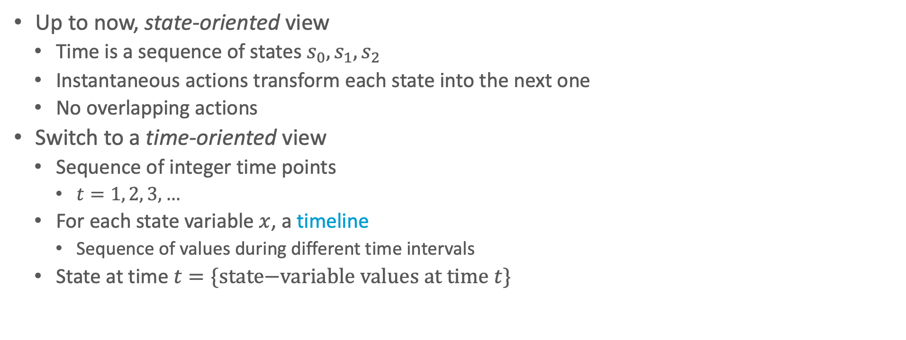
Timelines
Up to now, state-oriented view
Time is a sequence of states $s_{0}, s_{1}, s_{2}$
Instantaneous actions transform each state into the next one
No overlapping actions
Switch to a time-oriented view
Sequence of integer time points
$t=1, 2, 3, …$
For each state variable $x$, a timeline
Sequence of values during different time intervals
State at time $t=\{\text{state}\text{−}\text{variable} \text{values} \text{at} \text{time} t\}$
t
t+1
x
state variables
y
time
Notes:
Not yet continuous time

Slide 5
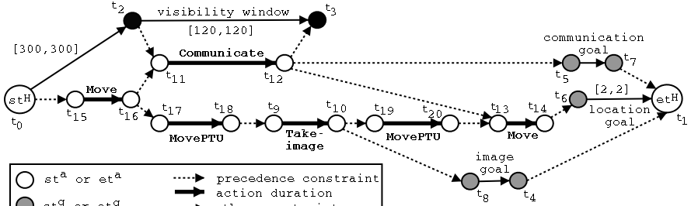
Timelines
Sets of constraints on state variables and events
Reflect predicted actions and events
Planning is constraint-based
Notes:
Timeline planning: constraint-based planning

Slide 6
Outline per the Book
4.2 Representation
Timelines
Actions and tasks
Chronicles
4.3 Temporal Planning
Resolvers and flaws
Search space
4.4 Constraint Management
Consistency of object constraints and time constraints
Controlling the actions when we do not know how long they will take
4.5 Acting with Temporal Models
Acting with atemporal refinement
Dispatching
Observation actions
Notes:
4.1 Intro

Slide 7
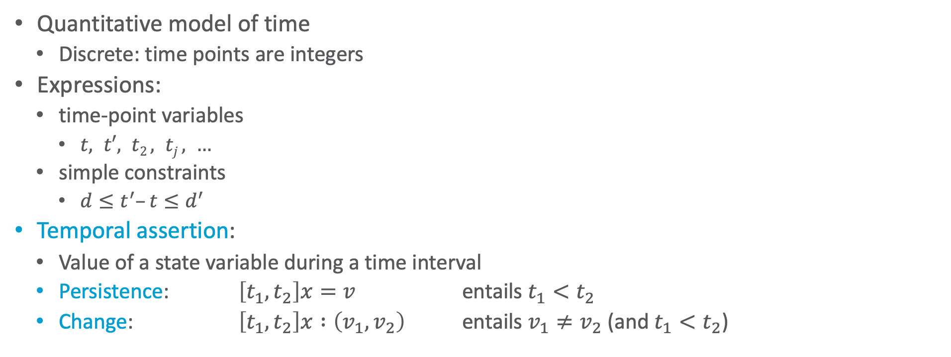
Representation
Quantitative model of time
Discrete: time points are integers
Expressions:
time-point variables
$t, t′, t2 , tj , …$
simple constraints
$d≤t^{′}–t≤d^{′}$
Temporal assertion:
Value of a state variable during a time interval
Persistence: $\left[t_{1}, t_{2}\right]x=v$ entails $t_{1}<t_{2}$
Change: $\left[t_{1}, t_{2}\right]x :\left(v_{1}, v_{2}\right)$ entails $v_{1}≠v_{2}$ (and $t_{1}<t_{2}$)

Slide 8

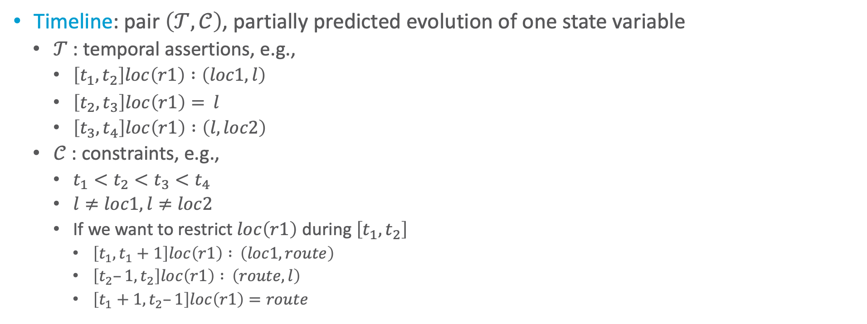







Timeline
Timeline: pair $\left(𝒯,𝒞\right)$, partially predicted evolution of one state variable
$𝒯$: temporal assertions, e.g.,
$\left[t_{1}, t_{2}\right]loc\left(r1\right) :\left(loc1, l\right)$
$\left[t_{2}, t_{3}\right]loc\left(r1\right)= l$
$\left[t_{3}, t_{4}\right]loc\left(r1\right) :\left(l, loc2\right)$
$𝒞$ : constraints, e.g.,
$t_{1}<t_{2}<t_{3}<t_{4}$
$l≠loc1,l≠loc2$
If we want to restrict $loc\left(r1\right)$ during $\left[t_{1}, t_{2}\right]$
$\left[t_{1}, t_{1}+1\right]loc\left(r1\right) : \left(loc1, route\right)$
$\left[t_{2}–1, t_{2}\right]loc\left(r1\right) : \left(route,l\right)$
$\left[t_{1}+1, t_{2}–1\right]loc\left(r1\right)=route$
$$l$$
Persistence
$$loc\left(r1\right)$$
$$loc1$$
Change
$$loc2$$
$$t_{1}$$
$$t_{2}$$
$$t_{3}$$
$$t_{4}$$
Notes:
A timeline does not say anything about when it happens and how much time passes between the ti’s
Constraints with route make it that r1 leaves loc1 at t1 and arrives at l at t2 and is in some intermediate state route in between

Slide 9

Timeline
Instance of $\left(𝒯,𝒞\right)$ = temporal and object variables instantiated
An instance is consistent if it satisfies all constraints in $𝒞$ and does not specify two different values for a state variable at the same time
A timeline is secure if its set of consistent instances is not empty
$$l$$
Persistence
$$loc\left(r1\right)$$
$$loc1$$
Change
$$loc2$$
$$t_{1}$$
$$t_{2}$$
$$t_{3}$$
$$t_{4}$$
Notes:
A timeline does not say anything about when it happens and how much time passes between the ti’s
Constraints with route make it that r1 leaves loc1 at t1 and arrives at l at t2 and is in some intermediate state route in between

Slide 10

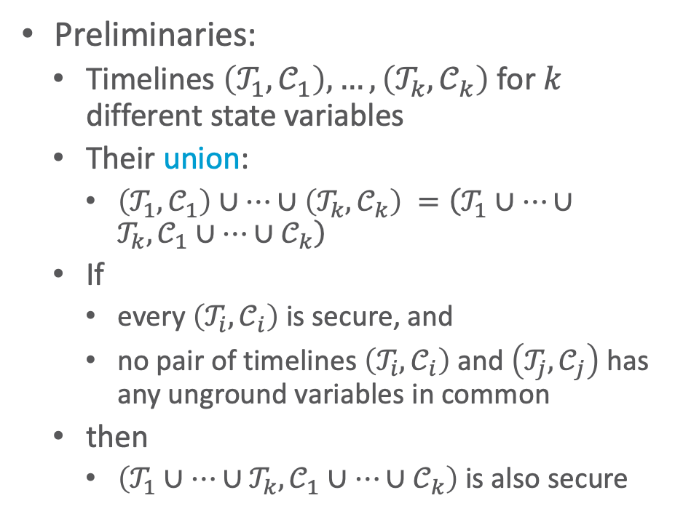
Actions
Preliminaries:
Timelines $\left(𝒯_{1},𝒞_{1}\right), …,\left(𝒯_{k},𝒞_{k}\right)$ for $k$ different state variables
Their union:
$\left(𝒯_{1},𝒞_{1}\right)∪…∪\left(𝒯_{k},𝒞_{k}\right) =\left(𝒯_{1}∪…∪𝒯_{k}, 𝒞_{1}∪…∪𝒞_{k}\right)$
If
every $\left(𝒯_{i},𝒞_{i}\right)$ is secure, and
no pair of timelines $\left(𝒯_{i},𝒞_{i}\right)$ and $\left(𝒯_{j},𝒞_{j}\right)$ has any unground variables in common
then
$\left(𝒯_{1}∪…∪𝒯_{k}, 𝒞_{1}∪…∪𝒞_{k}\right)$ is also secure
Action or primitive task (or just primitive):
a triple $\left(head,𝒯,𝒞\right)$
$head$ is the name and arguments
$\left(𝒯,𝒞\right)$ is the union of a set of timelines
Primitive at the planning level
May be further refined at the acting level

Slide 11
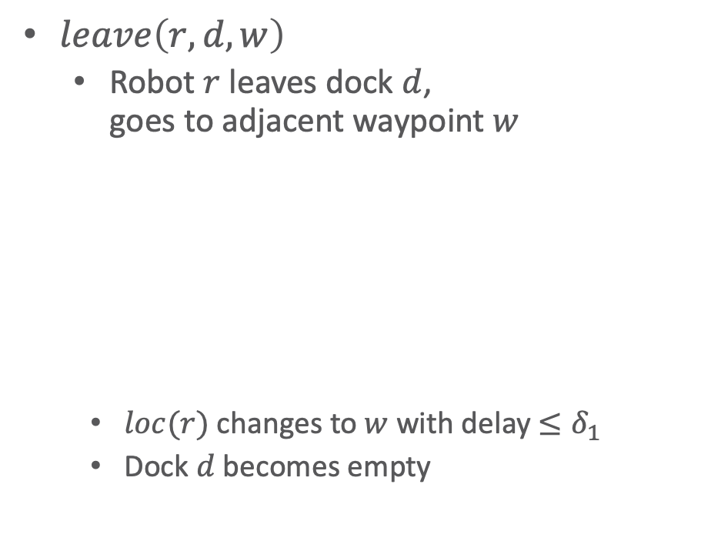
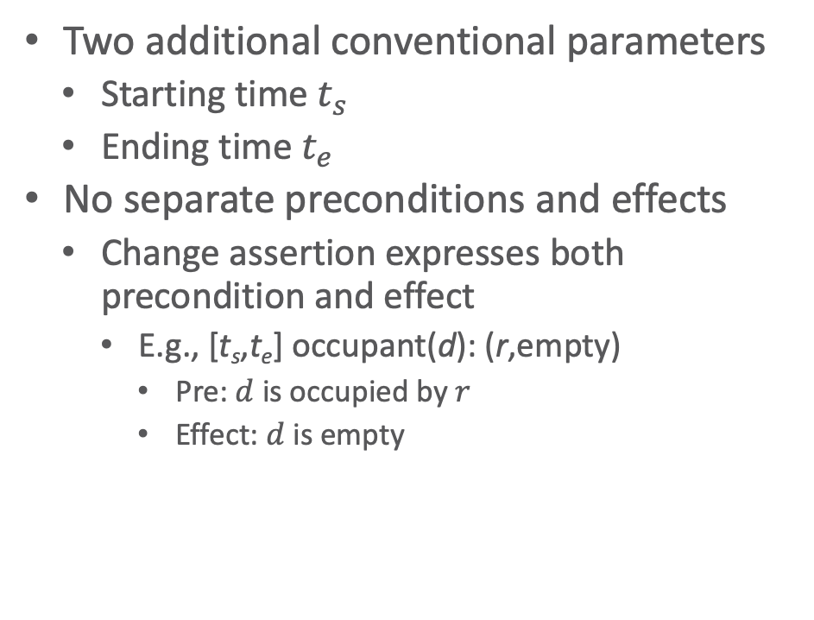
Actions
$leave\left(r,d,w\right)$
Robot $r$ leaves dock $d$, goes to adjacent waypoint $w$
$loc(r)$ changes to $w$ with delay $≤δ_{1}$
Dock $d$ becomes empty
Two additional conventional parameters
Starting time $t_{s}$
Ending time $t_{e}$
No separate preconditions and effects
Change assertion expresses both precondition and effect
E.g., [t_{s},t_{e}] occupant(d): (r,empty)
Pre: $d$ is occupied by $r$
Effect: $d$ is empty
leave(r,d,w)
assertions:
[t_{s},t_{e}] loc(r): (d,w)
[t_{s},t_{e}] occupant(d): (r,empty)
constraints:
t_{e} ≤ t_{s} + δ₁
adj(d,w)
• w
r
d

Slide 12


Actions
r
• w
$enter\left(r,d,w\right)$
Robot $r$ enters dock $d$ from an adjacent waypoint $w$
$loc(r)$ changes to $d$ with delay $≤δ_{2}$
Dock $d$ becomes occupied by $r$
$take\left(k,c,r,d\right)$
Action: crane $k$ takes container $c$ from $r$ on dock $d$
k
d
c
enter(r,d,w)
assertions:
[t_{s},t_{e}] loc(r): (w,d) [t_{s},t_{e}] occupant(d): (empty,r)
constraints:
t_{e} ≤ t_{s} + δ₂ adj(d,w)
r
book omits d
d
take(k,c,r,d) // crane k, container c, robot r, dock d
assertions:
[t_{s},t_{e}] pos(c): (r, k) // where c is
[t_{s},t_{e}] grip(k): (empty, c) // what k’s gripper is holding
[t_{s},t_{e}] freight(r): (c,empty) // what r is carrying
[t_{s},t_{e}] loc(r) = d // where r is
constraints: attached(k,d)

Slide 13
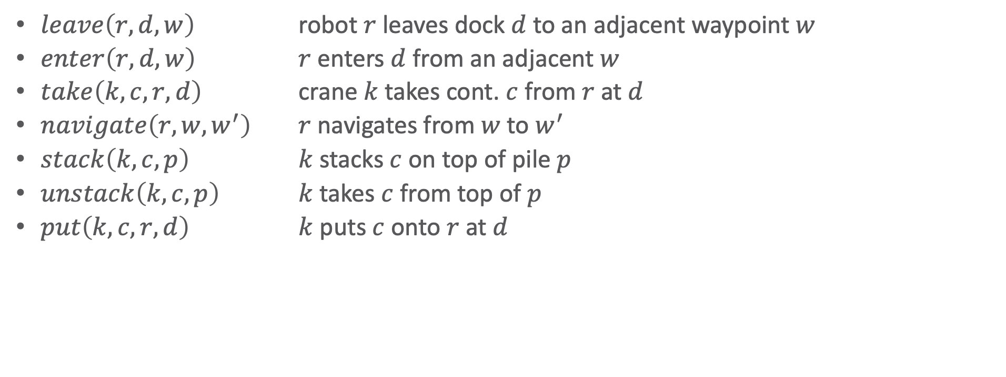
Actions in the Example
$leave\left(r,d,w\right)$ robot $r$ leaves dock $d$ to an adjacent waypoint $w$
$enter\left(r,d,w\right)$ $r$ enters $d$ from an adjacent $w$
$take\left(k,c,r,d\right)$ crane $k$ takes cont. $c$ from $r$ at $d$
$navigate\left(r,w,w^{′}\right)$ $r$ navigates from $w$ to $w^{′}$
$stack\left(k,c,p\right)$ $k$ stacks $c$ on top of pile $p$
$unstack\left(k,c,p\right)$ $k$ takes $c$ from top of $p$
$put\left(k,c,r,d\right)$ $k$ puts $c$ onto $r$ at $d$
k
book omits d
c
• w
r
d

Slide 14



Tasks and Methods
Methods implement a given task using refinements
Refinements can be actions or tasks again
Example only with actions as refinements
Task: move robot r to dock d, i.e., $\left[t_{s},t_{e}\right]move\left(r,d\right)$
Method:
$$\left[t_{s},t_{e}\right]move\left(r,d\right)$$
navigate
leave
enter
m-move1(r,d,d′,w,w′)
task: move(r,d)
refinement: [t_{s},t₁] leave(r,d′,w′) [t₂,t₃] navigate(r,w′,w) [t₄,t_{e}] enter(r,d,w)
assertions: [t_{s},t_{s}+1] loc(r) = d′
constraints: adj(d,w), adj(d′,w′), d ≠ d′, connected(w,w′), t₁ ≤ t₂, t₃ ≤ t₄
t_{s} t₁ t₂ t₃ t₄ t_{e}
$d^{′}$ becomes empty during $\left[t_{s},t_{1}\right]$ ➝ Another robot may enter it after $t_{1}$
$d$ does not need to be empty until $t_{4}$ ➝ When $r$ starts entering it
• w2
d2
• w1
r1
d1
Notes:
Refinements: all actions

Slide 15


Tasks and Methods
Task: remove everything above container $c$ in pile $p$
$\left[t_{s},t_{e}\right]uncover\left(c,p\right)$
Method:
$$\left[t_{s},t_{e}\right]uncover\left(c,p\right)$$
stack
unstack
uncover
m-uncover(c,p,k,d,p′) task: uncover(c,p)
refinement: [t_{s},t₁] unstack(k,c′,p) // action [t₂,t₃] stack(k,c′,p′) // action [t₄,t_{e}] uncover(c,p) // recursion
assertions: [t_{s},t_{s}+1] pile(c) = p [t_{s},t_{s}+1] top(p) = c′ [t_{s}, t_{s}+1] grip(k) = empty
constraints: attached(k,d), attached(p,d), attached(p′,d), p ≠ p′, c′ ≠ c, t₁ ≤ t₂, t₃ ≤ t₄
t_{s} t₁ t₂ t₃ t₄ t_{e}
k1
c1
c2
c3
p1
p2
Notes:
Refinements: actions + another task/method

Slide 16




Tasks and Methods
$$\left[t_{s}, t_{e}\right]bring\left(r,c,p\right)$$
pile(c) = p′
freight(r) = empty
move
Task: robot $r$ brings container $c$ to pile $p$
$\left[t_{s}, t_{e}\right]bring\left(r,c,p\right)$
Method:
move
t₁
uncover
load
unload
m-bring(r,c,p,p′,d,d′)
task: bring(r,c,p)
refinement: [t_{s},t₁] move(r,d′) [t_{s},t₂] uncover(c,p′) [t₃,t₄] load(k′,r,c,p′) [t₅,t₆] move(r,d) [t₇,t_{e}] unload(k,r,c,p)
assertions: [t_{s},t₃] pile(c) = p′ [t_{s},t₃] freight(r) = empty
constraints: attached(p′,d′), attached(p,d), d ≠ d′ attached(k′,d′), attached(k,d), k ≠ k′ t₁ ≤ t₃, t₂ ≤ t₃, t₄ ≤ t₅, t₆ ≤ t₇
t₂
Refine into $unstack$ and $put$ primitives
t_{s} t₃ t₄ t₅ t₆ t₇ t_{e}
k2
Refine into $take$ and $stack$ primitives
r1
• w2
d2
k1
p3
• w1
c1
d1
p1
p2
Notes:
Refinements: parallel actions

Slide 17
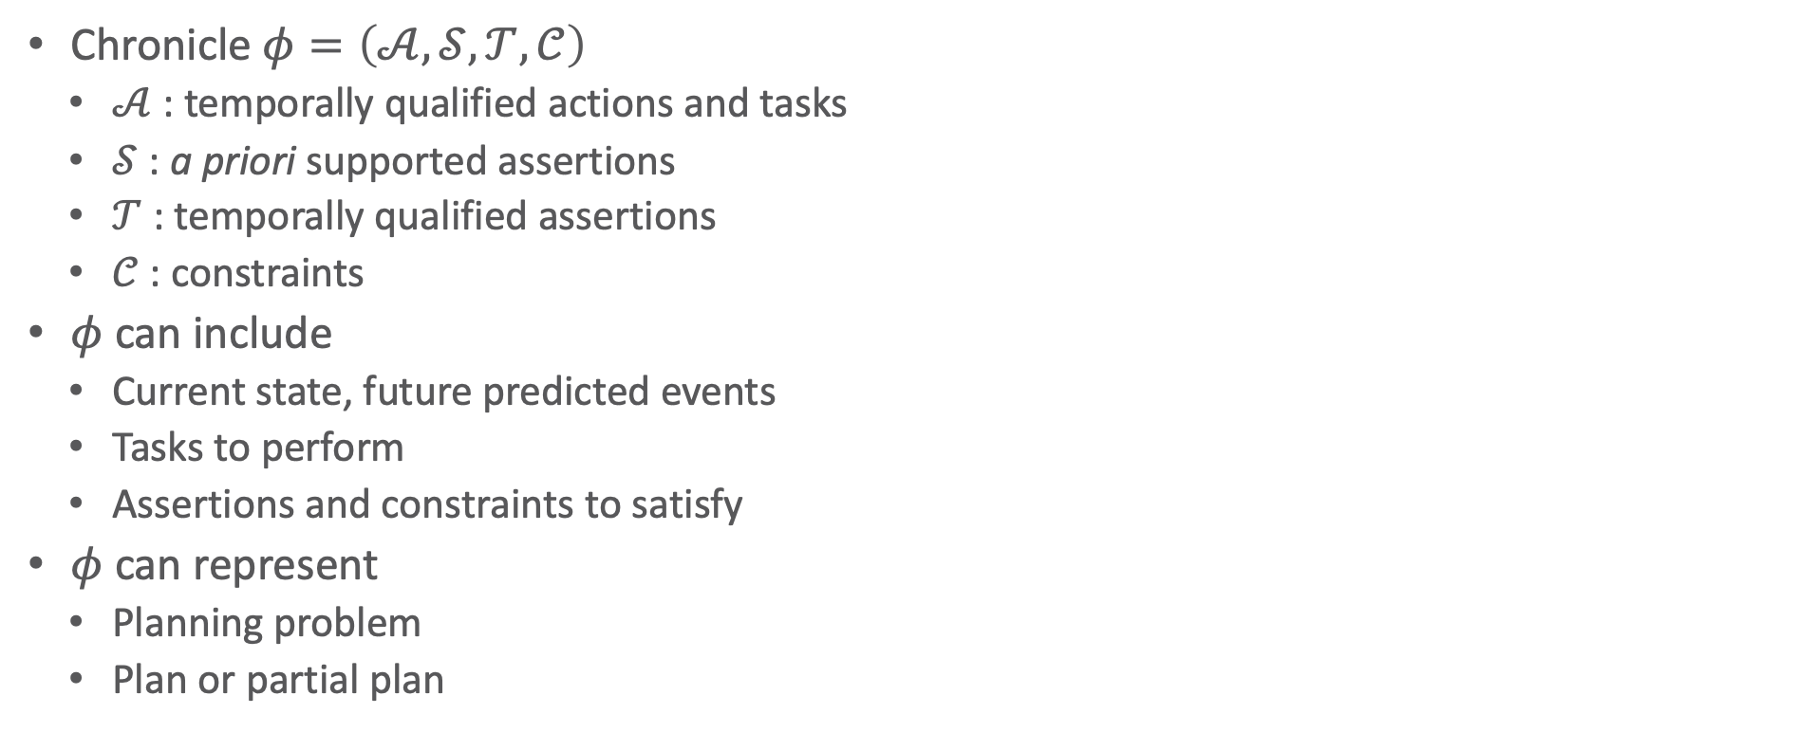

Chronicles: Unions of Timelines
$$\left[t_{s}, t_{e}\right]bring\left(r,c1,d4\right)$$
loc(r1) = d1
top(pile-ship1) = c1
docked(ship1) = d3
loc(r1) = d1
Chronicle $φ=\left(𝒜,𝒮,𝒯,𝒞\right)$
$𝒜$ : temporally qualified actions and tasks
$𝒮$ : a priori supported assertions
$𝒯$ : temporally qualified assertions
$𝒞$ : constraints
$φ$ can include
Current state, future predicted events
Tasks to perform
Assertions and constraints to satisfy
$φ$ can represent
Planning problem
Plan or partial plan
t_{s} t t_{s}+10 t_{s}+𝛿 t’ t_{e}
ϕ₀:
tasks: [t,t’] bring(r,c1,d4)
supported: [t_{s}] loc(r1)=d1 [t_{s}] loc(r2)=d2 [t_{s}+10,t_{s}+δ] docked(ship1)=d3 [t_{s}] top(pile-ship1)=c1 [t_{s}] pos(c1)=pallet
assertions: [t_{e}] loc(r1)=d1 [t_{e}] loc(r2)=d2
constraints: t_{s} = 0 < t < t' < t_{e} , 20 ≤ δ ≤ 30
Notes:
Problem representation that has flaws that need to be resolved ➝ turns problem into plan representation

Slide 18
Intermediate Summary
Timelines
Temporal assertions (change, persistence), constraints
Conflicts, consistency, security, causal support
Chronicle: union of several timelines
Consistency, security, causal support
Actions represented by chronicles
No separate preconditions and effects
Preconditions ⇔ need for causal support

Slide 19
Outline per the Book
4.2 Representation
Timelines
Actions and tasks
Chronicles
4.3 Temporal Planning
Resolvers and flaws
Search space
4.4 Constraint Management
Consistency of object constraints and time constraints
Controlling the actions when we do not know how long they will take
4.5 Acting with Temporal Models
Acting with atemporal refinement
Dispatching
Observation actions
Notes:
4.1 Intro

Slide 20



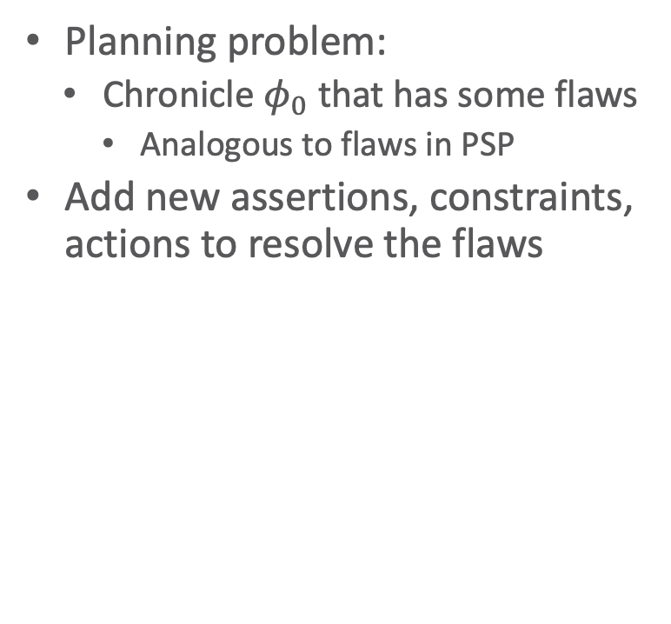













Planning
Planning problem:
Chronicle $φ_{0}$ that has some flaws
Analogous to flaws in PSP
Add new assertions, constraints, actions to resolve the flaws
ϕ₀: tasks: (none)
supported: (none)
assertions: [t₁,t₂] loc(r1) = l
[t₃,t₄] loc(r1) : (loc3,loc4)
constraints: adj(loc3,w1)
adj(w1,loc3)
adj(loc4,w2)
adj(w2,loc4)
connected(w1,w2)
ϕ₁: tasks: [t₂,t₃] move(r1,loc3)
supported: (none)
assertions: [t₁,t₂] loc(r1) = l
[t₃,t₄] loc(r1) : (loc3,loc4)
constraints: adj(loc3,w1)
adj(w1,loc3)
adj(loc4,w2)
adj(w2,loc4)
connected(w1,w2)
$$l$$
$$loc4$$
$$l$$
$$loc4$$
$$loc\left(r1\right)$$
$$loc\left(r1\right)$$
move
$$loc3$$
$$loc3$$
$$t_{1}$$
$$t_{2}$$
$$t_{3}$$
$$t_{4}$$
$$t_{1}$$
$$t_{2}$$
$$t_{3}$$
$$t_{4}$$
Notes:
Keep constraints consistent

Slide 21




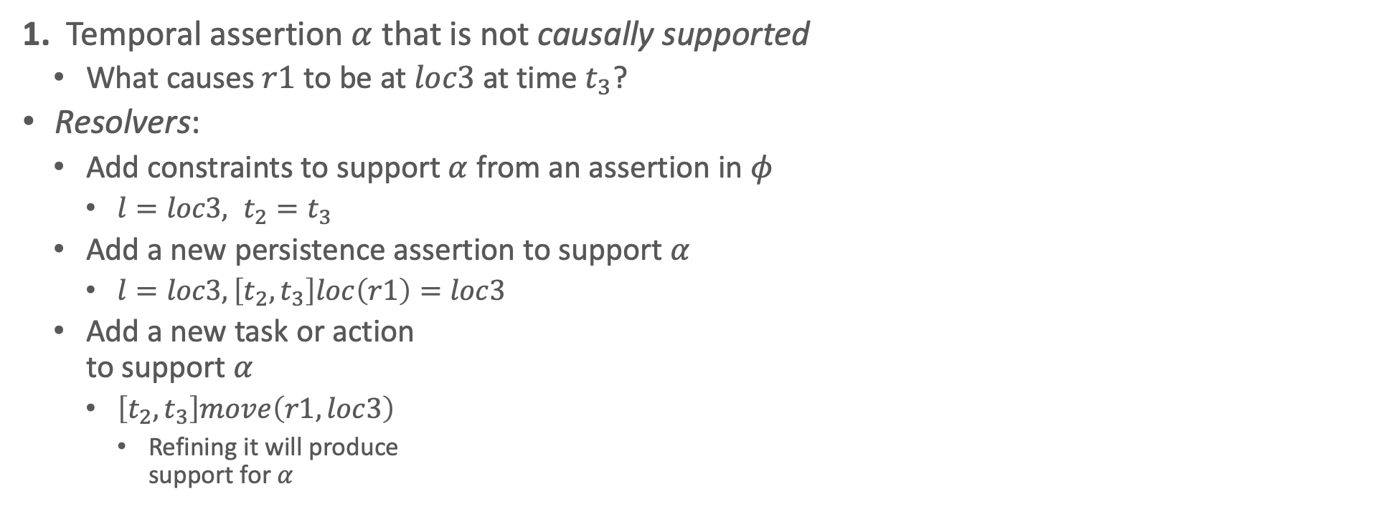

























Flaws (1)
1. Temporal assertion $α$ that is not causally supported
What causes $r1$ to be at $loc3$ at time $t_{3}$?
Resolvers:
Add constraints to support $α$ from an assertion in $φ$
$l=loc3, t_{2}=t_{3}$
Add a new persistence assertion to support $α$
$l=loc3, \left[t_{2},t_{3}\right]loc\left(r1\right)=loc3$
Add a new task or action to support $α$
$\left[t_{2},t_{3}\right]move\left(r1,loc3\right)$
Refining it will produce support for $α$
Like an open goal in PSP
$$l$$
$$loc4$$
$$loc\left(r1\right)$$
$$loc3$$
$$t_{1}$$
$$t_{2}$$
$$t_{3}$$
$$t_{4}$$
$$loc4$$
$$loc4$$
$$l$$
$$loc4$$
$$loc\left(r1\right)$$
$$l=loc3$$
$$loc\left(r1\right)$$
$$loc\left(r1\right)$$
move
$$l=loc3$$
$$loc3$$
$$t_{1}$$
$$t_{2}=t_{3}$$
$$t_{4}$$
$$t_{1}$$
$$t_{2}$$
$$t_{3}$$
$$t_{4}$$
$$t_{1}$$
$$t_{2}$$
$$t_{3}$$
$$t_{4}$$

Slide 22
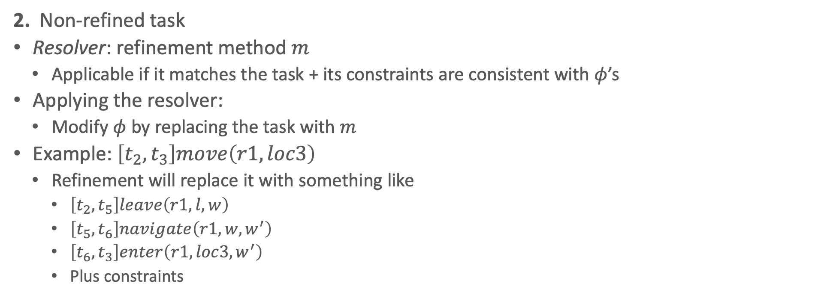
Flaws (2)
2. Non-refined task
Resolver: refinement method $m$
Applicable if it matches the task + its constraints are consistent with $φ$’s
Applying the resolver:
Modify $φ$ by replacing the task with $m$
Example: $\left[t_{2},t_{3}\right]move\left(r1,loc3\right)$
Refinement will replace it with something like
$\left[t_{2},t_{5}\right]leave\left(r1,l,w\right)$
$\left[t_{5},t_{6}\right]navigate\left(r1, w, w^{′}\right)$
$\left[t_{6},t_{3}\right]enter\left(r1,loc3,w^{′}\right)$
Plus constraints
Like a task in SeRPE
$$l$$
$$loc4$$
$$loc\left(r1\right)$$
move
$$loc3$$
$$t_{1}$$
$$t_{2}$$
$$t_{3}$$
$$t_{4}$$

Slide 23

















Flaws (3)
3. A pair of possibly-conflicting temporal assertions
Temporal assertions $α$ and $β$ possibly conflict if they can have inconsistent instances
Example: $\left[t_{1},t_{2}\right]loc\left(r1\right)=loc1, \left[t_{3},t_{4}\right]loc\left(r\right) :\left(l, l^{′}\right)$ ↓ ↓ ↓ ↓ ↓ ↓ ↘ $\left[1, 5\right]loc\left(r1\right)=loc1, \left[3, 8\right]loc\left(r1\right) :\left(loc2,loc3\right)$
Resolvers: separation constraints
$r≠r1$ or $t_{2}<t_{3}$ or $t_{4}<t_{1}$ or
$t_{2}=t_{3}, r=r1, l=loc1$
Also provides causal support for $\left[t_{3},t_{4}\right]loc(r) : \left(l, l^{′}\right)$
$t_{4}=t_{1}, r=r1, l^{′}=loc1$
Also provides causal support for $\left[t_{1},t_{2}\right]loc\left(r1\right)=loc1$
Like a threat in PSP
$$loc1$$
$$l^{′}$$
$$loc\left(r1\right)$$
$$loc\left(r\right)$$
$$l$$
$$t_{1}$$
$$t_{2}$$
$$t_{3}$$
$$t_{4}$$
$$loc1$$
$$loc3$$
$$loc\left(r1\right)$$
$$loc2$$
$$t_{1}=1$$
$$t_{2}=5$$
$$t_{4}=8$$
$$t_{3}=3$$

Slide 24
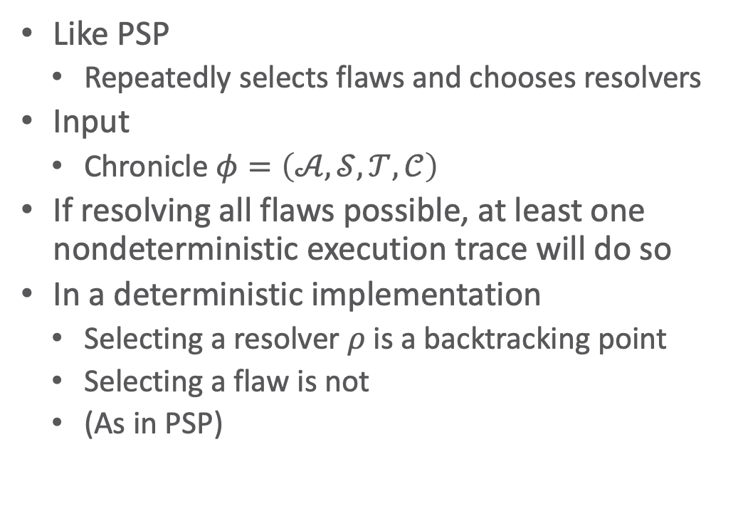
Planning Algorithm
TemPlan(𝜙) // recursive version (book)
Flaws ← set of flaws of 𝜙
if Flaws = ∅ then
return 𝜙
arbitrarily select f ∈ Flaws
Resolvers ← set of resolvers of f
if Resolvers = ∅ then
return failure
nondeterministically choose 𝜌 ∈ Resolvers
𝜙 ← Transform(𝜙, 𝜌)
TemPlan(𝜙,Σ)
Like PSP
Repeatedly selects flaws and chooses resolvers
Input
Chronicle $φ=\left(𝒜,𝒮,𝒯,𝒞\right)$
If resolving all flaws possible, at least one nondeterministic execution trace will do so
In a deterministic implementation
Selecting a resolver $ρ$ is a backtracking point
Selecting a flaw is not
(As in PSP)
TemPlan(𝜙) // iterative version
loop
Flaws ← set of flaws of 𝜙
if Flaws = ∅ then
return 𝜙
arbitrarily select f ∈ Flaws
Resolvers ← set of resolvers of f
if Resolvers = ∅ then
return failure
nondeterministically choose 𝜌 ∈ Resolvers
𝜙 ← Transform(𝜙, 𝜌)
Notes:
All resolvers for a flaw need to be tried to ensure completeness ➝ backtrack
How to do transform, we will see during the example

Slide 25
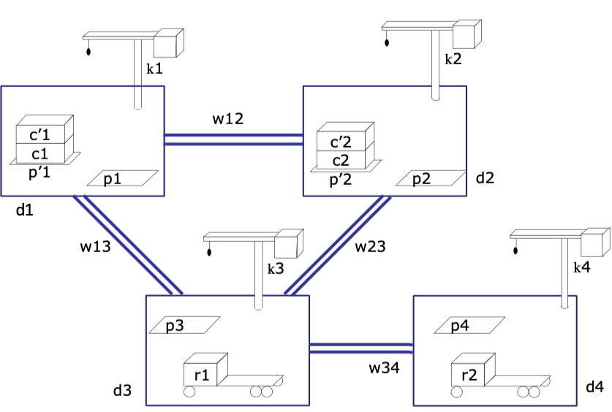

Example
ϕ₀: tasks: bring(r,c1,p3) bring(r′,c2,p4)
supported: [0] loc(r1)=d3
[0] freight(r1)=empty
[0] pile(c1)=p′1
[0] pile(c′1)=p′1
[0] pos(c1)=pallet
[0] pos(c′1)=c1
. . .
assertions: (none)
constraints:
adj(d1,w12)
adj(d1,w13)
. . .
$φ=\left(𝒜,𝒮,𝒯,𝒞\right)$
Establishes state-variable values at time $t=0$
Flaws: two unrefined tasks
bring(r,c1,p3)
bring(r′,c2,p4)

Slide 26
Example
ϕ₀: tasks: bring(r,c1,p3) bring(r′,c2,p4)
supported: [0] loc(r1)=d3
[0] freight(r1)=empty
[0] pile(c1)=p′1
[0] pile(c′1)=p′1
[0] pos(c1)=pallet
[0] pos(c′1)=c1
. . .
assertions: (none)
constraints:
adj(d1,w12)
adj(d1,w13)
. . .
Flaws: two unrefined tasks
bring(r,c1,p3), bring(r′,c2,p4)
Refinement for both:
m-bring(r,c,p,p′,d,d′,k,k′)
task: bring(r,c,p)
refinement: [t_{s},t₁] move(r,d′) [t_{s},t₂] uncover(c,p′) [t₃,t₄] load(k′,r,c,p′) [t₅,t₆] move(r,d) [t₇,t_{e}] unload(k,r,c,p)
assertions: [t_{s},t₃] pile(c) = p′ [t_{s},t₃] freight(r) = empty
constraints: attached(p′,d′), attached(p,d), d ≠ d′ attached(k′,d′), attached(k,d), k ≠ k′ t₁ ≤ t₃, t₂ ≤ t₃, t₄ ≤ t₅, t₆ ≤ t₇

Slide 27

Method Instance
ϕ₀: tasks: bring(r,c1,p3) bring(r′,c2,p4)
supported: [0] loc(r1)=d3
[0] freight(r1)=empty
[0] pile(c1)=p′1
[0] pile(c′1)=p′1
[0] pos(c1)=pallet
[0] pos(c′1)=c1
. . .
assertions: (none)
constraints:
adj(d1,w12)
adj(d1,w13)
. . .
Instantiate $c=c1$ and $p=p3$ to match $bring\left(r,c1,p3\right)$
$p^{′},d,d^{′},k,k^{′}$ instantiated to match book
Needed later to satisfy action preconditions
m-bring(r,c1,p3,p′1,d3,d1,k3,k1)
task: bring(r,c1,p3)
refinement: [t_{s},t₁] move(r,d1) [t_{s},t₂] uncover(c1,p′1) [t₃,t₄] load(k1,r,c1,p′1) [t₅,t₆] move(r, d3) [t₇,t_{e}] unload(k3,r,c1,p3)
assertions: [t_{s},t₃] pile(c1) = p′1 [t_{s},t₃] freight(r) = empty
constraints: attached(p′1,d1), attached(p3,d3), d3 ≠ d1 attached(k1,d1), attached(k3,d3), k3 ≠ k1 t₁ ≤ t₃, t₂ ≤ t₃, t₄ ≤ t₅, t₆ ≤ t₇
Notes:
Instantiation not yet needed

Slide 28

Modified Chronicle
ϕ₁: tasks: [t_{s},t₁] move(r,d1) [t_{s},t₂] uncover(c1,p′1) [t₃,t₄] load(k1,r,c1,p′1) [t₅,t₆] move(r,d3) [t₇,t_{e}] unload(k3,r,c1,p3) bring(r′,c2,p4)
supported: [0] loc(r1)=d3
[0] freight(r1)=empty
[0] pile(c1)=p′1
[0] pile(c′1)=p′1
[0] pos(c1)=pallet
[0] pos(c′1)=c1
. . .
assertions: [t_{s},t₃] pile(c1) = p′1 [t_{s},t₃] freight(r) = empty
constraints: t_{s}<t₁≤t₃, t_{s}<t₂≤t₃, t₄≤t₅, t₆≤t₇, adj(d1,w12), adj(d1,w13),
. . .
Changes to $φ_{0}$
Removed $bring\left(r,c1,p3\right)$
Added 5 tasks, 2 assertions, 10 constraints
Flaws
6 unrefined tasks, 2 unsupported assertions

Slide 29

Method Instance
ϕ₁: tasks: [t_{s},t₁] move(r,d1) [t_{s},t₂] uncover(c1,p′1) [t₃,t₄] load(k1,r,c1,p′1) [t₅,t₆] move(r,d3) [t₇,t_{e}] unload(k3,r,c1,p3) bring(r′,c2,p4)
supported: [0] loc(r1)=d3
[0] freight(r1)=empty
[0] pile(c1)=p′1
[0] pile(c′1)=p′1
[0] pos(c1)=pallet
[0] pos(c′1)=c1
. . .
assertions: [t_{s},t₃] pile(c1) = p′1 [t_{s},t₃] freight(r) = empty
constraints: t_{s}<t₁≤t₃, t_{s}<t₂≤t₃, t₄≤t₅, t₆≤t₇, adj(d1,w12), adj(d1,w13),
. . .
Instantiate $r=r^{′}, c=c2, p=p4$ to match $bring\left(r^{′},c2,p4\right)$
$p^{′},d,d^{′},k,k^{′}$ instantiated to match book again
m-bring(r’,c2,p4,p′2,d4,d2,k4,k2)
task: bring(r’,c2,p4)
refinement: [t_{s},t₁] move(r’,d2) [t_{s},t₂] uncover(c2,p′2) [t₃,t₄] load(k2,r’,c2,p′2) [t₅,t₆] move(r’, d4) [t₇,t_{e}] unload(k4,r’,c2,p4)
assertions: [t_{s},t₃] pile(c2) = p′2 [t_{s},t₃] freight(r’) = empty
constraints: attached(p′2,d2), attached(p4,d4), d4 ≠ d2 attached(k2,d2), attached(k4,d4), k4 ≠ k2 t₁ ≤ t₃, t₂ ≤ t₃, t₄ ≤ t₅, t₆ ≤ t₇
Notes:
Instantiation not yet needed
Is it ok to instantiate $r=r^{′}$?

Slide 30

Modified Chronicle
ϕ₂: tasks: [t_{s},t₁] move(r,d1) [t_{s},t₂] uncover(c1,p′1) [t₃,t₄] load(k1,r,c1,p′1) [t₅,t₆] move(r,d3) [t₇,t_{e}] unload(k3,r,c1,p3)
[t′_{s},t′₁] move(r′,d2) [t′_{s},t′₂] uncover(c2,p′2) [t′₃,t′₄] load(k4,r′,c2,p′2) [t′₅,t′₆] move(r′,d4) [t′₇,t′_{e}] unload(k2,r′,c2,p′2)
supported: [0] loc(r1)=d3
[0] freight(r1)=empty
[0] pile(c1)=p′1
. . .
assertions: [t_{s},t₃] pile(c1) = p′1 [t_{s},t₃] freight(r) = empty [t′_{s},t′₃] pile(c2) = p′2 [t′_{s},t′₁] freight(r′) = empty
constraints: t_{s}<t₁≤t₃, t_{s}<t₂≤t₃, t₄≤t₅, t₆≤t₇, t′_{s}<t′₁≤t′₃, t′_{s}<t′₂≤t′₃, t′₄≤t′₅, t′₆≤t′₇,
adj(d1,w12), adj(d1,w13), . . .
Changes
Removed $bring\left(r^{′},c2,p4\right)$
Added 5 tasks, 2 assertions, 10 constraints
Flaws
10 unrefined tasks, 4 unsupported assertions
Next, work on these two assertions

Slide 31
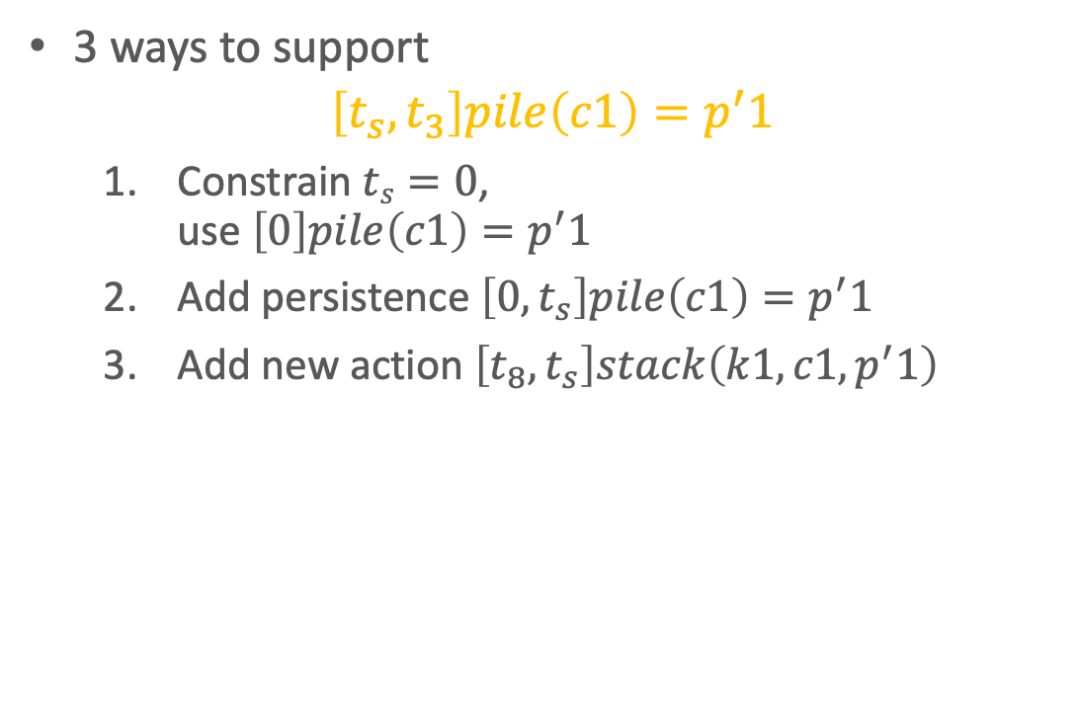
Supporting the Assertions
ϕ₂: tasks: [t_{s},t₁] move(r,d1) [t_{s},t₂] uncover(c1,p′1) [t₃,t₄] load(k1,r,c1,p′1) [t₅,t₆] move(r,d3) [t₇,t_{e}] unload(k3,r,c1,p3)
[t′_{s},t′₁] move(r′,d2) [t′_{s},t′₂] uncover(c2,p′2) [t′₃,t′₄] load(k4,r′,c2,p′2) [t′₅,t′₆] move(r′,d4) [t′₇,t′_{e}] unload(k2,r′,c2,p′2)
supported: [0] loc(r1)=d3
[0] freight(r1)=empty
[0] pile(c1)=p′1
. . .
assertions: [t_{s},t₃] pile(c1) = p′1 [t_{s},t₃] freight(r) = empty [t′_{s},t′₃] pile(c2) = p′2 [t′_{s},t′₁] freight(r′) = empty
constraints: t_{s}<t₁≤t₃, t_{s}<t₂≤t₃, t₄≤t₅, t₆≤t₇, t′_{s}<t′₁≤t′₃, t′_{s}<t′₂≤t′₃, t′₄≤t′₅, t′₆≤t′₇,
adj(d1,w12), adj(d1,w13), . . .
3 ways to support
$$\left[t_{s},t_{3}\right]pile\left(c1\right)=p^{′}1$$
Constrain $ts=0$, use $\left[0\right]pile\left(c1\right)=p^{′}1$
Add persistence $\left[0,t_{s}\right]pile\left(c1\right)=p^{′}1$
Add new action $\left[t_{8},t_{s}\right]stack\left(k1,c1, p^{′}1\right)$
Will any of them also provide support for [t_{s},t₃] freight(r) = empty ?
Notes:
No

Slide 32
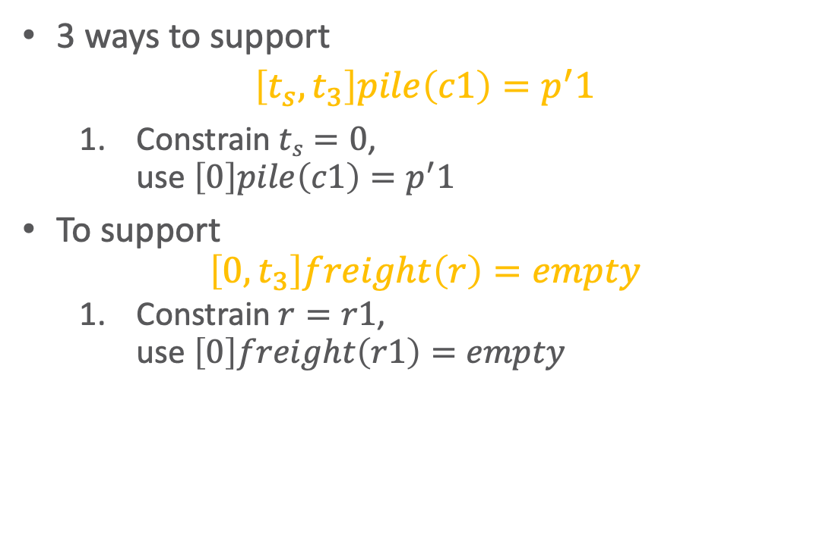
Supporting the Assertions
ϕ₂: tasks: [0,t₁] move(r,d1) [0,t₂] uncover(c1,p′1) [t₃,t₄] load(k1,r,c1,p′1) [t₅,t₆] move(r,d3) [t₇,t_{e}] unload(k3,r,c1,p3)
[t′_{s},t′₁] move(r′,d2) [t′_{s},t′₂] uncover(c2,p′2) [t′₃,t′₄] load(k4,r′,c2,p′2) [t′₅,t′₆] move(r′,d4) [t′₇,t′_{e}] unload(k2,r′,c2,p′2)
supported: [0] loc(r1)=d3
[0] freight(r1)=empty
[0] pile(c1)=p′1 . . . [0,t₃] pile(c1) = p′1 assertions: [0,t₃] freight(r) = empty
[t′_{s},t′₃] pile(c2) = p′2 [t′_{s},t′₁] freight(r′) = empty
constraints: 0<t₁≤t₃, 0<t₂≤t₃, t₄≤t₅, t₆≤t₇, t′_{s}<t′₁≤t′₃, t′_{s}<t′₂≤t′₃, t′₄≤t′₅, t′₆≤t′₇,
adj(d1,w12), adj(d1,w13), . . .
3 ways to support
$$\left[t_{s},t_{3}\right]pile\left(c1\right)=p^{′}1$$
Constrain $ts=0$, use $\left[0\right]pile\left(c1\right)=p^{′}1$
To support
$$\left[0,t_{3}\right]freight\left(r\right)=empty$$
Constrain $r=r1$, use $\left[0\right]freight\left(r1\right)=empty$
Notes:
Should 0<t1, 0<t2 have been there already?

Slide 33
Supporting the Assertions
ϕ₂: tasks: [0,t₁] move(r1,d1) [0,t₂] uncover(c1,p′1) [t₃,t₄] load(k1,r1,c1,p′1) [t₅,t₆] move(r1,d3) [t₇,t_{e}] unload(k3,r1,c1,p3)
[t′_{s},t′₁] move(r′,d2) [t′_{s},t′₂] uncover(c2,p′2) [t′₃,t′₄] load(k4,r′,c2,p′2) [t′₅,t′₆] move(r′,d4) [t′₇,t′_{e}] unload(k2,r′,c2,p′2)
supported: [0] loc(r1)=d3
[0] freight(r1)=empty
[0] pile(c1)=p′1 . . . [0,t₃] pile(c1) = p′1 [0,t₃] freight(r1) = empty
assertions: [t′_{s},t′₃] pile(c2) = p′2 [t′_{s},t′₁] freight(r′) = empty
constraints: 0<t₁≤t₃, 0<t₂≤t₃, t₄≤t₅, t₆≤t₇, t′_{s}<t′₁≤t′₃, t′_{s}<t′₂≤t′₃, t′₄≤t′₅, t′₆≤t′₇,
adj(d1,w12), adj(d1,w13), . . .
3 ways to support
$$\left[t_{s},t_{3}\right]pile\left(c1\right)=p^{′}1$$
Constrain $ts=0$, use $\left[0\right]pile\left(c1\right)=p^{′}1$
To support
$$\left[0,t_{3}\right]freight\left(r\right)=empty$$
Constrain $r=r1$, use $\left[0\right]freight\left(r1\right)=empty$
Notes:
Should 0<t1, 0<t2 have been there already?

Slide 34

Supporting the Assertions
ϕ₂: tasks: [0,t₁] move(r1,d1) [0,t₂] uncover(c1,p′1) [t₃,t₄] load(k1,r1,c1,p′1) [t₅,t₆] move(r1,d3) [t₇,t_{e}] unload(k3,r1,c1,p3)
[t′_{s},t′₁] move(r′,d2) [t′_{s},t′₂] uncover(c2,p′2) [t′₃,t′₄] load(k4,r′,c2,p′2) [t′₅,t′₆] move(r′,d4) [t′₇,t′_{e}] unload(k2,r′,c2,p′2)
supported: [0] loc(r1)=d3
[0] freight(r1)=empty
[0] pile(c1)=p′1 . . . [0,t₃] pile(c1) = p′1 [0,t₃] freight(r1) = empty
assertions: [t′_{s},t′₃] pile(c2) = p′2 [t′_{s},t′₁] freight(r′) = empty
constraints: 0<t₁≤t₃, 0<t₂≤t₃, t₄≤t₅, t₆≤t₇, t′_{s}<t′₁≤t′₃, t′_{s}<t′₂≤t′₃, t′₄≤t′₅, t′₆≤t′₇,
adj(d1,w12), adj(d1,w13), . . .
To support
$$\left[t_{s}^{′},t_{3}^{′}\right]pile\left(c2\right)=p^{′}2$$
Add persistence condition $\left[0,t_{s}^{′}\right]pile\left(c2\right)=p^{′}2$
Constrain $t_{s}^{′}=0$
Add new action $stack\left(k2,c2, p^{′}2\right)$
Notes:
Different choice to see effect

Slide 35
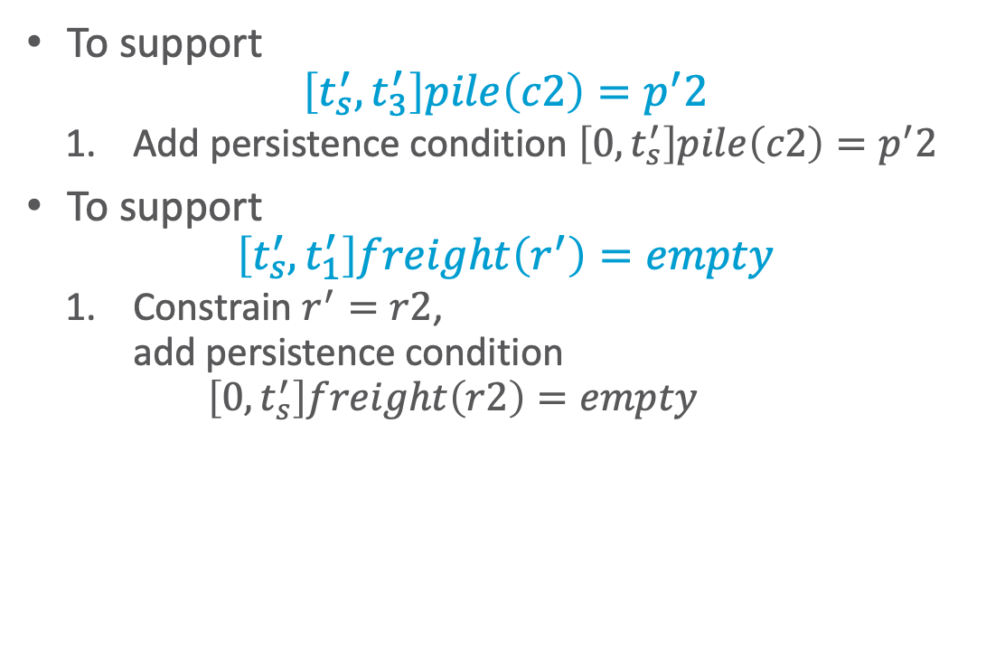
Supporting the Assertions
ϕ₂: tasks: [0,t₁] move(r1,d1) [0,t₂] uncover(c1,p′1) [t₃,t₄] load(k1,r1,c1,p′1) [t₅,t₆] move(r1,d3) [t₇,t_{e}] unload(k3,r1,c1,p3)
[t′_{s},t′₁] move(r′,d2) [t′_{s},t′₂] uncover(c2,p′2) [t′₃,t′₄] load(k4,r′,c2,p′2) [t′₅,t′₆] move(r′,d4) [t′₇,t′_{e}] unload(k2,r′,c2,p′2)
supported: [0] loc(r1)=d3
[0] freight(r1)=empty
[0] pile(c1)=p′1 . . . [0,t₃] pile(c1) = p′1 [0,t₃] freight(r1) = empty
[0,t′_{s}] pile(c2)=p′2
[t′_{s},t′₃] pile(c2) = p′2
assertions: [t′_{s},t′₁] freight(r′) = empty
constraints: 0<t₁≤t₃, 0<t₂≤t₃, t₄≤t₅, t₆≤t₇, t′_{s}<t′₁≤t′₃, t′_{s}<t′₂≤t′₃, t′₄≤t′₅, t′₆≤t′₇,
adj(d1,w12), adj(d1,w13), . . .
To support
$$\left[t_{s}^{′},t_{3}^{′}\right]pile\left(c2\right)=p^{′}2$$
Add persistence condition $\left[0,t_{s}^{′}\right]pile\left(c2\right)=p^{′}2$
To support
$$\left[t_{s}^{′},t_{1}^{′}\right]freight\left(r^{′}\right)=empty$$
Constrain $r^{′}=r2$, add persistence condition $\left[0,t_{s}^{′}\right]freight\left(r2\right)=empty$
Notes:
Persistence condition [0,t′_{s}] freight(r2)=empty because ts’ not constrained to 0 (compare to ts)

Slide 36
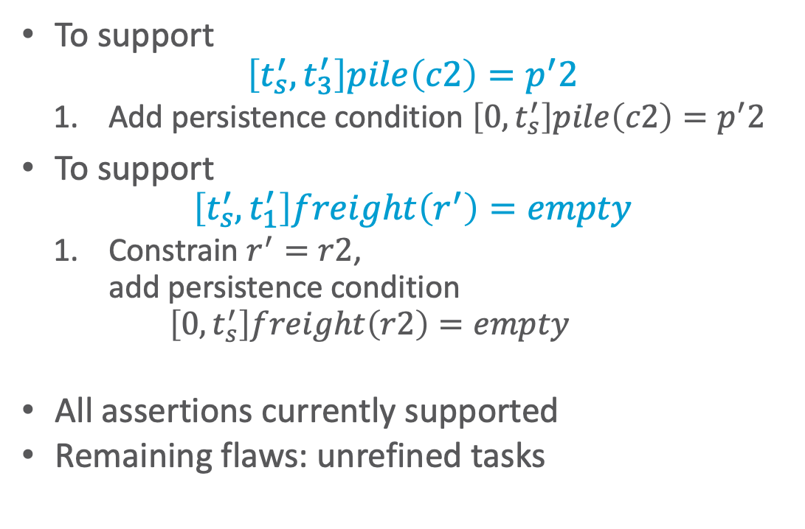
Supporting the Assertions
ϕ₂: tasks: [0,t₁] move(r1,d1) [0,t₂] uncover(c1,p′1) [t₃,t₄] load(k1,r1,c1,p′1) [t₅,t₆] move(r1,d3) [t₇,t_{e}] unload(k3,r1,c1,p3)
[t′_{s},t′₁] move(r2,d2) [t′_{s},t′₂] uncover(c2,p′2) [t′₃,t′₄] load(k4,r2,c2,p′2) [t′₅,t′₆] move(r2,d4) [t′₇,t′_{e}] unload(k2,r2,c2,p′2)
supported: [0] loc(r1)=d3
[0] freight(r1)=empty
[0] pile(c1)=p′1 . . . [0,t₃] pile(c1) = p′1 [0,t₃] freight(r1) = empty
[0,t′_{s}] pile(c2)=p′2 [t′_{s},t′₃] pile(c2) = p′2 [0,t′_{s}] freight(r2)=empty [t′_{s},t′₁] freight(r2) = empty
assertions: (none)
constraints: 0<t₁≤t₃, 0<t₂≤t₃, t₄≤t₅, t₆≤t₇, t′_{s}<t′₁≤t′₃, t′_{s}<t′₂≤t′₃, t′₄≤t′₅, t′₆≤t′₇,
adj(d1,w12),adj(d1,w13), . . .
To support
$$\left[t_{s}^{′},t_{3}^{′}\right]pile\left(c2\right)=p^{′}2$$
Add persistence condition $\left[0,t_{s}^{′}\right]pile\left(c2\right)=p^{′}2$
To support
$$\left[t_{s}^{′},t_{1}^{′}\right]freight\left(r^{′}\right)=empty$$
Constrain $r^{′}=r2$, add persistence condition $\left[0,t_{s}^{′}\right]freight\left(r2\right)=empty$
All assertions currently supported
Remaining flaws: unrefined tasks
Notes:
Persistence condition [0,t′_{s}] freight(r2)=empty because ts’ not constrained to 0 (compare to ts)

Slide 37
Example of Conflicts
ϕ₂: tasks: [0,t₁] move(r1,d1) [0,t₂] uncover(c1,p′1) [t₃,t₄] load(k1,r1,c1,p′1) [t₅,t₆] move(r1,d3) [t₇,t_{e}] unload(k3,r1,c1,p3)
[t′_{s},t′₁] move(r2,d2) [t′_{s},t′₂] uncover(c2,p′2) [t′₃,t′₄] load(k4,r2,c2,p′2) [t′₅,t′₆] move(r2,d4) [t′₇,t′_{e}] unload(k2,r2,c2,p′2)
supported: [0] loc(r1)=d3
[0] freight(r1)=empty
[0] pile(c1)=p′1 . . . [0,t₃] pile(c1) = p′1 [0,t₃] freight(r1) = empty
[0,t′_{s}] pile(c2)=p′2 [t′_{s},t′₃] pile(c2) = p′2 [0,t′_{s}] freight(r2)=empty [t′_{s},t′₁] freight(r2) = empty
assertions: (none)
constraints: 0<t₁≤t₃, 0<t₂≤t₃, t₄≤t₅, t₆≤t₇, t′_{s}<t′₁≤t′₃, t′_{s}<t′₂≤t′₃, t′₄≤t′₅, t′₆≤t′₇,
adj(d1,w12),adj(d1,w13), . . .
Refining tasks into actions will produce possibly-conflicting assertions
move(r2,d4) must go from d2 through d3
Conflict: occupant(d3)=r1, occupant(d3)=r2
Resolvers:
Separation constraints to ensure r2 only goes through d3 while r1 away from d3
E.g., by ensuring move(r1,d1) has happened

Slide 38
Heuristics for Guiding TemPlan
TemPlan(𝜙)
Flaws ← set of flaws of 𝜙
if Flaws = ∅ then
return 𝜙
arbitrarily select f ∈ Flaws
Resolvers ← set of resolvers of f
if Resolvers = ∅ then
return failure
nondeterministically choose 𝜌 ∈ Resolvers
𝜙 ← Transform(𝜙, 𝜌)
TemPlan(𝜙)
Flaw selection, resolver selection heuristics similar to those in PSP
Select the flaw with the smallest number of resolvers
Choose the resolver that rules out the fewest resolvers for the other flaws
There is also a problem with constraint management
We ignored it when discussing PSP
We discuss it next
PSP(Σ,𝜋)
loop
if Flaws(𝜋) = ∅ then
return 𝜋
arbitrarily select f ∈ Flaws(𝜋)
R ←{all feasible resolvers for f}
if R = ∅ then
return failure
nondeterministically choose ρ ∈ R
𝜋 ← ρ(𝜋)
return 𝜋

Slide 39
Intermediate Summary
Planning problems
Three kinds of flaws and their resolvers:
tasks (that need to be refined),
causal support (for assertions),
security (of instantiations)
Partial plans, solution plans
Planning: TemPlan
Like PSP but with tasks, temporal assertions, temporal constraints

Slide 40
Outline per the Book
4.2 Representation
Timelines
Actions and tasks
Chronicles
4.3 Temporal Planning
Resolvers and flaws
Search space
4.4 Constraint Management
Consistency of object constraints and time constraints
Controlling the actions when we do not know how long they will take
4.5 Acting with Temporal Models
Acting with atemporal refinement
Dispatching
Observation actions
Notes:
4.1 Intro

Slide 41
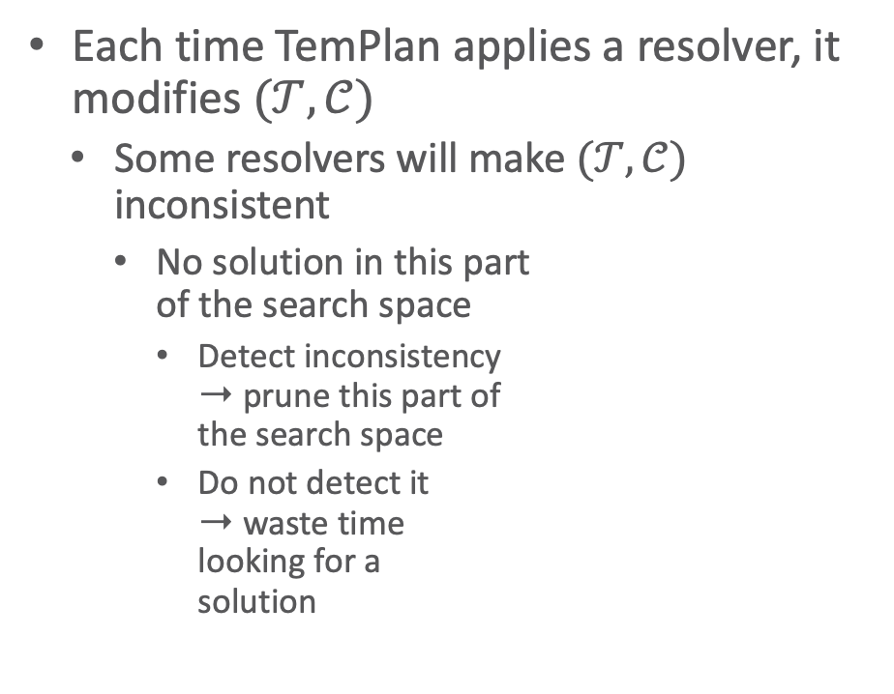
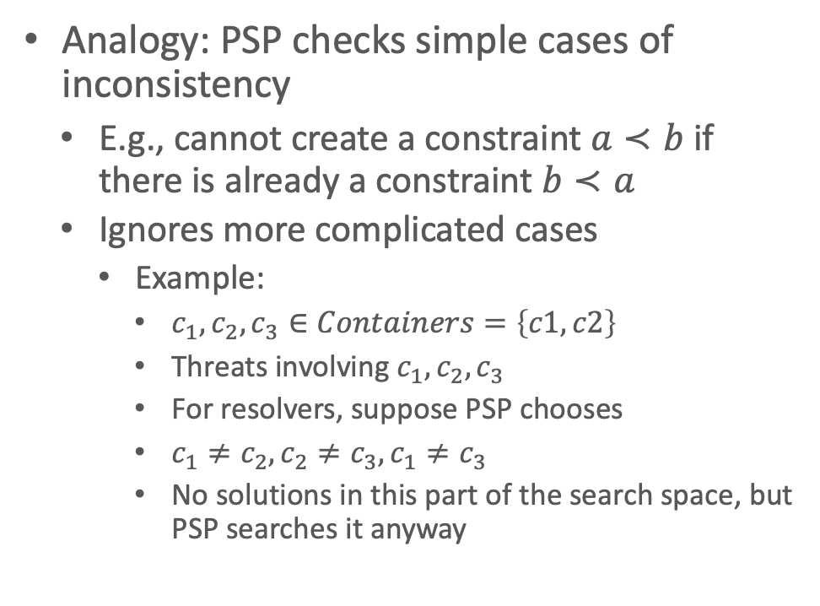
Constraint Management
Each time TemPlan applies a resolver, it modifies $(𝒯,𝒞)$
Some resolvers will make $(𝒯,𝒞)$ inconsistent
No solution in this part of the search space
Detect inconsistency ➝ prune this part of the search space
Do not detect it ➝ waste time looking for a solution
Analogy: PSP checks simple cases of inconsistency
E.g., cannot create a constraint $a≺b$ if there is already a constraint $b≺a$
Ignores more complicated cases
Example:
$c_{1},c_{2}, c_{3}∈Containers=\left\{c1, c2\right\}$
Threats involving $c_{1},c_{2}, c_{3}$
For resolvers, suppose PSP chooses
$c_{1}≠c_{2}, c_{2}≠c_{3}, c_{1}≠c_{3}$
No solutions in this part of the search space, but PSP searches it anyway
Notes:
Example: Because only two different containers c1 and c2 exist

Slide 42
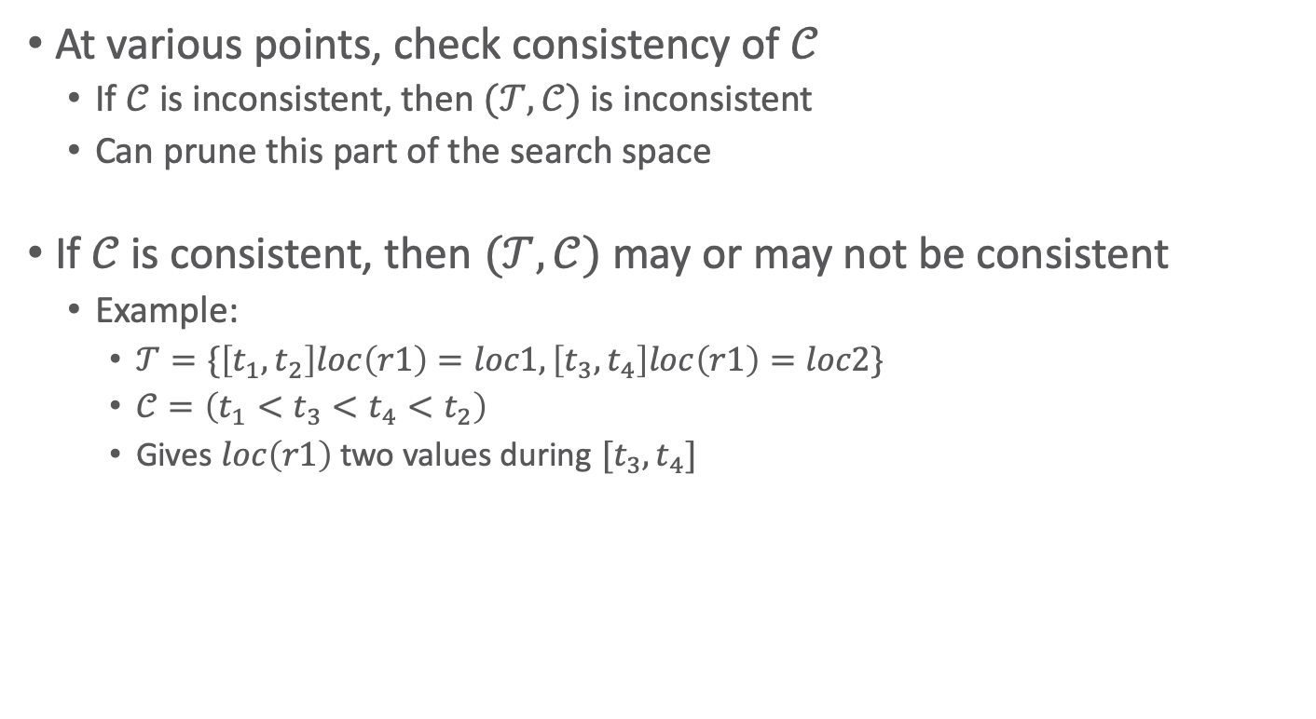
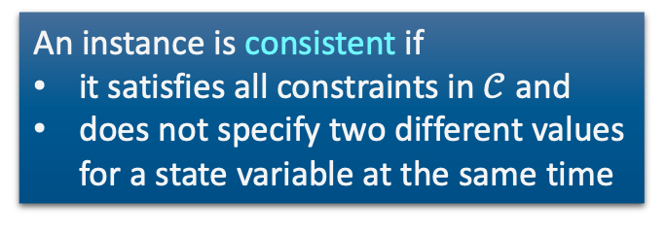
Constraint Management in TemPlan
At various points, check consistency of $𝒞$
If $𝒞$ is inconsistent, then $(𝒯,𝒞)$ is inconsistent
Can prune this part of the search space
If $𝒞$ is consistent, then $(𝒯,𝒞)$ may or may not be consistent
Example:
$𝒯=\{\left[t_{1},t_{2}\right]loc\left(r1\right)=loc1,\left[t_{3},t_{4}\right]loc\left(r1\right)=loc2\}$
$𝒞=\left(t_{1}<t_{3}<t_{4}<t_{2}\right)$
Gives $loc\left(r1\right)$ two values during $[t_{3},t_{4}]$
An instance is consistent if
it satisfies all constraints in $𝒞$ and
does not specify two different values for a state variable at the same time

Slide 43
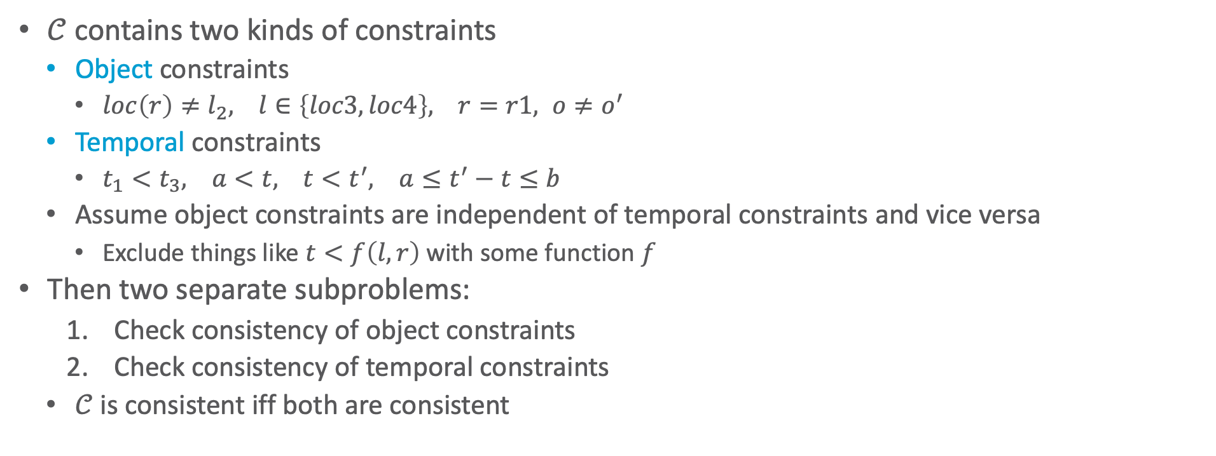

Consistency of $𝒞$
$𝒞$ contains two kinds of constraints
Object constraints
$loc\left(r\right)≠l_{2}, l∈\left\{loc3, loc4\right\}, r=r1, o≠o^{′}$
Temporal constraints
$t_{1}<t_{3}, a<t, t<t^{′}, a≤t^{′}−t≤b$
Assume object constraints are independent of temporal constraints and vice versa
Exclude things like $t<f\left(l,r\right)$ with some function $f$
Then two separate subproblems:
Check consistency of object constraints
Check consistency of temporal constraints
$𝒞$ is consistent iff both are consistent

Slide 44
Object Constraints
Constraint-satisfaction problem – NP-complete
Can write an algorithm that is complete but runs in exponential time
If there is an inconsistency, always finds it
Might prune a lot, but spends lots of time at each node
Instead, use a technique that is incomplete but takes polynomial time
Detects some inconsistencies but not others
Runs much faster, but prunes fewer nodes

Slide 45




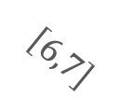
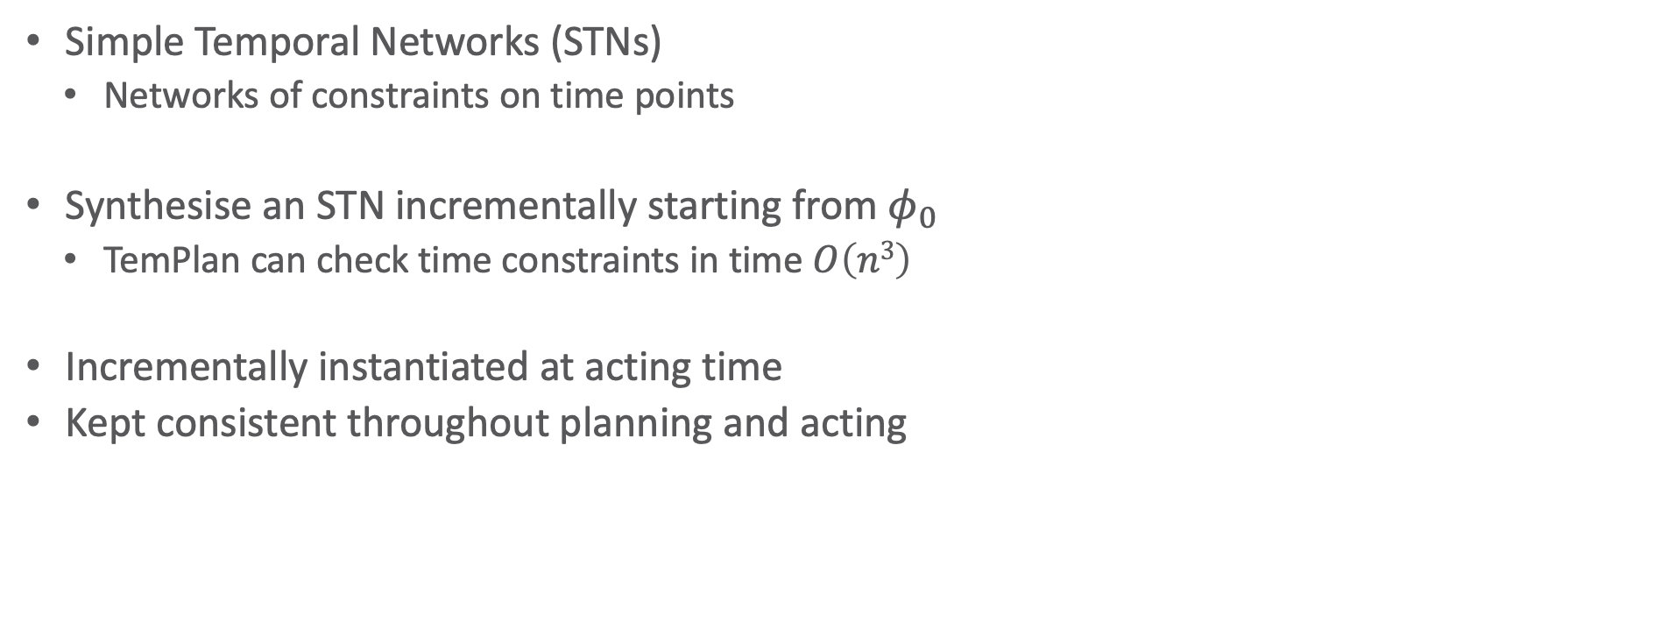






Time Constraints: Representation
Simple Temporal Networks (STNs)
Networks of constraints on time points
Synthesise an STN incrementally starting from $φ_{0}$
TemPlan can check time constraints in time $O\left(n3\right)$
Incrementally instantiated at acting time
Kept consistent throughout planning and acting
$$t_{2}$$
$$\left[3,4\right]$$
$$\left[1,2\right]$$
$$t_{4}$$
$$t_{1}$$
$$\left[1,7\right]$$
$$t_{3}$$
$$\left[1,2\right]$$
$$\left[6,7\right]$$
$$\left[4,5\right]$$
$$t_{5}$$

Slide 46
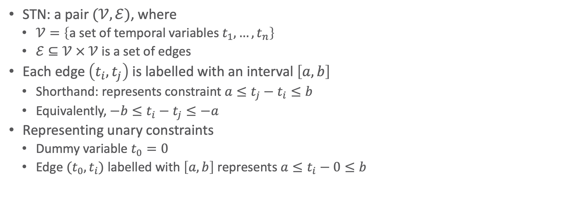
Simple Temporal Networks
STN: a pair $(𝒱,ℰ)$, where
$𝒱=\left\{\text{a} \text{set} \text{of} \text{temporal} \text{variables} t_{1}, …, t_{n}\right\}$
$ℰ⊆𝒱 × 𝒱$ is a set of edges
Each edge $\left(t_{i},t_{j}\right)$ is labelled with an interval $\left[a,b\right]$
Shorthand: represents constraint $a≤t_{j}−t_{i}≤b$
Equivalently, $−b≤t_{i}−t_{j}≤−a$
Representing unary constraints
Dummy variable $t_{0}=0$
Edge $(t_{0},t_{i})$ labelled with $\left[a,b\right]$ represents $a≤t_{i}−0≤b$
t₂
[1,2]
[3,4]
t₁
t₃
[2,3]
t₂
[1,2]
[3,4]
t₁
t₃
[–3,–2]
Notes:
[x,y] before it was an interval in an assertion, now it is a [min,max] duration in a constraint
Minimum duration t1, t2 + t2, t3 : 4 vs. duration between 2 and 3 => inconsistent
Complete calculation:
t1 = x
1 <= t2 - x <= 2 -> t2 = x+1 or t2 = x+2
2 <= t3 - x <= 3 -> t3 = x+2 or t2 = x+3
3 <= t3 - t2 <= 4 -> 3 <= (x + 2 oder 3) – (x + 1 oder 2) <= 4 -> 3 <= 2 oder 3 – 1 oder 2 <= 4
3 <= 2 – 1 <= 4 -> 3 <= 1 <= 4 X
3 <= 2 – 2 <= 4 -> 3 <= 0 <= 4 X
3 <= 3 – 1 <= 4 -> 3 <= 2 <= 4 X
3 <= 3 – 2 <= 4 -> 3 <= 1 <= 4 X
No

Slide 47
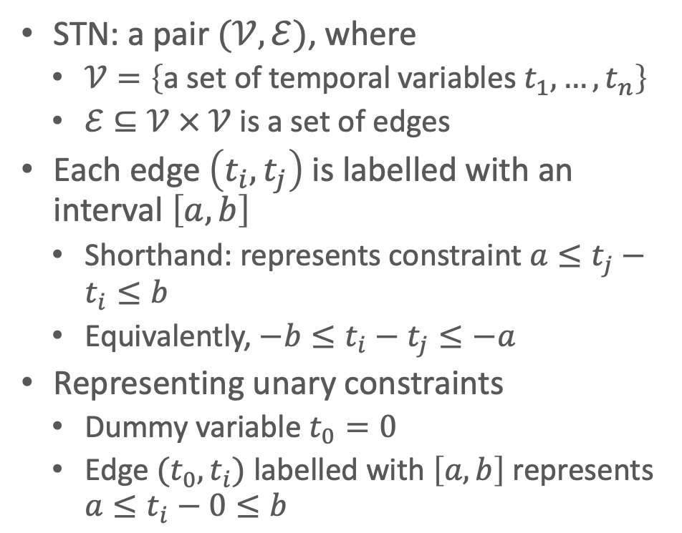


Simple Temporal Networks
!
STN: a pair $(𝒱,ℰ)$, where
$𝒱=\left\{\text{a} \text{set} \text{of} \text{temporal} \text{variables} t_{1}, …, t_{n}\right\}$
$ℰ⊆𝒱 × 𝒱$ is a set of edges
Each edge $\left(t_{i},t_{j}\right)$ is labelled with an interval $\left[a,b\right]$
Shorthand: represents constraint $a≤t_{j}−t_{i}≤b$
Equivalently, $−b≤t_{i}−t_{j}≤−a$
Representing unary constraints
Dummy variable $t_{0}=0$
Edge $(t_{0},t_{i})$ labelled with $\left[a,b\right]$ represents $a≤t_{i}−0≤b$
Book says:
Solution
Integer value for each $t_{i}$
Consistent:
Has a solution
All constraints satisfied
Solution to an STN
Integer value for each $t_{i}$
All constraints satisfied
Consistent STN
Has a solution
Is this network consistent?
t₂
t₂
[1,2]
[3,4]
[1,2]
[3,4]
t₁
t₃
t₁
t₃
[–3,–2]
[2,3]
Notes:
[x,y] before it was an interval in an assertion, now it is a [min,max] duration in a constraint
Minimum duration t1, t2 + t2, t3 : 4 vs. duration between 2 and 3 => inconsistent
Complete calculation:
t1 = x
1 <= t2 - x <= 2 -> t2 = x+1 or t2 = x+2
2 <= t3 - x <= 3 -> t3 = x+2 or t2 = x+3
3 <= t3 - t2 <= 4 -> 3 <= (x + 2 oder 3) – (x + 1 oder 2) <= 4 -> 3 <= 2 oder 3 – 1 oder 2 <= 4
3 <= 2 – 1 <= 4 -> 3 <= 1 <= 4 X
3 <= 2 – 2 <= 4 -> 3 <= 0 <= 4 X
3 <= 3 – 1 <= 4 -> 3 <= 2 <= 4 X
3 <= 3 – 2 <= 4 -> 3 <= 1 <= 4 X
No

Slide 48
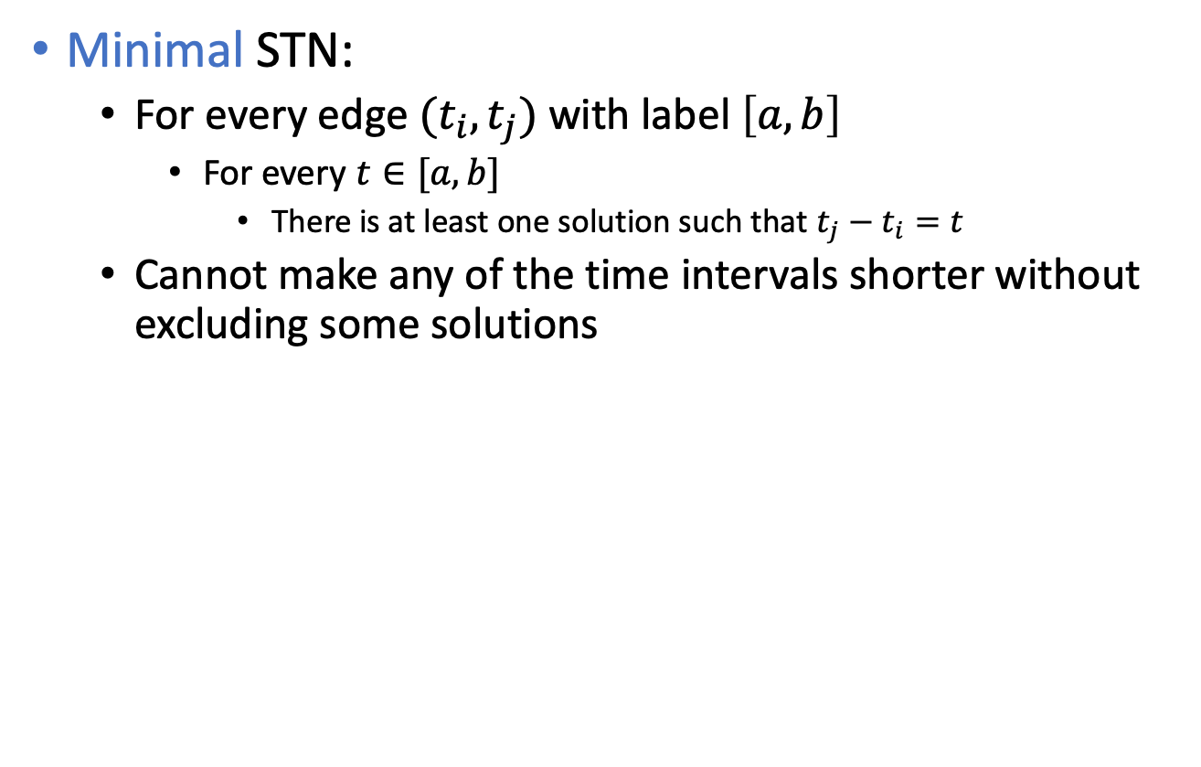
Time Constraints
Minimal STN:
For every edge $(t_{i},t_{j})$ with label $\left[a,b\right]$
For every $t∈[a,b]$
There is at least one solution such that $t_{j}−t_{i}=t$
Cannot make any of the time intervals shorter without excluding some solutions
t₂
[1,2]
[3,4]
t₁
t₃
[3,7]
Is this network minimal?
Notes:
Every value in interval belongs to a solution
Minimum duration t1, t2 + t2, t3 : 4 vs. duration of 3 in [3,7] => not minimal
Maximum duration t1, t2 + t2, t3 : 6 vs. duration of 7 in [3,7] => not minimal
Minimal with [4,6]
Complete calculation
t1 = x
1 <= t2 - x <= 2 -> t2 = x+1 or t2 = x+2
3 <= t3 - x <= 7 -> t3 = x+3 to t3 = x+7
3 <= t3 - t2 <= 4 -> 3 <= (x + 3 bis 7) – (x + 1 oder 2) <= 4 -> 3 <= 3 bis 7 – 1 oder 2 <= 4
3 <= 3 – 1 <= 4 -> 3 <= 2 <= 4 X
3 <= 4 – 1 <= 4 -> 3 <= 3 <= 4 v
3 <= 5 – 1 <= 4 -> 3 <= 4 <= 4 v
3 <= 7 – 1 <= 4 -> 3 <= 6 <= 4 X
3 <= 3 – 2 <= 4 -> 3 <= 1 <= 4 X
3 <= 5 – 2 <= 4 -> 3 <= 3 <= 4 v
3 <= 6 – 2 <= 4 -> 3 <= 4 <= 4 v
3 <= 7 – 2 <= 4 -> 3 <= 5 <= 4 X
t1 = x, t2 = x+1, t3=x+4 or t3=x+5
t1 = x, t2 = x+2, t3=x+5 or t3=x+6
t2-t1 in [1,2] : x+1-x = 1 or x+2-x = 2 v
t3-t1 in [3,7] : x+4-x = 4 or x+5-x = 5 or x+6-x=6 but no 3 or 7 X -> not minimal
t3-t2 in [3,4] : x+(4 or 5) – (x+1) = (3 or 4) or x+(5 or 6) – (x+2) = (3 or 4) v
No

Slide 49





Operations on STNs
r_{ij}
t_{i}
t_{j}
r′_{ij}
Intersection, $∩$
$t_{j} – t_{i}∈r_{ij}=\left[a_{ij},b_{ij}\right]$
$t_{j} – t_{i}∈r_{ij}^{′}=\left[a_{ij}^{′},b_{ij}^{′}\right]$
Infer $t_{j}–t_{i}∈r_{ij}∩r_{ij}^{′}=\left[\max\left(a_{ij},a_{ij}^{′}\right),\min\left(b_{ij},b_{ij}^{′}\right)\right]$
Composition, $∘$
$t_{k}–t_{i}∈r_{ik}=\left[a_{ik},b_{ik}\right]$
$t_{j}–t_{k}∈r_{kj}=\left[a_{kj},b_{kj}\right]$
Infer $t_{j}–t_{i}∈r_{ik}∘r_{kj}=\left[a_{ik}+a_{kj}, b_{ik}+b_{kj}\right]$
Reasoning: add up shortest and longest times
Consistency checking
Three constraints $r_{ik}, r_{kj}, r_{ij}$are consistent only if $r_{ij}∩(r_{ik}∘r_{kj})≠∅$
$$r_{ij}∩r_{ij}^{′}$$
r_{ik}
t_{k}
r_{kj}
t_{i}
t_{j}
$$r_{ik}∘r_{kj}$$
t_{k}
r_{kj}
r_{ik}
r_{ij}
t_{j}
t_{i}
$$r_{ik}∘r_{kj}$$
$$r_{ij}∩\left(r_{ik}∘r_{kj}\right)$$

Slide 50
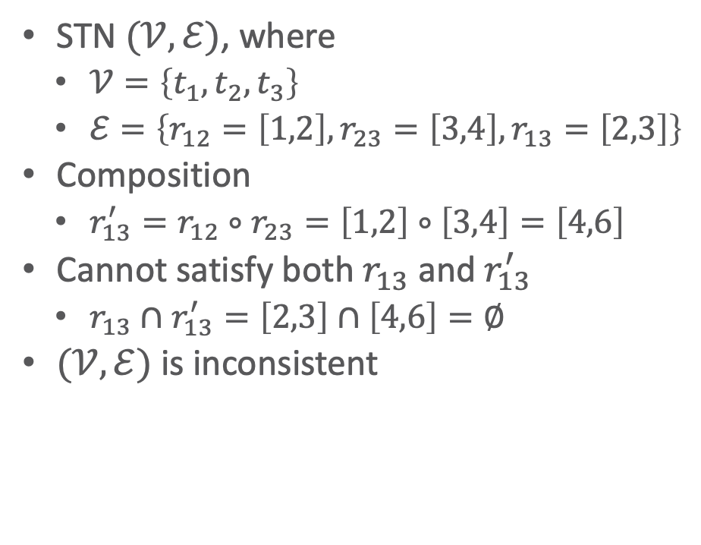
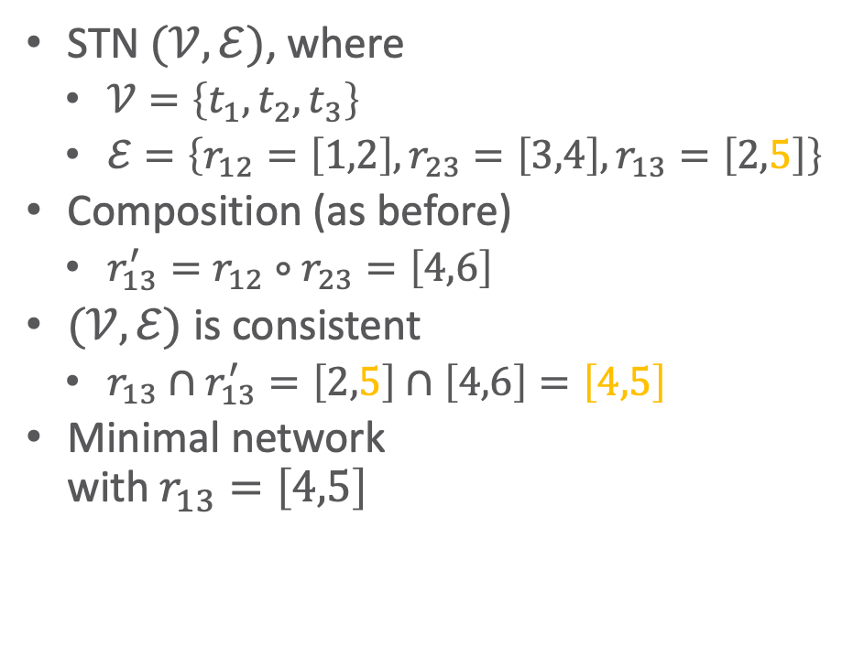
Two Examples
STN $(𝒱,ℰ)$, where
$𝒱=\left\{t_{1}, t_{2}, t_{3}\right\}$
$ℰ=\left\{r_{12}=\left[1,2\right], r_{23}=\left[3,4\right],r_{13}=\left[2,3\right]\right\}$
Composition
$r_{13}^{′}=r_{12}∘r_{23}=\left[1,2\right]∘\left[3,4\right]=\left[4,6\right]$
Cannot satisfy both $r_{13}$ and $r_{13}^{′}$
$r_{13}∩r_{13}^{′}=\left[2,3\right]∩\left[4,6\right]=∅$
$(𝒱,ℰ)$ is inconsistent
STN $(𝒱,ℰ)$, where
$𝒱=\left\{t_{1}, t_{2}, t_{3}\right\}$
$ℰ=\left\{r_{12}=\left[1,2\right],r_{23}=\left[3,4\right], r_{13}=\left[2,5\right]\right\}$
Composition (as before)
$r_{13}^{′}=r_{12}∘r_{23}=\left[4,6\right]$
$(𝒱,ℰ)$ is consistent
$r_{13}∩r_{13}^{′}=\left[2,5\right]∩\left[4,6\right]=\left[4,5\right]$
Minimal network with $r_{13}=\left[4,5\right]$
t₂
t₂
[1,2]
[3,4]
[1,2]
[3,4]
t₁
t₃
t₁
t₃
[2,3]
[2,5]
Notes:
$r_{13}∩r_{13}^{′}=\left[2,3\right]∩\left[4,6\right]=[4,3]$ = empty

Slide 51














Operations on STNs
PC (Path Consistency) algorithm:
Consistency checking on all triples
Input: STN $(𝒱,ℰ)$
If an edge has no constraint, use $\left[−∞, +∞\right]$
$n$ constraints ➝ $n^{3}$ triples ➝ time $O\left(n^{3}\right)$
Example: $k=2, i=1, j=4$
$r_{12}=\left[1,2\right]$
$r_{24}=\left[3,4\right]$
$r_{14}=\left[–∞,∞\right]$
$r_{12}∘r_{24}=[1+3, 2+4]=[4,6]$
$r_{14}← \left[\max\left(–∞,4\right),\min\left(∞,6\right)\right]=\left[4,6\right]$
PC(𝒱,ℰ)
for 1 ≤ k ≤ n do
for 1 ≤ i < j ≤ n, i ≠ j, j ≠ k do
r_{ij} ← r_{ij} ∩ [r_{ik} ∘ r_{kj}]
if r_{ij} = ∅ then
return inconsistent
return consistent
$$k$$
$$t_{2}$$
$$\left[3,4\right]$$
$$\left[1,2\right]$$
$$t_{4}$$
$$t_{1}$$
$$j$$
$$i$$
$$t_{3}$$
$$\left[1,2\right]$$
$$\left[6,7\right]$$
$$\left[4,5\right]$$
$$t_{5}$$
Notes:
Use in TemPlan

Slide 52











Operations on STNs
PC makes network minimal
Shrinks each $r_{ij}$ to exclude values not in any solution
Doing so, it detects inconsistent networks
$r_{ij}=[a_{ij},b_{ij}]$ empty ➝ inconsistent
Graph: dashed lines
Constraints that were shrunk
Can modify PC to make it incremental
Input
A consistent, minimal STN
A new constraint $r_{ij}^{′}$
Incorporate $r_{ij}^{′}$ in time $O\left(n^{2}\right)$
PC(𝒱,ℰ)
for 1 ≤ k ≤ n do
for 1 ≤ i < j ≤ n, i ≠ j, j ≠ k do
r_{ij} ← r_{ij} ∩ [r_{ik} ∘ r_{kj}]
if r_{ij} = ∅ then
return inconsistent
return consistent
$$t_{1}$$
bring&move
$$t_{2}$$
$$\left[30,50\right]$$
$$\left[25,55\right]$$
$$\left[−5,5\right]$$
$$\left[15,50\right]$$
$$\left[0,15\right]$$
$$t_{3}$$
$$\left[5,10\right]$$
$$t_{4}$$
uncover
Notes:
Shrunk: at least those with no constraints get an infinity constraint that gets most likely shrunk

Slide 53

Pruning TemPlan’s search space
Take the time constraints in $𝒞$
Write them as an STN
Use PC to check whether STN is consistent
If it is inconsistent, TemPlan can backtrack

Slide 54
Controllability
Constraint Management with Uncertain Durations

Slide 55







Controllability
Suppose TemPlan gives you a chronicle and you want to execute it
Constraints on time points
Need to reason about these to decide when to start each action
$$t_{1}$$
bring&move
$$t_{2}$$
$$\left[30,50\right]$$
$$\left[−5,5\right]$$
$$t_{3}$$
$$\left[5,10\right]$$
$$t_{4}$$
uncover

Slide 56
Controllability
Solid lines: duration constraints
Robot will do bring&move, will take 30 to 50 time-units
Crane will do uncover, will take 5 to 10 time-units
Dashed line: synchronisation constraint
Do not want either the crane or robot to wait long
At most 5 seconds between the two ending times
Objective
Choose time points that will satisfy all the constraints
$$t_{1}$$
bring&move
$$t_{2}$$
$$\left[30,50\right]$$
$$\left[−5,5\right]$$
$$t_{3}$$
$$\left[5,10\right]$$
$$t_{4}$$
uncover

Slide 57














Controllability
Suppose we run PC
PC returns a minimal and consistent network
There exist time points that satisfy all the constraints
Would work if we could choose all four time points
But we cannot choose $t_{2}$ and $t_{4}$
$t_{1}$ and $t_{3}$ are controllable
Actor can control when each action starts
$t_{2}$ and $t_{4}$ are contingent
Cannot control how long the actions take
Random variables that are known to satisfy the duration constraints
$t_{2}∈\left[t_{1}+30, t_{1}+50\right]$
$t_{4}∈\left[t_{3}+5, t_{3}+10\right]$
$$t_{1}$$
bring&move
$$t_{2}$$
$$\left[30,50\right]$$
$$\left[−5,5\right]$$
$$t_{3}$$
$$\left[5,10\right]$$
$$t_{4}$$
uncover
$$t_{1}$$
bring&move
$$t_{2}$$
$$\left[30,50\right]$$
$$\left[25,55\right]$$
$$\left[−5,5\right]$$
$$\left[15,50\right]$$
$$\left[0,15\right]$$
$$t_{3}$$
$$\left[5,10\right]$$
$$t_{4}$$
uncover
Notes:
STN below: minimal network

Slide 58












Controllability
Cannot guarantee all constraints satisfied
Start bring&move at time $t_{1}=0$
Suppose the durations are
bring&move $30$, uncover $10$
$t_{2}=t_{1}+30=30$
$t_{4}=t_{3}+10$
$t_{4}–t_{2}=t_{3}–20$
Constraint $r_{24}$:
$–5≤t_{4}– t_{2}≤5$ $–5≤t_{3}–20≤5$ $15 ≤ t_{3} ≤25$
Must start uncover at $t_{3}≤25$
But if we start uncover at $t_{3}≤25$, neither action has finished yet
We do not yet know how long they will take
Durations might instead be
bring&move $50$, uncover $5$
$t_{2}=t_{1}+50=50$
$t_{4}=t_{3}+5≤25+5=30$
$t_{4}–t_{2}≤30–50= –20$
Violates $r_{24}$
$$t_{1}$$
bring&move
$$t_{2}$$
$$\left[30,50\right]$$
$$\left[25,55\right]$$
$$\left[−5,5\right]$$
$$\left[15,50\right]$$
$$\left[0,15\right]$$
$$t_{3}$$
$$\left[5,10\right]$$
$$t_{4}$$
uncover
Notes:
$t_{4}–t_{2}$ plug in values for t4 and t2
t3<= 25: bring&move running

Slide 59

STNUs
STNU (Simple Temporal Network with Uncertainty):
A 4-tuple $\left(𝒱,\tilde{𝒱},ℰ,\tilde{ℰ}\right)$
$𝒱$ ={controllable time points}
E.g., starting times of actions
$\tilde{𝒱}$ ={contingent time points}
E.g., ending times of actions
$ℰ$ ={controllable constraints}
Next slide
$\tilde{ℰ}$ ={contingent constraints}
Next slide

Slide 60

STNUs
Controllable and contingent constraints:
Synchronization between two starting times: controllable
Duration of an action: contingent
Synchronization between ending points of two actions: contingent
Synchronization between end of one action, start of another:
Controllable if the new action starts after the old one ends
Contingent if the new action starts before the old one ends
Want a way for the actor to choose time points in $𝒱$ (starting times) that guarantee that constraints are satisfied

Slide 61

Three kinds of controllability
$\left(𝒱,\tilde{𝒱},ℰ,\tilde{ℰ}\right)$ is strongly controllable if the actor can choose values for $𝒱$ such that success will occur for all values of $\tilde{𝒱}$ that satisfy $\tilde{ℰ}$
Actor can choose the values for $𝒱$ offline
The right choice will work regardless of $\tilde{𝒱}$
$\left(𝒱,\tilde{𝒱},ℰ,\tilde{ℰ}\right)$ is weakly controllable if the actor can choose values for $𝒱$ such that success will occur for at least one combination of values for $\tilde{𝒱}$
Actor can choose the values for $𝒱$ only if the actor knows in advance what the values of $\tilde{𝒱}$ will be

Slide 62

Three kinds of controllability
Dynamic controllability:
Game-theoretic model: actor vs. environment
A player’s strategy: a function $σ$ telling what to do in every situation
Choices may differ depending on what has happened so far
$\left(𝒱,\tilde{𝒱},ℰ,\tilde{ℰ}\right)$ is dynamically controllable if ∃ strategy for an actor that will guarantee success regardless of the environment’s strategy

Slide 63


Dynamic Execution
For $t=0, 1, 2, …$
Actor chooses an unassigned set of variables $𝒱_{t}⊆𝒱$ that all can be assigned the value $t$ without violating any constraints in $ℰ$
≈ actions the actor chooses to start at time $t$
Simultaneously, environment chooses an unassigned set of variables ${\tilde{𝒱}}_{t}\text{⊆}\tilde{𝒱}$ that all can be assigned the value $t$ without violating any constraints in $\tilde{ℰ}$
≈ actions that finish at time $t$
Each chosen time point $v$ is assigned $v←t$
Failure if any of the constraints in $ℰ∪\tilde{ℰ}$ are violated
There might be violations that neither $𝒱_{t}$ nor ${\tilde{𝒱}}_{t}$ caused individually
Success if all variables in $𝒱∪\tilde{𝒱}$ have values and no constraints are violated
$r_{ij}=\left[l,u\right]$ is violated if $t_{i}$ and $t_{j}$ have values and $t_{j}−t_{i}∉\left[l,u\right]$

Slide 64

Dynamic Execution
Dynamic execution strategies $σ_{A}$ for actor, $σ_{E}$ for environment
$σ_{A}(h_{t−1})$ = {what events in $𝒱$ to trigger at time $t$, given $h_{t−1}$}
$σ_{E}(h_{t−1})$ = {what events in $\tilde{𝒱}$ to trigger at time $t$, given $h_{t−1}$}
$h_{t}=h_{t−1}⋅\left(σ_{A}\left(h_{t−1}\right)∪σ_{E}\left(h_{t−1}\right)\right)$
$\left(𝒱,\tilde{𝒱},ℰ,\tilde{ℰ}\right)$ is dynamically controllable if $∃ σ_{A}$ that will guarantee success $∀ σ_{E}$

Slide 65












Example
Instead of a single bring&move task, two separate bring and move tasks
Actor’s dynamic execution strategy
Trigger $t_{1}$ at whatever time you want
Wait and observe $t$
Trigger $t^{′}$ at any time from $t$ to $t+5$
Trigger $t_{3}=t^{′}+10$
For every $t_{2}∈\left[t^{′}+15, t^{′}+20\right]$ and $t_{4}∈[t_{3}+5, t_{3}+10]$
$t_{4}∈\left[t^{′}+15, t^{′}+20\right]$
So, $t_{4}–t_{2}∈\left[–5, 5\right]$
Thus, all constraints are satisfied
$$t_{1}$$
bring
$$t$$
$$t^{′}$$
move
$$t_{2}$$
$$\left[15,25\right]$$
$$\left[0,5\right]$$
$$\left[15,20\right]$$
$$\left[−5,5\right]$$
$$t_{3}$$
$$\left[5,10\right]$$
$$t_{4}$$
uncover
Notes:
replace t₃ with t’ in $t_{4}∈[t_{3}+5, t_{3}+10]$
Shortest time of t4 - longest time of t2
Longest time of t4 - shortest time of t2

Slide 66


Dynamic Controllability Checking
For a chronicle $φ=\left(𝒜,𝒮,𝒯,𝒞\right)$
Temporal constraints in $𝒞$ correspond to an STNU
Adapt TemPlan to test not only consistency but also dynamic controllability (*) of the STNU
If we detect cases where it is not dynamically controllable, then backtrack
Use PC as well
If PC($𝒱∪\tilde{𝒱}$, $ℰ∪\tilde{ℰ}$) reduces a contingent constraint, $\left(𝒱,\tilde{𝒱},ℰ,\tilde{ℰ}\right)$ not dyn. controllable
Can prune this branch
Otherwise: unknown if $\left(𝒱,\tilde{𝒱},ℰ,\tilde{ℰ}\right)$ dynamically controllable
Only necessary, not sufficient condition
Two options
Continue down this branch and backtrack later if necessary
Extend PC to detect more cases where $\left(𝒱,\tilde{𝒱},ℰ,\tilde{ℰ}\right)$ is not dynamically controllable (additional constraint propagation rules)
Notes:
Contingent constraints not controllable, reduction implies controllability

Slide 67



Additional Constraint Propagation Rules
Case 1: $u≥0$
$t$ must come before $t_{e}$
Add a composition constraint $\left[a^{′},b^{′}\right]$
Find $\left[a^{′},b^{′}\right]$ such that $\left[a^{′},b^{′}\right]∘\left[u,v\right]=\left[a,b\right]$
$\left[a^{′}+u, b^{′}+v\right]=\left[a,b\right]$
$a^{′}=a–u, b^{′}=b–v$
Should be $\left[a^{′},b^{′}\right]$ if I am not mistaken
t_{s}
[a, b]
t_{e}
[u, v]
t
⟹ contingent ⟶ controllable $a^{′}=a–u, b^{′}=b–v$

Slide 68


Additional Constraint Propagation Rules
Case 2: $u<0$ and $v≥0$
$t$ may be before or after $t_{e}$
Add a wait constraint $\left\langle t_{e}, α\right\rangle$
$α$ defined w.r.t. some controllable time point $t_{s}$
Wait until either $t_{e}$ occurs or current time is $t_{s}+α$, whichever comes first
t_{s}
[a, b]
t_{e}
[u, v]
t
⟹ contingent ⟶ controllable $a^{′}=a–u, b^{′}=b–v$

Slide 69
Extended Version of PC
We want a fast algorithm that TemPlan can run at each node, to decide whether to backtrack
There is an extended version of PC that runs in polynomial time, but it has high overhead
Possible compromise: use ordinary PC most of the time
Run extended version occasionally, or at end of search before returning plan
⟹ contingent ⟶ controllable $a^{′}=a–u, b^{′}=b–v$

Slide 70
Intermediate Summary
Constraint management
Consistency of object constraints
Constraint-satisfaction problem
Consistency of time constraints
STN, solution, minimality, consistency
PC
Controllability
STNU, controllable, contingent
Dynamic controllability

Slide 71
Outline per the Book
4.2 Representation
Timelines
Actions and tasks
Chronicles
4.3 Temporal Planning
Resolvers and flaws
Search space
4.4 Constraint Management
Consistency of object constraints and time constraints
Controlling the actions when we do not know how long they will take
4.5 Acting with Temporal Models
Acting with atemporal refinement
Dispatching
Observation actions
Notes:
4.1 Intro

Slide 72
Atemporal Refinement of Primitive Actions
TemPlan’s action templates may correspond to compound tasks
In RAE, refine into commands with refinement methods
TemPlan’s action template (descriptive model)
RAE’s refinement method (operational model)
leave(r,d,w)
assertions: [t_{s},t_{e}] loc(r): (d,w)
[t_{s},t_{e}] occupant(d): (r,empty)
constraints: t_{e} ≤ t_{s} + δ₁
adj(d,w)
m-leave(r,d,w,e)
task: leave(r,d,w)
pre: loc(r)=d, adj(d,w), exit(e,d,w)
body: until empty(e)
wait(1)
goto(r,e)

Slide 73
Discussion
Pros
Simple online refinement with RAE
Avoids breaking down uncertainty of contingent duration
Can be augmented with temporal monitoring functions in RAE
E.g., watchdogs, methods with duration preferences
Cons
Does not handle temporal requirements at the command level,
E.g., synchronise two robots that must act concurrently
Can augment RAE to include temporal reasoning
Call it eRAE
One essential component: a dispatching function
Notes:
E.g, useful to account for time needed to open door, assessed from statistics.
However, breaking this duration into how long it takes to reach for the handle and how long to turn the handle introduces more noise in operational models.
Still RAE requires some temporal reasoning
Dispatching takes into account past occurrences and the current time; these are propagated into the temporal network to keep it dynamically controllable

Slide 74










Acting With Temporal Models
Dispatching procedure: a dynamic execution strategy
Controls when to start each action
Given a dynamically controllable plan with executable primitives, it triggers corresponding commands from online observations
Example
robot $r2$ needs to leave dock $d2$ before robot $r1$ can enter $d2$
crane $k$ needs to uncover $c$ then put $c$ onto $r1$
k
r2
c′
w2
c
q
p
d2
w1
r1
$$t_{3}$$
leave(r2,d2)
d1
$$t_{1}$$
$$t_{2}$$
$$t_{5}$$
leave(r1,d1)
navigate(r1)
enter(r1,d2)
$$t_{7}$$
$$t_{8}$$
$$t_{9}$$
$$t_{4}$$
$$t_{6}$$
unstack(k,c,p)
putdown(k,c,r1)
leave(r1,d2)
unstack(k,c′,p)
stack(k,c′,q)

Slide 75

Dispatching
Let $\left(𝒱,\tilde{𝒱},ℰ,\tilde{ℰ}\right)$ be a controllable STNU that is grounded
Different from a grounded expression in logic
At least one time point $t^{∗}$ is instantiated
Bounds each time point $t$ within an interval $\left[l_{t},u_{t}\right]$
Controllable time point $t$ in the future:
$t$ is alive if current time $now∈\left[l_{t},u_{t}\right]$
$t$ is enabled if
It is alive
For every precedence constraint $t^{′}<t$, $t^{′}$ has occurred
For every wait constraint $⟨t_{e}, α⟩$, $t_{e}$ has occurred or $α$ has expired
$α$ has expired if $t_{s}$ has occurred and $t_{s}+α≤now$
Dispatch(𝒱,Ṽ,ℰ,Ẽ)
initialise the network
while there are time points in 𝒱 that
have not been triggered do
update now
update the time points in Ṽ that have
been newly observed
update enabled
trigger every t ∈ enabled s.t. now=u_{t}
arbitrarily choose other time points
in enabled and trigger them
propagate values of triggered
timepoints (change [l_{t},u_{t}] for
each future timepoint t)
Notes:
trigger elements of V at the right moment, given the observation of elements of V ̃, and given the progress of current time, denoted now
As time goes by, some time points have occurred: triggered by the actor for controllable points or observed for contingent ones
Trigger those points that cannot wait any longer
Arbitrary choice to trigger any other enabled point (consider domain specific considerations)

Slide 76

Example
Trigger $t_{1}$, observe leave finish
Enable and trigger $t_{2}$, enables $t_{3}$, $t_{4}$
Trigger $t_{3}$ soon enough to allow $enter\left(r1,d2\right)$ at time $t_{5}$
Trigger $t_{4}$ soon enough to allow $stack\left(k,c^{′}\right)$ at time $t_{6}$
Rest of plan is linear:
Choose each $t_{i}$ after the previous action ends
Dispatch(𝒱,Ṽ,ℰ,Ẽ)
initialise the network
while there are time points in 𝒱 that
have not been triggered do
update now
update the time points in Ṽ that have
been newly observed
update enabled
trigger every t ∈ enabled s.t. now=u_{t}
arbitrarily choose other time points
in enabled and trigger them
propagate values of triggered
timepoints (change [l_{t},u_{t}] for
each future timepoint t)
$$t_{3}$$
leave(r2,d2)
$$t_{1}$$
$$t_{2}$$
$$t_{5}$$
leave(r1,d1)
navigate(r1)
enter(r1,d2)
$$t_{7}$$
$$t_{8}$$
$$t_{9}$$
$$t_{4}$$
$$t_{6}$$
unstack(k,c,p)
putdown(k,c,r1)
leave(r1,d2)
unstack(k,c′,p)
stack(k,c′,q)

Slide 77











Example from Slide 61
Trigger $t_{1}$ at time $0$
Wait and observe $t$; this enables $t^{′}$
Trigger $t^{′}$ at any time from $t$ to $t+5$
Trigger $t_{3}$ at time $t^{′}+10$
$t_{2}∈\left[t^{′}+15, t^{′}+20\right]$
$t_{4}∈[t_{3}+5, t_{3}+10]=[t^{′}+15, t^{′}+20]$
so $t_{4}–t_{2}∈\left[–5, 5\right]$
Dispatch(𝒱,Ṽ,ℰ,Ẽ)
initialise the network
while there are time points in 𝒱 that
have not been triggered do
update now
update the time points in Ṽ that have
been newly observed
update enabled
trigger every t ∈ enabled s.t. now=u_{t}
arbitrarily choose other time points
in enabled and trigger them
propagate values of triggered
timepoints (change [l_{t},u_{t}] for
each future timepoint t)
$$t_{1}$$
bring
$$t$$
$$t^{′}$$
move
$$t_{2}$$
$$\left[15,25\right]$$
$$\left[0,5\right]$$
$$\left[15,20\right]$$
$$\left[−5,5\right]$$
$$t_{3}$$
$$\left[5,10\right]$$
$$t_{4}$$
uncover

Slide 78

Dispatching
Propagation step most costly one
$O\left(n^{3}\right)$
$n$ the number of remaining future time points in network
Ideally propagation fast enough to allow iterations and updates of $now$ consistent with temporal granularity of plan
Dispatch(𝒱,Ṽ,ℰ,Ẽ)
initialise the network
while there are time points in 𝒱 that
have not been triggered do
update now
update the time points in Ṽ that have
been newly observed
update enabled
trigger every t ∈ enabled s.t. now=u_{t}
arbitrarily choose other time points
in enabled and trigger them
propagate values of triggered
timepoints (change [l_{t},u_{t}] for
each future timepoint t)
Notes:
trigger elements of V at the right moment, given the observation of elements of V ̃, and given the progress of current time, denoted now
As time goes by, some time points have occurred: triggered by the actor for controllable points or observed for contingent ones
Trigger those points that cannot wait any longer
Arbitrary choice to trigger any other enabled point (consider domain specific considerations)

Slide 79
Deadline Failures
Suppose something makes it impossible to start an action on time
Do one of the following:
Stop the delayed action, and look for new plan
Let the delayed action finish, try to repair the plan by resolving violated constraints at the STNU propagation level
E.g., accommodate a delay in navigate by delaying the whole plan
Let the delayed action finish, try to repair the plan some other way
$$t_{3}$$
leave(r2,d2)
$$t_{1}$$
$$t_{2}$$
$$t_{5}$$
leave(r1,d1)
navigate(r1)
enter(r1,d2)
$$t_{7}$$
$$t_{8}$$
$$t_{9}$$
$$t_{4}$$
$$t_{6}$$
unstack(k,c,p)
putdown(k,c,r1)
leave(r1,d2)
unstack(k,c′,p)
stack(k,c′,q)

Slide 80
Partial Observability
Tacit assumption: All occurrences of contingent events are observable
Observation needed for dynamic controllability
In general, not all events are observable
POSTNU (Partially Observable STNU)
STNU where the contingent time points are given by a set of invisible and a set of observable timepoints
POSTNU = STNU if Invisible = ∅
Dynamically controllable?
Controllable
Timepoints Invisible
Contingent
Observable
Arthur Bit-Monnot, Malik Ghallab, Félix Ingrand: “Which Contingent Events to Observe for the Dynamic Controllability of a Plan”, IJCAI-16

Slide 81









Observation Actions
Example
$$\left[19:00,19:30\right]$$
$$t_{1}$$
$$t$$
$$t^{′}$$
driving
$$t_{2}$$
$$\left[1,2\right]$$
$$\left[20,25\right]$$
working
$$\left[−5,10\right]$$
$$t_{3}$$
$$\left[25,30\right]$$
$$t_{4}$$
Controllable
Contingent
cooking
Invisible
observable
Arthur Bit-Monnot, Malik Ghallab, Félix Ingrand: “Which Contingent Events to Observe for the Dynamic Controllability of a Plan”, IJCAI-16

Slide 82
Dynamic Controllability
A POSTNU is dynamically controllable if
there exists an execution strategy that chooses future controllable points to meet all the constraints, given the observation of past visible points
Check dynamic controllability
Map an POSTNU to an STNU by deleting invisible time points and adding corresponding constraints on controllable and observable time points
Check dynamic controllability of the mapped STNU
E.g., using the extended PC algorithm
More details in the paper
Arthur Bit-Monnot, Malik Ghallab, Félix Ingrand: “Which Contingent Events to Observe for the Dynamic Controllability of a Plan”, IJCAI-16

Slide 83
Dynamic Controllability
A POSTNU is dynamically controllable if
there exists an execution strategy that chooses future controllable points to meet all the constraints, given the observation of past visible points
Observable ≠ visible
Observable means it will be known when observed
It can be temporarily hidden
Aim: Find out which time points need to be observed for the plan to be dynamically controllable (details in paper)
Controllable
Timepoints Invisible
Contingent Visible
Observable
Hidden
Arthur Bit-Monnot, Malik Ghallab, Félix Ingrand: “Which Contingent Events to Observe for the Dynamic Controllability of a Plan”, IJCAI-16

Slide 84
Intermediate Summary
Acting
Atemporal refinement
eRAE
Dispatching
Alive, enabled
Deadline failures
Partial observability
Invisible, observable (hidden/visible)

Slide 85
Outline per the Book
4.2 Representation
Timelines
Actions and tasks
Chronicles
4.3 Temporal Planning
Resolvers and flaws
Search space
4.4 Constraint Management
Consistency of object constraints and time constraints
Controlling the actions when we do not know how long they will take
4.5 Acting with Temporal Models
Acting with atemporal refinement
Dispatching
Observation actions
⟹ Next: Planning and Acting with Nondeterministic Models
Notes:
4.1 Intro

