Slide 1




Human Pose Recovery
and Behavior Analysis
group
Posture Analysis and
Range of Movement Estimation
using Depth Maps
Miguel Reyes, Albert Clapés, Luis Felipe Mejía, José Ramírez, Juan R. Revilla, and Sergio Escalera
All rights reserved HuBPA©

Slide 2


Human Pose and Behavior Analysis
group
Index
Motivation
System Architecture
  Static posture (SP) analysis
    Data alignment and noise removal
    Matching protocol
  Spine curvature (SC) analysis
  Range of movement (RoM) estimation
Results
Applications
Conclusions
All rights reserved HuBPA©

Slide 3
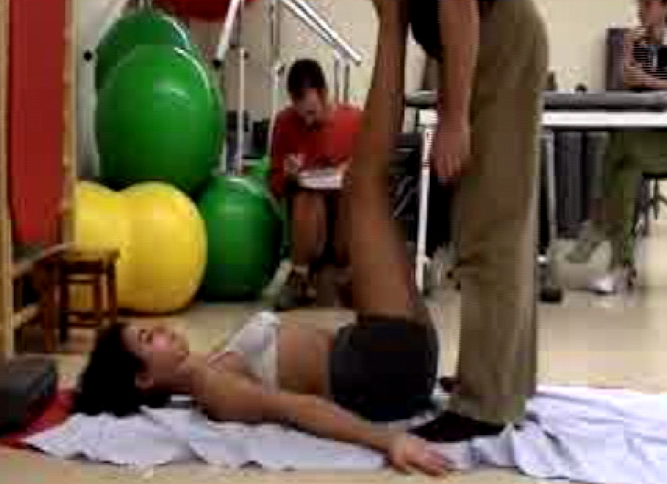
Human Pose and Behavior Analysis
group
Motivation
80% of the world population is affected of back pain during his life.
Many current practices to analyze back problems are expensive, subjective, and invasive.
A novel tool for posture and range of movement estimation based on the analysis of 3D information from depth maps:
  Reeducating to prevent MSDs.
  Tracking the patient’s evolution in rehab.
All rights reserved HuBPA©

Slide 4
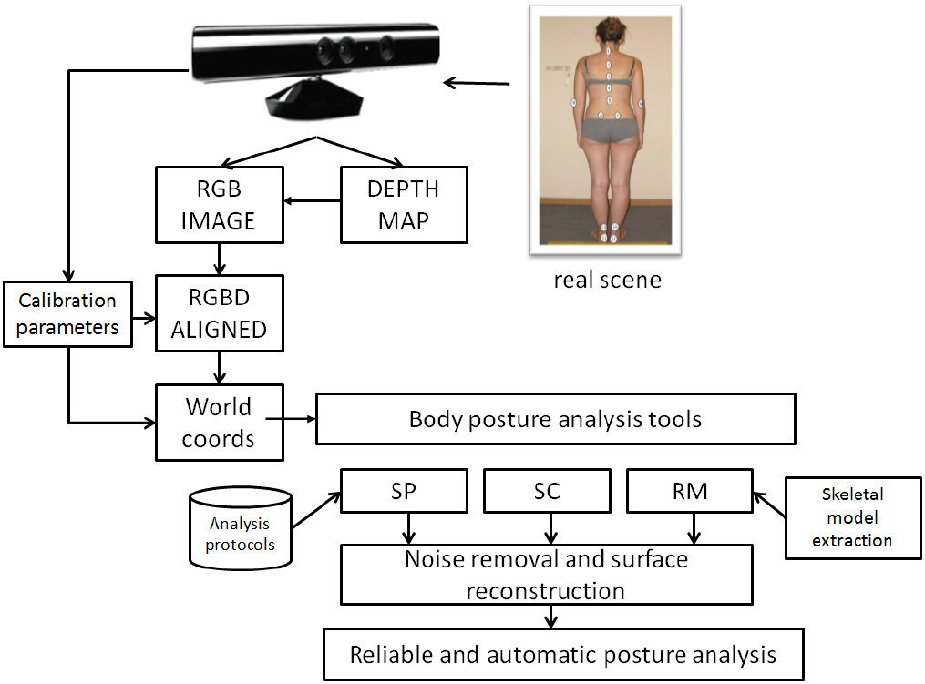
Human Pose and Behavior Analysis
group
System architecture
System architecture | Results | Applications | Conclusions
All rights reserved HuBPA©

Slide 5
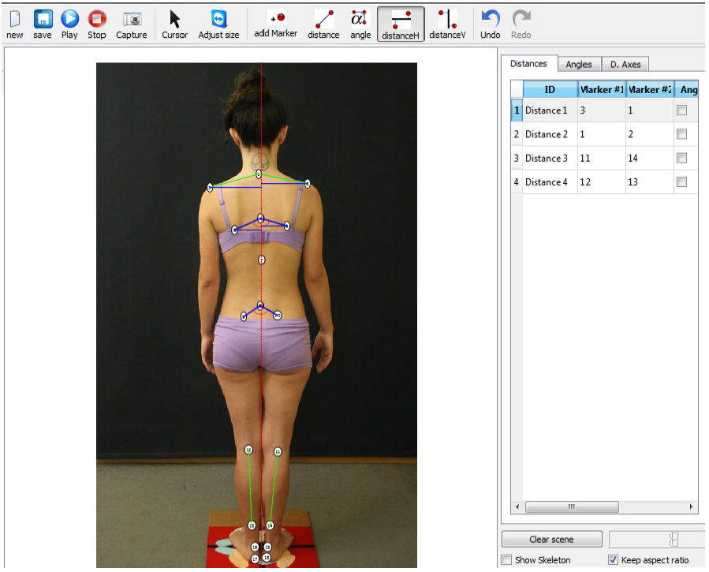
Human Pose and Behavior Analysis
group
Static Posture (SP) analysis
System architecture | Results | Applications | Conclusions
keypoints are manually set from RGB data displayed in the screen.
The relations (three-dimensional measurements) are established among the keypoints defined by the user.
We define a protocol as a set of keypoints and the relations among them.
Given a new set of points, we could apply a predefined protocol or perform a free analysis.
All rights reserved HuBPA©

Slide 6
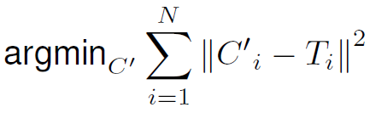
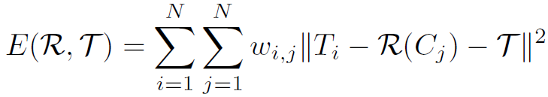
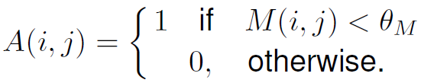
Human Pose and Behavior Analysis
group
SP analysis : Matching protocol
System architecture | Results | Applications | Conclusions
Sum of least squares minimization.
Soft pre-alignment using Iterative Closest Point (ICP).
Correspondence relaxation based on adjacency matrix A.
All rights reserved HuBPA©

Slide 7
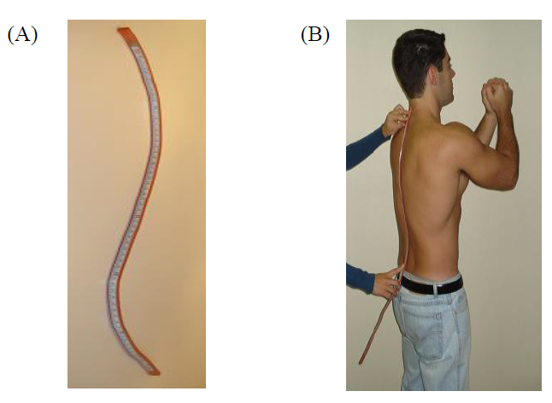
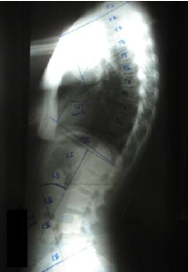
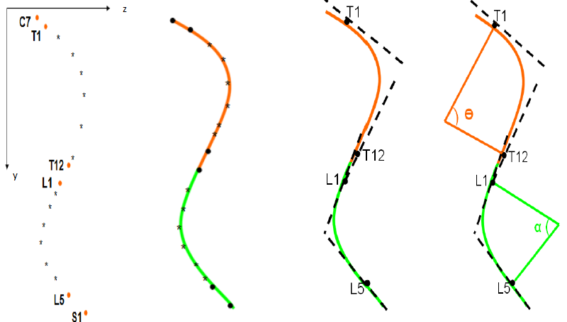
Human Pose and Behavior Analysis
group
Spine Curvature (SC) analysis
System architecture | Results | Applications | Conclusions
All rights reserved HuBPA©

Slide 8
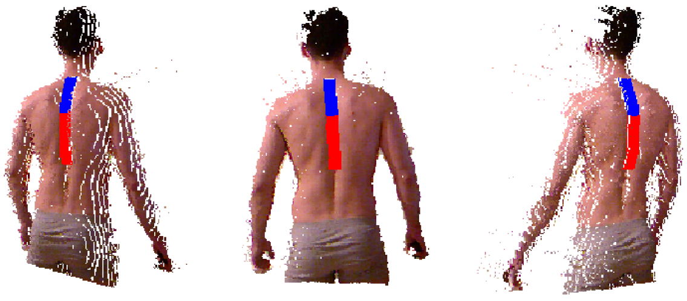
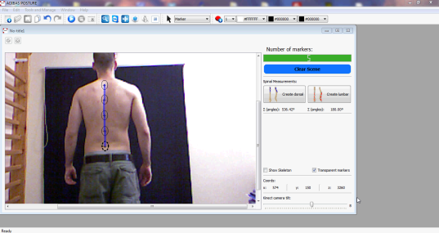
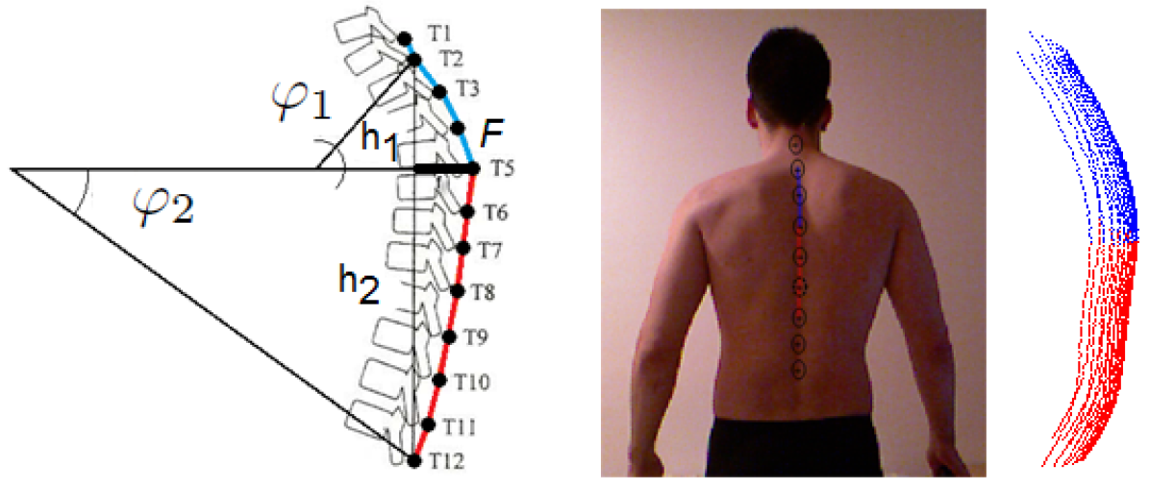
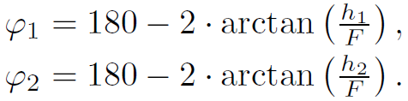
Human Pose and Behavior Analysis
group
Spine Curvature (SC) analysis
System architecture | Results | Applications | Conclusions
All rights reserved HuBPA©

Slide 9
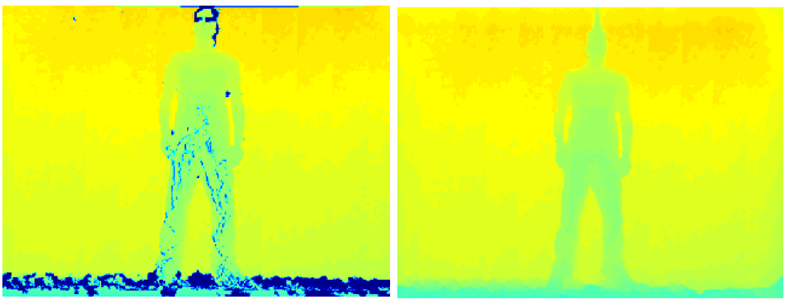
Human Pose and Behavior Analysis
group
Data alignment and noise removal
System architecture | Results | Applications | Conclusions
Noisy depth maps
  Statistical noise removal.
  Filling Holes (Inpaint Naive Strokes*).
M. Bertalmio, A. L. Bertozzi, G. Sapiro, ”Navier-Stokes, Fluid Dynamics, and Image and Video Inpainting”, Proceedings of the International Conference on Computer Vision and Pattern Recognition , IEEE, Dec. 2001, Kauai, HI, volume I, pp. I-355-I362
All rights reserved HuBPA©

Slide 10

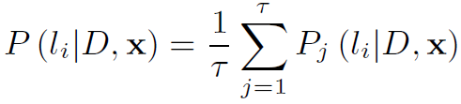
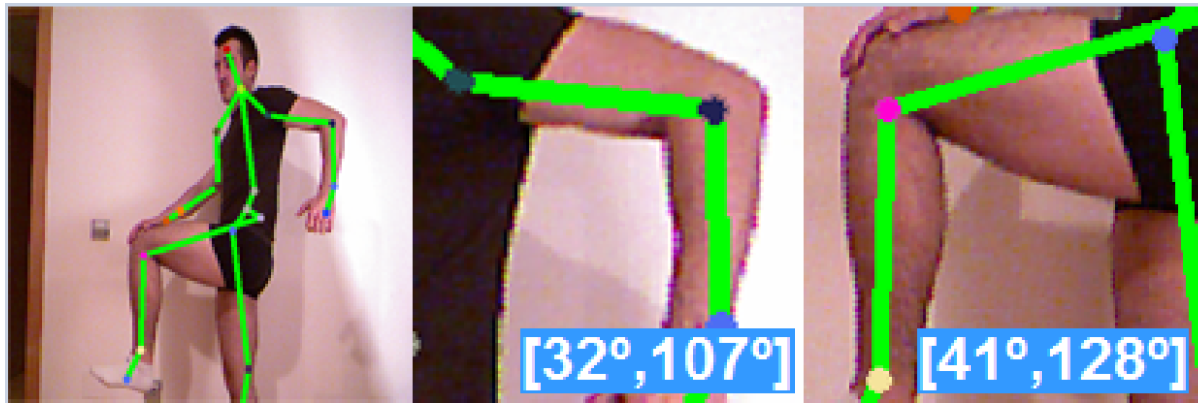
Human Pose and Behavior Analysis
group
Range of movement (RoM) analysis
System architecture | Results | Applications | Conclusions
Random Forest limbs pixel-level labeling.
Skeletal model extraction from the segmented limbs.
All rights reserved HuBPA©

Slide 11
Human Pose and Behavior Analysis
group
Results (I)
System architecture | Results | Applications | Conclusions
Data and settings
  SPA
    500 tests labeled by three different observers (inter-observer correlation > 99% for all planes).
    A test contains a set of angles and distances, placing twelve infrared led markers on the body of the subject.
    20 subjects.
    Automatic validation of the tests: infrared markers are detected by means of thresholding a HSV infrared-filtered image.
  SCA
    10 subjects.
    Leroux protocol, placing nine markers over the spine.
    The relationship between lateral anthropometric and radiographic measures was assessed with the mean of the differences.
All rights reserved HuBPA©

Slide 12
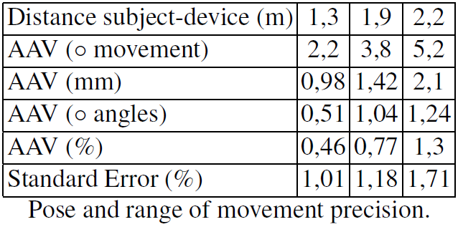
Human Pose and Behavior Analysis
group
Results (III)
System architecture | Results | Applications | Conclusions
Validation
  AVV correspond to the average absolute value
  ’◦’ corresponds to the degree.
  SPA
All rights reserved HuBPA©

Slide 13
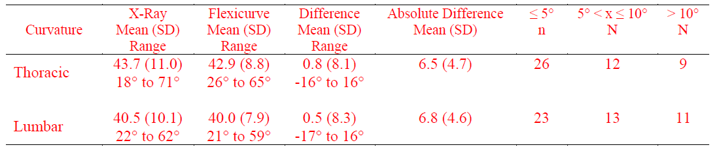
Human Pose and Behavior Analysis
group
Results (III)
System architecture | Results | Applications | Conclusions
Validation
  SP
All rights reserved HuBPA©

Slide 14

Human Pose and Behavior Analysis
group
Applications
System architecture | Results | Applications | Conclusions
All rights reserved HuBPA©

Slide 15
Human Pose and Behavior Analysis
group
Conclusions
System architecture | Results | Applications | Conclusions
Semi-automatic posture analysis and range of movement estimation using multi-modal data (rgb + depth).
Provides assistance in the posture reeducation task to prevent and treat MSDs.
Gaussian noise is removed and depth map is reconstruct as a preprocessing step.
Keypoints defined by the physician are matched using a novel point-to-point fitting procedure.
High precision in terms of distance, degree, and range of movement estimation.
Clinical specialists supports its inclusion in the clinical routine.
All rights reserved HuBPA©

Slide 16
Human Pose Recovery
and Behavior Analysis
group
Thanks
Miguel Reyes, Albert Clapés, Luis Felipe Mejía, José Ramírez, Juan R. Revilla, and Sergio Escalera
All rights reserved HuBPA©

