Slide 1
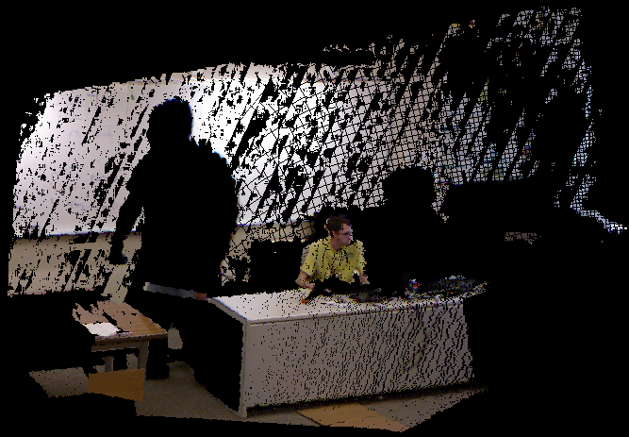
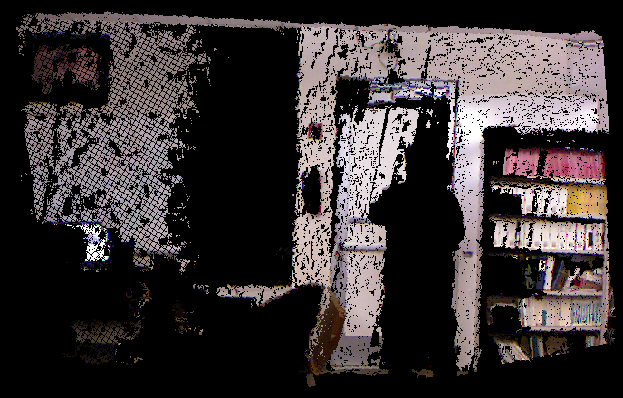
Removing Moving Objects from Point Cloud Scenes
Krystof Litomisky and Bir Bhanu
International Workshop on Depth Image Analysis
November 11, 2012
Notes:
Picture on the background!
Add “Center for Research in Intelligent Systems” somewhere

Slide 2
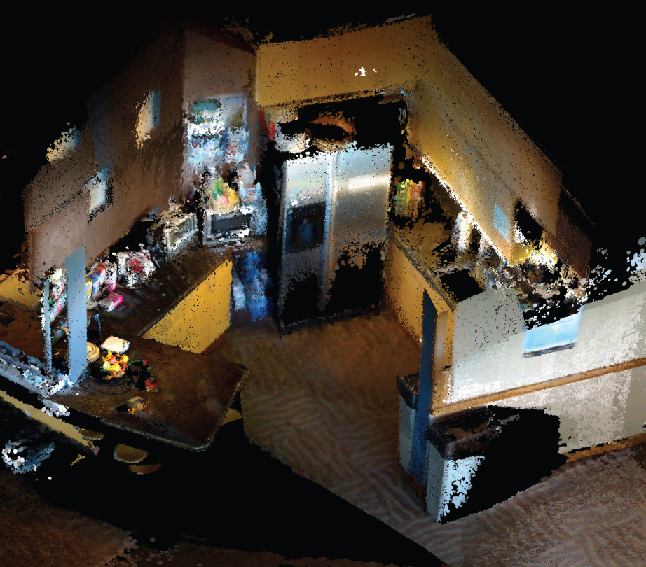
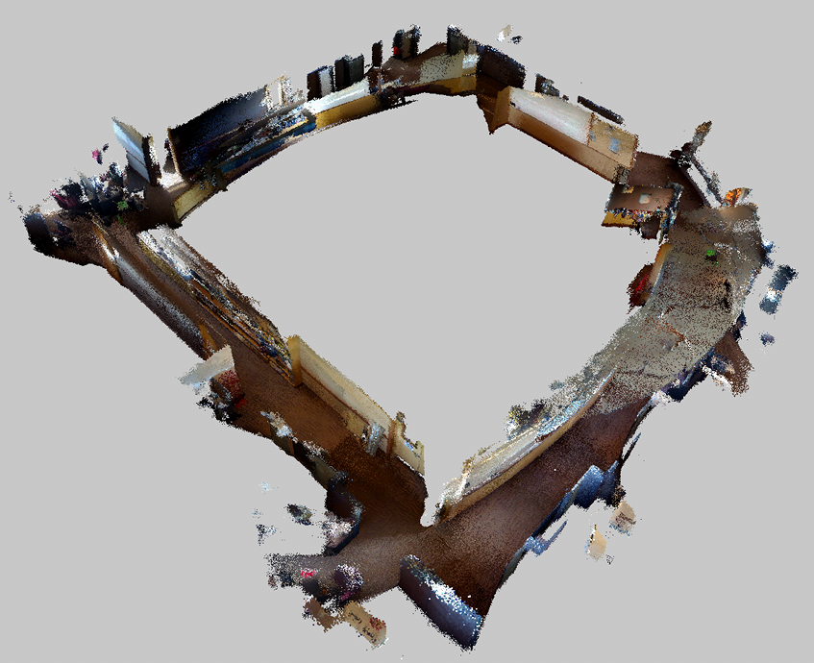
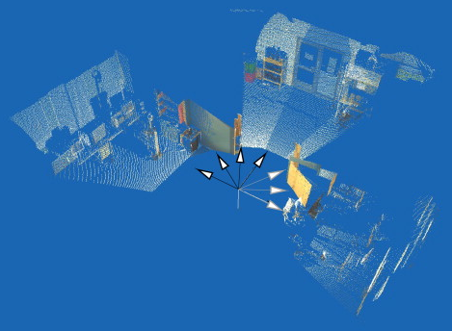
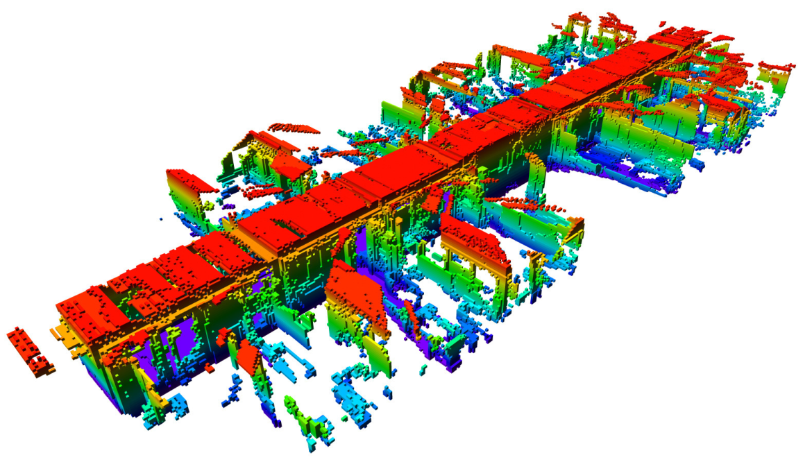
Motivation: SLAM
Du2011
Where is everyone?
Henry2010
Henry2012
Andreasson2010
Wurm2010
Notes:
Show the names of the authors with each image
Various pictures of SLAM result maps – what’s suspicious about them? Well, they were all created with no moving objects around

Slide 3
Moving objects can cause issues…
Registration
Localization
Mapping
Navigation
GOAL:
A SLAM algorithm that ignores moving objects, but creates accurate, detailed, and consistent maps.
Notes:
Why are moving objects bad?
-if using these maps as inputs to localization, moving objects would throw the localization off (another good argument why to be extra safe and remove even objects that we’re not sure about).

Slide 4
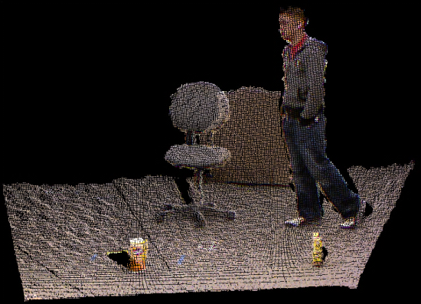
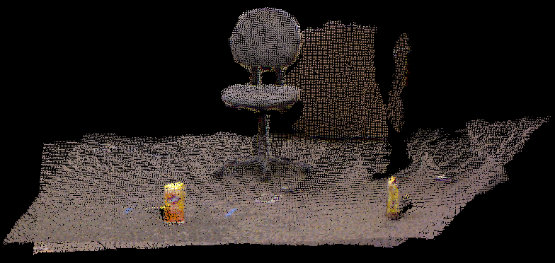
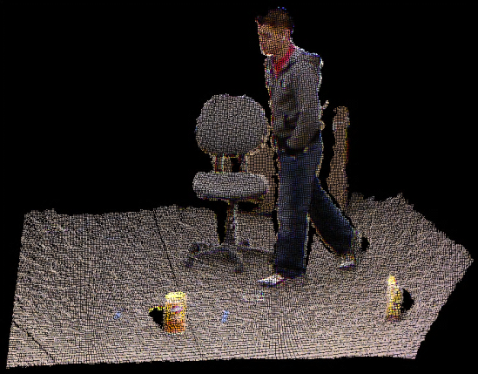
One Solution
Remove moving objects before registration!
Notes:
recreate the merged cloud!!!!
Use a more interesting scene?

Slide 5
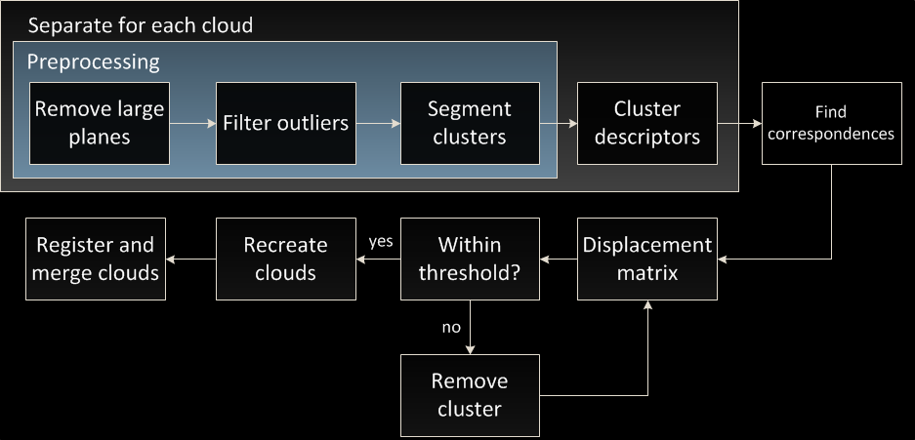
Overview
Identifying and removing arbitrary moving objects from two point cloud views of a scene.

Slide 6

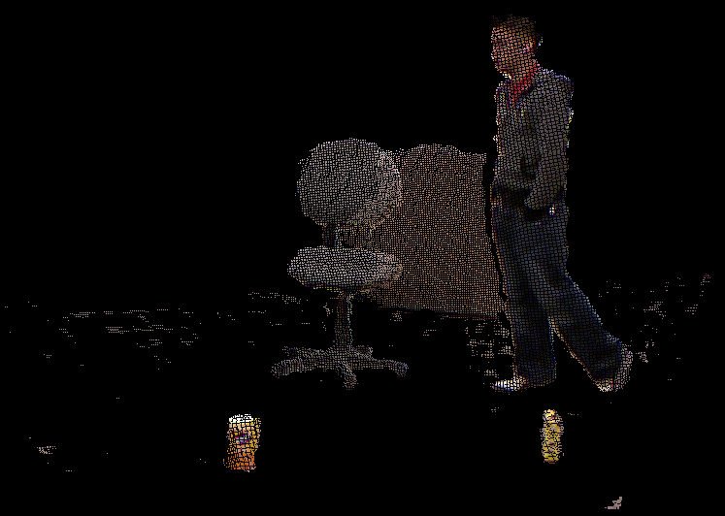
Plane Removal
Why?
Not moving
Helps segmentation
How? RANSAC.
Iteratively remove the largest plane until the one just removed is approximately horizontal
Notes:
ADD PICTURE!

Slide 8

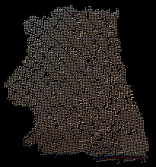




Euclidean Cluster Segmentation
Two points are put in the same cluster if they are within 15 cm of each other
Notes:
Cite Rusu’s dissertation as the source
Mention that you use Kd-trees to optimize this? Know the exact structure and time and space complexities of Kd-trees

Slide 10

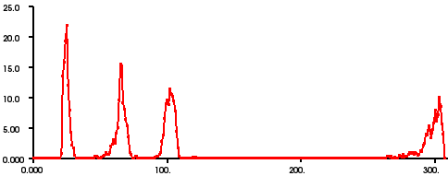

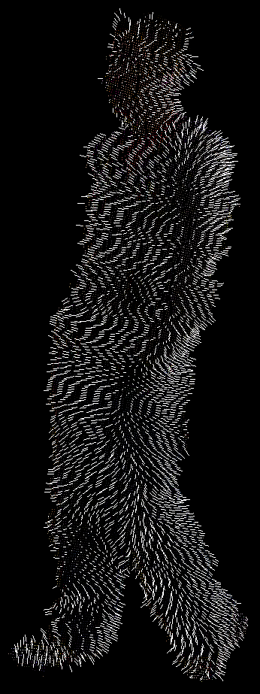
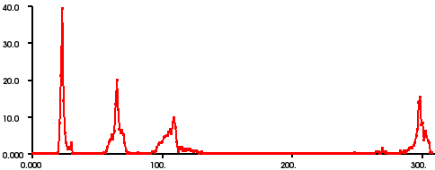
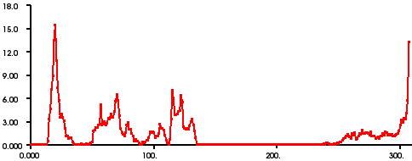
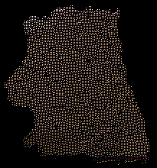
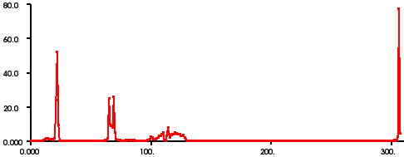
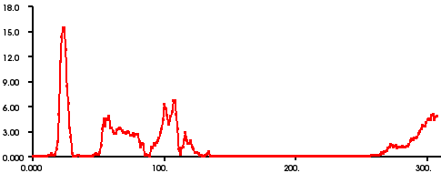
Viewpoint Feature Histograms
Notes:
NOTE: these are not with the same y-axis scale.
Order: 3 angles (45*3), 1 distance (45), 1 viewpoint angle (128)

Slide 12
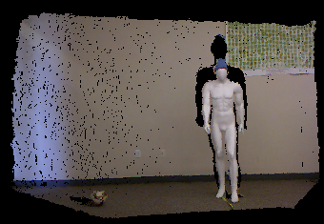
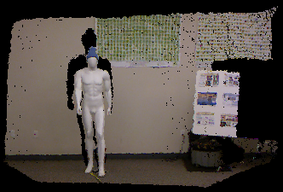
Finding Correspondences
Allow Warping
±5 bins (1.6%)
Notes:
Show the shift in VFH that results from camera pan/motion, show how DTW deals with it

Slide 13
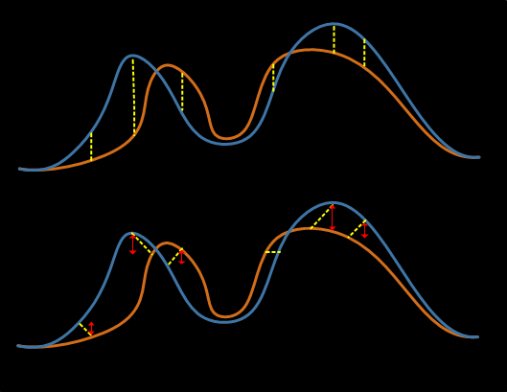
Dynamic Time Warping
Euclidean distance
Dynamic Time Warping
Iteratively take the closest pair of objects (in feature space) until there are no objects left in at least one cloud
Notes:
Get rid of this?
For panning, take half frame overlap -> pan of about 30 degrees. The corresponding change in number of histogram bins is the DTW constraint for the Sakoe-Chiba band
Sakoe-Chiba band, itakura parallelogram

Slide 14
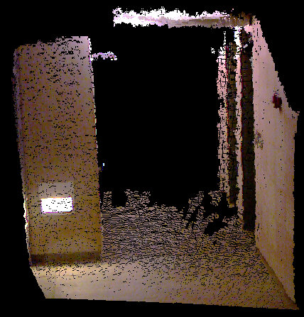
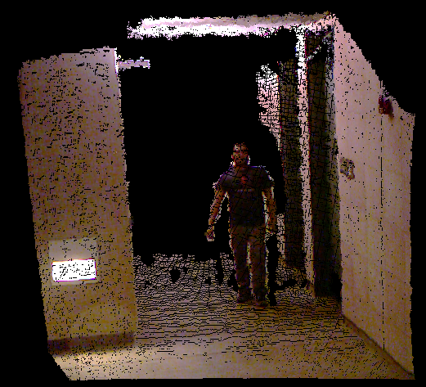
Correspondences
Some objects will have no correspondences
Object motion:
Notes:
Occlusion: an object can be completely occluded in one frame, and therefore only be present in the other frame. Also, an occlusion can split an object into two clusters in one frame, so at least one of the clusters won’t have a correspondence in the other. We remove all such objects.
Show a picture for each of these cases!!!!!!!

Slide 15
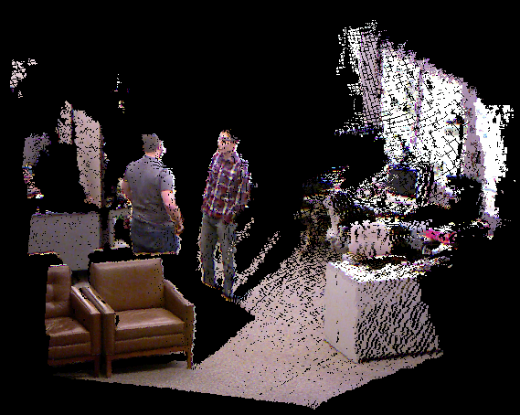
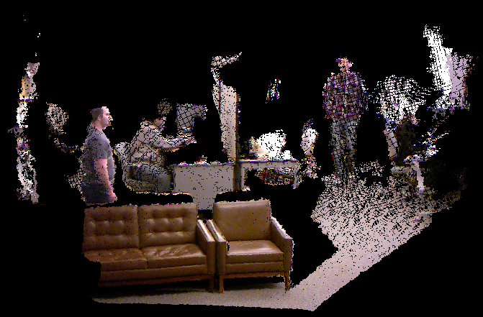
Correspondences
Some objects will have no correspondences
Camera motion:
Notes:
Occlusion: an object can be completely occluded in one frame, and therefore only be present in the other frame. Also, an occlusion can split an object into two clusters in one frame, so at least one of the clusters won’t have a correspondence in the other. We remove all such objects.
Show a picture for each of these cases!!!!!!!

Slide 16
Correspondences
Some objects will have no correspondences
Occlusion:
Notes:
Occlusion: an object can be completely occluded in one frame, and therefore only be present in the other frame. Also, an occlusion can split an object into two clusters in one frame, so at least one of the clusters won’t have a correspondence in the other. We remove all such objects.
Show a picture for each of these cases!!!!!!!

Slide 18
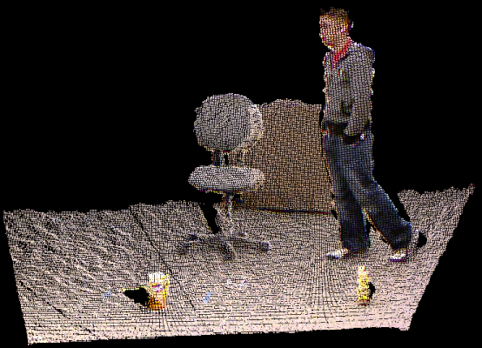
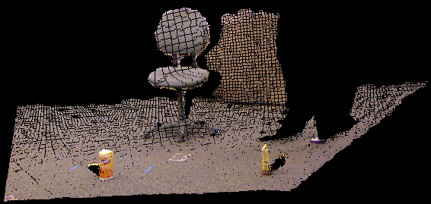
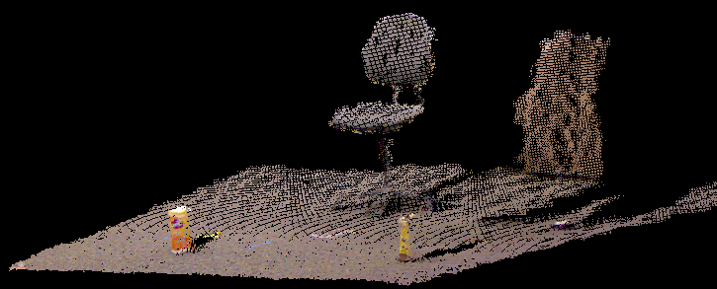
Recreating the Clouds
Each cloud is reconstructed from:
Planes that were removed
Objects that were not removed
original
recreated
recreated, viewpoint changed

Slide 20
Experiments

Slide 21
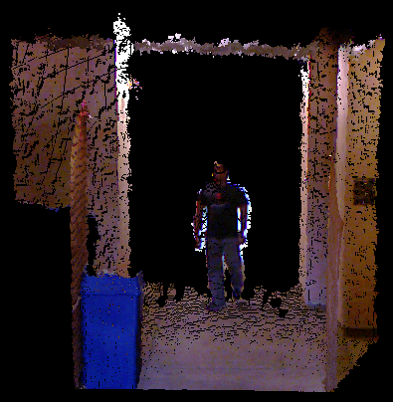
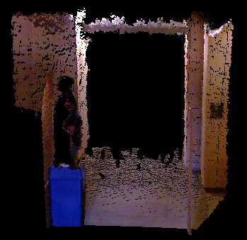
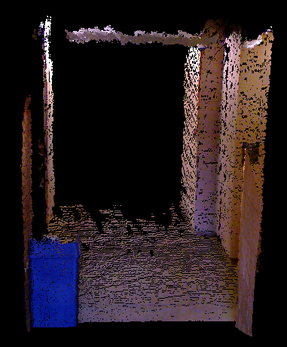
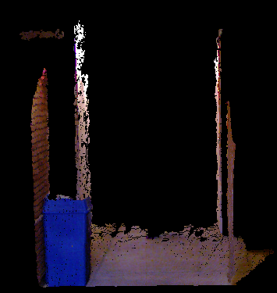
Results
input
output
Notes:
hallway2

Slide 22
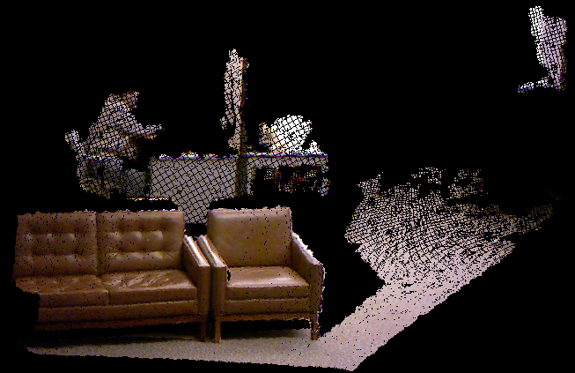
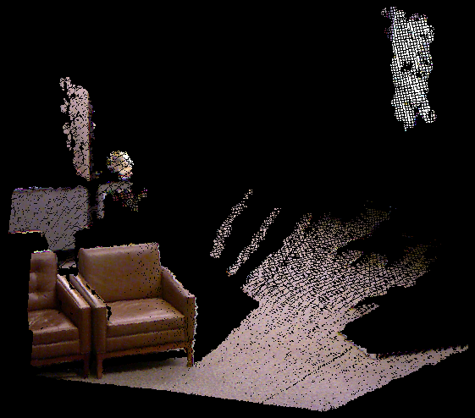
Results
input
output
Notes:
Point out: significant camera movement

Slide 23
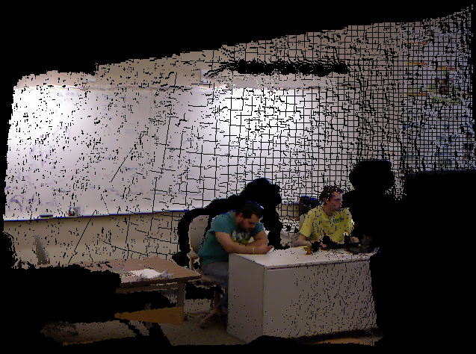
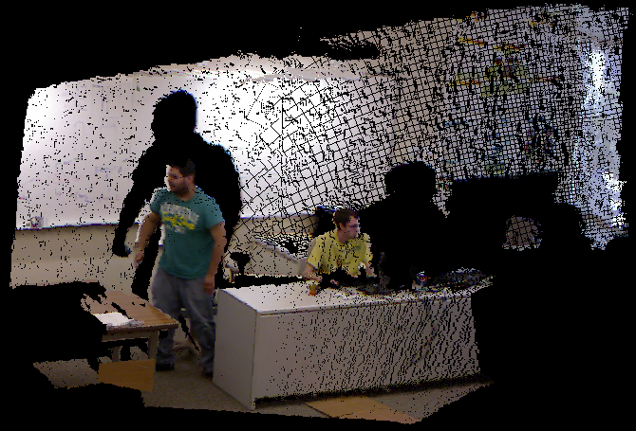
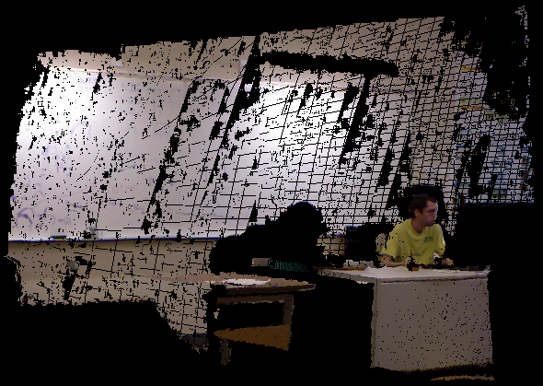
Results
input
output

Slide 24
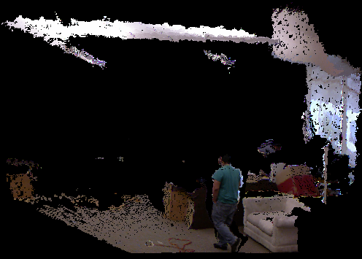
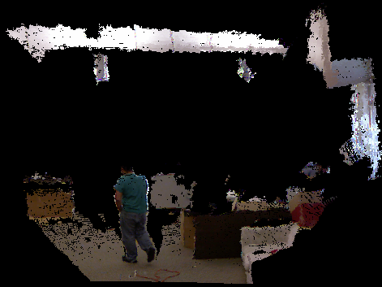
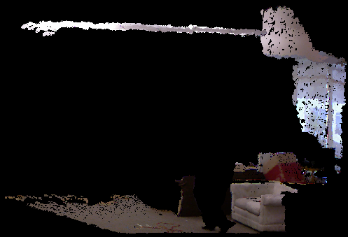
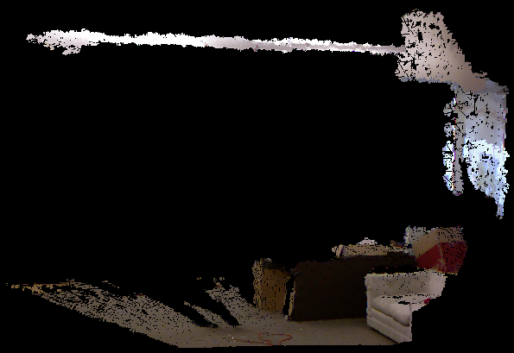
Results
input
output

Slide 25
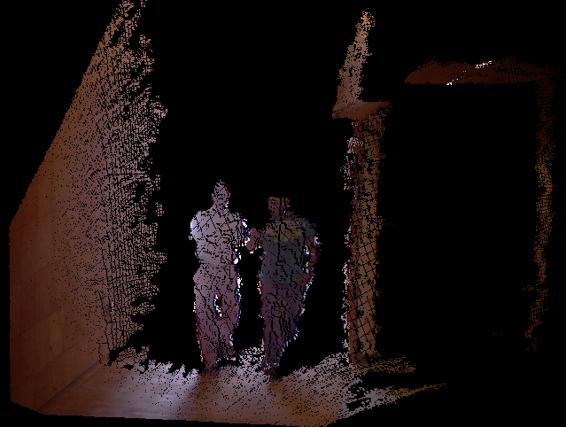
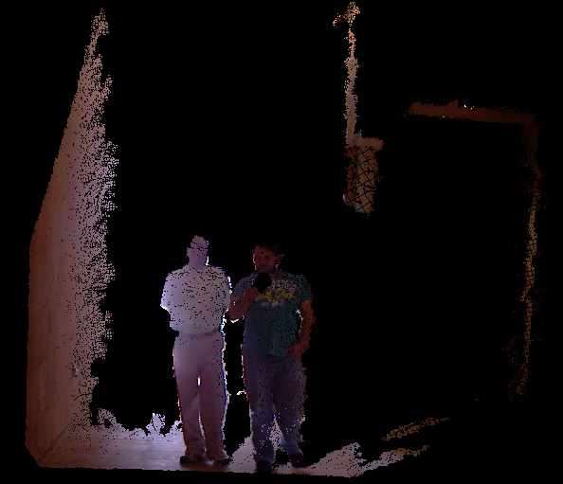
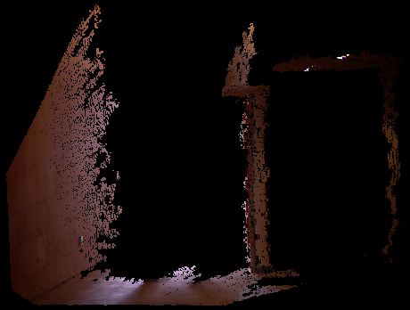
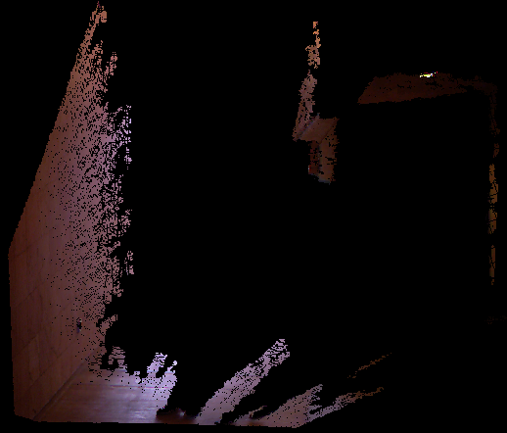
Results
input
output

Slide 26
Object ROC Plot
TPR: 1.00
FPR: 0.47
Notes:
End of flat part: 7.6 m

Slide 27
Fraction of Static Points Retained
Mean: 0.85

Slide 28
Conclusions & Future Direction
Remove moving objects from point cloud scenes
Arbitrary objects
Allow camera motion
Considerations:
Just look for people?
Runtime speed

Slide 29
Questions?
Thank you.

Slide 30
References
H. Du et al., “Interactive 3D modeling of indoor environments with a consumer depth camera,” in Proceedings of the 13th international conference on Ubiquitous computing - UbiComp ’11, 2011, p. 75.
H. Andreasson and A. J. Lilienthal, “6D scan registration using depth-interpolated local image features,” Robotics and Autonomous Systems, vol. 58, no. 2, pp. 157-165, Feb. 2010.
P. Henry, M. Krainin, E. Herbst, X. Ren, and D. Fox, “RGB-D mapping: Using Kinect-style depth cameras for dense 3D modeling of indoor environments,” The International Journal of Robotics Research, p. 0278364911434148-, Feb. 2012.
K. M. Wurm, A. Hornung, M. Bennewitz, C. Stachniss, and W. Burgard, “OctoMap: A probabilistic, flexible, and compact 3D map representation for robotic systems,” in Proc. of the ICRA 2010 Workshop on Best Practice in 3D Perception and Modeling for Mobile Manipulation, 2010.
P. Henry, M. Krainin, E. Herbst, X. Ren, and D. Fox, “RGB-D Mapping: Using depth cameras for dense 3D modeling of indoor environments,” in the 12th International Symposium on Experimental Robotics (ISER), 2010.

