Slide 1
Sources of Funding:
Some Examples
Fulbright Program (anything and everything)
Woodrow Wilson Center (focus international relations/topics)
American Philosophical Society (focus American Studies)
American Council of Learned Societies
American Institute for Contemporary German Studies (focus German-American relations, foreign policy, etc.)
Clements Center for Southwest Studies (Southern Methodist University, Dallas, Texas) — focus American Southwest

Slide 2
Fulbright Program — “the biggie!”

Slide 3
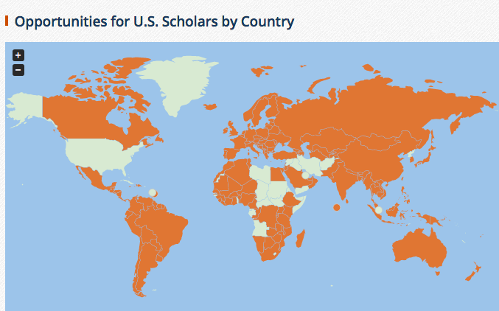

Slide 4
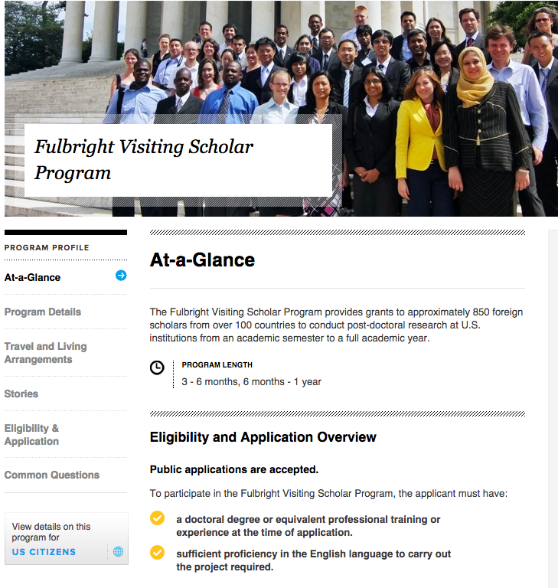

Slide 5
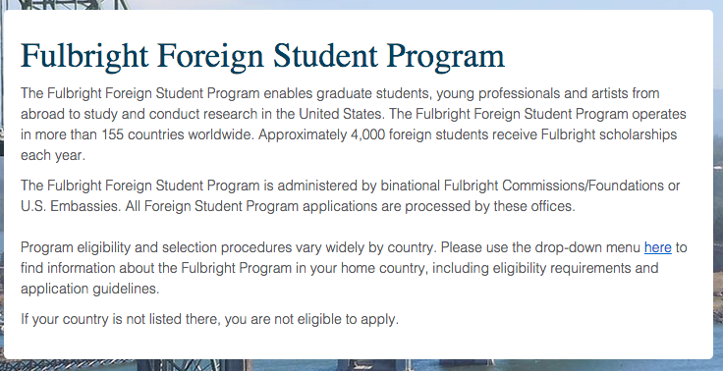
But what about students, especially graduate students?

Slide 6
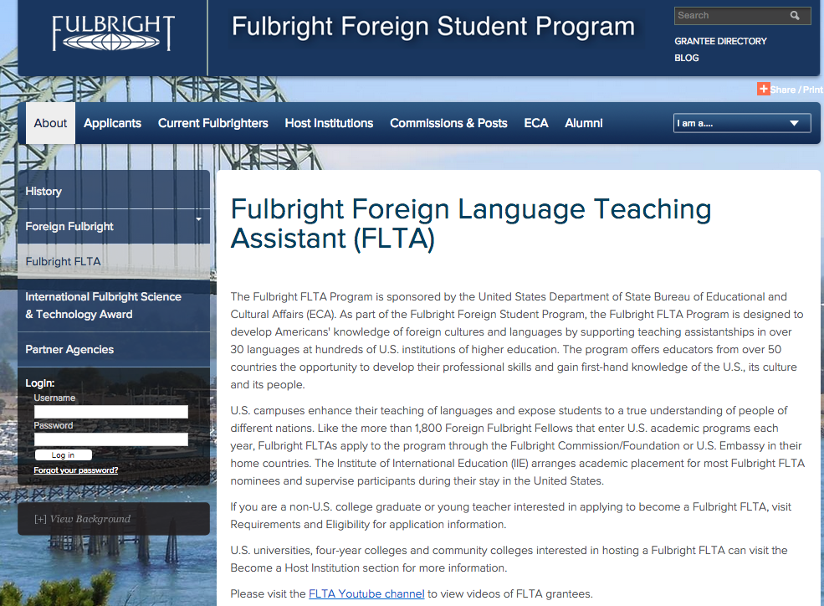

Slide 7
Berlin! Berlin! Wir fahren nach Berlin!

Slide 9
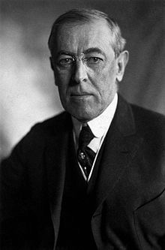
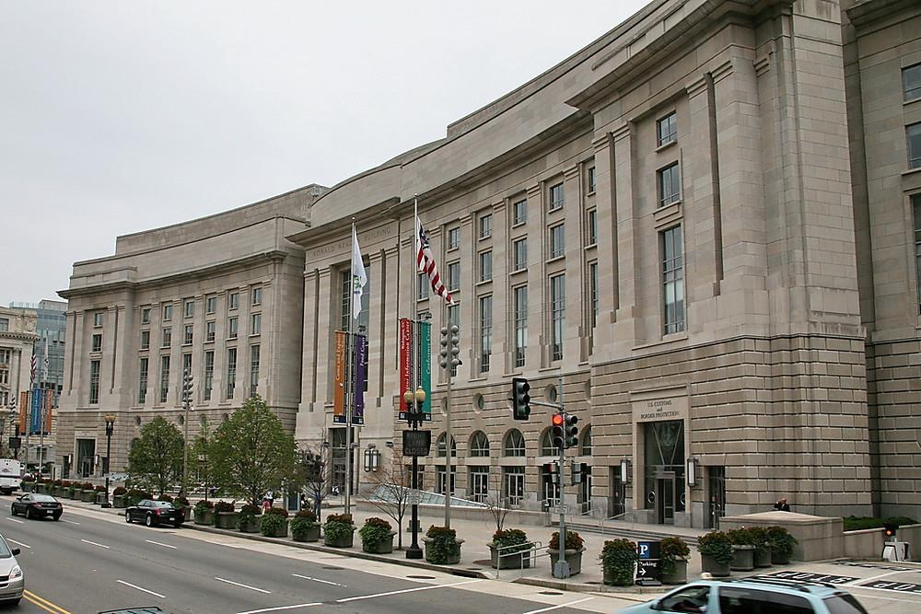

Slide 10
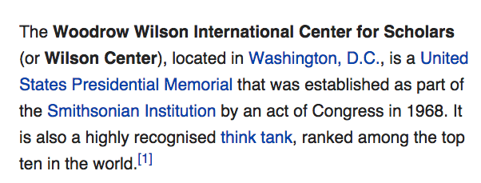
One of the top
“Think Tanks”….
160 scholars per year….

Slide 12
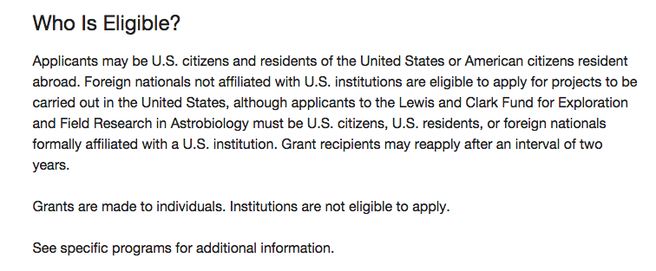
How large are the APS stipends?
Who is eligible to apply?

Slide 13
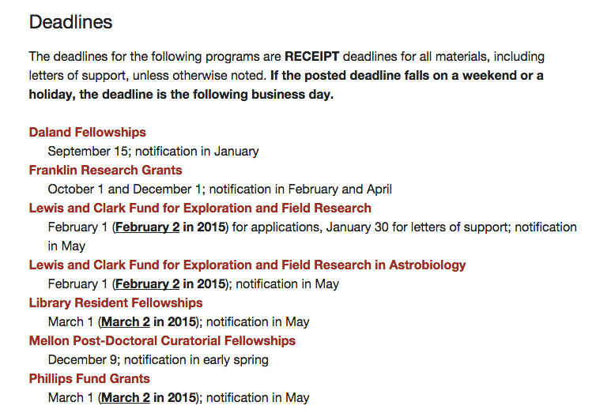

Slide 14
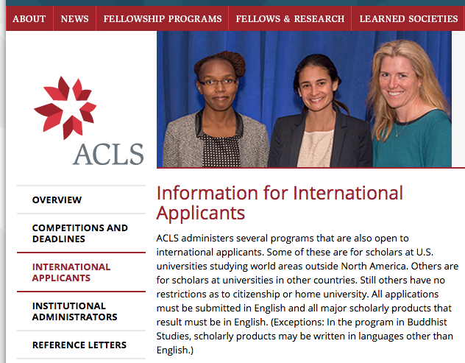

Slide 15
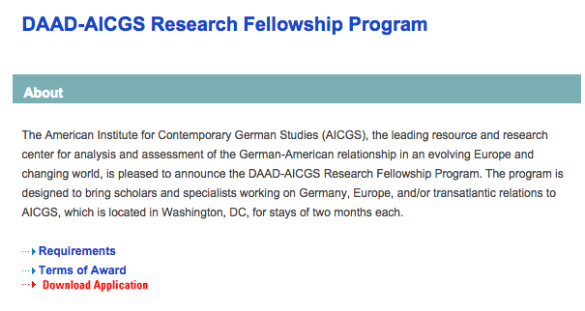
DAAD - German Studies

Slide 16
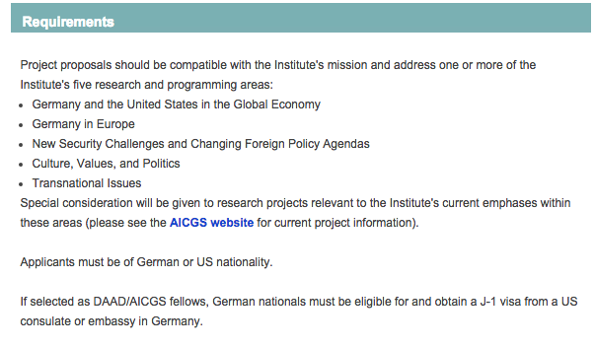

Slide 17
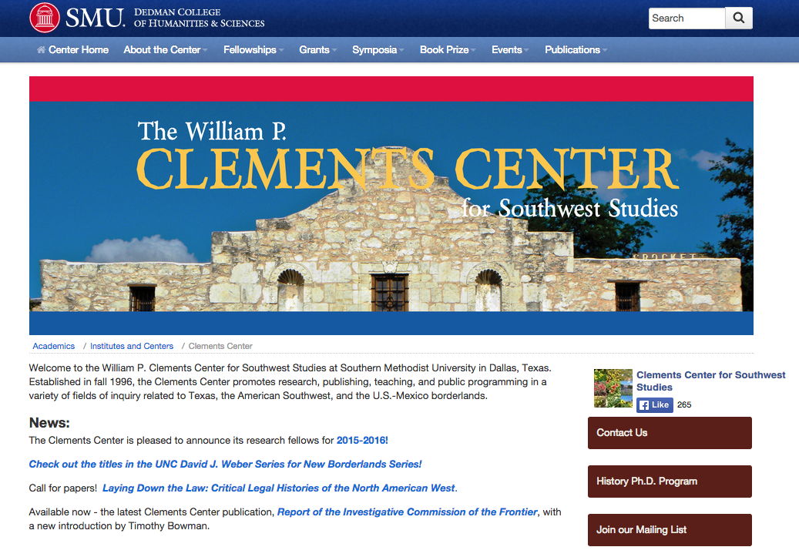

Slide 18
Clements Center for Southwestern Studies
Research Fellowships —
Postdocs — not for graduate research per sé
for “junior” or “senior scholars” engaged in “any field in the humanities or social sciences”
Stipend: $42,500 for academic year.
Allowance for Research: $4,000
Publication subvention

Slide 19
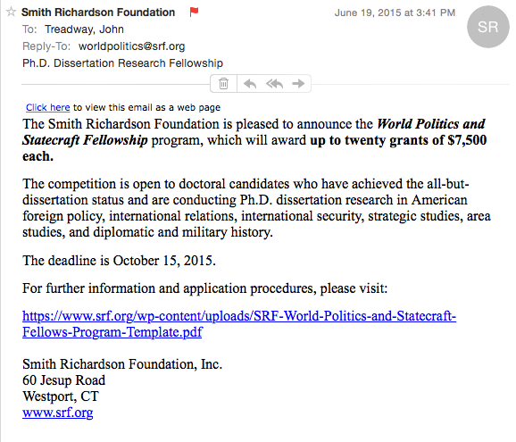
Many other sources….

Slide 20
Is there ONE source that lists scholarships and fellowships for graduate students, postdocs, and faculty who wish to study in the United States?
The answer is…

Slide 21
Yes — and Yes!
There are many sources — in print and online.

Slide 22
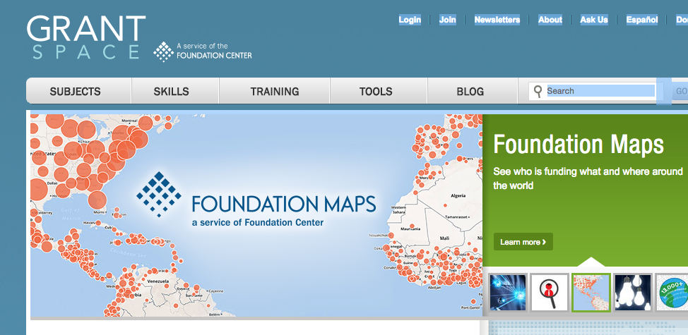
Por ejemplo
grantspace.org:
Knowledge Base

Slide 23
Books and Articles
Obst, Daniel (ed.), Funding for United States Study: A Guide for International Students and Professionals
Grants Register: The Complete Guide to Postgraduate Funding
International Exchange Locator: A Resource Directory for Education and Cultural Exchange

Slide 24
Websites
www.fundingusstudy.org Funding for US Study: International Scholarships/Institute of International Education

Slide 25
IIE - US Study Online

Slide 26
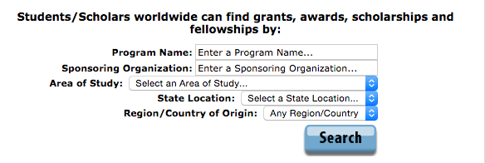

Slide 27
But where???

Slide 28
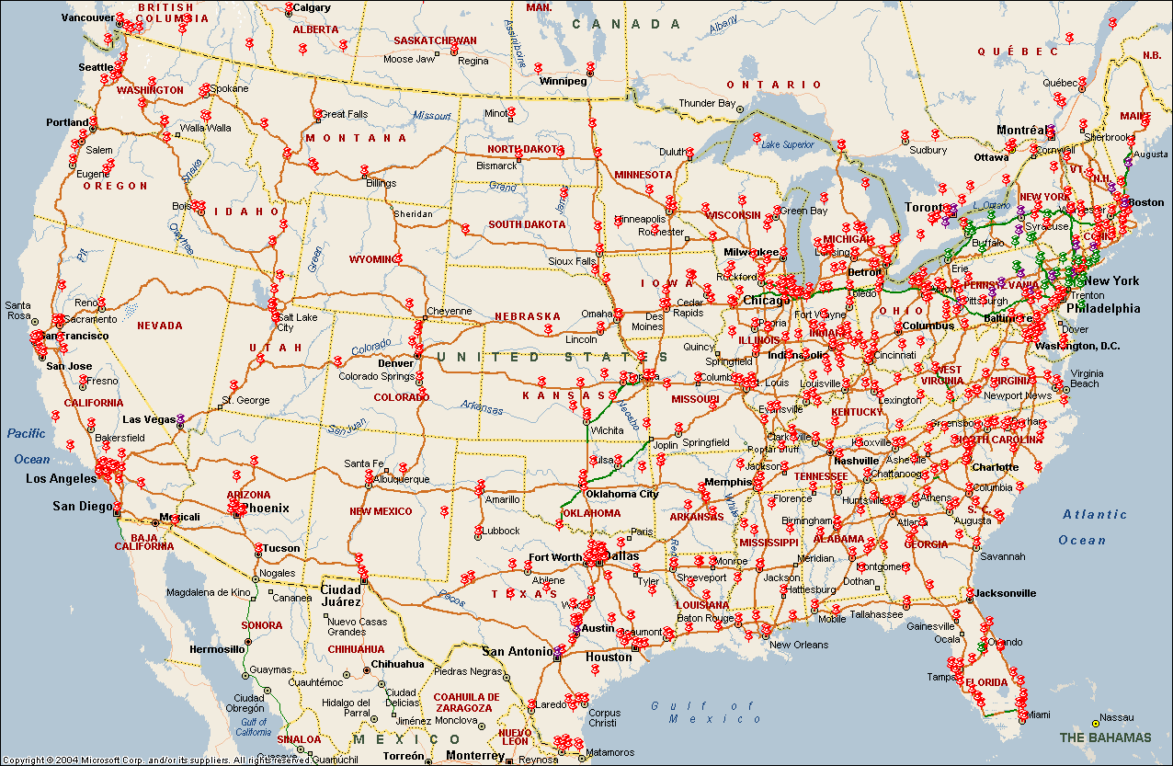

Slide 29
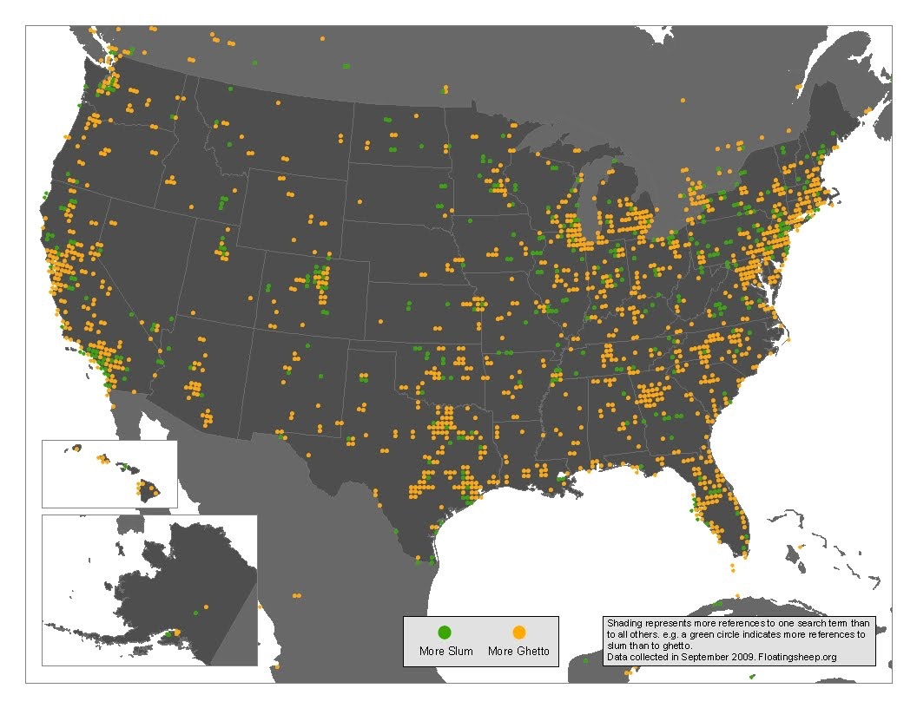

Slide 30
Where to look
Geographical location
Schools with strong departments in your discipline
Schools with strong academic reputations
Schools/institutions where money might be available
Schools/institutions with appropriate archives, libraries, and other facilities for your research agenda
Professional connections (Vitamin B….)

Slide 31
(Sometimes) a mistake to focus on the “top-ranked” schools or the “prestigious” fellowships.
Yes, “reputation” can’t be ignored — but it’s NOT the only consideration!
NOT everybody can/should go to Harvard, Princeton, or Yale — or UC-Berkeley, UCLA, or UVa (Virginia)

Slide 32
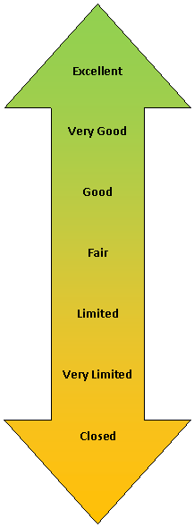
Your chances of placement differ widely — from year to year
from discipline to discipline

Slide 33
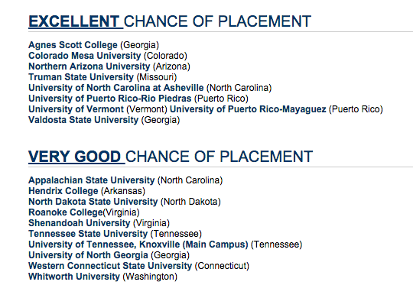
Example: ISEP
For undergraduate student exchanges…
(Anticipated Openings in the USA 2015-2016 - late applicants)

Slide 34
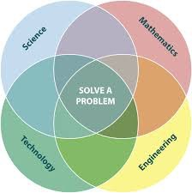
STEM
The new emphasis — funding affected….

Slide 35
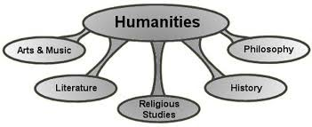
Some Good News: Humanities Initiative(s)

Slide 36
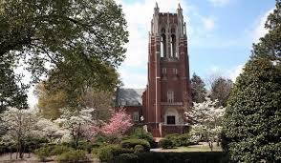
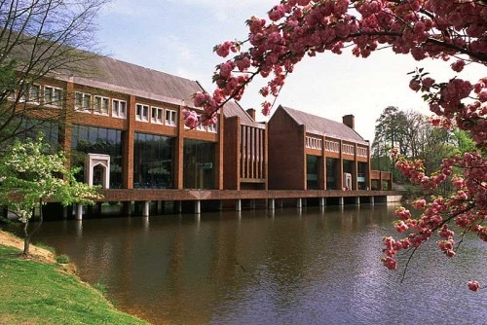
Case Study:
University of Richmond
Opportunities for…
Undergraduate Students
Graduate Students
Faculty/Professors

Slide 37
University of Richmond:
STEM Postdocs (not graduate students)
Departments of Biology, Chemistry, Physics, Math, Computer Science
Funding through Howard Hughes Medical Institute: $40,000
Health Insurance
Some funds for research
Travel to one meeting
Office space
Research and (some) teaching

Slide 38
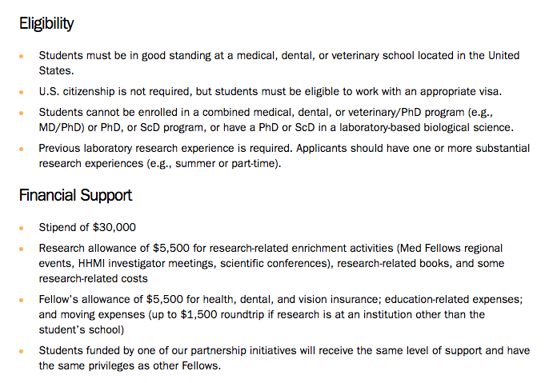
Howard Hughes Medical Institute — for graduate students

Slide 39
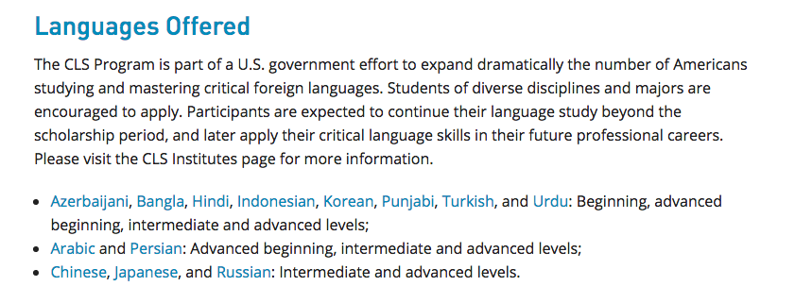

Slide 40
University of Richmond: Teaching “Critical Languages”
“For the Fulbright teaching assistants (graduate students assisting in the teaching of Turkish) – IIE-Fulbright provides them with a monthly stipend (I’m not sure how much) and reimburses UR for their room and board. Their tuition remissions is paid for by our office, up to two courses per semester. IIE provides the teaching assistant with the immigration documents needed to obtain a visa to work on our campus.”

Slide 41
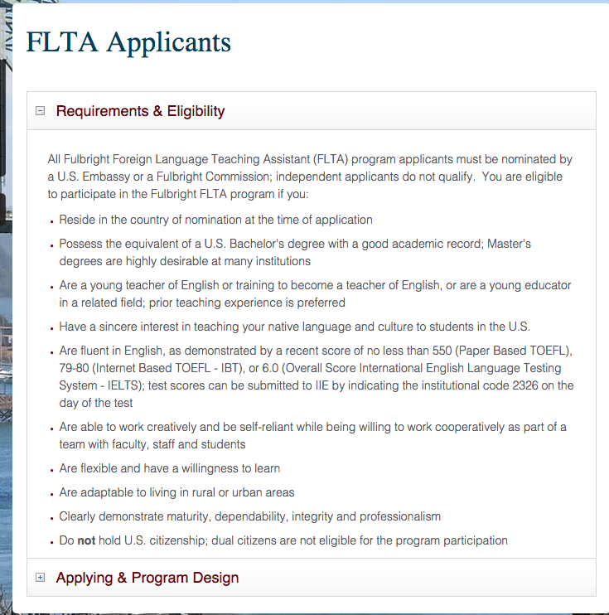

Slide 42
University of Richmond: Teaching Other “non-critical” Languages

Slide 43
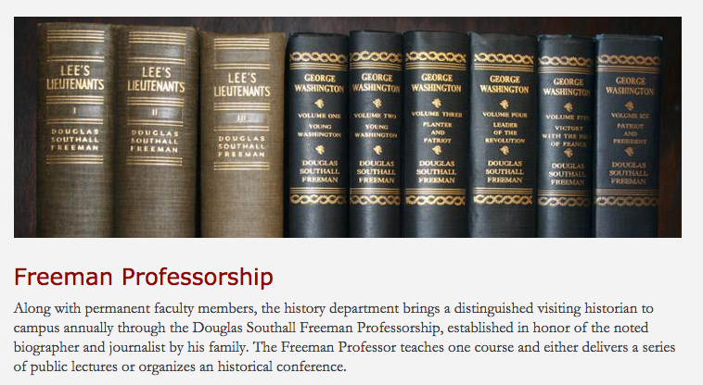
University of Richmond:
History
Visiting Professorship

Slide 44
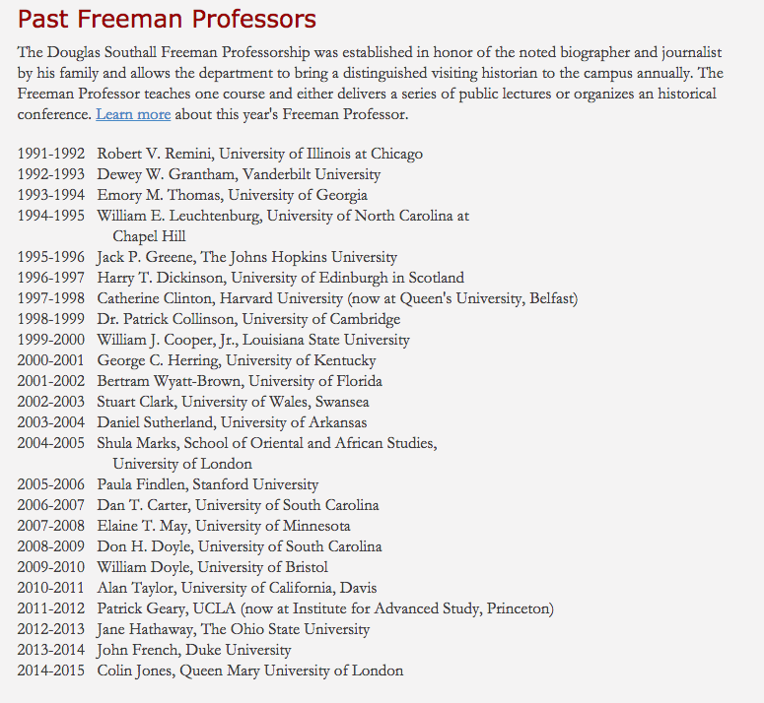

Slide 45
Very generous stipend — depending on one’s salary at home institution
and other “perquisites”

Slide 46
University of Richmond: English (recently ended)
De Tocqueville Seminar

