Slide 1
HPC at the University of Münster Raimund Vogl 24. November 2015

Slide 2
Das ZIV
Zentrum für Informationsverarbeitung
Center for Information Processing =
Central IT-Services for Münster University

Slide 3
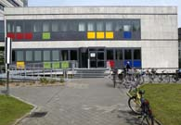
Das ZIV der WWU – www.wwu.de/ZIV
Founded 1964 as „Universitätsrechenzentrum“ – computer center
Since 1996 „Zentrum für Informationsverarbeitung“
approx. 100 staff (incl. Third party; add. 13 SHKs) in 3 departments (Abteilung):
Zusammensetzung Personalstand:
81,5 FTE (davon 26,5 WMA), 10 AZUBIs, 5 WHK
Abt 1: communication: 48,75 FTE (4 WMA, 7 UKM)
LAN and telecommunikation WWU and UKM, switchboard, AVM
Abt 2: Systems: 15 FTE (12 WMA)
central Servers and services (ADS, Mail, Exchange, Web, IdM, Backup/Archive, SOI (Storage, vSphere), HPC, …)
Abt 3: Applications and Services: 13,75 FTE (8,5 WMA)
ZIVline, Support, Printing, Software products, Web-Development/CMS, Courses, Media (Service Punkt Film)
Offices at Einsteinstraße, Röntgenstraße, Scharnhorststraße and Orleans Ring

Slide 4
Teaching @ ZIV
Wide variety of topics in teaching
Programming (Perl, C++, Java, PHP, Matlab)
Databases (MySQL)
HPC
Scientific publishing (LaTeX)
Additional courses in “standard” software
Office products (word, Excel, Powerpoint)
Graphics (Photoshop, Indesign, Dreamweaver)
Statistics (SPSS)
Usually once a semester. Language German
More information at:
http://www.uni-muenster.de/ZIV/Lehre/Vorlesungen/index.html

Slide 5
LaTeX @ ZIV
Regular 1-week-course for beginners
Usually in September and February/March
Teaching language English is possible on special request
Contains most (if not all) of the things you need for publishing your thesis
Document structure (titlepage, chapters, sections, table of contents …)
Including tables and pictures
Mathematics
References to literature, bibliography
…
Counseling in questions concerning LaTeX possible (but not a regular service of the ZIV)
Contact: Damian Bucher <bucher@uni-muenster.de>

Slide 6
HPC Systems
PALMA (In operation since Oktober 2010)
ZIVHPC (In operation since Januar 2009)
PHICUS/NWZPHI (In operation since 2014), IVV4 Cluster
PALMA II (planned for the beginning of 2017)
Construction for new Data Center Hall to start soon – to be completed end of 2016
2.25 Mio budget allocated – possible extensions

Slide 7
Documentation and Support
Information for users are located in the ZIV-Wiki at
https://www.uni-muenster.de/ZIVwiki/bin/view/Anleitungen/HPC
and at
http://www.uni-muenster.de/ZIV/Technik/Server/HPC.html
Holger Angenent: 31569, holger.angenent@uni-muenster.de
Martin Leweling: 31625, martin.leweling@uni-muenster.de
Please send your mails to hpc@uni-muenster.de

Slide 8
PALMA

Slide 9
PALMA
36 nodes with 2 4-Kern Intel Nehalem processors, -> 8 cores per node
252 nodes with 2 6-Kern Intel Westmere processors, -> 12 cores per node
4 SMP (shared memory) nodes with 32 cores each
2 SMP (shared memory) nodes with 40 cores each
-> Total of 3520 cores, about 35 TFlops

Slide 10
Schematic View
Lustre has been by GPFS in the meantime

Slide 11
PALMA - Software
The operating system will be updated from CentOS 5 to CentOS 7 in the next weeks step by step
Batchsystem: torque/maui
Installation of Software via EasyBuild: https://github.com/hpcugent/easybuild

Slide 12
Usage statistics of PALMA
Current values at http://www.uni-muenster.de/ZIV/Technik/PALMA/Statistik.html

Slide 13
ZIVHPC
Login node: 64 Core SMP System, 2,5 GHz Opteron, 512 GB RAM
Compute nodes:
20 nodes with 8 Opteron cores 2.1 GHz, 32 GB RAM
2 nodes with 8 Xeon cores, 2,4 GHz, 64 GB RAM and 4 5110P Xeon Phi accelerators
3 TB disc space in /home (BeeGFS)
4 TB storage for temporary data at /scratch/tmp
CentOS 6

Slide 14
NWZPHI/PHICUS

Slide 15
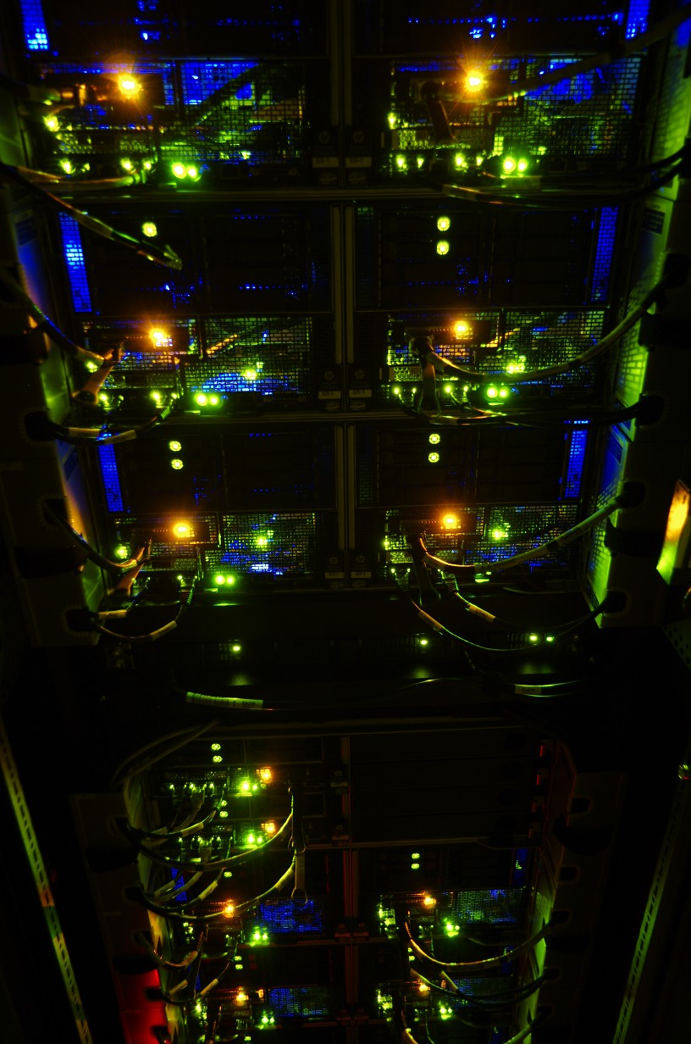
PHICUS - Setup
Development and Debugging
2 HP ProLiant SL 250s Gen 8
2 CPU (IvyBridge E5-2695 v2 12C), 2,4 GHz
64 GB RAM
1 Xeon Phi 5110p
Accelerator Nodes
12 HP ProLiant SL 270s Gen 8
2 CPU (IvyBridge E5-2695 v2 12C), 2,4 GHz
128 GB RAM
8 Xeon Phi 5110p

Slide 16
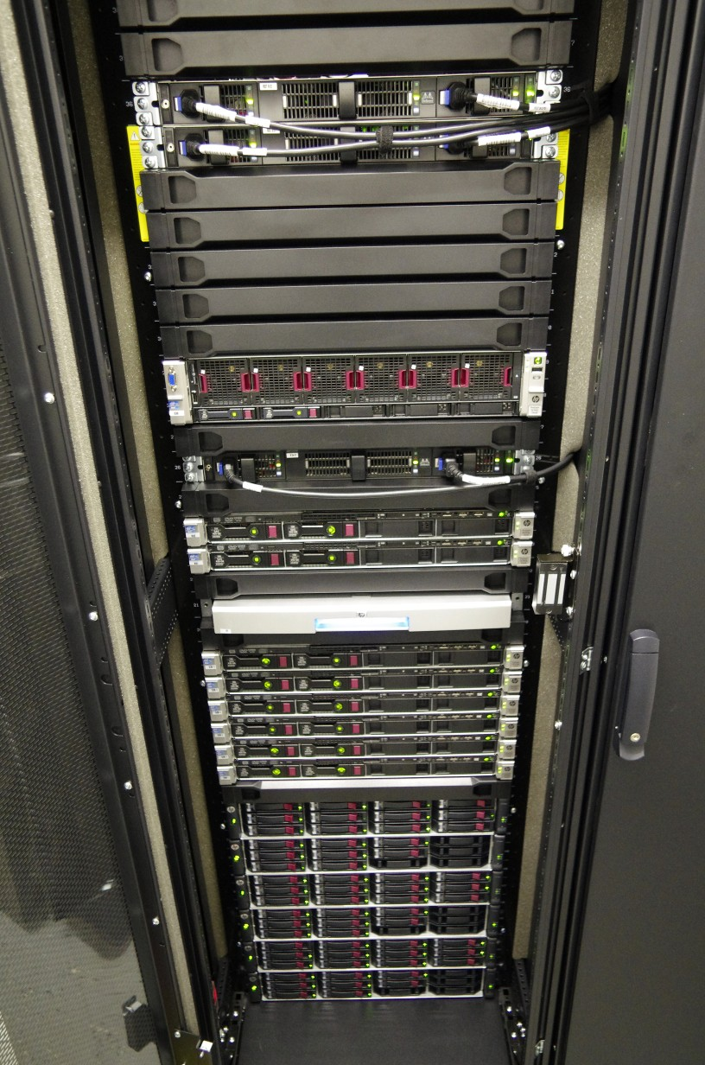
PHICUS
Shared Memory System
1 HP ProLiant DL 560 Gen 8
4 CPUs (IvyBridge E5-4640 8C), 2,4 GHz
1,5 TB RAM
71 TB Storage
FDR Infiniband

Slide 17
Xeon Phi
Accelerators are connected via PCIe

Slide 18
Xeon Phi
Full performance only available with parallelization and vectorization

